Slide 1
Exhibitor Workshop Webinar
29 July 2026

Slide 2

Agenda
Introduction – What to expect in the workshop and setting out SMART objectives for Autumn Fair 2026 from Event Director Matt Mein.
Buyer insights session - By Ami Rabheru, you’ll hear about what buyers are looking for and how you can meet their expectations. ​​
Operational essentials – From set up to logistics, get key operational tips to ensure a smooth and successful exhibition experience.
Marketing strategies – Explore strategies to maximise your marketing impact, including involvement in: Pitch Live, Autunm Fair website, Show guides and using your gleanin links.
Onsite content – An overview of the onsite sessions at Autumn Fair, where we’ll delve into thought-leading discussions led by industry experts.
PR insights – Learn from PR expert, Philippa Suitters from Good Results about how to work with PR to achieve the best possible results for your brand.
Q&A – an opportunity to ask those burning questions.

Slide 3
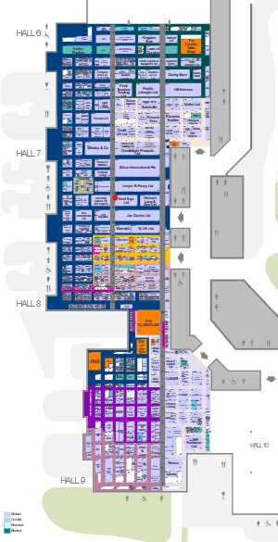
Autumn Fair 2026 floorplan

Slide 4
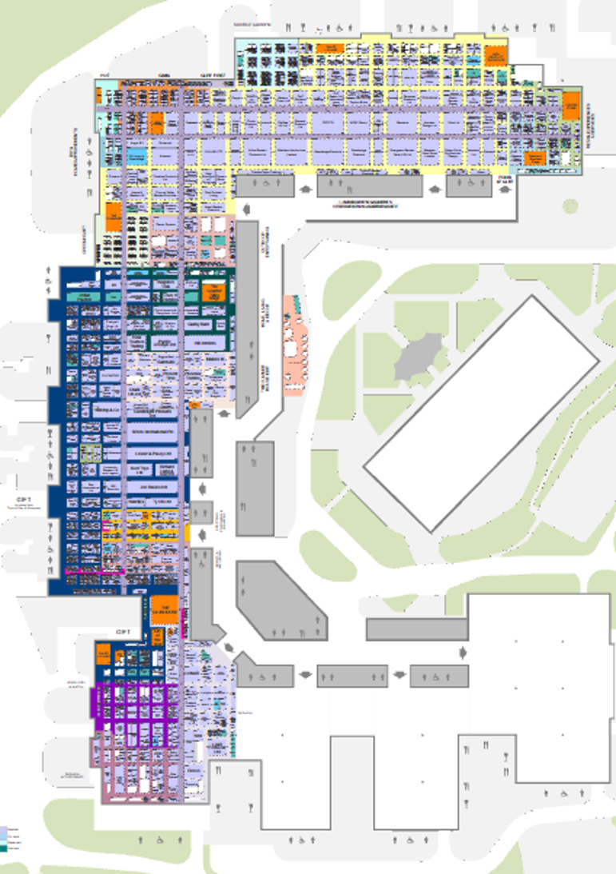
Autumn Fair and Glee 2026 floorplan

Slide 5
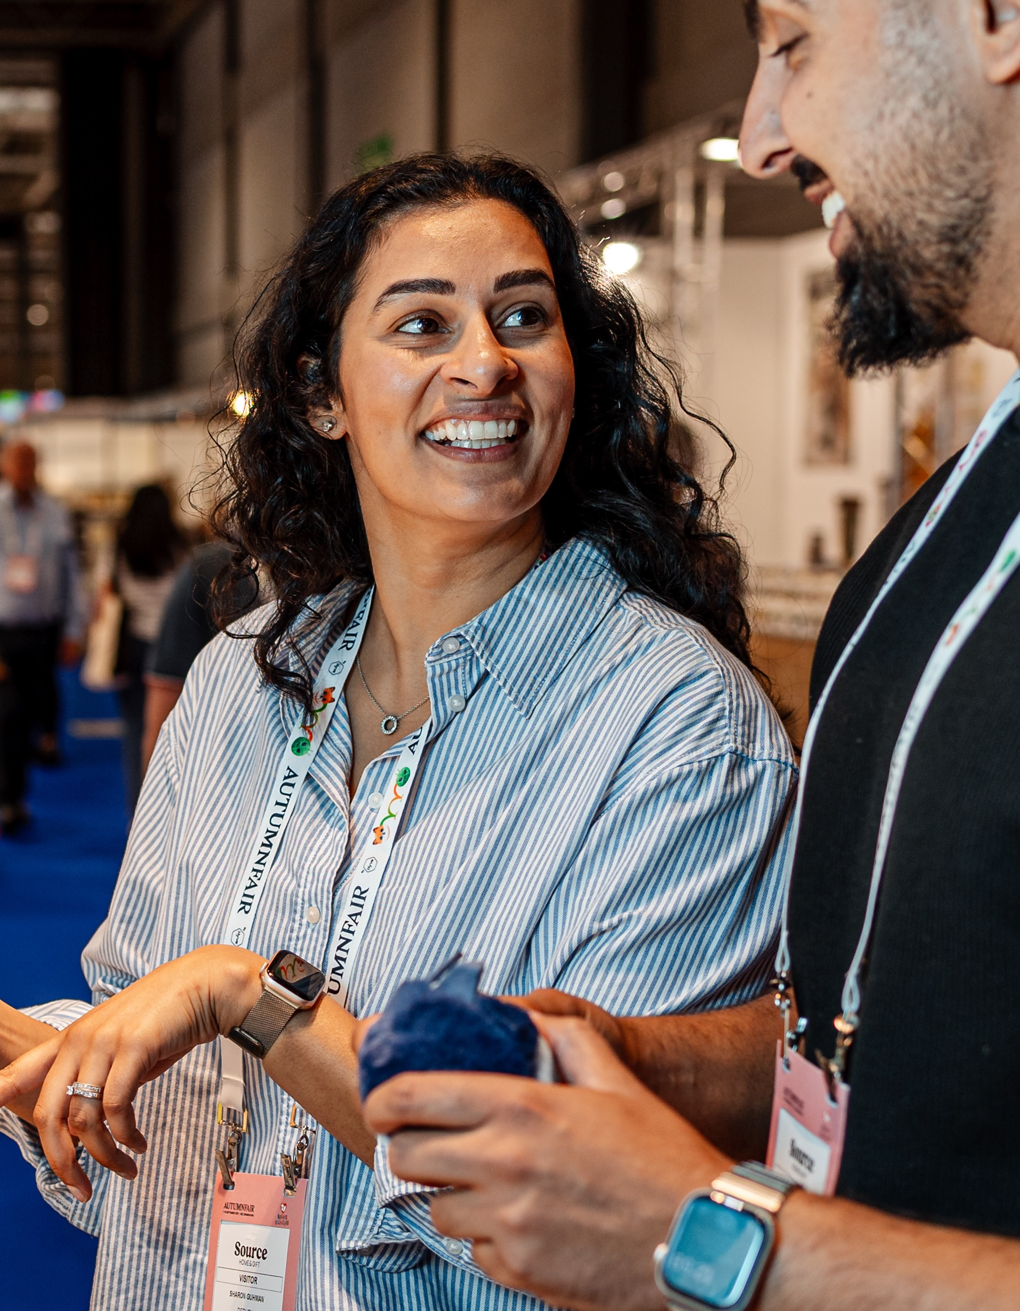
SMART Objectives for you at Autumn Fair
Specific​
Be clear about who, what, where, when, and how. Is it a target group of customers you want to meet at Autumn Fair? Accounts you want to open? Or Sales you want to create​
​
Measurable​
Set out what success will look like, use quantitative or qualitative measures to track your progress. This will help you determine if you've achieved your goal.​
​
Achievable​
Make sure your goal is realistic and tangible, set practical time frames for completing each step.​
​
Relevant​
Help your people understand the bigger picture so they can see how their contribution will help the company's goals onsite. Everyone in your team clear and consistent onsite with your company’s products/solutions.​
​
Time-bound​
Specify a deadline for completing your goal, as this can help you maintain momentum. Follow up promptly after the event, otherwise leads will go cold.​

Slide 6
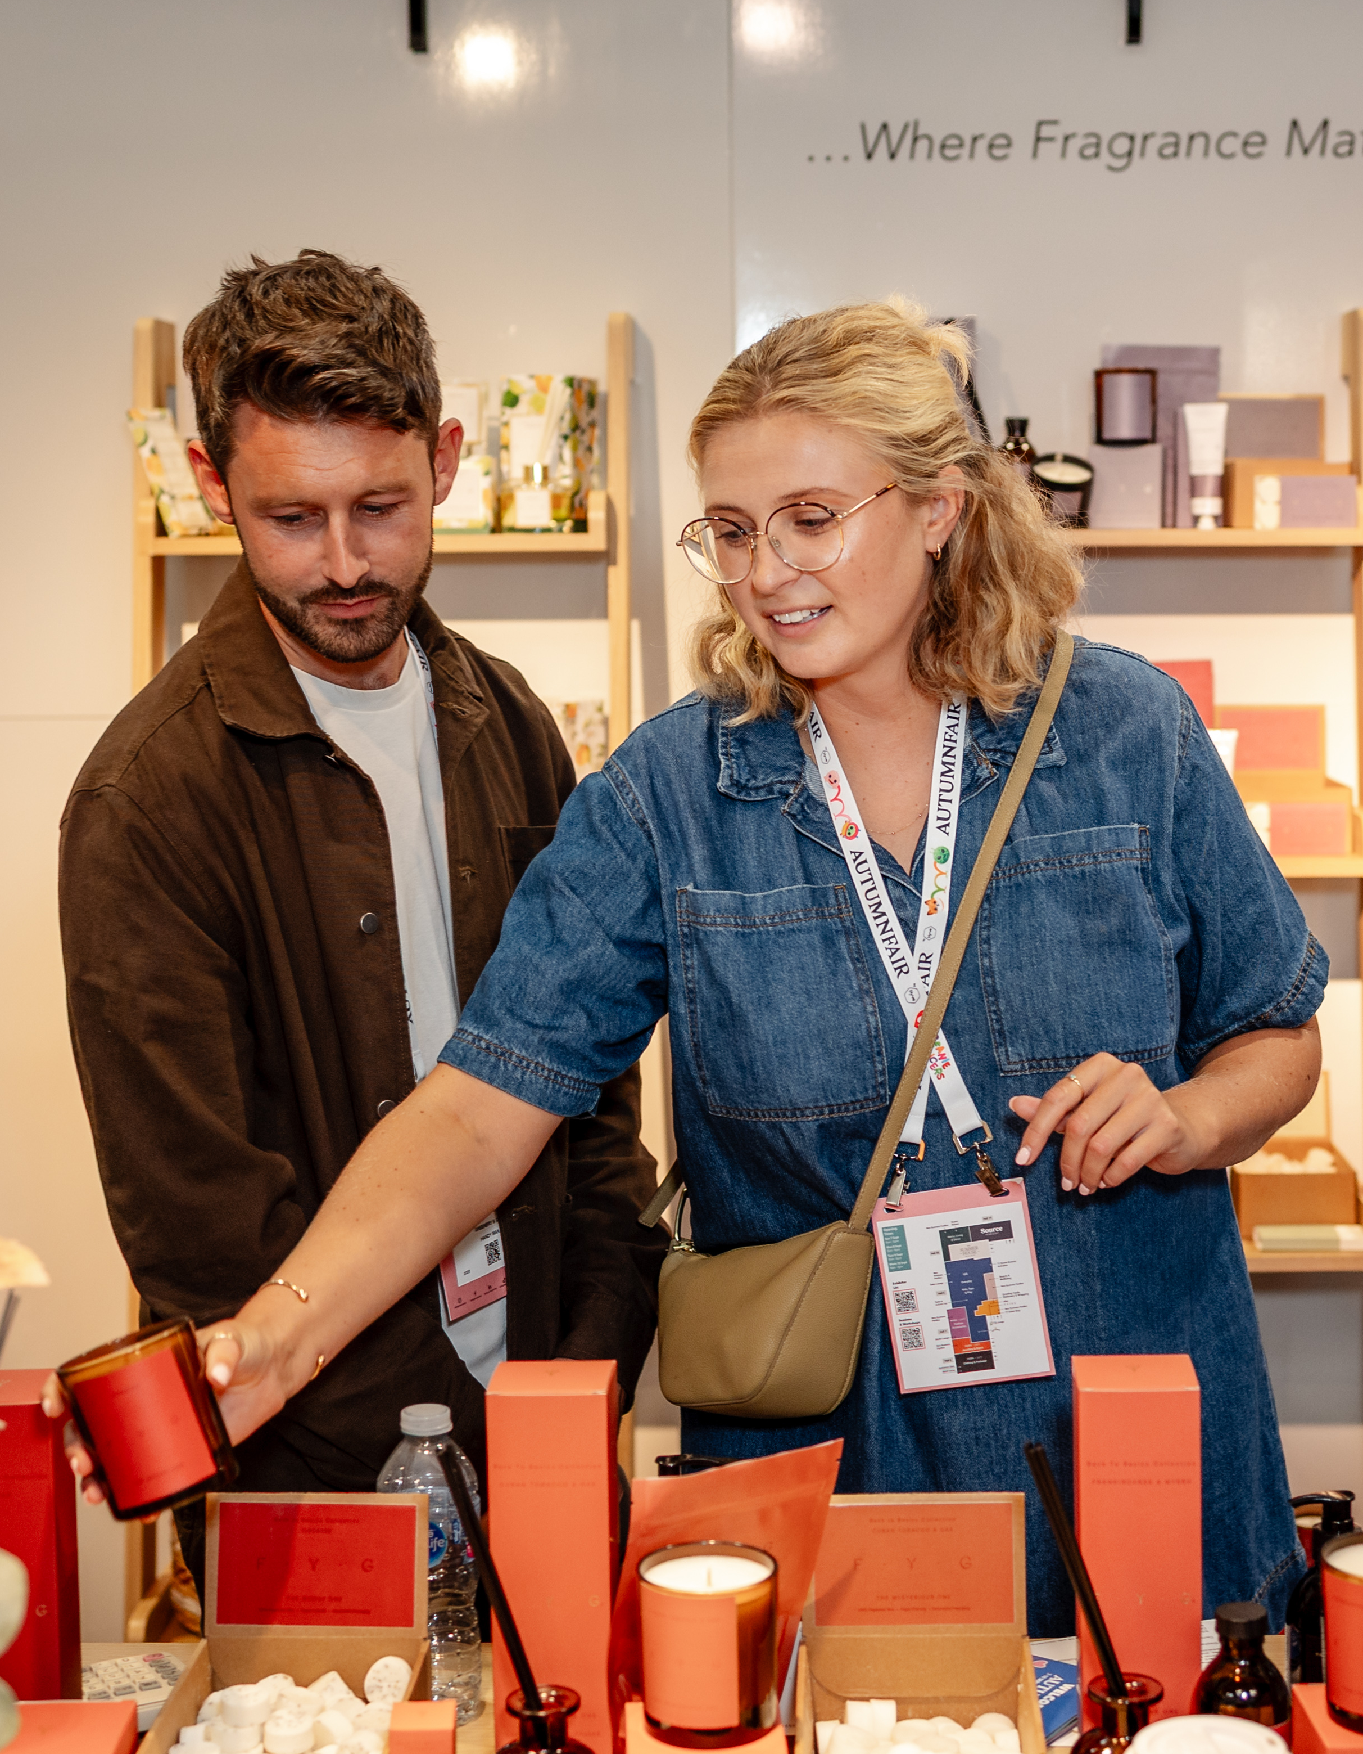
Buyer insights
By Ami Rabheru from Retail Huddle and co.lective

Slide 7
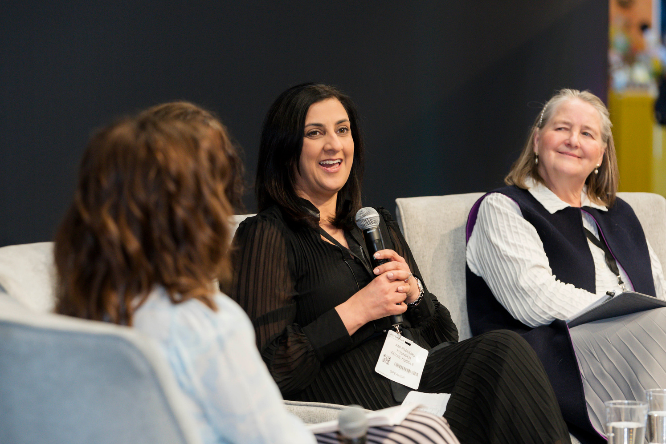
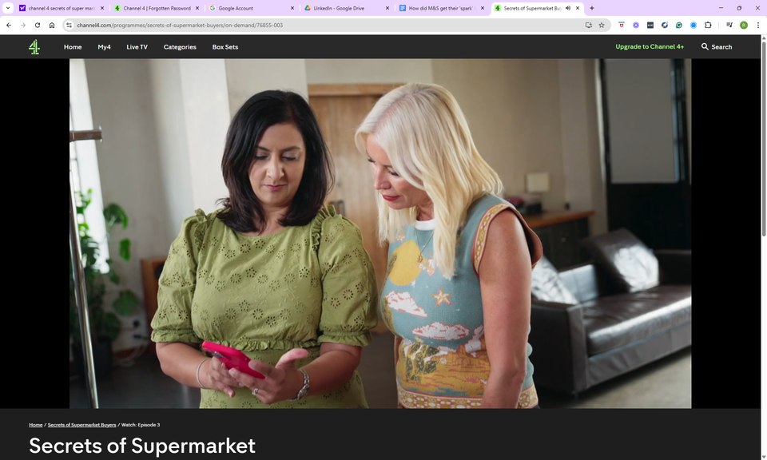
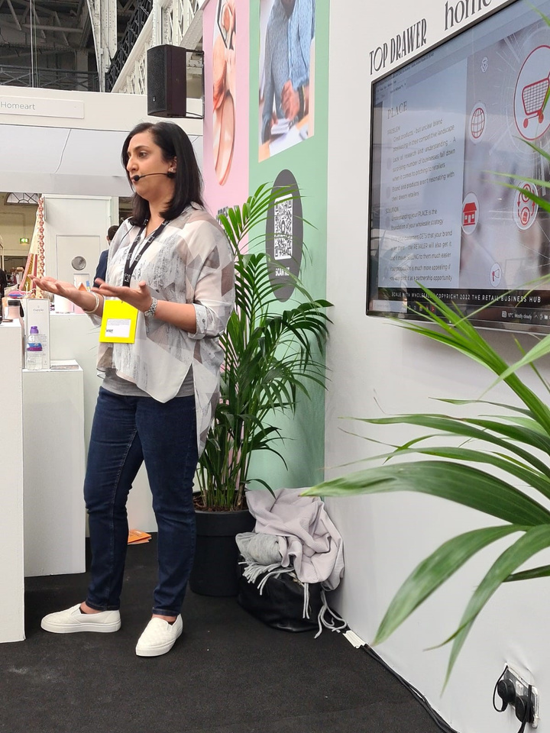


















You may have seen me here...
LinkedIn: Ami Rabheru
SOCIALS: @retailhuddle
Website: www.retail-huddle.com

Slide 8

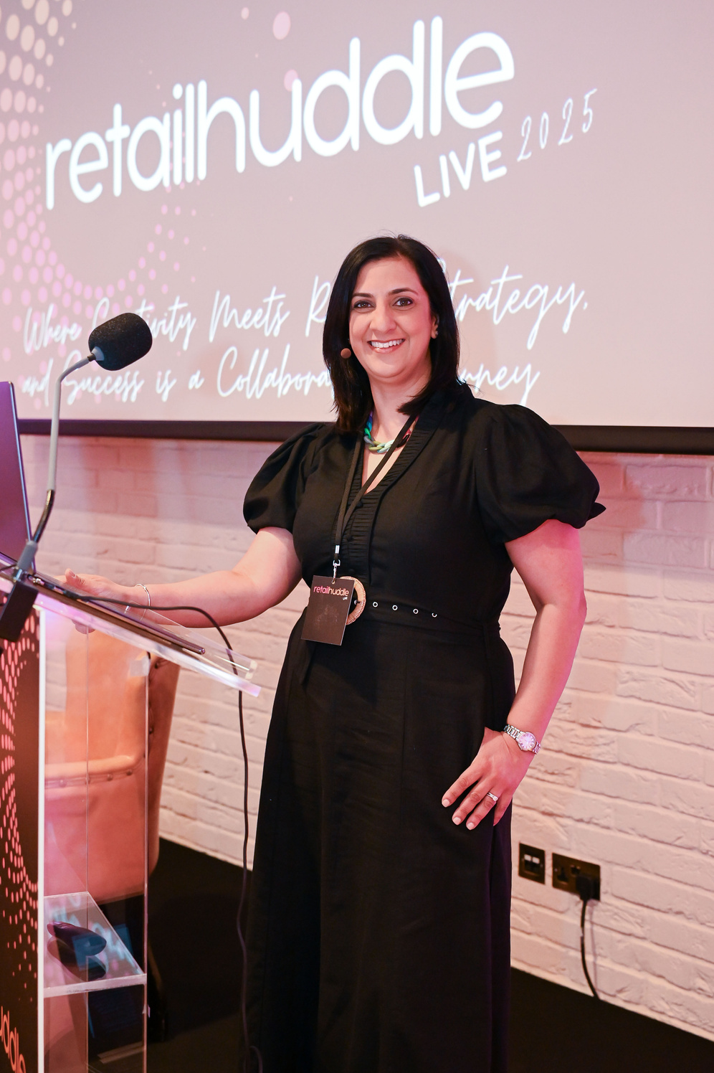
welcome
AUTUMN FAIR
EXHIBITORS WEBINAR
AMI RABHERU
©2026 COPYRIGHT WWW.RETAIL-HUDDLE.COM

Slide 9
The Mind of a Retail Buyer
Balancing the ART and SCIENCE
Buyer mindset - creative but highly commercial. Forward thinking - next new thing. Their job is to create a balanced offer for their customers.
ART
Does this product offer something different or is it range duplication? How does it fit in? Does it appeal to my customers? Growing trend? Will the branding / packaging stand out on the shelf?
SCIENCE
Will this product help me meet my KPI's?
Incremental sales?
Meet my margin targets?
Grow my market share?
©2026 COPYRIGHT | ALL RIGHTS RESERVED | RETAIL HUDDLE

Slide 10
The ONE question
“Why does my customer need this product, from this brand, in my store, right now?”
How to answer it
ALL RIGHTS RESERVED ¦ COPYRIGHT ¦ RETAIL HUDDLE
ALL RIGHTS RESERVED ¦ COPYRIGHT ¦ RETAIL HUDDLE

Slide 11
THE BUYER HAS A REASON TO CHANGE
MOTIVATING CHANGE
BROKEN
BETTER
BLANK
THE FOUNDATIONS OF SALES
STOP SELLING YOUR WARES, START MOTIVATING CHANGE

Slide 12

The T.R.U.T.H.S® of Pitching Retail Buyers
Target Market
Support
Relevance
Retail Pitch
T.R.U.T.H.S
®
Framework
Holistic Fit
Unique Value
Traction
ALL RIGHTS RESERVED ¦ COPYRIGHT ¦ RETAIL HUDDLE

Slide 13
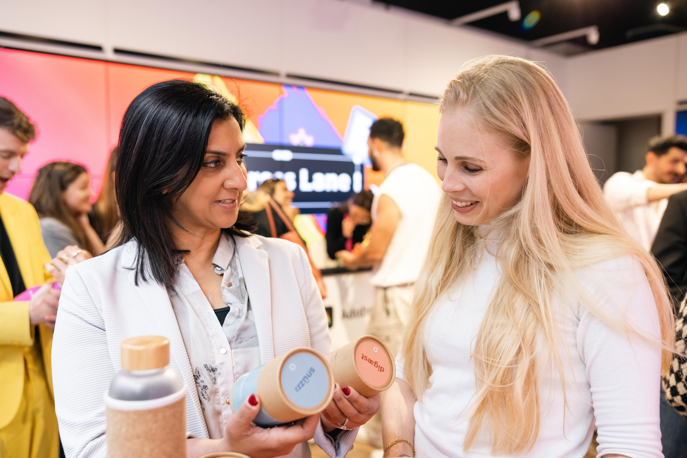
Selling isn’t just about presenting an offer.
Your Pitch is about communicating VALUE in a way that motivates change.
- AMI RABHERU

Slide 14
Right product, Right place, Right time
Right Product
Target Market
“Why does my customer need this product, from this brand, in my store, right now?”
Relevance
Right Time
Right Place
ALL RIGHTS RESERVED ¦ COPYRIGHT ¦ RETAIL HUDDLE
ALL RIGHTS RESERVED ¦ COPYRIGHT ¦ RETAIL HUDDLE

Slide 15


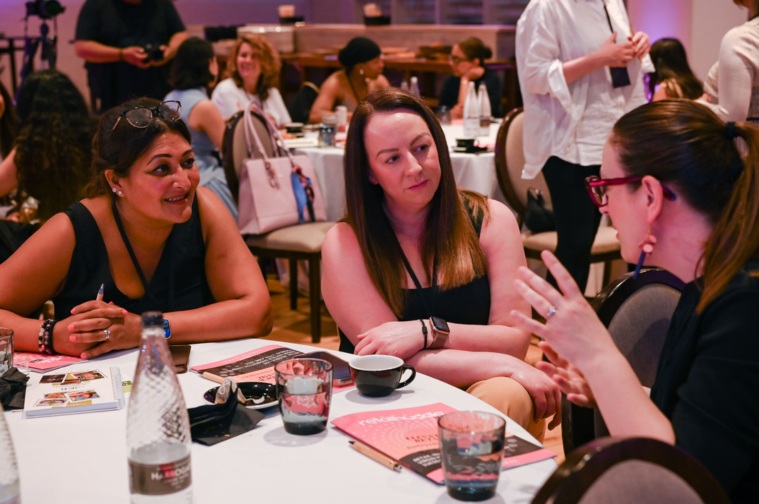
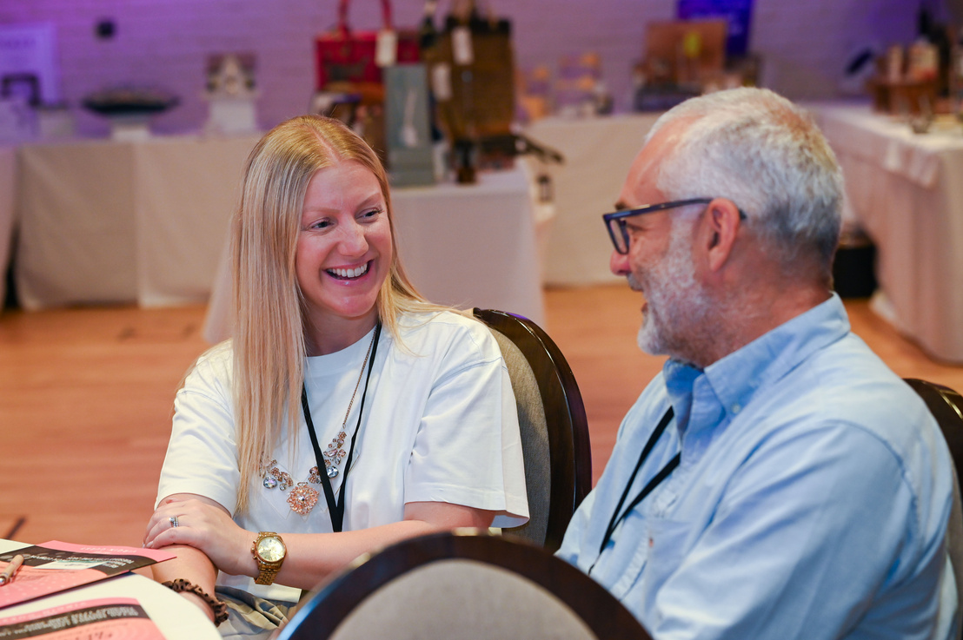



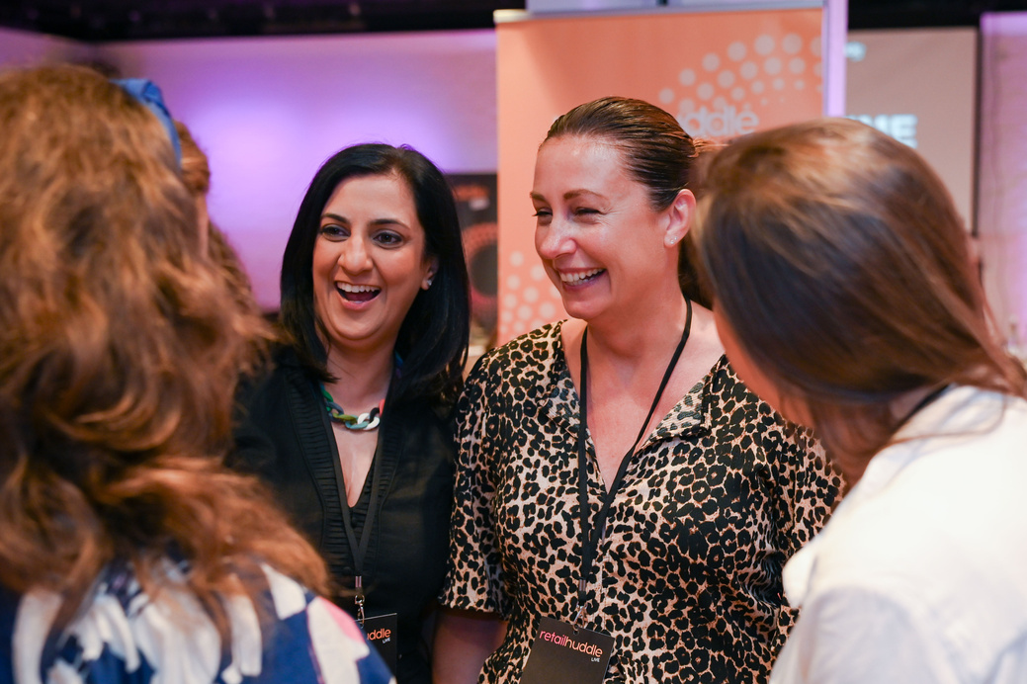
Join the Conversation
SAVE YOUR SEAT
X
9th September 2026
Workshops
Roundtables
Pull up a chair. The conversation starts here.

Slide 16
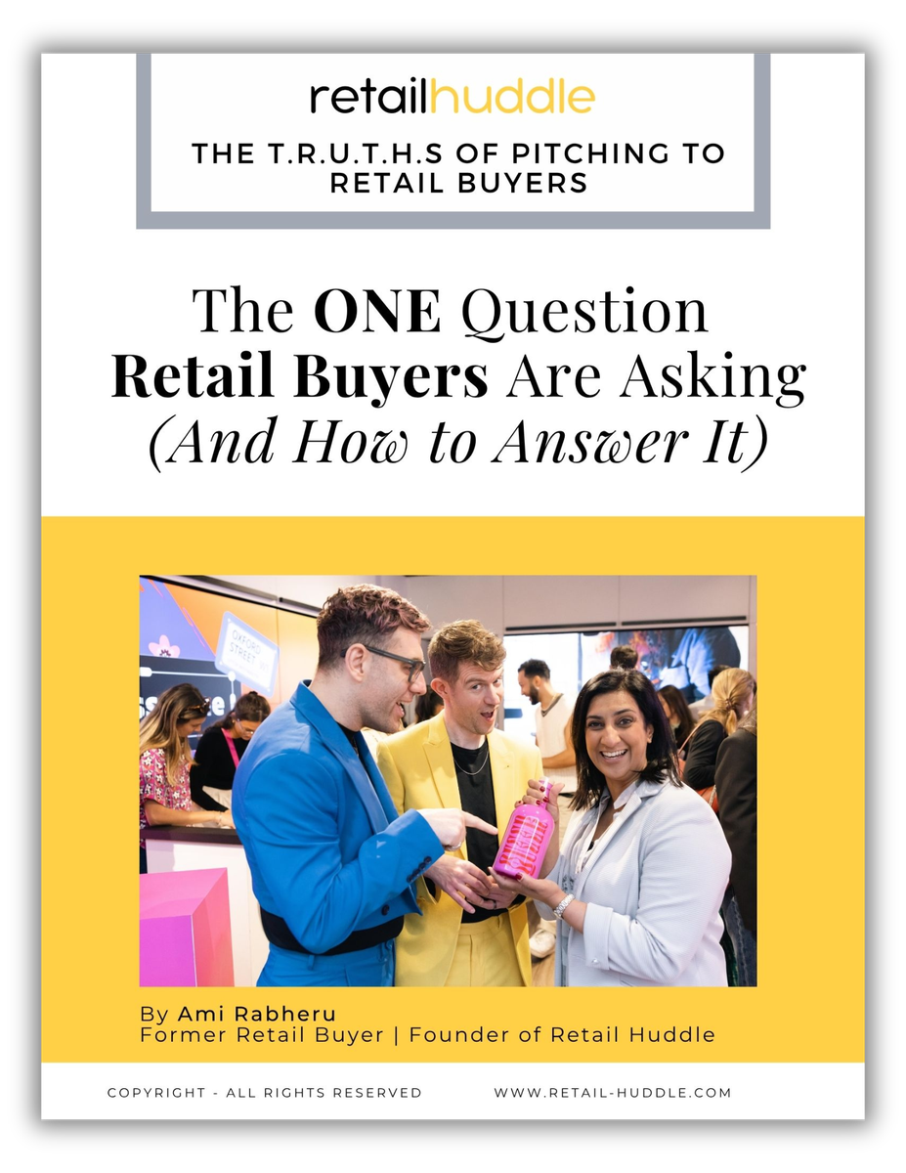
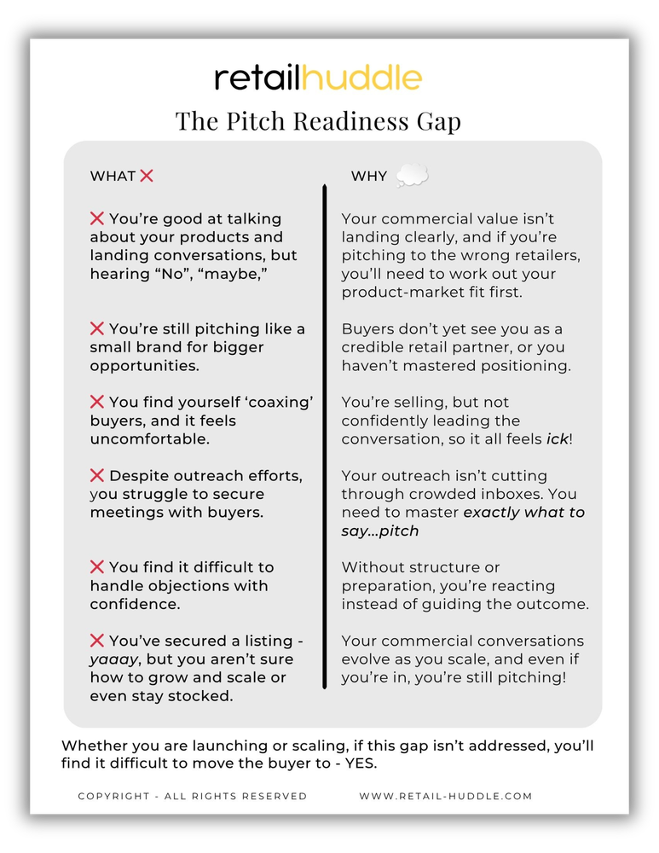
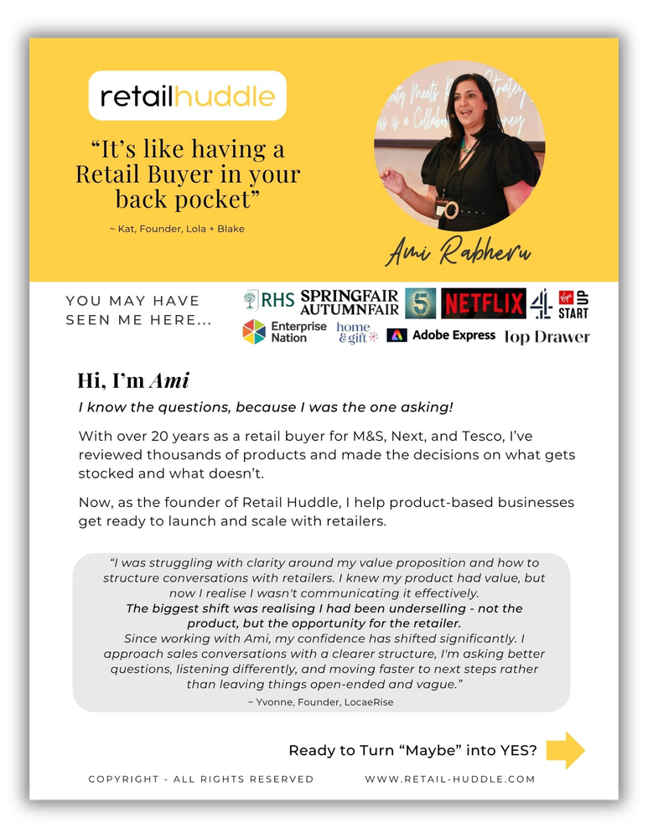



GET YOUR FREE
FULL GUIDE

Slide 17

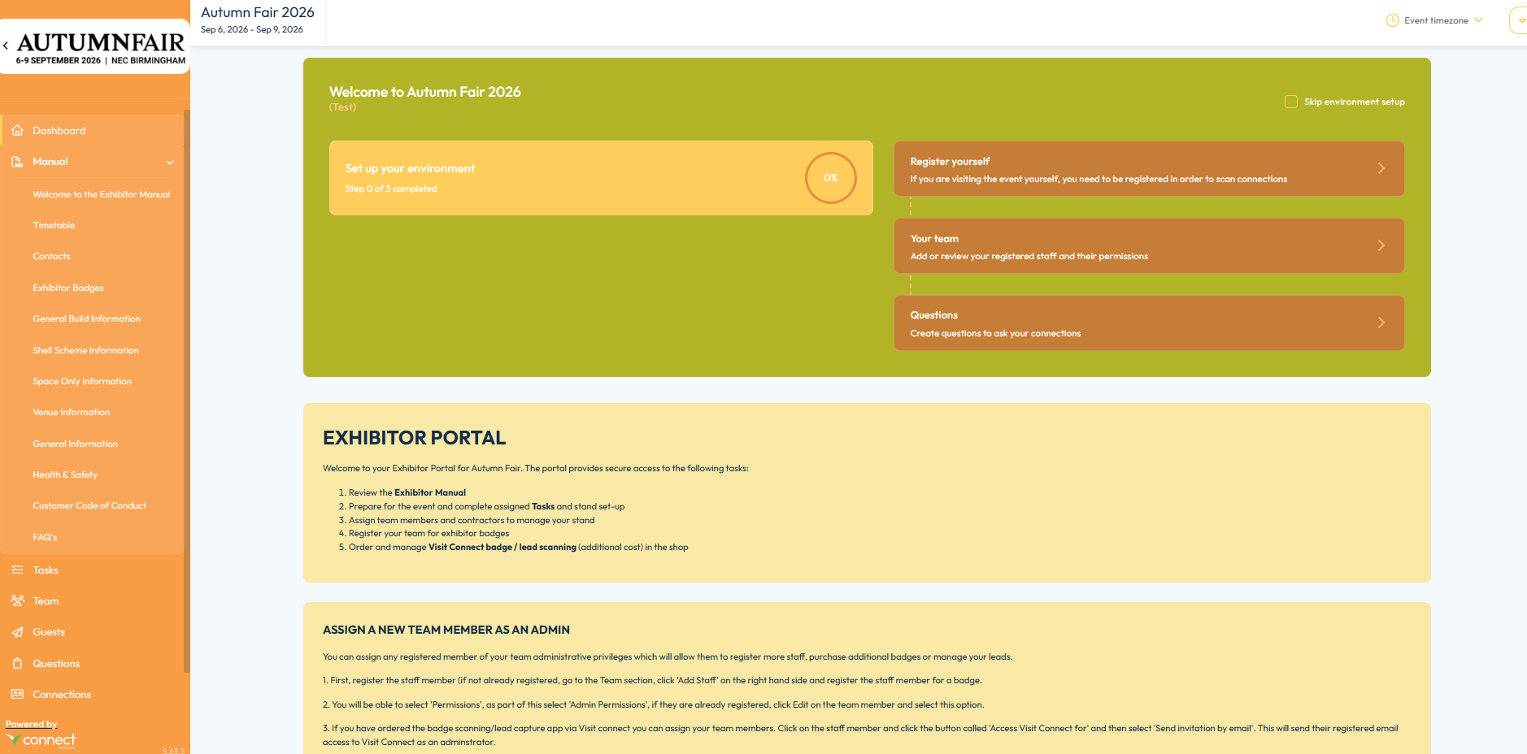
Operations
Exhibitor Manual – https://www.autumnfair.com/exhibitor-zone

Slide 18
Key Deadlines
GES – Carpet/Floor Covering, Electrics, Furniture, Graphics, Shell Scheme Extras https://ordering.ges.com/000033572
GES Early Bird Price | 5th August
GES Standard Price | 6th August – 1st September | 20% surcharge to the Early Bird price
GES Onsite Price | 2nd September onwards | 20% surcharge to the Regular Price
Venue Services – WiFi/IT, Catering, Utilities, Waste, Safety/Security, Rigging https://standbuy.necgroup.co.uk/
NEC Standard Price | 4th August
NEC Late Price | 5th August – 1st September | 20% surcharge on the Standard Price.
NEC Onsite Price | 2nd September onwards | 30% surcharge on the Late Price.
Space Only Stand Submission
Deadline 17th July 2026 Plans to be sent to Fiona at Essential Events fabbotts@essentialevents.co.uk Failure to submit paperwork and stand designs, will result in your Space Only stand not being allowed to build onsite.

Slide 19
Autumn Fair Timetable
BUILD UP | HALL OPEN | ACCESS FOR
Wednesday 2nd September | 08:00 – 20:00 | Space Only stands construction commences
Thursday 3rd September | 08:00 – 20:00 | Space Only stands construction continues
Friday 4th September | 08:00 – 20:00 | Shell scheme stands commence interior display Space Only stand construction continues
Saturday 5th September | 08:00 – 22:00 | Shell Scheme stands continue interior display Space Only stands continue construction All stands to be completed
OPEN DAYS | HALL OPEN | SHOW OPEN HOURS
Sunday 6th September | 07:30 – 19:00 | 09:00 – 18:00
Monday 7th September | 08:00 – 19:00 | 09:00 – 18:00
Tuesday 8th September | 08:00 – 19:00 | 09:00 – 18:00
Wednesday 9th September | 08:00 – 22:00 | 09:00 – 16:00
BREAKDOWN | HALL OPEN | ACCESS FOR
Wednesday 9th September | 16:05 – 22:00 | 16:05 – Breakdown commences 22:00 – All Shell Scheme stands must be cleared
Thursday 10th September | 08:00 –22:00 | 22:00 - All Space Only stands must be cleared Any items left in the halls after this time will be deemed abandoned and disposed of as rubbish. Any costs for this disposal will be passed onto the exhibitor.

Slide 20
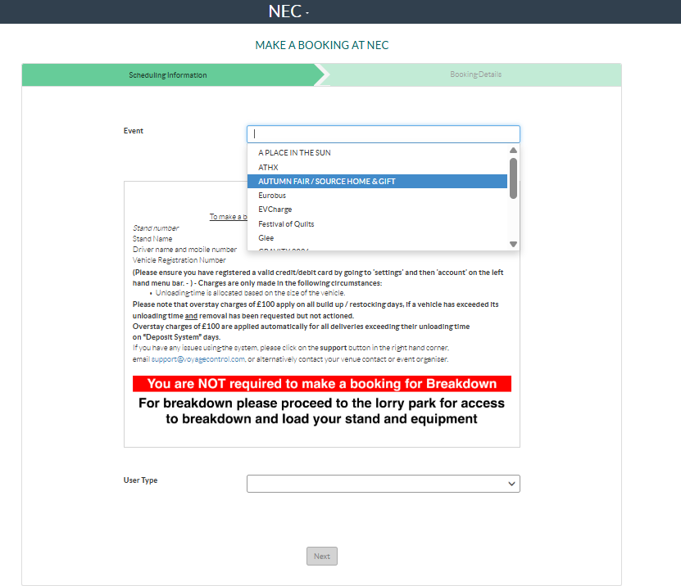
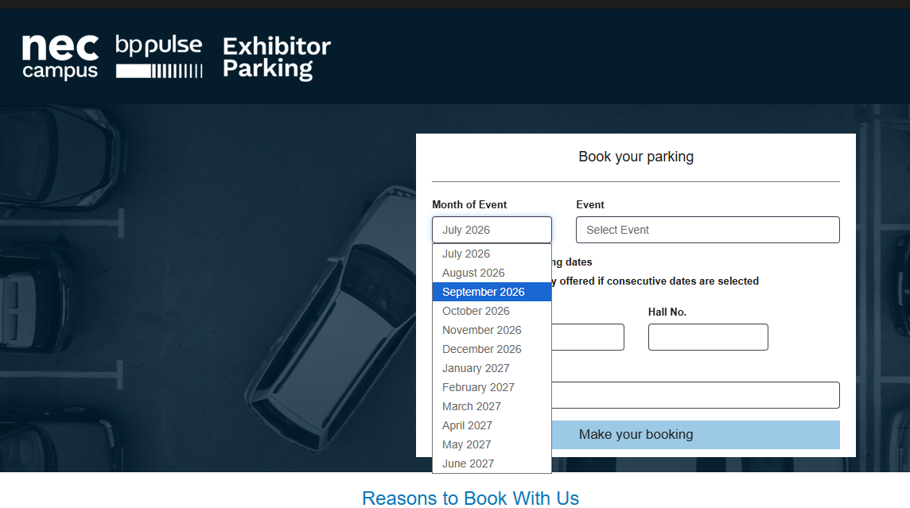
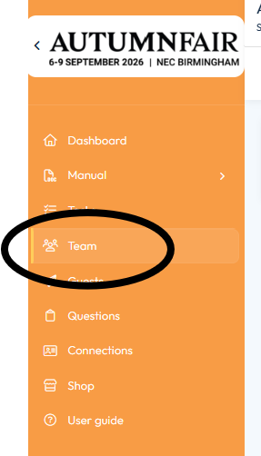
Frequently Asked Build-Up On-Site Queries
Voyage Control
All vehicles delivering or unloading during build-up must pre-book a timeslot through the Traffic Booking System and obtain an Event Delivery Pass before arriving at the NEC. Saturday will operate under a deposit system. https://necbirmingham.voyagecontrol.com/
Parking https://www.thenec.co.uk/media/4520/site-master-map-a5-for-a5-below.pdf
We're offering free parking for all exhibitors, contractors and visitors.
For the smoothest visit, pre-book your parking for build-up, during the show and breakdown using the code ATMN26EXB at https://parking.thenec.co.uk/NECBirminghamexhBooking. Do it any time up until midnight the day before you arrive. Once you've pre-booked, the barrier recognises your number plate automatically and lets you in and out with no other steps needed.
Pre-book parking for the entire event and you'll get free parking up to 96 hours before the event begins (build) through to a maximum of 48 hours after it ends (breakdown).
NOTE: Vehicles remaining on site after 2:00am may be subject to additional charges. Overnight parking is available, but only if selected during the original booking.
Didn't pre-book? No problem. Drive straight in, then either:
Validate your parking at a Pay on Foot machine inside the NEC - you'll need to do this each day, or
Scan your Voyage Control code, exhibitor badge, or contractor badge at the barrier on your way out.
Blue Badge parking is available, and shuttle buses run from all car parks to the main exhibition hall during show hours.
If you are making a delivery to the exhibition hall, you must still book your vehicle to offload at the rear of the hall using Voyage Control. Please refer to your Exhibitor Manual.
​Badges
Register your team through the ‘Team’ tab on the exhibitor manual.
Contractor Badges – Fiona from Essential Events will send through the badge for registration/QR code can be scanned onsite.
Logistics
Our official logistics contractor, GES Logistics, manages the complete movement and handling of exhibition materials, including customs clearance, secure storage, courier receiving and on-site lifting if you require any support.

Slide 21


Health and Safety Tips
Please submit the Health and Safety declaration on the ‘Tasks’ section on the exhibitor manual.
A risk assessment must also be completed by all exhibitors. This does not need to be submitted to the Organisers but it must be available on your stand at the show, so please print it after completion and bring it onsite.
Hi-Vis to be always worn in the outdoor loading bays.
Suitable Clothing – Closed Toe Shoes
PLEASE REMEMBER
NO overloading/daisy chaining of electrical sockets
Submit your stand plans to if you are…
Building a Space Only stand
Constructing within your Shell Scheme
NO standing on chairs, please use your own ladder instead

Slide 22
CONTACT US
exhibitor@autumnfair.com

Slide 23
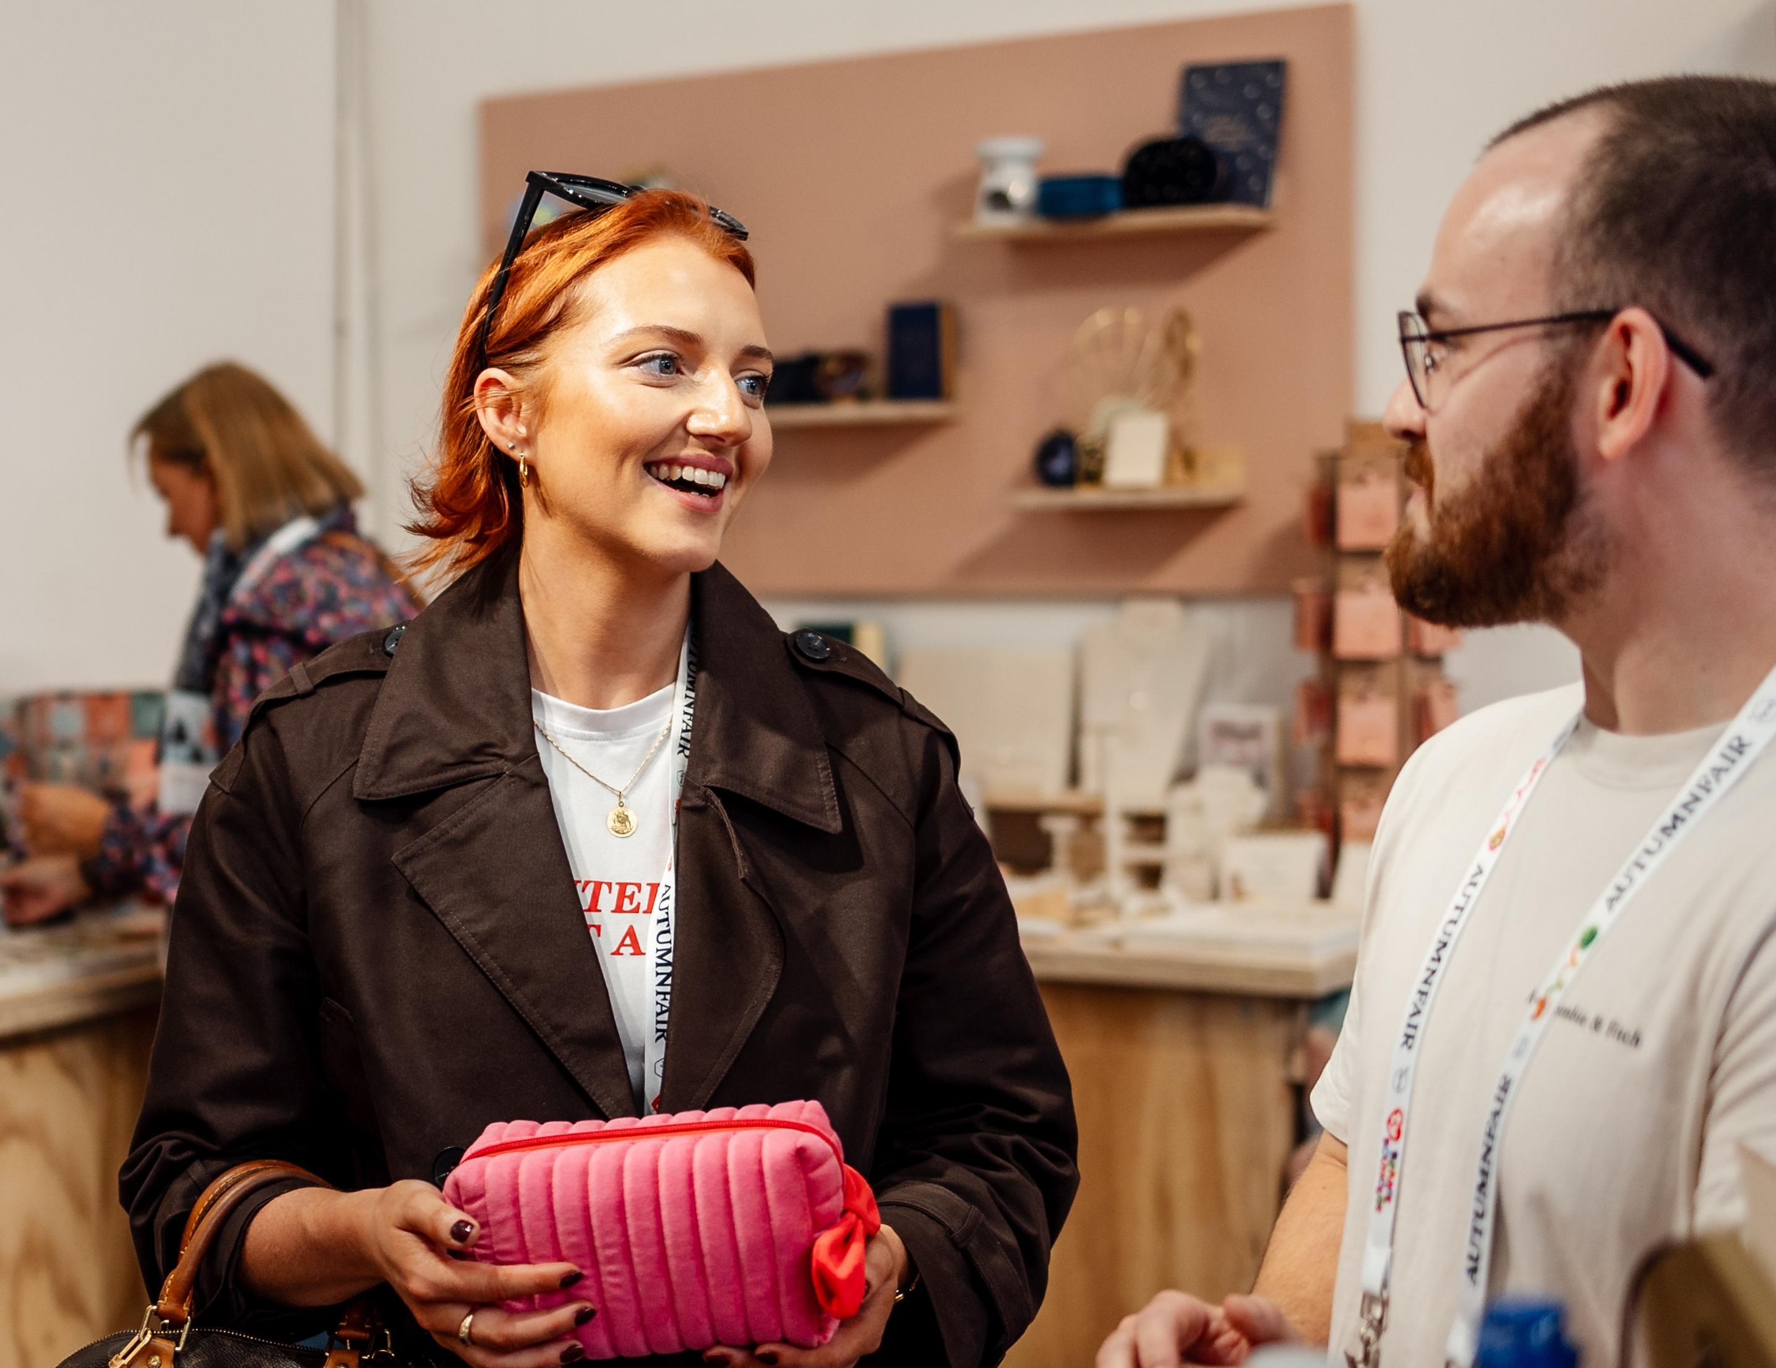



Marketing
Tag us on social media and use #autumnfair2026
@springautumnfair
Spring Fair & Autumm Fair
Spring & Autumm Fair

Slide 24

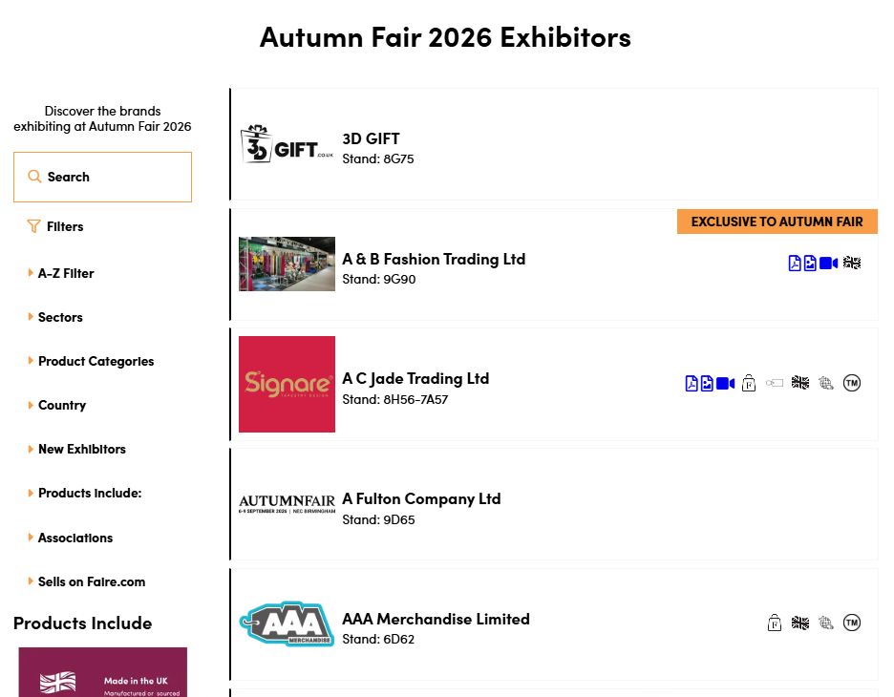
Ezone
We want you to get the most out of exhibiting at Autumn Fair so in the e-zone, which is your virtual shop window we have the following marketing support to help boost your business profile before, during and after the show.
Exhibitors are provided with login details for your online portal enabling you to add your logo, brand story, press releases, product categories and more!
Ensure your profile is up to date in the Exhibitor Zone for maximum visibility on our website.
Need help or logins details? Email exhibitor@autumnfair.com

Slide 25
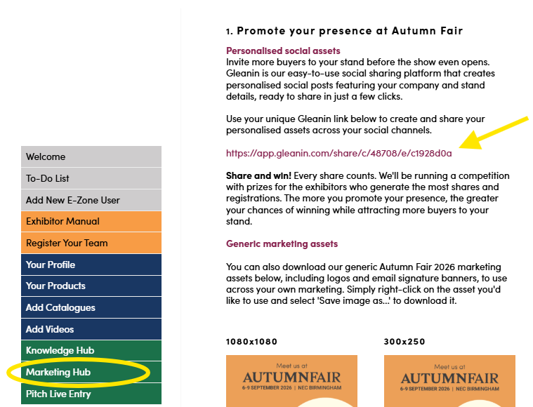
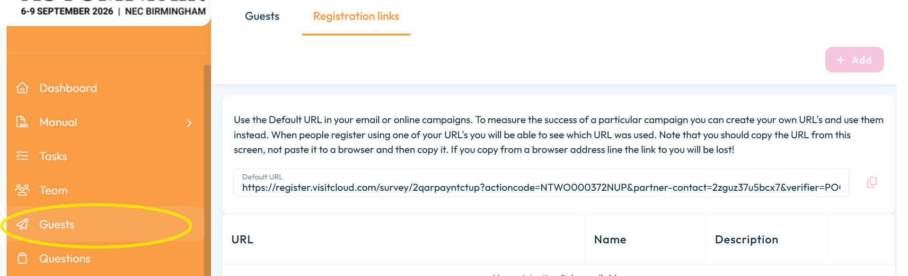
Promote your presence
Personalised banners
Gleanin is our easy-to-use social sharing platform that creates personalised social posts featuring your company and stand details, ready to share in just a few clicks.
Use your unique Gleanin link to create and share your personalised assets across your social channels.
Guest links
Each exhibitor gets their own unique registration link, so you can see exactly who's registered through your activity.
Head over to 'Exhibitor Manual' on the menu and you will be able to find this link under Guests.

Slide 26
Promote your presence
Share & win!
🏆 Most registrations – the exhibitor who brings in the most registration through their link will win 1spm of free stand space at Autumn Fair 2027 and a luxury hamper.
📣 Most Gleanin shares – top 3 exhibitors with the most shares will each receive a luxury hamper delivered to your stand at the show.
We'll also be sharing leaderboard updates throughout the campaign, so you'll be able to see how you're getting on.

Slide 27
Show Guide
Pitch Live
Show Guide is handed out to every visitor attending the show, making it a valuable resource for helping buyers discover your brand and plan their visit.
To ensure your company listing is included, please complete your profile in the ezone by 12 August.
Looking to increase your visibility even further?
Advertising opportunities are available in the Show Guide. To discuss options, please contact Gary Turner at gary.turner@newhallpublishing.com.
Give your brand the spotlight with Pitch Live in partnership with Retail Huddle - an opportunity to present your most innovative products to a panel of retail experts and a live audience. Gain valuable industry feedback, increase brand awareness, and compete for exclusive business growth prizes.
Submit your entry by the 14th August in your ezone, sharing your brands story, product information and imagery. Finalists will pitch their products live on the Autumn Fair stage.
Schedule
Fashion, Accessories & Jewellery Product Pitch: Sunday 6 September at 11:00
Home & Gift Product Pitch: Monday 7 September at 11:00
Toy, Play, & Kids Clothing Product Pitch: Tuesday 8 September at 11:00

Slide 28

First-time exhibiting?
We've created a handy guide taking you through the before, during and after of your first show.
What you’ll learn:
How to budget realistically and set targets you can measure
How to design and merchandise a stand that stops buyers in their tracks
How to work the floor, qualify leads and turn conversations into orders
How to follow up fast and measure the return on your first show
Access the guide here: https://www.autumnfair.com/news/first-time-exhibitor-guide

Slide 29
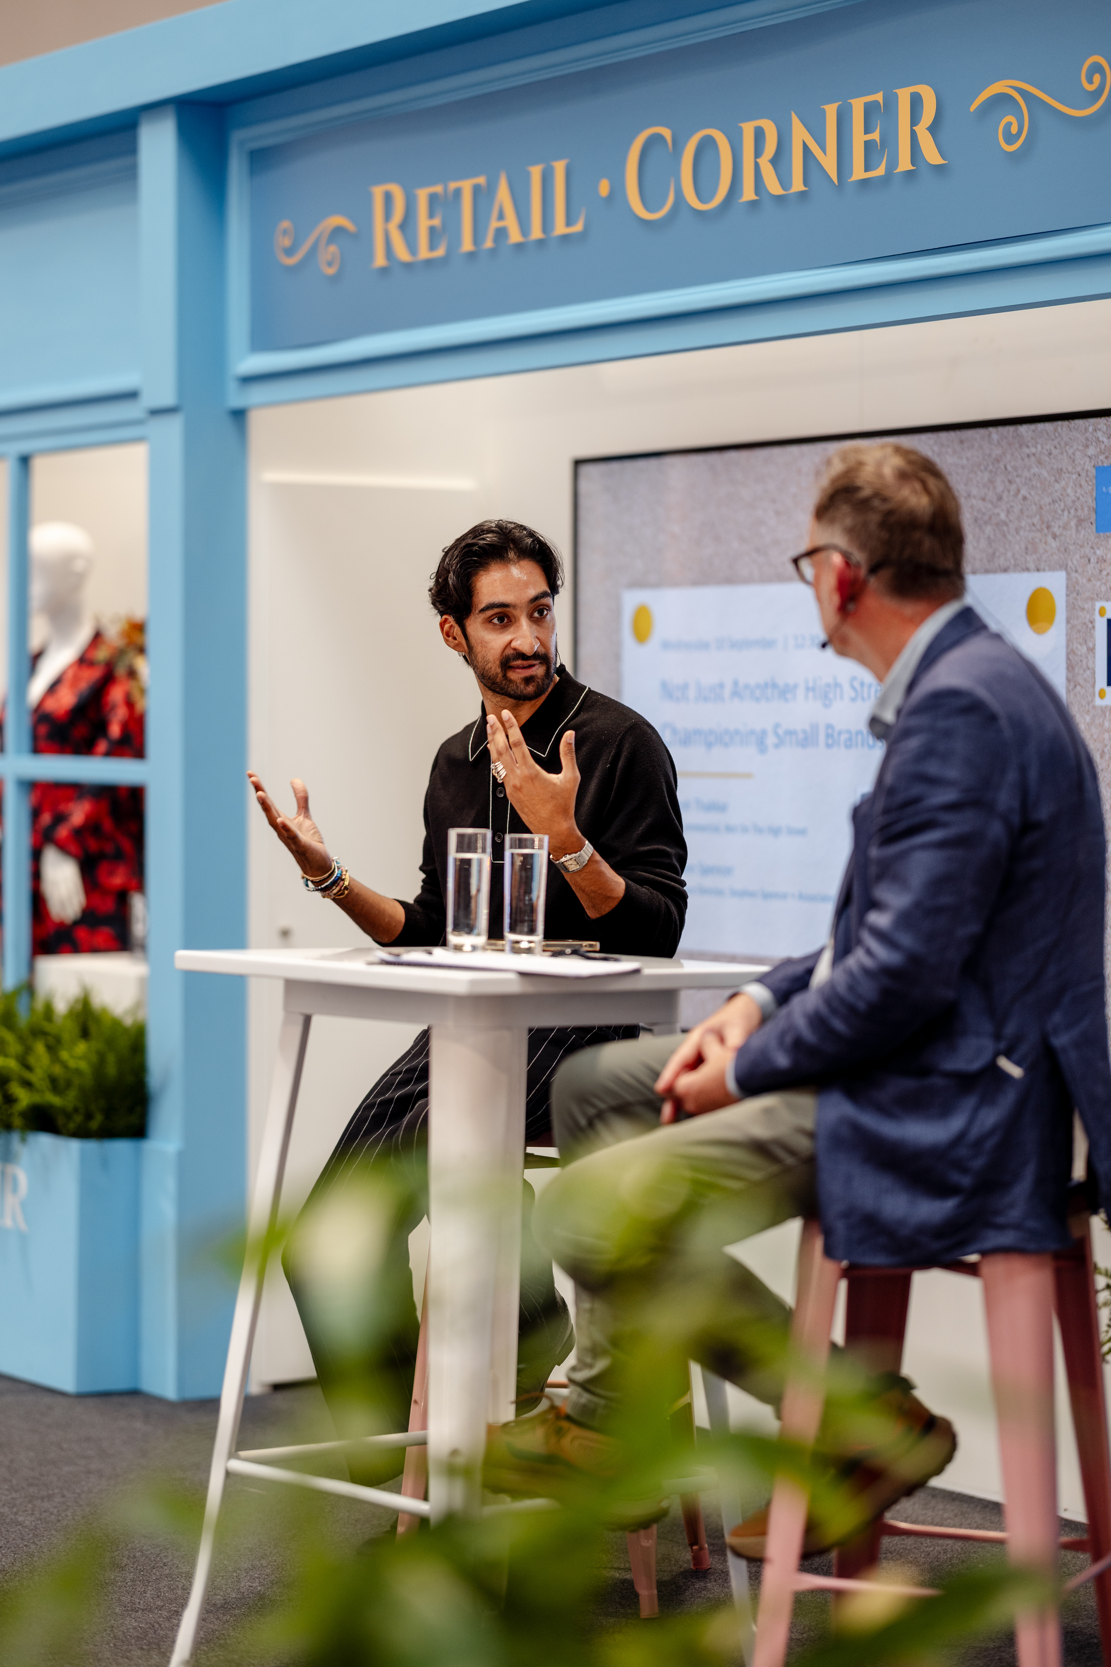
Onsite Content
Introducing...
The Counter
Talks Stage
The unmissable conversations supporting growth and the future of retail...
Customer Experience | Trends Leadership | Digital | Community
Hall 6

Slide 30

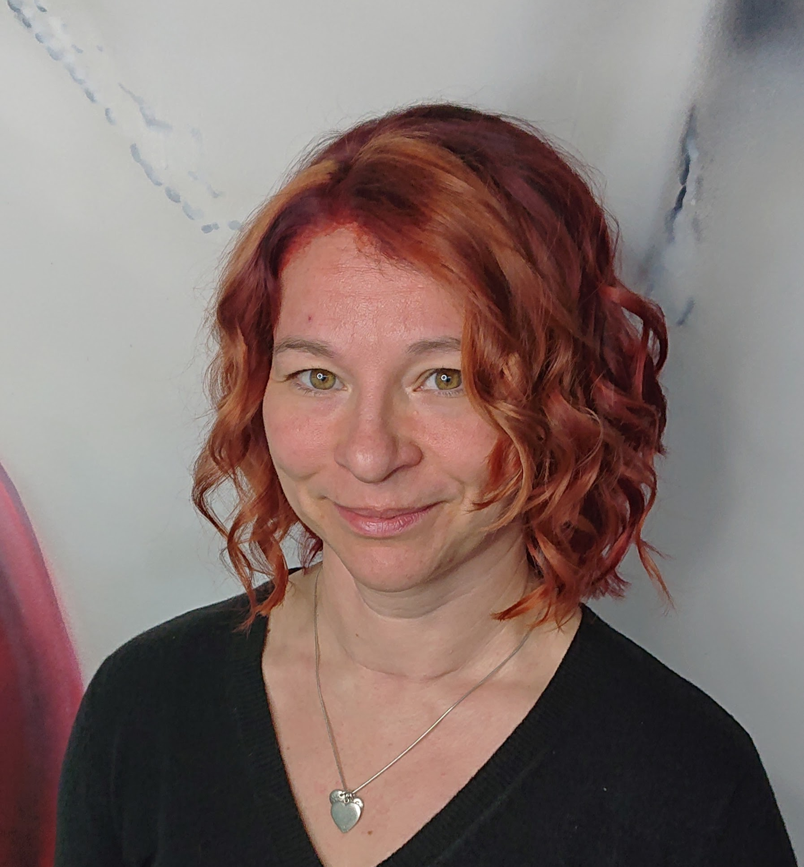
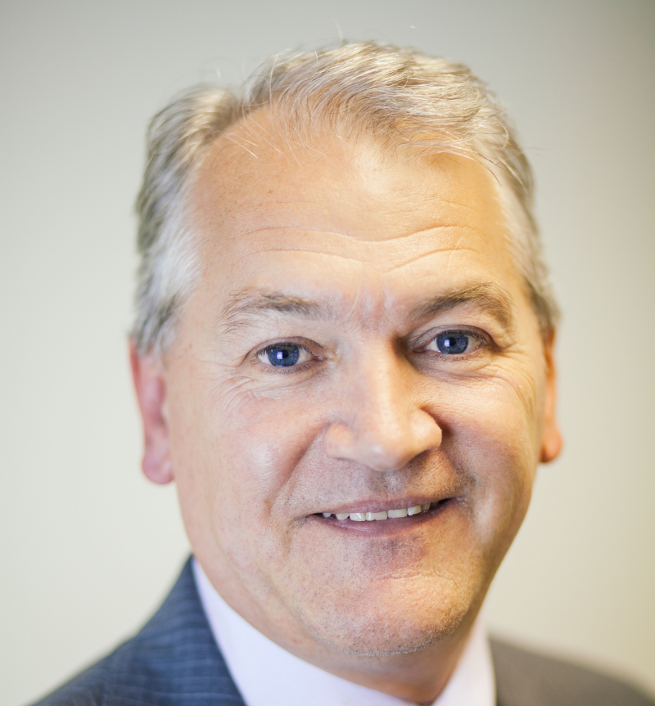
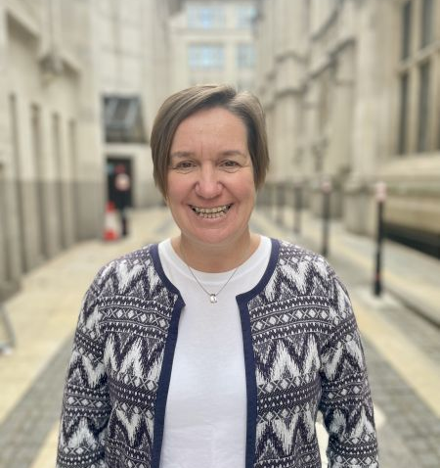
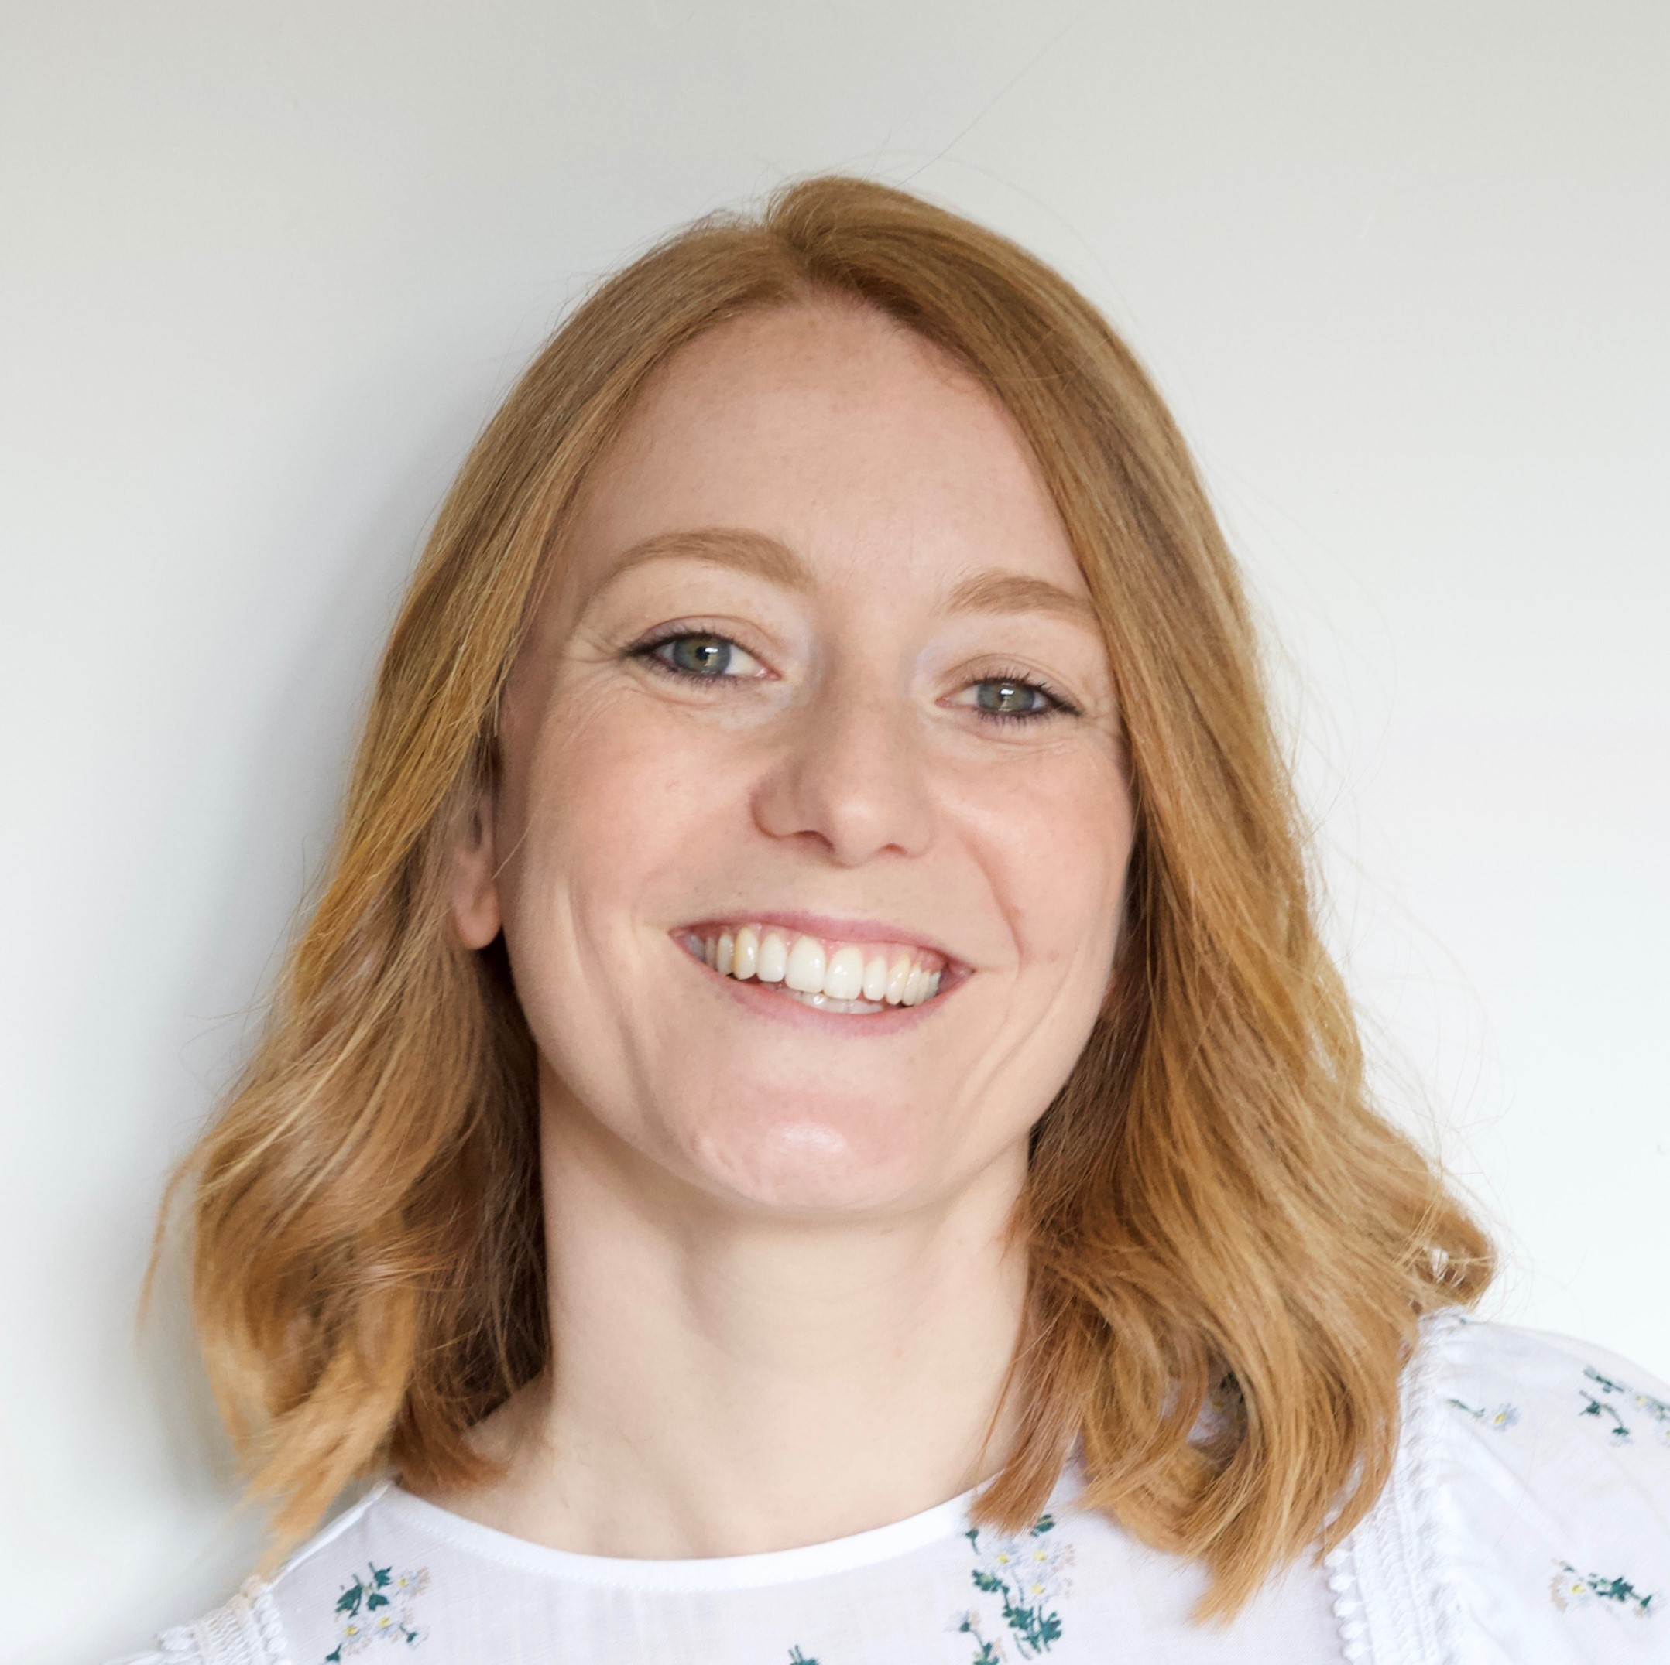
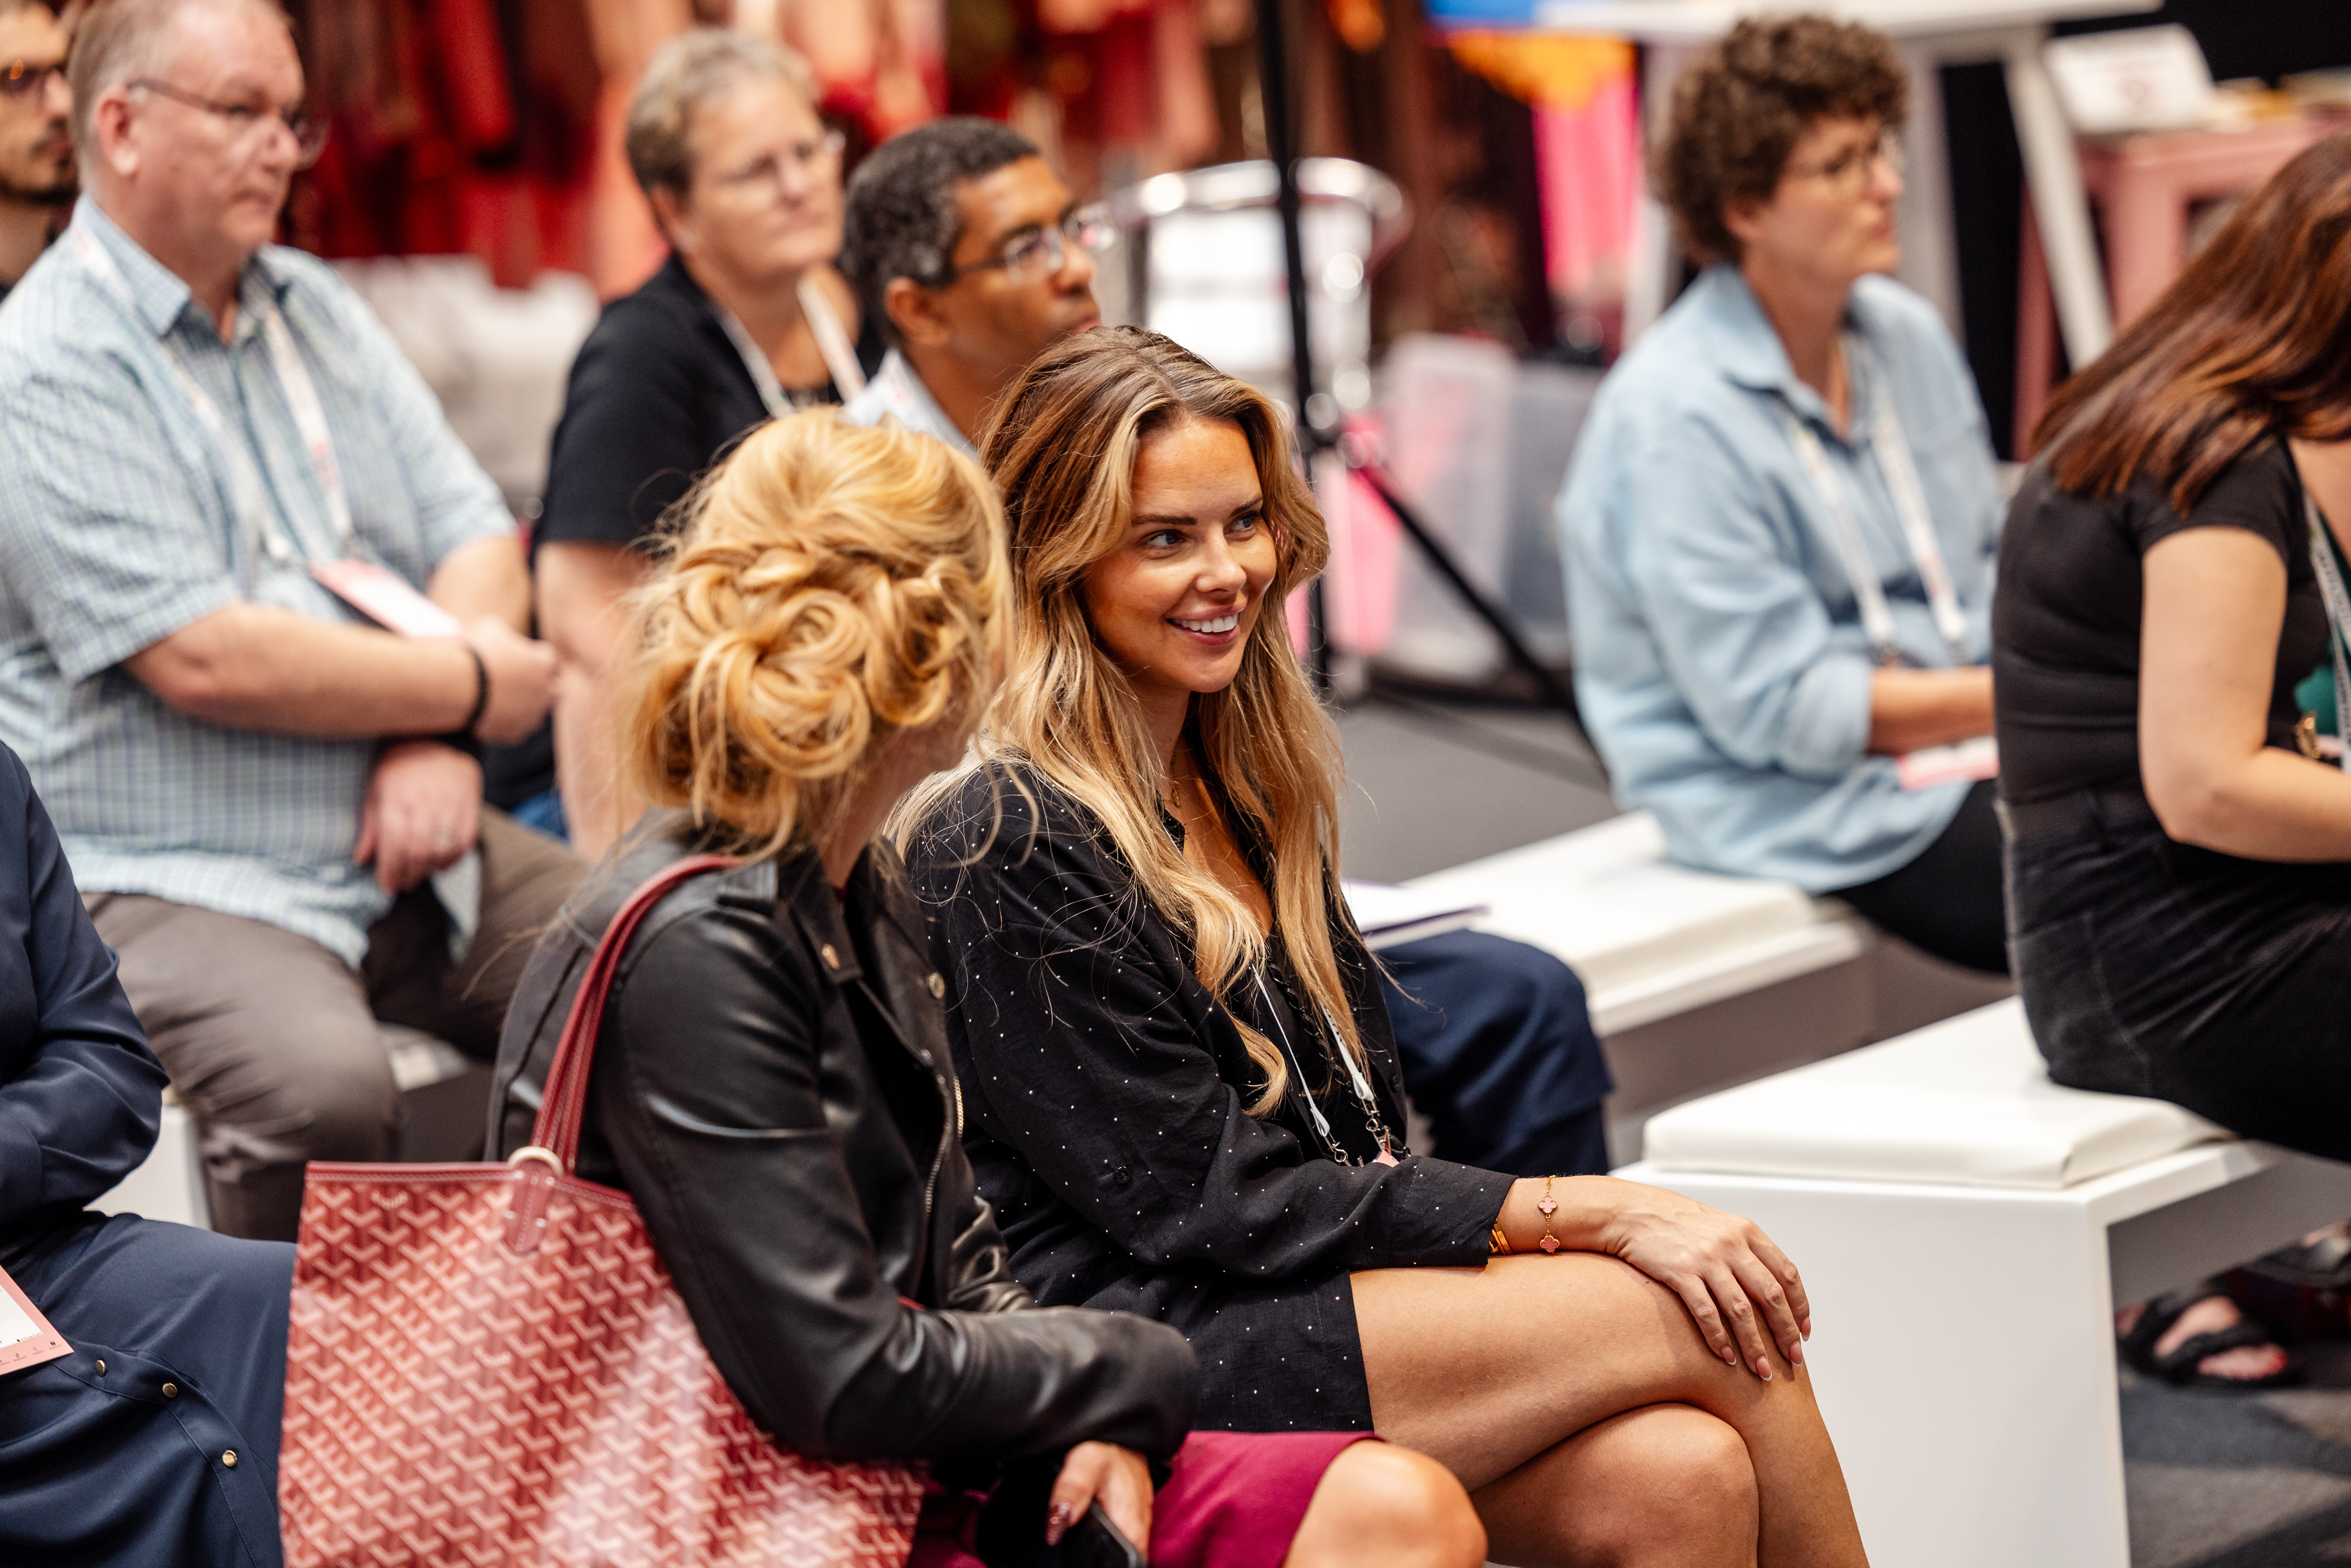
Hear from the leading voices and experts
in retail...
John Abbate
Economic Growth Lead for High Streets at Westminster City Council
Christine Braithwaite
Google
Andrew Goodacre
British Independent Retailers Association
Lisa Maslen
City of London Police
Alison Battisby
Avocado Social

Slide 31
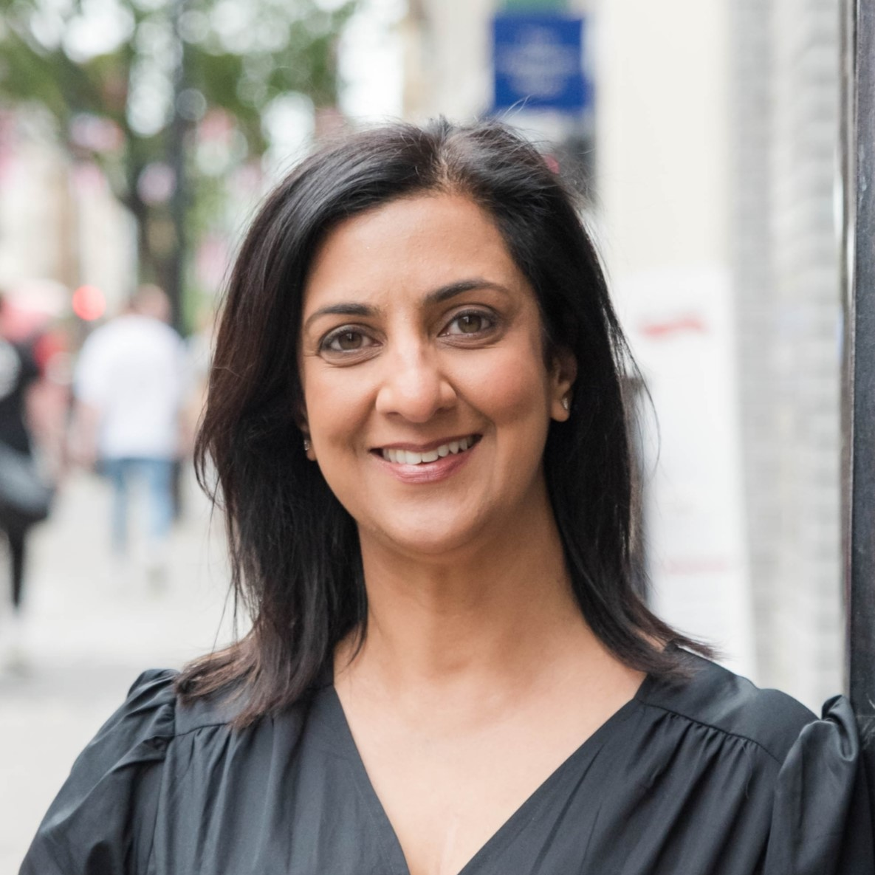



Hear from the leading voices and experts in retail...
Ami Rabheru
Retail Huddle
Steve Manners
Licensing International
Lynsey Norton & Katy Abbott
Buying & Beyond
Natasha Birk
FlightStory
(Diary of a CEO)

Slide 32
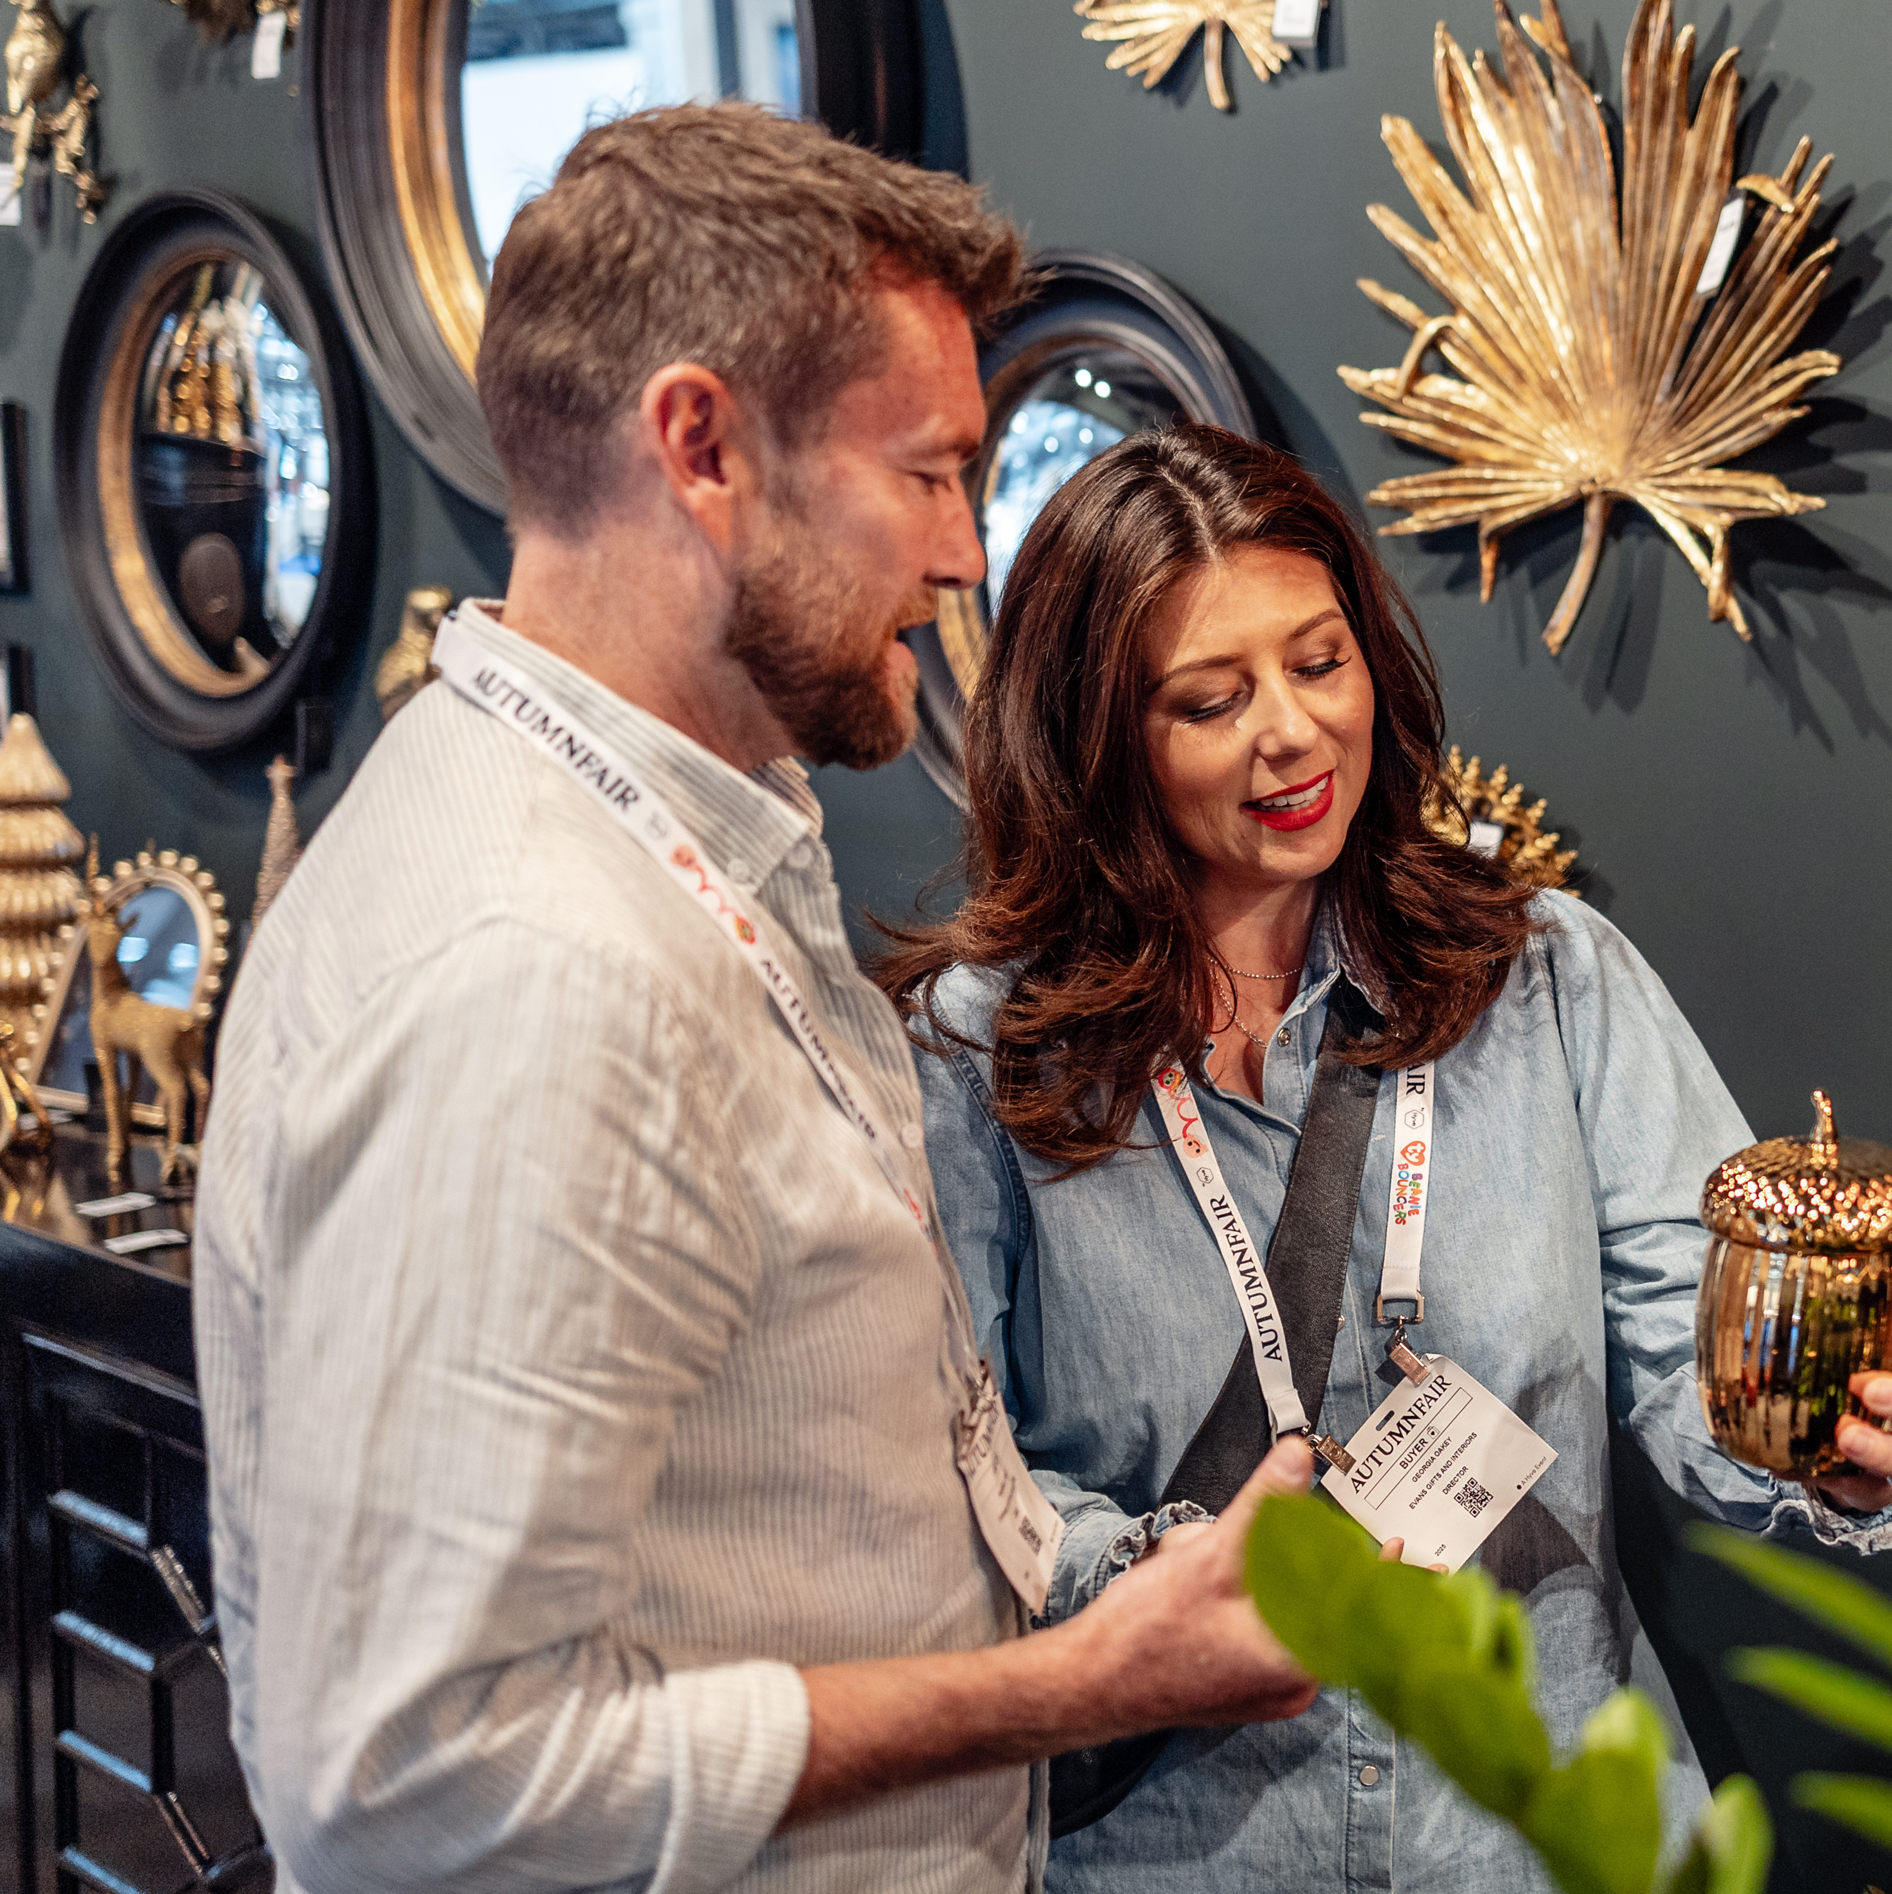
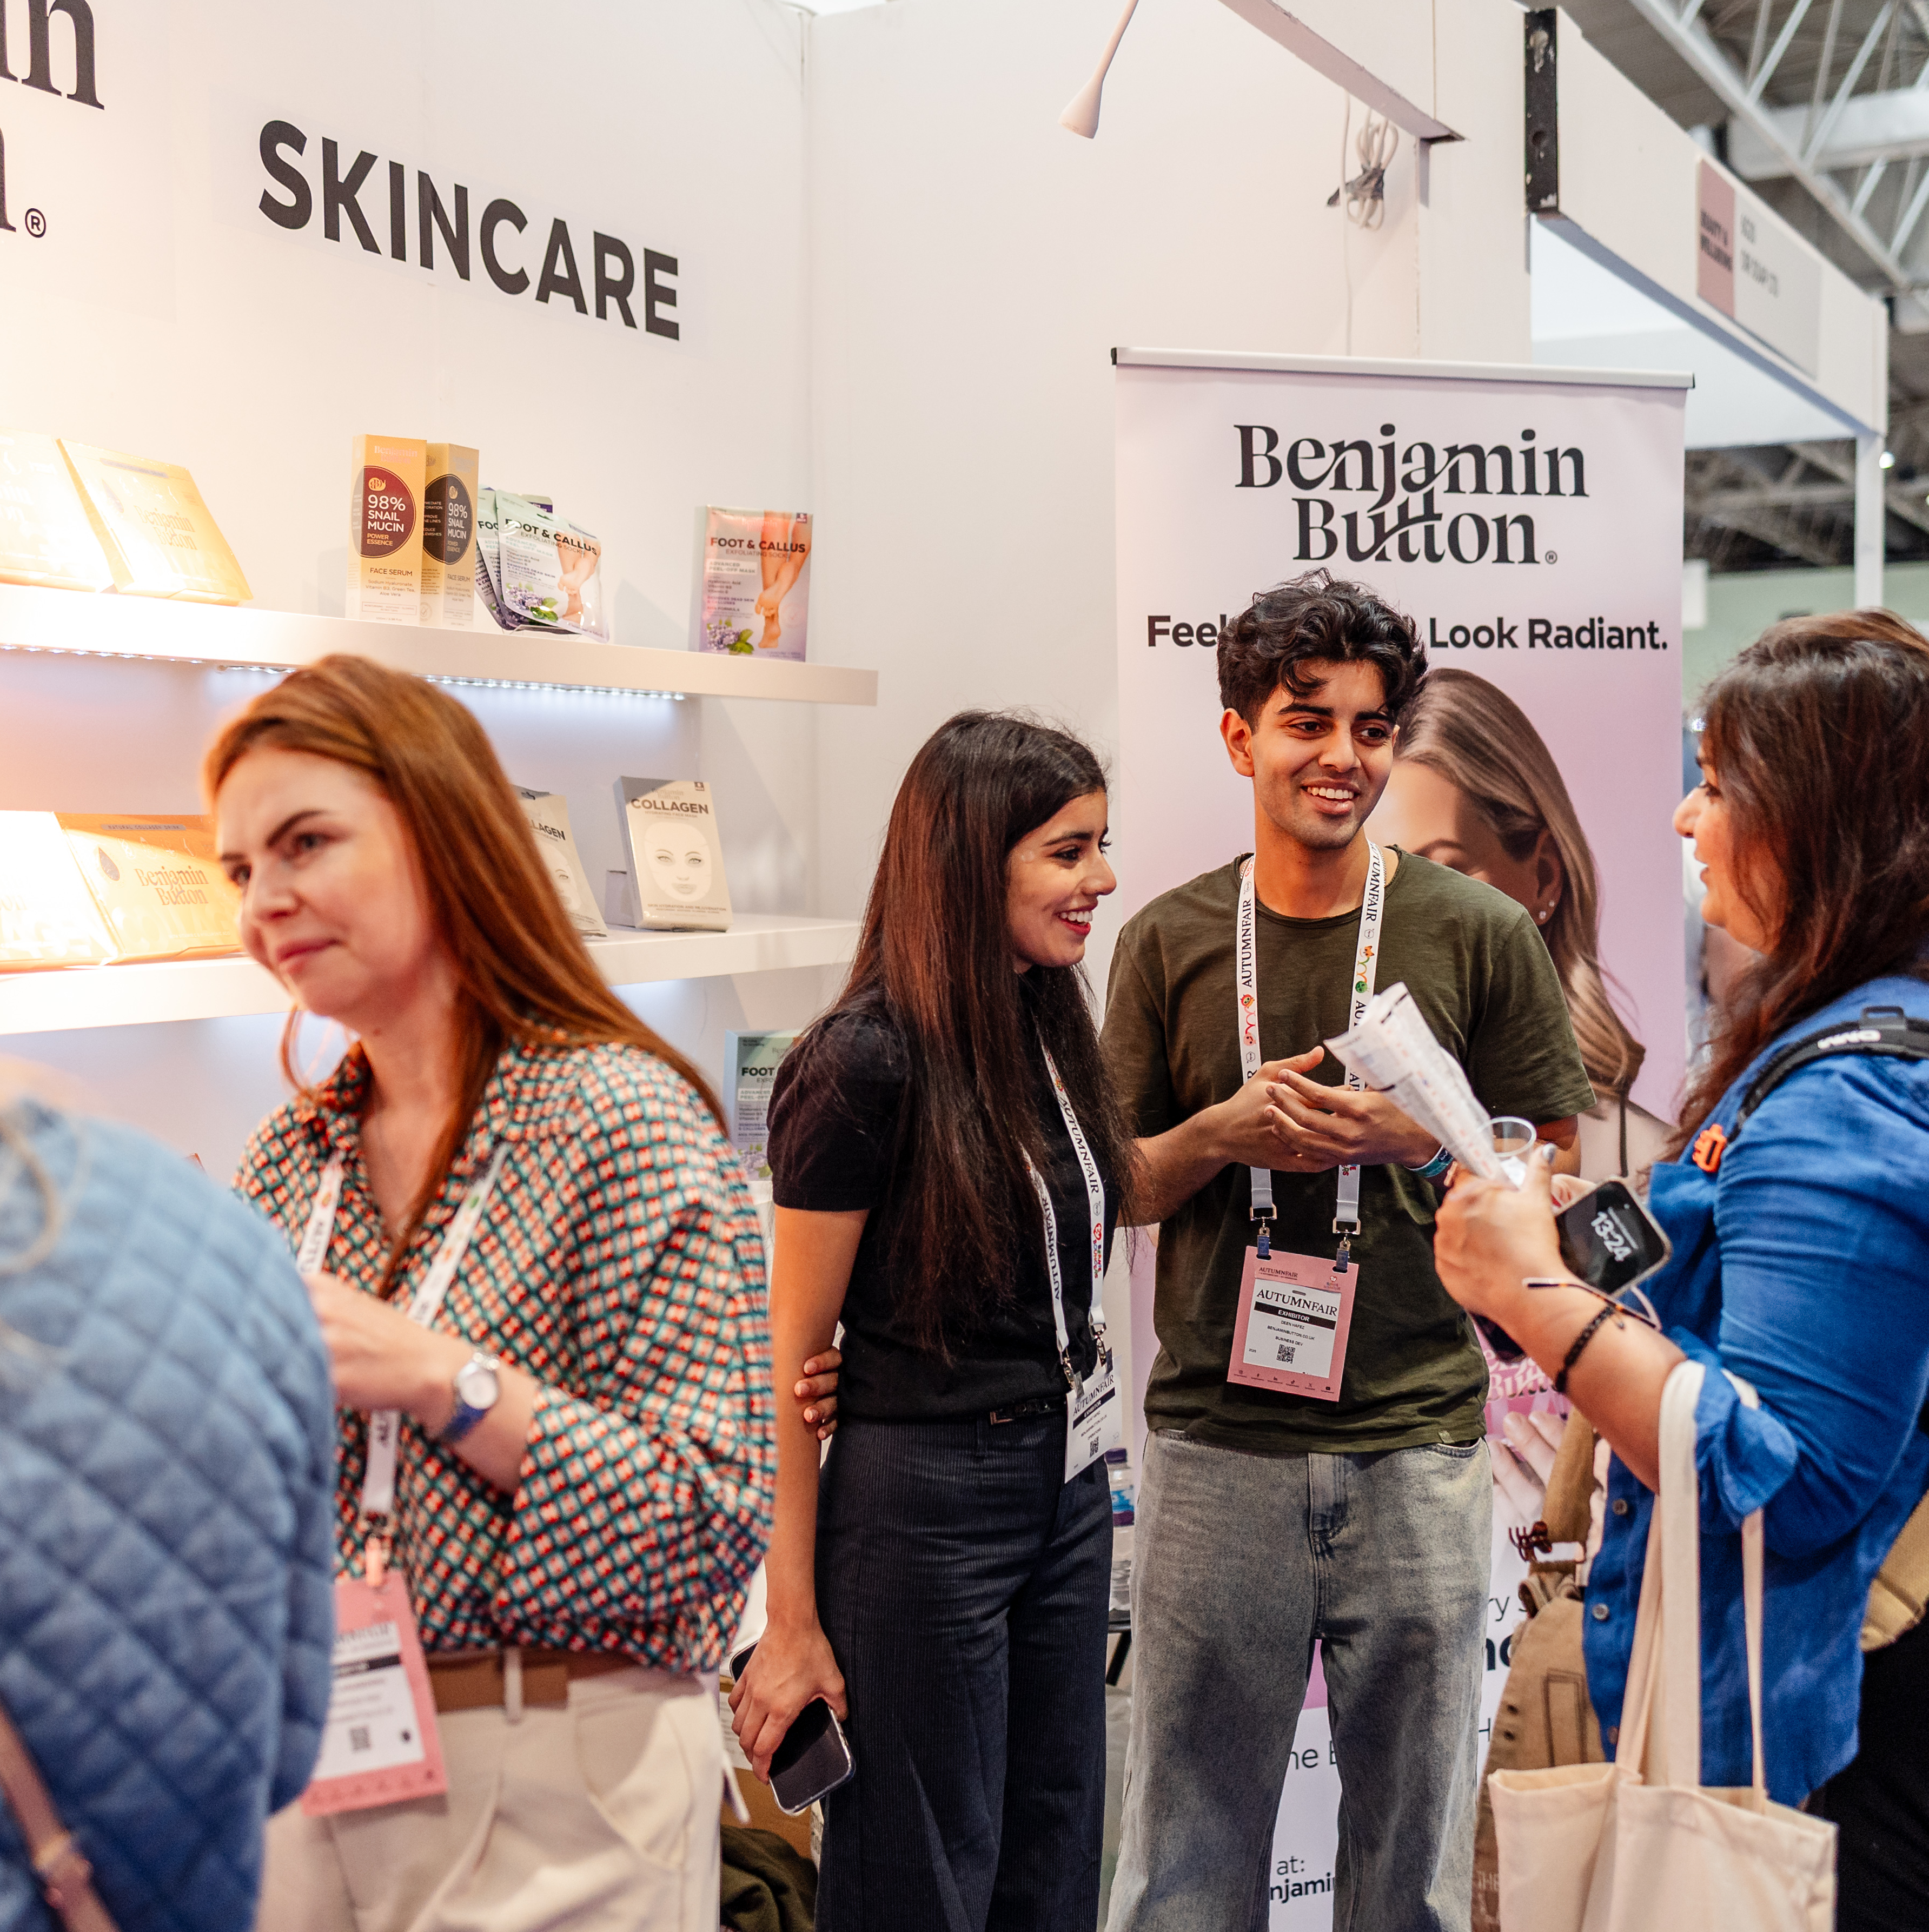
PR
Why PR Matters
You spend time and money exhibiting...So make sure people know you're there.
PR helps you:
Increase visitors to your stand
Build brand awareness
Launch new products
Attract buyers and generate retailer enquiries
Raise your profile long after the show finishes
We're here to help you make the most of your investment, so do make use of the PR support that's included as part of your exhibitor package.

Slide 33
PR
What Makes a Good Story?
Journalists do write about products, but they much prefer to write about stories.
Ask yourself...what would be interesting and what makes your story unique?
Good examples include:
- New product / First time exhibiting
- Company milestones
- Sustainability initiatives
- Celebrity collaborations
- Innovation
- Awards
- Founder stories
- British manufacturing
- Local success stories
For example:
“Family business celebrates 50 years by launching its biggest collection yet.”
“Former teacher launches educational toy helping children learn through play.”
Journalists love things that are: NEW, DIFFERENT, TIMELY, VISUAL, EMOTIONAL & SURPRISING
If you are a new business don’t miss the opportunity to enter Pitch Live. We will be giving finalists and winners extra PR.
Great Photography = Great PR
The biggest reason stories don't get used? Poor images.
Always send:
High resolution JPEGs
Lifestyle imagery
Clean product shots
Founder headshots
No logos & No text on images
Remember...
Editors often choose the story with the best image.
Think Local Too
Don't just target trade press.
You're also interesting because you're local.
For Example:
"Yorkshire entrepreneur exhibiting at UK's biggest retail trade show."
"Devon maker launches sustainable gift range."
"London designer takes business national."
Local media LOVE local success stories.
We are working on a press release to send to regional press highlighting the incredible brands from key regions so if you have a product or story that is particularly connected to your local area, please let me know.

Slide 34
Before • During • After
Before the Show
Announce:
new launches
anniversaries
collaborations
awards
If you're featured in the press, share the coverage
During the Show
Take photos
Film content
Share on LinkedIn & Instagram
Tag Autumn Fair
Give the press office a quote to include in our press releases
After the Show
Share:
Retail wins
Success stories
Keep the momentum going

Slide 35
PR - Onsite
Digital Press Office
Available for journalists in the leadup to, during and 6 months post show. Provide us with:
Your press release/s
High-resolution images - we need 1-2 hero images.
Digital look books
Please remember:
Label images with your brand name
No logos or text embedded
Minimum 1MB, max 3MB JPEGs
Media Lounge – Hall 9 Stand C90
The media visit the Media Lounge for show information, ideas, inspiration and to download the link to the Digital Press Office.
Press Goody Bags
25 goody bags will be distributed to key retail media including:
Progressive Gifts & Home
Gift Focus
Gifts Today
PGBuzz
Drapers
The Industry Fashion & Beauty
Boutique
Interiors Monthly
Progressive Housewares
Furniture News
Total Licensing
Garden Trade News
…and many more.
If you have a great product, let journalists experience it.
Press & Influencers
Inviting media or influencers?
Please tell us.
We'll make sure they receive accreditation and can access the show easily.
Filming
Any press, influencers or photographers wishing to film at the show will need to be pre-approved for accreditation. Please introduce them to us as early as possible.

Slide 36
We're Here to Help
If you're unsure whether something is newsworthy...
Ask us.
Sometimes the stories you think are ordinary are exactly what journalists are looking for.
Let's help buyers discover your brand before they even walk through the doors.
Remember, PR is not Advertising
Which means Press Coverage can never be guaranteed. We will do our best to include you in the Autumn Fair campaign where we can, but press coverage is at the media’s discretion and is never guaranteed.
Do this Today
Send us your story
Send 1-2 high-resolution images
Tell us if you're launching something new
The earlier you send us your news, the more opportunities we have to include it in previews and press releases before the show.
Don't wait until the week before the show.
Contact
Email: philippas@goodresults.co.uk
Thank You and See you in September.

Slide 37
Q&A

Slide 38
Thank you!
See you at Autumn Fair

