Slide 1

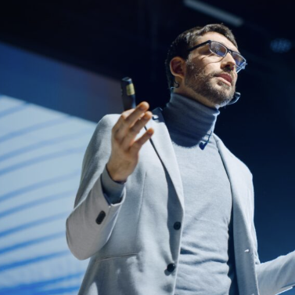
Use this area for your slides and send the layer backwards behind the black masking.
Full slide canvas is set to 4,533px x 1,067px
Leave this area as will be used for camera relay
And captions

Slide 2

EXAMPLE SLIDE
Leave this area as will be used for camera relay
And captions

Slide 3
Blank with mask

