Slide 1

Presentation guide

Slide 2
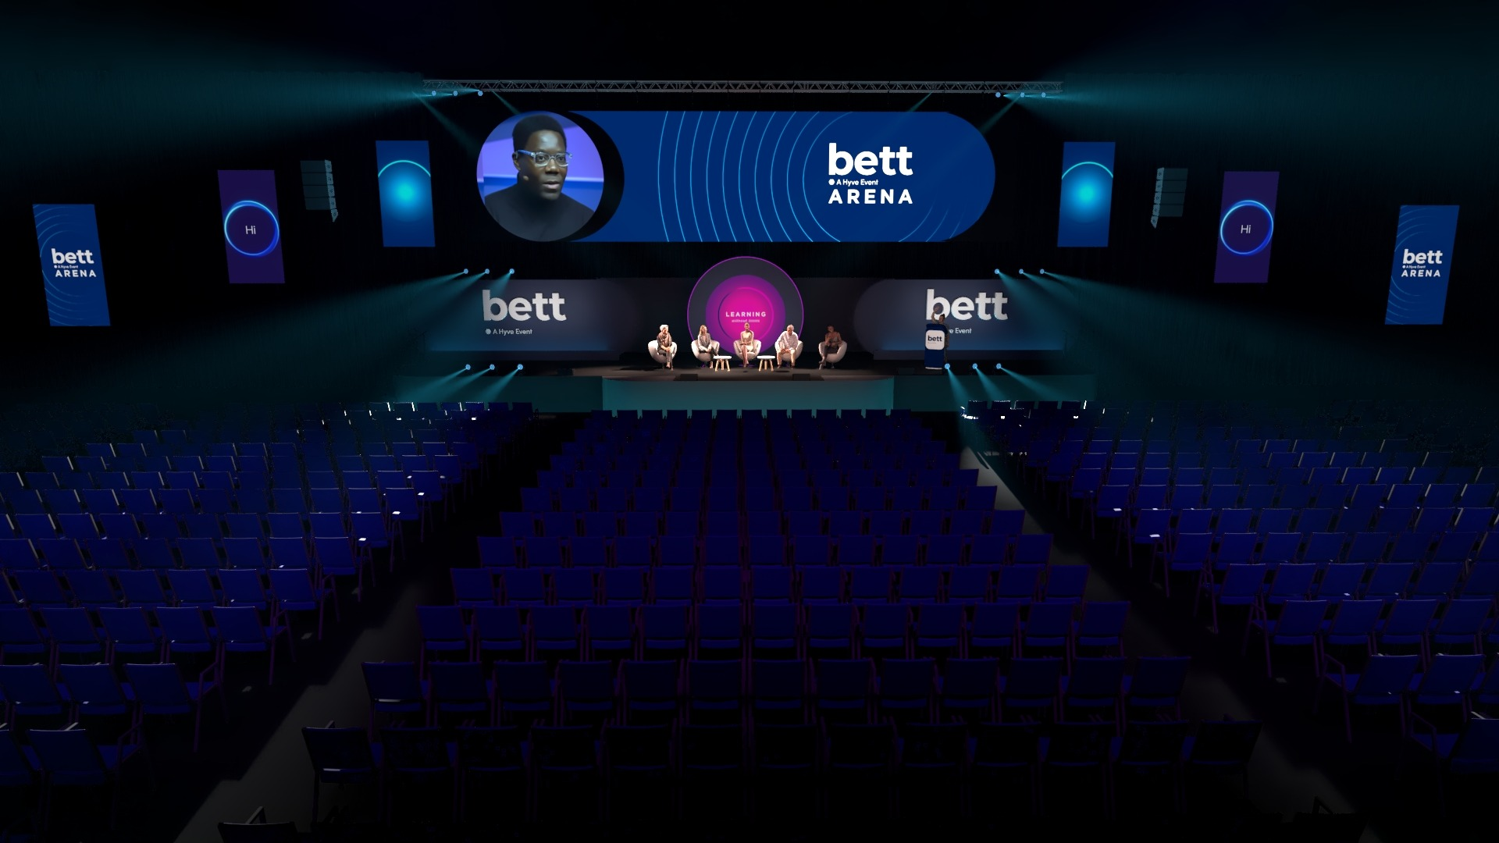
Slide Presentation
The Bett Arena has an extra wide screen with a custom overlay (mask). Before designing your presentation, please read through the two options on the following pages to decide if you will create a standard size or custom deck.

Slide 3
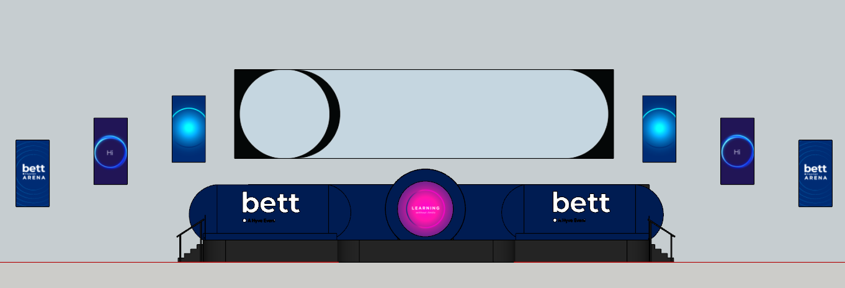

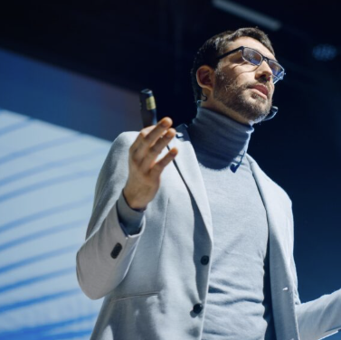

OPTION 1 – Standard 16x9 presentation
If you prefer to create your slides in a standard 16:9 format, we can layer this onto the screen as a 'Picture in Picture' (PIP) see below example. In which case, you can design your slides and videos as normal, and the AV team will scale in the system and layer on top of the Bett backdrop slide.
Videos and slides should be a minimum 1920 x 1080 pixels and captioned for accessibility. Videos should be a mp4 format at a minimum of 25 fps and embedded into your slides (do not use links to shared drives or online videos). Slides can be in PowerPoint, Keynote, CANVA or Google slides. We don't accept PDF's.
Camera image
Standard 16:9 slide or Video PIP example
These are captions - these are captions
these are captions these are captions

Slide 4

OPTION 2 – Custom presentation
In this option you can make full use of the presentation area to the right of the camera relay image.
For this, you need to bear in mind the black curved digital mask.
As PowerPoint cannot stretch to the full pixel resolution, please use the Arena PPT bespoke template here which is set at 2/3rds scale (4,533x1067px), the AV team will then re-scale to fit the canvas.
If you are creating in Keynote, Canva or another application, which can handle the pixel resolutions, then please set your canvas to 6,800 x 1,600 pixels and then use the LED mask template but avoid the circle area reserved for the camera relay. Videos and slides must be a minimum 1920 x 1080 pixels and captioned for accessibility. Videos must be mp4 format at a minimum of 25 fps and embedded into your slides and captioned for accessibility.
Don't use links to shared drives or online videos.
EXAMPLE SLIDE
These are captions - these are captions
these are captions these are captions

