Slide 1
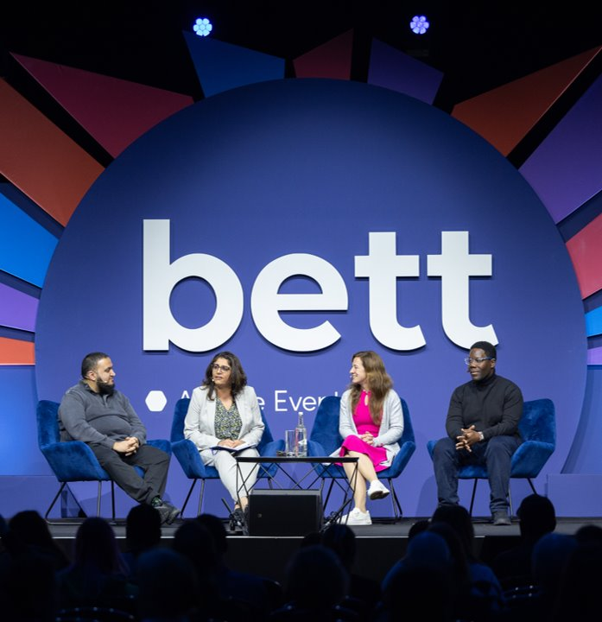

Session & Speaker Information Pack
Arena
Add a subtitle​
  Give general information about this topic to add depth and clarity. Write short, interesting reference points that don’t need to be read aloud.​
Add a subtitle
  Give general information about this topic to add depth and clarity. Write short, interesting reference points that don’t need to be read aloud.​
Add a subtitle​
  Give general information about this topic to add depth and clarity. Write short, interesting reference points that don’t need to be read aloud.​

Slide 2
Our mission for Bett 2026
Learning without limits:
Learning for All
How do we make education truly inclusive? From accessibility and equity to curriculum design and digital infrastructure, we look at what it takes to ensure every learner, no matter their background, ability or circumstance, has the support they need to thrive.
Learning to Innovate
From AI to XR, innovation isn’t just about having the latest tech—it’s about rethinking how we teach, how we lead, and how we learn. This is about creative problem-solving, sustainable budgeting, bold ideas, and the practical tools that help turn vision into action in every kind of learning environment.
Learning for Life
Education doesn’t end at the classroom door. We explore how to prepare learners, not just for exams and work, but for life. From digital citizenship to employability, wellbeing to lifelong learning, it’s about helping them build the confidence, skills and adaptability they need to become future-ready students in a rapidly changing world.

Slide 3
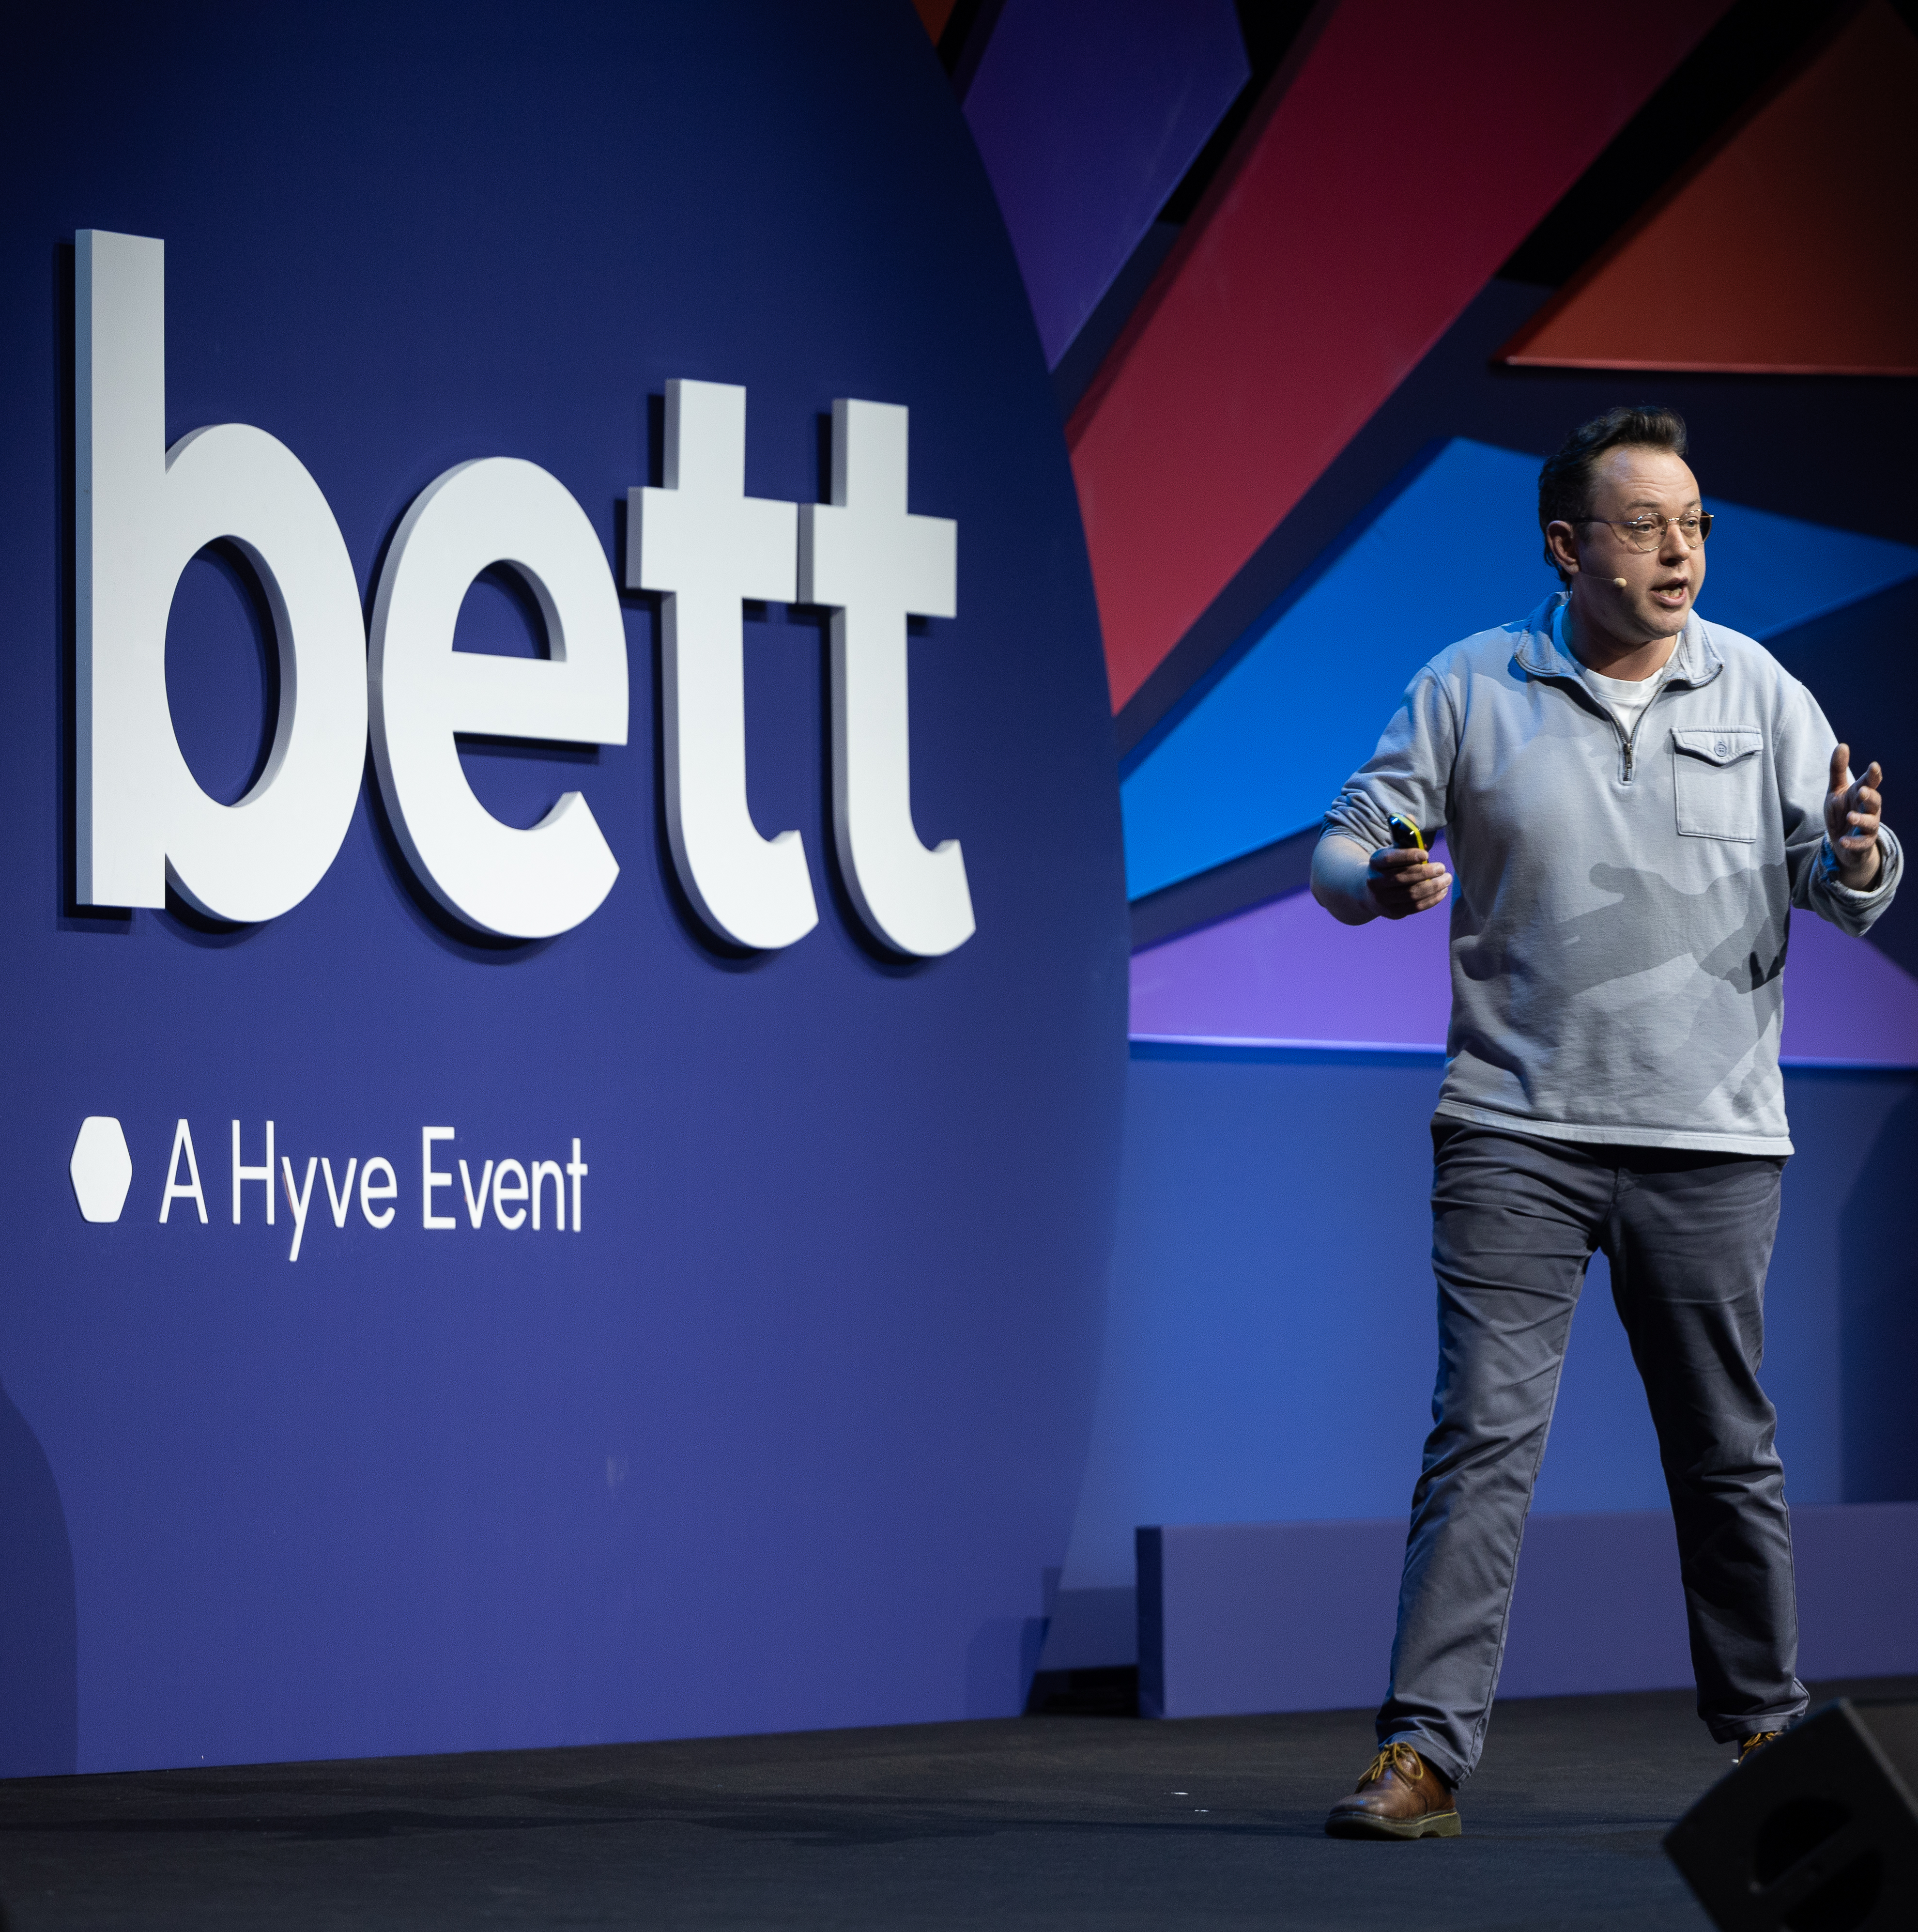
Thank you for speaking at Bett 2026
This pack contains useful information to help you prepare for your talk and contains details on:
Registration – page 2
Theatre FAQs – page 3
Presentation FAQs – page 4
Onsite information – page 7/8

Slide 4
Bett Milestones
Milestone | Due Date
Session forms and speaker details forms to be returned | Due now
AV form to be returned | 12 December 2025
Deadline for all speakers to have registered to attend the show | 12 December 2025
Briefing calls conducted (if required) with Bett content team | 8 January 2026
Presentations to be uploaded to Dropbox | 5pm GMT 13 January 2026
1

Slide 5
Speaker Registration
All speakers are required to pre-register for their Bett badge by Friday 12 December 2025.
Please select the ticket type that best matches your job title. Once you have registered, we will add a ‘Speaker’ label to your badge. Your badge details will be emailed to you a week ahead of the show.
To beat the queues, you're able to print your badge at home and collect a lanyard on site. Alternatively, you can print your badge on arrival in the registration area.
If you are speaking on behalf of a company, please contact the Content Team, so we can provide you with a registration link for a free ticket.
Please note, if you are bringing any students under 18 years of age, you will need to register them online ahead of the show using the school groups link.​
You are very welcome to bring colleagues, friends and guests to Bett 2026, and they can register for their visitor pass here. Tickets for educators are free.
2

Slide 6
Arena FAQs
Arena session details | Information
Is there a lectern for me to present from? | Yes
Is there autocue | No
How can I let you know what my presentation involves | Please complete the Run Order template and include details of who is on stage, when, what you want showing on the screen, when videos need to be played etc. Any information that will help the team to support you.
Will my session be filmed? | All sessions on the Arena will be recorded. If you do not wish your session to be recorded, please let the Content Team know by Monday 9 December
Can I use interactive Q&A or set up a poll? | Yes – Slido will be set up for this stage and we will have an iPad to display questions. Please refer to the Slido Guidelines on the Speakers Resources page and share your requirements with the Content Team by Wednesday 8 January
Will someone introduce me on stage? | Yes, you will be introduced to the stage by theatre host Laura McInerney, Founder, Teacher Tapp
What it the capacity of the theatre? | 1,400
3

Slide 7
Presentations
AV presentation details | Information
The Arena screen has a bespoke extra wide screen. Do you provide a PPT template? | Yes, there are two options for the Arena. Either standard 16 x 9 ratio or to use the full screen widtch, we have provided a bespoke PPT template. Please use it to ensure you're using the full size of the screen. Templates can be found in the Speaker Resources page here.
Do I need to bring my laptop or device with me? | No - Your slides will be shown on our device. Please ensure you share your PPT with us ahead of the show as requested by 5pm GMT 13 January 2026. If it is essential that you use your own device, you must let us know via the AV form and ensure you bring a HDMI or mac adapter to ensure it will be compatible with our AV set up.
How do I share my PPT with you? | Please upload your presentation, along with any other files/assets you plan on using in your session (eg audio and video files, font files) via this link here. This box link will be open until 5pm GMT 13 January 2026. If you have missed this deadline, please email your presentation to bett.speakers@bettshow.com. If you have any urgent amendments during the show, you must bring your presentations to the Speaker Lounge at least one hour ahead of your session starting.
Will I be able to see my slides on a comfort monitor? | Yes – there are two comfort monitors on stage that will show a countdown timer and your current and next slide.
Can I play videos during my PPT? | Yes – please ensure that they are embedded in your presentation and are shared with us as separate files and do not require the internet to play. Please ensure all videos are .Mp4 format with .h264 codec. Please remove any auto play settings.
4

Slide 8
Presentation submission
Our preferred presentation format is PowerPoint.
Please note we cannot support presenting directly from the cloud as we can’t guarantee wifi stability. We also can’t accept PDF presentations.
Please upload your presentation via this link which will be open until 5pm GMT 13 January 2026.
Please name your file using the following format:
Theatre name – Day – Session Time – Session Title
e.g. Teaching & Learning Theatre – Wednesday – 10:30 – Delivering a digital strategy
Please include a completed Run Order template with your presentation.
If you upload your presentation, then make edits and want to share the latest version, please name it using the same format, adding ‘v.2 or v.3’. Please also notify us via email to flag the new version.
Videos must be embedded into the presentation and also be uploaded as a separate files using the same naming format e.g. Plenary – Wednesday – 10:30 – Delivering a digital strategy – video v.1. Please remove any auto play settings.
Any unique fonts must also be uploaded as separate files, using the same naming format, otherwise standard fonts will be used, and text may appear skewed or at the incorrect size.
5

Slide 9
Accessibility
All sessions will be captioned
Ensure you use a sans-serif font with a size of 18pt or larger
Use sufficient contrast between your text and background colours and consider not putting text over imagery
If using PowerPoint, it may be helpful to refer to the accessibility checker which can help identify potential accessibility issues.
Please visit our general accessibility page for detailed information on how we address various accessibility and communication needs which can help assist in planning your time at Bett. In all our theatres, there will be designated accessible seating, including wheelchair bay seating with companion chairs and ambulant disabled seating at the end of the aisles. Please note that all raised theatre stages have access ramps.
6

Slide 10
Speaker Lounge
The Speaker Lounge is an exclusive area for all Bett speakers and moderators. We will have a dedicated team at the Speaker Lounge to help you check in and address any queries.
Please report to the Speaker Lounge on the day of your session, one hour before your scheduled session time. Our team will check you in and introduce you to the AV support team to check your presentation slides. You will then be taken to your theatre 30 minutes before you are due on stage.
Please also report to the Speaker Lounge if you have any problems or issues related to speakers or sessions onsite, including:
If a speaker is running late
If a speaker is unwell and cannot make their session
Presentation update
Session update on the website or app
Last minute AV request
The Speaker Lounge is located at the rear of the North Hall, with the nearest entrance via N9 Boulevard. This is a private area for registered speakers only. For access before 10:00 am, please use Entrance N8.
7

Slide 11
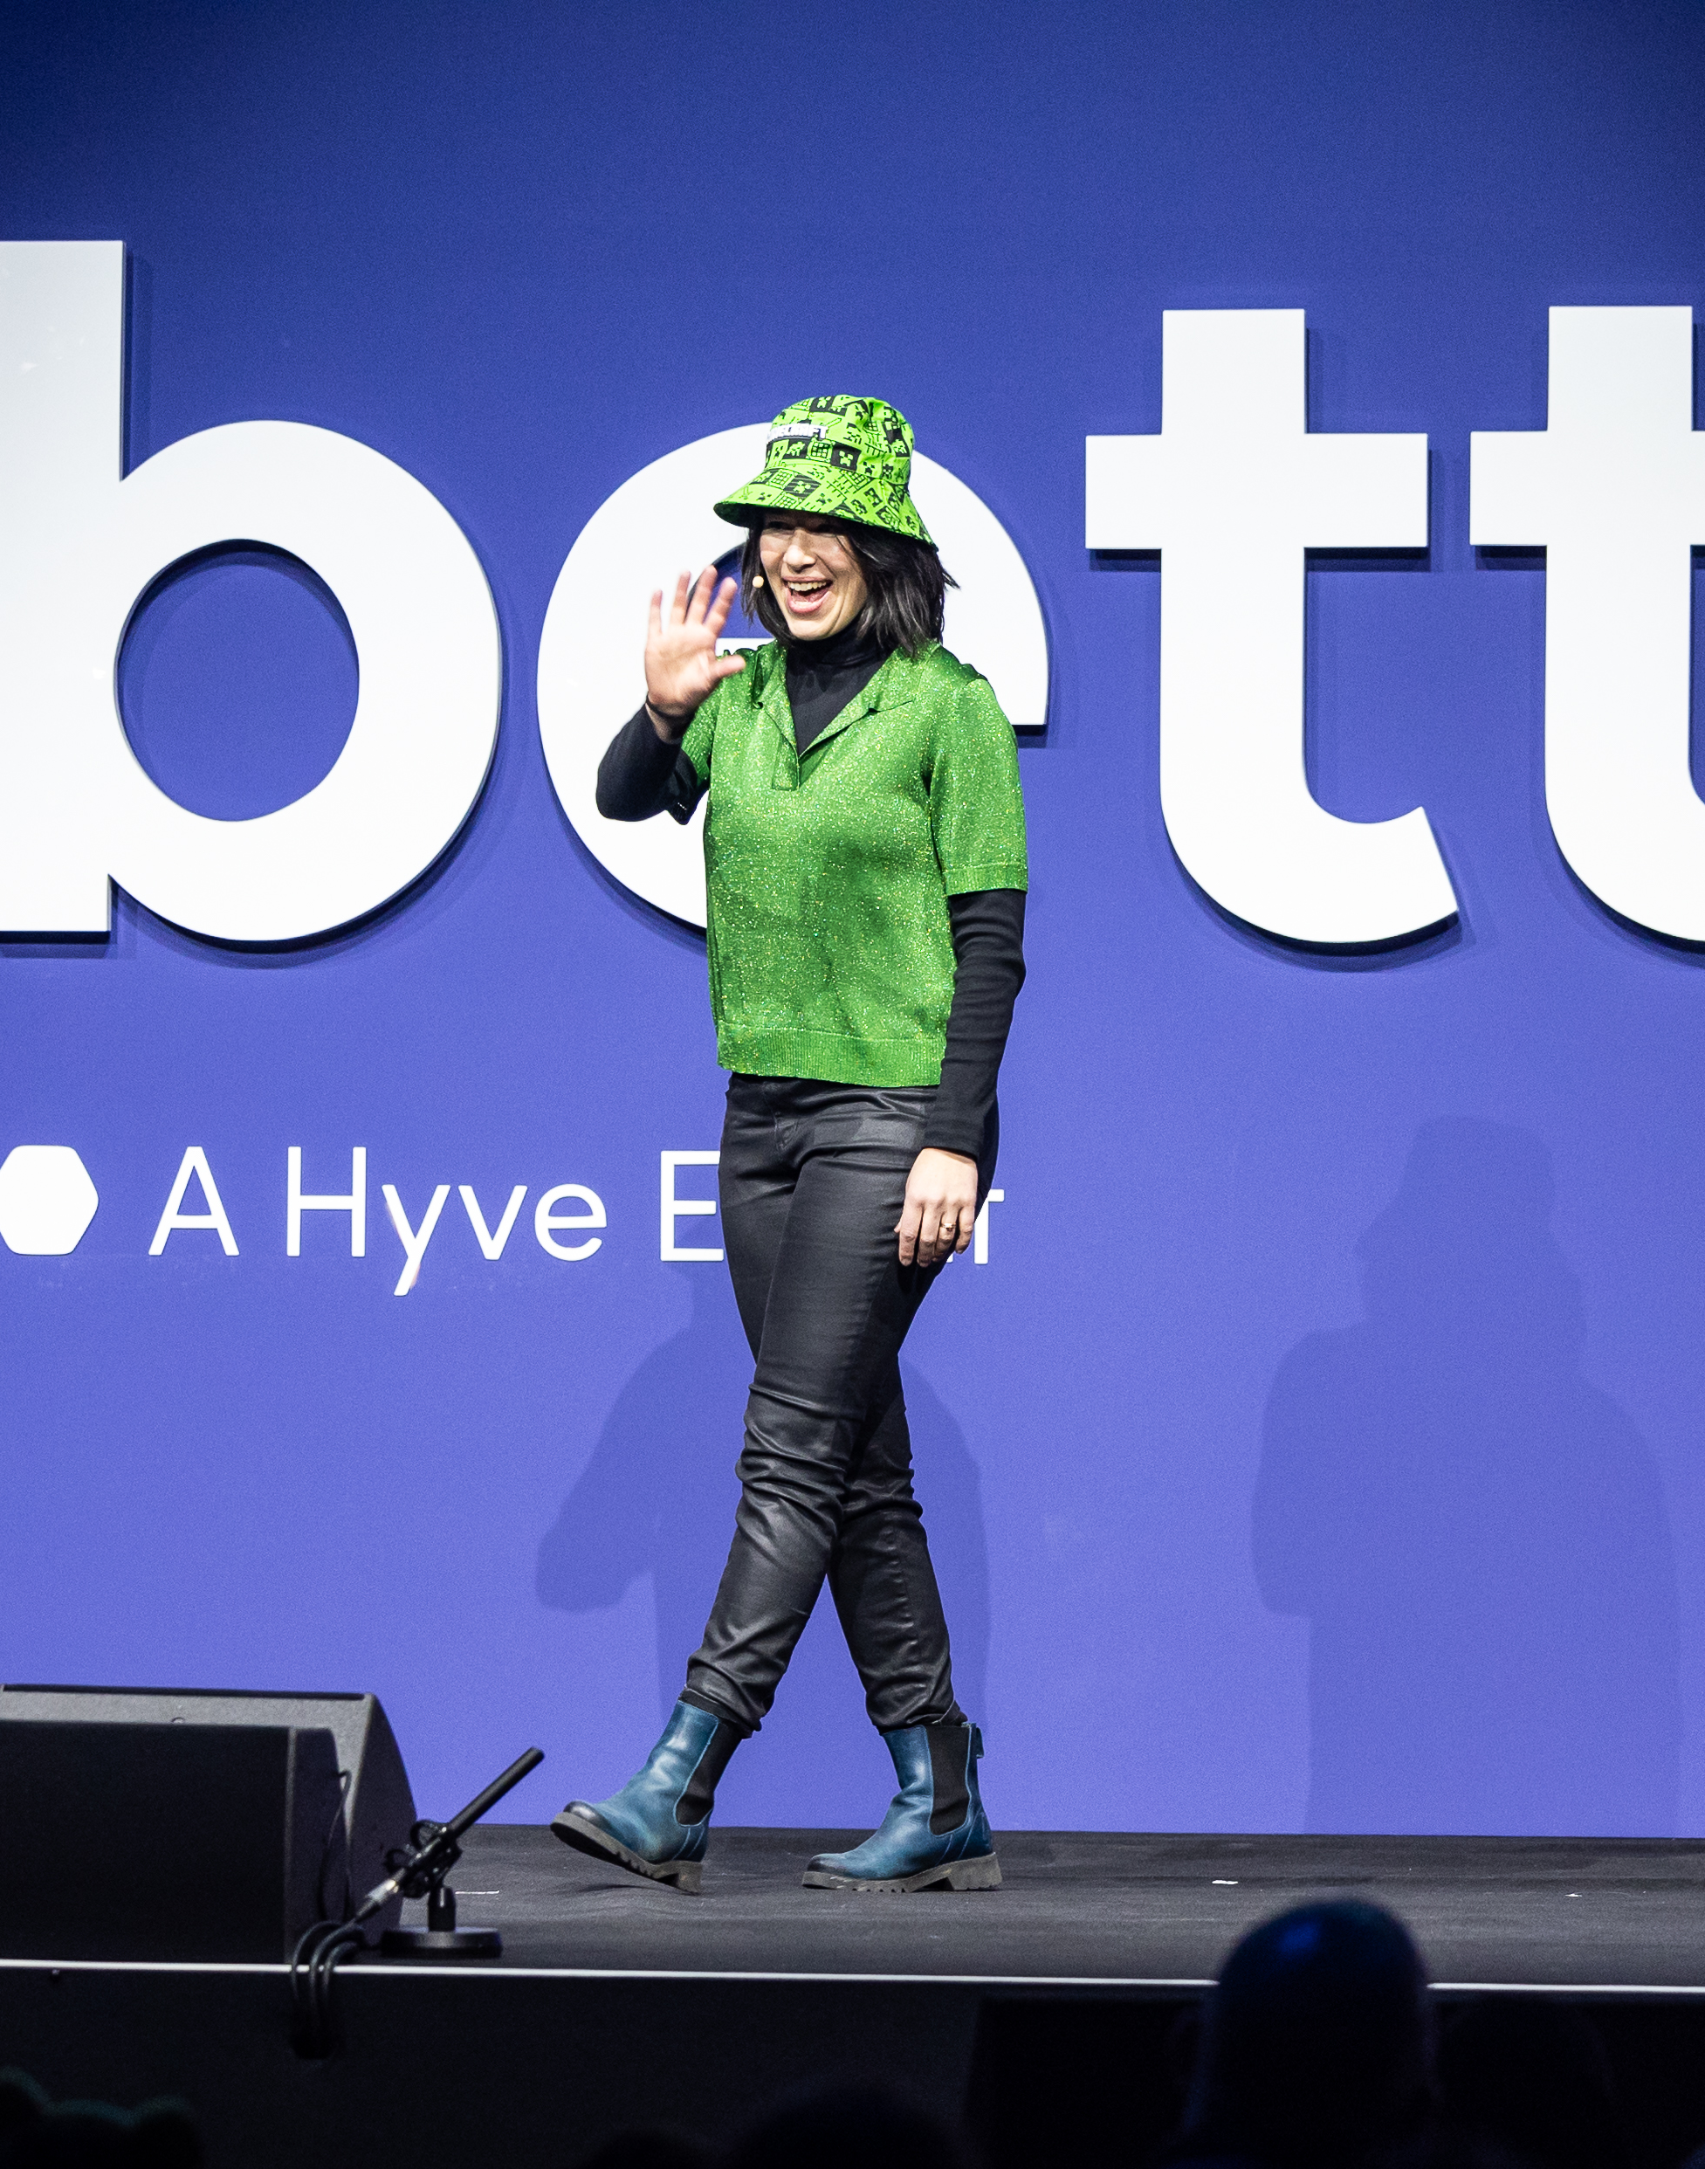
General Speaker FAQs
Please do not bring brochures, flyers or seat drops. We are keen to reduce the amount of paper and waste onsite and are keen to encourage the use of QR codes, embedded in your presentation, to direct the audience to additional resources.
There will be an AV team and Theatre Manager to support you in each theatre.
Please ensure you arrive at the Speaker Lounge an hour before your talk so we can check you in and ensure you have time to review your presentation with the AV team.
We will take you to the theatre 30 minutes before you are due on stage.
8

Slide 12
Travel & Accommodation
Speakers are required to book and plan their own travel and accommodation for Bett. We have negotiated for special discounted rates for attendees at a wide range of hotels across London for you to take advantage of.
Directions to the ExCeL Centre
By train: DLR services: Custom House and Prince Regent. Elizabeth Line services: Prince Regent. As we are located in the East wing of ExCeL London and the closest stop to Bett is the Prince Regent station. ExCeL is approximately 20-minutes walking distance away from Canning Town underground station. The DLR and Jubilee Line can be connected from multiple Overground lines such as Stratford, Canada Water, and Shadwell. It’s also possible to join the Overground and travel to ExCeL London from Euston station.
By car: Parking is available on a first come, first served basis, using pay and display. For parking FAQs and how to pre-book a parking space, click here. If you are travelling to ExCeL London by road please use postcode E16 1XL to find us.
By plane: London City, Gatwick and Heathrow Airport are the nearest airports to the venue.
9

Slide 13
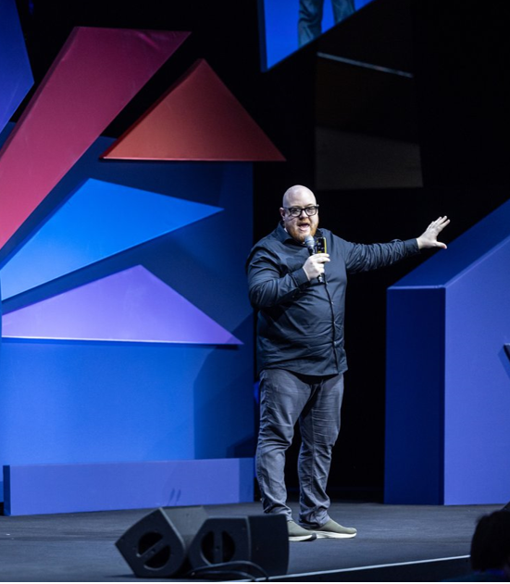
Promote your session!
We’d love you to shout about speaking at Bett UK and have created some social assets for you to share with your networks here.
Don’t forget to tag us @BettGlobal and #BettUK2026
Facebook: bettglobal
X (formerly Twitter): Bett_show
LinkedIn: Bett Global
IG: bett_show
10

