Slide 1
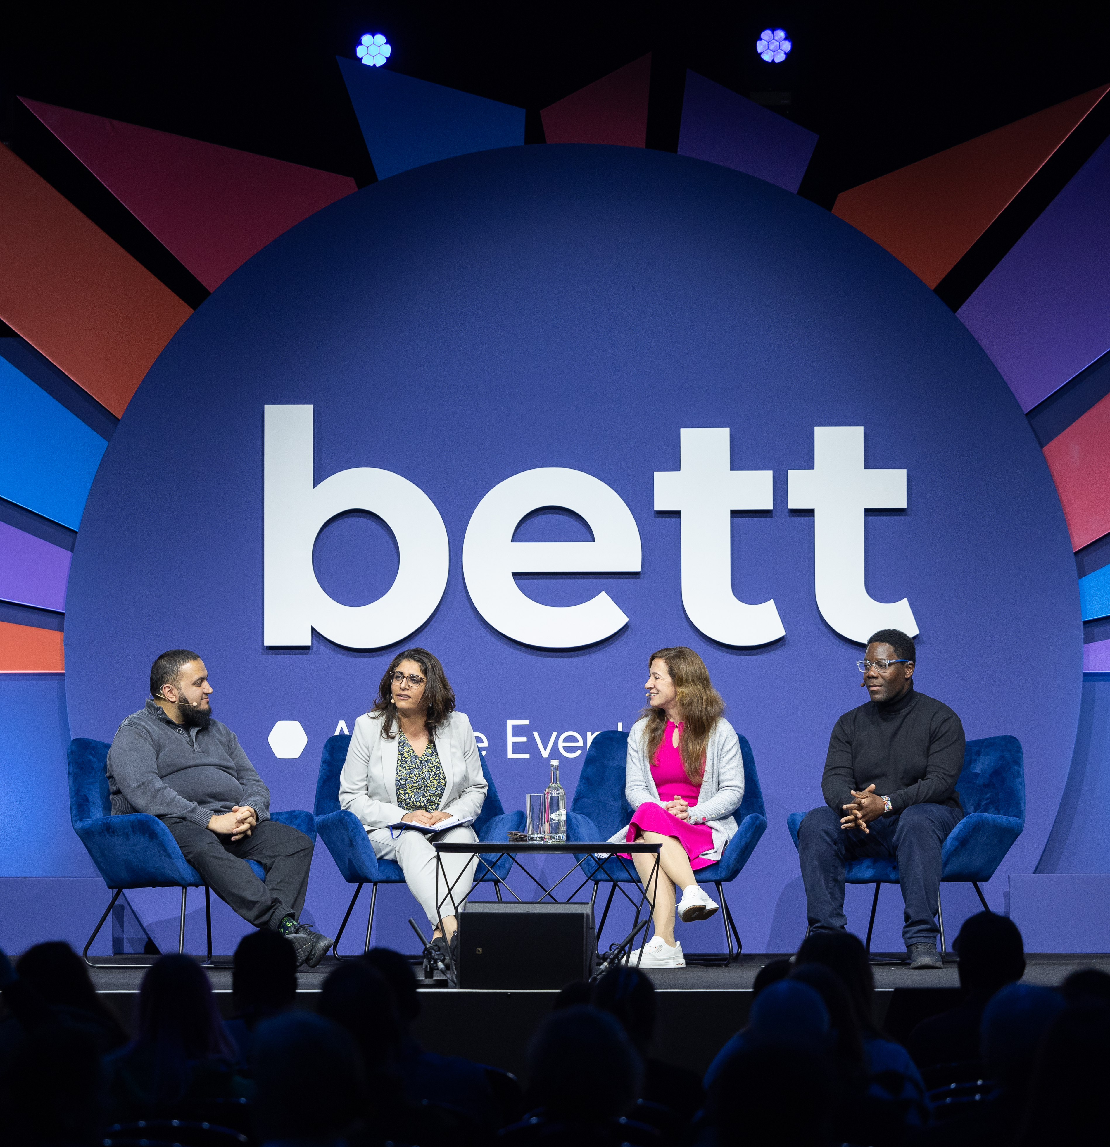

Session and Speaker Information Pack

Slide 2
Our mission for Bett 2026
Learning without limits:
Learning for All
How do we make education truly inclusive? From accessibility and equity to curriculum design and digital infrastructure, we look at what it takes to ensure every learner, no matter their background, ability or circumstance, has the support they need to thrive.
Learning to Innovate
From AI to XR, innovation isn’t just about having the latest tech—it’s about rethinking how we teach, how we lead, and how we learn. This is about creative problem-solving, sustainable budgeting, bold ideas, and the practical tools that help turn vision into action in every kind of learning environment.
Learning for Life
Education doesn’t end at the classroom door. We explore how to prepare learners, not just for exams and work, but for life. From digital citizenship to employability, wellbeing to lifelong learning, it’s about helping them build the confidence, skills and adaptability they need to become future-ready students in a rapidly changing world.

Slide 3
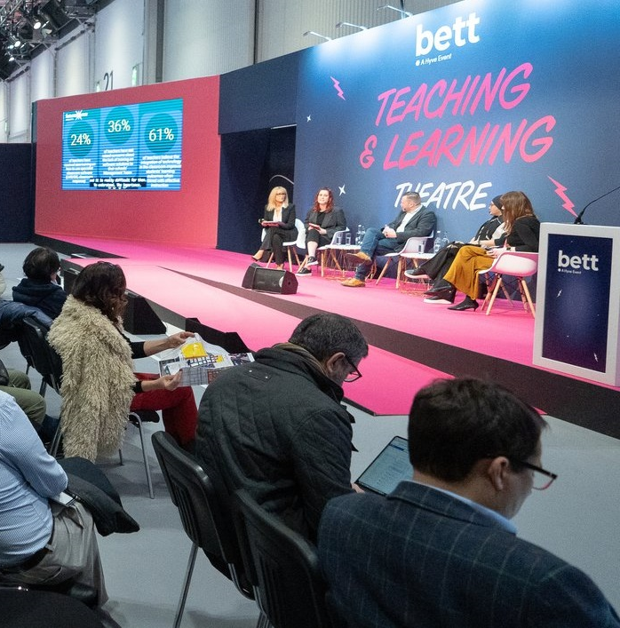
Thank you for joining us as a speaker at Bett 2026
This pack contains useful information to help you prepare for your session and contains details on:
Registration – page 2
Theatre FAQs – page 3
Presentation FAQs – page 5

Slide 4
Bett Deadlines
Action | Deadline
Session forms and speaker details forms submitted | Due now
AV forms returned (if required) | 12 December 2025
Speakers registered for their badges | 12 December 2025
Briefing calls conducted (if required) | 8 January 2026
Presentations uploaded to Dropbox | 5pm GMT 13 January 2026
1

Slide 5
Speaker Registration
All speakers are required to pre-register for their Bett badge by 12 December 2025. Click here to register.
Please select the ticket type that best matches your job title. We’ll add a ‘Speaker’ label to your badge and email your details a week before the show.
To avoid queues, we strongly advise you print your badge at home and collect a lanyard onside. If you are unable, your badge will be printed at registration upon arrival or at a self-printing desk.
Bringing student under 18? As a teacher once you have registered yourself, please register students online in advance using the school groups link here.
You’re welcome to bring colleagues, friends - they can register for their visitor pass here. Educators attend for free.
2

Slide 6
Theatre FAQs
 | Higher Education | Innovation | Arena | SEND | Operational Transformation | Tech in Action | Live Classroom | Teaching & Learning
Is there a lectern for me to present from? | Yes | Yes | Yes | Yes | Yes | Yes | Yes | Yes
Is there autocue? | No | No | No | No | No | No | No | No
Will my session be filmed? | Filming of sessions across theatres will not take place this year. However, we will have a film crew on site that will capture shorter segments of footage, to be used on our website, in marketing and on socials during 2025-2026 so you may have a film crew visit your theatre whilst you’re talking. If you do not want to be filmed, please let the Content Team know by Monday 8th December.
Can I arrange for my session to be recorded by a colleague? | Yes – As long as this doesn’t interfere with Bett’s technical set up, please refer to the Filming Guidelines document on the Speaker Resources page. For panel discussions you will need to get permission from the entire panel before you start filming.
Will someone introduce me on stage? | Yes | Yes | Yes | Yes | Yes | No | Yes | Yes
What is the capacity of this theatre? | 113 | 105 | 1,400 | 54 | 35 | 75 | 60 | 200
3

Slide 7
Presentation submission
Our preferred presentation format is PowerPoint.
Please note we cannot support presenting directly from the cloud as we can’t guarantee wifi stability. We also can’t accept PDF presentations.
Please upload your presentation via this link which will be open until 5pm GMT 13 January 2026.
Please name your file using the following format:
Theatre name – Day – Session Time – Session Title
e.g. Teaching & Learning Theatre – Wednesday – 10:30 – Delivering a digital strategy
If you upload your presentation, then make edits and want to share the latest version, please name it using the same format, adding ‘v.2 or v.3’. Please also notify us via email to flag the new version.
Videos must be embedded into the presentation and also be uploaded as a separate files using the same naming format e.g., Plenary – Wednesday – 10:30 – Delivering a digital strategy – video v.1.
Any unique fonts must also be uploaded as separate files, using the same naming format, otherwise standard fonts will be used, and text may appear skewed or at the incorrect size.
Ensure you use a sans-serif font with a size of 18pt or larger.
Use sufficient contrast between your text and background colours and consider not putting text over imagery.
If using PowerPoint, it may be helpful to refer to the accessibility checker which can help identify potential accessibility issues.
4

Slide 8
Presentation FAQs
 | Higher Education | Innovation Theatre | Arena | SEND Theatre | Operational Transformation | Tech in Action | Live Classroom | Teaching & Learning Theatre
Do I need to bring my laptop or device with me? | No - You do not need to bring a device but please ensure you share your PPT with us ahead of the show as requested by 5pm GMT 13 January 2026 If you wish to use your own device, you must let us know via the AV form and ensure you bring a HDMI or mac adapter to ensure it will be compatible with our AV set up.
How do I share my PPT with you? | Please upload your presentation, along with any other files/assets you plan on using in your session (eg audio and video files, font files) via this link here. This box link will be open until 5pm GMT 13 January 2026. If you have missed this deadline, please email your presentation to bett.speakers@bettshow.com. If you have any urgent amendments during the show, you must bring your presentations to the Speaker Lounge at least one hour ahead of your session start time.
Will I be able to see my slides on a comfort monitor? | Yes, there will be a comfort monitor for all theatres.
Can I play videos during my PPT? | Yes – please ensure that they are embedding in your presentation are shared with us as separate files and do not require the internet to play. Please ensure all videos are .Mp4 format with .h264 codec
Will there be captioning? | Yes, there will be live captioning above each screen.
5

Slide 9
Accessibility
Please visit our general accessibility page for detailed information on how we address various accessibility and communication needs which can help assist in planning your time at Bett. In all our theatres, there will be designated accessible seating, including wheelchair bay seating with companion chairs and ambulant disabled seating at the end of the aisles. Please note that all raised theatre stages have access ramps.
6

Slide 10
Speaker Lounge
The Speaker Lounge is an exclusive area for all Bett speakers and moderators. We will have a dedicated team at the Speaker Lounge to help you check in and address any queries.
Please report to the Speaker Lounge on the day of your session, one hour before your scheduled session time. Our team will check you in and introduce you to the AV support team to check your presentation slides. You will then be taken to your theatre 30 minutes before you are due on stage.
Please also report to the Speaker Lounge if you have any problems or issues related to speakers or sessions onsite, including:
If a speaker is running late
If a speaker is unwell and cannot make their session
Presentation update
Session update on the website or app
Last minute AV request
The Speaker Lounge is located at the rear of the North Hall, with the nearest entrance via N9 Boulevard. This is a private area for registered speakers only. For access before 10:00 am, please use Entrance N8.
7

Slide 11
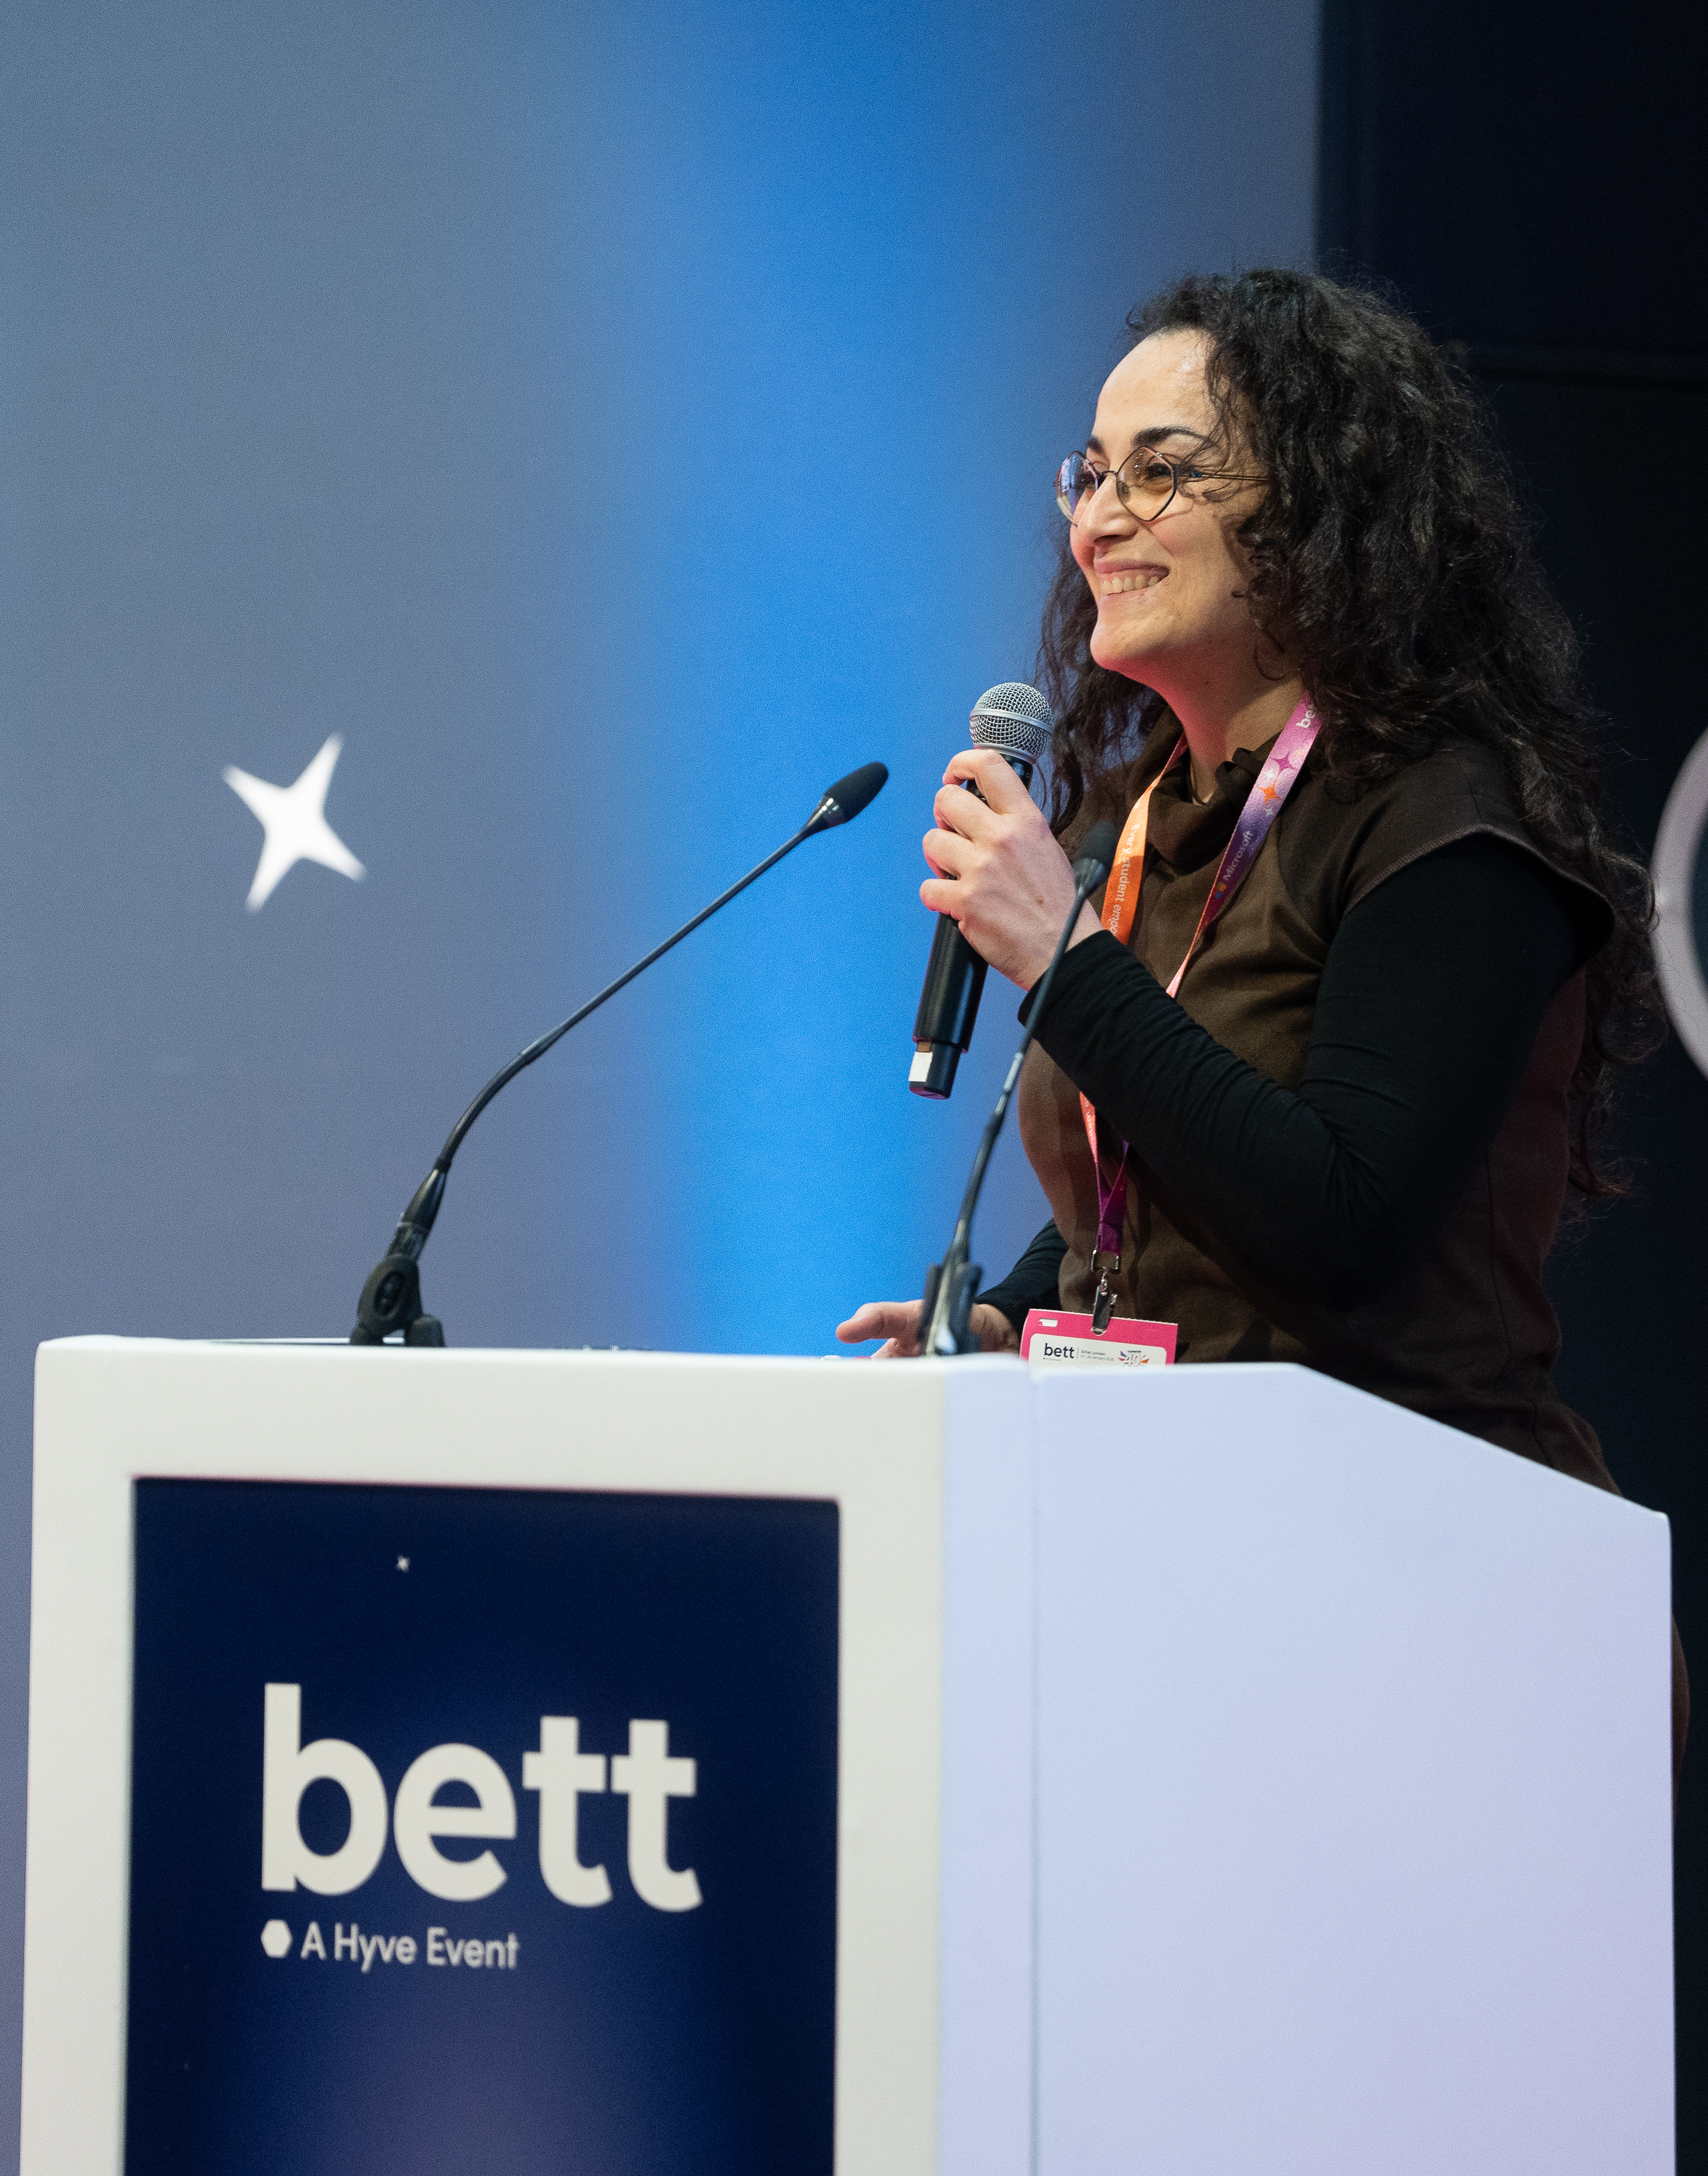
General Speaker FAQs
Please do not bring brochures, flyers or seat drops. We are keen to reduce the amount of paper and waste onsite and strongly encourage the use of QR codes, embedded in your presentation, to direct the audience to additional resources.
There will be an AV team and Theatre Manager to support you in each theatre.
8

Slide 12
Content Session Data (applicable to sponsored sessions only)
If you have a sponsored session, your leads will be shared via Visit by GES. If you have any questions please contact your client engagement contact or exhibitor@bettshow.com.
9

Slide 13
Travel & Accommodation
Speakers are required to book and plan their own travel and accommodation for Bett. We have negotiated for special discounted rates for attendees at a wide range of hotels across London for you to take advantage of.
Directions to the ExCeL Centre
By train: DLR services: Custom House and Prince Regent. Elizabeth Line services: Prince Regent. As we are located in the East wing of ExCeL London and the closest stop to Bett is the Prince Regent station. ExCeL is approximately 20-minutes walking distance away from Canning Town underground station. The DLR and Jubilee Line can be connected from multiple Overground lines such as Stratford, Canada Water, and Shadwell. It’s also possible to join the Overground and travel to ExCeL London from Euston station.
By car: Parking is available on a first come, first served basis, using pay and display. For parking FAQs and how to pre-book a parking space, click here. If you are travelling to ExCeL London by road please use postcode E16 1XL to find us.
By plane: London City, Gatwick and Heathrow Airport are the nearest airports to the venue.
10

Slide 14
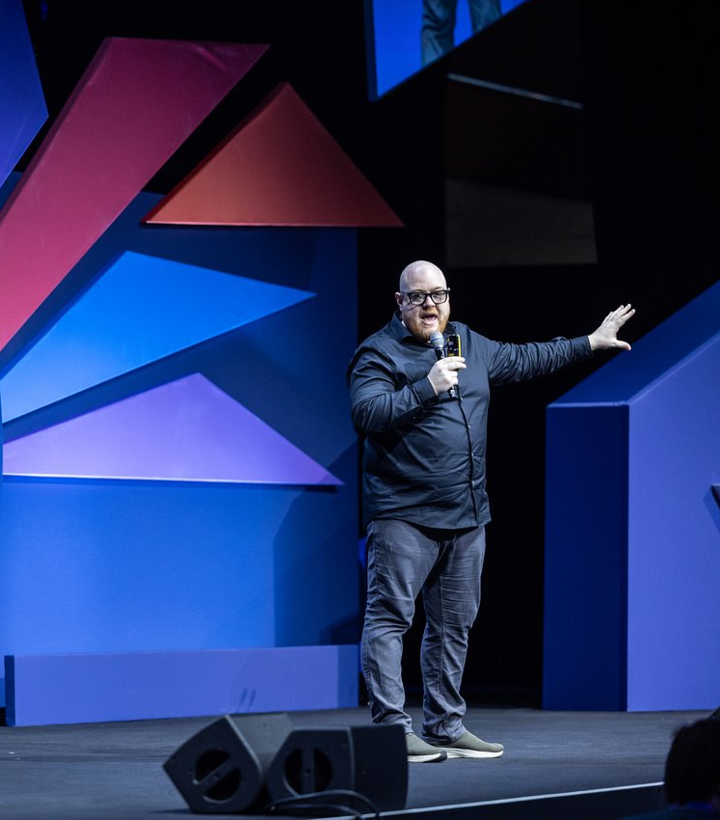
Promote your session!
We’d love you to shout about speaking at Bett UK and have created some social assets for you to share with your networks here.
Don’t forget to tag us @BettGlobal and #BettUK2026
Facebook: bettglobal
X (formerly Twitter): Bett_show
LinkedIn: Bett Global
IG: bett_show
11

Slide 15
Bett Content Team
James Moorhouse | Anna Bailey | Emily Colyer | Yuliya Strus | Tia Harrison
Senior Content & Communications Manager | Senior Content Producer | Content Producer | Content Producer | Speaker Logistics Executive
james.moorhouse@bettshow.com | anna.bailey@hyve.group | emily.colyer@bettshow.com | yuliya.strus@bettshow.com | tia.harrison@bettshow.com

