Slide 1
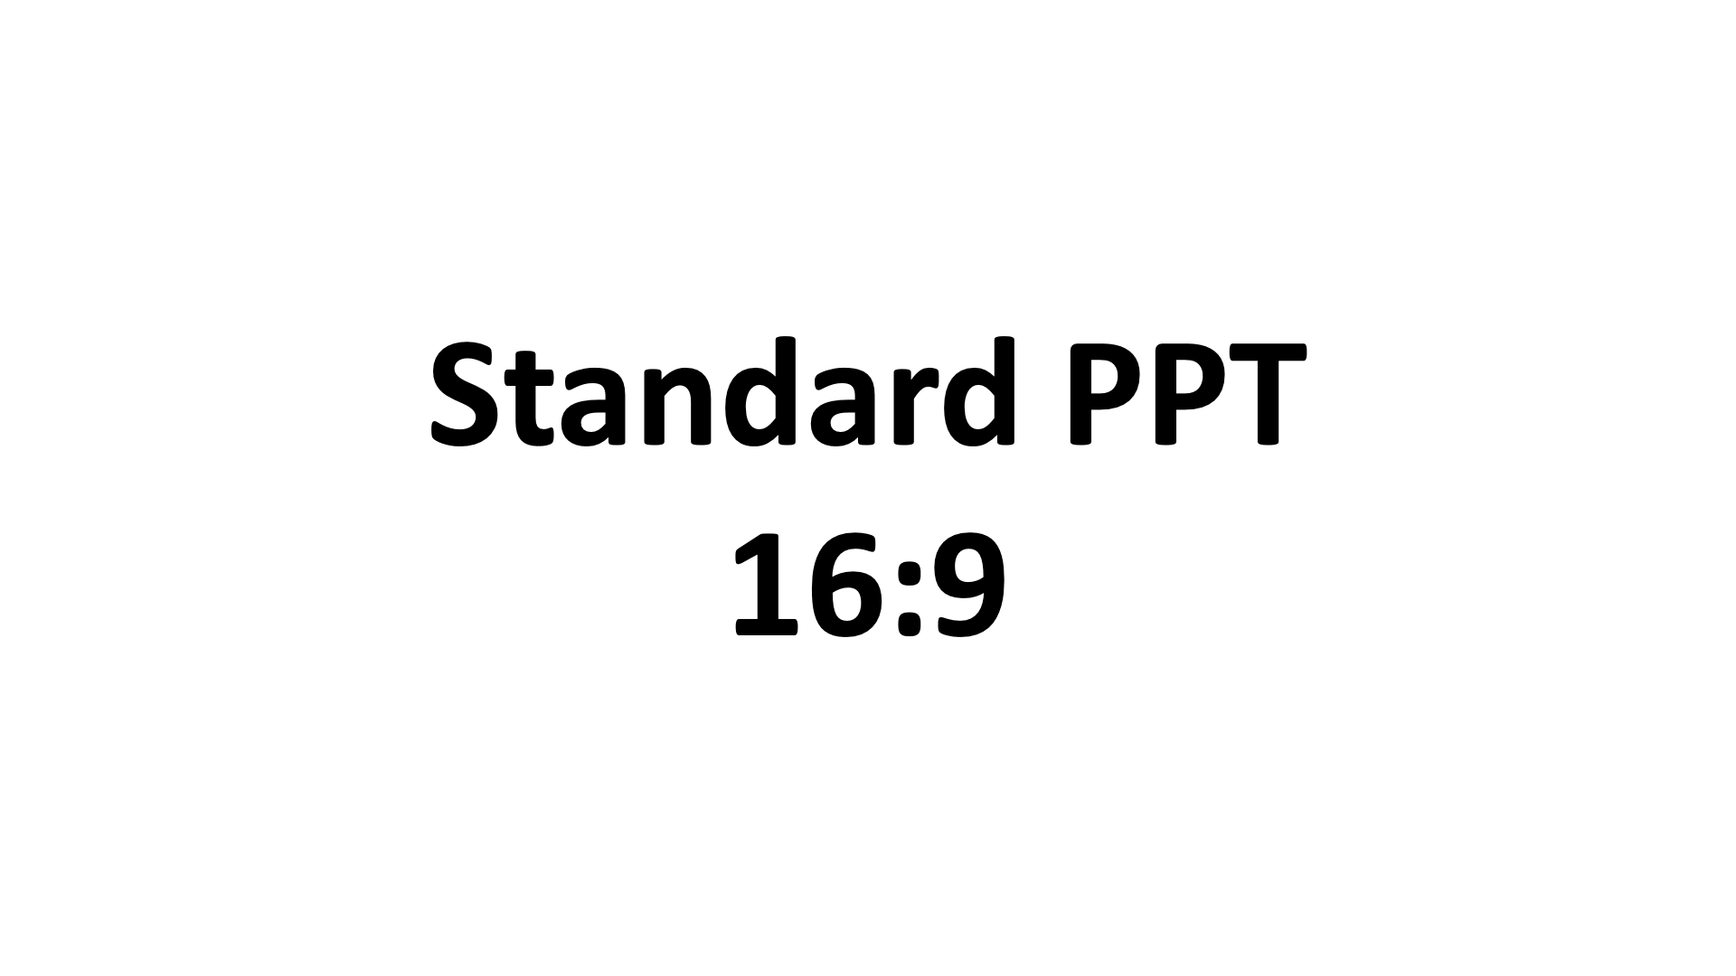
Center Screen @ 50%

