Slide 1
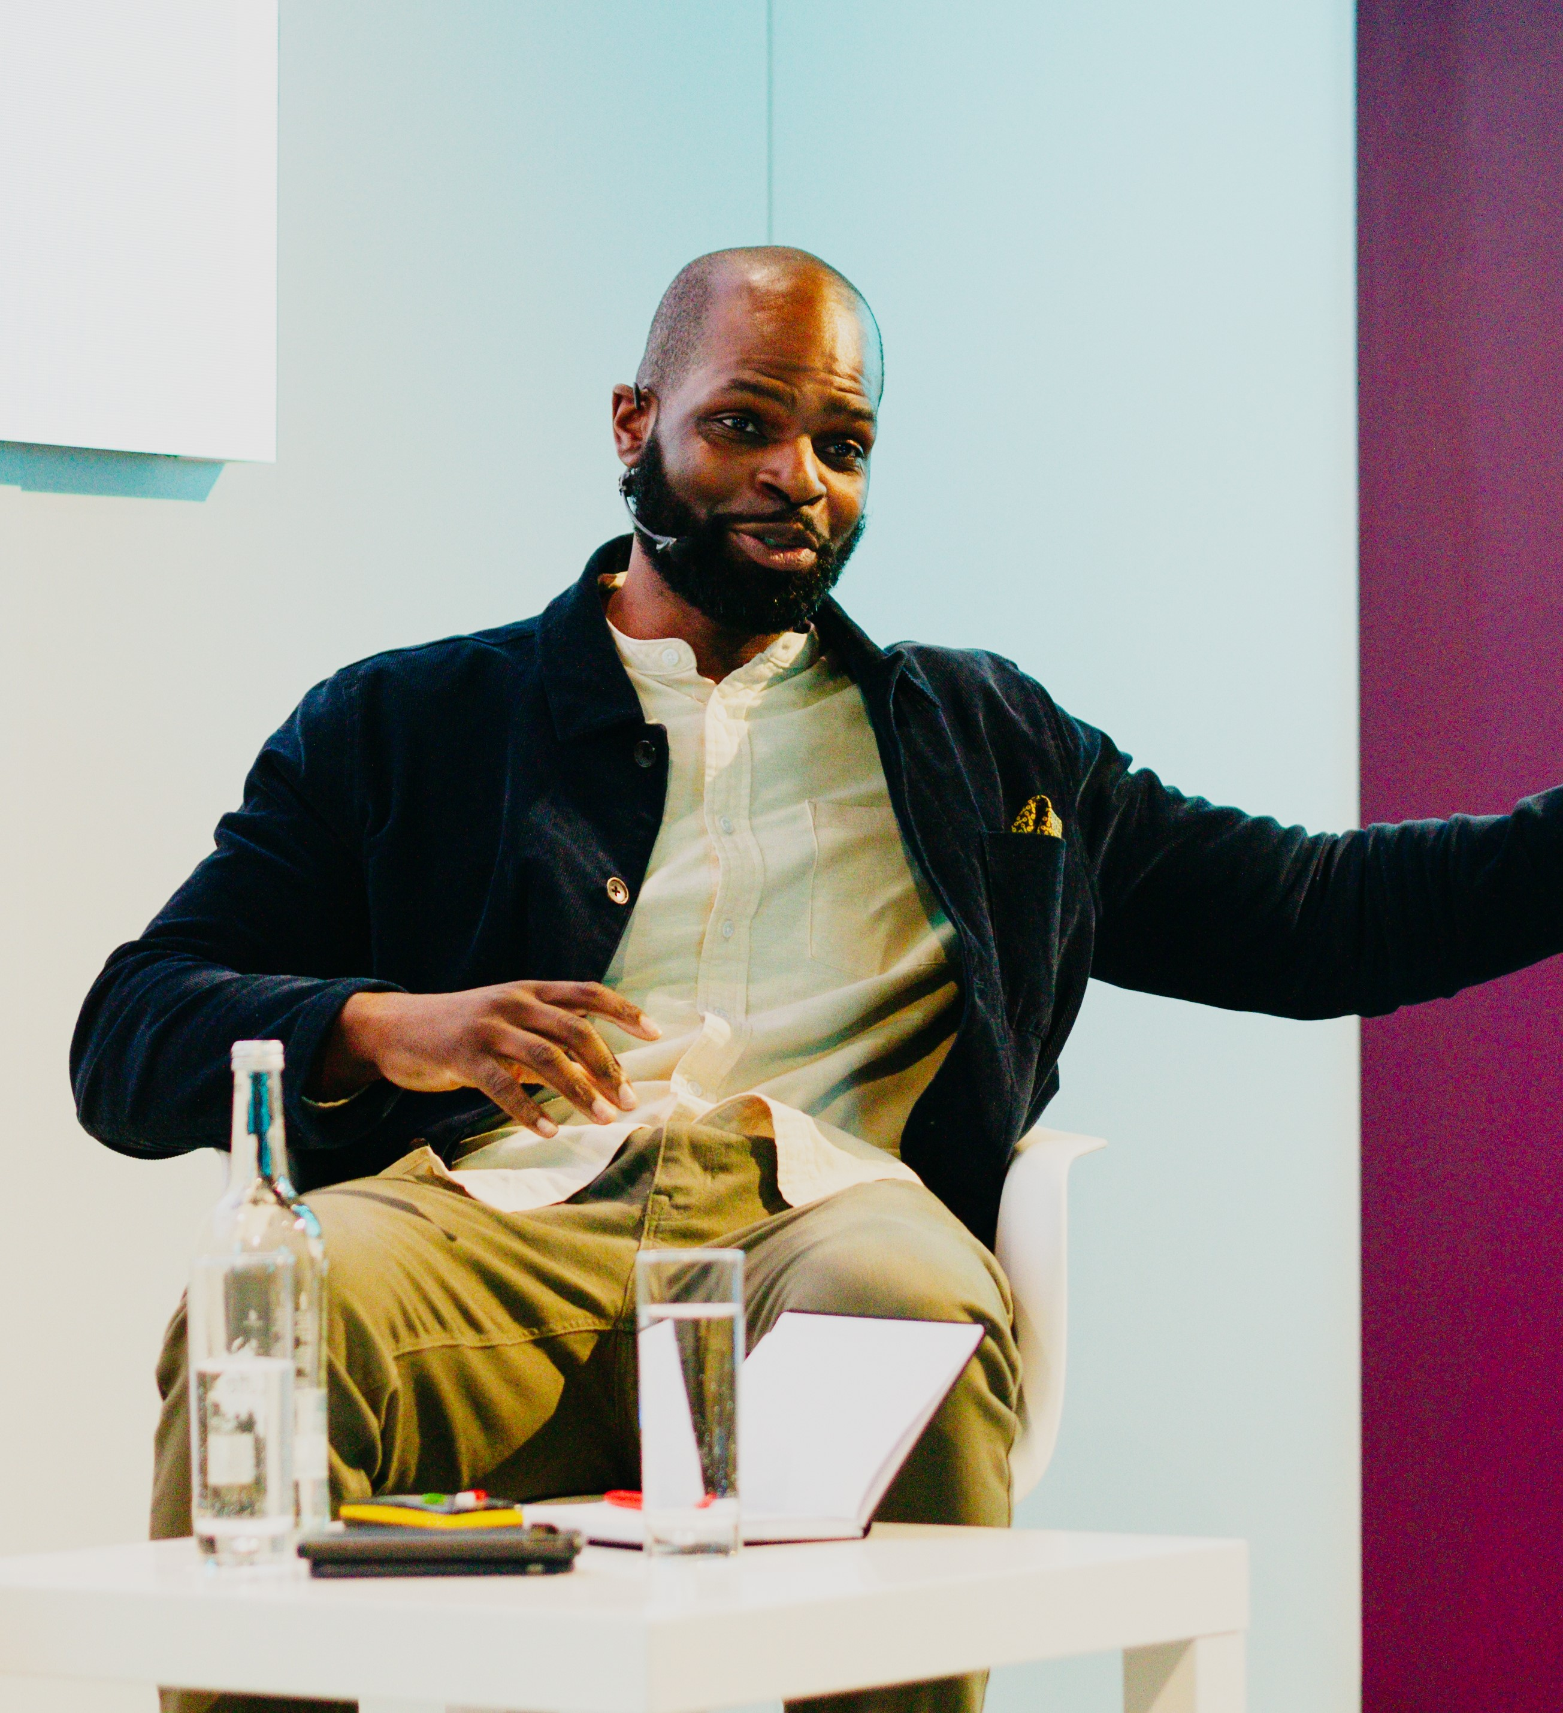
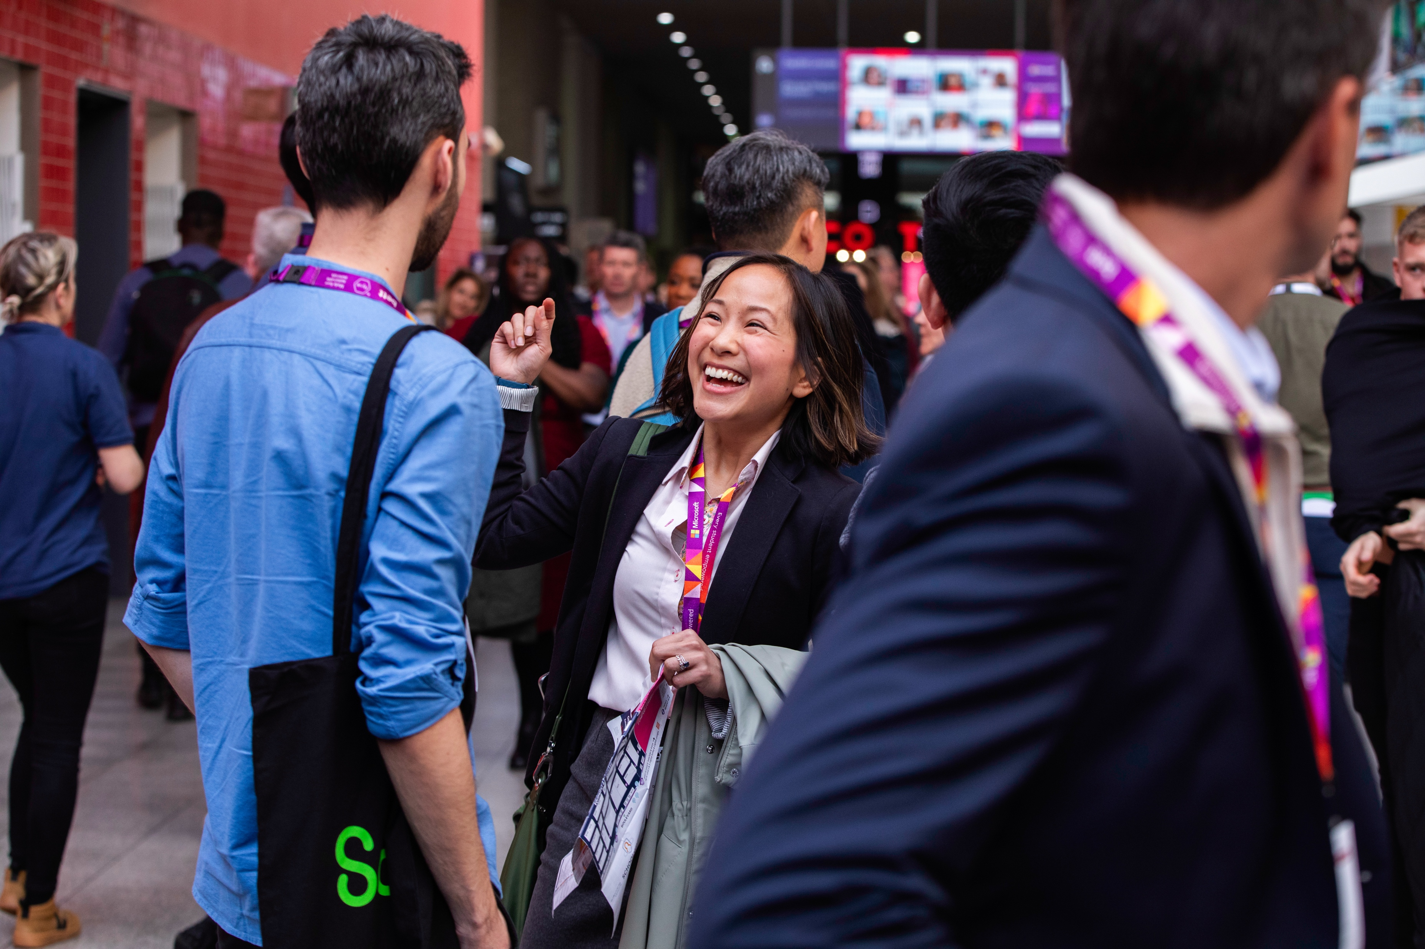
Session & Speaker Information Pack

Slide 2
Our mission for Bett 2025
Learning today, leading tomorrow
The education systems needs to adapt. From AI and data literacy to critical thinking and assessment, the skills prioritised in the classroom and the way we teach will change.
Embracing personalised learning approaches supported by AI technologies will allow us to better cater to diverse learning styles and pace, ensuring every student maximises their potential and is prepared for the workforce of tomorrow!

Slide 3
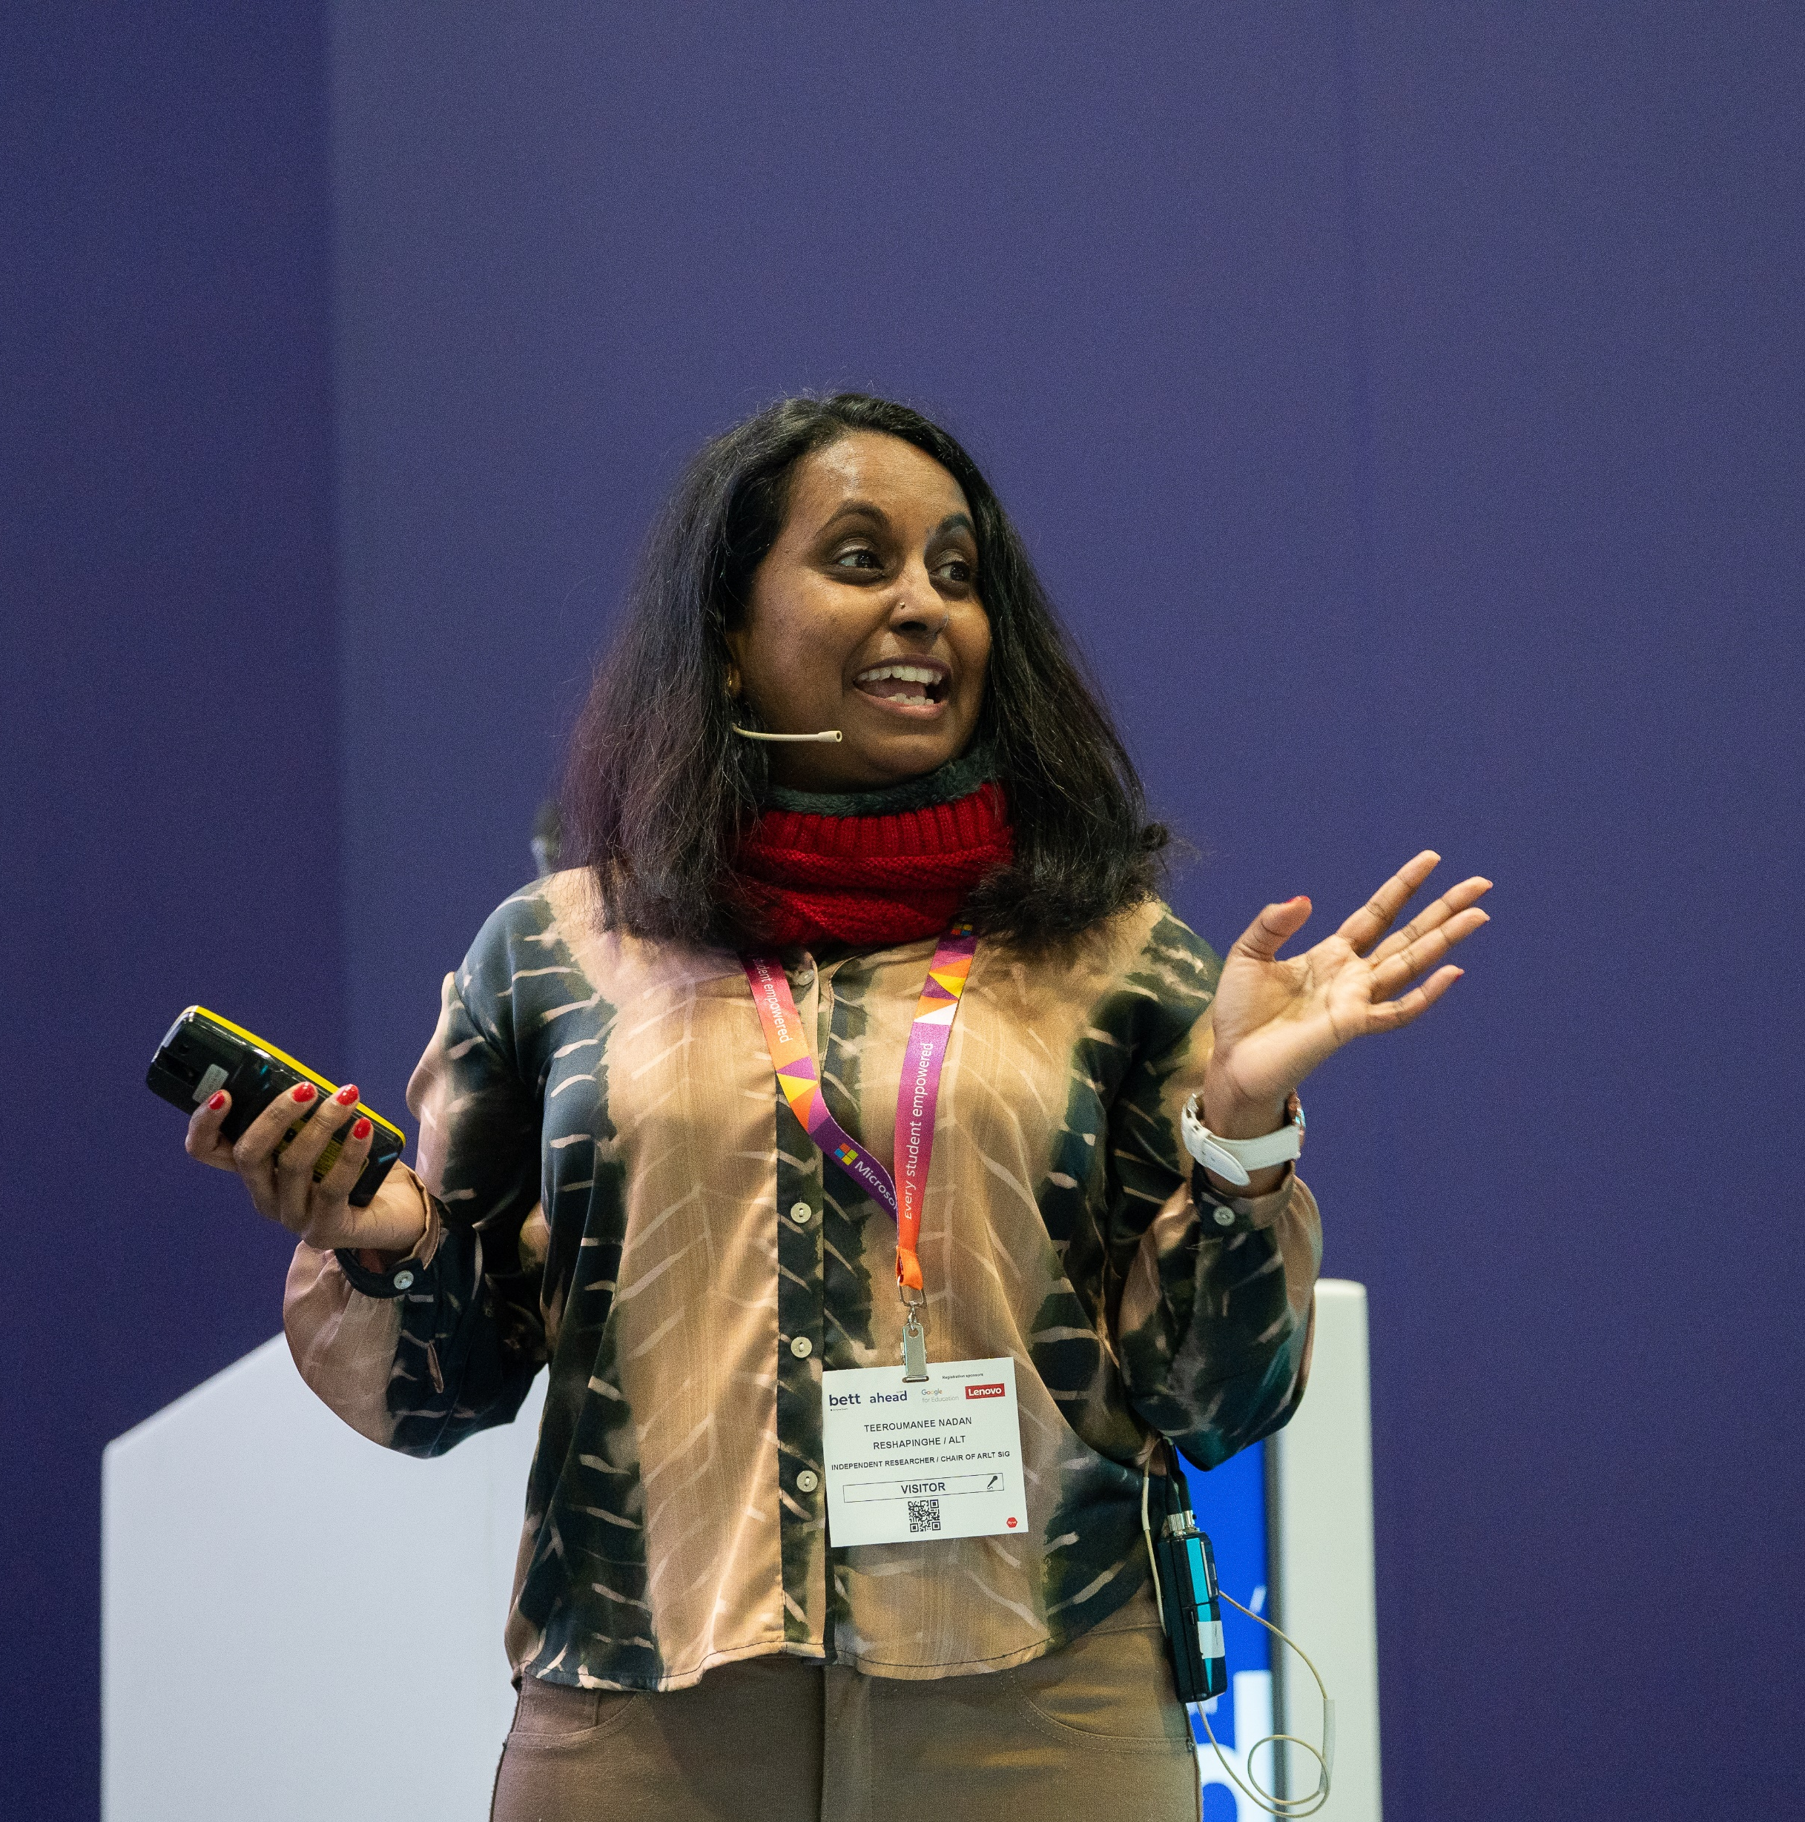
Thank you for joining us as a speaker at Bett 2025
This pack contains useful information to help you prepare for your talk and contains details on:
Registration – slide 2
Theatre FAQs – slide 3
Presentation FAQs – slide 4
Onsite information – slide 7/8

Slide 4
Bett Milestones
Milestone | Due Date
Session forms and speaker details forms to be returned to Bett | Due now
All AV requirements to be briefed to Bett content team | 9th December 2024
Deadline to confirm data scanning onsite at Bett (sponsored sessions only) | 11th December 2024
Briefing calls conducted (if required) with Bett content team | 17th January 2025
Deadline for all speakers to have registered to attend the show | 20th December 2024
Deadline for all presentations to be uploaded to Dropbox | 5pm GMT 14th January 2025
1

Slide 5
Speaker Registration
All speakers are required to pre-register for their Bett badge by Friday 20th December.
Please select the ticket type that best matches your job title. Once you have registered, we will add a ‘Speaker’ label to your badge. Your badge details will be emailed to you a week ahead of the show.
To beat the queues, you're able to print your badge at home and collect a lanyard on site. Alternatively, you can print your badge on arrival in the registration area.
If you are speaking on behalf of a company, please contact the Content Team, so we can provide you with a registration link for a free ticket.
Please note, if you are bringing any students under 18 years of age, you will need to register them online ahead of the show using the school groups link.​
You are very welcome to bring colleagues, friends and guests to Bett 2025, and they can register for their visitor pass here. Tickets for educators are free.
2

Slide 6
Theatre FAQs
 | Teaching & Learning | Esports | Tech in Action | Innovation Theatre | Ahead Auditorium | Live Classroom
Is there a lectern for me to present from? | Yes | No | Yes | Yes | Yes | Yes
Is there autocue | No | No | No | No | No | No
Will my session be filmed? | Filming of sessions across theatres will not take place this year. However, we will have a film crew on site that will capture shorter segments of footage, to be used on our website, in marketing and on socials during 2025-2026 so you may have a film crew visit your theatre whilst you’re talking. If you do not want to be filmed, please let the Content Team know by Monday 9th December.
Can I arrange for my session to be recorded by a colleague? | Yes – As long as this doesn’t interfere with Bett’s technical set up, please refer to the Filming Guidelines document on the Speaker Resources page. For panel discussions you will need to get permission from the entire panel before you start filming.
Can I use interactive Q&A or set up a poll? | Yes – Slido will be set up for this stage and we will have an iPad to display questions. Please refer to the Slido Guidelines on the Speakers Resources page and share your requirements with the Content Team by Wednesday 8th January
Will someone introduce me on stage? | Yes – this theatre has a theatre host |  | No | Yes – this theatre has a theatre host |  | No
What is the capacity of this theatre? | 300 | 120 | 100 | 100 | 90 | 30
3

Slide 7
Presentation FAQs
 | Teaching & Learning | Esports | Tech in Action | Innovation Theatre | Ahead Auditorium | Live Classroom
Do I need to bring my laptop or device with me? | No - You do not need to bring a device but please ensure you share your PPT with us ahead of the show as requested by 5pm GMT 14 January 2025 If you wish to use your own device, you must let us know via the AV form and ensure you bring a HDMI or mac adapter to ensure it will be compatible with our AV set up.
Do you have a PPT Template | No - Presentations across these feature are in a standard 16:9 format so we do not need to provide a custom template . ​ Please ensure your presentation is in .ppt format (not .pdf) and in 16:9 widescreen format.​ Please remove any settings which automatically advance your presentation slides as there will be a clicker available. ​ If you have any non-standard fonts in your presentation, please upload and label these fonts when you upload your presentation.
How do I share my PPT with you? | Please upload your presentation, along with any other files/assets you plan on using in your session (eg audio and video files, font files) via this link here. This box link will be open until 5pm GMT 14 January 2025. If you have missed this deadline, please email your presentation to bett.speakers@bettshow.com. If you have any urgent amendments during the show, you must bring your presentations to the Speaker Lounge at least one hour ahead of your session starting
Will I be able to see my slides on a comfort monitor? | Yes | No | Yes | Yes | Yes | No
Can I play videos during my PPT? | Yes – please ensure that they are embedding in your presentation are shared with us as separate files and do not require the internet to play. Please ensure all videos are .Mp4 format with .h264 codec
4

Slide 8
Presentation submission
Our preferred presentation format is PowerPoint.
Please note we cannot support presenting directly from the cloud as we can’t guarantee wifi stability. We also can’t accept PDF presentations.
Please upload your presentation via this link which will be open until 5pm GMT 14 January 2025.
Please name your file using the following format:
Theatre name – Day – Session Time – Session Title
e.g. Teaching & Learning Theatre – Wednesday – 10:30 – Delivering a digital strategy
If you upload your presentation, then make edits and want to share the latest version, please name it using the same format, adding ‘v.2 or v.3’. Please also notify us via email to flag the new version.
Videos must be embedded into the presentation and also be uploaded as a separate files using the same naming format e.g., Plenary – Wednesday – 10:30 – Delivering a digital strategy – video v.1.
Any unique fonts must also be uploaded as separate files, using the same naming format, otherwise standard fonts will be used, and text may appear skewed or at the incorrect size.
5

Slide 9
Accessibility
Please refer to the captioning template to ensure that your slides are structured in a way that allows them to be unobstructed by the captioning
Ensure you use a sans-serif font with a size of 18pt or larger
Use sufficient contrast between your text and background colours and consider not putting text over imagery
If using PowerPoint, it may be helpful to refer to the accessibility checker which can help identify potential accessibility issues.
Please visit our general accessibility page for detailed information on how we address various accessibility and communication needs which can help assist in planning your time at Bett. In all our theatres, there will be designated accessible seating, including wheelchair bay seating with companion chairs and ambulant disabled seating at the end of the aisles. Please note that all raised theatre stages have access ramps.
6

Slide 10
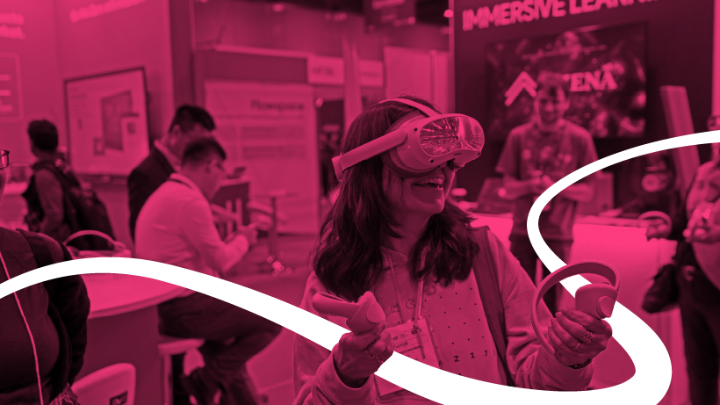
Captioning Template
This is where the captioning text will appear on the slide. Please ensure your slides are structured so that the captions do not obstruct any important information.
6

Slide 11
Speaker Lounge
The Speaker Lounge is an exclusive area for all Bett speakers and moderators. We will have a dedicated team at the Speaker Lounge to help you check in and address any queries.
Please report to the Speaker Lounge on the day of your session, one hour before your scheduled session time. Our team will check you in and introduce you to the AV support team to check your presentation slides. You will then be taken to your theatre 30 minutes before you are due on stage.
Please also report to the Speaker Lounge if you have any problems or issues related to speakers or sessions onsite, including:
If a speaker is running late
If a speaker is unwell and cannot make their session
Presentation update
Session update on the website or app
Last minute AV request
The Speaker Lounge is located at the rear of the South Hall, near entrances S9 and S10, adjacent to the Teaching & Learning theatre. Please note that this is a private area for registered speakers only.
7

Slide 12
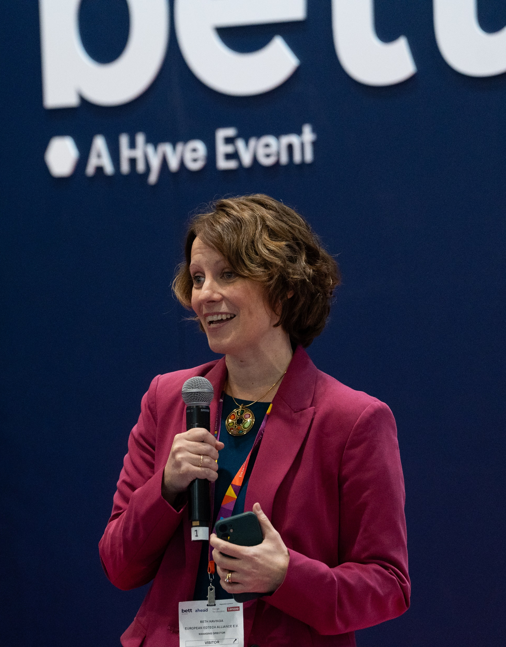
General Speaker FAQs
Please do not bring brochures, flyers or seat drops. We are keen to reduce the amount of paper and waste onsite and strongly encourage the use of QR codes, embedded in your presentation, to direct the audience to additional resources.
There will be an AV team and Theatre Manager to support you in each theatre.
Please ensure you arrive at the Speaker Lounge one hour before your scheduled session time so we can check you in and ensure you have time to review your presentation with the AV team.
We will take you to the theatre 30 minutes before you are due on stage.
8

Slide 13
Content Session Data (applicable to sponsored sessions only)
If you have a sponsored session and wish to collect leads, please contact your account manager or email exhibitor@bettshow.com. Once purchased, you can download the app onto your own device with a camera, such as a mobile phone or web-connected device, for real-time badge scanning. The app can be used on multiple devices at the show, including those already in use at your stand.
Content sponsors will only be permitted to scan their own content session and can only scan visitors when exiting their session.
You will need to ensure that you order your own app licence and have at least one scanning representative present at your session to collect the data on your behalf. We recommend scanning representatives be in branded clothing to show that they are collecting on behalf of your organisation, however, each theatre will also have sponsor sashes if you need them. This is to ensure scanners stand out as being from your organisation and distinguishable from the Bett representatives in the theatre
Please refer to the Scanning Data Guidelines for more information and deadlines.
9

Slide 14
Travel & Accommodation
Speakers are required to book and plan their own travel and accommodation for Bett. We have negotiated for special discounted rates for attendees at a wide range of hotels across London for you to take advantage of.
Directions to the ExCeL Centre
By train: DLR services: Custom House and Prince Regent. Elizabeth Line services: Prince Regent. As we are located in the East wing of ExCeL London and the closest stop to Bett is the Prince Regent station. ExCeL is approximately 20-minutes walking distance away from Canning Town underground station. The DLR and Jubilee Line can be connected from multiple Overground lines such as Stratford, Canada Water, and Shadwell. It’s also possible to join the Overground and travel to ExCeL London from Euston station.
By car: Parking is available on a first come, first served basis, using pay and display. For parking FAQs and how to pre-book a parking space, click here. If you are travelling to ExCeL London by road please use postcode E16 1XL to find us.
By plane: London City, Gatwick and Heathrow Airport are the nearest airports to the venue.
10

Slide 15
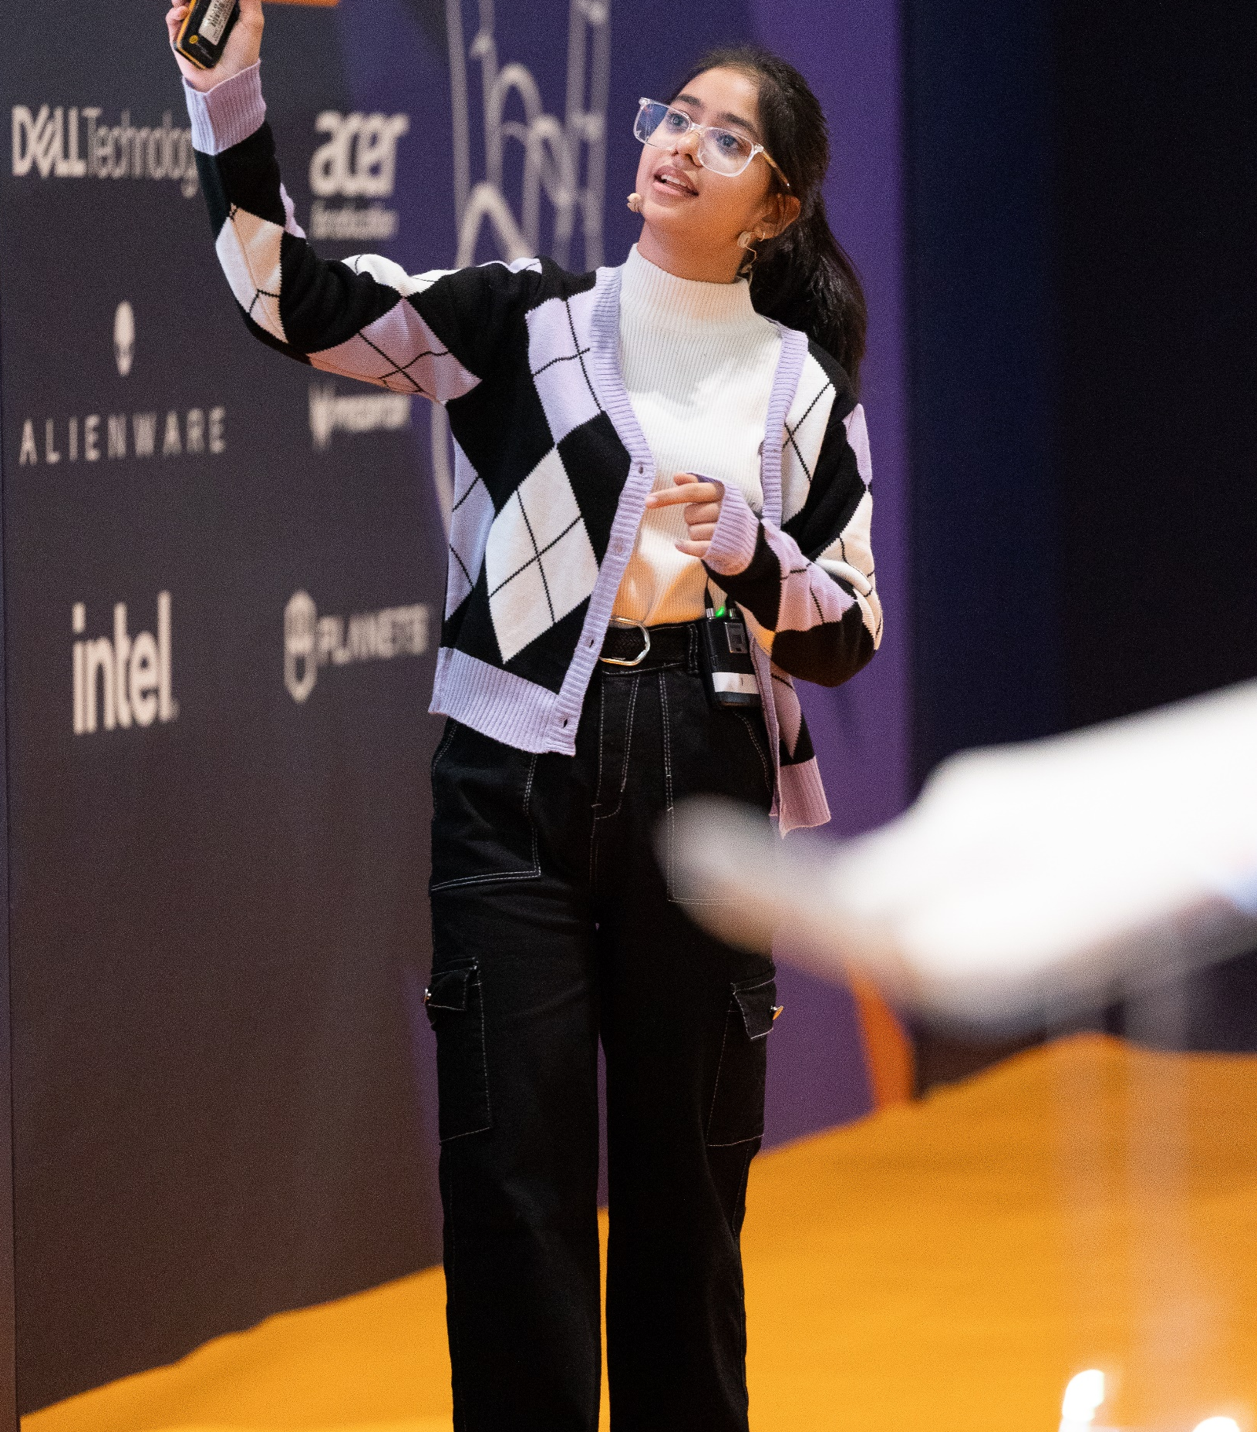
Promote your session!
We’d love you to shout about speaking at Bett UK and have created some social assets for you to share with your networks here.
Don’t forget to tag us @BettGlobal and #BettUK2025
Facebook: bettglobal
X (formerly Twitter): Bett_show
LinkedIn: Bett Global
IG: bett_show
11

Slide 16
Bett Content Team
James Moorhouse | Anna Bailey | Emily Colyer | Raphaela Svirinskaya
Senior Content & Communications Manager | Senior Content Producer | Content Producer | Speaker Logistics Executive
james.moorhouse@bettshow.com | anna.bailey@hyve.group | emily.colyer@bettshow.com | raphaela.svirinskaya@bettshow.com

