Slide 1
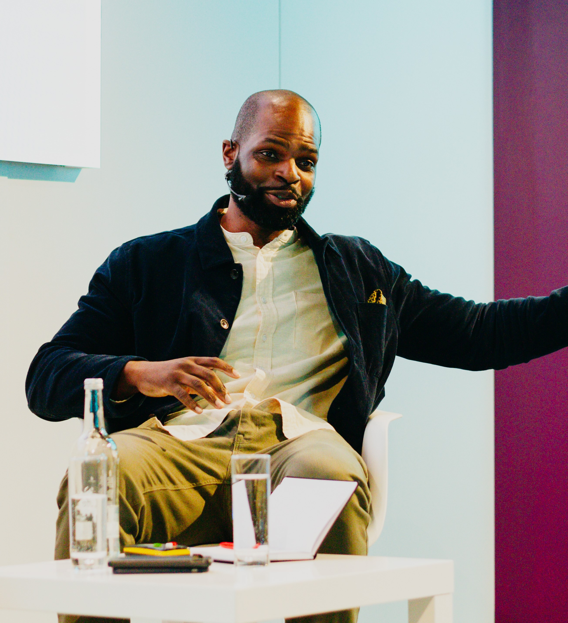
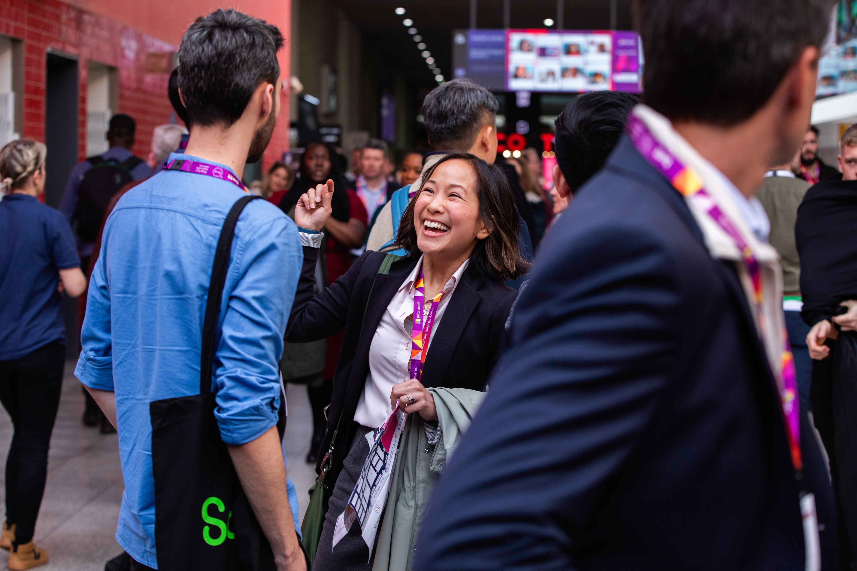
Tech User Labs Session & Speaker Information Pack

Slide 2
Our mission for Bett 2025
Learning today, leading tomorrow
The education systems needs to adapt. From AI and data literacy to critical thinking and assessment, the skills prioritised in the classroom and the way we teach will change.
Embracing personalised learning approaches supported by AI technologies will allow us to better cater to diverse learning styles and pace, ensuring every student maximises their potential and is prepared for the workforce of tomorrow!

Slide 3
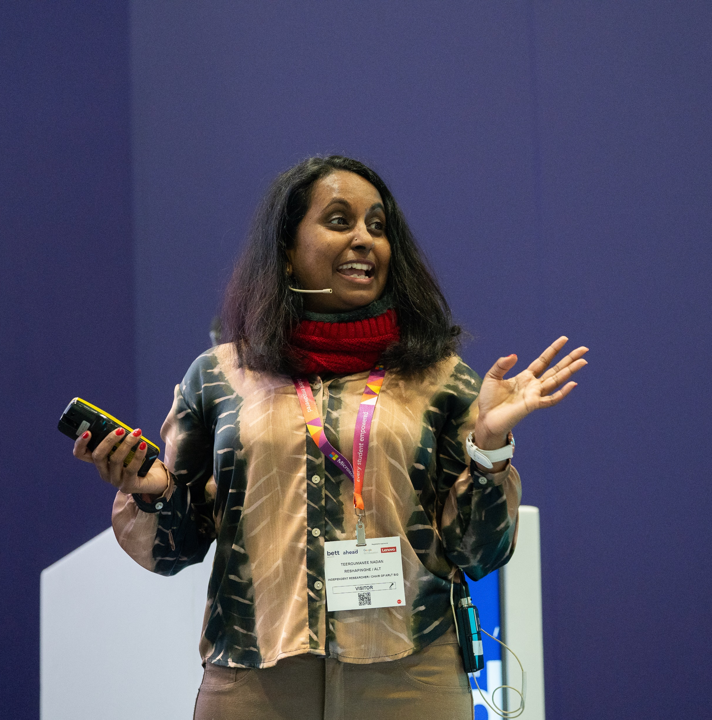
Thank you for joining us as a speaker at Bett 2025
This pack contains useful information to help you prepare for your session and contains details on:
Registration
Tech User Lab and presentation FAQs
Onsite information

Slide 4
Bett Milestones
Milestone | Due Date
Session forms and speaker details forms to be returned to Bett | Due now
Deadline to confirm data scanning onsite at Bett (sponsored sessions only) | 11 December 2024
Deadline for all speakers to have registered to attend the show | 20 December 2024
1

Slide 5
Speaker Registration
All speakers are required to pre-register for their Bett badge by Friday 20 December.
Please select the ticket type that best matches your job title. Once you have registered, we will add a ‘Speaker’ label to your badge. Your badge details will be emailed to you a week ahead of the show.
To beat the queues, you're able to print your badge at home and collect a lanyard on site. Alternatively, you can print your badge on arrival in the registration area.
If you are speaking on behalf of a company, please contact the Bett team, so we can provide you with a registration link for a free ticket.
Please note, if you are bringing any students under 18 years of age, you will need to register them online ahead of the show using the school groups link.​
You are very welcome to bring colleagues, friends and guests to Bett 2025, and they can register for their visitor pass here. Tickets for educators are free.
2

Slide 6
Tech User Lab and presentation FAQs
 | Tech User Labs
Will there be a screen to display any presentation slides on? | Yes, there will be a screen which you can plug your device into, as well as a PA system for you to use.
Is there a lectern for me to present from? | Yes
Is there an autocue? | No
Is hardwired internet connection available? | No, however, free ExCeL Wi-Fi will be available.
Will there be any tech support available onsite? | Yes, there will be an IT technician floating between the Tech User Labs rooms to help with any technical issues.
Are attendees expected to bring their own devices? | We encourage attendees to bring their own devices, which could range from laptops and tablets to mobile phones. However, bringing a device is not a prerequisite for attending a Tech User Lab. To ensure an inclusive learning experience, we recommend planning the session in a way that allows anyone without a device to still participate fully.
Will my session be filmed? | Filming of sessions across theatres will not take place this year. However, we will have a film crew on site that will capture shorter segments of footage, to be used on our website, in marketing and on socials during 2025-2026 so you may have a film crew visit your theatre/room whilst you’re talking. If you do not want to be filmed, please let the Bett team know by Monday 9 December.
Can I arrange for my session to be recorded by a colleague? | Yes – As long as this doesn’t interfere with Bett’s technical set up, please refer to the Filming Guidelines document on the Speaker Resources page. For panel discussions you will need to get permission from the entire panel before you start filming.
Will someone introduce me on stage? | No
What is the capacity of the Tech User Lab rooms? | Each Tech User Lab room has an audience capacity of 56 (roundtable layout – 7x tables of 8x chairs)
Do I need to bring my laptop or device with me? | Yes, please bring your own device with your presentation/PPT. You do not need to share your presentation with the Bett team before the show. However, the team is happy to review your slides upon request or if you have any queries.
Can I provide handouts ? | Please do not bring brochures, flyers or seat drops. We are keen to reduce the amount of paper and waste onsite and strongly encourage the use of QR codes, embedded in your presentation, to direct the audience to additional resources.

Slide 7
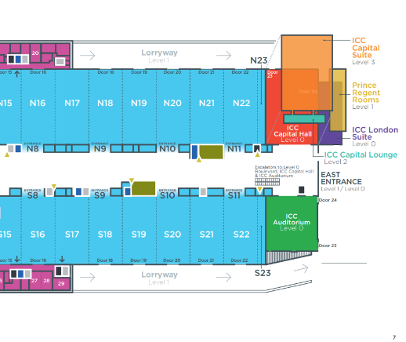
Accessing the Tech User Lab rooms onsite
Tech User Labs rooms are located within the ICC Capital suites on level 3
These can be reached by taking the escalators or lift up to level 3, located on the Prince Regent end of the ExCeL
Please arrive at your Tech User Lab room 30 minutes before your session start time to set up
At the end of your session, you will have 15 minutes to clear and leave the room to ensure it is ready for the next session.
When onsite, please report to Tech User Labs registration desks outside the ICC Capital suites if you have any problems or issues related to speakers or sessions onsite, including:
If a speaker is running late
If a speaker is unwell and cannot make their session
Session update on the website or app.

Slide 8
Presentation accessibility
Ensure you use a sans-serif font with a size of 18pt or larger
Use sufficient contrast between your text and background colours and consider not putting text over imagery
If using PowerPoint, it may be helpful to refer to the accessibility checker which can help identify potential accessibility issues.
Please visit our general accessibility page for detailed information on how we address various accessibility and communication needs which can help assist in planning your time at Bett.
6

Slide 9
Content Session Data (applicable to sponsored sessions only)
If you have a sponsored session and wish to collect leads, please contact your account manager or email exhibitor@bettshow.com. Once purchased, you can download the app onto your own device with a camera, such as a mobile phone or web-connected device, for real-time badge scanning. The app can be used on multiple devices at the show, including those already in use at your stand.
Content sponsors will only be permitted to scan their own content session and can only scan visitors when exiting their session.
You will need to ensure that you order your own app licence and have at least one scanning representative present at your session to collect the data on your behalf. We recommend scanning representatives be in branded clothing to show that they are collecting on behalf of your organisation. However, each theatre will also have sponsor sashes if you need them. This is to ensure scanners stand out as being from your organisation and distinguishable from the Bett representatives in the theatre
Please refer to the Scanning Data Guidelines for more information and deadlines.
9

Slide 10
Travel & Accommodation
Speakers are required to book and plan their own travel and accommodation for Bett. We have negotiated for special discounted rates for attendees at a wide range of hotels across London for you to take advantage of.
Directions to the ExCeL Centre
By train: DLR services: Custom House and Prince Regent. Elizabeth Line services: Prince Regent. As we are located in the East wing of ExCeL London and the closest stop to Bett is the Prince Regent station. ExCeL is approximately 20-minutes walking distance away from Canning Town underground station. The DLR and Jubilee Line can be connected from multiple Overground lines such as Stratford, Canada Water, and Shadwell. It’s also possible to join the Overground and travel to ExCeL London from Euston station.
By car: Parking is available on a first come, first served basis, using pay and display. For parking FAQs and how to pre-book a parking space, click here. If you are travelling to ExCeL London by road please use postcode E16 1XL to find us.
By plane: London City, Gatwick and Heathrow Airport are the nearest airports to the venue.
10

Slide 11
Promote your session!
We’d love you to shout about speaking at Bett UK and have created some social assets for you to share with your networks here.
Don’t forget to tag us @BettGlobal and #BettUK2025
Facebook: bettglobal
X (formerly Twitter): Bett_show
LinkedIn: Bett Global
IG: bett_show
11

Slide 12
Contact the Bett team
Should you have any queries ahead of the show, please reach out to your designated contact in the Bett team:
Alexandra Constantine | Head of Client Engagement (Mat Cover) | alexandra.constantine@bettshow.com
Mia Sutherland | Senior Client Engagement Executive | mia.sutherland@bettshow.com
Reece Pascall | Client Engagement Executive | reece.pascall@hyve.group
Freddy Smith | Client Engagement Executive | freddy.smith@hyve.group
Emily Colyer | Content Producer | emily.colyer@bettshow.com

