Slide 1
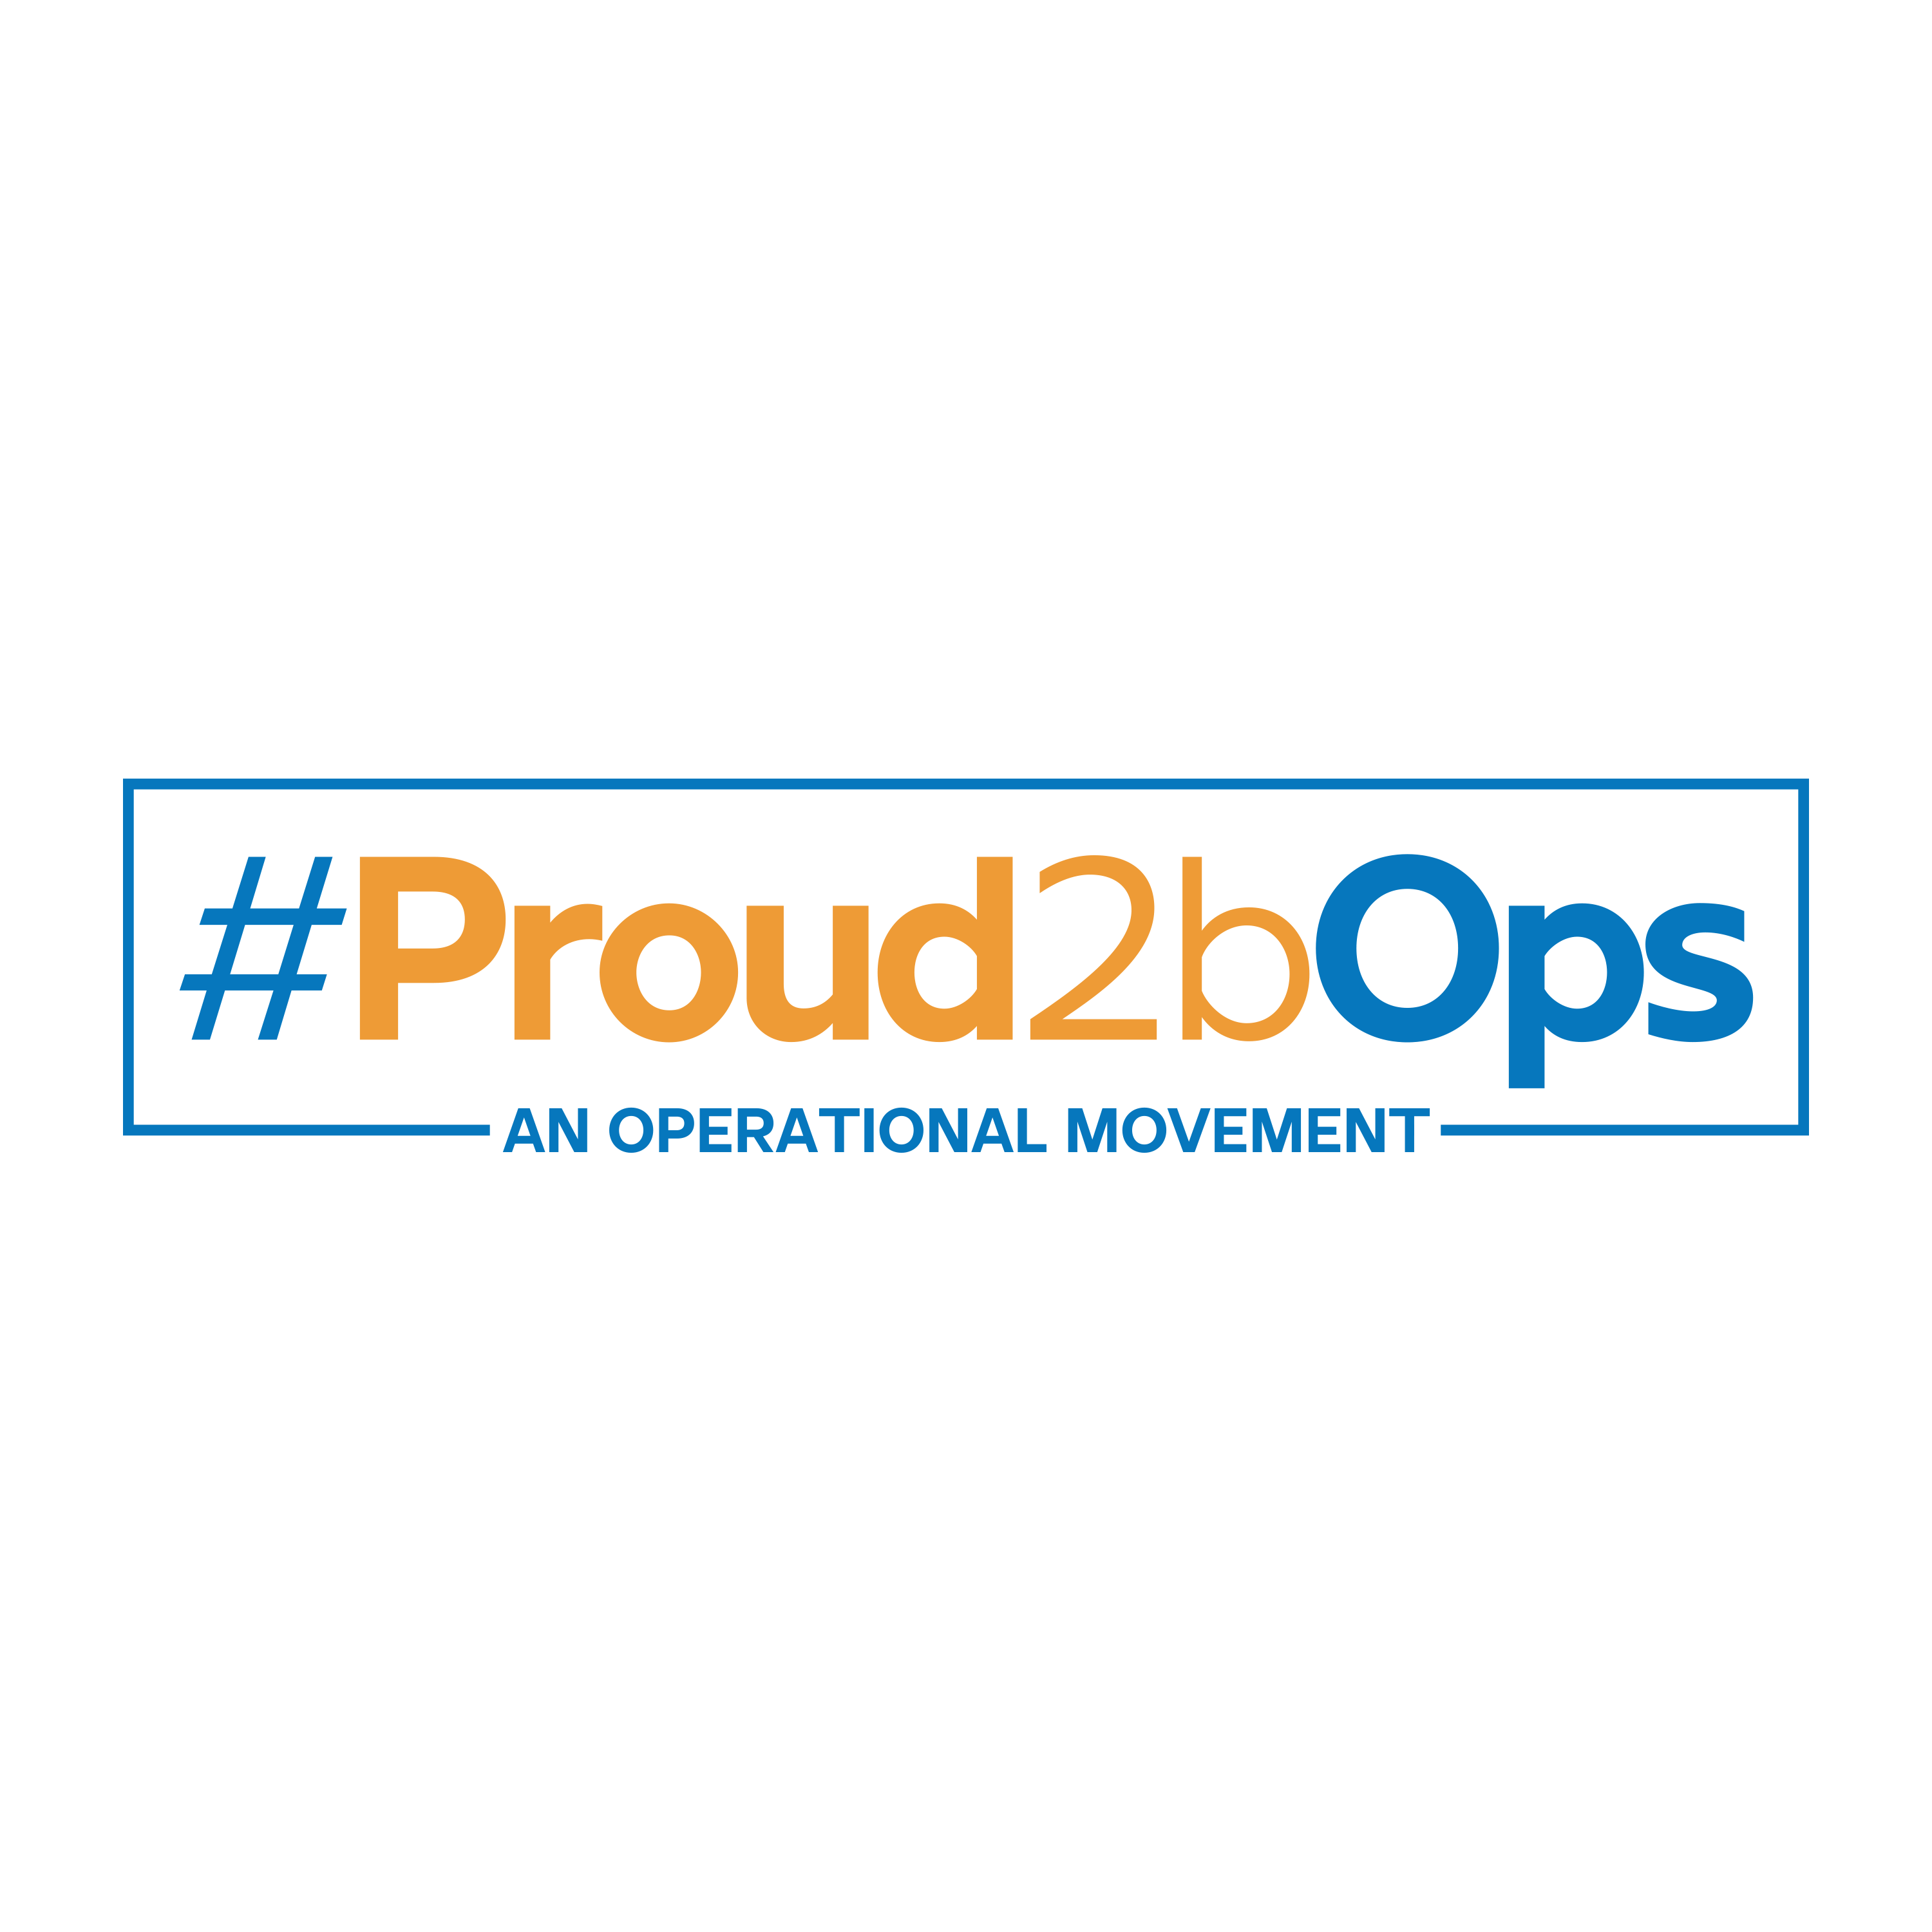
Building Belonging: Creating a sense of Purpose
@Proud2bOps
proud2bops.org
@Proud2bOps
® Proud2bOps, Proud2b and Proud2bAdmin

Slide 2
Hello…
Emma Challans-Rasool
Founder and Director of Proud2bOps
Director of NHS Horizons
@Emma Challans-Rasool
www.proud2bops.org
@emmachallans
® Proud2bOps, Proud2b and Proud2bAdmin
2

Slide 3
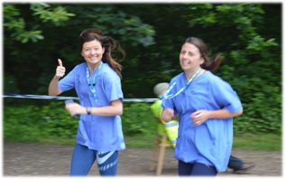
A little about me…
I started my career in healthcare as a Band 4 PA/Project Assistant in Community Healthcare
Equity of access to professional development and the opportunity to grow your identity and values into practice
I have taken a lot of time to understand myself, and the culture and climate I need to thrive.
I have thrived when I am supported by good leaders.
I am a specialist advisor leading and influencing at a national policy level.
I love Ops, large scale change and leading social movements. I am proud of my profession and peers…
Working across healthcare are blummin hard roles - long hours, relentless demand and often little reward or recognition.
I work hard to engage and involve people and professionals in operational improvement and climate and culture transformation.
I deliberately put myself out there, to engage, connect and learn from others. It’s where the magic happens…
I have led services across multiple sites, geographical boundaries, nationally and for professional groups.
3
3

Slide 4
Conversation today…
Belonging
Culture & Climate
Psychological Safety
Social Movement
Purpose
4
4

Slide 5
Belonging
.
Key reflections…
Deep rooted in people feelings
Valued for who you are and what you bring - your uniqueness
Understanding self - who am I, what motivates me, can I be me here
Reliant on recognition and celebration
Happiness – positive link between a sense of belonging and greater happiness as well as a reduction in mental health outcomes including; Anxiety, Depression, Hopelessness, Loneliness
Need to feel connected, supported and respected
Requires high trust
Equality, Diversity, Inclusion and Belonging (EDIB)
A Sense of Belonging: What It Is and How to Feel It Kendra Cherry, April 2023
How To Cultivate A Culture Of Belonging—And Why It’s The Ultimate Competitive Edge William Aruda, March 2023.
® Proud2bOps, Proud2b and Proud2bAdmin
5

Slide 6
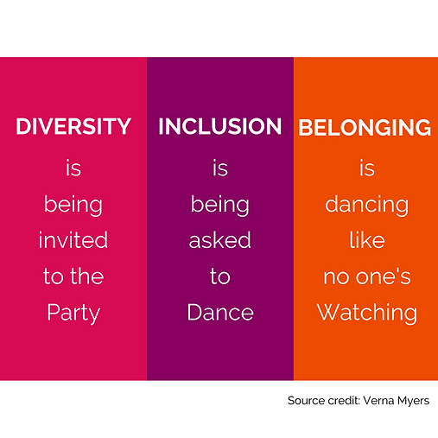
Belonging
.
How are we creating a sense of belonging so that everyone is seen and valued for their own unique and authentic selves?
Belonging counts more than diversity (the facts) or inclusion (a choice)
When we feel we belong, we thrive, and so do the people around us.
Sands, A (2019) Diversity and inclusion aren’t what matter. Belonging is what counts, Medium
® Proud2bOps, Proud2b and Proud2bAdmin
6

Slide 7
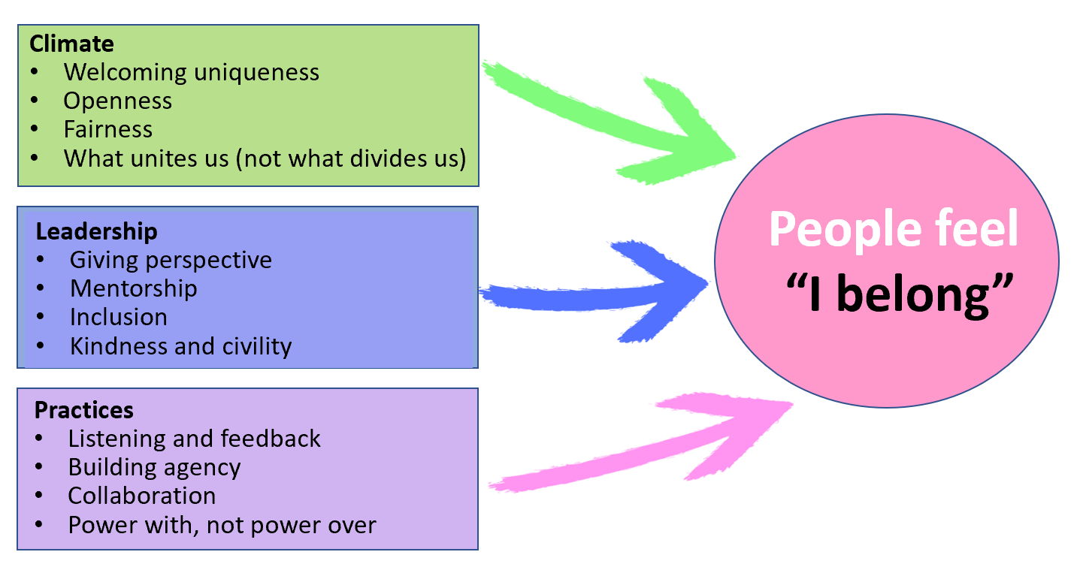
Belonging questions to reflect on
.
To what extent are we really getting to know the people in our teams and understanding the unique gifts that each person brings?
Are we making the space in a virtual world (where the lack of direct contact makes feelings, emotions and reactions harder to gauge) to build belonging?
Are we asking people if they feel they are included, feel they have power over the work or role they are allocated, feel they are in the know, and feel that their ideas are valued?
Bersin J (2020) Why belonging is such a big issue in business today,
® Proud2bOps, Proud2b and Proud2bAdmin
7

Slide 8
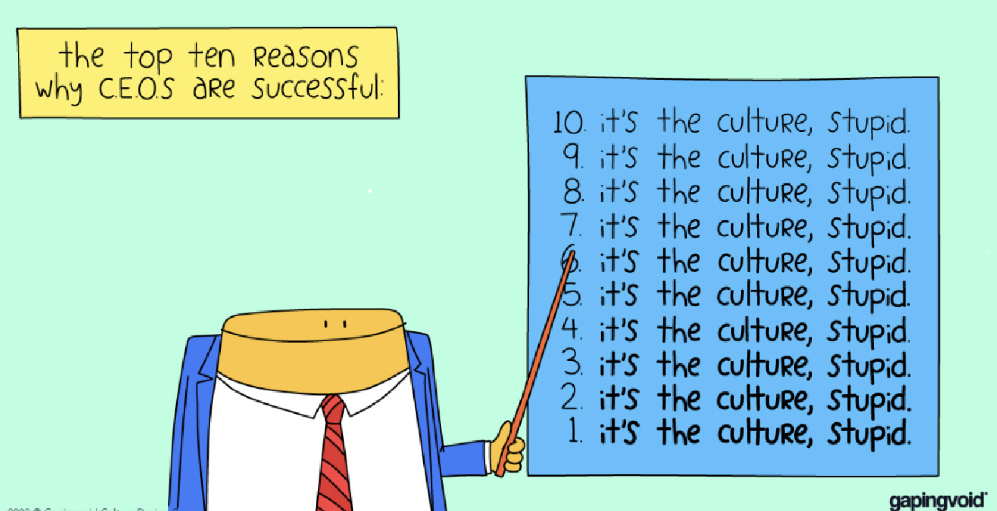
It’s not rocket science, right?
8
® Proud2bOps, Proud2b and Proud2bAdmin

Slide 9
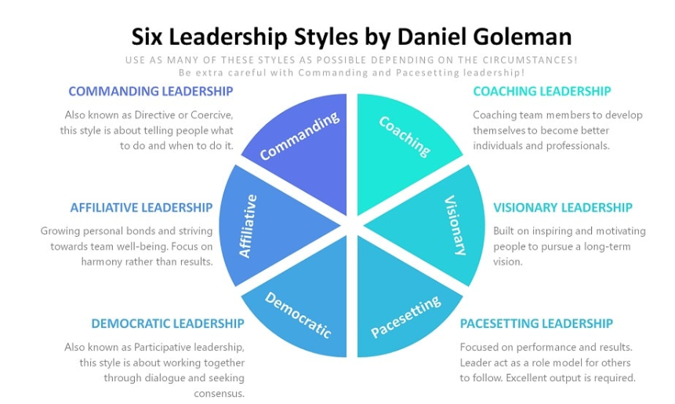
Leadership Styles
The Six Leadership Styles by Daniel Goleman - Leadership Ahoy!
® Proud2bOps, Proud2b and Proud2bAdmin
9

Slide 10
Culture and Climate…
Culture: Deep rooted workplace personality
This refers to the organisations shared values, beliefs and norms that influence the way employees think, feel and behave. It is the underlying fabric that shapes the identity of the business, helping to guide how to interact with each other and with external stakeholders. Culture is deeply embedded in history, traditions and leadership styles. It takes significant time to change and improve the culture.
Climate: Current workplace mood and emotional state
It is the collective perceptions and attitudes of people about their work environment. It is the immediate atmosphere of the workplace. Climate is more immediate whereas culture is much more, deep rooted and slower to change. Current policies, practices and management style can rapidly change and improve the climate.
® Proud2bOps, Proud2b and Proud2bAdmin
10

Slide 11
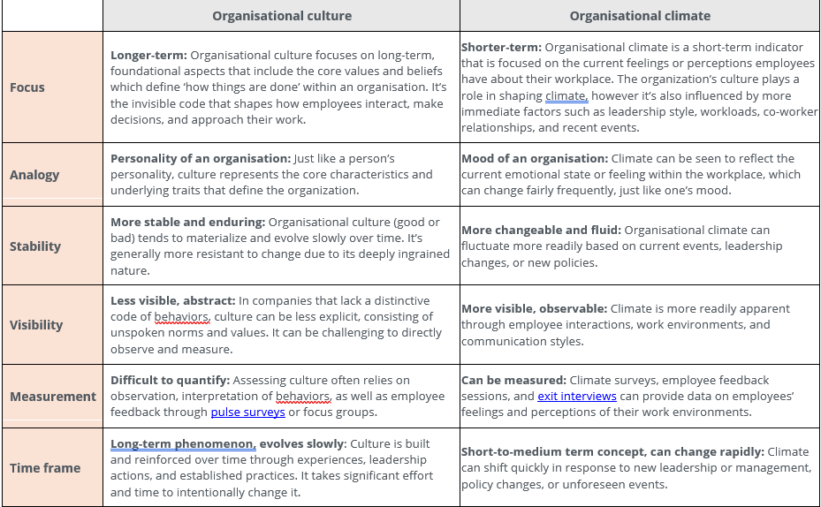
Culture and Climate…
Organizational Culture vs. Climate: The Key Differences (Plus Company Examples)
“Being a great place to work is the difference between being a good company and a great company.”
Brian Kristofek, President and CEO, Upshot
Organizational Culture vs. Climate: The Key Differences - AIHR
11
® Proud2bOps, Proud2b and Proud2bAdmin

Slide 12
Psychological Safety
Psychological safety within teams allows people to feel safety in speaking up. Speaking up and feeling listened to and valued as a person, leads to reduced errors, improves patient safety and contributes to performance, productivity and efficiency…
Psychological safety is “the belief that one will not be punished or humiliated for speaking up with ideas, questions, concerns or mistakes.” Amy C. Edmondson
“when the environment nurtures psychological safety, there’s an explosion of confidence, engagement, and performance” Timothy R. Clark
® Proud2bOps, Proud2b and Proud2bAdmin
12

Slide 13
Feel it-Act on it
If we want people to take, action we must connect with their emotions through values
Source: the work of Marshall Ganz
13
® Proud2bOps, Proud2b and Proud2bAdmin

Slide 15
Energising, Connecting and Developing Operational Managers and Leaders across health and care
@Proud2bOps
proud2bops.org
@Proud2bOps
® Proud2bOps, Proud2b and Proud2bAdmin

Slide 16
Proud2bOps
An innovative National Network created to fill a void in support, development and connection between Operational Managers and Leaders across health and care provider organisations; community, acute, mental health, primary care, independent, voluntary and ambulance sectors.
In summary, members come together to:
Learn through connection
Break the loneliness, safe conversations with peers
Support and share innovation and improvement
Influence and contribute to national policy and programmes
Personal professional development, operational skills and knowledge
Operational delivery and change management
Developing a culture of continuous improvement capability means we must
pay attention to the social and technical aspects for operational change
® Proud2bOps, Proud2b and Proud2bAdmin
16

Slide 17
Our story began in 2017…
When Deputy Chief Operating Officer (DCOO), and all-round people connector, Emma Challans-Rasool reached out to find a professional network for senior operational leaders in the NHS…but found nothing!
Undeterred, Emma took it upon herself to bring together a small group of like-minded DCOOs to shape the beginnings of what would become the Proud2bOps - an operational movement.
This group set out the initial vision and purpose of a professional network for operational managers and leaders and created a set of values and principles that have continued to guide and shape the Network.
® Proud2bOps, Proud2b and Proud2bAdmin
17

Slide 18
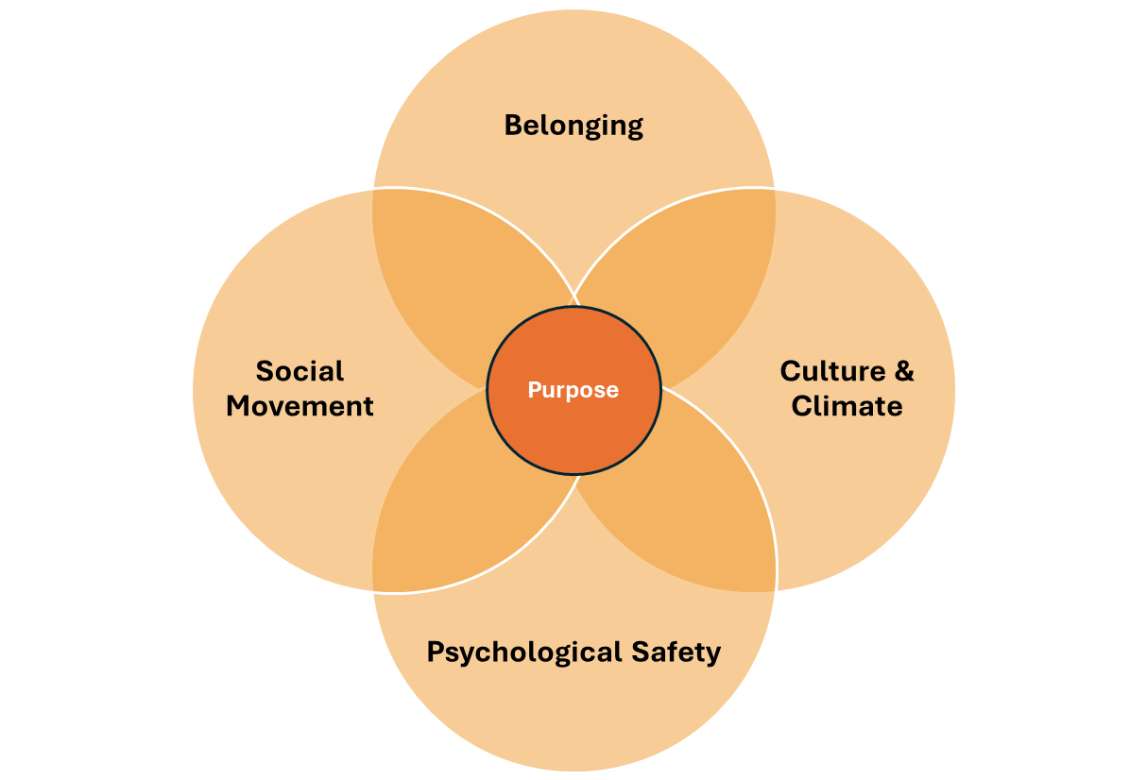
The case for change…
Operational management was often not seen as a credible or reputable profession, and operational roles felt unloved and unsupported and invisible to the public eye
No operational network existed to engage and influence at a national level, unlike other healthcare professional groups such as Nursing, Medics or corporate functions such as HR or Finance – who had a voice
A safe, supportive space was needed to connect with peers experiencing the same kinds of
challenges, to share and learn together, and to develop and understand self as a leader
Colleagues were feeling undervalued and underdeveloped as manager and leader
Colleagues wanted to break the loneliness of the role, to share in the successes,
and, also, the, ridiculousness!
® Proud2bOps, Proud2b and Proud2bAdmin
18

Slide 19
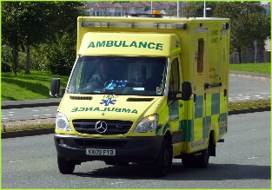
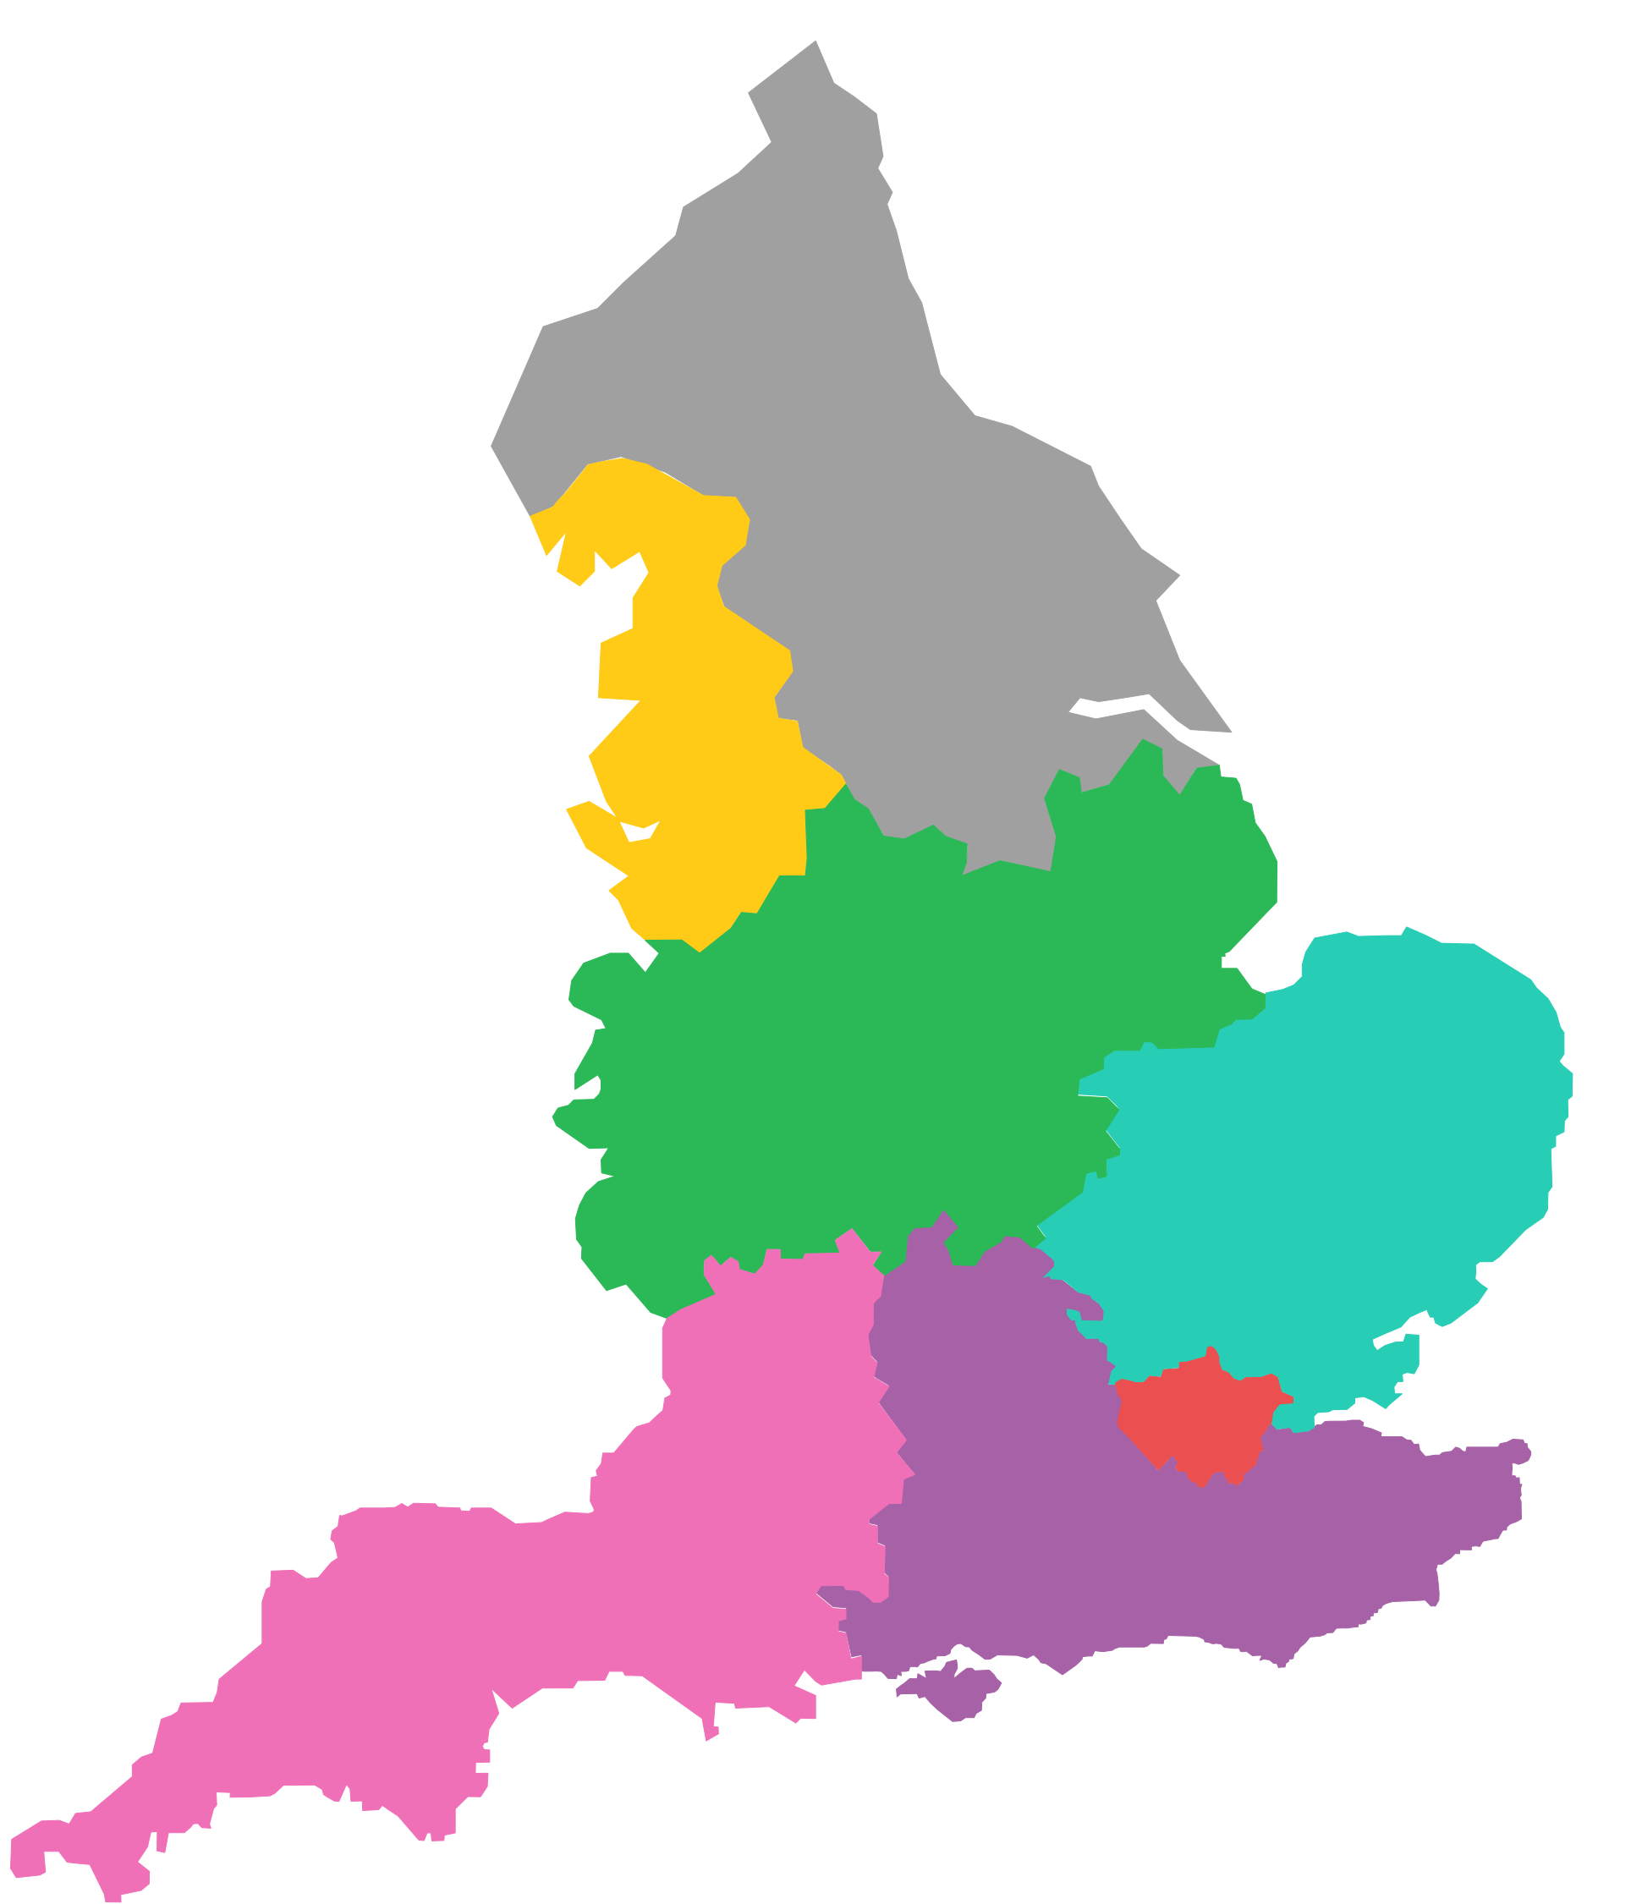
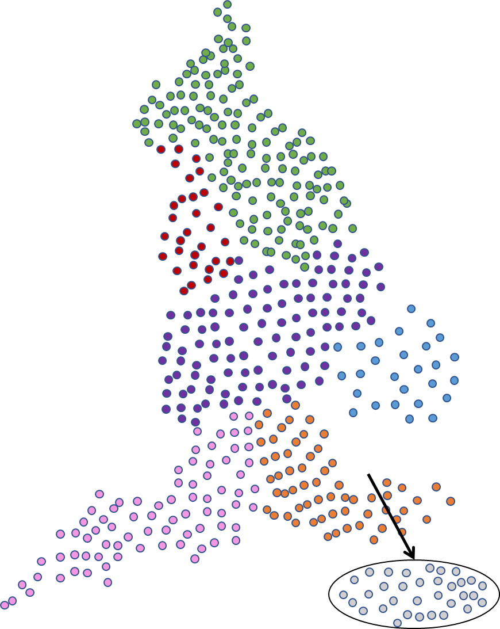
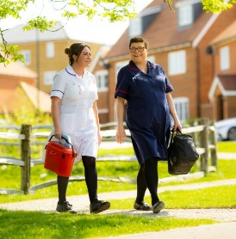
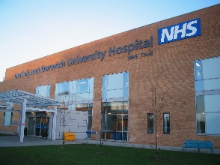
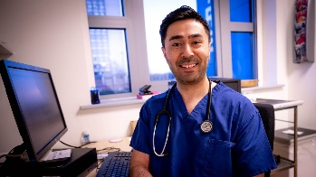
How it started…
How it’s going…
Spread and Scale
15 Members
15 members
October 2017
TODAY
This Photo by Unknown Author is licensed under CC BY
This Photo by Unknown Author is licensed under CC BY-SA

Slide 20
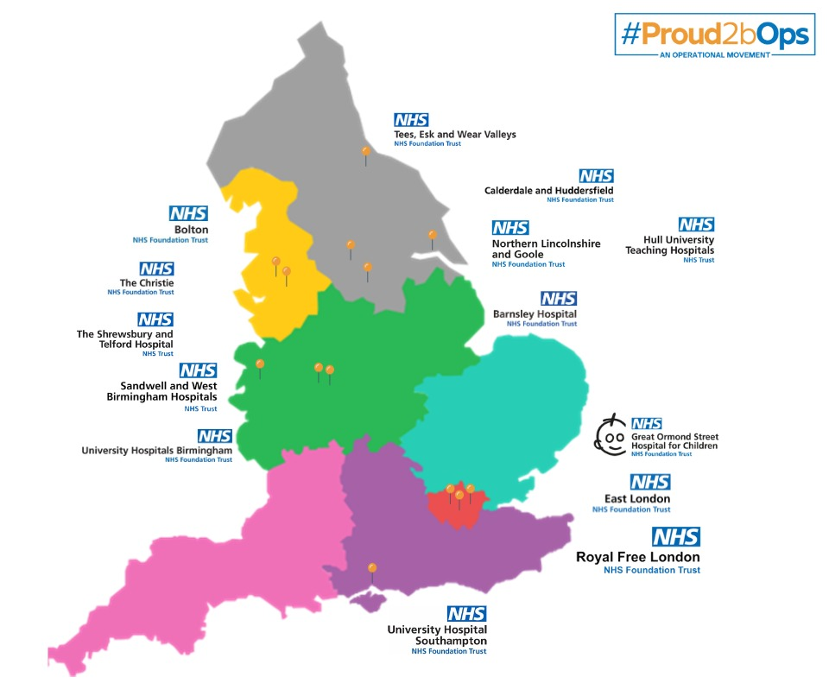
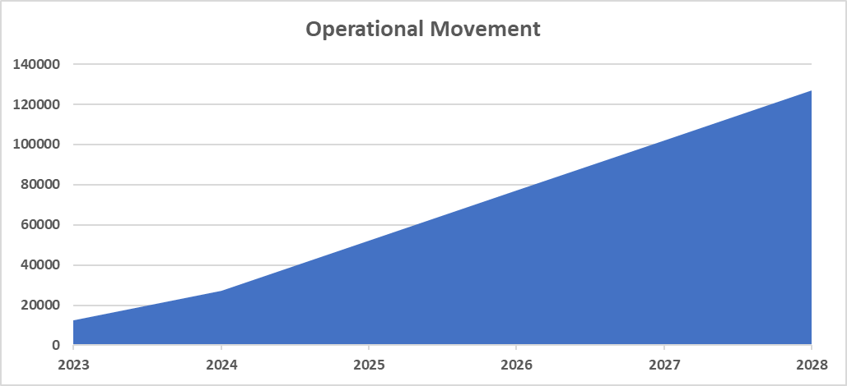
Operational Movement
Spread and Scale…
® Proud2bOps, Proud2b and Proud2bAdmin
20

Slide 21
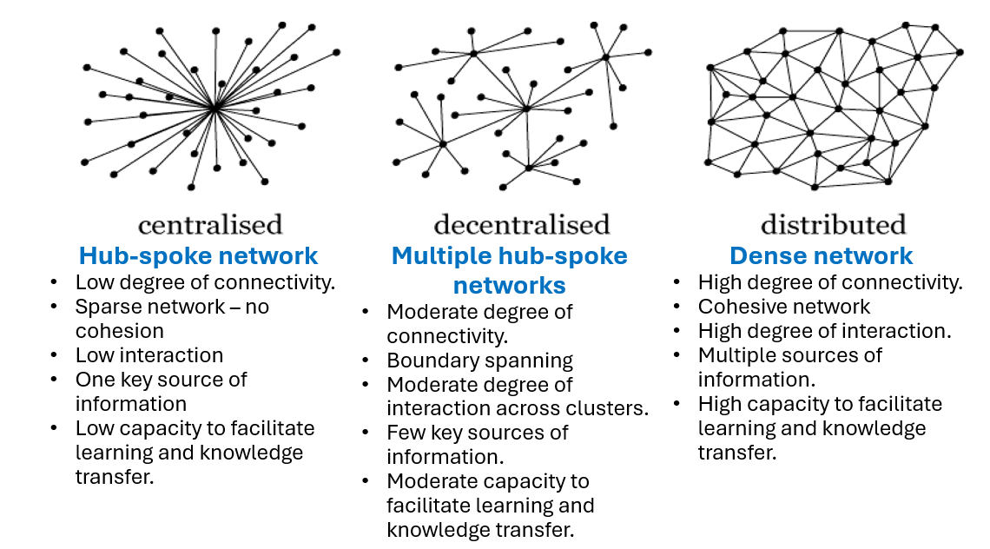
Structures and systems may be underpowered if we don’t also deliberately build strong relationally-based connections for delivery and improvement
What type of operational network will you build?
If we aspire to a high capacity for learning and knowledge transfer, we need to create a “dense network” as the relational foundations for a strong, adaptive learning system.
The NHS-Virginia Mason Institute experiment (2015-2021) showed that when five hospital trusts (systems) undertook identical whole system transformation (“same intervention, same progress, different outcomes”), the only significant factor that differentiated those trusts whose performance improved and those where performance deteriorated was the degree of social connectivity between those leading the change.
Source: Warwick Business School

Slide 22
Defining who we are…
Our Purpose
22

Slide 24
Objectives
Objective 1
Objective 2
Objective 3
Objective 4
Objective 5
Champion Recognition and raise the Profile of Ops.
Grow an Inclusive and Diverse Network.
Build Relationships and Partnerships.
Drive Leadership and Management Development.
Deliver
Network Sustainability.
® Proud2bOps, Proud2b and Proud2bAdmin
24

Slide 25
Our Impact
Identity
Belonging and increased loyalty
Motivation and direction-appetite for innovation
Healthy and meaningful relationships
Real world presence and grounding
Improved decision making & understanding
Fostering collaboration and active participation
® Proud2bOps, Proud2b and Proud2bAdmin
25

Slide 26
Our Impact
Innovative
Multi-Award Winning
Almost 10
year of age
Thousands members x 215 NHS Trusts in England
Proud2bOps@ almost x 20 NHS Trusts
Validated in national policy, inquiries as an exemplar
Growing UK & International presence
® Proud2bOps, Proud2b and Proud2bAdmin
26

Slide 27
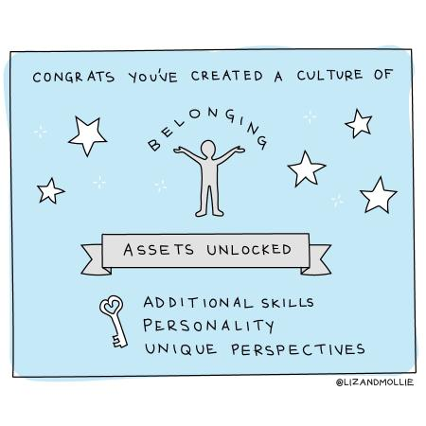
Our Impact
Action
We help people to increase their confidence and take care of each other wellbeing
We save people from reinventing the operational wheel
We connect people to conversations with national leaders
Change and Innovation: through network safety, celebration and relationships
We help develop national programmes through an operational voice
We engage, consult and work across government advisors, leaders and national healthcare strategy
Source of image: @LizandMollie from X/Twitter
® Proud2bOps, Proud2b and Proud2bAdmin
27

Slide 28
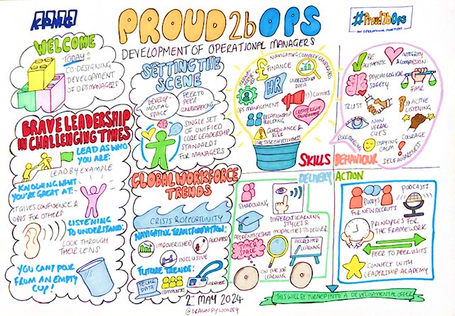
What we do well…
Live sessions: in conversations, hot topics, policy, consult
In person events
Learning Series
#Sharingnonelectivestuff #Sharingelectivestuff
Mentoring
Leadership and Executive development
Operational Management Development Programme
Proud2bOps Annual Congress and Awards
ProudNews
Proud2bOps Associates
Proud2bOps@ Network establishment
Proud2bAdmin@ Network establishment
Bespoke operational improvement and development
® Proud2bOps, Proud2b and Proud2bAdmin
28

Slide 29
Moving from static block building to cocreating a new world designed and built by us “Designed by us For us”

Slide 30
The DNA of Proud2bOps
Purpose and Vision
Relational & connection
Safety and trust
Energy, motivation and hope
Identity, personal and collective
Recognition and reward
Collaboration with collective responsibility
Discover – define - design – develop and deliver 2geth
Develop self and each other
Fun, Hope and Joy
Impact – measurable and tangible
30
® Proud2bOps, Proud2b and Proud2bAdmin
30

Slide 31
Reflections
Thoughts…
31

Slide 32
‘I am ready’ – Circle
What will I do?
Reflect on what you have heard and learnt so far today
Think about what you will do as, a result of today
Frame in your mind ‘I am ready to…………………………..’
When you feel able, step into the circle and tell your colleagues what you are ‘ready to do’ to doing as result of today.
Once finished, rejoin the circle and ask someone else to step into the circle
32
32

Slide 33
Thank
You
Emma Challans-Rasool
Founder and Director of Proud2bOps
Director of NHS Horizons
@Emma Challans-Rasool
www.proud2bops.org
@emmachallans
® Proud2bOps, Proud2b and Proud2bAdmin
33

