Slide 1
Leading Practically with (and for) Kindness
Sue Holden – Exec Chair, Aqua
BMJ Leader Conference – 15th November 2024

Slide 2
Framing [SLIDE NOT SHOWN]
This is an experimental session about a topic to do with state of mind, relationships and emotional response
Kindness implies active listening - receiving what’s offered with kindness, not reacting/defending/explaining
Strong emotional element for the listener - being open and showing vulnerability appears weak, but actually is a strength

Slide 3
Today’s learning objectives:
Think differently about kindness
Feel mobilised and equipped to act
Share ideas and approaches to help you to grow a culture of kindness
Invite you to join a ‘movement’ for kindness

Slide 6
Kind ≠ Nice

Slide 7
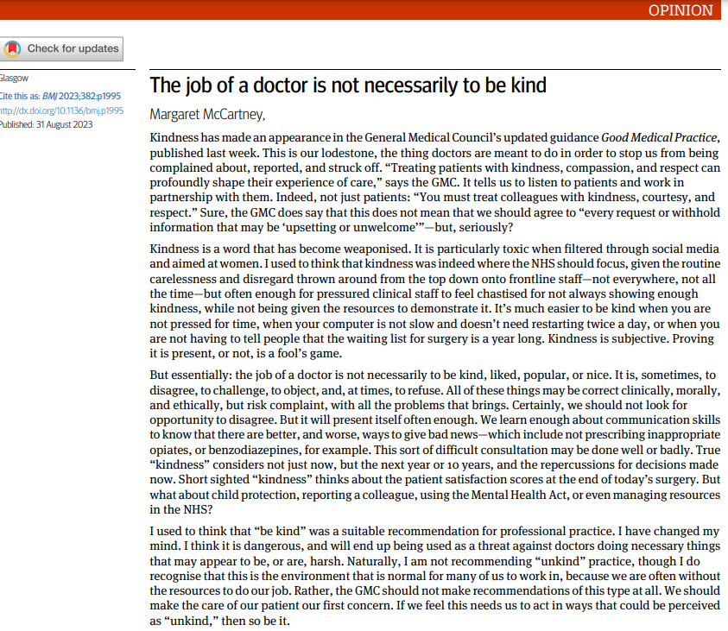
“But essentially: the job of a doctor is not necessarily to be kind, liked, popular, or nice. It is, sometimes, to disagree, to challenge, to object, and, at times, to refuse.”
“Short sighted “kindness” thinks about the patient satisfaction scores at the end of today’s surgery. But what about child protection, reporting a colleague, using the Mental Health Act, or even managing resources in the NHS?”
Notes:
“Kindness is a word which has been weaponised”

Slide 9
Kindness, then, is not a soft, sentimental feeling or action that is beside the point in the challenging, clever, technical business of managing and delivering health and social care.
It is a binding, creative and problem-solving force that inspires and directs the attention and efforts of people and organisations towards building relationships with those they care for, recognising their needs and treating them well.
Kindness is not a ‘nice’ side issue in the project of competitive progress.
It is the ‘glue’ of cooperation required for such progress to be of most benefit to most people.

Slide 10
The two lexicons of public policy:

Slide 11
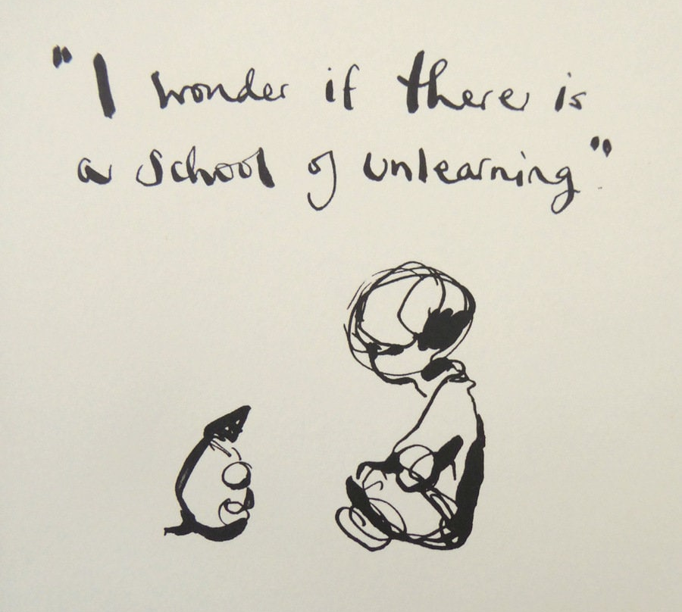

Slide 12
Psychological Safety
Google’s Project Aristotle
2 years, 180 teams and 37,000 employees
Impact | Team members can see and feel their work matters and it leads to change
Meaning | Work is personally important to team members
Structure and Clarity | Team members have clear roles, and their work has clear aims, measures and plans
Dependability | Team members deliver high quality work
Psychological Safety | Team members feel safe to take risks and to be vulnerable in front of each other

Slide 13
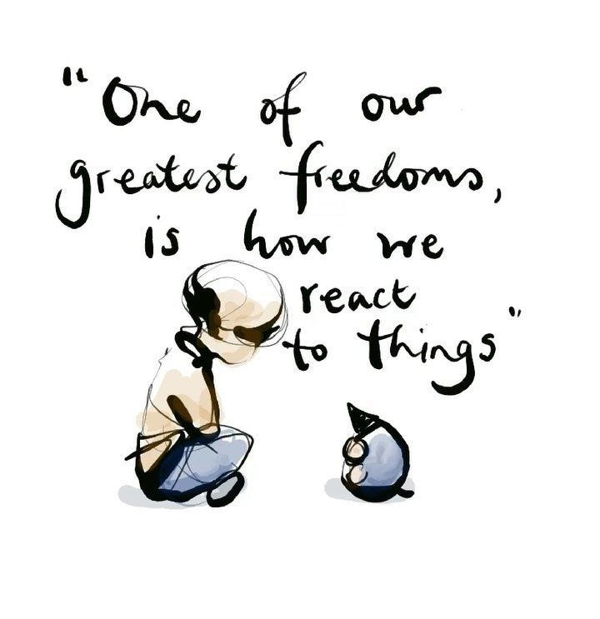

Slide 14
Listening, with fascination:
Tips from Nancy Kline
with thanks to Lita Currie

Slide 15
Task (in pairs)
Reflect on a time when you were received kindly:
What characterised it?
How did it make you feel?
What response did it evoke in you?
5 minutes as a storyteller and as a listener – then switch roles.
Notice what you are feeling in both roles.

Slide 16
Reflection exercise (in pairs)
How did it feel listening to and telling your story?
What was different to the ‘usual’ interactions/conversations?
What insights lie in this difference?

Slide 17
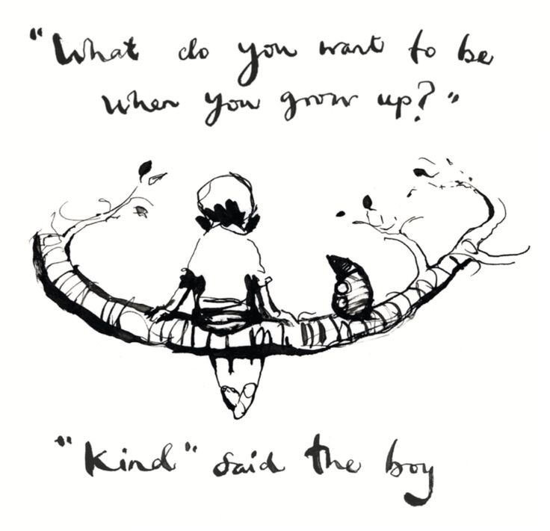

Slide 18
A Conversation for Kindness
Join us for a monthly call on the 3rd Thursday of the month (6 - 7pm in UK)
The next Conversation for Kindness: Thursday 21st Nov 2024 Listening, learning, thinking differently and mobilising for action
Sharing of resources, resilience, energy and ideas
Everyone’s welcome!
bob.klaber@nhs.net
www.kindnessinhealthcare.world
The sessions are facilitated and convened by:
Bob Klaber, Imperial College Healthcare NHS Trust, England
Maureen Bisognano, Institute for Healthcare Improvement (IHI), USA
Gabrielle Mathews, NHS England & NHS Improvement, UK
James Mountford, Royal Free NHS Foundation Trust, UK
Suzie Bailey, The Kings Fund, England
Göran Henriks, Region Jönköping, Sweden
Anette Nilsson, Region Jönköping, Sweden
Dominique Allwood, Health Foundation & Imperial College Healthcare NHS Trust, England
Cath Crock, Royal Children’s Hospital Melbourne and Hush Foundation, Australia
Nicki Macklin, University of Auckland, New Zealand

Slide 19
Over 1,200 contributors from 31 countries so far!
Denmark, Saudi Arabia, Norway, Singapore, England, Faroe Islands, Italy, USA, Scotland, Canada, Northern Ireland, Ireland, Sweden, Belgium, The Netherlands, Iceland, Australia, Wales, Germany, Hong Kong, Spain, Slovenia, Malta, Brazil, The Philippines, New Zealand, Portugal, Switzerland, China, Kenya, South Africa

Slide 20
36 months into the conversation:
The key themes and learnings that have (so far) emerged:
Kindness is a choice of action we can all take, role model and lead for | Leading with kindness needs to be central in work to reduce staff burnout and creating inclusive workplaces | There is a growing evidence base of the biological and psychological impact of kindness
Kind behaviours are as effective as any action in creating psychological safety at work | Systematically challenging unkind behaviours (and exploring why) is a crucial role of leaders | But what is more important - kind intent, or the outcome of kindness?
Kindness is a cycle - being kind stimulates more kindness | Small acts of kindness can have a big impact | If you do ONE thing: Make your kindness your starting point - and everything else follows

Slide 21
Strategic theme for 2024:
Kindness and Human Connection
“BMJ Leader is an international, peer-reviewed, online only journal that publishes articles in the field of healthcare leadership. With a focus on original research and reviews, the journal is a place of discussion and debate for the many disciplines that make up leadership in the health services.“
www.bmjleader.bmj.com

Slide 22
BMJ Leader has chosen kindness as a strategic priority...
Klaber et al., BMJ Leader - February 2024

Slide 23
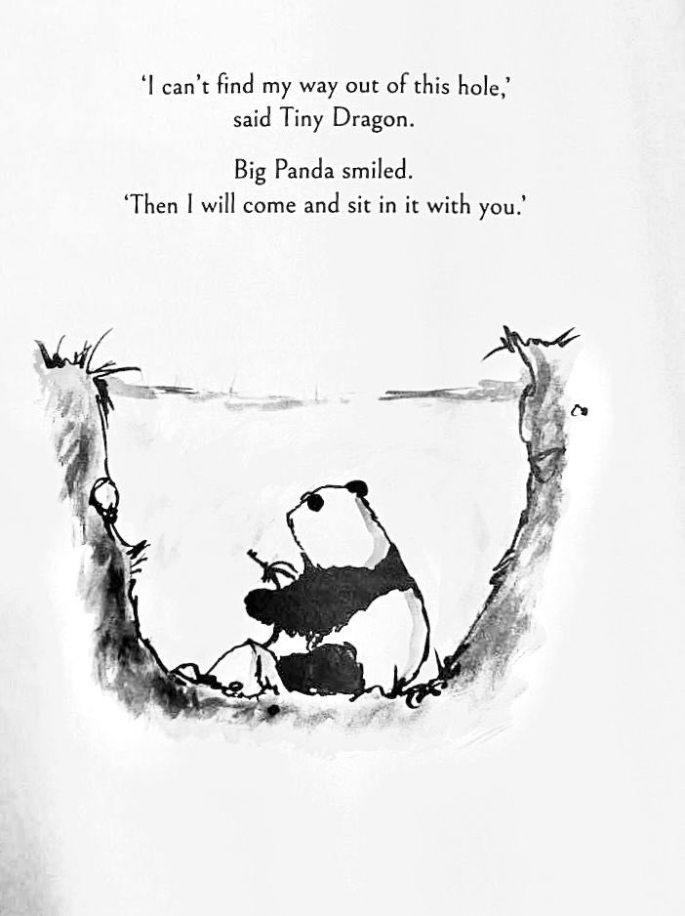

Slide 24
Thank you for attending and exploring kindness with us.
@Aqua_NHS
Advancing Quality Alliance
3rd Floor, Crossgate House, Cross Street, Sale, M33 7FT
Call: 0161 206 8938
Email: enquiries@aqua.nhs.uk
www.aqua.nhs.uk
FMLM Conference, 26 March 2024

