Slide 1
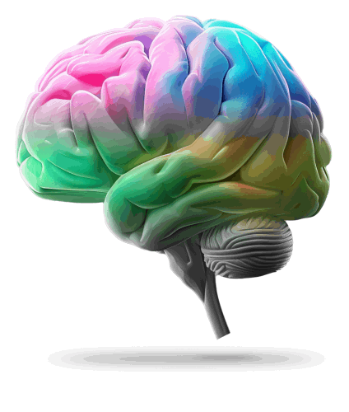
The Neurodiverse Advantage:
Leading in a
Changing World
Dr. Jasmine Murphy
Co-founder and Chief Clinical Officer
Former NHS Consultant in Public Health
Jasmine Murphy
@MurphyJasmine99
Notes:
Good afternoon, everyone – and welcome to this session on the neurodiverse advantage.
I am
CLICK Jasmine Murphy,
CLICKCo-founder and Chief Clinical Officer of ThinkDivergent with a mission to improve the lives of ND people.
Before this, I was in a senior leadership position as an
CLICK NHS Consultant at NHS England.

Slide 2
Show of hands!
How many of you have worked with someone who you thought operated in a completely different way?
A way that maybe seemed strange or even challenging at first, but then you realised they were bringing something unique to the table?
A different perspective, a new approach that no one else had thought of?
Notes:
I want to start today with some questions for a show of hands, please:

Slide 3
Power of neurodiversity in action
Credit: BigThinkEdge
Notes:
Thank you for engaging in that.
What you were likely witnessing was the
CLICK power of neurodiversity in action.
So, let me share something personal here with you. I only discovered my neurodivergence at the grand old age of 5-0 and as a neurodivergent leader in the NHS, I've navigated a unique path—one that’s been both challenging and also transformative. Leadership was long defined for me by a traditional mould—but my path has shown that leadership can be just as impactful—if not more so—when it comes from a different perspective.
In this session, we’re diving into the power of neurodiversity in leadership—how embracing it can unlock the unique strengths of neurodivergent individuals, offering fresh ways to lead and influence in today’s fast-evolving world.
We’ll explore why neurodivergent leaders—aren’t just valuable; they’re essential in shaping the future, especially in healthcare.
But first, let’s connect with the heart of the matter.

Slide 4
Being aware helps to
break down stereotypes and barriers
We are
not expected
to be
‘experts’
Notes:
…..and the first point to be made is this.
None of us is expected to be experts in ND, but being aware helps break down stereotypes and barriers.
Neurodiversity is not a new concept, but it’s one that is still misunderstood, particularly in leadership roles.

Slide 5
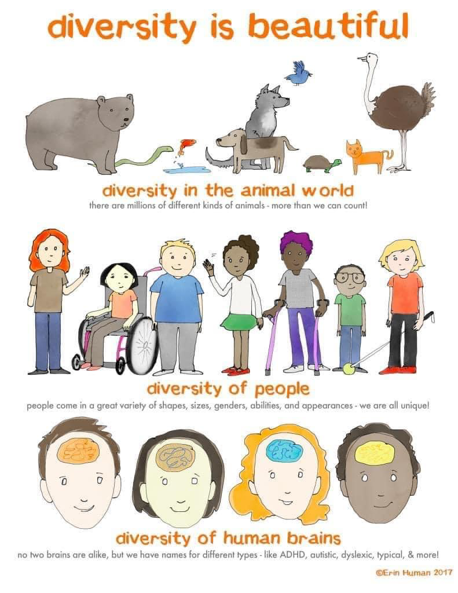
What’s neurodiversity?
A
Biological
Fact
Neurological diversity
Normal variation
in the
human genome
Notes:
So, let’s get stuck in with some basics.
What is neurodiversity?
Well, it’s basically short for
CLICK neurological diversity.
CLICK This acknowledges a fundamental truth, that our brains are all unique.
We think, learn, feel and experience the world in different ways.
CLICK ND is therefore a normal variation in the human genome and an essential aspect of human diversity, contributing to the uniqueness and richness of human experiences.

Slide 6
Neurodiversity
Every brain THINKS a little differently...........
DIFFERENT BRAINS mean NeuroDifferences
...........and some brains PROCESS INFORMATION or FUNCTION very differently to others!
Notes:
Here’s the key.
CLICK While no two brains think alike, some process information or function quite differently to others.
CLICK Different brains mean Neurodifferences
It doesn’t mean that it is the wrong way of processing information or functioning – it’s just different.
It could be said that while most people operate on similar "software," neurodivergent individuals might be thought of as running on a different "operating system."

Slide 7
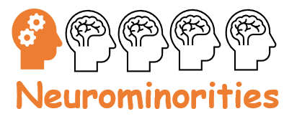
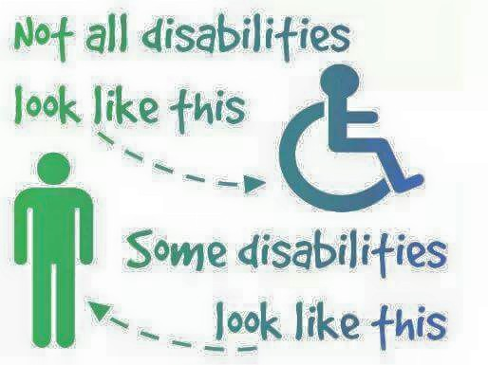
Neurodiversity
An Umbrella Term
Refers to the group of neurodevelopmental conditions
which can affect
brain functioning
Notes:
It is in this context, that ND serves as an
CLICK umbrella term for conditions which affect how brains function differently.
CLICK Studies suggest that up to 20% of the global population is neurodivergent, but a very small percentage are in leadership positions.

Slide 8
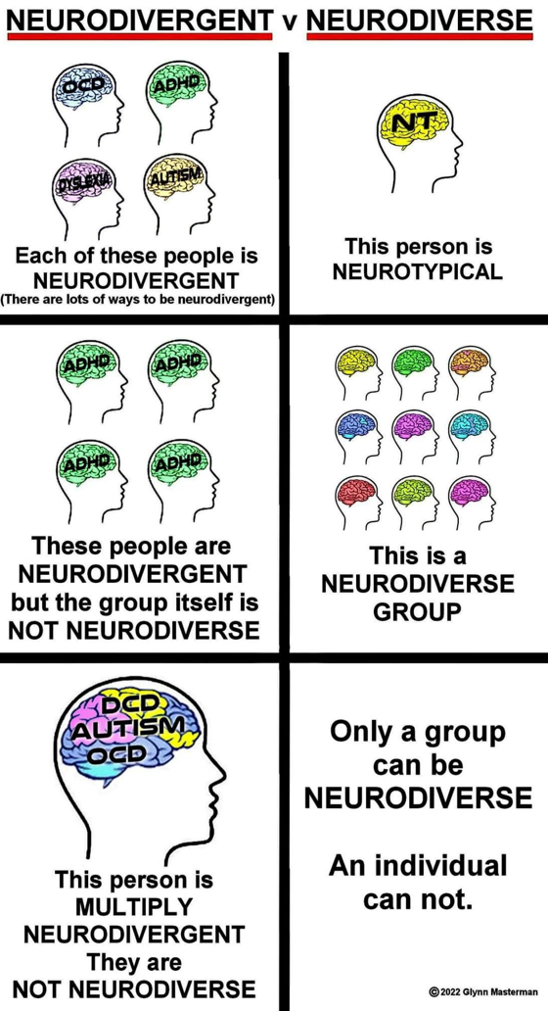
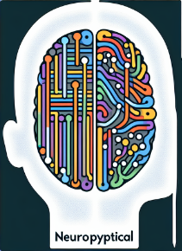
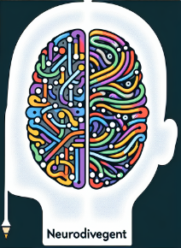
Some basic terminology
Neurotypical:
A person with typical
neurology
Neurodivergent:
A person whose neurology
that diverges from what is
typical
Notes:
Some very basic terminology here for you, just in case you’re not familiar with some terms:
CLICK NT refers to the majority of people in the general population – that is, those without NDgent conditions.
CICK Ndivergent refers to people like myself – that is, those of us with NDgent conditions.
Now the term 'neurodiverse' often gets misunderstood.
CLICK Neurodiverse refers to the full spectrum of neurological differences across both neurotypical and neurodivergent individuals.
While a person might be neurotypical or neurodivergent, only a group can be neurodiverse.
Now, let’s take a closer look at some of the more common ND conditions.

Slide 9
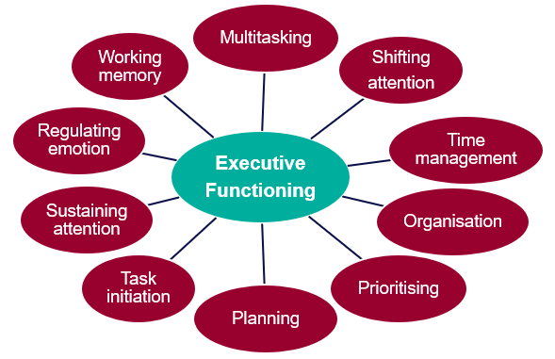
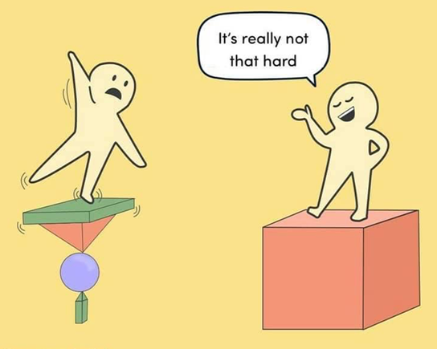
Dyscalculia
Strategic thinking, practical ability, love of words, creativity, intuition skills
Dyscalculia
Differences in learning number
concepts and calculations
Dyspraxia/DCD
Dyspraxia
Dyslexia
Problem solving, practical ability,
entrepreneurial skills,
thinking outside the box,
good memory for facts
Difficulties with
movements, co-ordination,
practical skills as well as tracking
and balance
Dyslexia
Problem solving, communication, long term memory, 3D visual skills, critical thinking
Differences in processing information
affecting acquisition of literacy skills
Executive
Functions
&
Neurodiversity
Traits
ASD
Autism
ADHD
ADHD
Memory ability, highly logical,
problem solving, specialist
expertise, creativity,
attention to detail
Differences in social interactions
and communication, sensory
processing, repetitive/restrictive
behaviour
Very easily distracted, reacting without thinking, excessive physical or mental energy, sensory processing, low frustration tolerance
Creativity, out-of-the-box thinking intense focus, high energy, calm under pressure, persistence, constantly curious, entrepreneurial
Tic disorders including Tourette’s
Verbal and physical tics
Tic disorders including Tourette’s
Hyperfocus, creativity,
observational skills
Notes:
Neurodiversity is complex, with a wide range of conditions falling under this umbrella term.
The conditions that will appear on this slide are not exhaustive but serve to provide a very basic introduction to some specific traits of some conditions such as
CLICK autism, CLICK ADHD, CLICK dyslexia, CLICK dyspraxia, CLICK dyscalculia and CLICK tic disorders.
While specific traits are highlighted here, no one should be defined by a label—variation within any condition is vast, shaped by factors like gender, age, ethnicity, and culture.
It is also important to note that many Ndgent people can also have higher than average abilities in specific mental processes,
CLICK such as hyper focus, creativity, enhanced ability to recall information and many more.
PAUSE
Now, despite these strengths, all individuals also struggle with EF challenges.
CLICK
Executive function (EF) is the brain's management system, key to planning, prioritizing, and decision-making.
When EF is impacted, as often is the case with neurodivergence, tasks like organizing, multi-tasking, and planning can become challenging, affecting team management and project flow.
Recognizing these challenges is essential for supporting effective leadership.
And therefore, with EF challenges and the specific ND traits CLICK, both of these immediately put NDgent people at a completely different baseline when compared against their NT peers. CLICK
One last point to note is that it is the norm and not the exception for ND conditions to co-occur CLICK, and therefore many traits will overlap with each other.
For this reason, any assumptions about a person’s needs or capabilities should never be made based on any specific diagnostic label.

Slide 10
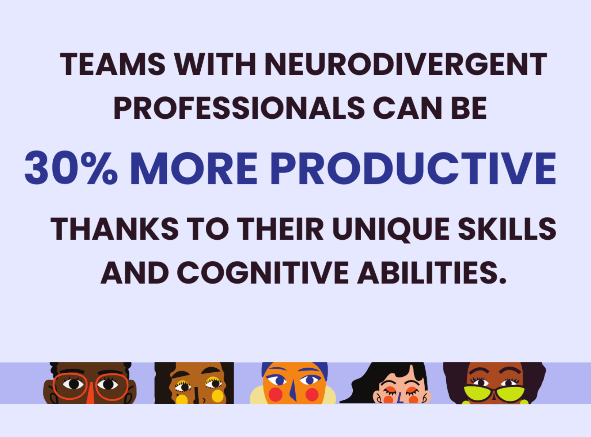
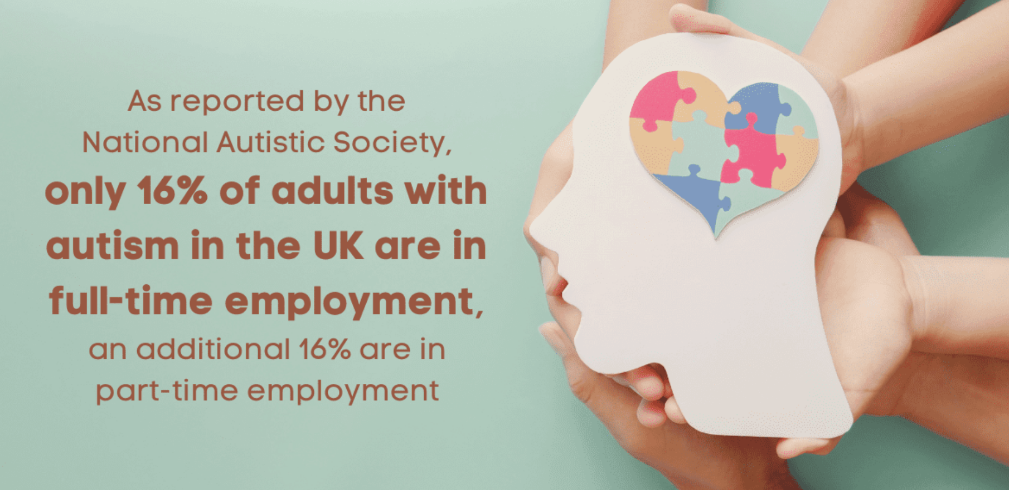
Some basic stats!
Silvio Bessa, General Manager and Global Leader of the SAP Business Unit at Microsoft
Notes:
Let me share some basic stats:
Only 16% of autistic adults are in full-time employment.
At the same time, many neurodivergent individuals report feeling underestimated or sidelined, with
CLICK 7 in 10 reporting discrimination in the workplace.
These challenges stem from systemic issues, not individual deficits.
Research shows that workplace culture, environment, and rigid systems often exacerbate the difficulties faced by neurodivergent professionals.
While the Equality Act protects neurodiversity, the benefits of embracing it extend beyond legal compliance.
Research indicates that teams with NDgent professionals can be
CLICK 30% more productive.
As a result,
CLICK an increasing number of organisations are investing in neuro-inclusion, including more than 25% of Fortune 100 companies.
But this is more than just data.
This is about real people with unique abilities, who can drive our NHS forward in unexpected ways.

Slide 11
Neurodivergent strengths
Observational
skills
Detailed factual knowledge
Pattern
recognition
Creativity
Entrepreneurial
Specialist
expertise
Memory ability
Attention
to
detail
Innovative
Lateral thinking
High levels
of
concentration
Energy
Constantly curious
Strengths
Conscientiousness
Strategic thinking
Compassion and empathy
Problem solving
Reliability
Highly logical
Determination
Visual thinking
Persistence
Notes:
As I have mentioned, neurodiversity is about differences, not deficits.
Neurodivergent individuals bring unique strengths to leadership roles, so let’s recap on them.
I'll let you read them yourself – to provide a break from listening to my voice!
CLICK
Do bear in mind that this isn’t an exhaustive list, and not every Ndivergent leader will share the same strengths but let’s explore some of this a little, for example:
CLICK Creativity and CLICK Problem Solving: Unconventional thinking allows neurodivergent leaders to see
CLICK patterns, spot trends, and anticipate developments others might miss. This foresight enhances
CLICK innovation, risk management, and resilience, helping organisations adapt proactively.
CLICK Hyper-focus: Individuals with ADHD, for instance, often achieve intense focus, driving results with
CLICK energy and commitment unmatched by conventional approaches.
CLICK Attention to Detail: Neurodivergent leaders often have a keen eye for detail, catching subtle errors or identifying risks early. In high-stakes fields like quality assurance or research, this precision significantly improves outcomes.
CLICK Visual Thinking: Many neurodivergent individuals excel at visualising solutions, enabling them to piece together complex problems creatively. This skill is invaluable in fields requiring design, process optimisation, or conceptual innovation.
• CLICK Compassion and Empathy: While neurodivergent individuals are sometimes perceived as less socially attuned, many possess a strong sense of compassion and empathy. Many have experienced challenges themselves, which can make them particularly sensitive to the needs and feelings of others. This enables them to create inclusive, supportive environments that foster team cohesion and psychological safety.
CLICK Reliability: Driven by a preference for structure, many neurodivergent leaders bring stability and organisation, making them dependable anchors for their teams.
CLICK Strategic Thinking: Their ability to see the big picture alongside intricate details enables them to design effective strategies and drive impactful change.
So, as you can see, these strengths form the foundation of their leadership style, shaping the way they think, approach challenges, and work with others.
Yet, despite their potential, they are often overlooked in traditional systems, leaving much of this talent untapped.

Slide 12
Barriers and challenges
Low frustration
tolerance
Planning complex procedures
Repetitive
behaviours
Lengthy team meetings
Organisational skills
Communication
clarity
Multi-tasking
Adapting to unexpected situations
Attention and
concentration
Prioritisation of tasks
Motor co-ordination
Holding and manipulating
information in the mind
Issues
due to
neurodiversity
traits
Issues
due to
executive
functioning
Social communication
differences
Maintaining
and/or monitoring
a schedule
Starting and
completing tasks
Workplace/social etiquette
Sensory
sensitivities
Understanding sarcasms, euphimisms,
implied messages
Shifting from
task to task
Breaking
down tasks
Time management
Rigid working
patterns
Receiving criticisms,
rejection, exclusion
Decision making
Notes:
All too often, we focus on the challenges neurodivergent individuals face, rather than considering how we can support them in harnessing their unique strengths. With that in mind, let’s take a look at some of the barriers neurodivergent individuals encounter, stemming from their
CLICK neurodivergent traits and
CLICK executive functioning differences.
I’ll let you read through these yourself for a moment.
CLICK
These examples are just a glimpse; each person faces unique barriers, and the impact varies widely.
So, tailored support can support effective leadership, which is important……..

Slide 13
Neurodiversity in a Leadership Context
Notes:
…….but the real opportunity that is not usually realized lies in harnessing the unique strengths that neurodivergent individuals bring to leadership roles.
CLICK
In fact, there are far more neurodivergent leaders than most people realise.
Our journey isn’t about ‘overcoming’ our neurodivergence; it’s about overcoming discrimination stemming from our differences.
Throughout my life, I have faced relentless challenges, including bullying and bias, which led me to believe I simply needed to work harder to ‘fit in.’ However, my success as an NHS Consultant didn’t come from trying to change who I am; it arose from overcoming the hidden discrimination entrenched in the system.
I know I’m not alone in this journey.
Many neurodivergent leaders are navigating similar, often unseen, battles.

Slide 14
Neurodiversity and Resilience
Notes:
This brings us to the vital concept of resilience.
Many neurodivergent individuals, myself included, encounter profound personal and professional challenges stemming from our hidden vulnerabilities.
These experiences build persistence and determination within us—qualities that are essential for effective leadership.
Our unique resilience not only empowers us to navigate obstacles with tenacity but also inspires those around us to keep moving forward, even when the path is difficult.

Slide 15
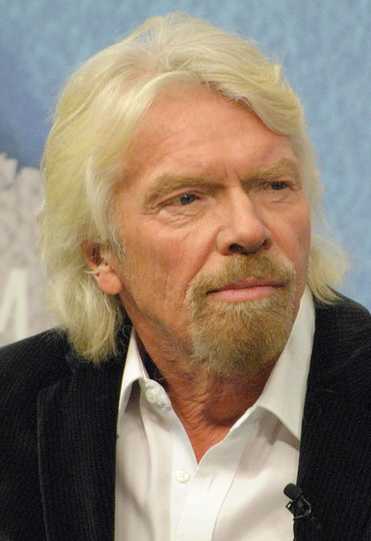
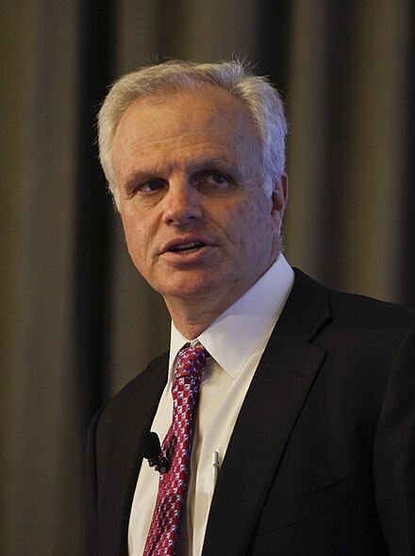
Neurodivergent Leaders
Notes:
This is exemplified by leaders like:
CLICK Richard Branson who credits his dyslexia as a ‘superpower’ that enables him to simplify complex problems and take unconventional approaches to business.
Similarly, CLICK Elon Musk’s experience on the autism spectrum has allowed him to think deeply and disregard conventional barriers, leading to groundbreaking advancements in technology.
CLICK David Neeleman, founder of JetBlue Airways, attributes his ADHD to a distinctive perspective on customer experience, which inspired the creation of an innovative, customer-focused business model.
These leaders showcase how embracing neurodivergent traits can transform challenges into powerful strengths, driving innovation and success.

Slide 16
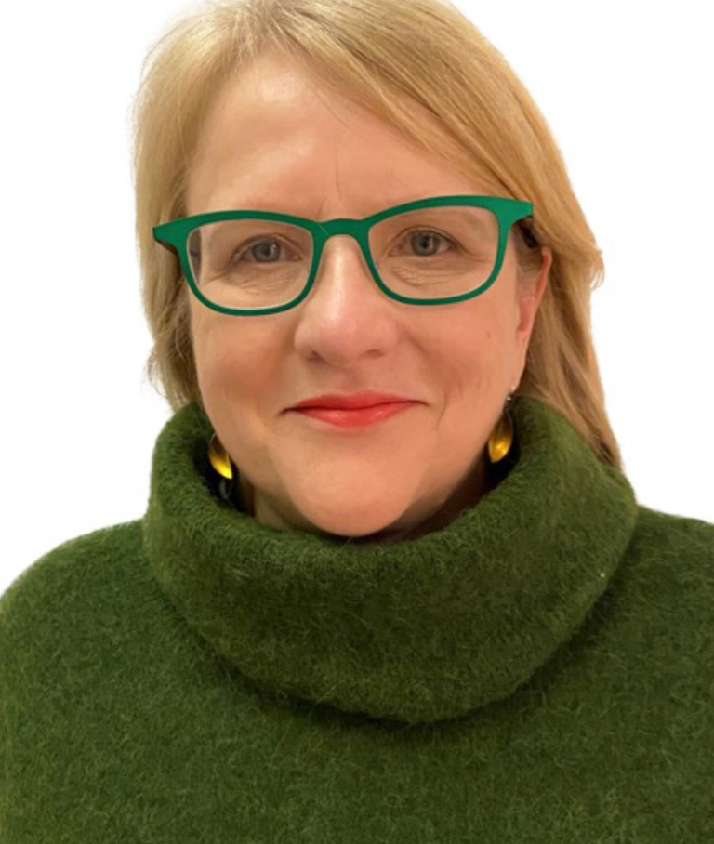
Neurodivergent Leaders in Healthcare
Notes:
But what about ND leaders in healthcare?
Though often underrepresented, pioneering voices are emerging, showcasing the powerful impact they are bringing to healthcare leadership.
CLICK Take Professor Sara Rankin at Imperial College London for instance – who is leveraging her unique perspective to tackle complex challenges in stem cell biology and regenerative medicine. She believes her neurodivergence powers her ability to see problems differently and innovate boldly.
Likewise, CLICK Dr. Nolan Stain at BartsHealth NHS Trust is advancing healthcare science by integrating wearable ECG technology into patient care—a breakthrough approach reshaping treatment pathways.
Both trailblazing leaders share a common story: transforming struggles with conventional structures into a superpower—a creative, lateral thinking approach that is now driving groundbreaking advancements in healthcare.

Slide 17
Typical leadership
Typical
leadership
Leadership style
Communication: Linear and explicit
Problem Solving: Solution focused, Analytical, Structured
Social Dynamics: Empathy through social norms
Risk Taking: Adhere to traditional models
Neurodivergent leadership
Notes:
Now, let’s explore an important comparison: typical leadership styles versus neurodivergent leadership.
Neurotypical leaders often excel in structured, linear communication and use traditional approaches to problem-solving that emphasize analytical thinking and established frameworks.
They are skilled in delegation and managing social dynamics, often navigating these through familiar norms of empathy and balanced risk-taking.

Slide 18
Neurodivergent leadership
Typical
leadership
Leadership style
Communication: Divergent and Conceptual
Problem Solving: Creative, Pattern-oriented, Holistic
Social Dynamics: Empathy through direct experiences
Risk Taking: Sees opportunities others consider too uncertain
Neurodivergent leadership
Notes:
In contrast, neurodivergent leaders often approach problems intuitively, bringing fresh perspectives that challenge conventional methods.
For some of us, our pattern-oriented problem-solving allows us to see opportunities where others perceive uncertainty, while our empathy is rooted in direct experiences.
Our ability to hyper-focus, think creatively and adapt during crises enables us to navigate complexities with agility, leading to transformative outcomes—especially in fields like healthcare, where innovation and forward-thinking are crucial.

Slide 19
Neurodiverse Leadership
Typical
leadership
Neuro-inclusive Leadership
Neurodivergent leadership
Notes:
We might therefore think of neurotypical leaders as taking a
CLICK chess like approach to leadership, utilizing methodical strategies and making calculated, incremental moves.
In contrast, neurodivergent leaders might approach challenges more like a
CLICK jigsaw puzzle, creatively piecing together complex scenarios for a clearer big picture.
Now, imagine the impact when you combine both approaches—
CLICK
When your leadership team is a mosaic of diverse cognitive styles, the impact can be transformational.
Research suggests that integrating neurodiversity into leadership teams helps organisations access untapped potential.
This is not just about ethics or diversity, which is important; but it’s also about harnessing the substantial advantages that diverse cognitive styles bring to the table.

Slide 20
02
Innovation & Creativity
Neuro-inclusive Leadership
Strengths
Impact
Pattern recognition
Lateral thinking
Unconventional thinking
Strategic thinking
Creative problem solving
Seeing connections others miss
Hyper-focus
Systematic
Empathy
Understanding individual team member needs
Aligning actions with values
Not conforming to typical personas
.
Fresh perspectives to challenges
Avoid groupthink
Drive breakthrough innovations
Inspire creative thinking in teams
Create inclusive, supportive environments
Boosts morale and collaboration
Create a culture of trust and openness
Encourage others to bring full selves to work
Build systems and processes that are efficient and scalable in finding root causes
Organisational resilience
.
03
Emotional intelligence & Empathy
04
Systemic & Detail-oriented thinking
05
Authentic Leadership
Notes:
When we shift from focusing on individual challenges to recognizing and supporting the
CLICK strengths of neurodivergent leaders, the
CLICK impact is powerful.
These leaders bring authenticity, fostering trust and creating an inclusive culture where team members feel safe to be themselves.
Their unique perspectives encourage diverse thinking and innovation, empowering teams to explore new ideas and take calculated risks.
Many neurodivergent leaders also excel in agility and adaptability, thriving in complex environments.
This enables their teams to respond quickly to change, enhancing focus, productivity, and clarity of expectations.
In essence, a neuro-inclusive leadership team creates a ripple effect that strengthens the organisation, making it more resilient and prepared for the future, particularly in fast-paced fields like healthcare.

Slide 21
Neurodiversity Leadership Model
Impact on:
Leaders
Teams
Patients
Organisation
System
Neurodivergent Strengths
Neurodiverse
Leadership
Enabling conditions
Notes:
So, we bring it all together in this Neurodiversity Leadership Model.
CLICK By tapping into neurodivergent strengths, we gain access to diverse perspectives that complement typical leadership traits.
CLICK This neurodiverse leadership approach not only enhances outcomes but creates a
CLICK positive impact for all leaders, teams, patients, organisation and the system.
However, the missing piece is the 'how.'
To truly realize this model’s potential, we must
CLICK create enabling conditions.
This means developing environments that are equipped to harness the strengths of neurodivergent individuals.
Only then can we empower neurodivergent talent to thrive in leadership roles, paving the way for a more dynamic and resilient organisation.

Slide 22
Enabling Conditions
TOWARDS
NEURO
INCLUSION
INCLUSIVE RECRUITMENT
&
LEADERSHIP
DEVELOPMENT
INCLUSIVE POLICIES
&
PROCEDURES
UNIVERSAL DESIGN
&
FLEXIBLE WORK
ENVIRONMENTS
CULTURE
OF
PSYCHOLOGICAL
SAFETY
Notes:
When the conditions are right, neurodivergent leaders will thrive.
So, how can we create environments where neurodivergent leaders thrive?
Here are four critical areas:
CLICK CLICK CLICK CLICK

Slide 23
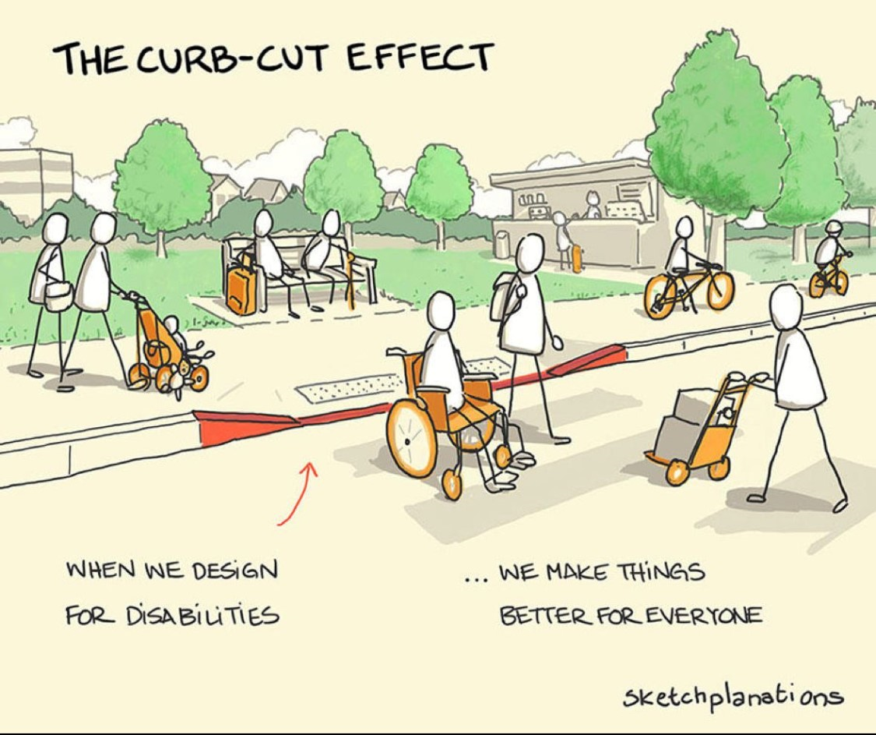
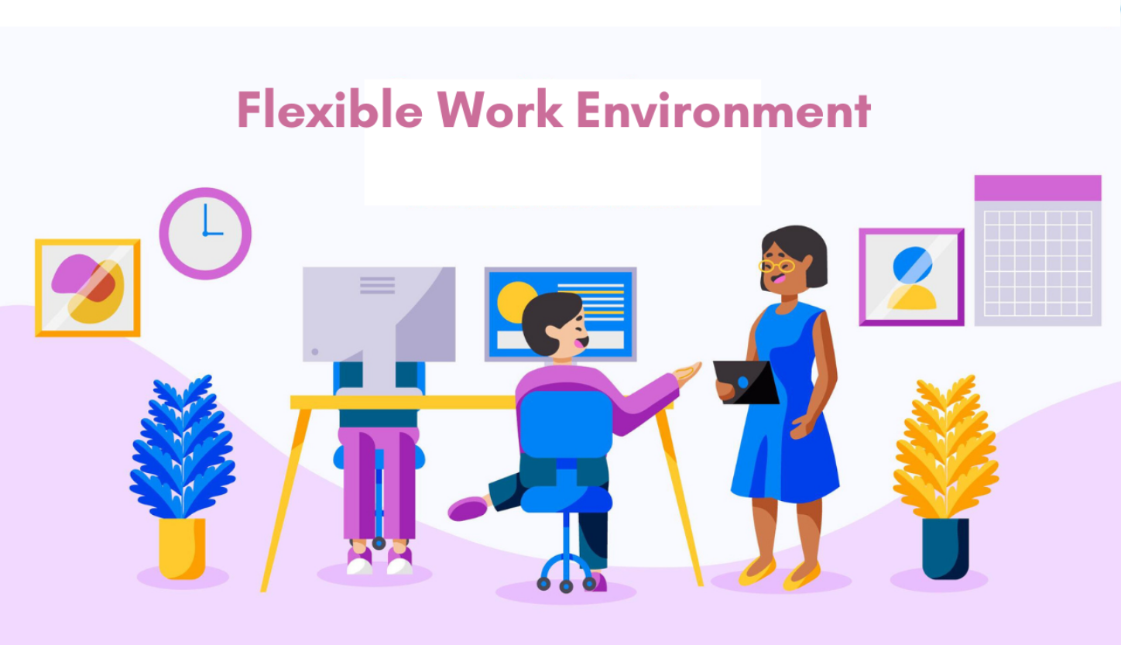
Enabling Conditions
CULTURE
OF
PSYCHOLOGICAL
SAFETY
Quiet areas
Soft lighting
Collaborative spaces
TOWARDS
NEURO
INCLUSION
Remote working
Flexible rotations
Customised workspaces
INCLUSIVE RECRUITMENT
&
LEADERSHIP
DEVELOPMENT
PERSON
CENTRED
APPROACH
UNIVERSAL DESIGN
&
FLEXIBLE
ENVIRONMENTS
INCLUSIVE POLICIES
&
PROCEDURES
Notes:
Let’s start with Universal Design and Flexible Work Environments.
Universal Design benefits everyone.
Consider the
CLICK Curb-Cut Effect: curb ramps were created for wheelchair users but help parents with strollers, delivery workers, and more.
Similarly, neuro-inclusive design improves workplaces for all.
For instance:
CLICK Quiet zones in break rooms allow everyone to recharge in a low-stimulation setting.
CLICK Soft lighting in administrative areas reduces sensory strain.
CLICK Collaborative spaces enhance shared productivity.
Flexible Work Environments are also key.
This includes:
CLICK Remote work options for focus-intensive tasks to enhance productivity.
CLICK Flexible rotations and shift exchanges to accommodate personal schedules.
CLICK Customized workspaces tailored to sensory and focus needs.

Slide 24
Enabling Conditions
Remote working
Flexible rotations
Customised workspaces
CULTURE
OF
PSYCHOLOGICAL
SAFETY
Inclusive assessments
Questions in advance
Sensory adjustments
Break during interview
Extra processing time
TOWARDS
NEURO
INCLUSION
Quiet areas
Soft lighting
Collaborative spaces
Communication
Learning
Management styles
Mentorship
Tailored pathways
INCLUSIVE RECRUITMENT
&
LEADERSHIP
DEVELOPMENT
PERSON
CENTRED
APPROACH
UNIVERSAL DESIGN
&
FLEXIBLE
ENVIRONMENTS
INCLUSIVE POLICIES
&
PROCEDURES
Notes:
Inclusive Recruitment & Leadership Development
CLICK Traditional interviews often emphasize social norms that can disadvantage neurodivergent candidates.
To foster inclusivity and allow candidates to showcase their true capabilities, consider these adjustments:
CLICK Neuro-inclusive assessments focused on individual strengths.
And neuro-inclusive interview formats create equity of opportunity, such as
CLICK Providing interview questions in advance
CLICK Sensory adjustments like reducing noise or adjusting lighting.
CLICK Breaks and
CLICK Extra processing time during interviews to accommodate varied cognitive processing speeds.
Leadership Development Programs should also reflect neurodiversity by embracing varied:
CLICK Communication
CLICK Learning and
CLICK Management styles with flexible training, like self-paced modules or one-on-one coaching.
CLICK Mentorship programs pairing neurodivergent leaders with experienced mentors for mutual learning and growth.
CLICK Tailored Leadership Pathways that harness neurodivergent strengths, offering diverse leadership roles.

Slide 25
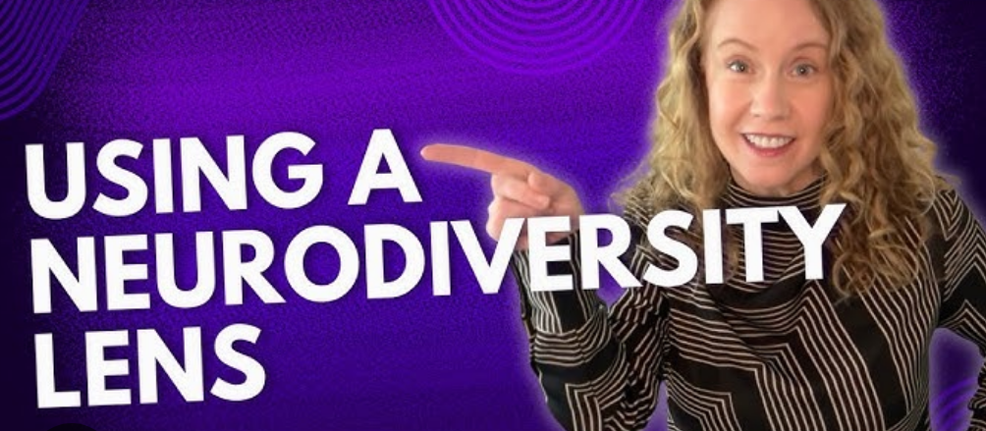
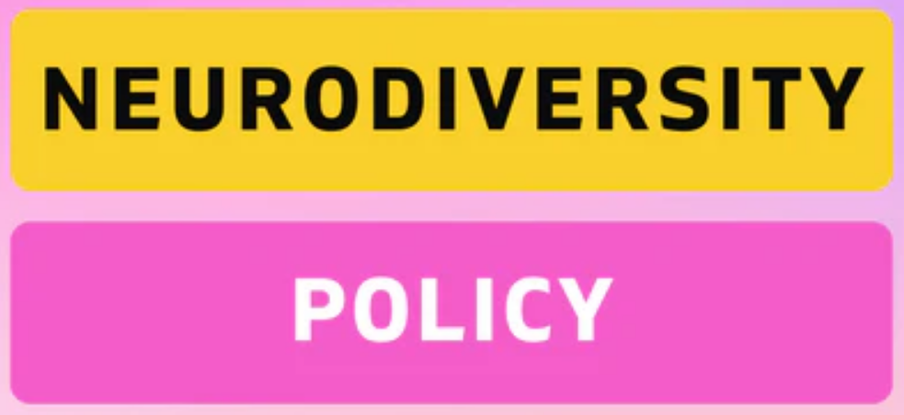
Enabling Conditions
Inclusive assessments
Questions in advance
Sensory adjustments
Break during interview
Extra processing time
Remote working
Flexible rotations
Customised workspaces
CULTURE
OF
PSYCHOLOGICAL
SAFETY
Adaptable
Flexible frameworks
Appraisals
Feedback loops
Communication
Learning
Management styles
Mentorship
Tailored pathways
TOWARDS
NEURO
INCLUSION
Quiet areas
Soft lighting
Collaborative spaces
Formal framework
Reduces discrimination
Commitment
INCLUSIVE RECRUITMENT
&
LEADERSHIP
DEVELOPMENT
PERSON
CENTRED
APPROACH
INCLUSIVE POLICIES
&
PROCEDURES
UNIVERSAL DESIGN
&
FLEXIBLE
ENVIRONMENTS
Notes:
Inclusive Policies and Procedures
Review all policies through a
CLICK Neurodiversity lens and make them
CLICK Adaptable to support neurodivergent leaders in utilizing their unique skills. Also,
CLICK Flexible frameworks that are neurodiversity specific also allow for:
CLICK Neuro-inclusive appraisals that focus on individual strengths beyond conventional metrics, with
CLICK Regular, clear feedback loops to ensure constructive growth and progress.
If there isn’t a
CLICK Neurodiversity Policy, create one. This provides:
CLICK A formal framework to
CLICK Reduce discrimination and foster inclusion.
It also signals a clear
CLICK commitment to neurodiversity at all levels, enhancing support and understanding across the organization.

Slide 26
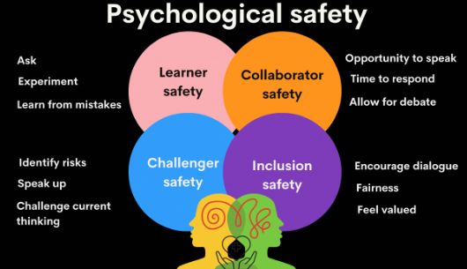
Enabling Conditions
Inclusive assessments
Questions in advance
Sensory adjustments
Break during interview
Extra processing time
Neuro-inclusion
Flexible frameworks
Appraisals
Feedback loops
Remote working
Flexible rotations
Customised workspaces
Express themselves
No fear of judgement
Seek support
Builds trust
Formal framework
Reduces discrimination
Commitment
Communication
Learning
Management styles
Mentorship
Tailored pathways
TOWARDS
NEURO
INCLUSION
Quiet areas
Soft lighting
Collaborative spaces
Embed values
Appreciation
Inclusive workplace
Sense of belonging
INCLUSIVE RECRUITMENT
&
LEADERSHIP
DEVELOPMENT
PERSON
CENTRED
APPROACH
CULTURE
OF
PSYCHOLOGICAL
SAFETY
UNIVERSAL DESIGN
&
FLEXIBLE
ENVIRONMENTS
INCLUSIVE POLICIES
&
PROCEDURES
Notes:
Building a Culture of Psychological Safety
Psychological safety allows neurodivergent leaders to
CLICK Express themselves freely, without
CLICK Fear of judgment, encouraging them to share unique ideas and confidently address challenges.
Research shows that many neurodivergent individuals do not disclose their condition in the workplace.
This is primarily due to fear of existing stigma, stereotypes and unconscious biases that persist today.
Psychological safety reduces the need for self-disclosure and empowers them to
CLICK seek support without any of these concerns.
With
CLICK Trust in place, they are enabled to express their needs, enhancing their effectiveness.
CLICK Neurodiversity training for all employees is vital to
CLICK Embed these values within the culture, fostering
CLICK Appreciation for diverse thinking and creating a more
CLICK Inclusive workplace where everyone feels
CLICK a sense of belonging.

Slide 27
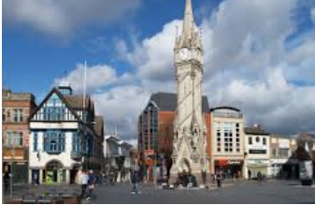
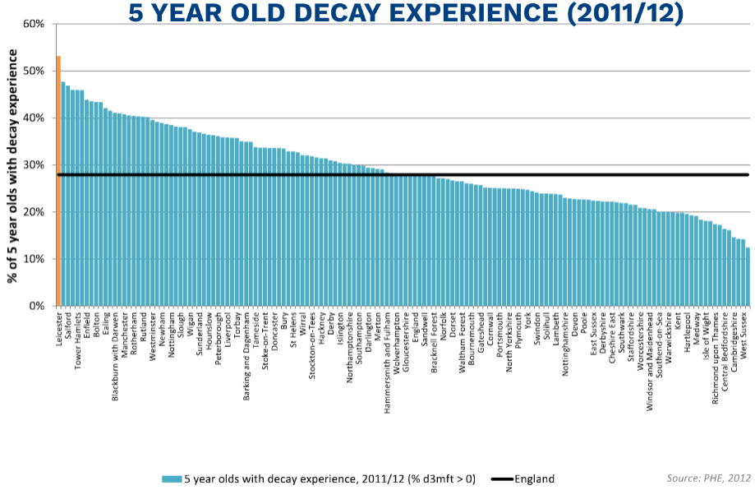
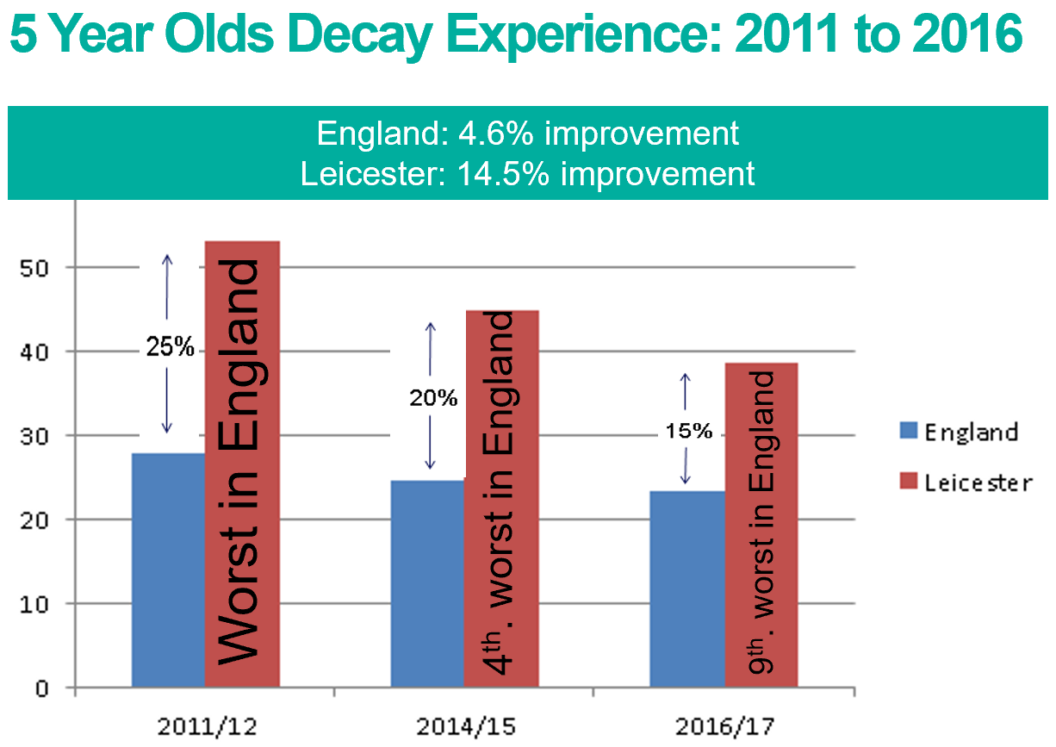
Case Study:
Transforming Oral Health in Leicester
Notes:
So, let’s bring this all together by examining a Case Study on how neurodivergent leadership transformed oral health for children in Leicester.
CLICK This is Leicester. It is a beautiful city with so much to offer. It is also one of the
CLICK most diverse cities in England, with no single ethnic group in the majority.
Yet, despite its cultural richness, Leicester faces significant challenges as one of
CICK the most deprived cities in England, with consequential poor health outcomes, including
CLICK the alarming rates of childhood tooth decay, which
CLICK stood at the highest in the nation.
Traditional approaches in addressing this issue showed no progress.
Upon my leadership appointment as an NHS Consultant, I introduced a fresh perspective to the problem.
In just two years,
CLICK Leicester experienced a remarkable turnaround.
It’s ranking improved dramatically—from the worst in the nation to the 4th worst, and later to the 9th worst.
This was more than a statistical shift; it was a public health transformation.
Our approach has since become a model for innovative, public-health-centered, and sustainable healthcare solutions that can be replicated in other communities facing similar challenges.

Slide 28
Making It Happen
Determination
Problem solving
Persistence
Creativity
Hyperfocus
Slow decision-making
Strategic thinking
Bureaucracy
Strengths
Out-of-the-box- thinking
Groupthink
Autonomy to operate
Barriers
Complexity
Conditions
Supportive leadership
Adaptable policies
Culture
Notes:
So, how did I make it happen?
Creating impact required leveraging
CLICK my key strengths and pushing boundaries:
My
CLICK Hyperfocus enabled me to deeply immerse myself in the issue, dissecting the complex interplay of factors within the system that were contributing to the problem.
CLICK Creative
CLICK Problem-Solving allowed me to design a multi-partnership strategy and implement an innovation program that broke free from conventional approaches.
CLICK Strategic,
CLICK Out-of-the-Box Thinking allowed me to challenge established norms and foster collaboration among diverse stakeholders, creating unified action.
CLICK Persistence and
CICK Determination drove me to push forward despite systemic obstacles, staying resilient through personal, professional and systemic challenges.
Overcoming
CLICK Barriers was a vital part of the journey. I navigated
CLICK bureaucratic hurdles by advocating for a flexible, adaptable approach.
CLICK Slow Decision-Making was countered with proactive leadership, accelerating critical stages of strategy and implementation.
CLICK Groupthink was tackled by promoting open dialogue and embracing diverse perspectives to break free from narrow, conventional thinking.
And simplifying the
CLICK complexity of the issue into actionable insights to gain stakeholder buy-in and build momentum.
CLICK Enabling Conditions that supported my success included:
Supportive Leadership and a
Culture open to innovation.
Adaptable Policies allowed for overcoming barriers and streamlining decision-making.
Autonomy to Operate gave me the freedom to pursue non-traditional strategies and drive effective change.
My strengths and these enabling conditions created the foundation for sustained impact, providing evidence of what’s possible when neurodivergent leadership is fully supported and embraced.

Slide 29
The Future of Neurodiverse Leadership
Notes:
And now it’s time to wrap up.
Let me leave you with this:
The world is evolving at an unprecedented pace, and the leadership models of yesterday simply cannot keep up.
The future demands something more—a broader, more inclusive approach that embraces the full spectrum of human diversity, including neurodiversity.
Tomorrow's leaders are here, many of them neurodivergent.
It’s up to us to create the foundations that will enable them to lead, inspire and innovate - not just in new ways, but in ways that will shape the very future of healthcare.
The impact of neurodiverse leadership can be transformational.
Embracing it isn’t just about equity or ticking diversity boxes; it’s about unlocking the vast, untapped potential of human talent to drive progress, solve complex problems, and create a more resilient, innovative world.
CLICK

Slide 30
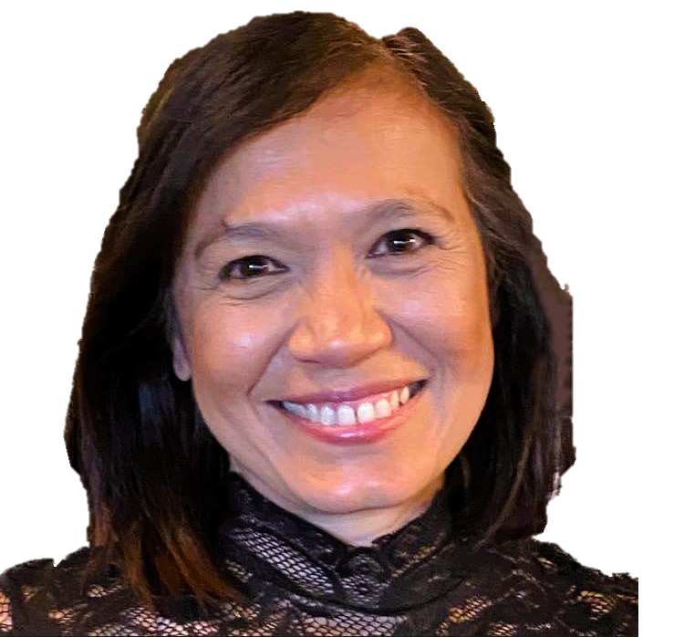
Thank You!
jasmine@thinkdivergent.co.uk
Jasmine Murphy
@MurphyJasmine99
Notes:
Thank you for listening and for your kind attention.
CLICK Please feel free to connect with me or share your thoughts — I’d love to continue the conversation.

