Slide 1
INCLUSIVE LEADERSHIP:
Some learning from the field
15th November 2024, www.brap.org.uk

Slide 2
Who we are
Equalities and human rights charity
Based in Birmingham, supporting and working with community groups for 25 years. Also, we have a national remit – focused on transforming the ‘way we think about and practice equality’
Learning & Organisational Development, Research and Evaluation, Community Development
We work with 9000+ people a year, providing learning and development support
Highly skilled team: researchers, sociologists, psychologists, teachers, mediators, process workers, OD practitioners etc.

Slide 3
Overview
Opportunity to critically reflect on inclusion
To reflect on the role of representation as a lever for inclusion
To think about the critical role that leaders play in progressing EDI

Slide 4
Audience participation
How important is representation as a means to support EDI ?
Hands up
It’s critically important – EDI won’t work without it
It can be over-rated – what you see isn’t always what you get
It can be tokenistic and is not a substitute for cultural change

Slide 5
Representation is important
Representation has become an important measure of progress for organisations – belief that offering opportunities to those previously under-represented means we are becoming fairer / more equitable
Workforce Race Equality Standard has helped NHS organisations to understand their progress and to compare themselves to others
Involving people from varied backgrounds in leadership positions will improve connection to previously underrepresented groups in the local community

Slide 6
Unintended consequences of focusing on representation in isolation…
Those who get to ‘represent’, often do so at great cost to themselves. E.g. conforming to become accepted as ‘leadership material’ – code-switching / ‘covering’ and masking difference to fit-in. Leads to negative impact on sense of self (Yoshino 2007).
When diverse individuals gain leadership positions they often do so against the odds. Belief that to lead as a diverse individual you have to be exceptional, no room for error. Held to a higher standard.
Efforts to increase diverse representation often rely on ‘deficit models’ – focus on leaders to improve / work hard, rather than notice systemic issues (e.g. access to networks) that sustain inequality.
Assumption that increasing development opportunities, mentoring, sponsorship is how to improve numbers – but we often ignore negative experiences of marginalized staff.

Slide 7
Too Hot To Handle (2024)…….
Not our intention to ‘prove’ racism
The report captures the experiences of staff ( over 1300 ) when trying to raise racism within the NHS
It brings together tribunal findings as learning for the NHS in the failings in how they respond to racism
Makes recommendations on what the NHS and others can do to be more intentional and to take racism seriously

Slide 8
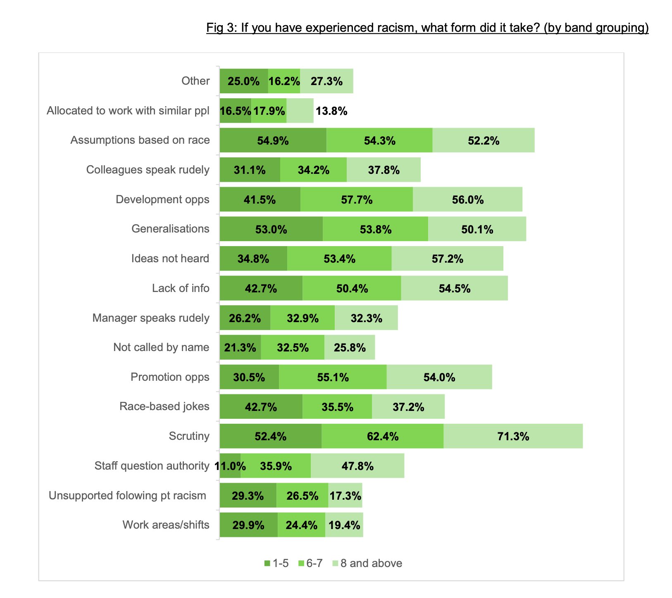

Slide 9
Take aways …
All people need to accept their part in making the change
Leaders need to be proactive and preventative –racism is here - don’t wait for individual staff to raise it
Needs to be more than policies … survey demonstrates the day to day experiences of everyday racism .. Most of which people put up with ..
Leaders need to set standards that make people accountable for everyday racism…
Leaders need to develop comfort with speaking up/ calling out and supporting others to understand and challenge racism

Slide 10
No short cut to culture change for leaders
Clarity about concepts of ‘inclusion’ and ‘representation
Belief that looks alone can create change – often miss the opportunity to address culture and support those that are systemically marginalized
Measures of progress that reflect complexity of how inequality manifests (not just representation)
Less focus on activities that seek to upskill ethnically marginalized staff but that leave the culture and systems of the organization intact
Leaders need to wrestle with root cause of inequality – privileging of particular social categories (e.g. male over female, White over Black…). Develop awareness of how beliefs about race, gender, class are hard-wired into systems. Employ anti-oppressive practice.

Slide 11
Questions?

