Slide 1
MOBILE APP & WEB PLATFORM
RESOURCE GUIDE

Slide 2
TABLE OF CONTENTS
Login, Web Platform | 3
Login, Mobile App | 4
Onboarding | 5
Edit Profile | 6
Calendar Availability | 7
Event Agenda | 8
Calendar Sync | 9
Push Notifications | 10
Browse & Filter | 11
Meetings, Requesting | 12
Meetings, Accepting | 13
Meetings, Unintentional Decline | 14
Export Contacts | 15
SPONSORS ONLY
My Team Dashboard | 16
Company Profile* | 17
Team Members* | 18
Leads* | 19
Lead Qualification* | 20
Meetings, Request for Team Members* | 21
Meetings, Accept for Team Members* | 22
Export Team Contacts* | 23

Slide 3
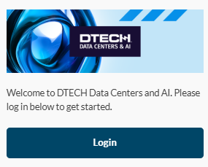
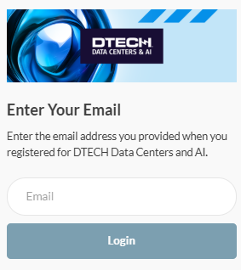
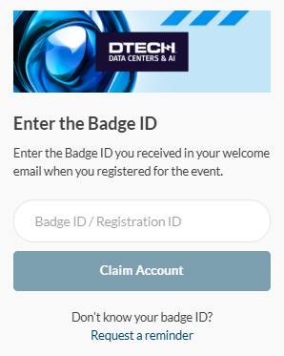
LOGIN
WEB PLATFORM
Navigate to the web platform and click “Login” to access. Your badge ID was provided to you when you initially registered for the event. If you have already logged in via the mobile app, you will just need your email address and password to access the web platform.
To reset your password, click "Request a reminder" on the login page.

Slide 4
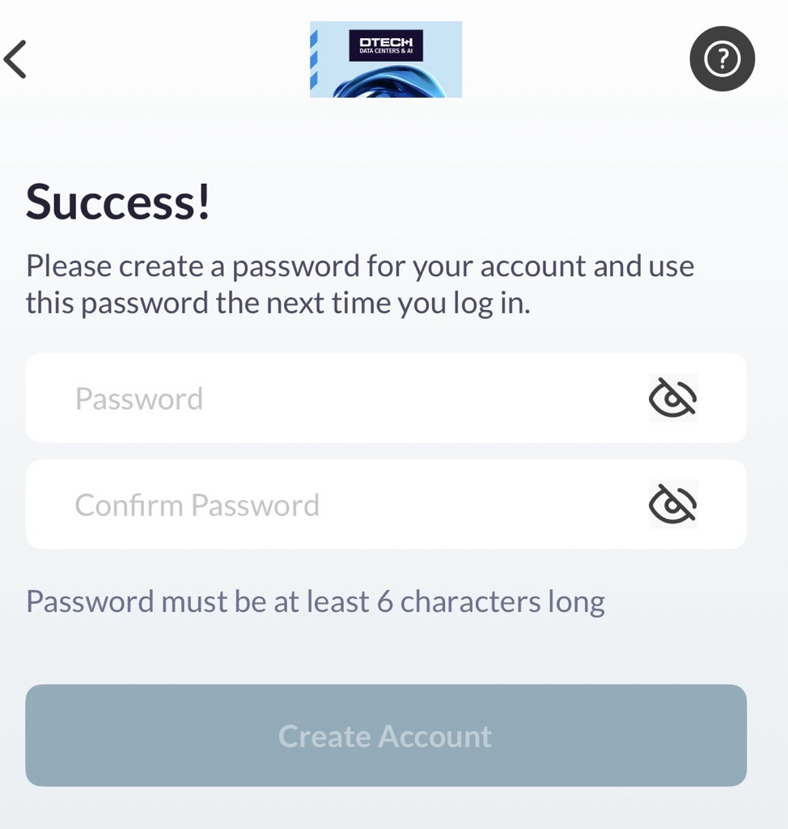
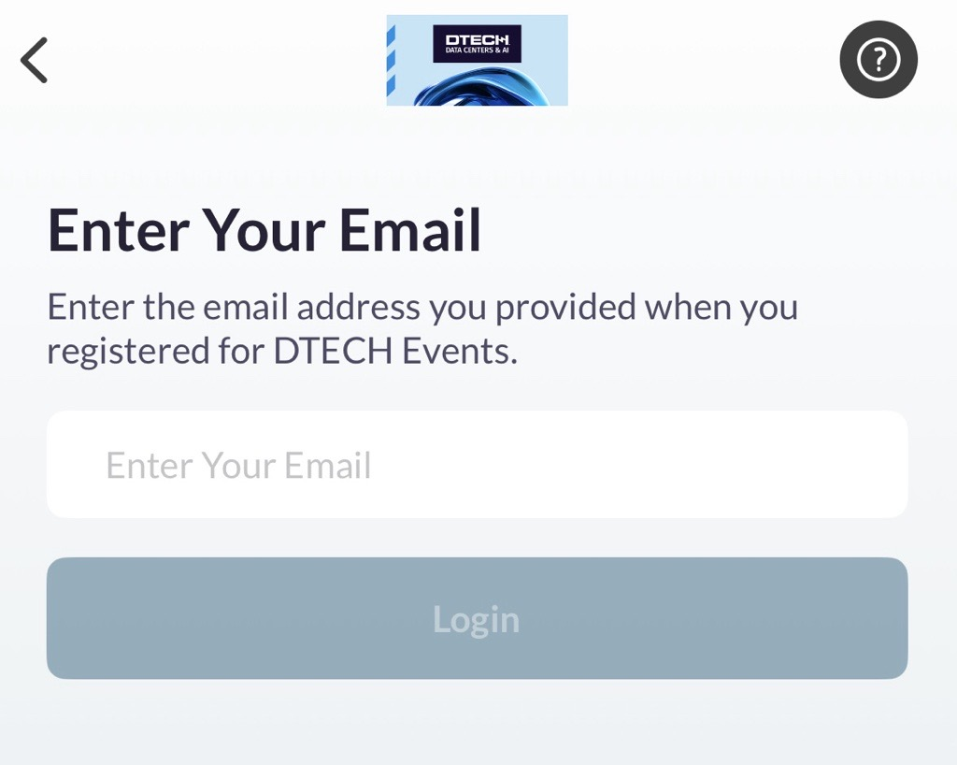
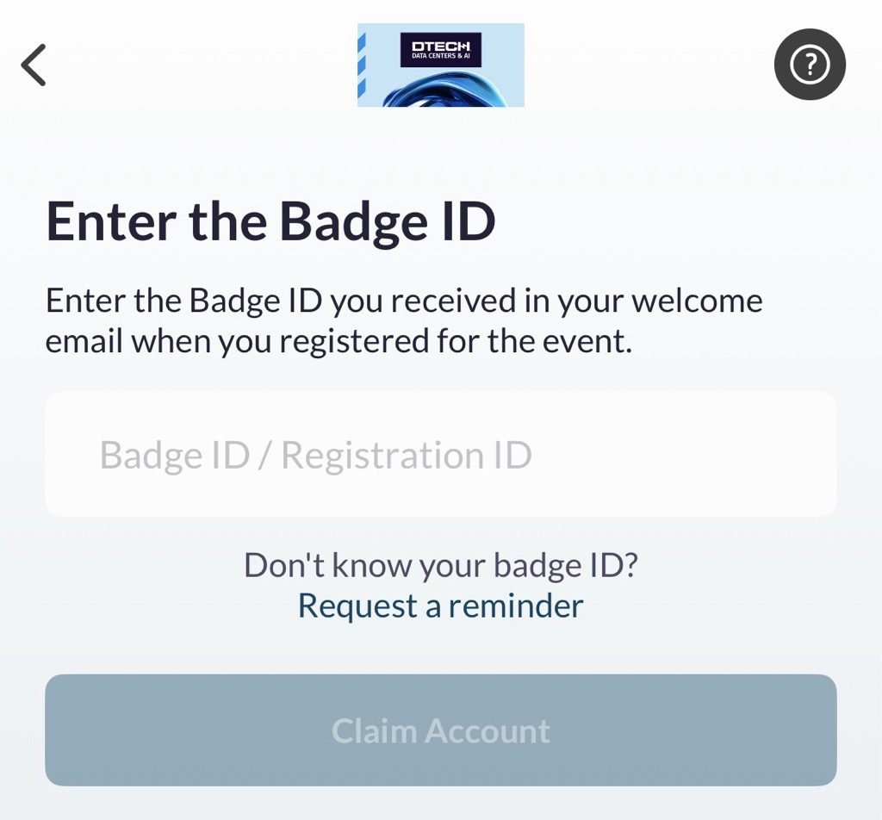
LOGIN
L O G I N
MOBILE APP
Download the mobile app from your app store, then click “Login” to access. Your badge ID was provided to you when you initially registered for the event. If you have already logged in via the web platform, you will just need your email address and password to access the mobile app. ​
To reset your password, click "Request a reminder" on the login page.

Slide 5
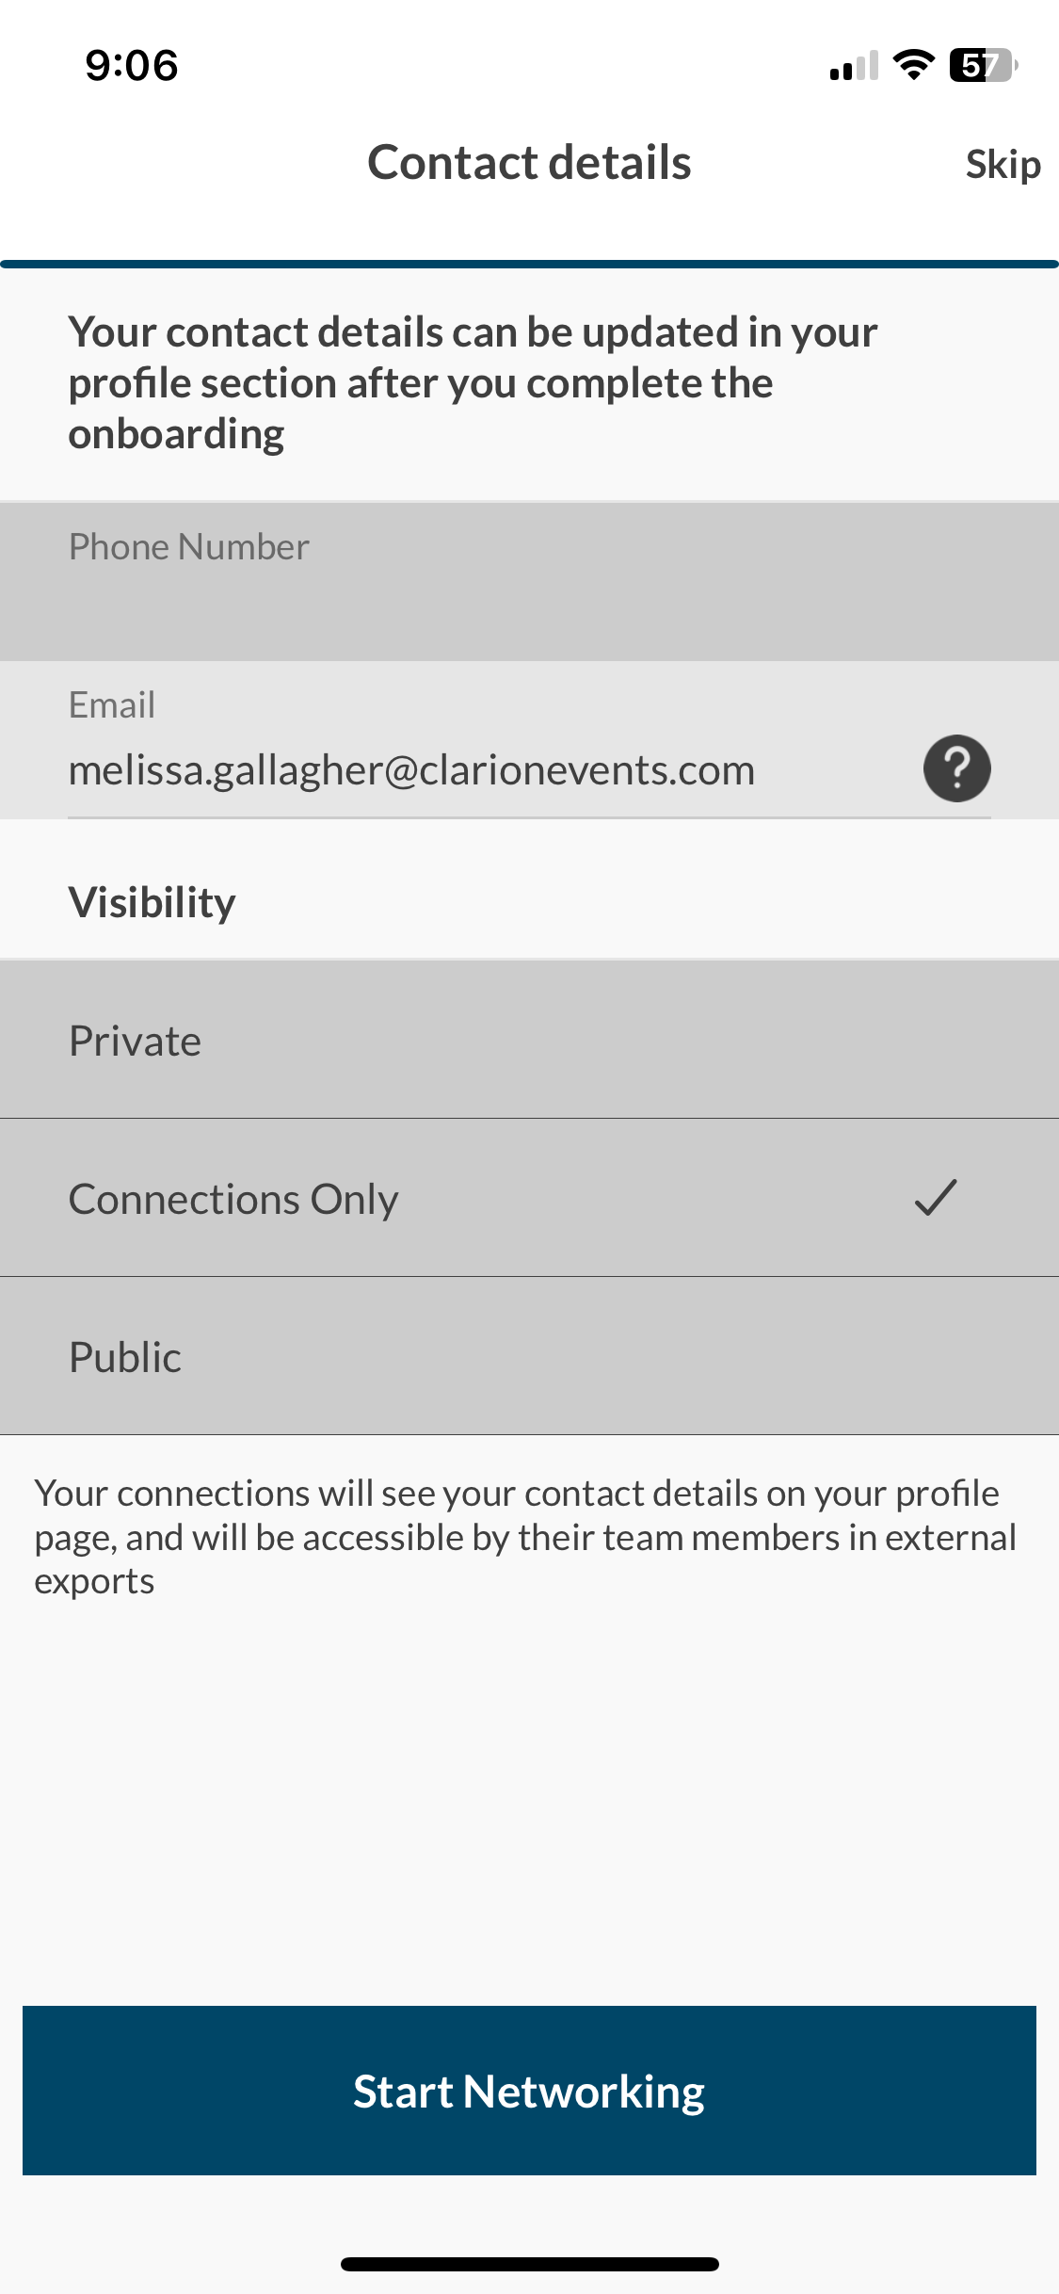
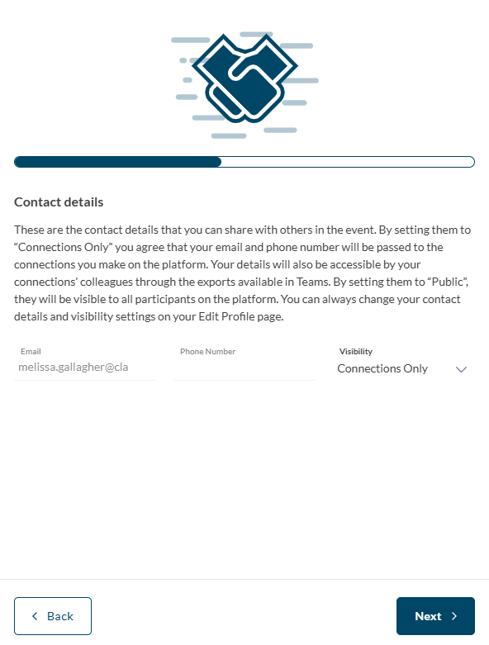
ONBOARDING
L O G I N
During onboarding, you’ll be asked to confirm your registration information. This will help recommend profiles to meet with. ​ You will also be asked to confirm how you’d like your contact information to appear in the platform. The platform will default to "Connections Only".
MOBILE APP
WEB PLATFORM
CONTACT SHARING OPTIONS
PRIVATE
No one can see your contact details
CONNECTIONS ONLY
Participants you've connected with will be able to see your contact details on your profile page, as well as in external exports from the platform
PUBLIC
Contact Details will be displayed on your profile page and available in exports for everyone at the event

Slide 6
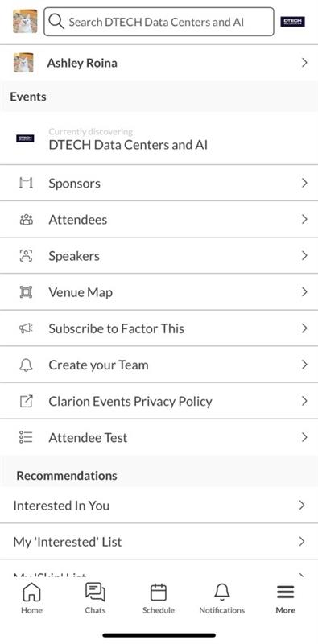
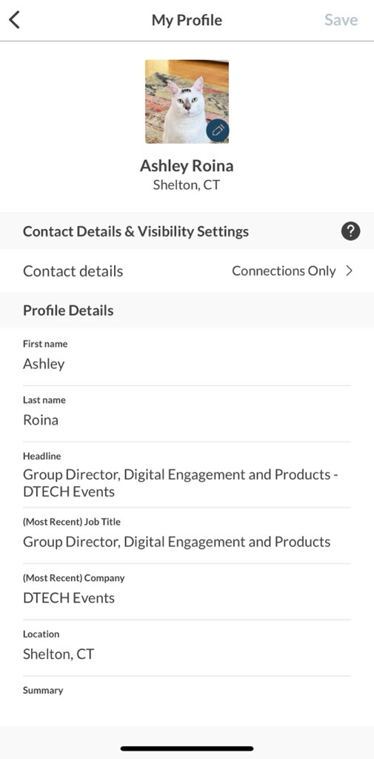
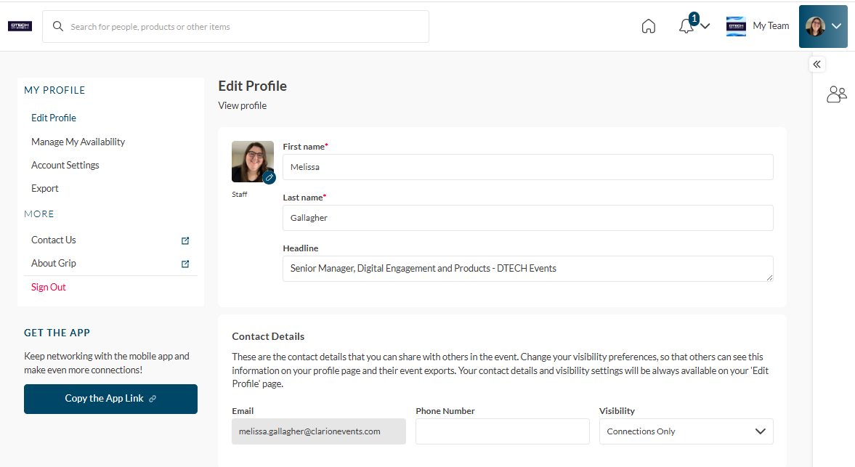
EDIT PROFILE
L O G I N
You can edit your profile at any time through both the mobile app and the web platform. ​
To edit via the web platform, click the icon at the top right of the home page. To edit via the mobile app, click the icon at the top left of the home page.
MOBILE APP
WEB PLATFORM

Slide 7
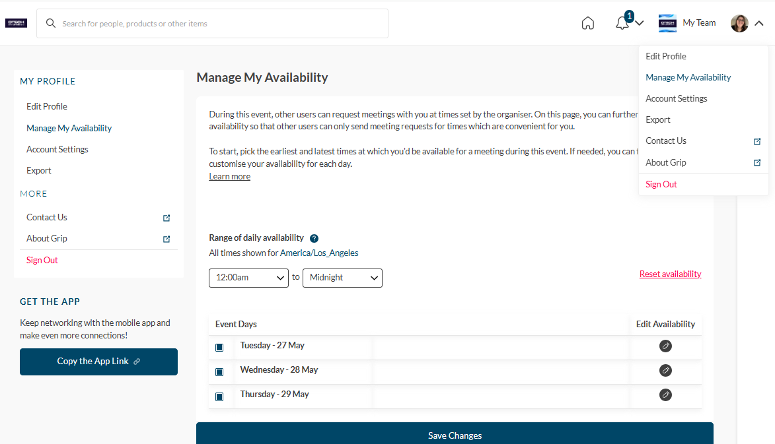
CALENDAR AVAILABILITY
L O G I N
To make yourself unavailable for meetings, either for a specific time block or day, you can manage your availability through the web platform. ​
Via the web platform, click “Profile”, “Manage My Availability”, the “Edit Availability”. Adjust the times your unavailable to meet for each day.

Slide 8
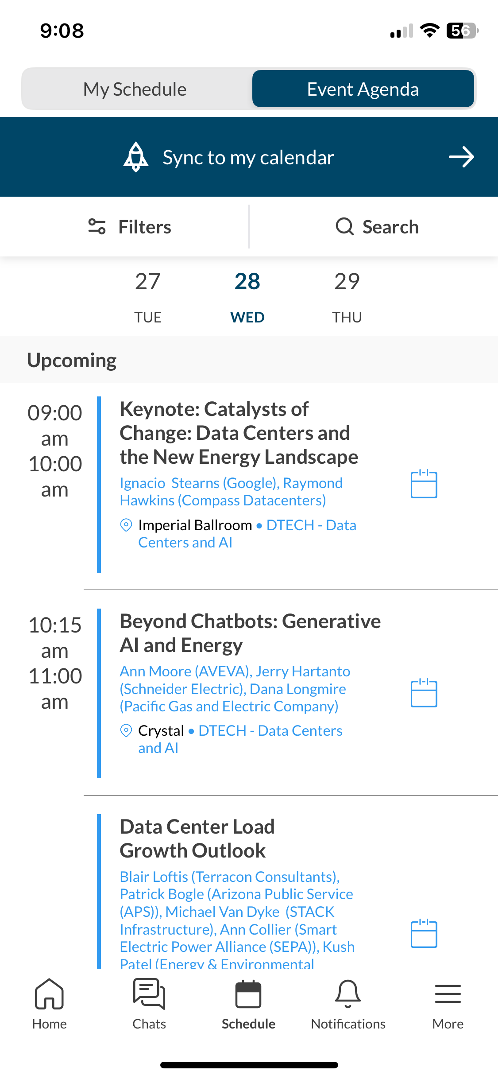
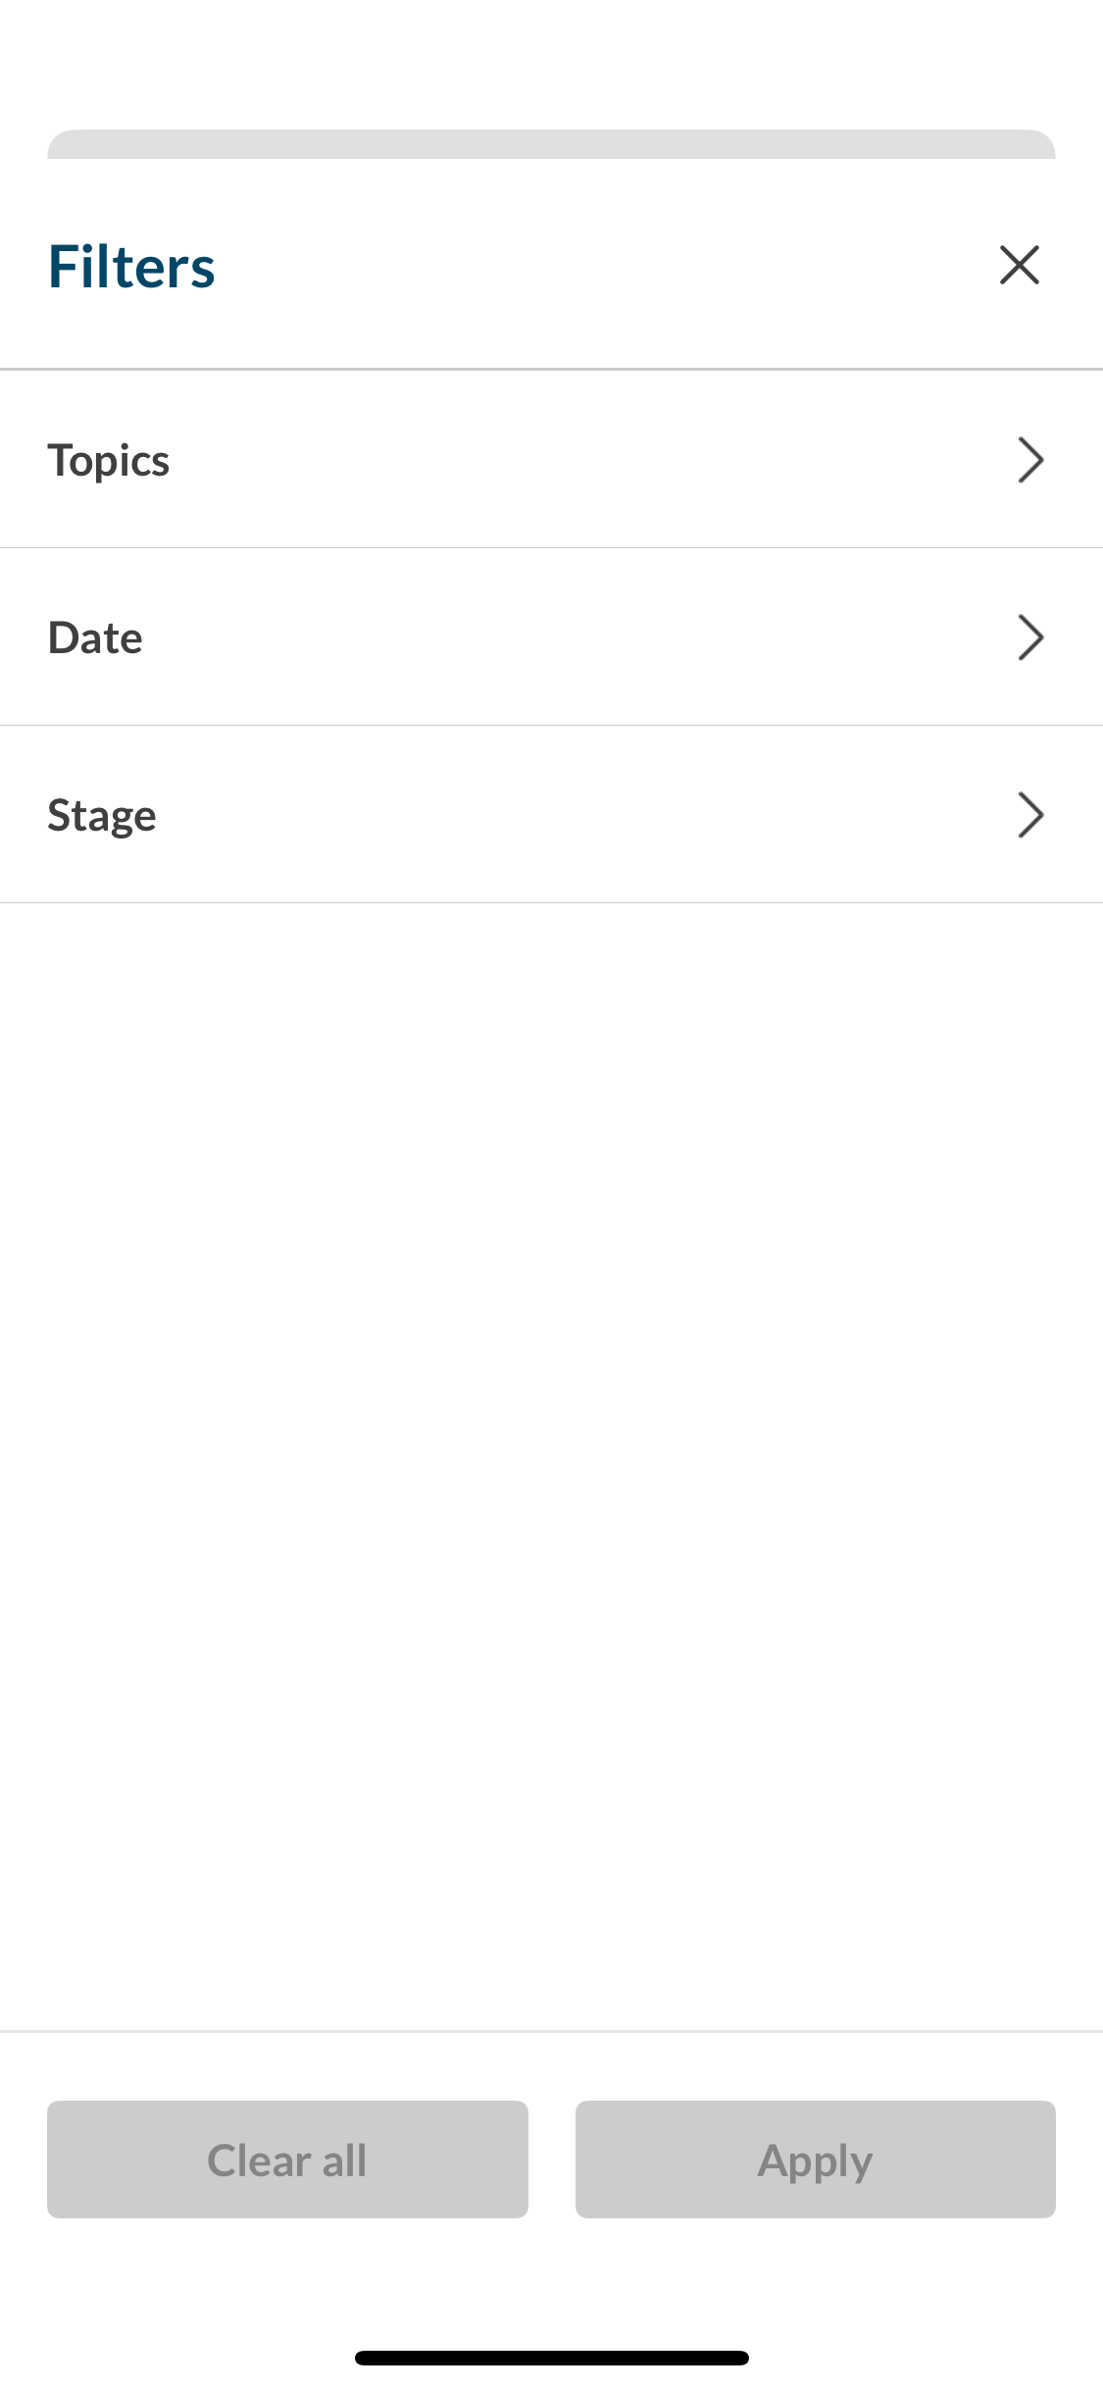
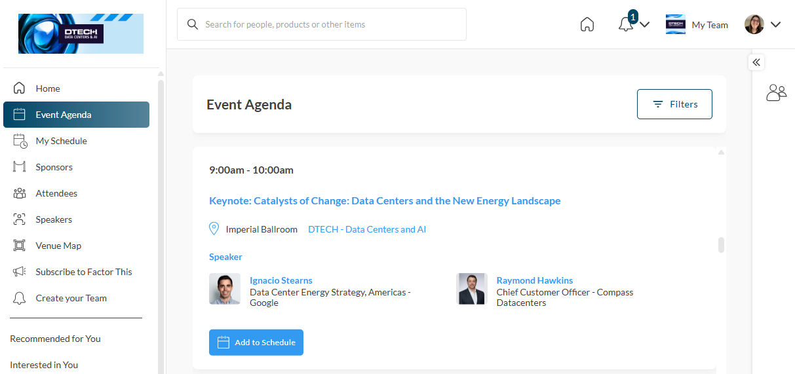
EVENT AGENDA
L O G I N
Tailor your event experience by adding sessions to your calendar. Filter the agenda by topics, location (stage), date. “Add to Schedule” or use the calendar icon to add a session to your calendar.
MOBILE APP
WEB PLATFORM
8

Slide 9
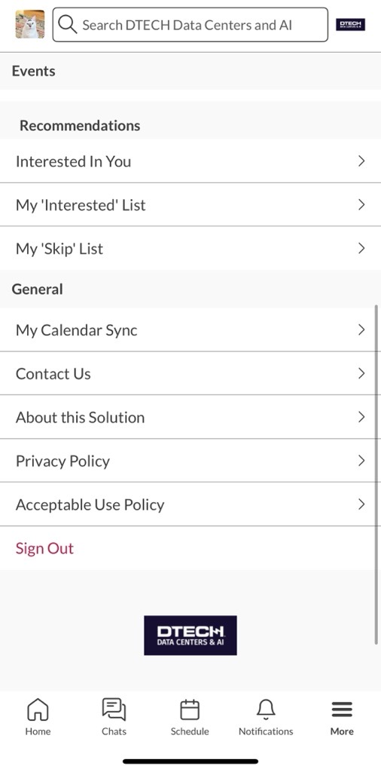
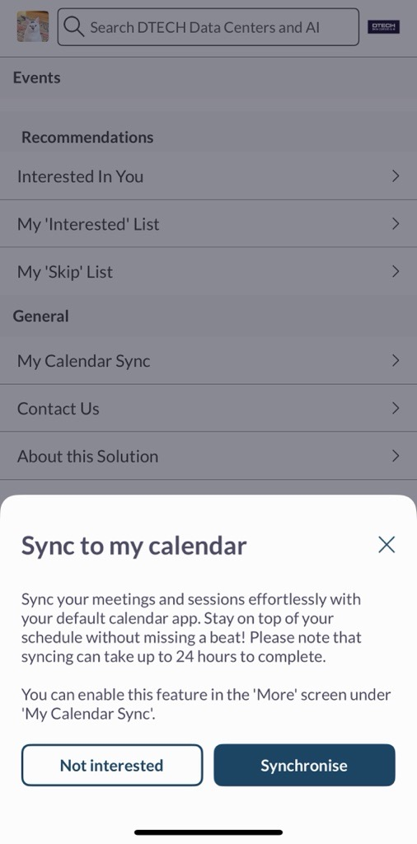
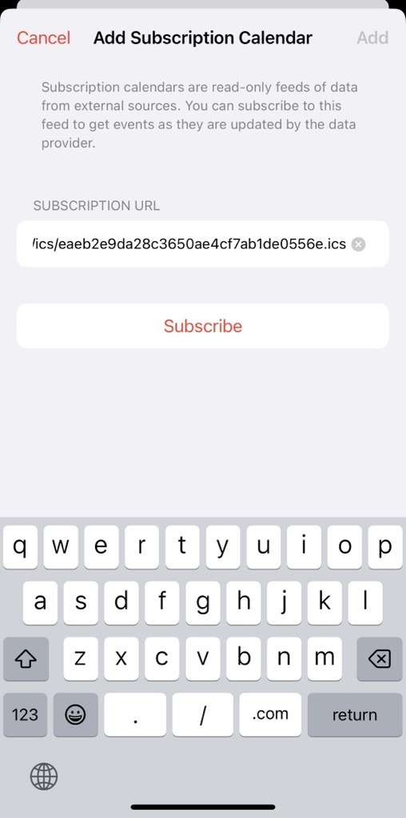
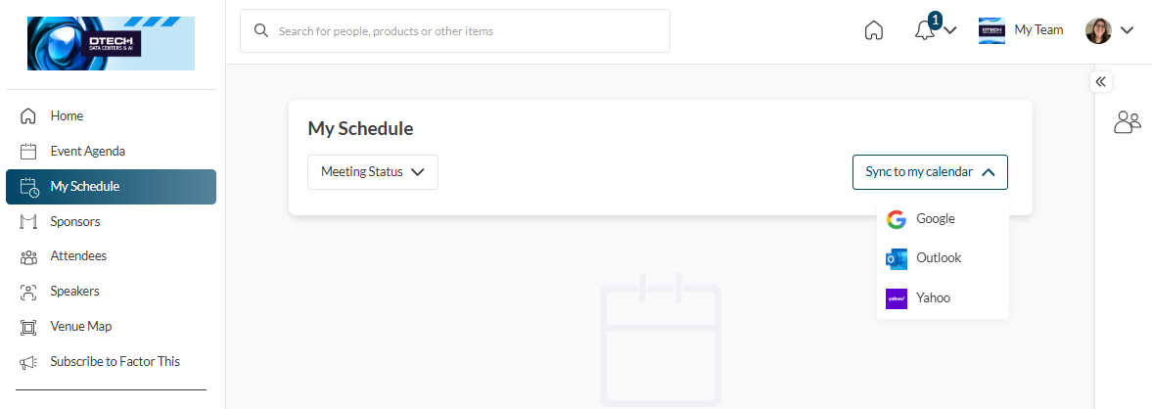
CALENDAR SYNC
C A L E N D A R S Y N C
L O G I N
Sync your calendar (confirmed meetings and registered sessions) automatically to your device. On the web platform, click “My Schedule”, then “Sync to my Calendar”. On mobile, from either the Event Agenda, or the “More” list click “My Calendar Sync”. Follow the instructions to add the Calendar to your device.
MOBILE APP
WEB PLATFORM

Slide 10
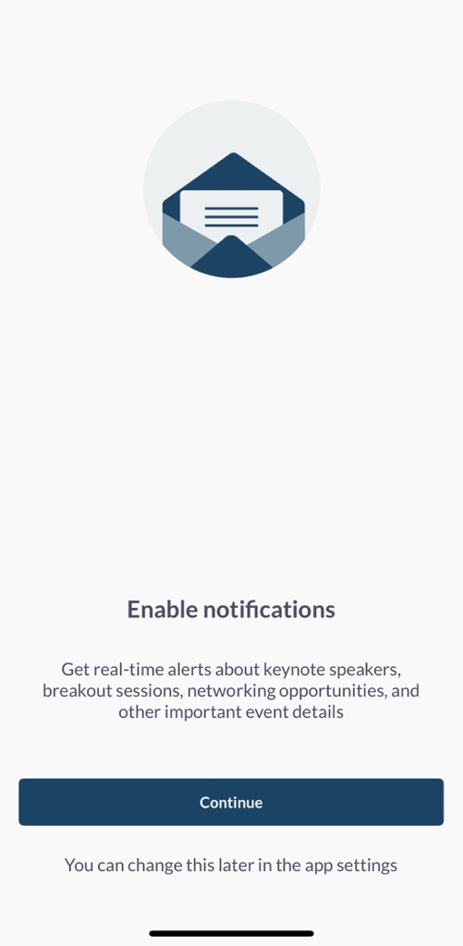
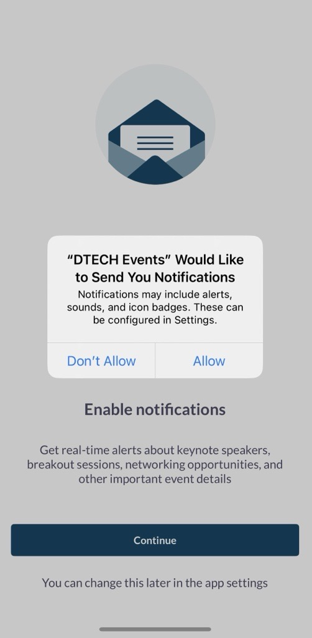
PUSH NOTIFICATIONS
Stay informed while at the show by enabling push notifications to your device. Using the mobile app, click "Notifications" at the bottom, then "Turn on Notifications". A box will pop-up asking you to "Allow" notifications on your device.

Slide 11
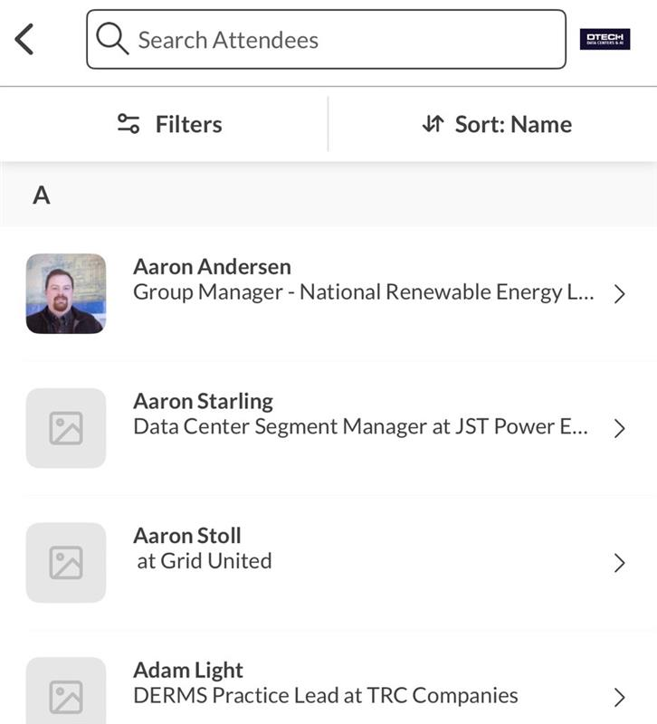
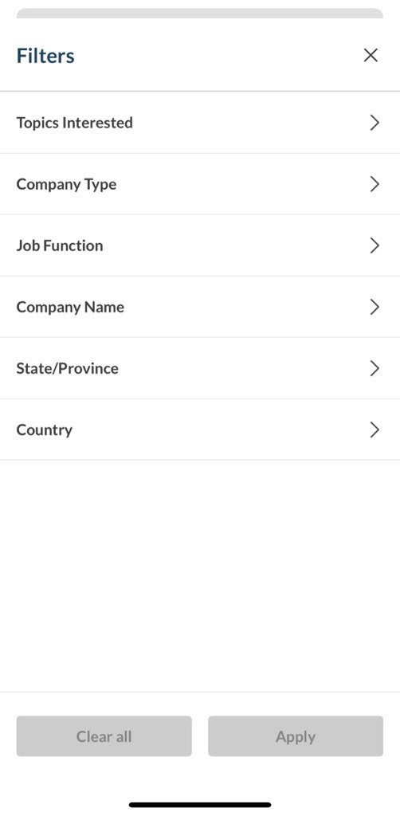
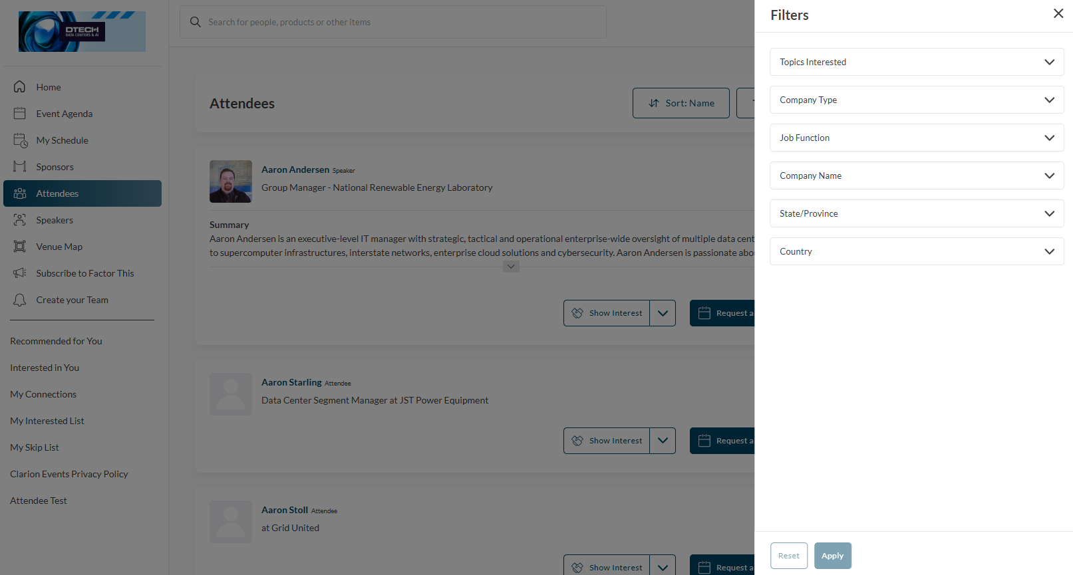
BROWSE & FILTER
BROWSE & FILTER
To browse for people or companies to connect with, you can click any list from the home page ("Attendees", "Sponsors", etc.) and filter the list. Check "Recommended for You" often to see the names the recommendations from the platform (the more actions you take the in the platform, the more tailored the recommendations will be!).
MOBILE APP
WEB PLATFORM

Slide 12
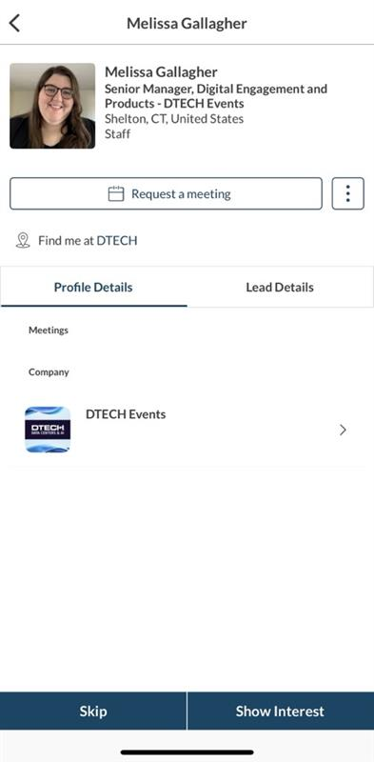
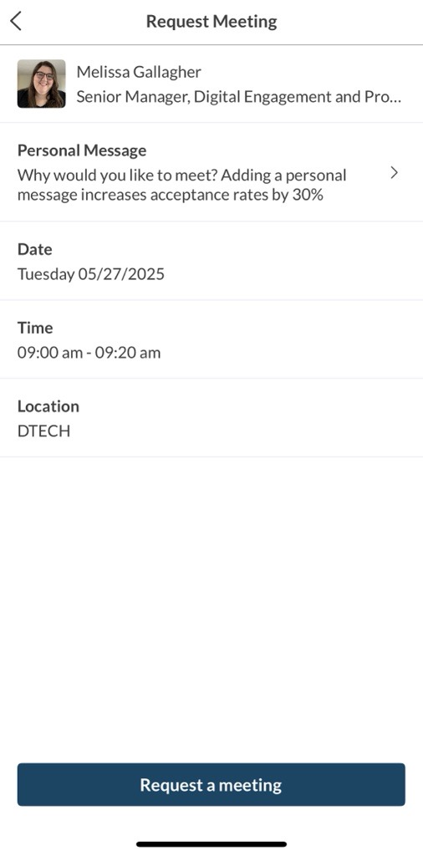
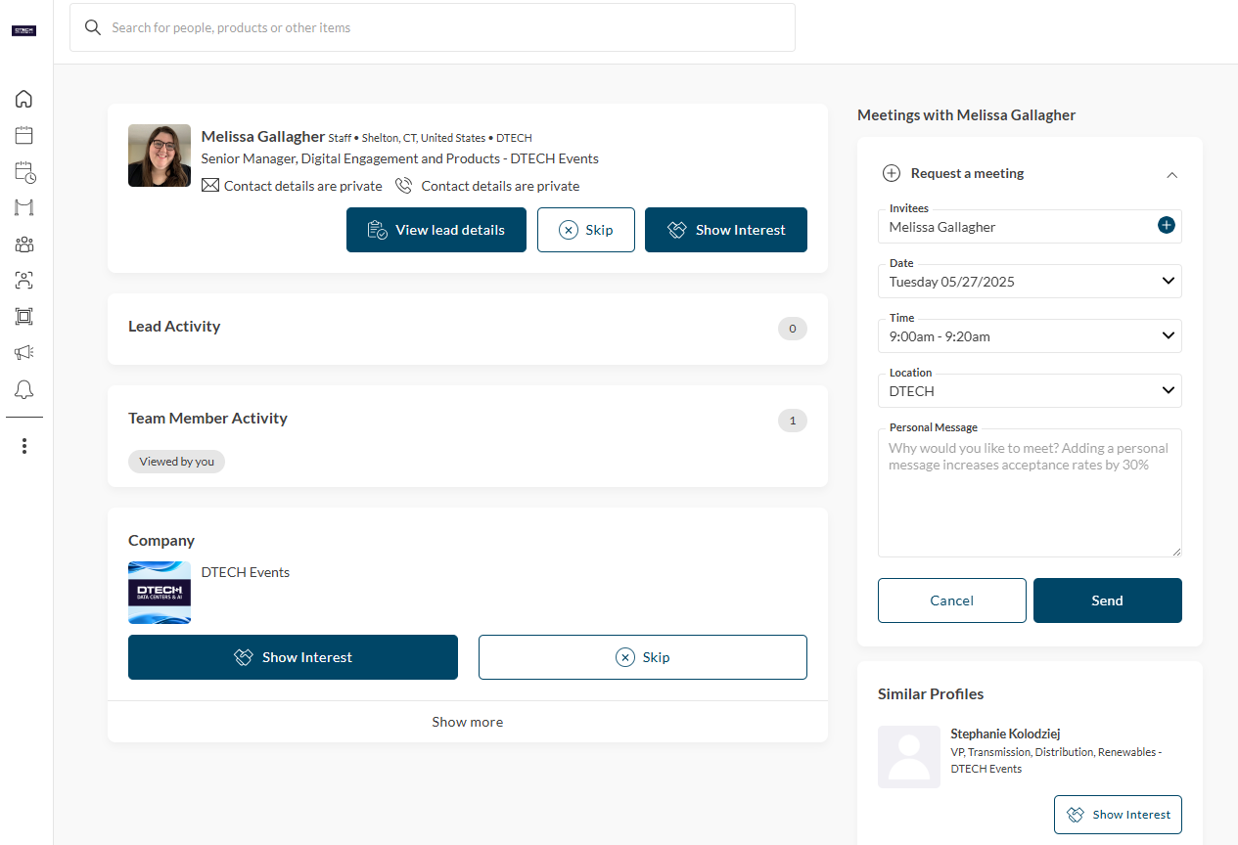
MEETINGS
REQUESTING
Once you find someone you would like to meet with, click “Request Meeting” next to their name. Add the date/time and location, as well as a personal message, then click “Request Meeting”. They will receive an email/push notification that they received a meeting request. Once a meeting is confirmed, you will receive a notification.
MOBILE APP
WEB PLATFORM

Slide 13
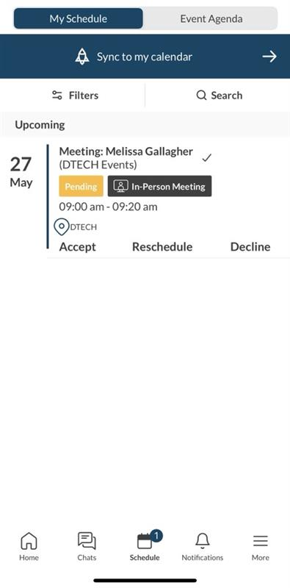
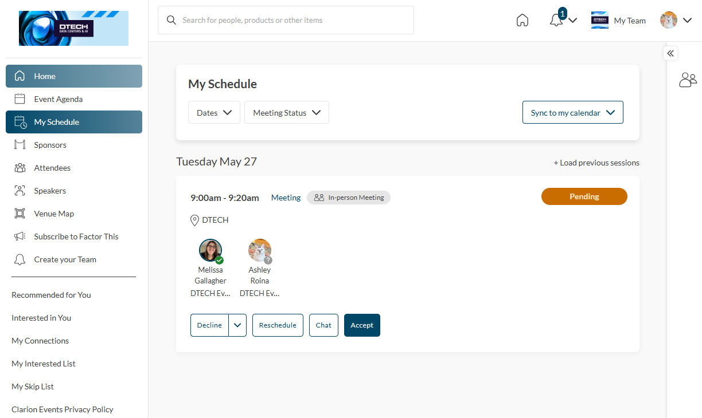
MEETINGS
ACCEPTING
If someone sends you a meeting request, you will receive an email/push notification with the meeting details. You can confirm via the “Accept Meeting” in the email or via the app. To filter your full list of meetings, click “My Schedule”, then “Meeting Status” or "Filter" to filter on pending meetings.
MOBILE APP
WEB PLATFORM

Slide 14
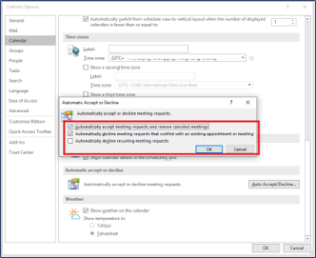
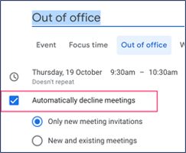
MEETINGS
UNINTENTIONAL DECLINE
If you are finding that your meetings are auto-declining, it may be your Out of Office. Some calendars include the option to auto-decline meetings while an Out of Office is enabled. Make sure this is turned off, or your meetings scheduled through the mobile app will be declined.
OUTLOOK
GOOGLE

Slide 15
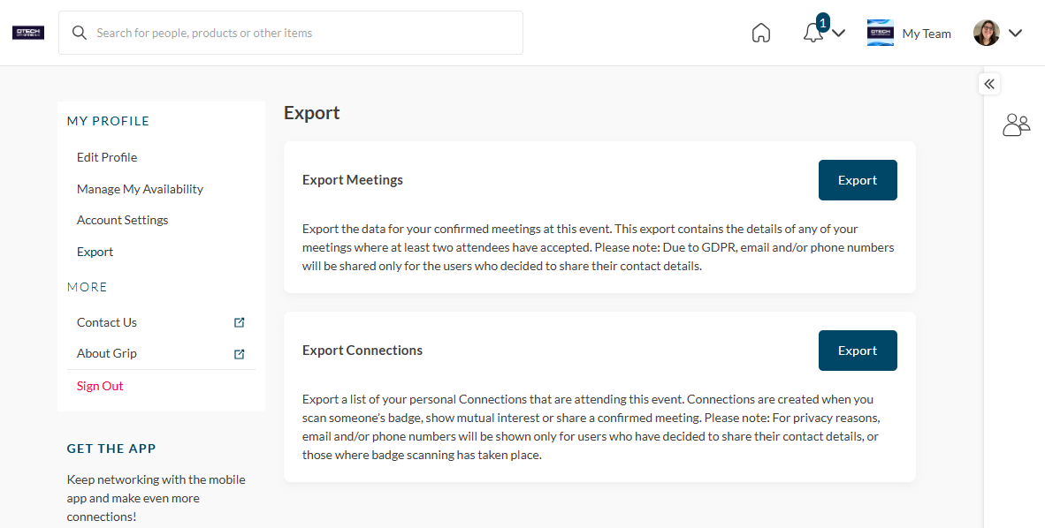
EXPORT CONTACTS
From the web platform, you can export a list of all your connections – anyone you’ve connected with through the platform or had a meeting with - into an .csv file by going to “Edit Profile” then “Export. ​
Due to GDPR email and/or phone numbers will be shared only for the users who decided to share their contact details.
NOTE: Sponsors, or anyone tied to a “Team”, can download the connections from everyone on their team. Learn more on how to download the connections from your team under the “Export” tab in your Teams Dashboard.

Slide 16
MY TEAM DASHBOARD
SPONSORS ONLY
As a Sponsor, you and your team have access to the “Teams” dashboard, only accessible via the web platform (top-right). From here, you can edit your company profile, manage meetings for your team members, view your Inbound Leads, and export the contacts for your entire team. ​
The first person to sign in via the web platform will create your team and become the admin for the team. ​
​
For issues or questions on creating your team, please contact: mobileapps@clarionevents.com, and we will be happy to help!

Slide 17
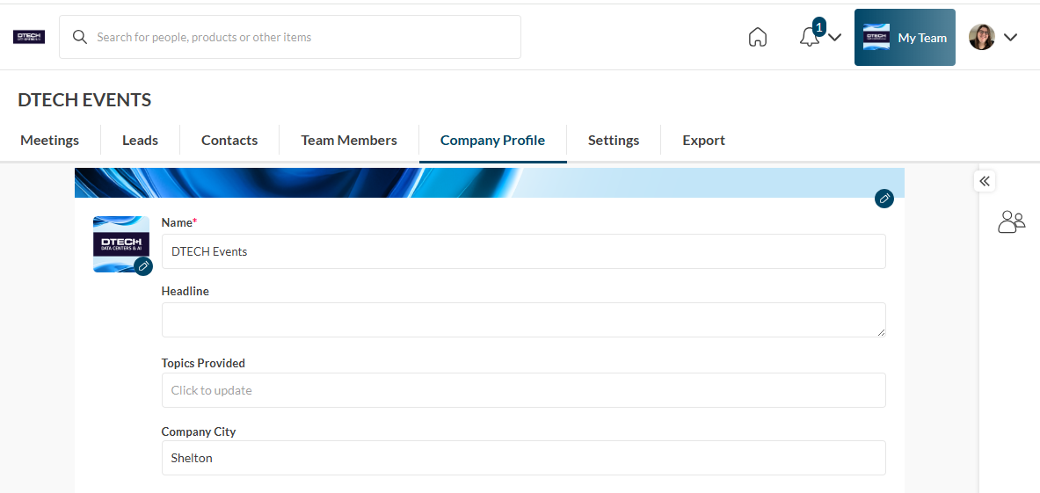
EDIT COMPANY PROFILE*
C O M P A N Y P R O F I L E *
In “My Team”, click “Company Profile” to edit your company profile with Topics, Company Description, Logo, etc. Ensuring your profile is filled out completely will help event participants when searching and filtering the Sponsor list. Once complete, click “Update Profile” at the bottom of the page. View our Sponsor Checklist to see what we recommend adding to your company profile.
NOTE: Cover photos may be added, however they will only appear on the web platform. Specs: 1476 x 634 px, 500kb

Slide 18
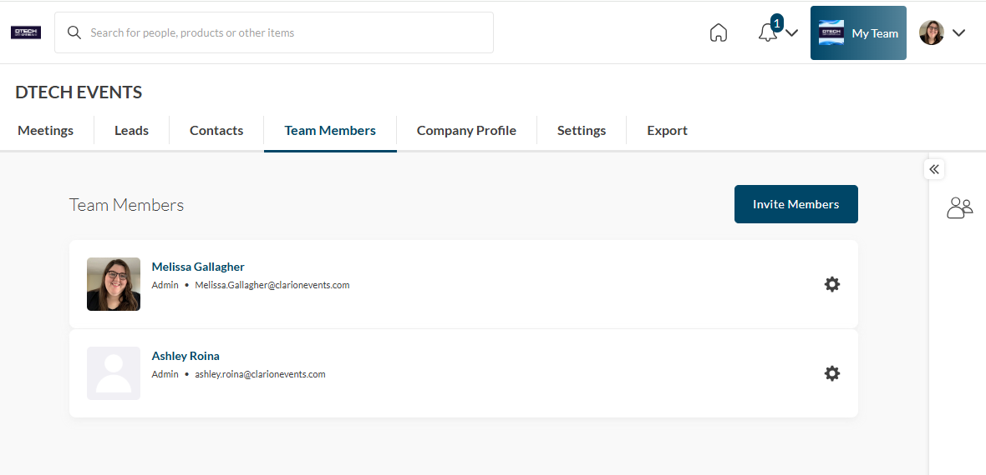
TEAM MEMBERS*
The first person from your company to login will create your team and be designated the "Admin". To invite team members to join your team, click “Team Members”, then “Invite Members”. Search for the participant by first and last name. They will receive an email requesting they join your team**.
ACCESS LEVELS
ADMIN
• Edit Company Profile
• Access Inbound Leads
• Export Connections (contacts) for entire team
• Request or Accept Meeting Requests on behalf of other team members
• Edit Team Member Profiles and Manage their Calendar Availability*
• Invite additional Team Members or remove Team Members*
TEAM MEMBER
• Edit Company Profile
• Access Inbound Leads
• Export Connections (contacts) for entire team
• Request or Accept Meeting Requests on behalf of other team members
**NOTE: Any person added to your team will be able to access the contacts and leads for ALL your team members. Only add team members to your team that should have access to see and export this information.

Slide 19
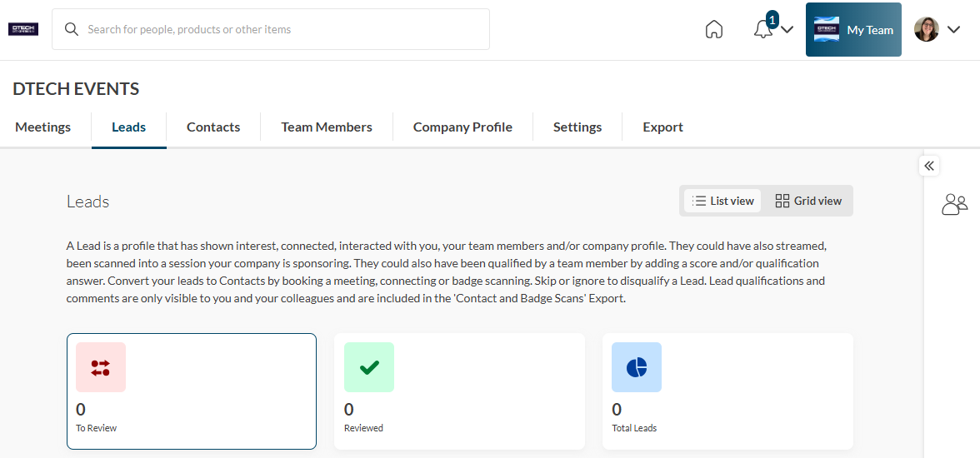
LEADS*
Event Participants that interact with you, your company, or your team members will appear in your “Leads”. This includes Profile Views; Connections/Interests; Session Registrations.​
NOTE: Toggle the view by clicking the menu icon on the top right.

Slide 20
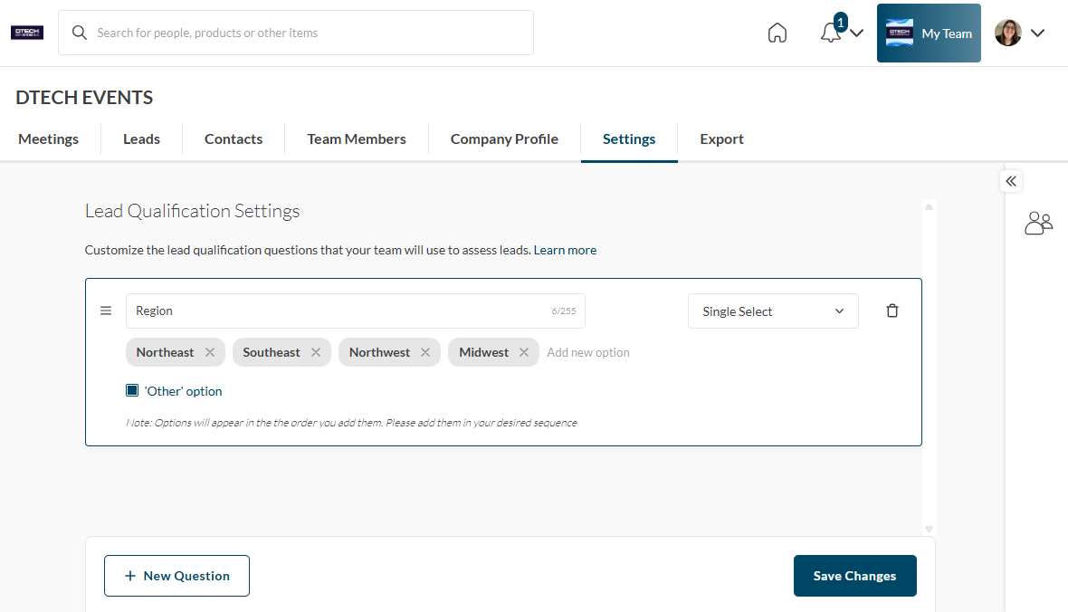
LEAD QUALIFICATION*
Once connected to a profile in the app, you have the option of adding "Lead Qualifications". These notes will be included in you Connections Export and can be customized for your company. In "Settings" you can add your Lead Qualification Questions. There are three options: Paragraph (text box); Single Select; or Multi-Select. These questions will appear on once you've connected with someone to add information to follow-up post-event. Answers will not be shared with the profile; however, they will be shared across your team in the "Export".

Slide 21
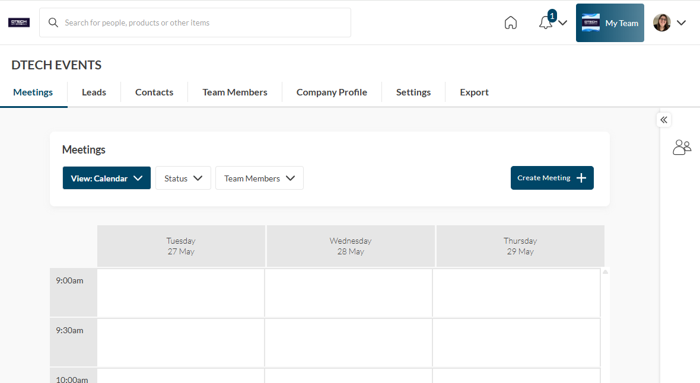
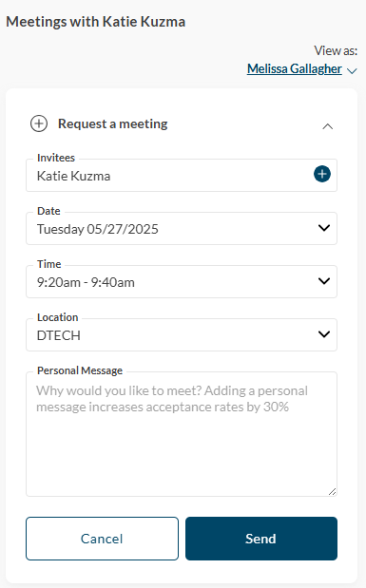
MEETINGS*
REQUEST FOR TEAM MEMBERS
To request a meeting on behalf of one of your team members, navigate to "My Team" at the top right of the home page. Then click "Create a Meeting". Then indicate the team member to request the meeting on their behalf. You can also navigate to the profile of who will receive the meeting request and click "View As" to change the person requesting the meeting to a Team Member.

Slide 22
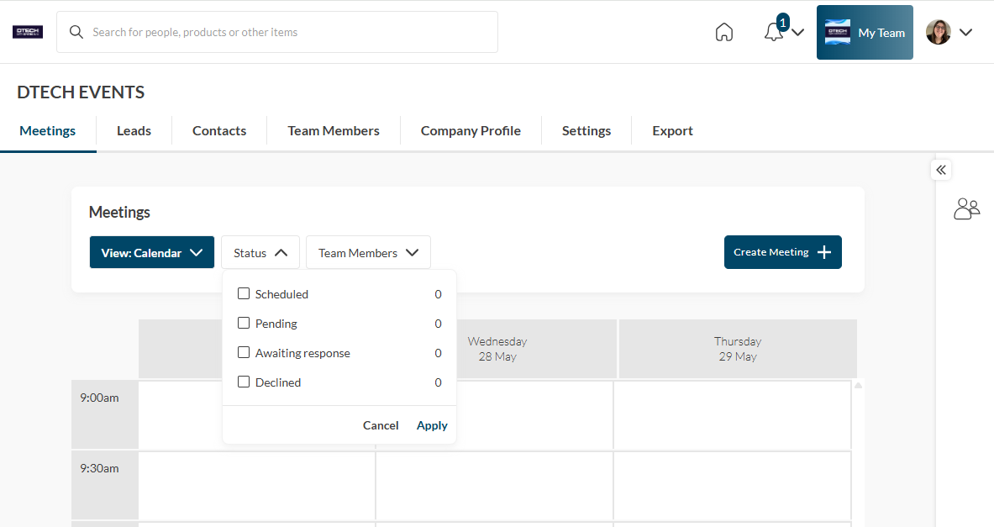
MEETINGS*
ACCEPT FOR TEAM MEMBERS
To accept a meeting on behalf of one of your Team Members, navigate to "My Team" at the top right of the home page. Then click "Pending" under "Status" at the top. After clicking on the Meeting, you'll be directed to the organizers profile. Then click "Accept". Both parties will receive an email confirmation of the meeting.

Slide 23
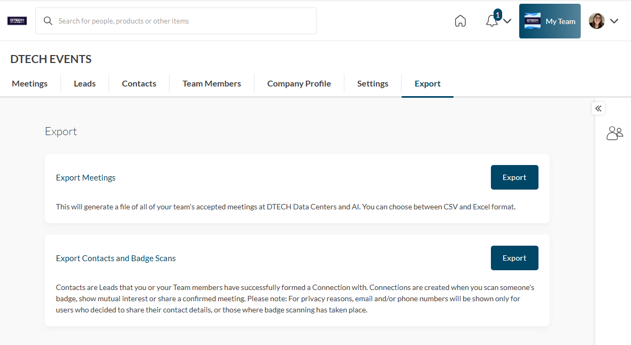
EXPORT TEAM CONTACTS*
From the web platform, you can export a list of all your connections – anyone you or your team has connected with through the platform or had a meeting with - into an .csv file by going to “My Team” then “Export. ​
Due to GDPR email and/or phone numbers will be shared only for the users who decided to share their contact details.
NOTE: To download your individual connections report, go to “My Profile”, then “Export”.​

