Slide 1
MATCH! Platform Guide

Slide 2
SUMMARY
For Sponsors Only
My Team, page 12
Inbound Leads, page 13
Meetings | Requesting on behalf of a Team Member, page 14
Meetings | Accepting on behalf of a Team Member, page 15
Login | Web, page 3
Confirm your Profile, page 5
Contact Sharing, page 6
Edit your Profile, page 7
Manage your Availability, page 8
Meetings | Requesting, page 10
Meetings | Accepting, page 11

Slide 3
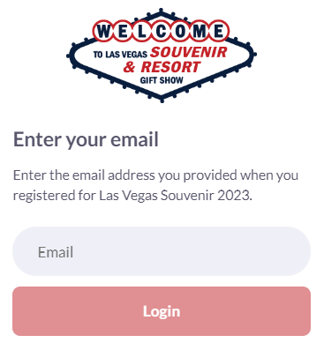
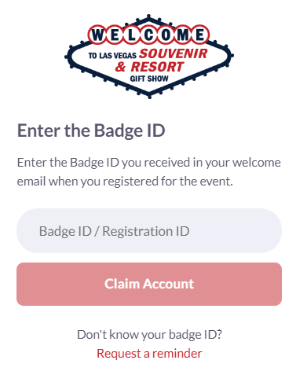
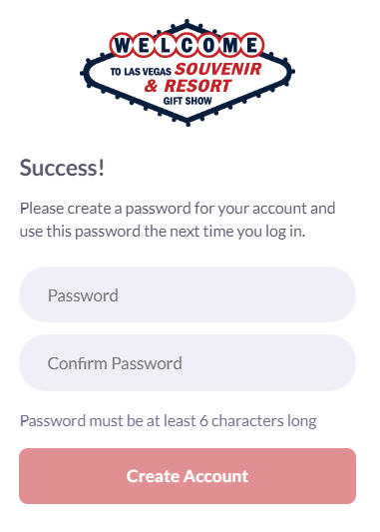
LOGIN | Web Platform
Navigate to the event platform and click “Login” to access the web platform.
STEP 1
Add your email address
STEP 2
Enter your Registration ID
STEP 3
Create a password

Slide 4
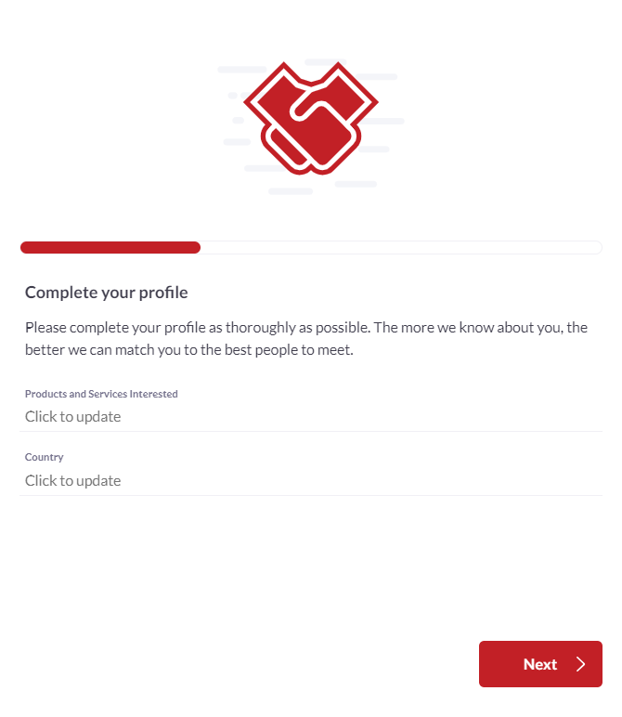
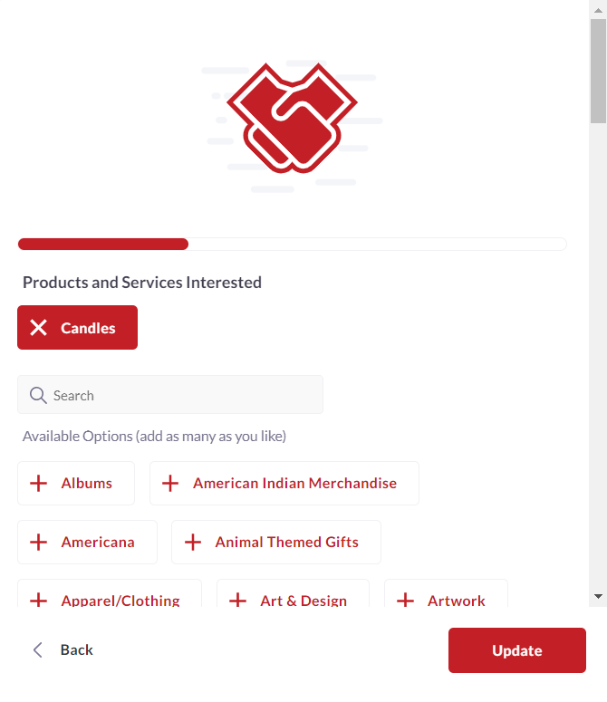
CONFIRM your PROFILE
When you first login, please confirm or adjust your registration by selecting the product categories.

Slide 5
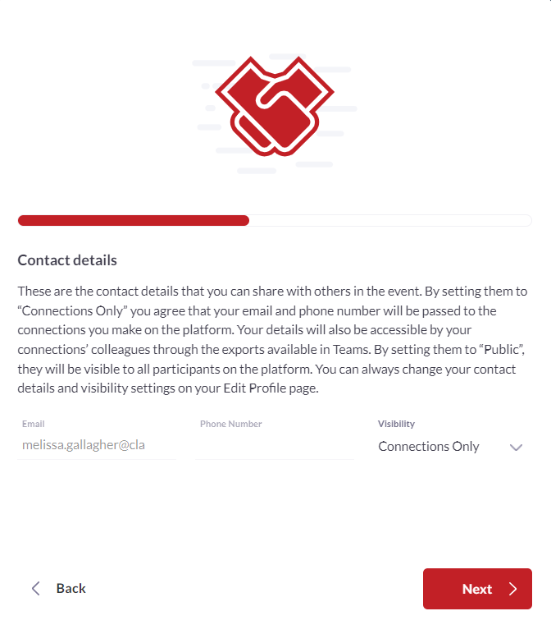
CONTACT SHARING
Confirm how you would like your contact information to appear in the platform. The platform will default to "Connections Only". You can edit your selection at any time by “editing your profile”.
PRIVATE
Users cannot your contact details
CONNECTIONS ONLY
Users with connections will be able to see your contact details on your profile page, as well as in external exports from the platform
PUBLIC
Contact Details will be displayed on your profile page and available in exports for everyone at the event.

Slide 6
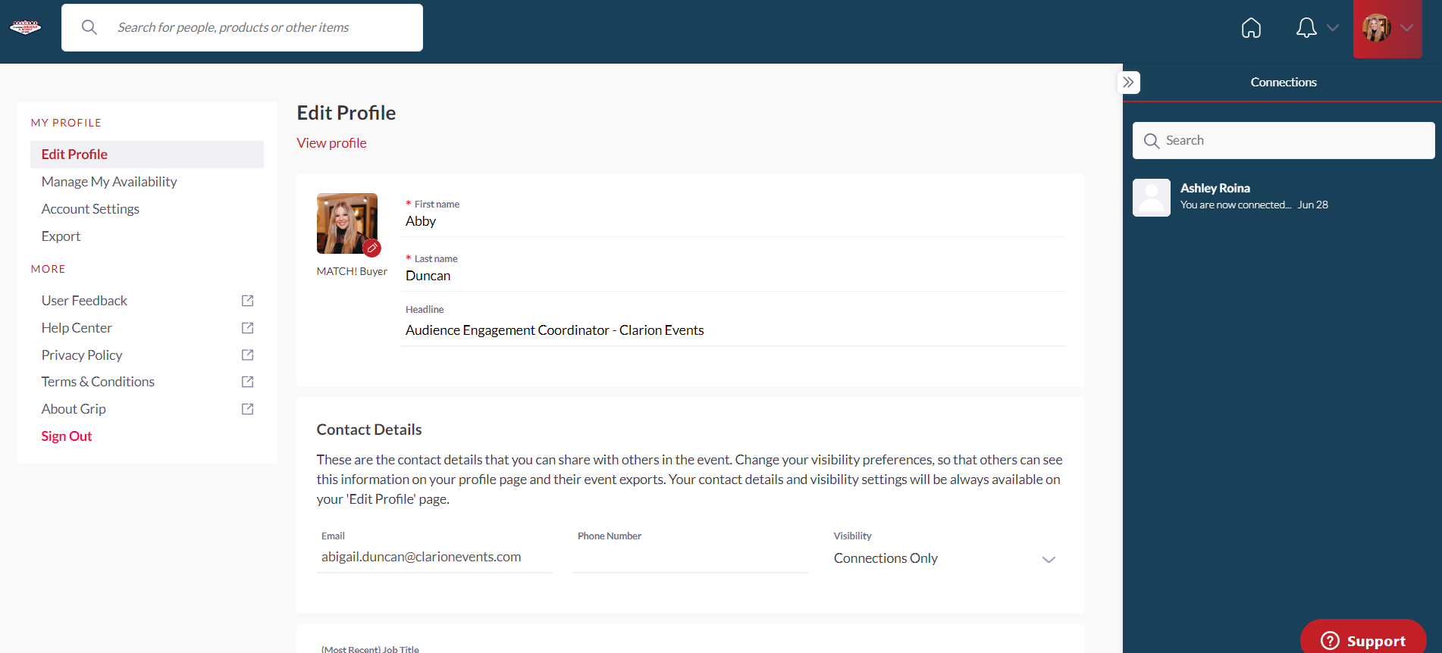
EDIT your PROFILE
You can edit your profile at any point while the platform is active.
VIP Sponsor Representative

Slide 7
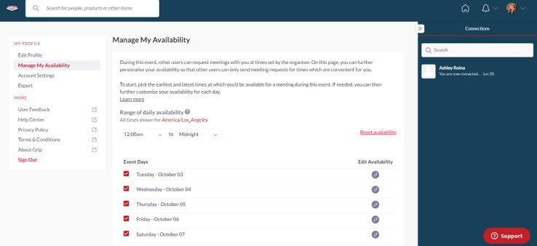
MANAGE CALENDAR AVAILIBILITY | Web Platform only
Click “Profile”, then “Manage My Availability” on the left navigation bar to update the times you’re available to meet.
Range of Daily Availability: Easily set up a single range of times for all show days.
Event Days: Change the times you are available for each day.

Slide 8
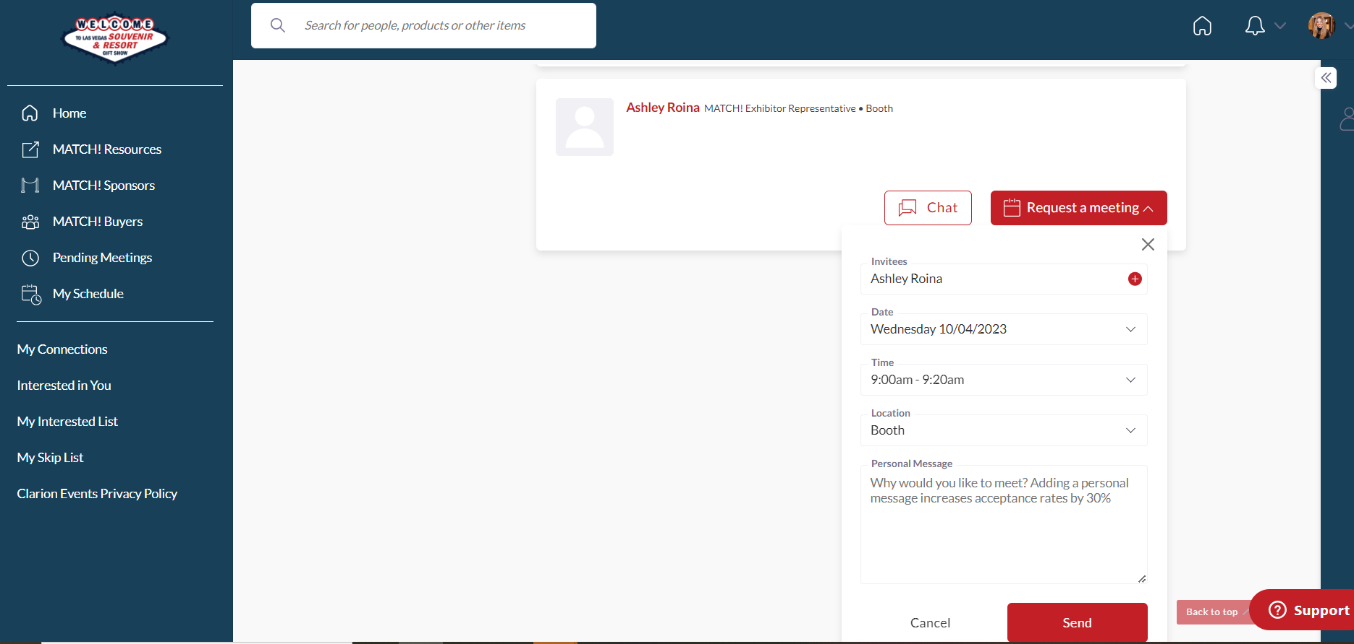
MEETINGS | Requesting
Once you find someone you would like to meet with, click “Request Meeting” next to their name. Add the date/time and location, as well as a personal message, then click “Request Meeting”. They will receive an email/push notification that they received a meeting request. Once a meeting is confirmed, you will receive a notification.

Slide 9
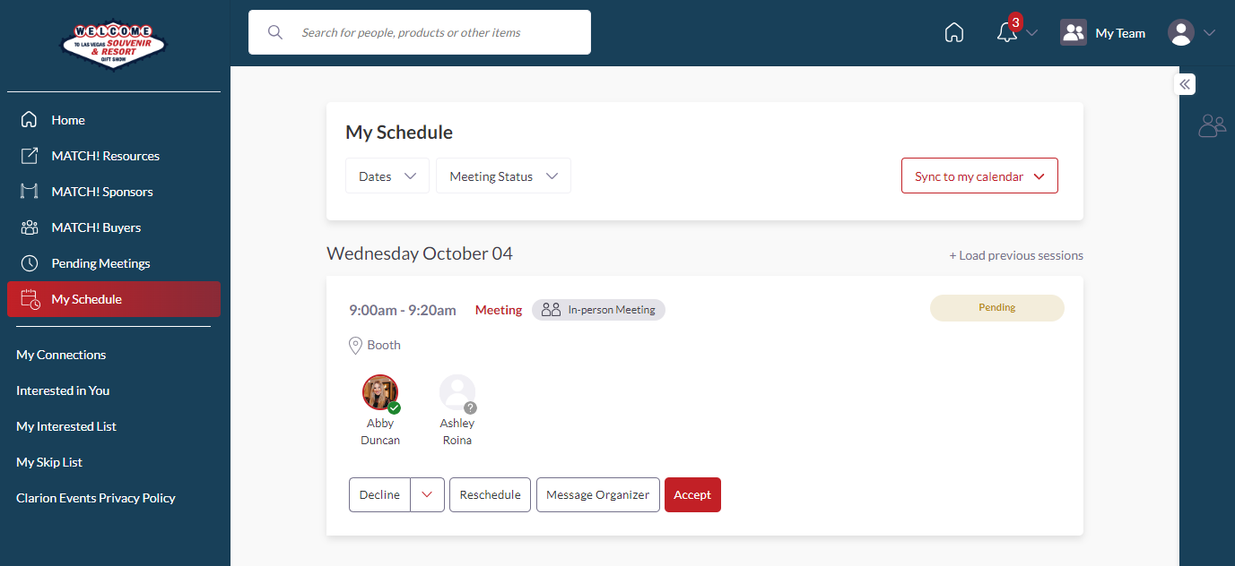
MEETINGS | Accepting
If someone sends you a meeting request, you will receive an email/push notification with the meeting details. You can confirm via the “Accept Meeting” in the email or via the app. To filter your full list of meetings, click “My Schedule”, then “Meeting Status” to filter on pending meetings. You can also suggest a new meeting time by clicking "Reschedule". This will send a new meeting request to the organizer.

Slide 10
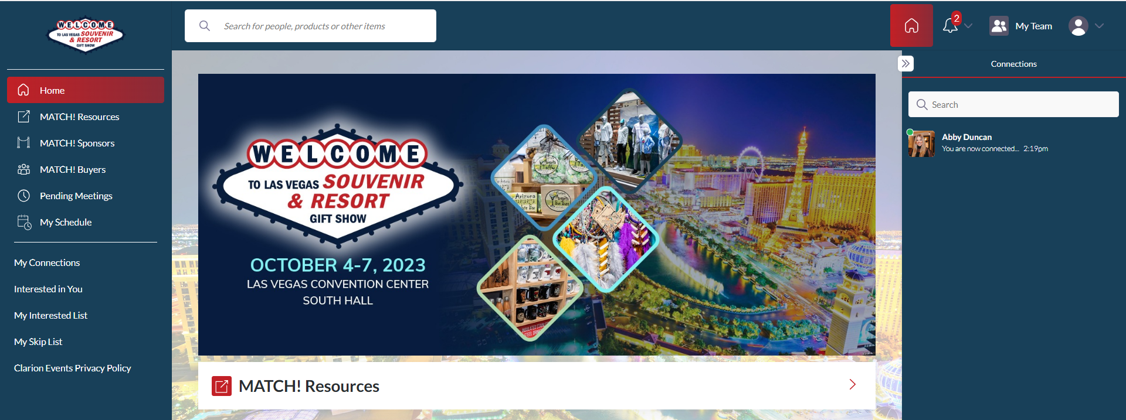
MY TEAM | Web Platform only
As a MATCH! Exhibitor, you and your team have access to a dashboard accessible via the web platform (top-right). From here, you can manage meetings for your Team Members, view your Inbound Leads, and Export the Contacts for your entire Team.
The first person to sign in via the web platform will create your Team and become the Admin for the Team.
If you registered as an "Attendee", you will not be connected to your team. Please contact mobileapps@clarionevents.com and we can add you to your company's Team.

Slide 11
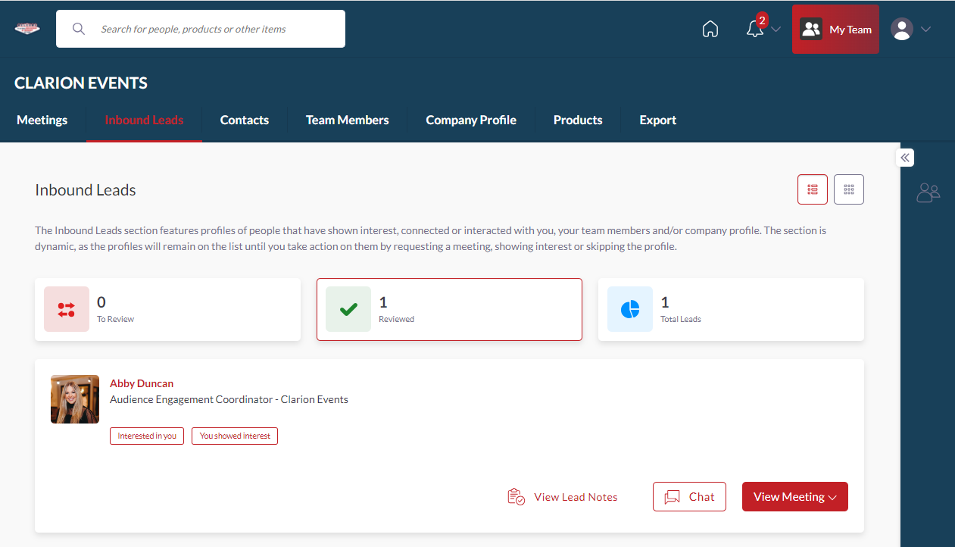
INBOUND LEADS | Web Platform only
As a Sponsor, you can view interactions event attendees have made with you, your company, or your team members. Click “My Team” at the top right of the home page, and then “Inbound Leads”.
Event Participants that interact with you, your company, or your team members will appear in your “Inbound Leads”. This includes:
Profile Views
Connections/Favorites
You can add “Lead Notes” for visibility across your team.
Connections for your entire team can be exported via “Export”. If they allowed contact sharing, their contact details will appear in this export.

Slide 12
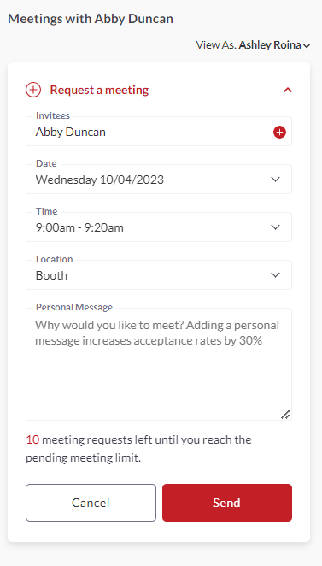
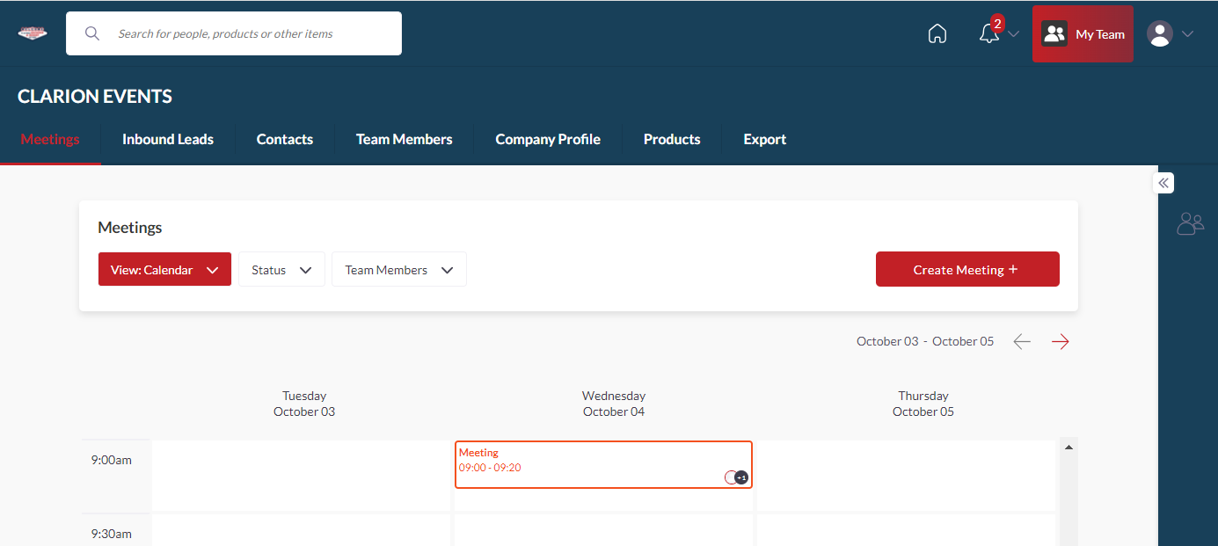
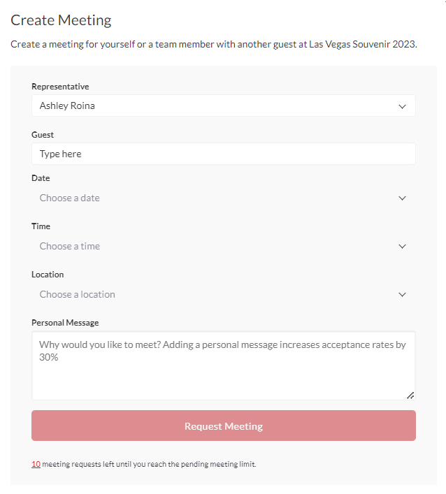
MEETINGS | Requesting on behalf of a Team Member | Web Platform only
To request a meeting on behalf of one of your Team Members, navigate to "My Team" at the top right of the home page. Then click "Create a Meeting". Then indicate the Team Member to request the meeting on their behalf. You can also navigate to the profile of who will receive the meeting request and click "View As" to change the person requesting the meeting to a Team Member.

Slide 13
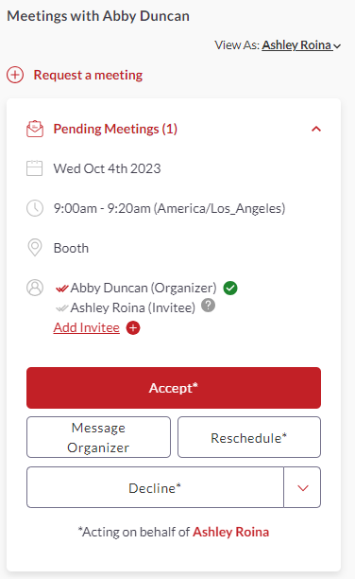
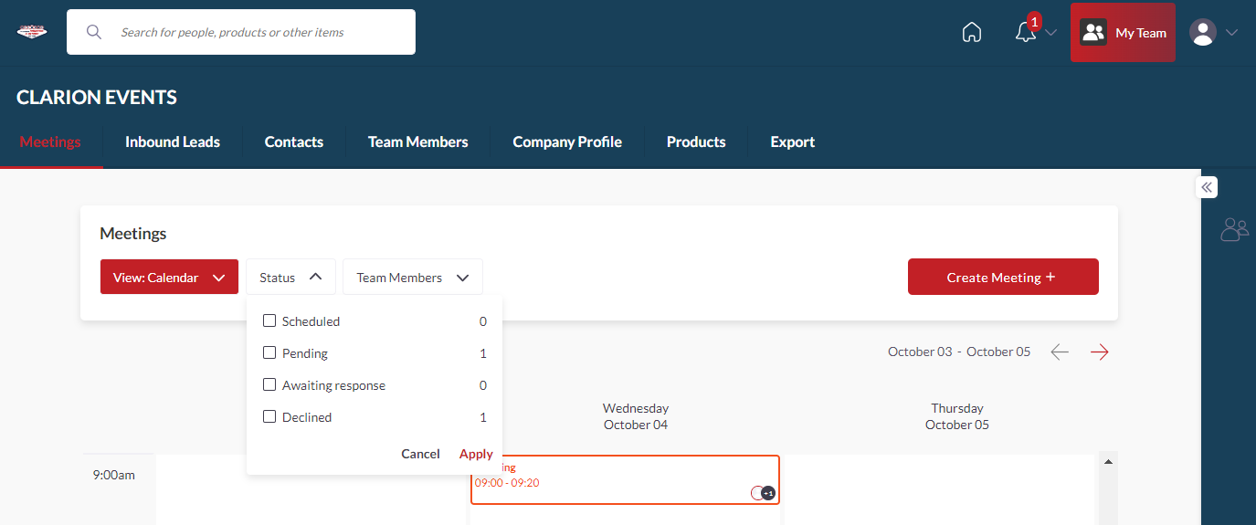
MEETINGS | Accepting on behalf of a Team Member | Web Platform only
To accept a meeting on behalf of one of your Team Members, navigate to "My Team" at the top right of the home page. Then click "Pending" under "Filter By" on the left. After clicking on the Meeting, you'll be directed to the organizers profile. Then click "Accept". Both parties will receive an email confirmation of the meeting.

