Slide 1
ATTENDEE KNOW BEFORE YOU GO
Tuesday March 11th

Slide 2
General Event Hours
IMPORTANT: Get your badge early – lines will be very long on Tuesday!
Sunday
Monday
Tuesday
Wednesday
Thursday
Registration: 11:00 am - 5:00 pm
Registration: 7:30 am - 5:00 pm
Utility University: 8:00 am – 5:00 pm
Tech tours: 8:00 am – 5:00 pm
Conference: 8:00 am – 5:00 pm
Partner Programming: 8:00 am – 5:00 pm
Workshops: 1:00 pm – 5:00 pm
Registration: 7:30 am - 6:00 pm
Opening Keynote: 8:30 am – 10:00 am
Exhibit Hall Open: 10:00 am - 6:00 pm
Conference: 10:00 pm - 5:00 pm
Partner Programming: 10:00 am – 4:30 pm
Connections Lunch: 12:00 pm - 1:00 pm
Afternoon Keynote: 3:15 pm – 4:15 pm
Cantina Receptions: 3:00 pm - 6:00 pm
Workshops: 3:00 pm – 4:30 pm
Opening Reception: 5:00 pm - 6:00 pm
Registration: 8:00 am - 5:00 pm
Conference: 9:00 am – 5:00 pm
Morning Keynote: 9:15 am – 10:15 am
Partner Programming: 10:00 am – 3:00 pm
Exhibit Hall Open: 10:00 am - 5:00 pm
Connections Lunch: 11:45 am - 1:00 pm
Cantina Receptions: 2:00 pm - 5:00 pm
Afternoon Keynote: 3:15 pm – 4:15 pm
It's 5 O'clock Somewhere: 4:00 pm - 5:00 pm
DTECH Networking Party: 5:00 pm - 6:30 pm
Partner Programming: 7:30 am – 5:00 pm
Registration: 8:00 am - 11:00 am
Conference: 8:00 am – 12:00 pm
Workshops: 8:00 am – 5:00 pm
Exhibit Hall Open: 9:00 am - 1:00 pm
Exhibit Excellence Awards: 11:00 am – 11:30 am
Initiate Awards: 10:30 am – 11:00 am

Slide 3
Attendee Badge Inclusions
All Access/Utility All Access
Exhibit Hall Only
The All Access pass provides the highest level of access at DTECH. Attendees will have access to our Technical Conference program, Utility University courses, workshops*, the exhibit hall floor, a ticket to the networking party, knowledge hubs, keynotes, roundtables and more.
What’s included:
Technical conference sessions Utility University Courses Workshops* Roundtables Ticket to Networking event Exhibit hall floor Knowledge hubs Keynotes Lunch on Tuesday and Wednesday
The Expo Only pass provides any attendee with access to the exhibit hall floor, knowledge hubs and keynote.
What’s included:
Exhibit hall floor Knowledge hubs Keynotes Lunch on Tuesday and Wednesday
No access to:
Technical conference sessions Utility University Courses Workshops* Roundtables Ticket to Networking event (can be purchased separately)

Slide 4
Exhibitor Badge Inclusions
IMPORTANT: Please register your company through the Exhibitor Resource Center.!
Exhibitor All Access
Exhibitor Booth Staff
The Exhibitor All Access pass will provide exhibitors with access to most of the activities at the event.
What’s included:
Technical conference sessions Workshops* Ticket to Networking event Exhibit hall floor Knowledge hubs Keynotes Lunch on Tuesday and Wednesday
No access to
Utility University Courses
Roundtables
Exhibitors with a booth staff passes will have access to the exhibit hall floor, knowledge hubs and keynote.
What’s included:
Exhibit hall floor Knowledge hubs Keynotes Lunch on Tuesday and Wednesday
No access to:
Technical conference sessions Utility University Courses Workshops* Roundtables Ticket to Networking event (can be purchased separately)

Slide 5
Venue and Key Locations
Level 1
A 100 Meeting Rooms
Coat Check (Room A103)
Athena Registration Lower A/B Lobby – exhibition only
Prayer/Quiet Room (Room D169)
Security/Medical Room (Room D160)
Conference Desk
Uber/Lift Pickup and Dropoff
C 100 Meeting Rooms
D 100 Meeting Rooms
Tech Tour Pickup/Dropoff

Slide 6
Venue and Key Locations
Level 2
A Ballrooms
C Ballrooms
Keynote
D 200 Meeting Rooms
Exhibit Hall
Meeting House (Level 2, Lobby F)
Zeus Registration D Lobby – all access, exhibitors
Color Me Empowered Art Installation
Food Locations
T-shirt (booth #3734)
Interview studio (booth #3734)

Slide 7
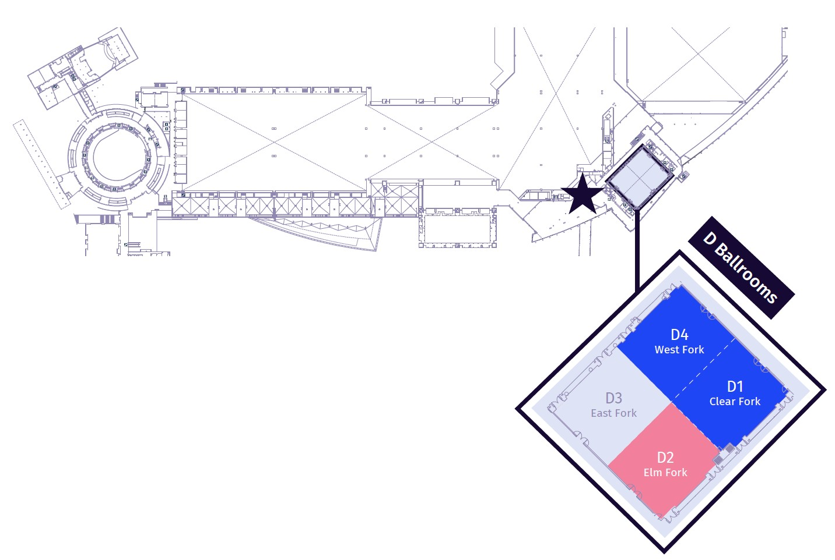
Venue and Key Locations
Level 3
D Ballrooms
DTECH booth

Slide 8
Food Locations
Connections Lunch For All Attendees
Complementary Lunches For All Attendees
Breakfast Roundtables For All Access Attendees Only that pre-registered.
Paid Concessions For All Attendees
Hall F
Tuesday March 25th 12:00 pm – 1:00 pm
Wednesday March 26th 11:45 am – 1:00 pm
Hall A
Tuesday March 25th 12:00 pm – 1:00 pm
Wednesday March 26th 11:45 am – 1:00 pm
Ballroom A1
(level 1)
Wednesday
8:00 am – 8:45 am
Thursday
8:00 am – 8:45 am
Located throughout the convention center
Hall A
A/B Lobby
Hall C
Hall F
Lobby F

Slide 9
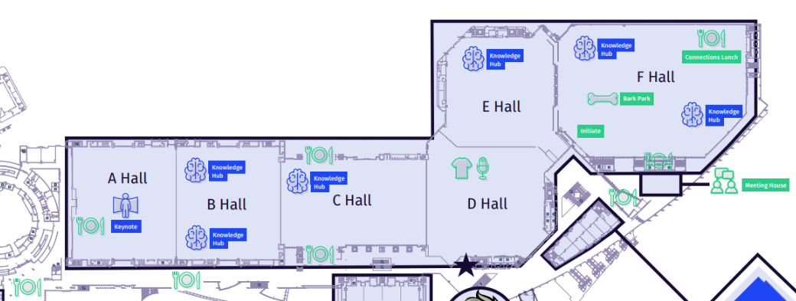
Food Locations

Slide 10
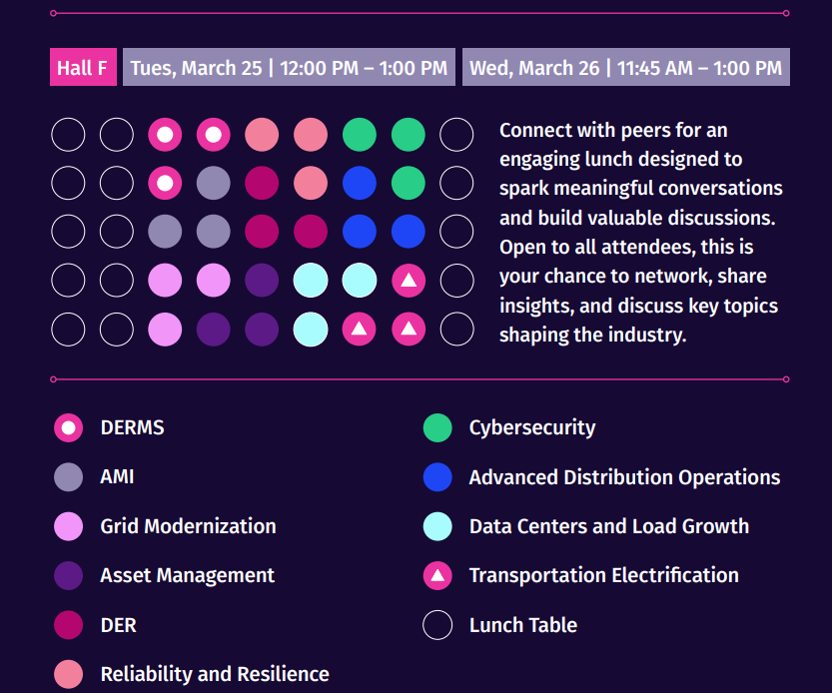
Connections Lunch

Slide 11
Special Events Map

Slide 12
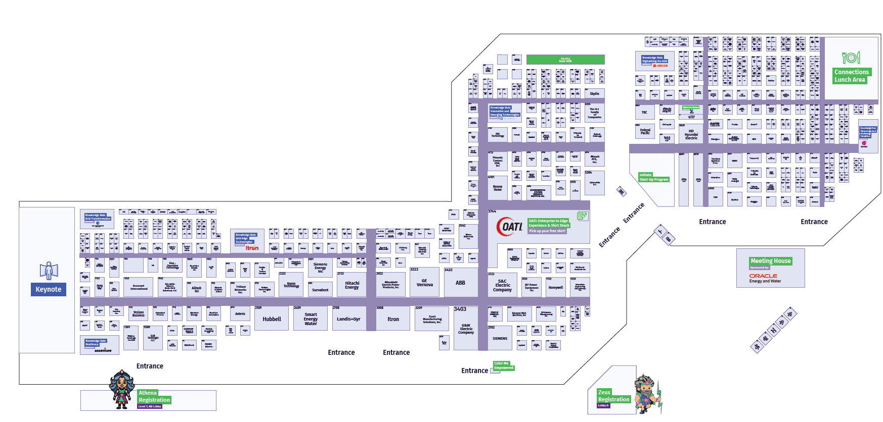
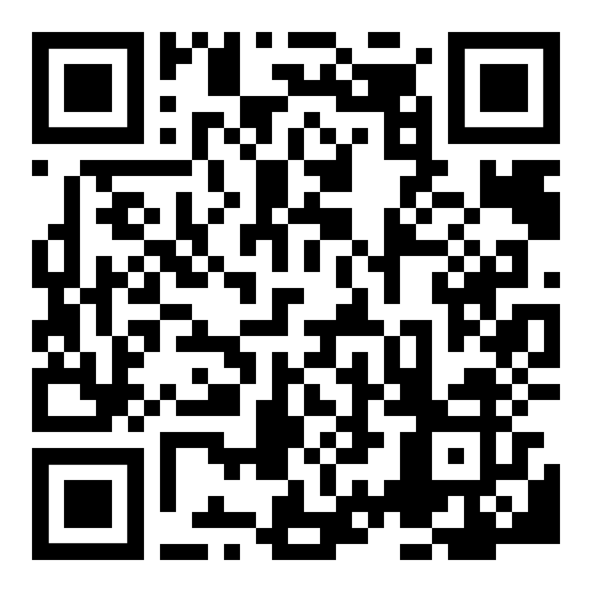
Exhibit Hall Map
Map showing where everything is
Download the mobile app and view the full floorplan!

Slide 13
Education Overview
Monday
Tuesday
Wednesday
Thursday
Utility University Courses (open to all access attendees only, first come, first served)
Technical Tours (pre-reg, additional cost)
Workshops (all access)
Co-located events
(pre-reg, additional cost)
Keynote sessions (morning and afternoon, open to all)
Conference sessions (all access)
Knowledge Hub sessions (exhibit hall, open to all)
Peer-to-Peer Exchange (first come, first served)
Co-located events (pre-reg, additional cost)
Keynote sessions (morning and afternoon, open to all)
Breakfast Roundtables (all access, first come, first served)
Conference sessions (all access)
Knowledge Hub sessions (exhibit hall, open to all)
Peer-to-Peer Exchange (first come, first served)
Breakfast Roundtables (all access, first come, first served)
Conference sessions (all access)
Knowledge Hub sessions (expo floor, open to all)
Workshops (all access)
Co-located events
(pre-reg, additional cost)

Slide 14
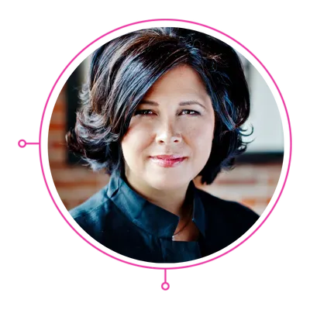
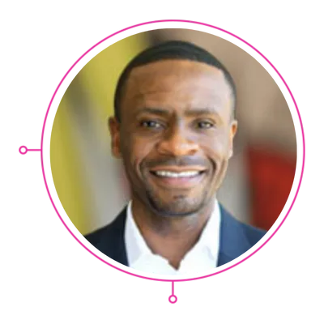
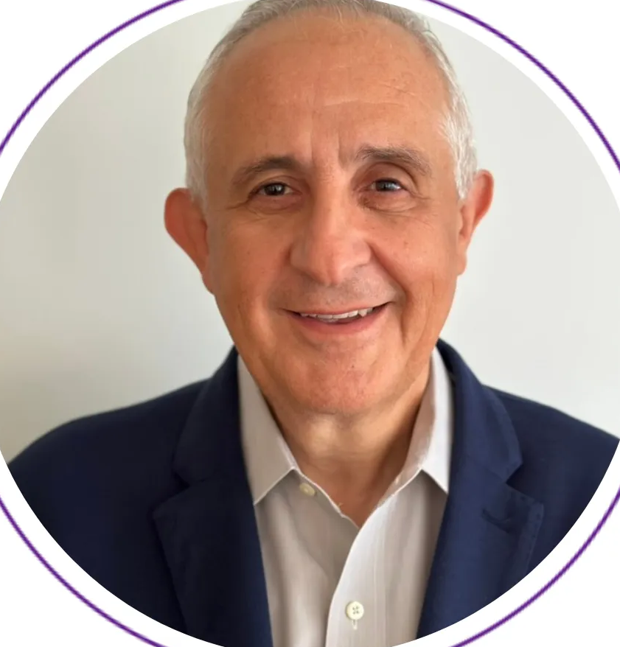
Keynote Speakers
All Held in Exhibit Hall A
Innovate. Adapt. Transform. Evolve. Inspire. A shared vision for electric utilities.
Tuesday 8:30 AM
Tuesday 3:15 PM
Wednesday 9:15 AM
Wednesday 3:15 PM
Vision To Innovate
Vision To Adapt
Vision To Transform
Vision To Evolve
Jamie Siminoff
Founder, Ring
Sheryl Connelly
Former Manager, Global Consumer Trends and Futuring, Ford Motor Company
John Josephakis
Global VP of Sales and Business Development for HPC/Supercomputing,
NVIDIA
Keith Ogboenyiya
Senior Vice President, Marketing, Texas Instruments

Slide 15
Post-Event Conference
Conference Proceedings
Certificate of Completion
All attendees with an all-access badge will receive a link to the presentations on Monday (March 24th) and Friday (March 28th) via email.
All attendees with an all-access badge will receive an email post event on Friday, March 28th to fill out a survey in order to receive their PDH certificate (14 hours).
UU course PDH certificates will be sent separately (4 or 8 hours) on Tuesday, March 25th.
IMPORTANT: You must compete the survey to receive the certificate of completion.

Slide 16
Future Energy Leaders Student Program
In partnership with state and local universities, The Future Energy Leaders program allows students pursuing engineering and computer science degrees an exclusive chance to attend DISTRIBUTECH®.
Monday
Tuesday
Wednesday
Thursday
Utility University: 8:00 am – 5:00 pm
Attendee tour: 2:00 pm – 3:00 pm
Utility Recruiter Panel: 5:00 pm – 6:00 pm
Opening Keynote: 8:30 am – 10:00 am
Exhibit Hall Open: 10:00 am - 6:00 pm
Private ABB Student Lunch: 11:45 am - 12:45 pm
Afternoon Keynote: 3:15 pm – 4:15 pm
Opening Reception: 5:00 pm - 6:00 pm
Morning Keynote: 9:15 am – 10:15 am
Exhibit Hall Open: 10:00 am - 5:00 pm
Student Meetup: 10:00 am - 11:00 pm
Connections Lunch: 11:45 am - 1:00 pm
Afternoon Keynote: 3:15 pm – 4:15 pm
DTECH Networking Party: 5:00 pm - 6:30 pm
Registration: 8:00 am - 11:00 am
Exhibit Hall Open: 9:00 am - 1:00 pm
Exhibit Excellence Awards: 11:00 am – 11:30 am
Initiate Awards: 10:30 am – 11:00 am

Slide 17
Affinity Group Meet Ups
All held in Room D227
Open to all attendees, meet ups are designed to bring together individuals who share commonalities that hold significant value in shaping their identities, as well as allies who support them. These shared affinities, along with mutual interests, serve as a pivotal cornerstone within the energy industry. Join these inclusive gatherings to connect with peers and foster new relationships within this vibrant community.
Time | Tuesday March 25th | Wednesday March 26th | Thursday March 27th
10:00 AM – 11:00 AM |  | Future Energy Leaders Students | Veteran
11:00 AM – 12:00 PM | Muni / Co-op | Government | Hispanic / Latino Professionals
1:00 PM – 2:00 PM | Female Professionals | Asian Professionals
2:30 PM – 3:30 PM | LGBTQ Professionals | Black Professionals
3:30 PM – 4:30 PM | International Attendees

Slide 18
Networking Events
Opening Reception
5 O'clock Somewhere
Cantina Receptions
Tuesday, March 25
5:00 PM – 6:00 PM
Exhibit Hall
Wednesday, March 26
4:00 PM – 5:00 PM
Exhibit Hall
Tuesday, March 25
3:00 PM – 6:00 PM | Exhibit Hall
Wednesday, March 26
2:00 PM – 5:00 PM | Exhibit Hall
DTECH Networking Party
Coffee
Connections Lunch
Wednesday, March 26
5:00 PM – 6:30 PM
Level 2, Lobby A/B
Tuesday, March 25 | 10:00 AM
Booths #5836 and #5304
Wednesday, March 26 | 10:00 AM
Booths #5726, #3712 and #4810
Tuesday, March 25
12:00 PM – 1:00 PM | Hall F
Wednesday, March 26
11:45 AM – 1:00 PM | Hall F

Slide 19
Wednesday Party
Where is it? Lobby A/B Level 2
When is it? Wednesday from 5:00-6:30
Who gets a ticket? Anyone with an All Access pass or those that purchase a ticket.
Attendees need to get their ’ticket’ in the following locations- they will NOT be given their ticket when they get their badge
Kraken Booth #2123
Rebooking Booth level 3, lobby D balcony
Info desk A/B level 1 lobby (not the reg desk)

Slide 20
Wednesday Party
Booth 2123
Party Location
Info Desk

Slide 22
Clarion Cares

Slide 23
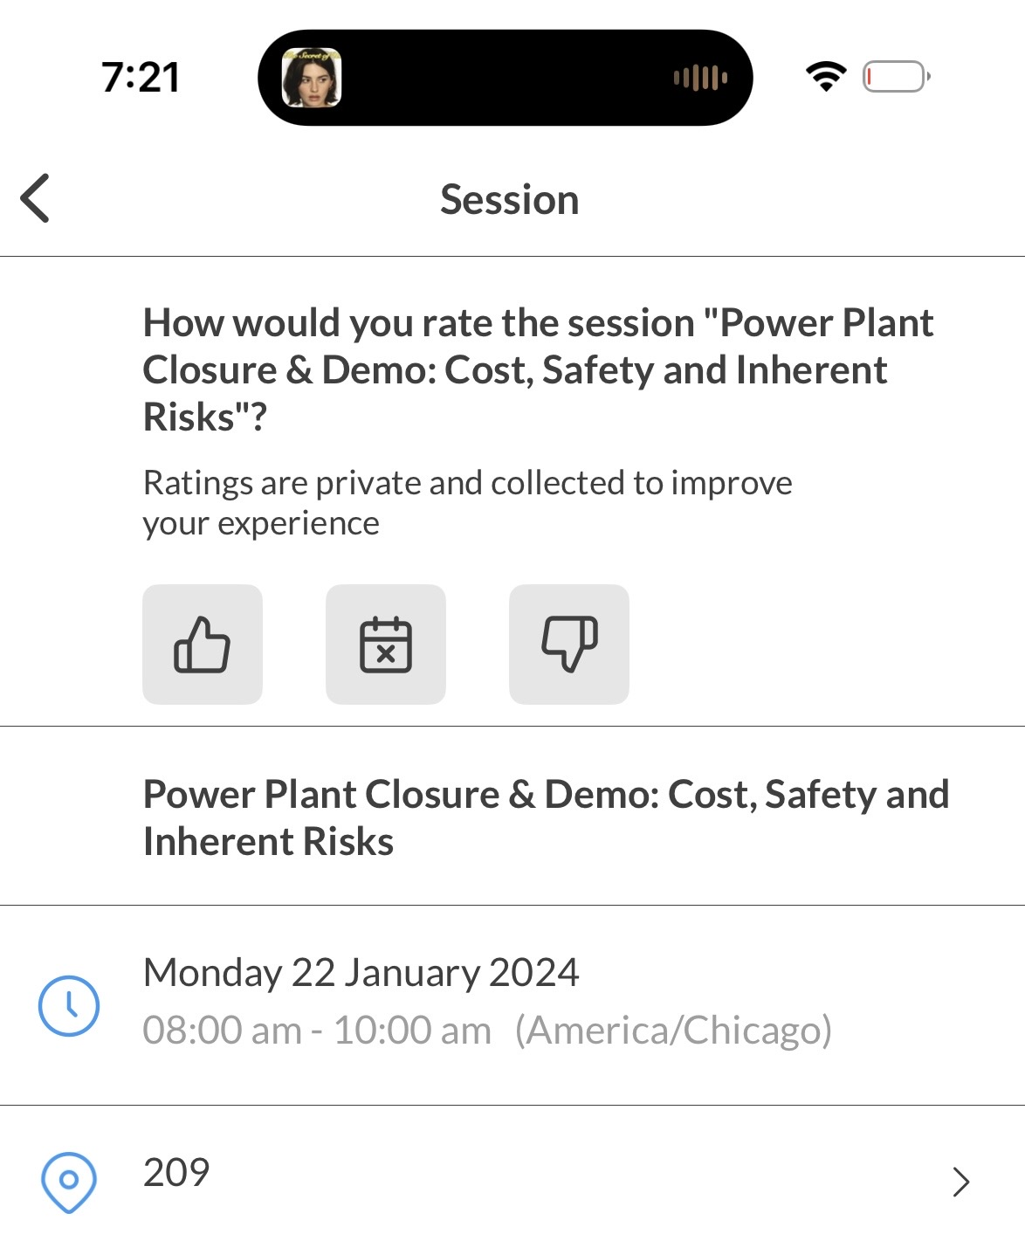
Session Surveys
After each conference session, attendees can rate the session in the app with a thumbs up or thumbs down.
Instructions are as follows:
Click into the session you'd like to provide feedback for
At the top of the page, under "How would you rate the session..." click the thumbs up or thumbs down button to submit your feedback
Want to rate all the sessions you added to your personal schedule? Access "my schedule" from the "schedule" button on the bottom of the app. Thumbs up or thumbs down a session based on your feedback.
Did not
attend
Good
Bad

Slide 24
Event Survey
We value your feedback!
You will get an email starting on Wednesday with a link to the survey.
Please take a moment to share your thoughts. Your input helps us improve and continue delivering valuable content.
IMPORTANT: You must compete the event survey to receive the certificate of completion.

Slide 26
Final Reminders
Get Your Badge Early!
Download the App
Don’t miss the keynotes
Complete the post event survey
Attend the meetups
Participate in the Attendee Tour

Slide 29
March 24-27, 2025
Dallas, Texas

