Slide 1
April 8, 2025
Leadership Conference
Indianapolis, Indiana
PUTTING OUT THE PERSONNEL FIRE BEFORE IT STARTS:
AN AFTER-ACTION REPORT YEAR IN REVIEW

Slide 2
Why do you do AARs after particular operational incidents?
Why should you do AARs after personnel-related incidents?
#FDIC2025

Slide 3
After-Action Review Personnel Issue Template
What plans were in place “pre-entry” to address the issue(s)?
*Identify issue(s)
*Pre-planning
*Training
Under those plans, what should have happened?
What actually happened?
Why did it happen that way?
How can we improve our response next time?
What went well?
Reflections
Revised, Original Source -FireEngineering, 5/1/18, Adam Lareau & Brice Long

Slide 4
What Steps Might An Agency (Your Agency) Implement to Reduce or Eliminate the Possibility of Similar Events Occurring?
#FDIC2025

Slide 5
During every post-incident review, communication holds the top position of problems encountered during an event. In most organizations, it is the root of most nonemergency problems as well. Communication in any large organization is tough, but throw in multiple shift schedules, districts, battalions, stations, and volunteers, and you find yourself in the middle of the old telephone game.
Chief David Rhodes, February 2025

Slide 6
Many lawsuits result from an initial lack of respect – Let’s Debrief
#FDIC2025

Slide 7
Abbt v. City of Houston et al – An Introduction
I was the only woman on the A-shift at Station XX. When I first arrived at Station XX, Captain Y told me he did not want a woman working there, and I was initially not allowed to ride on the ladder truck. However, I always worked hard to prove I was worthy of working at the station.
Because my co-workers and supervisors often ignored me during shifts, I would bring my personal laptop to work on my family business between calls. I was not aware of any rule that said we could not bring personal devices to the station, and most members of HFD would bring cell phones or other ways to pass the time during the quiet moments of a 24-hour shift.
While I trusted my fellow firefighters not to touch my laptop, I tried to keep it out of plain view in case a member of the public came into the station. I never imagined someone from the station would have broken into my laptop and taken my private files.

Slide 8
The “Evidence”

Slide 9
Timeline
2008: Video reviewed initially by Junior Captain, more than once, and by DC
2009: DC asks for new password to continue watching the video
May 2017: FF learned of disclosures for the first time after DC advised FF’s husband, also an HFD member, that he had seen video
May 2017: FF files OIG Complaint
October 2017: OIG sustains allegations and issues discipline
April 2018: Additional discipline for Junior Captain confirmed by arbitrator
CONSIDER THE TIMELINE IN OUR AAR

Slide 10
Review of Certain Policies
HFD Rules & Regulations
*No Section formally Called Harassment
*Found in Section Called “Relationships”
*First Subsection in 2005 leads with
“Racial, Ethnic and Gender Slurs”
*First Subsection is 2012 leads with “ Workplace Discrimination and Harassment Prohibited”
CONSIDER THE NAMES OF THESE SECTIONS WHEN THINKING ABOUT EFFECTIVE COMMUNICATION IN OUR AAR TEMPLATE

Slide 11
Racial, Ethnic and Gender Slurs: Members shall not verbally, non-verbally, or illustratively utilize racial, ethnic, or gender slurs or connotations towards another member. A slur is defined as a remark, language, illustration, or other media including, but not limited to, jokes and pornography, which degrade an individual's race, gender, or national origin. Members shall not create an intimidating, hostile, or offensive work environment by such conduct. Violations of this guideline are subject to disciplinary action up to and including discharge. Any member, who believes they have been the subject of a racial, ethnic, or gender slur, shall report the act immediately to their supervisor or manager and to HFD Staff Services. Supervisors or managers who fail to act on allegations or evidence of discrimination based on race, ethnicity, or gender shall be considered for disciplinary action.
2005

Slide 12
2012 Update, in Part
Any member who believes he/she has been subjected to or observed conduct in violation of this policy, is encouraged to report the conduct at the earliest possible stage to [multiple choices]…. Supervisors or managers receiving a complaint which violates this polivy or obseeves same shall report the conduct to the [Designated Department Representatives] assigned to the Department. Supervisors or managers who fail to act on allegations or evidence of discrimination based on race, ethnicity, or gender shall be considered for disciplinary action, up to and including suspension.

Slide 13
More “Evidence”
*Training
*Communication
*Access to video
*Viewing of video
*Sharing of video
*Viewing reaches FF
*Investigation
*Aftermath

Slide 14
What Happened Court-Wise?
*Pre-discovery
*Lawsuit filed in state court, removed to federal court, against City and Junior Captain, alleging, among other things, sexual harassment & retaliation
*District court dismissed case against City
*Appellate Court reinstates case against City –
◦P does not need to experience harassment in “real time” for it to be actionable
◦City can be liable if supervisor who receives notice does nothing
*In separate case, $250,000 jury verdict against Junior Captain
*Federal court case dismissed following settlement of $850,000

Slide 15
After-Action Review Personnel Issue Template
What plans were in place “pre-entry” to address the issue(s)?
*Identify issue(s)
*Pre-planning
*Training
Under those plans, what should have happened?
What actually happened?
Why did it happen that way?
How can we improve our response next time?
What went well?
Reflections

Slide 16
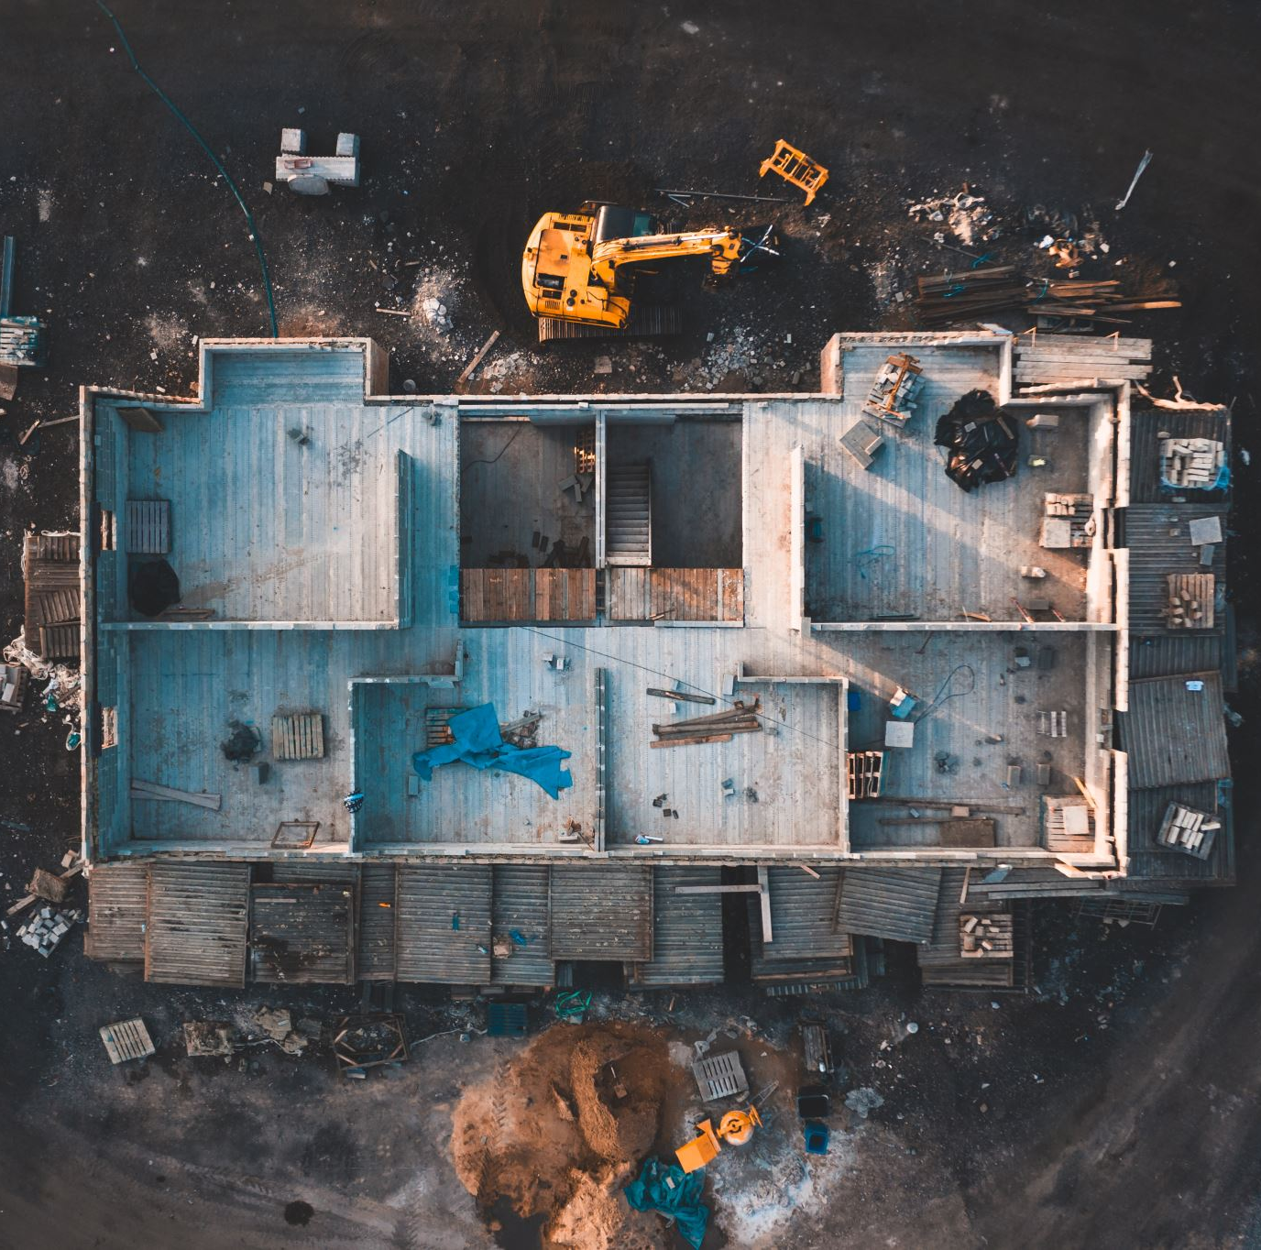
Alleged failure to provide religious accommodation – Let’s Debrief
#FDIC2025

Slide 17
Little v. County of Los Angeles et al – An Introduction
*Lifeguard Captain is an Evangelical Christian, a belief system which believes same-sex sexual activity is morally illicit and that sex is immutable regardless of gender identity
*County of Los Angeles issued a policy requiring all County agencies to raise a Pride Flag during the month of June at all County properties, starting with June 2023
*Captain sought, and was granted, a religious accommodation so he would not be responsible for flag activities inconsistent with his belief system
*Accommodation was pulled
*Captain lowered flag and was eventually suspended

Slide 18
The Allegations

Slide 19
Timeline
March 2023: EA-231 County Departments to explore how Progress Pride Flag can be flown at all county facilities
*May 25, 2023: LACFD memo says all Captains & Site Supervisors ensure PPF flown throughout June at all locations physically able to accommodate it (flag poles and adequate flag clasps – which were not at all locations)

Slide 20
May 25, 2023 Memo to Chief Officers & Administrative Sites (EA-231)
>Board of Supervisors passed a motion requiring the PPF to be flown at County facilities during the month of June.
>Captains/Site Supervisors shall:
>>Ensure flags are received and flown throughout the month of June, as note above.
>>At the end of June, ensure that the PFF flag is folded and stored for use the following year.

Slide 22
Timeline
June 18, 2023: Captain returns from pre-scheduled vacation and asks for an accommodation
June 19, 2023: Interactive process meeting held. Agreed (a) would be moved to a site not flying PPF; (b) need not personally raise PPF; and (c) if assigned to HQ, would not be involved in flag handling as would not be a supervisor there
>>Captain assigned to (a) oversee an area (#17) where PPF was not being flown; and (b) HQ
>>Prior to going to #17 Chief decided accommodation not in order & had #17 retrofitted with clasps to fly PPF

Slide 23
Timeline
June 21, 2023: Captain arrives at #17 and lowers PPF, Later told accommodation revoked and to re-raise PPF, which Captain refuses
June 22, 2023: Direct Order to fly PPF during June or ensure that it is flown; failure to comply may lead to discipline, including suspension and/or discharge
June 22, 2023: Captain files an internal discrimination & harassment complaint with LACFD
June 22, 2023: LACFD tells Captain he is the subject of an internal administrative investigation for lowering the PPF the day before
July 28, 2023: Captain’s complaint not sustained

Slide 24
Timeline
September 14, 2023: LACFD tells Captain he was being investigated due to complaints
March 2024: Captain advises County that he filed administrative agency complaints
April 2024: Captain advises County willing to mediate dispute prior to 2024 Pride Month
May 8, 2024: Captain renews his accommodation request, & seeks “standing accommodation”
May 23, 2024: County suggests holding another meeting, accepted by Captain
May 24, 2024: Captain files this lawsuit
*

Slide 25
Timeline
May 29, 2024: Informational meeting held
May 31, 2024: Interactive process meeting. Accommodation provided – shift hours changes so that Captain would not be responsible for raising or lowered of PPF, but still responsible for subordinate compliance; told he would have to renew his request annually
June 2024: Accommodations worked out but have to renew request annually
October 24, 2024: LACFD suspends Captain for 15 days

Slide 26
What’s Happening Court-Wise?
May 24, 2024: Original Complaint filed
>>Failure to Accommodate
>>Constitutional Violations
July 19, 2024: First Amended Complaint filed
February 10, 2025: Second Amended Complaint filed
February 24, 2025: Motion to dismiss Second Amended Complaint filed
December 26, 2025: Mediation to have been conducted
March 27, 2026: Final Pretrial Conference

Slide 27
After-Action Review Personnel Issue Template
What plans were in place “pre-entry” to address the issue(s)?
*Identify issue(s)
*Pre-planning
*Training
Under those plans, what should have happened?
What actually happened?
Why did it happen that way?
How can we improve our response next time?
What went well?
Reflections

Slide 28
What about social media? Let’s Debrief
#FDIC2025

Slide 29
Inendino v. City of Chicago - An Introduction
*FF had unblemished career
*FF responded to someone else’s FB post, which escalated & resulted in two citizen complaints
*FF FB page identified him as a Chicago FF
*City investigated, and reviewed FB direct posts by FF
*FF terminated

Slide 30
First Amendment
Congress shall make no law respecting an establishment of religion, or prohibiting the free exercise thereof; or abridging the freedom of speech, or of the press; or the right of the people peaceably to assemble, and to petition the government for a redress of grievances.

Slide 31
Starting Point – Public Employees & Free Speech
Pickering v. Board of Education (1968)
“As long as employees are speaking as citizens about matters of public concern, they must face only those speech restrictions that are necessary for their employers to operate efficiently and effectively.”
Garcetti v. Ceballos (2006)
“When public employees make statements ‘pursuant to their official duties’ they are not speaking as citizens for First Amendment purposes and the Constitution does not insulate their communication from employer discipline.”

Slide 32
When the First Amendment Might Come into Play
Did the employee speak as a private citizen on a matter of public concern?
If so, did the Agency identity possible harm to its interests or have some other valid justification for treating the employee different from any member of the general public

Slide 33
The “Evidence”

Slide 34
Personal conduct, both on duty and off duty, must be such that preserves the reputation of the department and the confidence of the public in whose service their duty is founded. The goal of the most professional, efficient and service-oriented department possible is a mutual, cooperative one toward which every member must continually strive.
Portions of CFD Code of Professional Conduct

Slide 35
Personal conduct off duty which reflects upon the Department, Unit or position must be such as will promote the confidence of the public and the representative integrity of the department. Both when in uniform and under circumstances which reflect upon the Department, members must govern themselves by standards of law-abiding, moral men and women who are also public servants. Conduct which is derogatory to the integrity of the Department as a whole or to the reputation of the overwhelming majority of dedicated and exemplary members, impairs the efficiency of departmental operations and will not be tolerated. Such behavior will be disciplined appropriately as conduct which is unbecoming a member of the Department.

Slide 36
Portions of CFD FDSocial Media/Social Policy
*The same policies and guidelines found in Department policies that apply to conduct off duty apply to activities online.
*Members are solely responsible for what they post online.
Before making an online post, members should consider the risks and rewards that are involved.
Members should be mindful that any conduct that negatively affects their job performance, the performance of their fellow members, the community, other people who work on behalf of the Department, or the Department’s legitimate interests may result in disciplinary action up to and including termination….

Slide 37
Portions of CFD FDSocial Media/Social Policy
*Prohibited Communications. Members are prohibited from posting on social media any content, communication or information that can be deemed offensive, a personal attack or a violation of an established internal policy, rule or law. Examples of prohibited communications include, but are not limited to, communications that:
* * *
Are deemed by CFD to offend persons based on race, ethnic heritage, national origin, sex, sexual orientation, age, physical or mental illness or disability, marital status, employment status, housing status, religion, or other characteristic that may be protected by applicable civil rights laws; or

Slide 38
What Happened Internally?
October 24, 2019: Third party, Hispanic individual posts a picture of police officer, claiming the officer assaulted her brother
October 24-29, 2019: FF sees the post and comments on it
>>”Your comments are all weak..can’t talk I have to go to work to pay for all of your scumbag kids that you welfare f^&(s keep having!!!”
>>”NOT get all HOOD on me YO…take your a*( back over the border where ya belong…gotta go I have a real job”
October 29, 2019: Citizen complaint about FF FB response
October 31, 2019: Second citizen complaint (mother of original poster)
February 8, 2021: OIG interviews FF
March 29, 2021: OIG recommends termination to CFD
June 7, 2021: CFD terminates FF

Slide 39
What Happened Internally?
October 29, 2019: Citizen complaint about FF FB response
October 31, 2019: Second citizen complaint (mother of original poster)
February 8, 2021: OIG interviews FF
March 29, 2021: OIG recommends termination to CFD
June 7, 2021: CFD terminates FF
*Matter is arbitrated, result in City’s favor; lawsuit filed in state court to vacate arbitration award

Slide 40
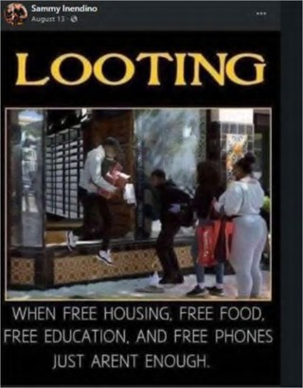

Slide 41
More “Evidence”
*Training
*Communications
*Stellar career
*FF not a supervisor
*Nothing showing actual disruption to CFD
*Off duty conduct
*Complainants never interacted with FF

Slide 42
What Happened Court-Wise?
*FF files his lawsuit in federal district court alleging a violation of his first amendment right to freedom of speech
*Both parties move for summary judgment
October 7, 2024: Summary judgment entered for City:
FF’s speech was not protected by the first amendment because his interests in making the speech were outweighed by the City’s interest in promoting the efficiency of the public services it provides through its employees
*October 24, 2024: FF appealed to the Seventh Circuit
December 2, 2024: FF filed his opening brief
April 2024: Remaining briefs due
??: Case will be set for oral argument

Slide 43
After-Action Review Personnel Issue Template
What plans were in place “pre-entry” to address the issue(s)?
*Identify issue(s)
*Pre-planning
*Training
Under those plans, what should have happened?
What actually happened?
Why did it happen that way?
How can we improve our response next time?
What went well?
Reflections

Slide 44
What about on-duty conduct related to current events? Let’s Debrief
#FDIC2025

Slide 45
My home of Evanston, Illinois- An Introduction
*Occurred Inauguration Day
*Photo taken at a Fire Station while on duty
*Someone posted on Reddit
*Went public pretty quickly
*Shared Widely
*How about some of the comments??

Slide 46
The “Evidence”

Slide 47
Policies
**City Code States:
“No employee while on compensated time shall intentionally: Use any City property or resources in connection with any campaign or political activity.”
“No political activity may take place on any City property or at any City Ward Meeting.”

Slide 48
Policies
*The CBA provides:
“Employees shall have the right to engage in political activities, including to identify themselves as members of the Evanston Fire Department, as long as they engage in such activities while they are off-duty and not in uniform and as long as they do not represent that their positions are positions that are sanctioned by the City or the Evanston Fire Department and make no threats and promises to voters concerning the delivery of services provided by the Evanston Fire Department.”

Slide 49
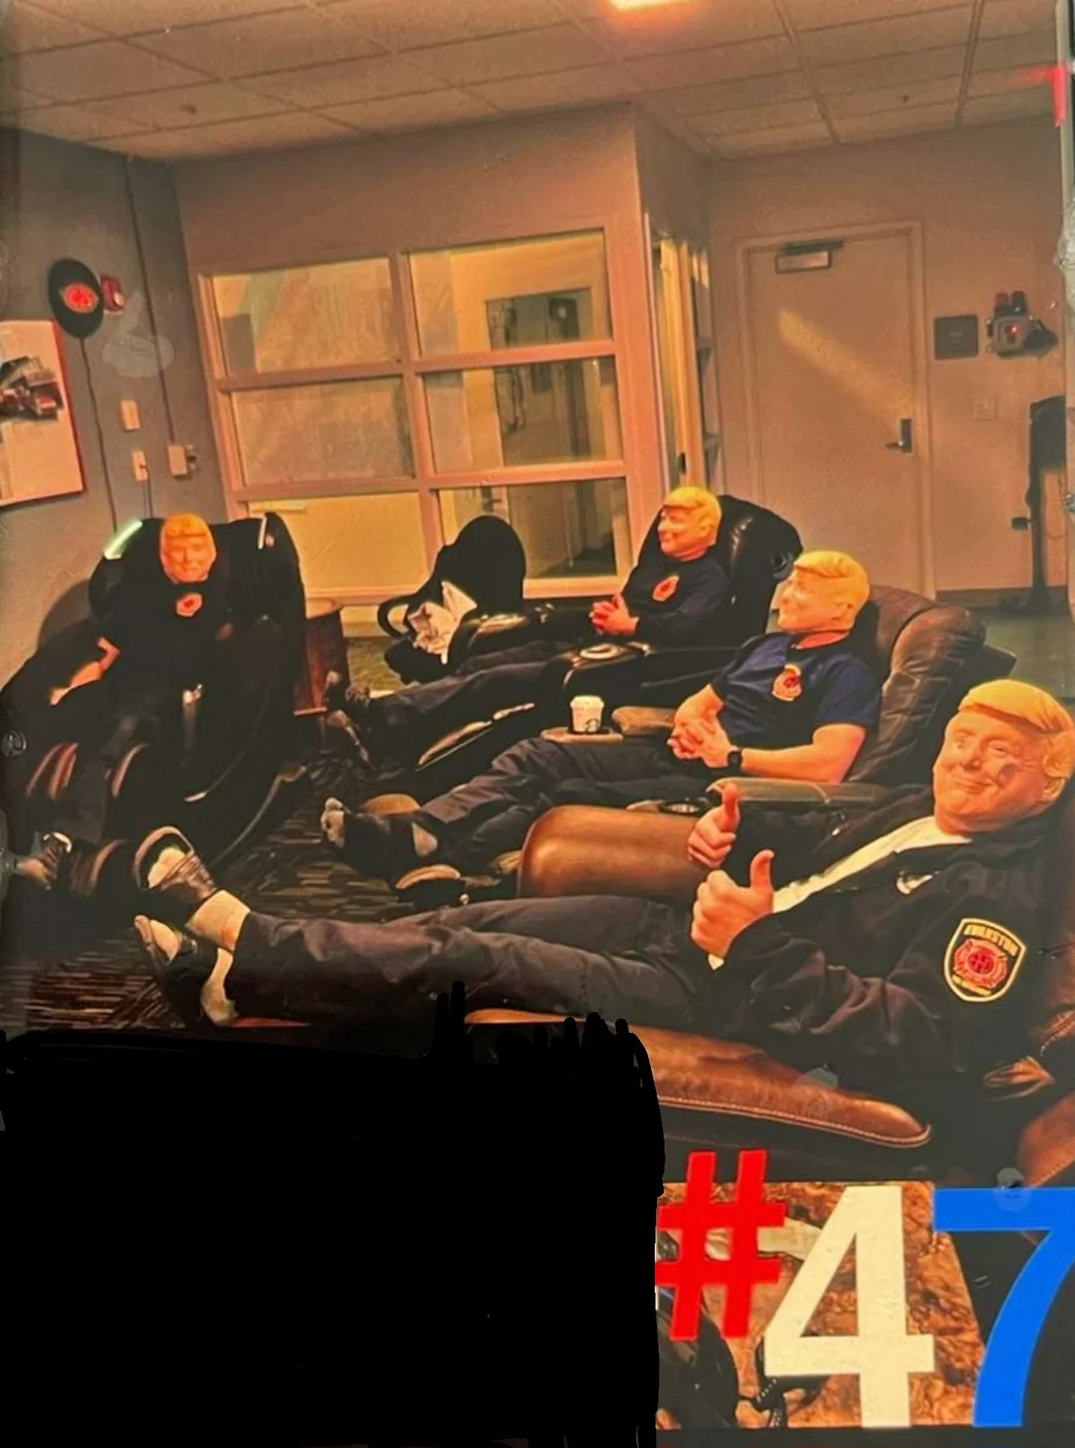
WHAT IS BEING COMMUNICATED IN THIS PHOTO???

Slide 50
Well that makes me feel unsafe. What if they decide someone isn't deserving of help? Maybe they respond to a fire, but then doubt the legal status of a person or believe the person they are supposed to help receives food stamps (just based on what they look like), will they still be willing help those residents in need? This is just more proof that America is so broken. And sadly Evanston is a perfect example of the failure of liberalism as we have defined it in the US for nearly a century. We need radical new ideas and a rejection of the status quo.
I cannot imagine being a minority firefighter and having to work side by side with idiots like this and having to trust (hope) that they would have my back in an emergency. These guys are shoving their disrespect down the throats of their colleagues and announcing that they don’t regard them as human beings. Picture a black female firefighter walking into this common room to pull up a chair and watch some tv, and this is what she sees. This is just gross.

Slide 51
In the grand scheme of things, I place firefighters on the highest pedestal there is. However, this is such a stain on a noble profession. Mixing politics, work, and social media together is just an idiotic look.
This is disappointing for so many reasons. I’m really disgusted by the Evanston fire department’s actions; I have lost any respect I had for them. I hope this was a joke and they take their jobs seriously.
Renders the question of does it take much intelligence to be a firefighter kind of moot.
Absolutely disgusting

Slide 52
Post-Posting Actions
*Chief reacted quickly, apologizing to Mayor & City Counsel, taking full responsibility
*15 firefighters, led by their Union president, apologized at a City Council meeting:
“I want to set the record perfectly straight that we are not the racist, bigoted, sexist, uneducated fools as has been described and portrayed on blogs, forums and social media. When someone calls 911, I want to offer firm confidence and reassurance that we will answer that call, we will fix problems no matter how big or small, and we will have no other consideration in mind other than to make someone’s life better.”
Notes:
*Discipline for those who posed in the masks while in uniform ranged from verbal and written reprimands to suspensions

Slide 53
BREAKING NEWS
*Two FFs received written reprimands
*Two FFs issued a two day suspension without pay
*Acting Captain on duty received a three day suspension without pay

Slide 54
After-Action Review Personnel Issue Template
What plans were in place “pre-entry” to address the issue(s)?
*Identify issue(s)
*Pre-planning
*Training
Under those plans, what should have happened?
What actually happened?
Why did it happen that way?
How can we improve our response next time?
What went well?
Reflections

Slide 55
QUESTIONS???

Slide 56
After-Action Review Personnel Issue Template
What plans were in place “pre-entry” to address the issue(s)?
*Identify issue(s)
*Pre-planning
*Training
Under those plans, what should have happened?
What actually happened?
Why did it happen that way?
How can we improve our response next time?
What went well?
Reflections

Slide 57
What Steps Might An Agency (Your Agency) Implement to Reduce or Eliminate the Possibility of Similar Events Occurring?
#FDIC2025

Slide 58
← Session survey
Alisa B. Arnoff
Personnel Fire Attorney
Scalambrino & Arnoff, LLP
www.sacounsel.com
aba@sacounsel.com
(312) 629-0546
@tervmom1
@abarnoff
← CAPSE EMS credit

