Slide 1
Tips and techniques for technical rescues
Captain Mike Giroux
Yonkers Fire Department, NY
Special Operations/ Training

Slide 2
who I am:
24.5 year veteran with Yonkers Fire Department- NY
Most of my career I was assigned to a SOC Unit (Rescue Co. 1 or Squad Co.)
Lead Instructor for Rescue School- Basic and Advance
Train SOC units in all disciplines of Tech Rescue and U.S.A.R. Operations
Train all units on PSS
Train fire departments, industry and military around the country in technical rescue. (Ropes, CSR, Collapse, NO HAZ-MAT)
Author of Technical Rescue: Tips and Techniques- Fire Engineering 2025.
So what does this all mean?

Slide 3
WHAT IS TECHNICAL RESCUE?
It is the APPLICATION of SPECIAL KNOWLEDGE, SKILLS, and EQUIPMENT to safely resolve unique and / or complex rescue situations

Slide 4
What do you consider a technical rescue?
High Angle Rope
Low Angle Rope?
Antenna or Tower Rescue
Confined Space
Trench Rescue
Collapse Rescue
Extrication?
RIT or F.A.S.T.?
HAZ-MAT

Slide 5
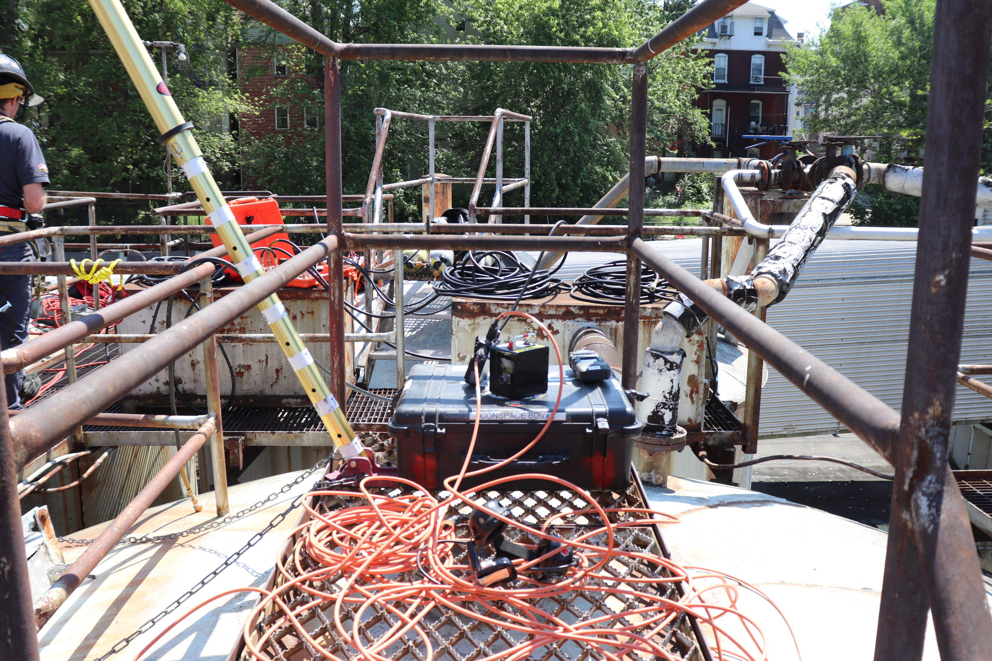
We will focus on a few “troubling” issues
Low edge transitions:
    For High angle rope
    Confined Space
    Trench

Slide 6
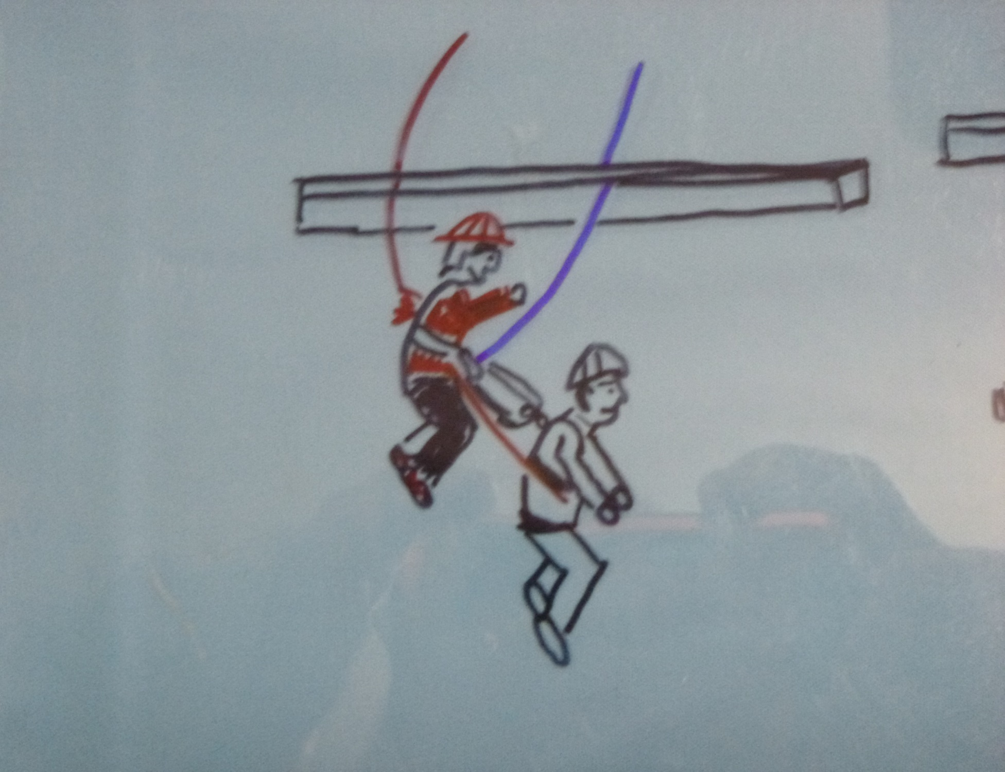
Another possible area that may create havoc
Static Line Pick-off / Line transfer
    100 different ways
    Do you have a set SOG/SOP
    Training?

Slide 7
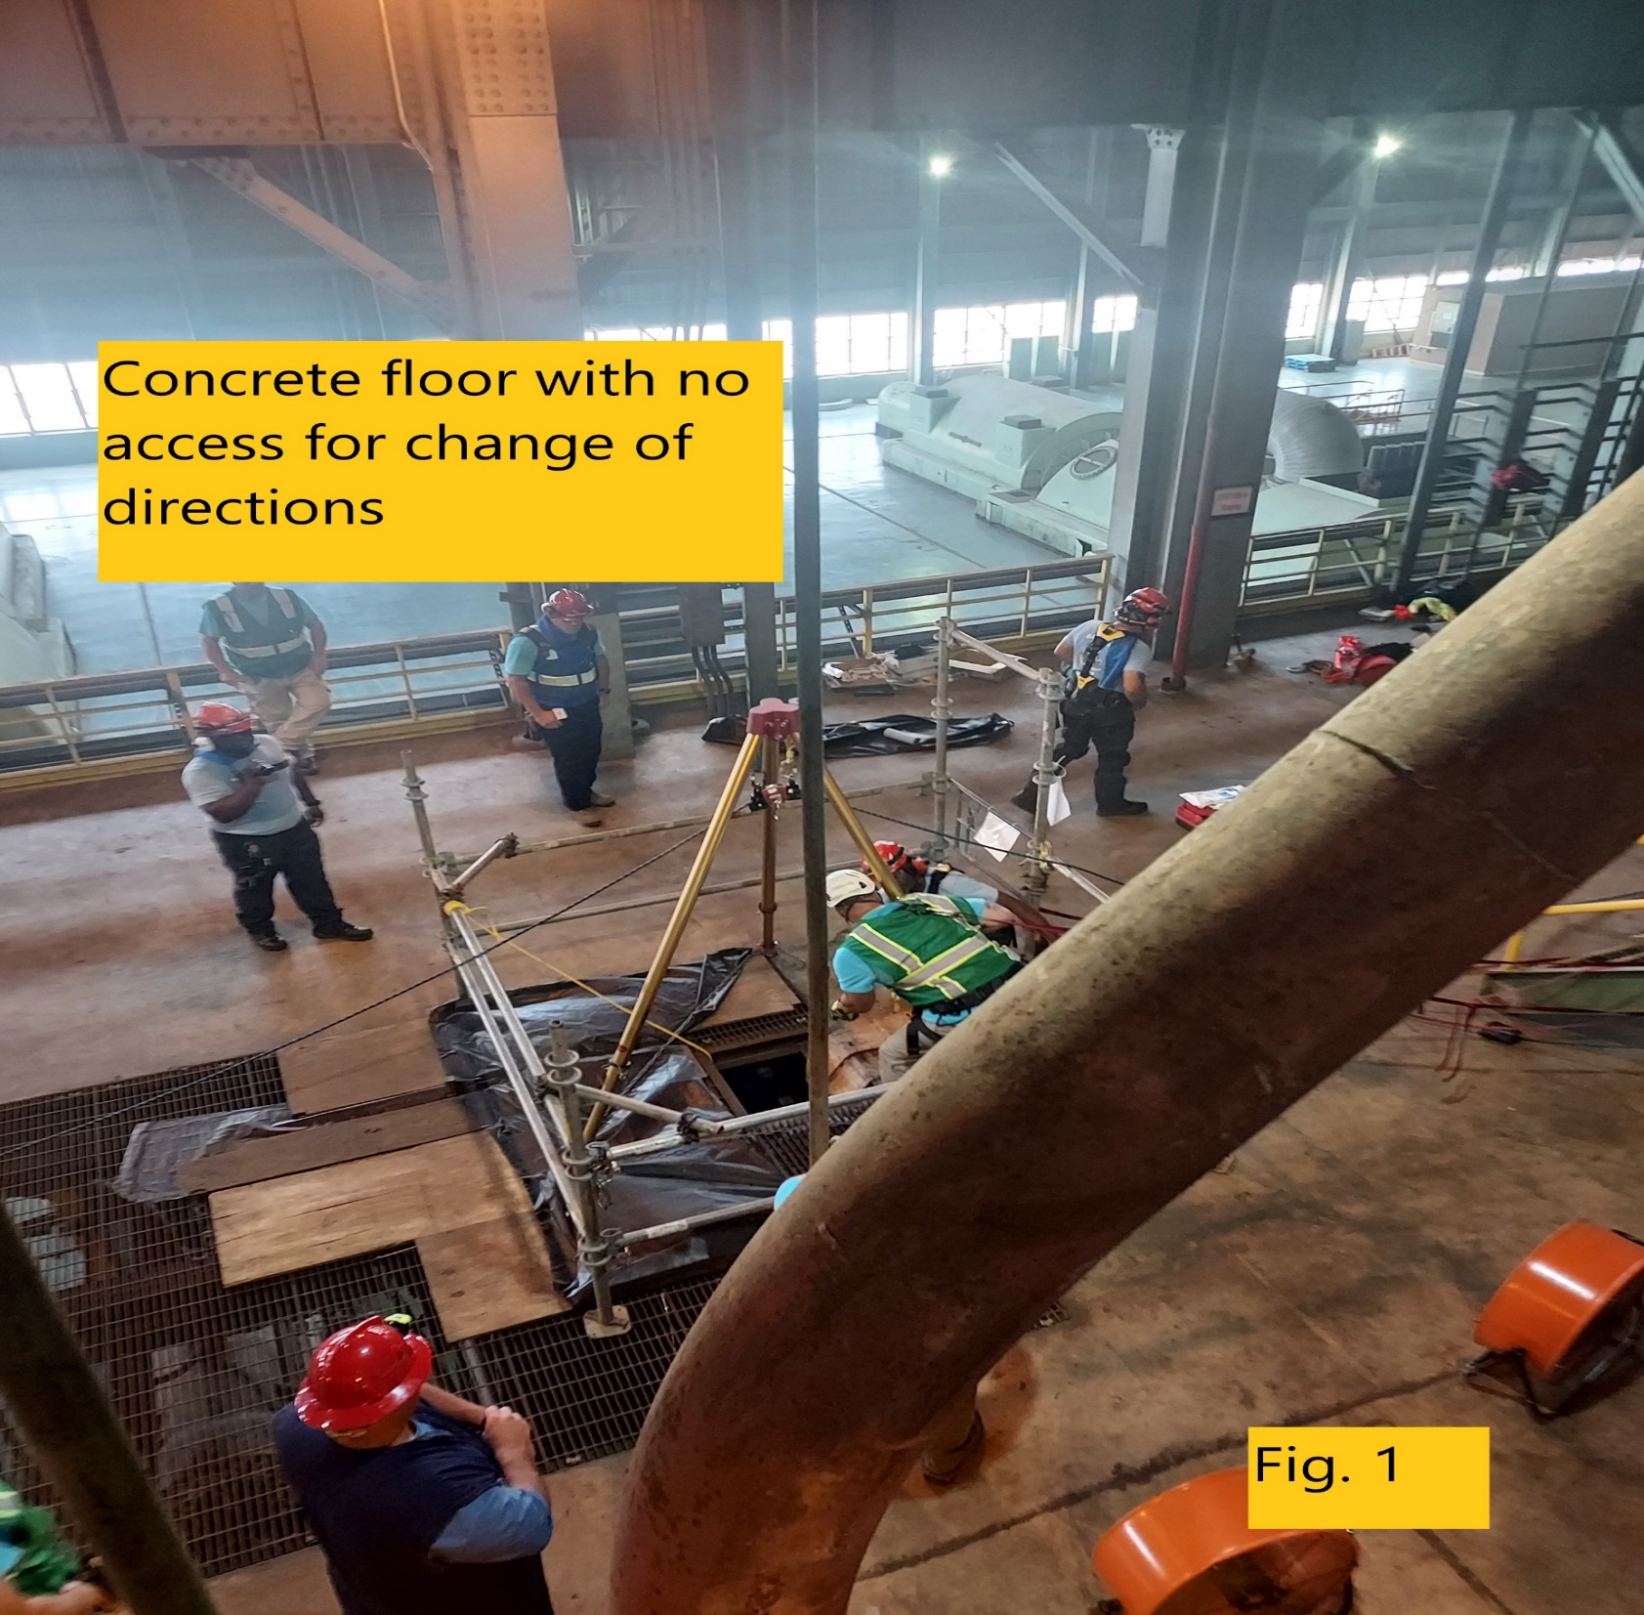
The most common problem we usually come across ?
Tripod Rigging when we don’t have:
  COD at bottom
  Any anchors around the hole
  How do you handle?

Slide 8
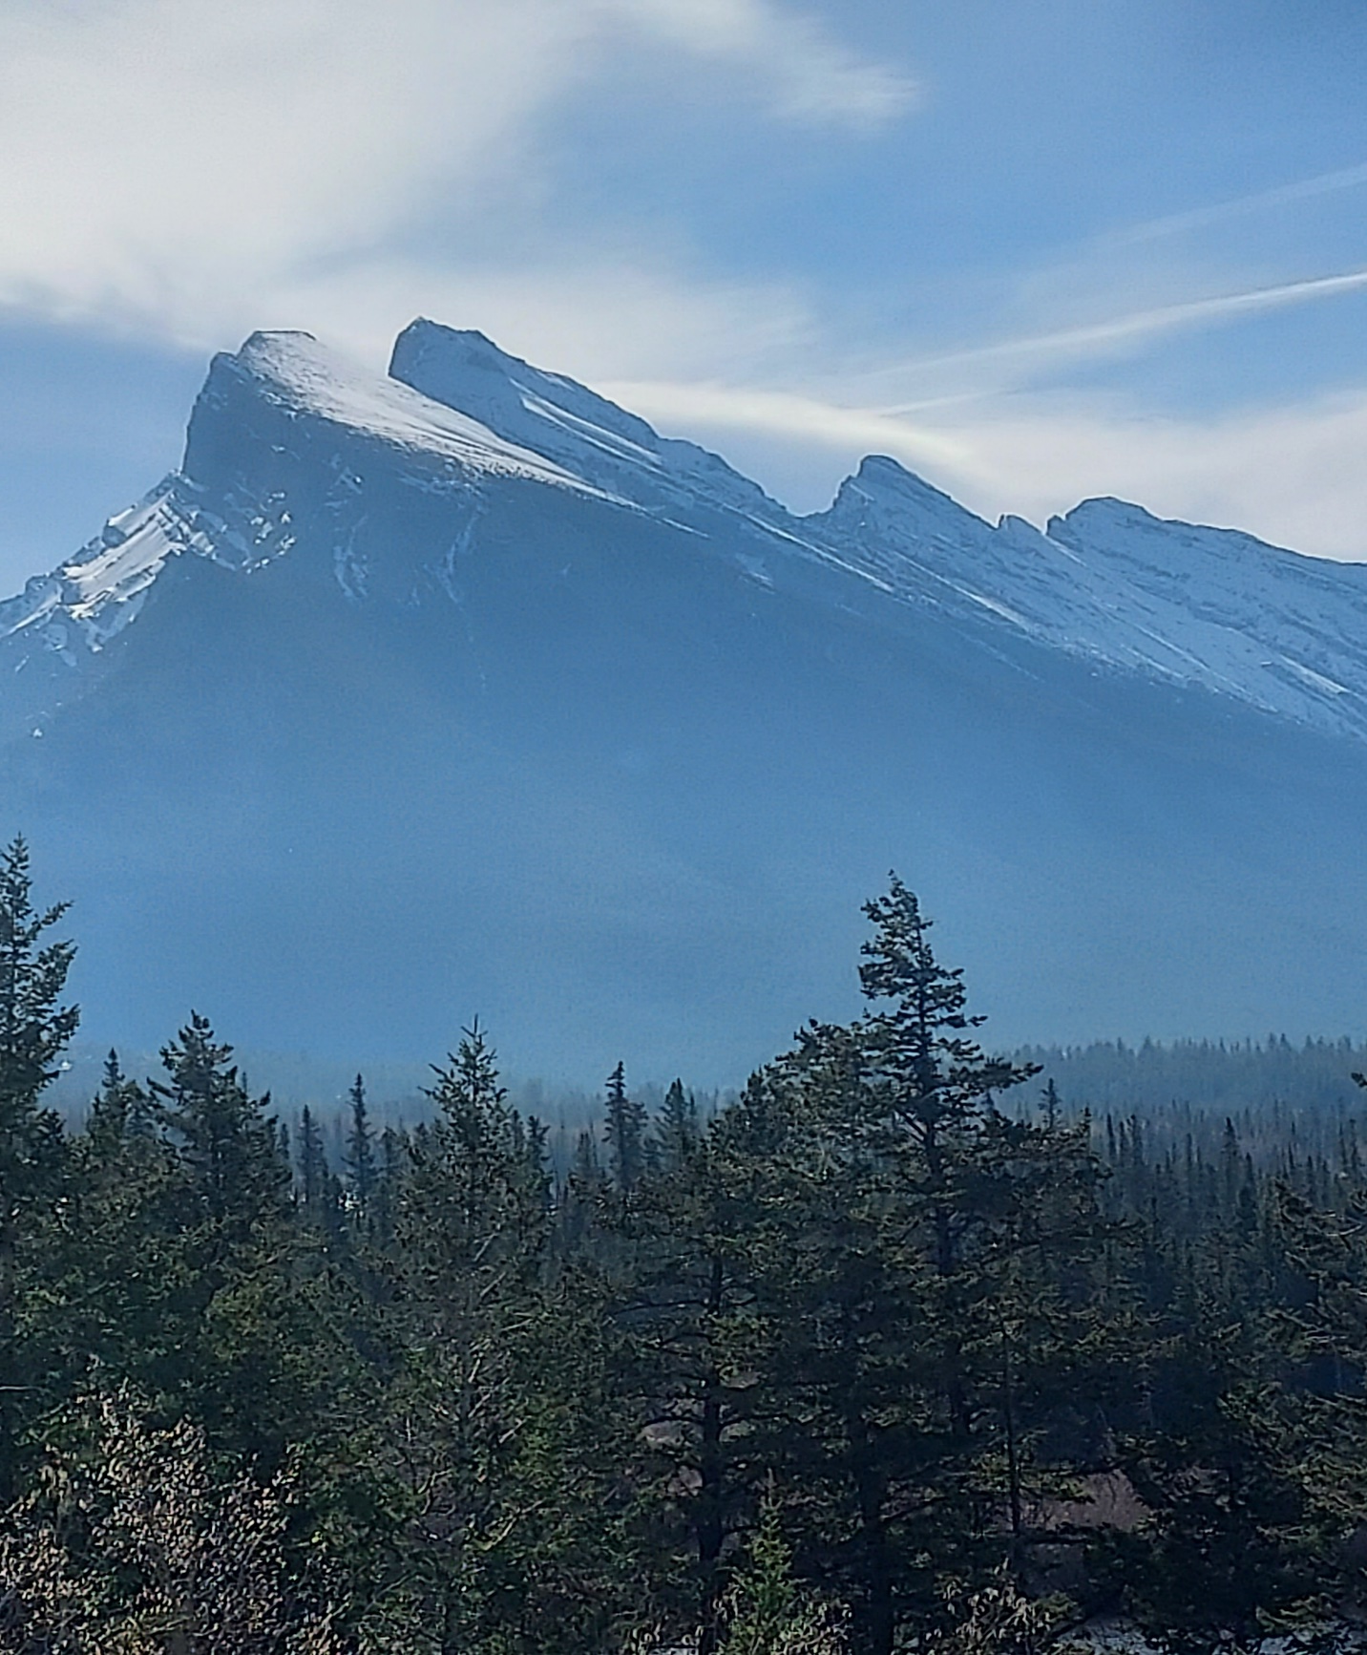
LASTLY, ANGLES/ FORCES/ NEWEST RESEARCH ?
ANGLES:
  Are they really that important
  What have we been taught so far
  What type of forces are we concerned about in the systems?
  Will the “NEW RESEARCH” change NFPA and how we approach rope rescue in the future?

Slide 9
To accomplish the objective……
3 THINGS MUST BE FOLLOWED.
(NON-NEGOTIABLE)
SIMPLE
SAFE
PROVEN ?

Slide 10
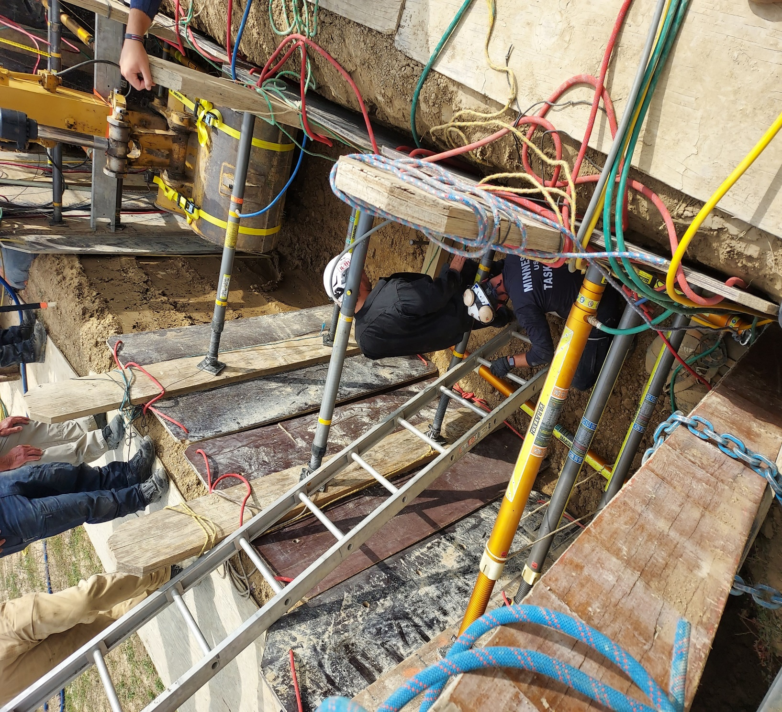
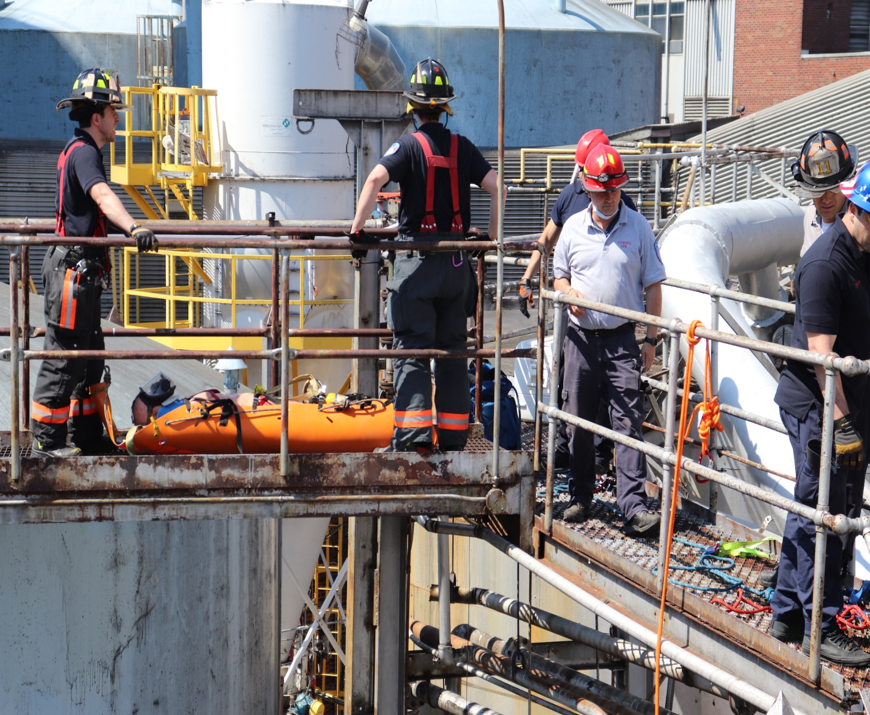
Low edge transitions:

Slide 11
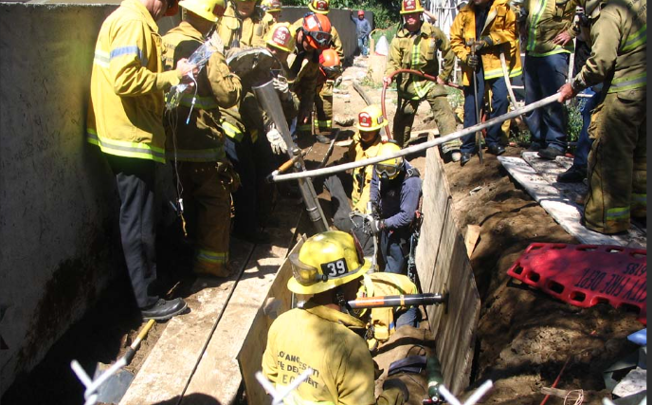
How do you overcome these issues???
Do you have an SOG/SOP to follow?
Is it simple, safe, and proven?
Is it dependent on the type of incident??
Or do you just…

Slide 12
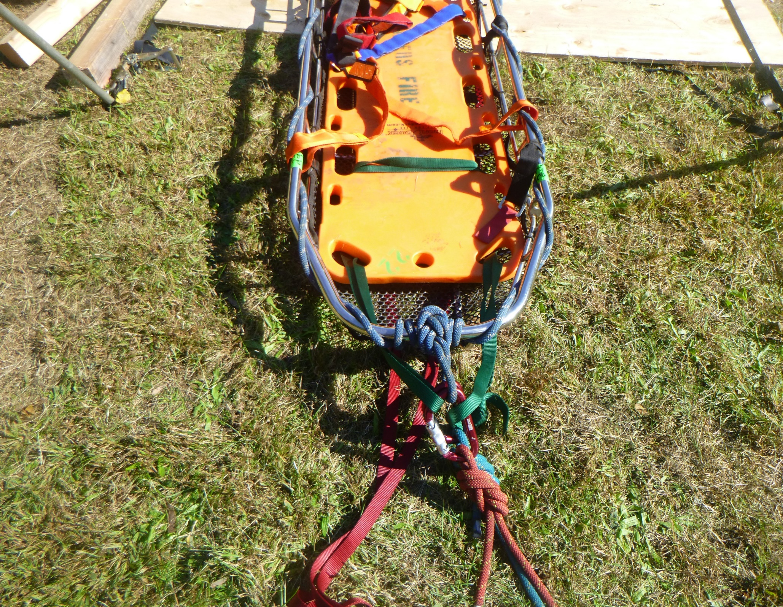
One simple, safe, and proven method is:
This technique will work for any low point transition.
Could be for trench, CSR, or any other low point that may arise
Equipment needed:
30 ft piece of 1” flat webbing
Your main and belay or twin system

Slide 13
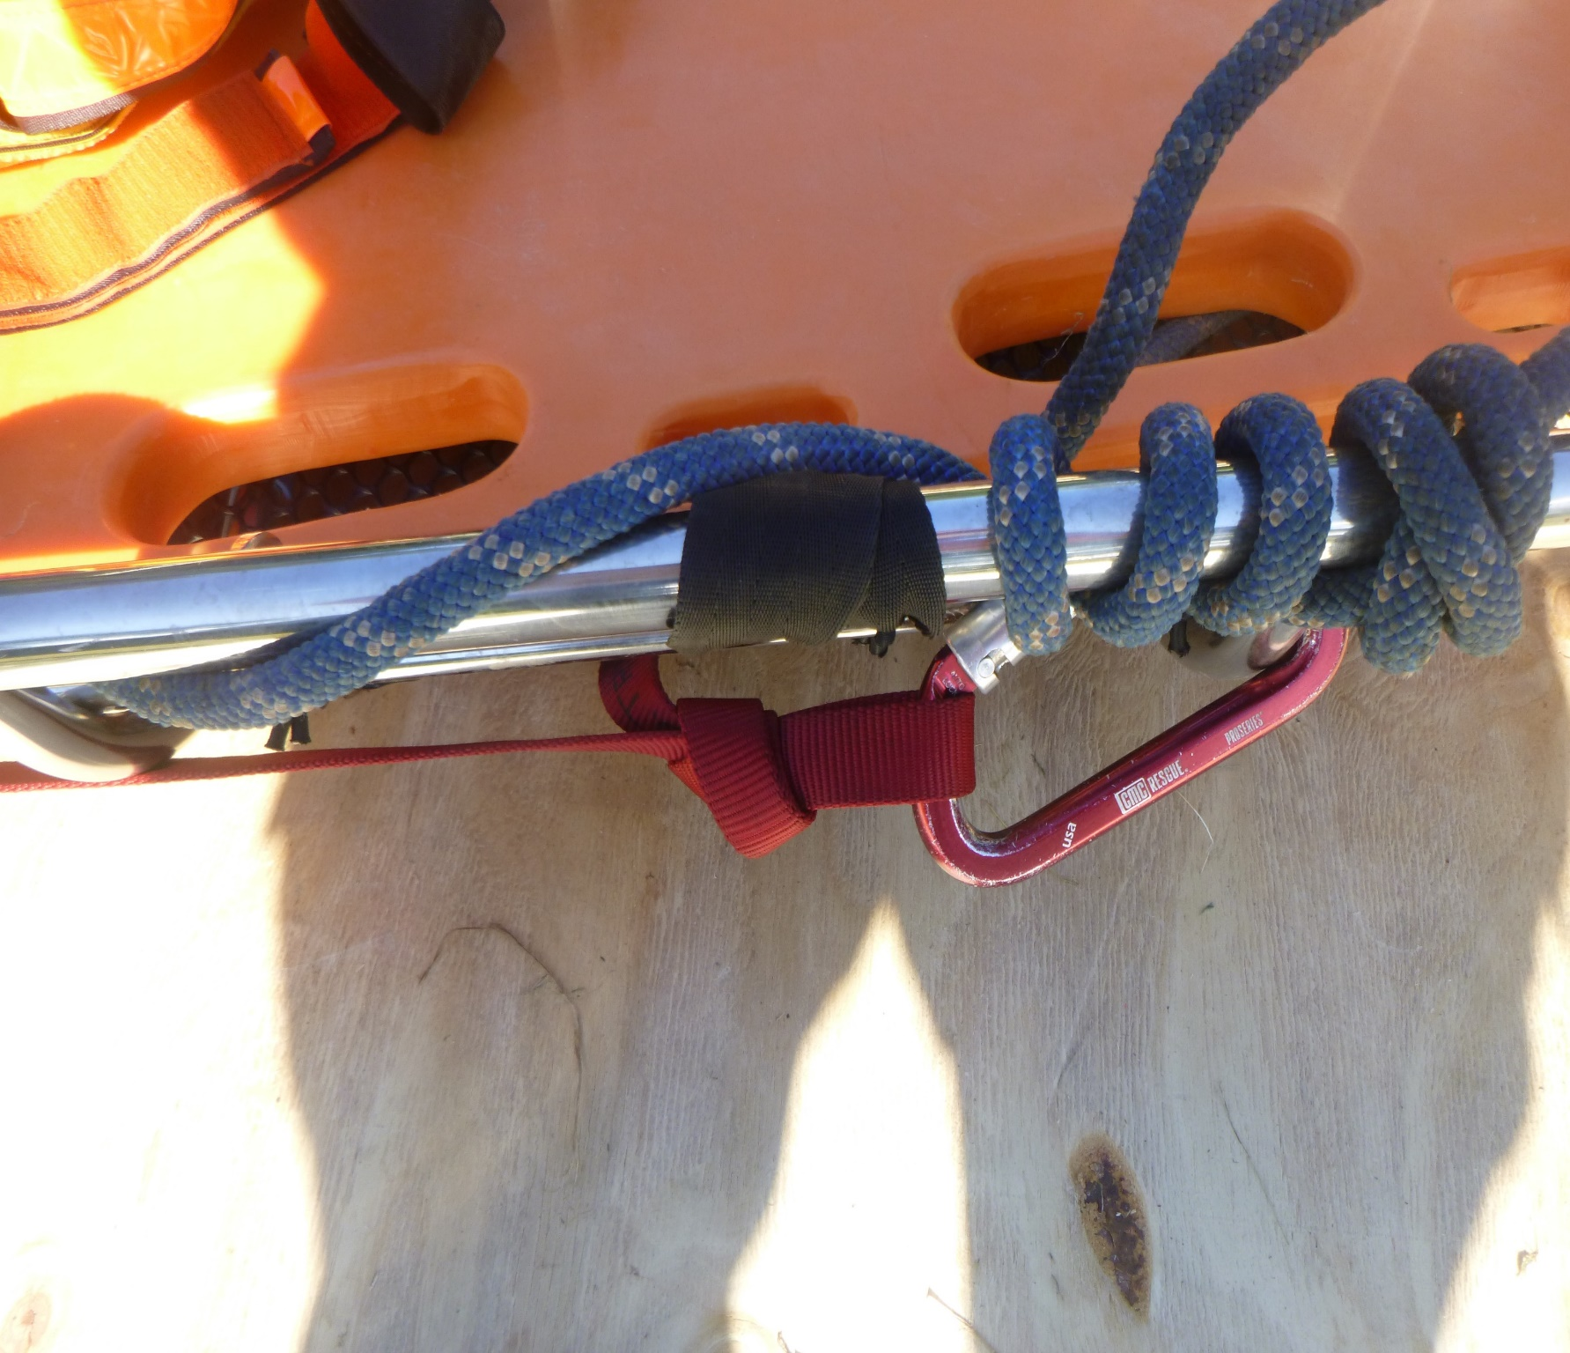
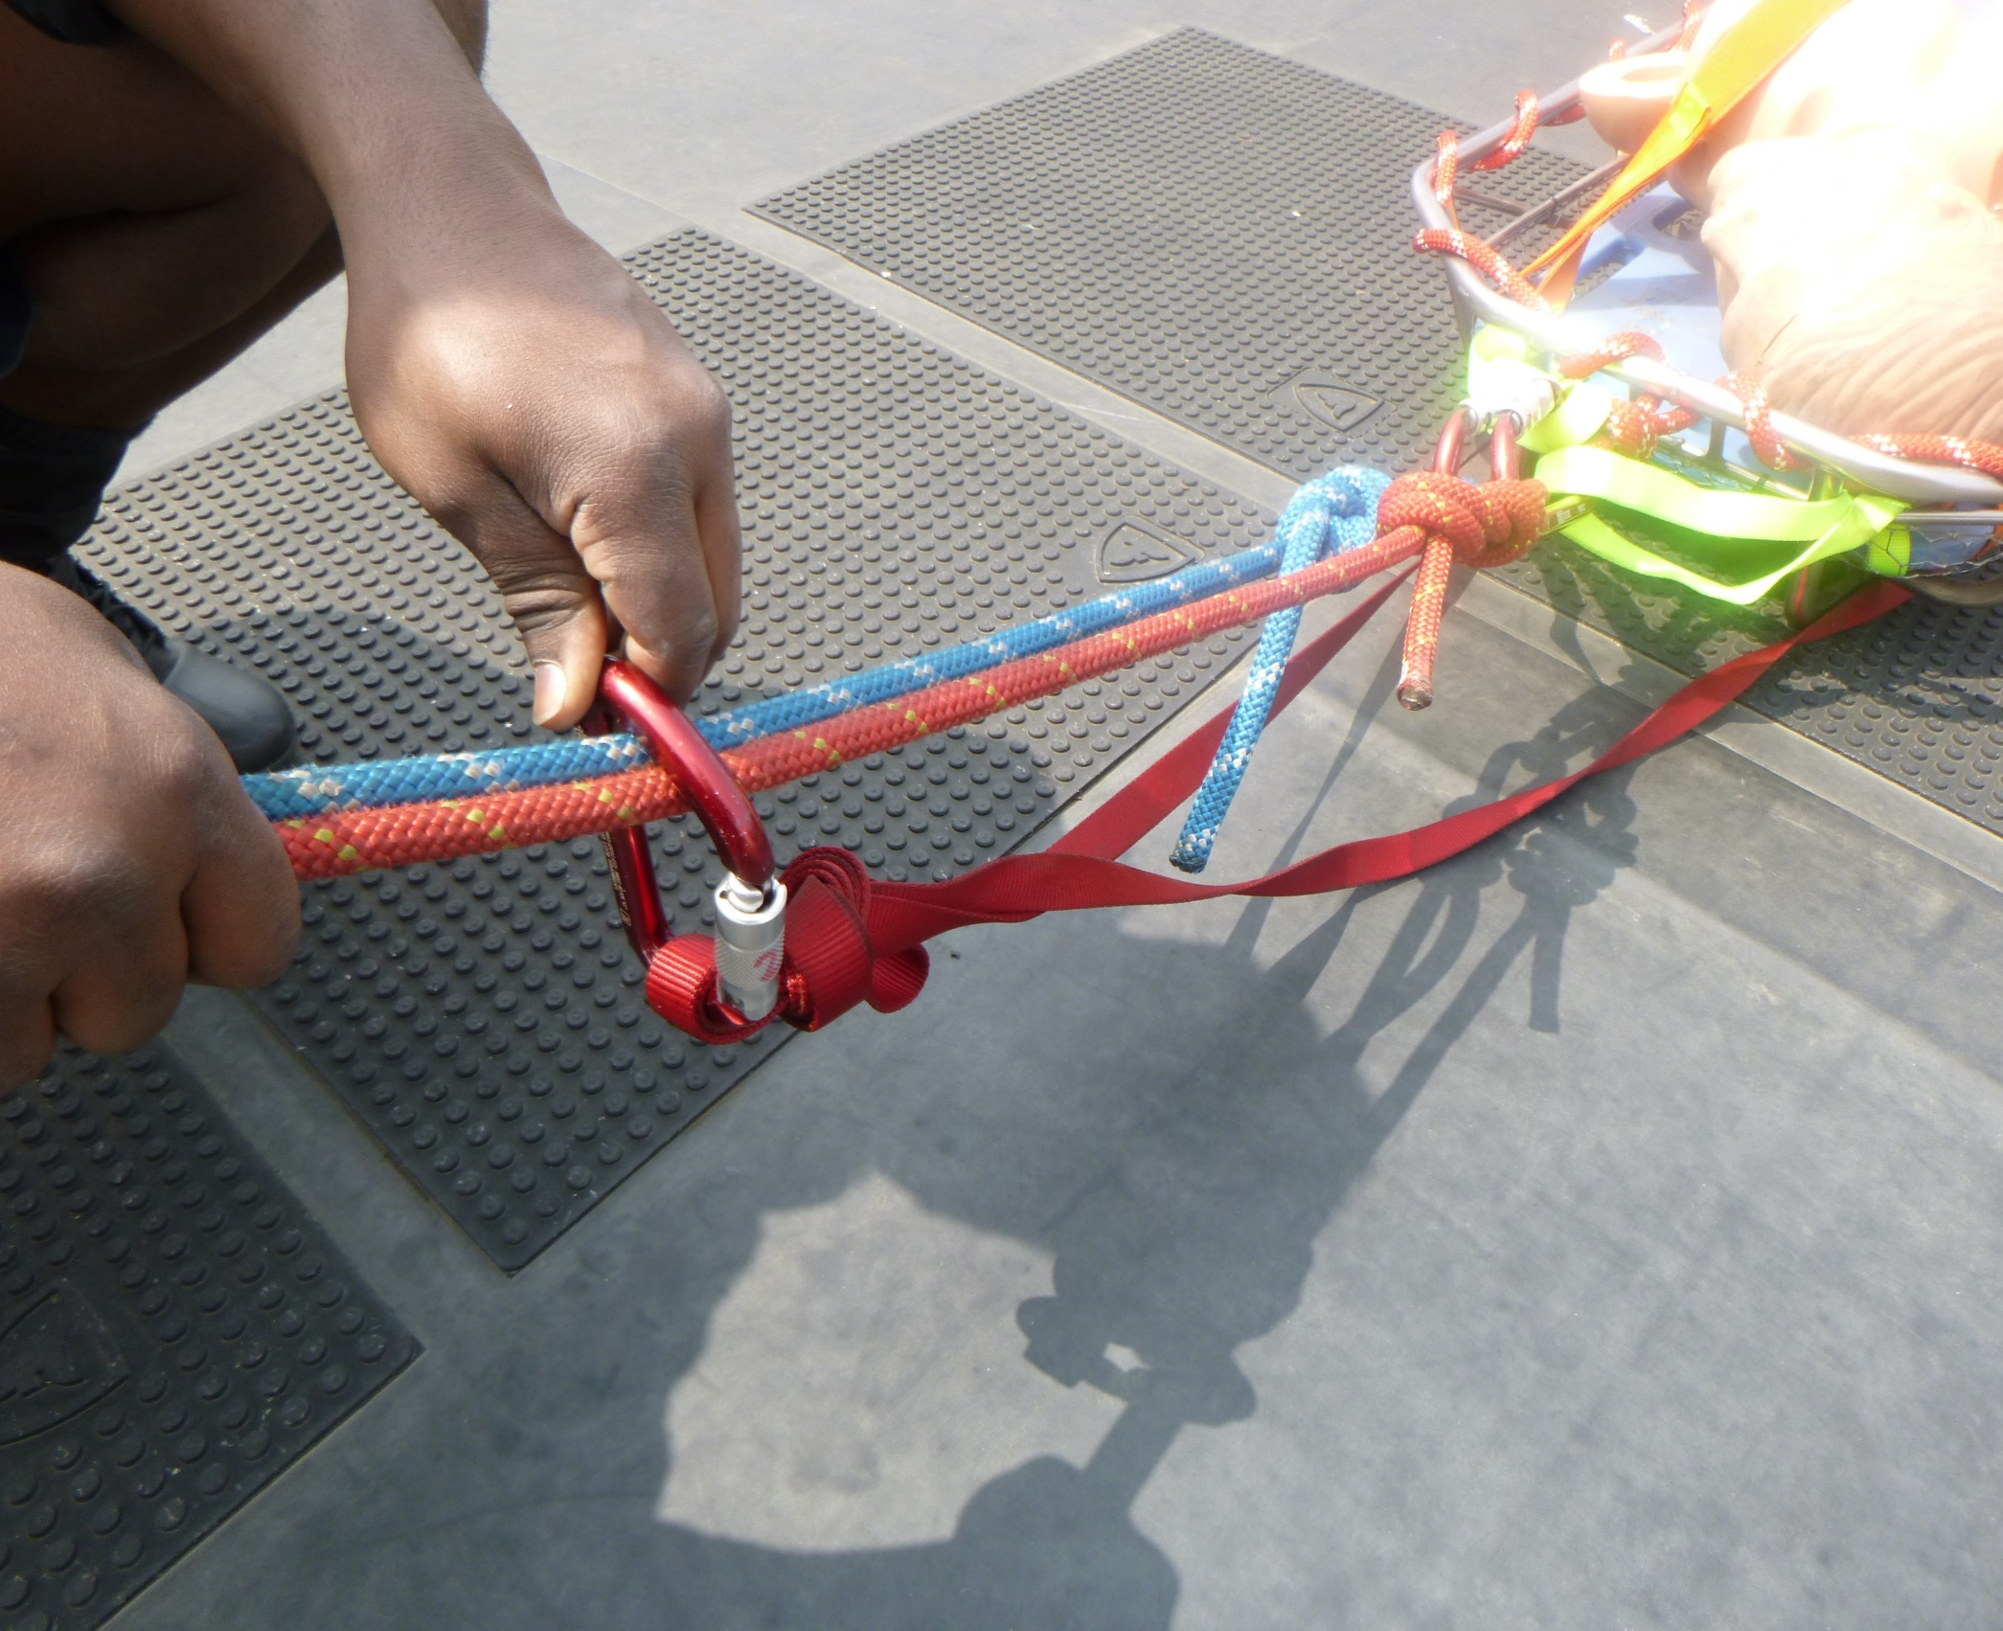
Low point transition:

Slide 14
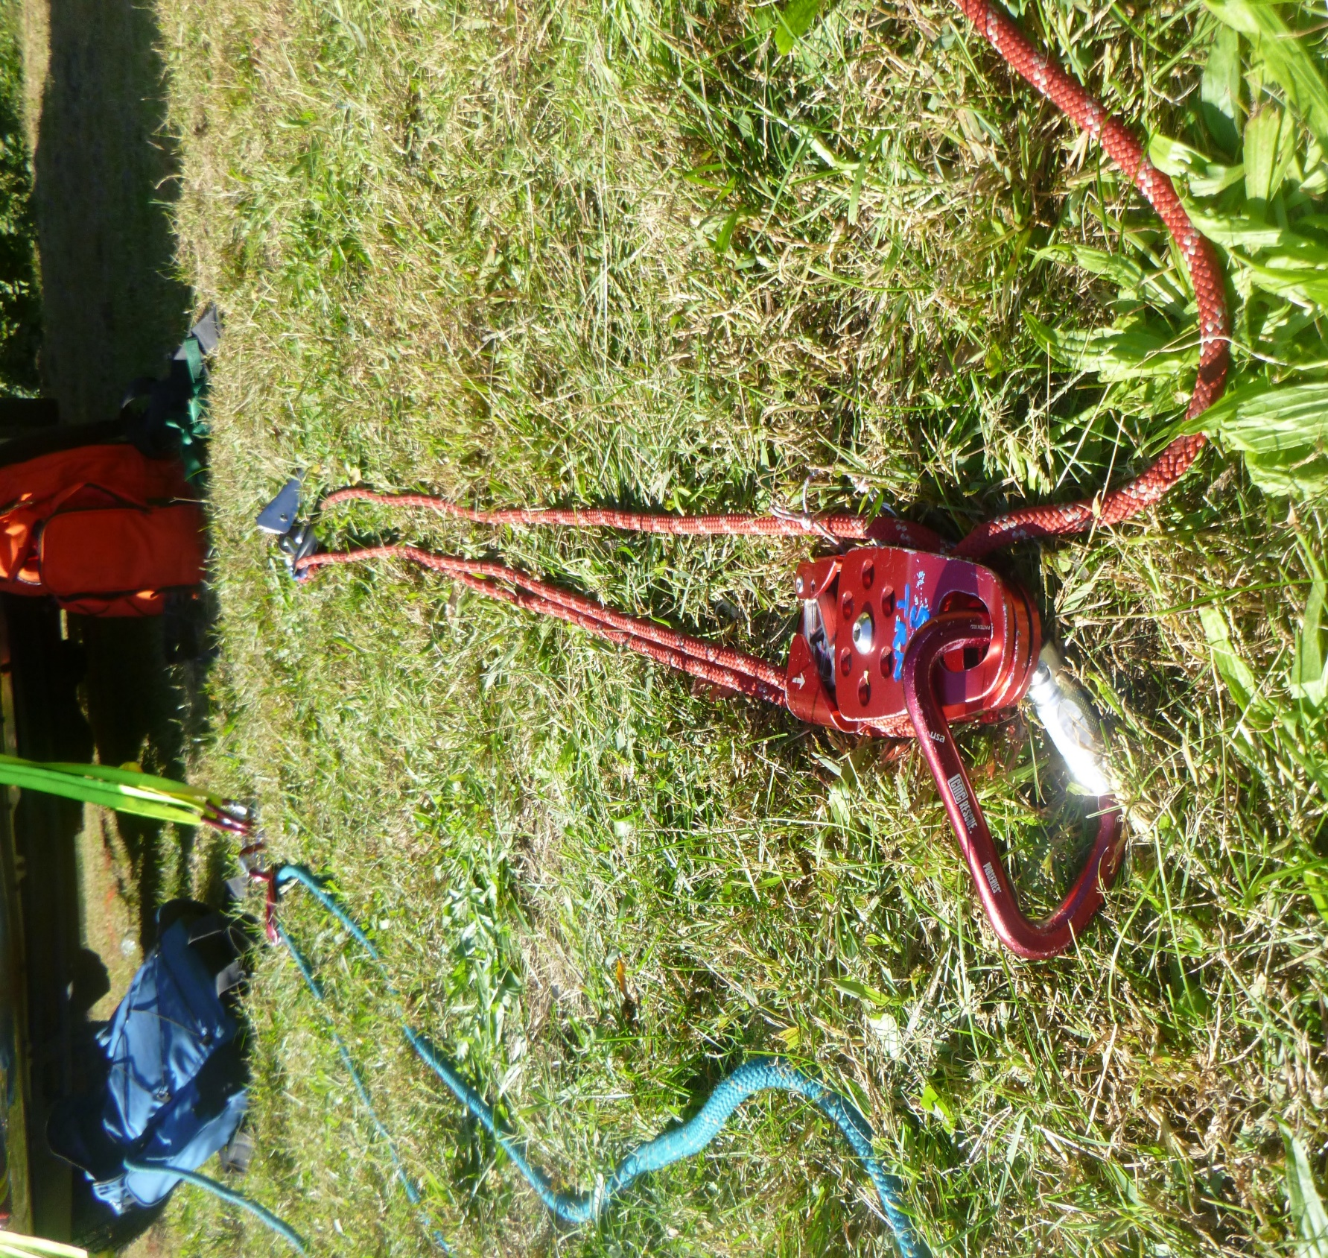
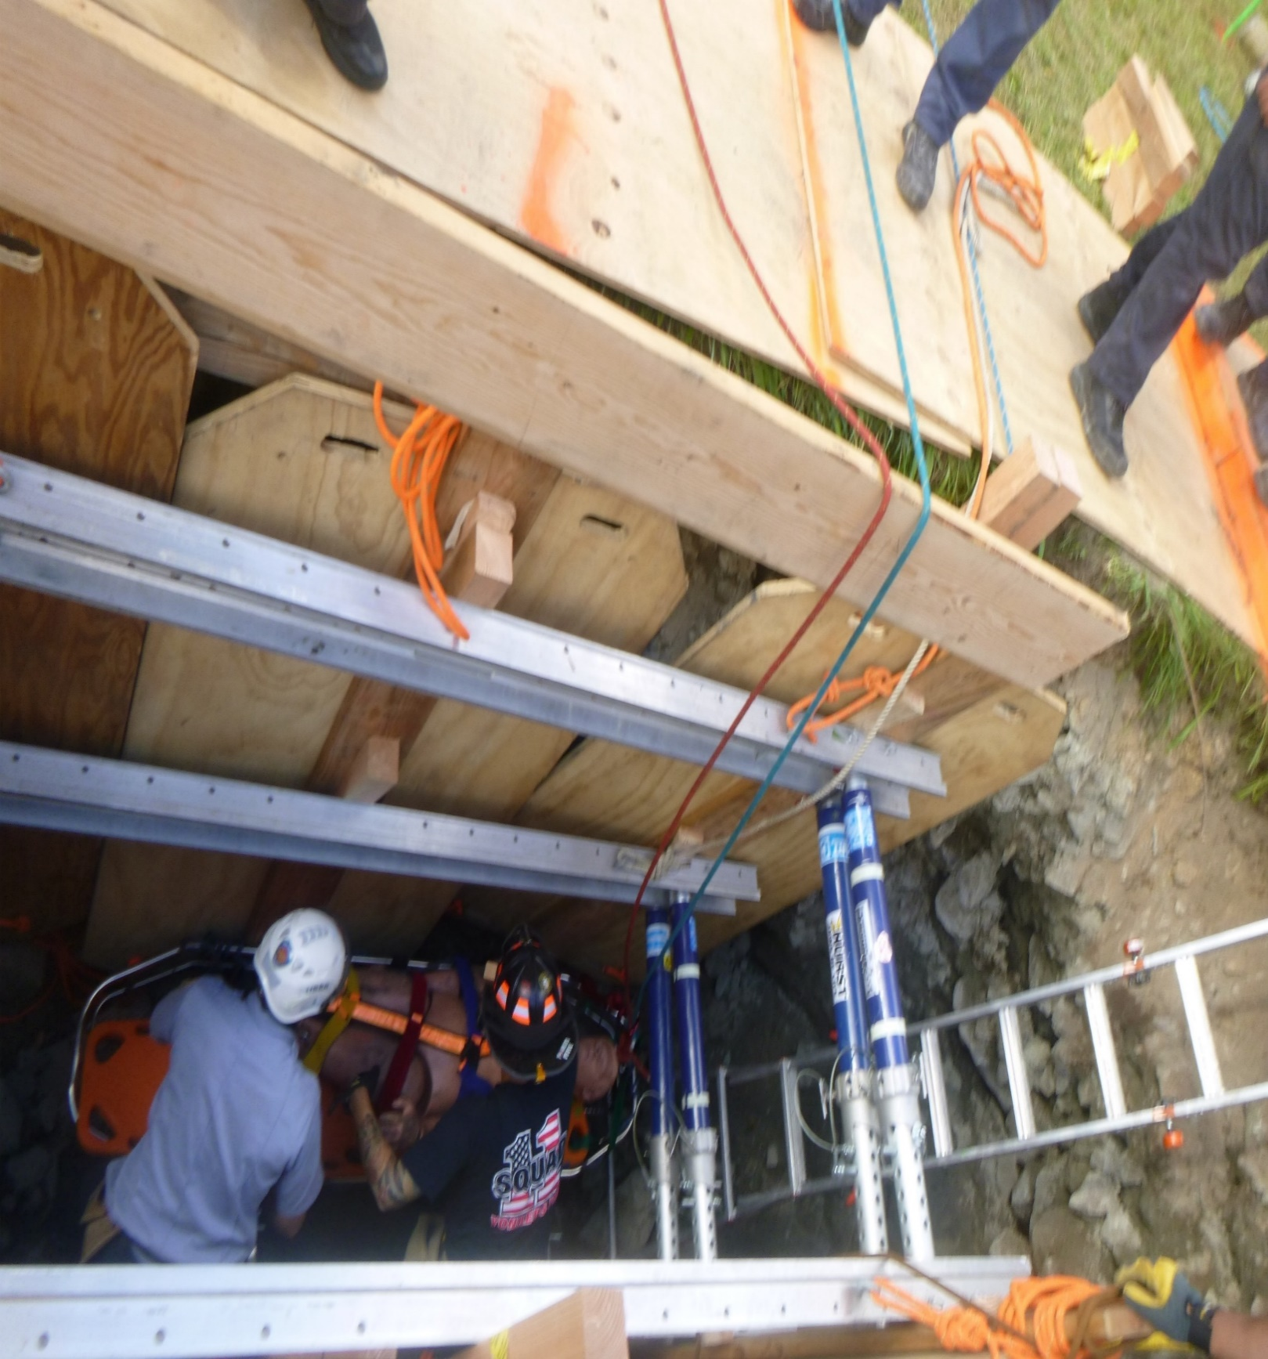
Low point transition:

Slide 15
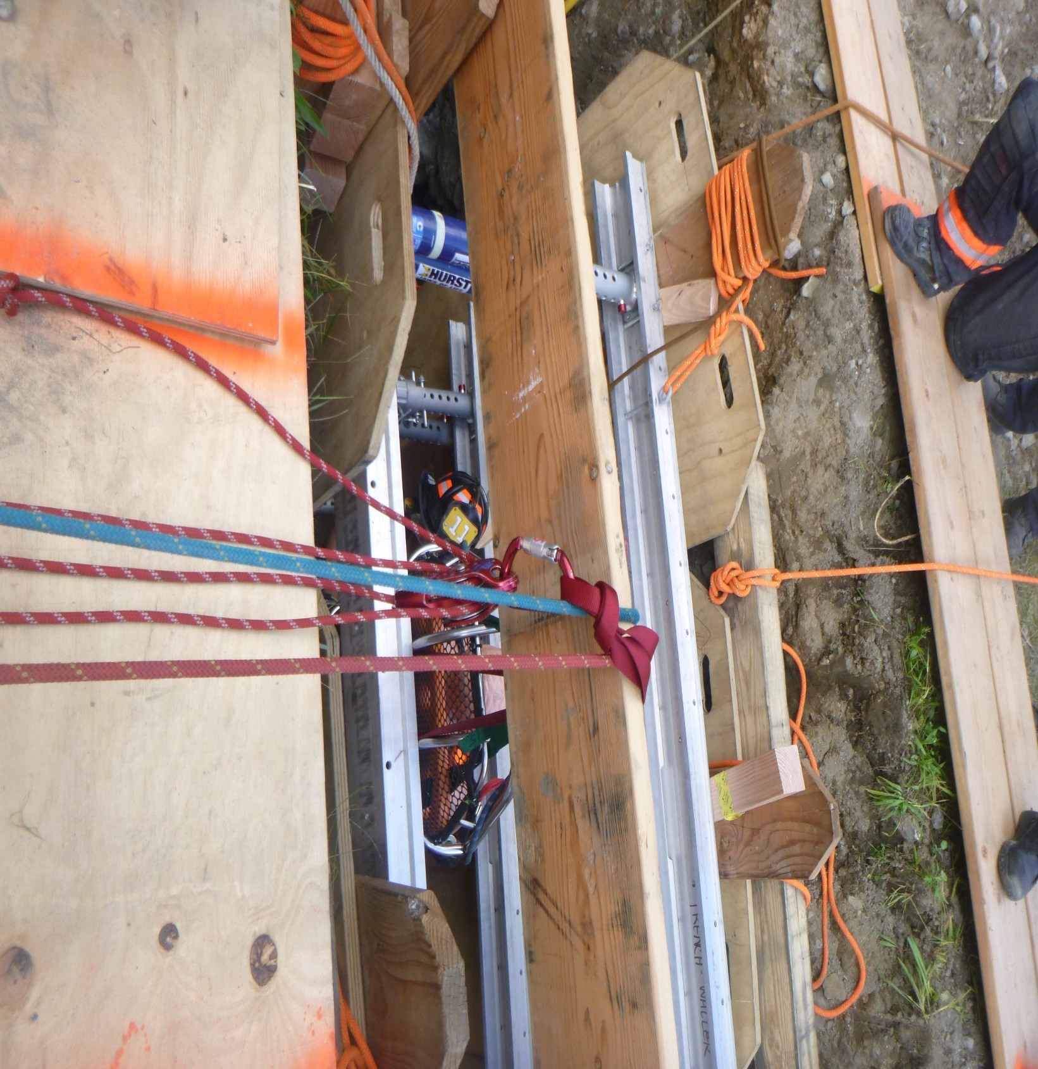
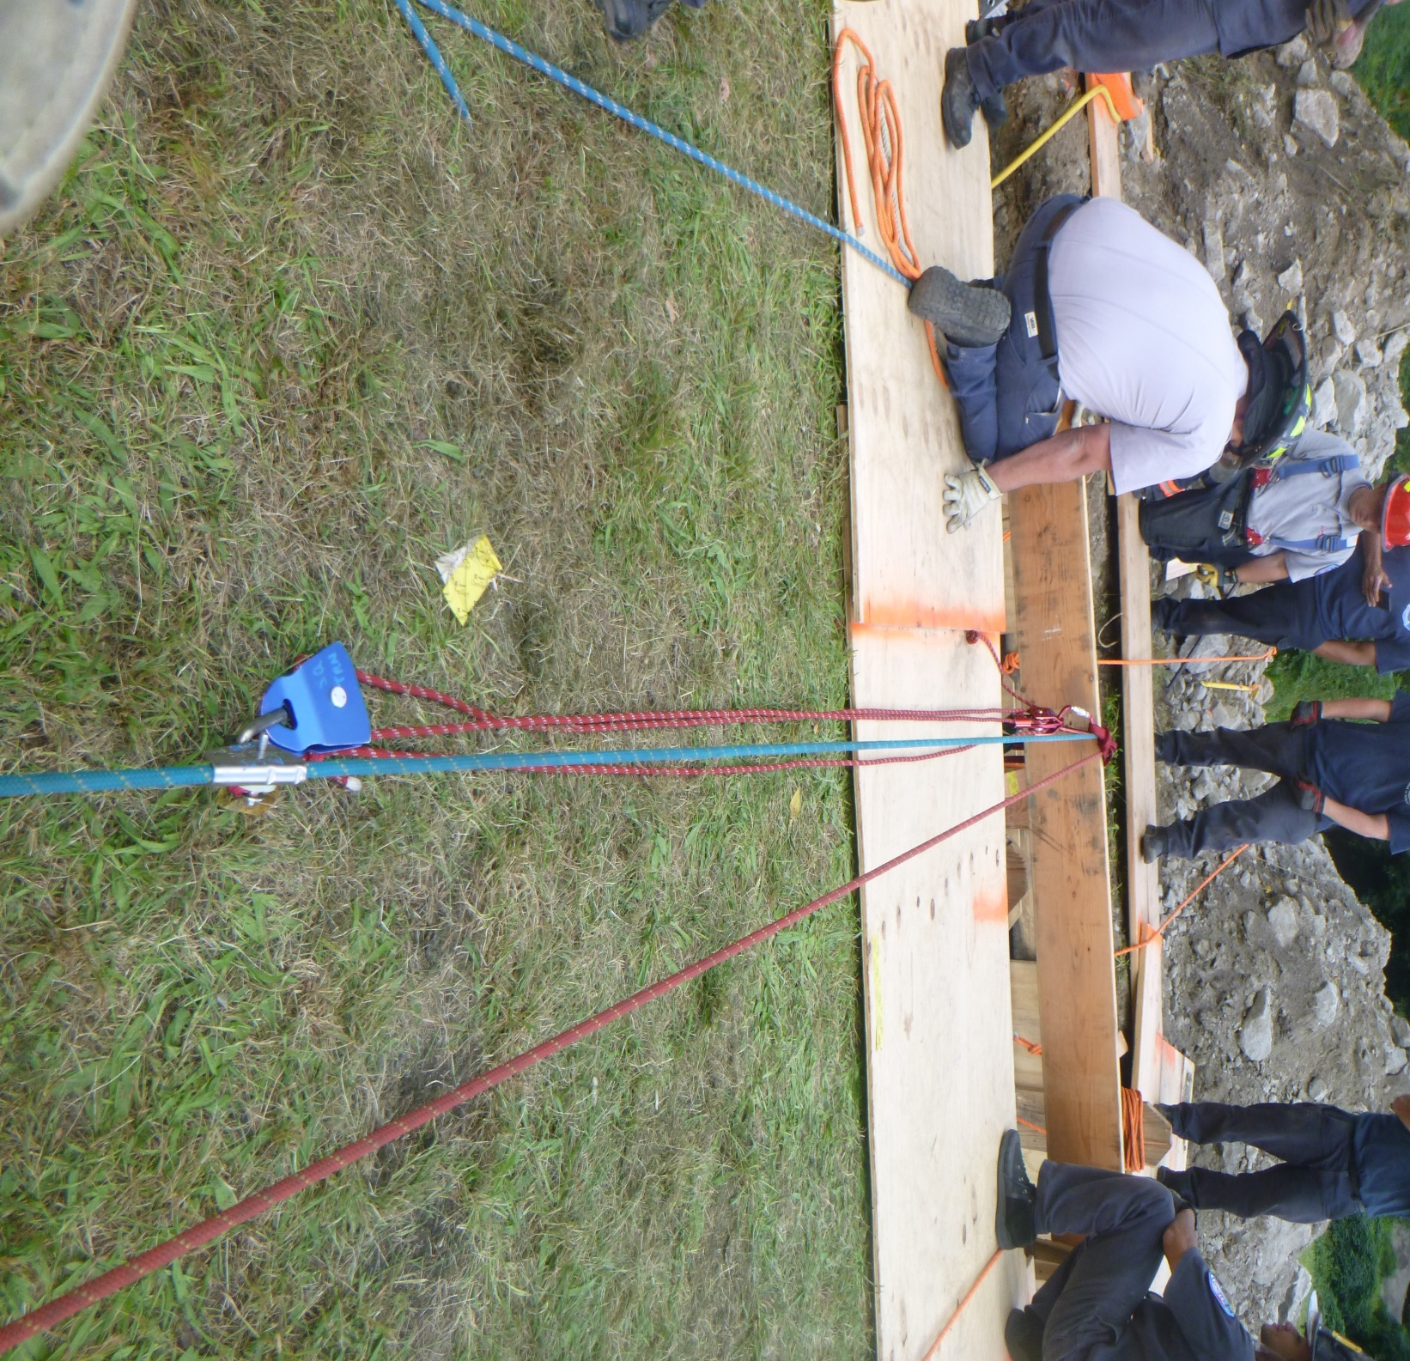
Low point transition:

Slide 16
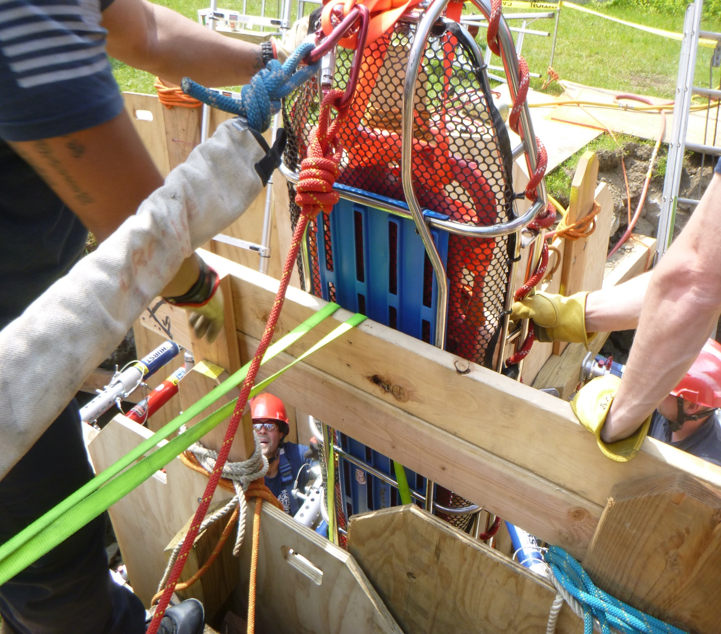
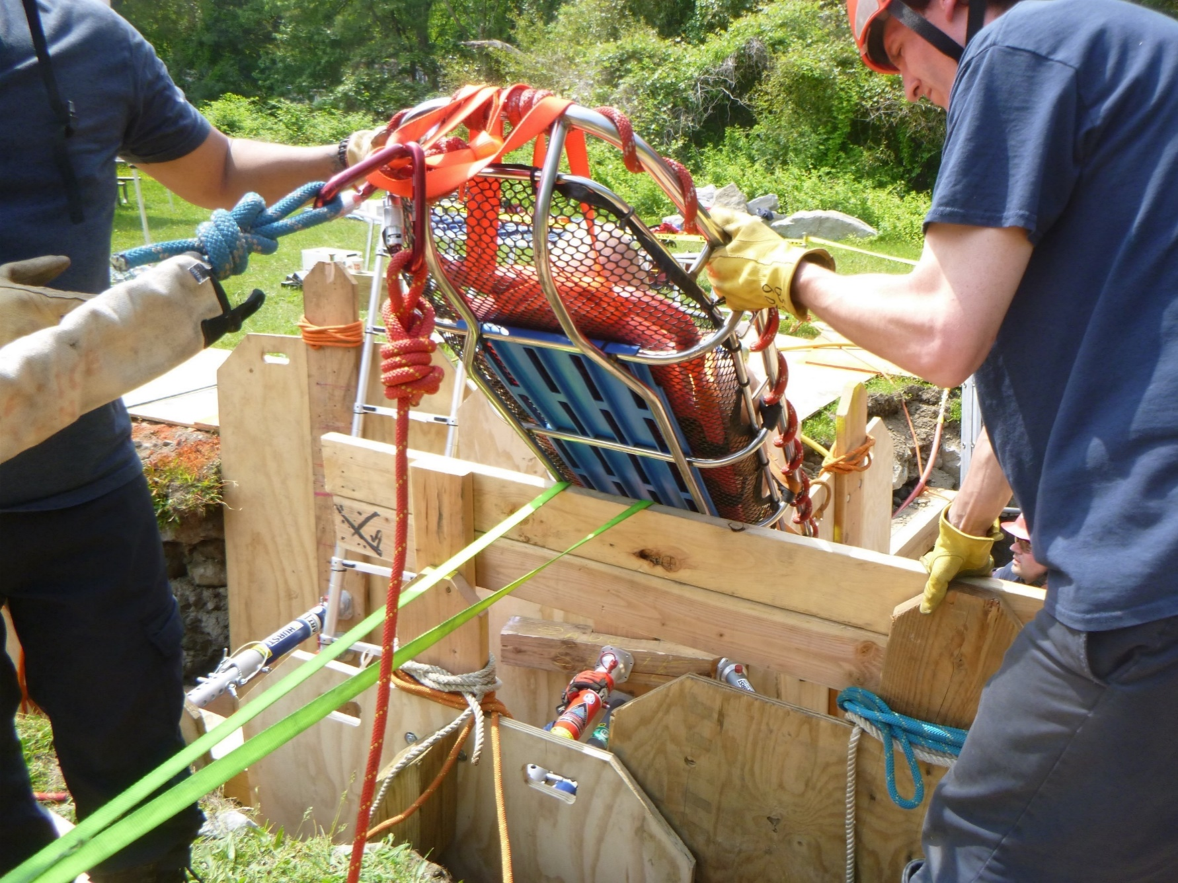
Low point transition:

Slide 17
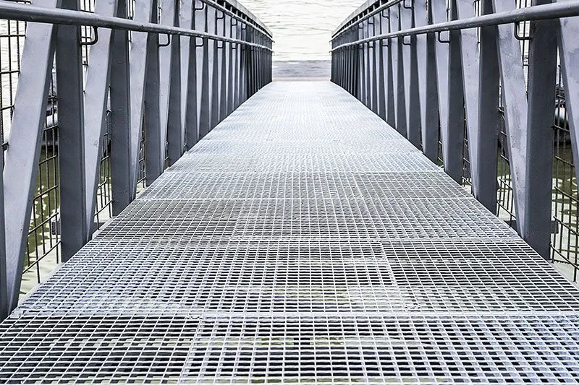
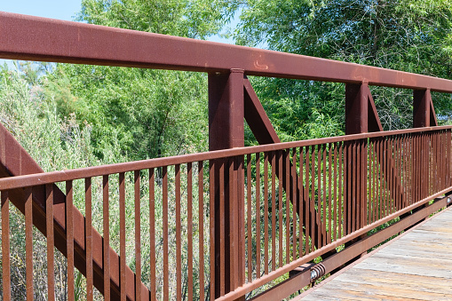
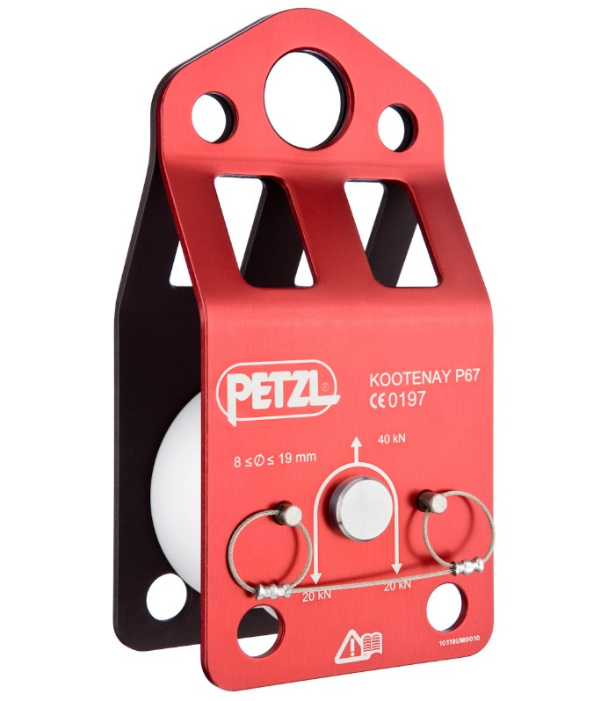
Low point transition:

Slide 18
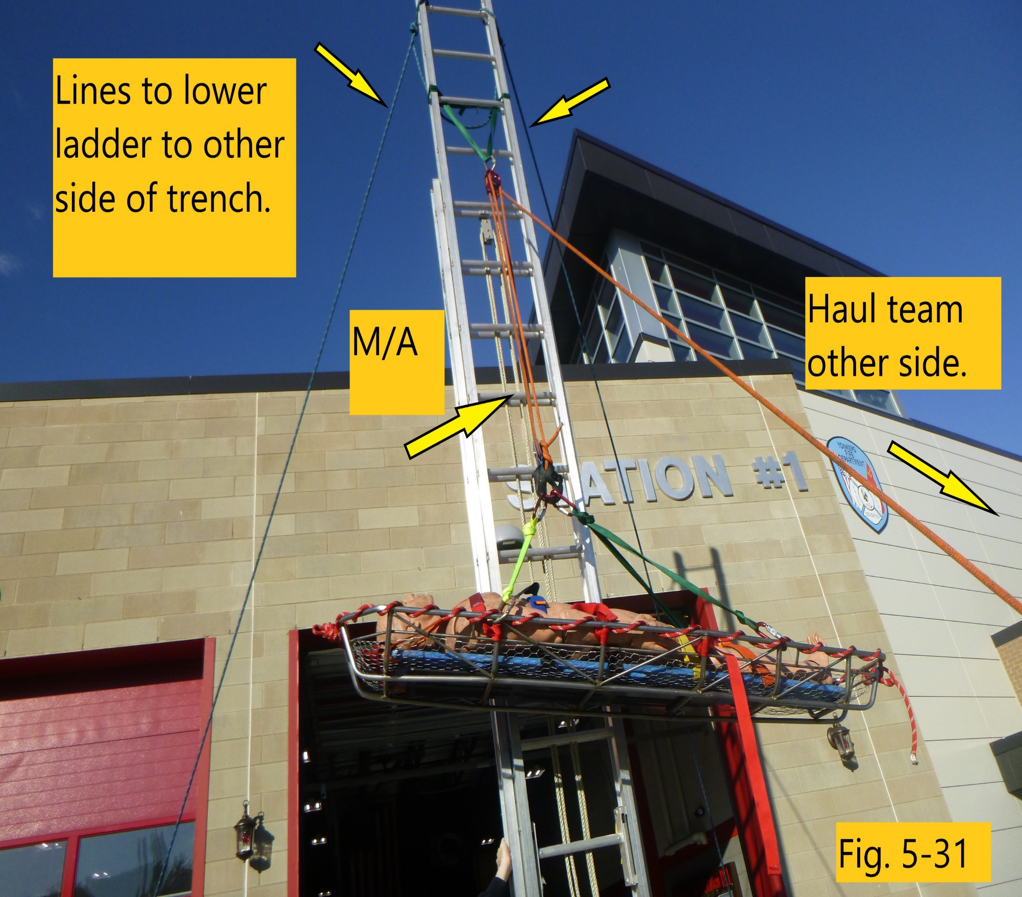
Other options:
Particularly for trench
  Set up bridges for tripod
  Portland Pick

Slide 19
STATIC LINE PICK-OFF/ LINE TRANSFER:
What is your SOG/SOP?
What type of rope system do you use? (single line/ main and belay or Twin tension system)
Who rigs the system?
Who goes over the side?
Who is in charge?
How many plans do you have?
Did you do WHATS UP??

Slide 20
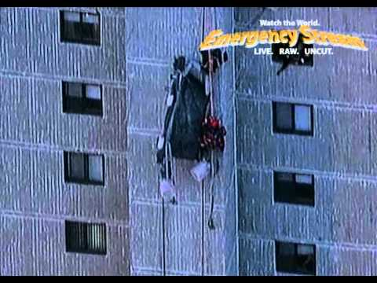
Static line pick-offs / line transfer
These situations can be difficult, but they don’t need to be.
Know your SOG / SOP
Know your systems
Train, train, and continue to train
Stay with our 3 PRINCIPLES
  SIMPLE
  SAFE
  PROVEN

Slide 21

Static line pick-off / line transfer:
Difference between the “old style” vs. the “newer style” (Y-method)
What whiteboarding showed us with the older one
How the newer one is safer
What about twin system with pick-offs. (slight rigging difference)

Slide 22
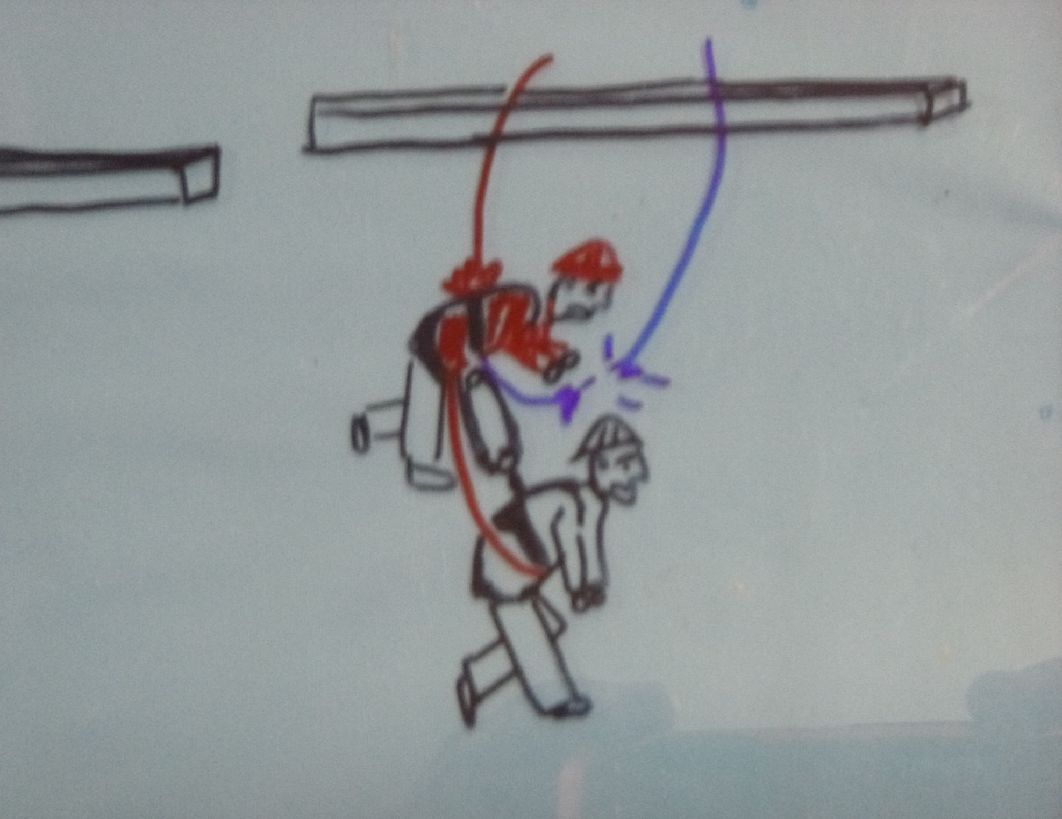
Static line pick-off / line transfer:
The “older” method had some very concerning safety problems
If the main line failed, where did all the force go to
The rescuer is absorbing the shock. Not only from the victim but also from the anchor
They are being pulled apart from the inside out. (OUCH!!)

Slide 23
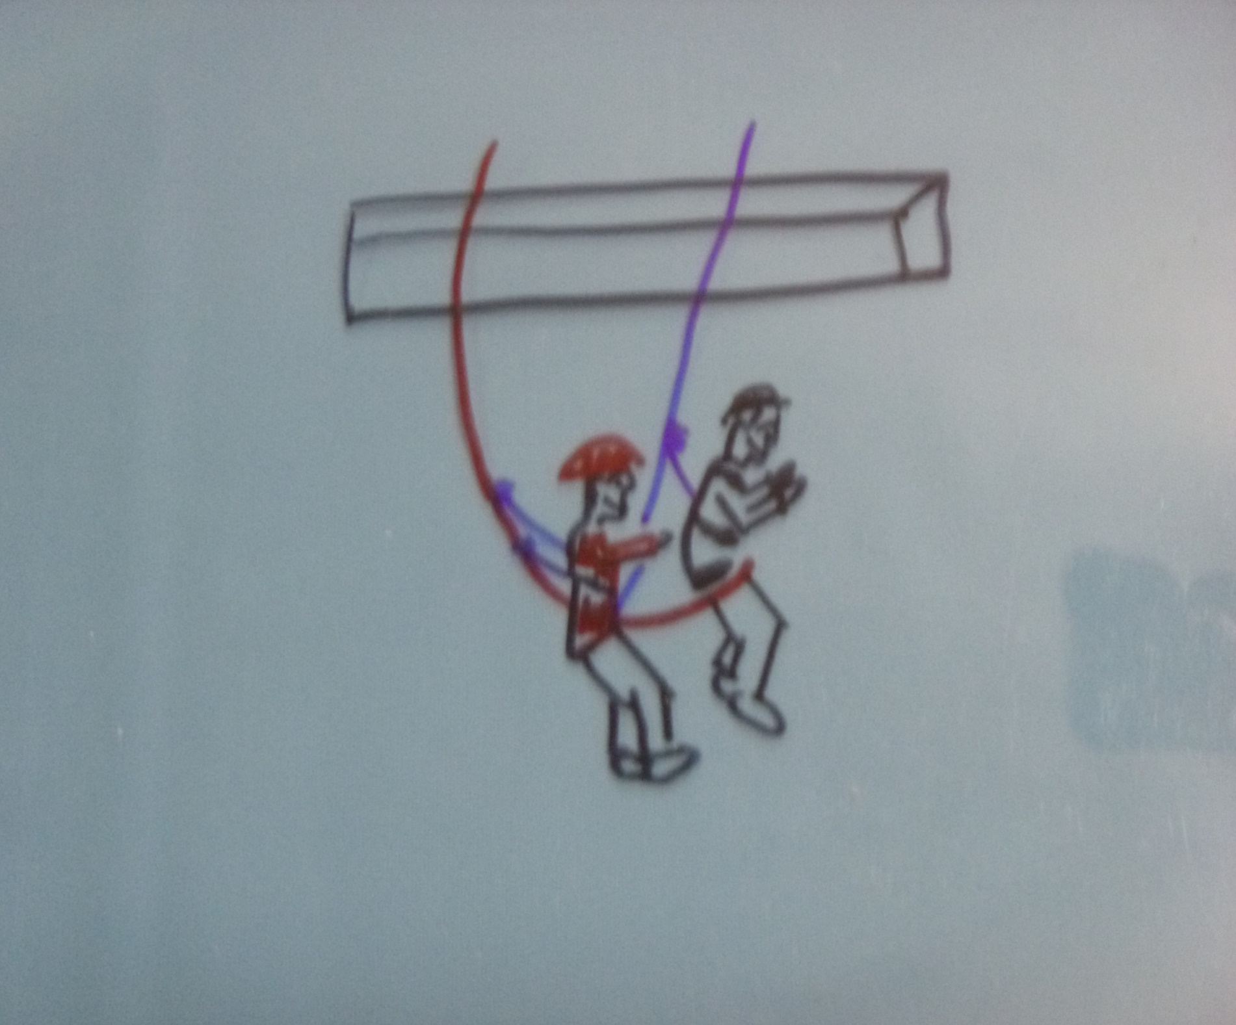
STATIC LINE PICK-OFF / LINE TRANSFER:
The Y-method of pick-off
Works the same regardless of the system you are working with
A few variations with attachment points depending on the system
Proven method

Slide 24
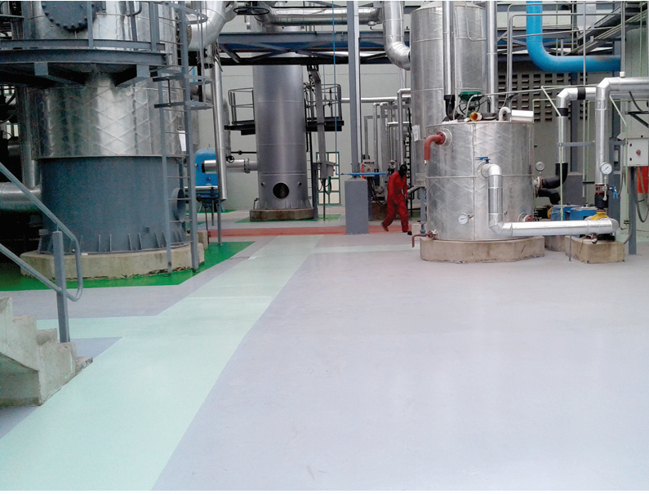
Tripod rigging with no cod at bottom???
This is the hypothetical hole
Depth is approximately 50 feet
No change of direction (COD) to rig to inside the footprint of the tripod.
WHAT ARE WE GOING TO DO AND HOW ARE WE GOING TO RIG THIS TRIPOD TO ACCOMPLISH OUR GOAL.

Slide 25
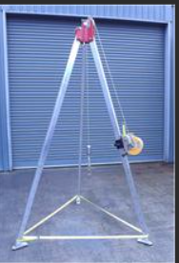
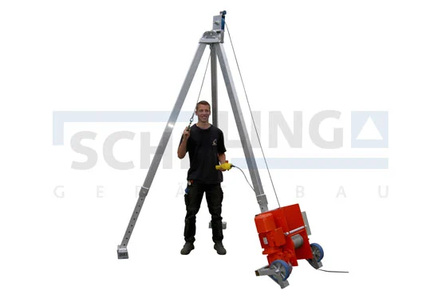
Different ways to use tripod

Slide 26
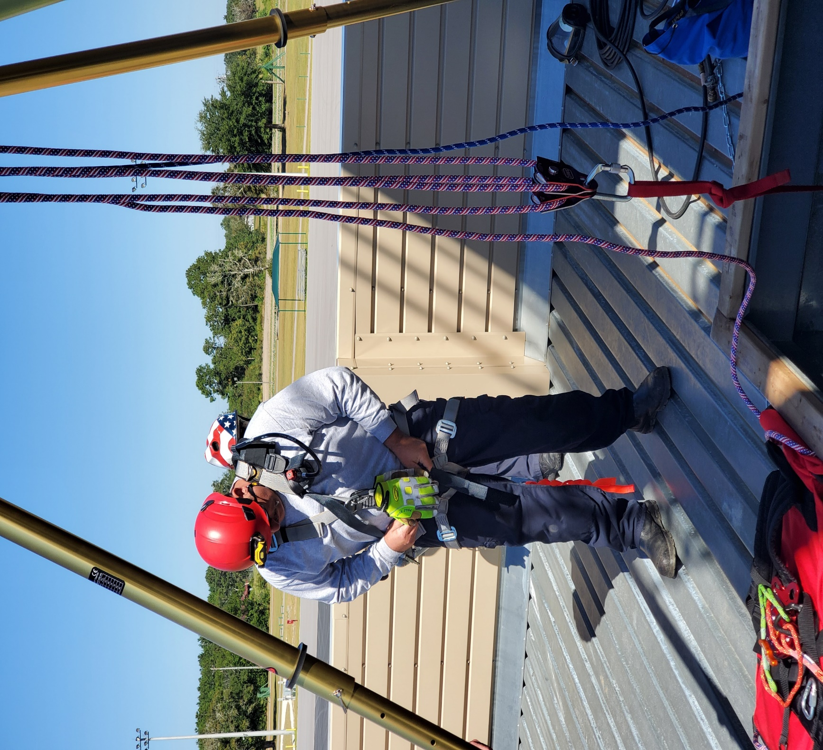
Can we rig it this way… yes/ no / maybe ?

Slide 27
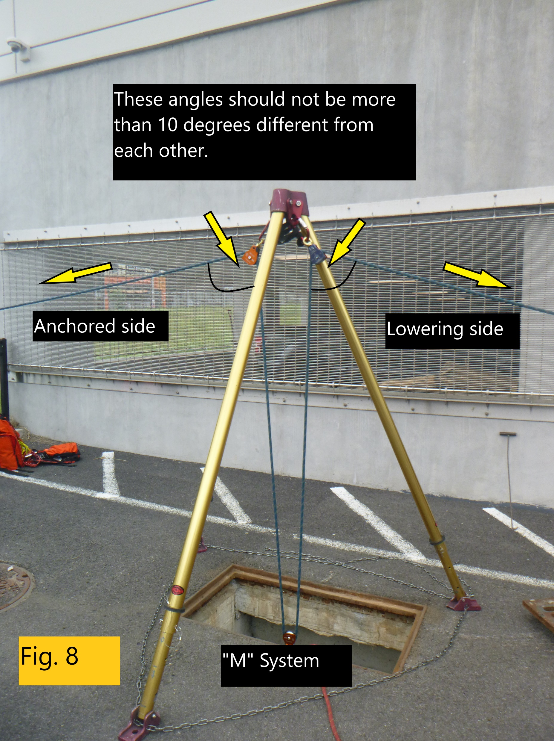
Lets talk about the “m” system
This system works great for areas that may not have that change of direction that we want
Can be set up very easily
Best when using swivel pulley, BUT not required
In this situation, angles are important. (regardless of any new info regarding angles)

Slide 28
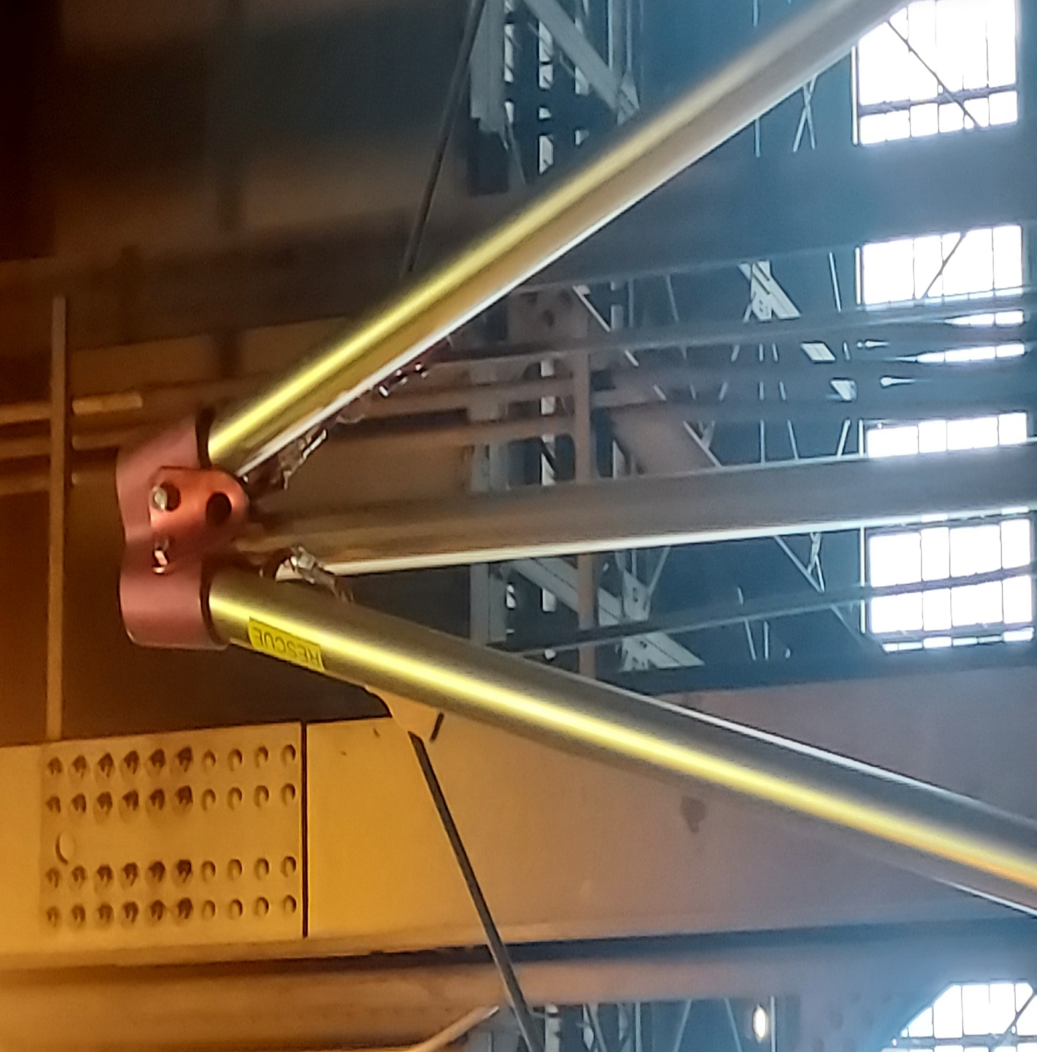
The set up- simple, safe, and proven
One side needs to be the anchor side. This side does not move.
The other side becomes the lower and haul side. Here is where you want your personnel to be
Two swivel pullies at the top, and one at the bottom. It should look like an “M” when completed
****No more than an10-degree difference when anchor and moving side come into the tripod

Slide 29
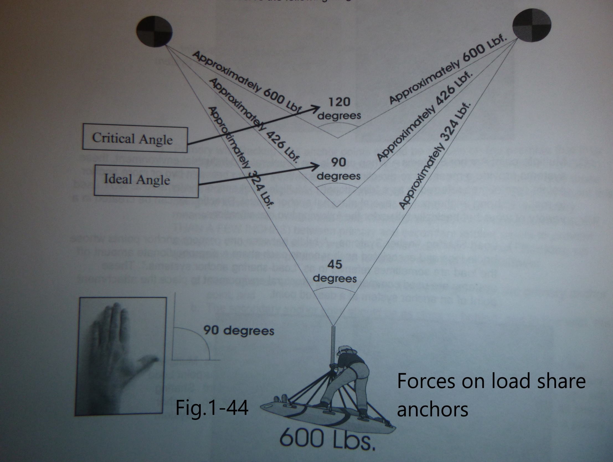
Angles and forces….what about them?
Who has seen this diagram before..
What does it mean for us??
Is it important for us to know…
Why or Why NOT??

Slide 30

The New research out of BC…….
We may have been looking at our systems in the wrong “light”
We always looked at it from a strength perspective
Maybe we should be looking at it from a force limiting perspective
WHAT ????

Slide 31

What is the important factor with NFPA? (when it pertains to components)
Three things that they look at:
    Composition
    Force (plane)
    STRENGTH

Slide 32
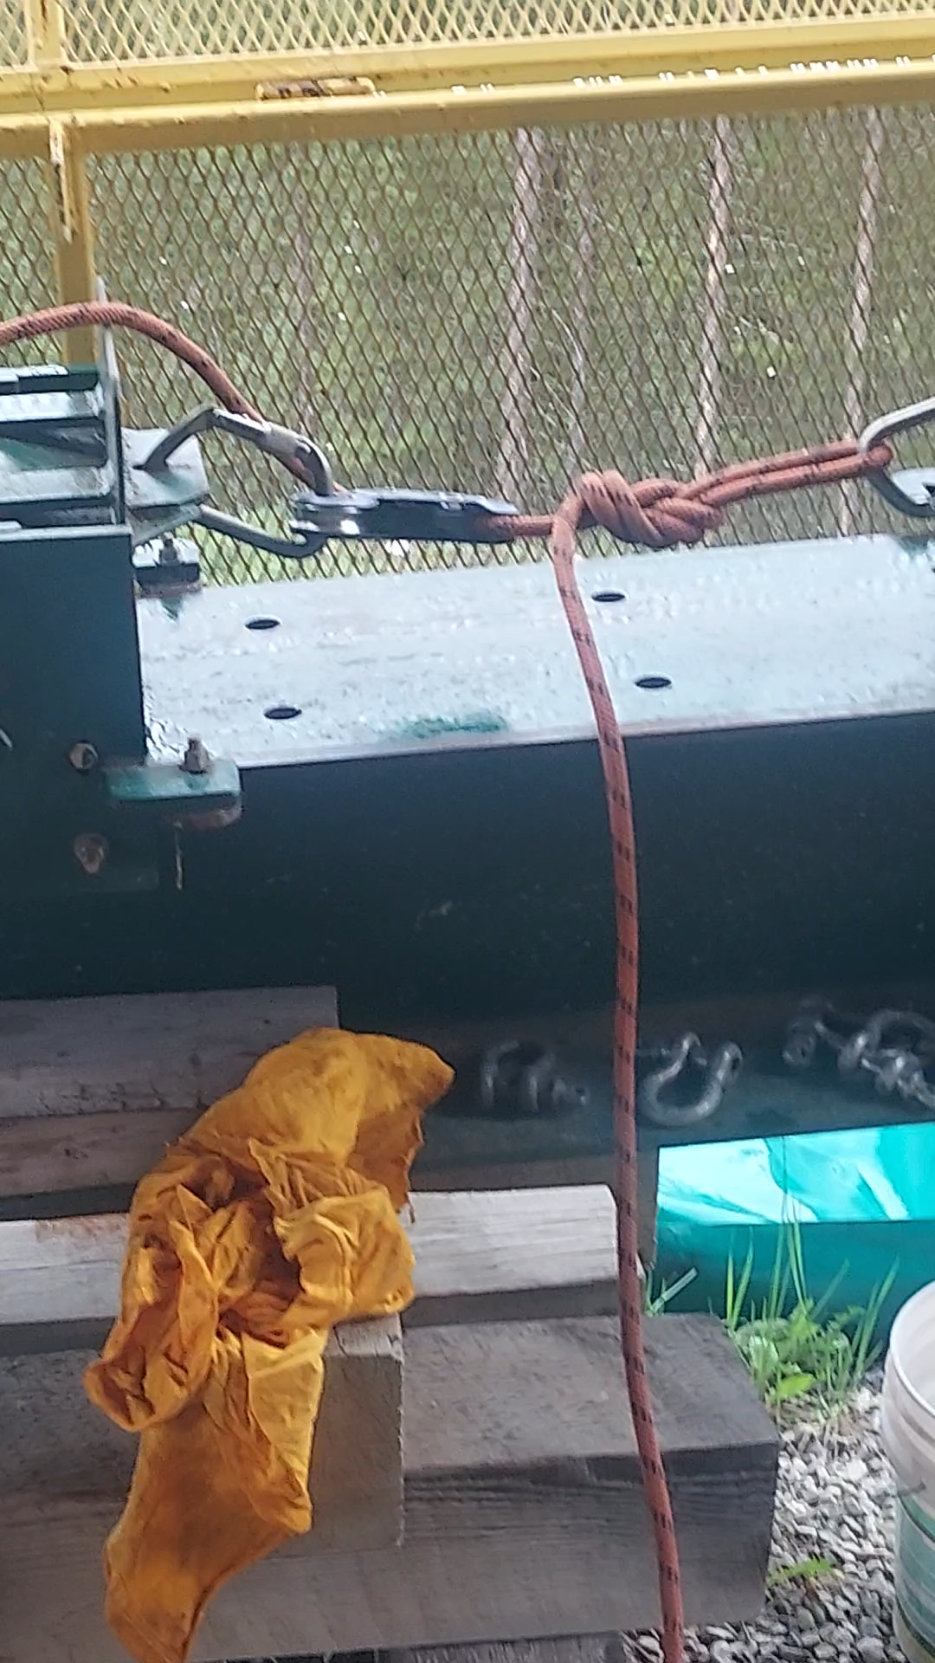
Force limiting
Using the same device but…
  Not G-Rated rope
  Technical rope with 2500 lbf associated with it.
  WOW!!!

Slide 33
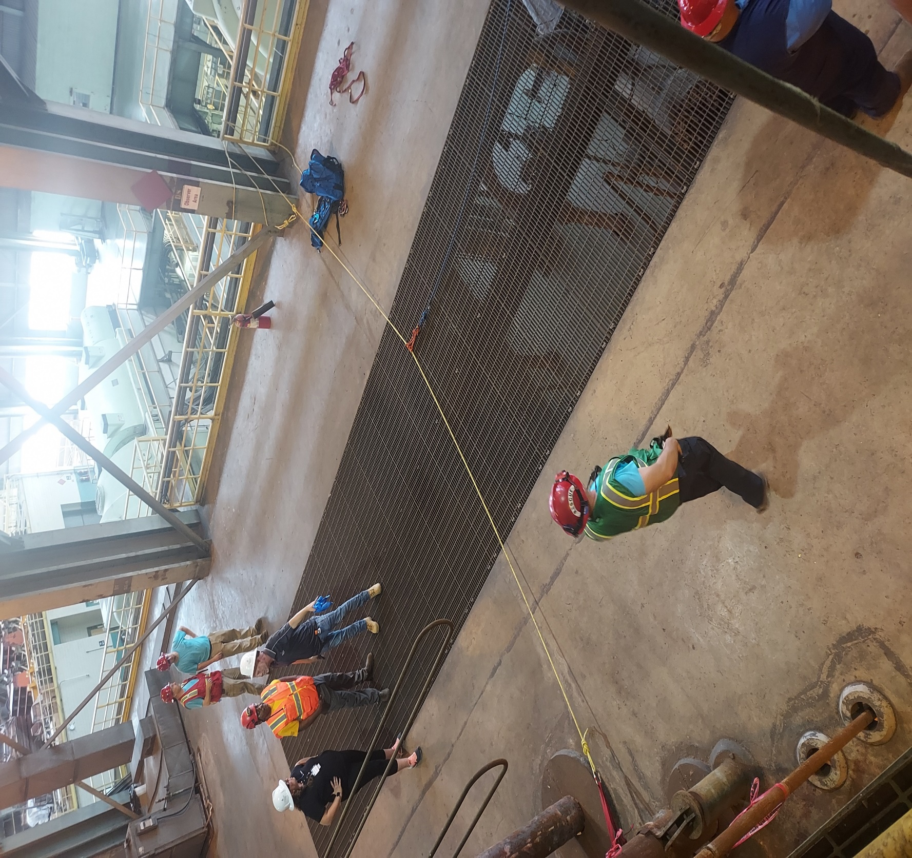
How this relates to what we can do
It allows us to use things like spanned anchors.
  “Spanchors”
  THEY WORK GREAT!!

Slide 34
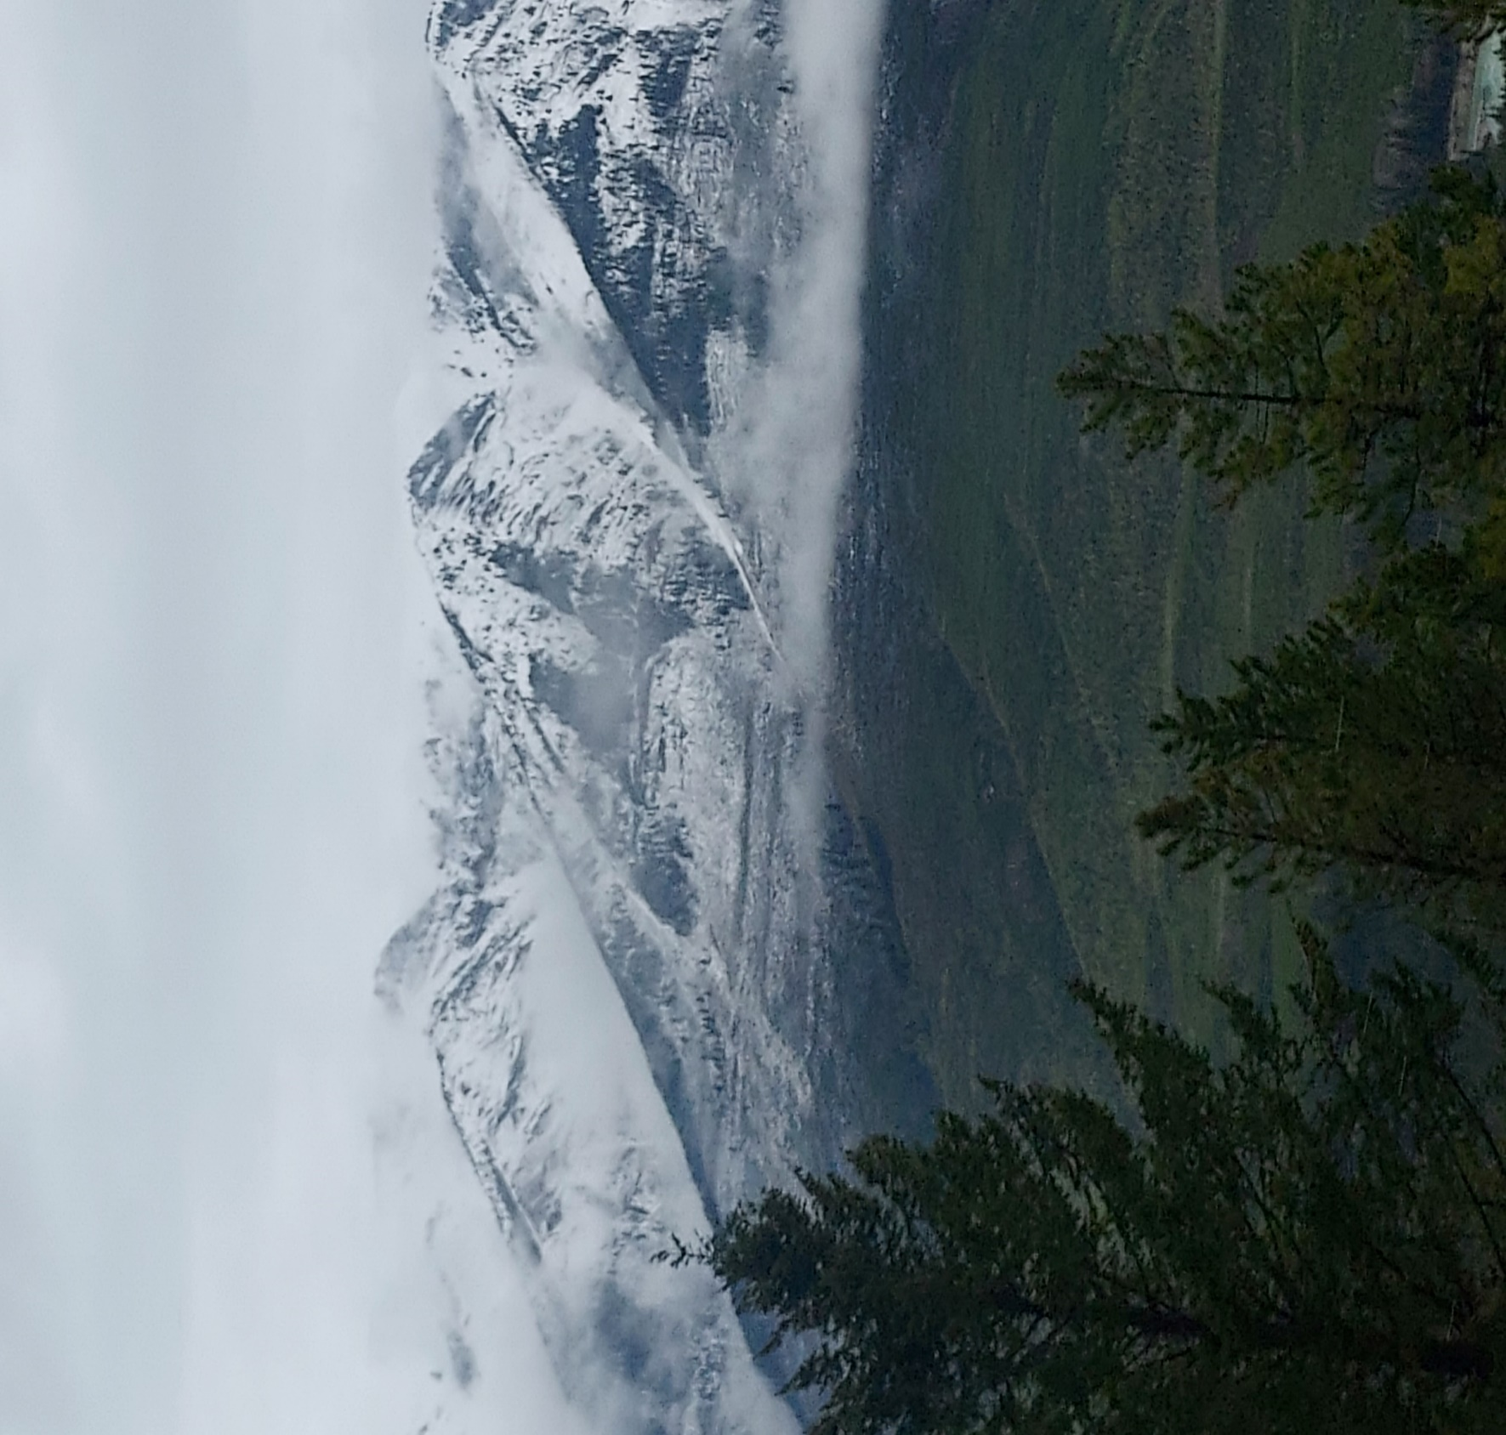
ADDITIONAL THINGS FOR FURTHER DISCUSSION
More work with force limiters in our systems
COMPATIBILITY OF COMPONENTS WITH ROPE
Better understanding of fall factors and can they really occur (4ft of rope with 1 foot drop)
Rope construction and design

Slide 35
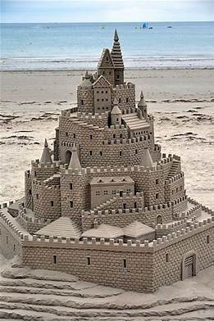

What type of operator are you training?

Slide 36

ANY QUESTIONS?

Slide 37

Please scan the qr code for this class evaluation.

Slide 38
THANK YOU FOR YOUR TIME
**girouxm845@gmail.com
Michael.giroux@yonkersny.gov
631-335-6044 (cell)

