Slide 1


Firehouse Law:
Mapping the Minefield
John Rukavina
APRIL 7 -11, 2025
Indiana Convention Center & Lucas Oil Stadium
FDIC.COM

Slide 2
Update: Presidential Executive Orders and How They Affect (or Don’t Affect) the Fire Service

Slide 3
EEOC Harassment Guidance? Where?

Slide 4
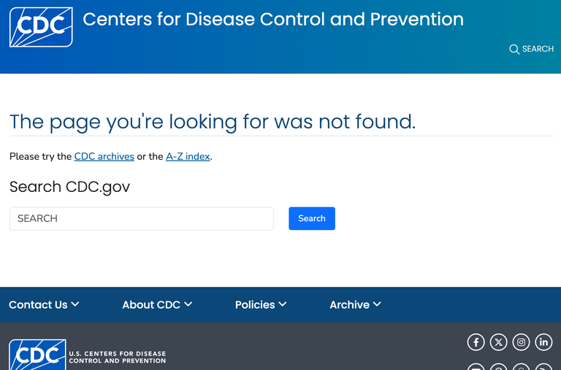
“Moving Towards Equality in the Workplace for LGBTQI+ Employees.” Where?

Slide 5
The Next EEOC Rule/Guidance to be Rescinded…
According to knowledgeable legal sources, the EEOC’s “Implementation of the Pregnant Workers Fairness Act—Rules and Guidance” is expected to be rescinded.
Bulletin! EEOC backtracks on transgender, pregnancy; full speed ahead against “anti-American” bias (21 February 2025)

Slide 6
Cobb County, GA, Fire Officials Modify Hiring Practices after Federal Probe
(April 5 2024)The Cobb County Commission will vote Tuesday on whether to enter a consent decree with the U.S. Department of Justice over the county fire department’s hiring practices that the federal government says discriminated against Black job applicants.
From 2016 to 2020, the fire department checked credit reports in the screening process for job seekers, which the DOJ found “disparately impacted African American applicants” because their credit history had no relation to firefighting ability. The department also used a standardized test for advancement that was found to be discriminatory. It is unclear how that violated federal law.

Slide 7
Justice Department Secures Agreement with Cobb County, Georgia, to Resolve Allegations of Race Discrimination in Firefighter Hiring Process
The Justice Department has secured an agreement with Cobb County, Georgia, resolving the United States’ claim that the County violated Title VII of the Civil Rights Act (Title VII) by using credit checks and a written exam that discriminated against African American firefighter candidates based on race. Cobb County has stopped using the challenged hiring practices and will pay $750,000 in back pay to applicants disqualified by those practices. The County will also hire up to 16 of those applicants with retroactive seniority.
"In light of the Department of Justice’s recent memo (January, 2025) ordering its civil rights division to pause any ongoing litigation and potentially revisiting some settlements obtained during the prior administration, the County is awaiting further communication from the DOJ regarding the status of the case moving forward."

Slide 8
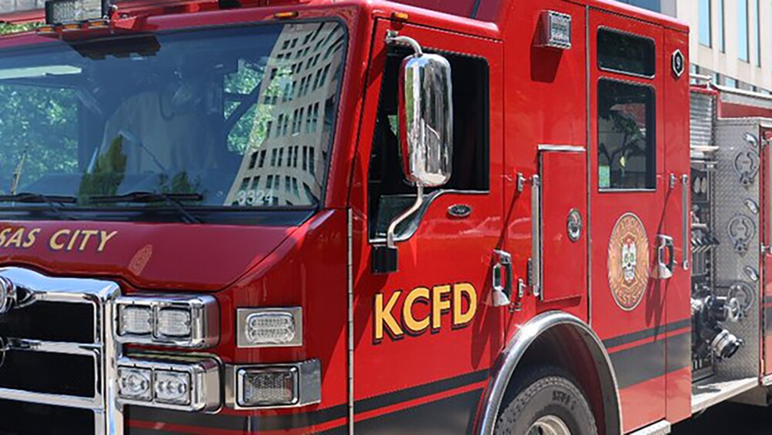
DOJ ends discrimination investigation into Mo. FD with no indication of findings

Slide 9
KANSAS CITY, Mo. 24 January 2025 — The U.S Department of Justice has ended its investigation into discriminatory employment practices at the Kansas City Fire Department three and a half years after it began in response to a Kansas City Star series outlining longstanding discrimination within department ranks.
The city legal department was notified of the decision in a letter dated Jan. 21, a day after President Donald Trump was sworn in to his second non-consecutive term. It’s unclear whether the timing was coincidental.
New leadership at the Justice Department put a freeze on civil rights litigation this week and suggested that it might reconsider existing agreements with police departments negotiated by the Biden administration, the Associated Press reported.

Slide 10
Attorney General Pam Bondi Dismisses DEI Lawsuits Involving Police Officers and Firefighters, Advances President Trump’s Mandate to End Illegal DEI Policies
Wednesday, February 26, 2025 - For Immediate Release DOJ Office of Public Affairs
This week, Attorney General Pam Bondi directed the Department of Justice’s Civil Rights Division to dismiss lawsuits against various jurisdictions across the country involving the hiring of police officers and firefighters. These lawsuits, launched by the previous administration, unjustly targeted fire and police departments for using standard aptitude tests to screen firefighter and police officer candidates.

Slide 11
Trump EPA Official Scraps Plan for Stricter Rules on PFAS
(23 January 2025) The Environmental Protection Agency announced it scrapped plans to regulate PFAS being discharged by corporations in wastewater. These draft guidelines had been sent to the White House last year before they were released for public review.
A senior advisor to the EPA Office of Chemical Safety said she supports a 'transition away' but not a ban of PFAS firefighting foam.

Slide 12
Trump's layoffs hit firefighter safety programs
“Among the federal workers let go were the ones who maintain the National Firefighter Registry for Cancer — which Trump signed into law in 2018.” (NBC News 19 February 2025). No new Registry applications are being accepted.
(Apr 2) Http/1.1 Service Unavailable
NIOSH Line of Duty Firefighter Death Investigations Discontinued as ofApril 1 2025

Slide 14

Statement on the cancellation of T2V It is with great disappointment that we report that the Department of Homeland Security (DHS) has notified us of its intent to terminate the Terrorism and Targeted Violence (T2V) in the United States project.

Slide 15
Executive Order – New Regs, Guidance, etc.
(January 31 2025) A new Executive Order says that, with limited exceptions, no federal agency can release new regulations unless it at the same time identifies 10 sets of regulations that can be repealed. The EO applies not only to actual regulations but also to less formal rules—”guidance,” “memoranda,” etc.
Federal gency heads will be required to ensure that the “total incremental cost of all new regulations” is less than zero.

Slide 16

National Fire Academy News: Feb. 18, 2025
NFA National Weekend CANCELLATION The U.S. Fire Administration's National Fire Academy is canceling the National Weekend Sponsored by Women in Fire, previously scheduled for May 17 and 18, 2025, at the National Emergency Training Center in Emmitsburg, Maryland. Your National Fire Academy regrets any inconvenience caused by this decision which follows DHS policy consistent and compliant with all applicable Executive Orders.

Slide 17
Female FF Cancer Coverage
In 2024, the DOL added presumptive workers comp coverage for breast, cervical and other cancers for federal firefighters. But the January DOL press release on this change was deleted from the DOL website. Where did it go? DOL: “We do not have any additional updates regarding your inquiry
Women in Wildland Firefighting Boot Camps Cancelled

Slide 18
What The President’s LGBTQ+ Executive Orders Mean for Fire Chiefs
Guidance and Regulations: Although the EEOC may remove resource documents and training materials, without a quorum of Commissioners, it cannot reverse any regulations or formal guidance, like this, that prohibits harassment based on gender identity-- https://www.eeoc.gov/laws/guidance/enforcement-guidance-harassment-workplace
Court Decisions Matter More: The EEOC’s position on gender identity carries little weight in the courtroom. And in the Supreme Court’s Bostock decision that did not specifically address bathroom use, the court has also said that LGBT discrimination generally violates Title VII.
State Laws Still Apply: Many states have their own gender identity protections that employers must follow, regardless of EEOC policy changes.

Slide 19
What The President’s LGBTQ+ Executive Orders Mean for Fire Chiefs
Presidential Executive Orders are not laws, and they do not reverse any Supreme Court decisions—Bostock v. Clayton County is still the law—and they do not overrule any EEOC regulations or formal guidance (like https://www.eeoc.gov/laws/guidance/enforcement-guidance-harassment-workplace).
What you’ll start to see on EEOC websites and document links:
“This document was approved by the Commission on April 29, 2024, by a 3-2 vote.
Any modification must be approved by a majority vote of the Commission”.
“The information on this webpage is being reviewed for compliance with the law
and executive orders and will be revised”.
If there’s a question of whether a government agency’s interpretation of a statute is correct, that question will be answered in court—not by Executive Order.

Slide 20
U.S. Supreme Court – 2020 Term – Bostock v. Clayton County GA Sexual Orientation And Gender Identity Take Center Stage
On June 15, 2020, the U.S. Supreme Court issued a landmark 6-3 decision affirming that the prohibition on sex discrimination in Title VII of the Civil Rights Act of 1964 extends to discrimination based on sexual orientation and gender identity. This decision resulted from three cases.
The Supreme Court combined these cases and issued a single opinion—Bostock v. Clayton County—in which it held that “an employer who fires an individual merely for being gay or transgender violates Title VII.” “[I]t is impossible to discriminate against a person for being homosexual or transgender without discriminating against that individual based on sex.”2

Slide 21
U.S. Supreme Court – 2020 Term – Bostock v. Clayton County GA
"They say sex-segregated bathrooms, locker rooms, and dress codes will prove unsustainable after our decision today but none of these other laws are before us; we have not had the benefit of adversarial testing about the meaning of their terms, and we do not prejudge any such question today.“
Supreme Court Justice Neal Gorsuch, author, in Bostock opinion.

Slide 22
Free Speech Concerns Lead to Injunction Against Federal DEI Restrictions
Last week, a federal court put the brakes on two executive orders aimed at ending federal support for Diversity, Equity, and Inclusion (DEI) programs. Citing First Amendment concerns, the court issued a temporary injunction against the USDOL’s enforcement of key provisions affecting DEI-related speech and activity

Slide 23
Employer Guidance - Back to Basics Amidst DEI Turmoil
What you CAN do:
• You can still support the concept of a diverse workplace
• Promotions, internships, scholarships, grant programs, interviews –
open to all
• Affinity groups - open to all
What NOT to do:
• Watch buzzwords on websites and in policies
• Do not use numerical quotas or goals
• Do not tie diversity goals to compensation
• Make decisions based on merit/qualifications

Slide 24

EEOC - What You Should Know About DEI-Related Discrimination at Work

Slide 25

EEOC Poster - What To Do If You Experience Discrimination Related to DEI at Work

Slide 26
What The President’s LGBTQ+ Executive Orders Mean for Fire Chiefs
So far, the only fire service agencies (and their local-government bodies) most likely affected by the President’s Executive Order will be FIRE Act grant recipients (Assistance to Firefighters, Staffing for Adequate Fire and Emergency Response, and Fire Prevention and Safety) and agencies that contract directly with the federal government…
“(B) recommend actions, such as Congressional notifications under 28 U.S.C. 530D, to align agency or department programs, activities, policies, regulations, guidance, employment practices, enforcement activities, contracts (including set-asides), grants, consent orders, and litigating positions with the policy of equal dignity and respect identified in section 1 of this order.”

Slide 27
BULLETIN!!!
On February 21, 2025, a federal judge in Maryland has issued a nationwide injunction halting key provisions of two executive orders that sought to limit workplace diversity, equity, and inclusion (DEI) programs. The ruling means that, for now, employers—especially federal contractors and grant recipients—can continue their DEI efforts without immediate legal risk.

Slide 28
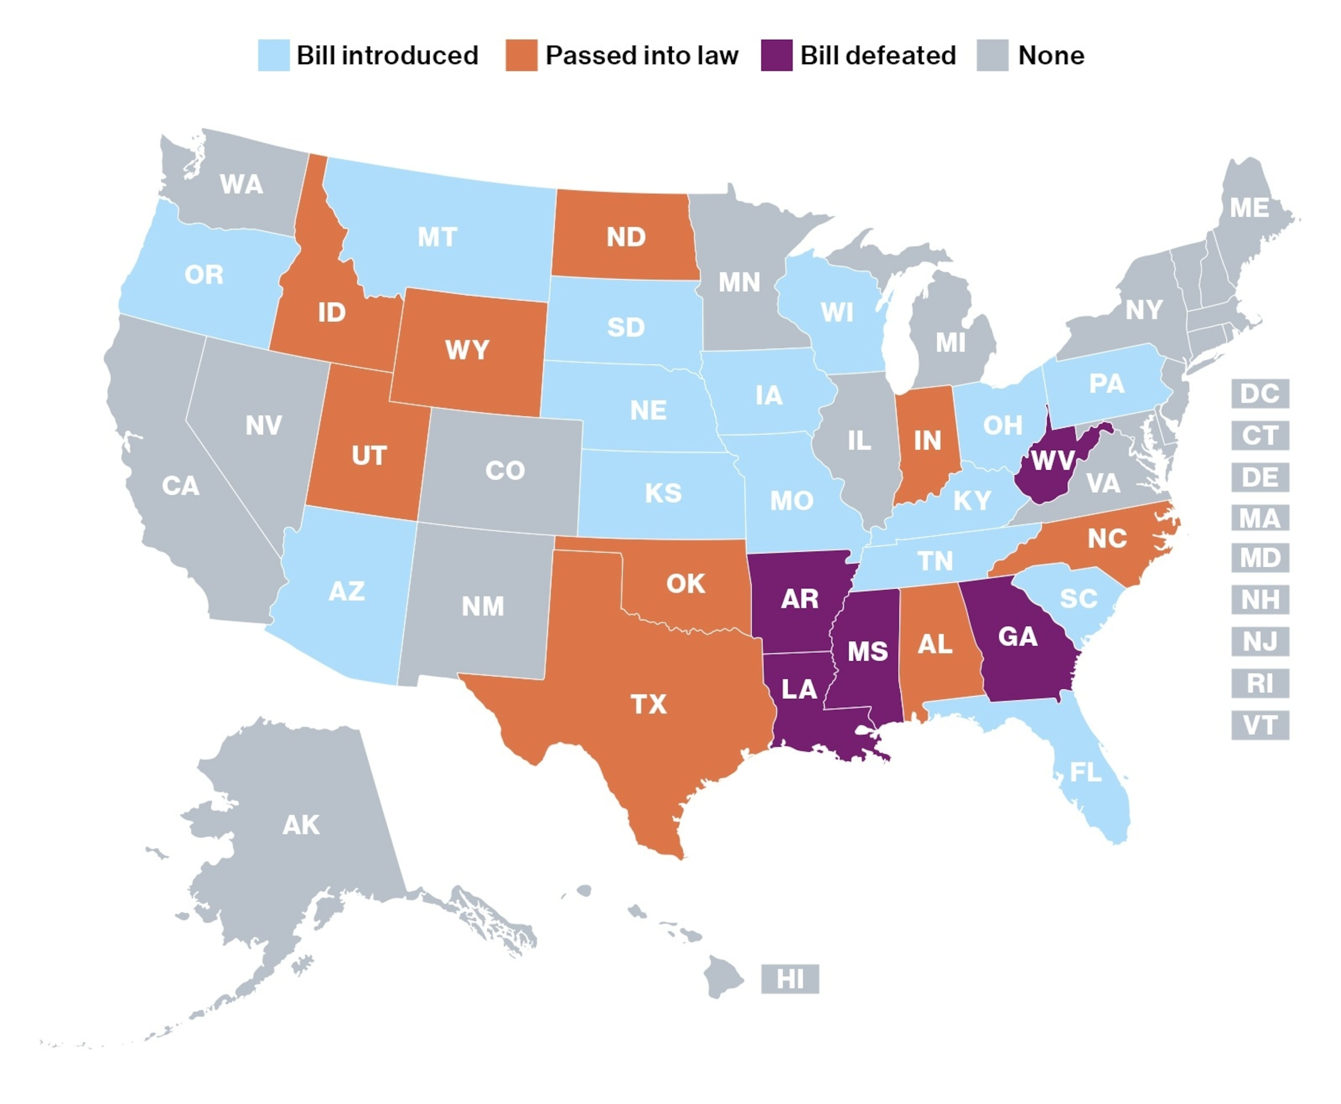
Anti-DEI Laws Across the Country - 2024

Slide 29
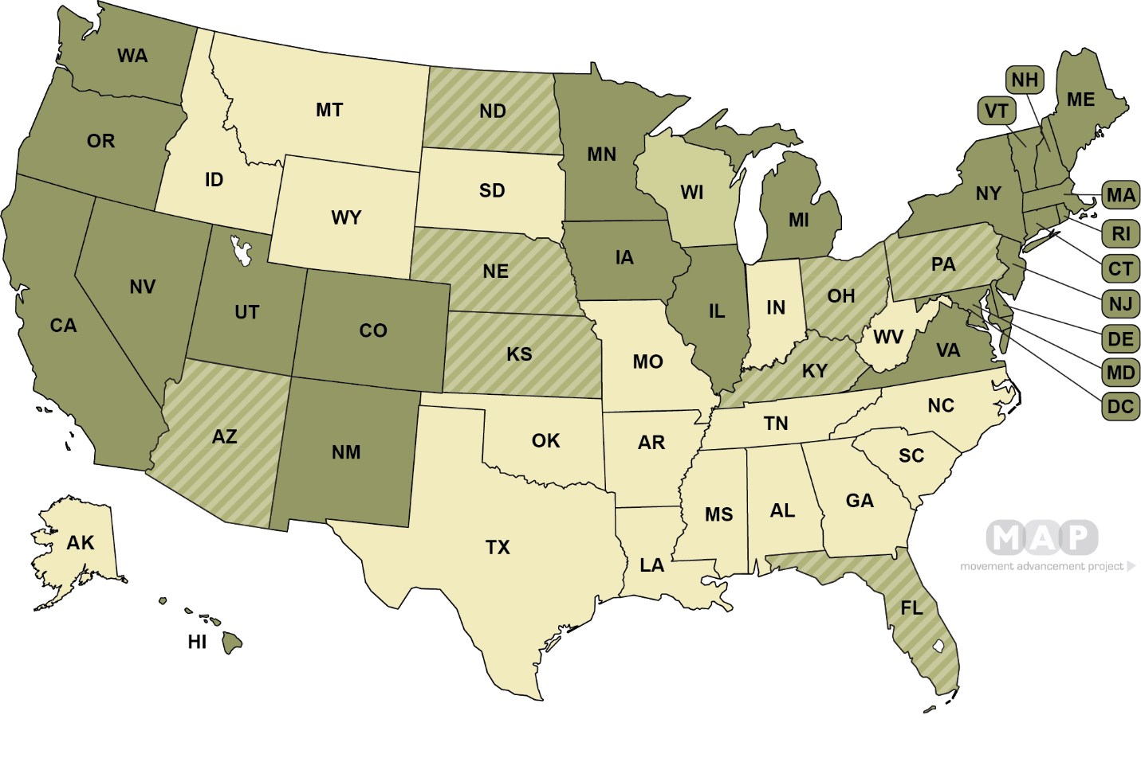
(Dark Green) State law explicitly prohibits discrimination based on sexual orientation and gender identity (23 states , 1 territory + D.C.)
(Green Stripes) State explicitly interprets existing prohibition on sex discrimination to include sexual orientation and/or gender identity (8 states)
(Light Green) State law explicitly prohibits discrimination based on sexual orientation only (1 state-Wisconsin)
(Khaki) No explicit prohibitions for discrimination based on sexual orientation or gender identity in state law (18 states, 4 territories)

Slide 30
Transgender Employees
Bostock v. Clayton County (US Supreme Court, 2020) – discrimination based on gender identity and sexual orientation is a form of sex discrimination prohibited by Title VII of the Civil Rights Act.
EEOC Enforcement Guidance (2024): The following are forms of gender-identity-based harassment:
Refusing to allow a transgender employee to use the bathroom of the gender with which they identify
Failing to use a transgender employee’s preferred pronouns, at least if deliberate and repeated
“Dead-naming” a transgender employee (using the transgendered employee’s old name), at least if deliberate and repeated
Texas and the Heritage Foundation are challenging this EEOC Guidance in court and Executive Orders are targeting these issues. Stay tuned!

Slide 31

Executive Order Tracker

Slide 32

Marijuana Issues 2025

Slide 33
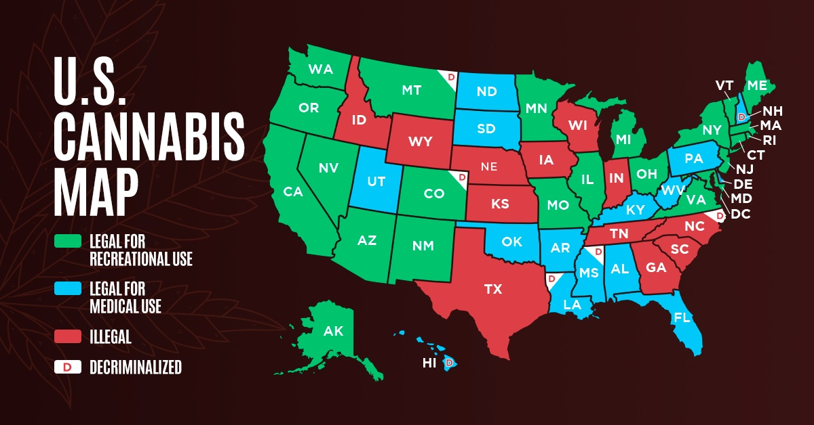
Marijuana Legalization by State – 2024

Slide 34
Drugs in the Workplace – General Rules
Federal law preempts inconsistent state laws – Employers with drug testing protocols mandated by federal law (such as Department of Transportation regulations) are likely exempt from inconsistent requirements imposed by state law. That generally doesn’t include firefighters.
Employers can regulate possession and use in the workplace – Despite growing state law protections for employees engaging in marijuana use, employers still generally retain the right to maintain a drug free work environment, and prohibit use and consumption in the workplace.
Employers can regulate workplace safety – Employers still may prohibit employees from showing up to work or performing their jobs while impaired. In addition, in states that do have certain testing requirements, employers are generally still able to conduct marijuana testing of employees in safety sensitive positions. More and more states require evidence of impairment in addition to a positive drug test.

Slide 35
State Drug-Testing Laws
https://asurint.com/getmedia/b470c390-a1c3-4dc6-a156-e240eca81231/50-State-Guide-Drug-Testing-Laws

Slide 36
A caution for employers in medical marijuana states
A positive THC test may not equate to impairment.
Marijuana stays in the body for weeks.
That is in contrast to the really bad drugs, like cocaine and heroin, which are usually in and out in a couple of days.
That is changing now. As marijuana use -- and, especially medical marijuana use -- becomes widely accepted, employers may have to assess not only whether the employee tests positive for marijuana but also whether the result indicates that the employee was under the influence while at work.
And it may be necessary for an employer who is challenged in court over a medical marijuana-related termination to have scientific expert testimony about the level of marijuana found in the employee's system and what that says about the employee's level of actual impairment.

Slide 37
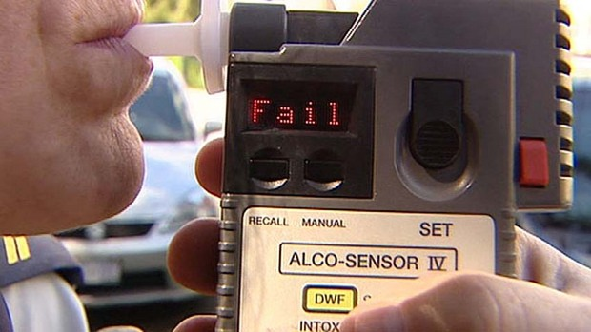
Don’t Hold Your Breath…

Slide 38
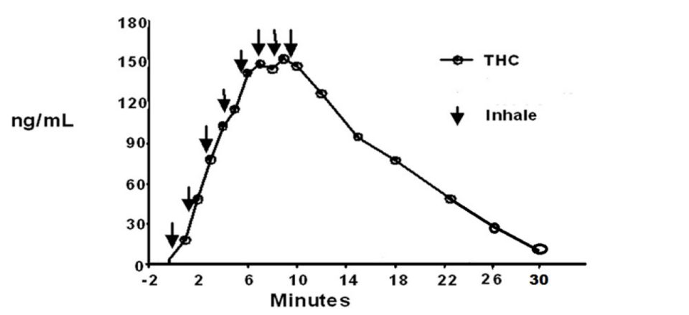
THC Concentration Over Time

Slide 39

Vape Weed
2019 – contaminated “vape weed” kills 68, injures hundreds…
2020 – CDC and FDA recommend against use of vape weed
No two vapes are alike
Contain lots of chemicals (besides THC) whose safety is unknown
THC dosage in vapes can be up to five times higher than smoked/ingested marijuana

Slide 40
Marijuana – DEA Reclassification
Earlier in 2024, the Drug Enforcement Administration announced that it would initiate moving marijuana from its Class 1 drug status (which includes cocaine and heroin) to Class 3 (with ketamine and anabolic steroids). A final determination is expected by mid-2025.
Right now, Class 1 drug use—including medical marijuana—is not protected by the federal Americans with Disability Act (but individual state ADA’s may offer that protection). If/when marijuana becomes a Class 3 controlled substance, the federal ADA will protect medical marijuana use in all 50 states.

Slide 41
One Last Suggestion…
Given the increasing complexity of workplace drug regulation, consider retaining a medical review officer to supervise your department’s drug regulation program. For more information on MRO’s: https://www.transportation.gov/odapc/mro

Slide 42
Is “Excited Delirium” for Real?

Slide 43
August 17, 2019: Elijah McClain of Aurora, Colorado was restrained by three Aurora police officers and treated by two Aurora Fire paramedics—Peter Cichuniec and Jeremy Cooper—for “excited delirium.” When Cichuniec and Cooper arrived, McClain was face down, handcuffed, had vomited and was having trouble breathing.
McClain went into cardiac arrent in the ambulance, and died three days later, on August 20, 2019. The cause of his death was listed as “undetermined”.

Slide 44
September, 2021, a Colorado grand jury indicted Cichuniec and Cooper on multiple counts of manslaughter and criminally negligent homicide.
September, 2022 McClain’s autopsy report was updated—the cause of his death was attributed to “complications of ketamine administration following forcible restraint.”
The case against Cichuniec, Cooper and two of the three police officers went to trial in 2023. Two of the three police officers were acquitted. Cooper and Cichuniec were convicted, largely on the basis of Cooper’s admission that when he prepared the ketamine injection, he misjudged the dosage of ketamine, drawing 500 mg, well above the safe therapeutic limit for someone of McClain’s size.
Peter Cichuniec was sentenced to five years in prison and three years’ probation, and Jeremy Cooper to 14 months’ work release.

Slide 45
The diagnosis of “excited delirium” has been with us for some 40 years, and is used to explain how someone experiencing “severe agitation” can suddenly die while being restrained. There is no blood or other diagnostic test that can confirm an “excited delirium” diagnosis.

Slide 46
As it turns out, the diagnosis of “excited delirium” was originally based on an American College of Emergency Physicians paper originally published in 2009. But…
The American Psychiatric Association withdrew recognition of excited delirium as a diagnosis in 2020, the American Medical Association in 2021 and the National Association of Medical Examiners in 2023.
In March, 2024, ACEP finally withdrew its 2009 paper and its recognition of excited delirium, leaving no clinical support for “excited delirium” as a medical diagnosis.

Slide 47
So what steps should fire service leaders take at this point?
First, educate themselves and their firefighters and EMS staffs. The Associated Press conducted an extensive study of cases like Elijah McClain’s in a report, “Lethal Restraint” (https://apnews.com/article/associated-press-investigation-deaths-police-encounters-02881a2bd3fbeb1fc31af9208bb0e310), along with a nine-minute video, (https://www.youtube.com/watch?v=V4skOjm955s) And Frontline has also created a video on lethal restraint: https://apnews.com/projects/investigation-police-use-of-force/?utm_source=Iterable&utm_medium=email&utm_campaign=yearend2024
Second, check in with fellow fire service leaders for help. Long Beach, California, for example, created an “integrated medical response” plan in 2022 for dealing with what were still then called “excited delirium” cases, but the Long Beach approach established a valuable series of plan components. (https://www.firerescue1.com/fire-products/communications/interoperability/articles/excited-delirium-the-long-beach-integrated-medical-response-bHLBq1OMLh2gxsmu/

Slide 48
And in 2024, the National Association of EMS Physicians, the IAFC, and the International Association of Chiefs of Police joined forces earlier this year to develop a consensus paper on dealing with behavioral medical emergencies: Consensus Statement of the National Association of EMS Physicians, International Association of Fire Chiefs and the International Association of Chiefs of Police: Best Practices for Collaboration Between Law Enforcement and Emergency Medical Services During Acute Behavioral Emergencies (https://www.tandfonline.com/doi/full/10.1080/10903127.2024.2402530)

Slide 49

Consensus Statement of the National Association of EMS Physicians, International Association of Fire Chiefs and the International Association of Chiefs of Police: Best Practices for Collaboration Between Law Enforcement and Emergency Medical Services During Acute Behavioral Emergencies

Slide 50
Former Sioux City (IA) Fire Rescue Paramedic Charged With Involuntary Manslaughter
SIOUX CITY IA – January 20 2025 — A former Sioux City Fire Rescue paramedic is facing an involuntary manslaughter charge for the 2023 death of a patient who the Woodbury County Attorney’s Office says was given the wrong medication and later died.
Charges were filed Thursday against Deanna Fay LaMere for allegedly giving 26-year-old James Foster Jr. a dose of the drug rocuronium instead of the drug ketamine in an attempt to get Foster to calm down during a medical assistance call.

Slide 51
Can a Transfer Be “Harassment” or Retaliation”?

Slide 52
2023 - Transfer after harassment complaint is OK if the new position is comparable
(July, 2023) The 8th Circuit Court of Appeals concluded it wasn’t an adverse action to separate a complaining employee from an alleged harasser by transferring the employee to a comparable position.
It ruled she had no case because the transfer wasn’t retaliation—it wasn’t an adverse employment action. The job she was offered was the same as her original position in all meaningful respects. (Courtnay Bell v. Baptist Health, 8th Cir., 2023)

Slide 53
But Wait—There’s More in 2024!!!
Sgt. Jatonya Muldrow, worked as a highly respected, plainclothes officer in the Intelligence Division for the St. Louis Metropolitan Police Department.^{[12]} In her specialized position, she investigated human trafficking cases, oversaw the Gang Unit, served as head of the Gun Crimes Unit, was deputized with the Federal Bureau of Investigation, and enjoyed various other employment benefits.
Her new Captain decided to replace her with a man who “seemed a better fit for the [d]ivision’s ‘very dangerous’ work,” and Muldrow was laterally transferred to a uniformed position.” Muldrow’s new duties were mostly administrative tasks, her schedule became irregular, she lost her FBI status and government-issued car. She sued the city, alleging discrimination based on gender. The district court held that these employment actions were “minor alterations of employment, rather than material harms” and granted summary judgment to the city

Slide 54
Sgt. Jaytona Muldrow
Sgt. Muldrow sued the PD, arguing that she was transferred because she was a woman, and that the transfer was a violation of Title VII of the Civil Rights Act.
Her suit was dismissed in US District Court, and the 8th Circuit Court of Appeals upheld the dismissal, applying the standard currently in use--she hadn’t shown that the transfer caused a “materially significant disadvantage”-- it didn’t affect her title, salary or benefits, and caused “only minor changes in working conditions.”
Sgt. Muldrow appealed to the U.S. Supreme Court…

Slide 55
Muldrow v. City of St. Louis
In April, 2024, the U.S. Supreme Court ruled unanimously in Muldrow’s favor, holding that Title VII does not require a plaintiff to show that an allegedly discriminatory act results in harm that is “significant,… serious, or substantial or any similar adjective.”
The Court majority set forth a new standard—while plaintiffs are no longer required to show “significant” harm, they must still show that they suffered “some” harm.
How much harm is “some harm”? Time—and future lawsuits—will tell.
So what do you think—did Sgt. Muldrow suffer “some harm”?

Slide 56
“Some Harm”? These Made the Cut
In Thomas v. JBS Green Bay (November 8 2024) Thomas alleged seven employer actions that were discriminatory. The District Court dismissed the suit on the grounds that none of the seven were “adverse employment actions. The 7th Circuit Court of Appeals, applying the new Muldrow “some harm” standard, ruled that three of those seven actions involved some harm:
A three-year delay in training on a new machine
Denial of vacation requests while co-worker requests were OK’d
Transfer to a different shift, with knowledge of child-care issues
The case goes back to District Court for trial.

Slide 57
Bulletin: Ames v. Ohio Department of Youth Services
Ames, a heterosexual female plaintiff sued her employer claiming that it demoted her from her current position and refused to promote her into a different position in each case because of her sexual orientation.
The district court applied a heightened pleading standard: that the plaintiff, because she was in a majority group, must show “background circumstances to support the suspicion that the defendant is that unusual employer who discriminates against the majority,” and ruled that Ames had not met that standard of proof.
Ames appealed. The Sixth Circuit Court of Appeals, applying the same standard, upheld the district court. While the 6th Circuit Court of Appeals noted that Ames would have been able to satisfy her burden to make an initial case of “traditional” discrimination, she couldn’t point to any “background circumstances”--showing that “a member of the relevant minority group” made the adverse employment decision or “by providing statistical evidence demonstrating a pattern of discrimination by the employer against the members of the majority group” that were required to support her claim. Ames appealed.
U.S. Supreme Court, 2024-5 Term -- On February 26, the Supreme Court heard oral argument in this case, but, overall, didn’t seem enthusiastic about the Sixth Circuit’s standard

Slide 58
Pregnant Worker Fairness Act Update

Slide 59
Simple Intro to the Basics
Title VII, Civll Rights ACT
Prohibits discrimination and harassment on the basis of gender
The Pregnancy Discrimination Act (PDA)
Amends Title VII to make clear that discrimination on the basis of pregnancy, pregnancy-related conditions and childbirth is illegal
The Americans with Disabilities Act (ADA)
Prohibits discrimination against otherwise qualified individuals who can do a position’s essential job functions with or without a reasonable accommodation

Slide 60
Is FMLA Leave Available to Care for an Adult Sibling?
Celestia Chapman requested FMLA leave to care for her terminally-ill sister. Her employer denied the request, stating that FMLA didn’t cover leave to care for an adult sibling. There was a dispute as to whether Chapman quit or was fired when she didn’t report for work.
The 6th Circuit Court of Appeals ruled that Chapman was entitled to FMLA leave to care for an adult with whom Chapman was in an “in loco parentis” relationship, which can develop between two adults, including siblings, when one adult becomes unable to care for himself or herself and the other intends to assume a parental relationship.

Slide 61
PWFA –THE SHORT VERSION
The PWFA applies ADA job-accommodation protections, plus waiver of “essential functions” for workers who are experiencing pregnancy, childbirth or pregnancy-related conditions in the form of “reasonable job accommodations” unless doing so would impose an “undue hardship” on the employer.
The PWFA applies to government employers regardless of size, and private employers with 15 or more employees—and “employees” includes “applicants”)
The EEOC will enforce the PWFA.

Slide 62
PWFA Violations – Employee Complaints
Unnecessary delays—no interactive dialog to start the process
Highly-detailed medical/accommodation documentation required (some employers are requiring ADA-level documentation which is NOT required under PWCA}
Denial of accommodation with no basis in law—“morale,” “undue hardship” claims with no explanation/justification, “violates our policies” claims
Limited/no access to sick leave, “absence” points
Forced leave

Slide 63
PWFA Violations – EEOC Lawsuits (So Far)
Bluemel (MD) – Pregnant employee requested maternity leave. When she attempted to return to work, told “no work available.” But Bluemel hired new non-pregnant employees before and after her attempted return. Violation?

Slide 64
PWFA Violations – EEOC Lawsuits (So Far)
Victra (NC) – Employer denied pregnant employee’s request to leave her first day of new-hire training early for a pregnancy-related “urgent medical evaluation.” The employer rescinded her job offer instead—while Victra allowed other new hires to adjust or reschedule new-hire training or start date for reasons unrelated to pregnancy. Violation?

Slide 65
PWFA Violations – EEOC Lawsuits (So Far)
Lago Mar Properties (FL) – Employer terminated an employee shortly after she requested leave to recover and grieve following a stillbirth in her fifth month of pregnancy. Violation?

Slide 66
PWFA Violations – EEOC Lawsuits (So Far)
Polaris Industries (AL) – A pregnant employee developed “pregnancy-related conditions such as nausea, swelling in her feet, aching joints and suspected gestational disabilities” which required her to be temporarily absent from work. Because she wasn’t eligible to accrue paid time off until after a 60-day probationary period, Polaris allegedly “assessed attendance points against [the employee]” for pregnancy-related absences for medical appointments and “pregnancy-related medical conditions.” Violation?

Slide 67
PWFA Violation? – EEOC Lawsuits (So Far)
Castle Hills/Bright (TX) A pregnant employee was diagnosed with placenta previa, a pregnancy-related disability. Her physician prescribed bed rest for the remaining month of her pregnancy, so she requested a leave of absence for that month as a “reasonable accommodation.” Her employer responded that she was not eligible for FMLA or short-term disability benefits, and terminated her employment. (Hint: What about ADA?)

Slide 68
The EEOC Gets Down
CHICAGO – The U.S. Equal Employment Opportunity Commission (EEOC) filed a subpoena enforcement action against R&L Carriers Shared Services, LLC, a freight transportation and logistics services personnel provider doing business in Illinois, to enforce a subpoena which the EEOC issued during the investigation of a charge of sex and pregnancy discrimination filed against the company, the federal agency announced today.

Slide 69
ADA Violation! – EEOC Lawsuit
EEOC: “Such alleged conduct violated the Americans with Disabilities Act of 1990 (ADA), which prohibits discrimination based on an individual’s disability, including pregnancy-related disability.”

Slide 70

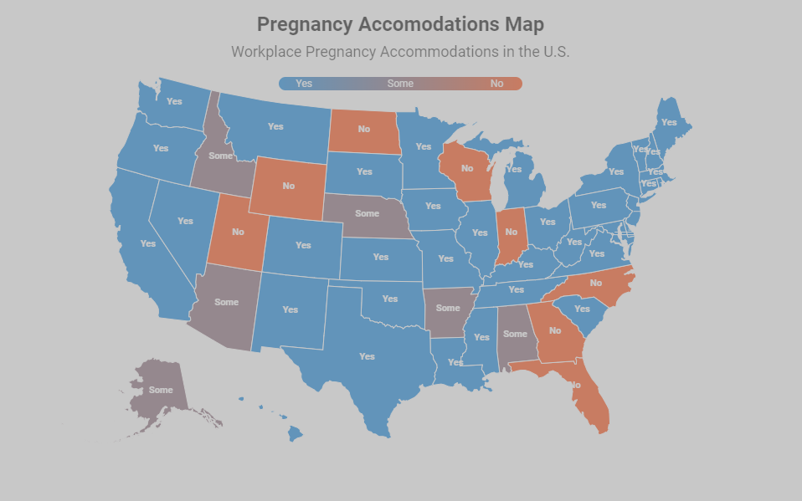
And Don’t Forget to Check Your State & Local Employee-Pregnancy and Nursing Laws
https://nosratilaw.com/pregnancy-discrimination-laws-by-state/

Slide 71
Should an On-Duty Firefighter Stop Pumping for an Alarm?
It would generally be "medically safe" to stop pumping after starting, but there are several factors to consider:
Just started pumping? Could be painful and lead to other issues
Sudden stop not advised if she is unable to resume pumping for an extended period
Case-by-case at the discretion of the pumping firefighter
(La Leche League NC)

Slide 72
Preplan the Firefighter/Paramedic Pregnancy
Pre - Birth
Post - Birth
Know the rules (federal/state law, HR/personnel rules).
Learn about firefighter pregnancy.
Organize a team to develop a firefighter pregnancy strategy that incorporates the rules and the facts of firefighter pregnancy (don’t wait for a firefighter to inform of her pregnancy).
Identify a team liaison to work with the pregnant firefighter
Be ready to familiarize the OB/GYN doc/nurse/nurse midwife with the firefighting environment and the tasks a FF is called upon to do.
Be ready to discuss reasonable accommodation options.
Be ready to set up a timetable of “check-in” meetings to review FF’s pregnancy/medical status.
Be prepared to address “knucklehead” conduct.
Keep the strategy team together
Know the rules (federal/state law, HR/personnel rules).
Understand that pregnancy and childbirth have major effects on a woman.
Understand how a legally-required accommodation need may mean extending the leave of absence.
The ability to return to full duty cannot be a requirement.
Be prepared to discuss possible/evolving new accommodations.
Have established return-to-work training and physical conditioning.
Have adequate lactation accommodations ready.
Be prepared to address “knucklehead” conduct.

Slide 73
So What’s an “Undue Hardship”?

Slide 74
So What’s an “Undue Hardship”?
“It’s going to cost us money” does not meet the legal standard for undue hardship. Neither does “This’ll be an undue hardship.” Employers need to provide “concrete evidence of substantial difficulty or expense.”
Primary elements used to determine undue hardship include
Nature and cost of the accommodation
The overall resources of the organization (more on this to come)
Effect on workplace resources (for example, doubling another employee’s workload to account for the accommodation can be an undue hardship)

Slide 75
In 2023 Groff v. DeJoy Changed “Undue Hardship” BIG TIME
Cast of Characters: Gerald Groff, USPS postal worker and “evangelical Christian and former missionary,” and Louis DeJoy, USPS Postmaster General
The Issue: Sundays off for religious purposes
“Undue Hardship”? More than a “de minimus” cost
Sundays off? Raises labor union issues and hurts employee morale. So, no deal—and Groff quits and sues.
Months later, the U. S. Supreme Court overrules the lower courts and “clarifies” the “undue hardship” standard.

Slide 76
Meet the Supreme Court’s “Reinterpreted” Undue Hardship Standard
“’Undue hardship’ is shown when a burden is substantial in the overall context of an employer’s business.”
“Courts must apply the test to take into account all relevant factors in the case at hand, including the particular accommodations at issue and their practical impact in light of the nature, size and operating costs of an employer.”
In other words, the Supreme Court required the USPS employers to analyze “undue hardship” in the context of how it would affect the entire USPS—not just the Post Office where DeGroff worked. In 2023, the USPS had 525, 469 career employees and 114,623 non-career employees, operating from 33,621 postal facilities.

Slide 77
What Does This Mean For the Fire Service?
If your fire department is part of a local government, the analysis of “undue hardship” will be based on the “nature, size and operating costs” of that local government—not just the fire department.
If another agency that’s part of your local government (PD, Parks and Rec, Public Works, etc.) has done it, your “undue hardship” argument will be uphill.

Slide 78
And Watch Out for Knucklehead Behavior!
Two members of Katy's work team were pregnant. Sometime after Katy told Biff (her boss) that she was giving IVF a third try, Biff visited Katy’s office suite and, apparently after looking at the two pregnant women and Katy, said he was “going to have to change the water in here.” Not long afterward, at a meeting that Katy attended, Biff told the attendees, “No one else on [Katy’s] team is allowed to get pregnant.”
Biff admitted that he made both comments.

Slide 79
Eighth Circuit Rules States May Challenge PWFA’s Inclusion of Abortion as a ‘Related Medical Condition’
On February 20, 2025, the U.S. Court of Appeals for the Eighth Circuit ruled that seventeen states—Alabama, Arkansas, Florida, Georgia, Idaho, Indiana, Iowa, Kansas, Missouri, Nebraska, North Dakota, Oklahoma, South Carolina, South Dakota, Tennessee, Utah, and West Virginia—had standing to challenge parts of the PWFA related to reasonable accommodations for employees seeking an abortion.
The PWFA requires employers to provide reasonable accommodations for employees with pregnancy-related health conditions, which include miscarriage, stillbirth, and abortion under the final rule. In the lawsuit, the states argued that the EEOC exceeded its authority in how it defined “pregnancy-related health definitions.” The states claimed the PWFA regulations would hinder their ability to regulate abortions and their interests in maintaining a pro-life message in dealing with state employees. The states also argued the PWFA regulations would subject them to economic harm because of compliance costs.

Slide 80
Resources – Pregnancy, Childbirth and Nursing Accommodations
Accommodations for Pregnancy, Childbirth and Related Health Conditions
https://static1.squarespace.com/static/65b0410bb0e9346f1200dab0/t/66df4f2b1db8e94a8bd0bef6/1725910832177/Accommodations+for+Pregnancy%2C+Childbirth+and+Related+Health++Conditions++with+photos.pdf
https://www.pregnantatwork.org/wp-content/uploads/Talking-About-Your-Pump-National-Guide.pdf

Slide 81
Title VII Religious Accommodation is Tricky

Slide 82
“Religious beliefs need not be acceptable, logical, consistent or comprehensible to others in order to merit First Amendment protection.”
Justice Anthony Kennedy, in Church of Lukumi Babalu v. City of Hialeah, FL, 508 U.S. 520 (1993)

Slide 83
Religious Discrimination Complaints Are Up
EEOC complaints alleging religious discrimination, harassment and denial of reasonable accommodations for religious needs have skyrocketed almost 700% from 2,111 cases in 2021 to 13,814 cases in 2022, involving turned-down accommodation requests and forced participation in employer-required religious meetings, prayer circles and other practices that conflict with some workers’ own religious beliefs and practices.

Slide 84
Since religion is protected by Title VII, “reasonable accommodation” and “undue hardship” govern religion in the workplace.
An employer cannot question the validity of a religious belief. It doesn’t matter that an employee’s religious denomination or leaders do not follow or endorse the employee’s particular belief.
And an employee doesn’t have to prove the religious practice or belief is an express requirement of the employee’s religion. The employer should engage in the interactive process to determine if the religious belief is indeed sincerely held and reasonable accommodation is in order.

Slide 85
Can an employer require an employee seeking a religious accommodation to produce a letter from a religious leader verifying an employee’s religious belief?
The EEOC sued Center One/Capital Management (October, 2024), alleging that in October 2016, a Center One employee, a practitioner of Messianic Judaism, requested a reasonable accommodation of his religious belief requiring abstaining from work on religious observance days.
According to the EEOC, Center One refused to grant the employee a schedule modification to observe religious holidays because he was unable to provide a certification from a religious leader or religious organization supporting his request. Instead, the company imposed disciplinary points against the employee for his religious-based absences. Violation of Title VII?

Slide 86
Can a health care worker refuse both COVID vaccination and the employer’s accommodation alternative of weekly COVID testing on religious grounds?
In Jackson v. Methodist Health Services, after Jackson declined both the COVID vaccination and the alternative--weekly COVID testing—proposed by Methodist on the grounds that the weekly test was not an acceptable accommodation. Methodist placed her on unpaid leave, and ultimately discharged her..
The 7th Circuit Court of Appeals dismissed her religious-discrimination lawsuit, ruling that Methodist’s alternative accommodation—weekly testing—was a “reasonable accommodation.”

Slide 87
Melino v. Boston Medical Center – 1st Circuit Court of Appeals – 29 January 2025
RN Alexandra Melino, sued her former employer, Boston Medical Center (BMC), alleging violations of Title VII of the Civil Rights Act and Massachusetts General Laws by denying her request for a religious exemption from BMC's COVID-19 vaccination mandate.
Melino's primary duties involved direct patient care in critical units. During the pandemic, BMC converted several units to COVID-19 units and faced significant staffing challenges due to the virus. BMC implemented a vaccination policy based on CDC recommendations to mitigate the risk of COVID-19 transmission among staff and patients.
The United States District Court for the District of Massachusetts granted summary judgment to BMC, holding that Melino's requested exemption would impose undue hardship on the hospital. The court found that Melino could not work remotely, could not work in-person unvaccinated without risking patient safety, and that any feasible accommodation would impose substantial costs on BMC. The Court of Appeals upheld the District Court decision

Slide 88
LA County Fire Makes Partial Concession to Lifeguard on Raising Pride Flag
(May 2024) The Los Angeles County Fire Department lifeguard captain who filed suit last month challenging a mandate that he raise the Progress Pride Flag during Pride Month, has received a partial accommodation.
Captain Jeffrey Little filed suit alleging that the county withdrew a religion-based accommodation, and found him to have violated the county’s Policy of equity.
The county granted Captain Little an accommodation from having to personally raise the Progress Pride Flag, but would have to ensure that subordinates raise the flag.

Slide 89
What about firefighter COVID vaccination mandates?

Slide 90
Spokane, WA – Mandatory Vaccination of Firefighters and Religious Objections
The State of Washington prohibited “any Health Care Provider from failing to be fully vaccinated against COVID-19 after October 18, 2021. Washington’s prohibition also required a “sincerely held religious belief” accommodation to be granted “in some cases”
Spokane firefighters were required to be licensed EMTs or paramedics, and so were considered “Health Care Providers” for purposes of COVID vaccinations. Spokane created a framework to evaluate exemption/accommodation requests, but after considering individual requests, decided that accommodating firefighters with religious objections would impose an “undue hardship.” Subsequently, firefighters who refused the COVID -19 vaccination were terminated.

Slide 91
Spokane, WA – Mandatory Vaccination of Firefighters and Religious Objections
Spokane continued to call on neighboring fire department for mutual aid assistance. Those neighboring departments granted COVID-19 religious accommodations. The terminated firefighters argued that, through mutual aid response, Spokane “implemented a vaccine policy from which it exempted certain firefighters based on a secular criterion—being a member of a neighboring department—while holding Spokane firefighters who objected to vaccination on purely religious grounds to a higher standard.’
The terminated firefighters lost in district court, but the 9th Circuit Count of Appeals ruled that Spokane’s vaccination policy was discriminatory because it was not “generally applicable”—"If the secular category of “firefighters from neighboring departments” is exempt from Spokane’s policy, then the Free Exercise Clause mandates that religious objectors be granted equivalent accommodation.” (June, 2024)
The 9th Circuit’s decision sends the case back to district court for a full hearing.

Slide 92
Religious Accommodation—Firefighter Beards?
After earlier rulings that varied from jurisdiction to jurisdiction, federal courts across the U.S. now generally agree that allowing firefighter beards as a religious accommodation imposes an undue burden on fire department employers by placing them in violation of OSHA regulations that prohibit facial hair at the mask interface regardless of fit test results.

Slide 93
Appellate Court Sends DC No Beard Rule Case Back to District Court
(February 2025) The US Court of Appeals for the District of Columbia has overturned a decision by a district court that refused to find the District of Columbia Fire Department in contempt for instituting a no beard rule. The procedural history of the case is complicated (it goes back to 2007), and the court did not rule on the merits of the case.

Slide 94
What’s a good process for developing a mutually-agreeable “reasonable religion accommodation” plan?
“Tell me about your religious belief and how it relates to your assignment.”
“Tell me how you settled on the accommodation(s) you’ve proposed, and how you think it will work.”
“What problems do you see? Other proposals or ideas?”
“Have you considered any alternative accommodations?”

Slide 95
Free Speech?

Slide 96
A Simple Free-Speech/Social Media Policy The Constitutional Ground Rule
First Amendment protection from department discipline applies to a public employee’s statement only when in making it
the employee speaks as a citizen,
the statement involves a matter of public concern and the employer couldn’t identify possible harm to its interests, or didn’t otherwise have an adequate justification for treating the employee differently from any member of the general public.

Slide 97
A Simple Free-Speech/Social Media Policy
A “yes” answer to one or more of these questions will determine whether such different treatment—discipline—is appropriate:
Did the speech impair the maintenance of discipline by supervisors?
Did the speech impair harmony among co-workers?
Did the speech damage close personal relationships?
Did the speech impede the performance of the public employee’s duties?
Did the speech interfere with the operation of the employer?
Did the speech undermine the mission of the agency?
Was the speech communicated to the public, or to co-workers in private?

Slide 98
A Simple Free-Speech/Social Media Policy
Actual harm to the employer’s interests is not required--it’s sufficient that the speech is “likely to” or “could be expected to/could be reasonably expected to” bring about harm to the employer’s interests.
Here are the foundation elements of the employer’s interests:
Firefighters work in an environment that depends on trust of co-workers of each other.
Firefighters work in settings that involve confidential information that cannot be shared (HIPAA, law enforcement matters, etc.)
Every member of the public trusts that response and treatment will be delivered at the highest level for all, regardless of race, color, national origin, religion, sex (including LGBTQ status), age, or disability, and that there will be no speech on the part of firefighters that will interfere with that trust. (“Speech” isn’t just spoken words—it can be a t-shirt, a tattoo, conduct or anything that is meant to convey a message.)

Slide 99
A Simple Free-Speech/Social Media Policy
Activities and/or statements made on social media sites are made in an online domain where no reasonable expectation of privacy exists. Members of the service creating “private” or “limited access” accounts, with customized “privacy settings,” must know that any statements, photographs, video clips or information that are sent via the internet may still be viewed and disseminated by third parties, even after the content has been edited or deleted by the user.
The same is generally true of texts (Adams v. County of Sacramento).

Slide 100
Proposed Updates to HIPAA Security Rule Would Require Entities to Adopt Enhanced Cybersecurity Measures
HHS is proposing an update to the HIPAA Security Rule in response to the significant increase in cyberattacks in the healthcare sector. “HIPAA-covered agencies” includes EMS.
The Proposed Rule also attempts to align the Security Rule with industry best practices such as the NIST Cybersecurity Framework and the EU’s General Data Protection Regulations (GDPR). Here’s more information from HHS: https://www.hhs.gov/hipaa/for-professionals/security/hipaa-security-rule-nprm/factsheet/index.html

Slide 101

The End—Time for Evaluations!

Slide 102

SCAN FOR CAPCE EMS CONTINUING ED CREDITS (Download the app and register first!)

