Slide 1



Leveraging Emotional Intelligence for Effective Stress Management
A Guide for Resilience in Public Safety
A Guide for Resilience in Public Safety
Lt Kirsten Martin

Slide 2
Introductions
Name
Rank/Position
Department/Locality
What’s one word that comes to mind when you think about stress?
Notes:
Stress means different things to each of us - it can be motivating or paralyzing
This course is designed to show the relationship between emotional intelligence and stress management. We'll start off with a brief overview of emotional intelligence and then move onto how EI helps with stress management.

Slide 3

What is Emotional Intelligence (EI)?
The ability to recognize, understand, manage, and influence emotions in yourself and others.
Notes:
Emotional Intelligence is about recognizing and managing emotions—our own and others.
Have you ever had a conversation with a fellow firefighter who was so fired up about something that you weren't really sure what the problem was? It took some unpacking to get past their emotions.

Slide 4
Why is EI Important to Public Safety?
Effective Communication
Empathy & Compassion
Stress Management
Teamwork and Collaboration
Decision Making
Crisis Negotiation
Community Relations
Adaptability
Emotional Intelligence has been shown to reduce stress, improve decision-making skills, promote effective communication, reduce burnout, increase job satisfaction and retention among emergency workers.
(Couper, 2014)
Notes:
Enhances communication, conflict resolution, and cooperation.
Supports empathy in crisis situations—improves outcomes and trust.
Aids stress management and builds resilience under pressure.
Promotes collaboration and cohesive teamwork.
Improves decision-making in high-stakes situations.
Critical in crisis negotiation—builds trust and safety.
Builds positive community relationships and trust.
Supports adaptability and strategic focus in uncertainty.
Boosts overall well-being, effectiveness, and safety outcomes.

Slide 5
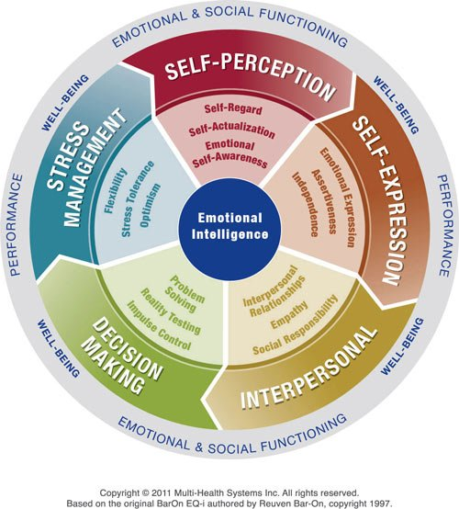
Five Key Components of EI
Self-Perception
Knowing Yourself
Self-Expression
Expressing Yourself
Interpersonal
Connecting with Others
Decision-Making
Making Smart Choices
Stress Management
Handling Stress
Notes:
These are the five components of EI. Think of these as muscles—ones we can strengthen with practice.
Five Key Components of EI (MHS Model):
Self-Perception – Understanding and recognizing your emotions and how they affect you.
Self-Expression – The ability to express your emotions clearly and constructively.
Interpersonal – Building relationships, understanding others’ emotions, and managing interactions.
Decision-Making – Using emotions to make sound decisions that align with goals.
Stress Management – Managing and regulating stress, maintaining balance in stressful situations.

Slide 6

Between stimulus and response there is a space. In that space is our power to choose our response. In our response lies our growth and our freedom.
Viktor Frankl ideas discussed by Stephen R. Covey
Notes:
Emotions are biochemical reactions that occur in response to stimuli. Stimuli are external events or circumstances that trigger a reaction. While we like to think we have 'control' over our emotions, what we have control over is how we respond.
This quote serves as a powerful reminder that between stimulus and response is a choice. It is emotional intelligence that helps us expand that space, opening up the potential for growth and change, and enabling us to respond with intention
Emotional intelligence is fundamentally about our responses to our own and others' emotions. These responses carry a significant weight, as they can have a profound influence on outcomes, making our actions and decisions crucial in shaping the future.

Slide 7
How Emotional Intelligence Helps with Stress Management
Recognizing & Managing Triggers
Self-awareness helps firefighters identify what causes their stress, whether it’s from work or personal life, allowing them to manage it proactively.
Staying Calm Under Pressure
Skills like impulse control and stress tolerance help firefighters stay composed, making thoughtful decisions during high-pressure situations, whether on a call or when facing personal challenges.
Empathy and strong relationships foster trust, teamwork, and mutual support, reducing feelings of isolation during tough times, both at work and in their personal lives.
Viewing Challenges with Optimism
Optimism, flexibility and realistic thinking help firefighters view stress as a manageable challenge, building resilience in the face of both work and life stressors.
Building Strong Interpersonal Connections
Notes:
Let’s break down how EI helps manage stress. Stress is not just about what happens to us; it’s about how we interpret and respond to challenges. Emotional intelligence gives us the tools we need to manage stress effectively, both on the job and in everyday life:
Recognizing & Managing Triggers: Self-awareness helps identify what causes stress, whether it’s from work or personal life, allowing us to manage it proactively.
Staying Calm Under Pressure: Skills like impulse control and stress tolerance help us stay composed, making thoughtful decisions during high-pressure situations, whether on a call or when facing personal challenges.
Building Strong Interpersonal Connections: Empathy and strong relationships foster trust, teamwork, and mutual support, reducing feelings of isolation during tough times, both at work and in our personal lives.
Viewing Challenges with Optimism: Optimism, flexibility and realistic thinking help us view stress as a manageable challenge, building resilience in the face of both work and life stressors.

Slide 8
Recognizing & Managing Triggers
Hot Button Drill
Hot Spot Check
Tactical Reset
Notes:
The word trigger has gotten a bad rap in the last few years. But we can’t deny we all have them. For some it’s European Helmets. For others is Rosenbauer’s Electric Engine.
Recognizing and managing what triggers us is an important step in stress management.
The Hot Button Drill, Hot Spot Check, and Tactical Reset are firefighter-specific strategies to recognize and manage stress triggers.

Slide 9

Firefighter Hot Button Drill: Identifying Your Triggers
Step 1: List Your Triggers
1
Step 2: Double-Check Your List
2
Step 3: Use This Intel to Improve Your Response
3
Notes:
Firefighter Hot Button Drill: Identifying Your Triggers
Just like knowing your tools and tactics, understanding what sets you off is key to keeping your cool under pressure. This Hot Button Drill will help you identify specific triggers—both on and off duty—so you can manage them effectively.
Step 1: List Your Triggers
Write down the exact situations that trigger frustration, stress, or strong emotional reactions. Be sure to describe only the observable event—not your interpretation of it.
On the job examples:
“Disrespectful firefighters” → (That’s an interpretation.)
“A firefighter interrupts me while I’m giving directions.”
“People being lazy” → (That’s an assumption.)
“A firefighter sits on their phone instead of helping with cleanup after a call.”
At home examples:
“My kids don’t appreciate what I do.” → (That’s a feeling.)
“My kids don’t say thank you when I cook dinner.”
Step 2: Double-Check Your List
Go back through each trigger and ask: Am I listing just the facts, or am I adding my own judgment?
If needed, rewrite each one to be purely observable.
Step 3: Use This Intel to Improve Your Response
Now that you know your hot buttons, you can train yourself to respond better when they get pushed.
Example:
• Trigger: “A firefighter interrupts me while I’m giving directions.”
• Instead of snapping back, I could say:
‘Hold on a sec—let me finish, and then I’ll hear you out.’
Final Thought: Stay in Control Under Pressure
Firefighters don’t let a tough fire dictate the outcome—we size it up, adjust, and take control. The same goes for our emotions. When you know what triggers you, you can lead with confidence instead of reacting on impulse.

Slide 10

Firefighter Hot Spot Check: Mapping Your Stress Triggers
Step 3: Dig Deeper – What’s Beneath That?
3
Step 1: Identify the Triggering Event
1
Step 2: Identify Your Flashover Reaction
2
Step 4: Address the Core Issue
4
Notes:
Firefighter Hot Spot Check: Mapping Your Stress Triggers
Just like identifying hot spots in a structure fire, it’s important to recognize the points where stress flares up in your mind and body. This Hot Spot Check will help you track your reactions, uncover deeper emotions, and regain control in high-stress situations.
Step 1: Identify the Triggering Event
Think about a situation that really sets you off—something that consistently gets under your skin at the station, on a call, or in leadership interactions.
Example: A newer firefighter ignores a direct order on the fireground.
Step 2: Identify Your Flashover Reaction
What’s your instant, gut-level response? Be honest, even if it’s something you wouldn’t say out loud.
Example: “What the hell is this rookie thinking?!”
Step 3: Dig Deeper – What’s Beneath That?
Just like fire spreads unseen in void spaces, there’s usually a deeper emotion fueling your initial reaction. Keep going down levels until you find the core issue.
Level 1: Frustration—They’re not listening to me!
Level 2: Concern—If they don’t listen, someone could get hurt.
Level 3: Self-Doubt—Do they not respect my leadership?
Core Issue: Fear of failure—If I can’t command effectively, am I really a strong leader?
Step 4: Address the Core Issue
Once you reach the foundation, you can work on building a better response. Instead of reacting with frustration, you can approach the situation with confidence, clarity, and control.
Instead of snapping at the firefighter, you could say:
“I need you to follow orders immediately on scene. Let’s talk after the call about why you hesitated.”
Final Thought: Train Like You Fight
Firefighters don’t ignore hot spots—we locate them, cool them down, and prevent flare-ups. The same goes for emotional triggers. By mapping out what fuels your stress, you can train yourself to stay in control, lead effectively, and keep your crew running smoothly.

Slide 11

Firefighter Tactical Reset:
Managing Stress Under Pressure
Acknowledge the Alarm
1
Establish a Safety Zone
2
Reset Your Gear
3
Handle the Call
4
Notes:
Firefighter Tactical Reset: Managing Stress Under Pressure
In the fire service, we thrive under pressure, but we also know that stress can impact our judgment and decision-making. This tactical reset is designed to help us maintain control and respond effectively in high-stress situations.
Step 1: Acknowledge the Alarm
Just like recognizing a Mayday situation, the first step is to call it out: “I’m triggered.” If you prefer call it something else “Alabama” Identifying what’s happening puts you back in control. When stress takes over, your brain’s emotional center (the amygdala) is running the show, and rational decision-making takes a back seat. Name it, so you can take command of your response.
Step 2: Establish a Safety Zone
When you’re in a heated moment, the worst thing you can do is react immediately. Just like we don’t rush into a fire without sizing it up, don’t act when you’re triggered. Instead, create space.
Direct approaches:
I need a second to clear my head. Let’s touch base after lunch and figure this out.
This isn’t going anywhere productive right now. Let’s take a break and come back with a fresh perspective.
Indirect approaches:
Step away for a “gear check.” Whether it’s grabbing some water or stepping outside, use this moment to reset.
Buy time. If someone’s throwing something at you that sets you off, respond with: “That’s an interesting take. Let me think it over and get back to you.”
A note for firefighters who avoid conflict: Creating space doesn’t mean dodging the issue - it means handling it with a clear head. The goal is to respond strategically, not emotionally.
Step 3: Reset Your Gear
Once you’ve stepped back, it’s time to shift your state. Just like cooling down after a fire, you need to reset your system so you can return to peak performance.
Tactical reset techniques:
Breathe like you’re on air. Slow, deep breaths - just like managing air consumption on SCBA - help bring your body back to baseline.
Get moving. A short walk, stretching, or even a few push-ups can help reset your nervous system.
Refocus your mindset. Take a moment to reflect: What really matters here? How do I want to handle this situation as a leader and teammate?
Step 4: Handle the Call
Once you’ve reset, it’s time to address the situation with a clear, level-headed approach.
If it’s a minor issue (like an encounter with someone you don’t interact with often), ask yourself: Is it worth my energy? If not, let it go and move on.
If it’s a teammate issue, avoiding it isn’t an option. Now that you’re in control, focus on what you want to accomplish and the best way to communicate it. Approach it like a debrief - stick to the facts, address concerns, and work toward a solution.
Final Thought: Train Like You Operate
Just like fireground tactics, this reset takes practice. The more you train yourself to recognize stress triggers and reset under pressure, the better you’ll perform in the moment. Firefighters don’t just react - we respond with skill, strategy, and composure.
Stay sharp, stay in control, and lead with intention.

Slide 12
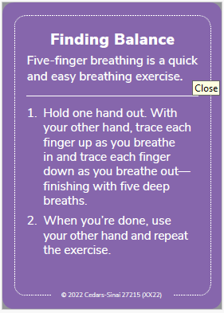
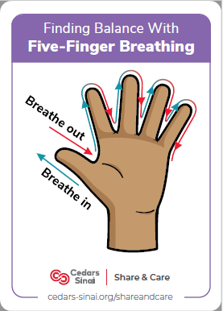
Notes:
1. Combines touch and breath (mind-body connection)
You trace one hand with a finger from the other, breathing in as you go up a finger, and out as you go down. This engages both tactile sensation and focused breathing, anchoring you in the present moment.
2. Activates the parasympathetic nervous system
The slow, rhythmic breathing helps shift you out of “fight or flight” and into “rest and digest,” calming the body and mind.
3. Easy and discreet
You don’t need any tools, training, or a quiet room. You can literally do it in the rig, at the station, or right after a stressful call.
4. Helps regulate emotions
By grounding you, it helps prevent emotional hijacks or reactive behaviors—making it especially useful during tense moments with coworkers or after tough scenes.
5. Builds mindfulness and self-awareness
The physical act of tracing your fingers keeps you focused, interrupting racing thoughts or mental spirals.

Slide 13
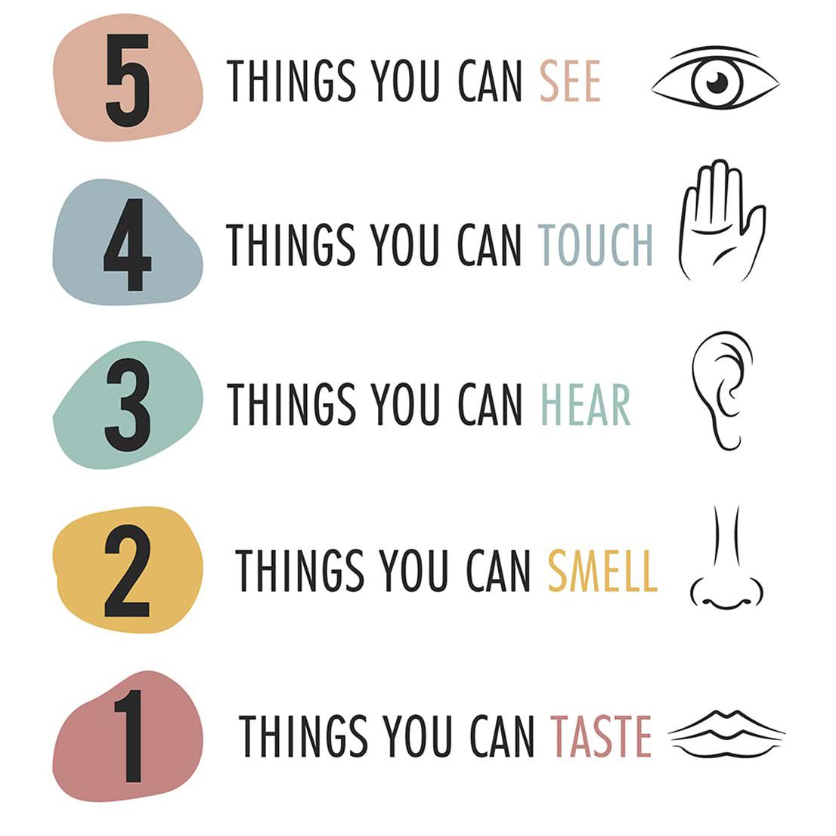
Notes:
The 5-4-3-2-1 grounding technique works so well for stress relief and anxiety because it pulls your attention away from spiraling thoughts or emotional overwhelm and reconnects you with the present moment through your senses.
5 – See:
Look around and name 5 things you can see.
✅ This engages your visual system and anchors you in your physical surroundings.
4 – Touch:
Name 4 things you can feel. (Your shirt, the floor under your feet, a breeze, etc.)
✅ This engages your sense of touch and reminds your body it is safe.
3 – Hear:
Name 3 things you can hear. (A hum, birds, distant voices…)
✅ Focusing on external sounds helps interrupt internal noise (racing thoughts).
2 – Smell:
Name 2 things you can smell (or think of favorite scents).
✅ Smell is deeply connected to memory and emotion, so this can be very grounding.
1 – Taste:
Name 1 thing you can taste. (Even if it’s just the aftertaste of coffee or mint.)
✅ Taste brings attention to the mouth and breath—another way to center you.
🌱 Why It Helps with Grounding:
Disrupts fight-or-flight: It switches off survival-mode thinking and activates the prefrontal cortex, where logical thinking happens.
Slows your breathing naturally: As you move through each step, you unconsciously regulate your breathing.
Redirects your focus: Instead of thinking about the past (regret) or future (worry), you're anchored in the now.
Accessible anywhere: No equipment needed. It works at work, in the car, on scene, or lying awake at 3 a.m.

Slide 14
Staying Calm Under Pressure
Impulse Control
Stress Tolerance
Notes:
Impulse control is key. Taking a tactical pause shows strength, not hesitation. Consider it a leadership move. Stress tolerance isn’t about ignoring stress—it’s about using it. Tactical breathing and support networks help keep us resilient.

Slide 15
Impulse Control
Wait!! Intentionally taking the time under trying circumstances to weigh the pros and cons before rushing to a decision is an admirable leadership skill that boosts your credibility with your team.
Tactical Pause
"Go To" Response
AAR of your Emotional Response
Notes:
1. Use the “Tactical Pause” Before Reacting
Firefighting demands quick decisions but pausing for just a few seconds can prevent costly mistakes. Before reacting under stress, take a deep breath and assess:
• What’s the immediate risk?
• Do I have all the necessary information?
• What’s the safest and most effective course of action?
This tactical pause allows your rational thinking to override emotional impulses, leading to better leadership decisions in high-pressure situations.
2. Control Stress with a “Go-To” Response
As a leader, your emotional state influences your team. Instead of letting stress trigger an impulsive reaction, develop a pre-planned response to stay grounded. This could be:
• A physical action (clenching and unclenching your fists, adjusting your posture).
• A mental cue (reminding yourself, “Calm is contagious.”).
• A quick breathing technique (inhaling for four seconds, holding for four, exhaling for four, hold for four).
By using the same response consistently, you train your brain to stay composed under stress, preventing rash decisions that could impact safety and morale.
3. Conduct an After-Action Review of Your Emotional Responses
After a critical incident or a stressful leadership challenge, don’t just review the tactics—analyze your own reactions:
• Did I stay calm and in control?
• Did my response positively or negatively affect the team?
• What will I do differently next time?
By reflecting on your emotional decision-making, you build awareness and improve impulse control, ensuring that next time, your response is more thoughtful, intentional, and effective.
Here are real-world examples of how to apply impulse control in fireground and administrative leadership situations using the three key strategies:
1. Tactical Pause – Preventing Rash Decisions on the Fireground
Scenario:
You’re the incident commander at a working structure fire. A firefighter urgently requests permission to enter a high-risk area to search for a possible victim, but conditions are deteriorating rapidly.
Impulsive Reaction:
Approving entry immediately without fully assessing the risk due to pressure from the crew.
Controlled Response (Tactical Pause):
• Take 3–5 seconds to assess:
• What is the smoke and heat behavior telling me?
• Do we have a survivable space in that area?
• Can I deploy additional resources to improve conditions first?
• Use the pause to gather information (confirm radio reports, check tactical benchmarks).
• Make a data-driven decision, ensuring firefighter safety while maximizing rescue potential.
Outcome: You prevent a rushed decision that could have placed firefighters in extreme danger, demonstrating level-headed leadership under pressure.
2. Go-To Stress Response – Staying Composed During Conflict
Scenario:
You’re in a department meeting, and a firefighter aggressively challenges a new policy you’re implementing, questioning your leadership in front of others.
Impulsive Reaction:
Getting defensive, raising your voice, or immediately shutting them down without considering their concerns.
Controlled Response (Go-To Stress Response):
• Physical action: Adjust posture, plant both feet firmly, and take a slow, deep breath.
• Mental cue: Remind yourself: “Stay steady—everyone is watching.”
• Verbal control: Respond calmly:
• “I hear your concern. Let’s talk through the reasoning behind this change.”
• “I appreciate the passion. Let’s work together to find solutions.”
Outcome: You defuse tension, maintain authority, and keep the conversation productive rather than escalating into an argument.
3. After-Action Review – Improving Emotional Responses in Leadership
Scenario:
A major emergency call doesn’t go as planned, and you realize you lost your temper with a firefighter who made an error.
Impulsive Reaction:
Ignoring the situation and assuming your frustration was justified without reflection.
Controlled Response (After-Action Review):
• After the call, ask yourself:
• Was my reaction proportional to the situation?
• Did my response help or hurt the firefighter’s ability to learn and improve?
• Speak with a trusted mentor or officer for feedback on how you handled the moment.
• If necessary, follow up with the firefighter—acknowledge your frustration but reinforce the lesson constructively.
Outcome: You build self-awareness, earn respect by holding yourself accountable, and foster a culture of continuous improvement.

Slide 16
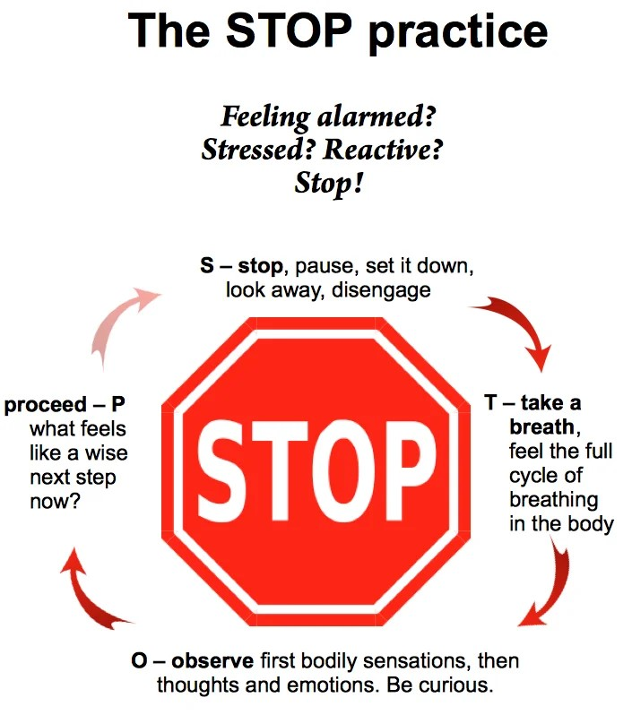

Slide 17
Stress Tolerance
Stress arises and shows up differently for everyone. Particularly when the pressure is on and the world is in major flux, leaders need to harness stress for its energy in order to remain resilient.
Tactical Breathing
Visualization
Strong Support Network
Notes:
1. Strengthen Mental Resilience Through Visualization
Firefighting leaders often face high-stress, unpredictable situations. One way to build stress tolerance is through pre-event visualization:
• Before a shift, mentally rehearse potential challenges (e.g., managing a mayday, handling personnel conflicts).
• Picture yourself staying calm, decisive, and in control as the situation unfolds.
• Use sensory details—imagine the sights, sounds, and emotions to prepare your mind for real-world stress.
Why It Works:
Visualization conditions your brain to respond with confidence instead of panic, reducing the emotional toll of high-pressure situations.
2. Regulate Your Stress Response with Tactical Breathing
Controlling your physiological response to stress is key to maintaining endurance in leadership. Tactical breathing (used by military and first responders) can reset your nervous system:
• Inhale deeply through your nose for 4 seconds.
• Hold the breath for 4 seconds.
• Exhale slowly through your mouth for 4 seconds.
• Hold the exhale for 4 seconds. Repeat as needed.
Why It Works:
This technique lowers heart rate and cortisol levels, helping you stay clear-headed and focused in high-stress situations like fireground command or personnel disputes.
3. Build a Strong Support Network and Debrief Regularly
Stress tolerance improves when you don’t carry burdens alone. Create a support system by:
• Building trusted relationships with peers who understand the challenges of leadership.
• Conducting informal debriefs after tough calls—not just operationally, but emotionally.
• Seeking mentorship from seasoned officers who can provide guidance on handling long-term stress.
Why It Works:
Regularly processing stress prevents burnout, helps you gain perspective, and reinforces that leadership stress is not a solo burden.

Slide 18
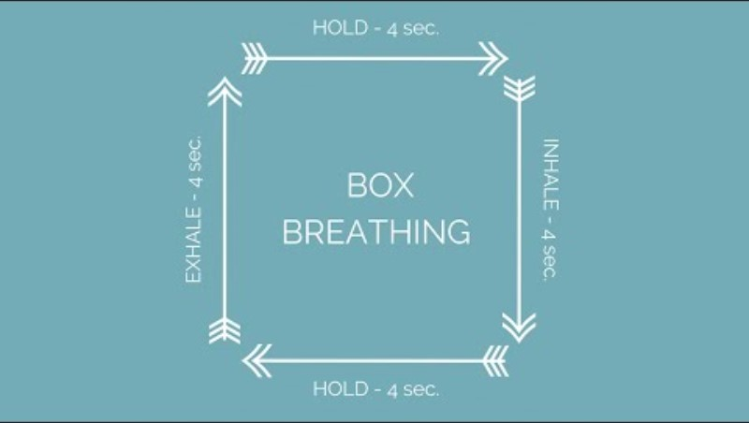

Slide 19
Staying Calm Under Pressure
Self-care & wellness
Set realistic expectations & Boundaries
Foster a culture of resilience through open communication
Notes:
Staying Calm starts before the pressure starts.
1. Prioritize Self-Care and Wellness
As a leader, you set the example for your team. Consistently maintaining physical and mental health is key to managing chronic stress:
• Exercise regularly (aim for a mix of cardiovascular, strength, and flexibility training) to release stress hormones and boost energy levels.
• Get adequate sleep—leaders often work long hours, but prioritizing sleep helps improve focus, decision-making, and emotional resilience.
• Practice mindfulness or meditation for 10–15 minutes daily to clear your mind and reduce the physiological impacts of stress.
Why It Works:
When you commit to self-care, you’re better equipped to handle the emotional and physical demands of leadership, reducing long-term burnout and stress overload.
2. Set Realistic Expectations and Boundaries
Chronic stress can stem from taking on too much, trying to please everyone, or neglecting your own limits. Set clear, realistic expectations for yourself and others:
• Delegate tasks to team members based on their strengths and development needs.
• Set boundaries around your work-life balance (e.g., no calls after a certain hour or designated “off-duty” days).
• Say no when your plate is full,and prioritize high-impact tasks that align with the department’s goals.
Why It Works:
Setting boundaries and realistic goals protects your time and energy, reducing the overwhelm that can lead to chronic stress. It also models healthy behavior for your team.
3. Foster a Culture of Resilience Through Open Communication
Leadership stress is often exacerbated by isolation or a lack of support from others. Fostering open communication within your team creates a culture of resilience:
• Encourage open dialogue about stress and mental health without fear of judgment.
• Model vulnerability by sharing your own stress management strategies and challenges.
Why It Works:
Creating an environment where team members feel heard and supported helps reduce collective stress. It also ensures that no one, including you as the leader, is bearing the weight alone.

Slide 20

Building Strong Interpersonal Connections
Empathy
Interpersonal Relationships
Notes:
Empathy and strong relationships make tough jobs more manageable. Build a culture where people feel safe to share and connect.

Slide 21


Slide 22
Interpersonal Relationships
Deepen your interpersonal relationships. Build stronger, more meaningful connections while increasing the engagement and productivity of your team.
Set up frequent 15-minute chats or check-ins
Swap stories of imperfection; be transparent about your learnings
Laughter relieves stress and acts as social glue
Notes:
When we make room for each other's humanity, we build trust – which is especially important in high-stress teams

Slide 23
Viewing Challenges with Optimism
Optimism
Realistic Thinking
Flexibility
Notes:
Optimism, flexibility, and reality testing help us shift perspective during challenging moments. These are learned skills.
These skills help us view stress as a manageable challenge, building resilience in the face of both work and life stressors.

Slide 24
Optimism
Believing that a challenging circumstance is temporary and finding the bright side when you don’t feel in control is a super-strength that you can benefit from in times of uncertainty.
Optimism can
be learned- view a setback as fleeting and changeable
Encourage
‘blue-sky’ thinking, brainstorm opportunities together
Look for the good in everything-it is out there

Slide 25
Flexibility
When unknowns arise, showing interest in how people are coping or resisting those changes is critical to the team’s future success.
Change is personal. Be sensitive to the different ways people approach change
Acknowledge emotions by discussing them
Explore alternate solutions

Slide 26
Reality Testing
Maintaining a realistic perspective is a vital leadership skill to ensure you are a guiding compass for your team in a quickly changing environment.
Gut-check+fact-check = balance emotions with data
Identify what
is clouding judgment
Check the perspective of someone outside of the situation

Slide 27

Creating an EI Strategy for Stress Management
Divide into groups,
Develop practical strategies firefighters can use daily to incorporate EI into stress management.
What’s one EI practice you can use at the start of your shift?
How can you reset after a high-stress call?
Share insights with the group.
Notes:
Divide participants into 5 groups. Assign each group one EI component (Self-Perception, Self-Expression, Interpersonal, Stress Management).
Ask each group to create a list of practical strategies or activities firefighters can implement in their daily routine to improve that EI component and manage stress.
After 5-7 minutes, have each group share their strategies with the larger group.

Slide 28
Key Takeaways
Emotional Intelligence is a crucial tool for managing stress.
Firefighters can use EI strategies to stay resilient under pressure.
Takeaways: Identify triggers, build connections, and develop strong coping strategies.

Slide 29

Next Steps
Take an Emotional Intelligence Inventory/Assessment
Identify areas for improvement
Develop an improvement plan
Kirsten Martin
Kirsten@martineq.net
804-432-3555
Notes:
Here’s your next step—take an EI inventory, identify areas for growth, and commit to a plan. I’m here if you want to talk more after today.

Slide 30


