Slide 1
What You Need to Know About Proper Post Exposure Follow UP
Katherine West, RN,BSN,MSEd,DICO-C
Infection Control Consultant

Slide 2
Objectives
Review Laws and regulations that govern the medical follow up process
Identify The Role of Your Designated Infection Control Officer
Cite the role of the medical facility in post exposure medical follow up
List the departments responsibilities in Post Exposure follow up
Understand YOUR role in post exposure medical follow up
Clarify an exposure event
Understand the formula for infection

Slide 3
Federal Laws
Ryan White Care Act – Part G
OSHA Bloodborne Pathogens Regulation

Slide 4
Medical Facility Role/Responsibility
Ryan White / OSHA
Draw source patient blood
Report results to the DICO

Slide 5
Department Responsibilities
Select a DICO
Selection of the medical care provider
Assist in the establishment of the step by step follow up process for post exposure
Support development of the Exposure Control Plan
Ensure proper staff education & training

Slide 6
Department Responsibility
Request childhood disease status
Request vaccine/immunization history
If not protected – offer vaccine free of charge
Declination forms
Immunization of Healthcare Personnel, CDC, 2011

Slide 7
Department Responsibility -Offer vaccines/Testing
Hepatitis B Vaccine
MMR Vaccine
Seasonal Flu Vaccine
COVID-19 Vaccine
Chickenpox Vaccine
TB Testing
CDC, 2011/2022, NFPA 1581

Slide 8
Ryan White Law
Requires that each emergency response entity have a Designated Officer
Outlines the process to be followed involving an exposure event

Slide 9
Players in Notification System
Exposed Responder
“Designated” Infection Control Officer (DICO)
Health Care Facility Representative

Slide 10
Communication Process
Hospital
DICO
Supervisor ?
Responder

Slide 11
Believe you sustained an exposure
Perform First Aid at the medical facility
Provide immediate first-aid care to the exposure site ·
Wash wounds and skin with soap and water. Do not use alcohol or strong disinfectants.
Splash/splatter eyes or mouth - wash with large amount of water
WHO/ CDC

Slide 12
Bloodborne Exposure
Employee/volunteer is responsible to report the event
Call the DICO from the medical facility
DICO will determine if an actual exposure occurred
If an exposure occurred, the DICO will request source patient testing

Slide 14
Procedure – Airborne/Droplet
Medical facility begins process
Notification to DICO (ASAP/48 hours)
Name of disease/date of transport

Slide 15
Airborne/Droplet Exposure
Medical facility notifies the DICO
DICO will interview the transport crew to determine if an exposure occurred

Slide 16
OSHA – Federal Law

Slide 17
Comparison Chart
Ryan White Notification Law Bloodborne/Airborne/Droplet | OSHA Bloodborne Pathogens & TB
Requires a liaison person for exposures (designated officer)- 24/7 | States a person should be charged with program management
Sets up a step-by-step process for hospitals and departments to follow | States compliance is “performance-based” does not give a set process
Gives coverage to volunteers | No clear coverage for volunteers
Covers all emergency response employees in all states | Does not give coverage in states that do not have their own state OSHA Plan
Gives set time frames for medical facilities to turn test results around | Does not give set time frames- refers to CDC guidelines
Requires medical facilities to notify emergency response employees if they transported a person suspect or confirmed for airborne & droplet transmitted diseases | Not noted by OSHA
Gives an administrative process for medical facility non-compliance | No administrative process
States medical examiner responsibilities for testing deceased persons if an exposure occurred | Not addressed
States Designated officer makes the first call on an exposure | Not addressed
States medical facilities have responsibility to test the source | Not as clear
Requires hospitals notify the DICO regarding airborne & droplet transmitted diseases | Only addresses HIV, HBV, HCV, Syphilis And TB

Slide 18
OSHA – Enforcement CDC Guidelines
Post Exposure
Tuberculosis Guidelines
Work Restriction Guidelines
Immunization/vaccination Guidelines

Slide 19
General Duty Clause – Section 5
Section 5 (a): Employers must protect employees from recognized hazards that are causing or are likely to cause death or serious physical harm
OSHA has authority to issue citations and fines even when there is no regulation that has been violated

Slide 20
DICO Responsibility
Represents the department and the employee to ensure that an exposed employee receives -
Proper post exposure medical care
Proper Counseling

Slide 21
Selection of the Medica Care Provider

Slide 22
Selection of medical care provider Work with Administration
Occupational Medicine
Infectious Disease Physician
Emergency Department

Slide 23
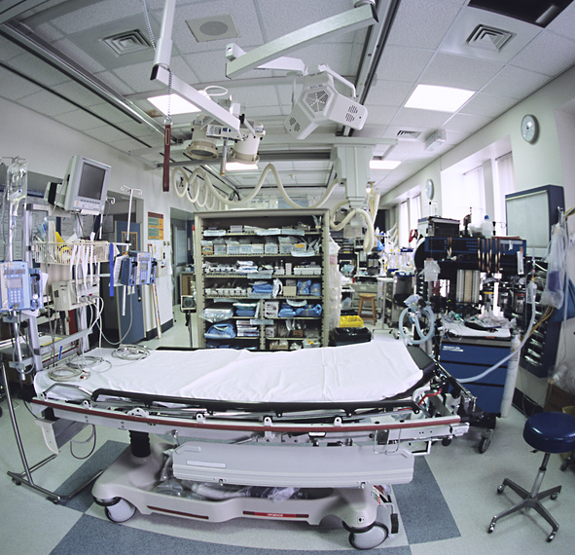
Emergency Department
Open 24/7
Wait time
Cost- high mark up
No training
Counseling (usually no time or training)

Slide 24
Average Cost for ED Use - 2024
Triage Fee
Facility fee
Professional fee
Supplies
Total – 2715.00
Healthcare Cost – Journal, 2024

Slide 25
Occupational Medicine
Not trained in Post exposure treatment protocols
Not trained in post exposure counseling
Contract for services/cost
No 24/7 coverage
May refer to ID physician

Slide 26
Infectious Disease MD
Trained
No contract needed
24 hour coverage
Less costly ($300.00- $600.00)

Slide 27
Why Selection is Important
The department is responsible to ensure the exposed employee receives “proper care and counseling”.
OSHA,1910.1030, CPL02-02.069

Slide 28
Post Exposure Follow – Up
You need to know the process
If you feel not correct – notify your DICO

Slide 29
Counseling Post Exposure
A major component of post exposure care
May Take up to an hour
Clarify events deemed not to be an exposure
Drug interactions - example

Slide 30
Cipro - Contraindications
Diabetes
Low Blood sugar
Abnormal healthy rhythm
Slow heart rate
Inflammation of tendon
Seizures
OTC meds – Vitamins, antacids,
Meds with caffeine - Excedrin
Rupture of tendon
Kidney disease
Transplant – heart or kidney
Pregnancy
C- diff
Asthma
Blood Thinners
Antidepressants
WebMD/ Drugs.com

Slide 31
State Law – HIV testing

Slide 32
Patient Consent to Testing
State Law Controls
Informed Consent
Court Order
Exception to Informed Consent
Deemed Consent

Slide 33
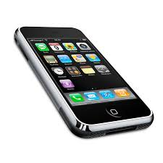
DICO Availability
24/7

Slide 34
Designated Officer & Back Up
NFPA 1581 – Infection Control
4.4.1.2 – requires a full or part time position depending on size of the department
4.4.1.2 requires a back up person for the DICO

Slide 35
Defining Exposure

Slide 36
Bloodborne Exposure
Contaminated Sharps Injury**
Blood/OPIM in direct contact with inner surface of the eye, nose or mouth

Slide 37
Bloodborne Exposure
Blood/OPIM in direct contact with an open area of the skin
Cuts with sharp objects covered with blood/OPIM
Bites – human (bloody)

Slide 38
OPIM
Amniotic Fluid
Peritoneal Fluid
Any fluid with “visible” blood
CSF
Pericardial Fluid
Synovial Fluid
Pleural Fluid
Vaginal secretions/semen only via sexual contact
CDC/OSHA

Slide 39
No Risk Body Fluids-HIV,HBV,HCV
Tears
Sweat
Saliva
Urine
Stool
Vomitus
Nasal Secretions
Sputum

Slide 40

Saliva – Protective Properties
Rarely a vehicle for HIV infection
Adv. Dental Research, 2006
Defensins in saliva – antimicrobial peptid
Med. Electron Microscope, 2003
Steady supply of saliva maintains non-immune and immune factors in the mouth
Acta Odontol Scand, 1998

Slide 41
BBP & Human Bites
1993 – 2011
No documented cases of transmission
Possibly risk – HBV but universal vaccination
J. Natl Med Assoc. 2013 Spring;105(1):92-95

Slide 42
Splashes with body fluids is thought to be near zero even if the fluids are overtly bloody
CDC, June 2015

Slide 43
Risk Statistics
HIV
HBV
HCV
Sharps injury 0.23%*
Mucous membrane 0.09%
Non-intact skin – 1 case
6% -30% non-vaccinated/unreported exposure
Sharps injury 0.2%
2 cases – blood to the eye
Non-intact skin – 1 case
CDC, OSHA, NIOSH

Slide 44
Exposure Event
Conduct First Aid
Report the event to your DICO

Slide 45
Exposure Event
You do NOT need to sign in the ED and have blood work drawn!
Source patient testing comes first
Rapid testing is required
Results in 1 hour for bloodborne pathogens
Test now for virus not antibody

Slide 46
Define Exposure Airborne/Droplet

Slide 47
Airborne/Droplet Exposure
Organism
Transport Time
Distance
Procedure/Task
Ventilation*
Health Status of employee

Slide 48
Exposure Does NOT mean You Are Infected !

Slide 49
Let’s Explain Why

Slide 50
Incubation Period
Time from exposure until there can be signs and symptoms for the disease
Risk for transmission to others

Slide 51
You do not need to go off duty!

Slide 52
Formula for Infection
Dose
Organism
Virulence
Mode of
Entry
Host
Resistance
Notes:
There is actually a formula for infection, the “certain circumstances” that must be present in order for there to be risk for disease transmission.

Slide 53
Organism
Bacteria
Virus
Fungi
Parasite
Organism
Notes:
The first factor is the organism present - could be a virus or bacteria, fungi pr a parasite

Slide 54
Dose
The infectious agent must be sufficiently virulent to cause illness in man
Dose
Notes:
The second and a very important factor is DOSE, the number of organisms present.
Example - hepatitis B may require on 1 virus present to cause infection while HIV may require 100,000 to 1 million to infect

Slide 55
Virulence
The ability of organisms to survive outside the reservoir or host
Virulence
Notes:
The next factor is virulence, ability of the organism to survive outside the body

Slide 56
Example - Virulence
HIV does not survive or maintain its infectiousness outside the host, except under laboratory conditions
Salmonella can survive and multiply outside the body in food
Notes:
An example for virulence is HIV - this organism is one that does not survive outside the host reservoir. Hepatitis B virus can survive up to seven days on surface containing dried blood.
But the bacteria, Salmonella is one that can not only survive but multiply under the right temperature

Slide 57
Mode of Entry
Can occur in two ways-
Direct contact ( actual physical contact with secretions that harbor infective organisms)
Indirect Contact ( organism resides outside the reservoir and is transferred to another host)
Mode of
Entry
Notes:
Disease can be transmitted two ways - direct or indirect contact
Ask class to give what they feel are examples -

Slide 58
Host Resistance
The host must be susceptible before an organism is able to cause infection
The healthier you are, the less susceptible you are
Host
Resistance
Notes:
Most people have forgotten that your own health status plays an important role in the risk for acquiring an infection in an exposure situation.
Even with the presence of an organism, the right dose and virulence - your degree of risk is lowered because of host resistance.
This also means that exposure does not mean you are definitely infected!

Slide 59
Remember
Formula for Infection
Dose
Virulence
Host Resistance

Slide 60
Why Isn’t this Absolute?

Slide 61
Body’s Natural Defenses - Skin
Unbroken skin is the body’s first line of defense
Organisms can not pass through
Some of the skin’s normal secretions are bactericidal
Notes:
We can revert back to high school biology class…many of us have forgotten that our body offers built in protective measures.
Skin for example - is like armor bacteria and viruses can not penetrate the skin like chemicals can

Slide 62
Normal Flora
bacterial flora depletes its environment of essential nutrients for pathogens, naturally occurring antibiotics and fatty acids are lethal to pathogens
APIC, 2010
Notes:
There are bacteria present on the skin, in the mouth, nose, respiratory tract etc. that serve to protect us from disease. Our normal flora provides a balance - homeostasis that prompts health and prevents disease.

Slide 63
Body’s Natural Defenses - Conjunctiva
Protected by the motion of the eyelids
Protected by washing of tears
Notes:
Other important body defenses include the conjunctiva and tearing of the eyes. Tearing serves as a flushing action. This action carries microorganisms down to the nose and eliminates them. Tears contain a secretion called - lysozyme, which may be bactericidal

Slide 64
Body’s Natural Defenses - Lungs
Cilia
Moist mucous membranes
Complex arrangement of nasal passages
Cough mechanism
Notes:
The lungs and upper respiratory tract offer protection as well -
Dust, bacteria and other particles adhere to mucous membranes and they are expelled from the body by sneezing or coughing. Cilia catch organisms and expels them when one sneezes.

Slide 65
Body’s Natural Defenses - Gastrointestinal Tract
The acidic nature of the gastric juices
Natural enzymes from intestine partially digest pathogens
Microorganisms
Notes:
The acidic nature of gastric juices kills some organisms. Hepatitis B is an example. This is one reason why Hepatitis B is not excreted in stool
Bile will also many organisms that enter the stomach.
Phagocytes ( action of ingestion and digestion) offer another defense mechanism.

Slide 66
Body’s Natural Defenses - Chemical Protection
Substances in the blood
Properdin
Interferon
proteins which kill viruses
Notes:
Chemical protection is also offered by the body. Substances in the blood such as Properdin and interferon are protein substances that kill viruses and bacteria.

Slide 67
Immune System
Antigen - foreign protein enters the bloodstream and stimulates special cells to produce protective antibody
Antibody - a protein produced by the body in response to presence of an antigen
Notes:
Our immune system acts immediately to fight off infection.
Antigen is the causative agent, the foreign organism
Antibody is the protein produced by the body to fight off infection

Slide 68
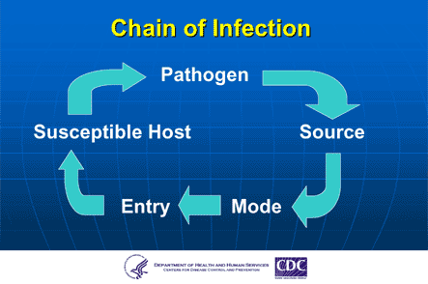
Chain of Infection
Notes:
You may have heard of the cycle or chin of infection. This is taking the pieces of the puzzle of the formula for infection and laying it out.
The questions asked by your Designated Officer following the report of an exposure are taken form this chart to access/evaluate risk and the need for medical follow up.

Slide 69
Block Mode of Entry
Personal Protective Equipment (PPE)
Gloves (latex free)
Mask/eyewear
Cover gowns
Resuscitative device
PPE adds an additional barrier to the body’s built in protections
Notes:
The use of personal protective equipment (PPE) gives a secondary line of defenses beyond what our body all ready offers us.
PPE - includes -
gloves ( low protein, powder free or non-latex) Need to comply with FDA and the National Institute for Occupational Safety & Health (NIOSH) in reducing the risk for latex allergy/sensitivity.
Mask/eyewear - to block splash or splatter
Cover gowns - to block contamination of the skin
Resuscitative devices - to block droplet contact

Slide 70
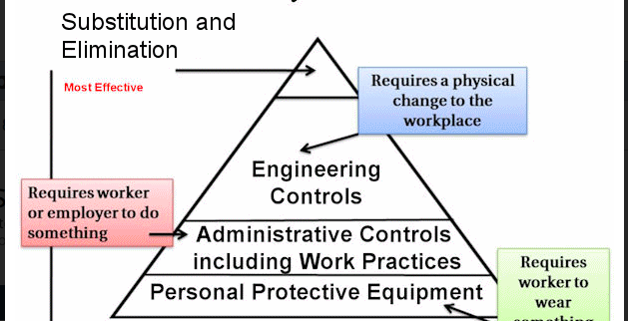

Slide 71
Exposure Control Plan
OSHA Required
Identify post exposure follow-up steps

Slide 72
Ryan White Disease List
Airborne
Measles (Rubeola)
Chickenpox
Tuberculosis
Bloodborne
HBV
HIV
HCV
Vaccinia virus
Cutaneous Anthrax
Rabies
Viral hemorrhagic fevers
(Lassa fever, Marburg virus, Ebola)
Federal Register, 11/2/11
Notes:
This is a listing of the diseases in the Federal Register that are listed to be added.
This listing greatly expands disease for which medical facilities must notify fire/EMS regarding possible exposures
I will be submitting this and other comments to the CDC via the Federal Register request for comments

Slide 73
Disease List Cont.
Droplet
Diphtheria
N. Meningitis
Mumps
Novel Influenza A viruses
Pertussis
Plague
Rubella
SARS-CoV
COVID-19 (2020)
Federal Register 11/2/11

Slide 74
Bloodborne Pathogen Exposures

Slide 75
Source Patient Testing
Hepatitis B surface antigen
Rapid Hepatitis C – RNA
Rapid HIV
Rapid Syphilis

Slide 76
Hepatitis B
Source patient tests positive for hepatitis B
DICO will check your medical record

Slide 77
Non-Vaccinated or Incompletely vaccinated - Employee
Source Patient
Source Negative
Source Positive
Start
Vaccine
Give HBIG x1 and 1 dose of vaccine
& complete the vaccine series
Titer at 1-2 months – HBsAg in 6 months
CDC, 2018

Slide 78
Post Exposure Protocol – Known Responder
CDC, 2018

Slide 79
Post-exposure Known Non-Responder to Initial Series (3 doses) – Give Heplisav-B
Adapted from CDC, MMWR, June 29, 2001, 2006, 2011, 2013, 2018

Slide 80
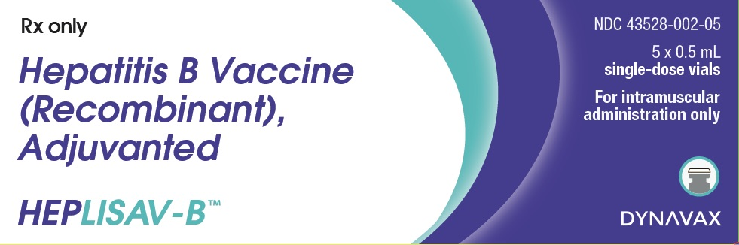
New Vaccine – Heplisav-B
CDC recommended April 20, 2018
2 dose series 0 – 1 month
Greater protection – 90% - 100%
Engerix – 70.5% - 90.2%
Shortage – Recombivax- HB
April, 2018

Slide 81
Post-exposure HBV Vaccine Response Unknown
Adapted from CDC MMWR, 2018

Slide 82
Currently no rapid test for Hepatitis B
Pending

Slide 83
Hepatitis C
Post Exposure

Slide 84
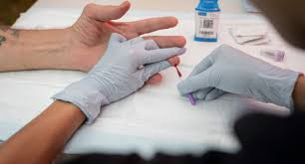
Rapid HCV Test – New One Step
OraQuick ®HCV RNA
FDA approved
Takes 20 - 60 mins.
No lab equipment required
Very accurate- 99.8%
CLIA waiver
Screens for VIRUS
FDA. June 27, 2024
Notes:
On June 25,2010, the FDA approved OraQuick rapid HCV testing. This test is performed on whole blood and takes 20 mins. to perform – no lab equipment is needed. This test is to be performed on the source patient.
OSHA is enforcing the use of rapid testing as part of post exposure medical follow up.

Slide 85
Incubation Period - HCV
6 - 9 weeks
CDC 2017
Notes:
The incubation period for HCV infection is between 6 - 7 weeks.

Slide 87

Hepatitis C – Early Treatment
HCV-RNA positive begin treatment
8 or12 weeks
July, 2013
Notes:
Research on this approach began in Germany at the University of Hanover. In their research showed that people treated within three months to six months successfully cleared the virus and did not develop chronic infection. Treatment included interferon alfa-2 for one month, followed by five weeks of drug given 3x a week. At six months follow-up almost all of the patients cleared the virus.
A second study was conducted in France and the results were published in May, 2006. In this study, the objective was to evaluate the efficacy and tolerability of a 24 week course of pegylated interferon alfa 2a (PegIFNa2a) and Ribavirin for the treatment of HCV in HIV-infected persons. Diagnosis was made using HCV-RNA. Treatment was started 12 weeks after diagnosis. All patients in the study have genotype 3 infection. Although this was a small study group (25), there was sustained viral response 24 weeks after treatment

Slide 88
Possible Vaccine – Clinical Trials
Gearing up once again
DNA based vaccine
Medical News Today – July, 2020

Slide 89
HIV Post Exposure

Slide 90
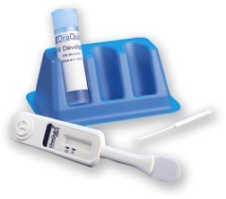
- Waiver
Health & Human Services has issued a “waiver” for CLIA compliance
OraQuick
Uni-Gold
Clearview
Chembio
INSTI
Ideal for small rural areas
Notes:
The Department of Health and Human Services has granted a waiver to laboratories that are not CLIA approved to conduct rapid HIV testing for the tests listed on the slide when testing is performed using whole blood. This means that a physician office with a lab can offer this testing as long as they follow the FDA required instructions. This will make testing the source patient easier.
This testing is being conducted in HIV testing sites across the country.

Slide 91
Rapid Test is Positive – need viral load testing

Slide 92
Rapid HIV Testing Issues- Post Exposure
If source patient is negative rapid test = NO further testing of the exposed health-care worker
CDC, 2001, 2005, 2013

Slide 93
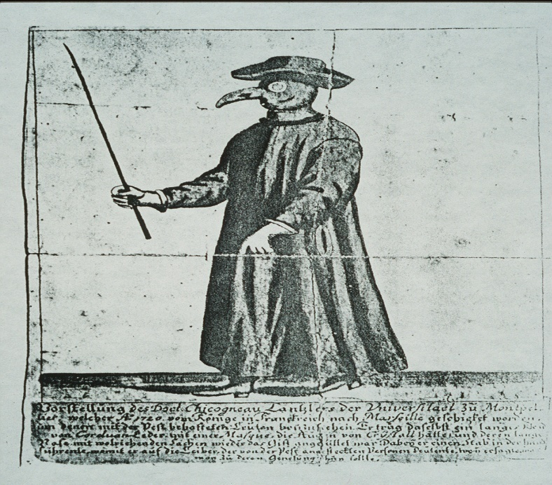
Non Progressors
Immune to HIV infection
Protected by a mutated gene
CCR5 –delta 32

Slide 94
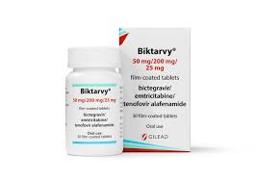
Biktarvy – One pill a day
Lowers viral load to undetectable in 8 – 24 weeks
Financial support available

Slide 95

No Viral Load = No Risk for Transmission

Slide 96
Source is Positive for HIV with Viral Load
Baseline employee
6 weeks later
4 months later
(use rapid testing)
CDC, Sept. 2013

Slide 97
PEP for HIV Exposure
Never automatic
Must be available at all times
Start within 72 hours if appropriate
No out of pocket expense for employee

Slide 98
Update 2013
“HCP exposure to HIV occur outside of occupational health clinic hours of operation and at sites at which occupational health services are unavailable, and initial exposure management is often overseen by emergency physicians or other providers who are not experts in the treatment of HIV infection or the use of antiretroviral medications”
“thus, recommend clear protocols using the PEPline”
CDC, PEP Update 2013

Slide 99
Post-Exposure Evaluation/Follow-up
Employer must provide confidential medical evaluation and follow-up following exposure incident
Baseline testing if PEP is to be started
CBC, liver function, pregnancy test, kidney function, etc.
Repeat every 2 weeks
2005, 2013

Slide 100
Syphilis Post Exposure

Slide 101
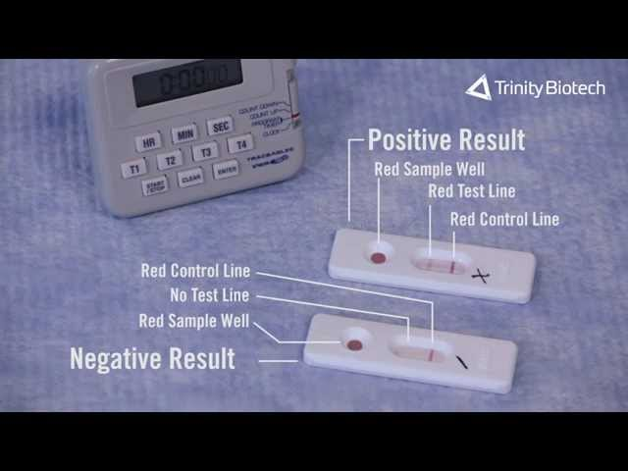
New Rapid Tests - Syphilis
FDA approved and CLIA Waiver Granted
Syphilis Health Check test
Determine
10 mins. – 15 mins.
Fingerstick
$2.70

Slide 102
Post - Exposure Syphilis
If positive, draw baseline on employee
If employee negative, give 2.4 million units procaine
penicillin G – no longer available
Bicillin L. A. To be given or Doxycycline

Slide 103
References for Syphilis Testing
CPL 02-02.069 – definitions –”to include more than just HIV and HBV. The standard applies to any pathogenic microorganism present in human blood that can cause disease in humans”.
CDC STD Guidelines, October, 2015
Screening for Syphilis Infection- JAMA, Sept. 2022

Slide 104
Airborne/Droplet Post Exposure

Slide 105
Exposure Chickenpox
Face to face contact while indoors for > 5 mins. – to up to 1 hour
Direct contact with drainage from lesions
CDC, 2009, 2011

Slide 106
HCPs & Varicella (Chickenpox)
Administer
Administer varicella vaccine to susceptible personnel, especially those that will have contact with patients at high risk for serious complications.
Do not perform
Do not perform serologic screening of persons with negative or uncertain history of varicella before administering varicella vaccine to personnel, unless the institution considers it cost-effective.
Do
Do not routinely perform postvaccination testing of personnel for antibodies to varicella.
CDC, HICPAC, Nov. 2024

Slide 107
Chickenpox Vaccine
Varivax
Do Not give to pregnant women or immune compromised
Avoid pregnancy for 4 weeks after each dose
Use consent form
CDC, Varicella Guidelines, June 20, 2007

Slide 108
Characteristics of Exposure - TB
Time Spent with Patient:
Frequency & duration of exposure
Volume of air containing droplets
Ventilation present
Exposure to sunlight
CDC, Dec., 2005
Notes:
The factors for exposure remain unchanged. TB is still not a highly communicable disease.
Most healthy persons immune systems fight off the disease.

Slide 109
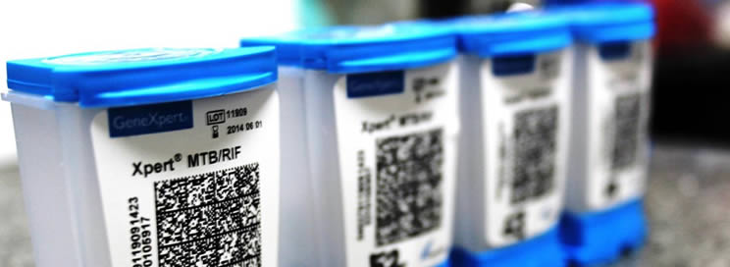
Newer - Faster
GeneXpert – sputum test
2 hour result
Can identify resistance
Cost - $9.98

Slide 110
Vehicle Built In Protections
Rear exhaust fan
HVAC on non-recirculating cycle

Slide 111
CDC Statement on Respirators in EMS - Tuberculosis
The CDC Guidelines for Preventing the Transmission of Mycobacterium tuberculosis in Health-Care Settings, 2005 has a section dealing with EMS starting on page 25. On page 26, it states “persons with suspected or confirmed TB who are transported in an ambulance should wear a surgical mask or procedure mask, if possible, and drivers, HCWs, and other staff who are transporting the patient might consider wearing an N95 respirator. There is no requirement for EMS personnel to wear a N95 respirator while transporting a TB patient.”
Marisa Fries, National Personal Protective Technology, March 2015

Slide 112
TB Post Exposure
Post Exposure Medical Treatment
Check when last TB test was given
If over 3 months, do a baseline
Retest in 8 – 10 weeks
If now positive, do a 1 x chest x-ray
If negative – may offer preventive drug treatment
No alcohol
Liver function studies monthly
(INH,RPT)
New short course of treatment - 2012

Slide 113
Exposure - Measles
HCP exposures to measles in a healthcare setting are defined as spending any amount of time while unprotected (i.e., not wearing recommended respiratory protection):
In a shared air space with an infectious measles patient at the same time, or
In a shared air space vacated by an infectious measles patient for up to 2 hours
CDC, HICPAC, 2024

Slide 114
Measlesa
Incubation Period
7 – 21 days
Infectious 4 days before onset of rash – 4 days after rash onset
CDC, 2008, 2011/2020/

Slide 115
Measles - Rubeola
Post Exposure Management
I.G. Given within 96 hours
Vaccine – within 72 hours of exposure
CDC, 2011

Slide 116
Work Restriction Post Exposure
Beginning 5 days after the exposure until the 21st day
Even if given vaccine post exposure
CDC, 2019

Slide 117
Droplet Transmitted Diseases

Slide 118
Transmission – Droplet Diseases
Requires direct contact with nasopharyngeal secretions

Slide 119
Mumps
Incubation Period
12 - 26 Days

Slide 120
Exposed HCP with Presumptive evidence of Immunity
Asymptomatic – presumptive immunity – no work restriction
Implement daily monitoring for signs and symptoms of mumps from the 10th day after their first exposure through the 25th day after their exposure.
CDC, HICPAC, Nov. 2024

Slide 121
Exposed healthcare personnel without adequate presumptive evidence of immunity
Exclude from work from the 10th day after their first exposure through the 25th day after their exposure.
Work restrictions are not necessary for healthcare personnel who received the first dose of MMR vaccine prior to exposure:
They should receive their second dose of the MMR vaccine as soon as possible (at least 28 days after their first dose).
Implement daily monitoring for signs and symptoms of mumps infection from the 10th day after their first exposure through the 25th day
CDC, HICPAC, Nov. 2024

Slide 122
Mumps
Post Exposure Medical Treatment
Immune personnel- watch for signs/symptoms – may work
non immune personnel – work restriction from day 12-26
No vaccine – post exposure
CDC, 2006, 2011

Slide 123
Complications - Mumps
Orchitis (unilateral)
30% of cases
Pancreatitis
Meningitis
Encephalitis
Hearing loss
Nephritis
Myocarditis
Mastitis
CDC

Slide 124
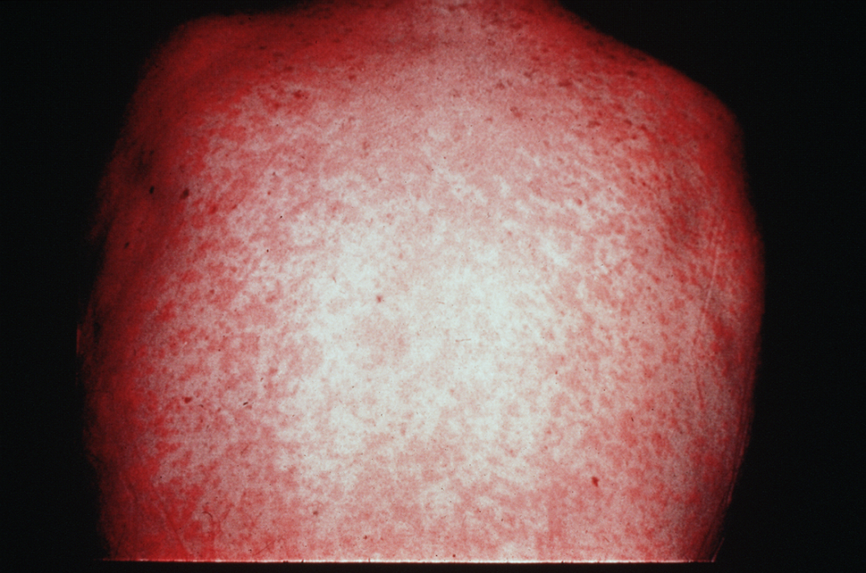
Rubella
German Measles

Slide 125
Rubella
Incubation period
12 - 23 Days
CDC, Nov. , 2011
Notes:
Less contagious than measles

Slide 126
Rubella
Post Exposure Medical Treatment
Offer Vaccine – not effective
I.G. In 72 hours may assist
Work restriction – 7 days after exposure – 23 day
CDC, Nov., 2011

Slide 127
Post Exposure – No Treatment Available
Mumps
Rubella

Slide 128
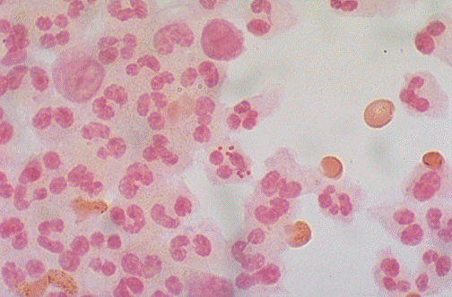
Meningitis
Bacterial
Viral

Slide 129
Meningitis
Incubation Period
1 -10 Days – bacterial
3- 7 days- viral
CDC, 2010, 2020

Slide 130
Meningitis
Exposure Criteria
Mouth-to-Mouth resuscitation
Intubation
Suctioning
Splash vomitus
8 hour contact
Inf. Disease Clinics of No. America, June, 1997Page 320/ &CDC, 2006, 2011 pg. 35

Slide 131
Meningitis
Post Exposure Medical Treatment
Rifampin PO X 2 days
Turns all body fluids orange
Do not give if taking birth control pills

Slide 132
Meningitis
Post Exposure Medical Treatment
CIPRO (500 - 750 mg.)
Given in a single dose
Side effects

Slide 133
Cipro - Contraindications
Diabetes
Low Blood sugar
Abnormal healthy rhythm
Slow heart rate
Inflammation of tendon
Seizures
OTC meds – Vitamins, antacids,
Meds with caffeine - Excedrin
Rupture of tendon
Kidney disease
Transplant – heart or kidney
Pregnancy
C- diff
Asthma
Blood Thinners
Antidepressants
WebMD/ Drugs.com

Slide 134
Substitute -
Azithromycin
CDC, Nov. 2011

Slide 135
Pertussis
Whooping Cough

Slide 136
Incubation Period
3 – 10 days (as long as 21 days)
Considered “highly contagious”
CDC, January 2005, 2011, 2024

Slide 137
Exposure
Contact with oral/nasal secretions of the source patient that are in contact with mucous membranes
Close face to face contact without a mask
CDC, March 25, 2024

Slide 138
Post Exposure Primary Choice
Azrithromycin – one dose daily x 5 days
Erythromycin 4 divided daily doses x 14 days

Slide 139
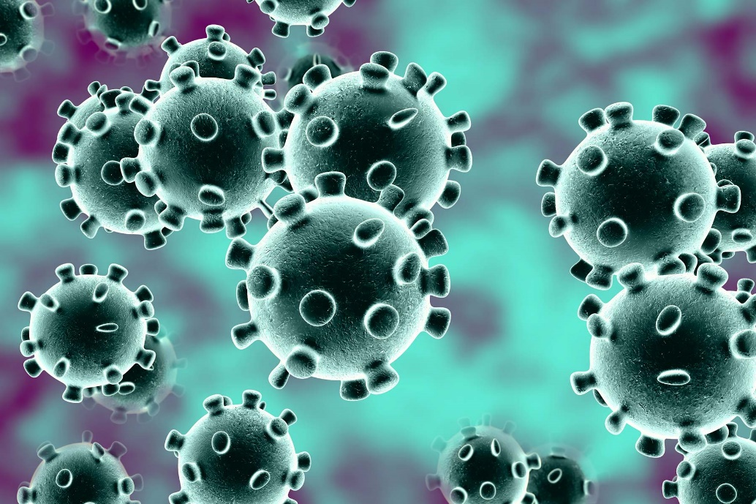
Novel Coronavirus ( COVID-19)
A new coronavirus
China – 2019

Slide 140
Mode of Transmission
Respiratory – droplet precautions (WHO)
Contact Precautions – (WHO/CDC)

Slide 141
COVID- Update – CDC, Dec. 23, 2021 Omicron Incubation period: 4 – 5 days
Incubation period 2 -14 days
Notes:
The incubation period is 1- 5 days

Slide 142
Prevention
Early recognition & control source
Place surgical mask on patient
O2 mask
Apply Standard precautions for all patient
Good hand hygiene
Implement – droplet and contact precautions
When applicable airborne precautions (AGPs)
Samples for testing – lower resp., upper resp., serum specimens – open suctioning, intubation, bronchoscopy, CPR
WHO, Jan. 22, 2020

Slide 143
New Vaccine - Bivalent
FDA approved on August 31, 2022
Previous vaccines not to be given
Protects against Omicron variants –
Can be given 2 months after vaccine

Slide 144
COVID-19 Work Restriction Guidelines – 2022/23
In most circumstances, asymptomatic HCP with higher-risk exposures do not require work restriction
Higher-risk exposures generally involve exposure of HCP’s eyes, nose, or mouth
to material potentially containing SARS-CoV-2, particularly if these HCP were
present in the room for an aerosol-generating procedure.
Work restriction is not necessary for most asymptomatic HCP following a higher-risk exposure, regardless of vaccination status.
Examples of when work restriction may be considered include:
HCP is unable to be tested or wear source control as recommended for the 10 days following their exposure;
HCP is moderately to severely immunocompromised;
HCP cares for or works on a unit with patients who are moderately to severely immunocompromised;
HCP works on a unit experiencing ongoing SARS-CoV-2 transmission that is not controlled with initial interventions;
CDC, Sept. 23, 2022
Notes:
Read

Slide 145
COVID-19 Work Restriction - Recommended
If work restriction is recommended, HCP could return to work after either of the following time periods:
HCP can return to work after day 7 following the exposure (day 0) if they do not develop symptoms and all viral testing as described for asymptomatic HCP following a higher-risk exposure is negative.
If viral testing is not performed, HCP can return to work after day 10 following the exposure (day 0) if they do not develop symptoms.
CDC, Sept. 23, 2022/23
Notes:
Read

Slide 146
Important
Know your childhood disease status
Know your vaccine/immunization status

Slide 147
Your Role -
Notify your DICO if you feel follow up is not correct!

Slide 148
Questions & Answers
703 -365-8388
www.ic-ec.com

