Slide 1
Indian Gaming Tradeshow & Convention 2024
Indian Gaming Tradeshow & Convention 2025

Slide 2
SUMMARY
For Exhibiting Companies Only
My Team, page 10
Inbound Leads, page 11
Meetings | Requesting on behalf of a Team Member, page 12
Meetings | Accepting on behalf of a Team Member, page 13
Export Contacts, page 14
Login page 3
Login (Guest Access) page 4
Contact Sharing, page 5
Edit your Profile, page 6
Event/Conference. Agenda, page 7
How to interact, page 8
Meetings, page 9

Slide 3
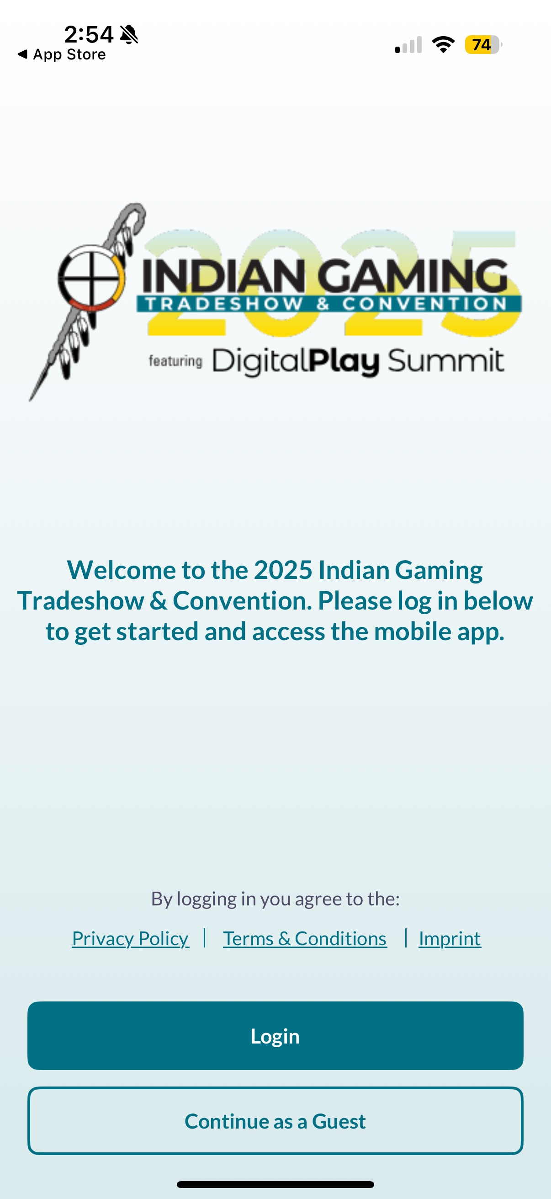
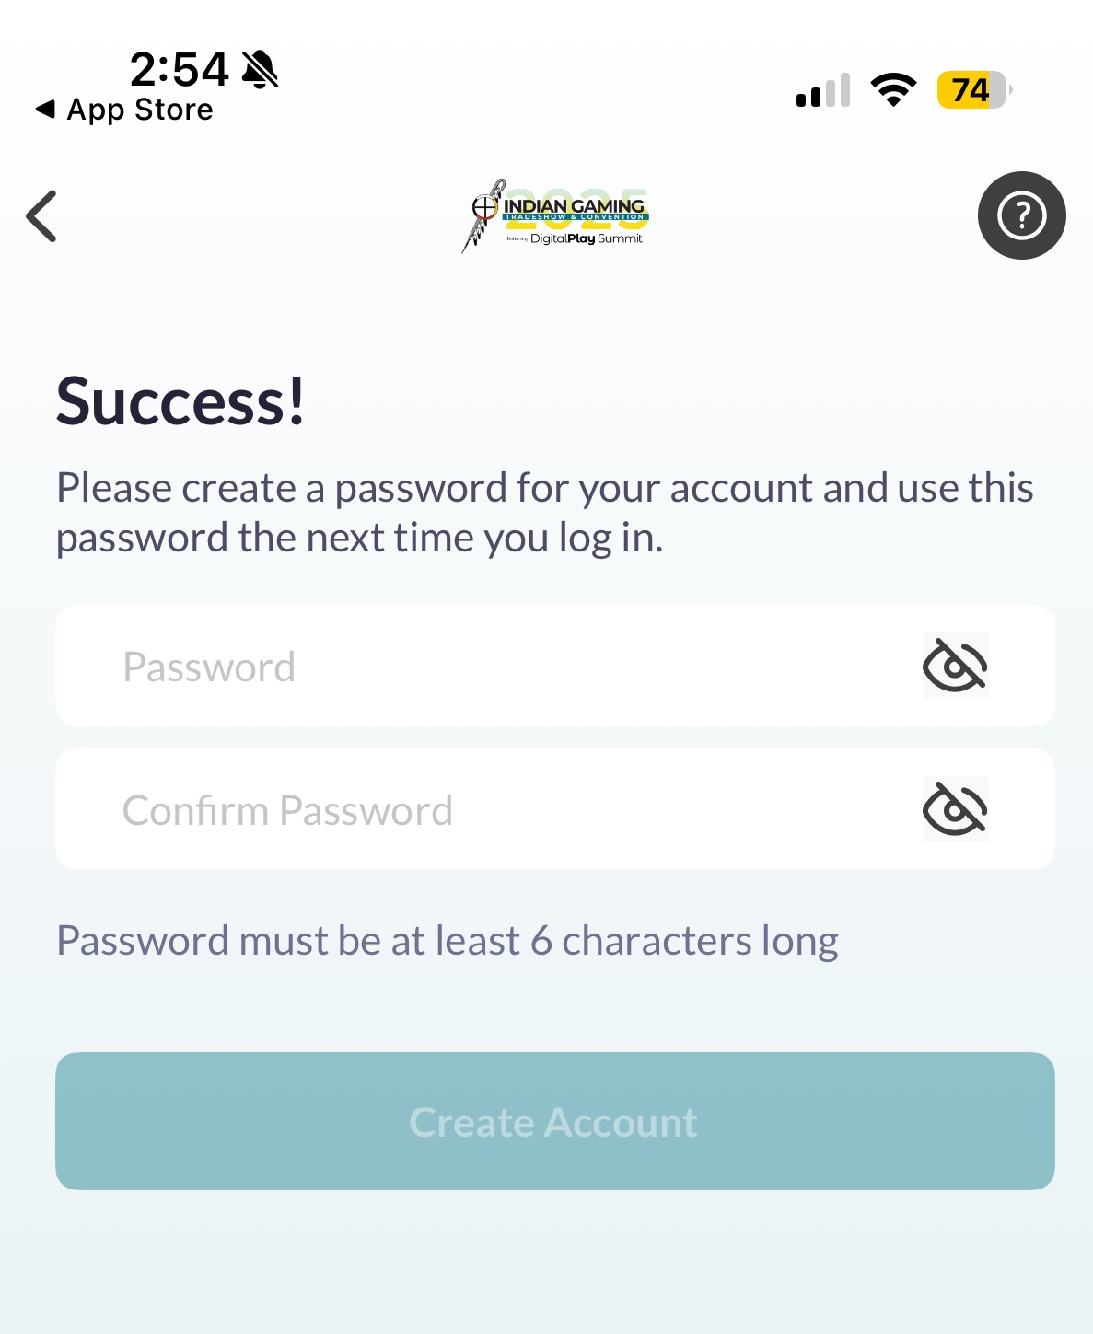
LOGIN
Navigate to the mobile app and click “Login” to access the mobile app.
STEP 1
Add your email address
STEP 2
Enter your registration ID
STEP 3
Create a password
Please use the email you used to register for the event with. The email must be unique
If you have already claimed your account via your computer on the web version, you will just need your email address and password to access the mobile app.

Slide 4
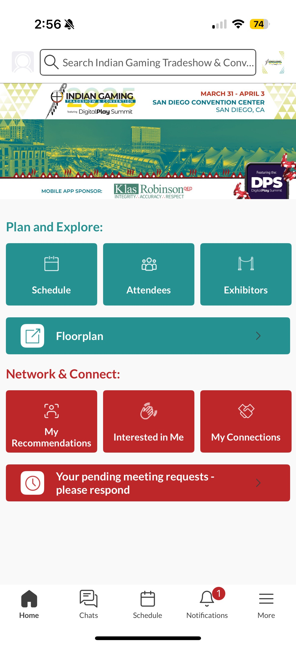
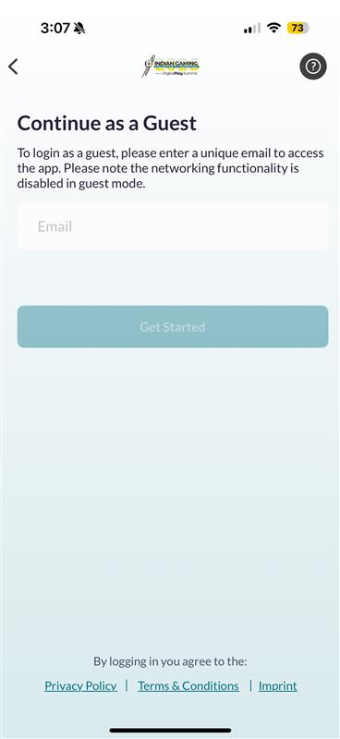
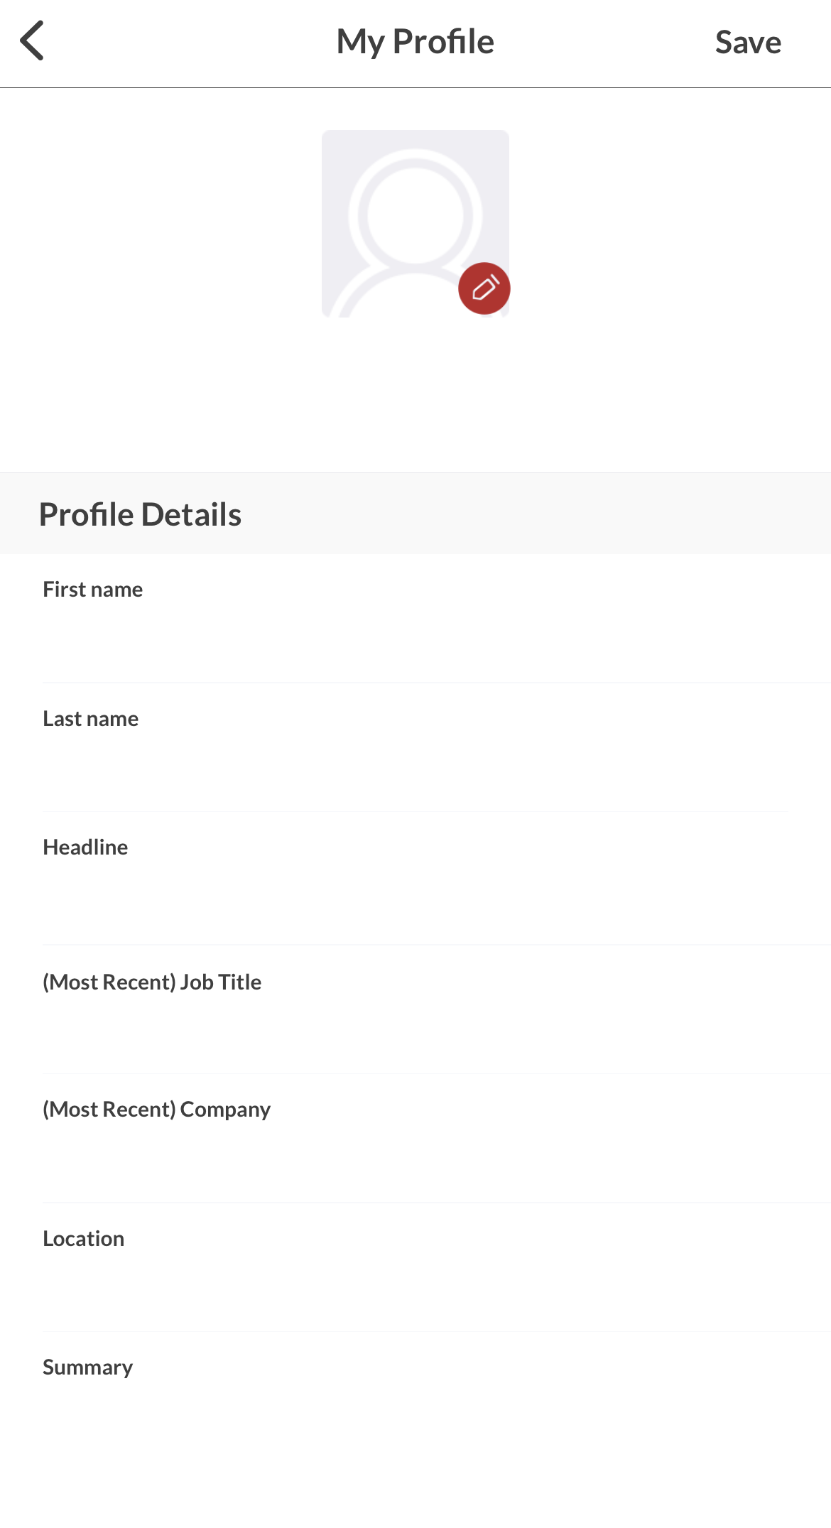
LOGIN – GUEST ACCESS
STEP 1
Download the mobile app from your app store, then click “Continue as a Guest” to access
STEP 2
You must enter a unique email address to access the app
STEP 3
Click on the upper lefthand gray square to update your profile information, such as your name and company

Slide 5
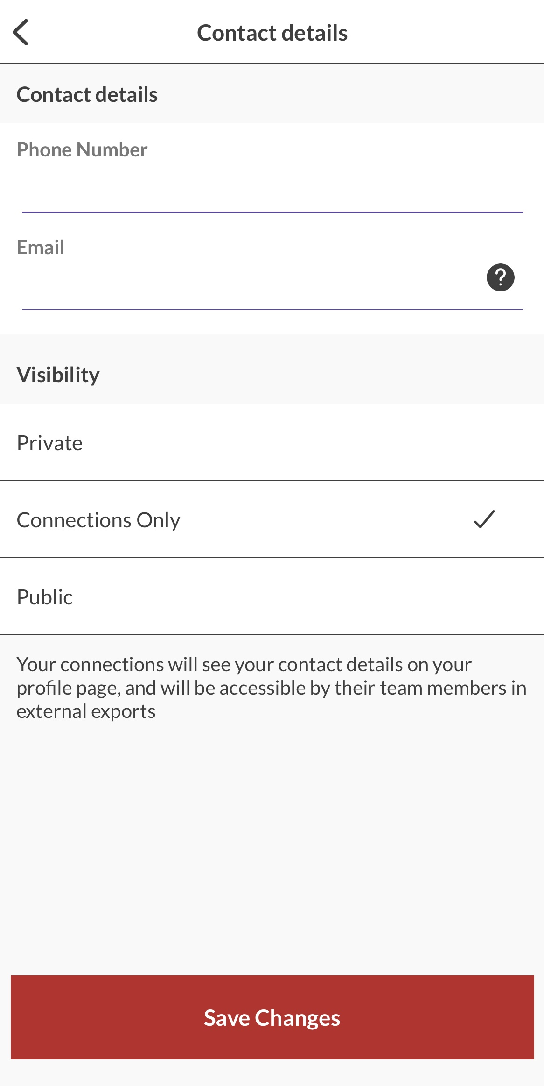
CONTACT SHARING
Confirm how you would like your contact information to appear in the platform. The platform will default to "Connections Only". You can edit your selection at any time by “editing your profile”.
PRIVATE
Users cannot your contact details
CONNECTIONS ONLY
Users with connections will be able to see your contact details on your profile page, as well as in external exports from the platform
PUBLIC
Contact Details will be displayed on your profile page and available in exports for everyone at the event.

Slide 6
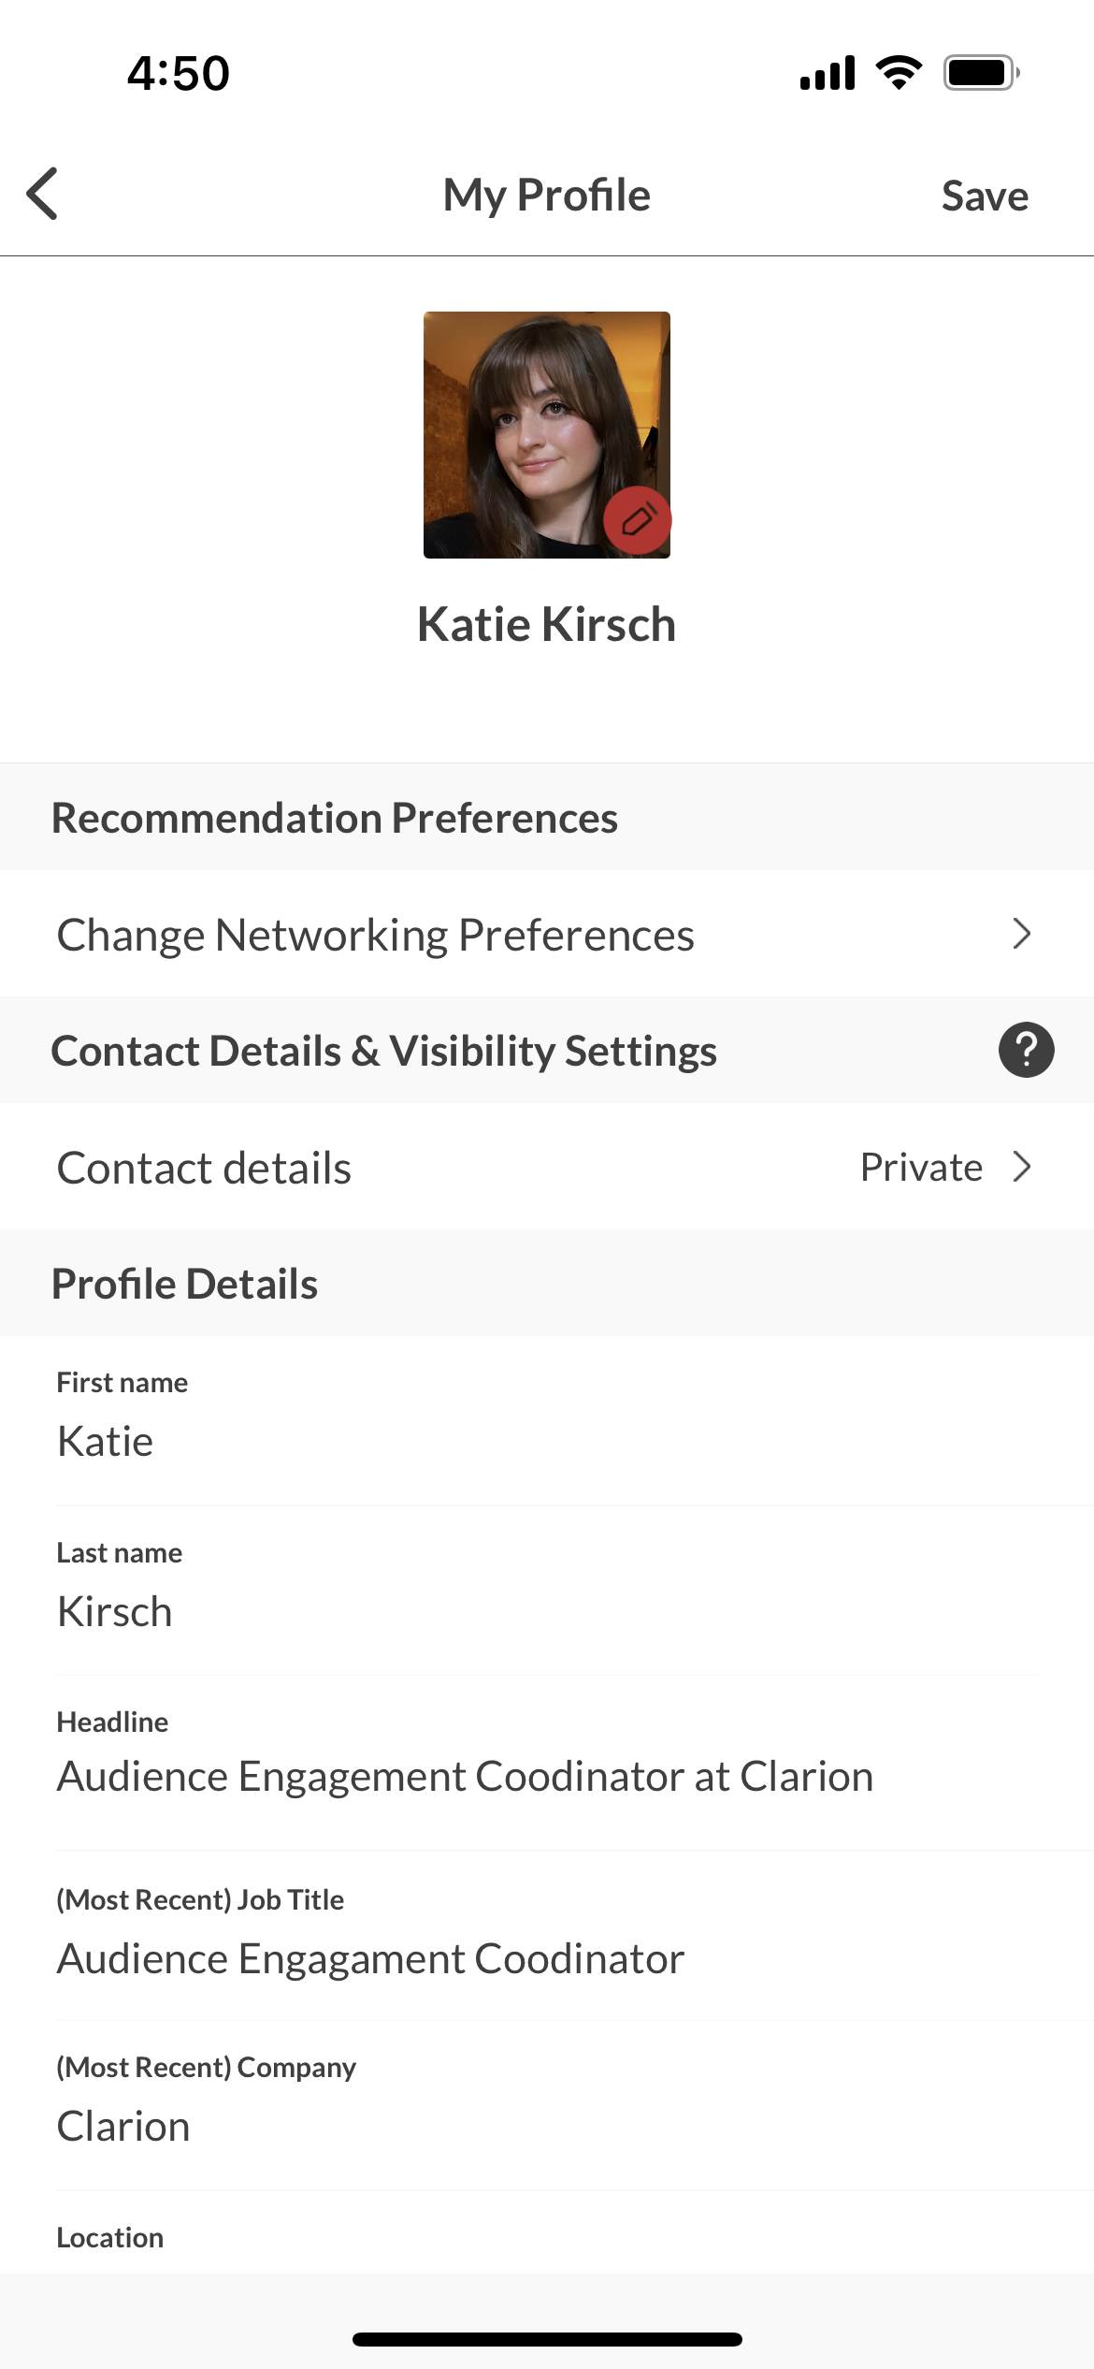
EDIT YOUR PROFILE
You can edit your profile at any point while the mobile app is active.
Click the icon on the TOP LEFT of the home page to edit your profile
NOTE: you can find additional resources such as Shuttle Services, Event Info, Help Guides, and more under the “More” button found in the bottom right-hand corner.

Slide 7
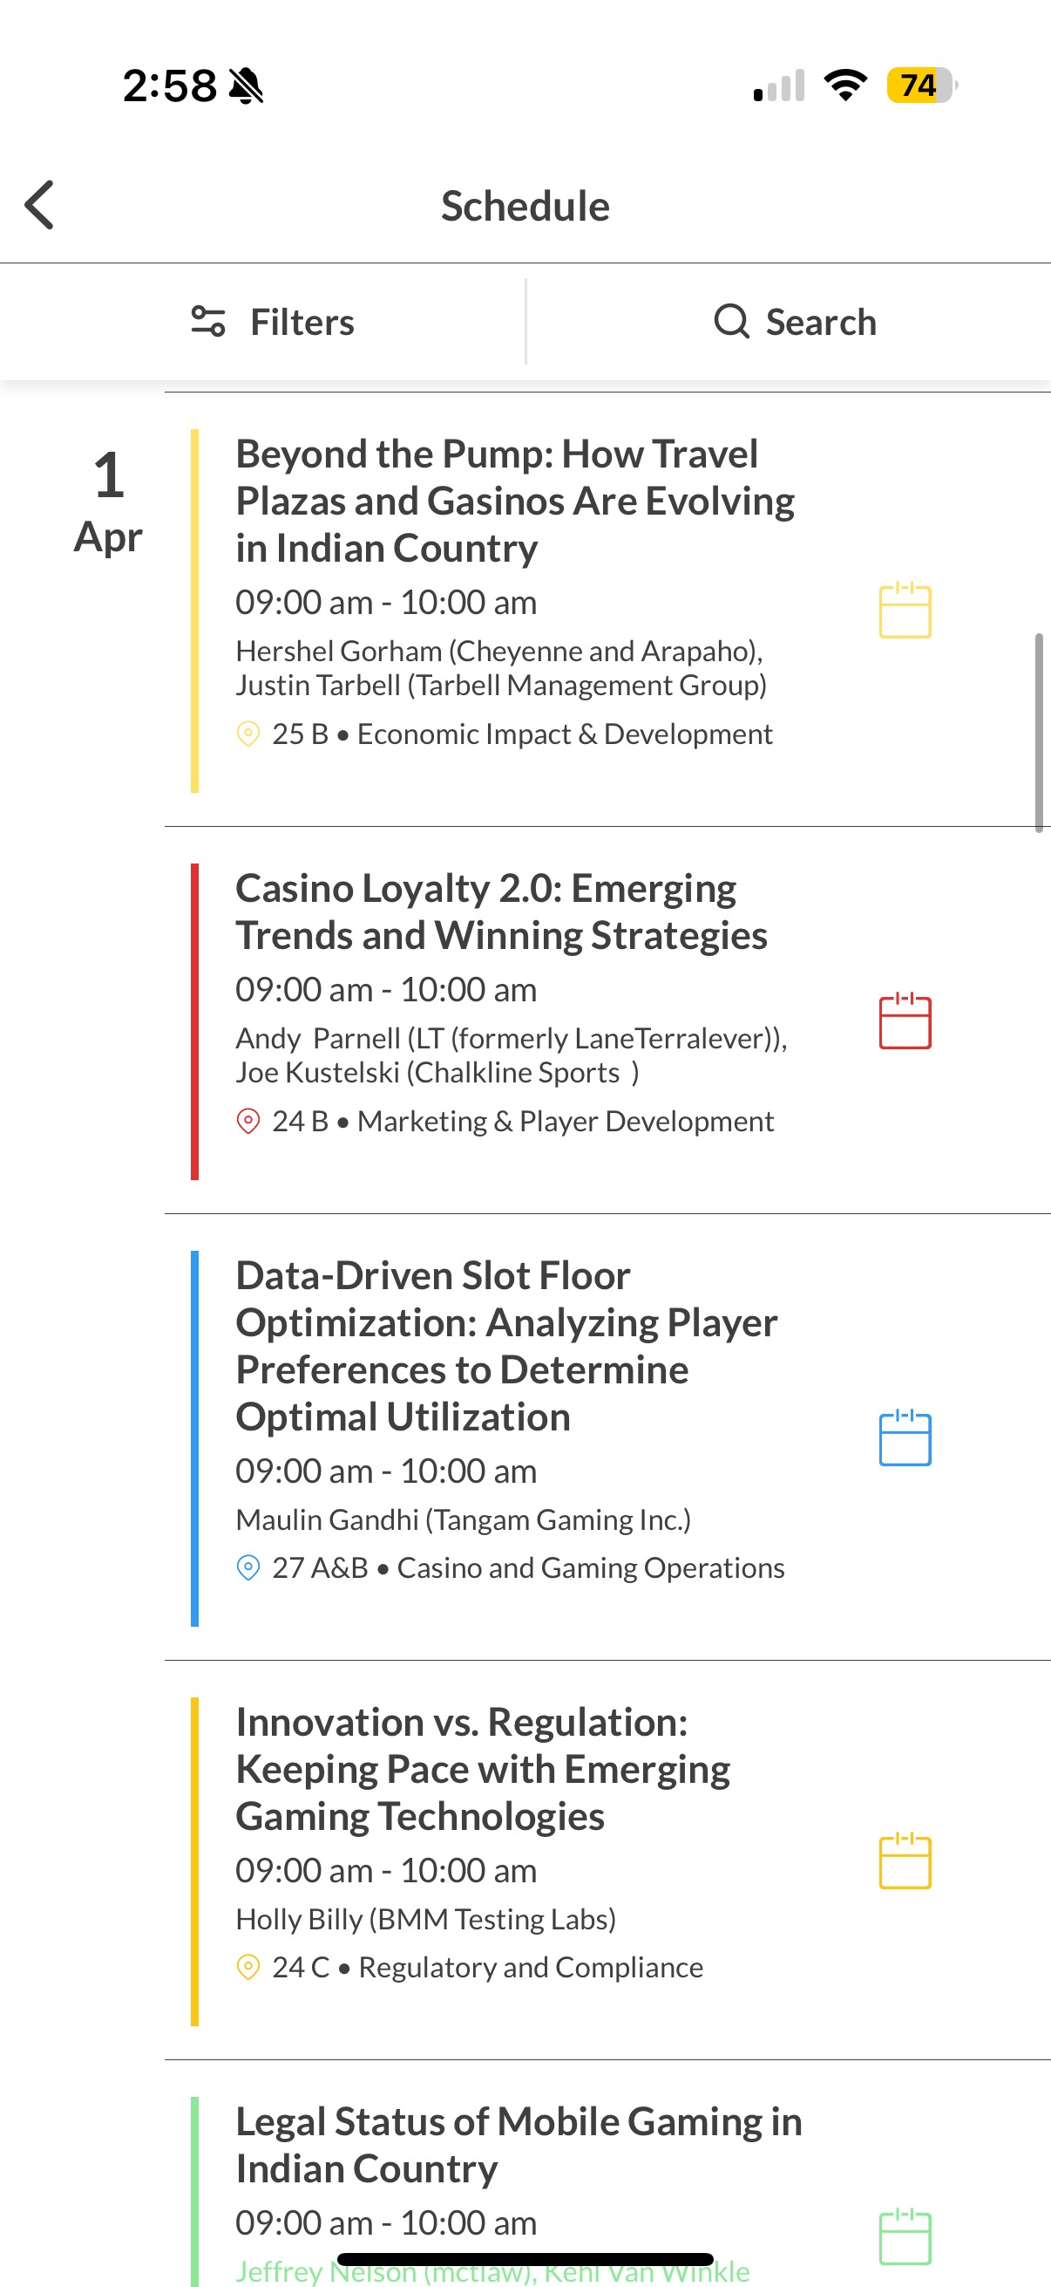
EVENT/CONFERENCE AGENDA
The “Schedule” block on the homepage allows you to see the entire event agenda
You can click the “Schedule” button on the middle of the app homepage to see the full agenda and personal schedule
On all the items above you can build out your schedule by additional filtering
Click the calendar icon next to the session to add to your personal agenda!

Slide 8
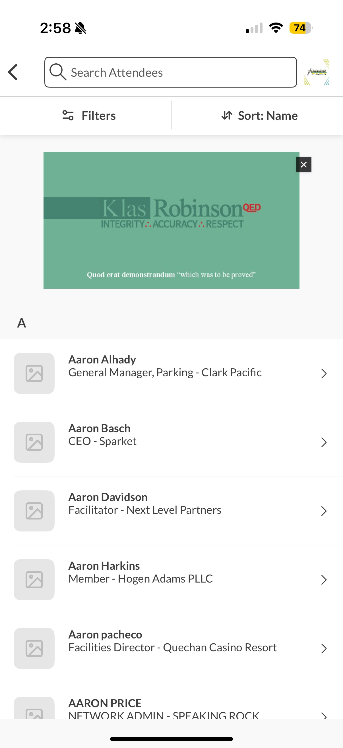
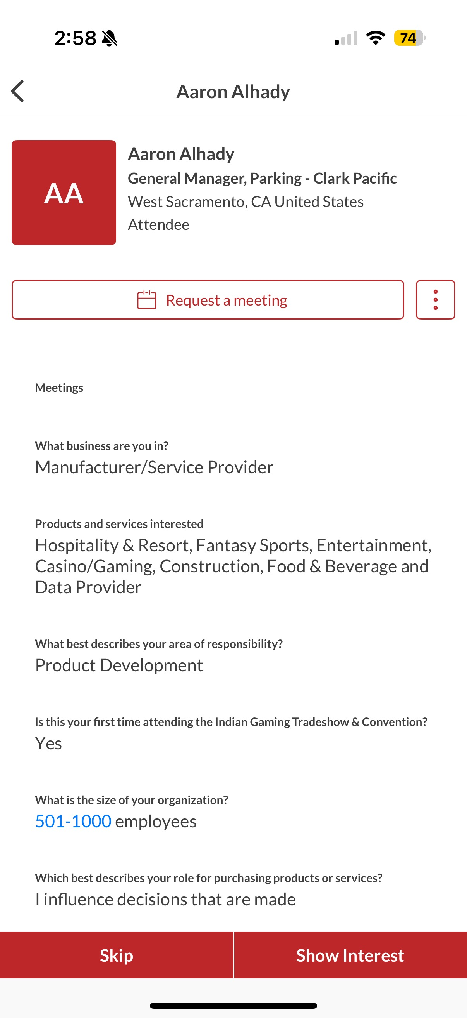
HOW TO INTERACT
There are multiple ways you can interact with others in the app:
Show an “interest”
“Skip” if you aren’t interested
Schedule a meeting (booths only)
There are different ways to interest and schedule meetings with other users. Those can be accessed from the homepage via the following blocks
Exhibitors and attendees – click into each to see who’s attending the show and use the filters to narrow your search!
Recommendations – the technology will read your profile and the profile of others to make recommendations for you! It will also take into account the actions you take in the app and will continue to generate recommendations for you.

Slide 9
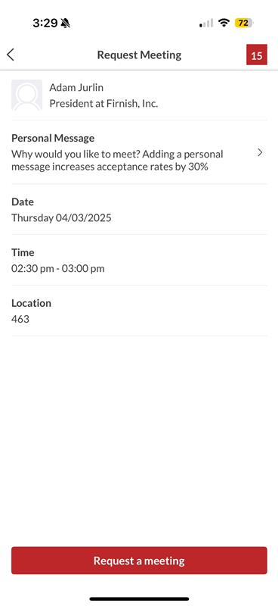
MEETINGS
Once you find someone you would like to meet with, click “Request Meeting” next to their name. Add the date/time and location, as well as a personal message, then click “Request Meeting”. They will receive an email/push notification that they received a meeting request. Once a meeting is confirmed, you will receive a notification. Note: you can only schedule meetings with users who are assigned a booth location
If someone sends you a meeting request, you will receive an email/push notification with the meeting details. You can confirm via the “Accept Meeting” in the email or via the app.
To view your list of pending received or sent meetings, please click the “Your pending meeting requests” block on the homepage.

Slide 10
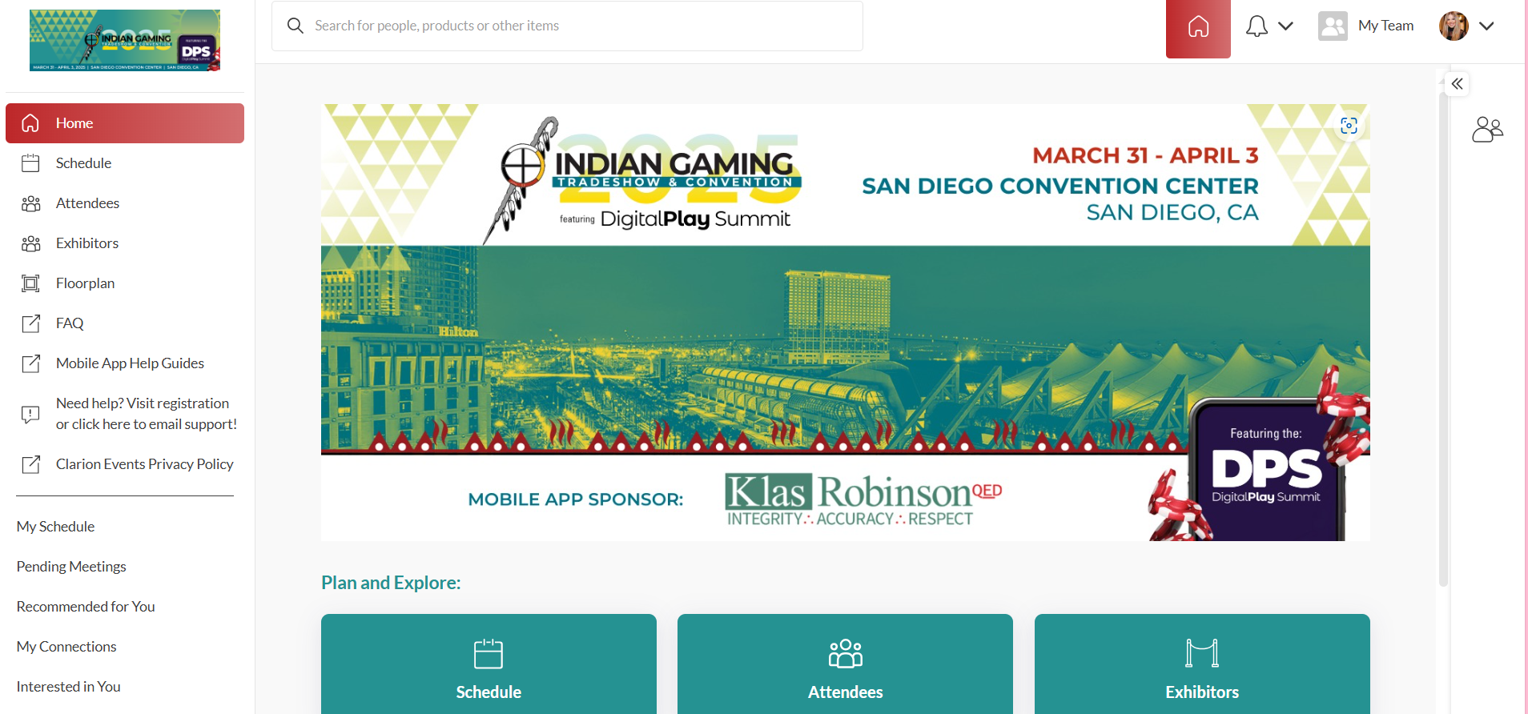
MY TEAM | Web Platform & Exhibitors only
As an exhibiting company, you and your team have access to a dashboard accessible via the web platform (top-right). From here, you can manage meetings for your Team Members, view your Inbound Leads, and Export the Contacts for your entire Team.
The first person to sign in via the web platform will create your Team and become the Admin for the Team.
Each team member must have a unique email in order to access the mobile app – if the email is not unique, it must be updated in registration for them to gain access.
Please create your Team prior to arriving on-site to ensure all contacts will be included on your Team Export.

Slide 11
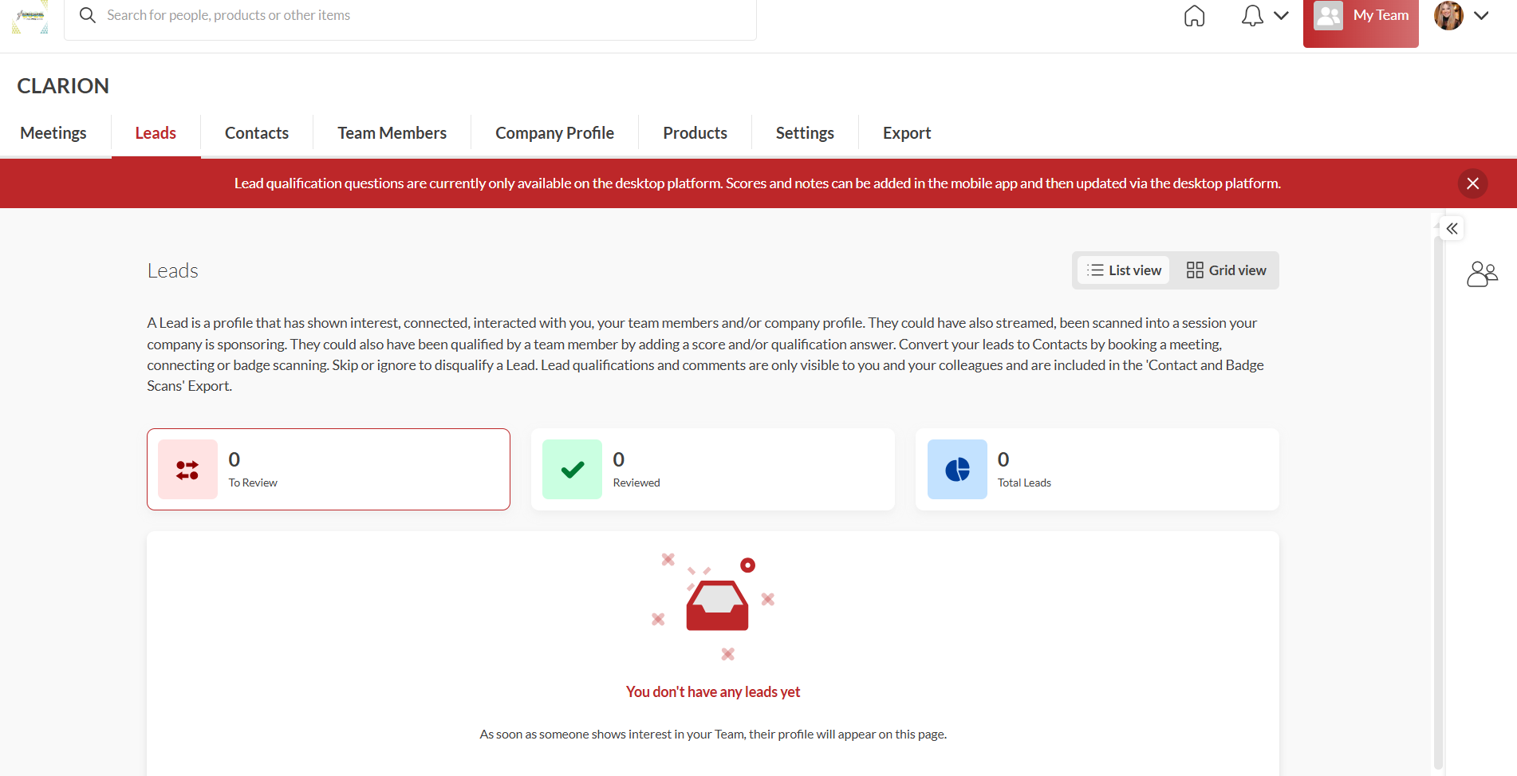
INBOUND LEADS | Web Platform & Exhibitors only
As an exhibiting company, you can view interactions event attendees have made with you, your company, or your team members. Click “My Team” at the top right of the home page, and then “Leads”.
Event Participants that interact with you, your company, or your team members will appear in your “Leads”. This includes:
Profile Views
Connections/Interests
Meetings
You can add “Lead Notes” for visibility across your team.
Connections for your entire team can be exported via “Export”. If they allowed contact sharing, their contact details will appear in this export.

Slide 12
MEETINGS | Requesting on behalf of a Team Member | Web Platform & Exhibitors only
To request a meeting on behalf of one of your Team Members, navigate to "My Team" at the top right of the home page. Then click "Create a Meeting". Then indicate the Team Member to request the meeting on their behalf. You can also navigate to the profile of who will receive the meeting request and click "View As" to change the person requesting the meeting to a Team Member.

Slide 13
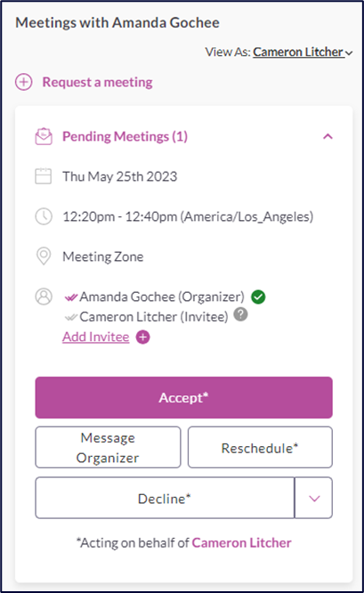
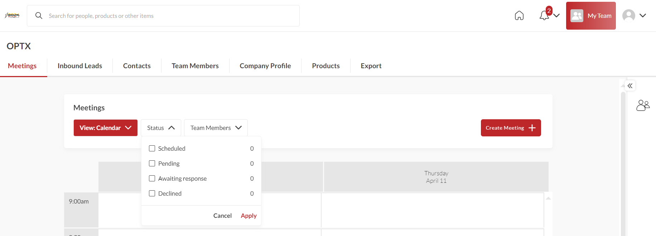
MEETINGS | Accepting on behalf of a Team Member | Web Platform & Exhibitors only
To accept a meeting on behalf of one of your Team Members, navigate to "My Team" at the top right of the home page. Then click "Pending" under "Filter By" on the left. After clicking on the Meeting, you'll be directed to the organizers profile. Then click "Accept". Both parties will receive an email confirmation of the meeting.

Slide 14
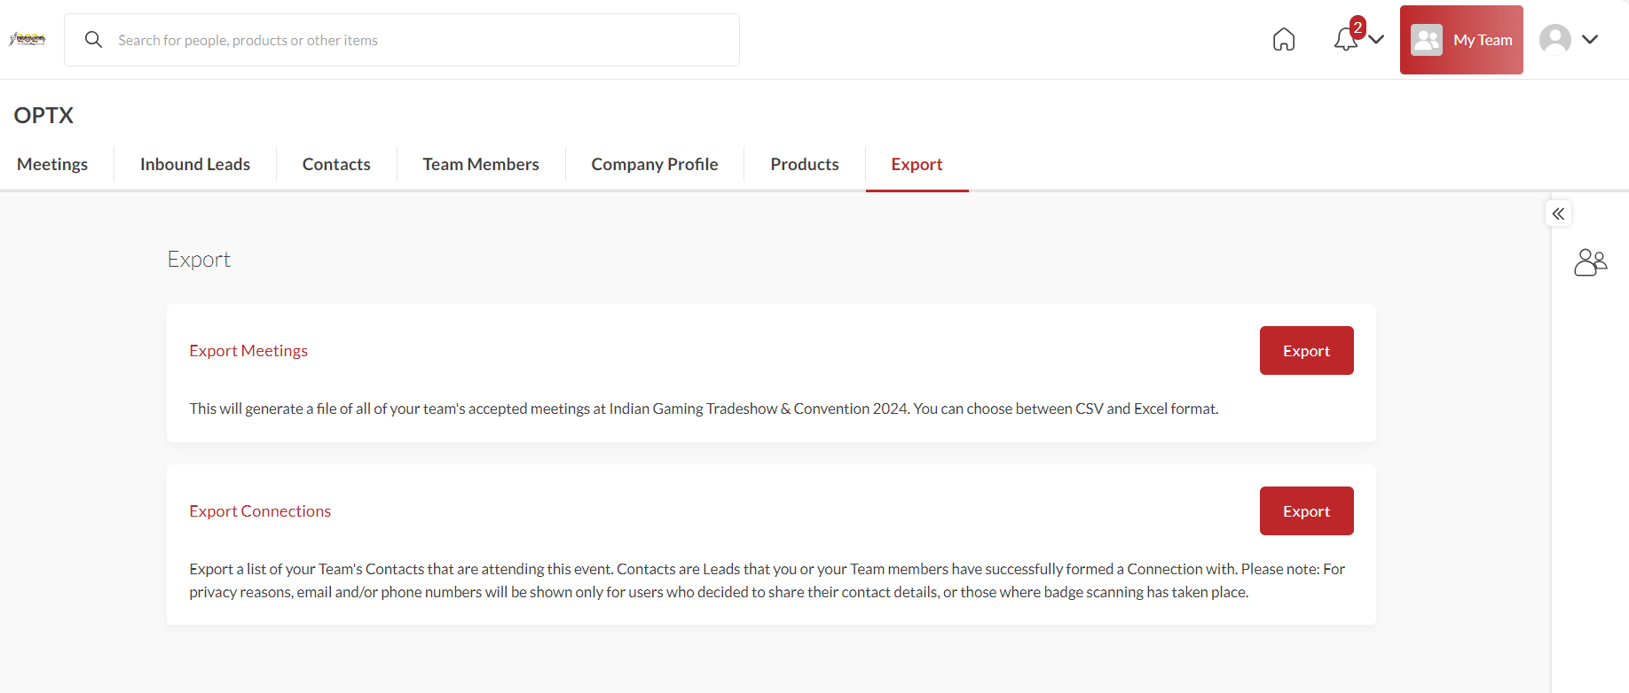
EXPORT CONTACTS | Web Platform & Exhibitors only
As an exhibiting company you can export the "Contacts" for your entire team. "Contacts" include connections your or your team has made through:
Included in the export is Name, Title, Company, Lead Notes, and Registration Information.
Due to GDPR email and/or phone numbers will be shared only for the users who decided to share their contact details.

