Slide 1
MOBILE APP SPONSORSHIPS

Slide 2
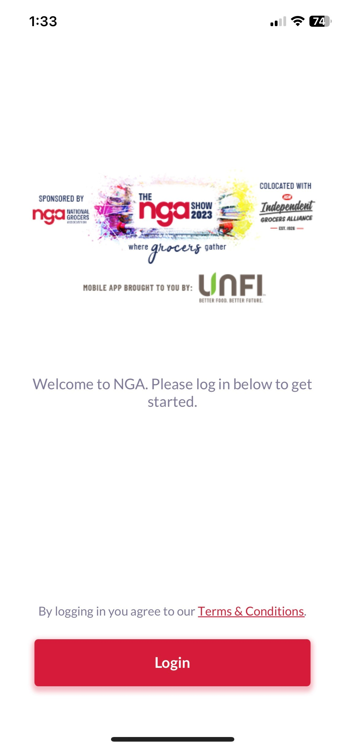
MOBILE APP SPONSORSHIPS
 | DELIVERABLE | DUE | QUANTITY | PRICE
Title Sponsorship | Logo | 11/1/2022 | 1 | $20,000
Notifications | text; target; date | 2/10/2023 | 3 per day | $1,500
Top of Listing |  | 1/20/2023* | 8 | $1,000
Featured Label |  | 1/20/2023* | unlimited | $750
Mobile App Banner Ads | banner ad; location | 1/20/2023* | 10 per location | $2,000
Floorplan Logo | .svg logo | 1/20/2023* | unlimited | $500
Floorplan Banner Ad | logo | 1/20/2023* | 5 | $1,000
*if received after this date, allow 2 business days to implement in app.

Slide 3
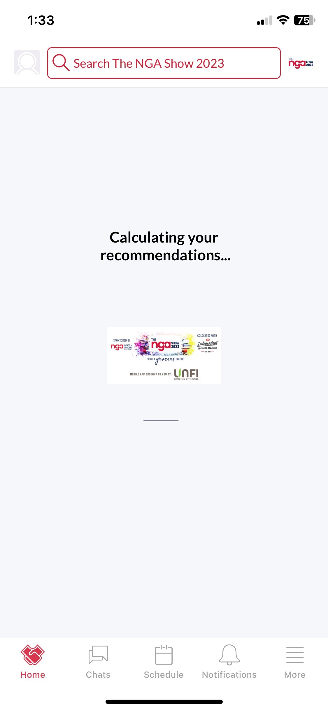
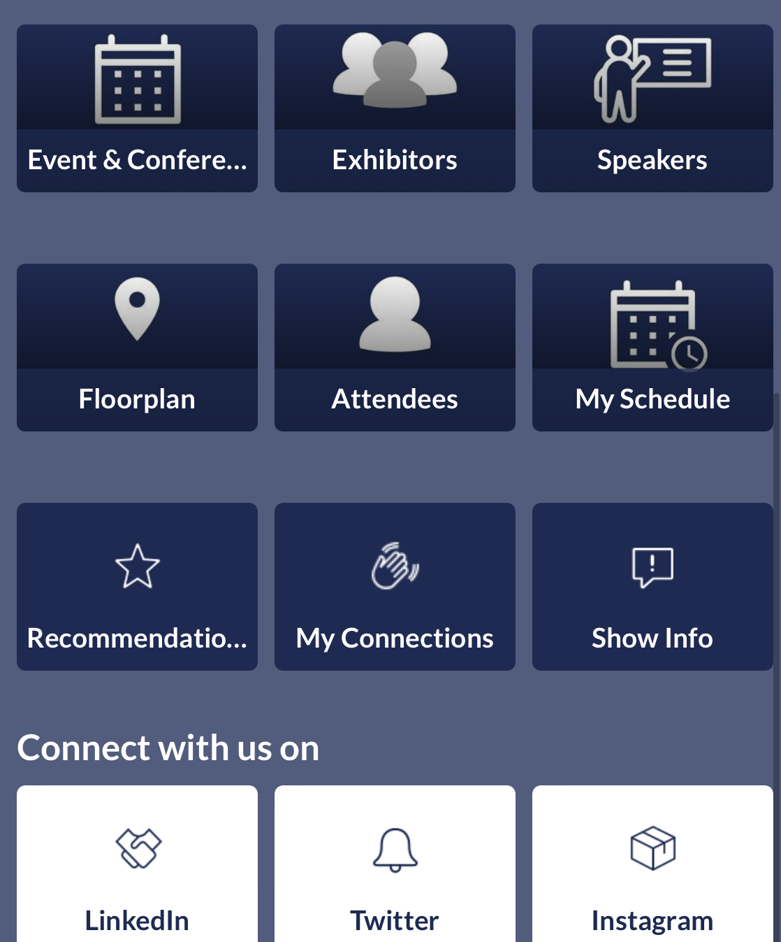
TITLE SPONSOR
Search The NGA Show 2024
Search The NGA Show 2024
Sponsor logo to be added to event branding on Home Feed for all users and will appear on the mobile app to all users during loading.
QUANTITY
1
PRICE
$20,000
DEADLINE
November 1, 2022

Slide 4
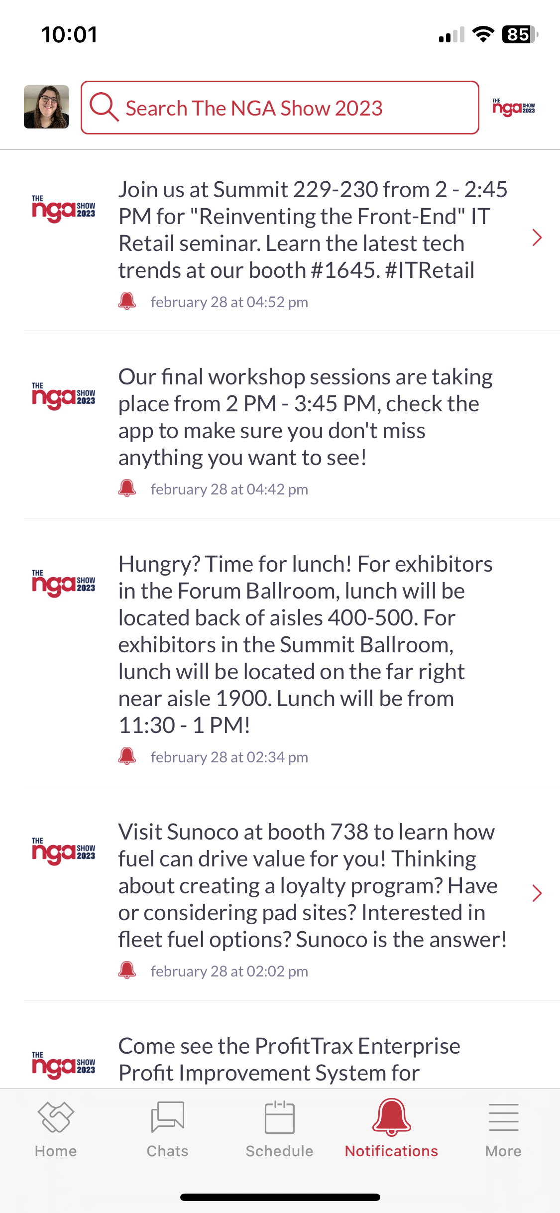
NOTIFICATIONS
Search The NGA Show 2024
Custom notification delivered as a hard notification to user’s home feed (only if user has notifications enabled on their device) or in the notification bar.
Can be targeted to take user to company profile page or session page within the app, or website URL outside of the app.
200-character limit.
QUANTITY
3
PRICE
$1,500
DEADLINE
February 10, 2023

Slide 5
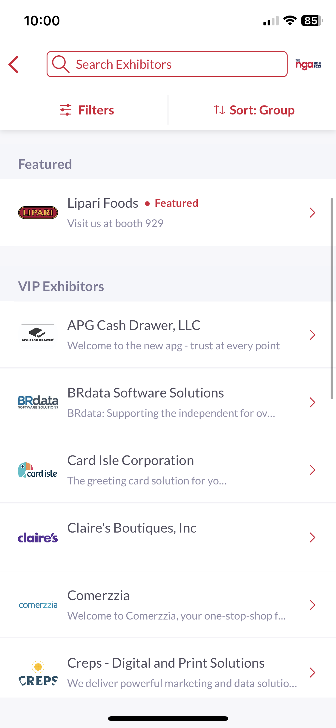
TOP OF LISTING
Sponsor profiles will appear at the top of the Exhibitor list, and within search of Exhibitor List. Listed alphabetically.
QUANTITY
8
PRICE
$1,000
DEADLINE
January 20, 2023*
* if received after this date, allow 2 business days to implement in app.

Slide 6
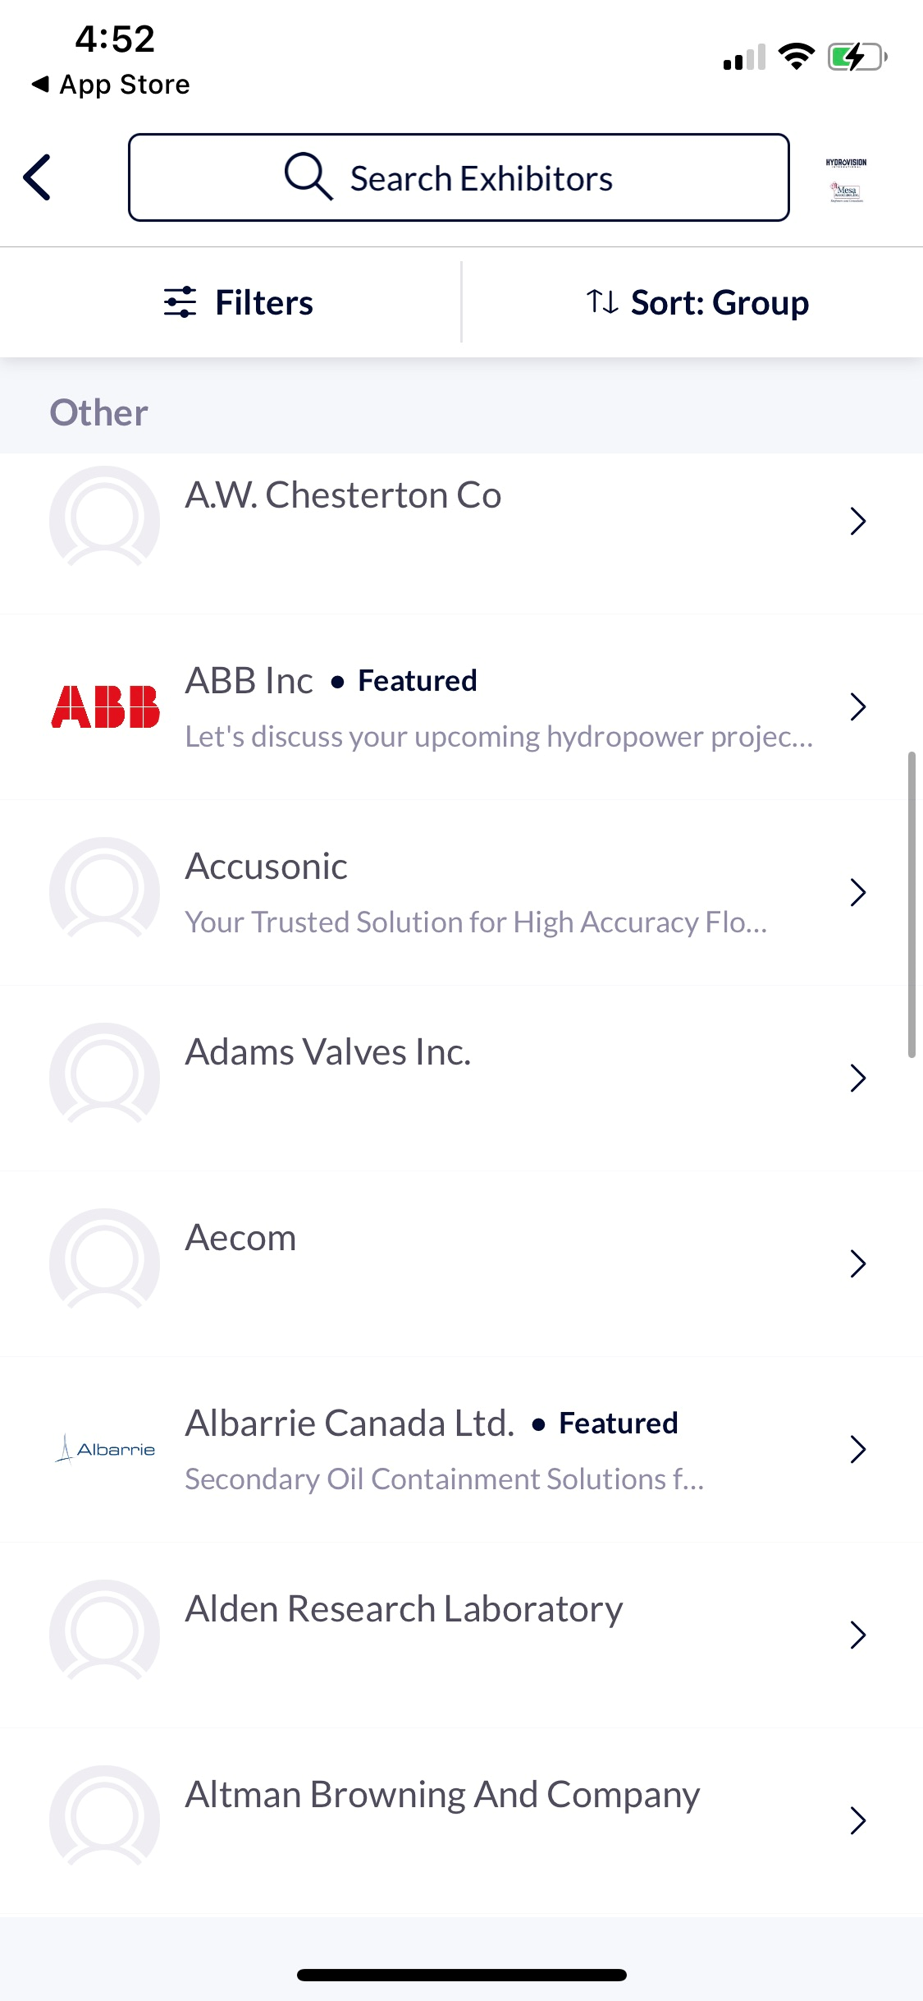
FEATURED LABEL
Add "Featured" tag next to Sponsor's name in the exhibitor list and their profile. Filter on exhibitor list to show all "Featured" Sponsors.
QUANTITY
Unlimited
PRICE
$750
DEADLINE
January 20, 2023*
* if received after this date, allow 2 business days to implement in app.

Slide 7
MOBILE APP BANNER ADS
Banner ad to appear on one of 3 locations within the mobile app: Profile Lists, Event Agenda, More menu. (see next slide for locations)
Banner ads rotate every 30 seconds, and a new ad will display every time a screen is reloaded.
Once clicked, user can be sent to company profile page or session page within the app, or website URL outside of the app.
Image Sizing: 600x320px, max 2MB
QUANTITY
10 per location
PRICE
$2,000
DEADLINE
January 20, 2023*
* if received after this date, allow 2 business days to implement in app.

Slide 8
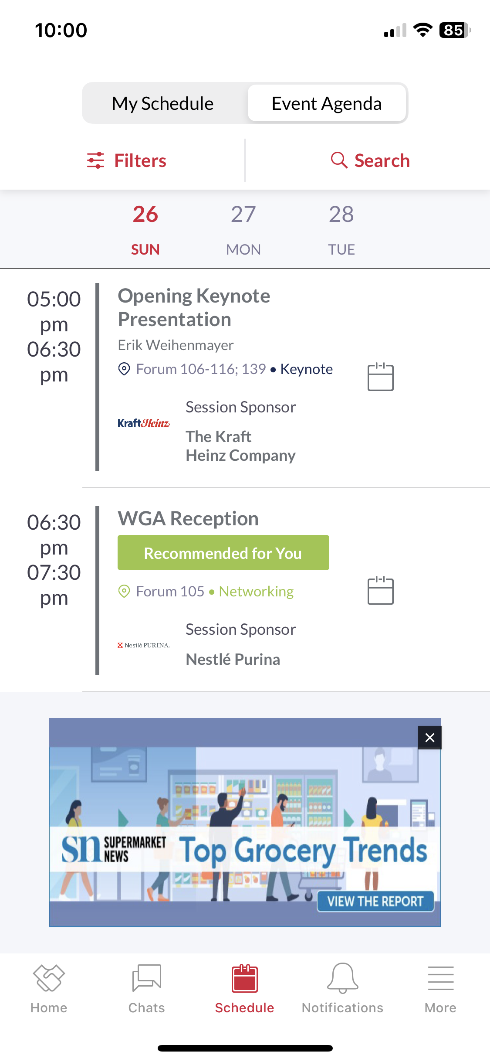
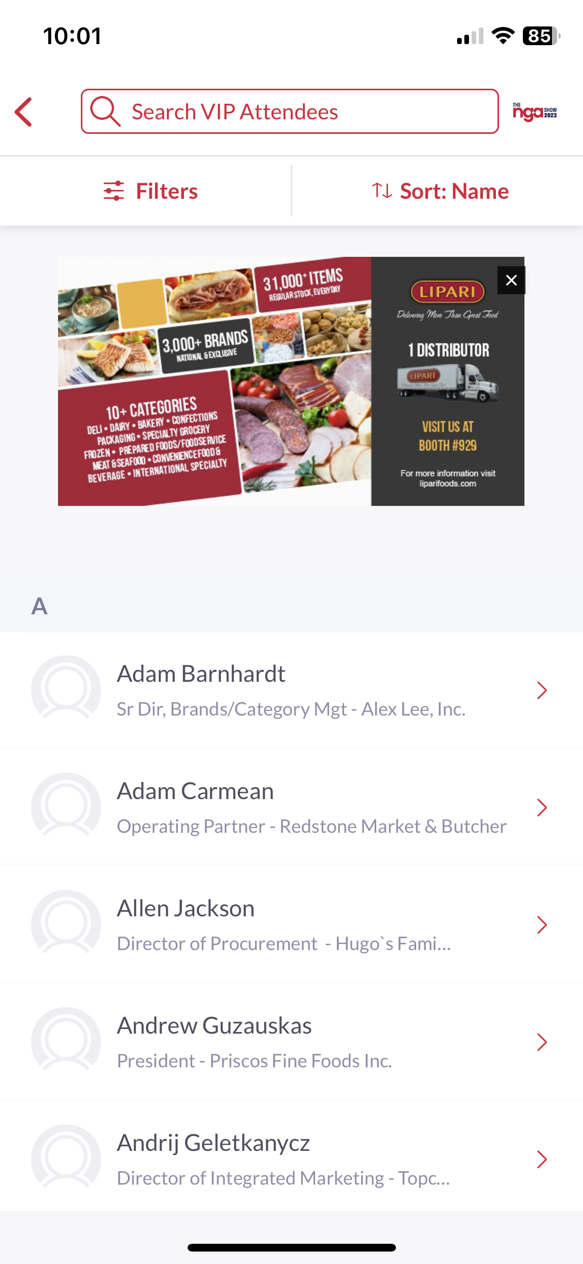
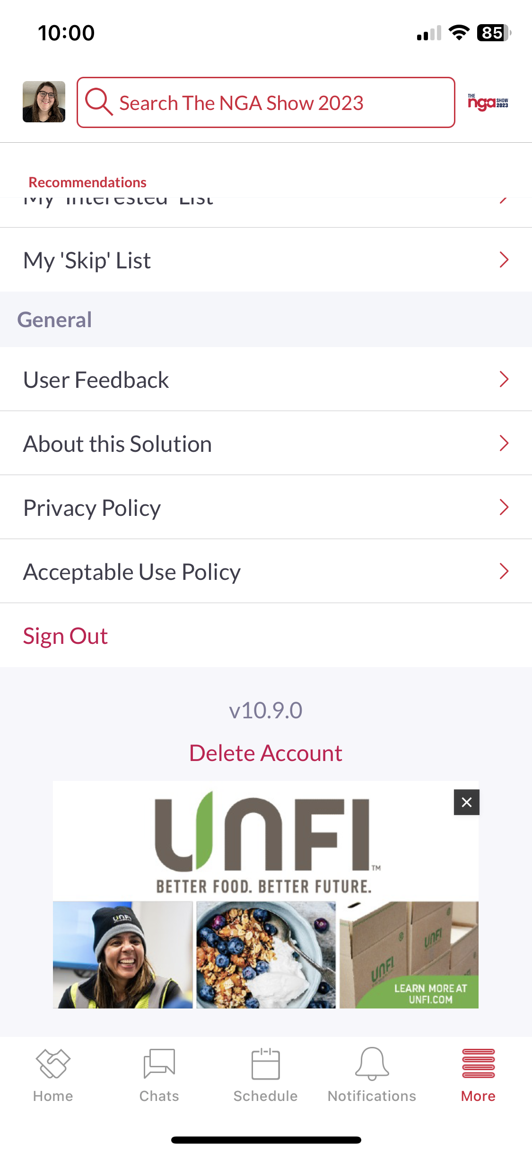
MOBILE APP BANNER ADS
EVENT AGENDA SCREEN
Placed after the last session on each day of the agenda.
PROFILE LIST
(Exhibitors, Products, Speakers, Attendees, etc)
Placed at the top of every profile list.
‘MORE’ MENU
(tab that contains all the app navigation items)
Placed at the bottom of the page.

Slide 9
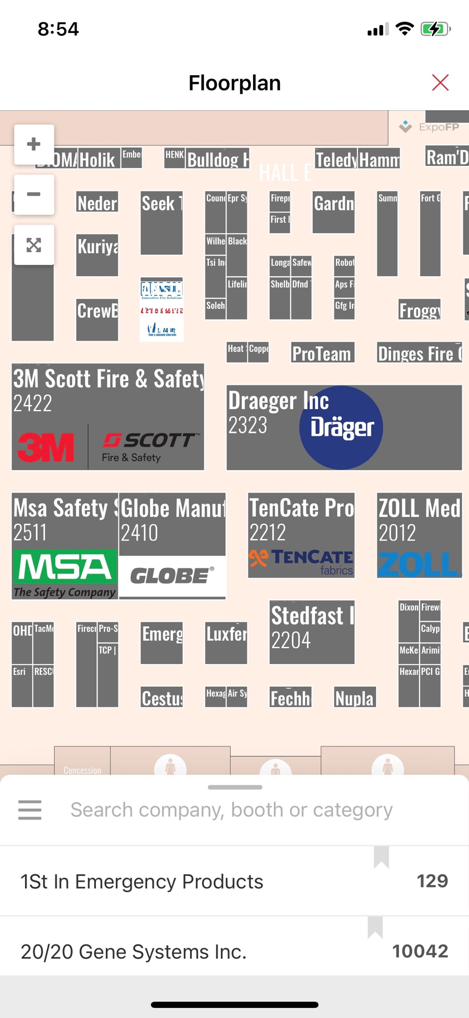
FLOORPLAN LOGO
Sponsor Logo to be added on top of booth in Interactive Floorplan.
Minimum booth size: 20’x20’.
File must be .svg.
QUANTITY
5Unlimited
PRICE
$500
DEADLINE
January 20, 2023*
* if received after this date, allow 2 business days to implement in app.

Slide 10
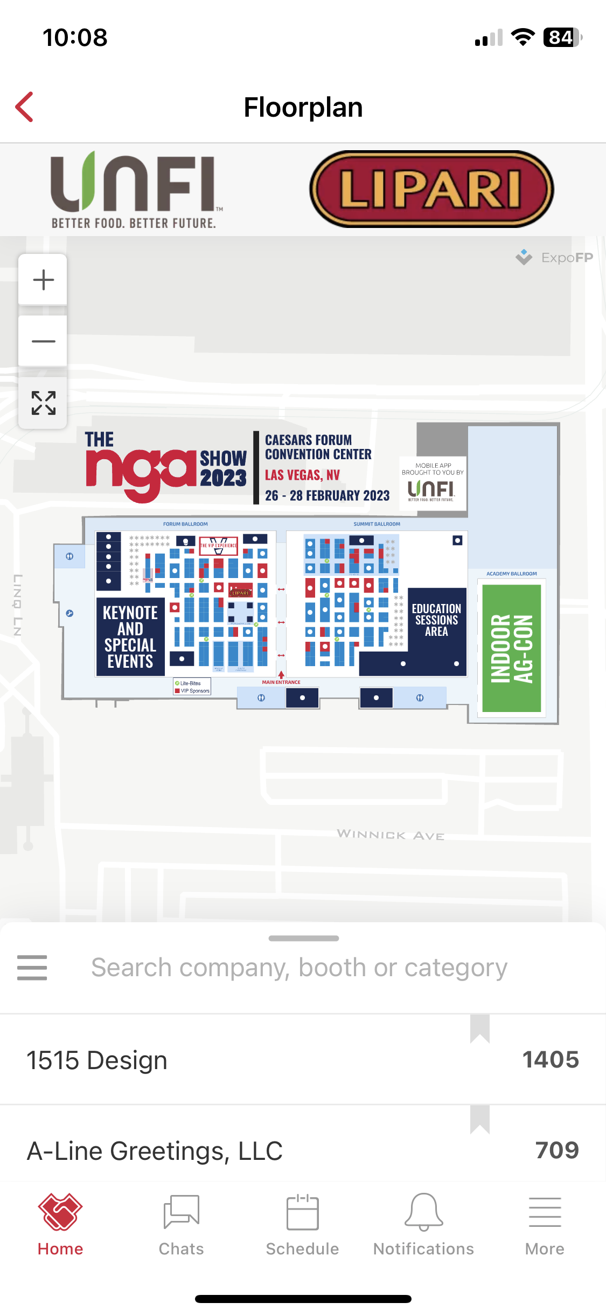
FLOORPLAN BANNER AD
Sponsor Logo to be add to top banner of floorplan. Once clicked, booth will highlight on floorplan.
QUANTITY
5
PRICE
$1,000
DEADLINE
January 20, 2023*
* if received after this date, allow 2 business days to implement in app.

Slide 11
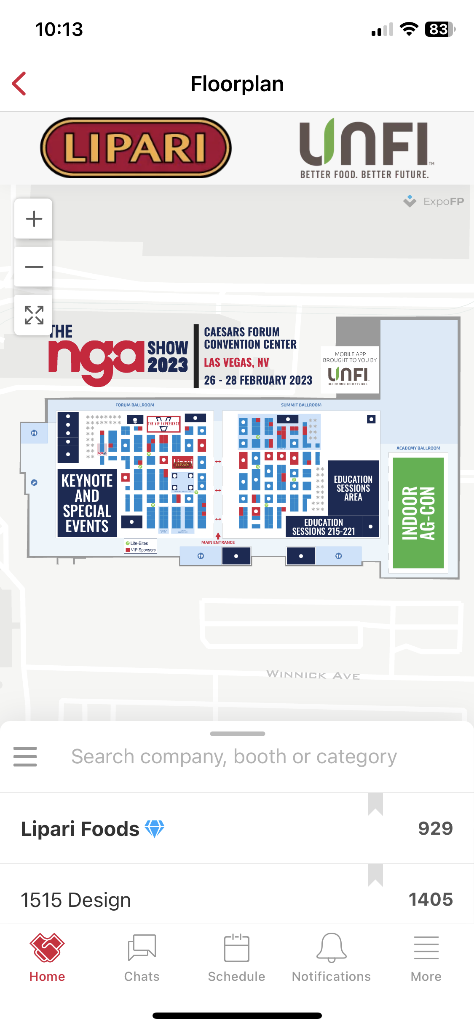
FLOORPLAN FEATURED LISTING
Sponsor name appears top of the exhibitor list within the floorplan. Sponsor name also appears bold, with a diamond icon.
QUANTITY
Unlimited
PRICE
$1,000
DEADLINE
January 20, 2023*
* if received after this date, allow 2 business days to implement in app.

