Slide 1
New Simulation Technologies for the Slovak Armed Forces
ARMED FORCES ACADEMY
of general Milan Rastislav Štefánik
SIMULATION CENTRE
Col. Aurel SABÓ, PhD.

Slide 2
Contents
Introduction
Comparison of MASA simulator training concept with current OneSAF simulator using doctrinal models of the Slovak Armed Forces
Possibilities of using AI in training
Testing of MASA interconnection with perspective C2 for Slovak Armed Forces
VR Capabilities: Introduction of technology to training, new possibilities of training, experimentation in the VR environment
Conclusion

Slide 3
Introduction
Realistic simulation environment (constructive simulators for staff training, virtual simulators for low level units) at different command and tactical level, possibility of logistics chain modelling, experimentation and evaluation of operational procedures
Implementation of the training of professional soldiers for command, control and co-operation in combat and peace support operations through simulation technologies
Information Exchange - developing the versatile capabilities of crisis managers, enhancing personal skills and communication capabilities between training audience
Sharing Best Practices and Lessons Learned to effective interaction for training of military and crisis staffs in preparation of operations (planning and mission rehearsal)

Slide 4
Introduction
The Simulator Construct (the combination of Virtual and Constructive) is made up of three components that consist of
A locally networked set of identical simulators typical of a fighter base (stand-alone simulators)
A networked set of disparate simulators (Distributed Mission Operations)
A locally closed-loop networked enclave of multiple simulator devices in support of High-End Testing, Tactics and Advanced Training
Virtual agents or so called Computer Generated Forces (CGFs) inhabit training simulations to make the simulations more realistic
Machine learning techniques may provide a solution, through the automatic generation of behavior models

Slide 5
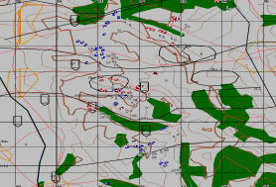
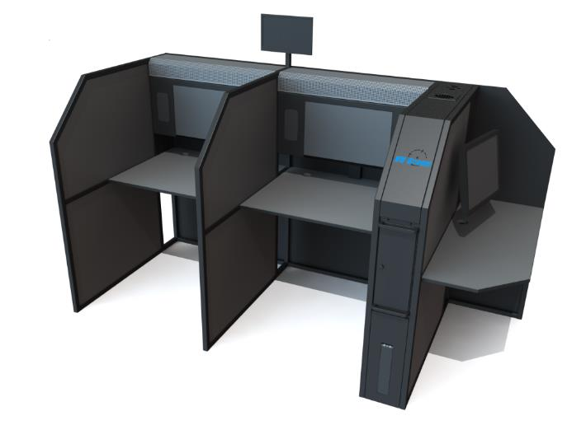
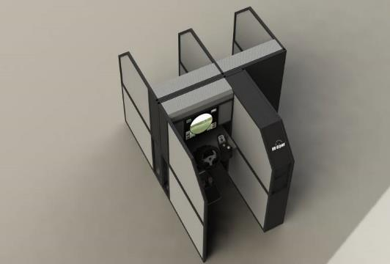
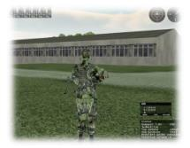
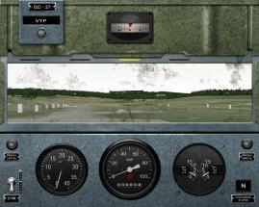
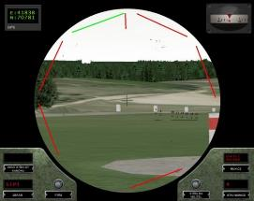
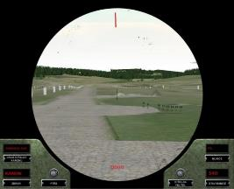
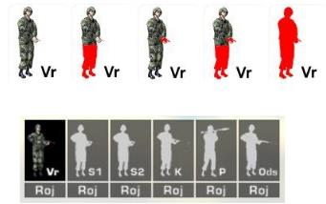
Introduction
SIMULATED RADIO NETWORKS
OTB/OOS constructive simulation
Crew Communication
INTERCOM

Slide 6
Constructive simulation training concept
Conduct staff training as closely as possible to the real deployment of troops
Integrated solution - to perform the full spectrum of military operations (offense, defence, stability and support manoeuvres) in a digitized battlespace environment
Use own command and control system (C2) in training to reduce the need to learn the simulation system and C2 system

Slide 7
Constructive simulation solution
TESTING ENVIRONMENT:
MASA SWORD a complete war-game solution with automated forces for high-level training and analysis
Operational level of warfare (Division, Brigade, Battalion and Company)
Light yet powerful: thousands of units on a single laptop
Units are driven by opportunistic behaviours (not pre-scripted), drastically reducing the required manpower and overhead
Fully customizable equipment & behaviours; delivered ready-to use including a generic database of ~ 300 missions/100 Units, terrain generator
Compliant with interoperability standards
Fully customizable physical capabilities and behaviour models
Both CP training and Logistic Command Post training
Artificial intelligence

Slide 8
Constructive simulation solution

Slide 9
Possibilities of using AI in training
Simulated forces are intelligent and autonomous
Simulated forces are able realistically adapt their reaction as situational unfold
This provides the trainees with a highly accurate training experience

Slide 10
C2 solution for Slovak Armed Forces

Slide 11
C2 solution testing environment

Slide 12
C2 solution testing environment
Simulation Environment

Slide 13
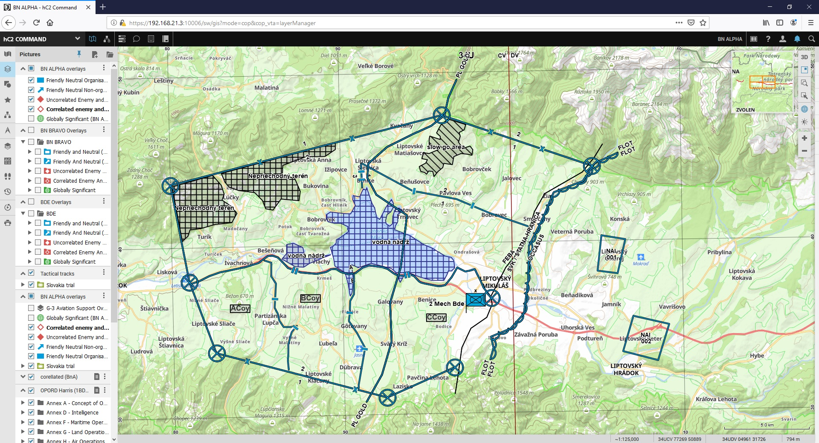
C2 solution testing environment

Slide 14
C2 – simulator interconnection

Slide 15
Test results

Slide 16
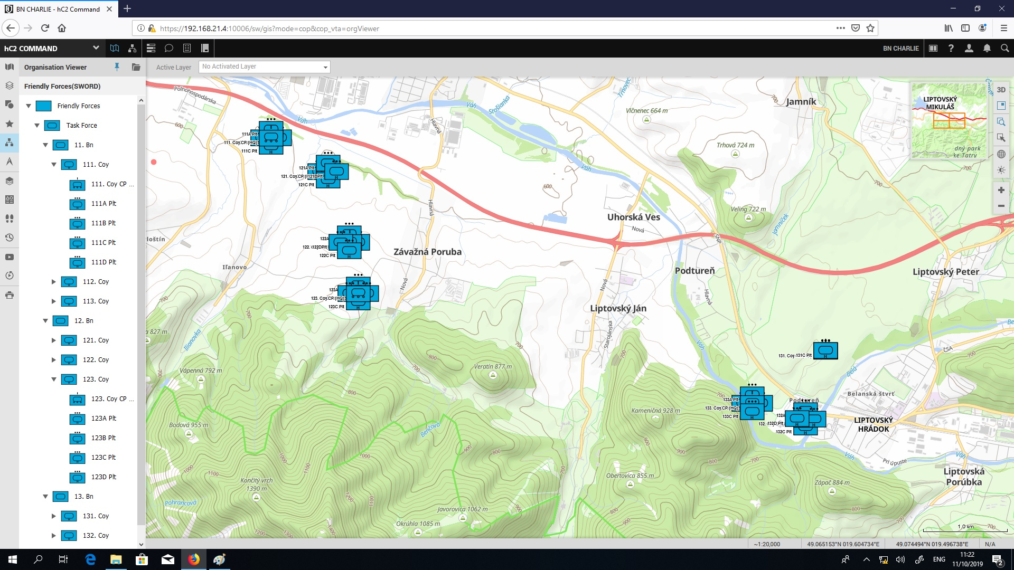
Test results

Slide 17
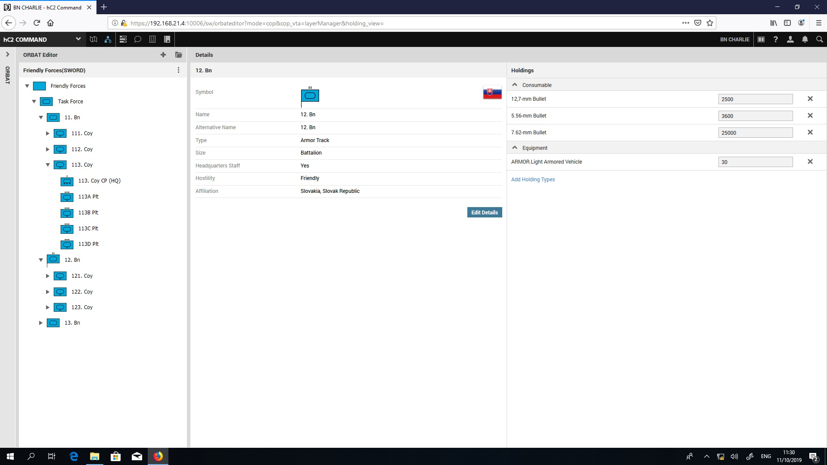
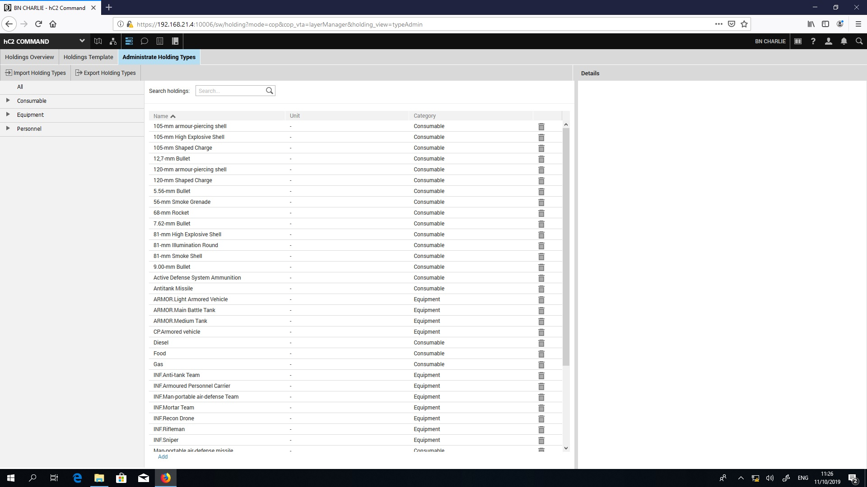
Test results

Slide 18
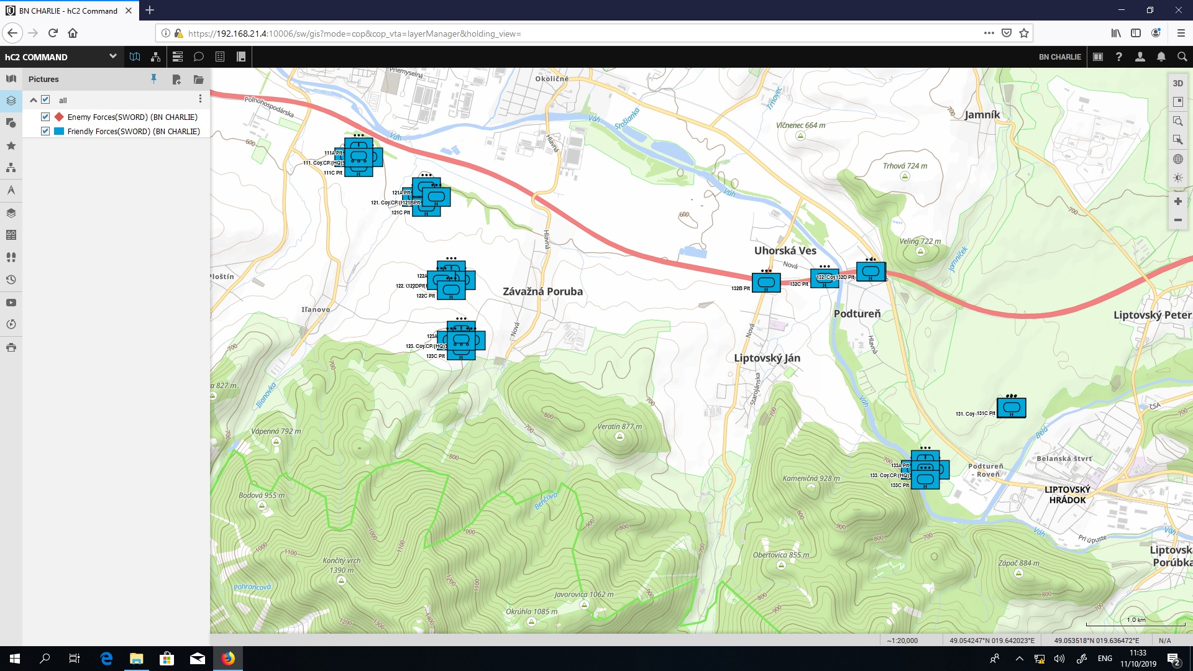
Test results

Slide 19
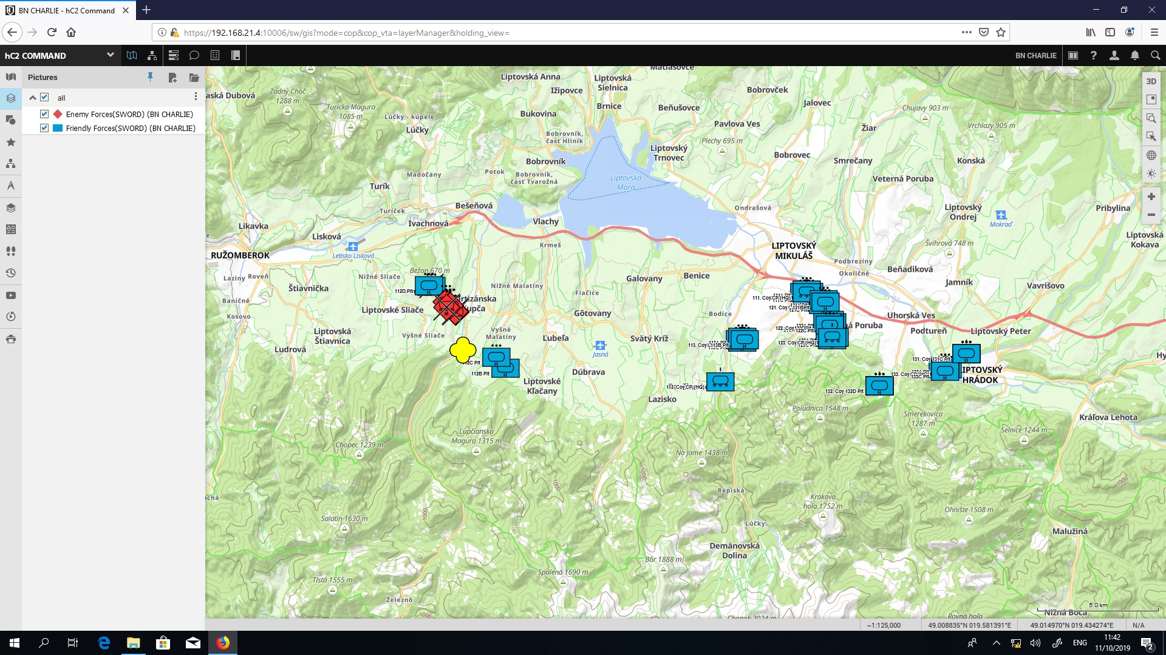
Test results

Slide 20
VR Capabilities: Introduction of technology to training
Replaces real world
Immersive multimedia/computer-simulated
Replicates environment
Simulates physical presence
Allows interaction

Slide 21
VR Capabilities: possibilities of use
Education of students in different areas
Environment for air traffic controllers – tower
Environment for JTAC
UAS operators
Combat simulation

Slide 22
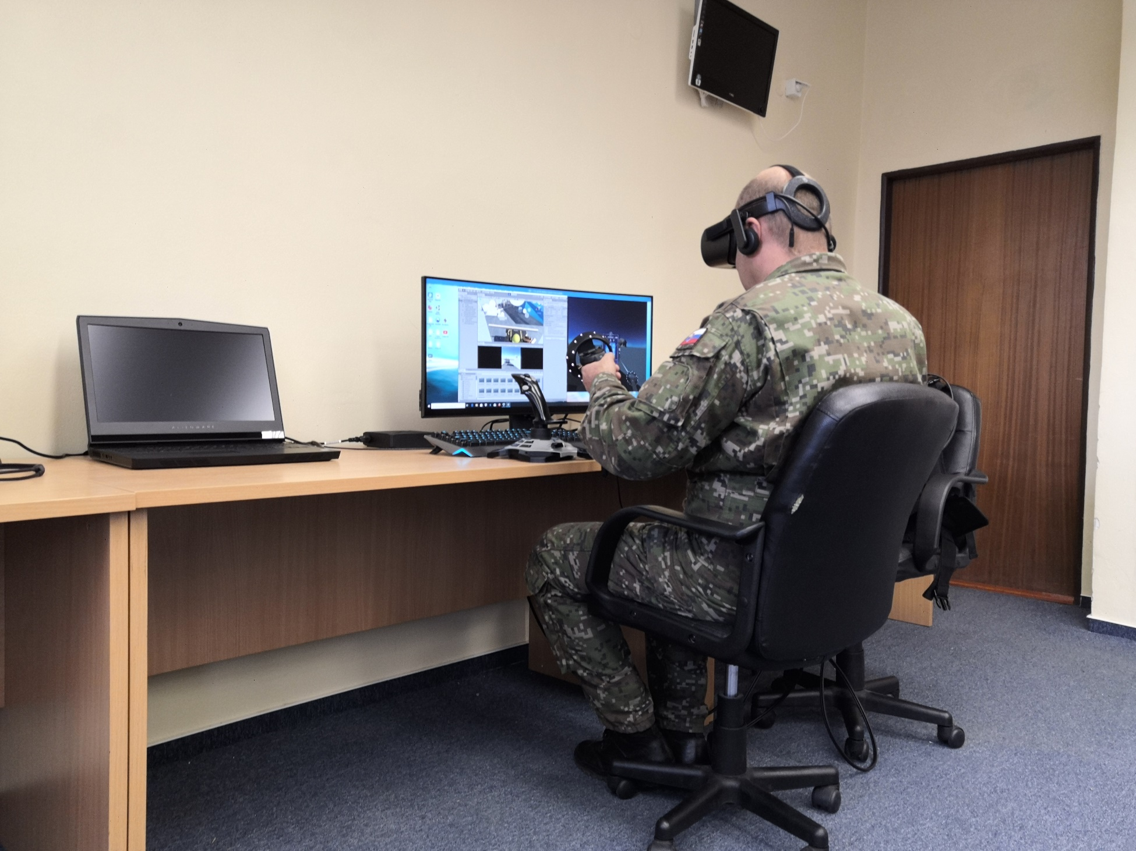
VR: Education and practice

Slide 23
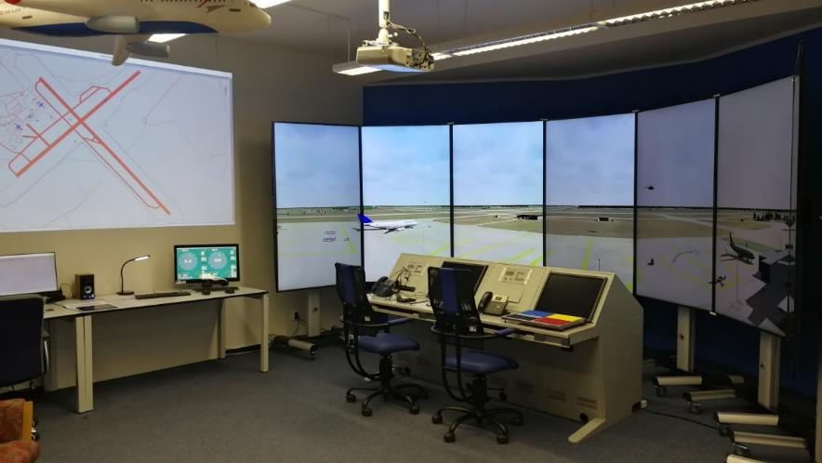
VR: Tower ATC and JTAC

Slide 24
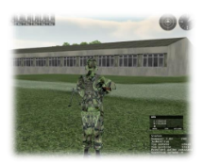
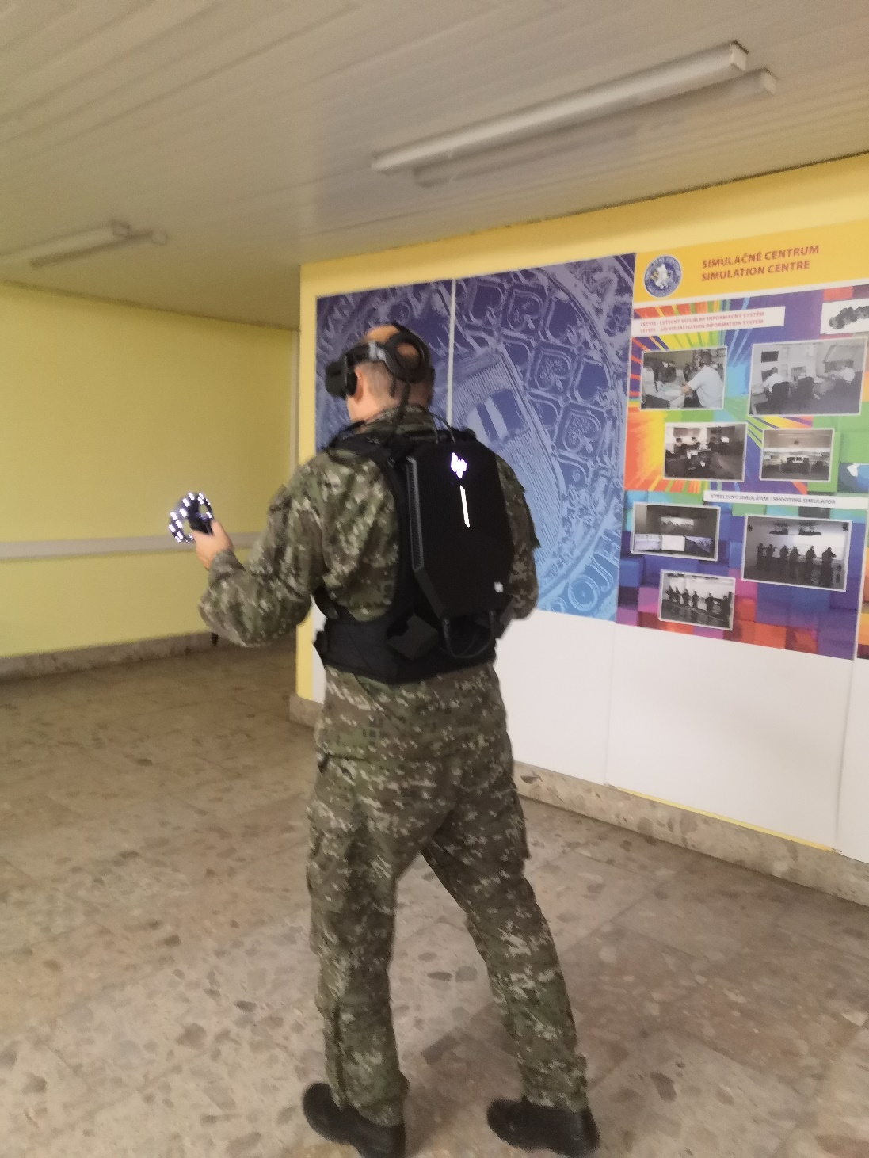
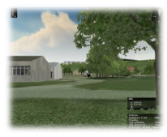
VR: Combat simulation

Slide 25
Conclusion
Presented technologies will improve the quality of the provided training
Training provide scenarios which are more realistic
Reduce risk = safe, controlled area
Can be done remotely saving time and money
Suitable for different learning styles
Innovative and interesting

Slide 26
Q/A?
Col. Aurel SABÓ, PhD.
Contact:
e-mail: aurel.sabo@aos.sk
http://www.aos.sk/sc
telephone: +421 960 422 623

