Slide 1
Development of Decision Support Tools
to Support the Commander
LT Linus Pocha, PlgAB IV 2 (4)

Slide 2
Overview
Content
The Why
The What
The How
Lessons Learned
Questions

Slide 3
„Be willing to make decisions. That‘s the most important quality in a good leader.“
George S. Patton

Slide 4
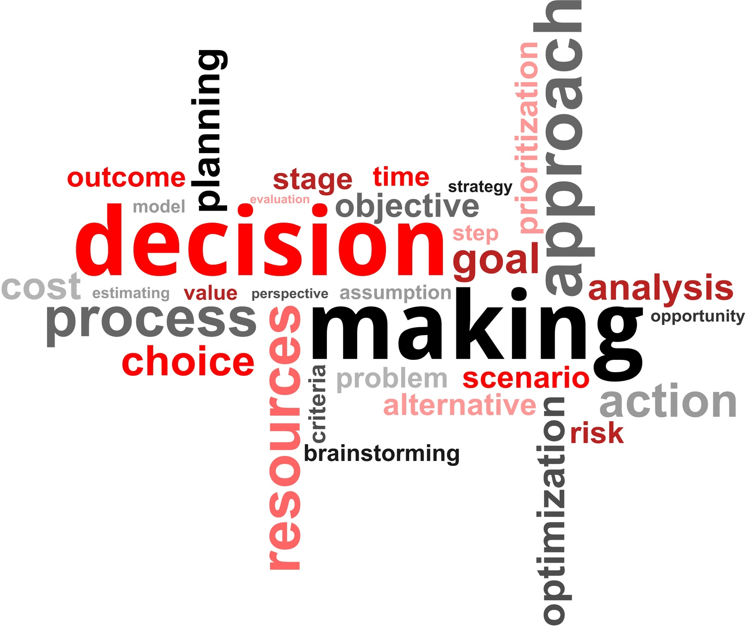
The WHY
Complexity of decision making
Increased abilities of simulation
New hard- & software capabilities
Assisting the leader to make more informed decisions
Notes:
„Whenever you see a successfull business, someone once made a courages decision“ -Peter Drucker

Slide 5
Decision Making
Alternatives
Uncertainty
High Risk Consequences
Complexity
Biases

Slide 6
„Although our intellect always longs for clarity and certainty, our nature often finds uncertainty fascinating“
Karl von Clausewitz

Slide 7
The What
Utilizing the Concept of Data Farming
Visualizing Simulation results for the decision maker
Offer reachback support across security domains
Providing simulation based decision support

Slide 8
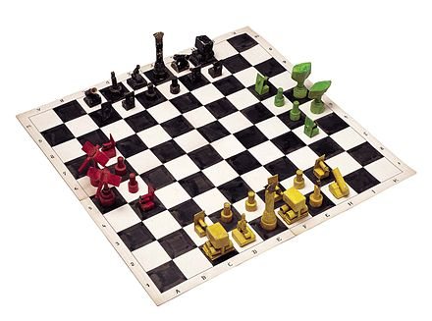
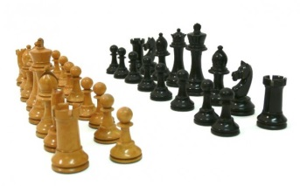
The What
Data Farming means with the respect to Chess: Play all possible moves
Chessboard -> Area of Operation
Type & Number of Figures -> Order of Battle
Valid Moves -> Tactics

Slide 9
DATA Farming

Slide 10
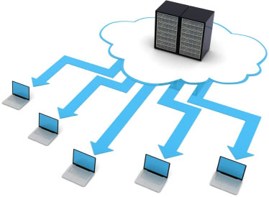
Scenario
Mission
Planning
Guidance
MN-COM
Crossing Security Domains
LOW
HIGH
DEU
Planning
Contribution
DEU-COM

Slide 11
„No good decision was ever made in a swivel chair.“
George S. Patton

Slide 12
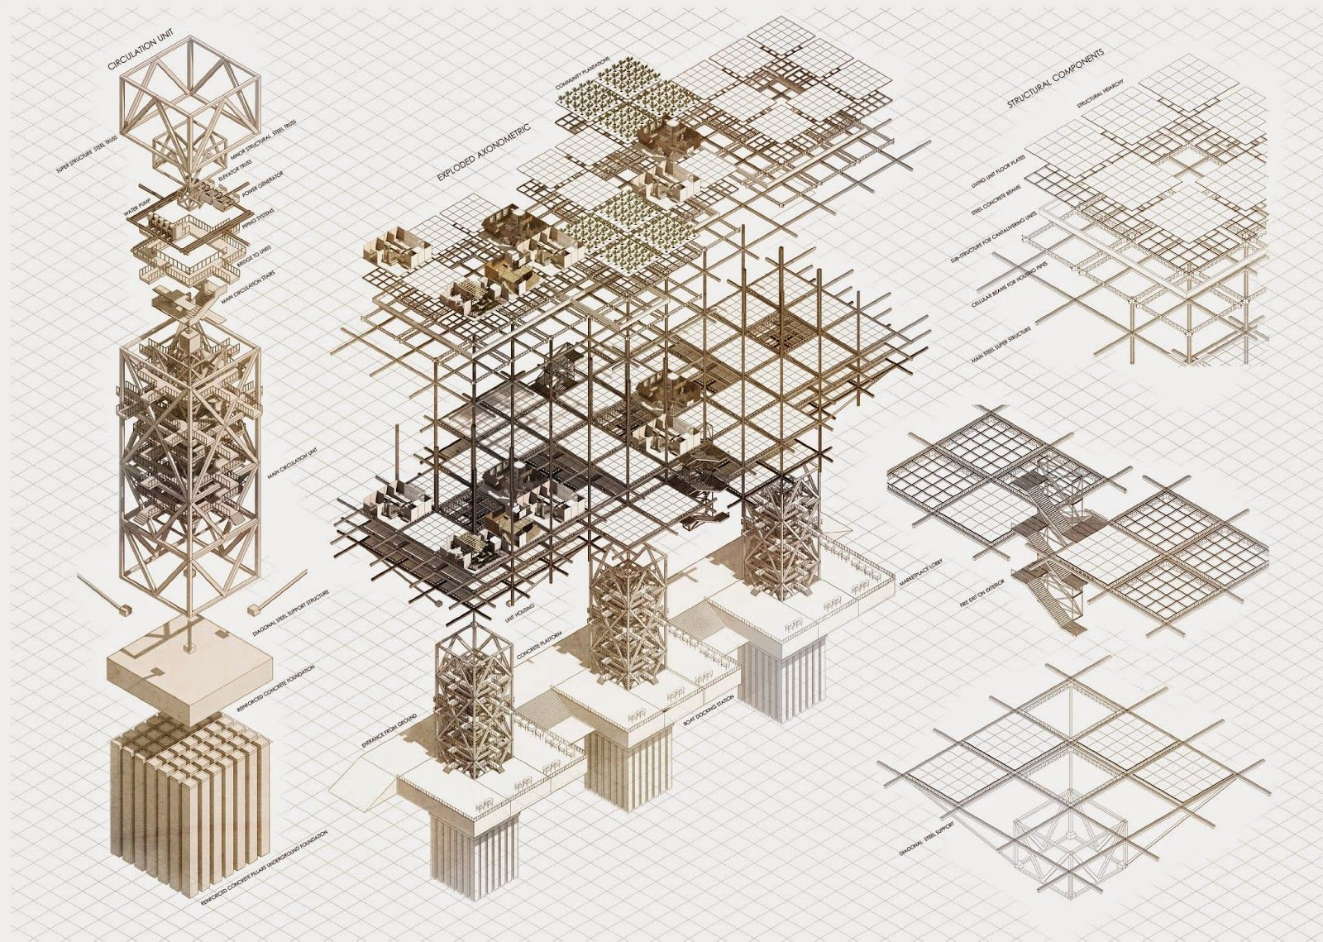
The HOW
State-of-the-art architecture
Variety of simulation systems
Open decision making platform
Integrating Security Gateways

Slide 13
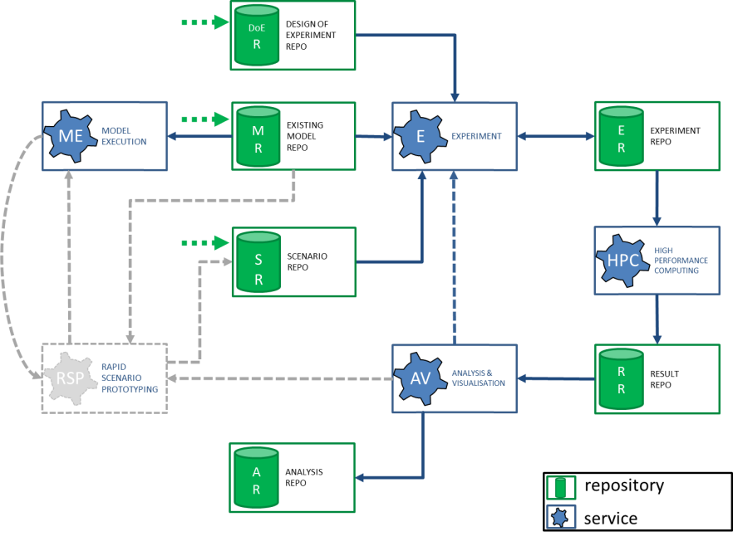
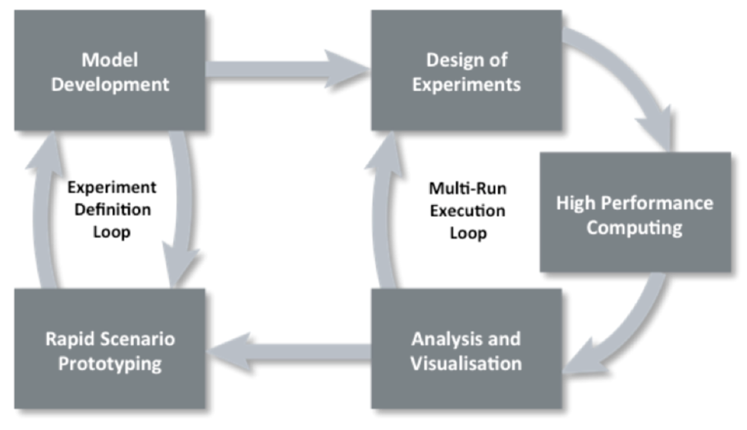
Model → REALITY

Slide 14
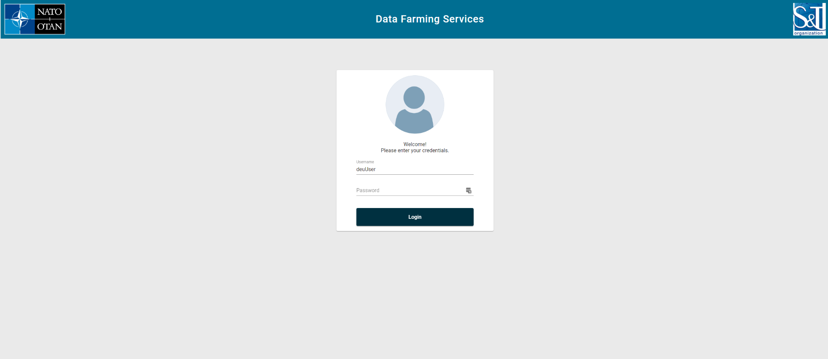
Data Farming Services

Slide 15
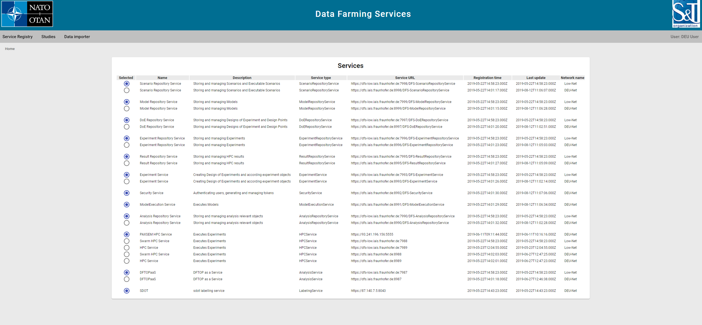
Data Farming Services

Slide 16
Simulation Systems
ITSimBw
PAXEM
DACDAM
JASS
JCATS

Slide 17
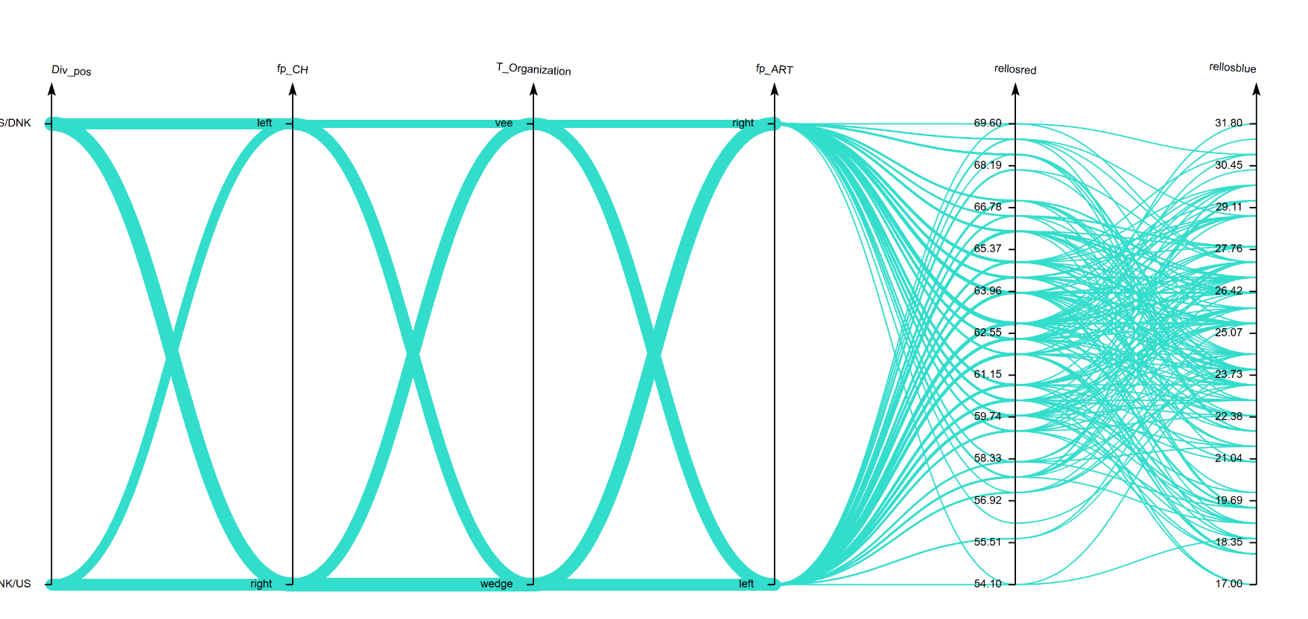
Analysis & Visualization (Modular)

Slide 18
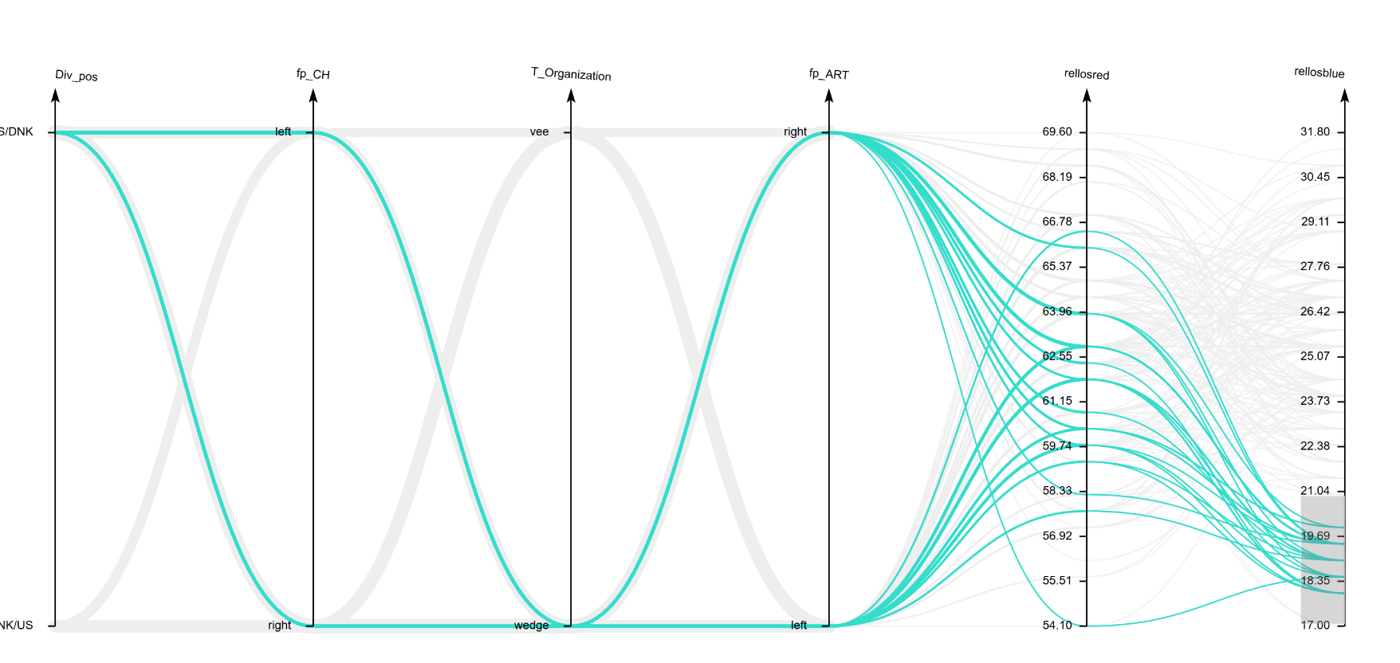
Analysis & Visualization (Modular)

Slide 19
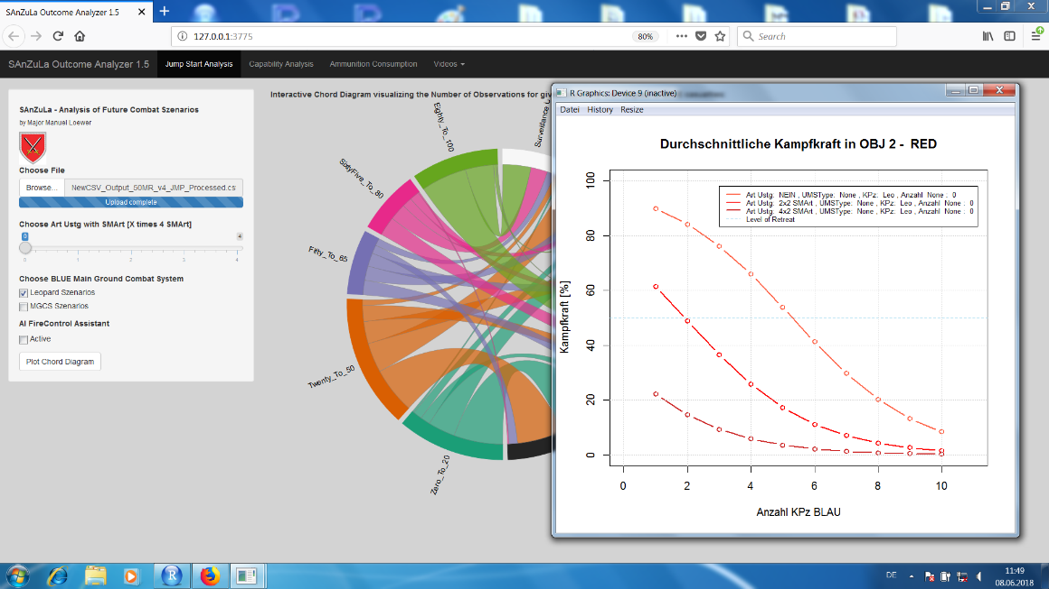
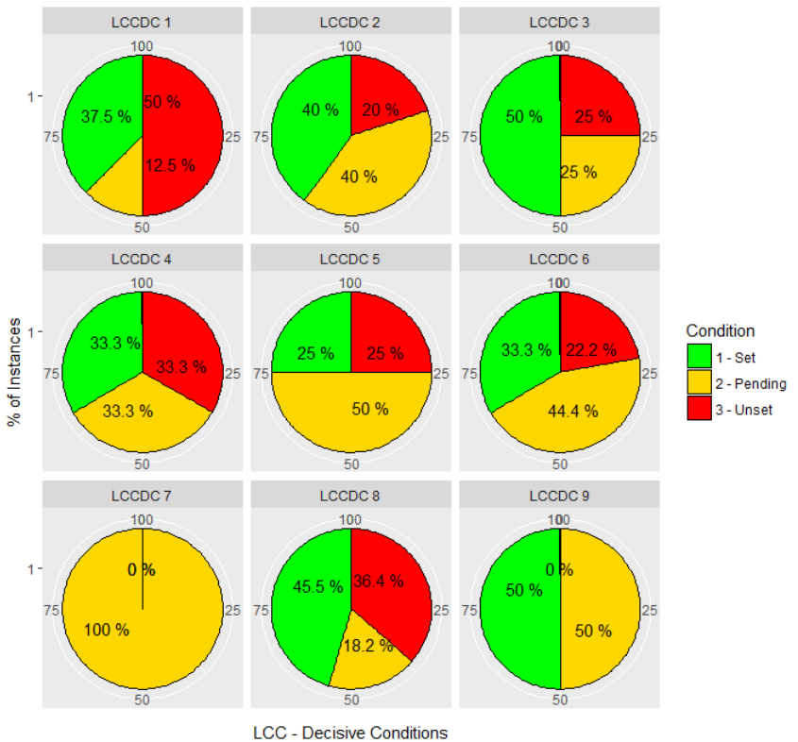
Analysis & Visualization (Modular)

Slide 20
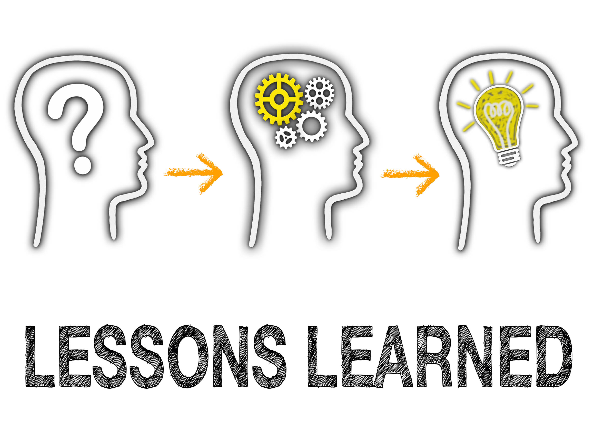
Lessons Learned
Transparency reduces resistance
Operator is essential
Choices increase usability
Allows one-size-fits-all approach

Slide 21
Questions

Slide 22
Contact
LTC Stephan Seichter
Branch Chief PlgABw IV 2 (4) Br IT ScSu NT/ SuTBw
Bundeswehr Office for Defence Planning
Directorate Scientific Support and Interoperability
Division Analysis / Modelling & Simulation
Einsteinstraße 20
84024 Taufkirchen
Germany
Tel. +49 89 6088-2177
Fax +49 89 6088-4092
E-Mail plgabwiv24itwissustgntsutbw@bundeswehr.org

