Slide 1

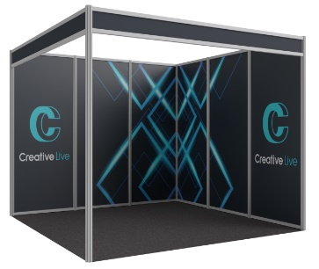
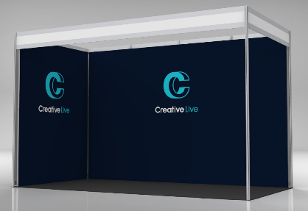
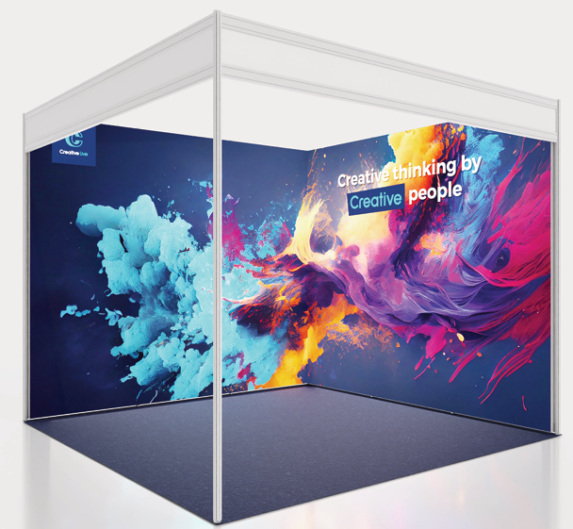
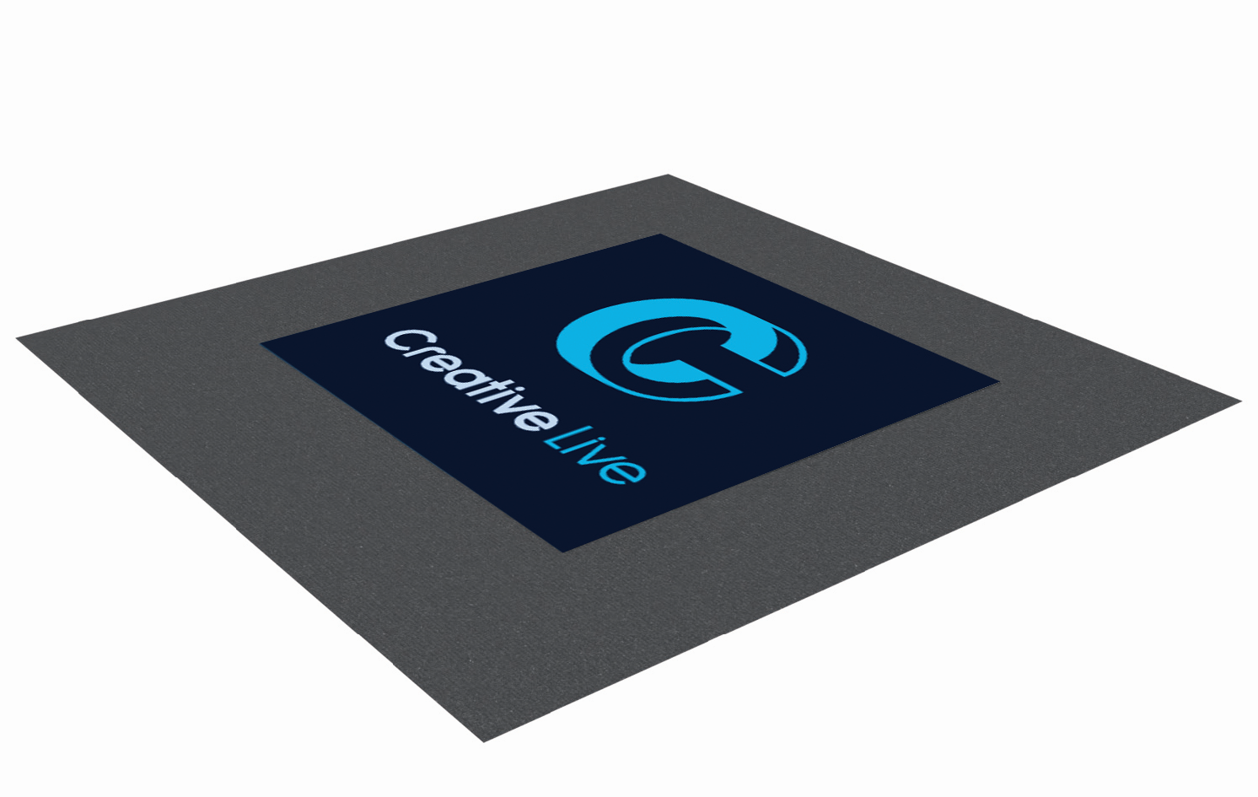
GRAPHICS OPTIONS
Branding is a great way to ensure your stand makes an impression and stands out from the crowd. We can assist you with any graphics that you require should you wish to enhance your stand. We offer a printing and installation service on all the below graphic types.
Please email us with your stand number and graphic choice from below and we can provide a quote – sales@creativelive.uk
Early Booking Deadline Date: 3rd August 2026
GRAPHIC TYPE | DESCRIPTION | COST PER LINEAR METRE
INFILL GRAPHICS | Printed on to individual Foamex panels, which replace the standard white shell scheme panels. They sit in between the aluminium framework and are a great way of branding your stand. Offering you a full height graphic display, whilst allowing additional fixtures to be fastened to the shell scheme uprights. | EB Rate £249.25 + VAT Standard Rate: £299.10 + VAT
SEAMLESS GRAPHICS | A full graphic clad, offering you an uninterrupted graphic display for your shell scheme walls. These graphics are printed onto fabric which is stretched and attached to a frame giving a complete seamless finish. The fabric can be taken away, washed and reused. If not, it is all recyclable material. | EB Rate: £282.70 + VAT Standard Rate: £339.24 + VAT
BACKLIT GRAPHICS | Create a buzz around your business with our stunning back lit graphics. Created with a graphic printed on Glacier Display Textile and LED lighting mounted behind the fabric image. | EB price: £350.68 per linear meter + VAT Standard price: £420.82 per linear + VAT
FLOOR VINYL STICKER GRAPHICS | Make use of your floor space with our self-adhesive, anti-slip floor graphics which can be produced in various shapes and sizes. | £150 + VAT per sqm 1m x 1m minimum size
ARTWORK FORMAT
We require artwork to be supplied as high-resolution PDFs. Any pantones supplied in artwork may not be converted correctly and can print a different shade to what you are expecting. Please ensure all pantones are converted to CMYK to ensure they print the correct colour.
All text and logos should be supplied in vector format and text converted to outlines where possible. Any instructional guides or boxes must be removed from artwork. You won’t need to consider leaving bleeding space when submitting your graphics unless otherwise specified. Any instructional guides or boxes must be removed from artwork/crop marks.
Items will not be supplied without full payment.

