Slide 1
FRAGMENTS AND FORMS; identifying abnormal red cells and what they mean when you find them.
Emma Dewhurst MA VetMB DipECVCP FRCPath MRCVS
IDEXX R&D Department
Notes:
This presentation was developed for the 0.5 FTE / tagging / pathologists week one introduction to Theia
Can use slides to create PowerPoints for training IRL pathologists in future

Slide 2

Disclosure:
I am an employee of IDEXX Laboratories Ltd.
Disclaimer:
The information contained herein is intended to provide general guidance only. As with any diagnosis or treatment, you should use clinical discretion with each patient based on a complete evaluation of the patient, including history, physical presentation, and complete laboratory data. With respect to any drug therapy or monitoring program, you should refer to product inserts for a complete description of dosages, indications, interactions, and cautions. Diagnosis and treatment decisions are the ultimate responsibility of the primary care veterinarian.
Notes:
You may select your own image or choose one from the Brand library on Box: https://idexx.box.com/v/idexxbrandphotos

Slide 3
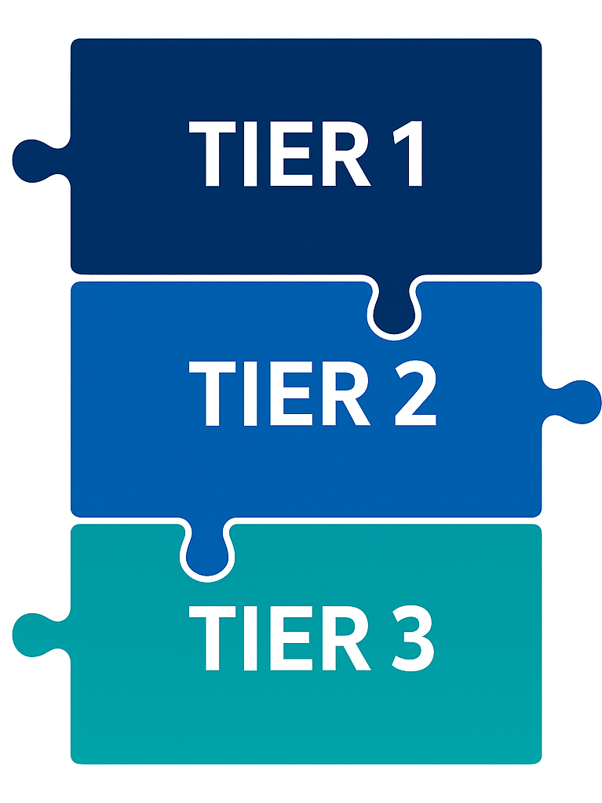
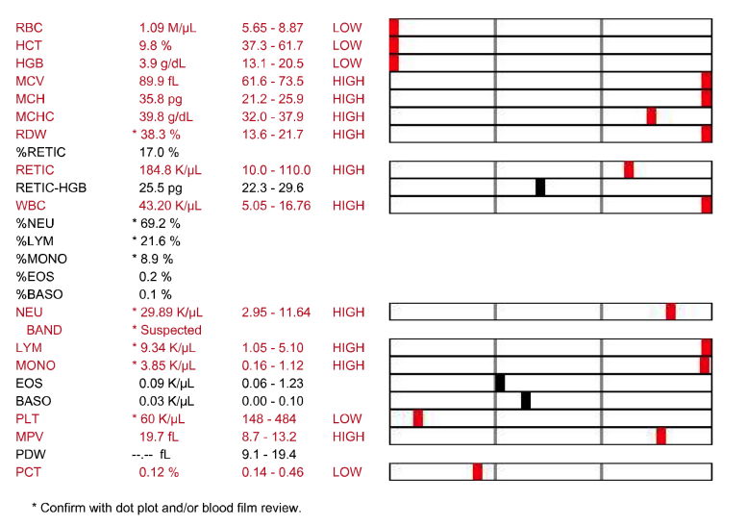
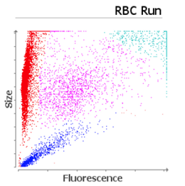
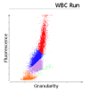

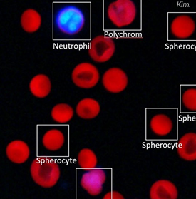
Notes:
Alice
This slide shows the three diagnostic tiers we rely on for accurate hematology interpretation.
Each tier adds a different layer of confidence, and together they create a complete, reliable picture of the patient.
Tier 1 is our starting point — the numerical data from the CBC.
This includes red blood cells, white blood cells, platelets and related parameters + flags.
Tier 1 gives us the first indication that something may be abnormal, but numbers alone often can’t explain the underlying cause.
Tier 2 adds context. At this stage, we look at the dot plots.
They help us understand more about any abnormal values, and they can also reveal abnormalities even when the numerical results appear normal.
Tier 3 is our confirmation step (the evaluation of blood morphology).
By reviewing blood morphology, we can move closer to the diagnosis — or rule out key differentials, which is equally important.

Slide 4
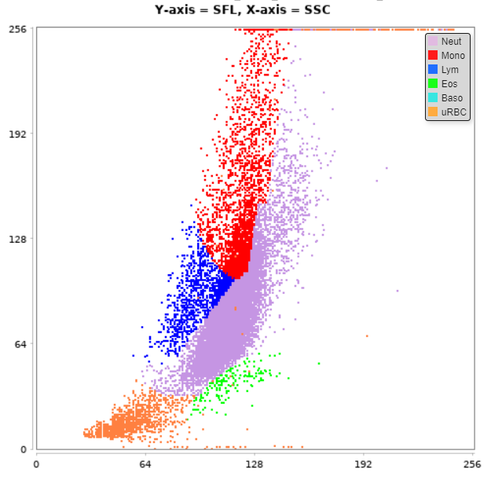
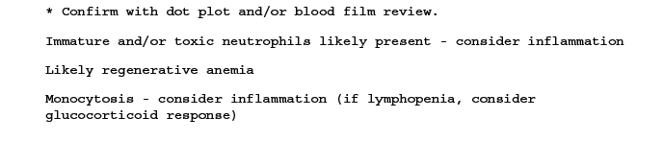
When should blood cell morphology be reviewed ?
Investigation of critically ill patient
Moderately to severely anaemic patients
Markedly high WBC counts
Markedly low WBC/Plt counts
Flags in dot plots/indistinct separation of clusters
Unexpected or suspicious instrument results
ProCyte Dx – Canine
Patient WBC Dot Plot

Slide 5
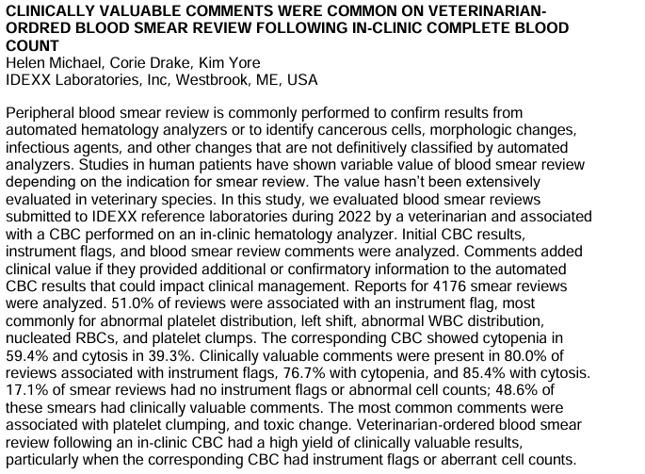
ACVP-ASVCP CHICAGO 2023
Although not stated in the abstract, it was also suggested that <1% of veterinarians requested a blood film review for a CBC

Slide 6
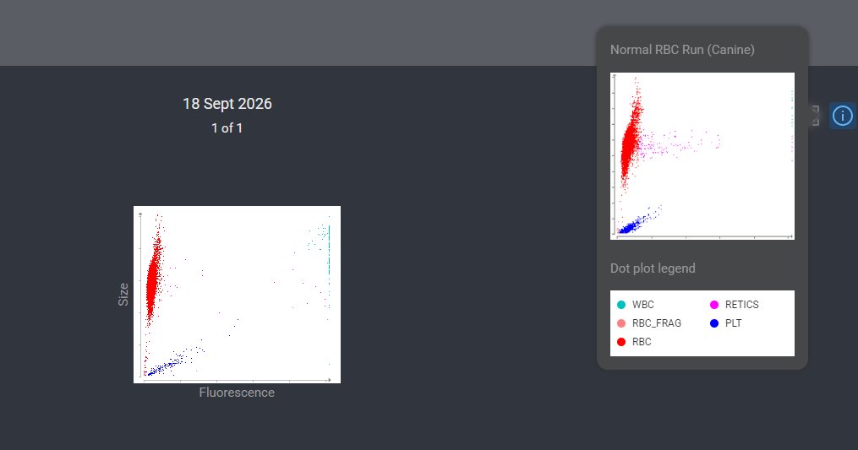

Slide 7
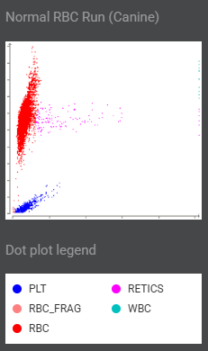
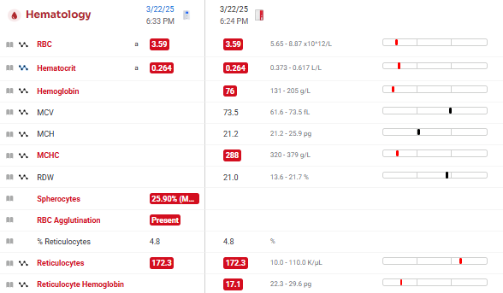
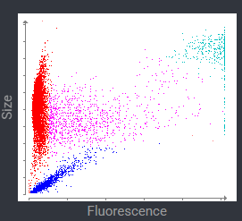

Jimmy, 2 year-old, male neutered, mixed breed dog
Notes:
Emma
https://vetconnectplus.com/diagnostics/5141322408558592/5141322408558592-20300588070
(SAP ID: 438390, Jimmy)
Here we have Jimmy’s ProCyte Dx results, which indicate moderate regenerative anemia. The main differentials for regenerative anemia include blood loss or hemolysis.

Slide 8
Jimmy, 2 year-old, male neutered, mixed breed dog
Notes:
Emma
https://vetconnectplus.com/diagnostics/5141322408558592/5141322408558592-20300588070
(SAP ID: 438390, Jimmy)
This is where inVue Dx adds clarity—by detecting moderate spherocytosis and agglutination, which, according to the ACVIM consensus statement on the diagnosis of IMHA, are strongly suggestive of immune-mediated hemolytic anemia (IMHA). The diagnosis is made quickly, enabling timely initiation of therapy.
Buckets for spherocytes: mild (< 1.5%), moderate (1.5-37.5%) and marked (>37.5%)

Slide 9

ACVIM Consensus Statement on the diagnosis of immune-mediated hemolytic anemia in dogs and cats – JVIM 2018
≥ 2 signs of immuno-mediated destruction:
Spherocytosis (dog)
Saline Agglutination test
Coombs Test or Flow Cytometry
(Se 82%, Sp 95-100%; Se 67-87%, Sp 100%)
≥ 1 sign of haemolysis:
hyperbilirubinaemia
(r/o hepatic disease, sepsis, cholestasis)
haemoglobinaemia
haemoglobinuria
Ghost cells
Notes:
Alice
In Jimmy’s case, we already have at least two indicators of immune‑mediated destruction. When we apply this to the 2018 ACVIM consensus statement, as mentioned by Emma, this places Jimmy within the category “supportive of IMHA”.
As a reminder, the ACVIM guidelines classify IMHA based on the combination of findings, which you can see highlighted here.
If none of these are present → IMHA can be ruled out.
And importantly, tests such as the saline agglutination test, Coombs test, or flow cytometry must be performed before any immunosuppressive therapy or transfusion, as these may interfere with interpretation.
“Two signs of immune‑mediated destruction + one sign of haemolysis → diagnostic for IMHA
Two signs of destruction, OR one destruction + one haemolysis → supportive of IMHA
One sign of immune‑mediated destruction → suspected IMHA, as long as other causes of anaemia are excluded.”
Spherocytosis → ≥ 5 /100x oil (Se 63% - Sp 95%)
SAT → 1:4 ± wash

Slide 10

Effect of dilution of canine blood samples on the specificity of saline agglutination tests for immune-mediated hemolysis
Prudence L Sun and Unity Jeffery JVIM 2020 34(6):2374-2383
Saline‑to‑blood ratio | Sensitivity % (95% CI) | Specificity % (95% CI) | Diagnostic accuracy % (95% CI)
1 : 1 | 88 (47–100) | 29 (20–38) | 33 (24–42)
4 : 1 | 88 (47–100) | 49 (40–58) | 51 (43–59)
9 : 1 | 67 (30–93) | 70 (62–78) | 70 (62–77)
49 : 1 | 67 (30–93) | 97 (93–99) | 95 (90–98)
Notes:
Alice
Another important point to highlight is that a 2020 JVIM paper showed that the traditional saline agglutination test with 1:1 or 1:4 dilution produces too many false positives,

Slide 11
Effect of dilution of canine blood samples on the specificity of saline agglutination test for immune-mediated hemolysis – JVIM 2020
Saline‑to‑blood ratio | Sensitivity % (95% CI) | Specificity % (95% CI) | Diagnostic accuracy % (95% CI)
1 : 1 | 88 (47–100) | 29 (20–38) | 33 (24–42)
4 : 1 | 88 (47–100) | 49 (40–58) | 51 (43–59)
9 : 1 | 67 (30–93) | 70 (62–78) | 70 (62–77)
49 : 1 | 67 (30–93) | 97 (93–99) | 95 (90–98)
Notes:
Alice
And instead the authors recommended using a 1:49 dilution. This higher dilution offers the best specificity and diagnostic accuracy — as clearly shown in the table.
Because the test produces very few false positives, this naturally reduces sensitivity to around 67%. For IMHA, though, this actually works in our favor. The last thing we want is to over‑diagnose IMHA, because a false positive can push us toward aggressive immunosuppression and completely shift the clinical plan in the wrong direction. The “harm” of a false positive is bigger than the harm of a false negative. So, having a highly specific test is exactly what we would like to have.

Slide 12
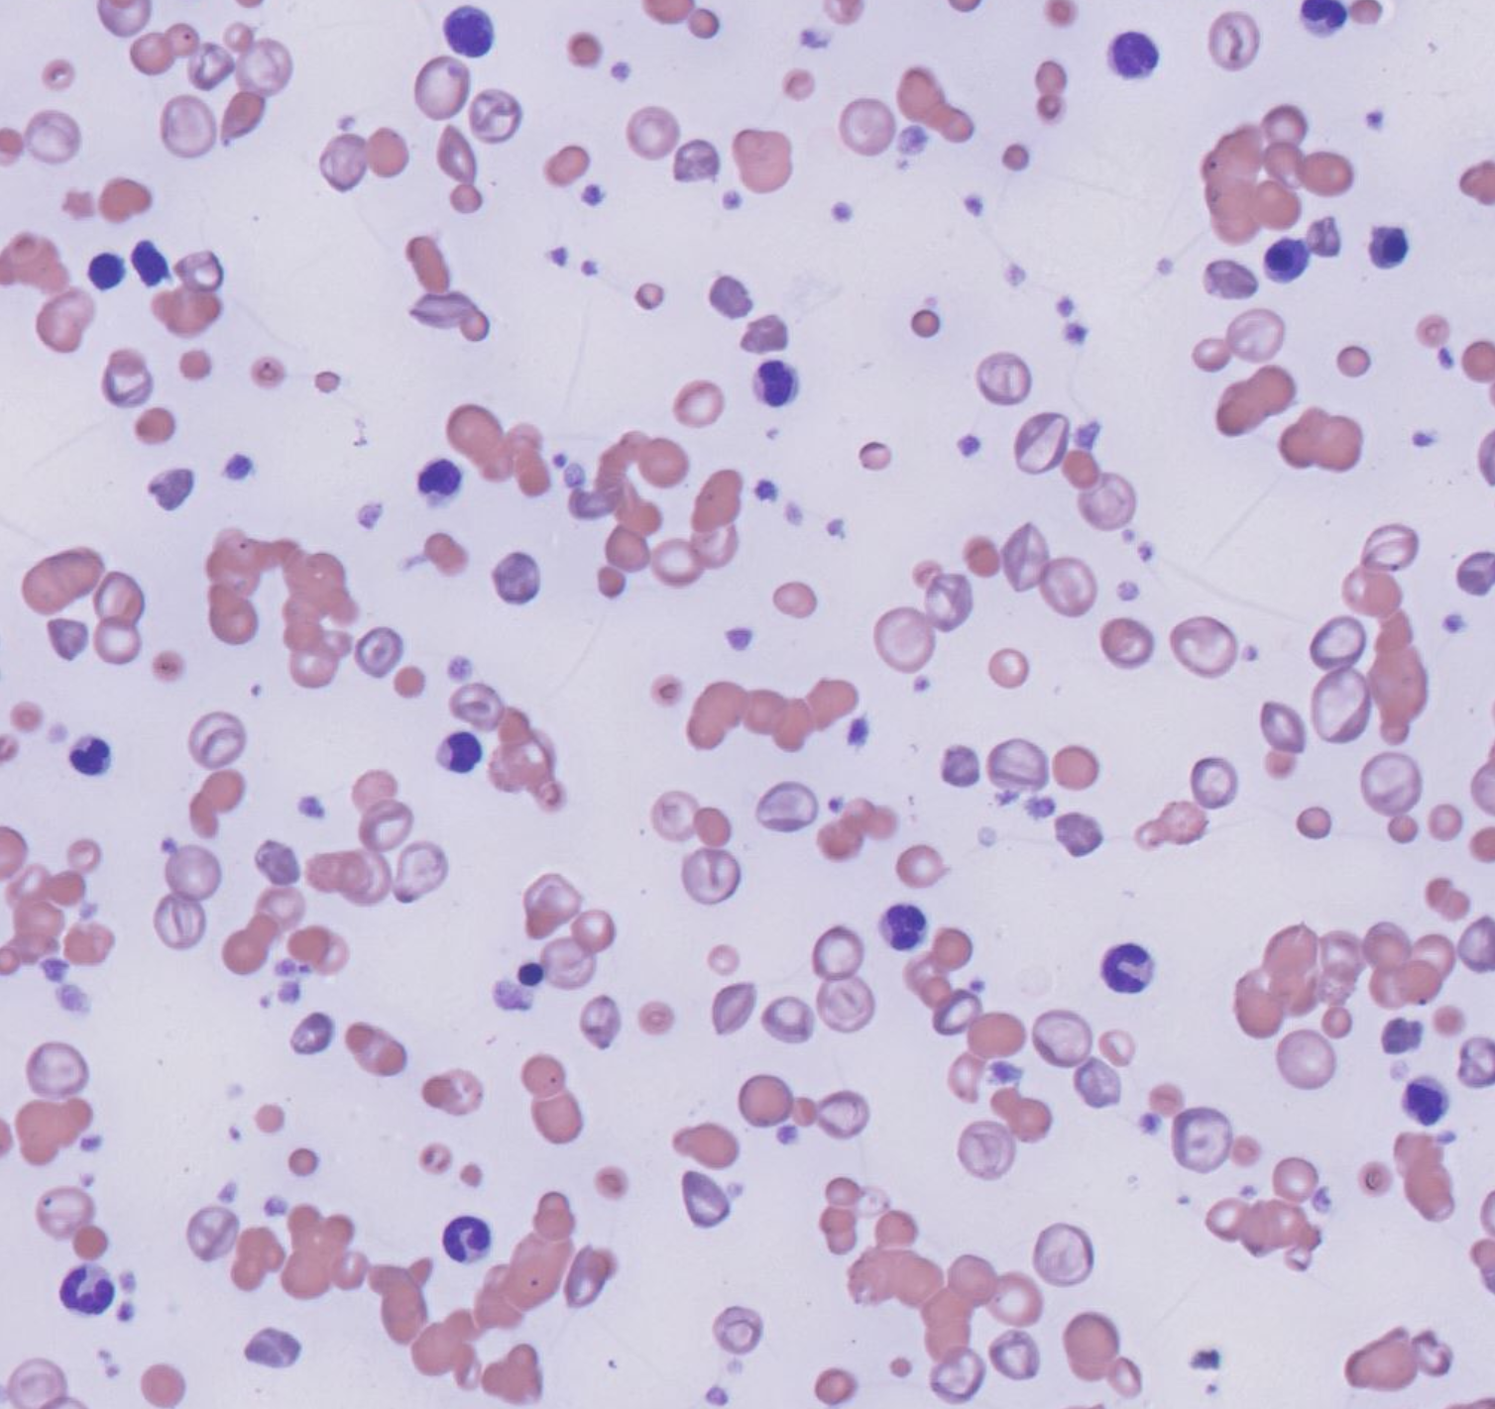
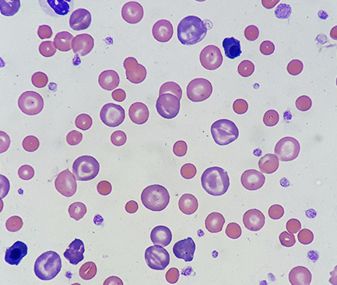
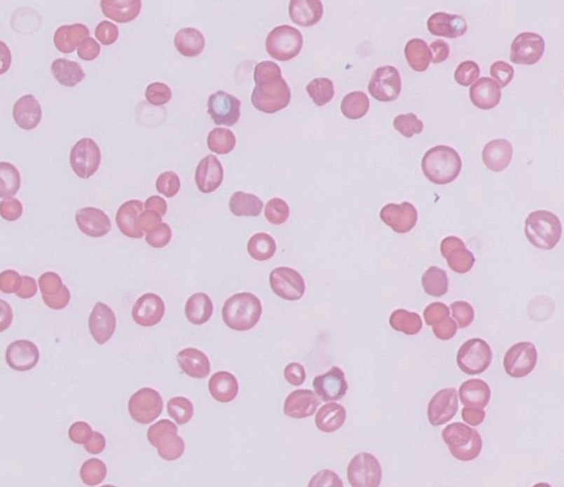
Jimmy
Features suggestive of immune mediated haemolytic anaemia
Agglutination
(Saline agglutination test)
(+/- Coombs test)
Spherocytes
Ghost cells (fresh smear)
Notes:
Buckets public domain image https://commons.wikimedia.org/wiki/File:Bucket_list_%2820054800529%29.jpg
RBC Images from previous Idexx presentation (LVC 2023)

Slide 13
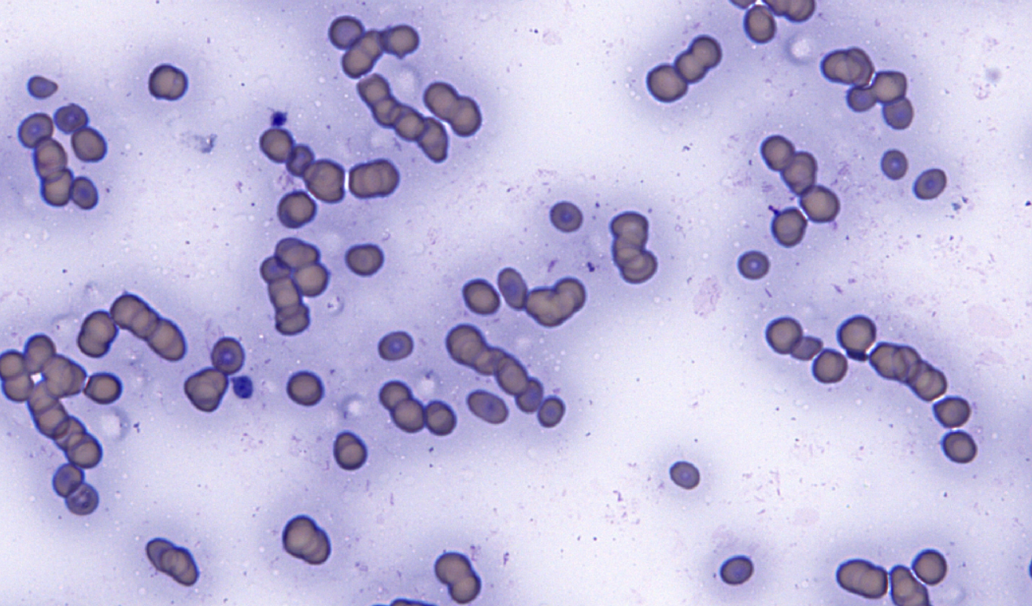
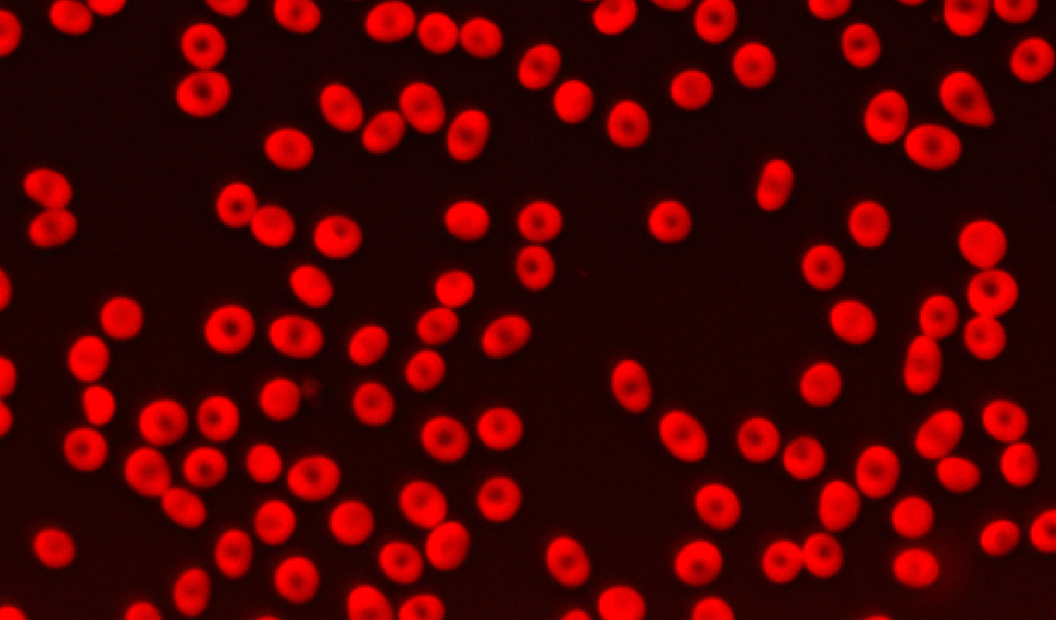
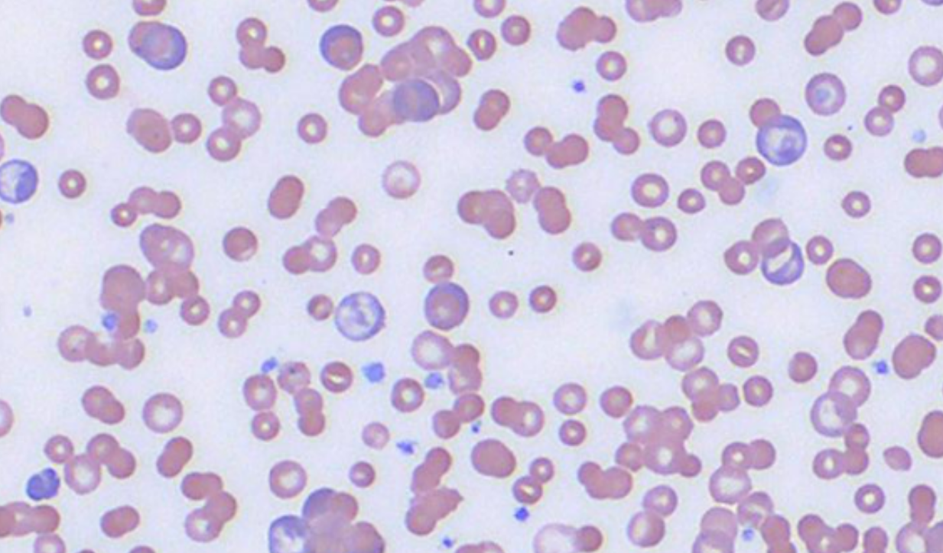
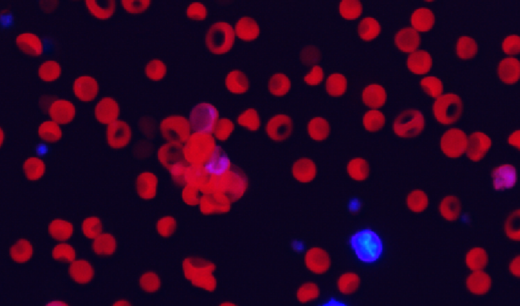
inVue Dx™ Helps Differentiate Rouleaux from Agglutination
Rouleaux
Agglutination
Notes:
Alice
This is exactly where inVue Dx makes a difference.
Because the system analyses samples at higher dilution—1:85—red blood cells are well dispersed. At this level of separation, rouleaux naturally disappear, so any cells that still appear clustered truly represent agglutination rather than an artifact.
The image clarity and overall specificity are excellent. It gives us real confidence that what we’re seeing is accurate.
By contrast, many practices still rely on a SAT with a dilution of 1:1 or 1:4, and that’s where we sometimes hear feedback like, “we saw agglutination,” but not when using inVue. It’s important to remember that a 1:1 or 1:4 SAT has a low specificity. At that dilution, rouleaux can very easily be mistaken for true agglutination, and even experienced clinical pathologists can find it difficult to distinguish between the two. And now, back to Emma, who will guide us through the inVue images of this case.
So it’s quite possible that some of the “positive” 1:4 results are actually rouleaux rather than genuine agglutination.

Slide 14
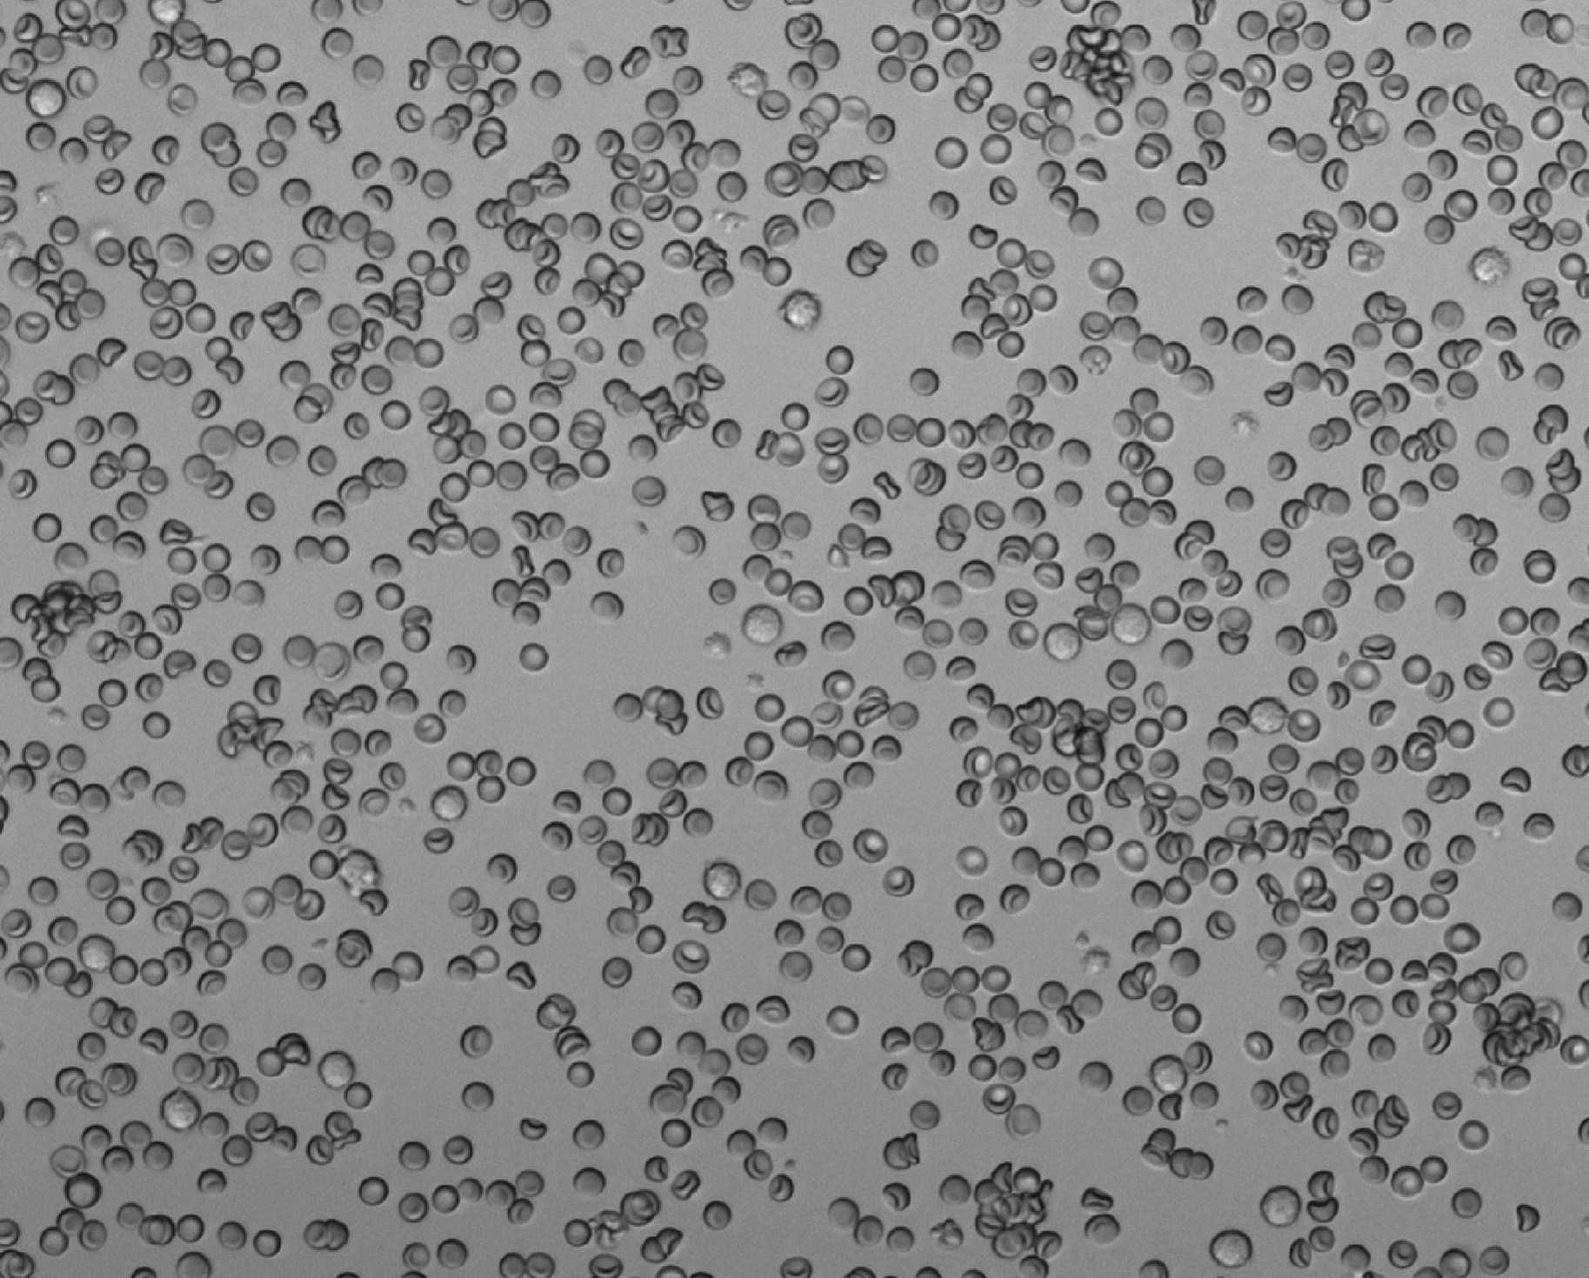
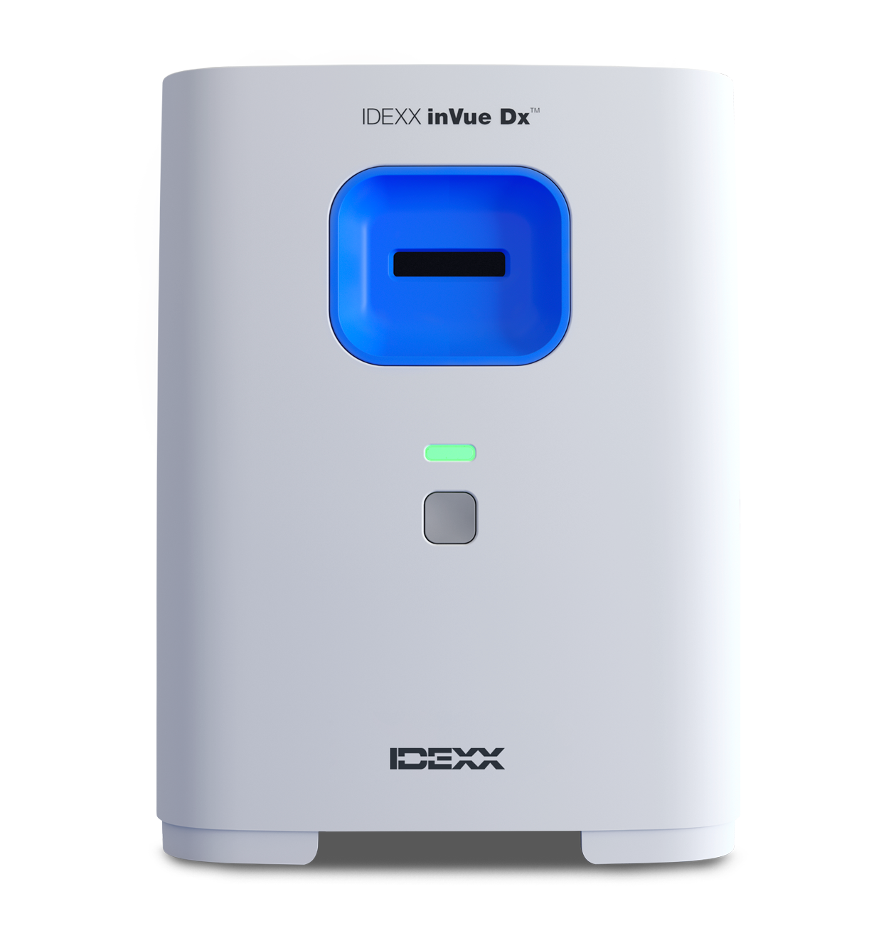
Brightfield image:
Agglutination
Spherocytes
Notes:
Emma
Here are some behind-the-scenes images. This is a brightfield image in shades of gray, where you can clearly see the biconcave red blood cells with their central pallor. Notice the highlighted features:

Slide 15
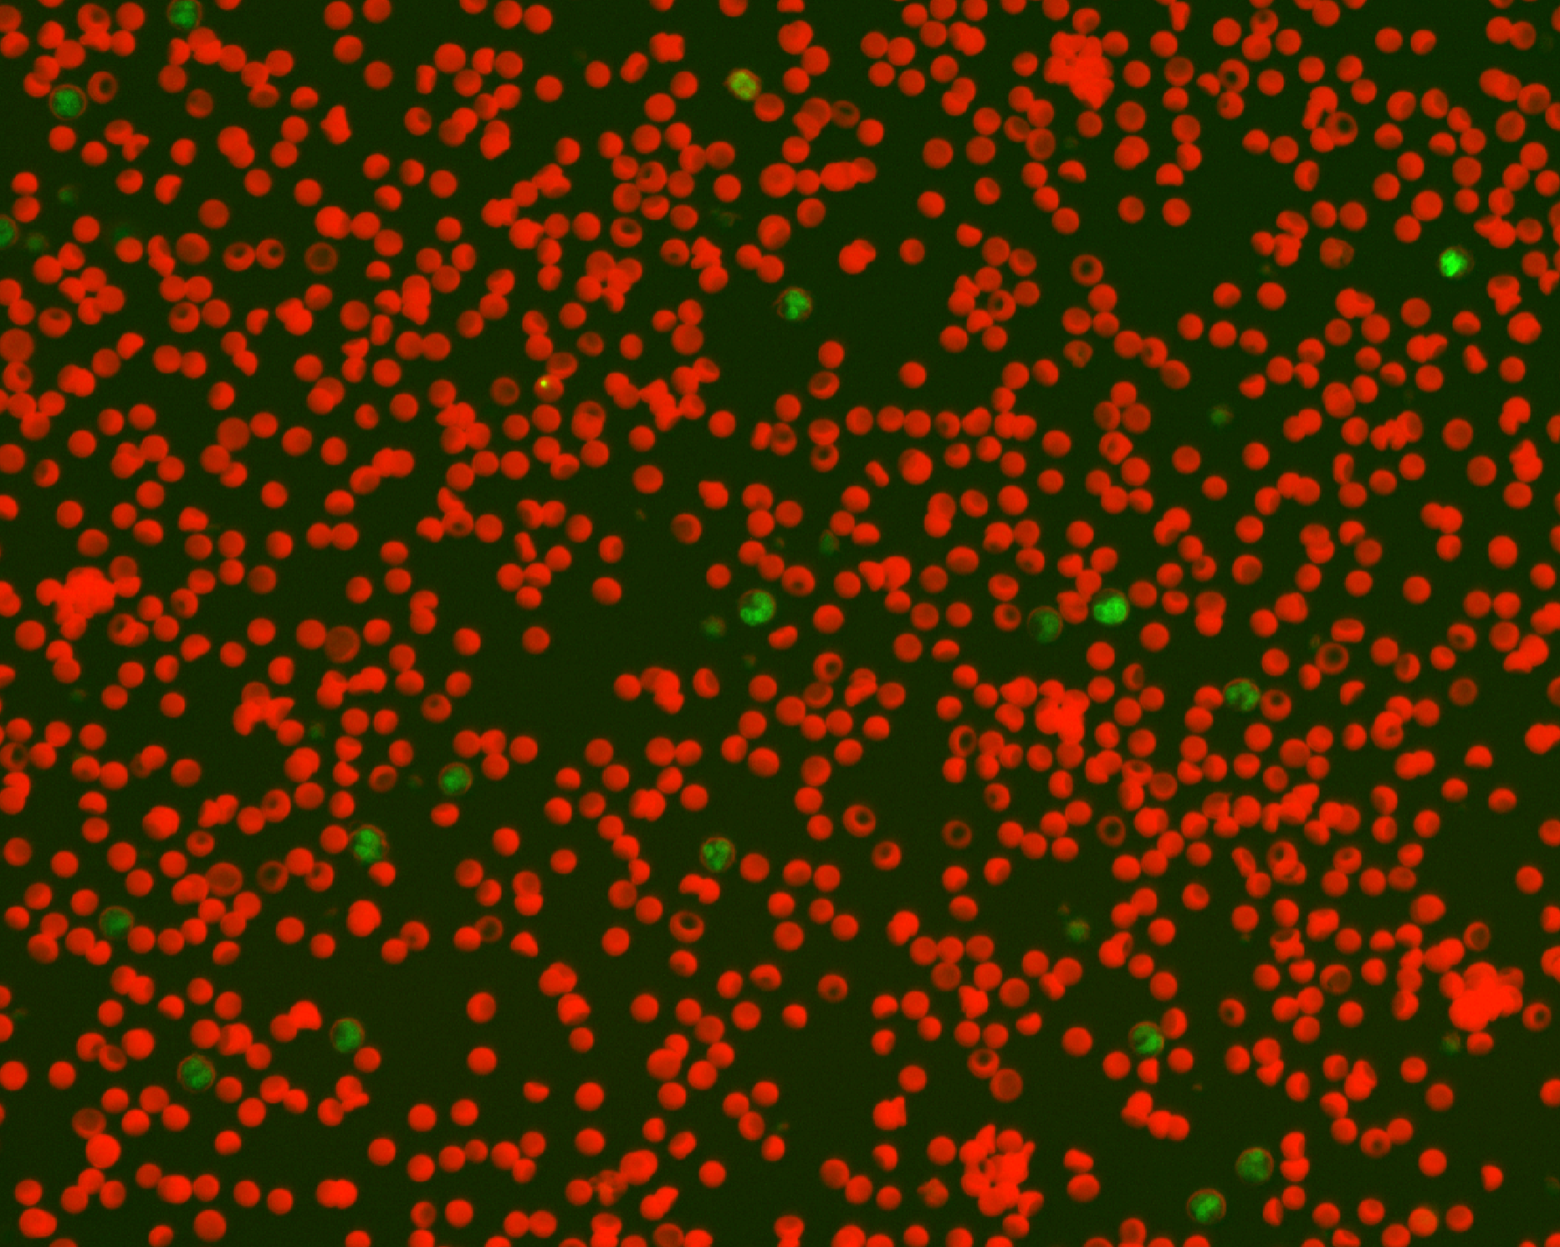
Composite image:
Agglutination
Spherocytes
HJ body
Notes:
Emma
This is the composite image showing red blood cells along with cells that have green nuclei. These nuclei can appear in different colours (blue or green) as we can play with the settings behind the scenes.

Slide 16
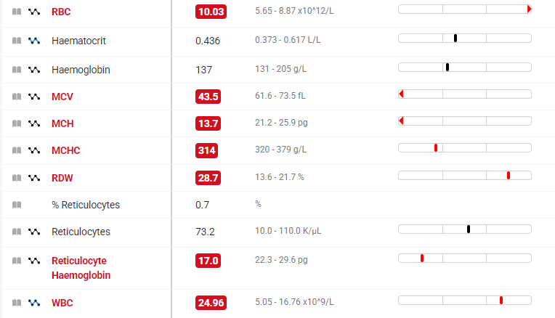
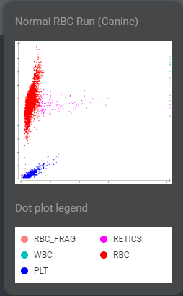
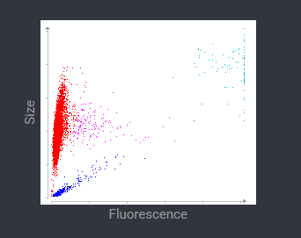
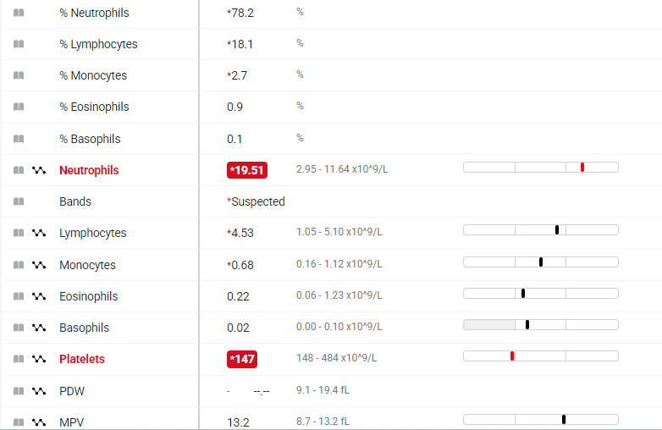
Belle, 9 year old, female entire dog
Notes:
Belle, poikiocytosis Belle Brant 285386

Slide 17
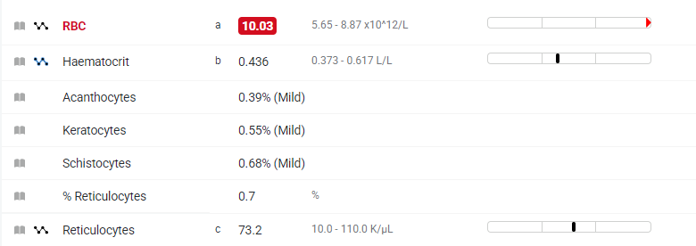
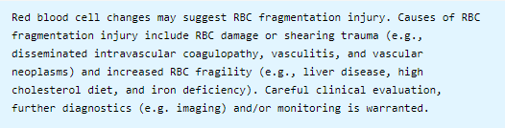
inVue Dx results for Belle

Slide 18
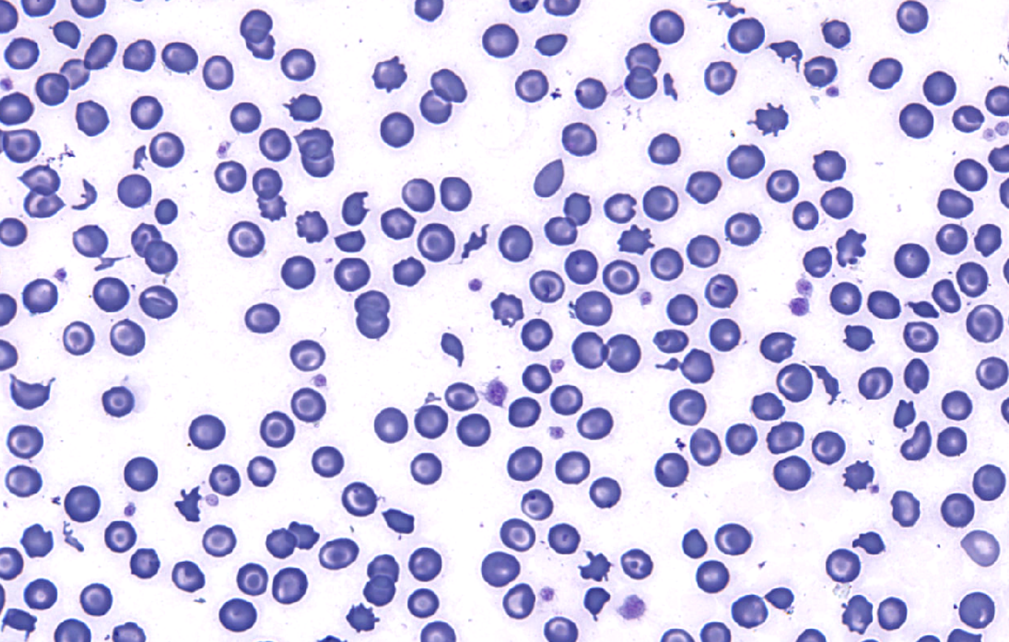
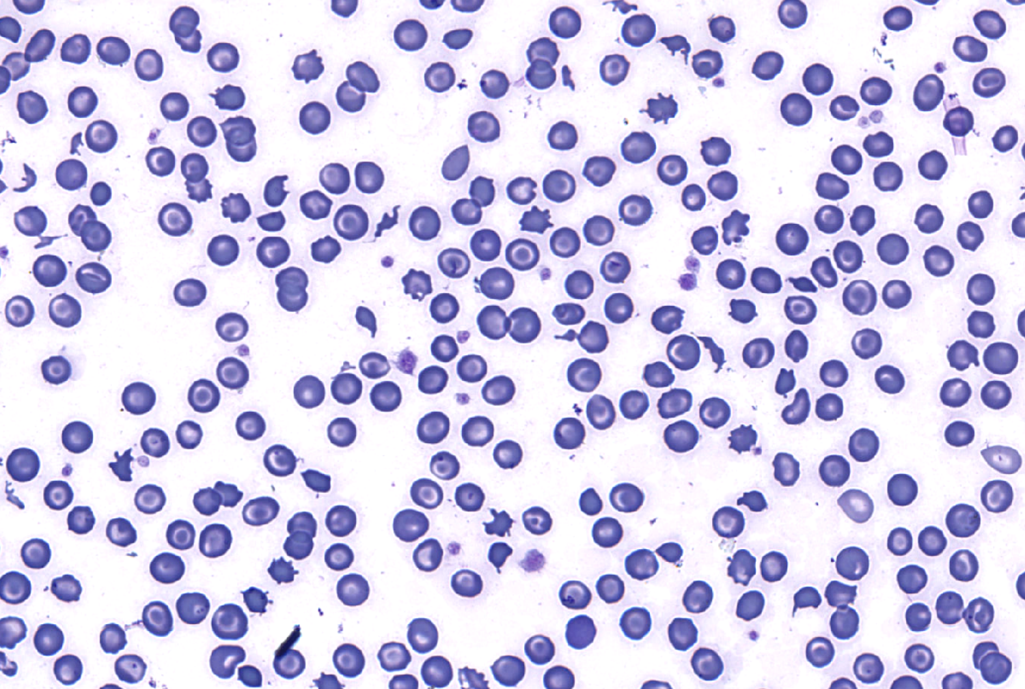
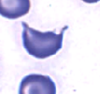
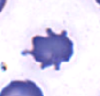

Notes:
Emma

Slide 19
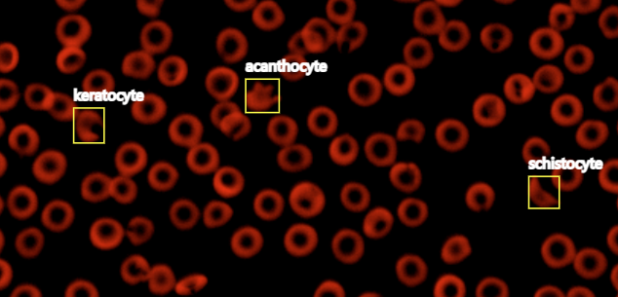
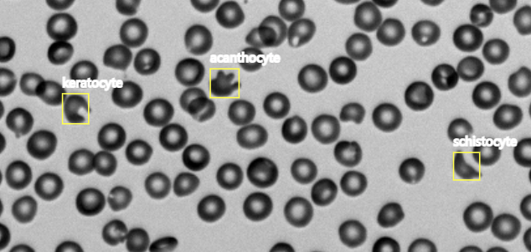

Slide 20
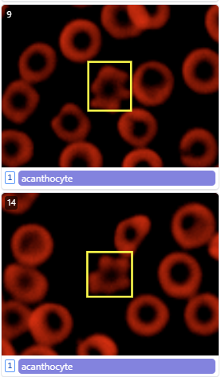
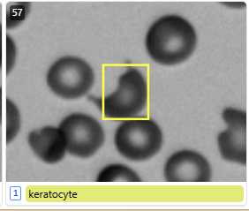
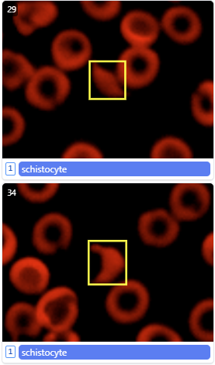
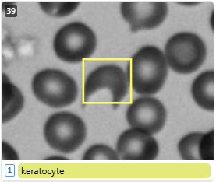

Slide 21
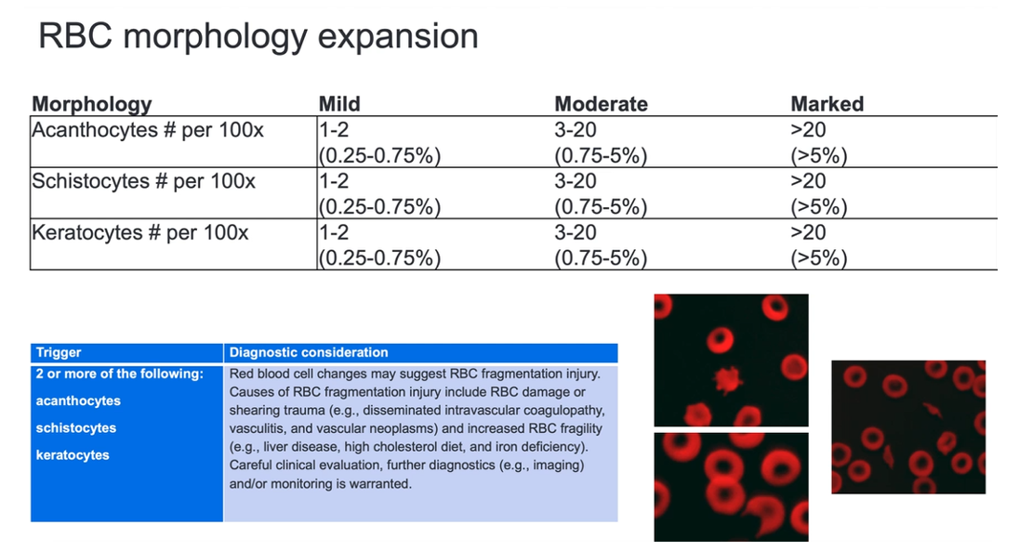

Slide 22
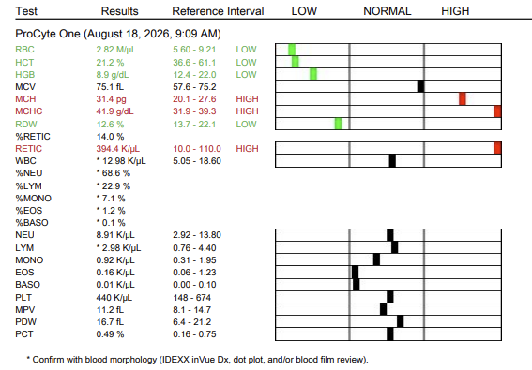
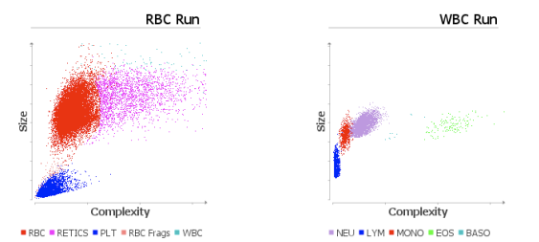
Eccentrocytes also added to red cell morphological menu: Lola 2 year old female Yorkshire Terrier
Notes:
A834236A-C9F0-436F-ACF6-0D4B12061D9C

Slide 23
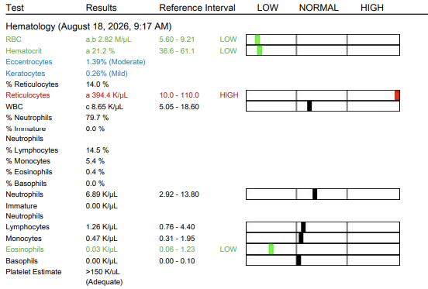
inVue Dx results for Lola

Slide 24



Slide 25
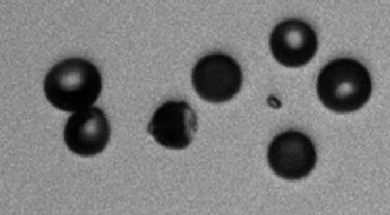
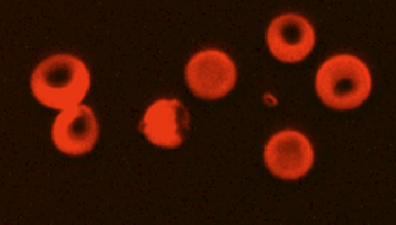
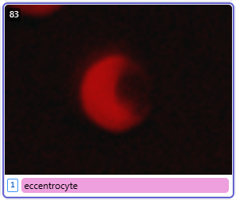
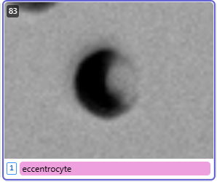
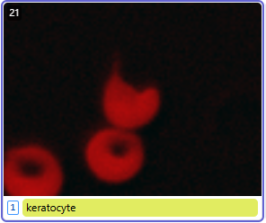
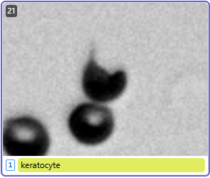

Slide 26
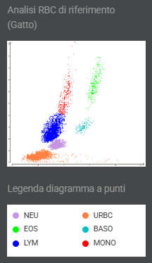

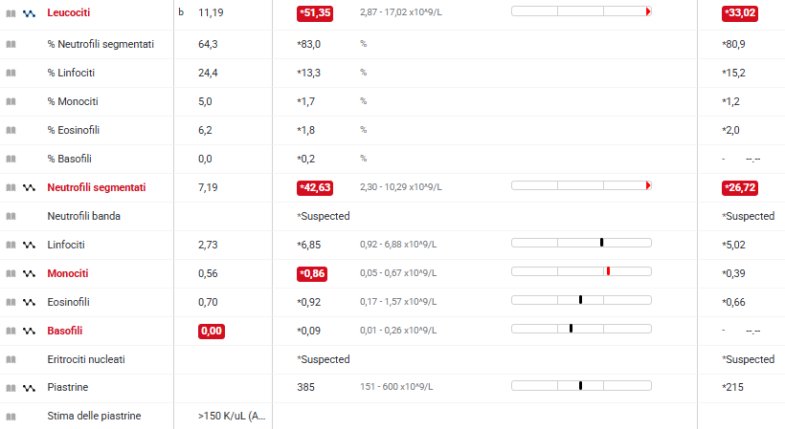

Penny 10 year-old female spayed DSH
Notes:
Penny Polito 159381
And next case is…Penny, a 10‑year‑old female spayed DSH cat that came in for routine pre‑anaesthetic blood ahead of a dental procedure. Clinically she appeared completely normal, and her biochemistry results were all within reference intervals. And she was NOT anaemic.
On the ProCyte Dx, both the total and differential WBC counts were qualified, and the dot plot looked distinctly abnormal — showing a bulging extension of the neutrophil and lymphocytes clouds and poor separation between the 2. The analyser also flagged the presence of NRBCs.

Slide 27
Penny 10 year-old female spayed DSH
Notes:
Alice
inVue Dx helped clarify the picture by estimating the number of nucleated red blood cells. Once the NRBCs were accounted for, inVue Dx automatically recalculated both the total and differential WBC counts.
After this recalculation, the dot plot finally made sense: the abnormalities were most likely attributable to the high number of NRBCs. Crucially, the cat did not have neutrophilia or monocytosis — every WBC population fell comfortably within normal limits once the NRBC correction was applied.
Because this cat had never had bloodwork done before, we had no baseline values for comparison, so it was impossible to know how long these changes had been present for.
And with that, I’ll hand over to Emma…
Emma- what should be noted here is that the PCDx classified these nucleated red cells as it would a nucleated cell, the WBC count is performed after lysis of the red cells, any red cells that remain due to presence of nuclei will be counted as white cells, most available haematology analysers would have performed in the same why as the PCDx here

Slide 28

Numerous NRBCs
Notes:
Emma
My biggest concern would be the potential for early/emerging erythroleukemia or a similar myeloproliferative disorder. Though uncommon, I have seen them present non-anemic and with evidence of regeneration early in the course of disease. I think FeLV/FIV testing would be the next best step

Slide 29
Following pathologist blood film review for Penny
INTERPRETATION
The appearance of the blood smear does not confirm the leukocytosis reported in the CBC but reveals erythroblastosis. Estimated total leukocyte count = 4954.
COMMENT
Close monitoring of the CBC is recommended; should leukopenia persist or worsen, a cytological examination of the hematopoietic bone marrow is advised to investigate whether the anemia is of central origin.
CYTOPATHOLOGICAL DESCRIPTION
Erythroid lineage: apparently normal density. Numerous nucleated red blood cells (830%) are observed, along with mild anisocytosis and polychromasia.
Myeloid lineage: normal to decreased density, overestimated due to the presence of nucleated red blood cells. A predominance of segmented neutrophilic granulocytes (65%) is observed, associated with small lymphocytes (25%), monocytes (5%), and eosinophilic granulocytes (5%). No morphological abnormalities are noted in this lineage.
Thrombocytic lineage: adequate platelet estimate. Numerous large platelet aggregates are observed at the tail of the smear.
Absence of any other cell populations; no microorganisms or other infectious agents are observed.

Slide 30



Notes:
Emma
FIV/FEL SNAP neg and blood lead low so lead exposure r/o
Owner declined bm and FeLV PCR on bm…

Slide 31
inVue and nRBC enumeration in dogs
inVue assesses white cell number and will correct if the number of true white cells is less than the WBCC reported by PCDx
Enumeration of nRBCs will be present as both #/100WBCs, and reported as an absolute number
Samples which are very anaemic or there is agglutination( which will affect red cell assessment) will be qualified or the value may be absent.

Slide 32


Lady Rose 5 year old female entire dog
Notes:
18A58E26-4A06-4828-9A62-C3399678BDBD

Slide 33



Slide 34




Slide 35

Practical Applications of Blood Morphology
Rule in
RBC regeneration: anisocytosis, polychromasia, nRBCs, reticulocytosis
Immune‑mediated haemolysis: spherocytes and agglutination
Systemic inflammation/infection: immature neutrophils
Presence of immature or atypical cells
True thrombocytopaenia: reduced platelet count without aggregates
Rule out
Absence of regeneration
Non‑immune‑mediated anaemia
Pseudothrombocytopaenia: reduced platelet count with aggregates
Notes:
Alice
And with that, a final thought to leave you with…
Thanks to the three tiers of haematology — numbers, dot plots and blood morphology — we can confidently rule in or rule out many key differentials. This structured workflow helps us interpret cases efficiently, streamline clinical decision‑making and avoid unnecessary treatments or delays.
So, think of Procyte and inVue Dx as tools that enables us to manage the vast majority of the cases quickly and accurately, while also helping recognise the patients who truly need to be escalated for a blood‑smear review by a clinical pathologist.

Slide 36
IDEXX inVue Dx™

Slide 37
How is the inVue Dx different?
It is unique within the market there is no blood smear examination from a slide
The cells are suspended within a fluid medium and analysed using a combination of modalities which highlight cell structure and complexity
This is not a counting machine giving total cell counts, the analyser identifies 500-2000 nucleated cells and then provides a relative and absolute differential count if the total white cell count has been provided
This is an analyser for which intelligence software is being constantly optimised

Slide 38
More about the inVue Dx technology
The use of a fluid medium allows cells to be examined in their natural state reducing cell preparation artefact seen with smears, particularly blood smears made with aged blood
InVue uses a combination of two brightfields, and with the addition of the fluorescent stain in the diluent, also uses two fluorescent channels.
This combination of modalities allows for examination of cell shape and structure to include DNA, RNA and protein complexity
A fifth image is also generated called the composite which combines a brightfield and both fluorescent channels

