Slide 1
Identifying future trends in warship design
Gavin Rudgley, Chief Engineer, Future Programmes BAE Systems Maritime - Naval Ships

Slide 2
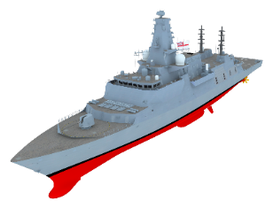
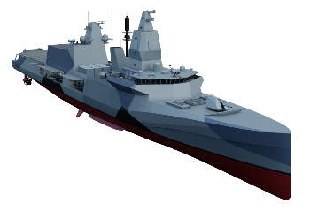
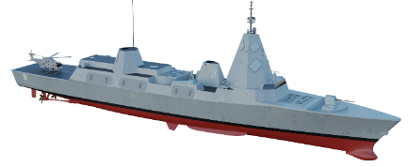
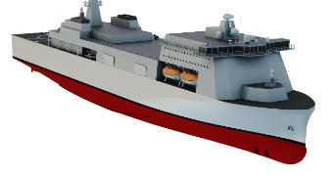
Introduction
who we are and what we do
The presentation will cover:
Who we are, what we do
How we operate
Our platform research themes
How innovative designs increase versatility
How innovative designs increase fuel efficiency
Who we work with
How ship designs are evolving
We are experienced in naval ship design and build, and strive to improve future delivery to customers

Slide 3
Naval Ship Design and Technology
how we operate
Concept Design
Basic Design
Maintain Design
In-Service
Combat Systems development
Ship Equipment and Material Procurement
Acceptance
Detail Design
Maintain Design
Production Outputs
Build
Integration
Technology Leadership
Sustainable Energy Management
Ship Automation
Mission Modularity
Digital Toolsets
Manufacturing Technology
We take an end to end holistic approach to naval ship design, technology, manufacture and delivery

Slide 4
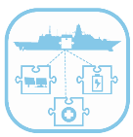
Platform Research and Technology Themes
Technology Leadership
Sustainable Energy Management
Ship Automation
Mission Modularity
Digital Toolsets
Manufacturing Technology
Technology watch for future products
Minimise demand
Efficient generation
Optimise energy use
Enable lean crewing
Improve survivability
Optimised integration (physical and info)
Pan-Lines of Development
Integrate digital landscape
Develop solutions for warship integration
Manufacturing techniques
Novel materials
Pathway to future naval ship design and build
Pathway to Green energy
Pathway to autonomous shipping
Pathway to agile capabilities
Pathway to accelerated ship design, build and acceptance
Pathway to increased competitiveness
Our platform research and technology is mapped to evolving Customer priorities

Slide 5
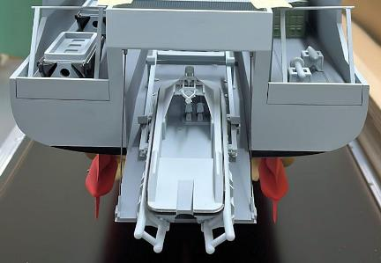
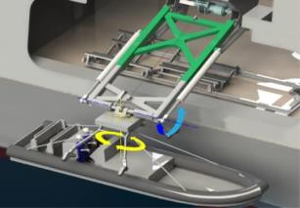
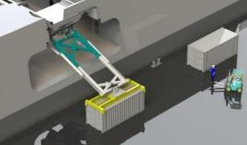
Mission Modularity
How innovative designs increase versatility
Notes:
Can we tidy up? Put in our colour pallet etc
ARRANGEMENT
LOGISTICS
TRANSVERSALS
MISSION
MODULARITY
SAFETY
INTERFACES
Safe to
Operate
Modular Systems
Operated
Safely
SECURITY
Technology example : successful implementation of mission modularity requires pan-defence approach

Slide 6
Sustainable Energy Management How innovative designs increase fuel efficiency
Example modern ferry
“Full Electric Power & Propulsion”
Type 26 GCS Hybrid “Gas Turbine Direct Drive or Diesel Electric”
Drivers
Evolutionary pathways
Modularity, Adaptability
NZC Targets
Energy Efficiency
pumps, motors, HVAC
Hull form optimisation
Propulsors
efficiency
Power Generation
efficiency,
Electrical Distribution
AC, DC
Future Sensors
Future Effectors
Architecture
hybrid or full Electric
Alternative Fuels
toxicity, safety, energy density, logistics (ammonia, methanol, hydrogen, HVO, bio and e-diesels)
Energy Storage
batteries, capacitors
Technology example : low cost and low carbon for naval ships drawn from merchant shipping sector

Slide 7
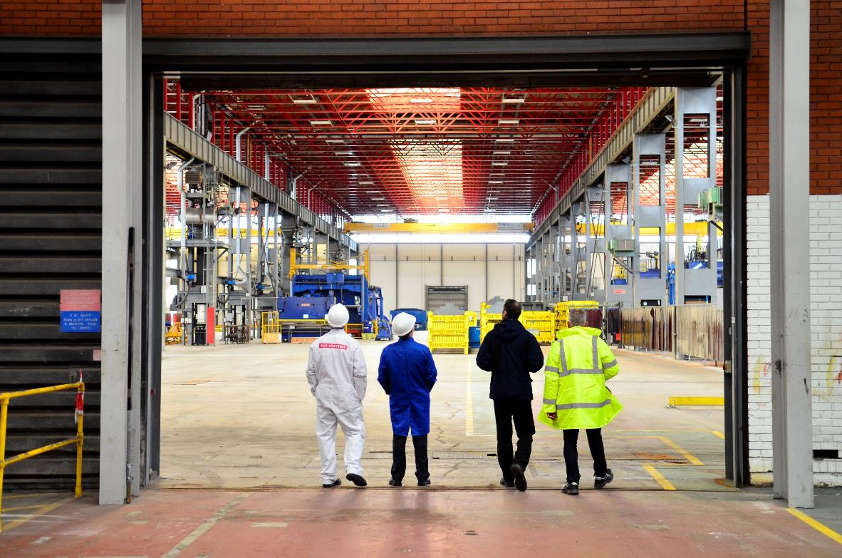
Who we work with
BAE Systems Naval Ships works with:
Customers
Tier 1 primes
Tier 2 suppliers / partners
Assurers
SMEs
Covering:
Concept Design
Basic Design
Detailed Design
Equipment
Build
Prime contractors
Consultancy
Assurance
Our success is dependent on our co-operation across the sector

Slide 8
Future Ship Requirements
how ship designs are evolving
Aspect | Trends
Mission | Sensors, effectors, combat management, networking with off board assets Physical interoperability with aviation, boats, UXVs
Manoeuvre | Speed, range, manoeuvrability for low carbon (energy demand, generation, management)
Availability | Improved availability, resilience on task, persistent presence
Live | Accommodation standards increasing, reduced husbandry, increased automation
Ship Safety / Survivability | Survivability extends ship safety into a threat environment Merchant shipping benchmark Damage stability and system redundancy – merchant shipping evolving to naval approach (e.g. “Safe Return to Port” for RoPAX ferries) Classification (Plan Appraisal, Material Certification, Production Oversight, “in” Class)
Support | Naval vs commercial (human factors, publications, spares, management systems, codification)
Adaptability | De-couple ship life from mission system life Mission modularity enables re-rolling, requires Pan-Lines of Development focus Defined in-service mission enhancements (e.g. maritime patrol, mine hunting) Infrastructure / margins for upgrade (space, weight, power, interfaces, systems capacities)
Evolving Customer expectations requires balanced approach to unit cost and whole-life cost

Slide 9
Summary
Notes:
Our business requires us to provide thought leadership for future naval ship integration
We take an end to end holistic approach to naval ship design, technology, manufacture and delivery
Our platform research and technology is mapped to evolving Customer priorities
Our success is dependent on our co-operation across the sector
Technology example : successful implementation of mission modularity requires pan-defence approach
Technology example : low cost and low carbon for naval ships drawn from merchant shipping sector
Evolving Customer expectations requires balanced approach to unit cost and whole-life cost

