Slide 1
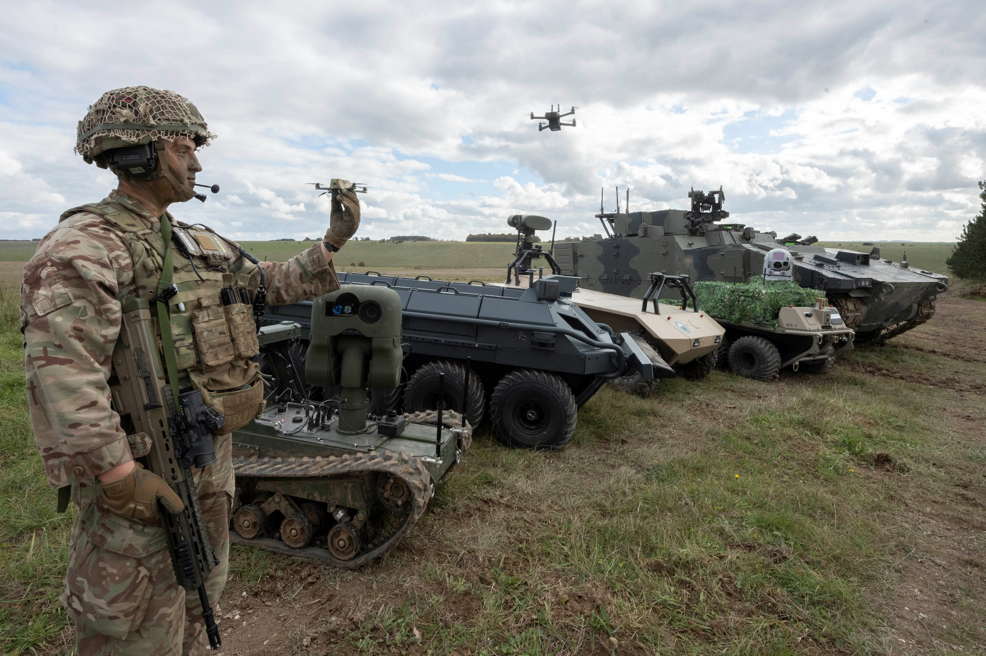
FCG Briefing
23 May 2022
Mission: Accelerating novel ways of working and technology into Operational Capability
* All information and comment is subject to contract
Notes:
TED TALK style slides.

Slide 2
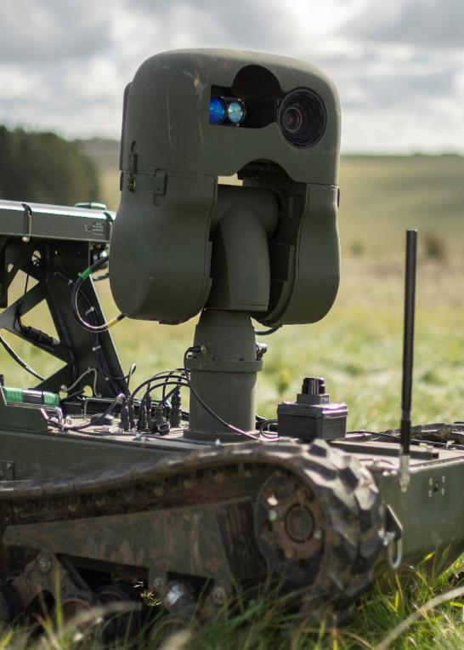
Mission: Accelerating novel ways of working and technology into Operational Capability
120 FTEs, ‘Cross-Functional’ teams.
Circa 50 Projects/Progs, circa £0.25bn last year
Front-Line Commands direct & fund (TRL 5-9)
Do not do research... accelerate capability to exploitation
90% of work started in DSTL, DASA, Innovation Hubs
Notes:
As it says on the tin

Slide 3
“Innovation is a team game”
(Roughly where FCG fit in)
Innovation Hubs & FLCs
Delivery Teams
E.g. RPAS, STSP, HELS, etc
Experiment
Explore
Exploit
Notes:
FCGs place in the innovation ecosystem, and the intent to Exploit technology, not more ‘innovation tourism’.

Slide 4
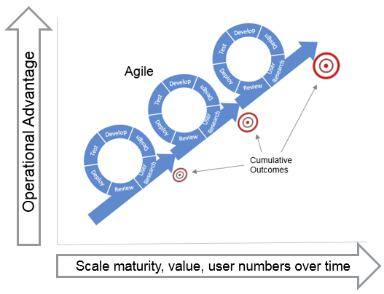
Agile Values & Principles
Speed to Value. You will need to keep up…..
Ruthless application of the Agile Values & Principles – Iterative delivery
Adoption of Modular Open System Architecture & Open APIs
Notes:
3 challenges Industry

Slide 5
Agile by Default: Optimisation
Industry
FCG
FLC
3 months
3 months
Transitional
Projects
Industry
FCG
FLC
Weeks
Days
Optimised
Programmes
/ Portfolios
Backlog
Hours

Slide 6
Category Management & Capability Portfolios
#1 Incubate #2 Iterate #3 Scale
MVP
Programme
of Record
Indicative only
TRL 1 – 5 TRL 6-7 TRL 8-9
Notes:
The sorts of commercial frameworks.

Slide 7
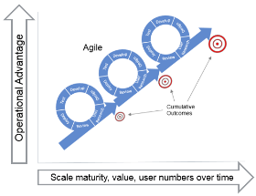
Mission Partner Model
FLC Customer (Users)
SRO
Customer Experts
(Intelligent Customer & Experimentation)
Mission Partner IDIQ
(4FTE HQ + Projects…20-60FTEs, + Equip purchases ££?)
PM / Eng / Finance / Commercial Team
Direct & Assure
P1
P2
P3
P4
P5
P# +

Slide 8
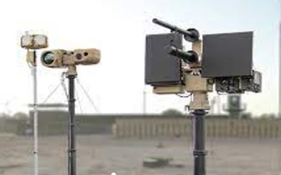
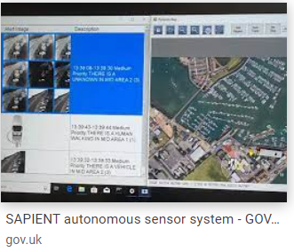
Agile Principles for One Defence:
How SYNERGIA / ORCUS worked iteratively
TBC Prog or Rec (X40)
SYNERGIA
77 C-UAS systems Globally
JESENS DT
C2 system for Sensors
Indicative only
TRL 1 – 5 TRL 6-7 TRL 8-9
Notes:
The sorts of commercial frameworks. Probably wont have time for this.

Slide 9
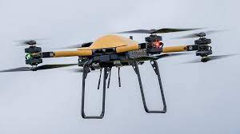
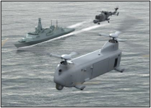
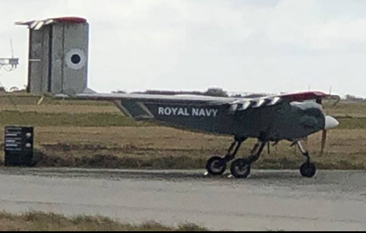
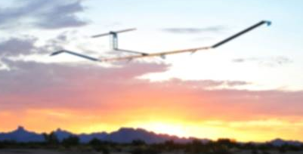
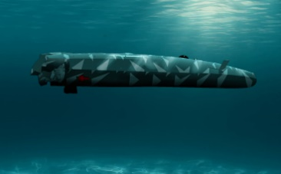
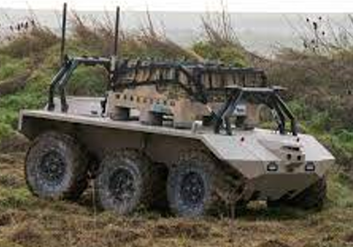
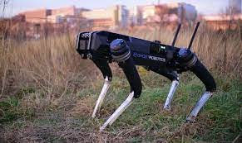
Expeditionary Robotics Centre of Expertise (ERCoE)
Experiment
Explore
Exploit
Nano-UAS
Medium-UAS
Large RW-UAS
Swarming-UAS
Logistics & others
High Alt UAS
UWV
UGV/RPV
Remote Ops
Advanced
HMI
Aligned with C-UAS
Notes:
The sorts of things we look at….depending on time at this point, I talk on what we are doing…..

Slide 10
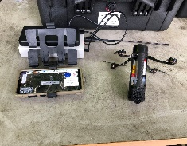
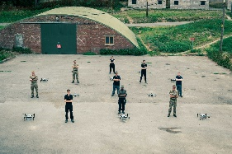
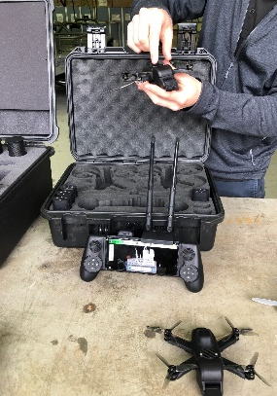
Nano/Small UAS: has blended UKR & MOD FLC needs
Lot1 Incubate Lot 2 Iterate Lot 3 Scale
£12m for Army & RAF
££££ Pending……
ISR mission
Swarming
Buying hundreds
for trails and use
Bought Thousands for war
Buying dozens for trials
Notes:
In this example (needs to be played in reading View or Slide mode) you will see how this framework has been used to scale from experiments, to more mature exploration and onto exploitation at scale.

Slide 11
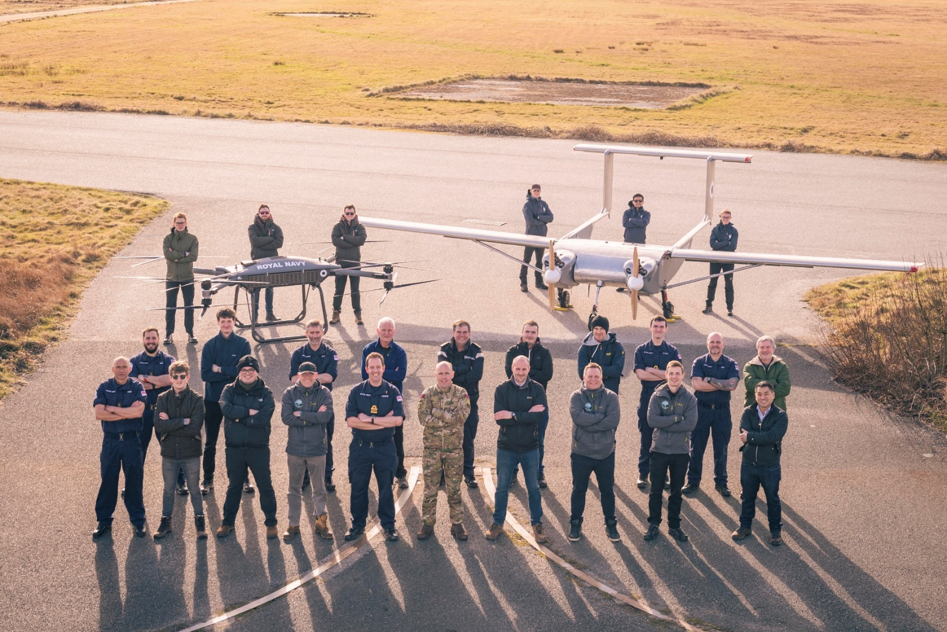
Heavy Lift Challenge- Iterative Journey
2021:
-Replace Helicopters on some missions
-50-300kg lift
OCTO / 700X / FMAF / DES joint working
“Mission Representative Flying” –
-Inter-theatre lift (mock Carrier landing)
-Intra-theatre lift (beach re-supply)
-Other Missions?
Address sub-system challenges
Routes to Mil Certification underway
Increasing RN/DES/MAA collaboration

Slide 12
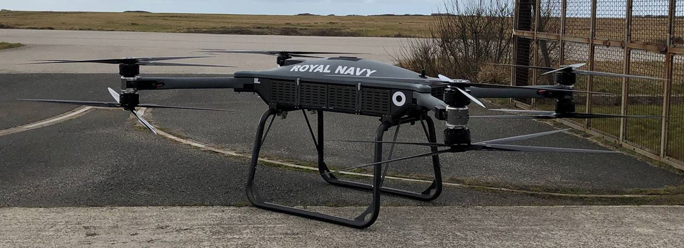
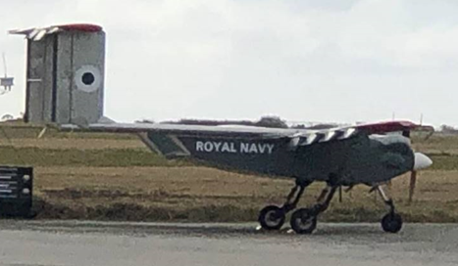
HLC: RAPSO - Rapid Agile Procurement Scale Operationalise
#1 Incubate #2 Iterate #3 Scale
NEW
NEW
Indicative only
TRL 1 – 5 TRL 6-7 TRL 8-9
Notes:
The sorts of commercial frameworks. Probably wont have time for this.

Slide 13
HLC3 – RNs OCTO/FMAF + other FLCs (?)
2 year plan of work across FY23/24, FY24/25
Iterating through challenges to Operationalise for the UK MOD
Platform Trials, Windracer, Malloy. Maybe other platforms
Simulated Deck Landing
Beach resupply
Capability & sub-system challenges:
Operating within GPS Denied Environment
Sense and avoid: Reduce the likelihood of air-to-air collision
Enhanced Power and Endurance
Long range early warning: multiple UAS platforms working together
Laser designators and more…………

Slide 14
HLC: Tech Focused ‘Lots’ of interest (50-300kg lift UAS)
Lot 1 – Intra Theatre Lift
Lot 2 – Inter Theatre Lift
Lot 3 – Additional Use cases
Lot 4 – Flight Clearances & Operational Deployment
Lot 5 – Enabling Technologies
Lot 6 – Counter UAS
Lot 7 – MVP/Operational
Notes:
After HLC2 considering where next for the platforms….but also will be looking at operationalising (step by step), and sub-system elements, to help mature to Operations.

Slide 15
MDIS Programme
Called:
‘Connectivity of Disparate Remote Autonomous Systems’
(CODRAS) in 6 Lots:
Lot 1: Autonomous platform and payload integration
Lot 2: Data management and fusion
Lot 3: Machine tasking and decision making
Lot 4: System of systems management, integration and implementation
Lot 5: Comms bearers, network architecture and services
Lot 6: Customer advisory network
Notes:
Update to follow

Slide 16
Requirements De-Risking
Pan-DLOD Capability Decisions
Strategic
Insights
Reach back
to industry
& Academia
Shaping & Informing Defence Thinking & Operating Models
* All information and comment is subject to contract
Notes:
Replaced Niteworks. Don’t have time to show lots of slides on the current and upcoming tasks.

Slide 19
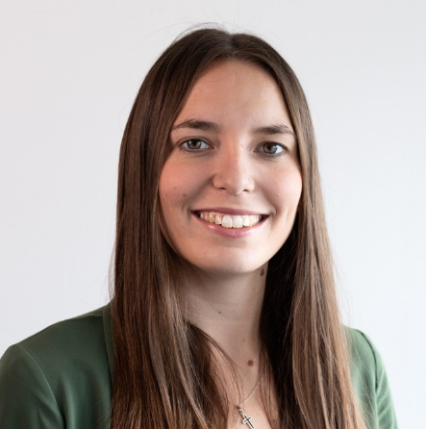
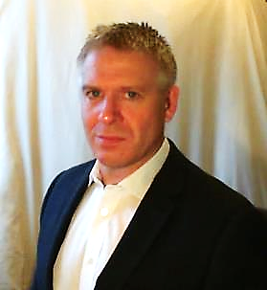
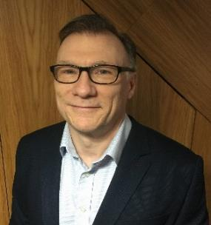
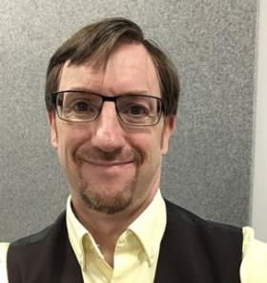
Join our Growing Network
Provider Network Primary Contact
Commercial | FsLabProcurement@qinetiq.com | AuroraProviderNetwork@qinetiq.com
Service Delivery Lead
Beth Fitzpatrick |  | bfitzpatrick@qinetiq.com
Command Leads
Alex Aitken - Navy |  | AAITKEN@qinetiq.com
Mike Bird - Strat Com |  | MBIRD2@qinetiq.com
Steve Rowley - Air |  | SRROWLEY@qinetiq.com
Francesca Riches - Land |  | fdriches@qinetiq.com
Sign up to our New Joiners Briefings
www.auroraengineeringpartnership.com

Slide 20
Key Acquisition points
Via Defence Sourcing Portal
HLC framework has re-opened Now
MDIS framework to re-open over coming few months
HMT framework to re-open over next few weeks
EVE @ SCALE Mission Partner: June-Sept (TBC?)
Get involved with Futures Labs (direct)

Slide 21
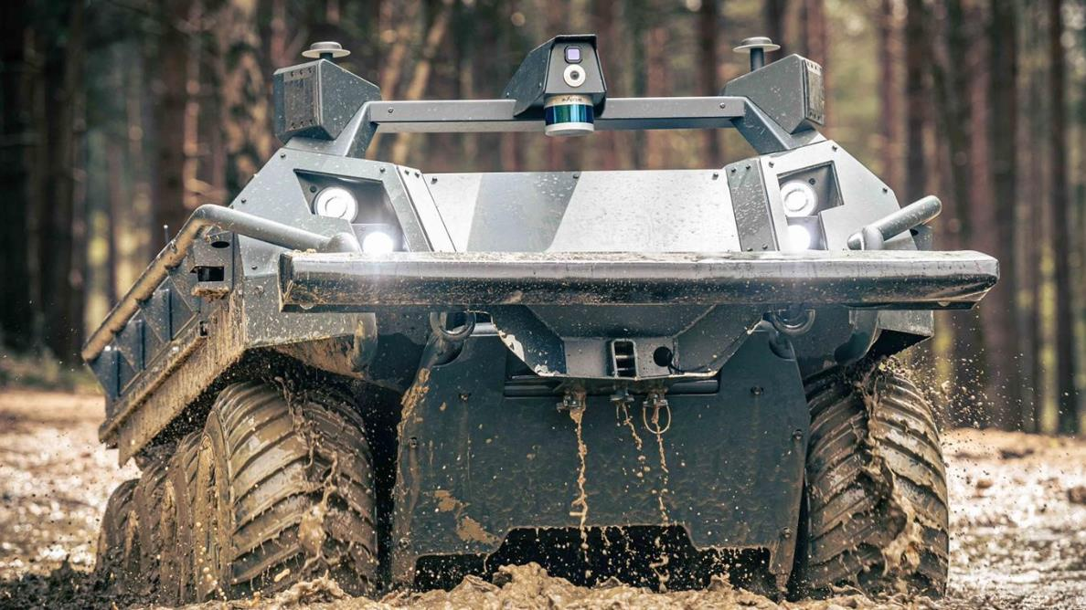
Questions?
Futures Labs:
FsLabProcurement@qinetiq.com
FCG email: (How to contact FCG)
DESEngSfty-FCGSMT@mod.gov.uk
* All information and comment is subject to contract

