Slide 1
Enhancing Your Operational Capabilities
Through Advanced Membrane Filtration
Thomas Welch, Global Strategy Marine and Defense

Slide 2
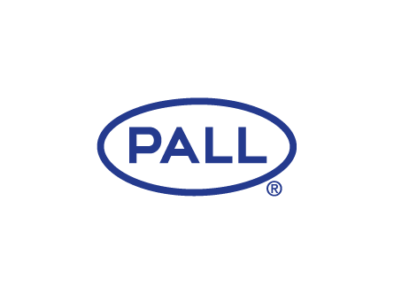
DO NOT DELETE - PLEASE READ:
This a master content deck. For each upcoming customer presentation, we recommend you add your own section to this deck then add any bespoke customer content to the new slides
DO NOT edit existing content without prior review with BU MarCom. Each existing slide is meant to be used or hidden/removed NOT edited
Always Save As PDF before sharing content outside the organisation
For support with additional slides or similar full presentation decks please email BU MarCom :: Maya Dumitru min 72h in advance of your customer meeting (1 week preferred)

Slide 3
Agenda
Pall Marine Solutions
Freshwater Generation Systems Overview
Conventional Reverse Osmosis Vs Membrane Filtration Reverse Osmosis
Advanced Membrane Filtration
Performance Case Studies
Conventional Fuel Filtration vs Cross Flow Membrane Filtration
System Trial Performance
Notes:
In terms of the agenda, I’m going to give a run through on who Pall are, what we do in the Marine sector and then provide a slightly deeper dive into looking at our technologies related to water and our newer concepts in fuel filtration onboard surface ships.

Slide 4
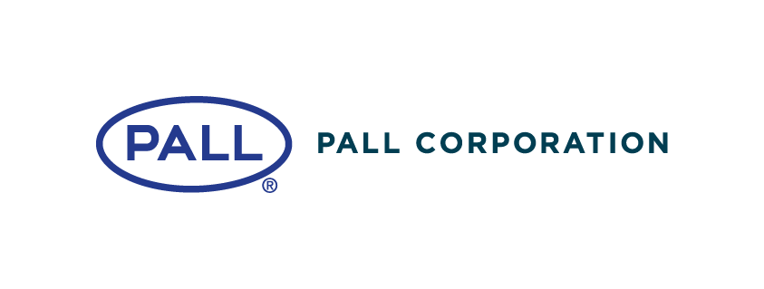
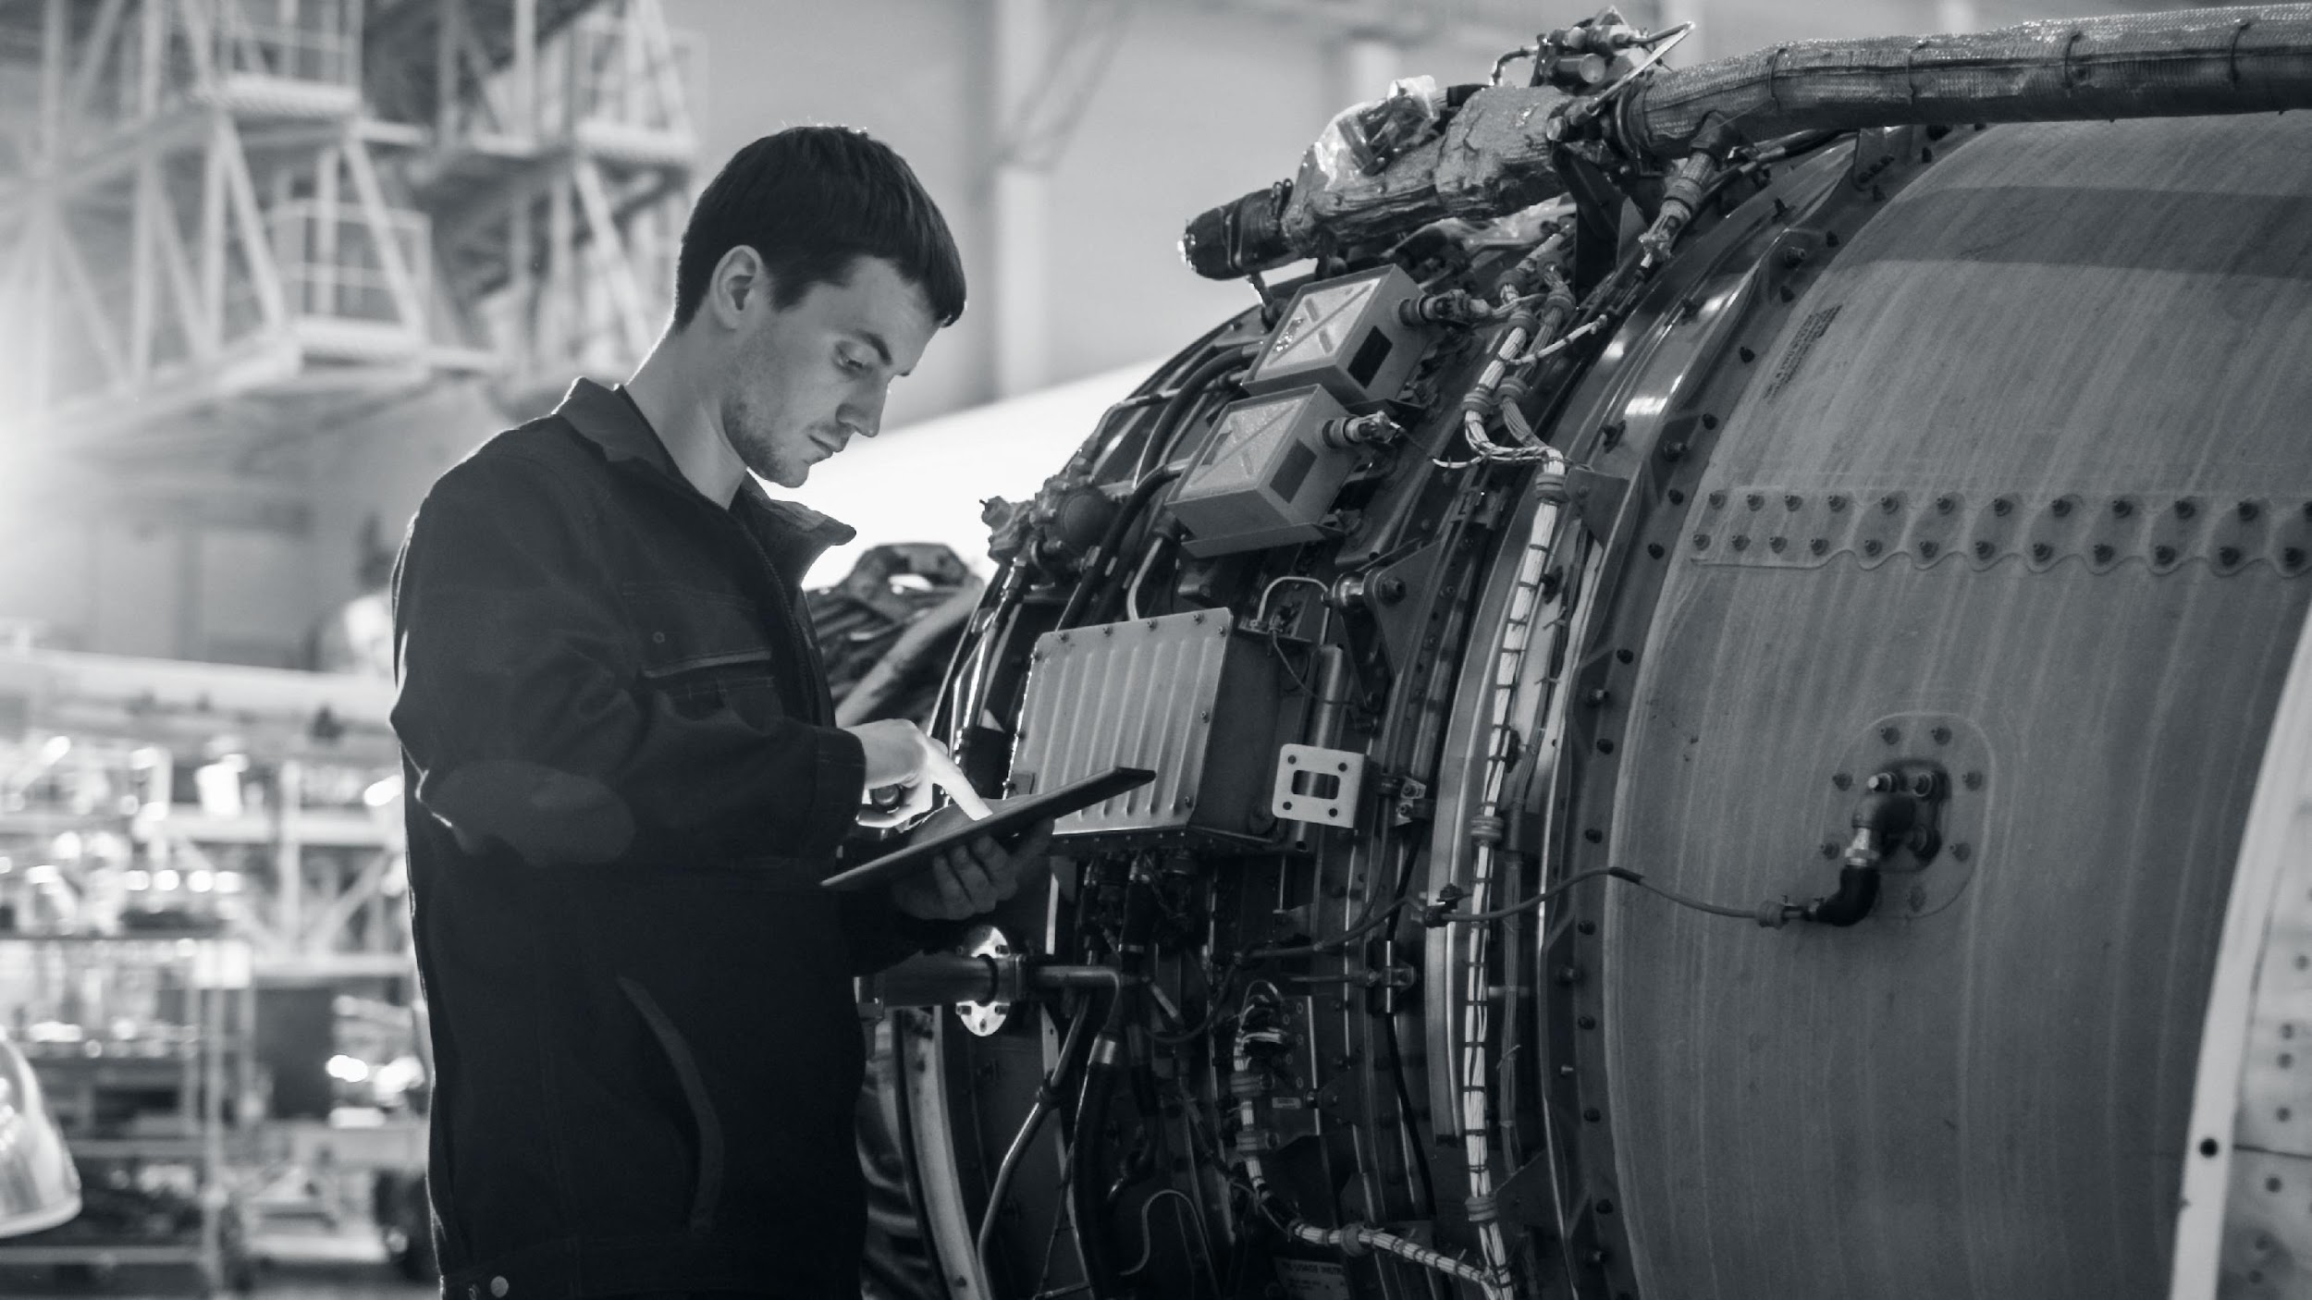
About Pall
Global provider of filtration and separation science that enables cutting edge technology
Deep customer application knowledge
World-class engineering capability
Worldwide reach, with local technical support
Delivering innovative process solutions to solve the most complex challenges across a range of industries from aerospace, microelectronics and food and beverage to petrochemical and power generation
‹#›

Slide 5
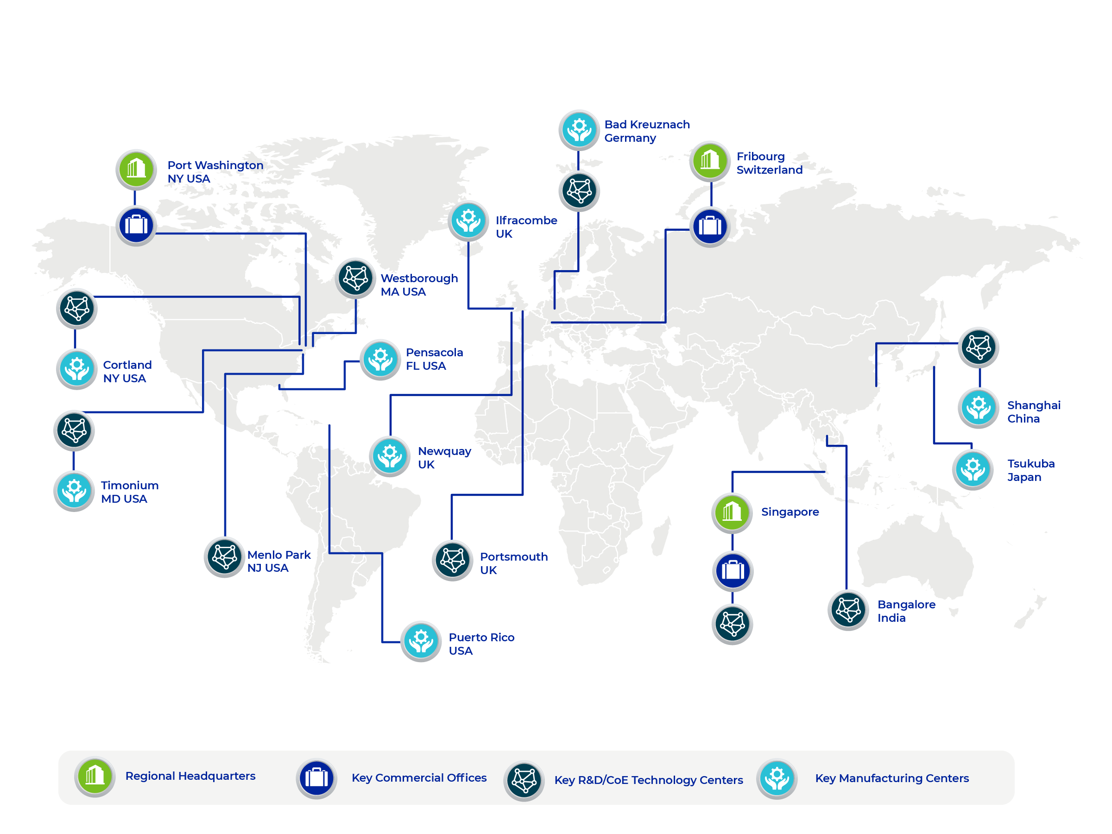
Global Footprint
Redruth
UK
Pall Footprint Global presence | Local support
DeLand
FL USA
New Port Richey
FL USA
‹#›
Notes:
So just a quick brief on who Pall are for those that don’t know, Pall are a global provider of filtration and separation devices to multiple different industries. We have 80 locations across 30 countries, and we’ve been manufacturing filtration solutions for over 75 years. We have a global presence, so wherever you’re operating, we’ll be able to support you.

Slide 6
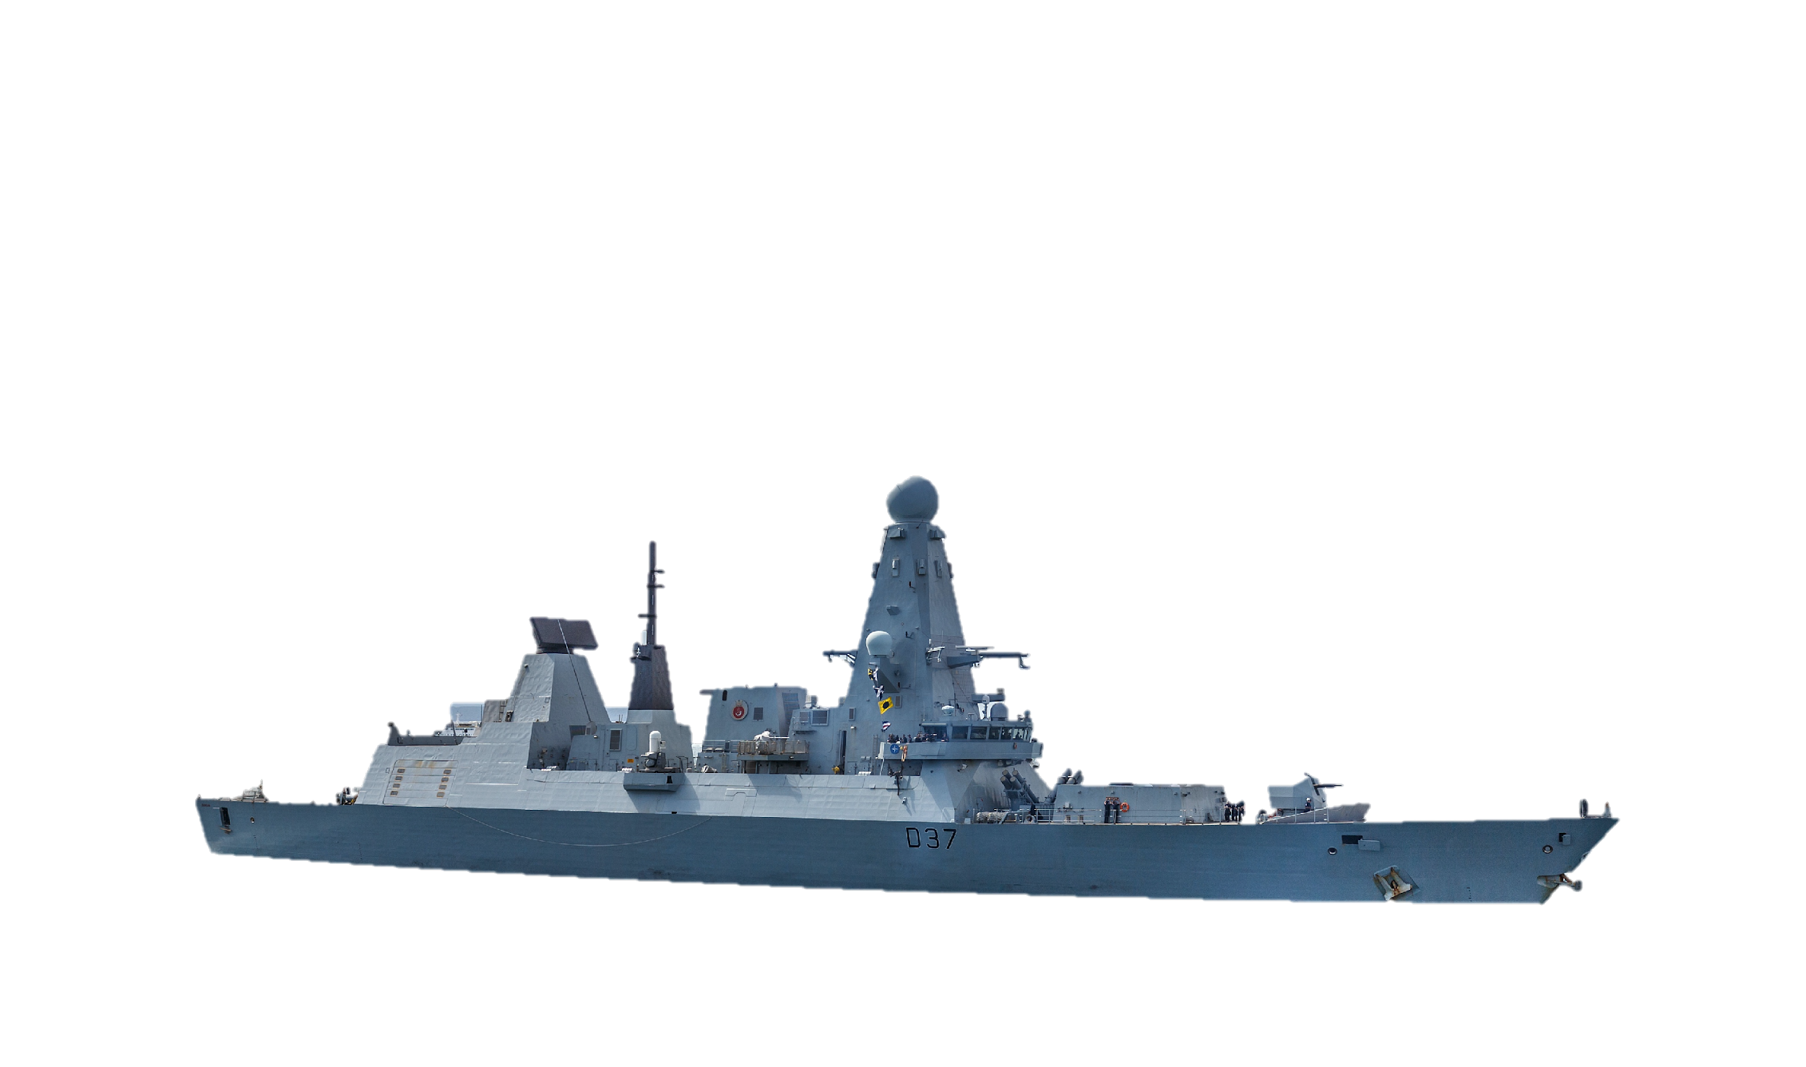
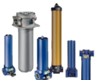
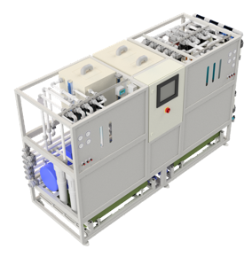
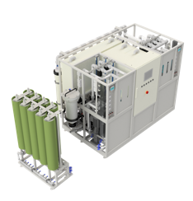
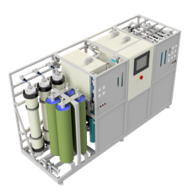
Marine Solutions
Hydraulic System Filtration Manifolds and Assemblies
Fresh Water Generation and Membrane Filtration Reverse Osmosis Systems
Engine and Drive Transmission Assemblies
Bulk Fuel Filter Assemblies and Manifolds
Diagnostic and Monitoring Systems
Engine Lube Filter Elements and Assemblies
Fuel System Filter Elements and Assemblies
Notes:
Our standard product range covers all aspects of fine filtration needed onboard, from fluid diagnostics equipment and sensors, to consumable hydraulic, fuel oil and lube filters.
But, we’re going to take you through some of our more cutting-edge, non-standard product offerings that we really feel could have an operational impact to you and your vessels in the future.

Slide 7
Fresh Water Systems
MFRO Freshwater Generators
Notes:
Firstly let me talk you through fresh water systems. Most modern naval vessels are designed to ensure that each crew member has 150 litres of fresh drinking water made available to them per day while onboard. Systems that produce water onboard for the crew also need to provide additional technical water to be used for weapons and engine cooling, galleys and for general cleaning duties. The one clear expectation is that water is available on tap at anytime.

Slide 8
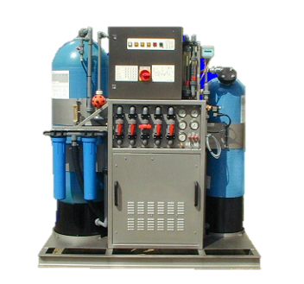
Conventional Reverse Osmosis Systems:
Depending on water quality, conventional pre-filtration solutions (in most cases), utilise a sand filter and cartridge filter to reach the required limits of freshwater system.
The lower the quality of the feedwater, the more ineffective and expensive conventional systems are in the long term.
Other Challenges:
Mission profiles close to shore
Available space onboard and weight requirements
High life cycle costs for service and maintenance:
System downtime
Personnel and Labour costs
Cost for replacement parts
High chemical cleaning requirements
Consistent freshwater quality and production can only be guaranteed while in open sea - NOT in coastal waters, littoral areas, canals / rivers, ports and harbours.
Notes:
So, You’ll all likely have conventional Reverse Osmosis systems onboard such as the Pall plant here, we’ve sold over 2,500 of these, many of which are in-service with NATO users today.
To produce potable water onboard Reverse Osmosis systems need to provide two stages of treatment:
First they must treat the suspended solids or contaminant present in the feed water, which is taken care of by the pre-treatment system and is conventionally carried out by passing feedwater through sand and cartridge filters.
Then you must treat the dissolved contaminants, such as salt, which is removed by the process of Reverse Osmosis and the Reverse Osmosis membranes.
The success of any RO system is solely dependant on the success and efficiency of the pre-treatment system, identified in red on this slide.
Conventional pre-treatment systems are only able to handle low amounts of suspended solids in feedwater before the filtration in place needs changing out, the lower the quality of the feedwater, the more ineffective and expensive RO systems become as filter changeout becomes more frequent. In general conventional systems have high life cycle costs and high demands for routine maintenance.
To avoid high running costs and maximise reliability operators need to be selective in where they are running RO Systems, typically fresh water production can only be guaranteed while plants are operated in open sea conditions, where the water is relatively free from particulate and suspended solids. This means that you can’t run an RO plant alongside, close to shore, in harbours or the littoral zone without quickly damaging your pre-treatment systems and fouling your RO membranes with dirt.
Ultimately there are limits

Slide 9
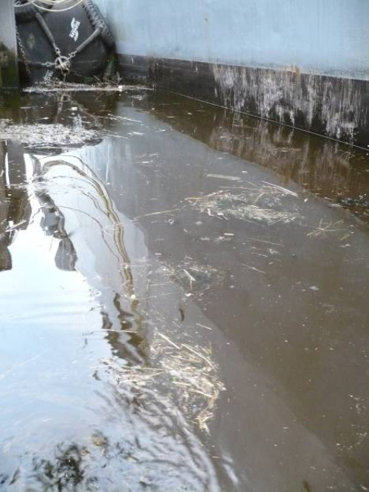
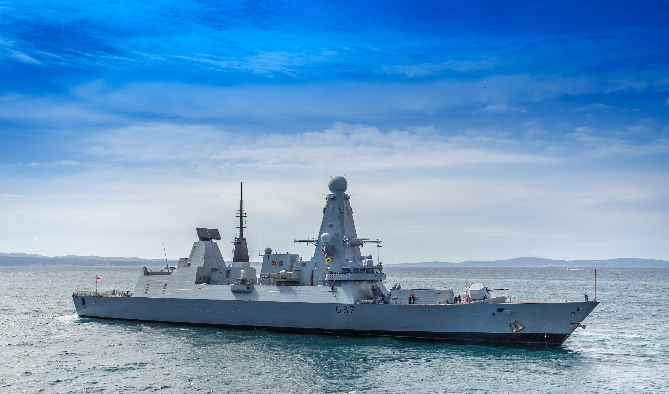
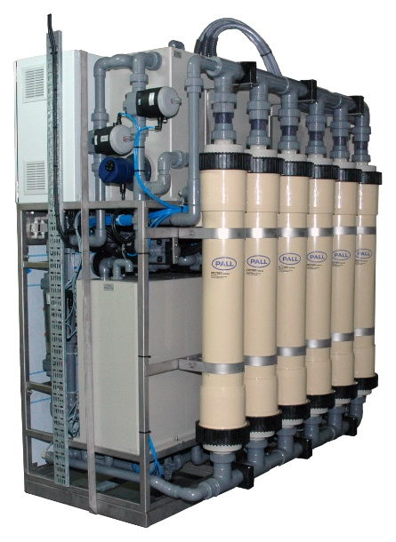
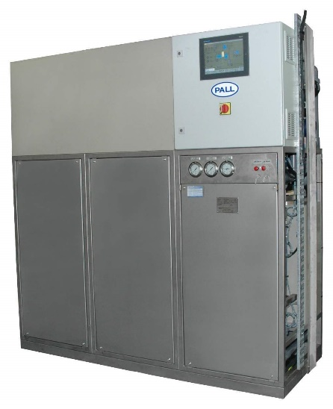
Make Water Anywhere Capability With Pall MFROs (Membrane Filtration Reverse Osmosis Systems)
IMG: Snapshot of actual water quality during a Pall membrane filtration system trial
Notes:
Globally we know there is an increased demand for vessels to be able to operate close to shore for extended periods of time. If conventional RO systems cannot operate in these areas, the only way to have availability of potable water onboard is to bunker it in large quantities. Which brings about it’s own cost, weight and logistical burdens.
To combat these issues Pall developed the RO systems with enhanced pre-filtration. These systems allow operators to make water anywhere, without the constraints seen by conventional RO systems. This means systems can be run in harbour, littoral areas, rivers, estuaries and areas with a high silt density index where conventional systems are unable to do so.
HMS Daring shown on the right hand side here, has been equipped with Pall Membrane Filtration Reverse Osmosis systems since 2012. When first installed the plants were run through multiple trials to test their performance. The MFRO plants were run continuously through transits in the Suez and while alongside in Mumbai Harbour, areas where conventional systems cannot be run. Here the plant was able to produce water throughout the whole operation for the entire ship’s company without the need to bunker water at any point or to go onto water rationing.
We also know that port water quality can vary from location to location and may not necessarily be able to be sourced if local infrastructure is not available or you are in a conflict zone, with these systems you are not reliant on having to further treat bunkered water, and you can guarantee the quality that your fresh water systems can produce from any source. This has proven particularly important for naval forces when they are supporting disaster and humanitarian relief efforts, as the vessels have been able to provide drinking water for locals when their infrastructure isn’t available. The image on the far left shows us some of the actual water quality the system was able to handle during these exercises, which is on first inspection about as poor as it comes.
The benefit of having such a system means operators no longer have a necessity to move away from their theatre of operations to generate fresh water, and they no longer have a dependency on bunkering water from port.
The MF systems are designed to be self-cleaning and fully regenerable, minimising maintenance activities and through life costs. When compared to a conventional system producing between 15-30 cubic metres of water per day, the maintenance time required on an MFRO system is reduced by 80% on average. This means you can free up approximately 30 minutes of operator time per day per system on maintenance and system checking duties. There are other knock on impacts to plant performance as well, increased pre-filtration means extended life of other system components such as the RO modules. Which on a standard system would have a changeout rate of 12-18 months, now we are seeing figures in the 3-5 year range.

Slide 10
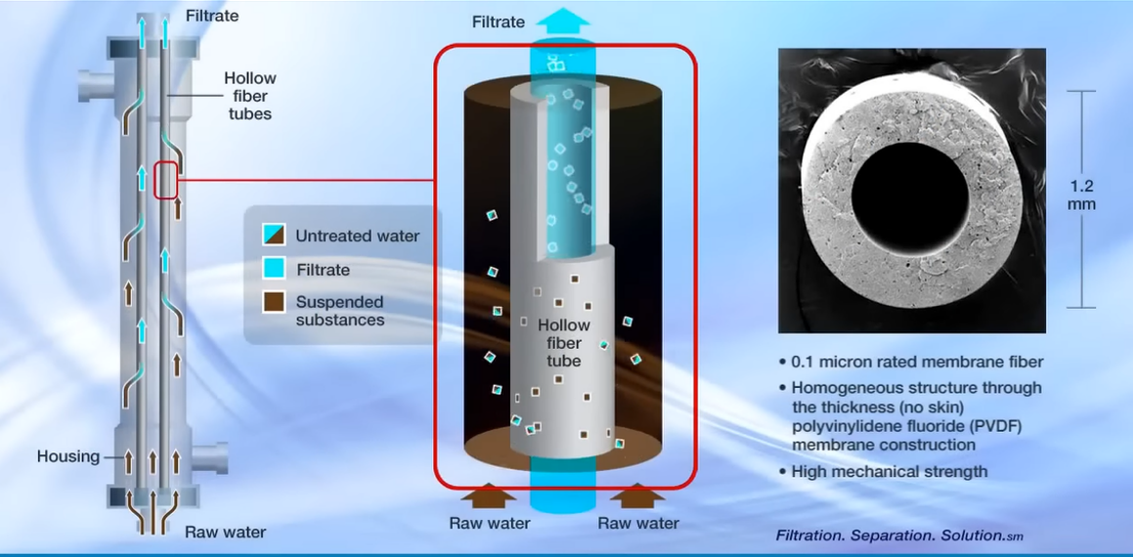
Pall Advanced Membrane Pre-Filtration
© 2023 Pall Corporation
Notes:
https://www.youtube.com/watch?v=ONrV1pZuA8M
So how does the technology work:
A typical Membrane Pre-Filter is made of up to 6,000 hollow fibres, about 1.2mm in diameter as shown on the right hand side image. These are made up of a high strength thermoplastic material, that is oxidant resistant, highly permeable and is able to remove all suspended solids in the feedwater. This includes the removal of particulate and sediment, micro organisms, algae, bacteria and viruses including Legionella’s and E-Coli.
Raw water enters the base of the filter housing and the particulate and suspended substances are collected on the outside of the hollow fibres, only clean filtrate water passes through the fibres into a holding tank to then be supplied to the Reverse Osmosis plant.
At specified pre-programmed intervals the modules are mechanically cleaned via an automated process, where air is injected at the base of the module agitating any suspended substances caught on the outer skin of the fibres. Clean water is then injected into the modules to flush out the suspended solids and washed away as system waste.
This means that the modules are fully regenerable, hugely decreasing the need to carry any spare replaceable filter cartridges and eliminating the need for manual operator intervention. Typically over 90% of all hollow fibre pre-filtration membranes are still in operation after an 8 year service life in water applications, this is only shortened slightly for fuel based applications that we will come onto later.

Slide 11
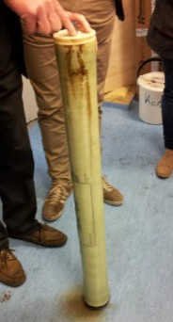
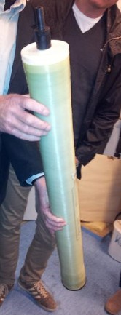
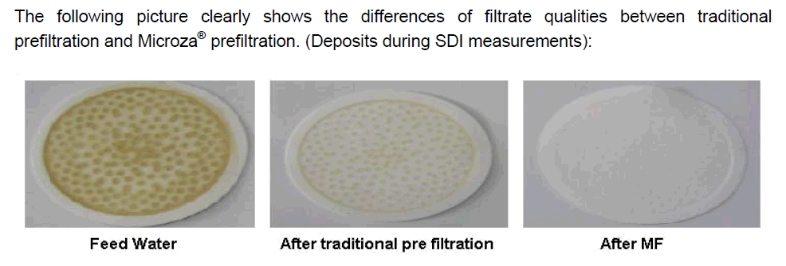
Consequences of Inadequate Pre-Filtration
Excerpt from a test report on Pall MFRO: “The Pall membrane pre-filtration system connected to the RO system has been running for three years without any problems, the RO Modules are receiving a particulate free feedwater… the system has operated fully automatically so that the production of drinking water has been guaranteed even during the backwashing process*.” *Military EU NATO Member
The following image illustrates the effect of MF filtration (test filter after SDI measurement)
Feed Water
Conventional pre-filtration
After Pall MF
RO membrane with conventional pre-filtration
Clean RO element after Pall MF pre-treatment
Notes:
So what does this mean in practice?
Pall ran system trials with a conventional RO system and a Pall MF side by side, the left hand image shows the dirt and fouling to the RO membrane and the right hand side shows a clear membrane after MF pre-filtration.
When looking at the filtrate qualities under analysis you can also see the difference clearer in terms of contamination. Visually it’s quite a telling picture of the performance benefits.
I’ve also included a brief bit of customer feedback, showing that their RO Modules have been running for three years without any problem, which a testament to the performance of the pre-filtration.

Slide 12
Performance Trials MFRO Vs RO
Parameters Tested | MFRO Plant | RO Plant
Cartridge Filter Usage | 20 | 80
Bag Filter Usage | 0 | 50
Chemical Cleaner (Litres) | 70 | 125
Average Fresh Water Quality | 500μ | 850μ
Average Fresh Water Production | 1.6m^{3/}hr | 1.1m^{3/}hr
Maximum Production | 1.75m^{3/}hr | 1.5m^{3/}hr
Run in Littoral Zone / Alongside | Yes | No
“In comparison to the other RO Plants fitted, it outperforms them in all areas”
Notes:
In terms of data, performance trials were also carried out while an MF system was run alongside and the standard RO was run in open sea conditions to give a comparison.
The results showed a 75% reduction in consumable and chemical usage, a 52% increase in average fresh water quality, and a 45% increase in water production rate of the MF plant over the standard system.
The end user feedback went on to note:
Operating alone, the plant sustained the Ship’s Company water consumption throughout the Suez transit and time alongside India and there was no need to ration water, unlike previous operating experience still evident in some of our ships. In comparison to the other RO Plants fitted, it outperforms them in all areas. Ships Staff are very encouraged by both its performance and high level of availability.
“The MFRO system is a fantastic evolution in fresh water tech. As shown by the humanitarian assistance provided following a hurricane in the Philippines, it is a true ‘make water anywhere’ solution, and should set the standard for all future water generating installations. […] if I had my way we would have this unit fitted to every ship in the fleet!”

Slide 13
Fuel Filtration
Pall Hollow Fiber Membranes
Notes:
Now I’m going to touch on our application of the same technologies for water in fuel, and how we are hoping to use this advanced pre-filtration to reduce the complexity and size of your fuel systems while maximising performance.
As part of Pall Marine we’re aiming to introduce this new technology to the Marine market.

Slide 14
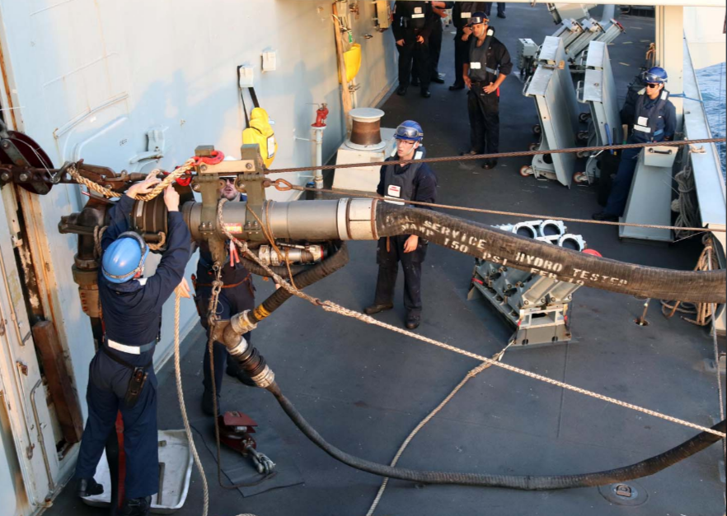
Conventional Fuel Filtration Systems:
Conventional fuel filtration setups operate around 4 stages of filtration: A pump transmits fuel to a separator system, centrifuge then to separate water from fuel, clarifier or purifier to separate particulate from fuel. A pre-filter to take particulate that has passed earlier stages and a final coalescer to elimante further water.
Challenges:
Maintenance heavy systems
High energy to run
High weight and volume
Major services common after 4,000hrs
Not effective at removing fine water and particulate
High consumable usage & maintenance burden
Notes:
Conventional fuel cleaning setups operate around 4 stages of filtration, first a centrifuge is used to separate the water from fuel, then a clarifier or purifier is used to separate particulate from fuel, a pre-filter then eliminates any particulate that has been able to pass through these stages and then finally an additional coalescer is used to get down any further water present in the fuel.
Commonly these conventional systems are maintenance heavy. Centrifugal systems require high amounts of energy to run, they have considerable moving parts which are susceptible to wear and they require major servicing every 4,000 hours. They are also limited in how much fine particulate they can eliminate from fuel, and fine filtration is also passed onto in-line consumable filters and coalescers. Ultimately high levels of maintenance and investment are needed to keep your fuel clean onboard.
Your fuel systems are obviously reliant on the quality of fuel they receive at the front end, even if bunkered fuel meets set ISO quality standards on initial delivery, it can quickly deteriorate over time.

Slide 15
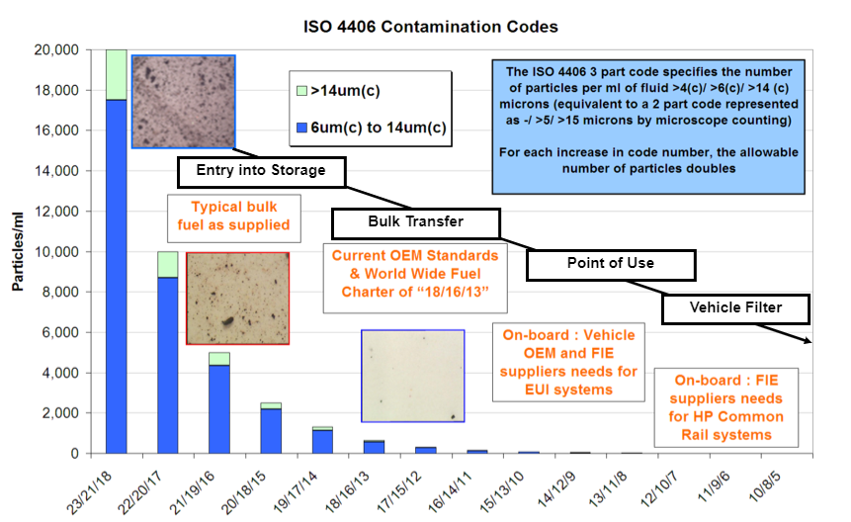
Conventional Fuel Filtration and Supply:
Fuel System Contamination:
Multiple entry points for contaminants from refinery to point of use
Common points of contamination are at transfer and storage:
Water ingress
Environmental dust/particulate
Corrosion
Biological Growth
Challenges
High Pressure Common Rail (HPCR) Diesel Injection systems very susceptible to particulate and catalytic fines
Fuel passes injectors at 1,500mph
Notes:
So just like bunkered water, operators do not have the luxury of selecting the fuel quality they are getting from location to location.
When you’re operating remotely you have to deal with what your given and your vessel needs to be fitted with the correct equipment to handle whatever fuel you’re going to receive
There are multiple ways in which fuel is contaminated, and this contamination commonly occurs during transfer and storage.
The most common contamination is due to water, followed by particulate, corrosion and biological growth. The chart on the left shows the different levels of contamination seen across the spectrum from fuel supply to point of use onboard.
Modern high pressure common rail diesel injection systems are very reliant on receiving fuel that is free from particulate or water.
As fuel velocity is so high through the injectors, any particulate in the fuel stream that passes will very quickly cause erosion and injector damage. Any hard contaminant can cause damage, and unlike your skin, these scratches will not repair. In fact, for every micron of wear on the injector, you can lose 10 Bar in fuel pressure.
Wear on the injector causes onward impacts to spray pattern, which in turn will impact your combustion efficiency. A deviation of just two degrees in spray pattern from optimum injection levels will result in a measurable increase in smoke and fuel consumption. Incorrect spray pattern can also mean cylinder walls are not correctly lubricated, leading to early fatigue and power loss.

Slide 16
Fuel Contamination Overview:
Contaminant | Source | Effect
Particulate / Sediment | Environment Rust, scale, oxidation Fuel instability Transportation process | Erosive wear Nozzle failure Deposits Plugged filters / orifices
Water | Condensation Heating / cooling leaks Transportation | Corrosion Sludge Microbial growth
Microbial Growth | Water in storage tanks Transportation | Slime / gel formation Plugged filters / orifices
Trace Metals- Na, K | Crude fuel contamination Transportation Heating / cooling leaks | Deposits Turbine blade corrosion Engine corrosion
Organic Compounds | Fuel degradation | Deposits Smoke Plugged filters / orifices
Notes:
So above we can see all the contaminants that your fuel filtration system can be faced with, the common source for these contaminants and the impact these can have on your vessel.
The yellow highlighted source contaminants can all be present and impact your fuel cleanliness when onboard.

Slide 17
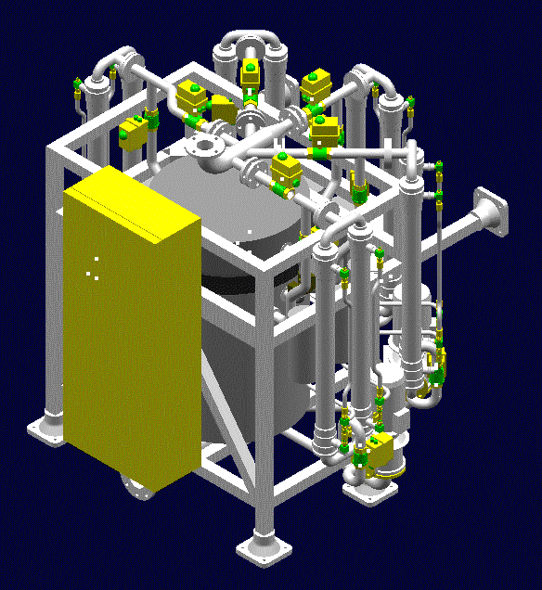
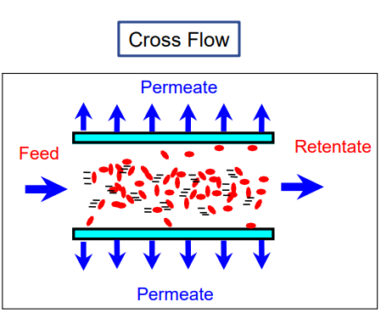
Pall Cross Flow Fuel Membrane Filtration 1/3:
What is Cross Flow Filtration?
Cross flow filtration involves flowing the fluid to be filtered across a membrane at pressure and then returning the bulk of the fluid and all the contaminant to the supply tank.
A portion of the inlet flow permeates through and exits the membrane as clean fluid.
Service Tank
Double Bottomed Tank
Concentrated contaminant
Cross Flow Filter System
Our filter module uses a series of polymeric tubes bonded into a housing. The dirty fuel flows down the tubes and is returned to tank.
The permeate is filtered to 0.4 micron and flows to the daily service tank.
MEMBRANE
Notes:
We believe that conventional fuel treatment systems as described on the previous slides are not the most cost efficient or compact solution available to operators, and we have looked to develop a system that functions using the same membrane filtration media as our MFRO systems, to separate contaminant from fuel.
So what sets these apart from conventional setups, Pall cross flow units are smaller in size, have
These systems work by holding transferred fuel in a double bottomed tank, feed fuel is then pumped through a hollow fibre membrane at pressure where via the process of cross flow filtration clean fuel permeates through the membrane layer, and is passed onto the service tank. Contaminated fuel then passes back to the retentate tank to be filtered again in a constant loop.
On the right-hand side you can see a system designed for a NATO Destroyer. This design is 30% under the specification weight of a conventional treatment system and 40% under the specification volume. This system contains 5 pairs of twin modules, each of which can be switched on or off line as the demand for fuel dictates. As the PLC takes each twin module offline, they are automatically cleaned to ensure they are in optimal condition for when they are next brought online.

Slide 18
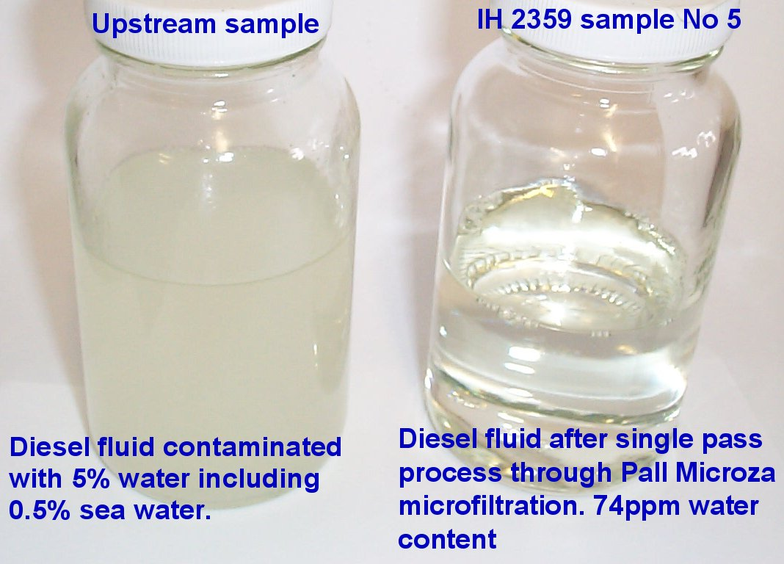
Pall Cross Flow Fuel Membrane Filtration 2/3:
Performance Trials:
With one pass the system removed sample of fuel with 5% water ingression (10% seawater 90% fresh water)
Original fuel spec was 62ppm and filtrate was 70ppm
No need for fine particle prefiltration or system upkeep & carriable spares
Notes:
These concept designs have been prototyped into functional systems by Pall at our R&D facilities and have been specifically designed to meet the requirements onboard military vessels.
Unlike conventional systems the Cross Flow Fuel unit is able to handle both particulate and water contaminant. There is no need for separate centrifuges to handle particulate and water which reduces initial cost and alike the pre-filtration for our water systems these are fully autonomous and regenerable reducing maintenance and operator burdens.
Our R&D Teams have run trials of these systems to prove their efficiencies, when challenged with diesel fuel with water ingression of 5%, made up of 10% sea water and 90% fresh water, with one pass through the system were able to bring fuel back to a contamination level of 70 parts per million, compared to the original 62 from source.
There was also no need for fine particle prefiltration to protect the module, which will help reduce running costs.

Slide 19
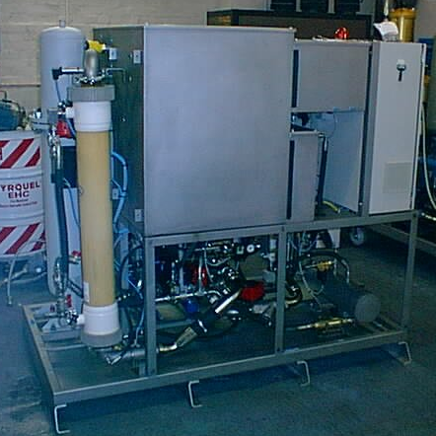
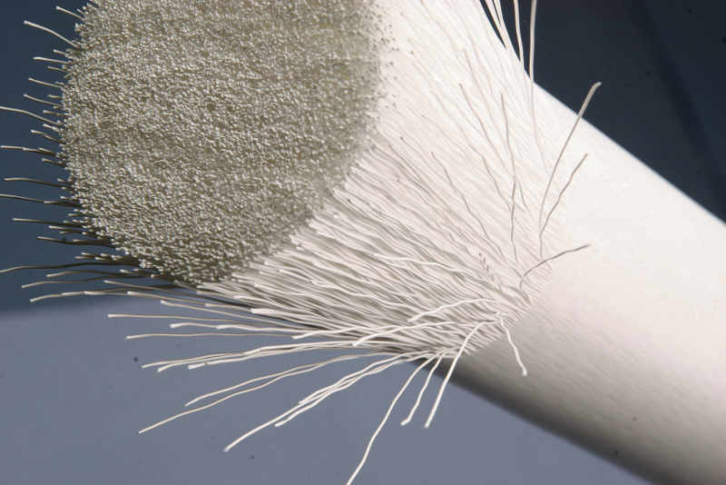
Pall Cross Flow Fuel Membrane Filtration 3/3
Benefits:
High technology readiness
Designed specifically for Naval applications
Handle particulate and water separation as one system
Less moving parts
Fully autonomous and regenerable
Lower power / energy usage
Designed to function with existing infrastructure
Modular for easy retrofit
Lower CAPEX in comparison to conventional systems
Significantly longer filter life due to self cleaning membranes
Up to 50% lower in maintenance demands
Optimised for HPCR Injection systems
Notes:
So just to run you through, the opening benefit is that this is a proven concept that can be adapted as a modular design to be retrofitted onboard your existing fleet. Or that it can be designed into a new build vessel, in a considerably smaller space envelope than you would have to specify for a conventional fuel system setup.
Our concept has been specifically developed to meet the requirements of naval users, capable of meeting 15G shock loads above the vibration dampeners. Unlike the conventional systems requiring both a purifier and a clarifier, the cross flow unit is able to tackle the removal of both fine particulate and water from just one system. Meaning it’s lower in initial cost, and it’s lower in terms of it’s energy consumption. Alike the water systems, one of the main benefits is it’s fully regenerable nature, and the lack of need for consistent consumable filter changeouts.
With a growing demand to increase sustainability, cut emissions and reduce weight these benefits all are easily recognisable.
Whilst this is still in it’s prototype phase, we believe this would significantly improve the current problems faced from fuel contamination within the marine Industry and it would be great to hear from anyone here today who feels this may give you an operational advantage in the future.

Slide 20
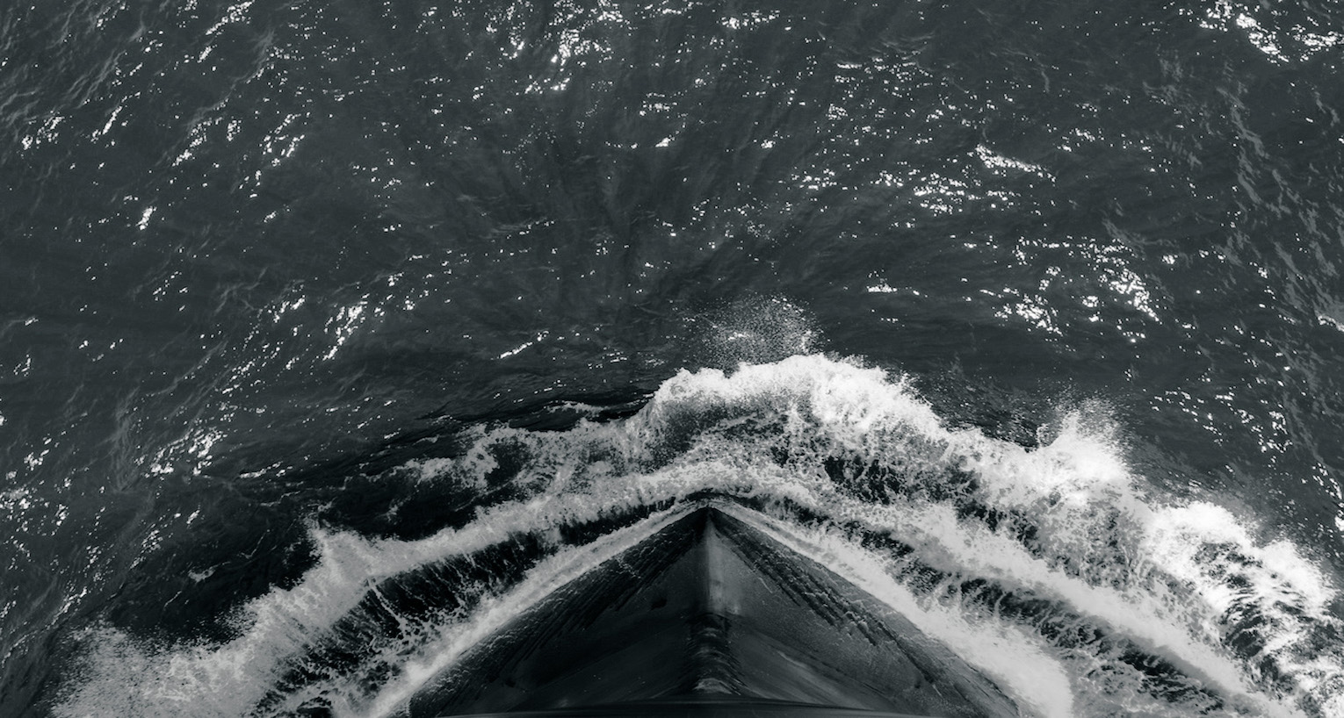
Key Takeaways
Enhanced Membrane Filtration gives greater operational freedom
Lowers through life cost
Lowers maintenance and minimises system downtime
Minimises logistical burden
Reduces your weight and maximises space
Fully autonomous and regenerable
Guaranteed output with variable inputs for both fuel and water
Established technologies but not necessarily known in the marine sector
© 2023 Pall Corporation
Notes:
PALL protect many assets on rotorcraft platforms.
Range of products include Engine lubrication and fuel filtration, transmission filtration, hydraulic systems and Engine air inlet

Slide 21
THANK YOU
Visit: aerospace.pall.com Email: aerospace@pall.com

