Slide 1
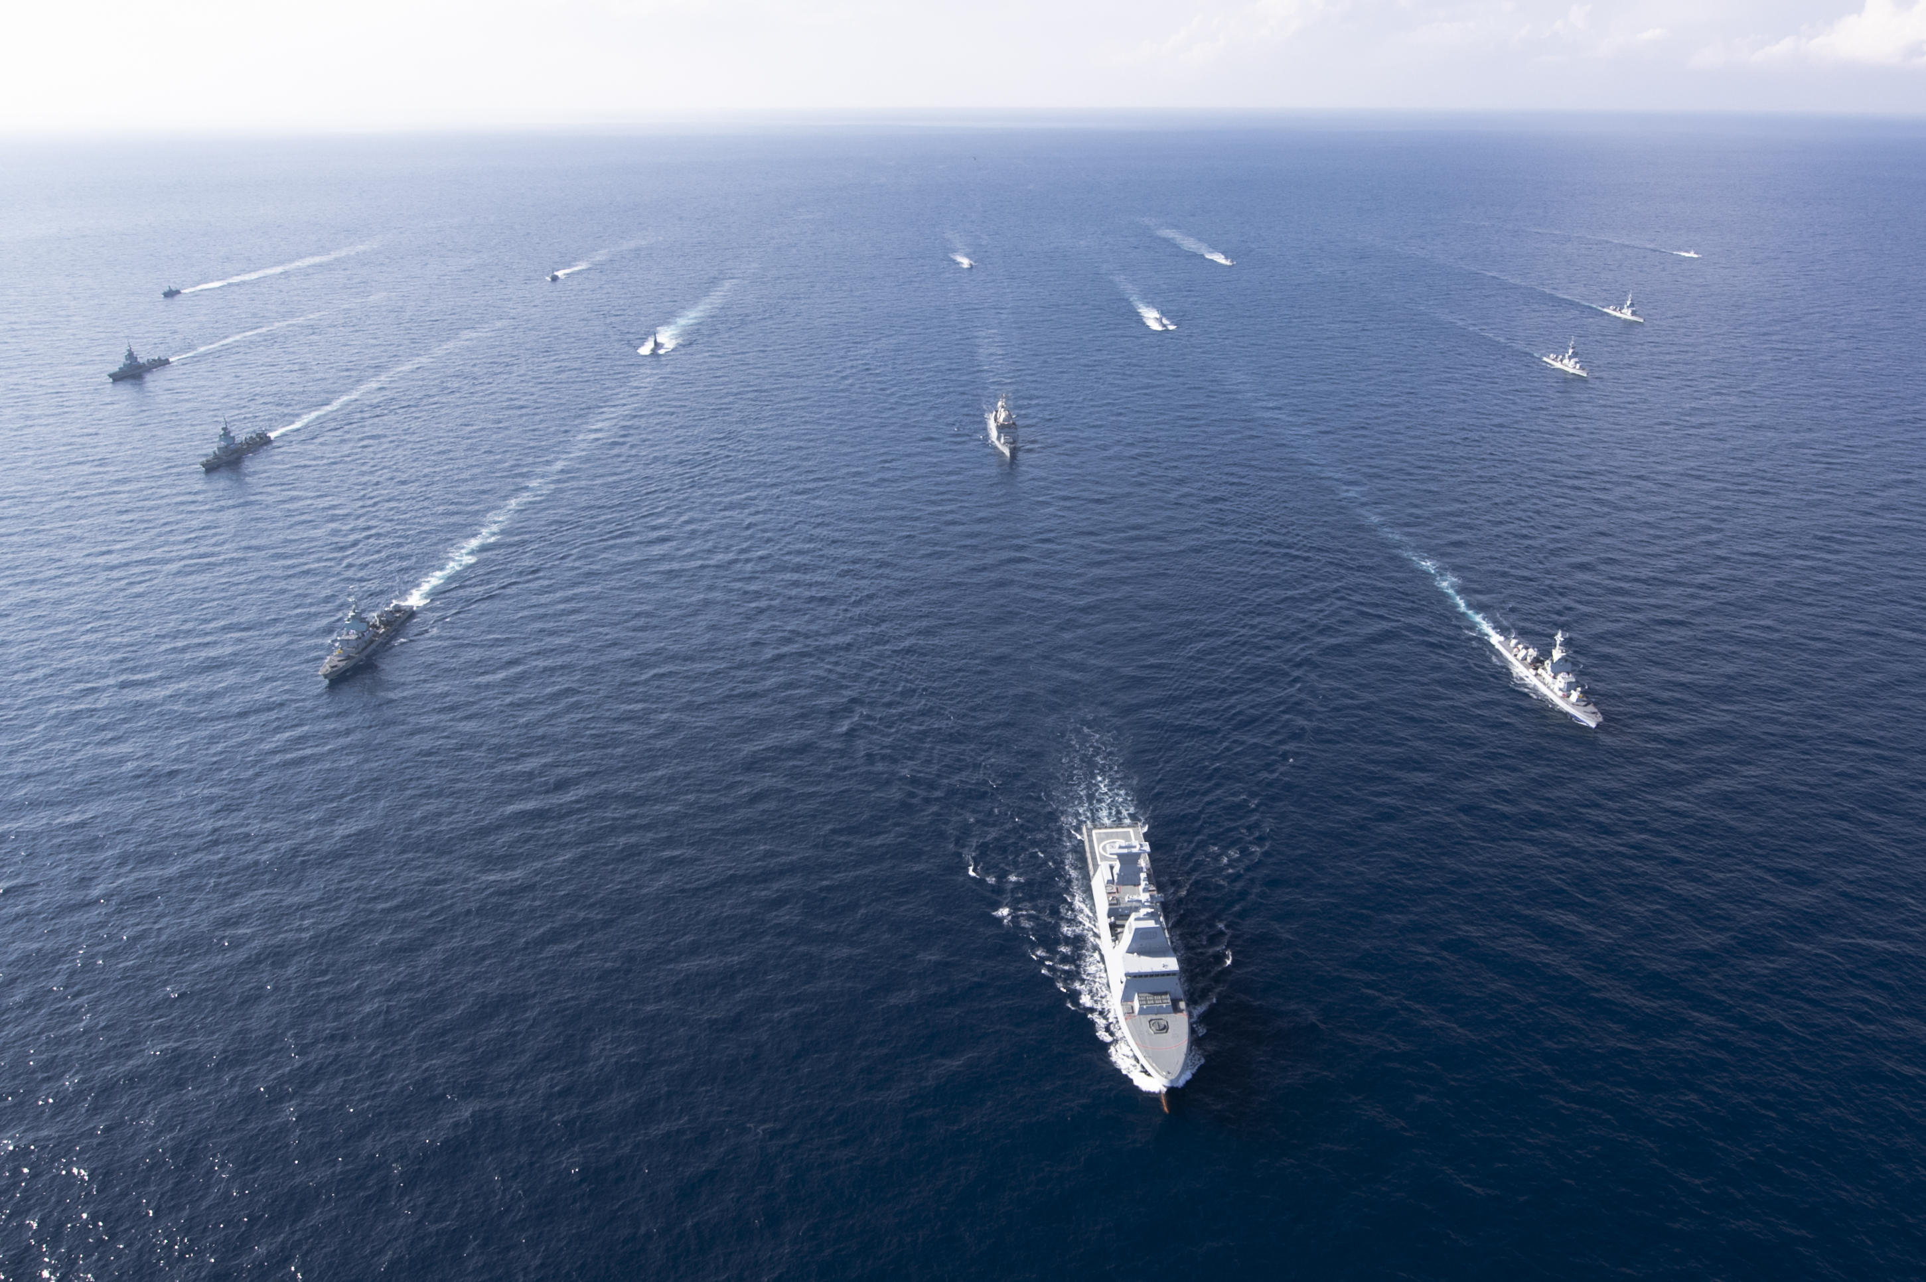
Israeli Navy
Technology meets Surface Fleet

Slide 2
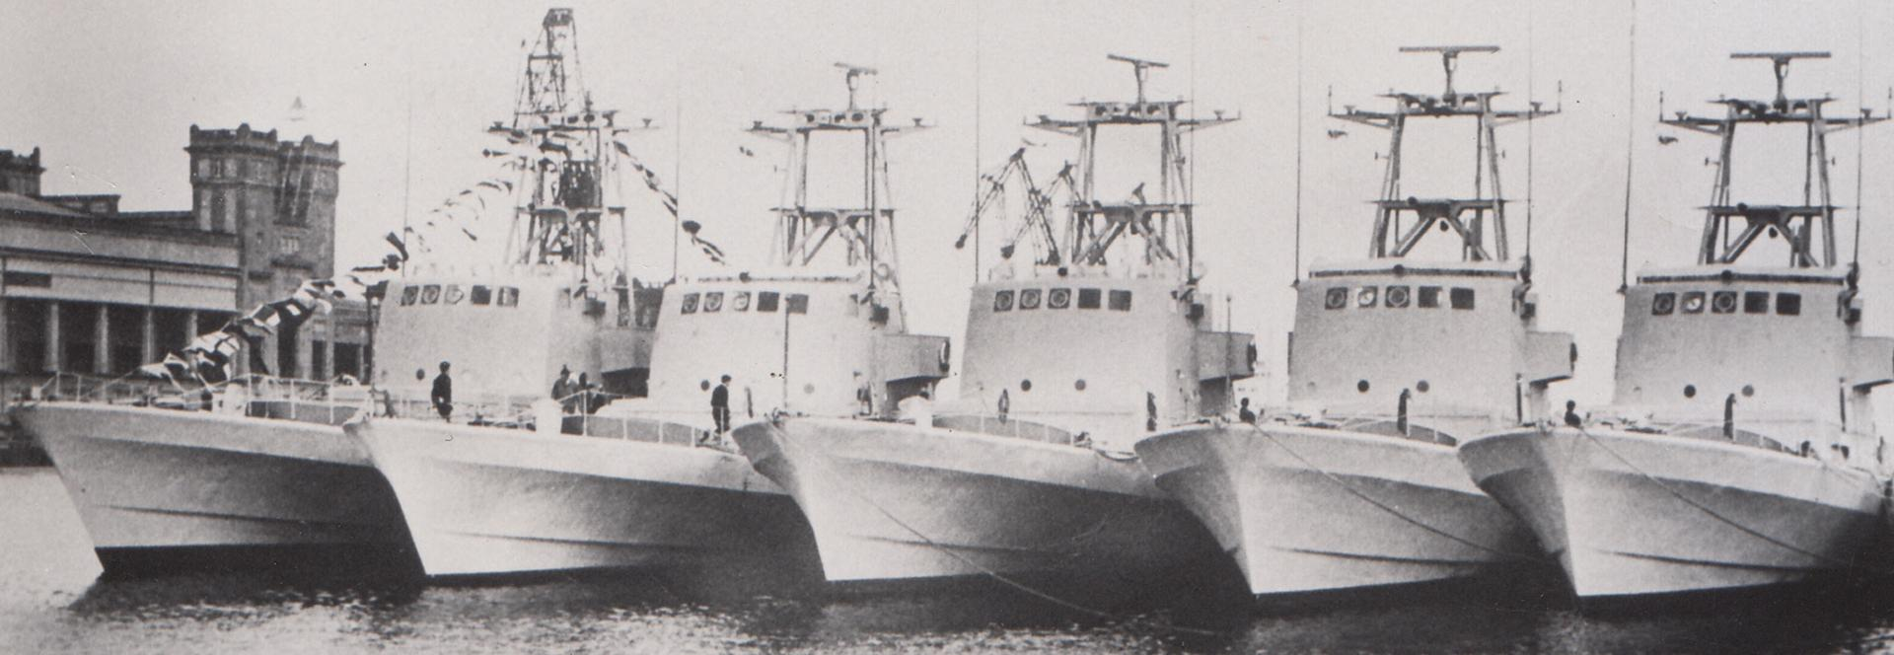
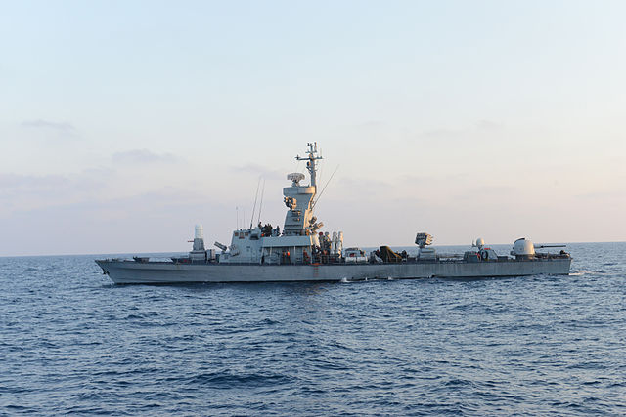
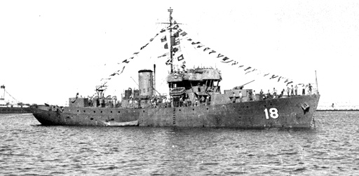
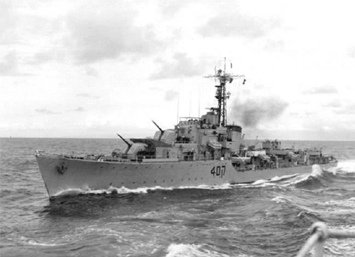
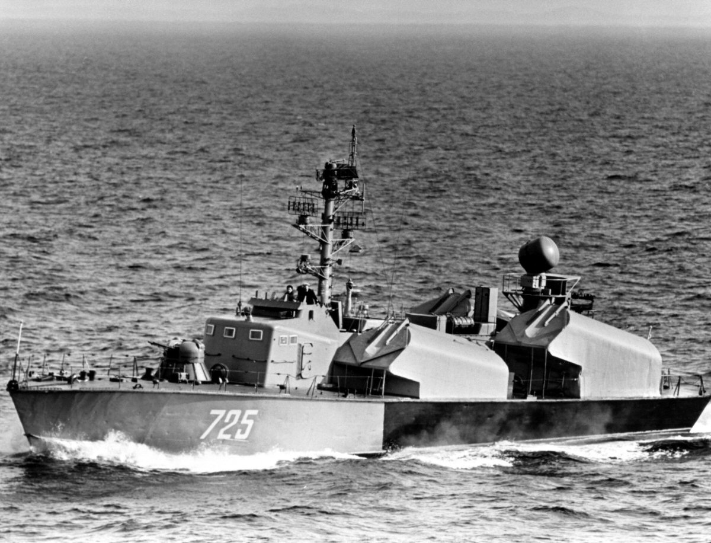
From Immigration boats to Missile ships
The War of Independence
Yom Kippur War
Battle of Latakia
Six Days War
1948
1955
1967
1973
1984

Slide 3

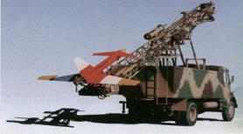
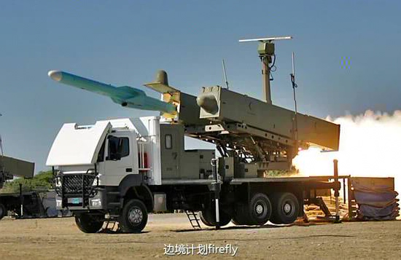
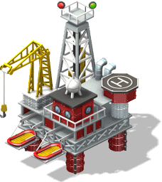
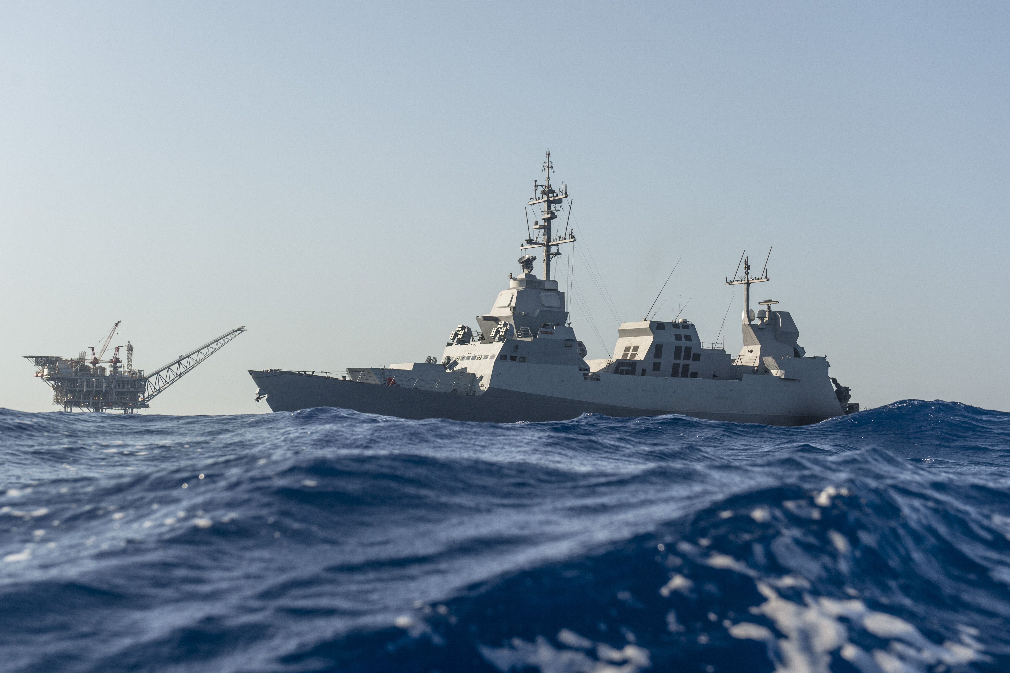
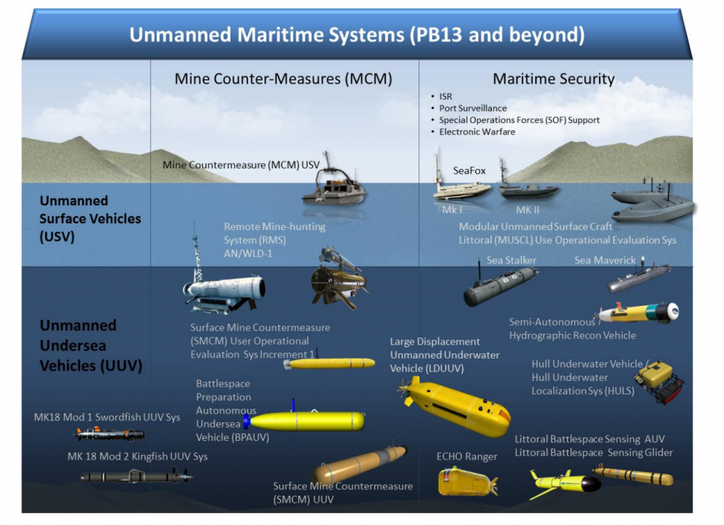

21th Century threats & Tech Challenges

Slide 4
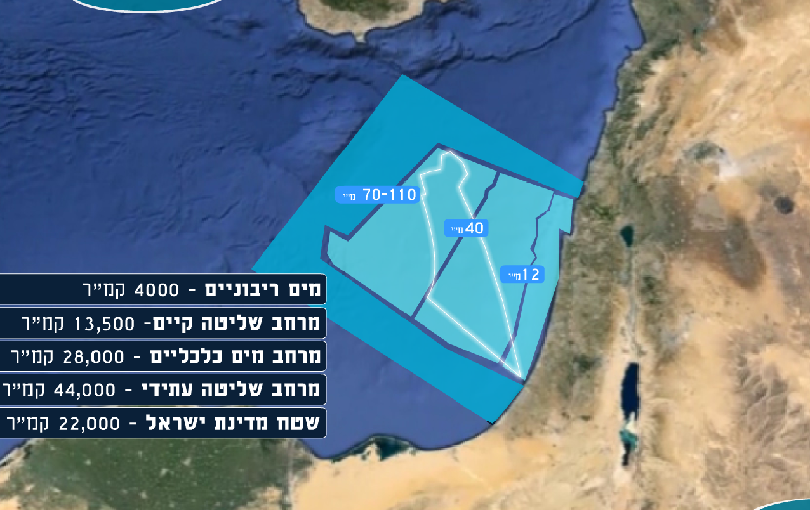
Growing arena
“Exclusive Economic Zone” (EEZ) extends up to 200 NM from shore or until the maritime border of two countries”
Territorial Water 4,000 km²
Past Controlled area - 13,500 km²
EEZ - 28,000 km²
New Controlled area - 44,000 km²
State of Israel - 22,000 km²

Slide 5
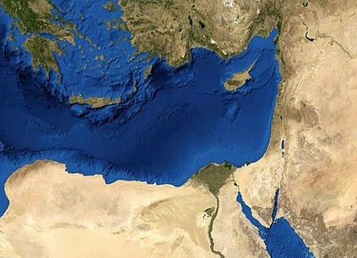
Growing arena

Slide 6
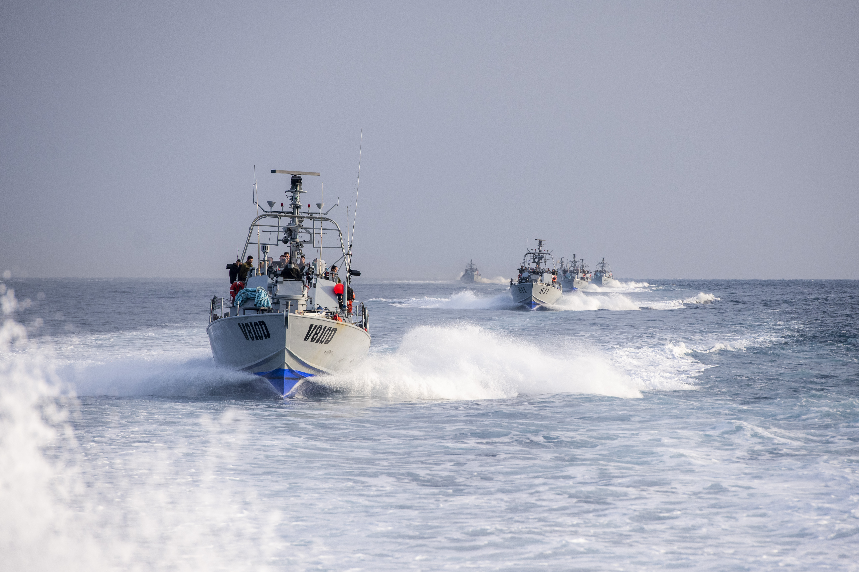
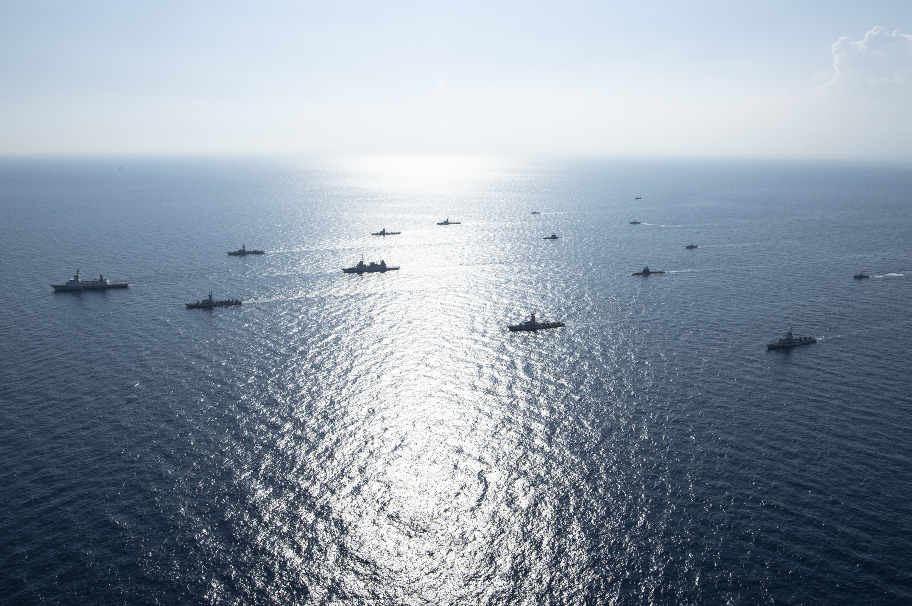
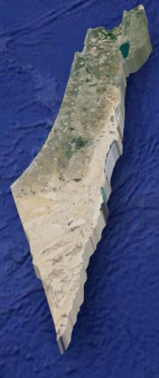
Force Border Protection
914 Squadron
Dvora MK 1
Dvora MK 3
Speed : 40 Kn
Typhoon 25 mm
12.7, 7.62 guns
Defense systems
916 Squadron
Shaldag MK 1
Dvora MK 3
IN Surface Fleet
915 Squadron
Dvora MK 1

Slide 7
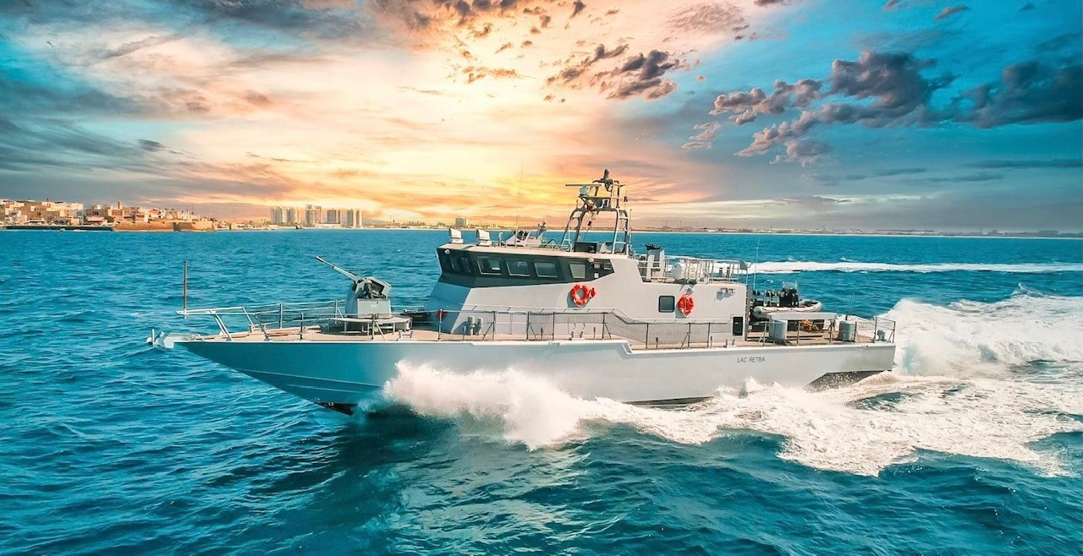
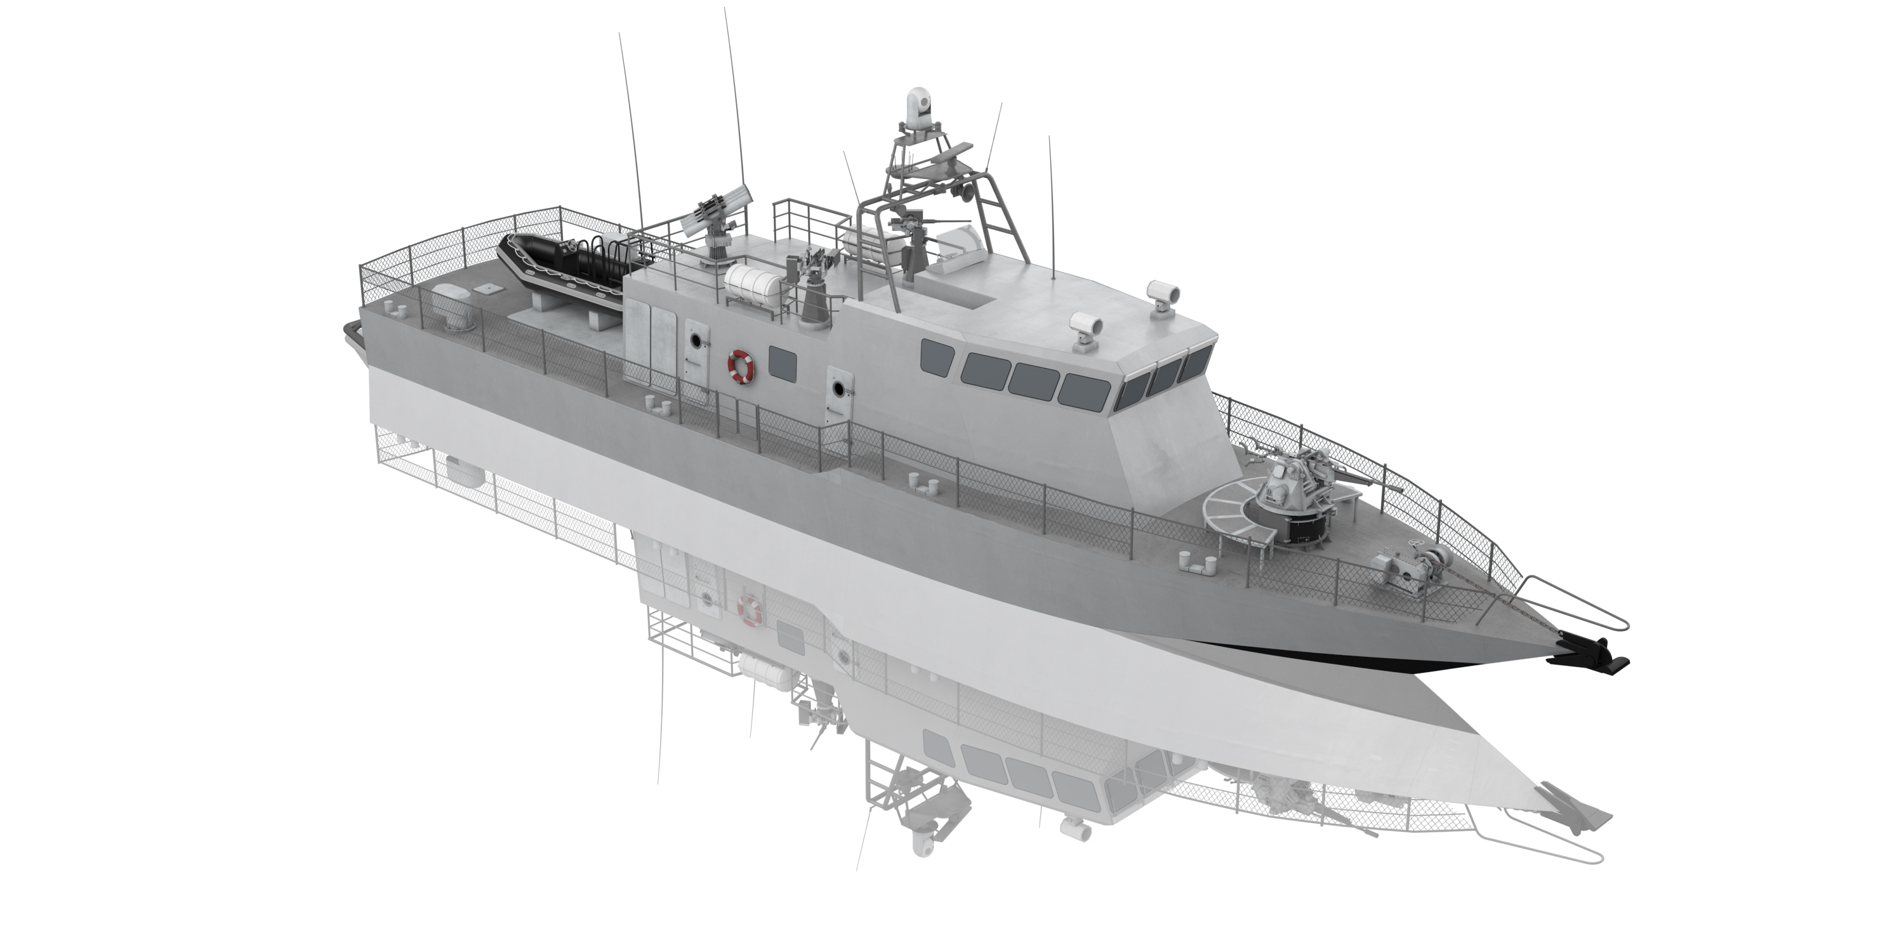
Shaldag MK 5
Construction: Israeli Shipyards
Delivery: 2023-2025
Communication systems
Sea state survivability
Offensive capabilities
96 Hours Force protection
Efficient and fast maneuvering
Up to 40 Kn

Slide 8
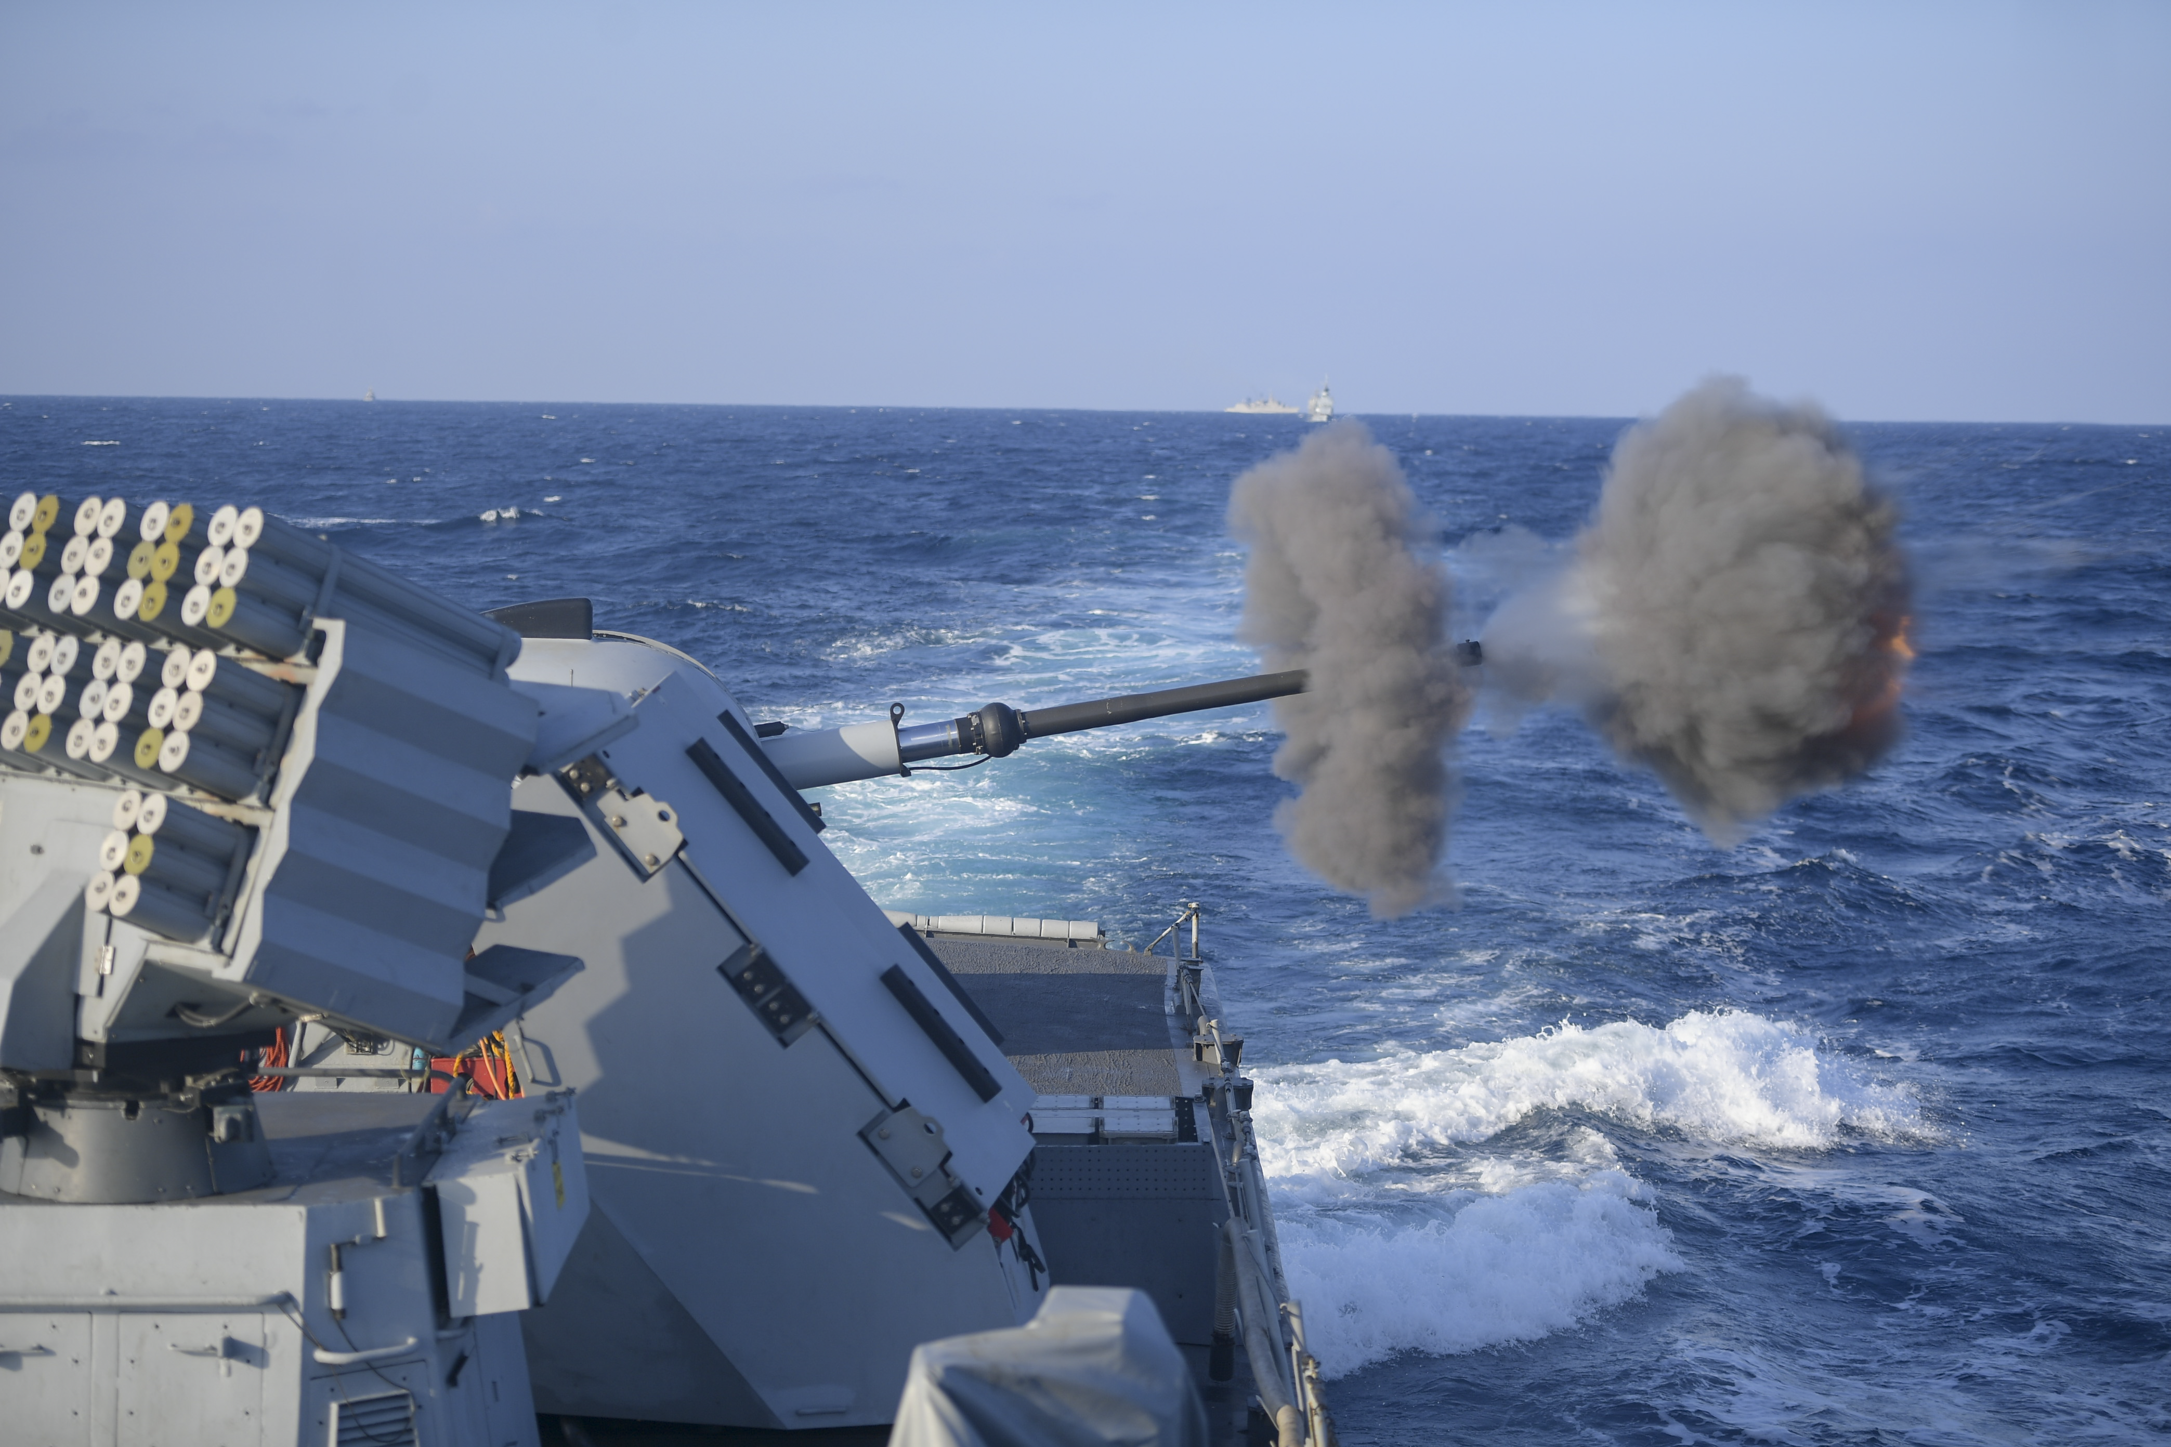
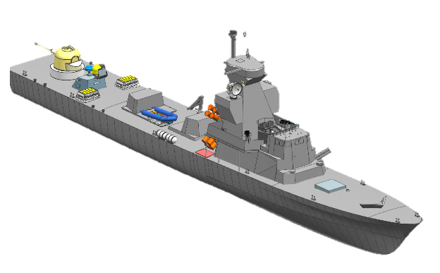
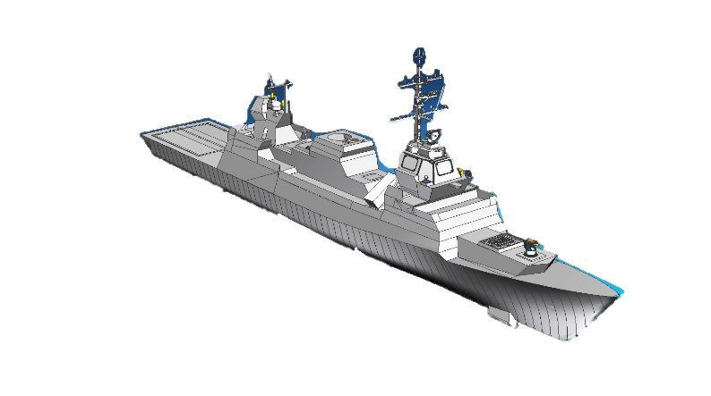
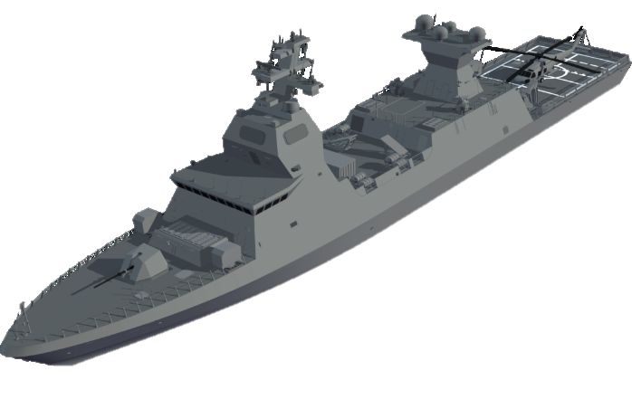
Saar 4.5
Length: 62 m
Height: 20 m
Width: 7.5 m
Displacement: 488 Ton
Saar 5
Length: 85 m
Height: 25 m
Width: 12 m
Displacement: 1350 Ton
1990’s
Saar 6
Length: 90 m
Height: 28 m
Width: 13.5 m
Displacement: 2000 Ton
2020

Slide 9
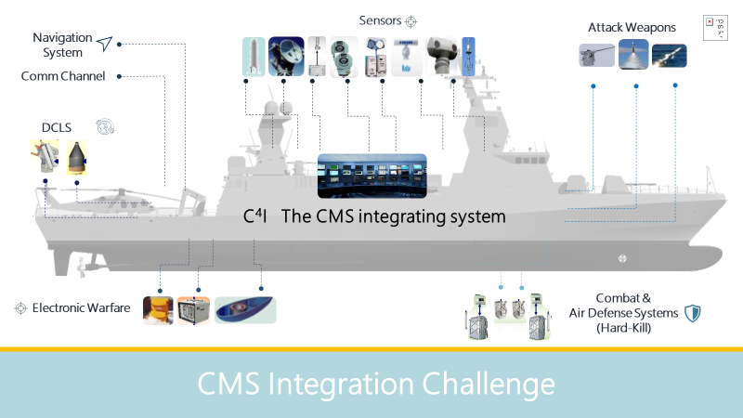
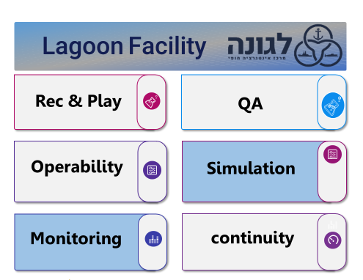
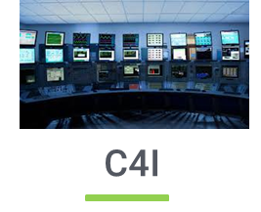
Saar 6 Magen
18 Israeli industries
18 Month
Defense Operational Capability
24 Month
Final Operational Capability

Slide 10
MLU
Saar 5
(Lahav)

Slide 11
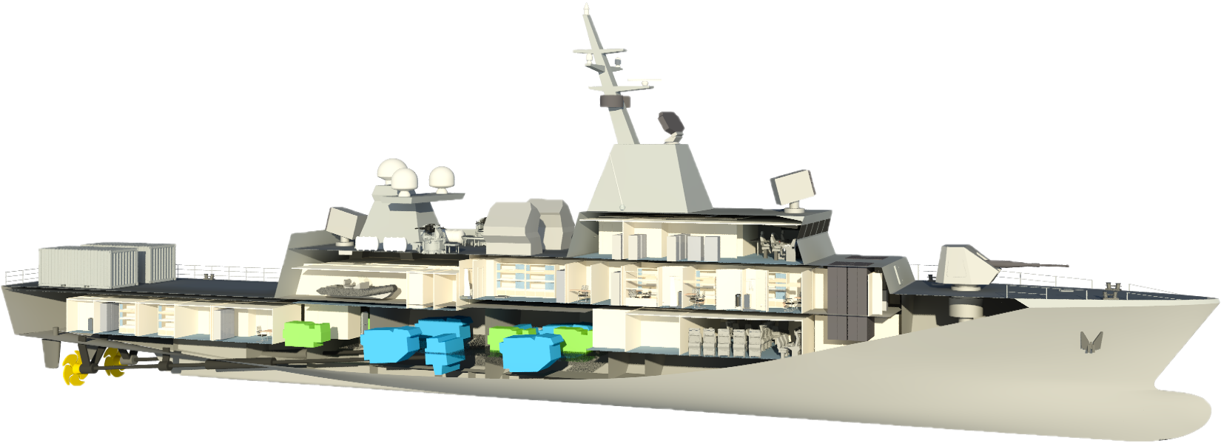
76-77m | Length- LOA
10.88m | Width
3.12m | Draft
1000T | Displacement
30KN | Speed
RESHEF - New Israeli Patrol Corvette
Sea skimming anti-ship missiles
Typhoon 30 mm Gun
Phased Array air radar
Active ECW
Iron Dome
Multi-purpose
Mooring Deck
Active ECW
76 mm Gun
SATCOM

Slide 12
Thank You!

