Slide 1
Renauld Hock, MScEng.
LtCdr
Project Leader
DGMRSys-N/rMCM
Farnborough, 24May2023
rMCM update
Combined Naval Event
Notes:
Thank you for coming here today and for me to be able to share with you some insight of the most impressive programme the Belgian Navy has lead those 30 last years and more over with our long time partner, the Dutch Navy. It is therefore a real pleasure for my as Belgian Programme Lead to present you the Belgian-Dutch MCM replacement programme today.

Slide 2

Notes:
Why are we here today ? We all know the importance of Sea Line of Communication (SLOC). Radar picture provide by the Satellite Sentinel 1 of the EU Copernicus program. It shows the the superposision of all radar picture taken by this satellite in 2020 and show the importance of the protection of our SLOC here in the Channel.
Obviously I could also have used the Sea Cable example or pipeline example mentioned by other speakers.

Slide 3

Notes:
Belgian and Dutch Territorial Waters and Exclusive Economical Zone. The main shipping lanes are visible but also the wind farms and fishing zone. Here starts our Concept of Operation, securing this zone and more broadly those Sea Line of Communication vital for our econnomy.
The only threat of a mine layed in Suez Canal or into another Choke Point would be devastating.
In Ukraine mine have been used and certainly influenced the conflict.
Sea Mines are a important threat to Blue Economy, more broadly to our World economy. Mines have been used in conflict in the past, are used today and will certainly be used tomorrow.

Slide 4
Ever-Evolving Sea Mine Threats
Mines with counter-counter measures
Mobile mines
Smart weapons systems
Notes:
If the threat of a sea mine is very much reallistic, rhe concept of mine warfare is evolving due to the emergence of "new-generation" sea mines benefitting from technological evolution, with a view to escape the current counter measures.

Slide 5
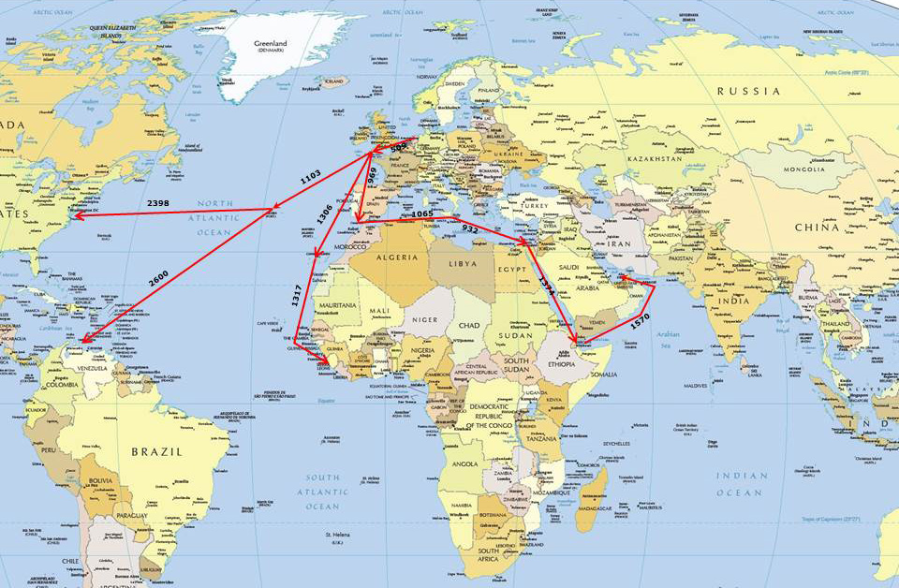
Distances to several areas of interest of ABNL forces.
Capable of sailing 3500 nautical miles without refueling.
Sufficient facilities to sustain a deployment for 200 days
Operate at sea 30 days without resupplies (not including fuel) for with MCM toolbox and 63 crew.
Notes:
To counter that threat, Belgian and Netherland have designed revolutionary MCM systems of systems capable of sailing 3500 nautical miles without refueling to be deployed from the North Sea to the Atlantic, the Mediterranean and up to the Persian Gulf to secure our SLOCs in our zone of interest.

Slide 6
Navtrack
1
CONOPS
2
Contract
Process
Scope
Execution
Time
Product
Challenges & Opportunities
3
Conclusion
4
Q&A
6
Notes:
NavTrack of Today
Our CONOPS is based on a stand off concept further developed based on the lessons learned from exercice to coope with the challenges of working with unmaned systems.

Slide 7
Naval Mine Warfare
Mining
Possible but not part of the rMCM programme
Defensive
Passive
Active
Sweeping
Jamming
EOD
Hunting
Localization
Risk reduction
REA
Self-Protection
CONOPS - Primary Tasks: NMW
Notes:
The Naval Mine Warfare can be divided as proposed on this slide: two type of operations, mining and defensive and further detailed. We designed MCM systems capable to executed the full range of Naval Mine Warfare Operation with a small exception on the Mining capacity which is not in scope of this rMCM programme but can easily added later.

Slide 8
CONOPS - Secundary Tasks: MA & MSO
Maritime Assistance
Maritime Security
Monitoring
Assistance
Support
Embargo
Counter Piracy
Counter Terrorism
Counter Illicit Trafficking
Notes:
Our rMCM platforms will also be able to contribute to secondary task in the scope of Maritime Assitance and Maritime Security

Slide 9
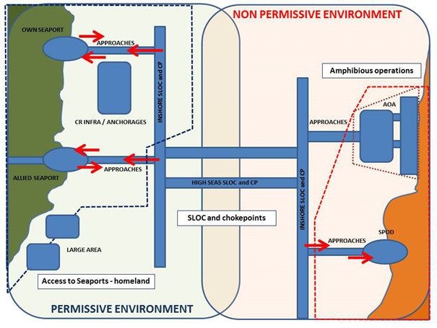
CONOPS - Scenarii
Notes:
Our rMCM platforms will also be able to contribute to secondary task in the scope of Maritime Assitance and Maritime Security

Slide 10

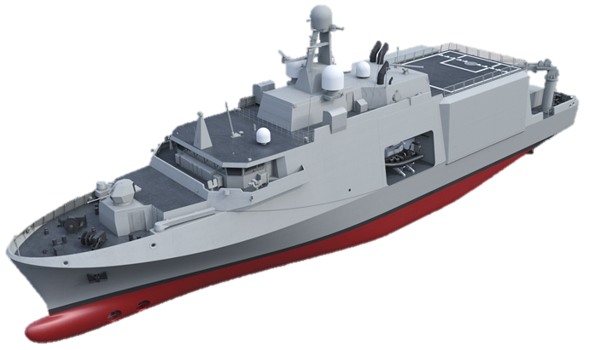
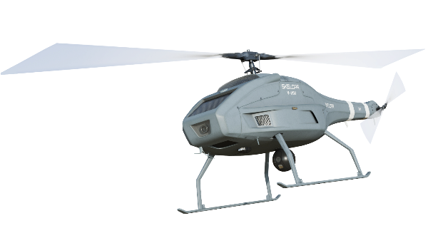
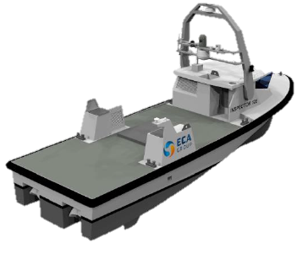
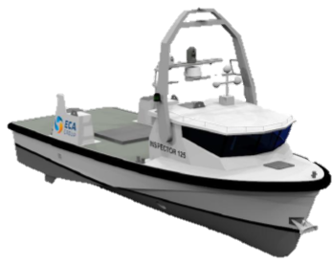
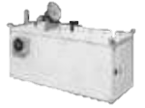
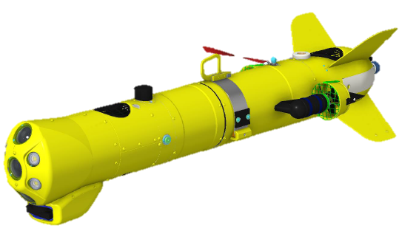
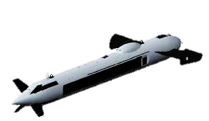
CONOPS – overcoming shortfalls
Recognised shortfalls
Transit speed
Operations Time
Covert operations
Risk for personnel
Limited self-defence
Limited COMMS
Limited endurance
Staff facilities
Drifting /buried mines
CURRENT MCM (LEGACY)
ROV, LAUV, MIDS, …
MCM "PLATFORM"
Inside
minefield
Stand off ~ OTH
Stand off ~ OTH
Outside minefield
rMCM PF
System of Systems
Dedicated Platform
STAND-OFF MMCM
Platfom of Opportunity
Shore based
UAV
rMCM C2
Containerized TB
USV
ROV, TSSS, TSAS, Sweep, M-AUV, MIDS, divers …
M-AUV
Notes:
But Why new MCM capabilities? Belgian and Netherlands have been partners and specialist of Mine Warfare for years, hosting of course the NATO Center of Excelence in Ostende and sailing with the MBV’s since thirty years.
Therefor we intend to remain top level specialist but we need to overcome important shortfalls that current MCM platforms encounter.
From a traditional static warfare to dynamic warfare with fast and efficient exploratory capacity to select optimal route, evade the threat if possible, neutralise it if necessary
For that we need to maximize intelligence and knowledge of the environment. We need fast, multiple and automated sensors at large standoff ranges.
We need bigger platform, with better transit speed, able to operate longer, while reducing the risk for the crew in hybrid environment with various threats.

Slide 11
CONOPS – overcoming shortfalls
Enhanced Capabilities
Deployed worldwide - High readiness
Joint & combined env.
Permissive. & non perm. env.
Efficient, effective and safe manner
Covert posture
Inside
minefield
Stand off ~ OTH
Stand off ~ OTH
Outside minefield
rMCM PF
System of Systems
Dedicated Platform
STAND-OFF MMCM
Platfom of Opportunity
Shore based
UAV
rMCM C2
Containerized TB
USV
ROV, TSSS, TSAS, Sweep, M-AUV, MIDS, divers …
M-AUV
Notes:
We therefor choose to develop a Stand Off concept of a dedicated MCM Mothership optimized to operate from outside the minefield a revolutionary toolbox of drones. Those drones can also be deployed from a containerized toolbox.
Our new MCM platform will be able to operate in three generic scenarios: Access to Seaport // (homeland and allied) SLOC and Chokepoint Protection // and expeditionary-amphibious support operations.

Slide 12
CONOPS – overcoming shortfalls
Operating Risk | Operational Risk
Command decisions | Maintenance
 | Training
 | Technology
Inside
minefield
Stand off ~ OTH
Stand off ~ OTH
Outside minefield
rMCM PF
System of Systems
Dedicated Platform
STAND-OFF MMCM
Platfom of Opportunity
Shore based
UAV
rMCM C2
Containerized TB
USV
ROV, TSSS, TSAS, Sweep, M-AUV, MIDS, divers …
M-AUV
Notes:
Belgium and the Nederlands choose to start their programme right away when others are still mostly doing tests and focusing on the Toolbox. We want to start right away with dedicated and future proof motherships capable of deploying Toolboxes that will evolve, be upgraded in the future. The Mothership will be there for a least 30 years but capable from 2026 to operate in real operational theatre.
The Toolbox will evolve more quickly with the technology and our operational lessons learned.
It is therefore mandatory for us to find the correct balance between operating risk being linked to maintenance, training and maturity of the technology and operational risk linked to the command decision and therefore also the trust we place in technology.

Slide 13
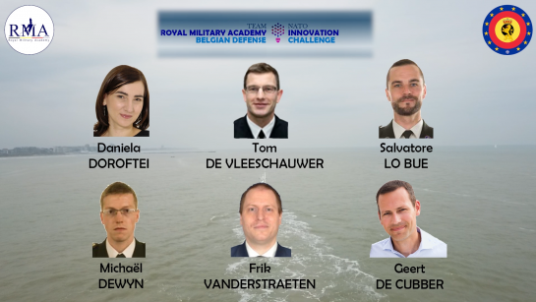
CONOPS – Operating vs Operational risk ➔ Trust
Reliable performance
Understanding the process
Use conforming to design
Socio-Ethical issue
Operating Risk | Operational Risk
Command decisions | Maintenance
 | Training
 | Technology
Inside
minefield
Stand off ~ OTH
Stand off ~ OTH
Outside minefield
rMCM PF
System of Systems
Dedicated Platform
STAND-OFF MMCM
Platfom of Opportunity
Shore based
UAV
rMCM C2
Containerized TB
USV
ROV, TSSS, TSAS, Sweep, M-AUV, MIDS, divers …
M-AUV
Notes:
To summarize, what we need is a paradigm shift. For that we need to address the four level of trust. I will not further develop this point but recommend you the excellent work that the Royal Military Academy of Belgium have done with the Belgium Navy on that point, winning the Innovation Challenge Award of Nato three years ago.

Slide 14
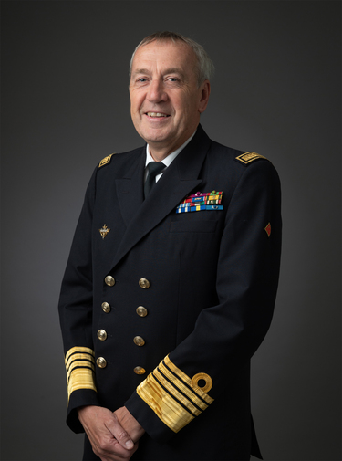
CONOPS – overcoming shortfalls
“In the context of mine warfare, the idea of increasing the distance between the threat and the crews is not new.
In the 2015 NATO Maritime Operations study, the main shortcomings of the on-board systems were the slowness of the operation, the poor discrimination of mines, the impossibility of detecting buried and drifting mines, the self-defense and the possibility of platforms to easily project themselves globally.
It was then already obvious that the existing classic platforms could not provide an answer to all these challenges.
For this, we were looking for a reliable partner to carry out this small revolution in the field of mine counter measures”
30th November 2021 – Keel Laying Ceremony of M940 Oostende
Notes:
I will not read this quote of our CHOD, Amiral Hofman during the Keel Laying ceremony of the first of Class M940 Oostende but basically he summarize it, since 2015 NATO had identified those shortfalls and we will overcome them.

Slide 15
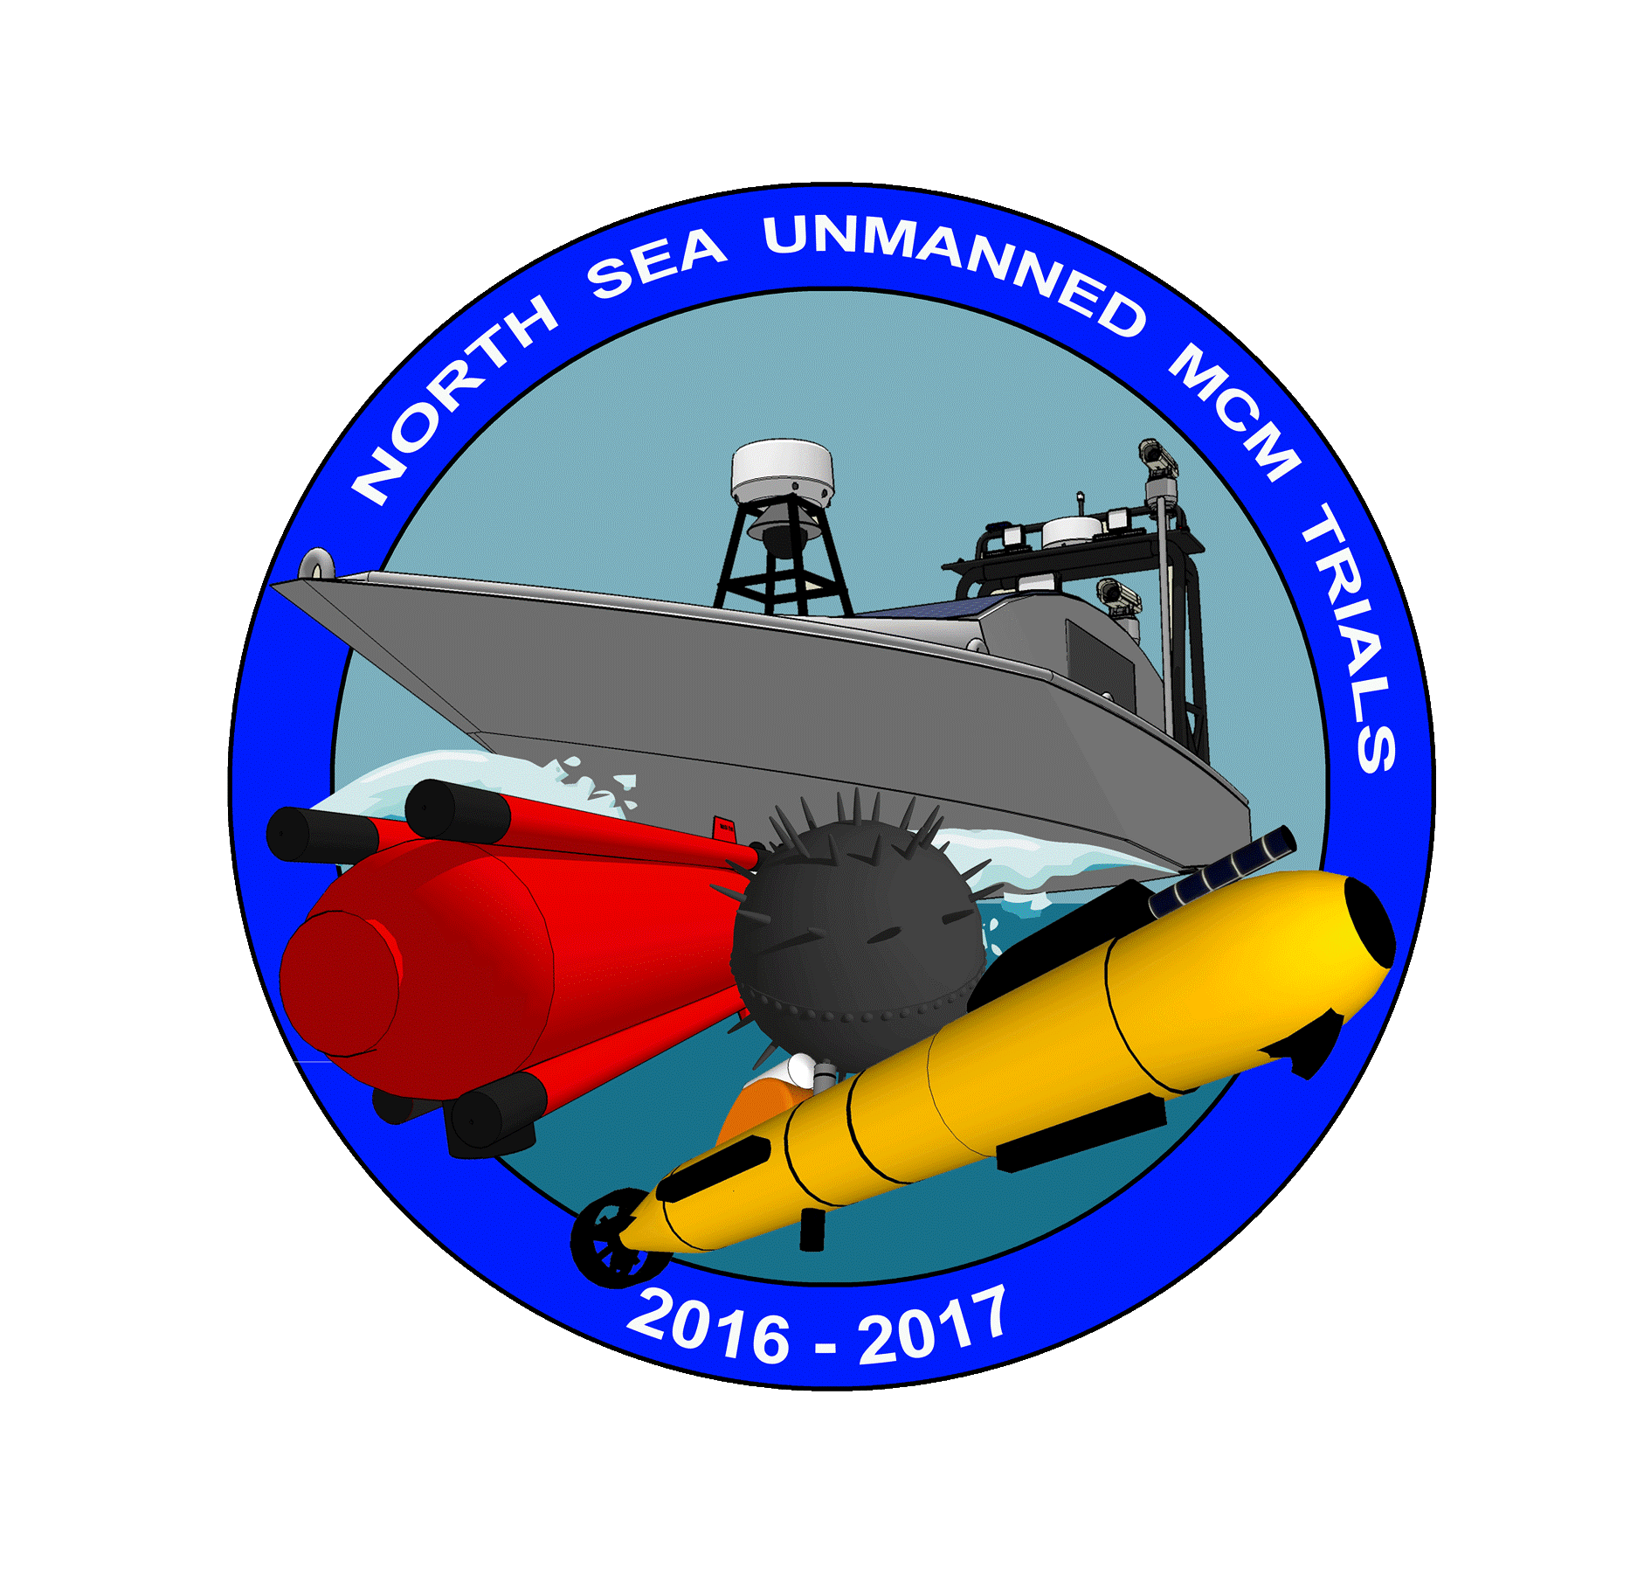
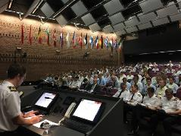
CONOPS - Validation
Technological
North Sea Unmanned Trials
MCM : Sep 16 – Jun 17
COMMS : Nov 16
Operational
CDAG (Concept Development Game Assessment)
Dec 16 – Mar 17
Technical & Budgetary
Market consultations Jul 17
CD&E
Notes:
Of course such a ambitious CONOPS need to be validated. That’s why we have organized unmanned trials in 2016 and 2017 to get a technological demonstration and evaluation of the modern unmanned vehicles and to make an assessment of their Technological Readiness Level.
I will not go into details about the results of this trials, but we noticed that the new MCM concept will lead to a total different way of thinking and that operating with drones doesn’t mean an automatic crew reduction but a paradigm shift.
Unmanned MCM Trials
august-september 2016 + May-June 2017
capability demonstation of autonomous unmanned systems
assessment of the Technological Readiness Levels (TRL)
no ranking nor selection of system
analyses by CMRE
total different way of thinking
no crew reduction

Slide 16
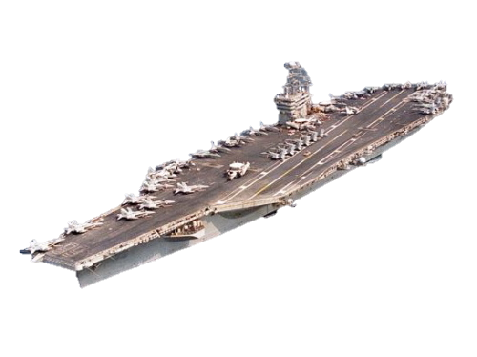
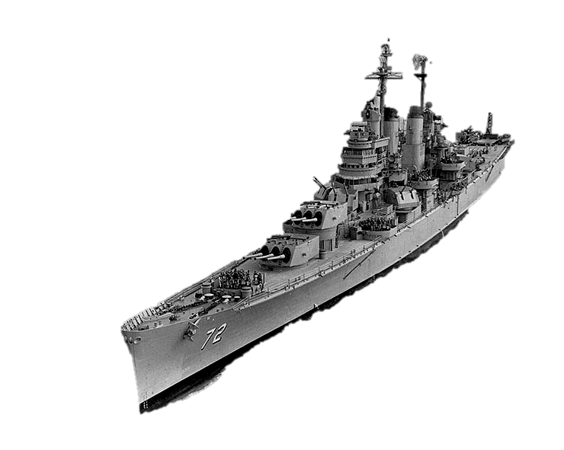

CONOPS - Paradigm shift
Cruiser | Aircraft Carrier
System | System of Systems
Centralized: Fire power C4I | Decentralized: Fire power C4I
 | Command & Control
 | Covered Area / Area of Influence
Notes:
The paradigm shift we need is similar to the one we encounter during WWII: from the Cruiser to the Aircraft carrier. From a centralized system to a decentralized systems of systems that rely on a important Command and Control suite and have large area of influence.
We intend to help both the Dutch and the Belgian Navies to make the next paradigm shift a reality.

Slide 17
Conclusion - Paradigm shift
Aircraft Carrier | Future « Ships »
System of Systems | System of Systems – Unmanned
Decentralized: Fire power C4I | Decentralized – Unmanned & Automated: Fire power C4I
Command & Control | Command & Control - Unmanned & Automated
Covered Area / Area of Influence | Covered Area / Area of Influence
Notes:
More precisely in Naval Mine Warfare but the same is happening with more and more unnamed system integrated in all type of Warfare: decentralized systems of systems in which trusted unmanned systems capable of automated operating actions on a large area of influence integrated with maned crews.

Slide 18
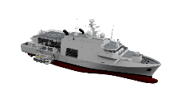
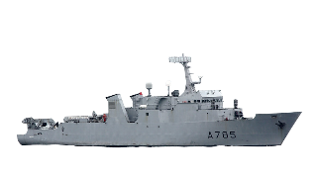


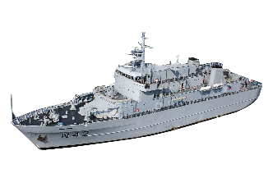


CONOPS – Tasking Authority
MTA
NMW AREA 1
NMW AREA 2
U 02.01
NMW AREA 3
MCMTA 01
MCMTA 02
U 02.02
MCMTA 03
U 02.03
TAMA 01
TAMA 03
TAMA 01
TAMA 03
Notes:
MCMTA (MCM Tasking Authority) = commanding a group of several MCMV. This could be a CTG. But Also a CTU, or CTE, only when TU or TE are composed of several ships, depending of the amount of MCM units in the MTF, which is the case in big task organizations were MCM forces are part of a large (even joint) Maritime Task Force (MTF).
TAMA (Tasking Authority Mission Area) = the Q-routes and Boxes in which a MCMTA is tasked by its higher echelon.

Slide 19
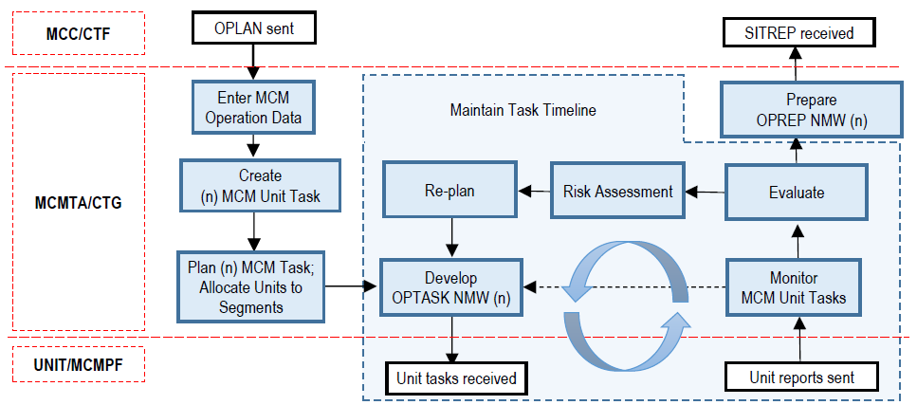




CONOPS – CTG P&E
MCMTA
Unit
Unit
Unit
Notes:
MCMTA (MCM Tasking Authority) = commanding a group of several MCMV. This could be a CTG. But Also a CTU, or CTE, only when TU or TE are composed of several ships, depending of the amount of MCM units in the MTF, which is the case in big task organizations were MCM forces are part of a large (even joint) Maritime Task Force (MTF).
TAMA (Tasking Authority Mission Area) = the Q-routes and Boxes in which a MCMTA is tasked by its higher echelon.

Slide 20

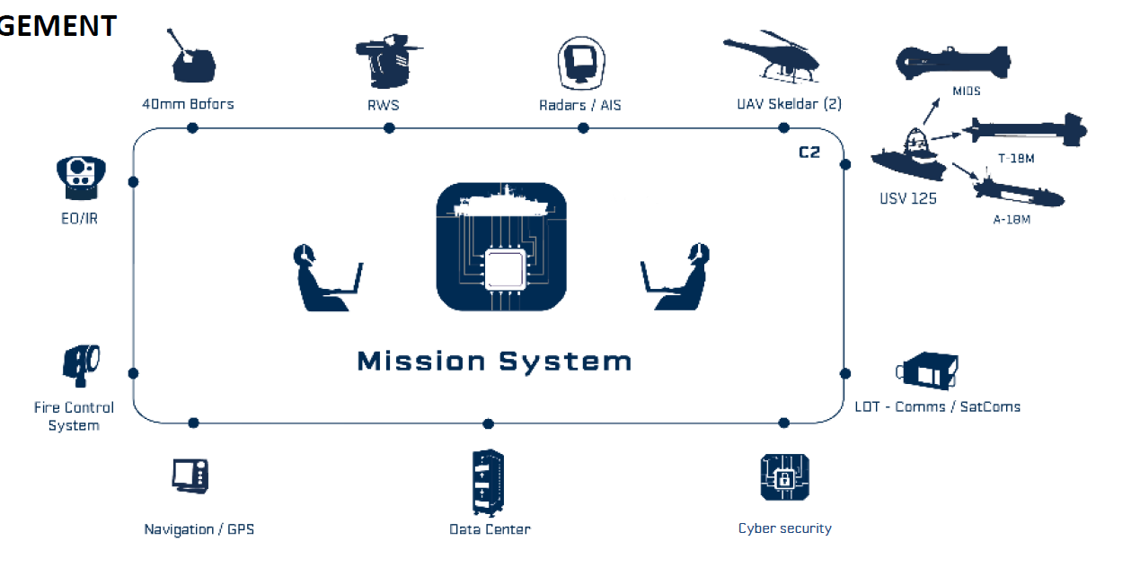
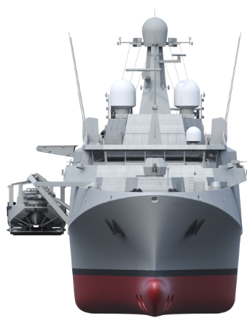

CONOPS – Networks & Data centric
Modern Cyber Security Architecture
Secured Communications
RF : blue
ACOM : yellow
SATCOM : red
MCMPF : MCM Platform
MCMTB : MCM Toolbox
CONTTB : Containerised Toolbox
MCMTB
C2CONT
CONTTB
MCMPF
MTA
LOS
BLOS/OTH
Notes:
To make that paradigm shift a reality our rMCM platform and drones will used modern and secured communication and more broadly specific Cyber Security architecture to guarantee the Confidentiality, Integrity and Availability of all communication systems essential for all tasks in Operations

Slide 21
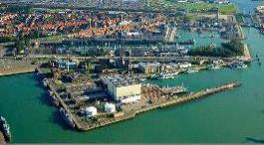



CONOPS – Networks & Data centric
Modern Cyber Security Architecture
Link with ILS - Exchange and maintenance + Entreprise Resources Program (ERP)
Defence ERP
Interface
Close collaboration
INDUSTRIE - DEFENSIE
Database
Support Desk
ERP
OEM
IPMS
OEM
Maritime Operations Center
Security Operations Center
Notes:
But also to stay securely connected with our shore facilities, especially the Maritime Operations Center to support a global integrated logictic support (ILS) strategy and to a dedicated Security Operations Center dedicated to Cyber Security
ILS: Integrated Logistic Support

Slide 22
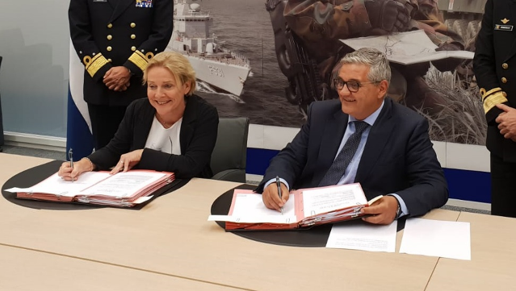
Binational Programmes
MoU June 2018: rMFF (4 frigates) + rMCM (12 vessels)

Slide 23
Process overview
Key User Requirements (summer 2016 – Apr 2017)
  Vision → KUR (ops community)
i/c Operational User
Drafting specifications (Feb – fall 2017)
  Sensors / weapons – platform – ILSP
Ops review (May 2017)
  Ops review vs KUR
Market consultation (Jul 2017)
  Technical & budgetary consolidation
i/c Project Leader
Procurement (2018 - March 2019)
  Aquisition proces
  Contract
i/c Leading Service

Slide 24
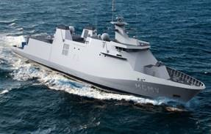
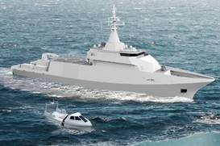
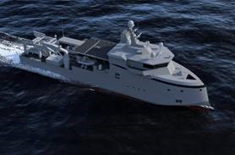
Process overview
Damen
Imtech Belgium
Naval Group
ECA Robotics
Sea Naval Solutions
with Chantiers de l'Atlantique
Thales
Socarenam
Engin Deck repair

Slide 25
Scope
Product
CONOPS
Cost
Time
Notes:
The objective of the rMCM programme is to provide Dutch and Belgian Navy, ABNL with a new MCM capability able to execute this ambitious CONOPS.
As ABNL has a duty of success and not of means, the priority of the rMCM programme is to provide ABNL the best possible MCM capability (Product) within a given time and budgetary (Cost) frame. Therefore, during the preparation and execution of the rMCM contrat, the priority will always be given to the Product before Costs and Time.

Slide 26
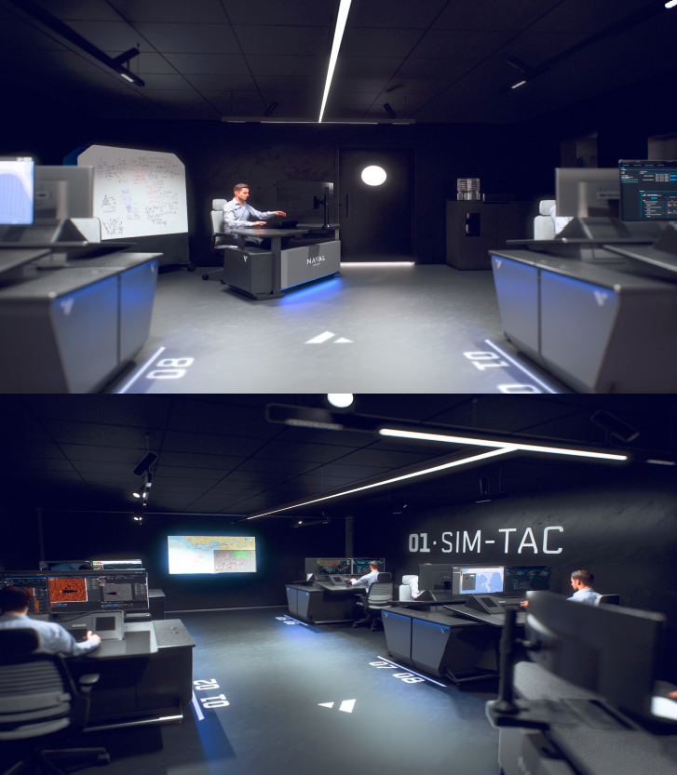

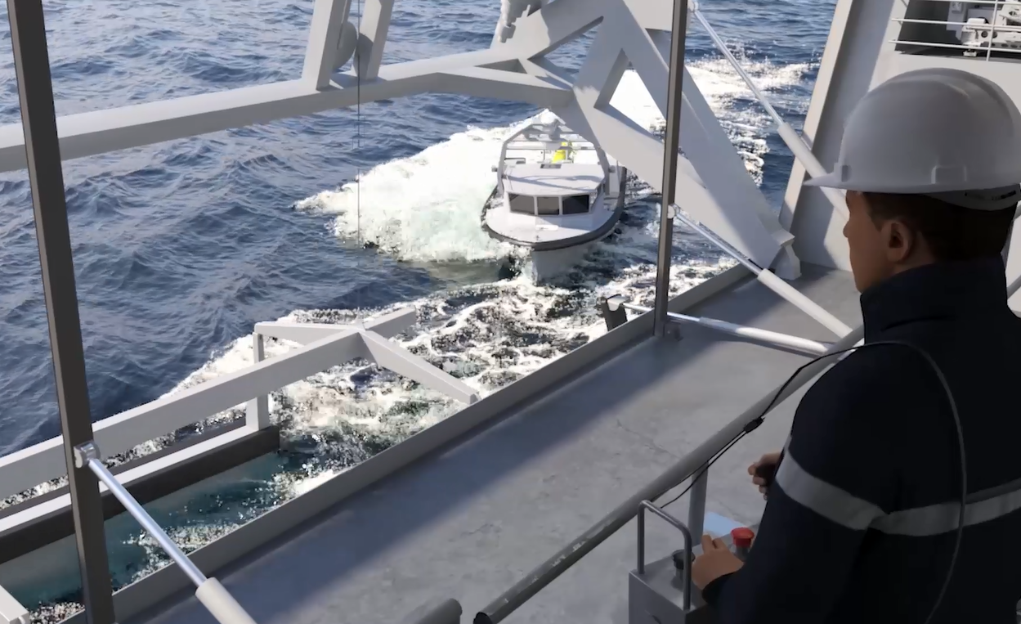
Scope
TACT SIM
TRAIN CIC
TRAIN TECH
12 MCM Platfoms
MCM Toolbox
Simulator
Linked in common scenario
L (m) | W (m) | D (m) | T (T) | S (kts) | PAX
82,6 | 17,0 | 3,87 | 2.800 | 15,3 | 30 - 63
±100 Tools
USV (unmanned & manned)
  Divers/EOD/FP
  TSAS
  AUV
  MIDS (2 type of ROVs)
  Sweep (IMS)
UAV (EO/IR & LiDAR)
Containerized C2
VR SIM
TRAIN DECK
TRAIN TECH
Dedicated MCM PF with Military characteristics: HMS, acoustic & electromagnetic discretion, shock resistance, Cybersecurity, COMMS, FP & self-defense
LARS for 2 USV & Helideck
Notes:
From the Concept of Operation to the Scope of the contract because this is how you run such a programme. You define you Operation needs and then draft a solution that will be further detailed and tested with the industry.
At the end of the day our programme will deliver to both the Dutch and the Belgian Navy 12 modern MCM Platforms of about 83 meters long 2800 T, and about 100 Tools. We also will have a modern simulator to train our CIC and technical personal on Multiple Functional Consoles and with dedicated Virtual Reality environment.
Those three elements shall allow us to operate the paradigm shift we need in the MCM Warfare. Toolboxes and simulator will certainly be updated more frequently than the platform in the future but all will be ready for us to operate as soon as 2026: within less than 4 years, this is tomorrow for us.

Slide 27
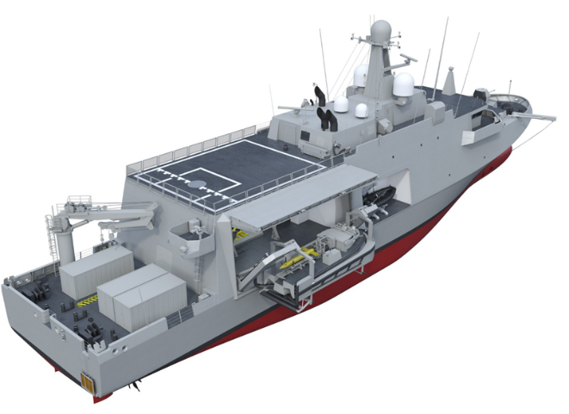
rMCM Platform
UAV Deck
Crane
RHIB
20 ft containers
LARS
Length (m) | Width (m) | Draught (m) | Bridge (m) | Mast (m) | Tonnage (ton) | Speed (kts) | Accomodation
82,6 | 17,0 | 3,87 | 9 | 23,8 | 2.800 | 15,3 | 30 - 63
Notes:
Talking about the stand off concept, you can see:
UAV deck to operate up to 2 UAV’s type Skeldar (including hangars), also able to receive a small helicopter (<3t)
2 LARS (A-frame Davits) for 2 USV’s, with in between the mission bay where AUV and ROV’s are stored
We will talk later about the tools, but one of the reason why the ship is so wide (17m) is that it must be able to lower the 18 tons (12,3m) USV’s on the side.
(USV: 19,5 tonnes en full load – 13,4 tonnes empty + boom to assist during launch and recovery)
3 20ft-containers for 42 tons in total (Decompression chamber, container for the influence magnetic sweep, container with additional accomodation)
Crane on the aftdeck to move containers, to put AUV in the water (not certified to put small boat with personnel inside in the water)
Small diving platform on the stern.
2 Rhibs 7m – 2 USV 12,3m
Accomodation for 63 pax on board. Off course the modularity offered by this concept of toolbox will be reflected in the total crew: 33 pax basic crew and up to 30 pax in modules for the toolbox (6 modules extended MCM, 8 modules USV1&2, 5 modules UAV1&2, 6 modules data analyst).
External modules are also possible (MCM: EOD 6 Pax, CDT 4 pax, VSW 3 Pax, Staff 9 pax // non-MCM for MSO et MA: SOF, boarding teams, FP, …) but at the expense of MCM tools modules.
Talking about the stand off concept, you can see:
UAV deck to operate up to 2 UAV’s type Skeldar (including hangars), also able to receive a small helicopter (<3t)
2 LARS (A-frame Davits) for 2 USV’s, with in between the mission bay where AUV and ROV’s are stored
We will talk later about the tools, but one of the reason why the ship is so wide (17m) is that it must be able to lower the 18 tons (12,3m) USV’s on the side.
(USV: 19,5 tonnes en full load – 13,4 tonnes empty + boom to assist during launch and recovery)
3 20ft-containers for 42 tons in total (Decompression chamber, container for the influence magnetic sweep, container with additional accomodation)
Crane on the aftdeck to move containers, to put AUV in the water (not certified to put small boat with personnel inside in the water)
Small diving platform on the stern.
2 Rhibs 7m – 2 USV 12,3m
Accomodation for 63 pax on board. Off course the modularity offered by this concept of toolbox will be reflected in the total crew: 33 pax basic crew and up to 30 pax in modules for the toolbox (6 modules extended MCM, 8 modules USV1&2, 5 modules UAV1&2, 6 modules data analyst).
External modules are also possible (MCM: EOD 6 Pax, CDT 4 pax, VSW 3 Pax, Staff 9 pax // non-MCM for MSO et MA: SOF, boarding teams, FP, …) but at the expense of MCM tools modules.
9 crew willl be composed iot ensure a sound turn-over amongst the 6 platforms (Total OT 468 PAX).
(Watermist partout)
9 crew willl be composed iot ensure a sound turn-over amongst the 6 platforms (Total OT 468 PAX).
(Watermist partout)

Slide 28
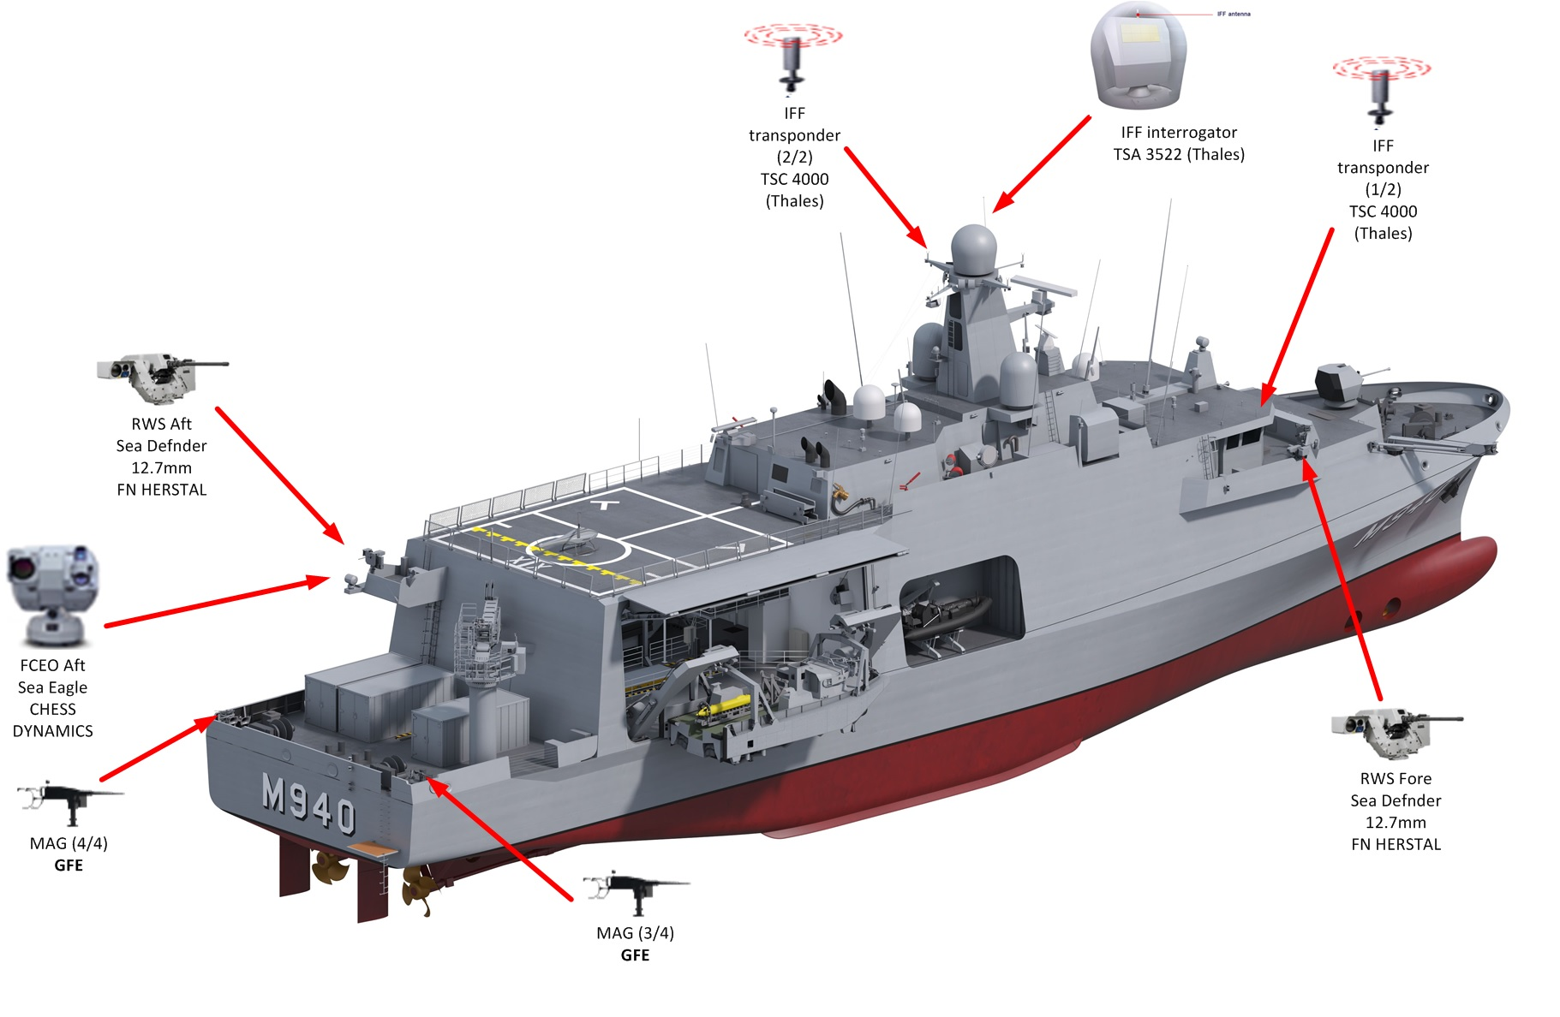
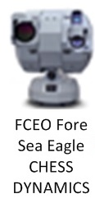
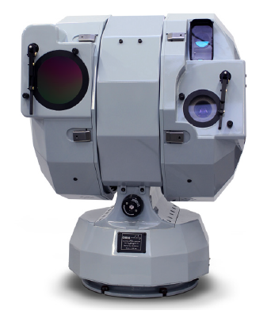

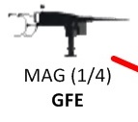
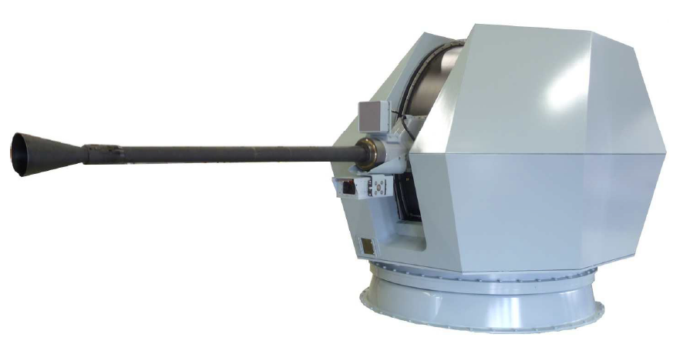
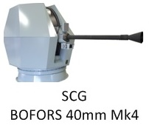
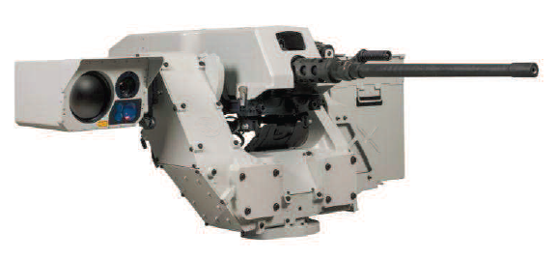
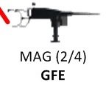
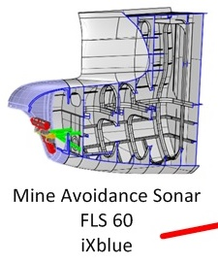



rMCM Platform
LRAD
Water canon
Notes:
On the Sewaco point of view:
Main Surveillance Radar NS54 Thalès. 4D
Canon 40 mm Bofors Air & Surface
2 SeaDeFNder (quasi 360° sauf grue et canon)
Fire Control
Long range acoustic Device
Mne Avoiding Sonar
+ Degaussing
(Full Electric -2x1.8 MW)

Slide 29
rMCM Platform – Conventional requirements
Compliant to all applicable NATO Allied Force Standards
Compliant with all classic IMO Standards:
  MAPROL TIER III
  SOLAS
  COLREG
  …

Slide 30
rMCM Platform – Protection
NBCD
EMC
DC
Signatures
Classified

Slide 31
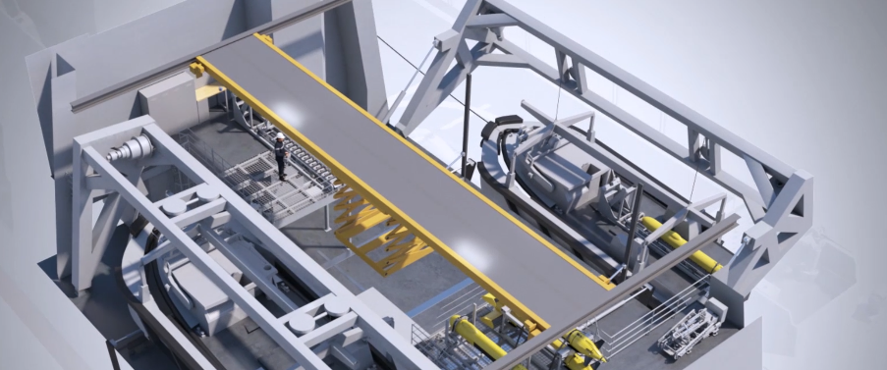
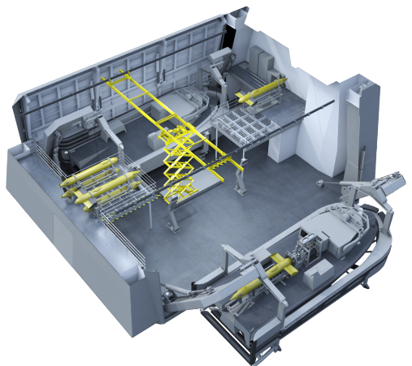
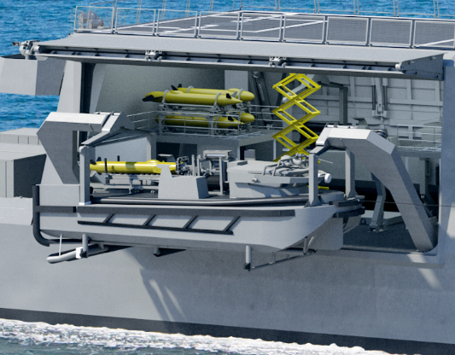
Toolbox Area –Mission bay
2 Heavy USV LARS
1 ammunition lift
1 gantry crane
1 rail-guided heavy-duty trolley
1 multipurpose crane
UAV facilities
Notes:
The Toolbox area will host the launch and recovery system (LARS), two USVs and all other drones that he will deployed.
The USV’s are configured with the desired tools, payload and configuration inside the mission bay, by means of different rail and crane systems, before being put in the water for their MCM tasks.
Challenges
1/Launch and recovery of USVs, which is up to Sea State 5
2/Handling of storage of the 50 (?) drones

Slide 32
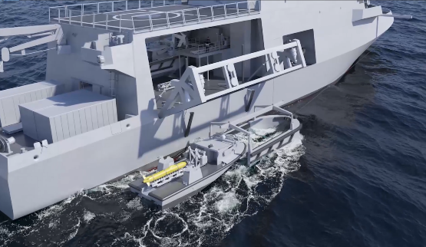
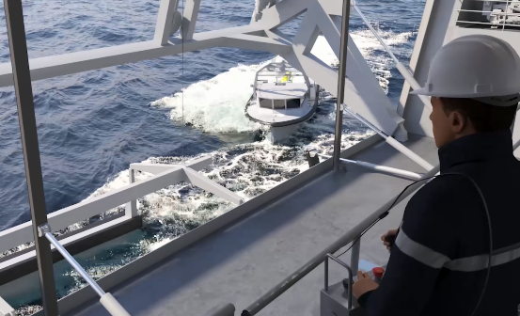
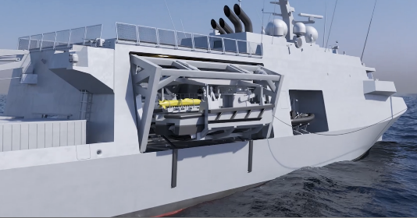
Toolbox Area – LARS
  Special Ops capacilities : FRISC
Notes:
Some more illustrations of the LARS
Before launching the USV, the drone will be equiped with the required configuration inside the mission bay on board of the mother ship. The LARS is made of a Davits A-frame is used to put the USV in the water from the mission bay.
At this stadium the USV is still in a craddle.
An operator controls the USV to sail inside and outside the craddle from a RCS (remote control system) where he has a video feedback from the USV.
Once freed from its craddle, the mast of the USV can be deployed and the USV is taken under control from the USV operator in the CIC or in autonomous mode.
The USV mast is pulled down before entering its floating dock. Inside the floating dock, the hull is layed on crosspieces. Once the locking mechanism is activated, the recovery can take place
Locking system in the craddle before reconvery. USV Hull lays on cross pieces.
Possibility to operate up to Seastate 5. Excellent stability of the USV thanks to an in-board stabilisation system.
LARS and craddle were tested from a ship of opportunity with wind 30-45 kts. Pictures of the test later.

Slide 33
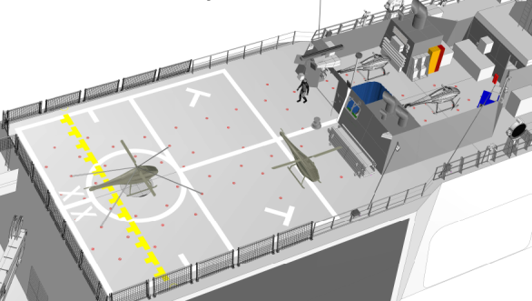
rMCM Platform – Aviation System Arrangement
Aviation deck fitted with VERTREP marking and deck cleats
Aviation Hangar
2 UAV storage
FDO office
Foldable panels
Landing grid
Ø1,8m
Innovative and (R)evolutionary

Slide 34
rMCM Platform – Operational Cycle
Innovative and (R)evolutionary
Notes:
The operational cycle of the rMCM platform is particularly long: 5 years among followed by 1 year of maintenance.
This didn’t exist so far in the Naval Ship Code but was accepted by the classification society. An annex will be added.
During the 5 years of availability, there are of course small maintenance periods planned, of 2 weeks every trimester and 1 month every year.
(UP 1: 2 weken, overal mogelijk maar met ondersteuning van de Shore Support Team (marine personeel, maar niet van het boord), OLM & ILM taken
UP 2: OLM & ILM taken, in zeebrugge tegen de kant, 6 weken, door Navlog
UP 3: 16 weken in droogdok door de industrie (BNR zal werken met Flanders Ship Repairs in MBZ)
6 jaar levencyclus bestaat niet in de Naval Ship Code (nu wel aanvaard door BV): heel lang.
Uitdaging voor Navlog: UP2 zijn er 12 per jaar, dus moet exact verspreid worden. Belang van planning!
Daarbovenop moeten de onderhoud van de TB gesynchroniseerd worden met de PF…
ILSP= Integrated Logistic Support Plan
Higher level than the maintenance cycle en i-ISS: ook de beheer in Ilias, budgetlijnen, de structuur, de organisatie, de verantwoordelijkheden, de i-ISS, enz.)
Bedoeling met Clemaco is dat ze zelf hun personeel opleiden in de toekomst, en niet meer de marine, dat zal minder beheer voor de marine betekenen).

Slide 35



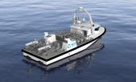
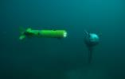
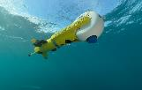
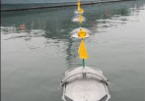
rMCM Toolbox – Overview
DETECTION
CLASSIFICATION
UAV
INSPECTOR 125 USV
A18-M AUV
T18-M Towed SAS
IDENTIFICATION
INSPECTOR with 2 SEASCAN
SEASCAN
NEUTRALISATION
INSPECTOR with 2 SEASCAN & 6 K-STER
SWEEP
Notes:
These are the classical phases conducted during a MCM task.
With the new concept, 2 new phases: Relocalisation since no Sonar remains in contact with the object during the process flow (before identification but also between neutralisation) which can be a challenge for the industry (more performant sensors and automation on seascan f.e.) and also recognition (with nowadays technologies = classification, but could approach an identification in the future).
ATR is foreseen o/b MCMPF with neural network.
Relocalisation entre Classification et Identification (le sonar ne reste pas sur le contact contrairement au CMT)
Avant neutralisation aussi
Relocasition géographique par l’USV.
MIDS: mode automatique, semi-auto, manuel. Automatique peut être pour la neutralisation aussi (en théorie).
Semi-auto: navigation auto, mais l’opérateur confirme le contact et le tir. Le système peut orienter sur le choix du contact.
Detection: MILEC
Classification: MILCO ou non-MILCO
Recognition: l’ATR permet de reconnaitre le type de mines (fait encore partie de l’étape classification – AI neural networks algorithme). En route vers l’identification.
Identification (visuelle): Mine ou nombo (identification visuelle pourrait disparaitre à l’avenir)

Slide 36
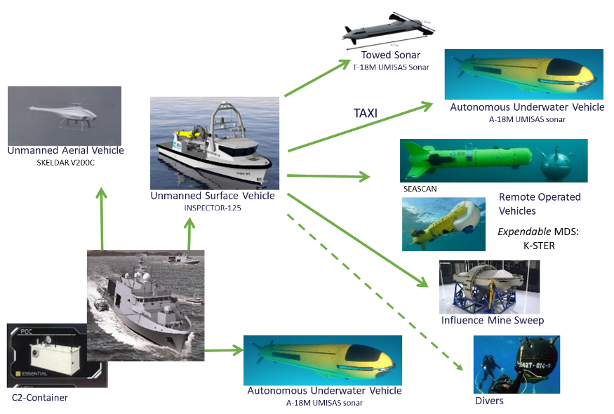
rMCM Toolbox – Overview
Notes:
The standoff concept implies to have on board a serie of MCM tools like Unmanned Autonomous vehicles and ROV’s.
While the platform is developed by Naval Group, all tools are developed by ECA (also developper of the PAP in the past) except the UAV which is a Skeldar V200 developed by SAAB as a sub-contractor of ECA
We see again the two main concepts of the new capability: stand-off mcm and modularity. All those MCM tools will be embarked on the platform on a modular base depending on the mission profile.
The mother ship will be able to operate drones in all 3 environments: Air (UAV), Surface (USV), and subsurface (AUV)
Role of the USV = Taxi for all other tools (Towed sonar, autonomous sonar, MID, MDS, IMS, Divers)
Role UAV = Relay Comms + ISR + Mine detection with a LIDAR and an EO/IR sensor. Up to 2 UAV’s on board of a mother ship.
The AUV can be operated from the USV but also directly from the platform.
As last, we have also a Containerised toolbox, which is a set of 2x 20ft-container to be deployed from ashore or from a ship of opportunity and that can control a full toolbox. A sort of mini-CIC.
OT&E:
Doel: ervaring opdoen en sensorperformantie inschatten
OT&E: volledig gescheiden van het contract, apart contract
De meeste tools zullen gebouwd worden in de fabriek van Oostende. Dit past in het kader van de Essentiële Veiligheidsbelangen. (artikel SeaTalk nr2 met CEO ECA)

Slide 37




rMCM Toolbox – USV
2 types: Hunt or Sweep
Unmanned missions
  Detect & classify
  Identify & Dispose
  Minesweeping
  AUV Taxi
Manned missions
  Divers / EOD
  Force Protection
Innovative and (R)evolutionary
Notes:
The USV exists in two versions: a hunt version and a sweep version.
Hunt version can be reconfigure on board of the mother ship in 3 different layout:
With a L&R system for the TSAS
With a L&R system for the AUV
With a L&R for the mine idendification system seascan and the mine destruction system K-STER-C.
It is a steel hull of 18 tons, 12,3m, max speed 25 kts
The sweep version has been designed to tow the heavy influence sweep, we will have 2 USV’s in sweep version in total. Technically, it is different from the hunt version on the propulsion point of view: this version is equiped with shafts and not with water jets like the hunt version (to increase the traction capacity). It is also slowlier with a max speed of 12 kts.
Sonar MOAS and an Optronic sensor.
The concept of operations of the capacity has also foreseen two manned configuration of that drone, namely in a Force Protection role with additional weapon or with a CDT embarked on board.
USV MOAS (when deployed and operating) provides a forward bathymetry (3D seabed data).
Rerolling
SWEEP version: towing IMS. Main difference of this specific USV is the propulsion:
- 2 propellers and 2 rudders replace the hydrojets, which considerably increases the traction capacity at the expense of the maximum speed.
- Furthermore, this USV is not equipped with the MOAS sonar and the optronic sensor. Therefore, precursor ops with UAV or USV-H should be executed in case of shallow moored mine threat (e.g. snaglines) or MCCM in form of floating obstacles as fishing nets
Challenges:
- COLREG compliance in autonomous mode
- Explosion confirmation, especially for IMS
12,3 m – 18 tonnes (13,4 tonnes à vide; 19,5 tonnes avec payload)
USV unmanned except for FP and Diving. Pas de manipulation payload en mode manned (uniquement lorsque remote from platform). Place pour LARS pour 1 seascan et 3 KSTER-C. On pourrait mettre un deuxième LARS seascan à bord (MAX 6 Canisters)
Les NLD ne plongeront pas depuis l’USV (plongeurs à la ligne pas possible si pas à l’ancre).
Moins de rerolling d’une payload à l’autre (entre TSAS et MIDS, AUV, FP, Plongeurs, ) si on taske deux navires différemment.

Slide 38

rMCM Toolbox – AUV A18M
Characteristics
Dimensions | Length: 4.5m Diameter: 465mm
Weight
Max Speed
Nominal Speed (ops)
Min Speed (ops)
Battery Capacity
Altitude
Operating Depths
Standoff Range
Coverage Rate
Classified
Innovative and (R)evolutionary
Notes:
The Alister 18 M or A18M is the Autonomous Underwater vehicle included in the toolbox.
It can be launched and recovered from the mother ship or autonomously from the surface drone, the USV.
That tool is equipped with a very performant Synthetic Aperure Sonar. The results shown during the operational test and evaluation are truly impressive: high resolution, high reliability. Moreover it is equipped with a ATD (Automatic Target Detection) which processes directly the sonar pictures to detect possible mines.
It is equipped with an acoustic communication capacity (ACOM) allowing to transmit a certain amount of data to the mother ship or to the surface drone which will relay to the mother ship. Alternatively, the tool can also surface regularly to transmit its picture and data in RF to the mother ship, possibly via the UAV.
It is also equipped with a Forward Looking Sonar (FLS) to avoid obstacles (malheureusement pas pour détecter les mines, en discussion).
AUV: a un ATD à bord, il envoie par ACOM (à la PF ou l’USV qui relaie) les snippets en basse résolution et les positions des MILEC. Il peut remonter en surface et envoyer autant que le TSAS. Ordre qui peut être donné depuis l’opérateur, par ex. Il peut ou pas rester dans le range ACOM des plateformes (covert mission)
A-18 M « Alister » (18 cm de diamètre, il existe aussi le 9cm et le 27 cm)
SLS – SAS => excellent results during OT&E, resolution is impressive.
AUV: mort à l’hameçon pour être remonté (système accoustique ou réflecteur TBC).
Plan optimal en fonction de l’environnement et des conditions pour avoir une image optimale. Courant, ripples, calculateur à bord qui compense les angles. Environ 5m au-dessus du sol. Lors de son arrivée sur zone, il peut ré-évaluer la situation et re-planifer par lui-même en prévenant la plateforme.

Slide 39


rMCM Toolbox – TSAS T18M
Characteristics
Dimensions | Length: 4.7m
Weight
Nominal Speed (ops)
Min Speed (ops)
Endurance
Operating Depths
Operating Altitude
Coverage Rate
Classified
Notes:
The TSAS, or towed synthetic aperture sonar, can be automatically launched and recovered by the surface drone and remains permanently connected to the USV via a Fiber Optical Cable (FOC).
This sensor is a new concept of ECA specially developed for rMCM.
Basically, it is the same device as the AUV A-18-M that we just saw and which already exists, but this one will allow, thanks to its towing cable to transmit its sonar picture in (near) real time. The aim is off course to gain time because the amount of data that have to be processed on board of the mother ship by analysts is huge(idem with ATR).
This is the fastest sensor for detection and classification of underwater contacts, because of this real time data transmission capacity, but also thanks to its high operating speed (coverage rate is doubled compared to the AUV A18M).
On board of the USV, there is an Automatic Target Detection (ATD) which already processes the information and identify possible MILEC. The analyst on board of the mother ship receives the full sonar picture as well as the results of the first automatic processing and can do the rest of the job.
On board of the mother ship, there is as well an ATR, automatic Target Recognition, which helped by a neural network will help with the recognition of the mine-like contacts. The classification process will be automated to a limited extent. Until the arrival of automatic target recognition (ATR) algorithms, the operator workload will remain high.
The vehicle incorporates the same battery as the A18-M.
TSAS: on reçoit les images en directe (ATD à bord de l’USV qui envoie par RF des snippets haute résolution des MILEC et toutes l’image en basse résolution).
Sonar coque CMT: forward looking sonar, fréquence plus basse (moins bonne résolution). Side looking (Remus, TSAS, AUV) = SLS (side-looking sonar). Plusieurs familles: SSS – Side scan Sonar (Remus) – SAS – Synthetic Aparture Sonar (T18-A18) – simulation d’une antenne plus grande – la résolution reste la même avec la distance (excellente résolution avec une sorte de reconstruction 3D de l’image).
MAS = FLS, MOAS = FLS.
Endurance USV = 48h
Endurance TSAS = 20h (ne recharge pas à bord de l’USV) – l’énergie ne passe pas par le cable. Avantage: cable léger, manipulation plus aisée.
Endurance AUV = 20h
UAV = 6h ou 5h selon la payload (relay comms tout le temps – soit LIDAR, soit EO/IR)

Slide 40



rMCM Toolbox – MIDS: Seascan & K-STER-C
Notes:
When the USV is not configured for the TSAS or the AUV, it can be equipped with a mine identification and destruction payload: the seascan on the left side is used for the identification of mines and is reusable, while the K-STER-C on the right side is equipped with a shaped charge in a rotating head and is used for the destruction of mines. Both ROV’s are launched automatically by the USV, the seascan is also recoverd automatically and can recharge on board the USV in between taskings, while the K-STER-C is off course a fire&forget solution.
The SEASCAN is equipped with 3 different camera’s (2 B&W plus efficaces pour le traitement d’images + 1 color pour l’identification visuelle humaine) and 1 sonar. The Seascan already exists on the market but that particular model is a more advanced one, especially developped for the rMCM capacity. In fact, its sensors (cameras and sonar) are more advanced than the existing current version iot allow a full automatic mode (navigation, relocalisation of the contact, approach, hovering, etc, the visual id is off course done by an operator on board of the mother ship, but the return trip and the recovery occur again fully autonomously).
K-STER has a sonar and a camera as well, but is also equipped with a Laser (to measure the distance before impact and to ensure a good alignement)
"The sonar of the K-STER C is a mechanical scanning sonar, it allows to relocate the mine and is used for the approach phase until the video image allows the final disposal phase.“
K-Ster: utilisé en Lithuanie (il existe une version identification, mais moins performant que le seascan).
Singapour: USV avec MIDS
Seascan: une version nouvelle pour nous avec matériel adapté à nos exigences (mode automatique jusqu’à 50 cm de visibilité, hover, l’identification même se fait en manuel, puis retour auto). Sonar et caméra adaptés pour ce mode automatique. 2 caméra N&B (plus efficace pour le traitement d’image) et 1 caméra couleur. The vehicle has a positive buoyancy (+10N) and is reusable. L&R Seascan prévoit 100 récupérations sur le cable.
Sur un USV: 3 K-STER + 1 Seascan
Possibilité de faire 2 Seascan et 4 K-STER (on ne l’a pas acheté). Mais on pourrait prendre le LARS du seascan d’un USV et le mettre sur l’autre.

Slide 41



rMCM Toolbox – UAV Skeldar V200
1. MCM
D-C-I
MCM support
  REA
  Comms relay (AUV; USV)
2. ISR
Fused RMP
Target reporting unit for SD/FP
SAR
Characteristics
Dimensions | Rotor diameter: 4.6m Airframe length: 4m Height: 1.3m Width: 1.2m
Max Takeoff Weight
Max Speed
Cruise Speed
Economical Speed
Endurance
Coverage Rate
Classified
RELAY
HOTO
Payloads :
Comms relay
+ EO/IR
OR
+ LIDAR
ISR
MH
MTA
Notes:
Each ship can be equipped with 2 UAV (Skeldar V200 model built by SAAB).
This is a total new tool, total new capacity for BEL Navy with implications on many fields like organisation, logistics, legal, qualifications, and so on. Experience feedback from CAN would be interesting.
The UAV has a triple role (MCM, Comms Relay, ISR).
- It is permanently equipped with his comms relay payload that will allow to increase significantly the SOR at wich we can operate the tools (BLOS).
It can next to this be equipped with a LIDAR (Light Detection And Ranging device) whose aim is the rapid and unmanned location of floating mines or anchored mines close to the water surface. The new RIEGL VQ-840-G is a fully integrated compact airborne laser scanner for combined hydrographic and topographic surveying. Industry is still facing a serious challenge with that sensor since the max payload weight of the Skeldar doesn’t allow the Lidar to be powerful enough for the requested performance. That aspect will still be under development after the delivery of the first ships and tools, meaning that the mine detection role could be relatively limited in the beginning.
- And finally another possible payload is an electro optic infrared sensor with the same purpose: visual inspection of the sea surface or the few visible meters below to spot drifting, floating or anchored mines.
And That EO/IR sensor allows as well to conduct ISR mission, or even SAR missions.
Like all other tools it can fly and operate fully autonomous according to certain patterns, behaviours and reactions.
Endurance is approx 5-6 hrs depending on the payload (relay comms tout le temps – soit LIDAR, soit EO/IR)
Pas certifié au-dessus des zones habitées
MW role: LIDAR mines flottantes et sous la surface / camera EO/IR pour mines flottantes. But est que tout soit automatique. EO-IR sert aussi pour l’ISR
Relais comms
Peut-être repris en contrôle par une autre plate-forme
Pattern pré-défini, comportement automatisé (autour d’un COI) ou pattern chasseur de mines ou suivre/précéder la plateforme. Pattern SAR. Images Eo/Ir passe en direct.
Skeldar v200 déjà utilsé (SWE, DEU), pas en mode MW.
But est d’avoir une detection automatique, mais pas de pas d’ATD ou ATR.
LIDAR (Light Detection and Ranging ⬄ RADAR = Radio Detection and Ranging)
Pas d’image radar, uniquement EO/IR embarqué avec son laser
UAV: de projectleider benadrukt dat het gaat om een nieuwe capaciteit in volle ontwikkeling met gevolgen voor de organisatie op operationeel, logistiek en technisch gebied. Daarnaast moeten afspraken gemaakt worden tussen BE en NL om het beheer zoals voorzien in de binationale akkoorden mogelijk te maken. Voor BE neemt NPS (Naval Policy Staff) het initiatief. De contacten tussen de diverse binationale stakeholders (Policy, Legal, materieelbeheer, airworthy authorities,…) lopen. Het proces wordt tevens bewaakt door de CT MAR MCM in de diverse LoDs.
This is the only MCM module able to perform aerial mine hunting tasks. It is indispensable for the rapid and unmanned location of floating mines or anchored mines close to the water surface at a large SOR from the MCM-PF.
MW : cycle for moored & drifting mines pending environmental conditions
ISR: Condribution to RMP, & target reporting
EO/IR : contributing to build up of RMP by ID & target tracking
LIDAR: The new RIEGL VQ-840-G is a fully integrated compact airborne laser scanner for combined hydrographic and topographic surveying.
Comms relay : MCMPF – USV: An important additional task of the UAV is to increase the SOR of the USV-H or USV-S (beyond the LOS radio range).
HOTO capability

Slide 42


rMCM Toolbox – UAV Skeldar V200
Characteristics
Dimensions | Rotor diameter: 4.6m Airframe length: 4m Height: 1.3m Width: 1.2m
Max Takeoff Weight
Max Speed
Cruise Speed
Economical Speed
Endurance
Coverage Rate
Classified
RELAY
HOTO
Payloads :
Comms relay
+ EO/IR
OR
+ LIDAR
ISR
MH
MTA
Notes:
Each ship can be equipped with 2 UAV (Skeldar V200 model built by SAAB).
This is a total new tool, total new capacity for BEL Navy with implications on many fields like organisation, logistics, legal, qualifications, and so on. Experience feedback from CAN would be interesting.
The UAV has a triple role (MCM, Comms Relay, ISR).
- It is permanently equipped with his comms relay payload that will allow to increase significantly the SOR at wich we can operate the tools (BLOS).
It can next to this be equipped with a LIDAR (Light Detection And Ranging device) whose aim is the rapid and unmanned location of floating mines or anchored mines close to the water surface. The new RIEGL VQ-840-G is a fully integrated compact airborne laser scanner for combined hydrographic and topographic surveying. Industry is still facing a serious challenge with that sensor since the max payload weight of the Skeldar doesn’t allow the Lidar to be powerful enough for the requested performance. That aspect will still be under development after the delivery of the first ships and tools, meaning that the mine detection role could be relatively limited in the beginning.
- And finally another possible payload is an electro optic infrared sensor with the same purpose: visual inspection of the sea surface or the few visible meters below to spot drifting, floating or anchored mines.
And That EO/IR sensor allows as well to conduct ISR mission, or even SAR missions.
Like all other tools it can fly and operate fully autonomous according to certain patterns, behaviours and reactions.
Endurance is approx 5-6 hrs depending on the payload (relay comms tout le temps – soit LIDAR, soit EO/IR)
Pas certifié au-dessus des zones habitées
MW role: LIDAR mines flottantes et sous la surface / camera EO/IR pour mines flottantes. But est que tout soit automatique. EO-IR sert aussi pour l’ISR
Relais comms
Peut-être repris en contrôle par une autre plate-forme
Pattern pré-défini, comportement automatisé (autour d’un COI) ou pattern chasseur de mines ou suivre/précéder la plateforme. Pattern SAR. Images Eo/Ir passe en direct.
Skeldar v200 déjà utilsé (SWE, DEU), pas en mode MW.
But est d’avoir une detection automatique, mais pas de pas d’ATD ou ATR.
LIDAR (Light Detection and Ranging ⬄ RADAR = Radio Detection and Ranging)
Pas d’image radar, uniquement EO/IR embarqué avec son laser
UAV: de projectleider benadrukt dat het gaat om een nieuwe capaciteit in volle ontwikkeling met gevolgen voor de organisatie op operationeel, logistiek en technisch gebied. Daarnaast moeten afspraken gemaakt worden tussen BE en NL om het beheer zoals voorzien in de binationale akkoorden mogelijk te maken. Voor BE neemt NPS (Naval Policy Staff) het initiatief. De contacten tussen de diverse binationale stakeholders (Policy, Legal, materieelbeheer, airworthy authorities,…) lopen. Het proces wordt tevens bewaakt door de CT MAR MCM in de diverse LoDs.
This is the only MCM module able to perform aerial mine hunting tasks. It is indispensable for the rapid and unmanned location of floating mines or anchored mines close to the water surface at a large SOR from the MCM-PF.
MW : cycle for moored & drifting mines pending environmental conditions
ISR: Condribution to RMP, & target reporting
EO/IR : contributing to build up of RMP by ID & target tracking
LIDAR: The new RIEGL VQ-840-G is a fully integrated compact airborne laser scanner for combined hydrographic and topographic surveying.
Comms relay : MCMPF – USV: An important additional task of the UAV is to increase the SOR of the USV-H or USV-S (beyond the LOS radio range).
HOTO capability

Slide 43



rMCM Toolbox – Influence Minesweeping System
Composition
5 solenoids (EEG)
1 UW acoustic generator GEN (AAG)
Towing vessel: USV
Innovative and (R)evolutionary
Notes:
In order to be as complete as possible, the rMCM toolbox combines hunt and sweep capacities. We used to have minesweepers in the BEL and NLD navies but that technics was given up approx. 20 years ago.
Sweep expertise will have to be build again in the Belgian Navy.
That tool combines electric, magnetic and acoustic sweeping.
The IMS consists of a total of 5 solenoids (EEG) combined with an underwater acoustic generator (AAG) (supported by a surface float) to activate influence mines and detonate them under certain tactical conditions.
The number of solenoids that can be towed varies between 3 and 5. They are able to generate static and alternating magnetic and electric fields.
The IMS will be designed by the Polish CTM and will be similar to the existing ‘Promienicki’ sweeping gear.
The complete IMS will fit into 3 20-ft containers
The acoustic generator is generally attached to the last solenoid and is supported by a surface float.

Slide 44

rMCM Toolbox – Influence Minesweeping System
Innovative and (R)evolutionary
Notes:
The IMS is launched in the water from the mother ship before being connected to the unmanned surface vehicle.

Slide 45


rMCM Toolbox – Influence Minesweeping System
Innovative and (R)evolutionary
Notes:
Some more illustration of this process

Slide 46

rMCM Ops cycle

Slide 47






rMCM Mission System
All Multifuctional Consoles
  Principal Warfare System
  Mine Warfare System
Innovative and (R)evolutionary
Notes:
The Mission Management System (MMS or CMS) is divided into two different levels:
- Principal Warfare System, with the POLARIS software, for the building and monitoring of the air and surface picture, and the control of the main gun and the different radar and optronic sensors.
- Next to that, we have the Mine Warfare System which is based on two different softwares. On one hand SMMD developed by Naval Group for a higher level of mission planning, on the other hand UMISOFT developed by ECA which allows a lower level management like for tools operators f.e. Of course SMMD and UMISOFT interface each other.
The Mission Management System (MMS) Infrastructure provides the common digital services to all the systems connected to the MMS under different forms and conditions likes:
• Virtualized system hosting (PW CMS, NMW P&E, MCM CMS and MCM C2)
PW = Polaris (CMS)
MW = Umisoft
MCM Expert en développement pour les side looking sonar.

Slide 48


Simulator
Innovative and (R)evolutionary
Notes:
And to support all of this, to train our personnal on those revolutionnary platform with those modern tools but also to support the NATO Center of Excelence Eguermin, a new Simulator

Slide 49



TACT SIM
TRAIN CIC
TRAIN TECH
VR SIM
TRAIN DECK
TRAIN TECH
Linked in common scenario
Target Audiance | System simulated
Recruits | Ship discovery in VR
OPS personnel | CIC (MWS, PWS)
NAUT personnel | Deck in VR
TECH personnel | IPMS, EIB
Innovative and (R)evolutionary
Notes:
Both Tactical and Virtual reality simulator to support complexe simulation scenario for the all range of our personnel: recuit and specilist from Ops, Nautical and technical departments.

Slide 50



Time: On track
MCMPF# | Delivery
1 | 23 Dec 24
2 | 23 Jun 25
3 | 23 Jan 26
4 | 23 Jun 26
5 | 23 Dec 26
6 | 23 Jun 27
7 | 23 Dec 27
8 | 23 Jun 28
9 | 26 Dec 28
10 | 25 Jun 29
11 | 24 Dec 29
12 | 24 Jun 30
Milestones: Long term (>1 year)
Launch: PF1: 29Mar23
  PF2: Sep23
T₀
1st MCMPF
12th MCMPF
23 May 19
CDR
IOC
FOC
MCMPF
2018
2019
2020
2021
2022
2023
2024
2025
2026
2027
2028
2029
2030
TRR
Preparation
Excecution
X 12 City Class
CONOPS
KUR
ANALYSE
LOI
MOU
DEFINITION
First
crew
Bidding
Eval
Contract
DESIGN &
DEVELOPMENT
BUILD
DELIVERY
& TRIALS
Contract I-ISS
Initial ISS
contract
ISS
2018
2019
2020
2021
2022
2023
2024
2025
2026
2027
2028
2029
2030
2035
MCMTB
SIMULATOR
TRR
Batch 3 => Batch 8
Start - SIM Infra
B1
B2
V0.1
V1.0
V2.0
V3.0: TBD
Notes:
But Were are we ?
Around 2012 we started to develop this revolutionary CONOPS after many draft and contact with industries we organized operational tests to finalize this CONOPS and to start a proper contract, opening the market to all European industries.
Since medio 2019 and after the signature of the contract we are fully engage in the execution of the contract and actually at a critical point of this execution has we should pass the Critical Design Review of the Programme in the coming weeks. From that point with a final design the building phase will proceed and the first ship should be delivered at the end of 2024 to be IOC at the end of 2025 and be deployed in operation in 2026.

Slide 51

Time: On track
MCMPF# | Delivery
1 | 23 Dec 24
2 | 23 Jun 25
3 | 23 Jan 26
4 | 23 Jun 26
5 | 23 Dec 26
6 | 23 Jun 27
7 | 23 Dec 27
8 | 23 Jun 28
9 | 26 Dec 28
10 | 25 Jun 29
11 | 24 Dec 29
12 | 24 Jun 30
Milestones: Long term (>1 year)
Launch: PF1: 29Mar23
  PF2: Sep23
T₀
1st MCMPF
12th MCMPF
23 May 19
CDR
IOC
FOC
MCMPF
2018
2019
2020
2021
2022
2023
2024
2025
2026
2027
2028
2029
2030
TRR
Preparation
Excecution
X 12 City Class
CONOPS
KUR
ANALYSE
LOI
MOU
DEFINITION
First
crew
Bidding
Eval
Contract
DESIGN &
DEVELOPMENT
BUILD
DELIVERY
& TRIALS
Contract I-ISS
Initial ISS
contract
ISS
2018
2019
2020
2021
2022
2023
2024
2025
2026
2027
2028
2029
2030
2035
MCMTB
SIMULATOR
TRR
Batch 3 => Batch 8
Start - SIM Infra
B1
B2
V0.1
V1.0
V2.0
V3.0: TBD
Notes:
But Were are we ?
Around 2012 we started to develop this revolutionary CONOPS after many draft and contact with industries we organized operational tests to finalize this CONOPS and to start a proper contract, opening the market to all European industries.
Since medio 2019 and after the signature of the contract we are fully engage in the execution of the contract and actually at a critical point of this execution has we should pass the Critical Design Review of the Programme in the coming weeks. From that point with a final design the building phase will proceed and the first ship should be delivered at the end of 2024 to be IOC at the end of 2025 and be deployed in operation in 2026.

Slide 52
Transition
MCM overall capacity
IOC
FOC
Number of ships
Batch 3 => Batch 8
B1
B2
Notes:
Just a slide to show the transition between the current and future capacity. The comparison in number of ships is of course not the good one as the new platforms are systems of systems with much higher capabilities but it give you some ideas on the timeline. In red a idea of the overall MCM capacity : decreasing until the first MCM Platform is ready for duty end 2025 with the IOC of the new rMCM that shall be FOC in 2031.

Slide 53




MCMPF #1 –Keel Laying

Slide 54






MCMPF #1 - M940 BNS Oostende in Concarneau
Propulsion line
Notes:
Some illustration of the first platform currently being build in Concarneau, the first of the City Class, the BNS Ostende.

Slide 55

MCMPF #1 - M940 BNS Oostende in Concarneau
Notes:
Some illustration of the first platform currently being build in Concarneau, the first of the City Class, the BNS Ostende.

Slide 56

MCMPF #1 - M940 BNS Oostende in Concarneau
Notes:
Some illustration of the first platform currently being build in Concarneau, the first of the City Class, the BNS Ostende.

Slide 57

MCMPF #1 - M940 BNS Oostende in Concarneau
Notes:
Some illustration of the first platform currently being build in Concarneau, the first of the City Class, the BNS Ostende.

Slide 58

MCMPF #1 - M940 BNS Oostende in Concarneau
Notes:
Some illustration of the first platform currently being build in Concarneau, the first of the City Class, the BNS Ostende.

Slide 59


MCMPF #1 - M940 BNS Oostende in Concarneau
Notes:
Some illustration of the first platform currently being build in Concarneau, the first of the City Class, the BNS Ostende.

Slide 60


MCMPF #1 - M940 BNS Oostende in Concarneau
Notes:
Some illustration of the first platform currently being build in Concarneau, the first of the City Class, the BNS Ostende.

Slide 61


MCMPF #1 - M940 BNS Oostende in Concarneau
Notes:
Some illustration of the first platform currently being build in Concarneau, the first of the City Class, the BNS Ostende.

Slide 62


MCMPF #1 - M940 BNS Oostende in Concarneau
Notes:
Some illustration of the first platform currently being build in Concarneau, the first of the City Class, the BNS Ostende.

Slide 63




MCMPF #1 - M940 BNS Oostende in Concarneau
Launch
Notes:
Some illustration of the first platform currently being build in Concarneau, the first of the City Class, the BNS Ostende.

Slide 64



MCMPF #2 - M840 Zr.Ms. Vlissingen in Lorient
Notes:
Some illustration of the first platform currently being build in Concarneau, the first of the City Class, the BNS Ostende.

Slide 65

MCMPF #2 - M840 Zr.Ms. Vlissingen in Lorient
KL
Lauching planned in Oct23
Notes:
Some illustration of the first platform currently being build in Concarneau, the first of the City Class, the BNS Ostende.

Slide 66

MCMPF #3 - M941 BNS Tournai
KL
Lauching planned in Jun24
Status - Assembly
Notes:
Some illustration of the first platform currently being build in Concarneau, the first of the City Class, the BNS Ostende.

Slide 67


MCMPF #4 - M840 Zr.Ms. Scheveningen in ROU
KL
planned in Jul23
In ROU
Notes:
Some illustration of the first platform currently being build in Concarneau, the first of the City Class, the BNS Ostende.

Slide 68


LARS - Successful tests at sea (SS3-4 → SS5-6)
Notes:
Finally illustration of tests at sea of the LARS up to SS4 but the system is design up to SS5-6

Slide 69


LARS - Successful model tests SS5-6 in NLD
Final design consolidation ongoing
Notes:
Test Plan

Slide 70
Programme Challenges
Challenges | Opportunities
New Concept | Link with industry Interest of other Nations More than NMW only
Binational | Best of both Burden sharing: OT&E
Notes:
This programme has a lot of challenges but as we are still in the last part of the design phase I will not yet detailed Lessons Learned today. What I want to mention are two challenges that brings opportunities.
First the fact that this is a brain new concept that come as mentioned today with a challenge of finding a balance between operating and operational risk but this bring us opportunities to enhance our links with industry by building Lab and developing trust in unmanned system in general.
We are also convinced that it will interest other nations like France for example that shows great interest to joint the programme.
Second challenge: A full binational programme, completely integrated is a big challenges that come with multiple opportunities, one being taking the best of the systems of both countries. We, Belgian, are leading the programme and the Netherlands supports us, being integrated in the Project Office team but also from the outside of the project with for example other contract like the OT&E contract which is similar to what other countries are currently doing: testing. We are doing both: building a real solution while testing technological development and prototyping.

Slide 71
New Concept
Development with industry
  Large dedicated MCMPF to operate drone at stand-off distance
  MCMPF to operate for 30 years
  MCMTB with C² from MCMPF and CONT
  MCMTB to be more regulary upgraded: MCMTB 2.0 discussion already started
Collaboration possible at many levels (Ops, R&D, Standards, Logistics, …)
  PESCO MAS MCM project
  NATO Initiative on MUS
  Common standards
More than NMW: studies ongoing
Notes:
The scope of this OT&E contract is the preparation to integrate this new revolutionary capability within the Navy: to test, to evaluate, to train, to improve product in parallel of our rMCM programme and for that we must thank the Netherlands.

Slide 72


Interest of other Nations
  Open for other collaboration
    Binational programme
    Admission of additional participants through dedicated MoU
  Joint declaration by France, Belgium and the Netherlands on MCM ships
  (18 October 2022) @ EURONAVAL
  Intention to sign a BEL-NLD-FRA MoU in 2023

Slide 73
OT&E contract on MCM Toolbox
NLD contract
  Scope en specs OT&E not identical to rMCM
  Info sharing wirh rMCM & NATO COE Eguermin
Objectives: Preparation
“The substantial investment in OT&E proves to be worthwhile and even necessary for a project like rMCM with such a high degree of innovation; both product and process wise.”
  Builing up knowledge
  Way of working
  Effectivity & efficiency evaluation
  Maintenance & training
  Improving product with industry
Notes:
The scope of this OT&E contract is the preparation to integrate this new revolutionary capability within the Navy: to test, to evaluate, to train, to improve product in parallel of our rMCM programme and for that we must thank the Netherlands.

Slide 74



OT&E contract on MCM Toolbox
NLD contract
  Scope en specs OT&E not identical to rMCM
  Info sharing wirh rMCM & NATO COE Eguermin
Objectives: Preparation
Planning:
  DEC 2020: Contract awarded
  APR 2020 – JUL 2022: Tools delivery incl. training
  APR 2020 – OCT 2024: Support & Maintenance
  JUL 2022 – DEC 2022: C2 container & MW software delivery + training
X
X
Ship lease: practical & necessary
X
Notes:
To be clear there are no official link with rMCM and the scope is limited as illustrated here in red but to test those news tools is very important for a latter successful integration of such new capacity in a modern Navy.
Of course we are also contributing in other development project like the European MIRICLE that intend to develop the Toolbox 2.0 or the NATO Exercises REPMUS in Portugal.

Slide 75
Concluding remarks
New innovative & (r)evolutionary MCM concept
  Disruptive "stand-off" concept with cutting edge Toolbox
  A flexible drone carrier vessel for next generation MCM capabilities & more
Challenging (project office, also for industry)
Importance of trials, research & development
Integration = key factor to success
Possibilities of exchange and collaboration
Notes:
To conclude, I can say that the new MCM concept of “stand off” will also need a new way of thinking and operating.
The project is very challenging, not only for my staff, but also for the industries, as we deal with quickly evolving technologies.
That is why trials, research and development are and will remain so important.
The integration of the tools and the mother platform will be crucial.
And even we are executing this procurement programme fully binationally with the Netherlands, there are many opportunities for further collaboration.

Slide 76
Conclusion - Paradigm shift
Aircraft Carrier | Future « Ships »
System of Systems | System of Systems – Unmanned
Decentralized: Fire power C4I | Decentralized – Unmanned & Automated: Fire power C4I
Command & Control | Command & Control - Unmanned & Automated
Covered Area / Area of Influence | Covered Area / Area of Influence
Notes:
As a final conclusion, I would like to re-use this slide: what Belgium and the Netherlands intend to do and are currently building is a step toward the next Paradigm Shift of Naval Warfare.

Slide 77
Questions Answers
77

