Slide 1
Supporting Manufacturing Capability Acquisition
Gareth Drew FIMechE
Chief Engineer

Slide 2
Transforming Industry for a More Sustainable World
About Me
Chief Engineer for Aerospace, Defence, Security and Space.
Fellow of the Institution of Mechanical Engineers.
31 Years in Engineering including:
  15 Years in Design and Manufacturing Engineering
  11 Years Delivering Manufacturing R&D & Capability Acquisition Programmes
Leading the manufacturing technology activities for the SEG’s Shipyard of the Future Task and Finish Group.

Slide 3

Transforming Industry for a More Sustainable World
Manufacturing
“Manufacturing is building the machine that makes the machine, if you think the machine is important well, building the machine that makes the machine is also extremely important.
Often the manufacturing in volume is harder than producing the original product.
We can make one (Tesla) easily but making 1000s with high reliability and quality, and where cost is affordable, is extremely hard. Maybe 10x harder than one prototype, maybe even more”.
Elon Musk (2015)

Slide 4
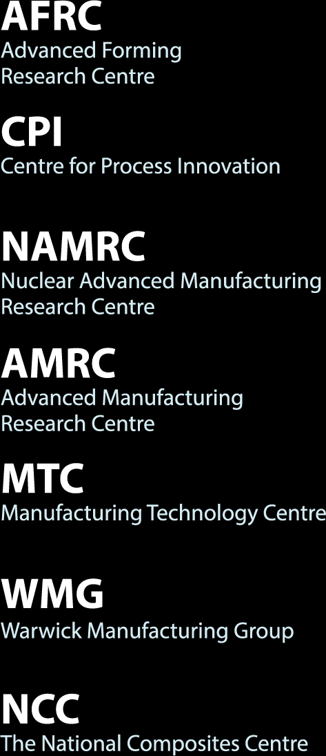
Transforming Industry for a More Sustainable World
The HVM Catapult
The HVM Catapult

Slide 5
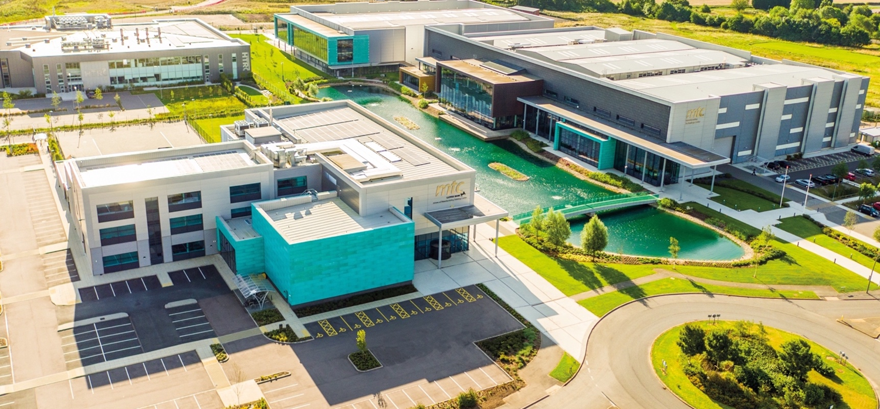

Transforming Industry for a More Sustainable World
The MTC
Opened in 2011
Independent RTO
Prove innovative manufacturing ideas
Manufacturing systems solutions
Training and Skills
800 Employees
£100m Turnover

Slide 6
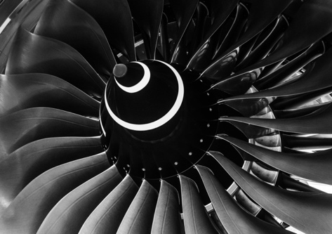
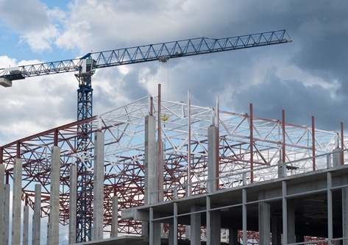
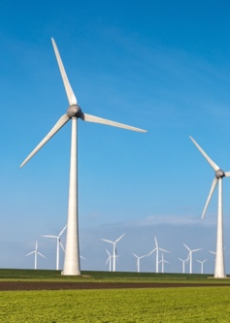
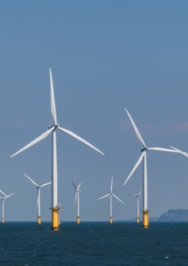
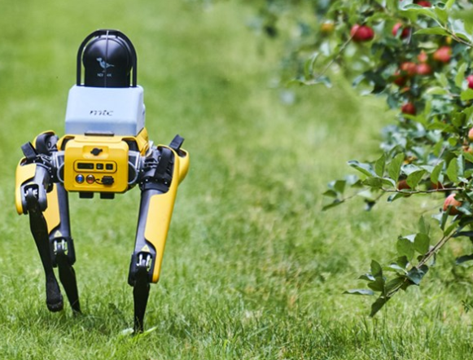
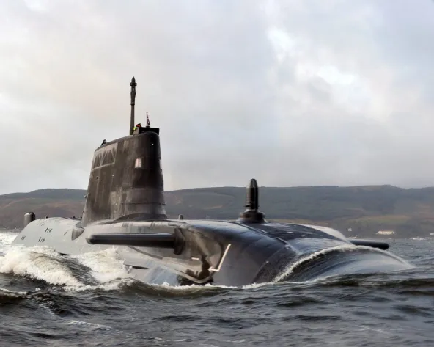
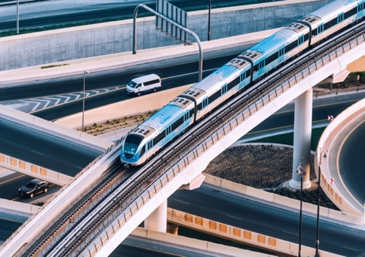
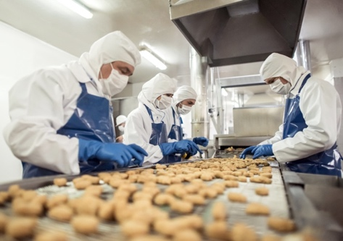


Transforming Industry for a More Sustainable World
Primary Markets
Aerospace, Defence, Security & Space | Construction and Infrastructure | Power & Energy | Industrial Growth
Aerospace | Construction | Power & Energy | Agri-Tech
Defence & Security | Infrastructure |  | Food & Drink
Space |  |  | Healthcare

Slide 7
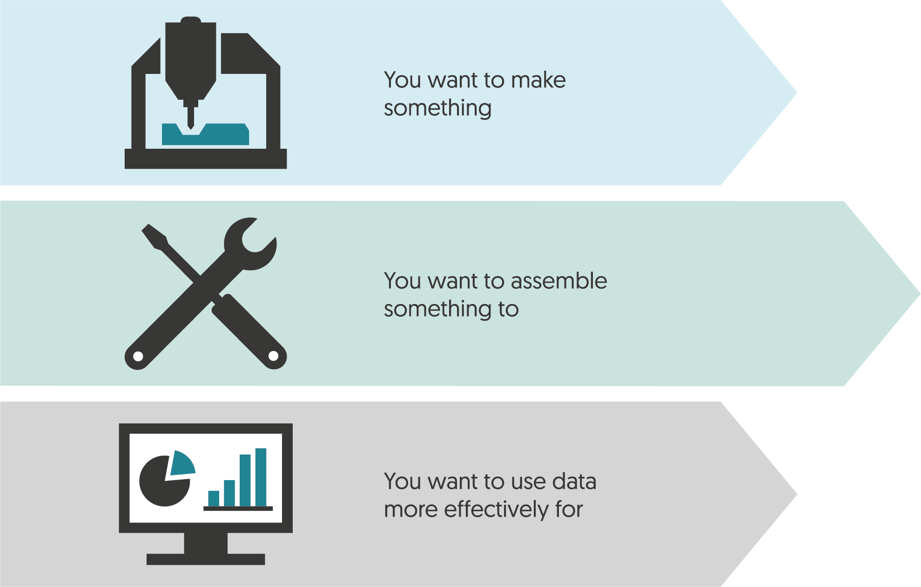
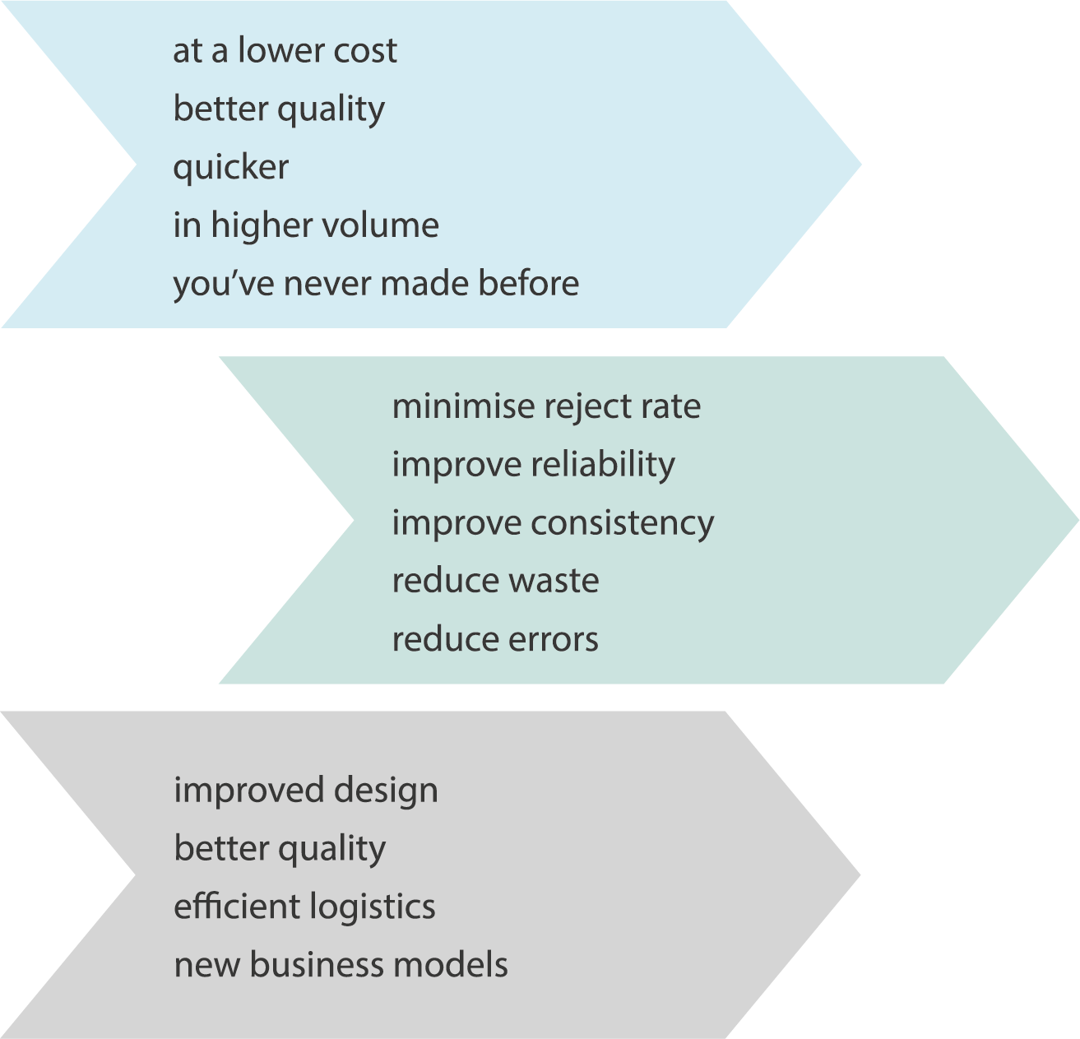
Transforming Industry for a More Sustainable World
Industry Challenges
Industry Challenges

Slide 8


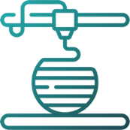


Transforming Industry for a More Sustainable World
Technology & Transformation
Digital Engineering | Advanced Production Systems | Component Manufacturing Technology | Transformation Team | Future Skills
Modelling and Simulation | Automation, Mechatronics and Electronics Manufacturing | National Centre for Additive Manufacturing | Business Transformation | Manufacturing Engineering Apprenticeships
Metrology and NDT | Design & Build | Laser Processing | Digital Transformation | Advanced Manufacturing Training
Data and Informatics | Process, Product and Equipment | Advanced Materials Processing | Technology Transformation | Technology Adoption

Slide 9
Transforming Industry for a More Sustainable World
Importance of TRL/MRL Alignment
How We Work
“US Government Accountability Office cite a lack of manufacturing knowledge and maturity at key decision points as a leading cause of acquisition program cost growth and schedule slippages in major DoD acquisition programs”.
UK National Audit Office (NAO)​
Improving the performance of major equipment contracts. Ministry of Defence (2021)​

Slide 10
Transforming Industry for a More Sustainable World
Importance of TRL/MRL Alignment
How We Work
To introduce new produce quickly and to produce at pace and to cost there needs to be alignment between the developing products TRL and the manufacturing systems MRL, skills and supply chain.
Pre-Concept Refinement​ |  | Concept Refinement​ |  | Technology Development​ |  | Systems Development and Demonstration​ |  |  |  | Production and Deployment​
TRL 1​ | TRL 2​ | TRL 3​ | TRL4​ | TRL 5​ | TRL 6​ | TRL 7​ |  | TRL 8​ |  | TRL 9​ | ​
Basic principles observed and reported​ | Technology concept​ | Proof of concept​ | Basic validation in laboratory environment​ | Basic validation in a relevant environment​ | Model or prototype demo in a relevant environment​ | Technology prototype demonstration in an operational environment​ |  | Actual technology qualified through test and demonstration​ |  | Actual technology qualified through successful mission operations​
​ |  | MRL 1​ | MRL 2​ | MRL 3​ | MRL 4​ | MRL 5​ | MRL 6​ | MRL 7​ | MRL 8​ | MRL 9​ | MRL 10​
 |  | Mfg. process concept proposed​ | Mfg. process concept vetted​ | Mfg. process proof of concept developed​ | Mfg. process validated in a laboratory environment​ | Demonstration Mfg. process in a relevant environment​ |  | Capability and rate confirmed in factory environment​ | Pilot line capability demo for low initial production​ | Low rate production demonstrated​ | Full rate production​

Slide 11
Transforming Industry for a More Sustainable World
Pros & Cons
How We Work
Cons | Pros
TRL 3 to TRL 9 pathway/ programme for a new product has additional upfront cost and complexity. | Minimises time and cost from initial concept to availability in numbers.​ ​ Has minimal impact developing a capability to TRL3.​ ​ From TRL 3 onwards the risk of a capability not being able to be delivered is de-risked.​ ​ Better designed products resulting in reduced cost per unit.​ ​ Identifies early on if significant investment has to be made in:​ manufacturing process development​ supply chain development ​ skills development​

Slide 12
Transforming Industry for a More Sustainable World
How We Work
How We Work
1 | 2 | 3
One to One Single Client Projects | Government Backed Collaborative R&D Projects | Membership Collaborative R&D project funded by members
Collaborative R&D project funded by members | Involvement in 2000+ CR&D projects | £9.7m+ total core research project value
Company owns all IP generated | £9.7m+ total core research project value | £9.7m+ total core research project value

Slide 13
Shipbuilding Manufacturing Capability Acquisition

Slide 14
Transforming Industry for a More Sustainable World
Supporting Shipbuilding
In the past 5 years the MTC has delivered in excess of 84 projects for either shipbuilding OEMs or the supply chain.
The core focus has been to meet the challenges of:
      Improving safety
      Increasing productivity
      Improving quality
      Skill shortages
      Sustainability

Slide 15
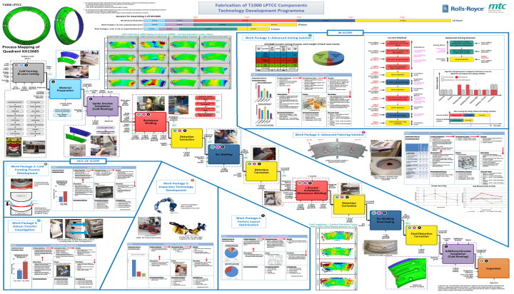
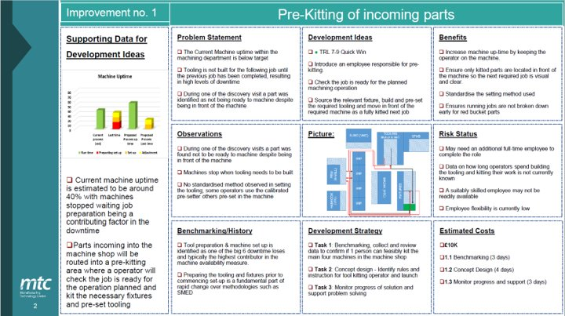
Transforming Industry for a More Sustainable World
MTC Discovery Process
Initial Engagement usually takes the form of the MTC Discovery Process.
Method:
Impartial, multi-skilled teams embed themselves into the workforce to fully understand the problems.
Outputs:
Recommended improvements to production methods, safety, planning and logistics and maintenance.
Identification technology solutions and best practice
Gives the client a prioritised roadmap for implementation considering cost, TRL/MRL, ease and effect.

Slide 16
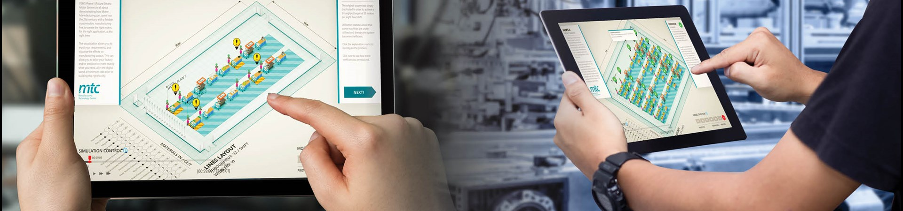
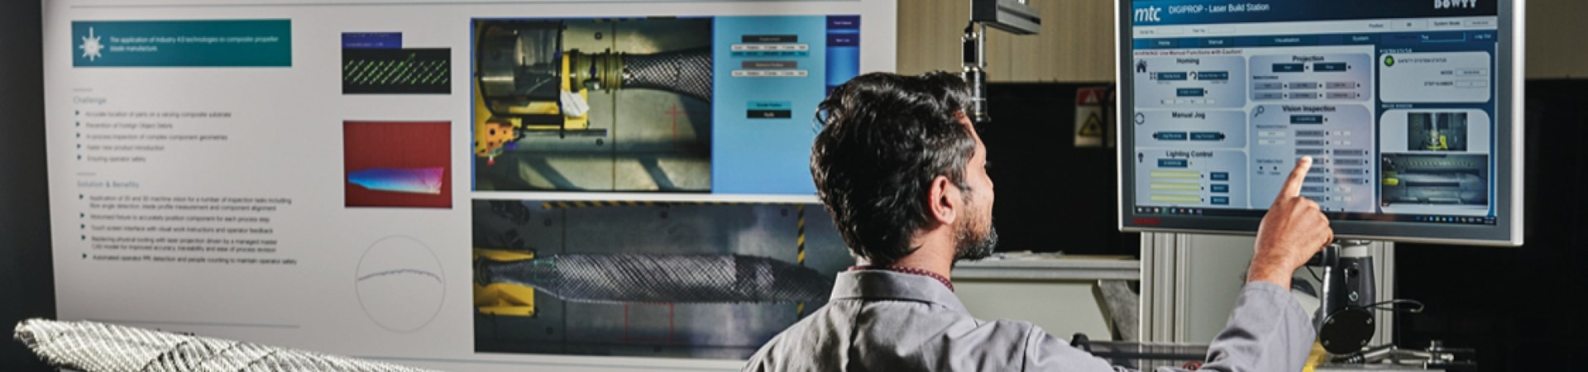
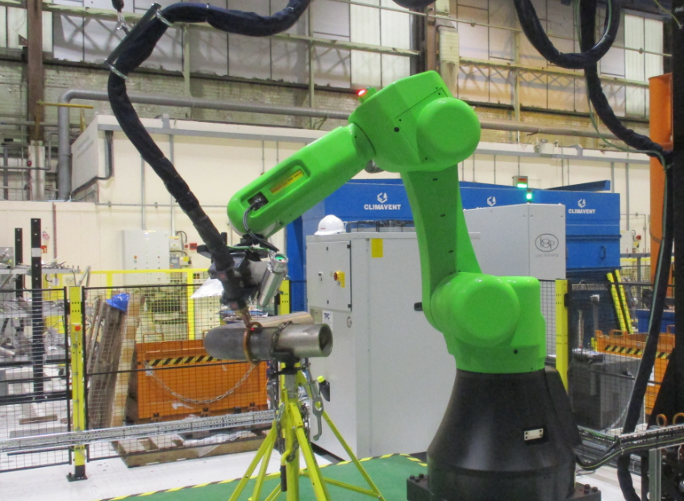
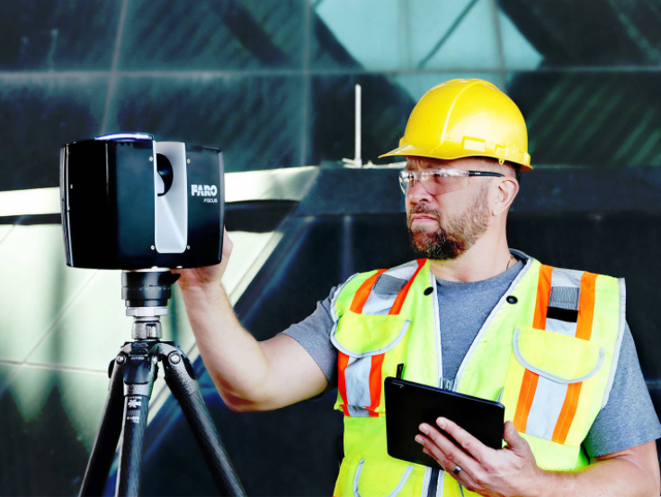
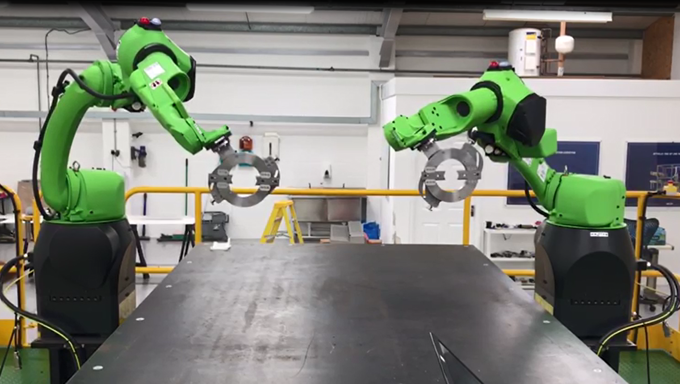
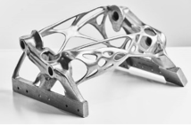
Transforming Industry for a More Sustainable World
Examples of Work
Factory Layout Optimisation
Digitisation of the Manufacturing Environment
Automation of Hazardous Manual Processes
On Machine Measurement of Large Fabrications
Inventory Reduction
Alternative Net Shape Methods & Rapid Manufacture

Slide 17
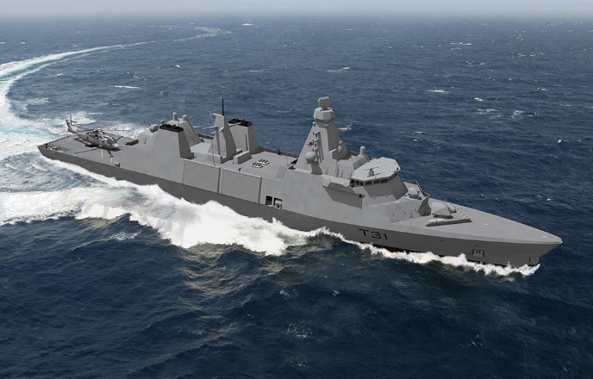
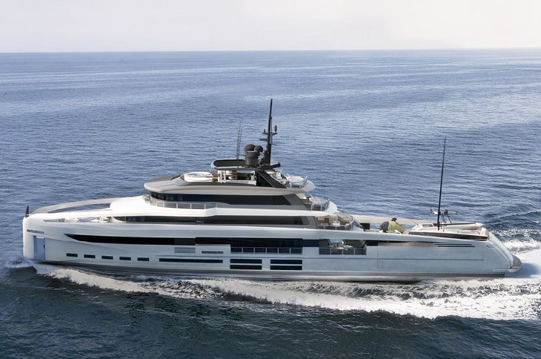
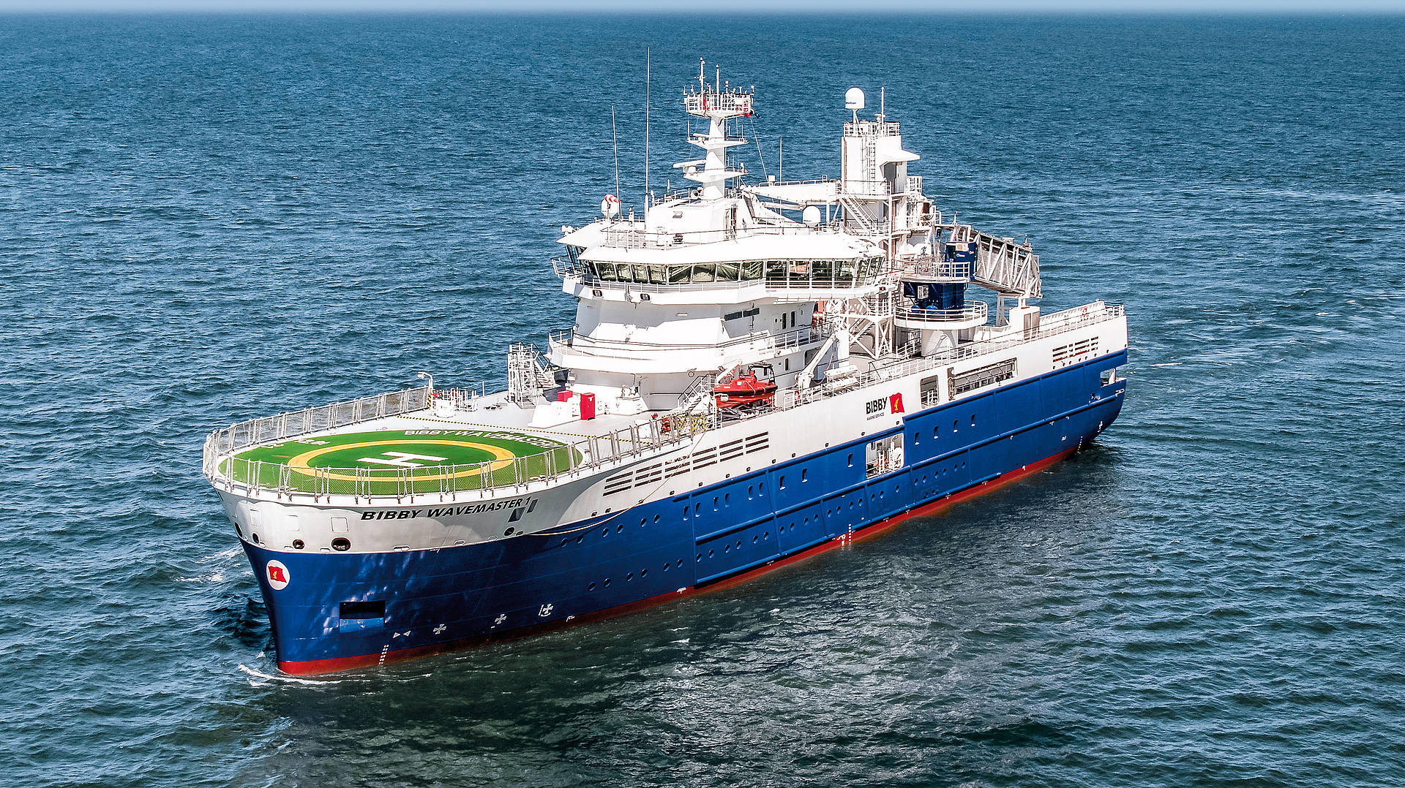
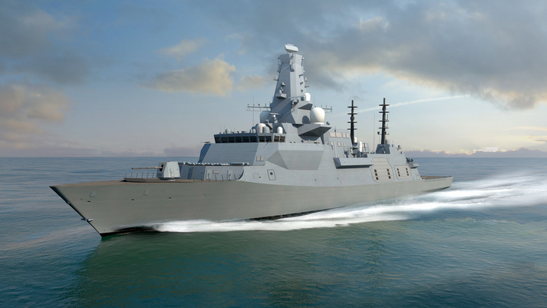
SEG Shipyard of the Future

Slide 18
Transforming Industry for a More Sustainable World
Task and Finish Group
Chaired by Clive Hickman OBE, the Group is made of industry leads from 15 organisations.
The vision of the SEG is that shipyards will be:
Modern, Efficient and Safe
Draws upon advanced manufacturing technologies, like robotics and automation
Digitally enabled and integrated with the broader supply chain
The model for how world leading, next generation shipyards operate and deploy technology needs to be answered by the work of the group.

Slide 19
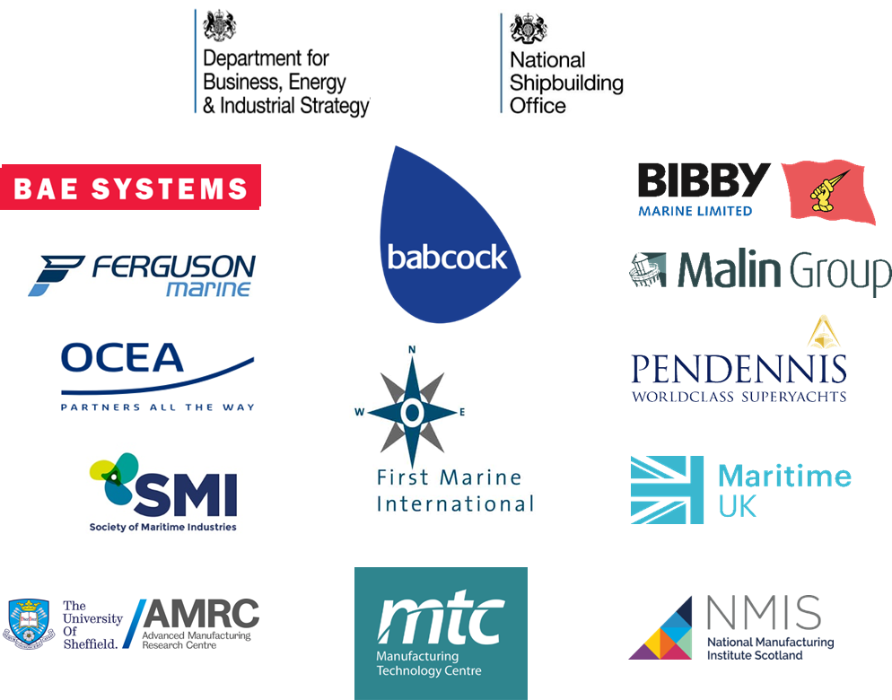
Transforming Industry for a More Sustainable World
Group Members

Slide 20
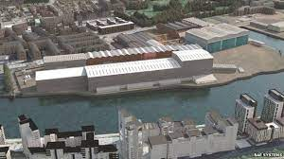
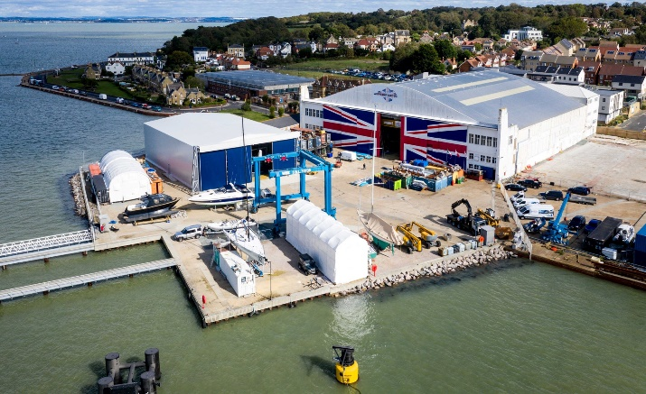
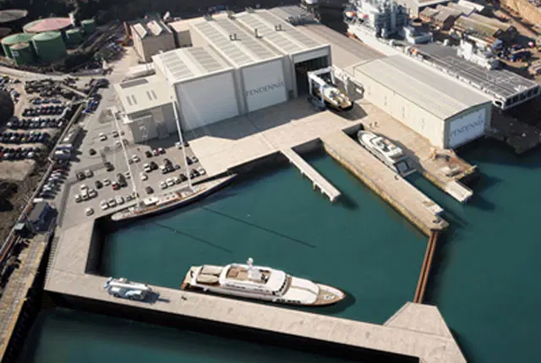
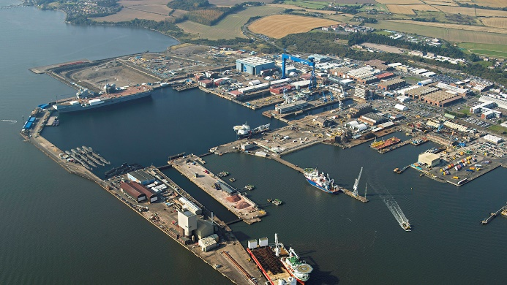
Transforming Industry for a More Sustainable World
End State
Targeting an end date of March 2024, the Shipyard of the Future Task and Finish Group will:
Produce a model for how shipyards of the future must aim to operate.
Identify the advanced manufacturing technologies (digital and physical) required in production and pre-production and give guidance as to how and where to they should be implemented
Provide an underlying body of evidence to support future investment programmes.

Slide 21
Transforming Industry for a More Sustainable World
Closing Message
In addition to maintaining sovereign capability, The MTC sees the importance to the UK of having thriving world-class shipbuilding industry.
We are here to de-risk the acquisition and adoption of new manufacturing technology and processes.

