Slide 1
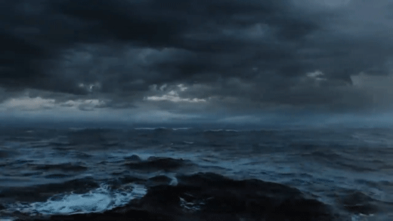




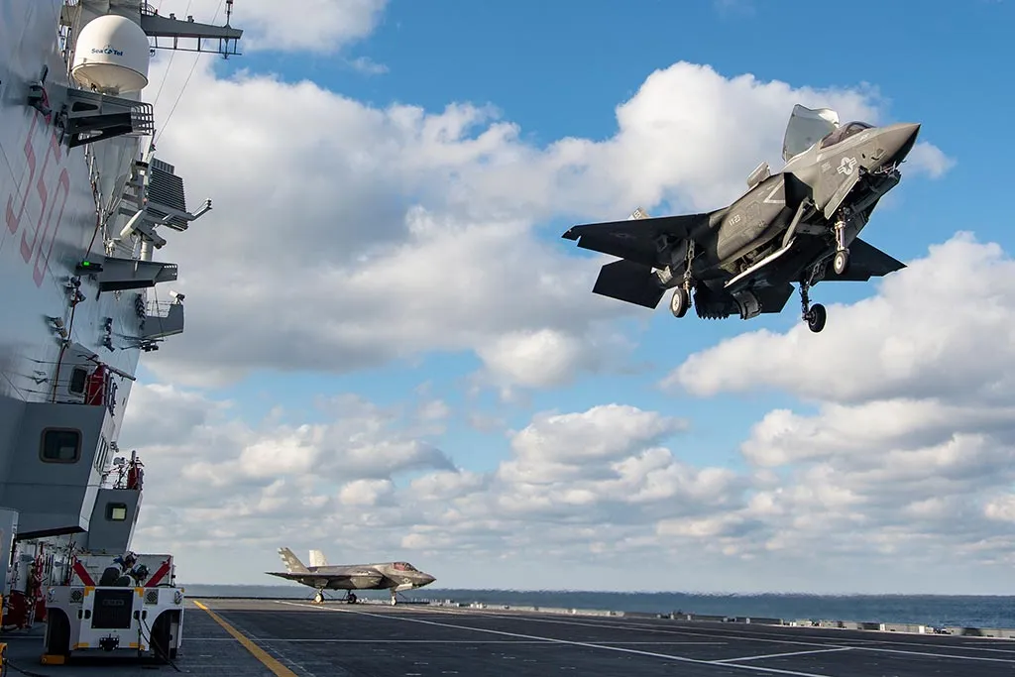









EPC PESCO Project
EPC PESCO Project
Capt Andrea Quondamatteo
CAPDEV Head of Office
Plans Operations and Maritime Strategy Dept.
Italian Navy General Staff

Slide 2
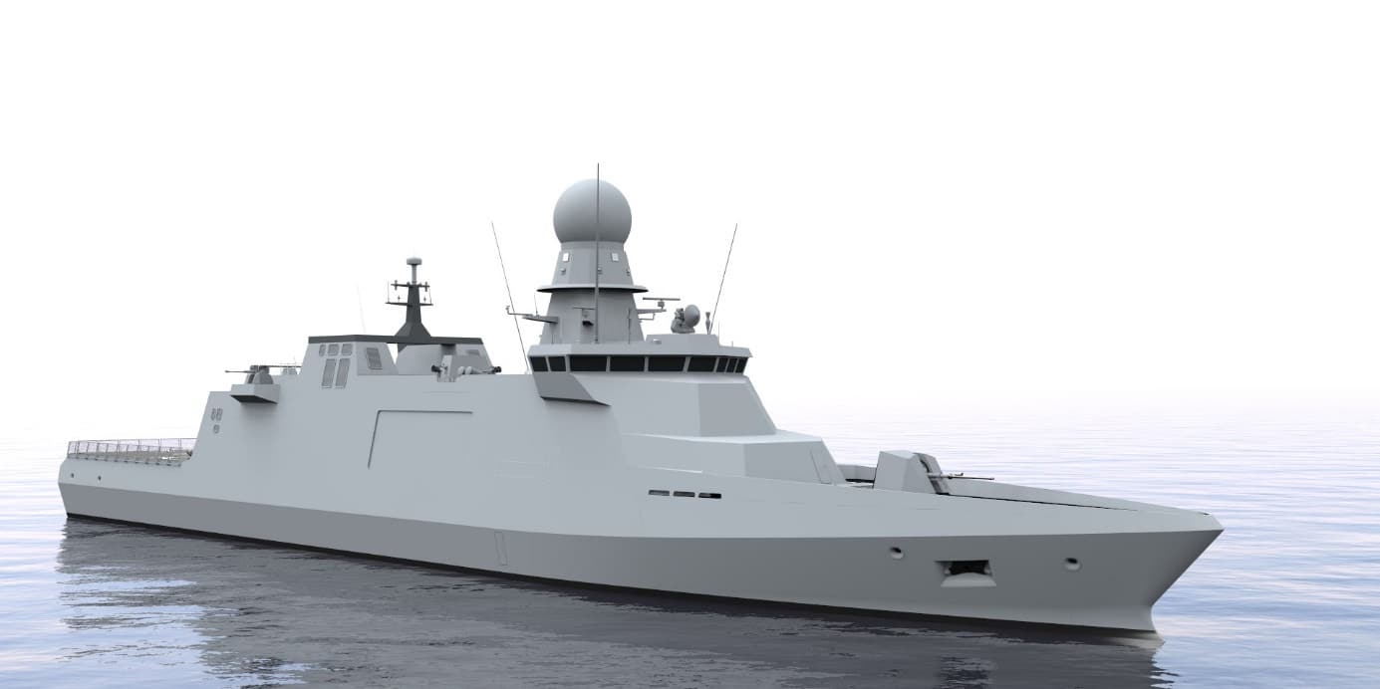
AIM
Provide an update on the EPC PESCO Project with a focus on:
    understanding the 21st century challenges
    growing importance of innovative techno bricks
    investing for the future: how best to enhance performance

Slide 3
AGENDA
State of Play of the EPC PESCO Project
Scenario and use cases (Critical Seabed Infrastructures Protection)
New capabilities (Flex zone/Modularity, UxV multidomain integration for EEZ, Seabed Warfare)
Interoperability challenge

Slide 4







PROJECT TEAM AND PARTICIPANTS
3rd wave PeSCo projects
on 3rd of Jun 2019 Letter of Intent (LoI)
Greece participant from Jan 2020
Spain participant from Mar 2020
Portugal observer from Sep 2020
Ireland observer from Feb 2023
Romania participant from Mar 2023
OBSERVERS
PARTICIPANTS

Slide 5
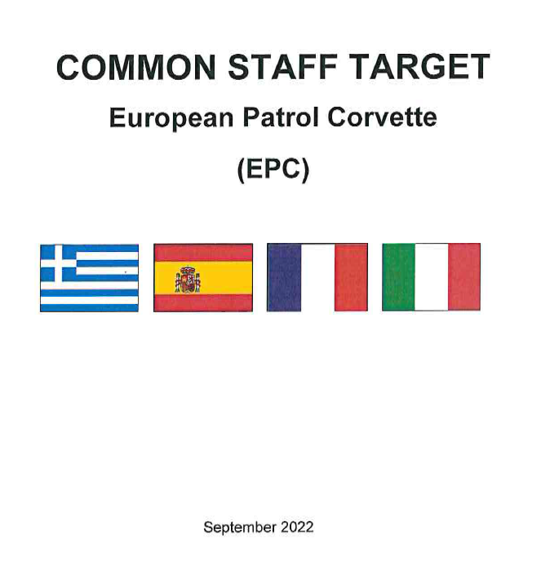
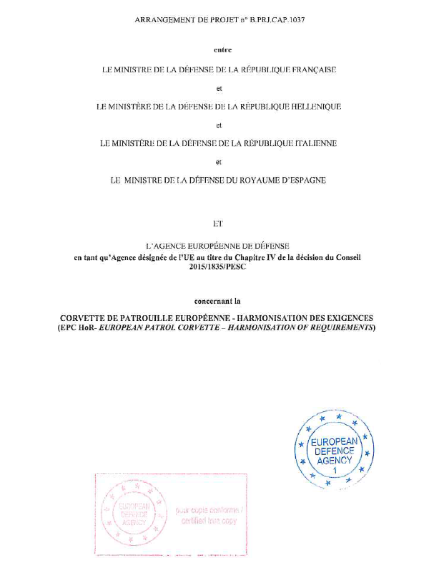
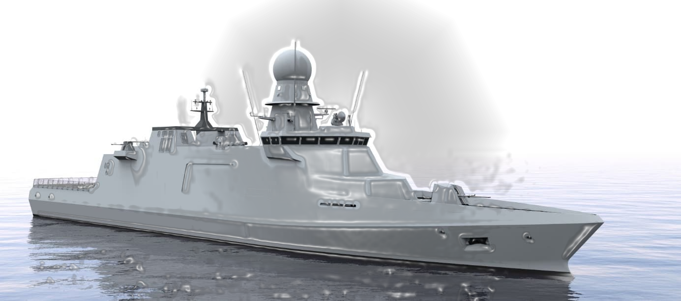
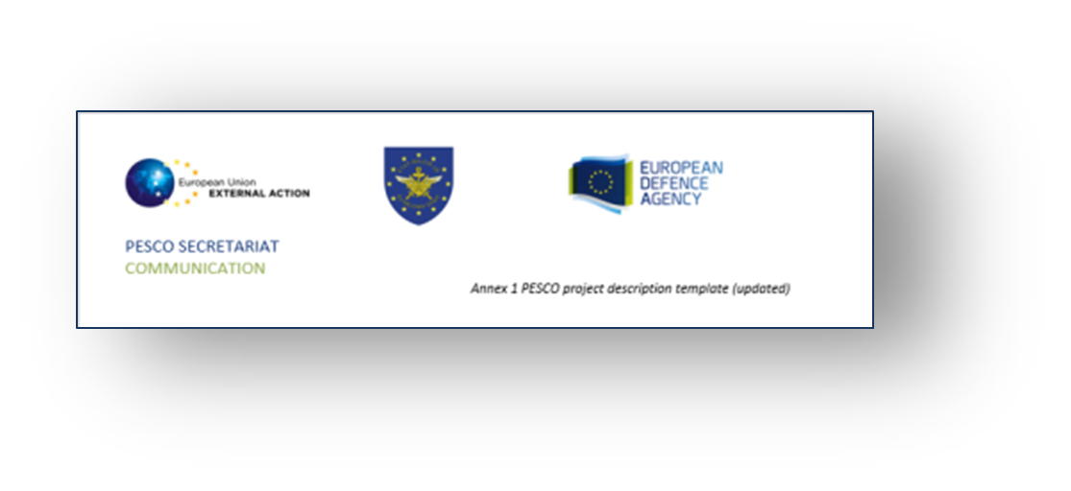
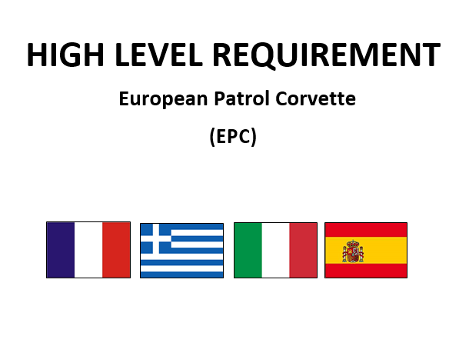





COOPERATION TIMELINE
8 MAY 2022
IN PERSON MEETING IN ROME
Next steps
CSR
EDF MMPC call n.2
SEPT 2022 CST APPROVED
NOV 2019 PESCO 3 WAVE
SEP 2020
PORTUGAL JOINED EPC (OBSERVER)
AUG 2021
HLR VALIDATED
PA APPROVED
MAR 2020 SPAIN JOINS EPC
MAR 2023
ROMANIA JOINED EPC
JUN 2019 ITA – FRA LOI
22 DEC 2022
2° REALITY CHECK
WITH INDUSTRY
FEB 2023
IRELAND JOINED EPC (OBSERVER)
6 OCT 2021
1° REALITY CHECK
WITH INDUSTRY
MAY 2020
EPC KOM
(EDA SUPPORT)
DEC 2020
EDA CAT.B AD HOC PROJECT APPROVED
JAN 2020
GREECE JOINED EPC
NOV 2020
OD APPROVED

Slide 6
EPC VERSIONS FITTED TO A COMMON HULL
2 versions are defined:
Full Combat Multipurpose (FCM) version (Italy/Greece):
up to 4000NM at 14 kts, endurance 20 days at sea
adequate self-defence in ALL warfare areas
Range
endurance
days at sea
Buoyancy
Up to 15% lpp
flooded
EPC
challenge:
common hull
concept
Speed
Max 25 kts
Up to 24kts
Displacement
Max 3.300
tons
Long Range Multipurpose (LRM) version (France/Spain):
Extended: up to 9.000 NM at a minimum speed of
12 kts, endurance 38 days at sea
adequate self-defence in SELECTED warfare areas
Draft
Max 5,5 mt

Slide 7
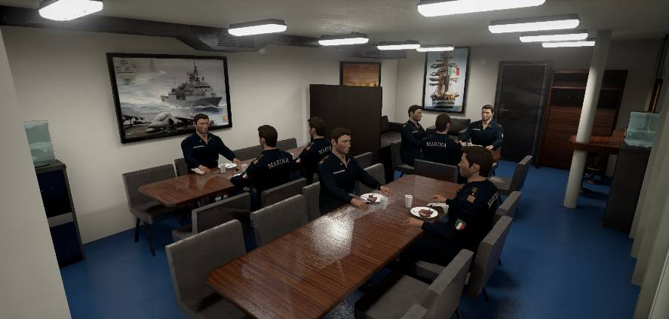
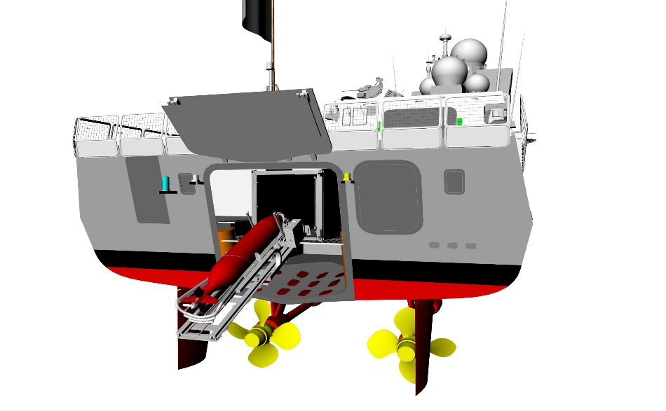
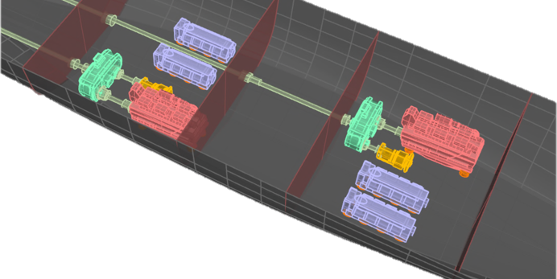
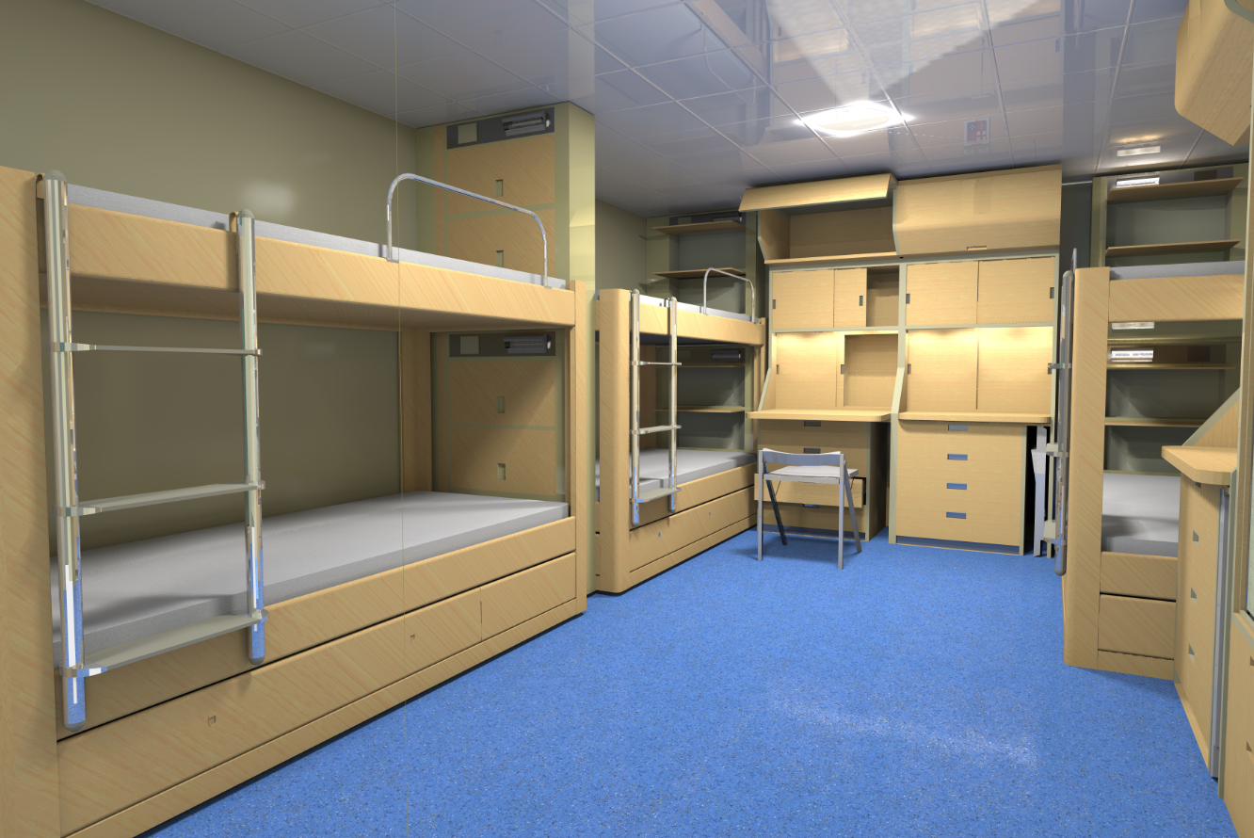

GENERAL DESCRIPTION
Wardroom
AUV LARS
3300 tons displacement
110mt x 15mt x 5.5 mt
range 4000/9000 @14/12kts
endurance 20/38 days at sea
Speed 25/24 KTS
115/125 berth places
Corvette Class Vessel
wide range of missions
modular and flexible design
more interoperable
more energy-efficient
green concept
cyber-secured by design
Propulsion plant
Accommodation

Slide 8


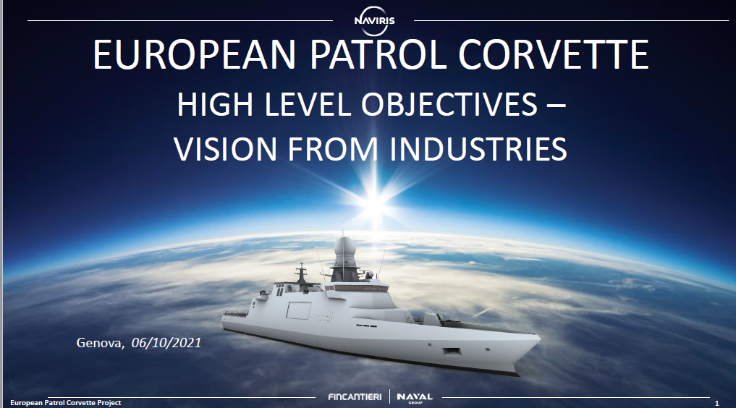


INNOVATION
ship data
management
3 WORSTRANDS
DIGITALIZATION
OPER OUTPUT
E-EFFICIENCY
smart damage
management system
digital twin
and decision support
WORKSTRAND
DIGITALIZATION
modularity
and interoperability
capability to deploy multiple UxV
flex zone preparation
and handling system
active signature management
WORKSTRAND
INCREASING OUTPUT
Marpol compliant
reduction of emission
waste management refrigerating gas
innovative green propulsion E-production
design oriented to circular economy
WORKSTRAND
ENERGY EFFICENCY
Notes:
During my presentation I stated that EPC is an innovative project.
The reason why Innovation is a driver can be correlated with the aim to implement a variety of techno bricks, divided in 3 workstrands as shown on the slide:
In light blue the workstrand regarding the improvement of operational capabilities;
In purple the workstrand for the digitalization featuring of the project;
In green the workstrand for the greening aspects.

Slide 9

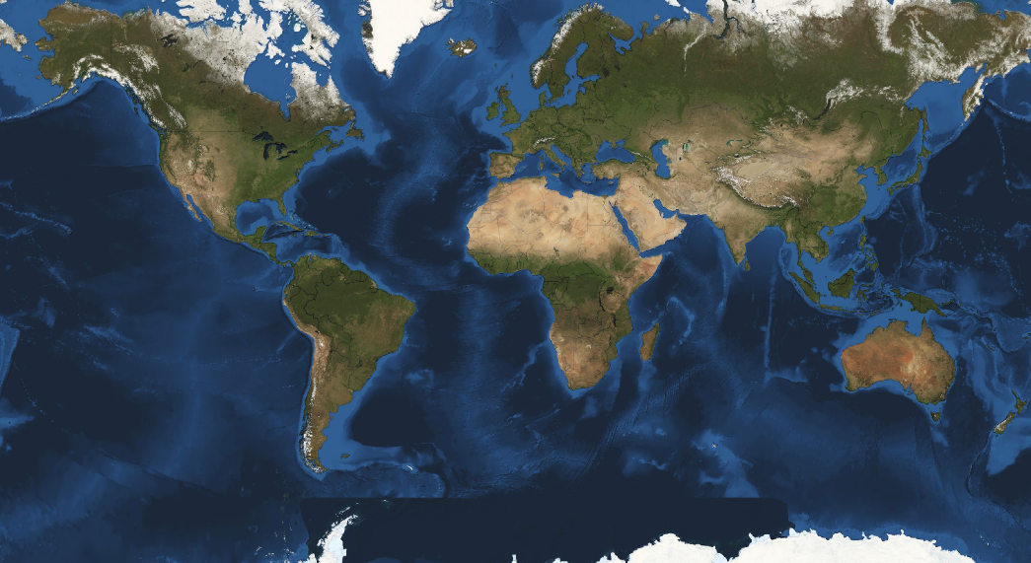






















CHALLENGES AND CONEMP
INTERESTS
COMMODITIES
TRADES
FISHERY INDUSTRY
SCIENTIFIC RESEARCH
INDUSTRY
PROMOTION
RISKS
ILLICIT TRAFFICS
PIRACY
SPREAD OF VIOLENCE
ILLEGAL MIGRATION
FAMINE
TERRORISM
LAWFARE
CYBER WARFARE

Slide 10
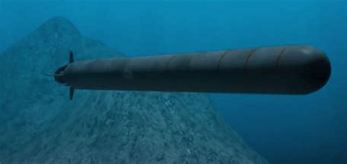
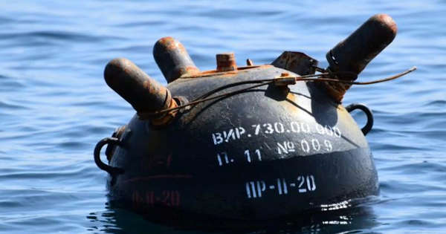
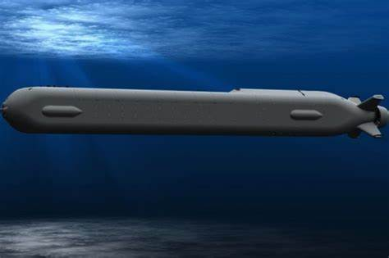
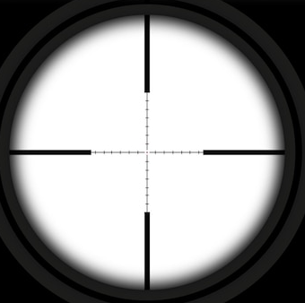

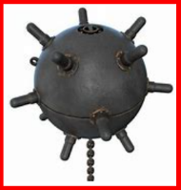

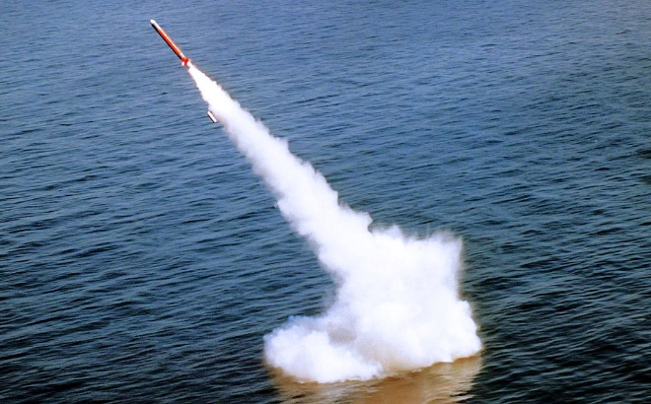
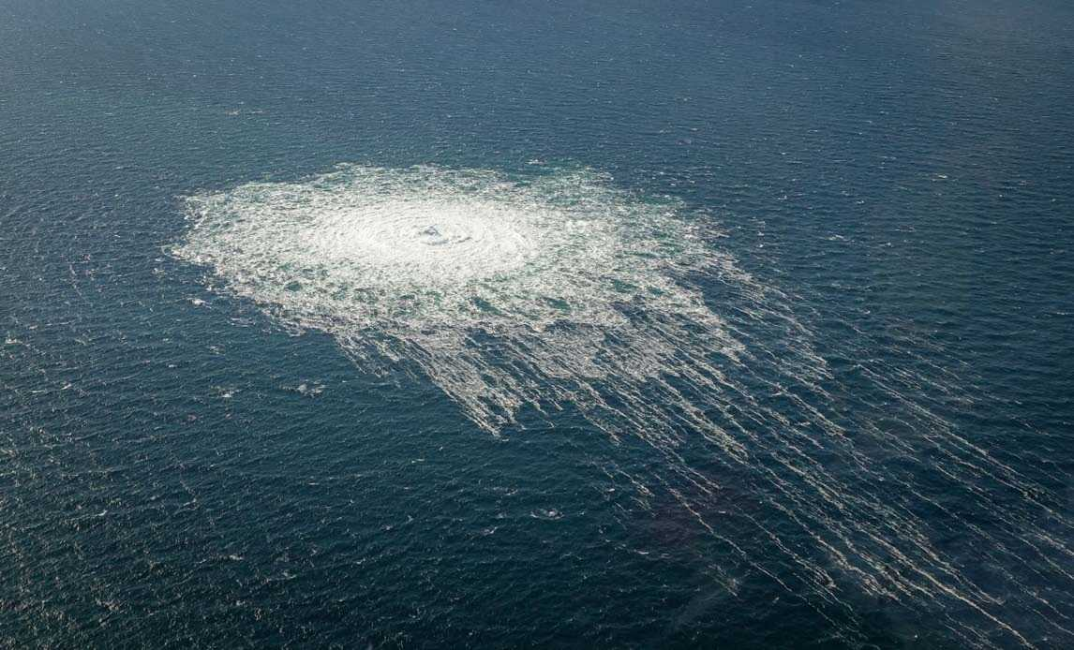
A new paradign for the UWW and the Underwater Dimension
UW threat immanent
ANTISUBMARINE
WARFARE
MINE
WARFARE
SEABED
WARFARE

Slide 11
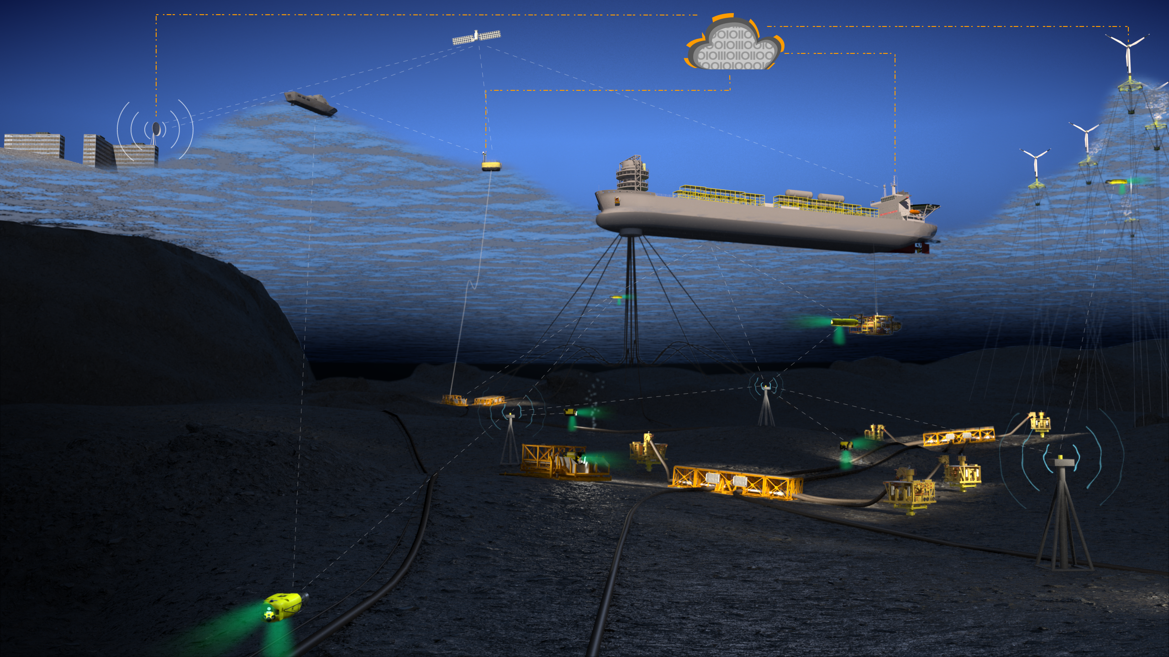
CAPABILITY GROWTH POTENTIAL
Industry vision: a system of systems
Moving into the era of autonomous drones: AI driven solutions, modular and interoperable
© 2023 Saipem property. All rights reserved.

Slide 12
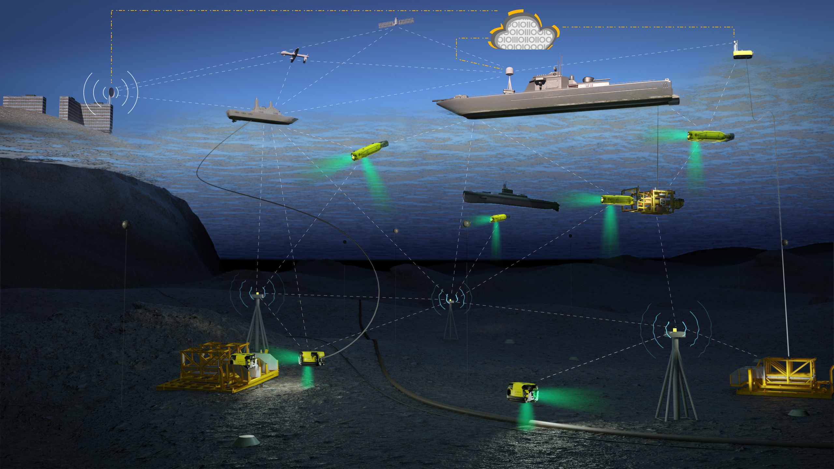
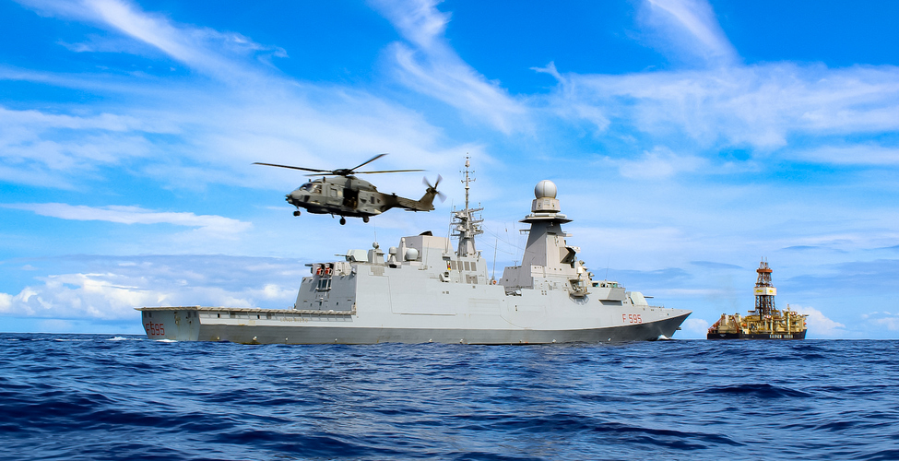
CAPABILITY GROWTH POTENTIAL
From offshore energy to defence applications
Expanding the control capability into the deep sea
© 2023 Saipem property. All rights reserved.

Slide 13

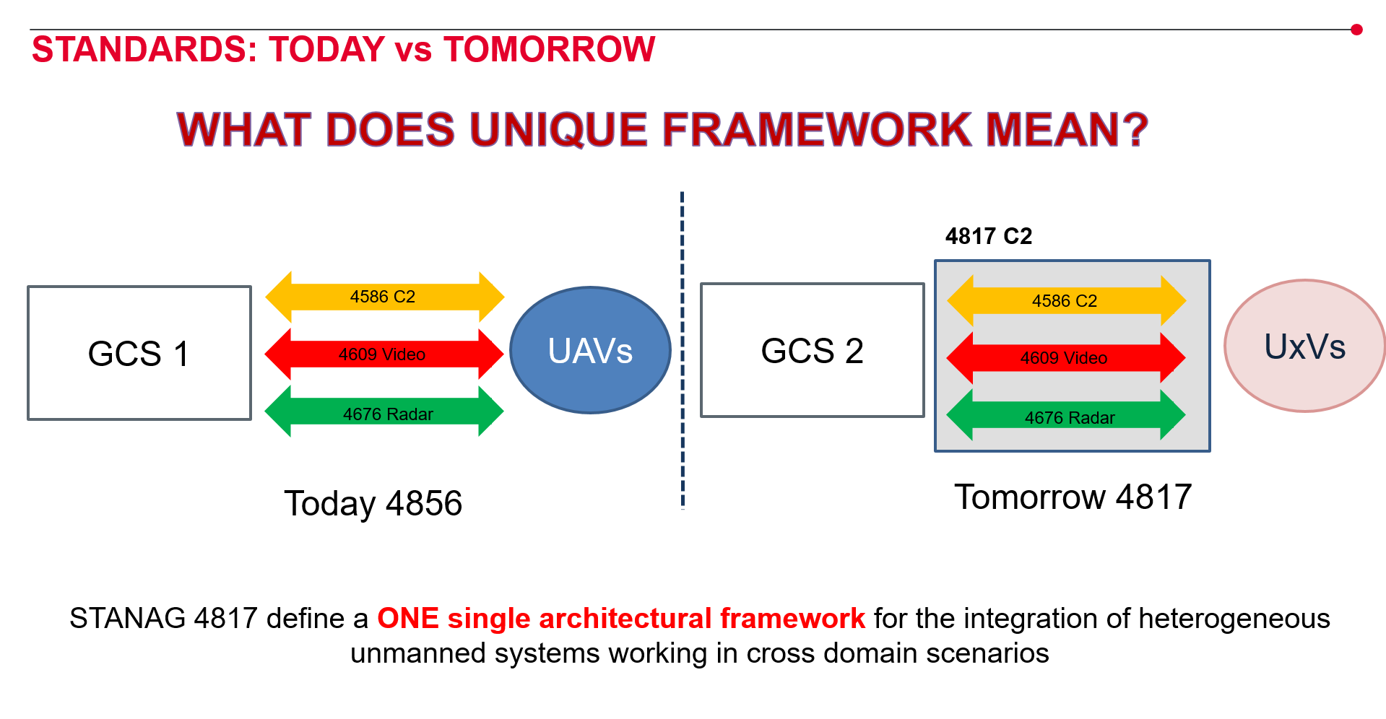
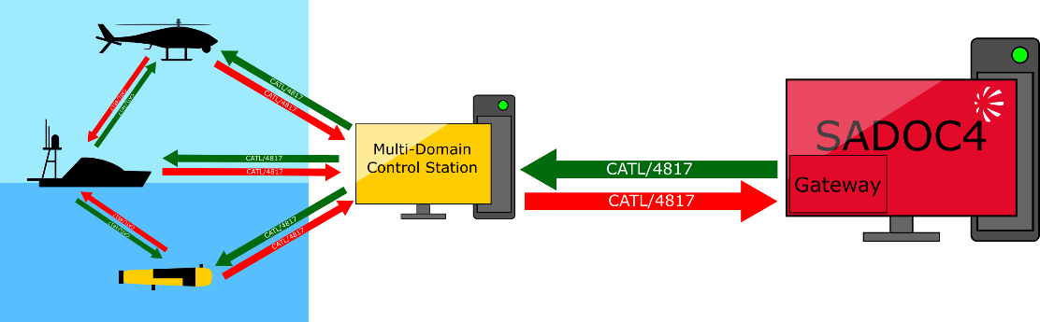
STANAG 4817 – Multidomain C2 interoperability for UxV
Requirements
Open Architecture
Domain agnostic
Based on the CATL by NATO CMRE
Multilayer Integration
A single protocol
Interoperable with national CMS/C2
Able to manage classified data
CMS
13

Slide 14
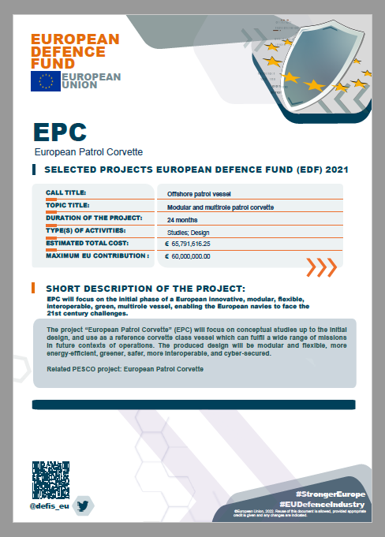
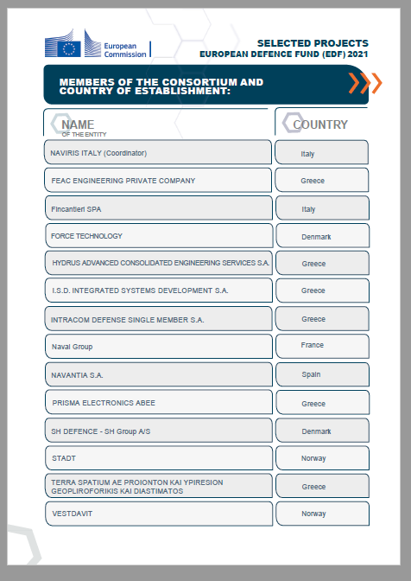
OUTCOMES FROM THE 2021 EDF CALL
Deliverables on GOV side
HLR
PA
CST
Goals on NAD side
Industry Consortium
MMPC call n.1
Contracting Auth.
MOU and Impl. Agrmnt
EPC project Team
Additional pMS/Obs
3 reality checks with
the Industry

Slide 15
WAY AHEAD
CSR ready to sign by Sept 23
2023 EDF MMPC call n.2
Deliverables from the MMPC
2025 Contract
2030 FOC commissioning

Slide 16
CASE STUDY ON THE COMMON STAFF REQUIREMENT (CSR) NEGOTIATION
REQ. TITLE | IMPACT
RANGE | pMS defined significantly different range requirements which have an impact on the fuel capacity. A meeting point solution is envisaged.
RESERVE BUOYANCY | Different buoyancy and stability criteria can require a different definition of the compartment arrangement (or even a different hull). A meeting point solution is envisaged.
ISO CONTAINERS | pMS expressed a different quantity requirement (2 or 1 ISO 20’) and also indicated the module position requirement which represents a very impactful design constraint.
SMALL BOATS | PMs expressed a different requirement in terms of boat size, quantity and position.
SPEED | According to the common hull concept, the 2 version will significantly differs in Displacement. This means different cruise speed for the LRM/FCM that require studies
HOW BEST TO SEEK FOR CONSENSUS TO
BETTER SUPPORT THE COMMON HULL CONCEPT
Adoption of Threshold and Objective values for KPP 1.1.2.7. “range” correlated with MARPOL 12A rule and KPP 1.1.4.3. “reserve of buoyancy”.
4000NM @ 14 kts - FCM
9000NM @ 14 kts - LRM
2 next flooded compt - IT, EL, ES
Up to 15 lpp% - FR
Adoption of ad hoc Classification Society rules
Modularity and flexibility above the main deck
Max optimization of implementing solutions
1 ISO 20’ amidship – IT, EL
2 ISO 20’ (amidship and aft) FR, ES
2 rhibs sideways-IT, EL
3 rhibs sideways-ES
2 rhibs sideways with
stern ramp-FR

Slide 17
KEY TAKEAWAYS
a successful cooperation project and why
the criteria of being a PESCO Project
the best practices introduced to the project

Slide 18
EPC PESCO Project
EPC PESCO Project
Capt Andrea Quondamatteo
CAPDEV Head of Office
Plans Operations and Maritime Strategy Dept.
Italian Navy General Staff

