Slide 1
Naval Programmes managed by OCCAR with a focus on the modern Logistic Support Ship (LSS)
Combined Naval Event 2023 – Farnborough (UK)

Slide 2
Agenda
OCCAR overview
Programmes managed in the Naval Domain
Technical focus
    LSS Programme
    FREMM Programme
    PPA Programme
    MMCM Programme
    MALE RPAS Programme
    LWT Programme
Questions

Slide 3


OCCAR
OCCAR (Organisation Conjointe de Coopération en matière d'Armement)
International Organisation for the management of cooperative defence equipment programmes
Created through the Convention signed in 1998 and entered into force in 2001
GE
FR
IT
UK
ES
BE
FI
LT
LU
NL
SE
PL
TR
AU
AU
BR
Member States
Non-Member Participating States
Observer States
Notes:
Australia is observer in Boxer and Tiger and PS in LWT Programme.
Brazil is observer in LSS Programme

Slide 4
Agenda
OCCAR overview
Programmes managed in the Naval Domain
Technical focus
    LSS Programme
    FREMM Programme
    PPA Programme
    MMCM Programme
    MALE RPAS Programme
    LWT Programme
Questions

Slide 5
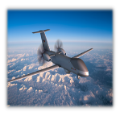
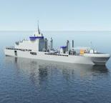
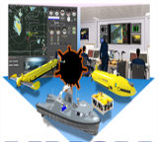






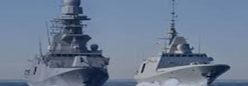
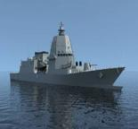
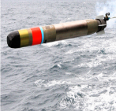
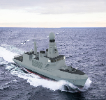
OCCAR in the Naval Domain
  Medium Altitude Long Endurance Remotely Piloted Aircraft System (MALE RPAS)
  Logistic Support Ship (LSS)
  Maritime Mine Counter Measures
  (MMCM)
Observer
  Lightweight Torpedo (LWT)
  Modular Multirole Patrol Corvette (MMPC)
  Multi Mission Frigates
  (FREMM)
  Offshore Multipurpose Patrol ships
  (PPA)
Recently integrated in OCCAR…
Future perspectives…

Slide 6




Naval Programme Division Sites
Paris (LSS, FREMM-HORIZON, MMCM, LWT Programme management)
La Spezia (LSS, PPA, HORIZON – Satellite Office & Shipyard)
Saint Nazaire (LSS – Satellite Office & Shipyard)
Castellammare di Stabia (LSS Programme management & Shipyard)
Rome (FREMM-HORIZON, PPA, Programme management & Satellite Office)
Munich (MALE-RPAS Programme management)
1
2
3
1
6
4
3
5
6
2
5
4
Notes:
Here the 7 seven OCCAR-EA office locations.
Siti produttivi:
LSS – Riva Trigoso – Castellammare – Saint Nazaire
PPA – Riva Trigoso
LWT – Saint Tropez – Livorno
FREMM/Horizon – Riva Trigoso – Tolone
MALE RPAS – Final assembly in Manching (DE)
MMCM - Brest (FR), Templecombe (UK), Portchester (UK), Stonehaven (UK), Linkopin (Sweden)

Slide 7
Agenda
OCCAR overview
Programmes managed in the Naval Domain
Technical focus
    LSS Programme
    FREMM Programme
    PPA Programme
    MMCM Programme
    MALE RPAS Programme
    LWT Programme
Questions

Slide 8
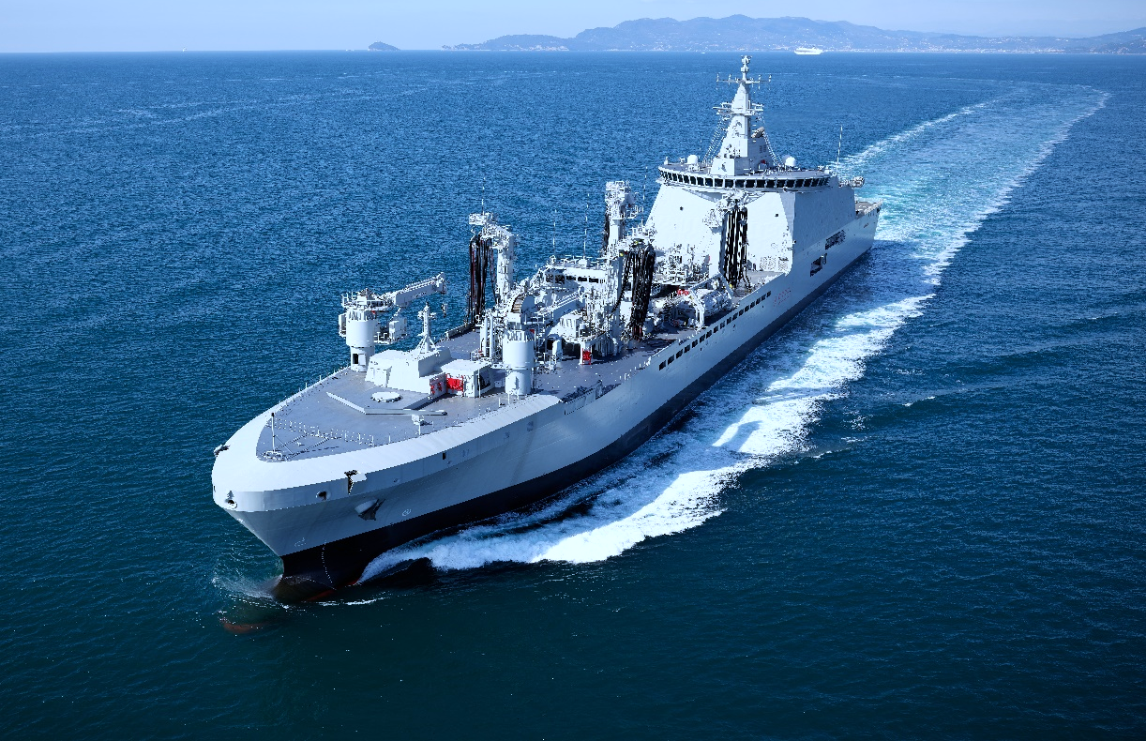
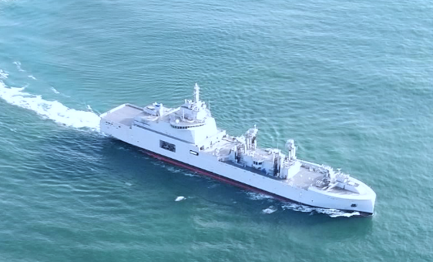

LSS Programme overview
Logistic Support Ship
Photo credit: Fincantieri
Photo credit : Naval Group
LSS PD
P-8

Slide 9





Programme Overview
Stakeholders
Observer
Temporary Consortium
LSS PD

Slide 10
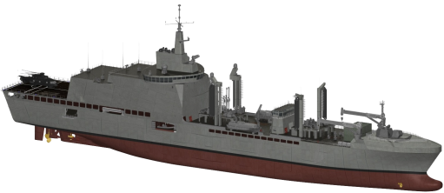
The strength of co-operation
How to make defence expenditures more effective (get more for less)?
2015
Contract Started
2019 France joined OCCAR programme
2021
1st Ship delivered
2023
2nd Ship
To be delivered
from 2024 onwards
Up to 4 FR units
Up to 2 IT units (+1 option)
The business in figures…
Amministrative
Budget (AB)
Managing large
Programs:
Ratio AB/OB ≈ 1.5 %
Operational
Budget (OB)
2016 Brazil
became observer
LSS PD
P-10

Slide 11
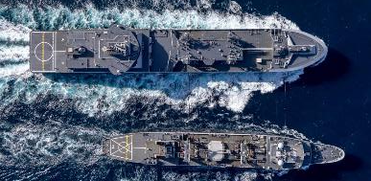
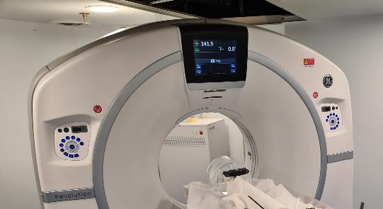
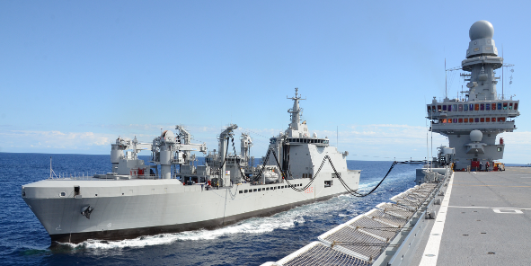
Tasks and capabilities
LSS will perform the main following tasks
  Multirole and Dual Use:
Logistic support to a naval group for an extended period;
Technical assistance and support of systems/equipment embarked;
Medical and surgical support;
Disaster relief, humanitarian response, provision of medical aid;
Search and rescue operations and aid to vessels in distress;
CIVILIAN
MILITARY
LSS PD
P-11
Notes:
The main tasks that can be performed by LSS highlight the "dual use" capability.
As you know it means that LSS can be used also for civil purposes if it is necessary. (clic)
In detail, LSS will perform the following tasks:
Logistic support (refuelling at sea with NATO fuels F76 and F44, lubricants, ammunition, spare parts, food, drinking water, specialist medical products, equipment and other materials) to a naval group for an extended period;
civil protection roles at times of crisis;
participation to operations for disaster relief, humanitarian response, provision of medical aid, etc.;
medical and surgical support (NATO Role 1 or 2 light manoeuvre, depending on the configuration);
technical assistance, maintenance and repair up to level 3 of systems/equipment embarked on the first line ships;
support to search and rescue operations and aid to vessels in distress;
support to special forces and to an embarked joint operational command, depending on the configuration;

Slide 12
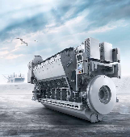
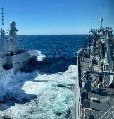
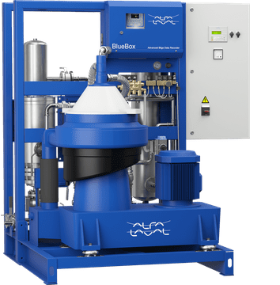
Common French-Italian objectives
FR-IT feedback
& improvement
A win-win cooperation through OCCAR
Design
Development
Production
In-Service
Support
Exchange of technical information
COMMON SYSTEMS
LEVEL OF COMMONALITIES
Time saving &
Production
control
ISS STUDY
FR-IT
Mutual Government
Quality Assurance (GQA)
LSS PD
P-12

Slide 13

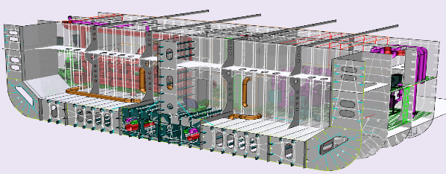
Environmental commitment
BILGE OIL SEPARATOR
BALLAST WATER TREATMENT
Key factors
DOUBLE HULL DESIGN
REDUCED ENVIROMENTAL FOOTPRINT
RINA’S GREEN PASSPORT NOTATION
WASTE TREATMENT
SEWAGE TREATMENT
Double Hull - according IMO MARPOL 73/78
LSS PD
P-13
Notes:
RINA GREEN PASSPORT is a goal-based class notation committed to environmentally friendly: it is based on an environmental performance index, which covers all aspects of the vessel’s impact on the environment, including carbon emissions.
The class notation will be granted to new vessels that make a significant investment in design solutions, onboard equipment, and operational procedures which contribute to an improvement in environmental performance beyond the minimum levels required by international regulation on environmental protection.
In particular, about the ballast water treatment…
International Convention for the Control and Management of Ships' Ballast Water and Sediments (BWM)
Invasive aquatic species present a major threat to the marine ecosystems, and shipping has been identified as a major pathway for introducing species to new environments. The problem increased as trade and traffic volume expanded over the last few decades, and in particular with the introduction of steel hulls, allowing vessels to use water instead of solid materials as ballast. The effects of the introduction of new species have in many areas of the world been devastating. Quantitative data show the rate of bio-invasions is continuing to increase at an alarming rate. As the volumes of seaborne trade continue overall to increase, the problem may not yet have reached its peak.
However, the Ballast Water Management Convention, adopted in 2004, aims to prevent the spread of harmful aquatic organisms from one region to another, by establishing standards and procedures for the management and control of ships' ballast water and sediments
Under the Convention, all ships in international traffic are required to manage their ballast water and sediments to a certain standard, according to a ship-specific ballast water management plan. All ships will also have to carry a ballast water record book and an international ballast water management certificate. The ballast water management standards will be phased in over a period of time. As an intermediate solution, ships should exchange ballast water mid-ocean. However, eventually most ships will need to install an on-board ballast water treatment system.
Ballast Water Treatment
The unit shall be equipped with a ballast system, consisting mainly of:
- A module consisting of two electric pumps in transported diesel pumps,
- A module consisting of two electric pumps in the bow thruster compartment.
Each pump installed on the modules will be able to process a flow rate of 200 m3/h at 3 bar.
The system will allow the tanks to be filled by sucking water from the sea and to empty the tanks.
The ballast service will host two filtration type ballast treatment plants and UV sterilization.
Waste treatment
The Unit will be able to:
- store the waste to be treated,
- treat solid waste (glass, metal, plastic, paper, unsorted rubbish, etc.),
- store the processed waste.
For the treatment of waste produced by the crew and of waste produced by assisted vessels, it will be
provided a dedicated room equipped with n. 3 type solid waste conversion systems latest generation NV100 size converter.
Sewage treatment
The black and gray waters coming from the sanitation drains indicated will be fully treated by two approved type sewage treatment plants, arranged one
in Aft Auxiliaries Room and one in Bow Engine Room, each sized for 60% of the daily production of sewage considering the simultaneous presence on board of 200 people.
Effluents from black and gray water treatment shall be compliant as indicated in the IMO – MEPC 227 (64).

Slide 14
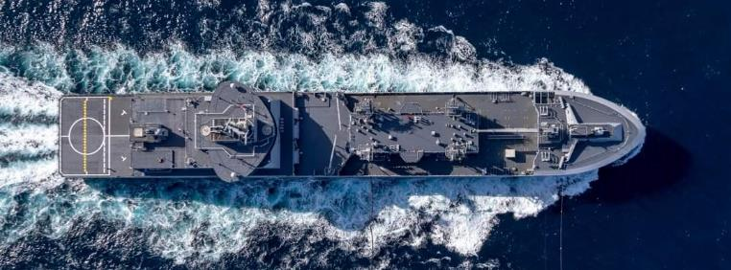
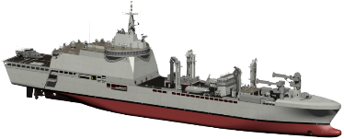
Technical Overview (1 of 4)
Main Characteristics
Displacement: up to 31.000 t.
Length: ≈ 194 m
Speed: more than 19 Kts
Range: up to 8.000NM
Crew: up to 235
Diesel-Electric Propulsion Plant
(low environmental impact)
Flight Deck & Hangar up to 2 Helos
Medical Facilities, NATO Role 2 LM
Photo credit: Marine Nationale
LSS PD
P-14
Notes:
Here it is possible to see the capabilities of the ship.
Focus on Hangar
The LSS will be equipped with a flight deck 27.6m long and 24m wide, with related systems
and equipment and landing grid, sized for the loads given by the landing of
helicopters currently supplied to the Armed Forces, with a maximum weight of 33.3 t.
In the hangar it will be possible to maintain 2 helicopters at the same time.
The French and Italian designs share as many similarities/commonalities as possible.

Slide 15
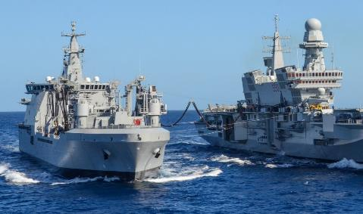
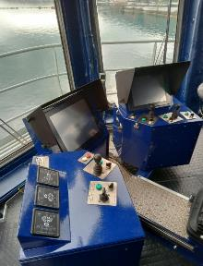
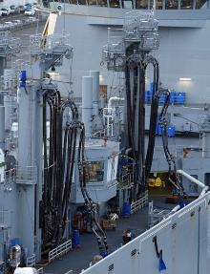
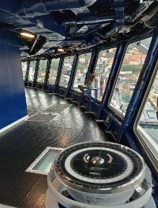
Technical Overview (2 of 4)
Photo credit: Fincantieri
  SUPPLY & LOGISTIC CAPABILITIES:
  4 refuelling stations for fuel and JP5
  2 stations for heavy material transferring
  1 aft refuelling station for fuel
  Workshops and labs for repair activities
≈ 8.700 m³
Naval Fuel
≈ 3.700 m³
Avio Fuel
≈ 800 m³
Fresh Water
≈ 30.000
Food rations
LSS PD
P-15
Notes:
With regards to the peculiarities of the ship, the transportable loads are highlighted, before and after the modifications, as well as the sketches related to the filling stations. In particular the payload is now composed by:
8700 cums of diesel oil; 3700 cums of avio fuel; 800…;
The main stations to deliver the payload are the following (characteristics):
- 4 refuelling stations with pipes as represented in the sketches; 2 stations for heavy materials (2.5 tons);
- 2 stations for light materials 250 Kg; 1 aft refuelling station;
Several workshops and labs for support activities for the benefit of deployed naval forces.

Slide 16
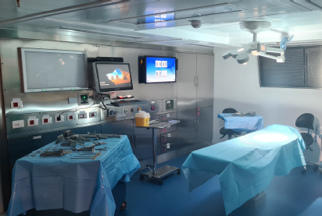
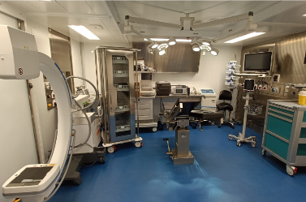
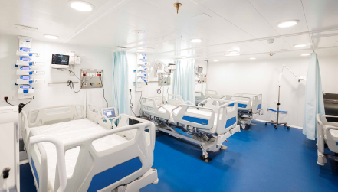
Technical Overview (3 of 4)
Surgery 1
Surgery 2
Intensive care
Photo credit: Fincantieri
  ROLE 2 MEDICAL SUPPORT:
  Connection with hospitals ashore
  Telemedicine / VTC medical consultation / Second opinion
  Diagnostic imaging
  HOSPITAL CRITICAL AREA:
  First aid: 8 beds
  Burn unit: 1 bed
  Intensive care: 4bd + 4bd
  Surgery : 2 rooms
  HOSPITAL INPATIENT AREA:
  Hospital stays: 2bd + 2bd
  Infectious stays: 2bd + 2bd
  RX, Orthopantomograph, CAT
  Analysis laboratory
  Pharmacy/
LSS PD
P-16
Notes:
Medical Support
The term "Role" is used to describe the stratification of the four tiers in which medical support is organised, on a progressive basis, to conduct treatment, evacuation, resupply, and functions essential to the maintenance of the health of the force.
Role 2 support is normally provided at larger unit level, though it may be provided farther forward, depending upon the operational requirements.
Hospital Critical Area:
first aid: 8 beds
Burn unit: 1 bed
Intensive care: 4bd + 4bd
Surgery : 2 rooms
Hospital Support Services:
RX, Orthopantomograph, CAT (computerized axial tomography - TAC)
central sterilization
analysis laboratory
Pharmacy
Hospital Inpatient Area:
Hospital stays: 2bd + 2bd
Infectious stays: 2bd + 2bd
Dental clinic
Gynaecological clinic

Slide 17
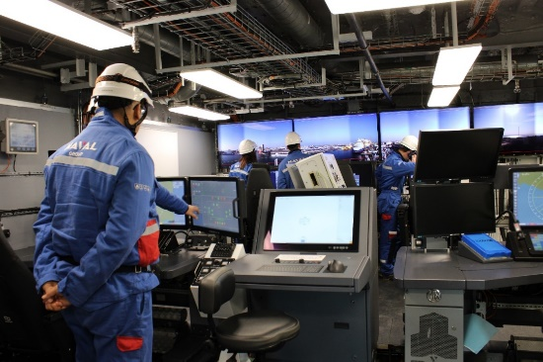
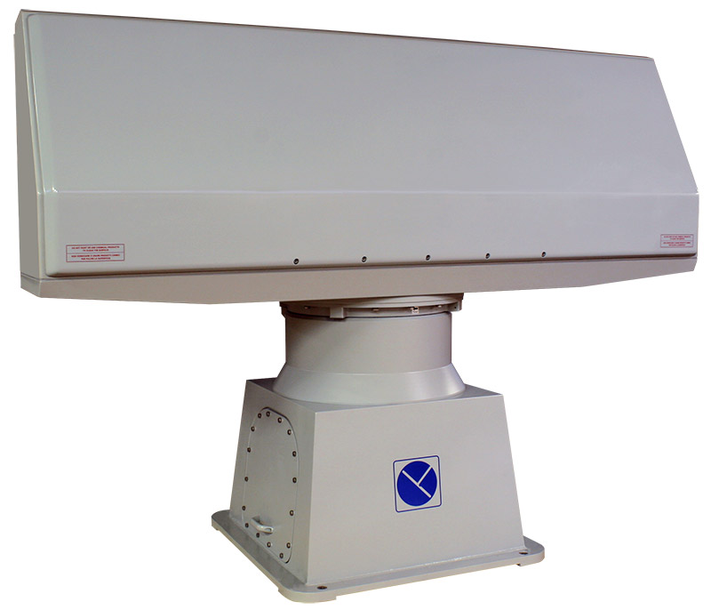
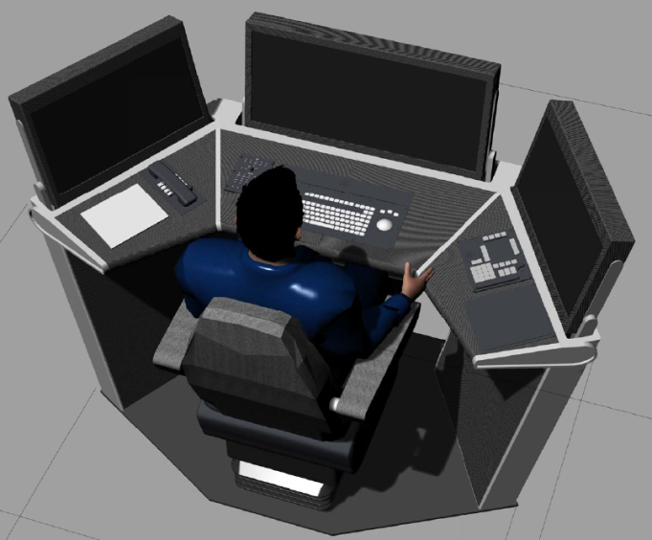
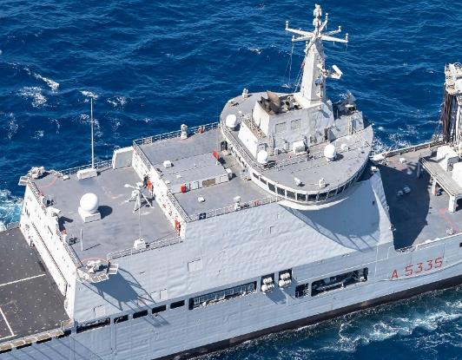
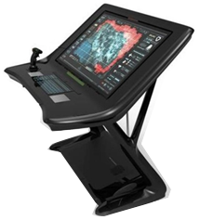
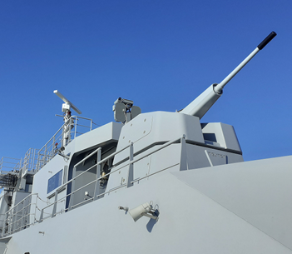
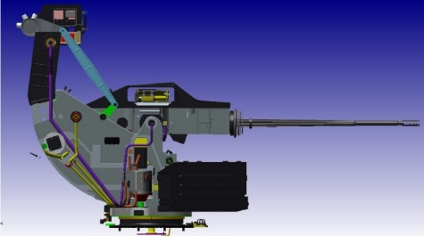
Technical Overview (4 of 4)
Range of Combat System capabilities
Radar and ASW Suite
Integrated Bridge
Combat Management System
Fire Control System
Medium Caliber Gun system (MCGS)
360° Asymmetric Warfare Center
Close-In Weapon Systems (CIWS)
Electronic Warfare (EWS)
Torpedo Detection System (TDS)
AAW/ASW Decoy Launching System
Ship Board Protection
Communication System
Photo credit: Chantiers de l’Atlantique /Naval Group
Photo credit: Chantiers de l’Atlantique /Naval Group
LSS PD
P-17
Notes:
Regarding the Combat System capabilities that can be implemented or updated according to requirements, the LSS units can perform the following features:
- a capacity for aerial, surface and underwater detection;
a Command Bridge with integrated conduct and detection systems;
An advanced Combat Management and Communication Systems deriving from the PPA Program developments for IT and French Frigates Programmes for France; the Combat management System is developed to also with a high redundancy. The Communication System and the INS (Internal networking system) include also the capacity tomanage both in integrated and in autonomous way targets and best reaction to a threat. CMS and CoS are also developed to reduce the manpower and increase the efficiency operate with a staff on board
a System of self-protection with lethal (25mm calibre or 40mm calibre) and non-lethal weapons (LRAS – long range acoustic system that include also a non-lethal laser reaction)

Slide 18
Agenda
OCCAR overview
Programmes managed in the Naval Domain
Technical focus
    LSS Programme
    FREMM Programme
    PPA Programme
    MMCM Programme
    MALE RPAS Programme
    LWT Programme
Questions

Slide 19
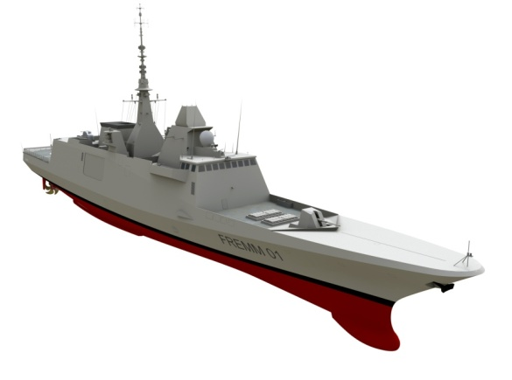


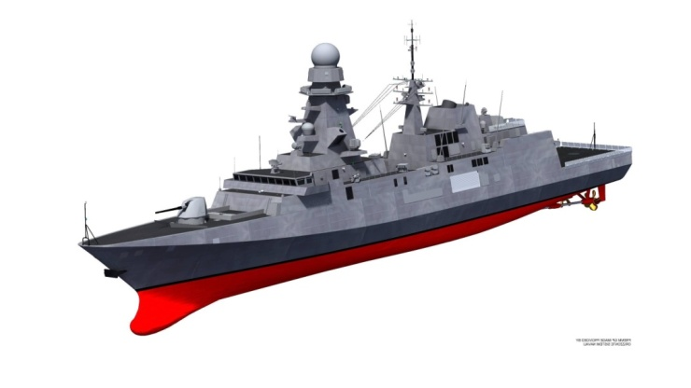
FR-IT Multimission Fregates (FREMM Programme)
FREMM PD
(Paris and La Spezia sites)
2 Prime Contractors
France
8 ships & ISS
Last ship delivery: Dec 2022
ISS for MCTO CMS & EWS till 2024
Italy
10 ships & ISS
- Last ship delivery: Apr & Oct 2025
- ISS for IT ships till 2034
OCCAR
Three different configurations: ASW – General Purpose – AAW (Freda)
Notes:
The FREMM Programme is the most ambitious and innovative European naval defence project. These multirole Frigates, designed to meet the through life requirements of the French and Italian navies in a changing environment, set new standards for design and build costs.
The management of the development, production and initial In-Service Support phases of this important naval Programme was assigned to OCCAR in 2005. The FREMM Programme contemplates the construction of 18 ships: 8 for France, 10 for Italy.
There are three configurations of the FREMM ships: antisubmarine versions Warfare (ASM/ASW), anti-air Warfare (FREDA) and General Purpose (GP).
The last ship delivery for France was in Dec 2022 with a ISS coverage till 2024. For Italy, the last delivery will be in Apr & Oct 2025, and the ISS will cover till 2034.

Slide 20
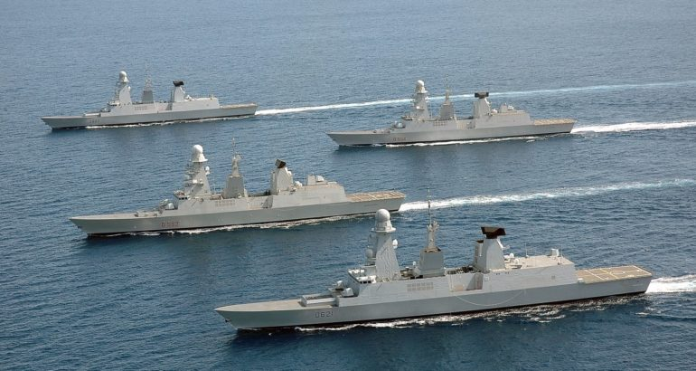


FR-IT HORIZON (class frigates) Mid-life Upgrade Programme
FR FOS
2030
2 Prime Contractors
IT FOS
2028
Obsolescence treatment and AAW evolution for 2 (IT) and 2 (FR) frigates
FR FOC
2029
Contract signature within mid 2023
OCCAR
IT FOC
2027
Significant evolutions in C/S domain (combined with update CMS):
  AAW evolutions (new PAAMS + LRR)
  new EWS
Obsolescence treatment (with updated systems) in PTF domain
Notes:
OCCAR was also engaged to carry on the Mid-Life Upgrade for the Horizon class frigates (2+2 Fr and IT).
The main goal is to enhance the AAW and EWS domains for the current and future threats and to perform the obsolescence treatment in other domains (PTF, ASW and CMS).
The industrial stakeholders selected are Eurosam (consortium composed by Thales, MBDA-IT, MBDA FR) and Naviris (joint venture between naval Group and Fincantieri).
The negotiation is in the final mile and the contract signature is expected in the upcoming months.

Slide 21
Agenda
OCCAR overview
Programmes managed in the Naval Domain
Technical focus
    LSS Programme
    FREMM Programme
    PPA Programme
    MMCM Programme
    MALE RPAS Programme
    LWT Programme
Questions

Slide 22
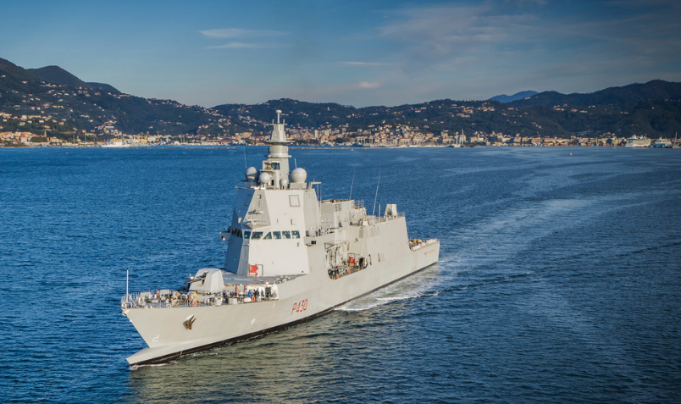
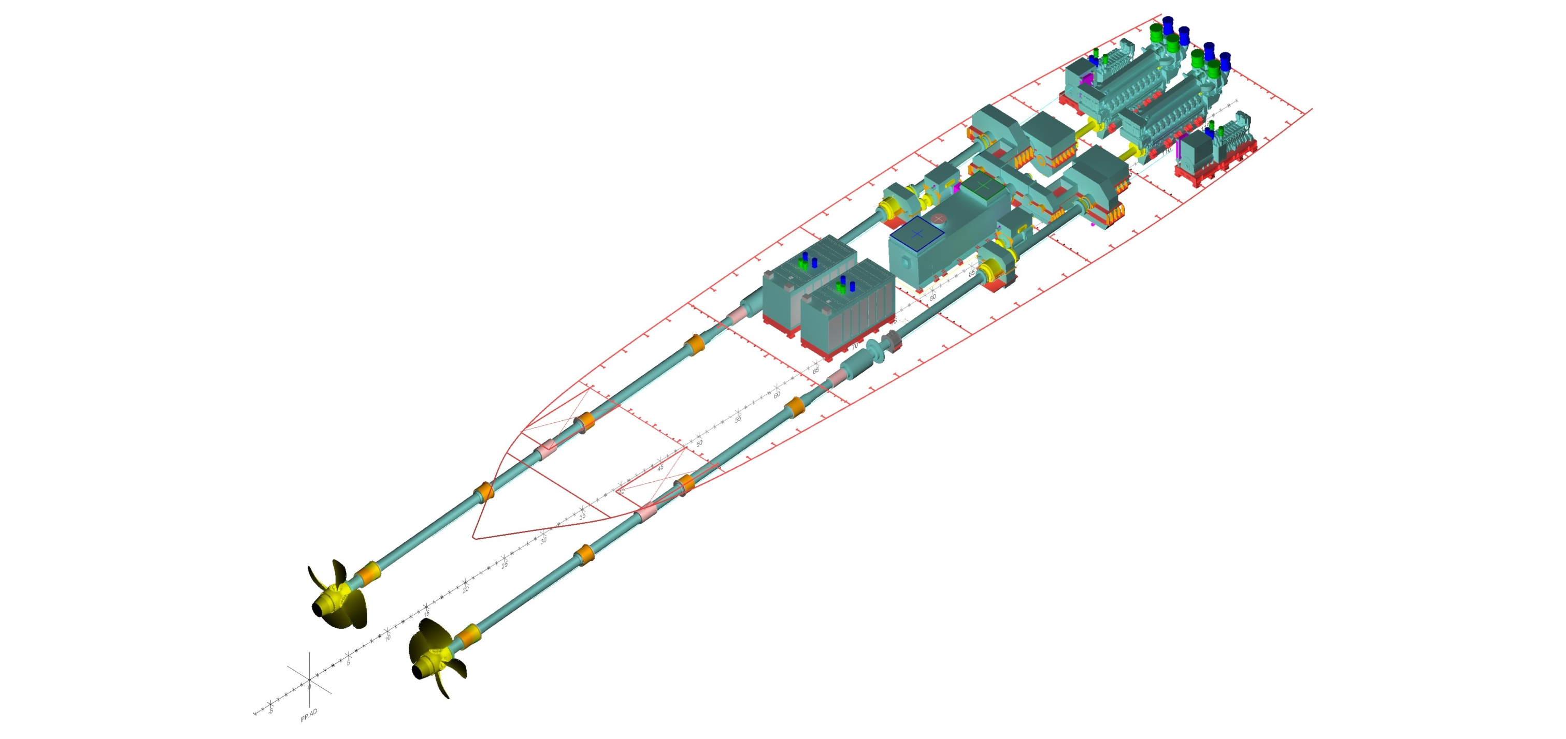
PPA Programme - Ship main features and capabilities
1
2
3
Architecture
Propulsion
Accomodation & Hangar
Lenght (b.p.) 133 m
Co.D.a.G.o.L.
Crew 145
Beam 16.5 m
Max Speed 32 Knt
Accomodation 181
Draft 5.2 m
Range 5,000 NM at 15 Knt
Hangar 1 EH 101 or 2 SH 90
Displacement ~ 6,000 t
  Main diesel engines
Diesel Generating Set
Electric Propulsion Motors
  Gas Turbine
  cross connected Gear box
Boxed Diesel Generating Set
Notes:
ITS Paolo Thaon di Revel is the first of the seven Offshore Multipurpose Patrol ships that are part of the Naval Renewal Plan (PRN), launched in May 2015 under the aegis of OCCAR.
The patrol ship has a double staggered bow, similar to the rostrum of ancient Roman ships, an engineering solution that allows the reduction in wave formation and the reduction of fuel consumption, increasing the maximum speed (32 knots).
PPA has a displacement of about 6.000 tons and a Combined Diesel and Gas or Electric propulsion system, that allows for a maximum speed of about 32 knots, with 7 knots in electric propulsion.
Thanks to enhanced automation, there is a lean manning with a crew of 145, with accommodations up to 181 beds, to allocate the different configurations needed for each mission (air component, force protection, navy seals, ... and so on).
The hangar can host and maintain one helicopter EH101 or two NH90.

Slide 23
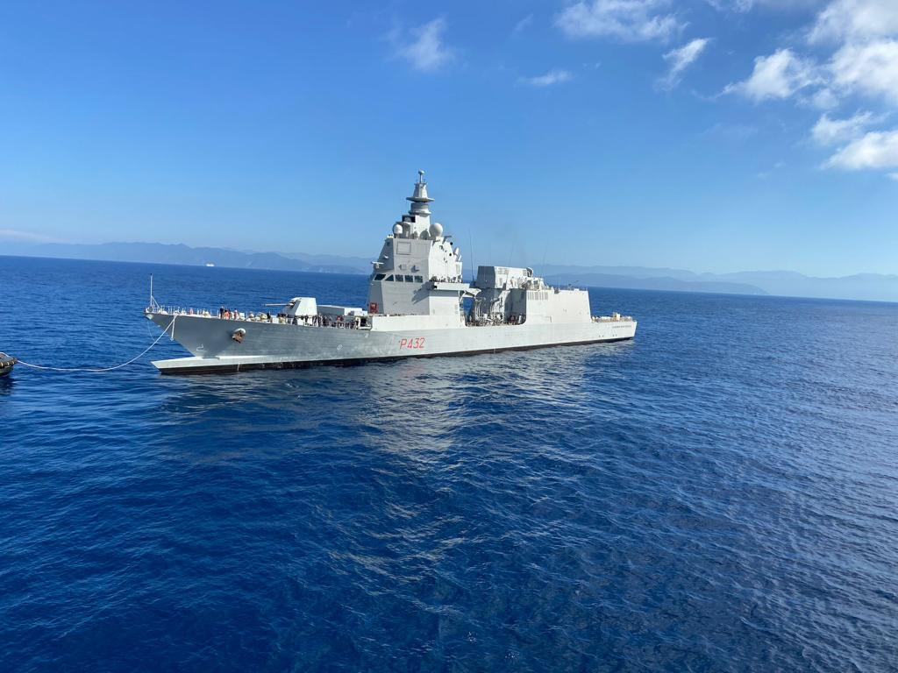
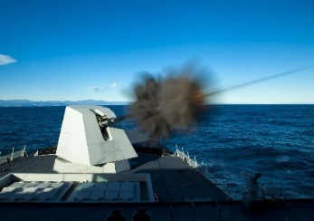

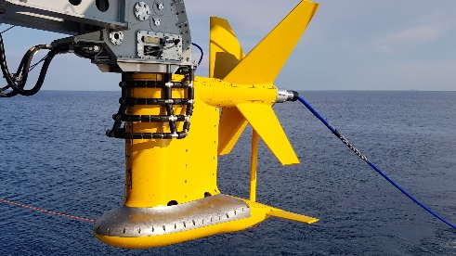
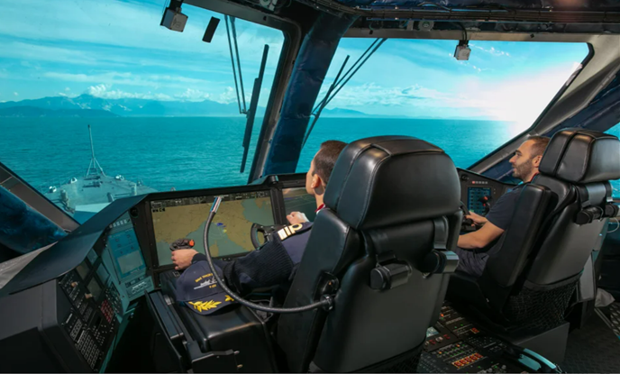
PPA - CS Configuration: Light, Light + and Full versions
Innovations and new generation systems
Equipment | Light | Light+ | Full
5’ Inch Firing Gun (127mm) – Vulcano Ammunition 3’ Inch Firing Gun (76mm) – Strales/Vulcano Amm. Small Caliber Gun (25mm) CESM (Communication Electronic Support Measure) RESM (RADAR Electronic Support Measure) THS (Torpedo Handling System) DDS (Diver Detection Sonar )
RADAR AESA-X 4FF
RADAR AESA-C 4FF RECM (RADAR Electronic Counter Measure) Missile Sistem SAAM – ESD (ASTER 15/30) -B1NT
ATAS (Active Towed Array Sonar) TLS (Torpedo Launching System for LW Torpedo) DLS (Decoy Launching System) MJTE (Mobile Jammer Target Emulator)
Fitted
for
Fitted
for
Fitted
for
P-23
Notes:
ESM Electronic Support Measures
ECM Electronic Counter Measures
Based on a common platform, PPAs are built in 3 different CS configurations: light (2 ships), light plus (3 ships) and full (2 ships).
The LIGHT version has a complete set of artillery.
The LIGHT+ version adds the missile firing capability with actuators planned also for ballistic missile defence.
The FULL version will be able to operate in all maritime warfare domains such as: AAW, ASW and ASuW.
Light and Light Plus have been developed with the “fitted for” approach: every system of the “Full” can quickly be deployed also on L and L+, facilitating growing operational capabilities during the operational life of the Ships.
So, operational flexibility is the main characteristic of this class, in terms of both growing capabilities (fitted for) and mission modularity (as we see in next slides) .
Il Programma PPA impiega la maggior parte dei S/S delle UUNN del PRN, le cui categorie di componenti sono FDI, MDI, NDI, COTS.

Slide 24
Agenda
OCCAR overview
Programmes managed in the Naval Domain
Technical focus
    LSS Programme
    FREMM Programme
    PPA Programme
    MMCM Programme
    MALE RPAS Programme
    LWT Programme
Questions

Slide 25
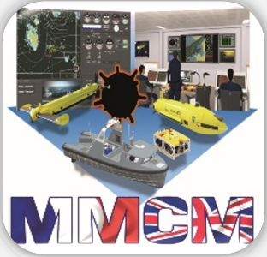
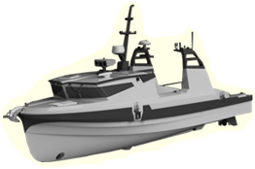
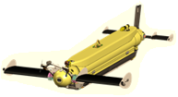
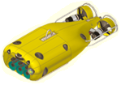



FR-UK Maritime Mine Counter Measures (MMCM)
A Capability comprising Autonomous Unmanned Systems operating remotely, at a stand-off distance from Mother Ships, through a Command and Control Centre (either embarked or deployed ashore)
Main Activities 2023
Continuation of National evaluation of the 2 Prototype/Demonstrators
Ramp-up of the Production and preparation of the In-Service Support
Looking towards 2024
Production Phase : Qualification and Delivery of the First Systems (out of 8 in total)
Kick-off of In-Service Support
Notes:
France and the United Kingdom initiated a programme to assess and develop “Maritime Mine Counter Measures” (MMCM) capabilities comprising unmanned systems operating remotely, at a stand-off distance from mother ships or through a command and control centre, either on board ship or deployed ashore.
This concept will be develop on the next slide.
The objective of the MMCM Programme is to deliver an agile, interoperable and robust MMCM capability. The programme will help to determine the options for replacing existing Mine Counter Measure Vessels when they retire from service and the life-cycle cost benefits of delivering mine counter measure capability in a new way.
Additional info:
The programme phase: Stage 1 is completing Demonstration. Stage 2 is in production;
FR and UK produce together roughly 50/50 workshare (plus Sweden);
The production sites are Brest (FR), Templecombe (UK), Portchester (UK), Stonehaven (UK), Linkopin (Sweden);
ISS will start upon delivery;
USV (unmanned Surface Vessel) are designed to be autonomous;

Slide 26
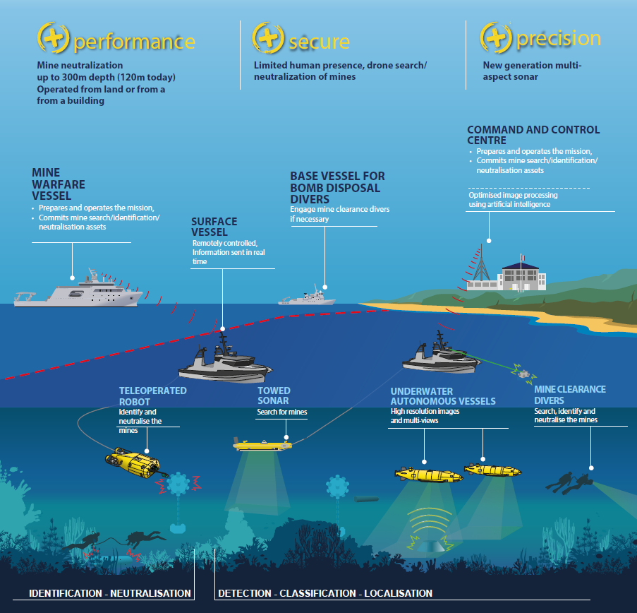
MMCM
Mother Ship or Base Vessel outside the Scope of Cooperation managed by OCCAR
Notes:
The stand-off concept is based on off-board capabilities aimed at keeping personnel outside minefields whenever possible. By defeating static underwater threats at pace, these systems will give strategic, operational and tactical freedom of maneuver and thereby assure the delivery of maritime force projection and maritime security at the time and place of the Nations’ choosing in support of a wide range of naval operations.

Slide 27
Agenda
OCCAR overview
Programmes managed in the Naval Domain
Technical focus
    LSS Programme
    FREMM Programme
    PPA Programme
    MMCM Programme
    MALE RPAS Programme
    LWT Programme
Questions

Slide 28
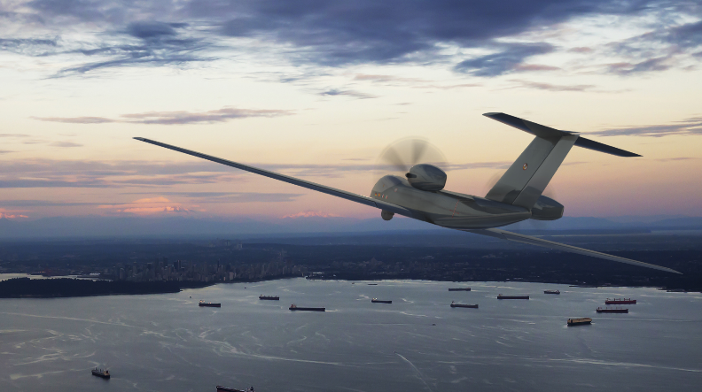
MALE RPAS - Advanced Maritime ISR Missions
Multi-domain situational awareness with best in-class sensors
Naval Force Support
Detection from Surface Vessels to Small Maritime Targets (Submarine Periscopes)
Maritime Search, Inverse SAR, Maritime MTI, Small Maritime Target Modes
Collaborative/non-cooperative Vessel identification
Maritime Radio system
Naval Datalink System
Search & Rescue
EO/IR Imagery and Full Motion Video
Personal Locating System
Small Maritime Target Modes
Law Enforcement
Monitoring of Anti-piracy, smuggling and illicit trafficking thanks to small targets detection
P-28
Notes:
The MALE RPAS programme, known also as the Eurodrone, is a multination defence programme strongly wanted from the 4 participating nations, France, Spain, Germany and Italy, to develop the very first Medium Altitude Long Endurance remote Pilot System in Europe. The system will integrate state of the art sensors and capabilities in the ISTAR field and the current baseline already provides exceptional maritime capabilities.
As you can read in the chart, its different sensors and capabilities in the maritime domain, allow the Eurodrone to perform different types of maritime missions covering a very large surface over water.
After completion of the first development design reviews, the Preliminary Design Review (PDR) and the Critical Design Review (CDR), the manufacture of the first Prototype is expected to commence in 2025 and the delivery of serial items to PPS is targeted by end of the decade.
Final assembly in Manching (DE)
Industrial involved:
AIRBUS DEFENCE AND SPACE GMBH Germany
AIRBUS DEFENCE AND SPACE S.A.U. Spain
DASSAULT AVIATION France
LEONARDO S.P.A. Italy
Inverse Synthetic Aperture Radar (SAR)
Acronyms
EO/IR: Electronic opctical/Infra-Red
MTI: Moving Target Indication

Slide 29
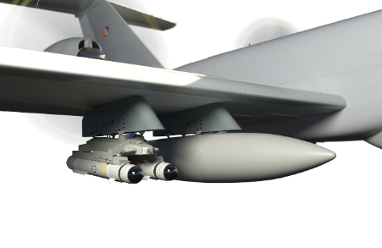
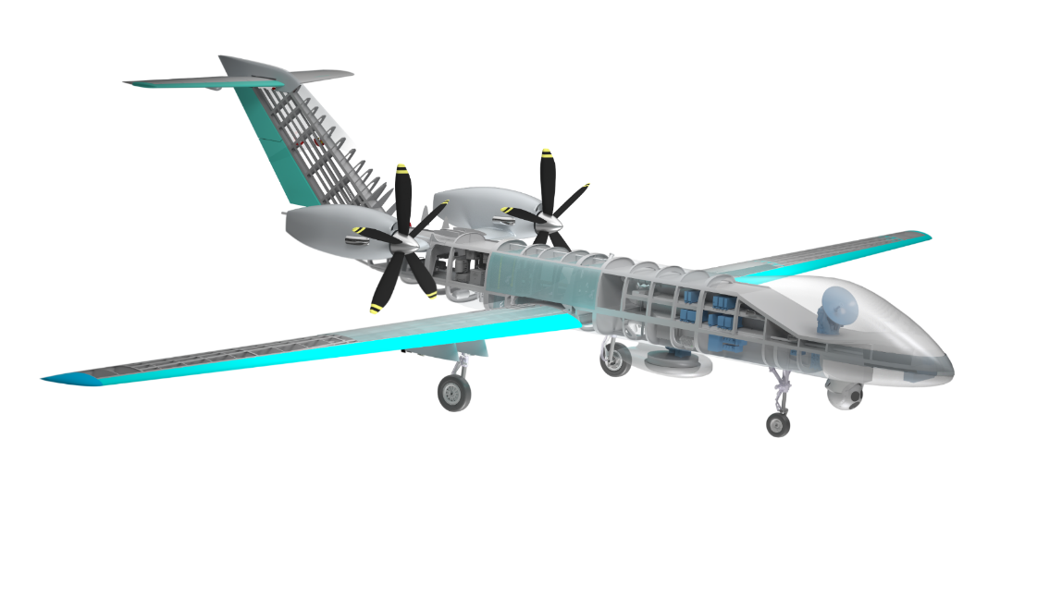

MALE RPAS Payload
Weaponization
Multifunctional Information Distribution System (MIDS)
Link 16 for NATO coalition communications with airborne/ground assets
SatCom WB
Personal Locating System (PLS)
for search and rescue of isolated civil and military ground forces
W-AIS
LOS COM
SAR/MTI
Mission Radar
V/UHF
Maritime Radar
EO/IR Sensor
High payload capacity (2,300 kg)
P-29
Notes:
The Eurodrone will be equipped with a wide selection of datalinks providing the perfect solution both for military and civilian operations.
The extensive Eurodrone growth potential will allow to expand further more the already exhaustive type of missions with the possibility to integrate new future sensors and capabilities.
His sensors kit includes but it is not limited to state of the art electronic scanned array radar, new generation EO/IR sensor, AIS, Personal locator system and many more.
Personal Locating System (PLS)
Beacon per il Search And Rescue (SAR)
Weaponization
The baseline include the integration of the follow missile: GBU 49 (US) and Brimstone (UK)
Maritime Radar
The current baseline has with the mission radar already extensive maritime capabilities. As a growth potential it’s possible to install the radar under the belly.
Acronyms
AIS: Automatic Identification System
W-AIS LOS COM: Wide-AIS Line Of Sight Communication (LOS COM)
Details:
SatCom WB: Satellite Communications Wide Band for command and control.
W-AIS transponder: It features a secure mode in which all AIS traffic is received, but own messages are sent out through an encrypted radio channel that only authorized vessels can decode. It is the ultimate combination of stealth and situational awareness in AIS.
Public AIS operates on two global VHF channels, AIS1 and AIS2. W-AIS data link can be used in parallel with AIS1 and AIS2, giving the complete AIS picture at all times.
SAR/MTI Mission Radar:
Syntethic-Aperture Radar (SAR) and Moving target indication (MTI) is a mode of operation of a radar to discriminate a target against the clutter. It describes a variety of techniques used for finding moving objects, like an ship, and filter out unmoving ones, like hills or trees. Production of the “patter of life” (sovrapposizione di layer nel tempo).
Multifunctional Information Distribution System (MIDS) is the NATO name for the communication component of Link-16.
MID is an advanced command, control, communications, computing and intelligence (C4I) system incorporating high-capacity, jam-resistant, digital communication links for exchange of near real-time tactical information, including both data and voice, among air, ground, and sea elements. MIDS is intended to support key theater functions such as surveillance, identification, air control, weapons engagement coordination and direction for all Services.

Slide 30
Agenda
OCCAR overview
Programmes managed in the Naval Domain
Technical focus
    LSS Programme
    FREMM Programme
    PPA Programme
    MMCM Programme
    MALE RPAS Programme
    LWT Programme
Questions

Slide 31


Light Weight Torpedo
In Service Support for the MU90 lightweight torpedo developed in cooperation by FRA and ITA and later on adopted by DEU and COA
Utilized by 13 navies
More than 350 sea trials performed
Qualified for use from ships, helicopters and airplanes
Operational depth from 3 to 1.000 m
Engagement distance superior to 12.000 m
High resistance against decoys and jammers
Looking towards 2024
Extension of operational life
Reduction of total life cycle cost
Activating option to develop a new test bench
Photo credit: EUROTORP
Notes:
MU90 is a high-performance lightweight torpedo co-developed by France and Italy in the 1990s. Commissioned in early 2000, it has been adopted in large numbers by the French, Italian, German and Australian Navies.
The lightweight torpedo represents the main weapon to counter the threat posed by modern submarines. Launched from ships, airplanes and helicopters in close proximity to a target, it performs autonomous search, discovery and attack. Thanks to its high speed and endurance, coupled with its strong resistance to countermeasures, the performance of MU90 still remains unmatched in the market.
In 2007, France, Germany and Italy agreed to cooperate to support the weapon throughout its operational life. Australia entered the cooperation soon after. Until 2022, the French Direction Générale de l'Armemement (DGA) signed four ISS contracts on behalf of the four countries, with which the weapon system was supported until 2022.
In 2023, all ISS activities were integrated into OCCAR as the “LWT Programme”.
The main challenges of the LWT Programme are currently represented by the management of obsolescence and the extension of the operational life, together with the reduction of the entire life cycle cost.

Slide 32
Agenda
OCCAR overview
Programmes managed in the Naval Domain
Technical focus
    LSS Programme
    FREMM Programme
    PPA Programme
    MMCM Programme
    MALE RPAS Programme
    LWT Programme
Questions

Slide 33

OCCAR believe in the future of cooperation…
More than a procurement agency

