Slide 1
Meeting the Unique Demands of Operations in the Baltic Sea Region
Combined Naval Event
Farnborough May 23 2023
Michael Jonsson and Karl Sörenson, FOI

Slide 2
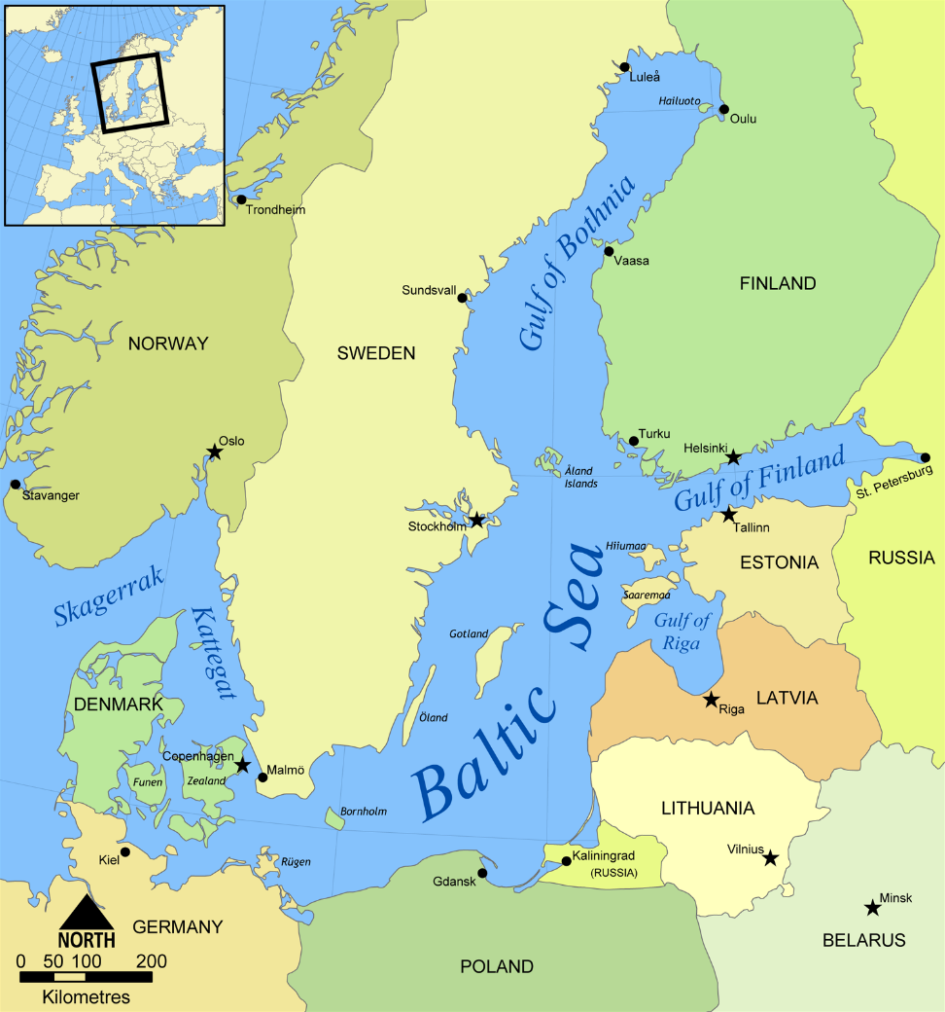
The Missing Pieces of the Puzzle
Finnish (and Swedish?) NATO membership adds crucial new capabilities and facilitates defence of the Baltic countries.
It also provides the possibility to gradually turn the Baltic Sea into a ”NATO Lake”.
Differences in strategic culture and threat perceptions however complicates matters.
And – new mission sets require partly new capabilities over time.

Slide 3
Reframing the Baltic as a Joint Operational Space
NATO’s Baltic conundrum hinges largely on timely reinforcements.
Access to Swedish territory could greatly facilitate this, as can Finnish capabilities.
Cooperation could also secure SLOCs.
But, none of the Scandinavian countries see this as their main defence problem.
…and hence, have not optimised their armed forces to resolve it.

Slide 4
Essential Missions and New Operational Directions
From sea denial to sea control.
A range of new of possible new operations, some essential, some potential.
Most require collaboration or division of labour, given limited assetts.
The Baltic Sea also generates some unique operational requirements.

Slide 5
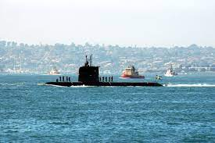
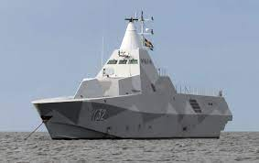
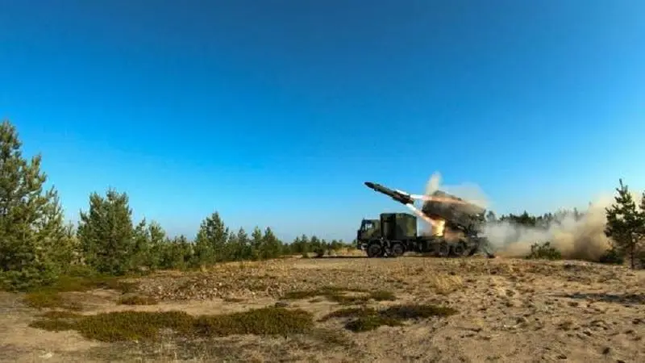
Old and New Roles - Platforms and Future Acquisitions
Cold War: Capabilities primarily geared towards sea denial.
From static (coastal batteries etc.) to flexible (RBS 15 etc.).
Ukraine war vidicates many of previous choices for effective national defence and (sea denial) deterrence.
NATO membership changes strategic outlook
What is Sweden’s role?
Deterrence perspective
Defence perspective
I.e. Sea Control: Operationally agressive; tactically defensive.
Hence, retain old knowedge; understand new technological enviroment as a piece of puzzle.

Slide 6
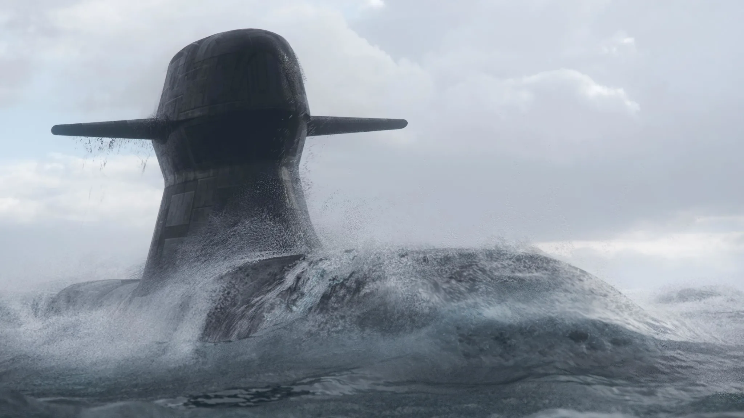
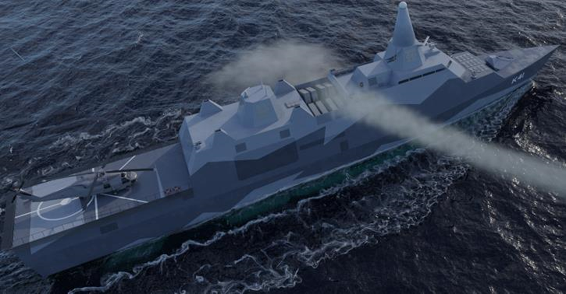
Adressing Future Capability Needs
New capabilities include:
New submarine (A26)
New surface platform (YSF2030)
New AShM (RBS 15 mark IV)
Does it add upp to Sea Control?
Does it Deter?
Does it Defend?
NATO role still not clear.

