Slide 1


Chloe Rowland
Project and Knowledge Exchange Manager – Cyber-SHIP Lab
Aaron Barrett
Technical Specialist – Marine Autonomous Systems
Notes:
Autonomous navigation technology
Environmental impact
Simulation
Piracy
Cyber security
Impact on maritime workforce and human factors
Research projects
Remote satellite communications

Slide 2
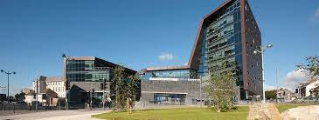
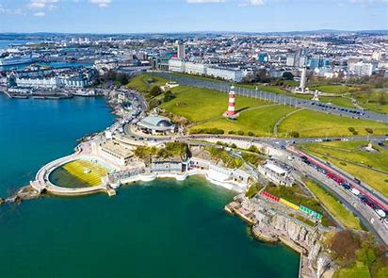
The University of Plymouth
The first and largest Marine Institute in UK, with over 3000 staff and students looking at the Ocean
Three-time winner of the Queen's Anniversary Prize for Higher and Further Education, UK Top 25 for Teaching Quality & World Top 25 for Research Citations
1st in the world for research towards SDG 14 (Life Below Water), Times Higher Education 2021

Slide 3


Maritime Cyber Threats Research Group
The Maritime Cyber Threats Research Group at University of Plymouth is the largest of its kind globally
Uniquely placed in the understanding of risks to maritime vessels, port infrastructure and national security
Novel thinking around Risk Assessment Frameworks, and the Cyber-SHIP Lab to deliver effective mitigation measures to safeguard the sector

Slide 4

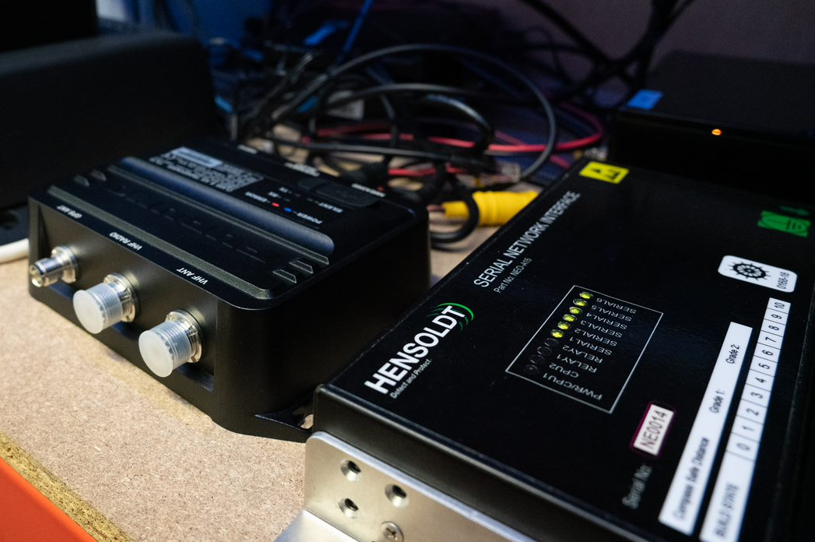
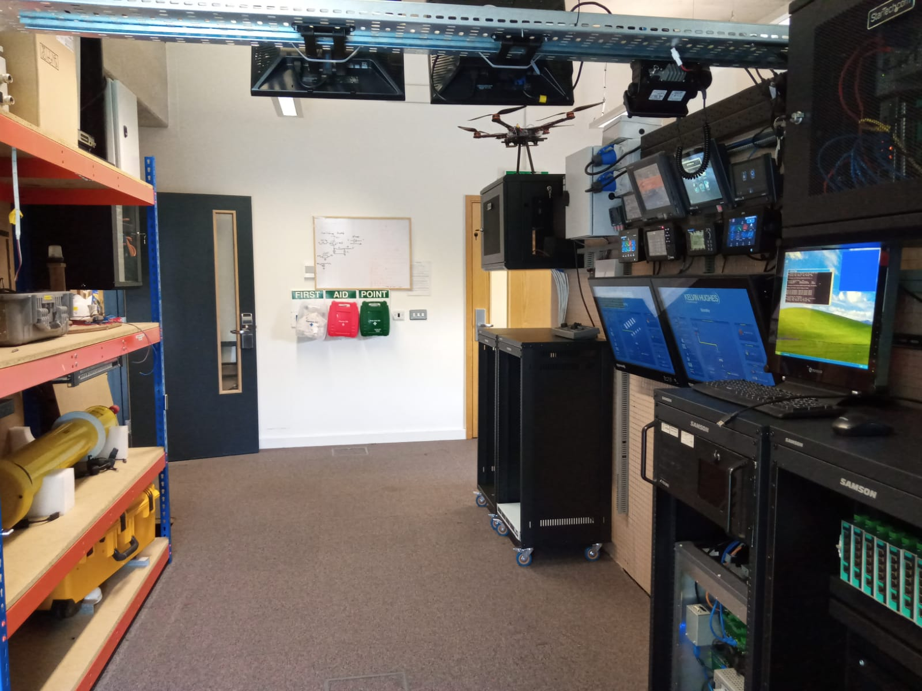
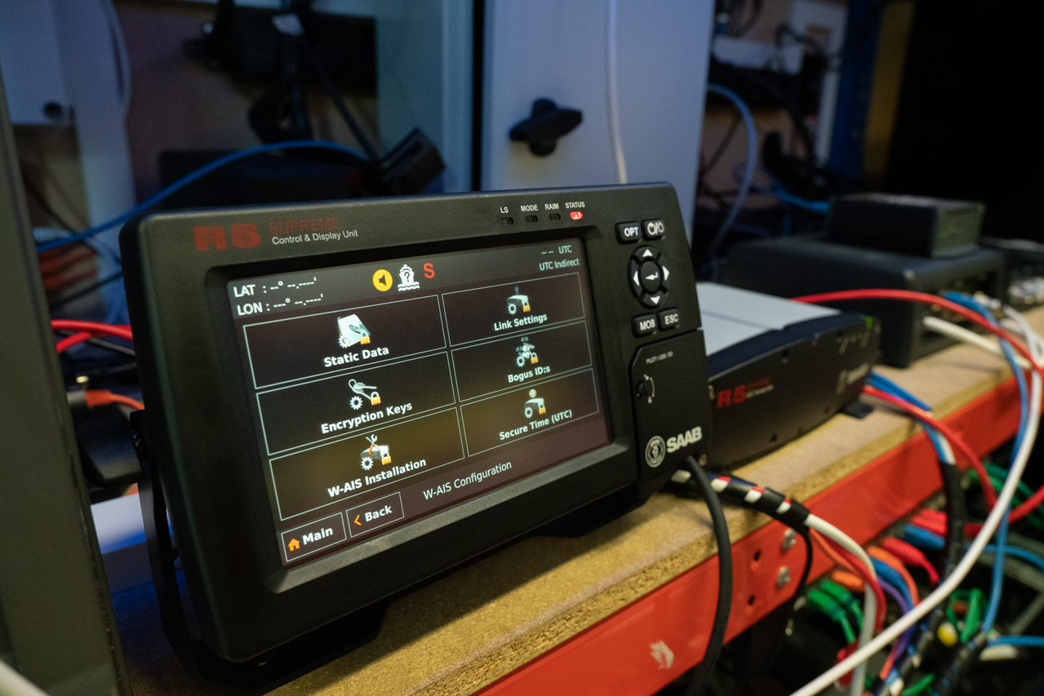
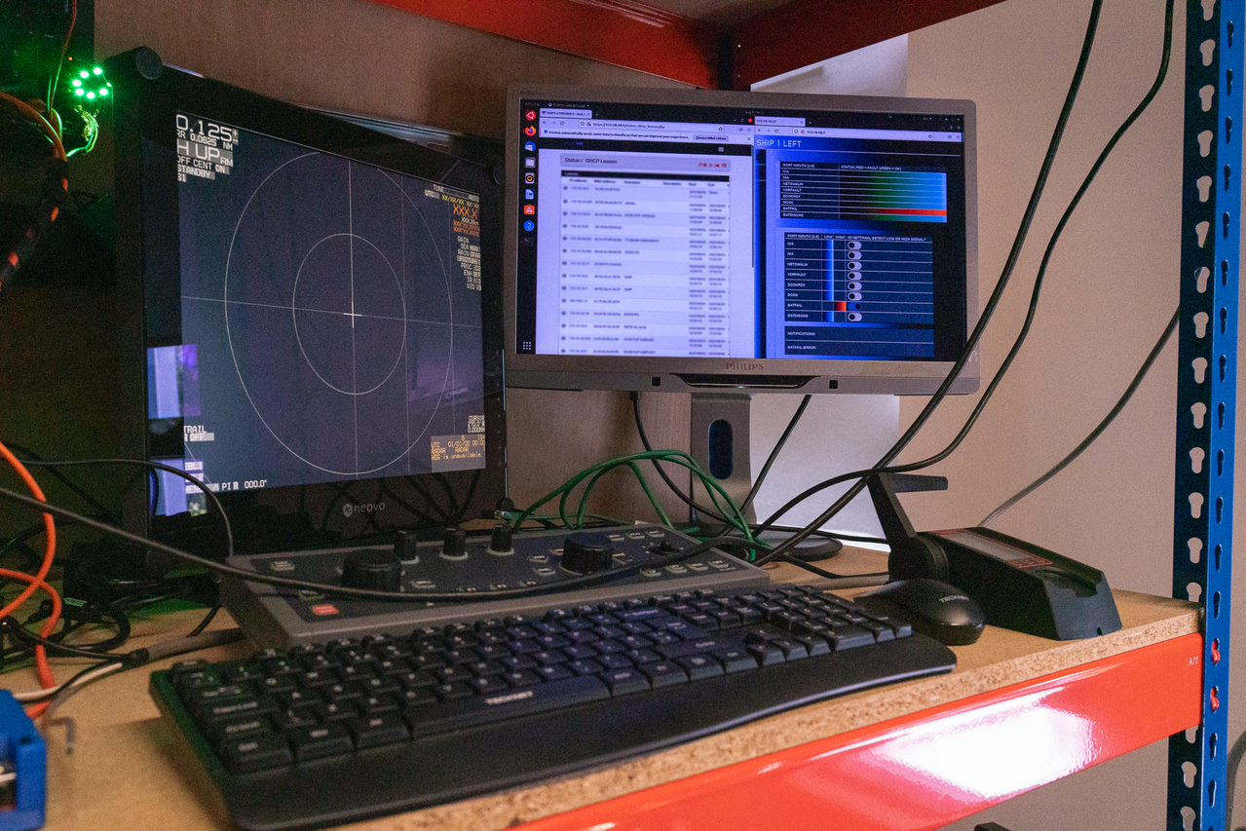
Cyber-SHIP Lab
Maritime cyber-physical research facility
A unique £multi-million hardware-based platform
Physical twin
Real-world solutions to real-world problems

Slide 5


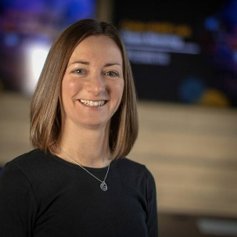
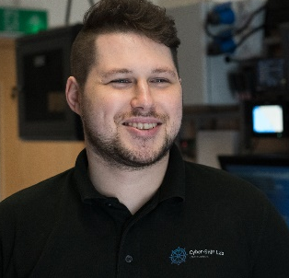
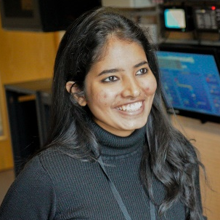


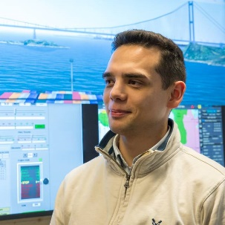

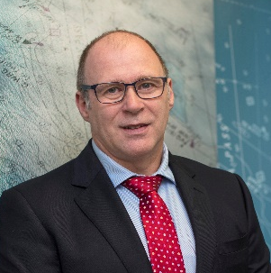

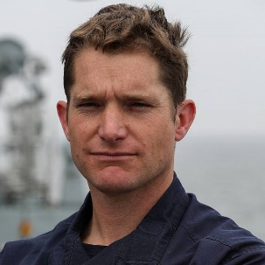
Cyber-SHIP Core Team Specialisms
Cyber risk experts
Software and hardware design
Penetration testing
Electronic/Electrical engineering
Navigation and Watchkeeping
History
Policy and governance
Visualisation
Law
Economics
Knowledge Exchange/Sector Engagement

Slide 6
















Engagement with the university and industry
Contract Research, Consultancy and PhDs
Standard Academic programmes, Masters, MRes, PhD
Bespoke training
Joint public research
Scenario development
Engagement with Armed Forces
Use of Cyber-SHIP Lab with University team
Commercial MaCRA services

Slide 7
Academic perspective on the challenges/opportunities for autonomy in the future of Naval platforms
In 15 min

Slide 8
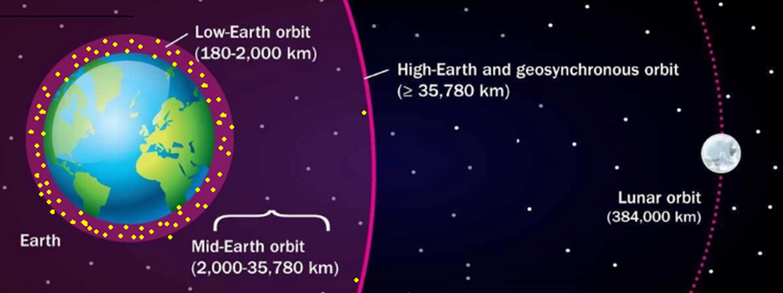


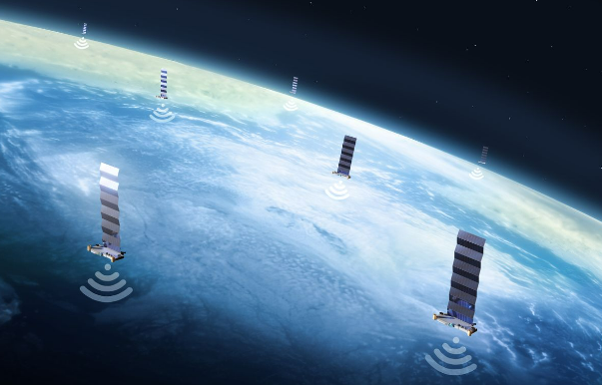


New Tech Opportunities
New communications technology
Well engineered hybrid power trains
Highly efficient reliable maintenance free systems – think Mars Rovers
AI delivering adaptive learning and multispectral machine vision and intelligent sensor fusion
High Speed
Low Latency
Much Lower Cost
Multiple Providers

Slide 9

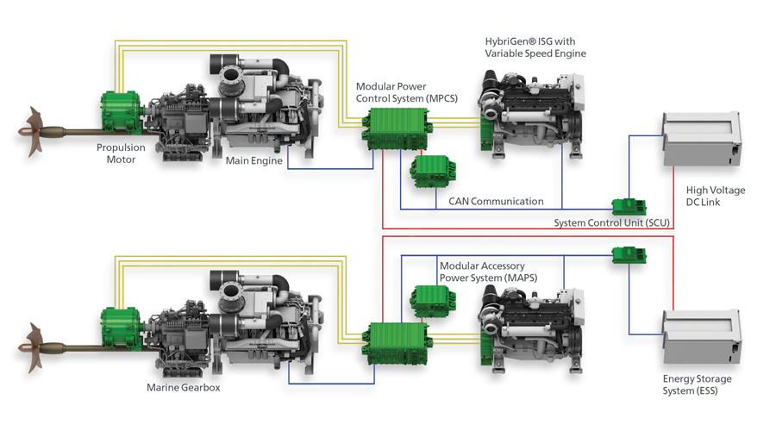
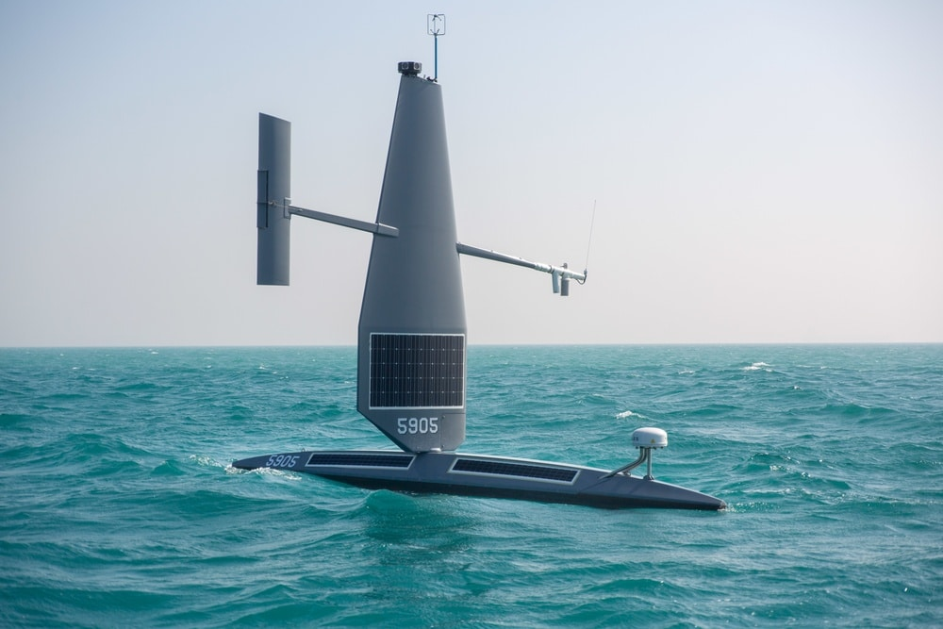

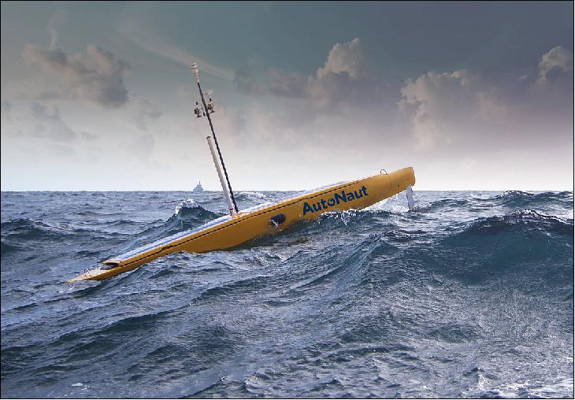


New Tech Opportunities
New communications technology
Efficient, well engineered hybrid power trains
Highly reliable maintenance free systems – think Mars Rovers
AI delivering adaptive learning and multispectral machine vision and intelligent sensor fusion
Highly Efficient
Low Carbon
Multiple system Redundancy
Long endurance

Slide 10
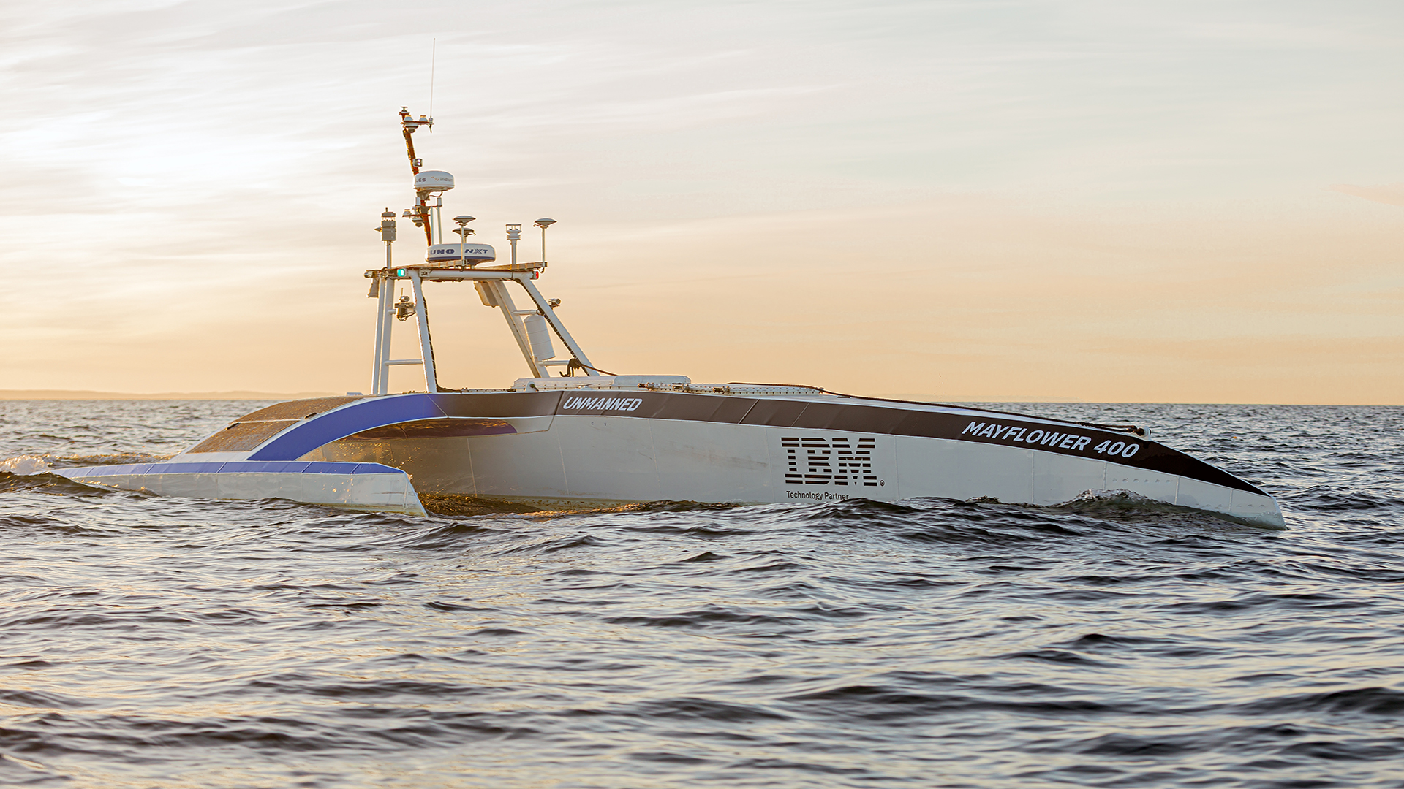
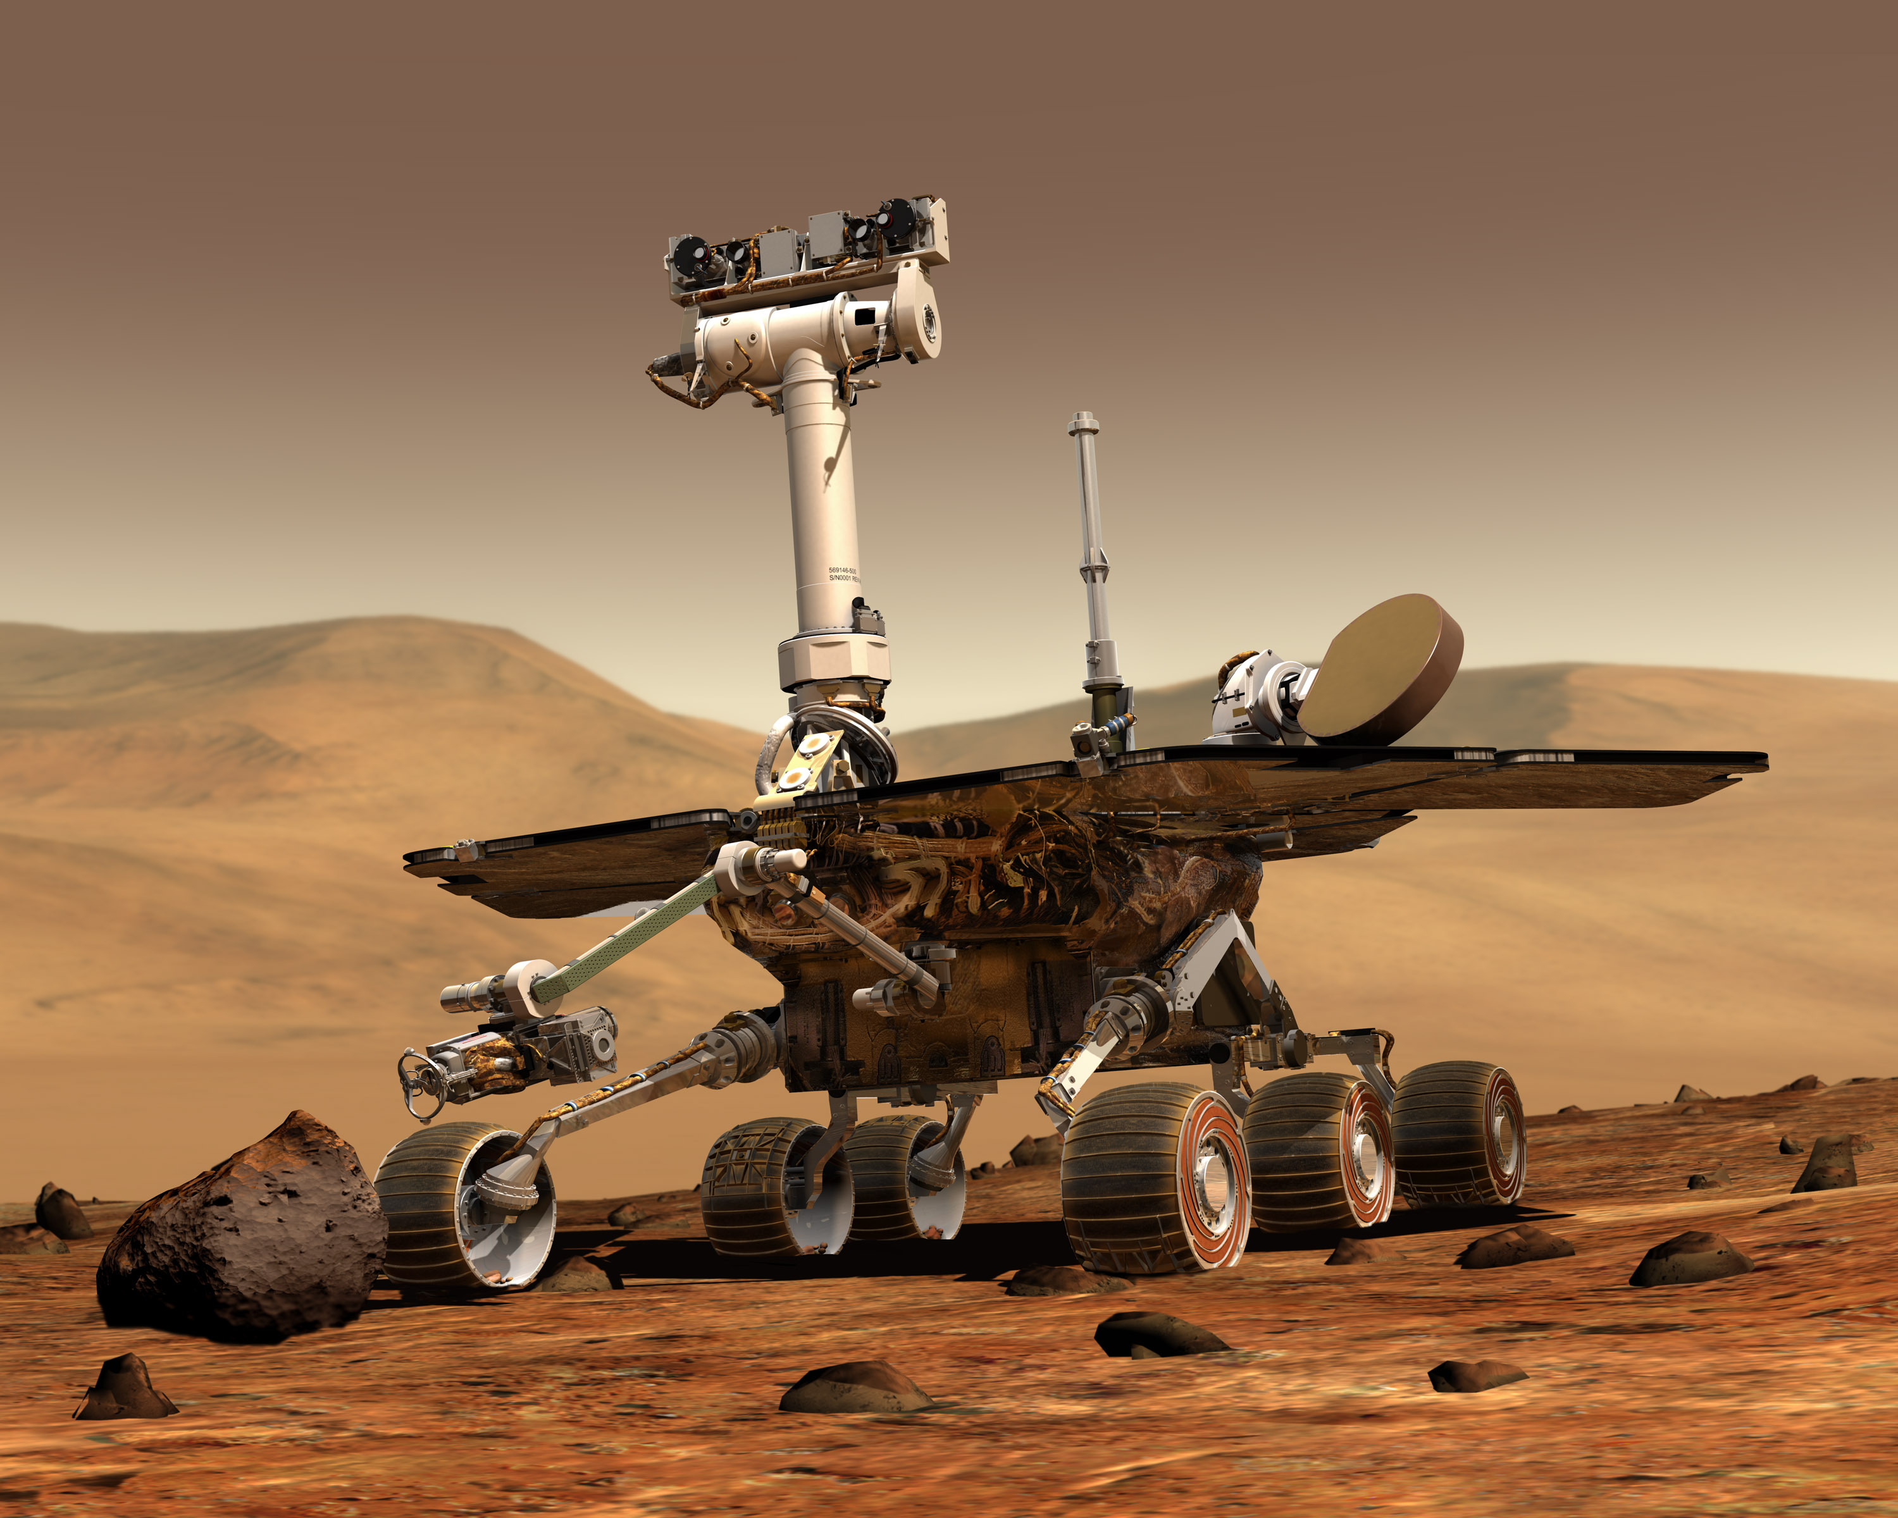

New Tech Opportunities
New communications technology
Efficient, well engineered hybrid power trains
Highly reliable maintenance free systems – think Mars Rovers
Reduced maintenance intervals and costs
Long endurance
AI delivering adaptive learning and multispectral machine vision and intelligent sensor fusion

Slide 11


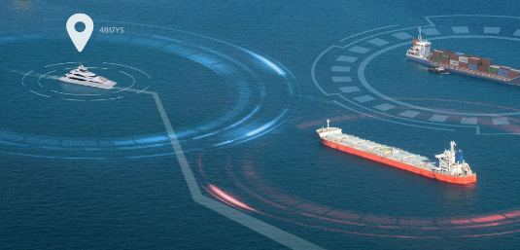

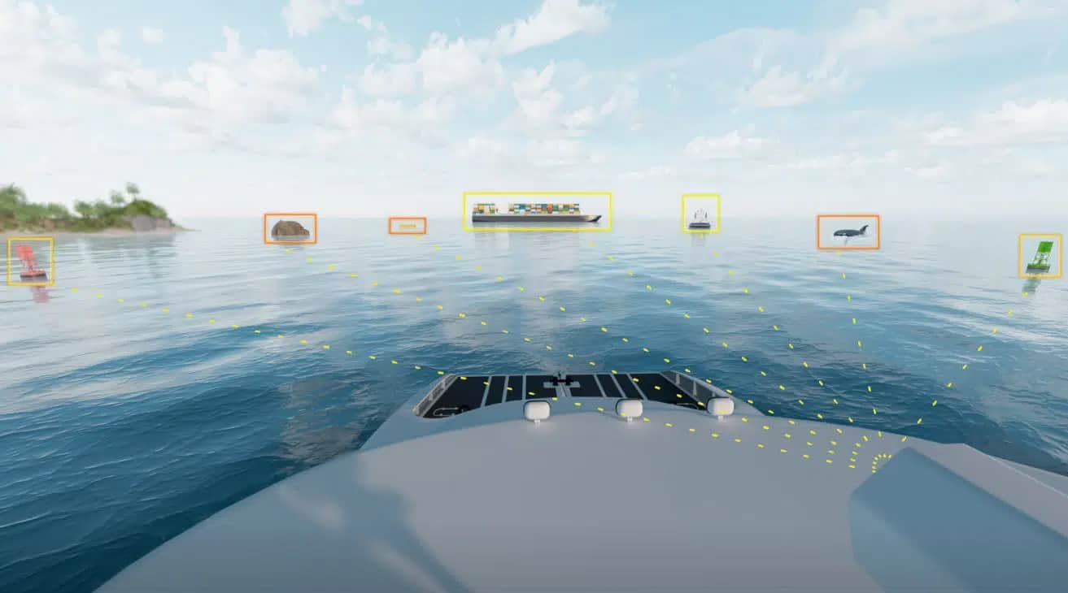

New Tech Opportunities
New communications technology
Efficient, well engineered hybrid power trains
Highly reliable maintenance free systems – think Mars Rovers
Reduced communication requirements
Resilience to GPS denial and ECM
Increased cyber security resilience
Lighter personnel requirements
AI delivering adaptive learning and multispectral machine vision and intelligent sensor fusion

Slide 12
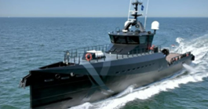
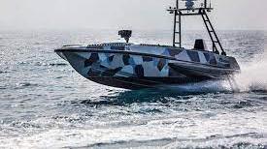
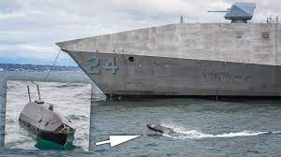
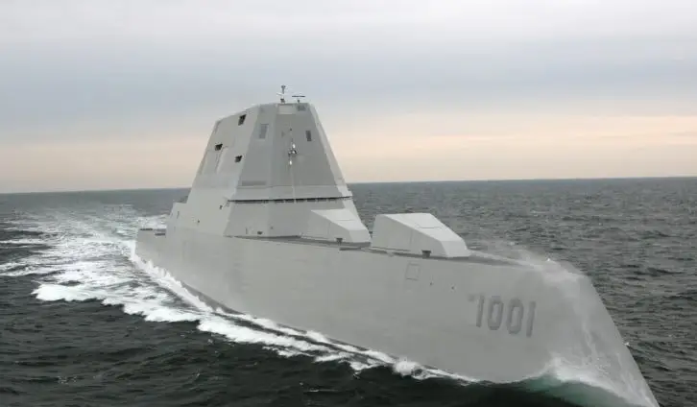
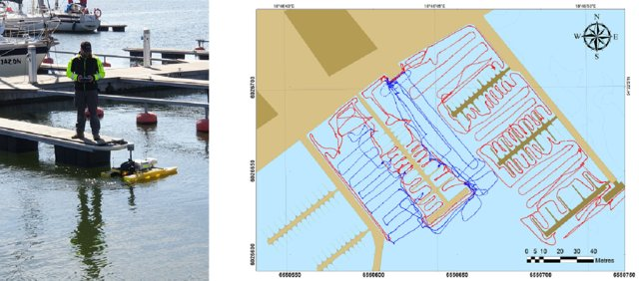
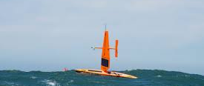
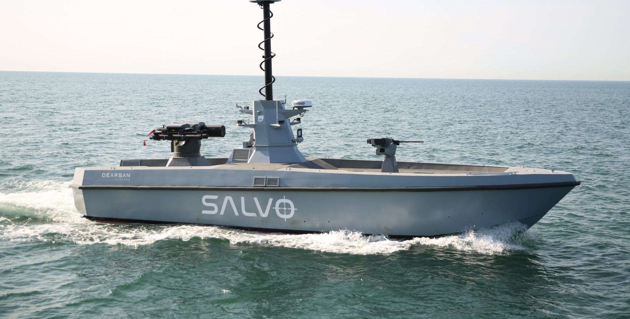
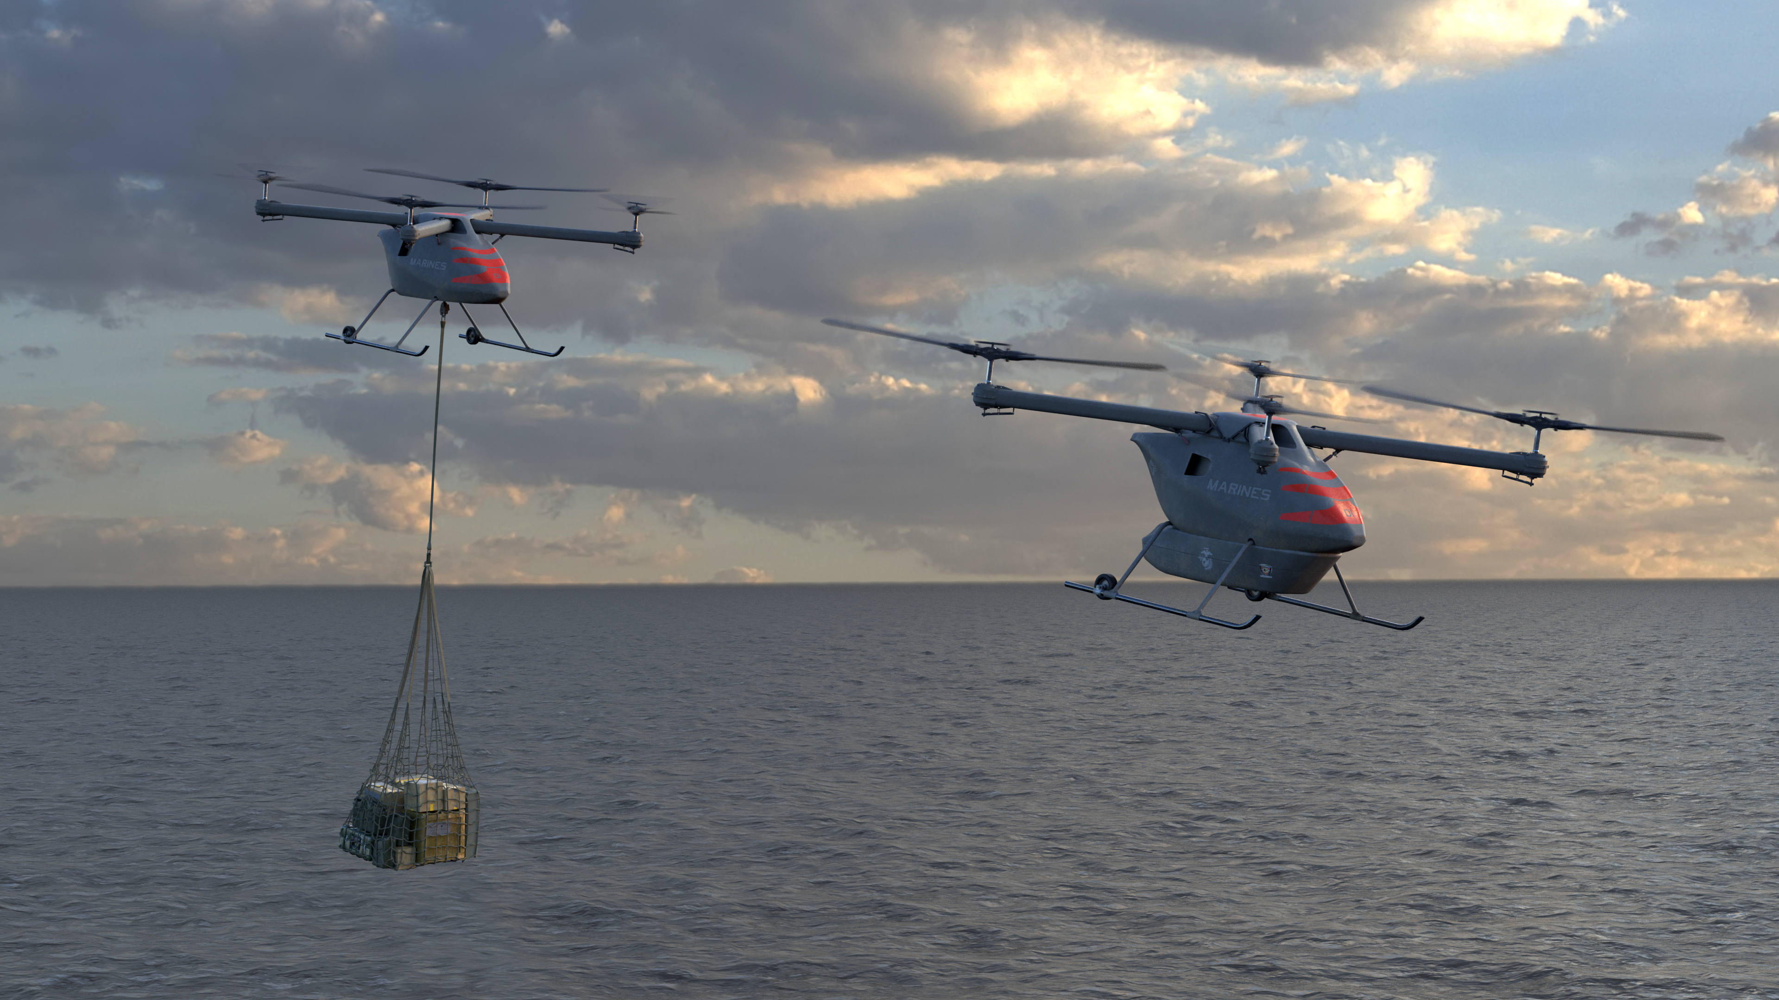
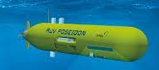
Gives Access To…..
Lean crewed or uncrewed (will focus on uncrewed)
All parts of the autonomy spectrum - Remote control to completely thinking for itself
Huge range of size points
Enormous range of environments (harbours Littoral Open ocean)
Different domains
Level 0
)
Level 5 )

Slide 13
Ultimate opportunities
Removes humans from Dirty Dangerous & Dull – Removes people from the war zone - Less injury and death
Cuts cost – do more with less
Increases global reach
Reduces carbon emissions
Increases resilience (swarming systems)
MDG
ISR
Kinetic

Slide 14
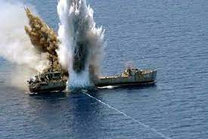
Challenges
……to Naval Deployment of marine Autonomy
Are no longer related to platform performance
REGULATORS
CYBER SECURITY
ROBOT POLITICS

Slide 15
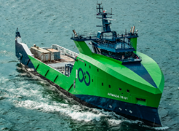
Regulators
In many democratic countries – increasing propensity to insist on zero risk. We risk losing this technological race to those that are less risk averse. A balance must be maintained.
Civilian RnD needs to flourish to allow innovation
Ocean Infinity UK – Lean crewed remote operations – Flagged in Singapore
Many regulators are under funded and understaffed, and are not given the resources to quickly keep on top of rapid technological changes.
A stretched, in-agile regulator will simply maintain safety by preventing innovative activity.

Slide 16
Regulators
Solutions:
Fund and staff regulators properly
Give them appropriate targets for the deployment of new technologies whilst maintaining safety
Encourage a realistic approach to risk management - Kinetic Energy, Operational Mode, Location

Slide 17
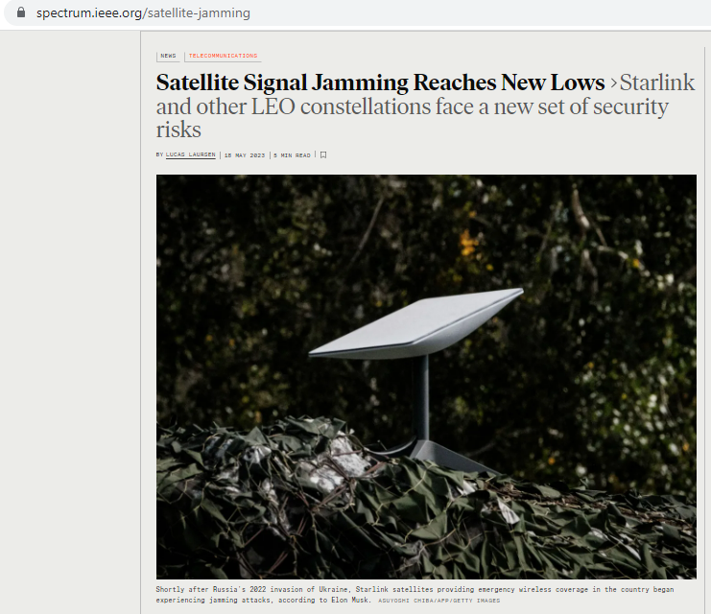

Cyber Security

Slide 18
Cyber Security
Solutions:
Invest in effective cyber security infrastructure via funded research
Do not rely on single communications channels
Use AI to plug the ‘communications gap’

Slide 19
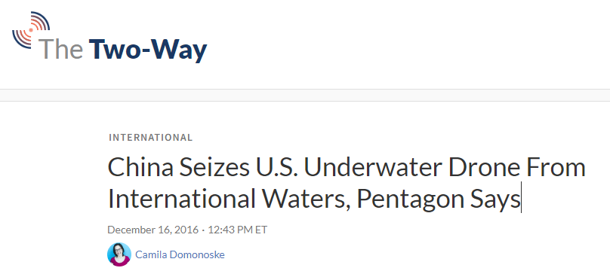
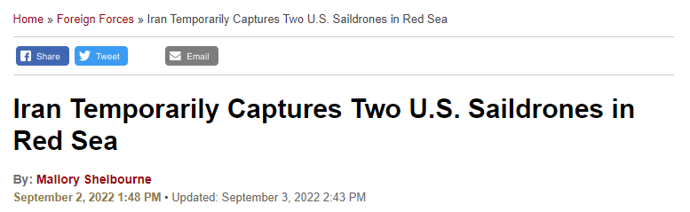
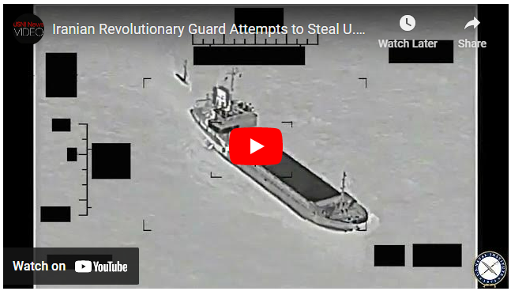
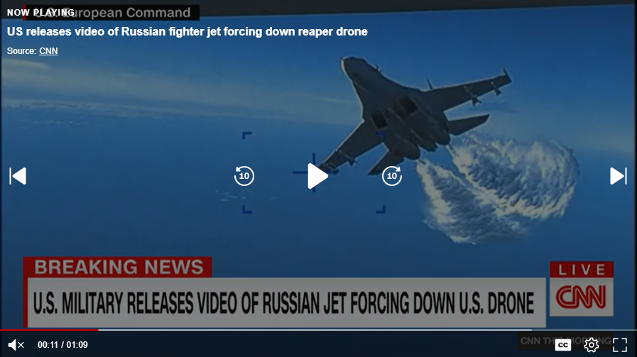
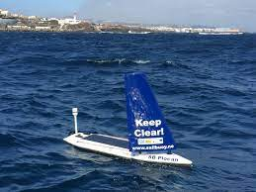
Robot Politics
We were just maintaining a safe waterway!

Slide 20
Robotic Politics – Conclusions
Uncrewed systems are not respected like crewed systems
Being in international waters is not going to prevent an adversary from taking out your system
‘Killing’ a robot is clearly not an act of war

Slide 21
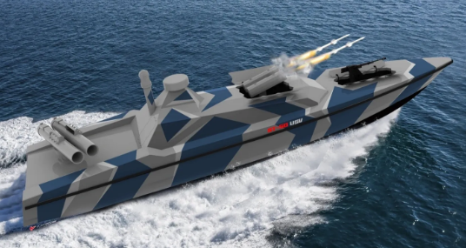
Robotic Politics
Solutions:
Unless already engaged in conflict, it is not worth starting a war over hardware

Slide 22
Robotic Politics
Solutions:
Stealth
High Speed
Multi domain
Dangerous?
Not immune to kinetic action?

Slide 23
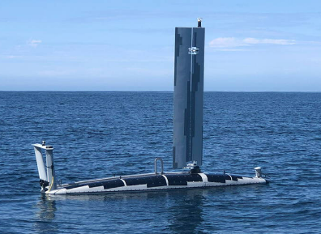


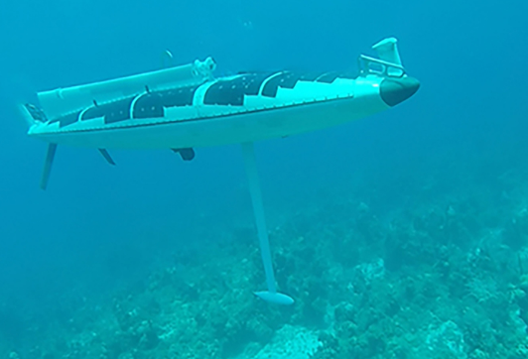
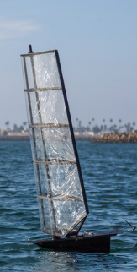
Robotic Politics

Slide 24
Robotic Politics
Example:
For uncrewed marine survey in deep, hostile water, we need the accuracy of surface positioning, but be able to carry a deep water multibeam (big!) and travel long distances – and dive to escape interference.
Such a system has not yet been built

Slide 25
Conclusion
Investing in the correct type of marine autonomy will be essential in winning the wars of the future.
Technology is there with regards to platforms and communications design.
Issues with regulation (civilian and military), cyber security, and robot politics (the way that uncrewed systems are viewed), will need to be overcome to realise the potential of marine autonomous system in a naval context

Slide 26


Thank you
PLEASE CONTACT:
Chloe Rowland
Cyber-SHIP Lab Project and Knowledge Exchange Manager
chloe.rowland@plymouth.ac.uk
Aaron Barrett
Technical Specialist – Marine Autonomous Systems
aaron.barrett@plymouth.ac.uk

