Slide 1

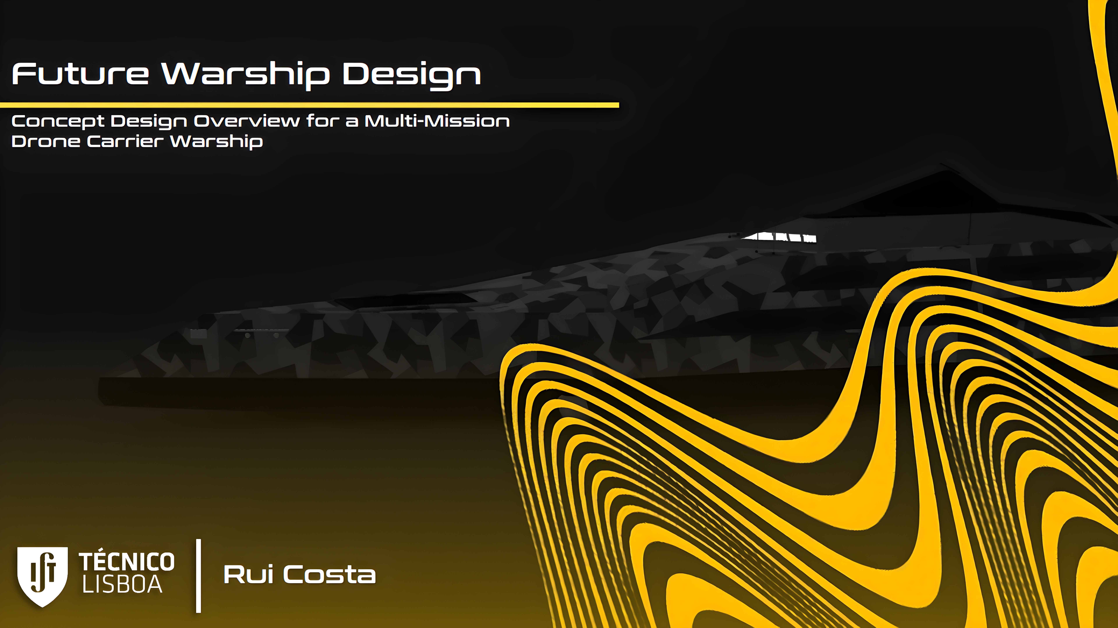

Future Warship Design
Concept Design Overview for a Multi-Mission Drone Carrier Warship
Rui Costa

Slide 2
1.
Introduction & Agenda

Slide 3
Context
Agenda
Work Structure
State of the Art
Operational Requirements & Concept
System Design
Ship Synthesis Model

Slide 4
2.
Context

Slide 5
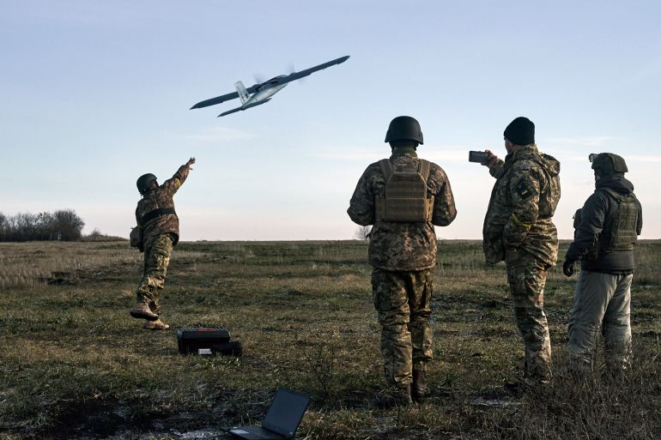
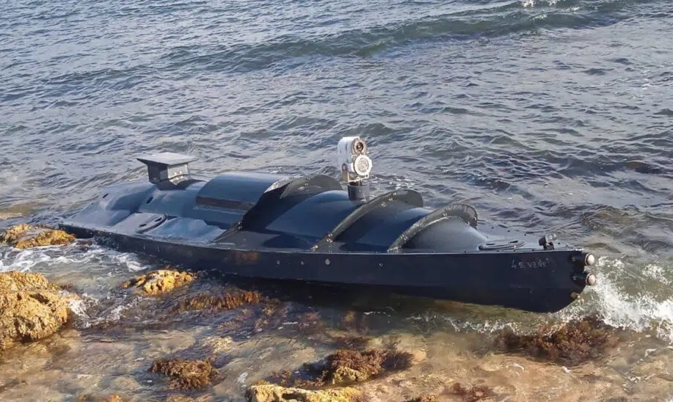
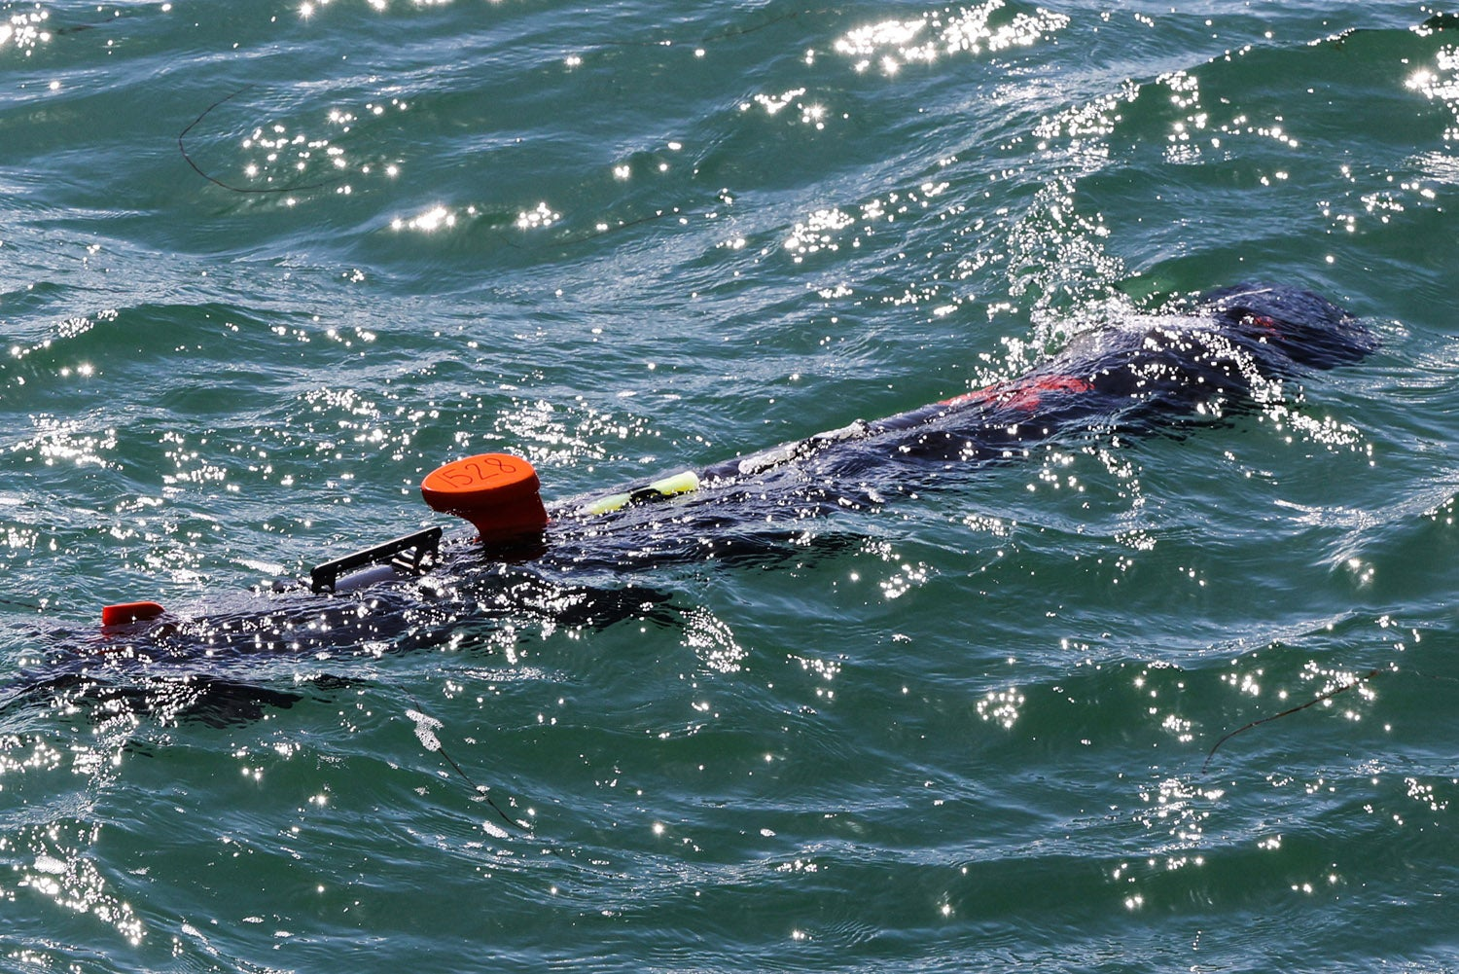
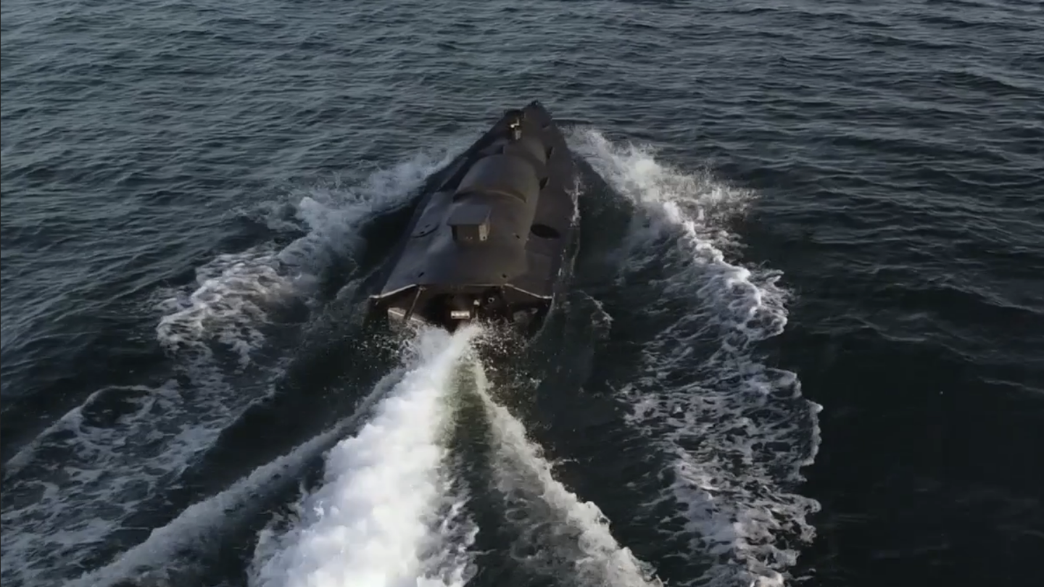
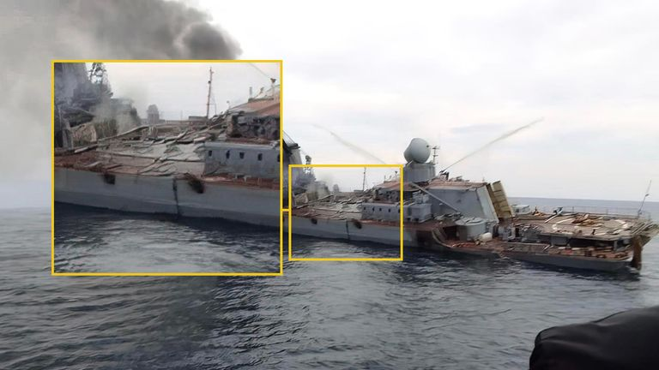
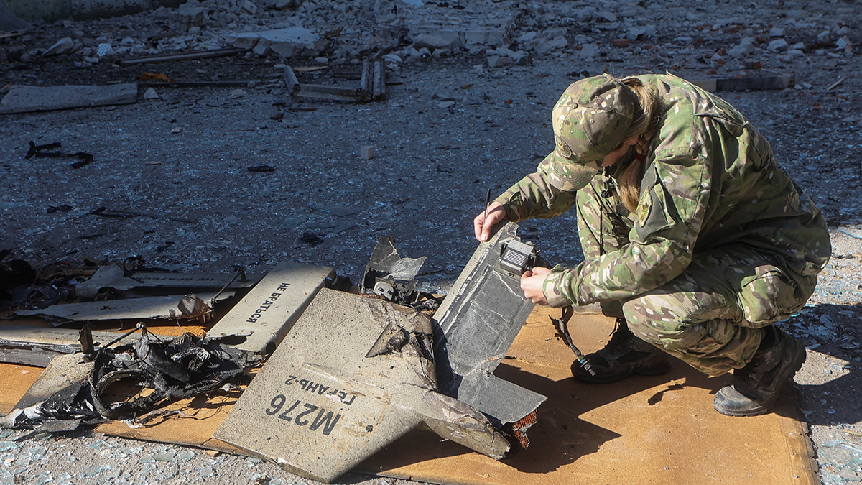
2.
Context

Slide 6
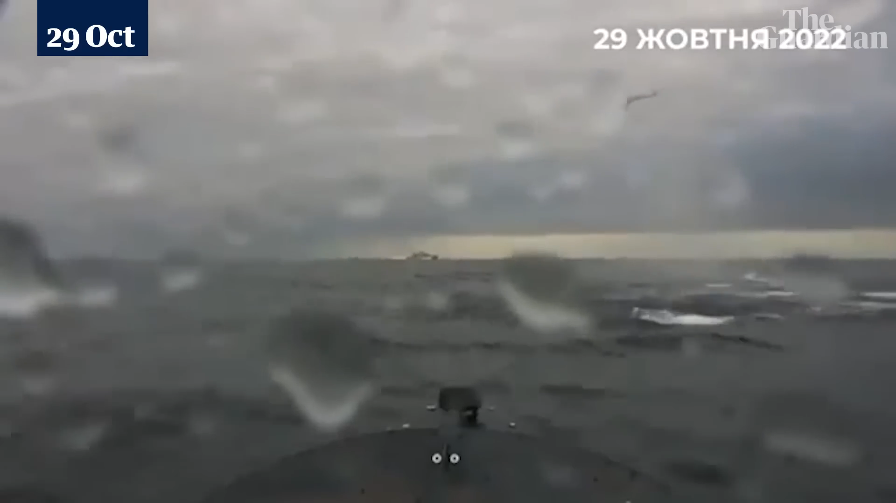
2.
Context
The Guardian

Slide 7
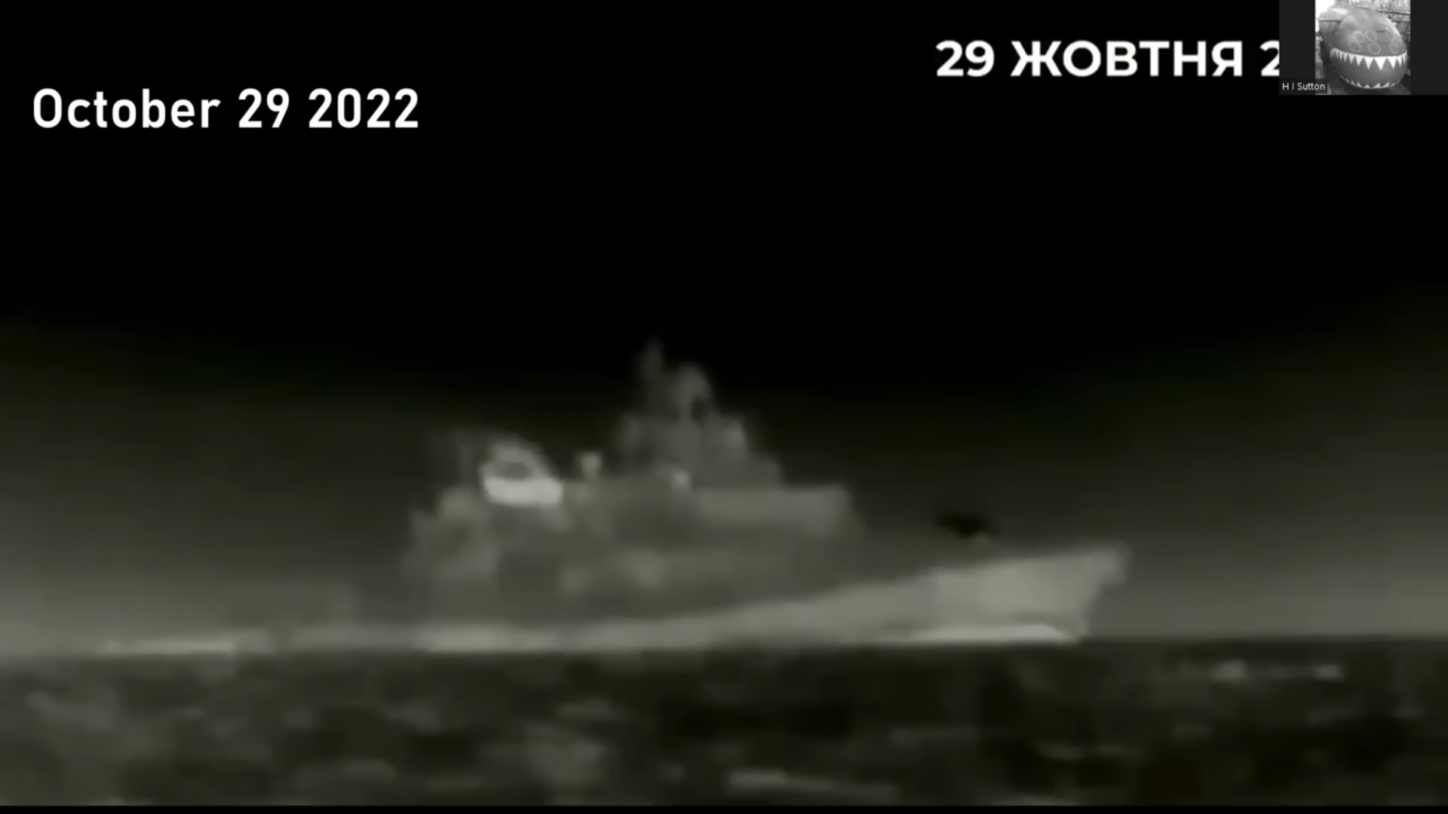
2.
Context
Sevastopol Naval Base: Admiral Makarov Frigate & Mi-8/17 Helicopter
Covert Shores

Slide 8
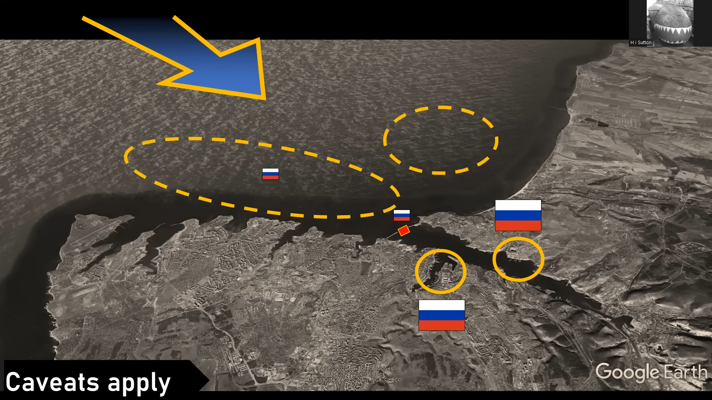
2.
Context
2 Main Anchorage Areas: Frigates & Submarines
Covert Shores

Slide 9
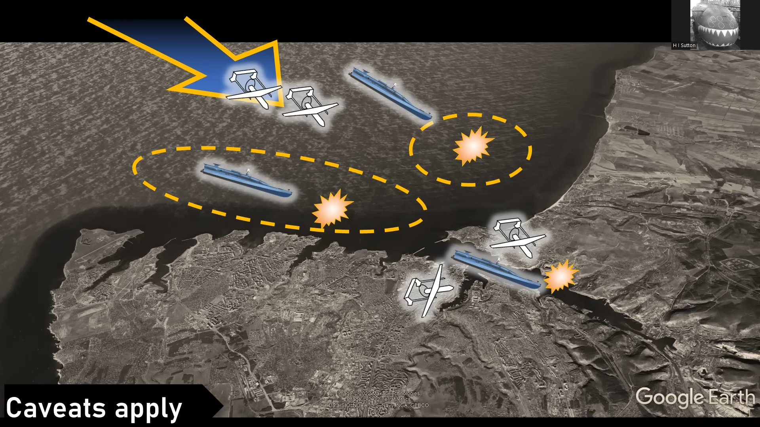
2.
Context
UAV [9] & USV [7] Combined Attack
Covert Shores

Slide 10
2.
Context
2 Damaged Warships: Frigate & Minesweeper
Service Vessel and Dam infrastructure also Damaged
Covert Shores

Slide 11
2.
Context

Slide 12
Context
Agenda
Work Structure
State of the Art
Operational Requirements & Concept
System Design
Ship Synthesis Model

Slide 13
3.
Work Structure

Slide 14
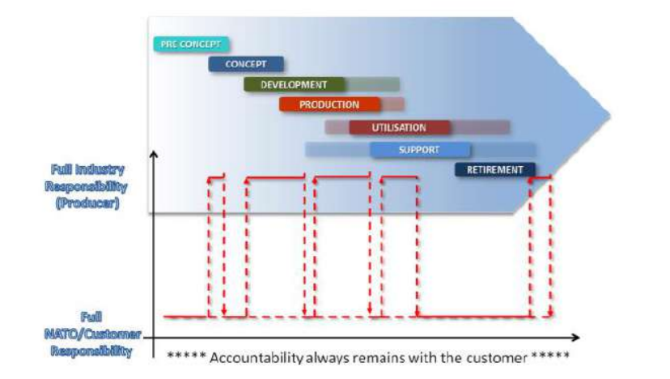
3.
Work Structure
NATO AAP-20: NATO Programme Management Framework

Slide 15
3.
Work Structure
NATO AAP-20: NATO Programme Management Framework

Slide 16
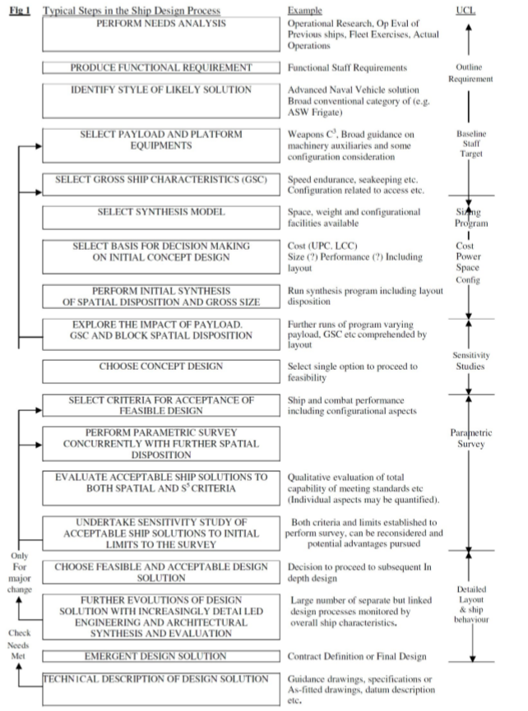
3.
Work Structure
University College London & RN Procedures

Slide 17
3.
Work Structure
University College London & RN Procedures

Slide 18
Context
Agenda
Work Structure
State of the Art
Operational Requirements & Concept
System Design
Ship Synthesis Model

Slide 19
4.
State of the Art

Slide 20
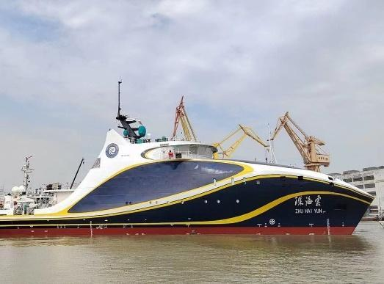
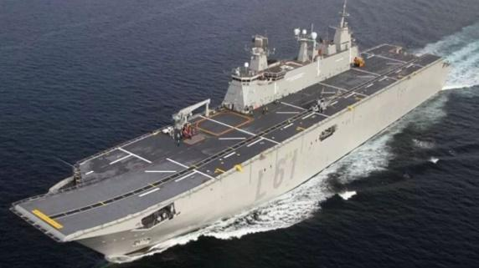
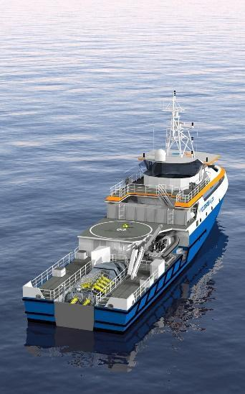
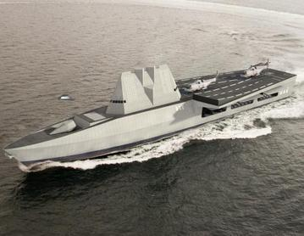
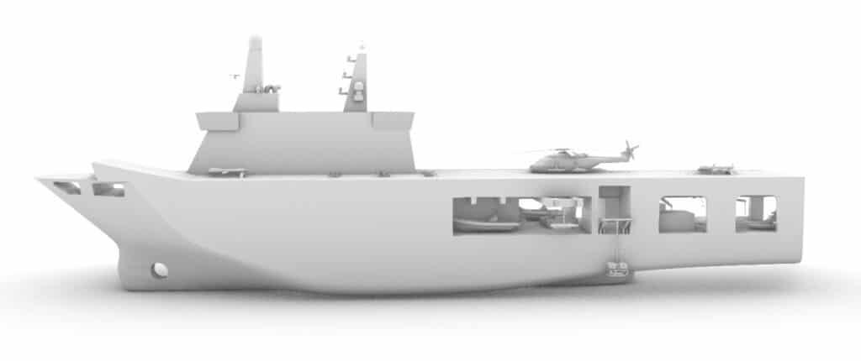
4.
State of the Art
Zhu Hai Yun (PLA Navy);
TCG Anadolu (Turkish Navy);
Drone carrier concept vessel (PoN);
UXV Combatant (BAE Systems);
Octopoda 500 (Mauric);

Slide 21
4.
State of the Art
Key Notes & Takeaways;
Operational use context;

Slide 22
Context
Agenda
Work Structure
State of the Art
Operational Requirements & Concept
System Design
Ship Synthesis Model

Slide 23
5.
Operational Concept & Requirements

Slide 24
5.
Operational Concept Development
4 Key-Questions:
“What Market sector will the solution be aimed at?”
“What areas will the ship operate in?”
“In what context will it operate in?”
“How will the concept solution’s sucess be measured?”

Slide 25
5.
Operational Concept Development
The process:
Mission Type 1
Key Mission Requirements
Mission Type 2
Benchmarks
Operational Requirements & URD
Operational Concept
Mission Type 3
OPFOR Benchmarks
Mission Type 4
Environmental Conditions
Mission Type 5

Slide 26
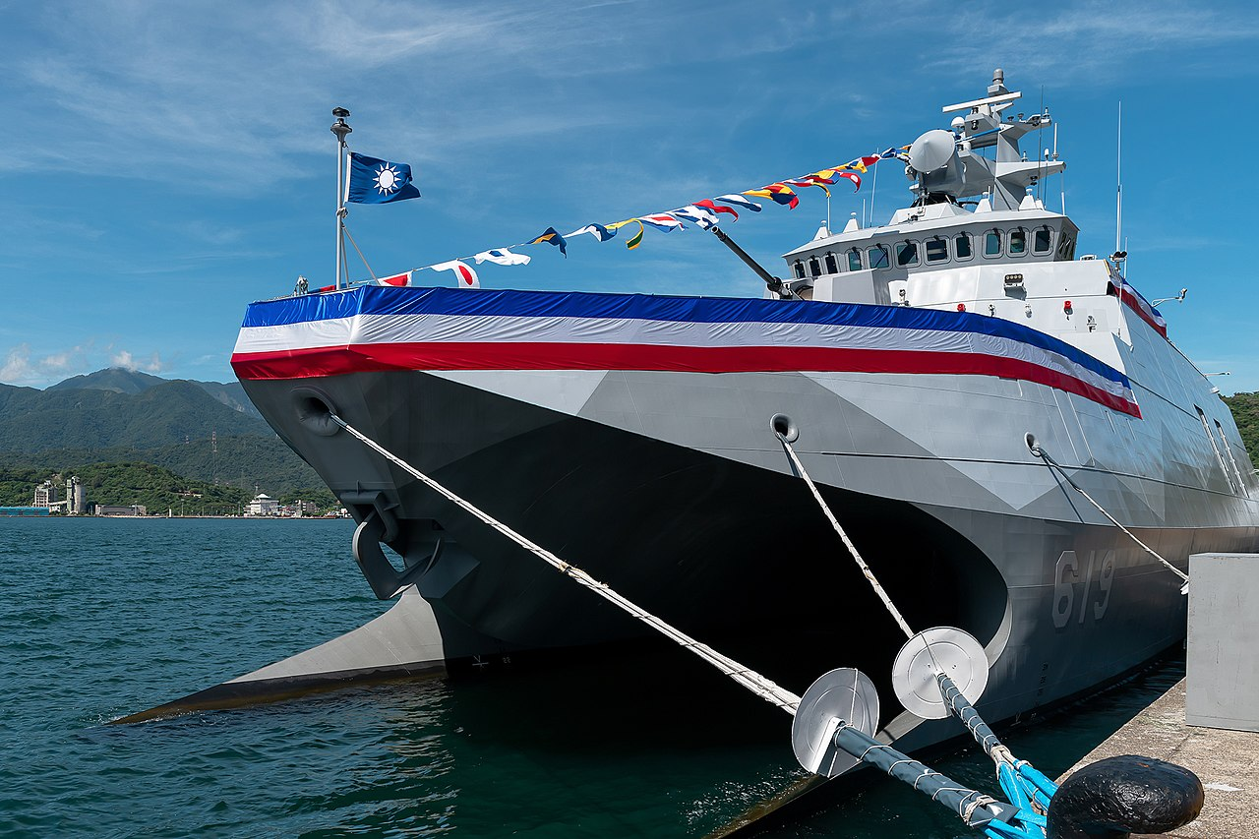
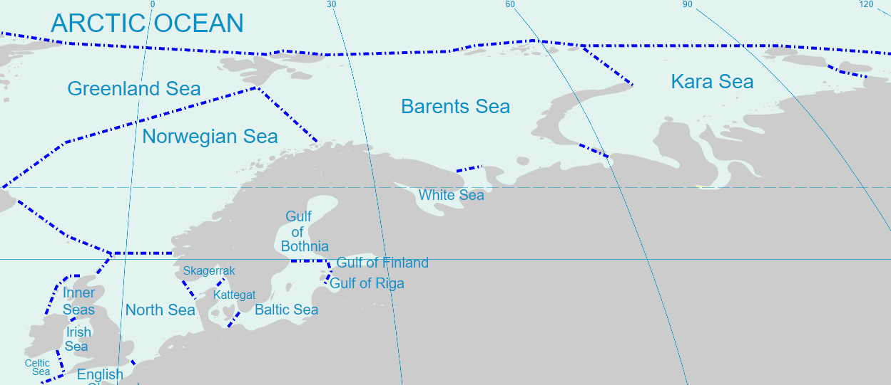
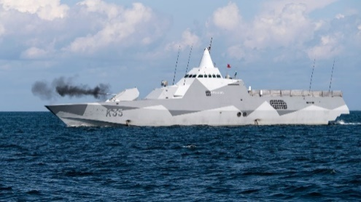
5.
Mission Type 1: Example
Coastal & Infrastructure Strike Operations
Tuo-Chiang Class
Area of Operations
Visby Class

Slide 27
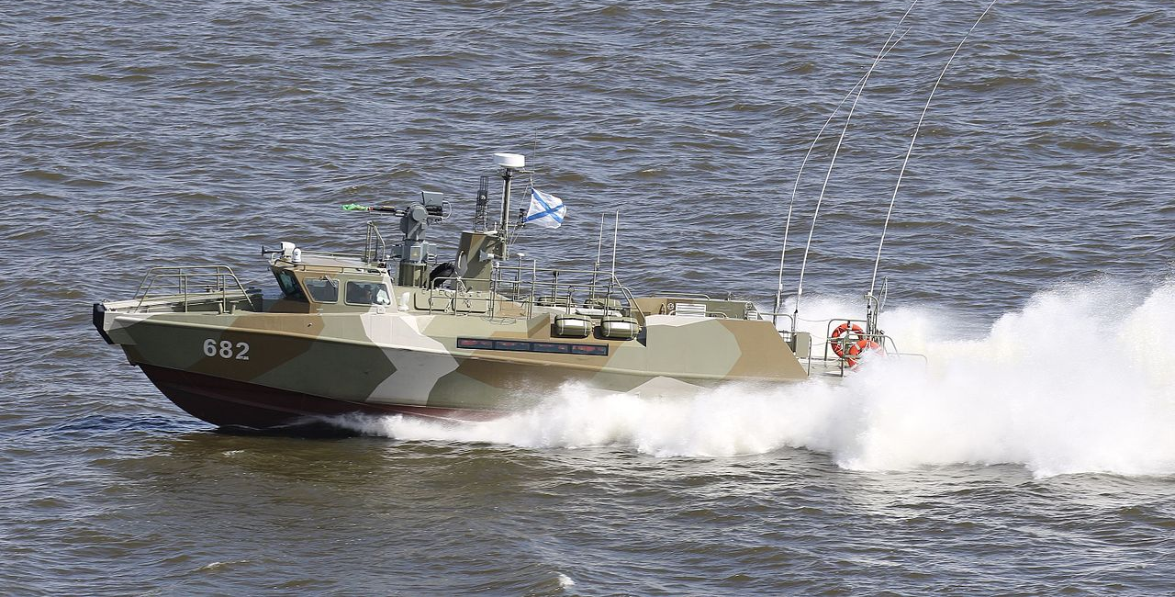
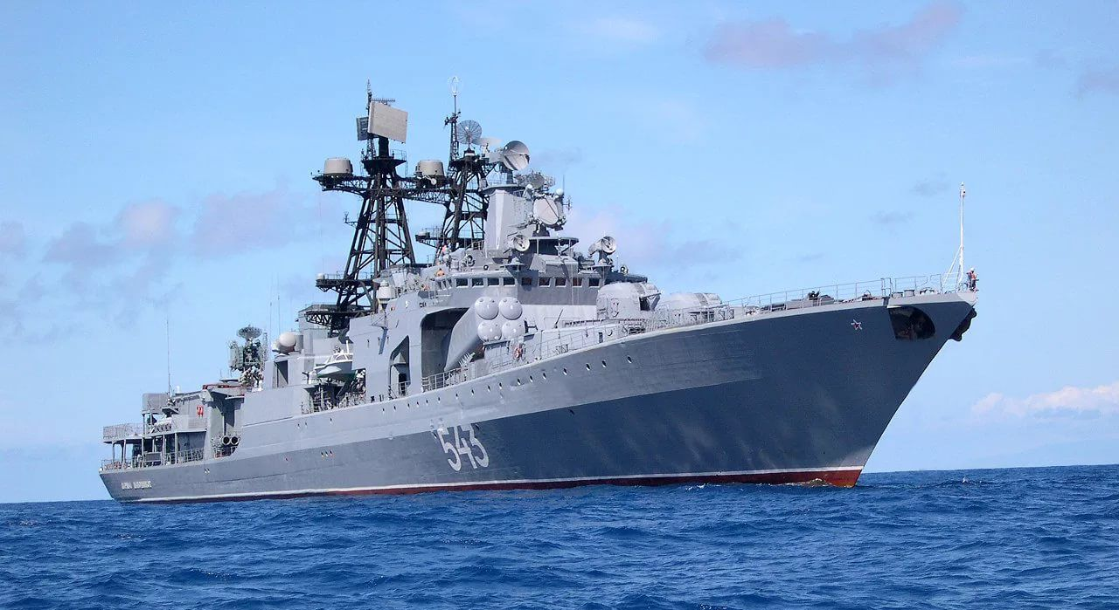
5.
Mission Type 1: Example
Coastal & Infrastructure Strike Operations
OPFOR Benchmarks
Udaloy Class Destroyers
Admiral Gorshkov Class Frigates
Admiral Grigorovich Class Frigates;
Neustrashimyy Class Frigates;
Buyan-M Class Corvettes;
Karakurt Class Corvettes;
Steregushchiy Class Corvettes;
Project 22160 Class Patrol Ships;
Grachonok Class Patrol Boats;
Raptor Class Patrol Boats;
Kilo Class Submarines;
K-300P Bastion-P coastal defence system;
A-222E Bereg-E 130mm coastal mobile artillery system;
9M133 Kornet portable guided missile system;
Sukhoi Su-24 bombers;
Tupolev Tu-22M bomber;
Mikoyan MiG-29 fighter aircraft;
Various mines using Soviet Era technology;

Slide 28
5.
Mission Type 1: Example
Coastal & Infrastructure Strike Operations
Maximum Speed: 35 knots;
Protective countermeasures and CUAVs and/or VLS missile systems capable of effectively countering small patrol boats (Range >5,500 metres);
Composite material hull to minimise magnetic signature and reduce the threats of mines;
Carry USVs capable of performing ASW reconnaissance and deploying countermeasures;
Radar and threat detection systems with a range of over 300 km;
Deploy and retrieve USV, UAV and manned vessels at a minimum distance of 150 km from shore;
Carry manned craft to transport special operation forces to and from shore (2 teams of 12 operators);
Carry a minimum of 5 long range reconnaissance UAVs supplemented by 6 long range CUAVs;
Carry up to 10 USVs designed to carry explosive payloads between 50 and 200 kg;
CHAFF and decoy countermeasures for missile defence purposes;
Deploy up to 2 medium to large MM-USVs;
Minimise both its radar cross section, acoustic and infrared detectability;

Slide 29
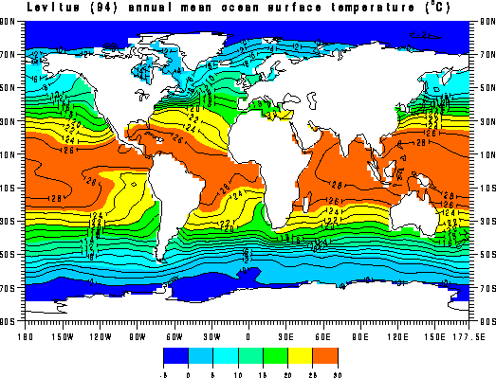
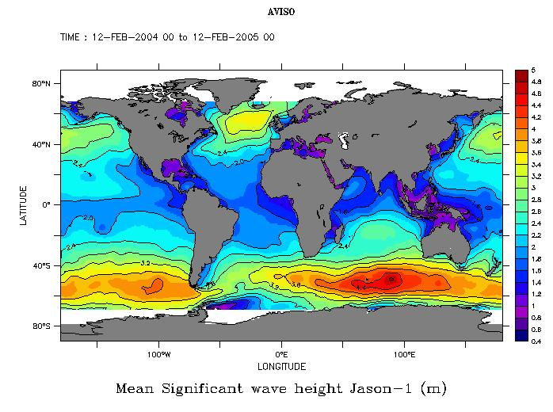
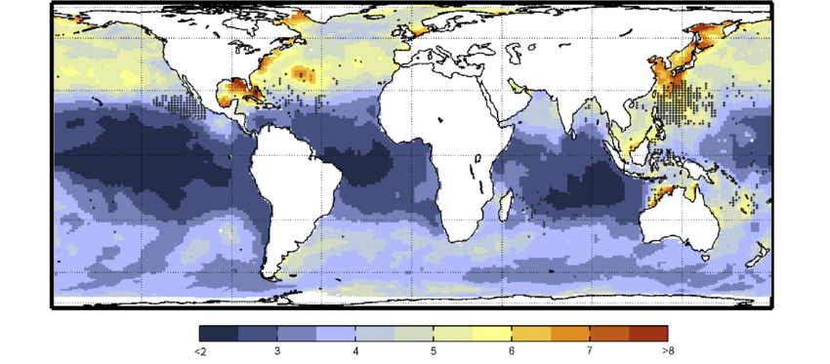
5.
Area of Operations
North Atlantic
Surface Temperature
Significant Wave Height
Average Sea States

Slide 30
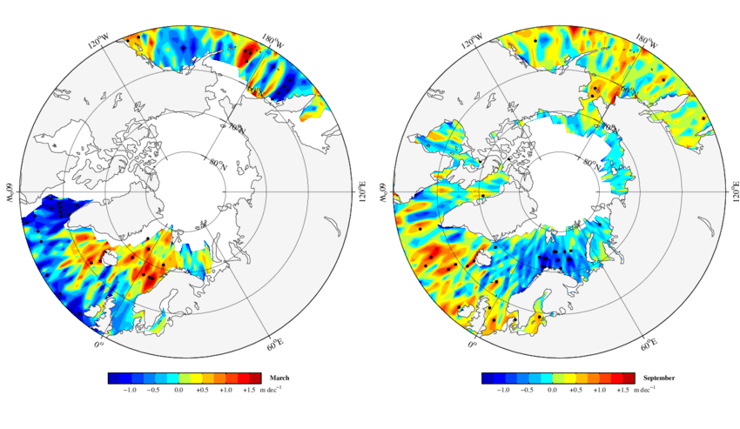
5.
Area of Operations
North Sea, Baltic, Arctic
Average Seasonal Surface Temperature

Slide 31
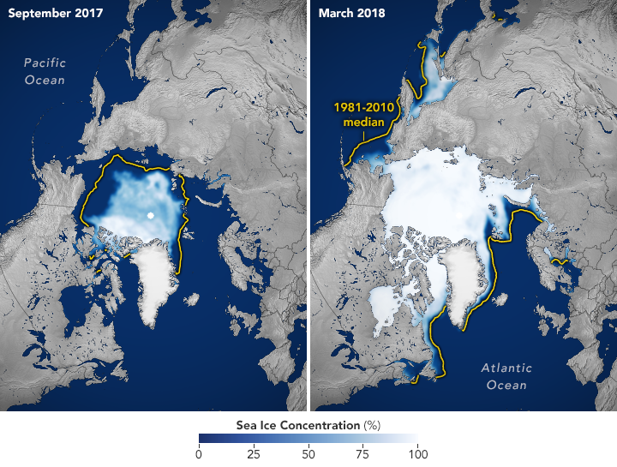
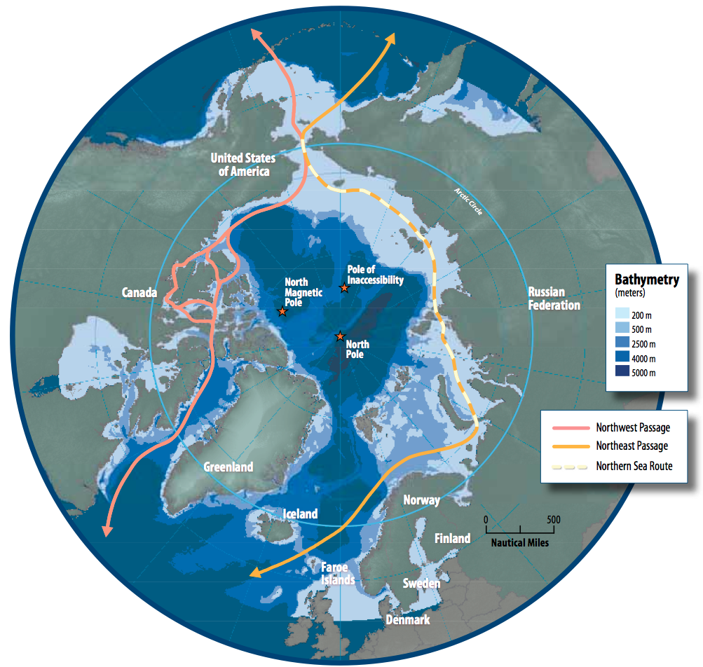
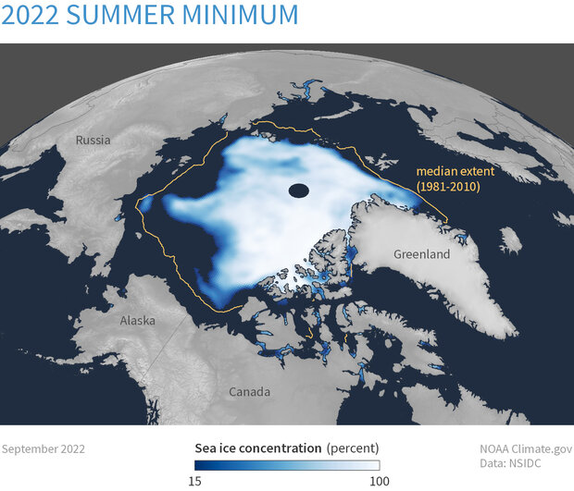
5.
Area of Operations
North Sea, Baltic, Arctic
Polar ice cap seasonal changes
Arctic Navigation Pathways
Ice cap reduction (1981, 2010, 2022)

Slide 32
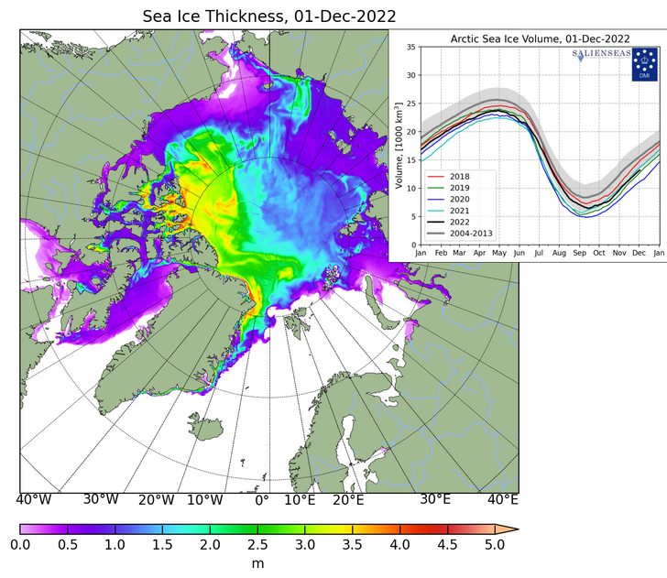
5.
Area of Operations
North Sea, Baltic, Arctic
Mean Ice Thickness (2022)
Main Takeaways:
Unmanned systems temperature requirements;
Topside Sensors & Effectors: ice & temperature requirements;
IMO Polar code Ice class PC(7);
DNV-RU-SHIP: Cold Climate ICE-C Class;
Flight deck, bridge and auxiliary requirements;

Slide 33
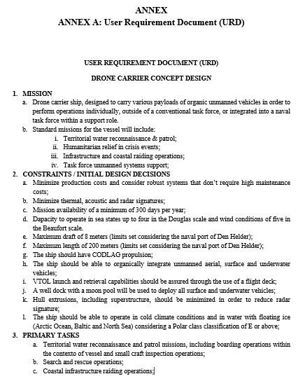
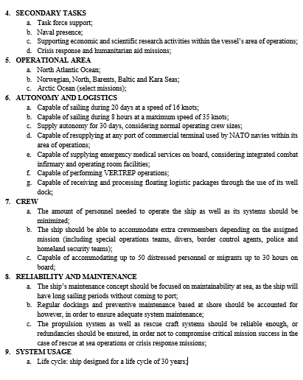
5.
User Requirement Document (URD)
Defined main ship operational and technical requirements on the final user’s end;
Will serve as reference for final concept adequacy evaluation;
Guideline for system selection and initial design decisions;
Base-line restrictions set for ship synthesis model & initial sizing;
Definition of operational capability metrics for design evaluation;

Slide 34
Context
Agenda
Work Structure
State of the Art
Operational Requirements & Concept
System Design
Ship Synthesis Model

Slide 35
6.
System Selection

Slide 36
6.
System Selection
The Process
Hull
CS & NATO Requirements
Propulsion
Operational Concept
NATO Benchmarks
Sensors & Effectors
System Selection
Operational Requirements
NATO Suppliers
Energy
System Op. Requirements
Unmanned Vehicles
Auxiliary

Slide 37
6.
System Selection
The Process
Mission Type 1
Configuration 1
Selected Systems
Mission Type 2
System Design
Variable Systems
Configuration 2
Mission Type 3
Configuration 3
Mission Type 4

Slide 38
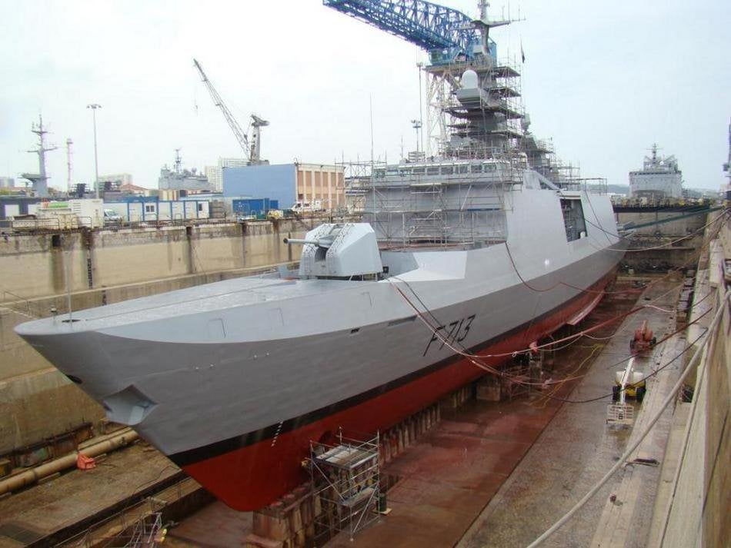
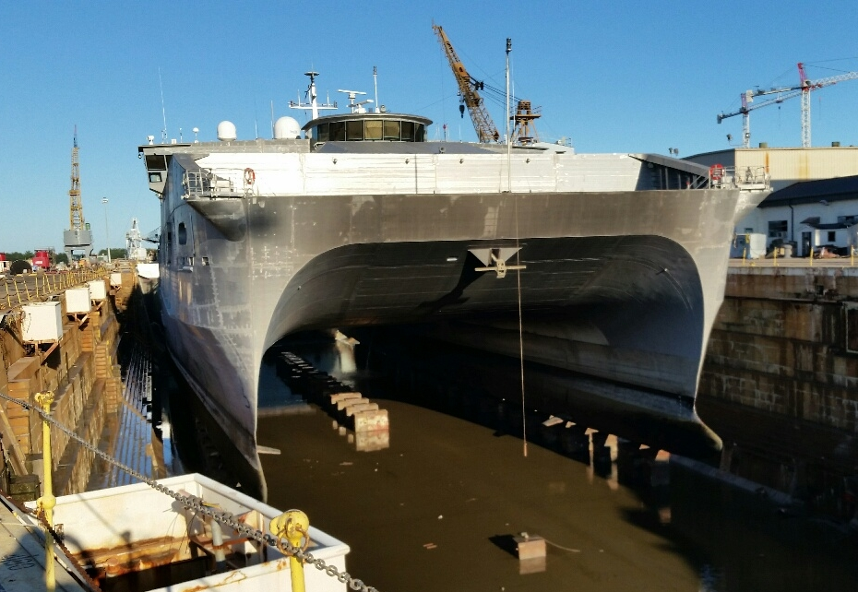
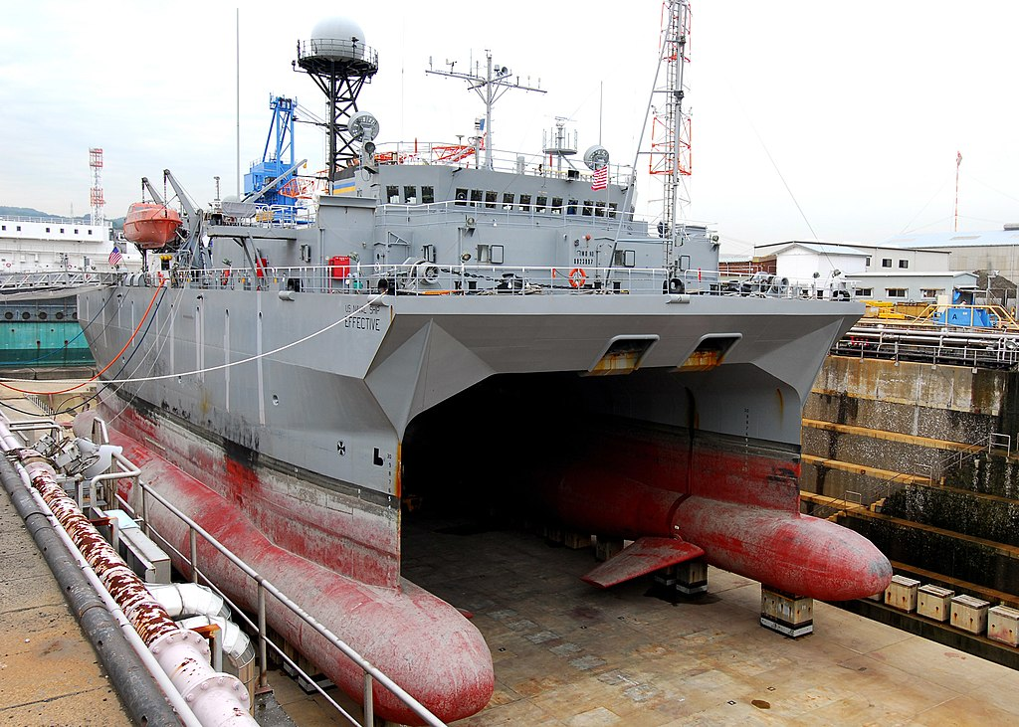
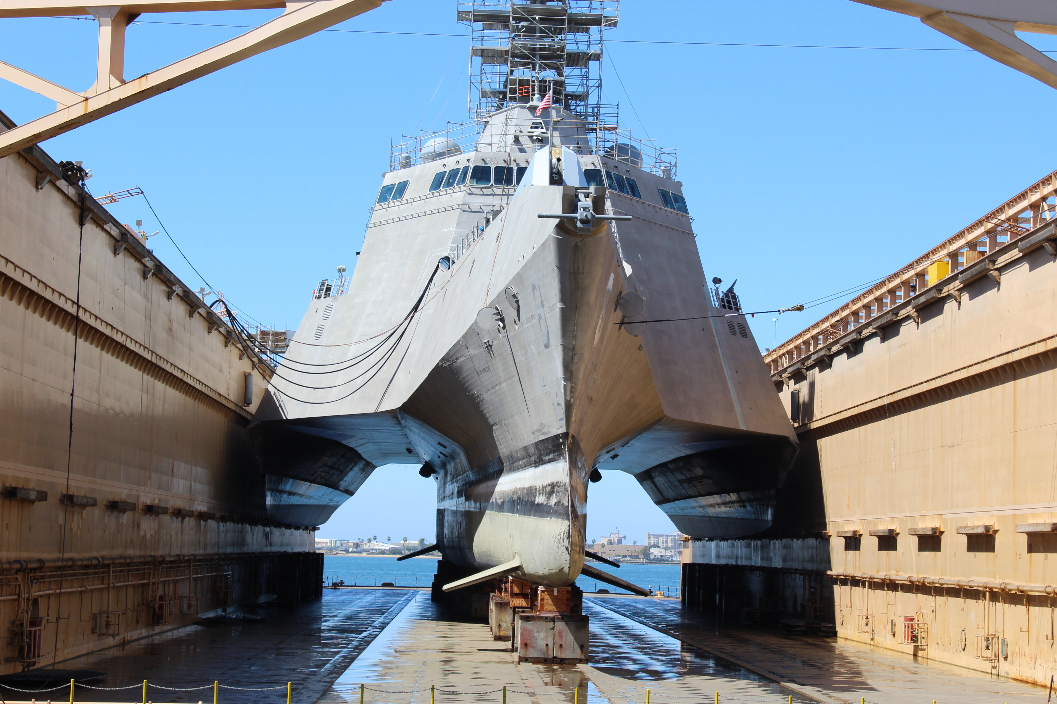
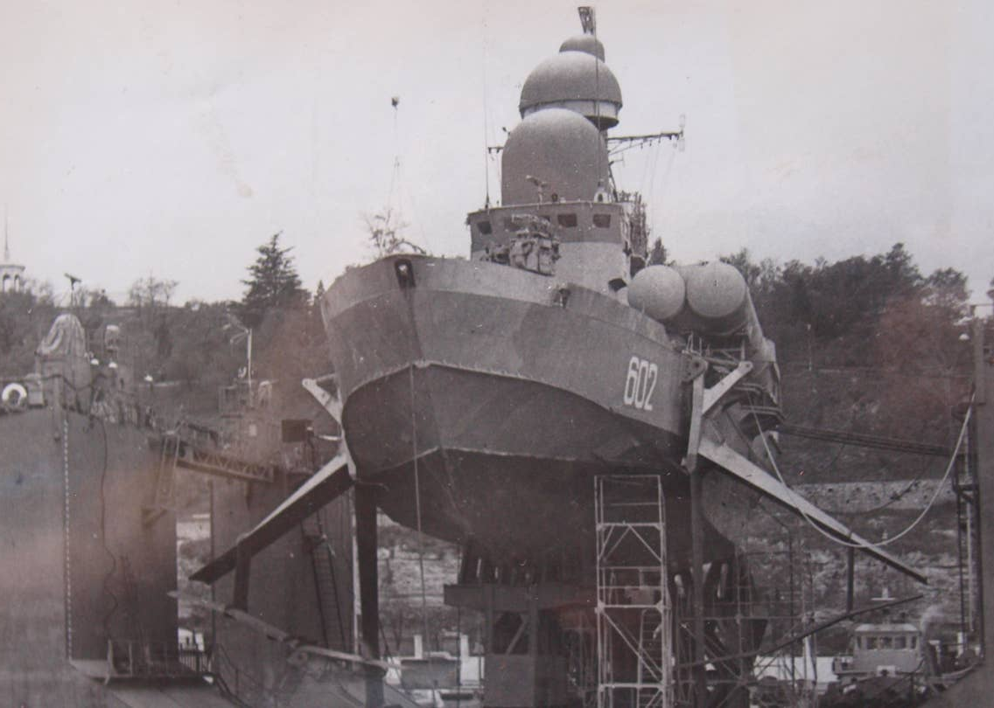
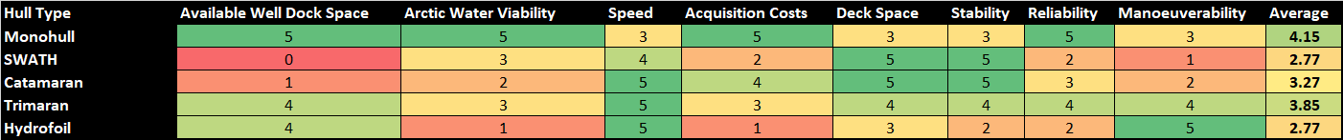
6.
System Selection
Example: Hull
Available well dock space (5)
Arctic water viability (5)
Speed (4)
Stability (3)
Maintainability & Reliability (2)
Manoeuverability (1)
Acquisition Costs (3)
Deck Space (3)

Slide 39
6.
System Selection
Example: Hull
Available well dock space (5)
Arctic water viability (5)
Speed (4)
Stability (3)
Maintainability & Reliability (2)
Manoeuverability (1)
Acquisition Costs (3)
Deck Space (3)

Slide 40
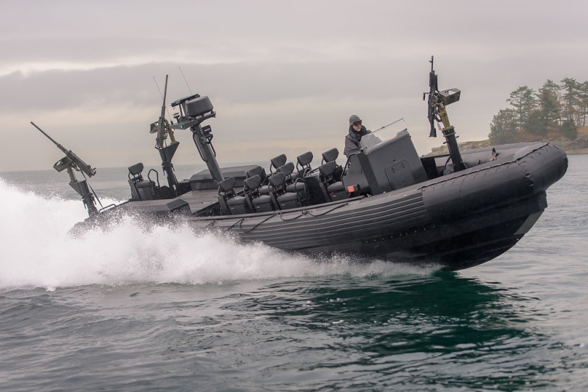
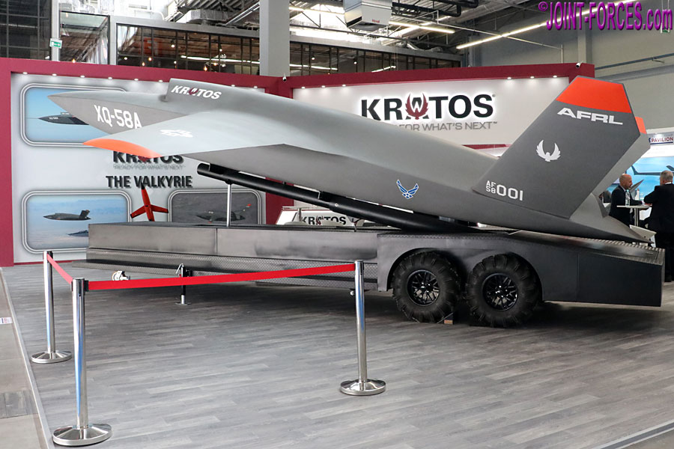
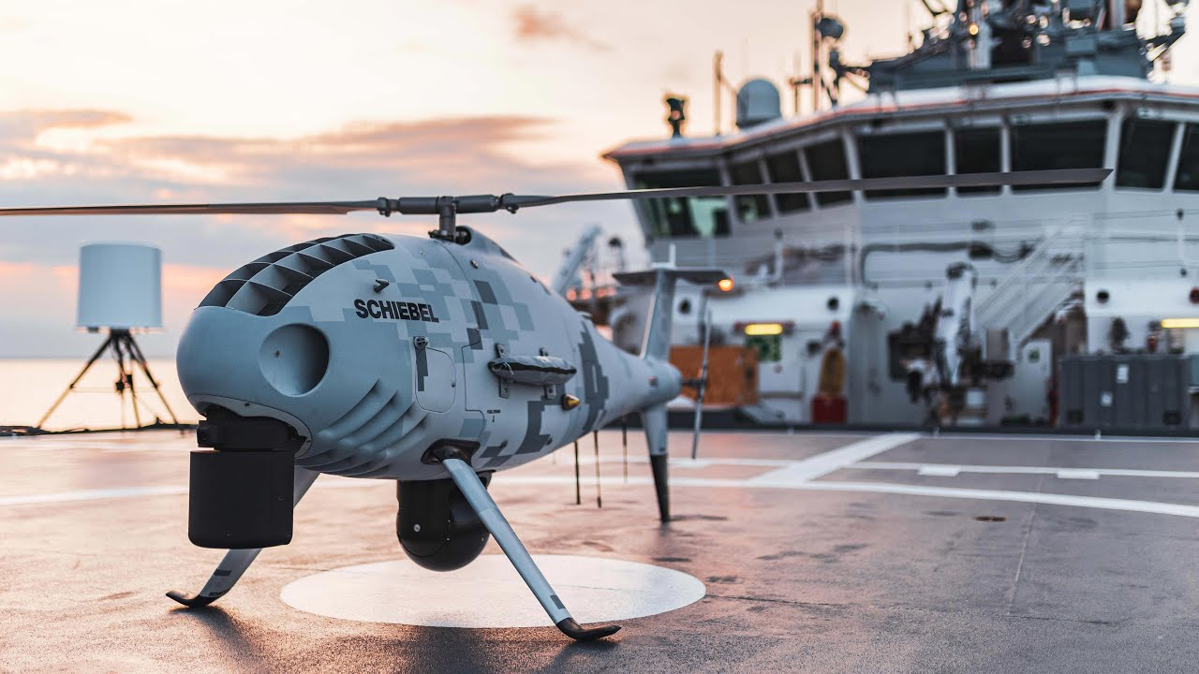
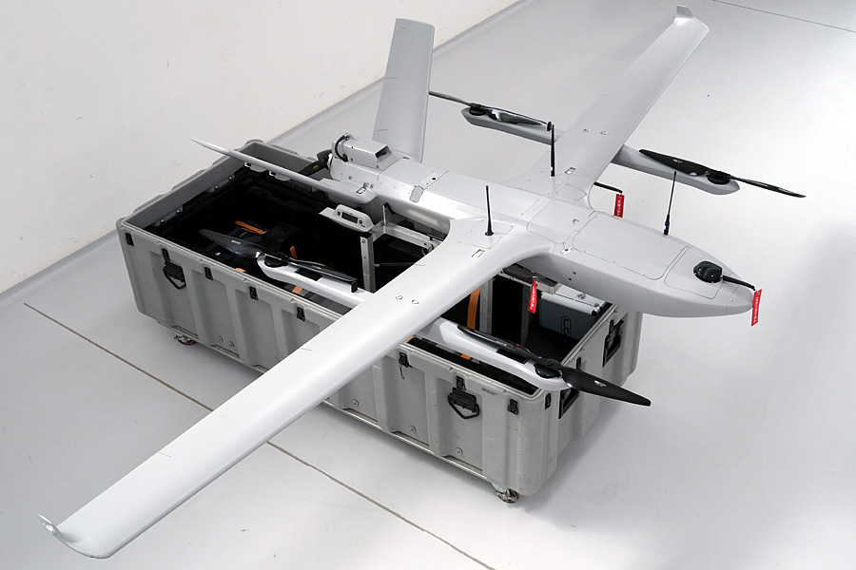
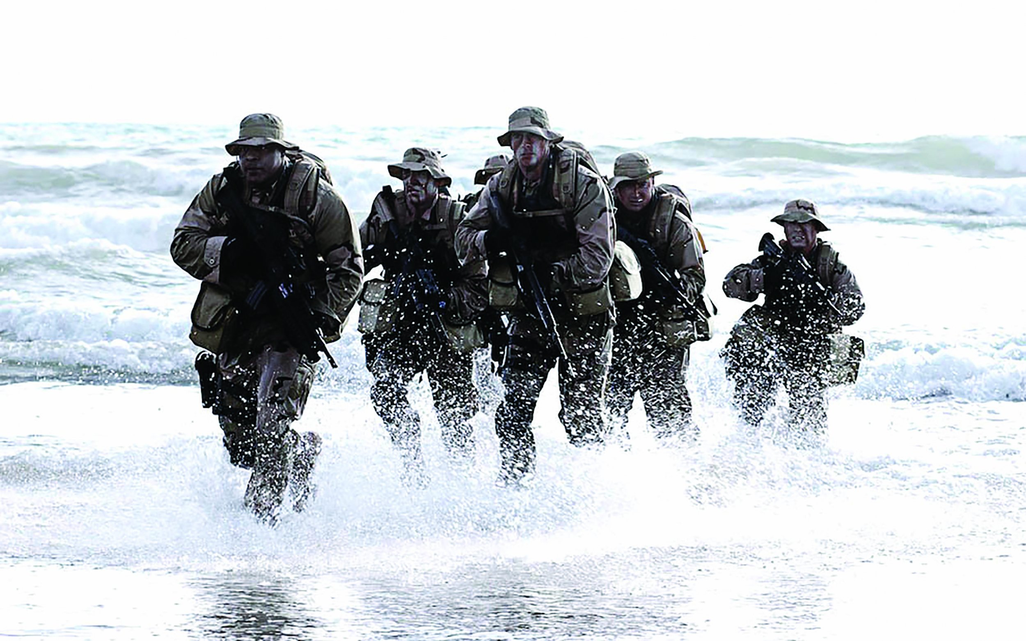
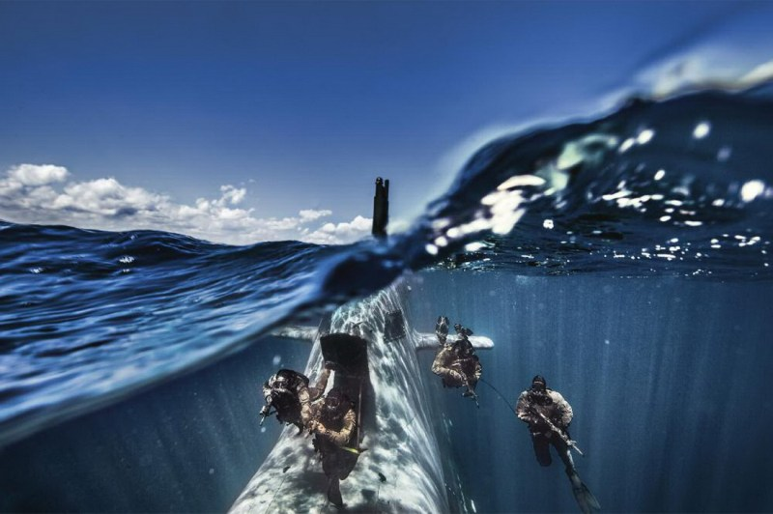
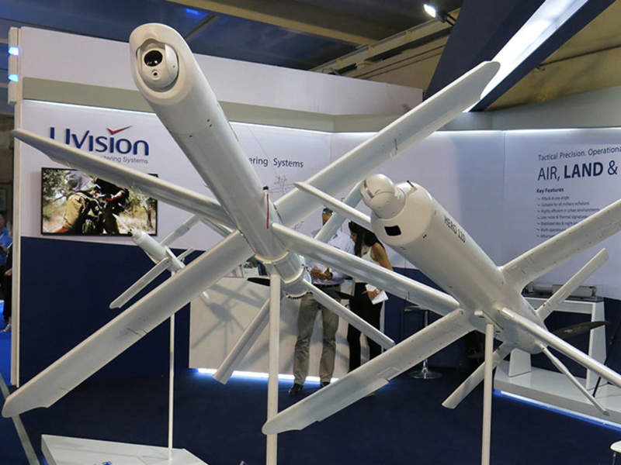
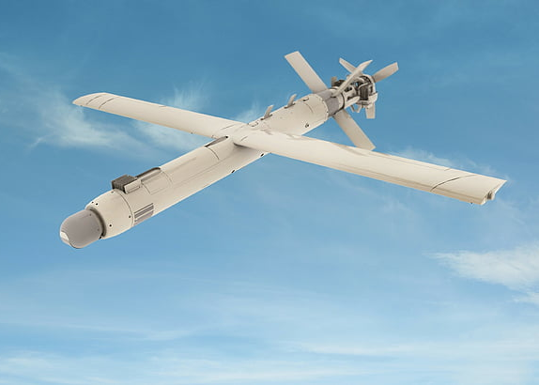
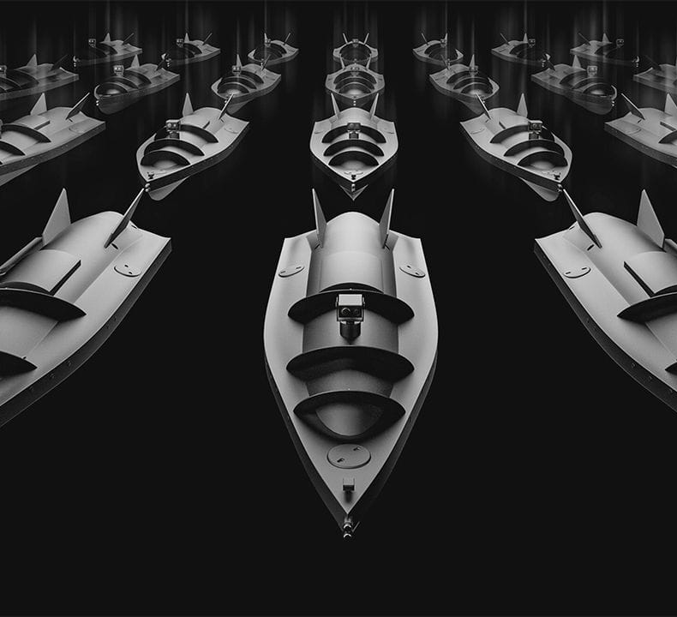
6.
System Selection
Example: Unmanned Payload 1
Mission Scenario:
Coastal Raiding/Strike
With amphibious capabilities
Variable Payload Requirements:
Zodiac MM RHIB [3]
UCAV [3]
UAV (Recon) [10]
Or: SDV [3]
UAV (Loitering) [60]
USV (Loitering) [20]

Slide 41
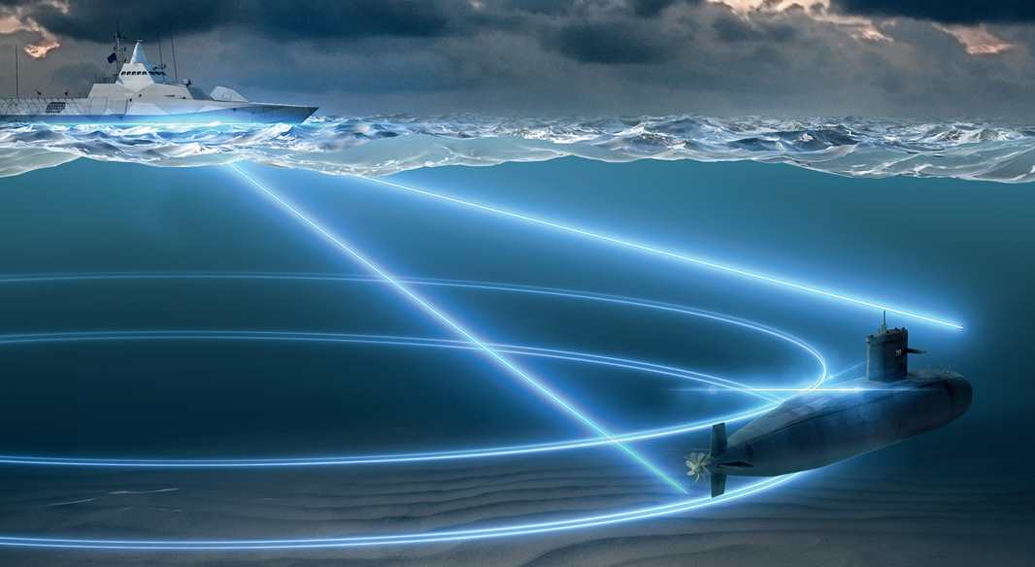
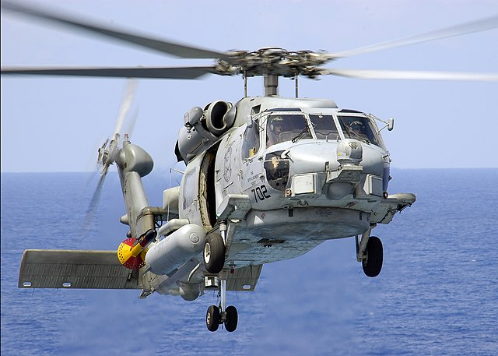




6.
System Selection
Example: Unmanned Payload 2
Mission Scenario:
ASW Task Force Support
Variable Payload Requirements:
Helicopter [1-2]
UAV (Recon) [10]
UUV (MM) [2]
USV (MM) [2]
UUV (Loitering) [20]

Slide 42
Context
Agenda
Work Structure
State of the Art
Operational Requirements & Concept
System Design
Ship Synthesis Model

Slide 43
7.
Ship Synthesis Model

Slide 44
7.
Ship Synthesis Model
Inputs
Ship Synthesis Model
Ship Main Dimensions
Hull Form Coefficients

Slide 45
7.
Ship Synthesis Model
Ship Synthesis Model

Slide 46

7.
Ship Synthesis Model
Resistance & Propulsion
Ship Synthesis Model
Weight Groups [SWBS Based]
Weight Distribution
Volume Distribution
Stability Calculations
Voyage / Operations Model
Endurance & Autonomy Calculations
Complement & Crew Calculations
Costing Model
Unmanned Payload & Systems Database
Cost/Capability Calculations
Naval Ship Database

Slide 47
7.
Ship Synthesis Model
Restrictions & Requirements
Ship Synthesis Model
Ship Main Dimensions
Cost/Capability Optimization
Concept Solution
Hull Form Coefficients

Slide 48
7.
Ship Synthesis Model
Non-linear Optimization Algorithm
Inputs
Ship Synthesis Model
Ship Main Dimensions
Hull Form Coefficients

Slide 49
8.
The Ship

Slide 50
8.
The Ship
Scope
Software Analysis
Seakeeping
General Arrangement
Concept Solution
Verification & Validation Process
Structural Design
3D Model
CFD & FEA Analysis
RCS & LO Optimization

Slide 51

8.
The Ship

Slide 52
8.
The Ship
VTOL UAVs / Helicopter
Modular Bay
Loitering UAVs & UCAVs
USVs & UUVs

Slide 53
8.
The Ship

Slide 54
8.
The Ship

Slide 55
9.
Something Special

Slide 56
QUESTIONS
Rui Costa

