Slide 1
DE&S Strategy:
Unlocking our capacity and increasing Defence’s outputs

Slide 2
“Russia and [China] pose different challenges. Russia poses an immediate threat to the free and open international system, recklessly flouting the basic laws of the international order today, as its brutal war of aggression against Ukraine has shown."
"The P.R.C., by contrast, is the only competitor with both the intent to reshape the international order and, increasingly, the economic, diplomatic, military and technological power to advance that objective," the president wrote, using the acronym for the People's Republic of China.
President Joe Biden
US National Security Strategy, Oct 2022

Slide 3
DEFENCE IS BEING ASKED TO DO MORE
TODAY. INCREASED AVAILABILITY
DELIVERING SUSTAINED IMPROVEMENTS IN THE OUTPUTS OUR ARMED FORCES REQUIRE
TOMORROW. IMPROVED DELIVERY
OUTPACING ADVERSARIES WITH RAPID CAPABILITY UPDATES & TECHNOLOGY ADVANCES
WE EQUIP OUR ARMED FORCES WITH THE EDGE TO PROTECT OUR NATION
TOGETHER. BETTER INTEGRATED
WORKING MORE EFFECTIVELY ACROSS MOD, INDUSTRY & INTERNATIONAL PARTNERS
Increasing Defence outputs by unlocking our capacity…
UNLOCK OUR CAPACITY
INCREASE DEFENCE OUTPUTS
Reduce systemic waste - with lean, digitally enabled processes which work for our people
Prioritise our efforts - driving efficiencies, to deliver more where it counts
Grow & better utilise our talent - with the right person, in the right role, at the right time
Increase our pace, agility & quality - to enable sustained availability and resilience
Strengthen the UK Industrial base - as a more integrated and intelligent customer
Drive a One Defence mindset - with better partnering to optimise overall military output
…driven through tangible action to deliver our strategy.
Prioritised sprints to accelerate internal change
3
Collaborating externally to tackle defence-wide challenges
1
2
Optimising our operating model to align to our strategy
Notes:
WHAT?
To deter our adversaries and protect our armed forces, we need to work smarter and move faster, with greater precision, purpose and ingenuity.
Today – We put the right people in place to ensure our soldiers, sailors and aviators have life-saving, battle-winning capabilities. We get the right kit into their hands quicker, with more availability, when and where they need it.
Tomorrow – We’ll exploit cutting-edge technology and new ways of working to better deliver our mission. We’ll pioneer integration across DE&S and UK Defence. We will be an intelligent, threat-aware, market-informed supplier; a true partner to industry, front-line commands and allies.
Together – We will do all of this as part of a One Defence team, driving excellence across UK Defence, to face down the threats we can see clearly and those yet to emerge.

Slide 4
IMPLEMENTATION
UNLOCKING OUR CAPACITY AND INCREASING DEFENCE’S OUTPUTS
Phase 0
Strategy
Today
Phase 1 – Mobilise and Define
Jul 23
Phase 2 - Implement
Sept 25
WHY
WHAT
HOW
HOW
OUTCOME
The threat is growing fast
Russia
China
Climate Change
TODAY
Increasing availability
Deliver more of what the forces need
OPTIMISING OUR OPERATING MODEL
CHANGE
Local
Individual & Team
CHANGE
CHANGE
Current State
Review
Foundation
Phase
Concept Design
Phase
Detailed Design
Phase
CHANGE
Initial hacks to kick-start capacity release.
Internal
Refocus our organisation
To deter our adversaries – Protecting our nation and our allies
TOMORROW
Update capability faster than our adversaries
Rapidly spin-in technological advances
PRIORITISED SPRINTS
Toolsets to help everyone eliminate waste
Build our ability to change …
OUTCOMES
Enterprise
DE&S
Our people want things to be better
Value people’s time.
Reduce frustrations
Enrich people’s roles & careers
… Change becomes
Working in an organisation that constantly changes and evolves for the better
part of all our roles
CHANGE
CHANGE
CHANGE
CHANGE
TOGETHER
Better integrate our efforts
across the MOD, Industry and International Partners
External
Defence
MOD,
Industry & Allies
CONTROL CENTRES
Make the challenges and opportunities visible
OUTCOMES

Slide 5
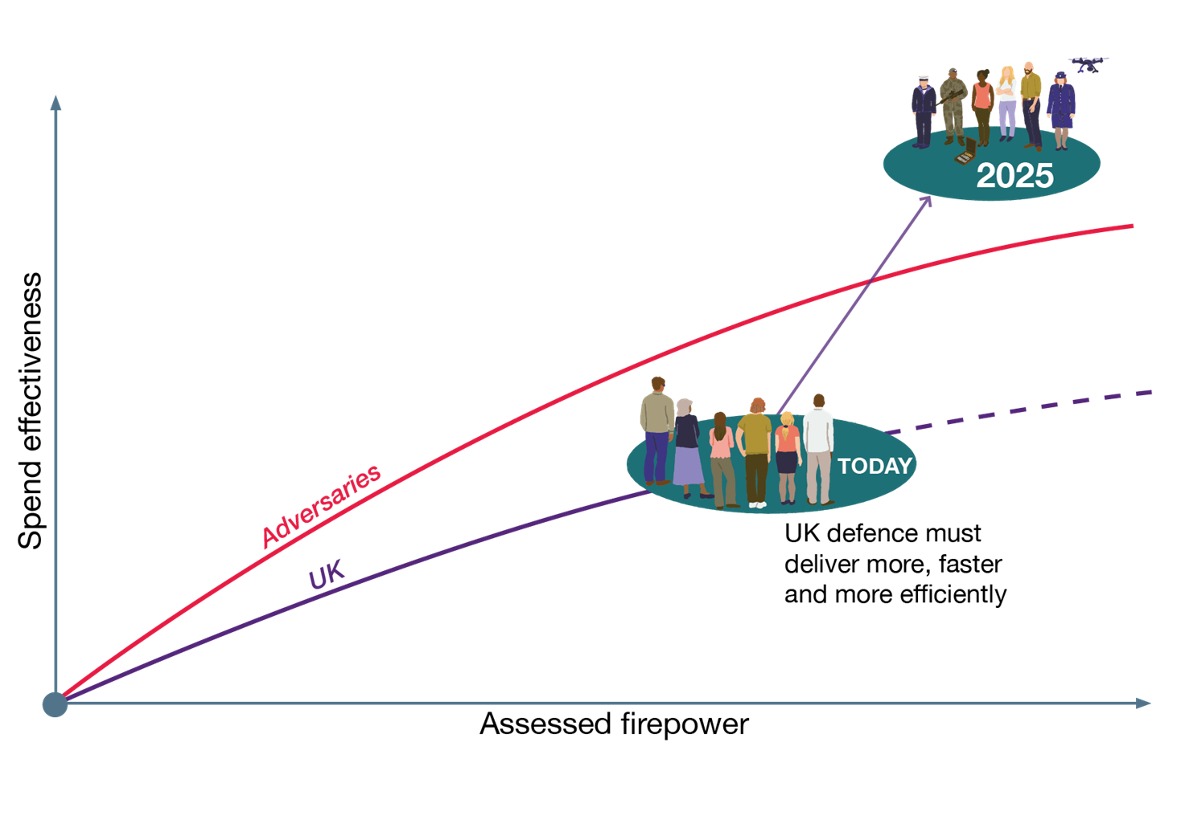
To excel as a competitor to our adversaries, we need to deliver more from our supply chain, faster and more effectively for our available budget
Notes:
Strategic Response
DE&S and the UK Defence Enterprise as a competitor with our global adversaries, not a process
We must position DE&S AND THE UK DEFENCE ENTERPRISE in competition to the acquisition and delivery organisations of our adversaries.
To succeed we need to be much better than our adversaries and collaborate with our Allies.
This is a helpful mindset because it allows us to think about ourselves and the Defence Enterprise as a competitor not a process. The UK does not consistently fare well in the global military strength ranking (spend versus assessed firepower) – we need to face up to having to change.
We need to deliver more from our supply chain, faster and more effectively for our available budget.
We emphasise the whole Defence Enterprise and supply chain because many perceive DE&S as a purchasing department and not the Defence systems and service integrator.
If we fail to do that our armed forces lose and our nation loses.
We currently optimise the wrong thing - and it's why we waste time, effort and millions of £££ saving pennies.

