Slide 1
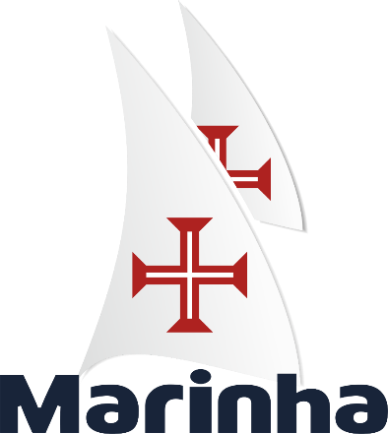





Connecting the domains: Centre for Operational Experimentation (CEOM)
Farnborough, 24th of May 2023
Captain José Pedro Oliveira
Notes:
Good morning, Good afternoon all,

Slide 2
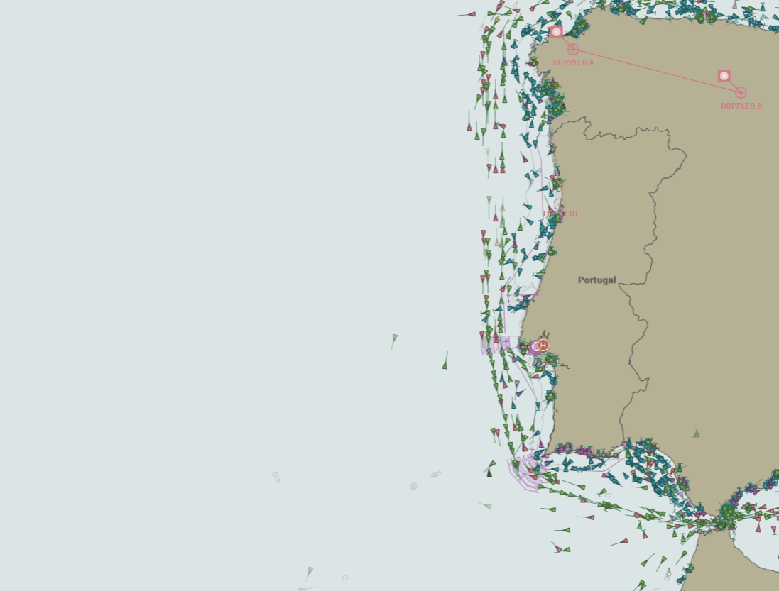
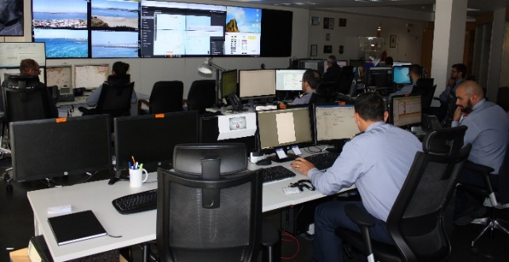








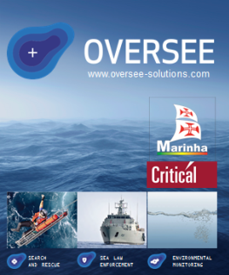
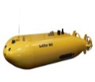

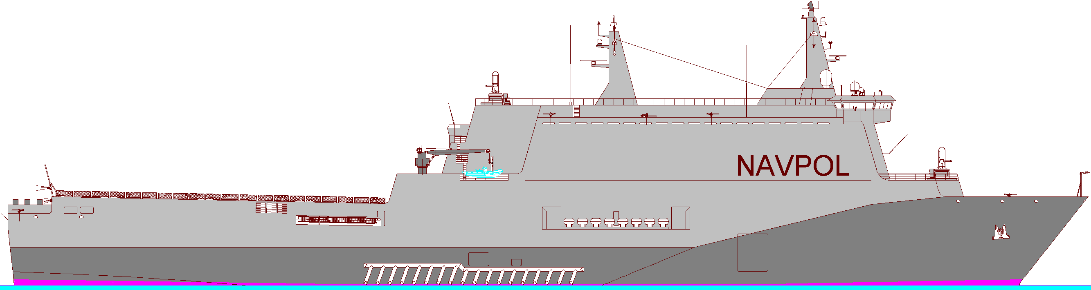
Concept
SAT
RF Network
UAV
UAV
Maritime Situational
Knowledge (MSK)
MUS under direct control of MOC
USV
Swarm
MARITIME OPERATIONS CENTRE (COMAR)
c
USV
Acoustic comms
UUV
Submarine
LR UUV
UAV
USV
UUV
CIS
Fusion, Analysis &
Validation
Naval Units
Notes:
I will start by exposing the Portuguese Navy concept to extend our Maritime ISR capabilities through the use Maritime Unmanned Systems, or, in short, MUS, and how this concept requires multidomain interconnectivity.
I must start by confessing that Portugal, with regards to the monitoring of our maritime spaces, has an issue: persistent surveillance of our huge area of responsibility requires a mass that the Navy currently doesn’t have. We have identified some years ago that we would need to rely in Unmanned and autonomous systems, in a strong interdomain connectivity and in Artificial Intelligence, to overcome this challenge.
So we developed a holistic concept to foster our maritime ISR capabilities based on the use of these new technologies.
This is a twofold concept that considers the use of MUS to extend our ISR in two ways:
The first through the use of this systems in a networked manner, under the direct command and control of Maritime Operation Centers ashore; these systems are required to have long endurance, and the network itself requires good multidomain connectivity through several communication channels, running from satellite to acoustic comms, including of course 5G and RF mesh networks. The maritime unmanned systems may operate with several degrees of autonomy, including in heterogeneous networks or swarms with distributed IA and autonomous behaviour based on the changing properties of the swarm.
The second through the use of the Naval Units with their own organic Unmanned assets extending the surveillance reach of the ships and contributing with their data to the integrated Maritime Situational Knowledge, and also benefiting from it.
The ability to process, fuse, analyse and validate Big Data is critical for this concept, so a robust C4 backbone is required. We are developing it under the Virtual Ship concept, in alignment with our NATO partners supporting STANAG 4817 to assure interoperability. A system of systems is key for this architecture. Portuguese Navy jointly with a national IT industry developed the OVERSEE, our system of systems that is in use in our Maritime Operations Center since 2012 and is still evolving in order to meet all Navy’s requirements regarding big data management, fusion and analysis. (CLICK)

Slide 3


THE MARITIME OPERATIONAL EXPERIMENTATION CENTRE

Slide 4
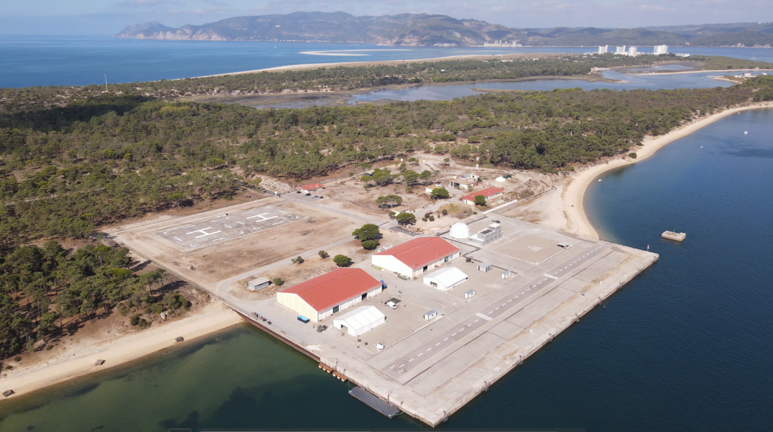
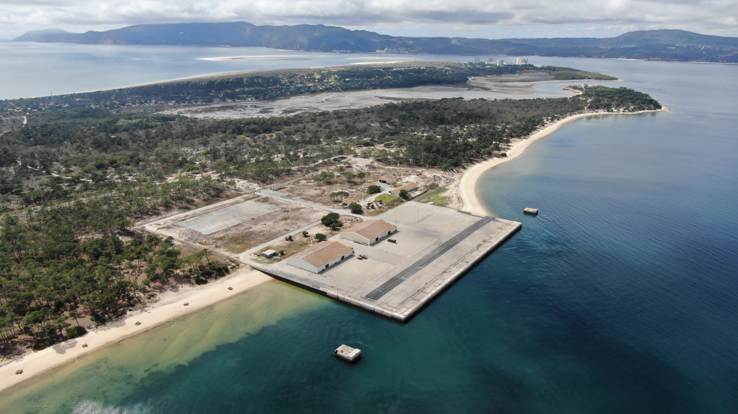


Slide 5
















CEOM
(What is?)
Born in 2020 at the Tróia Naval facilities, focusing on unmanned systems
Workshop space for rapid prototyping, mechanics and electronics
Promote technological cooperation in unmanned systems
Operational requirements identified with academia, industry and other partners
Command and control building
Develop new dual-use concepts and technologies
Storage, meal and limited accommodation spaces
FACTS
INFRASTRUCTURES & SERVICES
ACTIVITIES
Availability of infrastructure and services to support experimentation
Runway and airspace reservation
Conduct experimentation campaigns involving academia and industry
Available to support R&D activities, mainly in the security and defense areas, subject to agreed planning
Validation of systems and technologies
Collaborative work with centres, industries and academies
Land and underwater test zones for drones
Foster innovation and collaborative work with other centres

Slide 6

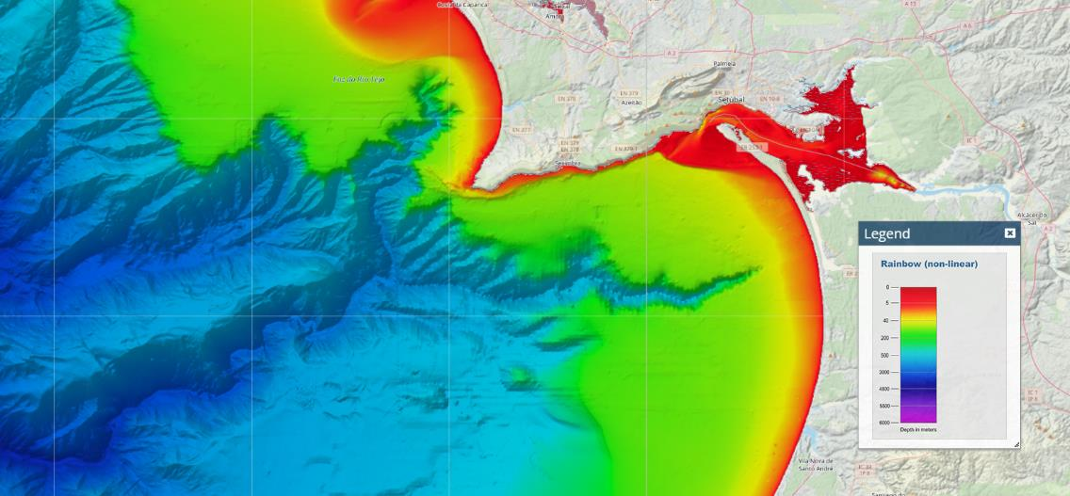
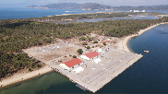
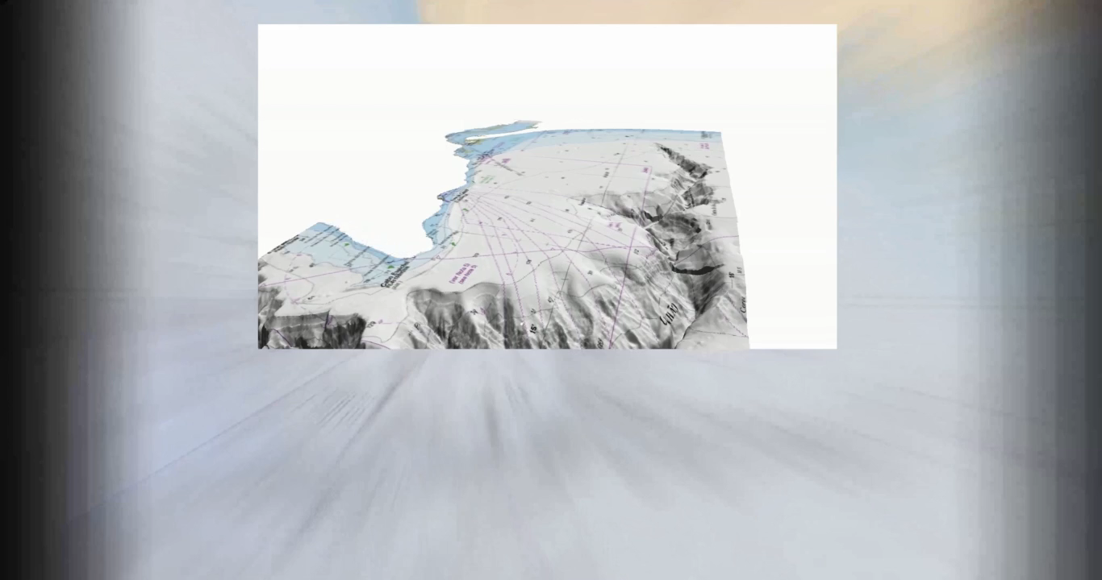
CEOM
(Why in Tróia?)
1460 MTS
200 MTS
Setubal Canyon
Canyon for deep sea developments

Slide 7
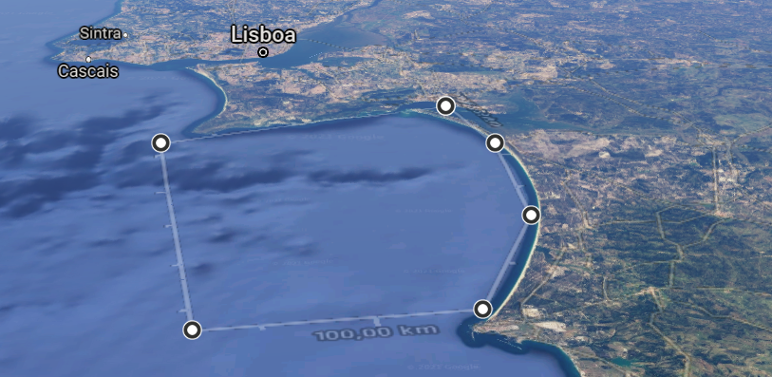
CEOM
(National recognition)
ENVIRONMENTS
SUBSURFACE
SURFACE
AIR
SPECTRUM
SPACE
OTHER FEATURES
CEOM pier: 9mts minimum depth
Navy exercise areas
Lisbon city: 130Km
Setubal city at 30 mins distance
Montijo & Beja military airbase
Two major harbors
(Sines & Setubal)
Setúbal
Sesimbra
Alcácer do Sal
FREE TECH ZONE
Grândola
Santiago
do Cacém
Sines
Free Tech Zone: Regulatory sandbox of 1000 square nm | Official announcement – 19JUL22 |

Slide 8
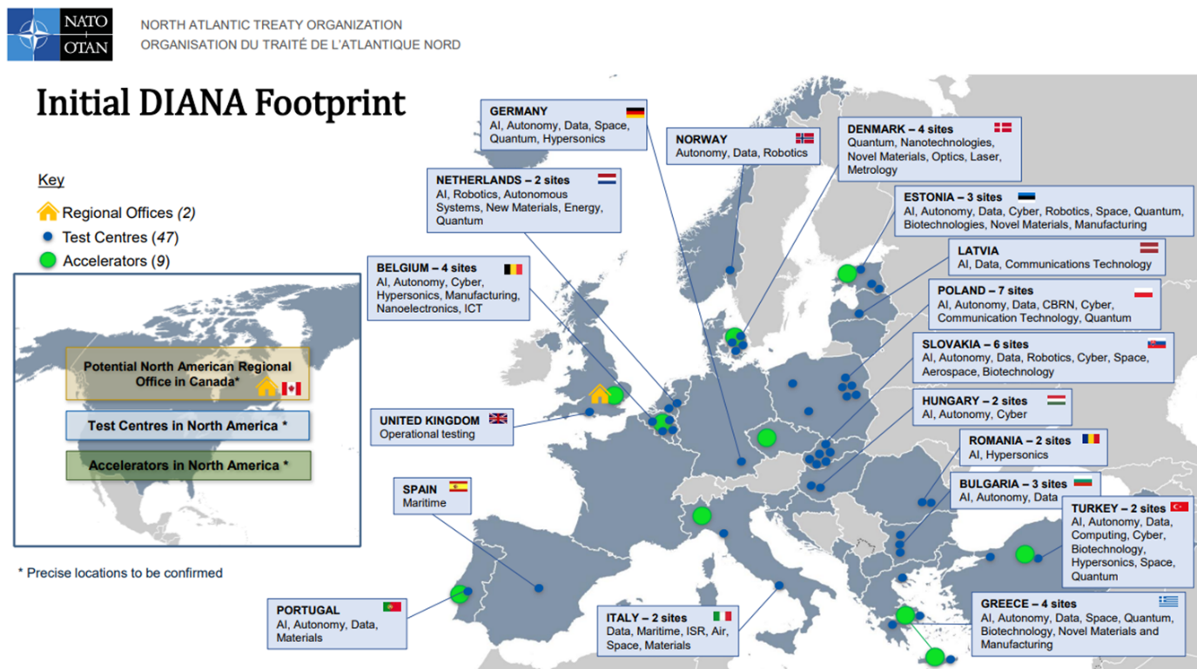
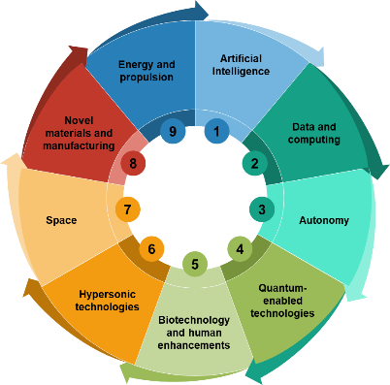
CEOM
(International recognition)
Recognized as a new technologies test centre for NATO

Slide 9
THE EXERCISES REPMUS & DYNAMIC MESSENGER

Slide 10
REPMUS & DYMS
(Concept)
REP(MUS)
  Supporting MUS conceptual and technological development.
  Assuring MUS integration and interoperability for DYMS.
DYMS
  Supporting MUS operational doctrine development (CONOPS, TTP’s, …). Exercising MUS integration and employment in Maritime Operations.
CONEMPs> Technology > Operacional Experimentation (OPEX) > CONOPS e TTPs > Operations
D
O
T
M
L
P
F
I
X X X X X X X

Slide 11
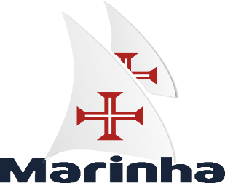



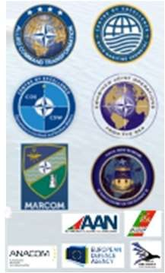
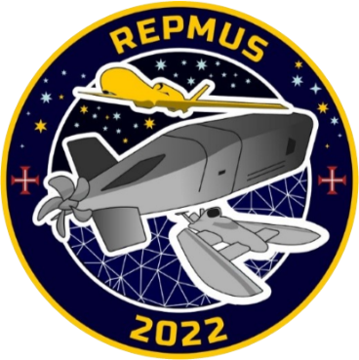




REPMUS 22 - PARTICIPANTS

Slide 12
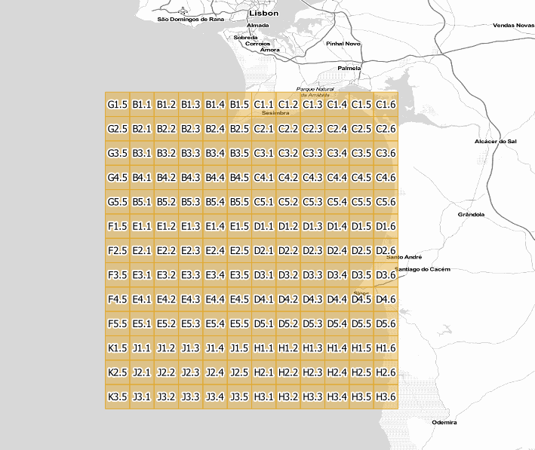
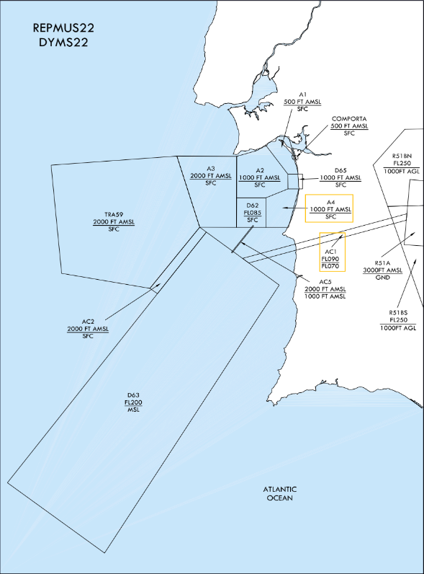
REPMUS22
(allocated areas)

Slide 13
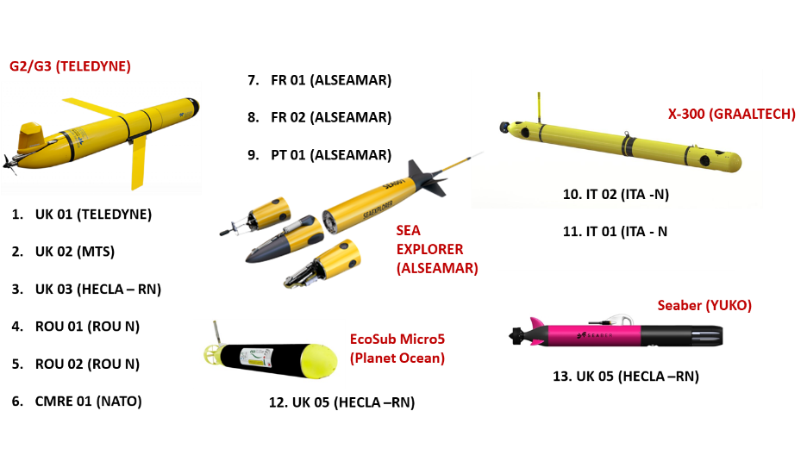
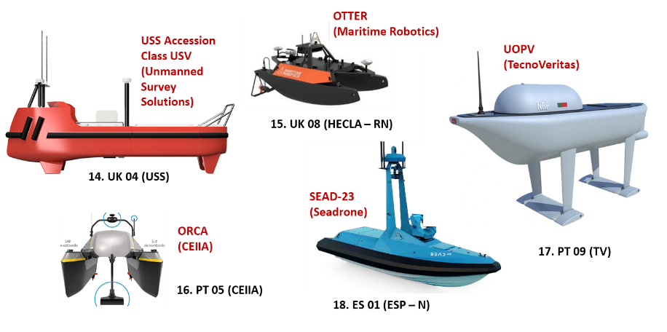
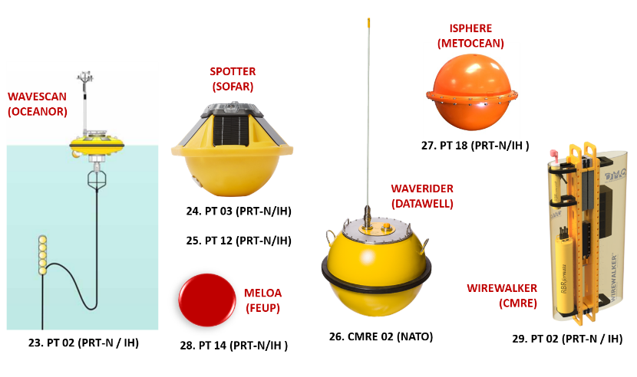
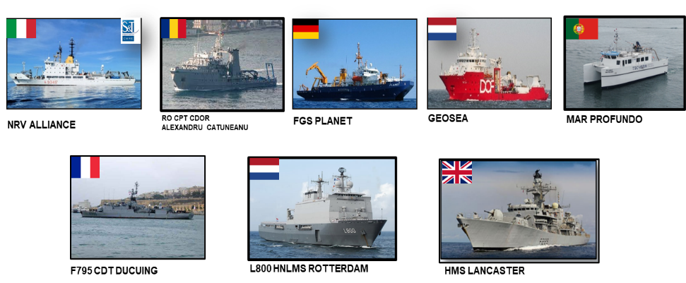
REPMUS22
Force Laydown
Unmanned vehicles Aerial 39 - Surface 24 - Underwater 64 | Warships 10 | Research and support vessels 7

Slide 14
FUTURE DEVELOPMENTS

Slide 15
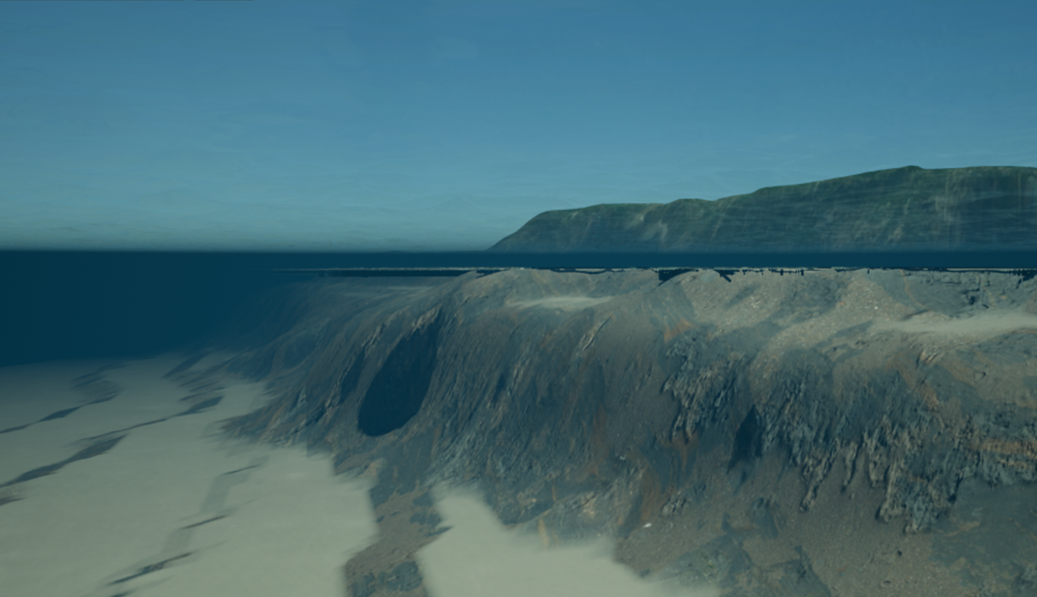
CEOM
(The future)
Digital Twin of the ocean (free tech zone)
Ongoing project

Slide 16
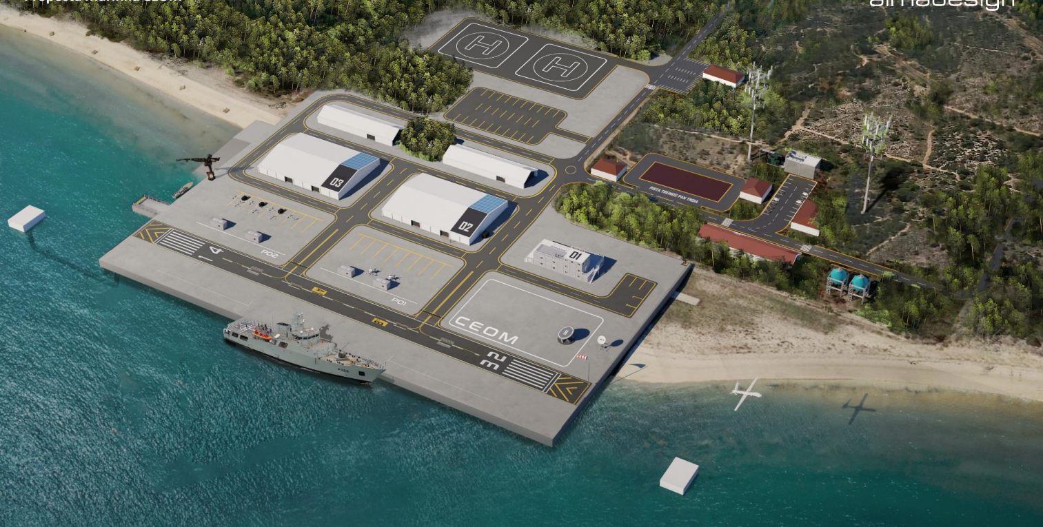
CEOM
(The future)
Improving facilities
Ongoing project

Slide 17
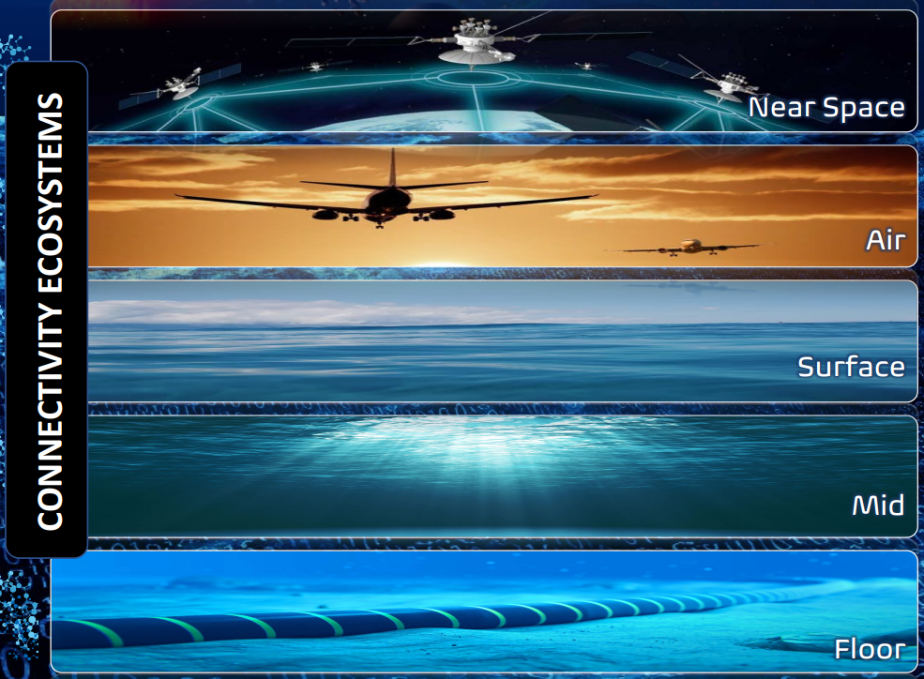
CEOM
(The future)
Connectivity encompassing different environments
Concept in development

Slide 18
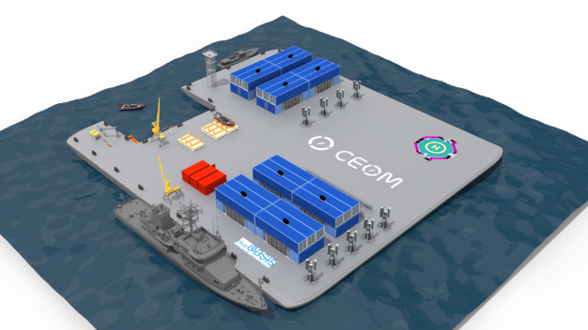
CEOM
(The future)
Multipurpose platform - Island “Infante D. Henrique”
Concept in development

Slide 19
COOPERATION POSSIBILITIES

Slide 20
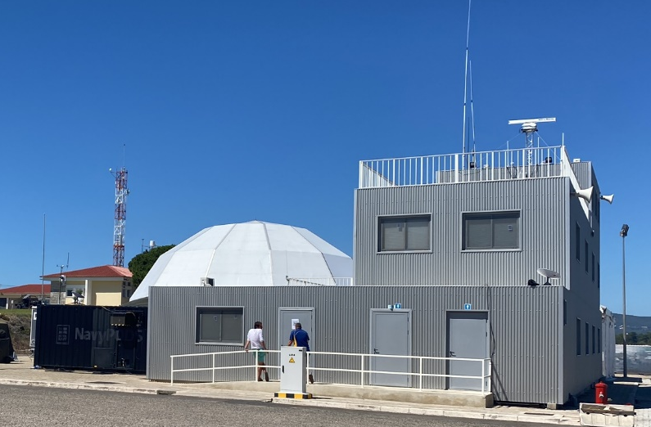
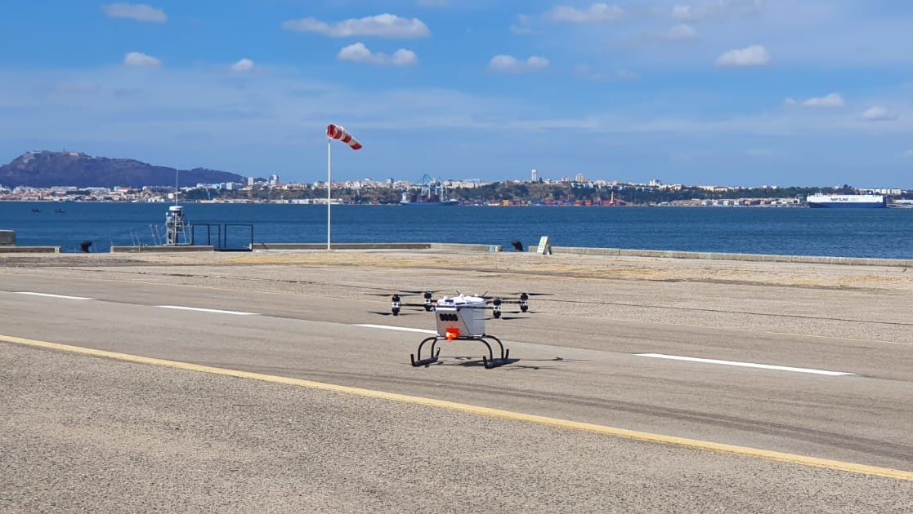
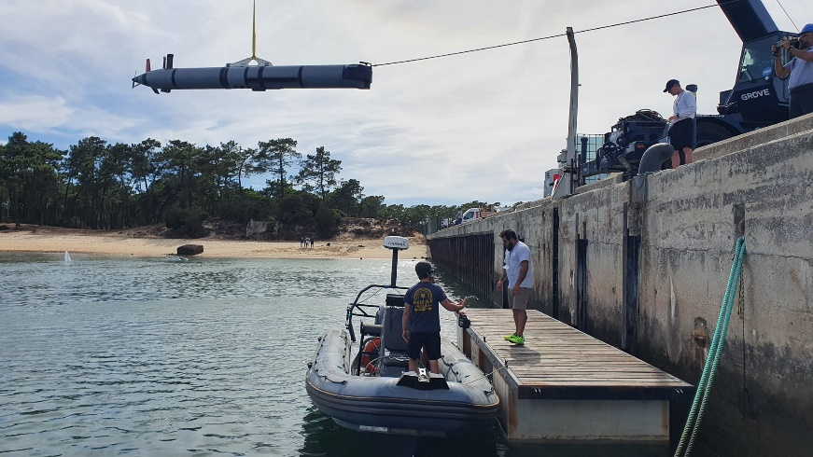
CEOM
(Cooperation)
Availability for cooperation with Partners:
Expertise in conducting, designing, controlling, and analyzing the results of experimentational campaigns and exercises, promoting technological and operational cooperation in unmanned systems and emerging disruptive technologies. (e.g. joint development of prototypes to fulfil common operational requirements)
Ability for hosting education and training activities and courses within the scope of OPEX and EDTs.

Slide 21

C E M
(@ Troia Peninsula)

