Slide 1
NEW AND FUTURE CAPABILITY DEVELOPMENT
MOVING CURRENT TECHNOLOGY AND CAPABILITY FORWARD
ISR, COLLECT & PROTECT, BETTER SHARING AND BETTER EFFECTS
IAIN BRECKENRIDGE OBE MA CMMar AFNI – Key Account Manager Maritime LEONARDO UK
Iain.Breckenridge@Leonardo.com

Slide 2
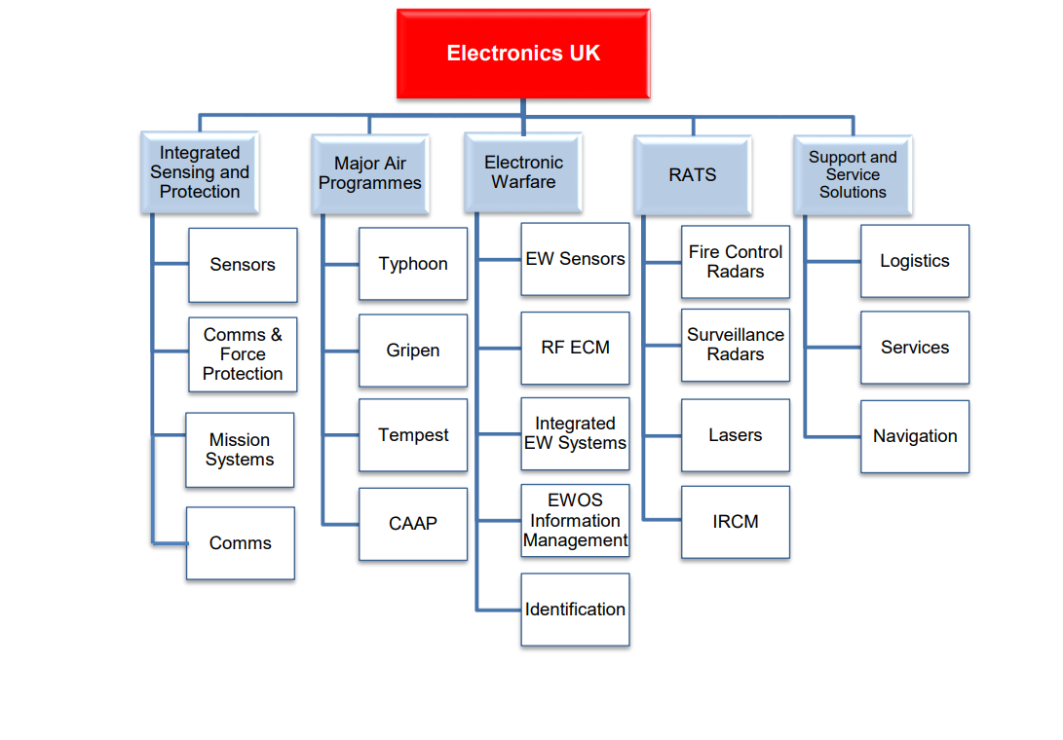
Future Combat
Air
LUTON, BASILDON, SOUTHAMPTON, YEOVIL, BRISTOL, LINCOLN, NEWCASTLE AND EDINBURGH

Slide 3










The Leonardo Digital Platform
Strategic
Partner Cloud Services
Leonardo Cloud
Each platform can offer or exploit Radar, ESM, EA, EO, IR targeting and other services to/from the cloud
Higher-level Information Advantage, data fusion, command and control services can also be developed and made available
Thus the capabilities of each platform become individually or collectively available to all in theatre actors, maximising utility
Through the use of higher-level services the cloud can dynamically optimise, prioritise, balance and automate the demand and supply of services and improve OODA loop timings across an entire ecosystem. This would include AI/ML, rule-based and other forms of control
Can also offer/consume info and services from centralised clouds when connectivity permits
The ecosystem can exploit multiple communication bearers to dynamically scale, connecting local clouds with other centralised clouds to provide a seamless mix of embedded and non-embedded services and data to in-theatre and other actors
All in theatre assets can offer and consume services and information to/from the local cloud
Any actor (or software App) can make use of any/all info and services currently available (in theatre or from the wider ecosystem) without worrying who/what is providing the service
All capabilities, services and knowledge can be maximally exploited by all…
Tactical
Operational
3rd Party Apps

Slide 4
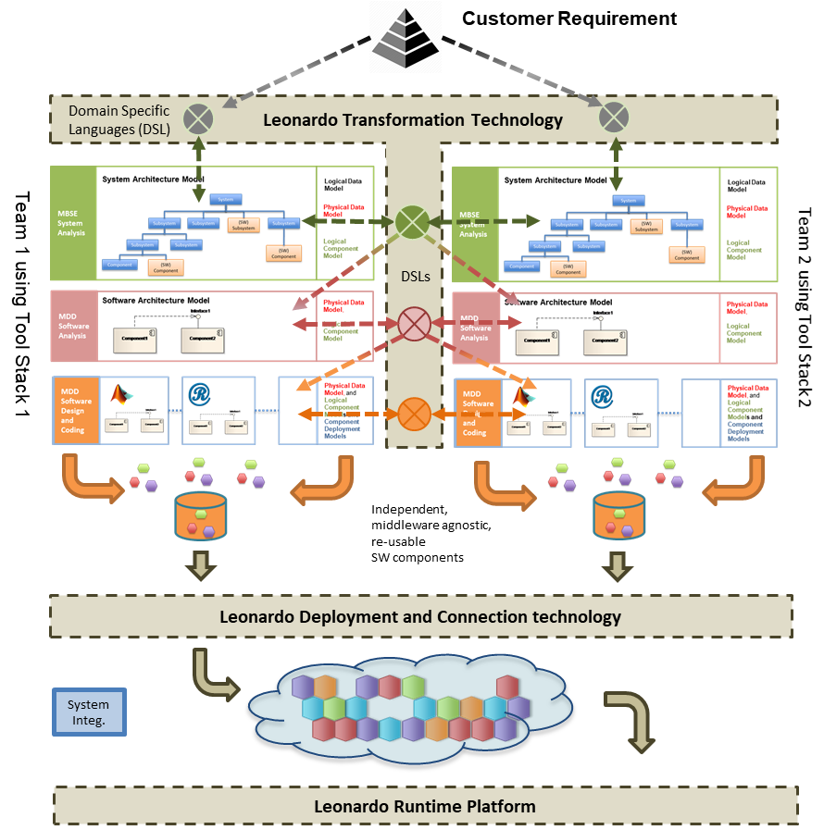
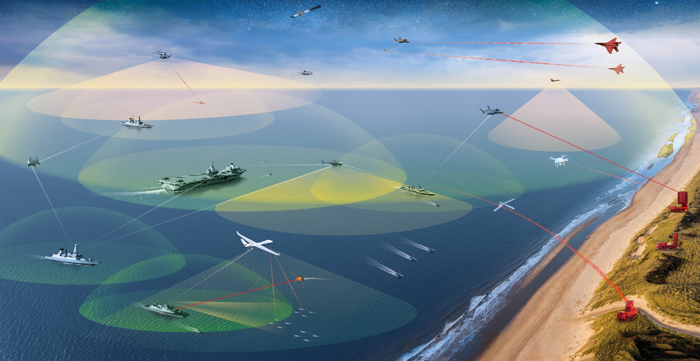
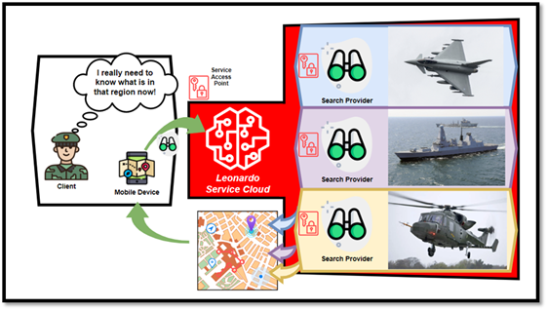
THE DIGITAL PRODUCT ECOSYSTEM
Turns this
into this
So that all capabilities, services and knowledge can be maximally exploited by everyone
C2 function: allocation, apportionment, prioritisation

Slide 5
CLOUD AND DIGITAL PLATFORM
SCALEABLE & CREATE INSIDE THE BATTLESPACE
  CAN CONNECT TO HIGHER LEVEL SERVICES
SOFTWARE ON SENSORS/PLATFORMS – EXCHANGE SERVICES & SHARE
TRULY OPEN – ALLIES AND PARTNERS
FOUNDATION FOR MORE COMPLEX SYSTEMS
FRAMEWORK DECIDED BY USER
  CHOICE OF DIRECT FEED TO/FROM CMS
  TASKING RULES, MISSION PRIORITIES, MISSION COMMAND FREEDOMS
  SHARE SENSOR SCREENS NOT JUST DATA
  LEVEL OF AUTOMATION

Slide 6
TECH TO ENABLE SPECTRUM ACCESS
FUSE ARCHITECTURE TO COMPETE, DEFEND AND DENY – EXPLOIT AI
MANAGE – PROCESS AND DECIDE
DEVELOP COMMS SYSTEM
SENSE AND EFFECT
SDR & TECHNIQUES
Best use of available communications system to connect systems on multiple platforms.
Acts as a communications broker by managing available communication and security resources
Network Management, Intelligent Routing, Service Brokering, Multi-domain security.
Sense the spectrum – monitor the adversary – share available spectrum – Use AI

Slide 7
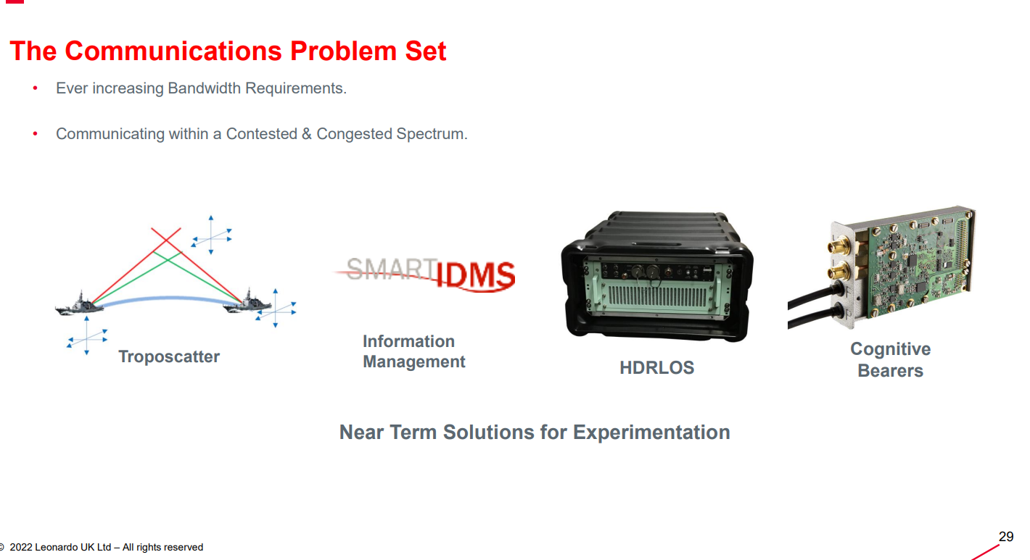

Slide 8
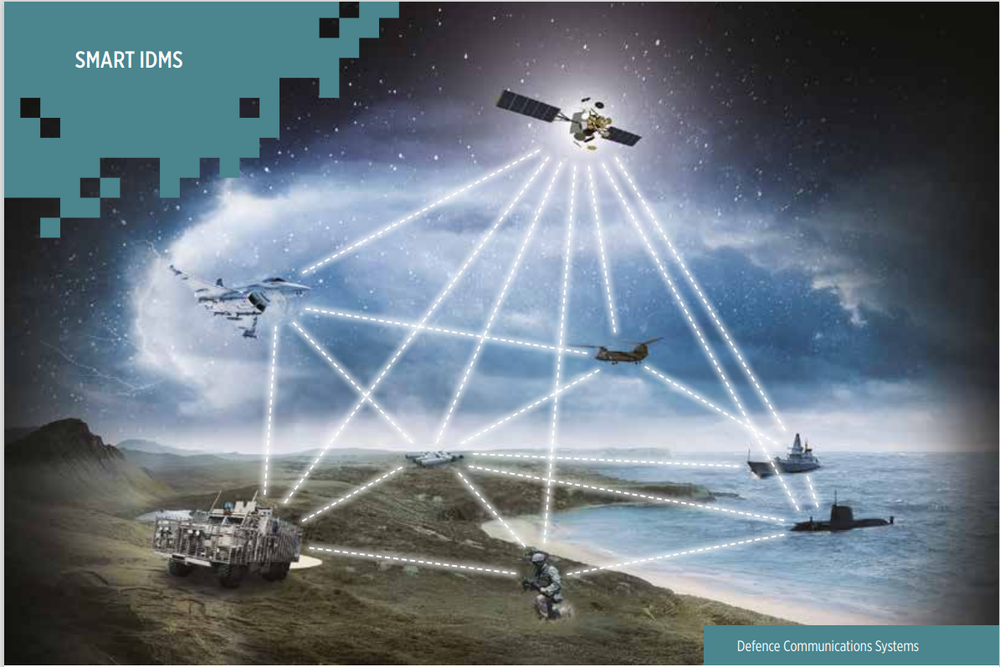

Slide 9
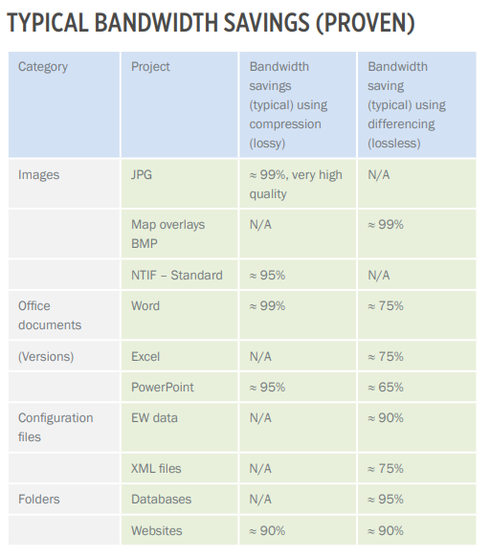

Slide 10
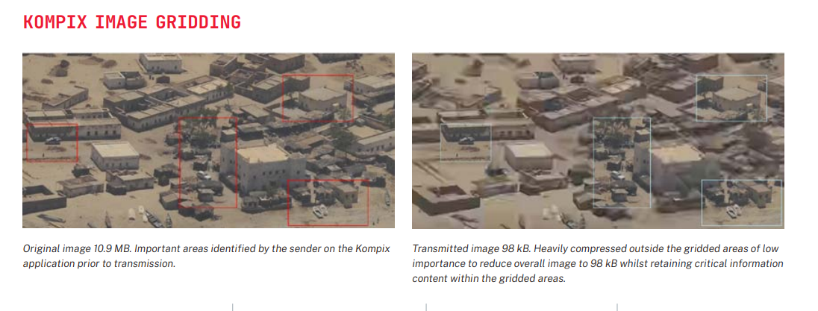

Slide 11
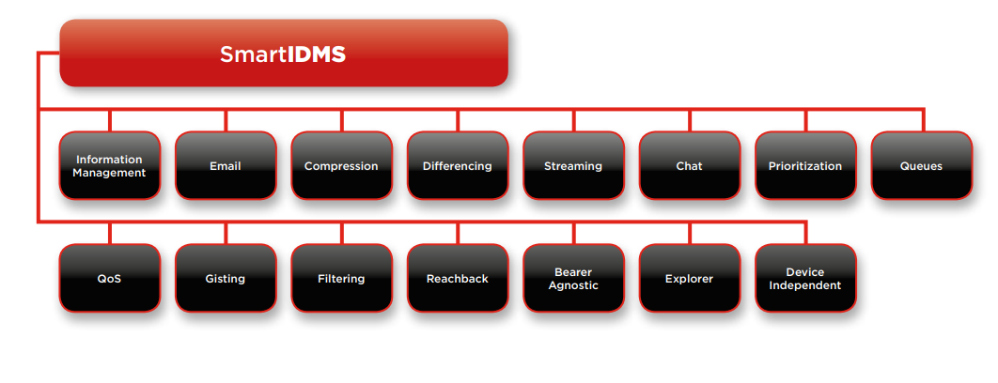

Slide 12
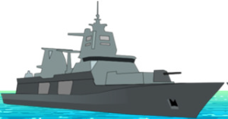
HIGH DATA RATE LINE OF SIGHT - System Overview
HDR LOS is an independent bearer providing RF connectivity for platform to platform Internet Protocol (IP) traffic.
The HDR System provides:
Hot pluggable replacement
A Mesh networking environment
Omni-directional, dual polarisation, 3dB gain LOS coverage antennas
Multiple Input Multiple Output (MIMO), using a sophisticated signal processing that enables a higher probability of successful data transmission in all environments
Range of 10 NM
Data rate +100 Mbps

Slide 13
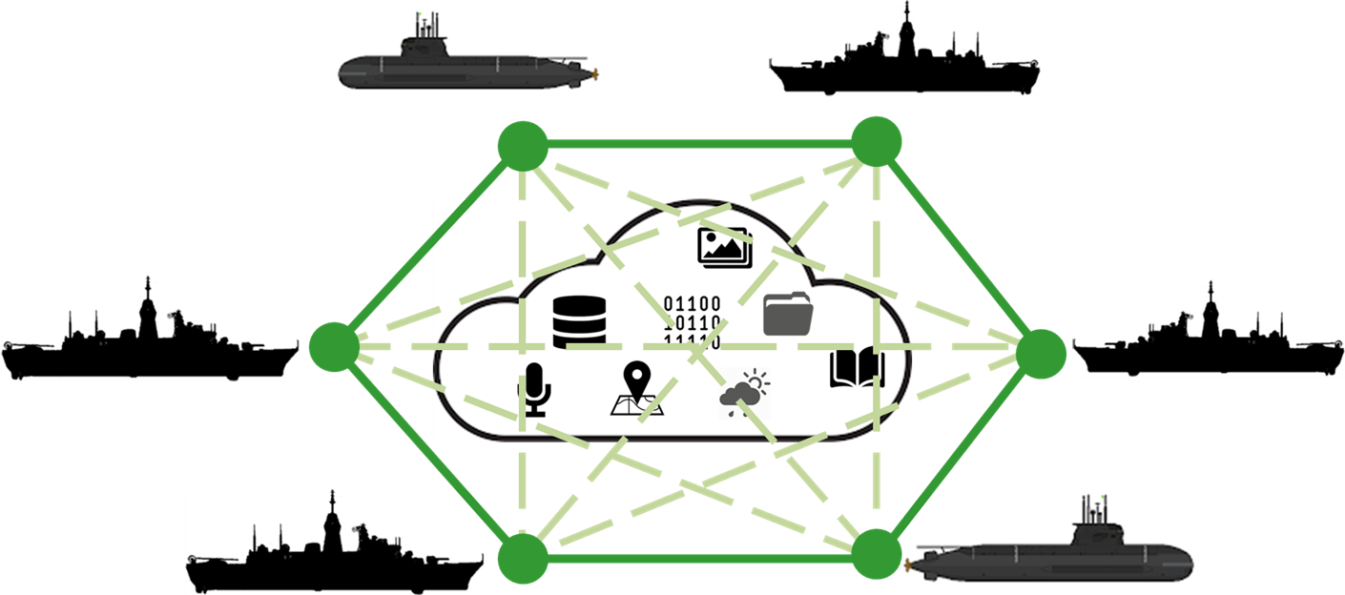

HDR LOS Benefits
Data Transfer Rates:
Maximum rates exceeding 100 Mbps with a 20 MHz bandwidth signal.
Throughputs of 18 Mbps and 48 Mbps are provided with 5 MHz and 10 MHz bandwidth respectively, dependant on range, sea state and weather conditions.
Video teleconferencing
Voice over Internet Protocol (VoIP) communications
Live Chat (Text)
File/data transfer
Live C2 of remote operational situation

Slide 14
RF PAYLOADS
Low SWAP RF payloads – draw on BRITECLOUD technology
Exploit future hardware to expand payload capability
  RF tasks – EW, radar emulation, radar, comms, offensive cyber
  a multifunction RF payload.
Payloads largely independent from the preferred delivery platform
Need to rapidly sense/process/decide/disseminate signals, data and information, adaptively updating system behaviour
  Digital platform role within a SoS construct

Slide 15
DATA LINK BETWEEN PLATFORMS
Platform
Platform
Platfrom
Platform
Platform
Data Link system is low observable capable of providing high data rate communications
Maritime environment - ship to ship and air including USV and UAV in future, air to air
Low observability, directional beams, low probability of detection,
The system is composed of a number of directional antennae

Slide 16
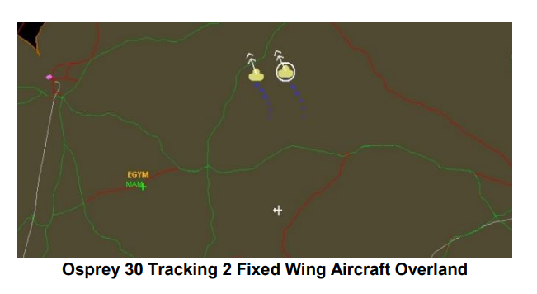
UAV – SENSE AND AVOID
OSPREY 30 Radar – Air surveillance and MT modes
Capable of meeting DO-366 regulations - Minimum Operational Performance Standards for Air-To-Air Radar for Traffic Surveillance – further development work ongoing

Slide 17

UNCREWED AERIAL FORCE MULTIPLIER

Slide 18
