Slide 1
Arrowhead 140/Type 31:
Lesson learnt from an adaptable frigate
Notes:
M Howard
Ship Build Technical Director responsible for the Babcock’s international and UK ship build programmes, including T31 and Arrowhead 140 which has been selected for both the Indonesia and Poland (Miecznik) programmes (at the time of writing). His previous roles include the Type 31 Frigate Chief Engineer, 2017 to April 2022, which included Design Authority responsibility for the platform and gun systems. His tenure as Type 31 Chief Engineer included the Competitive, Basic, Functional and Detailed Design phases.

Slide 2
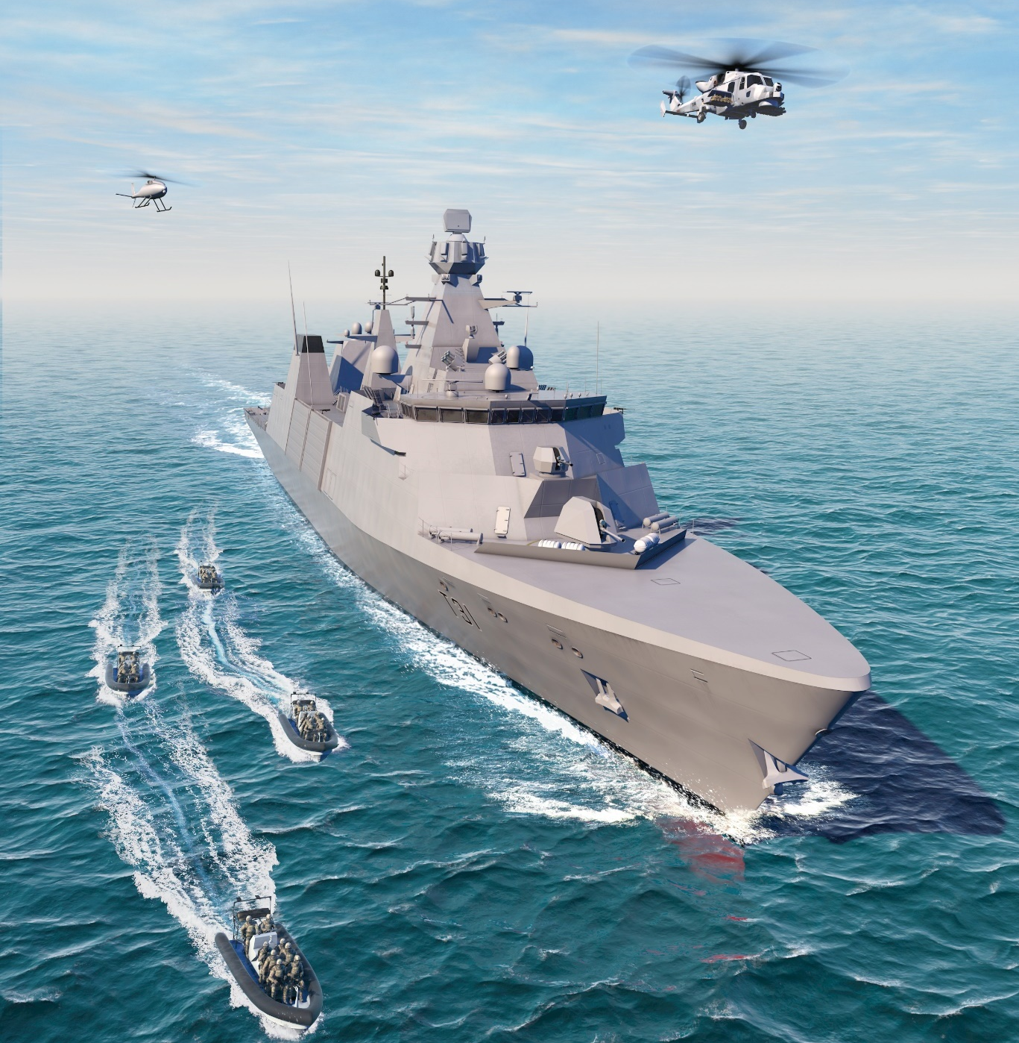
Contents
Introduction
Type 31 - doing things differently
Arrowhead 140 – designing an adaptable warship
Arrowhead 140 – adaptability paths, what we have learnt
Arrowhead 140 - where next?
Notes:
BIO: M Howard
Ship Build Technical Director responsible for the Babcock’s international and UK ship build programmes, including T31 and Arrowhead 140 which has been selected for both the Indonesia and Poland (Miecznik) programmes (at the time of writing). His previous roles include the Type 31 Frigate Chief Engineer, 2017 to April 2022, which included Design Authority responsibility for the platform and gun systems. His tenure as Type 31 Chief Engineer included the Competitive, Basic, Functional and Detailed Design phases.

Slide 3


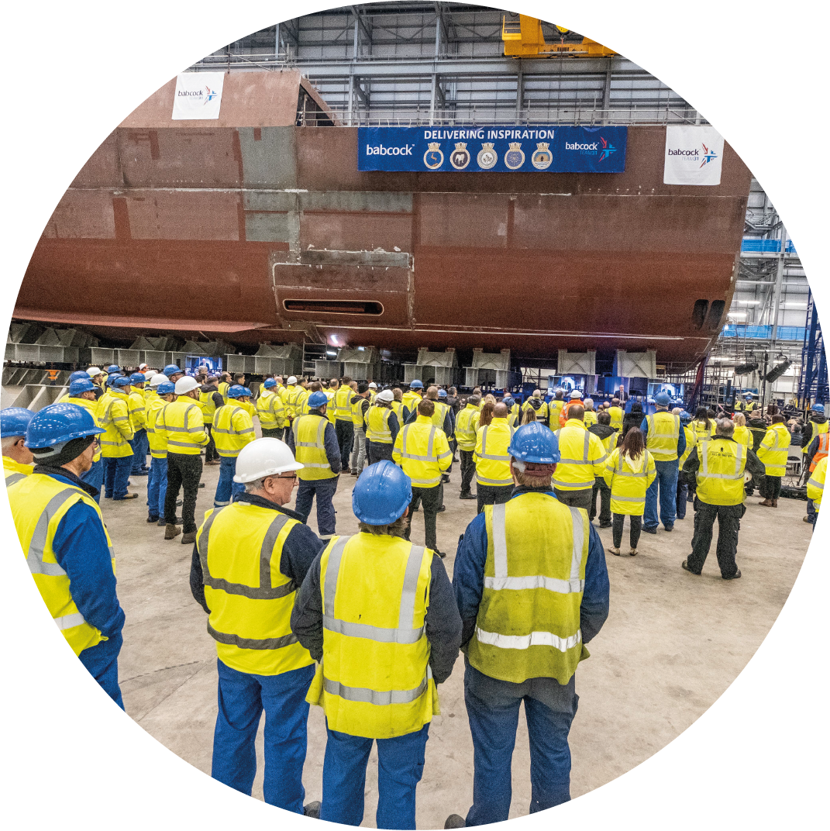



Type 31 design and build contract summary timeline
Preferred bidder phase
Preliminary design review
Critical design review
Steel cut
HMS Venturer
Steel cut
HMS Active
HMS Active Keel Laying
2019
June 2020
Feb 2021
Sep 2021
Jan 2023
Next
Milestone

Slide 4
Type 31: Doing things differently

Slide 5
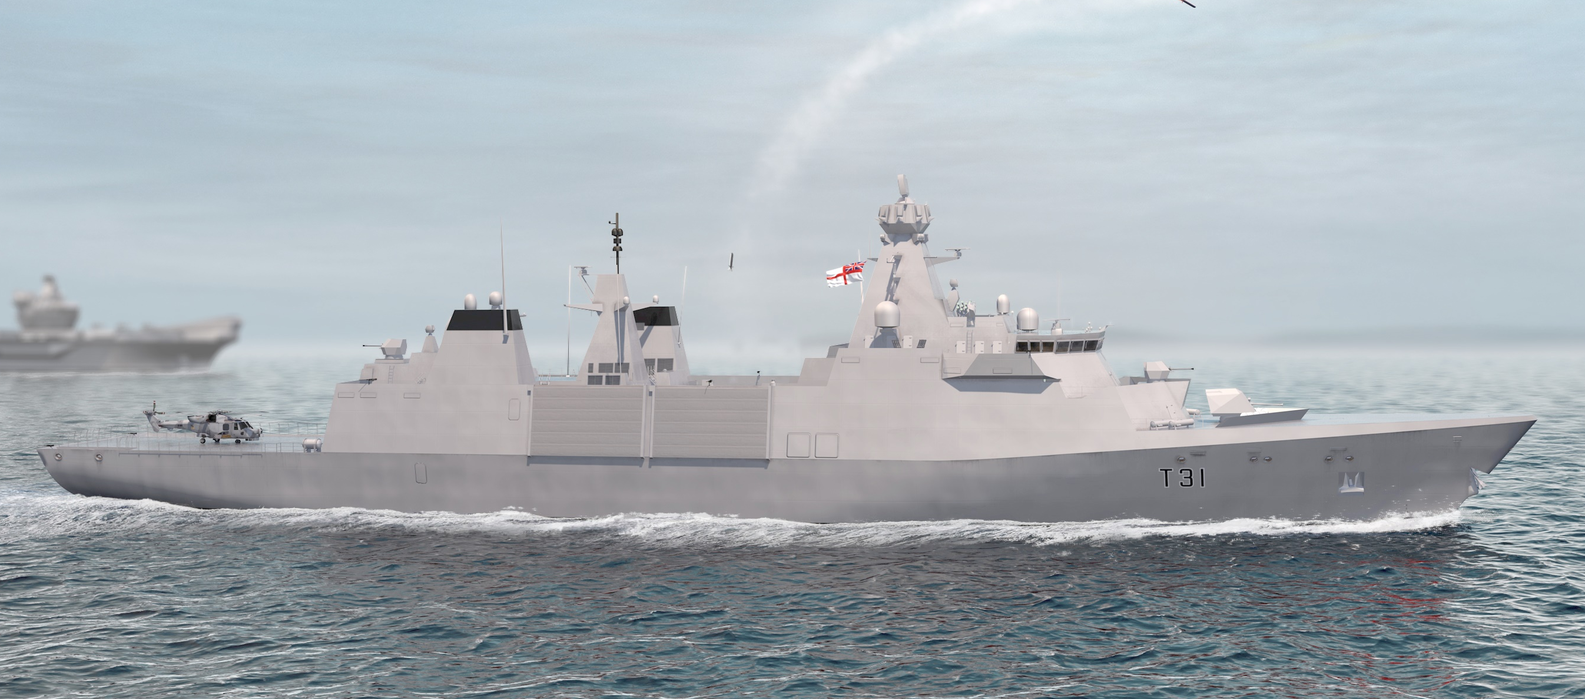
Procurement strategy
‘Type 31, the pathfinder project of the 2017 strategy, got to contract on schedule and for the headline price demanded, with the capability exceeding many expectations. The project is remarkable for the speed and innovation shown in its procurement, including valuing UK prosperity and adaptability for export.’
The refresh to the UK National Shipbuilding Strategy included the paragraph:

Slide 6

Procurement analogy
mobile phones
A
You go directly to a phone manufacturer’s head office and tell them that you want a new mobile phone to your bespoke and exact specification and ask them to design and manufacture it for you.
B
You sit down with your immediate family and draw up a list of features that you want your new phones to have and choose the phone available on the market that best matches those requirements.
Notes:
A: You go directly to a phone manufacturer’s head office and tell them that you want a new mobile phone to your bespoke and exact specification:
Every design option from screen resolution to battery capacity to software features has to be presented to, and decided, by yourself.
A cost / capability trade-off process is used, where the benefits of each option are considered against any increased cost and any potential delay in delivery.
You may identify a new feature in the process that you decide is essential in your new phone to suit a new need, and direct that these new features must be added as the benefit is assessed to be worth the impact.
Finally, once this lengthy design process is complete, you order two handsets of this bespoke phone design and unique manufacture parameters from the supplier.
B: You sit down with your immediate family and draw up a list of features that you want your new phones to have (camera features, screen size, operating system etc).
You then go to a mobile phone store or website and compare your list against the features of the products on offer in your price range, and select the phone that has the most functions from your list.
You place a full order at the fixed advertised price for that product, walk away, and a week later all of the phones for your family are delivered.
Once delivered you select and add accessories, such as a case, to suit the needs of each family member

Slide 7
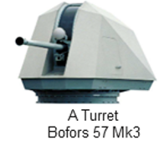
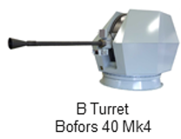
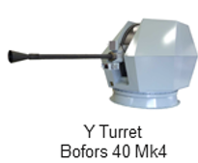
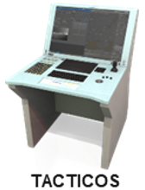

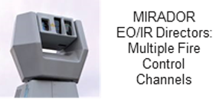
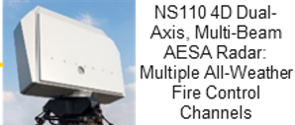
Build specification
‘Build specification’ describes the entire product
Example statement:
  ‘Arrowhead 140 will provide 2 BAE Systems Bofors 40 Mk4 Naval Gun Systems’
‘Prime contractor’s responsibility is to deliver the product as per the fixed build specification
Babcock and Thales are the design authority for the platform and mission systems scopes respectively
The design authority makes all design decisions and equipment selections
Notes:
‘Build Specification’ describes the entire product.
Example statement:
‘Arrowhead 140 will provide 2 BAE Systems Bofors 40 Mk4 Naval Gun Systems
The prime supplier’s responsibility within this fixed price contract is therefore to deliver the product as detailed in the fixed Build Specification.
The prime (Babcock), together with their mission system integrator (Thales UK), are the Design Authority for the platform (including gun systems) and mission systems scopes respectively.
The Design Authority makes all design decisions and equipment selections to deliver this product in accordance with the Build Specification.

Slide 8
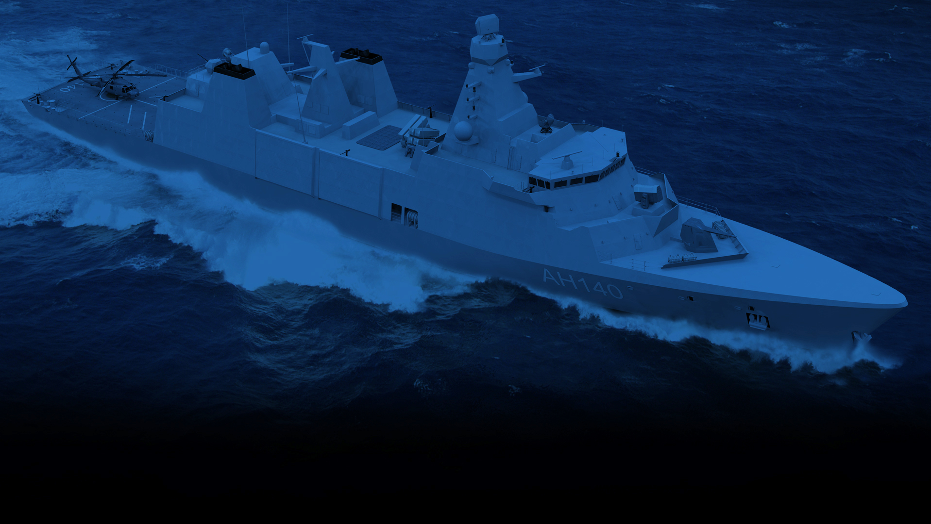
Arrowhead 140: Designing an adaptable warship

Slide 9
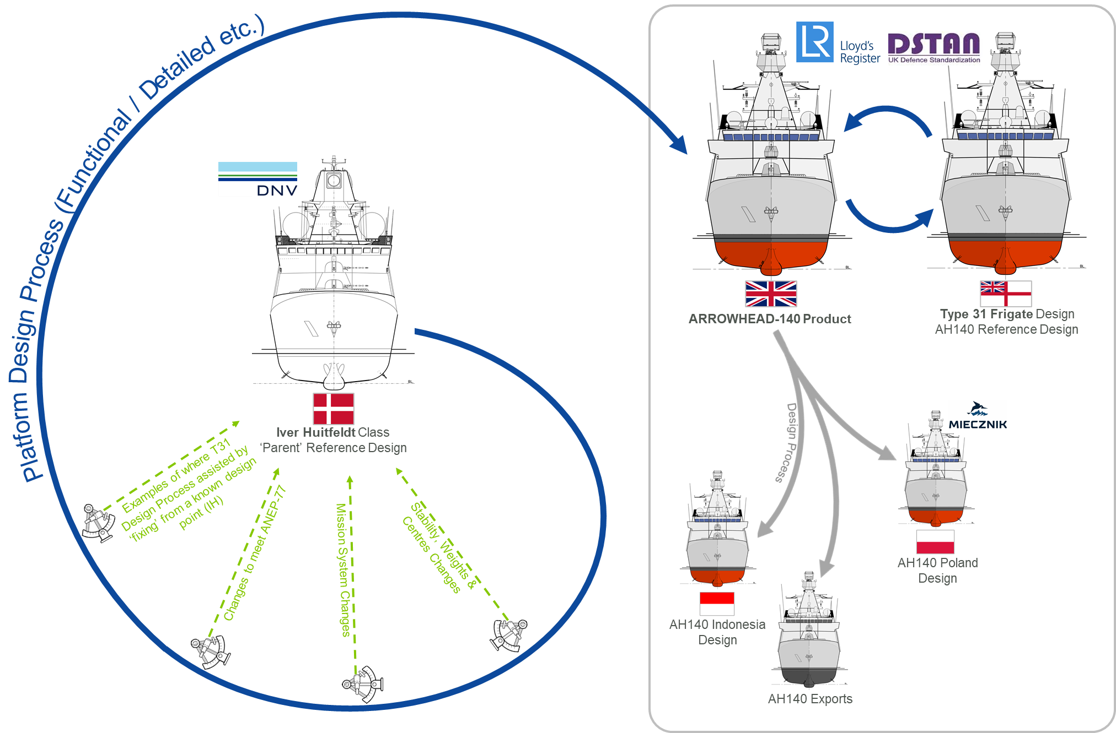
Type 31 frigate design relationship
Notes:
Type 31, and the ARROWHEAD-140 product, are derived from the ‘parent’ Royal Danish Navy (RDN) IVER HUITFELDT Class of area air warfare Frigates; however, it is not a ‘build to print’ of the IVER HUITFELDT design

Slide 10
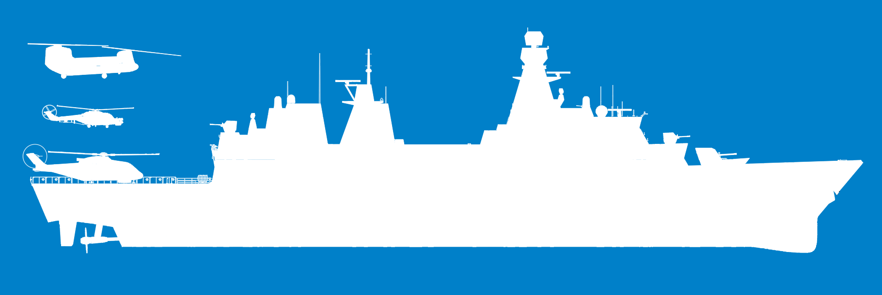

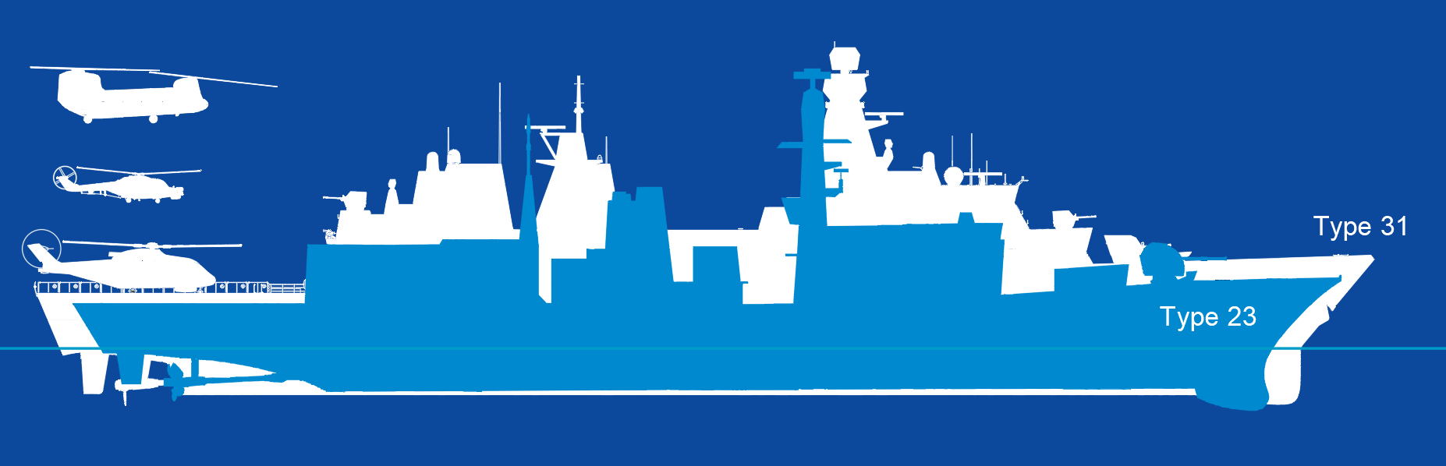
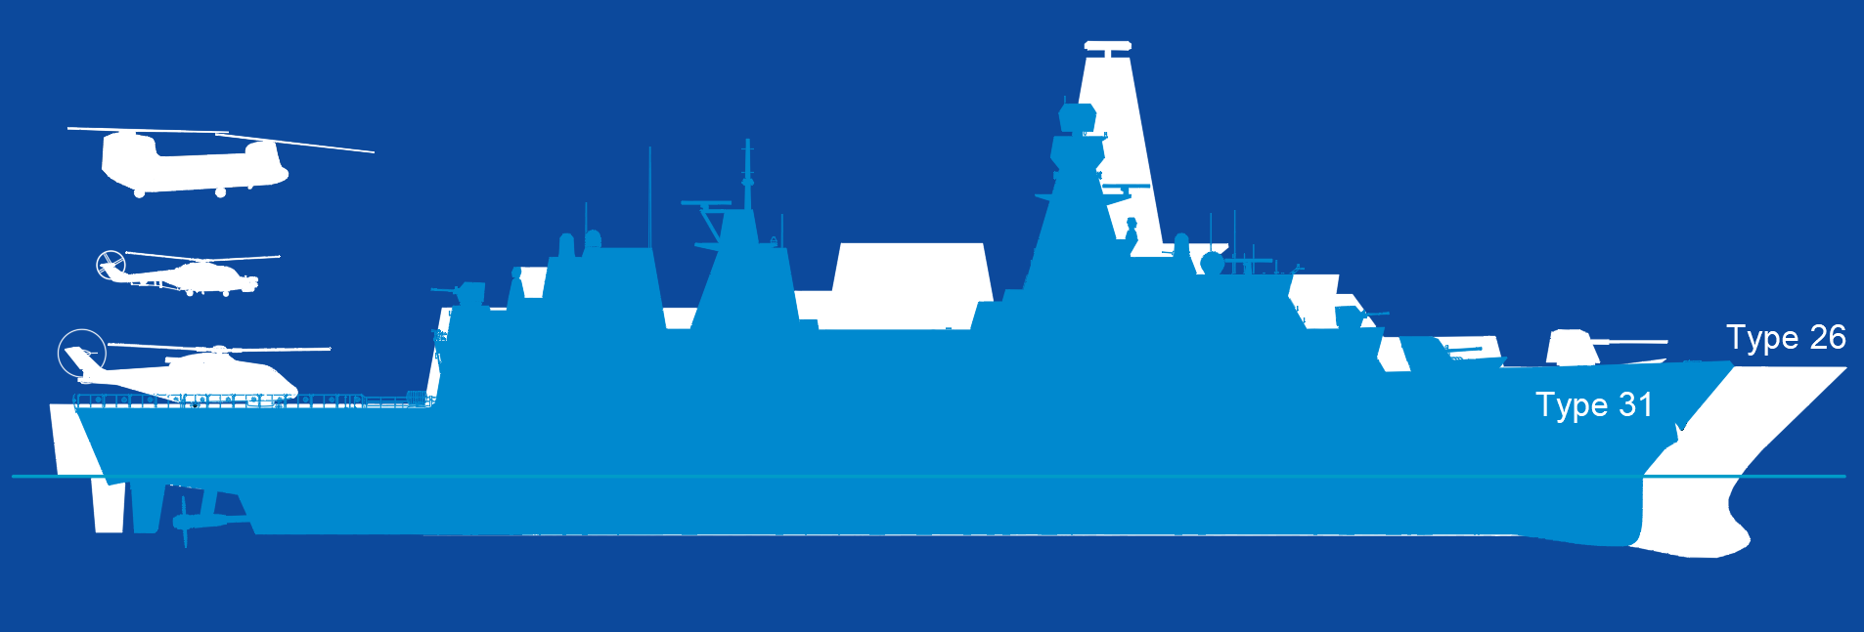
Adaptability
Platform size comparison
 |  | Type 31 General Purpose Frigate | Type 23 General Purpose Frigate
Principal Particulars | Length (Overall) | 138.7m | 133m
 | Beam (Maximum) | 20.36m | 16.1m
 | Speed (Maximum) | >27kts | >27kts
Principal Particulars | Displacement | ~7,000 tonnes | ~4,900 tonnes

Slide 11
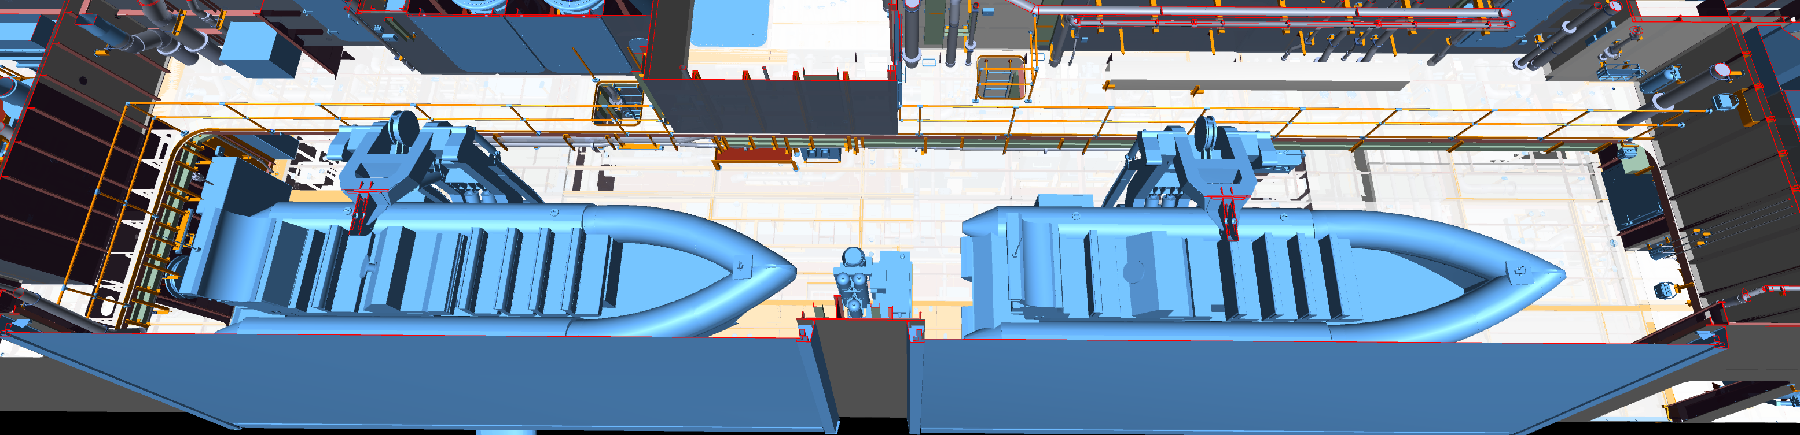
Detail design & adaptability
Design and through-life margins to facilitate future capability
Containers in Mission Bay/areas with waterline access
Boat handling equipment already fitted
Excess power created for future capabilities
Chilled Water, HVAC, IPMS, Electrical Distribution and Network Infrastructure Systems
Survivability, habitability, recoverability, structures and stability designed to accommodate future capability
3D model includes the outfit equipment used by adaptable roles
Large Future Mission Craft shown in the Type 31 Frigate Starboard Boat Bay
Notes:
Margins within the platform designed to facilitate future incorporation of capability, including mission modules (such as future NavyPODS);
Container positions available in the Mission Bay and in locations with direct access to the waterline, to operate future mission craft;
Boat handling equipment (davits etc) already fitted with increased capacity over baseline requirements;
Power generation systems in Type 31 create in excess of a megawatt of power margin solely assigned to be harnessed by future capabilities as technologies develop;
Other margins include Chilled Water, HVAC, IPMS, Electrical Distribution and Network Infrastructure Systems (amongst others);
It is essential that the platform features such as survivability, habitability, recoverability, structures and stability of the baseline vessel are designed to accommodate this future capability – to maintain compliance with UK Key Hazard Certification;
Type 31 Detail Design 3D model includes the outfit equipment used by adaptable roles, to de-risk the future installation;

Slide 12
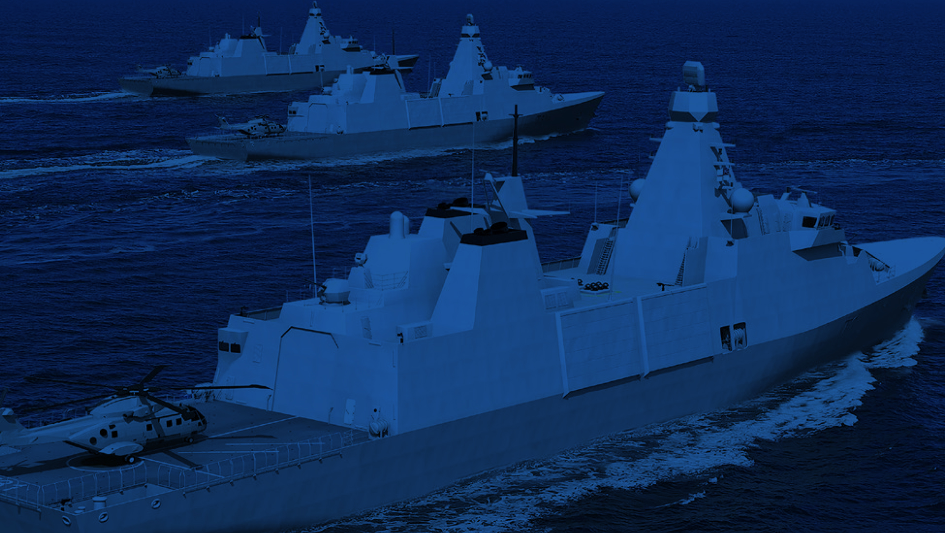
Adaptability paths:
What we have learnt

Slide 13
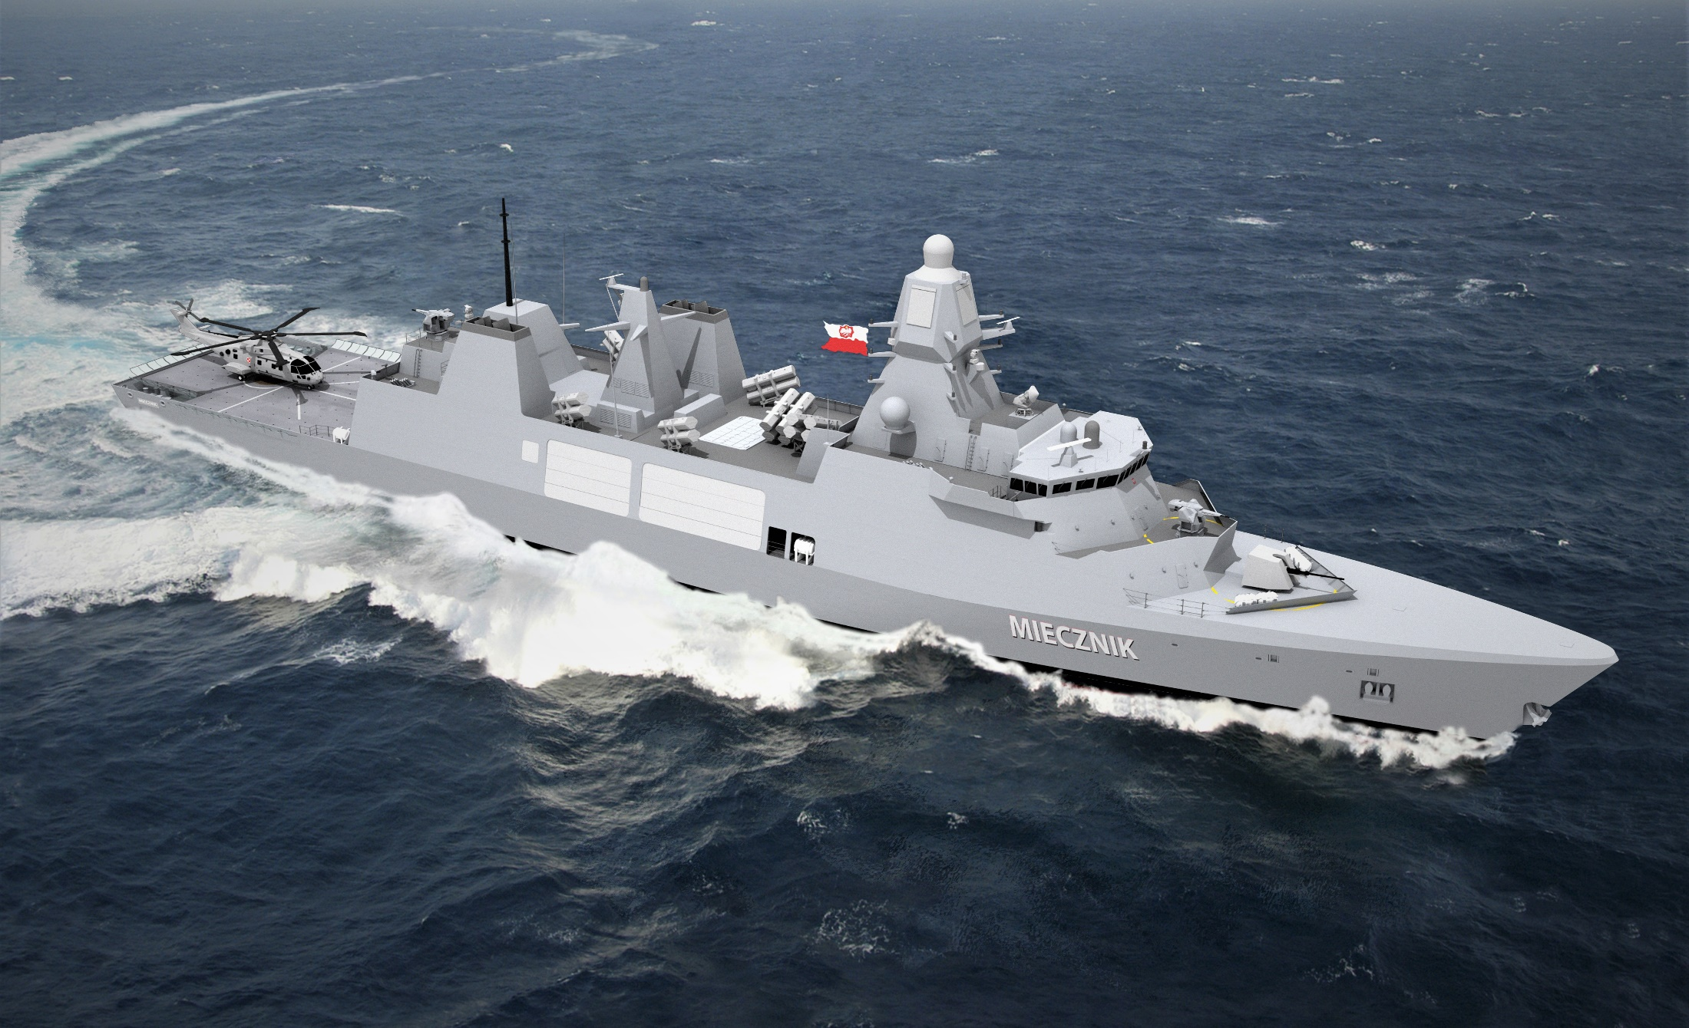
Arrowhead 140
What we have learnt
Adaptation paths
Export control
Updates to baseline platform
What export customers need
to think about:
  Mission system
  Standards
  Cross functional requirements

Slide 14
Arrowhead 140
Where next?

Slide 15

Arrowhead 140:
Where next?
Anti-submarine warfare
Capability through modularity - CUBETM
Explore more Carbon Net Zero options for Arrowhead 140

Slide 16

Questions
Notes:
Type 31, and the ARROWHEAD-140 product, are derived from the ‘parent’ Royal Danish Navy (RDN) IVER HUITFELDT Class of area air warfare Frigates; however, it is not a ‘build to print’ of the IVER HUITFELDT design

