Slide 1
MINISTRY OF DEFENCE BOATS
Phil Gittins, Boats Team Leader
DE&S
Notes:
Good morning, my name is Phil Gittins and I am the Boats team leader.
And this is Iain Prior our Chief Engineer
Thank you all for coming to hear about what we do and our forthcoming challenges.

Slide 2
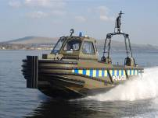
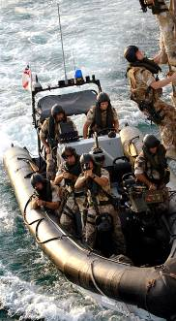
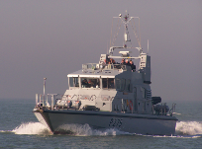
Agenda
Introduction to the Boats Team
In Service Support
Acquisition
Decarbonisation
Questions
Notes:
I’m going to give you some background on the organisation I work for, the MOD Small Boats fleet. Then talk about our In-Service Support and Acquisition.
I was keen to do this briefing to publicise our current work and future procurements to thank our existing supply chain and to ensure maximum participation in our future competitions.
For those of you not looking to work directly for the MOD, there are opportunities in the supply chain working with primary contractors to increase innovation in this area and achieve better VfM.
Finally, Iain will talk about some of our technical challenges

Slide 3
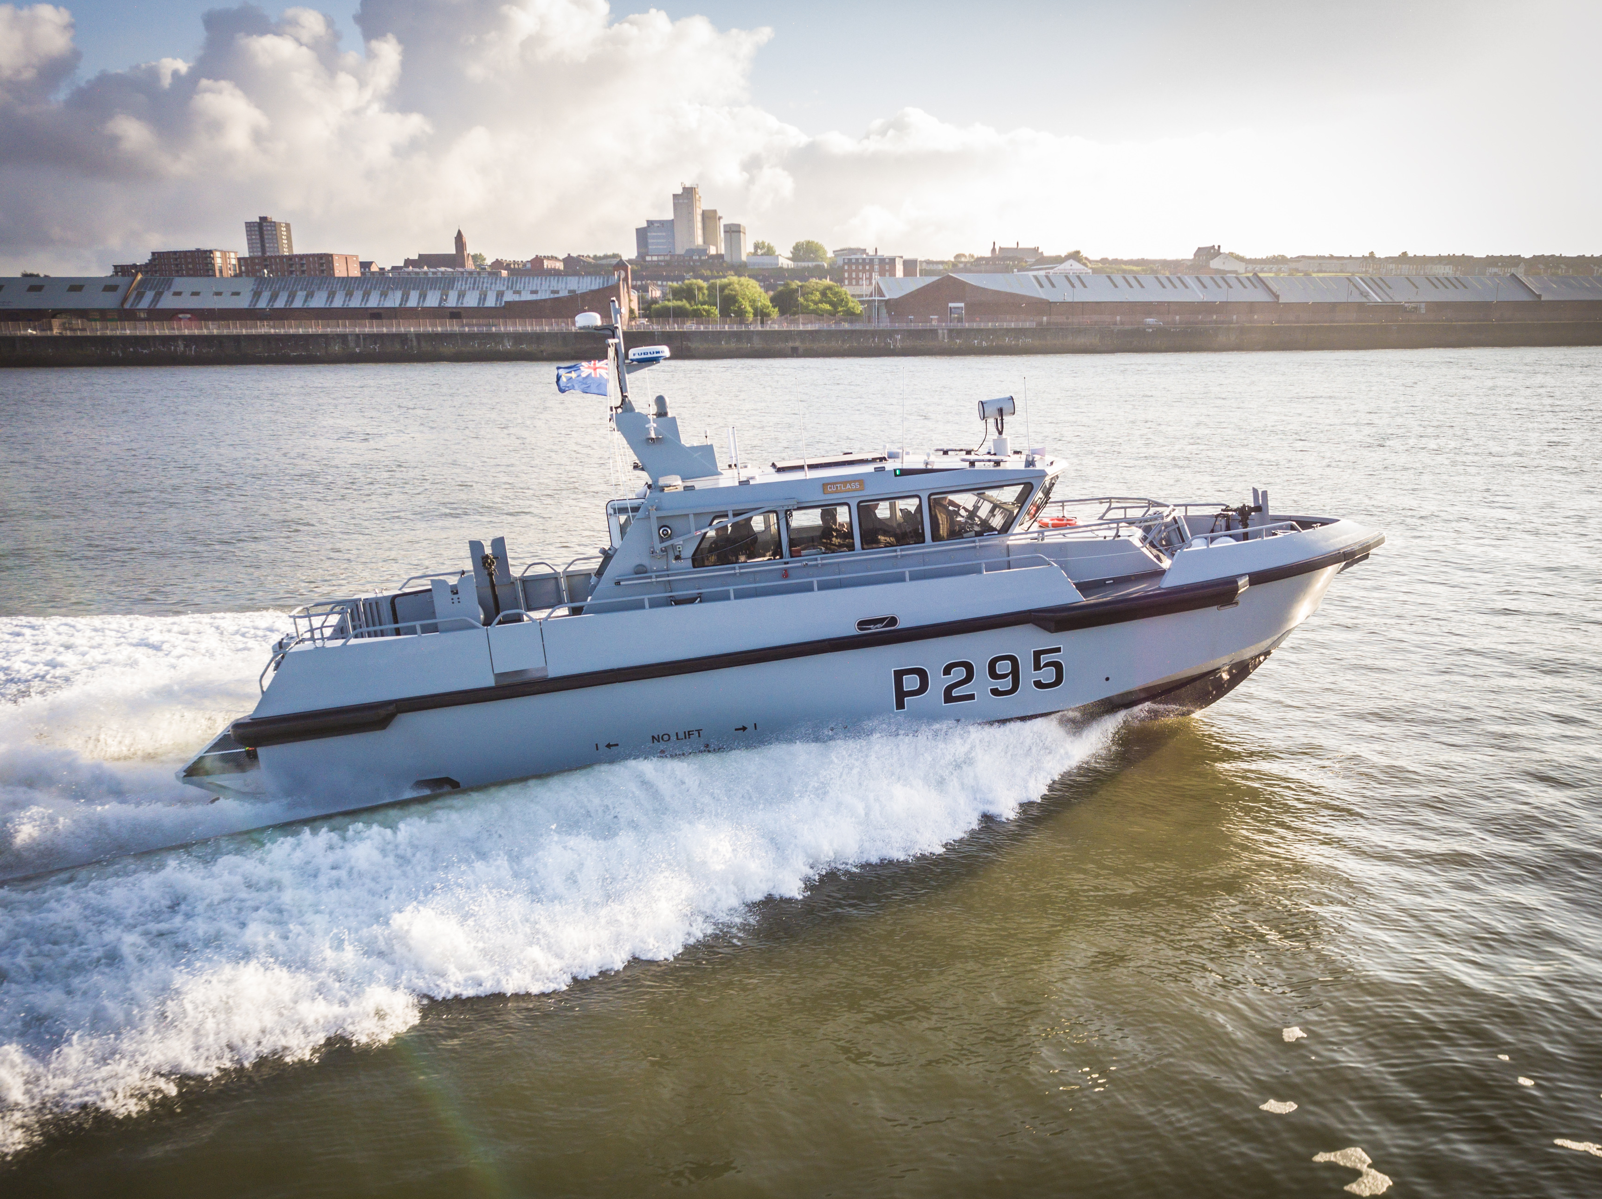
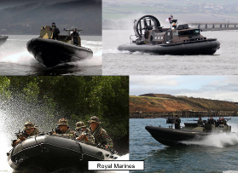
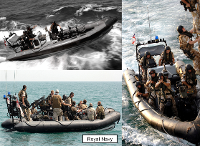
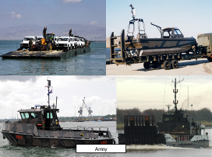
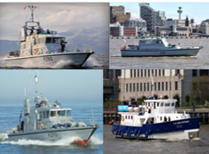
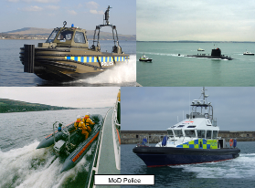
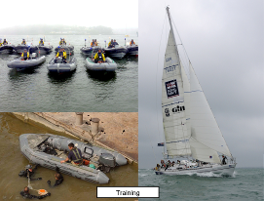
Boats Team
Through-Life Management of over 2,000 craft
delivering to a wider range of MoD Customers.
Marine Specialised Technology Ltd
Royal Navy
Royal Marines
Army
Royal Navy Cadets
MOD Police
Training
Royal Navy Cadets
Notes:
Here’s just a snapshot of some of the Boats we support, the key being the diversity and disparate nature of the user community.
We also have regular dialogue with Other Government Departments such as the Border Force, Police forces and the RNLI.
We spend approximately £30M every year on supporting the boats fleet with additional significant funding for new boats.
3

Slide 4
In Service Support
Boats In Service Support (BISS) has been running for four years of six and a half. The total value of the BISS contracts are £180 Million approx. The contracts are broken into 11 lots detailed in the below table. The contracts will be re-let in 2026 and are preparing the groundwork for this procurement.
Lot | User | Contractor | Contract Award Value
Lot 1 | Overseas Boats | Babcock | £11,000,000.00
Lot 2 | RN / RFA Boats | BAE Systems | £37,000,000.00
Lot 3 | Ministry of Defence Police Boats | BAE Systems | £27,500,000.00
Lot 4 | Inflatables | Marine Specialised Technology | £1,600,000.00
Lot 5 | Royal Marines Tamar | Griffon Hoverwork | £5,000,000.00
Lot 6 | Army Boats | BAE Systems | £19,000,000.00
Lot 7 | 2nd Line Training Boats | Babcock | £20,500,000.00
Lot 8 | Faslane Boats | Holyhead Marine | £5,000,000.00
Lot 9 | 4th Line Training Boats | Babcock | £19,500,000.00
Lot 10 | Royal Marines Poole | BAE Systems | £35,000,000.00
Lot 11 | Dive Boats | Marine Specialised Technology | £6,500,000.00
Notes:
When we last presented in person at Seawork we were closing out contract award for Future Boat Support.
As you can see we now have established contracts with 5 contractors who are providing us with support across our flotilla.
SO thank you to Babcock, BAE Systems, MST, Griffon and Holyhead Marine for all your support.

Slide 5
In Service Support - Achievements
On track to Deliver a Whole Body Vibration mitigation programme across our fleet meaning all of our craft will be compliant with Whole Body Vibration Legislation by August 2023.
Commando Raiding Craft (Offshore Raiding Craft Mid Life Upgrade Boat) First of class delivered in February 2023.
Pacific 28 WBV complaint first of class delivered May 2023
Arctic 28 WBV Compliant First of Class expected July 2023

Slide 6
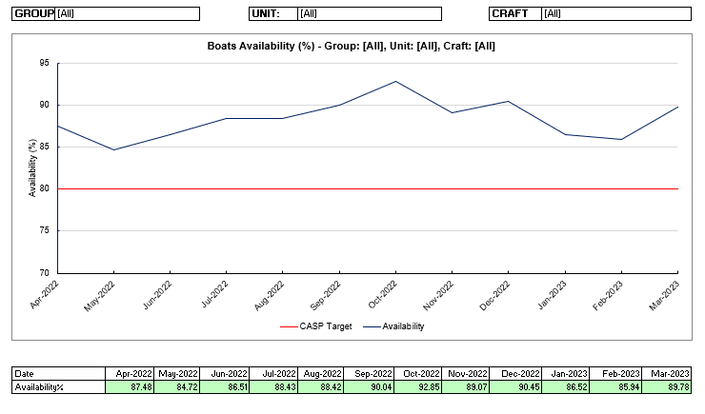
Boats Availability
The Boats In-Service Support team focus on driving boat availability.
We are looking to find efficiencies in how we do our maintenance as well as increased resilience and reliability to drive as increase in the platform availability we deliver to Navy Command.

Slide 7
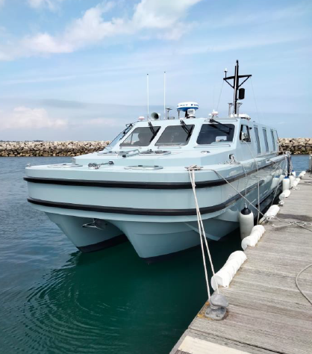
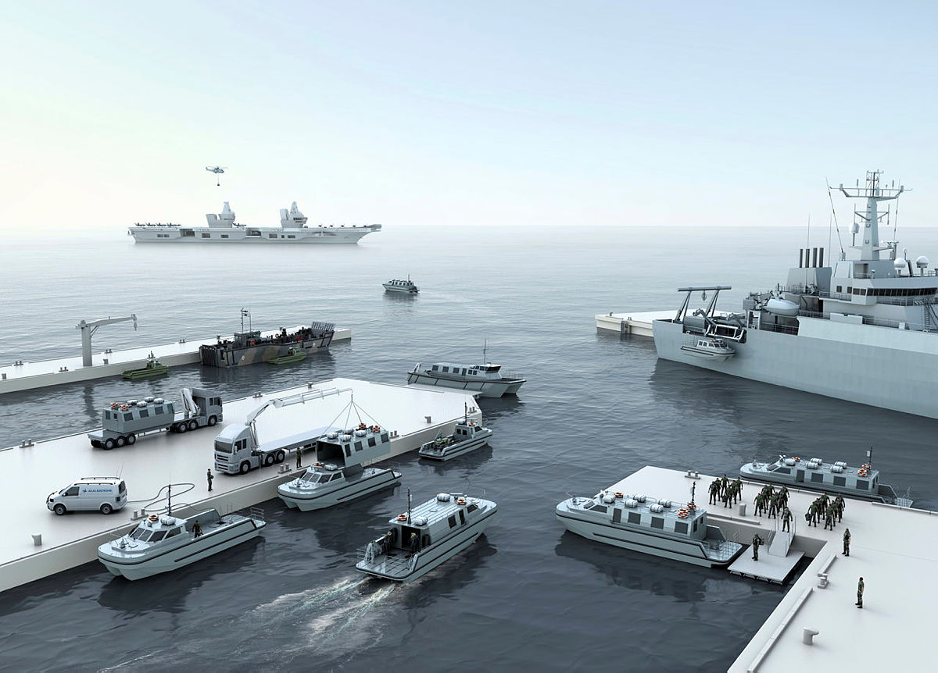
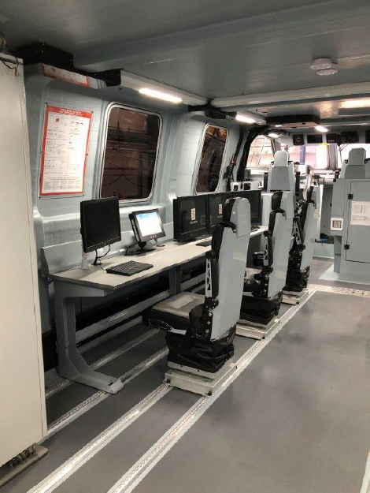
Acquisition - Achievements
Acceptance of Vahana Dive Support Boats (DSBs) and Survey Motor Boats (SMBs)
Replaces aging capability reaching out-of-service date (OSD);
Provide modern and reliable operational and training platforms to Royal Navy;
Modular Vahana design delivers commonality with rest of fleet, enhancing supportability and providing economies of scale.
Designed, built and supported by Atlas Elektronik UK.

Slide 8
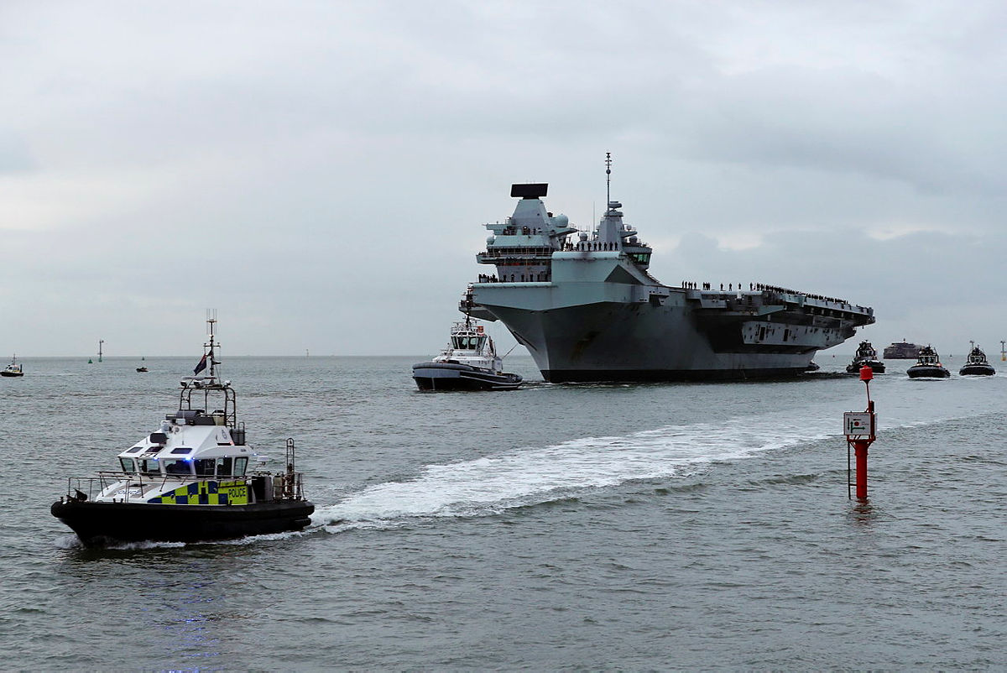
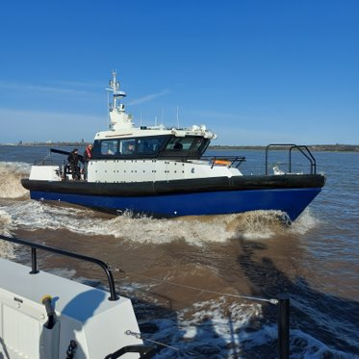
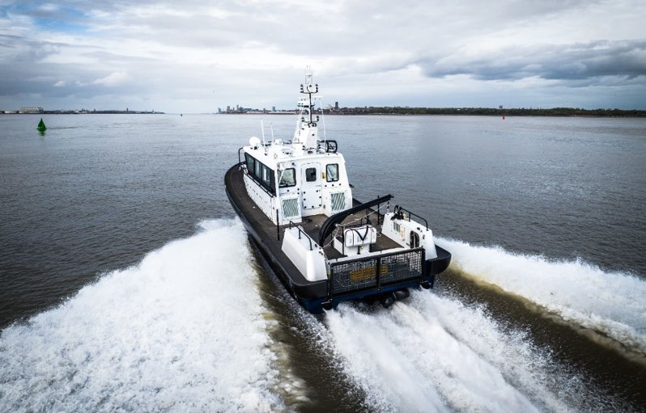
Acquisition - Achievements
Acceptance of Police Patrol Craft (PPC):
Boat 1 accepted off contract;
Boats 2 and 3 in final stages of production;
Operator training delivered;
Delivering improved policing of HM Naval Bases and escort of visiting ships by replacing obsolete craft with modern, capability-enhancing vessels.

Slide 9
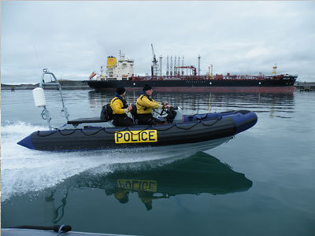
Boats Acquisition – Future Contracts
DE&S is currently undertaking a significant and comprehensive programme of boat acquisition, with procurements both planned and underway across a wide range of capabilities to replace and supplement in-service craft.
Intercept & Escort Craft (IEC):
Replacement of a number of in-service crafts primarily operated by MOD Police and Gibraltar Defence Police, plus options to extend roll-out to other operators including Fleet Diving Units.
Replacing a number of extant boat classes with a single class of highly capable RIBs improves ability to deliver coherent logistics, training and infrastructure solutions.
Currently in competition. Contract Award expected Q4 2023.
Commando Insertion Craft (CIC)
Replacement for Royal Marines’ medium lift capability.
Requirements definition underway (informed by, amongst other workstreams, outcomes of MSQ and DASA Novel Amphibious Craft competition).
Critical part of Future Commando Force concept.
Tendering planned to commence late 2024.

Slide 10
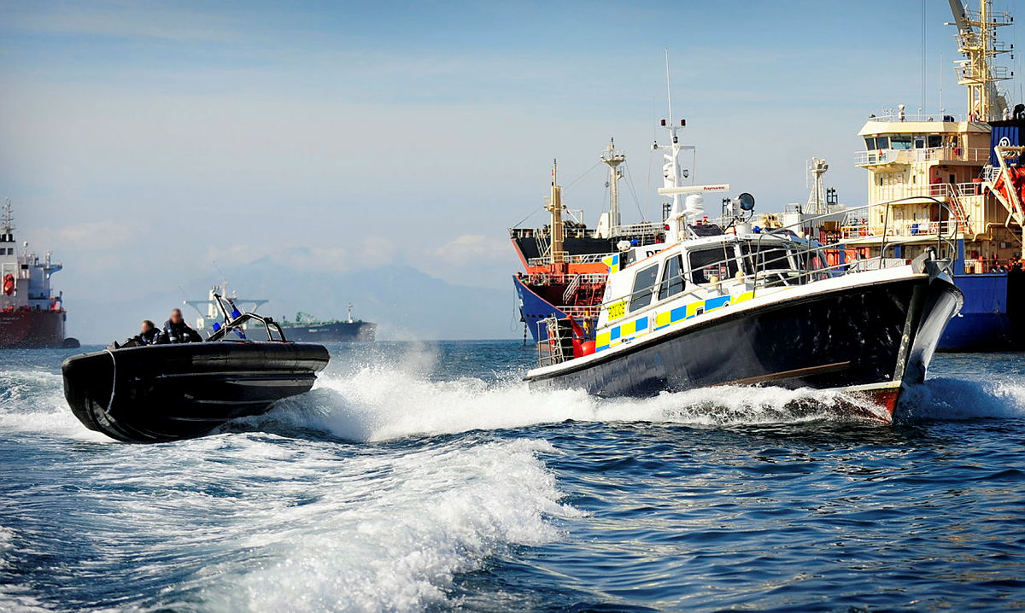
Boats Support – Future Contracts
Vahana In Service Support
Future Boats In-Service Support (F-BISS)
Replacement for existing Vahana support contracts expiring on 31st March 2024
Provides support for 35 Vahana craft.
Market engagement (PQQ) to commence in August.
Replacement for existing BISS contracts, expiring 31 Mar 2026.
Provides support for c.3000 boats across MOD portfolio.
Commencing early engagement to inform support architecture design.
Tendering planned to commence mid 2024.
The vast majority of Boats Team procurements are awarded following competition, with opportunities advertised through the Defence Supplier Portal (www.contracts.mod.uk).
We welcome expressions of interest from any relevant party, including SMEs and those who have not done business with DE&S previously.

Slide 11
DECARBONISATION

Slide 12
Beginning our journey
Seawork June 2022 made it clear that we needed to start to plan decarbonisation activities.
Different infrastructure
Multiple user groups
Where to start?
The challenge was to develop an approach that would provide useful insights that were transferrable across the fleet, giving us a scalable model to take us into the future.
100+ boat classes
Multiple use cases

Slide 13
Our Vision
The Boats team is recognised as the thought leaders for decarbonisation within DE&S; with the ability to implement net zero outcomes across the Boats portfolio and lifecycle.
Annual

Slide 14
Future Technologies for Boats
Technology
Use of Biodiesel
Anti-fouling
Solar paint
Condition based maintenance
Hydrofoil
Boat Trim/Stern Flap appendages
Microfilters
What can we do next in this space?
Technology
Hybrid (Diesel/Electric)
Hybrid electric outboard motors
Solar/wind renewable energy
Hydrogen/Oxygen Steam Propulsion system
Clean Hybrid alternative marine powertrain (CHAMP)
Automatic Lubricating Oil Analysis
Auxiliary Smart Drives
Alternative Deployed Energy
Alternative Base Energy
Journey towards decarbonisation
Diesel / Electric hybrid
Technology
Alternative Energy Sources - Batteries
Alternative Fuel Source - Hydrogen
Alternative Fuel Source - Ammonia
Future Strategy
Fleet baselining
Cadet Boat Pilot
Time
Notes:
Understanding the demand cycle
Making best use of on board energy

Slide 15
Cadet Boat Pilot

Slide 16
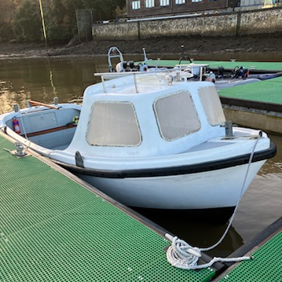
Cadet Boat Pilot – Cheverton Champ
Training
Doctrine /Concepts
Current certification under LR iaw SCV Code. Key safety considerations:
System installation and arrangement
Position of controls
Suitability of bilge pumping solution
Stability
Fire Safety
Certification
Maintenance
Used to run 4 day RYA Powerboat course with up to 4 cadets per boat; Used from March to October (09:00 – 12:00, and 13:00 to 15:00 each day); 12Nm (within 3 miles of JP) covered daily, typically cruising at up to 6 knots
4 Cheverton Champ boats at Jupiter Point
1 additional Champ to be relocated at JP and electrified
450kg payload or 6 adults at 75kg each
45l diesel fuel tank
Equipment
Logistics
With the exception of 42 vessels, all Champs are located at single sites across the country - in total, the vessels are therefore found at 86 different locations (DMR Boats Register March 2023).
114 vessels, split into 2 distinct user groups:
86 vessels
28 vessels
People / Organisat-ion
Infrastruc-ture
Jupiter Point currently has a pontoon-based shore electrical infrastructure. It is underpowered for the current demands of the craft situated there and regularly trips. Feeder cables are also undersized.

Slide 17
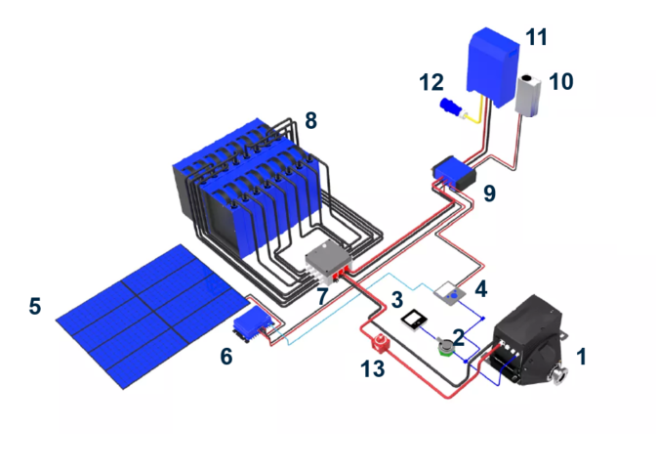
Cadet Boat Pilot – Cheverton Champ
Based on the data provided, a potential electric solution could include the following:
13kW electric drive system, capable of producing a propeller shaft speed of 1010RPM at 118Nm Torque
Battery capacity and charging capability to cover 6 hours of use per day
A battery management system
A controller, battery gauge, associated cabling and controls
System cooling as required
Remote monitoring and performance data
Weight budget of approx. 250kg
Solar panel to provide a trickle charge to the batteries over winter when not in use to prevent battery damage
AXC12 electric drive shaft motor
Control lever
Oceanvolt display
System control and monitoring
Solar panels
Solar charger
Battery connection box
Propulsion battery pack
BUS bar
DC/DC converter
Charger/inverter (pontoon)
Shore power input
Main switch

Slide 18
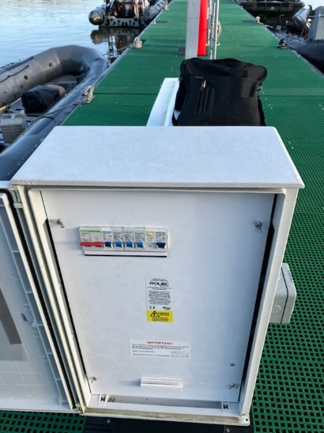
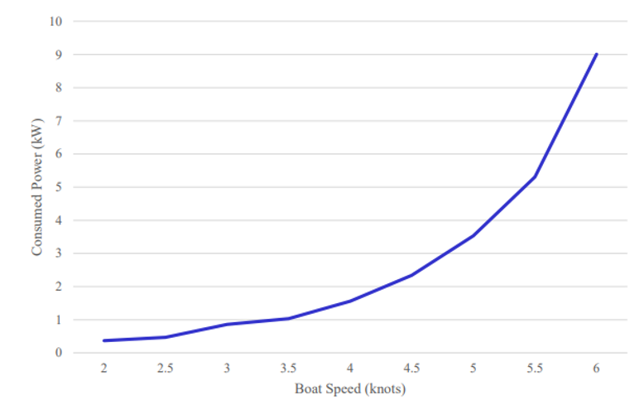
Lessons Learned
The pilot study highlighted several challenges:
Logistical (multiple locations of vessels with differing infrastructure arrangements)
We need to fully survey infrastructure impacts and offer alternative solutions such as a mixed fleet diesel/electric and fully electric
Environmental (End of life battery disposal)
Financial (decarbonisation produces no ROI; limited economies of scale)
Costs can be dominated by wider infrastructure impacts on the energy chain, avoiding these simplifies the application
And most significantly – collection of data
Design dominated by the energy use case - assumptions and estimates need to be challenged with data. Complete use case data will inform energy requirements and reduce battery weight.

Slide 19
Future Technologies for Boats
Technology
Use of Biodiesel
Anti-fouling
Solar paint
Condition based maintenance
Hydrofoil
Boat Trim/Stern Flap appendages
Microfilters
What can we do next in this space?
Technology
Hybrid (Diesel/Electric)
Hybrid electric outboard motors
Solar/wind renewable energy
Hydrogen/Oxygen Steam Propulsion system
Clean Hybrid alternative marine powertrain (CHAMP)
Automatic Lubricating Oil Analysis
Auxiliary Smart Drives
Alternative Deployed Energy
Alternative Base Energy
Journey towards decarbonisation
Diesel / Electric hybrid
Technology
Alternative Energy Sources - Batteries
Alternative Fuel Source - Hydrogen
Alternative Fuel Source - Ammonia
Future Strategy
Fleet baselining
Cadet Boat Pilot
Time
Notes:
Understanding the demand cycle
Making best use of on board energy

Slide 20
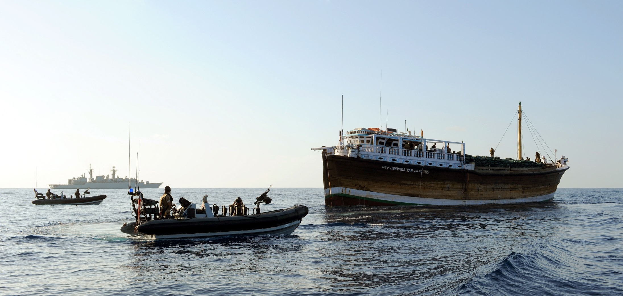
QUESTIONS
Follow up questions can be sent to: DESShipsCSS-Boats@mod.gov.uk

