Slide 1
ROMANIAN NAVY DIVING CENTRE
&
INSTRUCTION by SIMULATION, WAR GAMINGS AND EVALUATION CENTRE
THE CURRENT STATE
AND
FUTURE DEVELOPMENTS
DEFENCE LEADERS
COMBINED NAVAL EVENT
23 – 25 MAY 2023 | FARNBOROUGH UK
Romanian Navy Diving Centre Commander
Captain (Navy) Fănel RĂDULESCU
UNCLASSIFIED

Slide 2
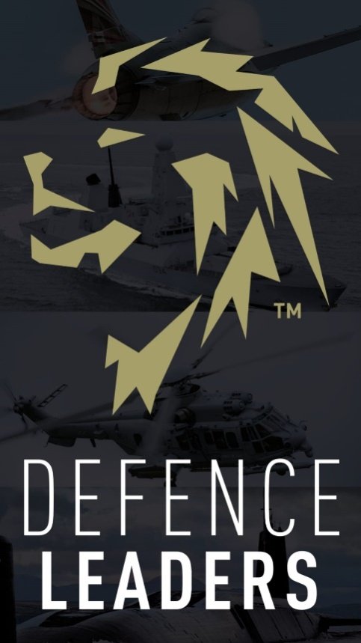
AGENDA
1. HISTORICAL BACKGROUND
2. MISSION, ROLE AND COMPETENCIES
3. CURRENT STATUS AND FUTURE DEVELOPMENTS
4. TRAINING BY SIMULATION
5. WARGAMING
6. WAY AHEAD
UNCLASSIFIED

Slide 3
HISTORICAL BACKGROUND
55+ years
of excellence in diving
4000+
trained professional divers
1000+
of deep sea dives
Among the best Black Sea divers
17.05.2023

Slide 4
DIVING CENTRE ROLE & MISIONS
UNCLASSIFIED

Slide 5
COMPETENCIES
17.05.2023

Slide 6
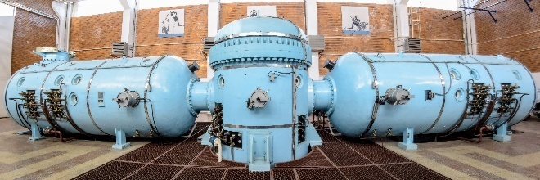
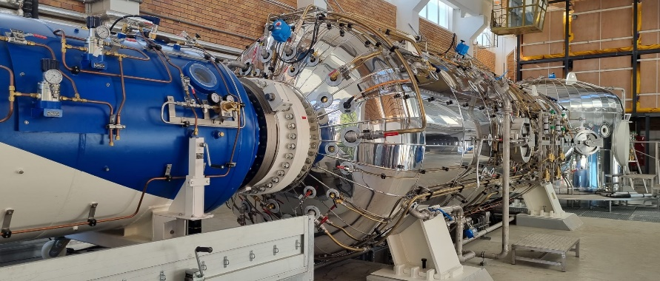
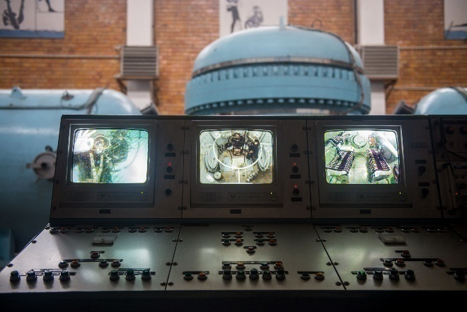
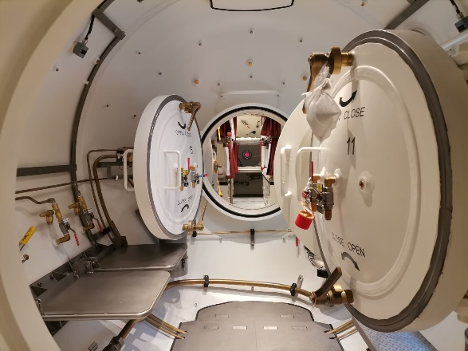
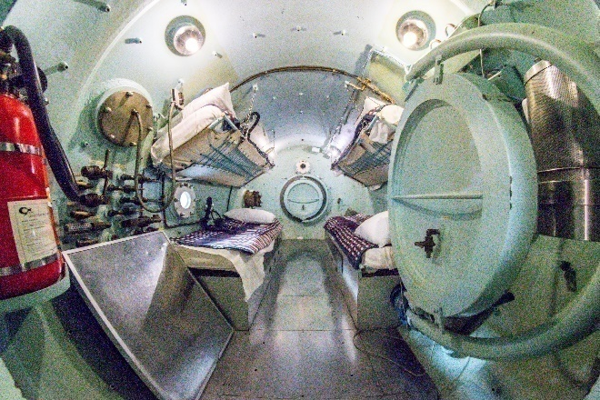
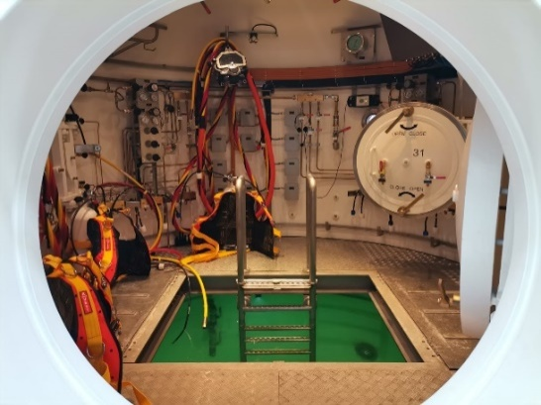
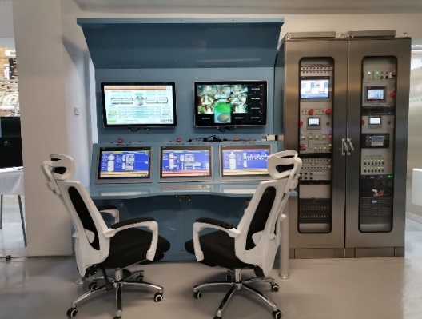
CURRENT STATUS & FUTURE DEVELOPMENTS
L
H
3
0
0
17.05.2023
UNCLASSIFIED

Slide 7
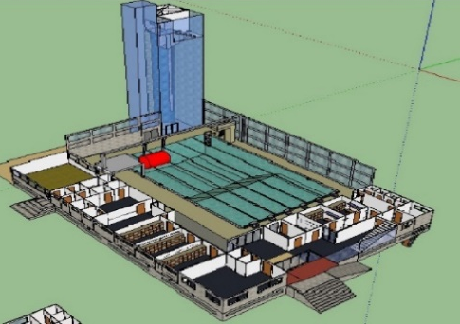
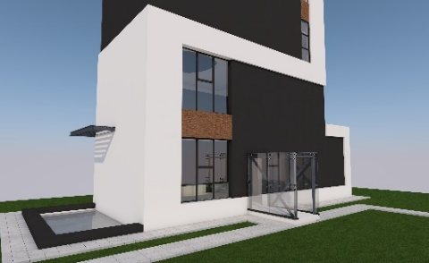
ONGOING PROJECTS
SEMI-OLYMPIC SWIMMING POOL
25 m long;
variable depth 2 to 4 meters;
6 swimming lines;
sauna
meeting rooms
office spaces
medical office
changing rooms and showers
Bosiet, life raft and VBSS training
tower 25m high and 5 meters in diameter for complex training divers, underwater operators,
salvage divers for intervention on a damaged submarine and submarines evacuation training
2023
2025
17.05.2023
UNCLASSIFIED

Slide 8
ONGOING PROJECTS
GRIGORE ANTIPA deep sea divers ship
UNCLASSIFIED

Slide 9
ONGOING PROJECTS
UNCLASSIFIED

Slide 10
ONGOING PROJECTS

Slide 11
ONGOING PROJECTS
PESCO - EUROPEAN UNION NETWORK OF DIVING CENTRES (EUNDC)
ROADMAP
UNCLASSIFIED
11

Slide 12
ONGOING PROJECTS

Slide 13
TRAINING BY SIMULATION
Skills Procedures Tactics Ideas
Can simulate various operational elements, including: enemy/enemy situation, joint forces, electromagnetic environment, geographical environment, weather and hydrology, etc. These elements can be static or dynamic.
The process is intuitive.
The result is objective.
Can integrate training from individual soldiers/boats/ships to battalions/task groups task force from tactical level to strategic.
provide a higher level and wider range of action environment.
Strengthen the understanding and execution of tasks by commanders.
Strategic
Operational
Tactical
Advanced Technologies
The application of simulation training has a major impact over the traditional training.
The purpose is not to replace actual training, but to enhance its level and improve the skills of commanders and trainees. Though weapon systems can be tested before acquisition.

Slide 14
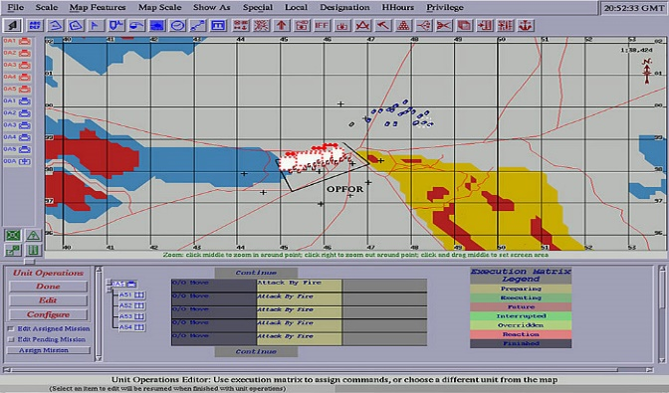
WARGAMING
Simulate aspects of warfare at the tactical, operational, or strategic level.
Examine warfighting concepts, train and educate commanders and analysts, explore scenarios, and assess how force planning and posture choices affect campaign outcomes.
Allows the commanders to test developed COAs.
Spots the weak points as well the strong ones.
The outcomes will provide valuable insights to commanders regarding the capabilities required and shape the force structure. It is performed in a safe environment and it is resource saving.
However requires advanced technologies as well as skilled personnel to run specialized software.

Slide 15
WAY AHEAD
Romanian navy will shift its sailors and HQs trainings to virtual environment using dedicated hardware and software.
Based on virtual models our personnel will provide specialized insights and advice on future weapon system and assets acquisitions
The value of training will increase, procedures and tactics will evolve into a safe environment and less consuming resource.
Time saving and tested capabilities in a virtual area will influence the future force structure and tactics
Joint interaction develops adequate mindset to comprehensive approach.
Connection with allies into safe and secure networks improves the strategies and tests concepts.
TRAINING BY SIMULATION
ADVICE COMMANDERS
FORCE SHAPE
FUTURE FLEET
training
wargaming
Tests
procedures
skills

Slide 16
ROMANIAN NAVY DIVING CENTRE
Notes:
This concludes my presentation,
Thank you for your attention!

