Slide 1
ADVENT
NETWORK ENABLED DATA INTEGRATED COMBAT MANAGEMENT SYSTEM
Dr.Ekrem SERIN (Ret.Captain)
System Architect

Slide 2
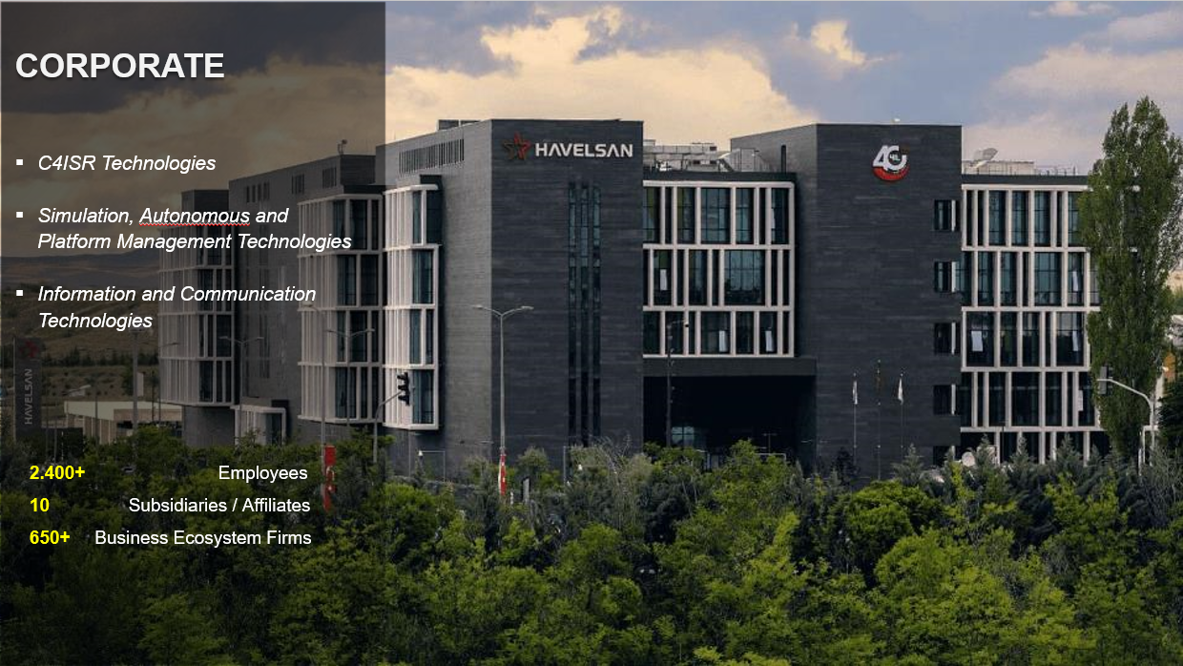

Slide 3

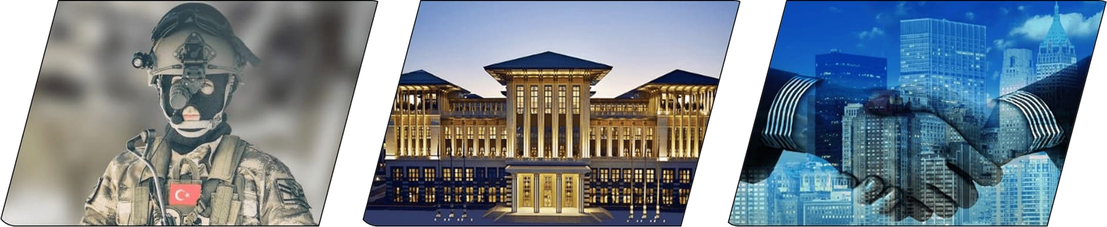

4 | ABOUT US
ARMED FORCES
GOVERNMENT
LOCAL AND GLOBAL COMPANIES
1982
2023
20+
COUNTRIES

Slide 4
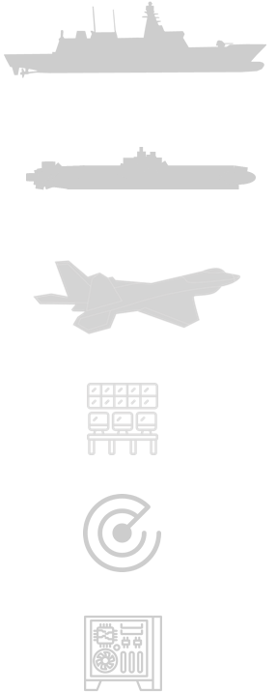


C4ISR
Technologies
Simulation, Autonomous and
Platform Management Technologies
Information and Communication
Technologies
SIMULATOR TRAINING CENTERS AND SYSTEMS
SURFACE
DIGITAL
TRANSFORMATION
ELECTRONIC WARFARE
TEST and TRAINING
RANGE
IMAGE PROCESSING
UNDERWATER
ROBOTICS and
AUTONOMOUS
SYSTEMS
BIOMETRIC DATA AND DATA MANAGEMENT
AIR
LAND / JOINT
TF-X NATIONAL
COMBAT AIRCRAFT
INTERNET OF THINGS (IOT)
SURVEILLANCE AND TRAFFIC MANAGEMENT SYSTEMS
CIVIL AVIATION
OPEN SOURCE
HARDWARE
TRAINING
SERVICES
CYBER SECURTY SOLUTIONS

Slide 5
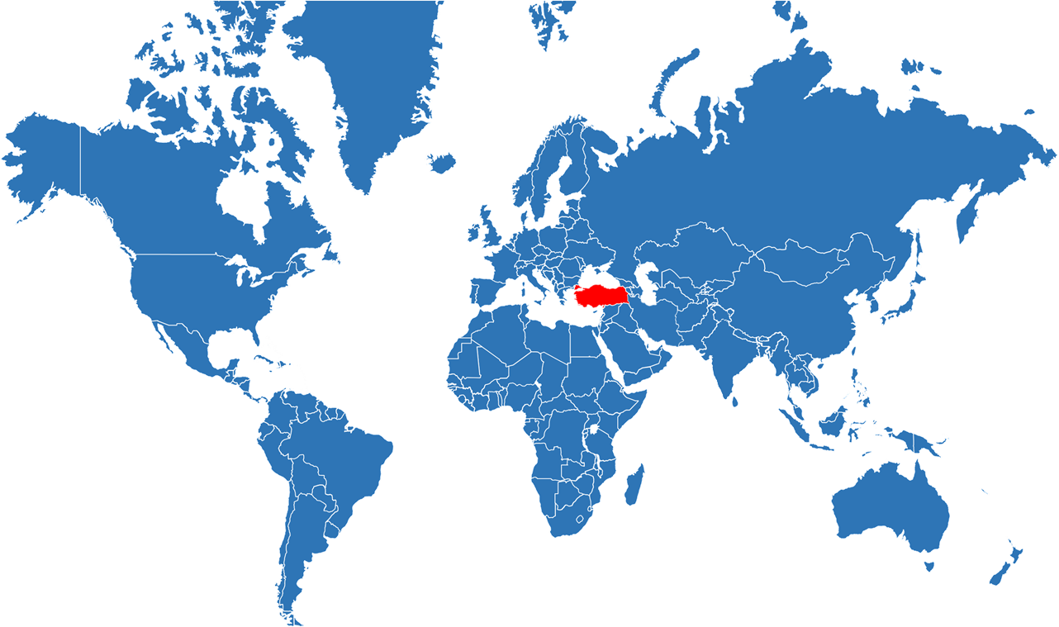
6 | ABOUT US
Azerbaijan
United States of America
Quantum3D
Bangladesh
Malaysia
Indonesia
Oman
Qatar
Pakistan

Slide 6






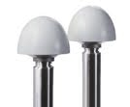




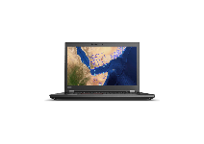
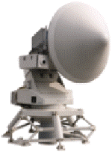
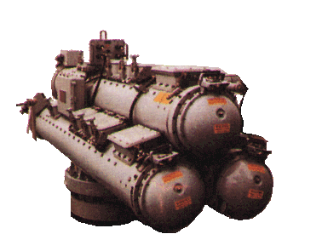



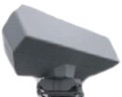










WHAT IS COMBAT MANAGEMENT SYSTEM (CMS) ?
HMI
LINK & COMMS SYSTEMS
Controls Combat System
Increases Situational Awareness
Provides Decision Support
Provides effective use of Sensors and Weapons
NAVIGATION SYSTEMS
CMS
Central Component of
Combat System
SENSORS
WEAPONS
COUNTERMEASURES
we make platform smarter

Slide 7
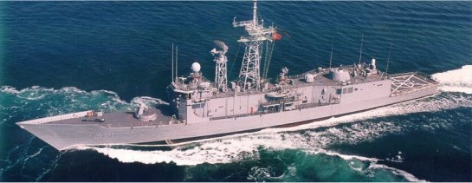
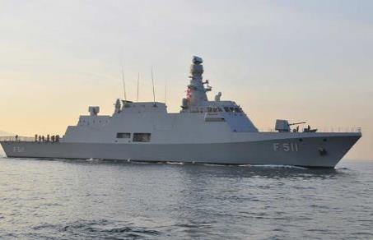
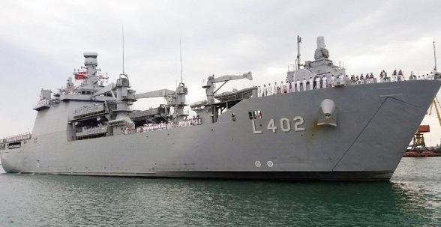
HAVELSAN NAVAL CMS EXPERIENCE
GENESIS
Combat Management System
GABYA (PERRY) Class Frigates
GABYA 1-8
ADA (MILGEM) Class Corvettes
MILGEM 1-2
LST Ships
LST 1-2
HAVELSAN started CMS development activities in the early 2000s.

Slide 8
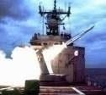
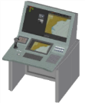
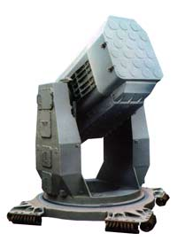
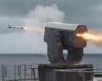
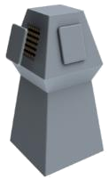
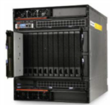
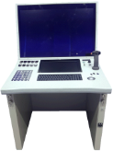
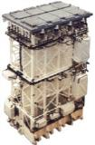
HAVELSAN NAVAL CMS EXPERIENCE
OPERATIONAL REQUIREMENTS
USER DEMANDS
Network Enabled Capability
Common Engagement
Common Training
Common Operation
Ease of Use
Situational Display
Multi Language Support
Rapid Reaction
High Performance & Capacity
Redundancy & Fault Tolerance
Additional Warfare Capabilities
New Assignment Types
FULLY INTEGRATED TDL
FORCE CENTRIC APPROACH
TECHNOLOGY
NETWORK ENABLED CAPABILITY
Weapon & Sensor Technology
Software Technology
Hardware Technology
Communication Technology
DECISION SUPPORT SYSTEMS
TECHNOLOGICAL INDEPENDENCE

Slide 9

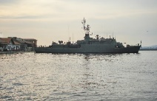
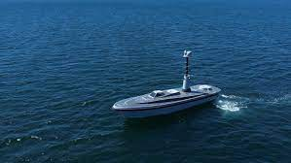






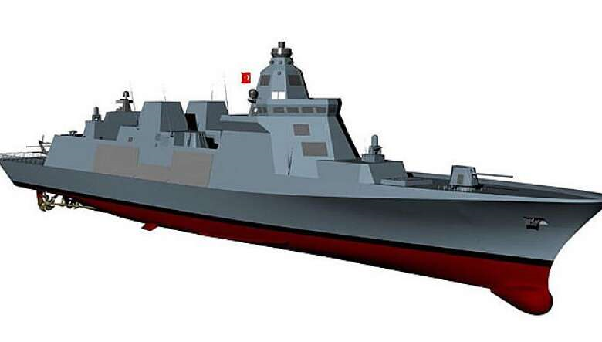
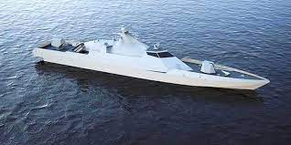
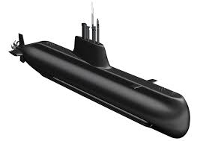
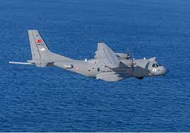
HAVELSAN NAVAL CMS EXPERIENCE
ADVENT
Combat Management System
COMPLETED PROJECTS
ONGOING PROJECTS
SANCAR AUSV
MILGEM 3
BARBAROS
SUBMARINE
Link System
I-CLASS
MILGEM 6-8
MILGEM 4
UFUK
BEYKOZ
TN OPV
MELTEM
Ş
SUBMARINE Link
System
ADVENT Link System
DERYA
I-CLASS
MILGEM 5
UU-IMSS
LHD
ONGOING EXPORT PROJECTS
POTENTIAL PROJECTS
TF-2000
NATIONAL FAC
NATIONAL SUBMARINE
MARTI
POTENTIAL EXPORT PROJECTS
HAVELSAN CMS provider for more than 15 years

Slide 10
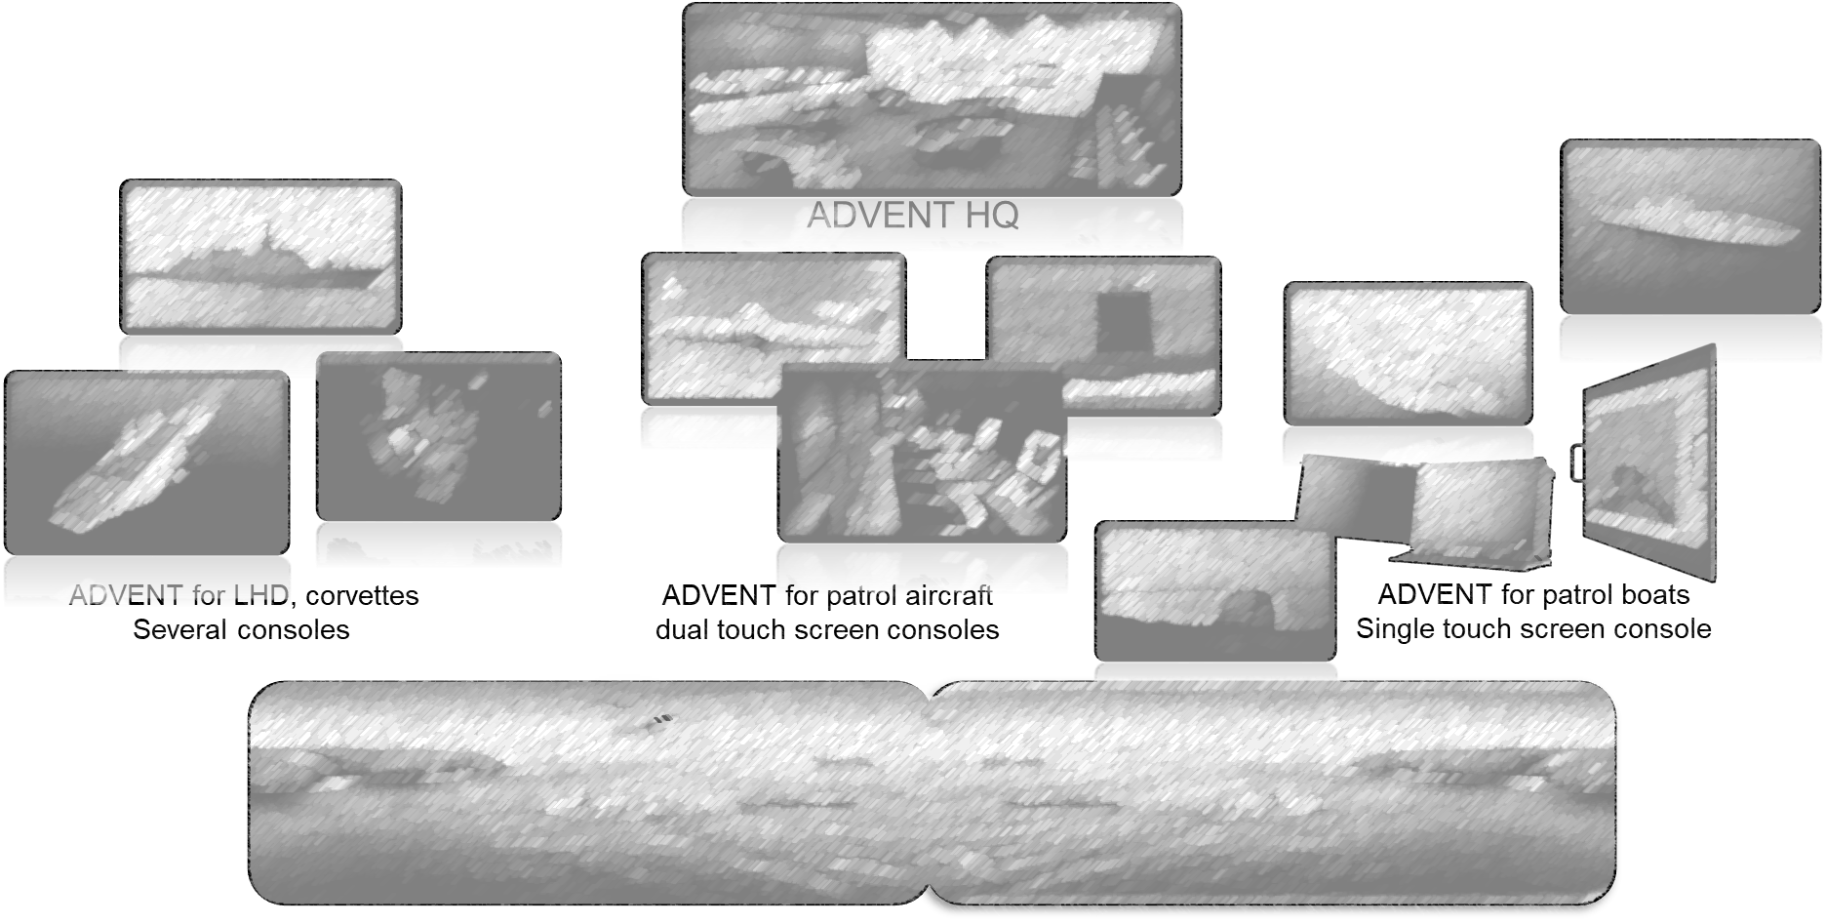
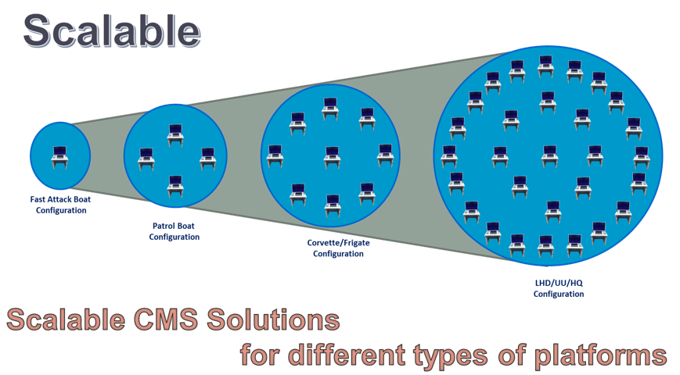
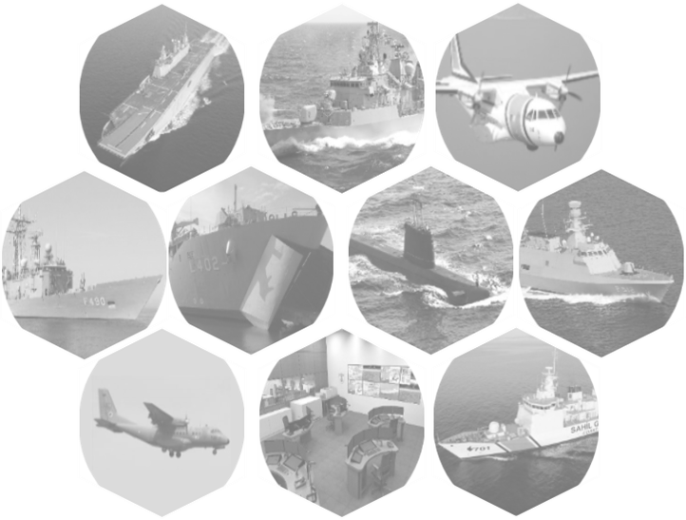
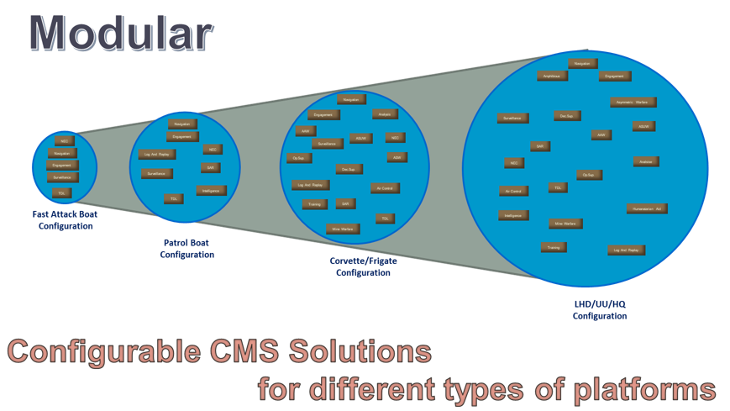
ADVENT CMS

Slide 11
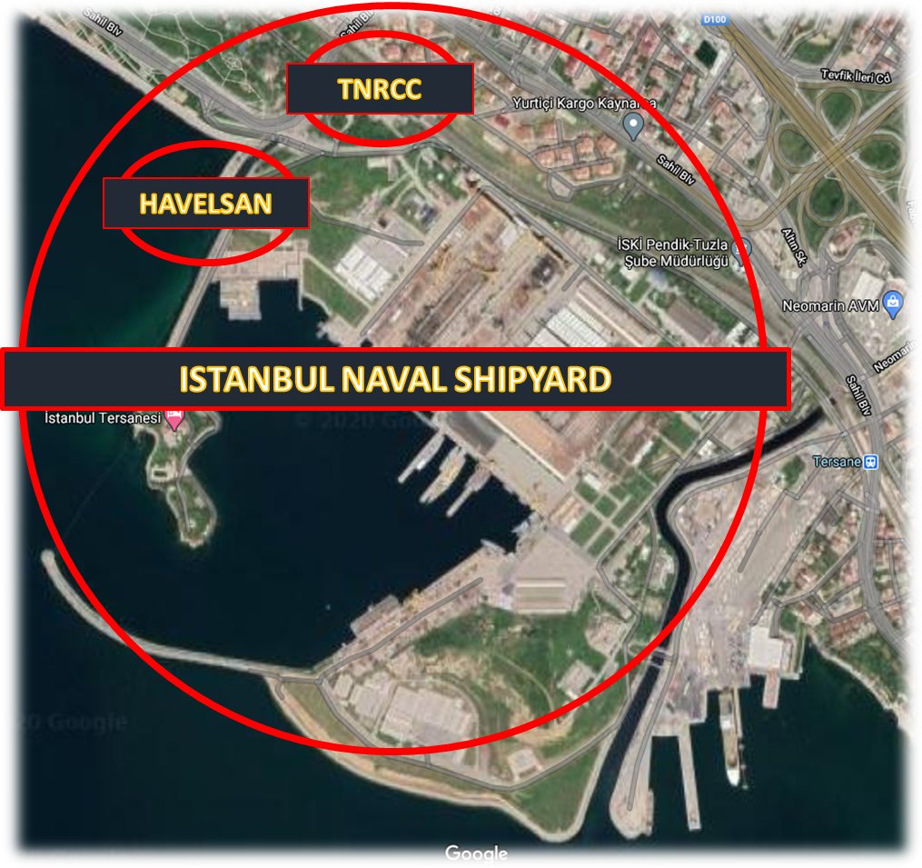
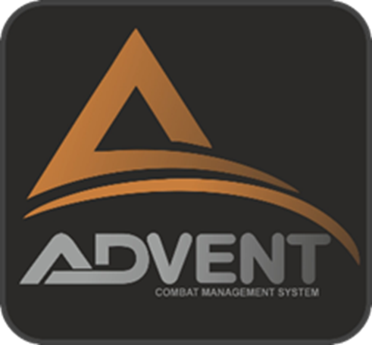
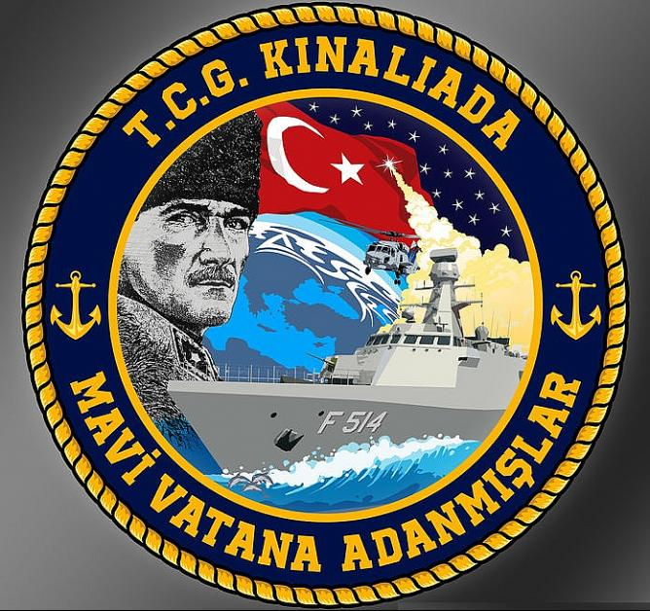

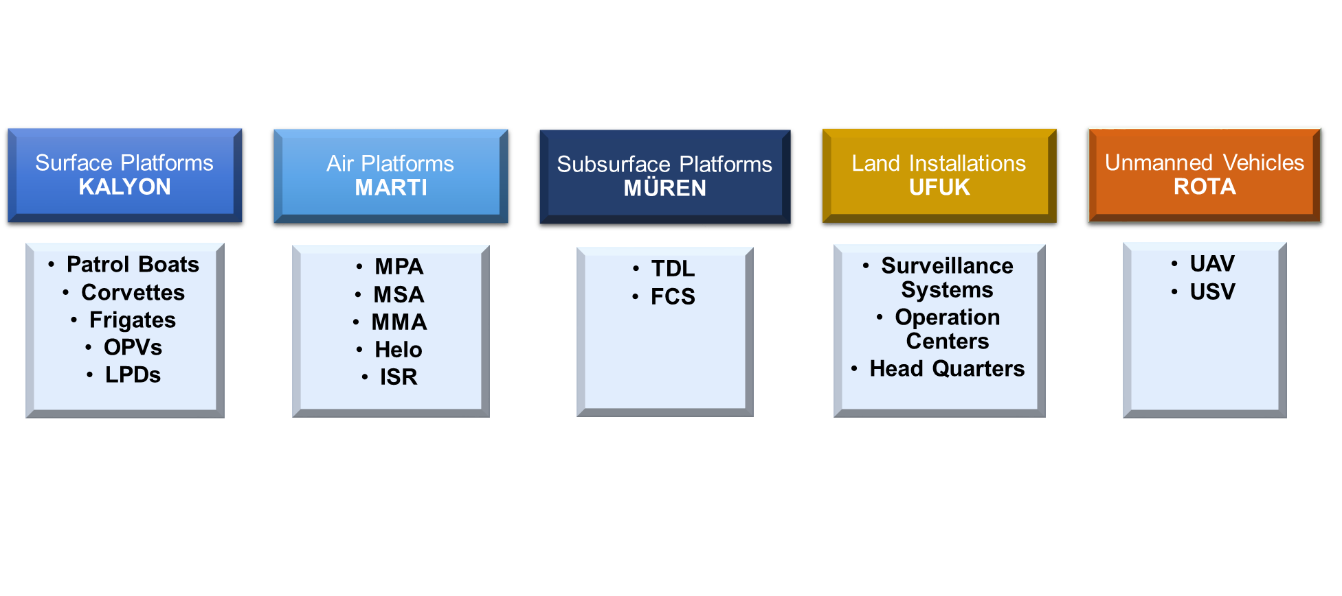
ADVENT CMS Product Tree
ADVENT is developed
WITH
Turkish Navy R&D Command
Cooperative
Requirement Analysis, Design,
Development, Test,
Acceptance, Maintenance
User Feedbacks
Turkish acronym stands for; "Network Enabled Data Integration” to fulfil future requirements for Naval Platforms

Slide 12
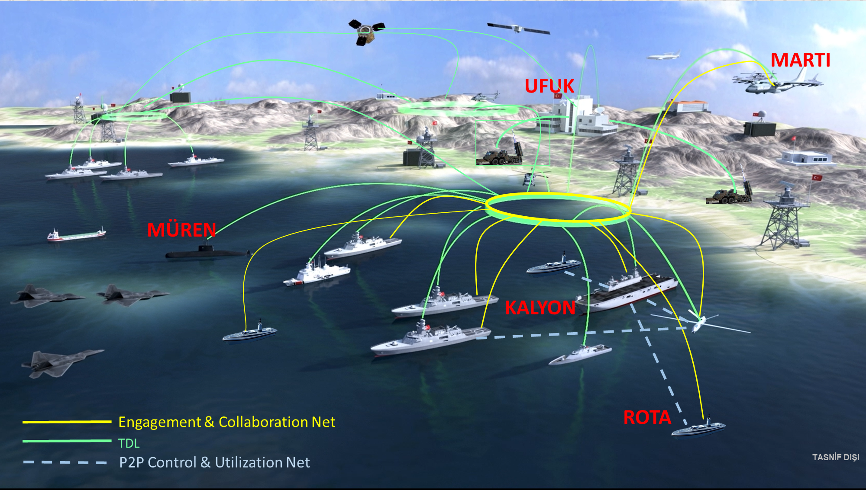
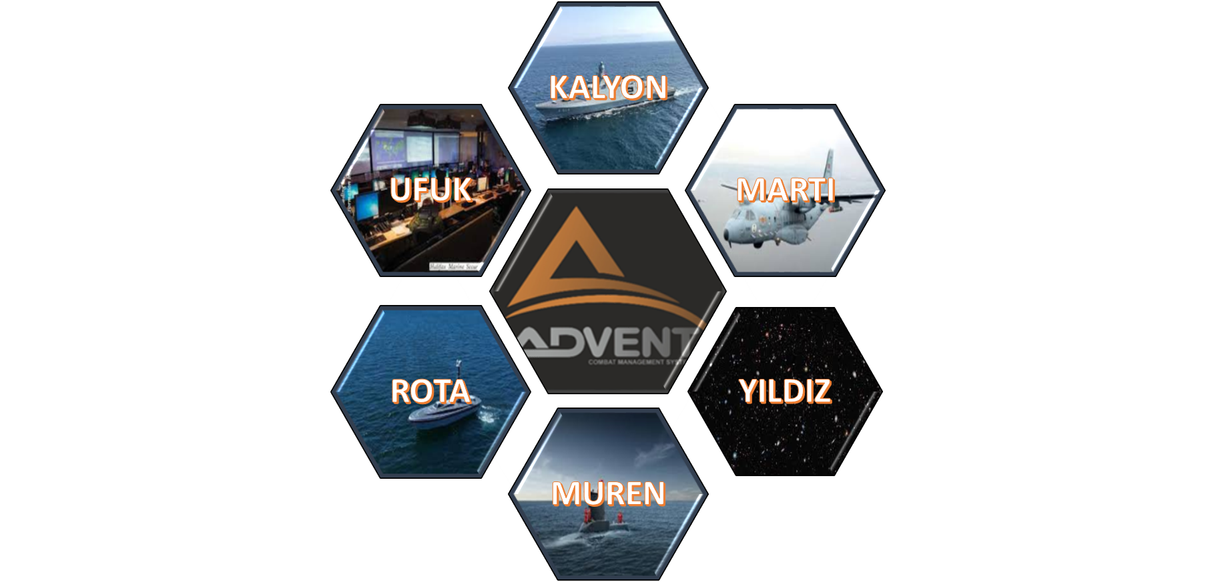

Slide 13


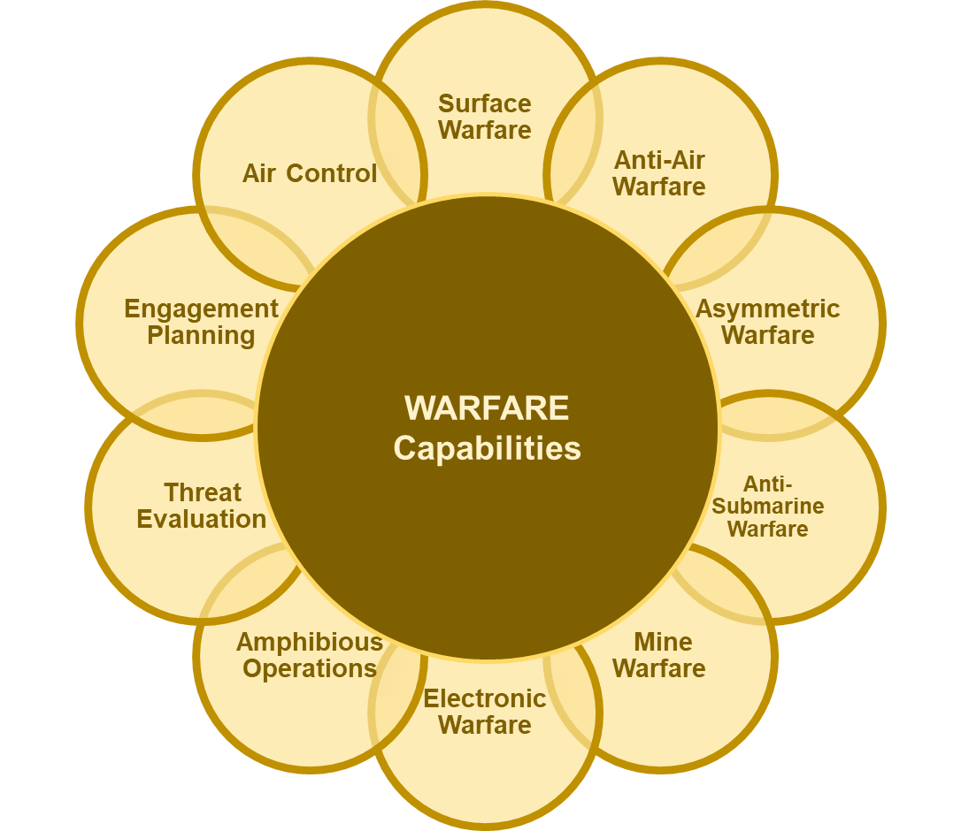
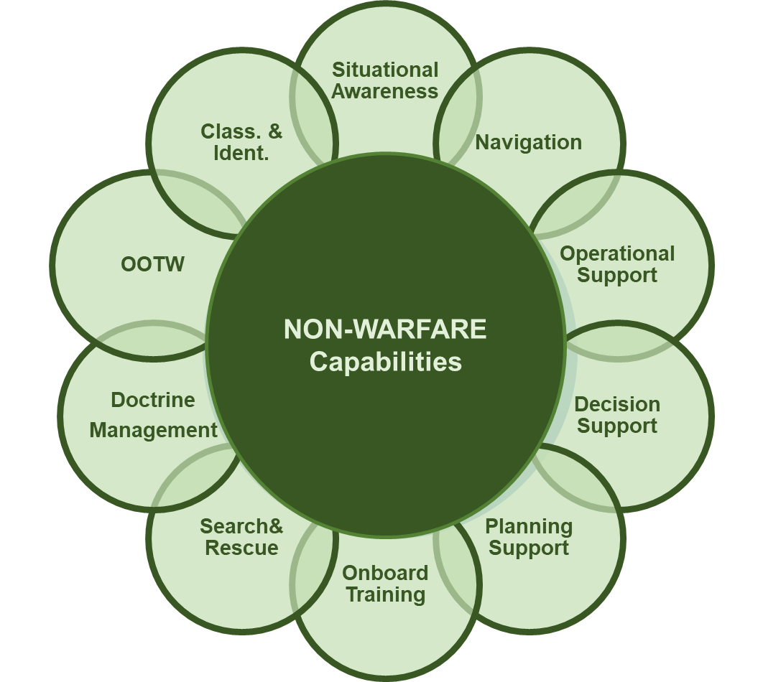
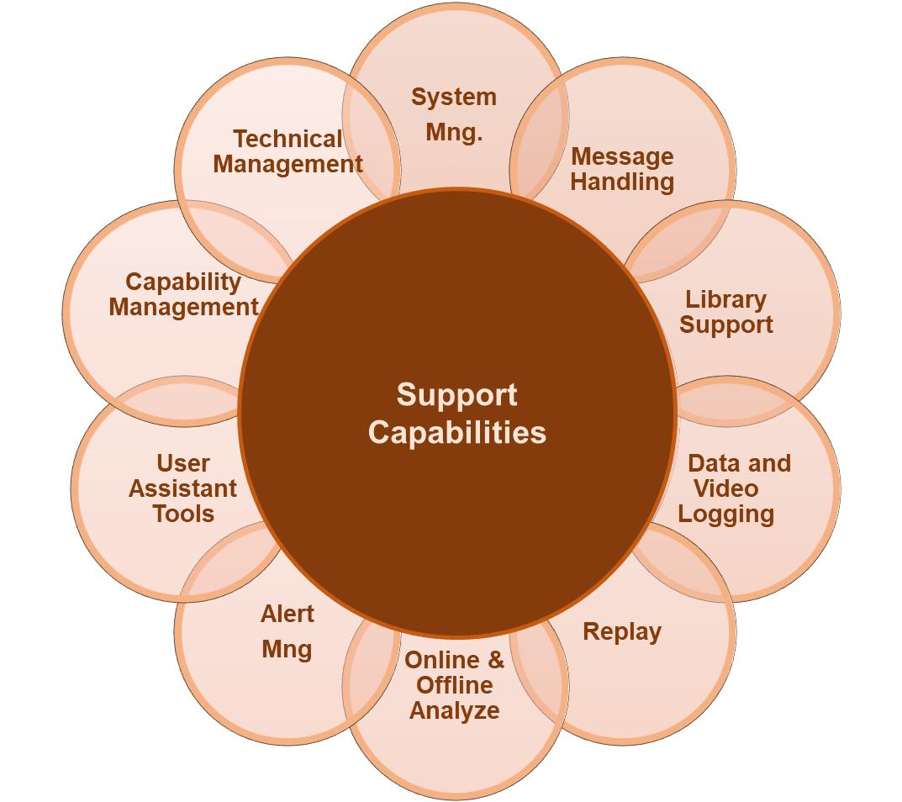
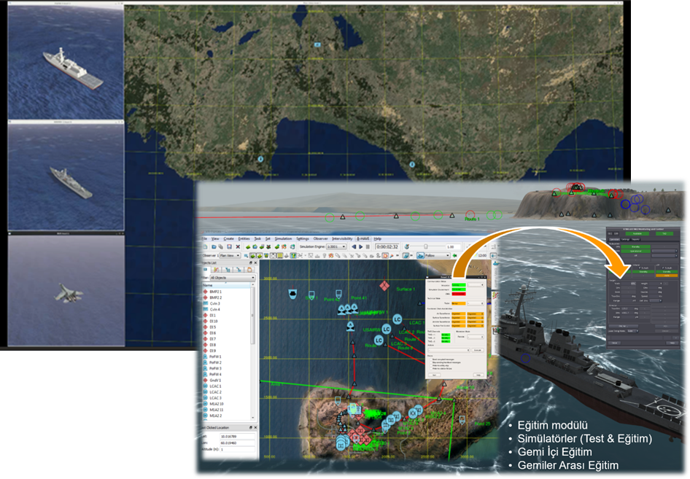
CAPABILITIES
ADVENT provides all the capabilities of a modern CMS.
  Advanced training capabilities offered in virtual and real environment.
  Supported with real weapon/sensor systems simulators.
  Fully interactive training environment.
  Single ship CIC training / Joint force trainings with NEC.

Slide 14

Decision Support System
DSS
Rule Engine
Operator defined rules
Track database
Tactical situation
  Rule based decision support system
  Decision support for
    Threat evaluation
    Identification and classification
    Execution of operations
  Area access control
  Supported with alert warning
Decision
Support

Slide 15
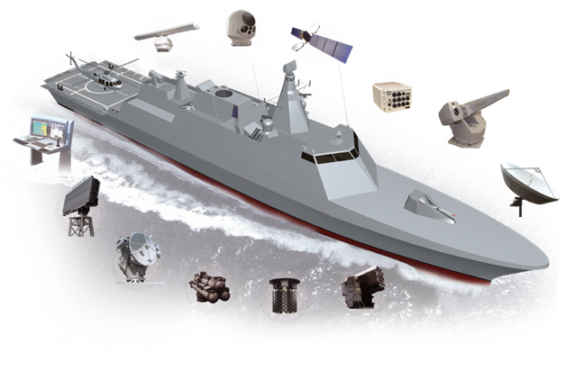
Weapon & Sensor Entegration
CMS INTEGRATION
  Integrated to more than 95 systems
  Flexible & Dynamic integration model
  Plug play like approach with runtime registry mechanism
  Fully integrated systems (SONAR, ESM, TDL and FCS)
    reduces integration costs
    provides redundancy

Slide 16
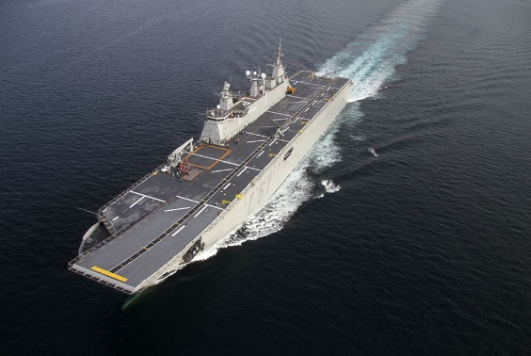
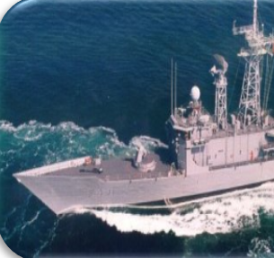
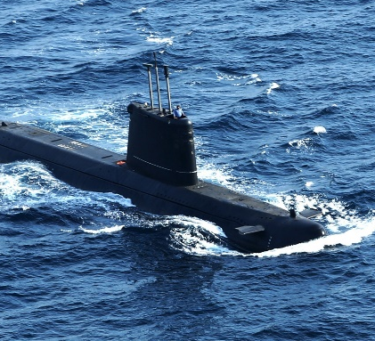
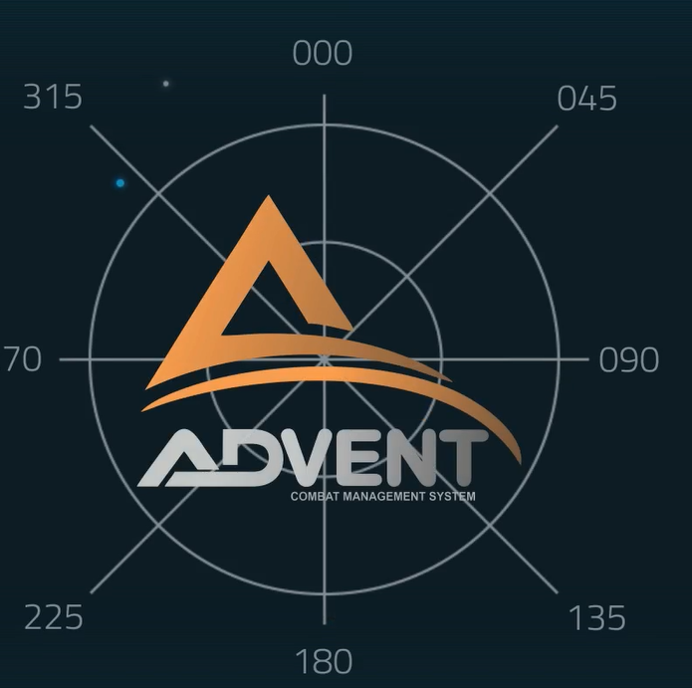
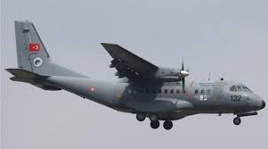

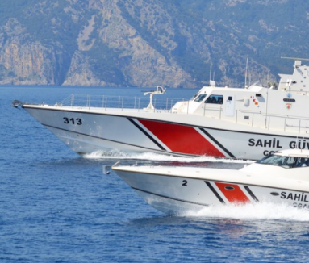
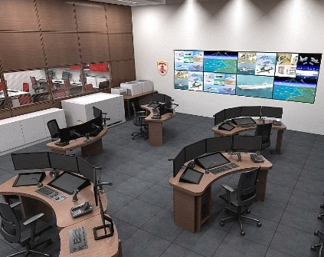
Network Enabled Capability
Success in naval operations requires;
  strict coordination and fast data exchange
  interoperability among platforms
Interoperability requires;
  convenient infrastructure
  communication environment
  Interoperable software - ADVENT

Slide 17
Network Enabled Capability
With NEC it is aimed to;
  Jointly be aware of the situation in the area of operation
  increase the speed of command
  increase the rhythm of operation
  make the naval force more effective
  establish self synchronization among the platforms
FORCE MULTIPLIER, GAME CHANGER

Slide 18
Network Enabled Capability
NEC is FORCE MULTIPLIER - GAME CHANGER
Common Engagement
Common Training
Common Operation
ADVENT NEC capability is an important asset to perform
cross-platform interoperability
the entire ADVENT force fights, trains and operates as a Single Unit

Slide 19
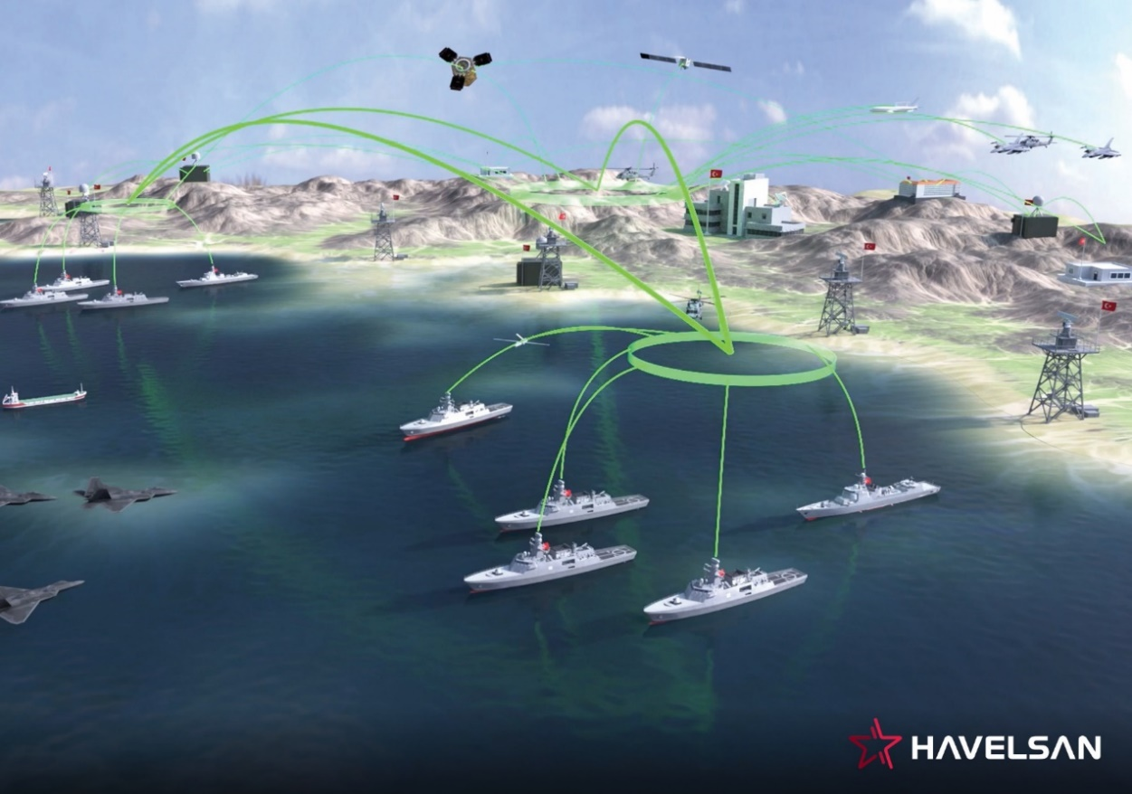
Network Enabled Capability
Common Engagement
  Common threat evaluation
  Central planning and distributed execution of anti air warfare,
  Optimized use of warfare resources
  Increased effectiveness of anti-air warfare
  Providing engageable track data to other platforms for engagement;
    During radar silence
    In case of sensor malfunction
    To increase weapon coverage
  Goalkeeper capability for HVU’s,
  Sharing battle damage assessments

Slide 20
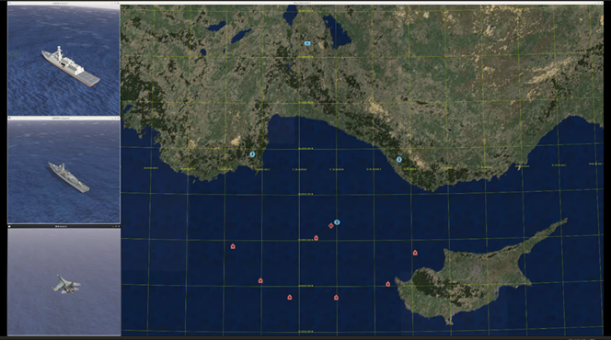


Network Enabled Capability
Common Training
  Shared virtual environment, with synthetic objects
  System simulators interact with simulation environment
  Controlled by a training center or a platform
  Interactive joint training capability
  Simulator supported on board training system
Advanced training capabilities are offered both in virtual environment and in real environment. Trainings can be carried out on a single platform basis and can be realized together with other platforms that are operated with NEC.

Slide 21


Network Enabled Capability
Common Operation
Ship-oriented CMS Capabilities (navigation plans, operation plans, search and rescue, etc.) will be planned and presented by taking into account other platform capabilities where operations are carried out jointly.

Slide 22


TACTICAL DATA LINK (TDL)
Key Features
  Built-in TDLs
    NATO Links- Link 11/16/22, JRE, SIMPLE, VMF
    National Links, Link-Y
    LINK-H
  Fully customizable Native Link Capability
  No additional HW/SW for processing link
  Fully integrated multilink capability
  Unlimited number of subnets
  Simultaneous access to different link systems
  Data forwarding among TDLs
  Integration of legacy link systems
Fully Interoperable TDL

Slide 23

CMS approach of Interoperability
Interoperability aims for units to carry out operation, training and warfare
together in high coordination.
To achieve this goal, units need to exchange large-scale data very fast.

Slide 24
CMS approach of Interoperability
Interoperability requires
  Channels to communicate
  Exchange of vast amount of data
  Common understanding of data
Units must have
  Common data interfaces
  Common data definitions
  Common data exchange media
  No conversion or adaptation of data
To succeed this
Standard Interfaces
Same CMS

Slide 25







CMS approach of Interoperability
Same CMS with different configurations
KALYON
What is common?
  Common Services
    TM, SM, DRC, AM…
  Common Capabilities
    NAV, C&I
  Common Data Definitions
    International Standards
  Common Message Interfaces
    STANAG 5516/5518/4586/4609..
UFUK
MARTI
ROTA
YILDIZ
What is different?
  Platform Specific Capabilities
    Warfare, Air Control …
  Platform Specific Weapons/Sensors
  User interactions
MUREN

Slide 26
CONCLUSION
ADVENT CMS
FLEXIBLE
SCALABLE
RELIABLE
MODIFIABLE
PORTABLE
SECURE
AFFORDABLE
PROVEN

Slide 27
Thank you

