Slide 1
Availability Improvement – Project Resolution Overview Keith Beckett CBE – SDA Technical Director

Slide 2
Why?

Slide 3
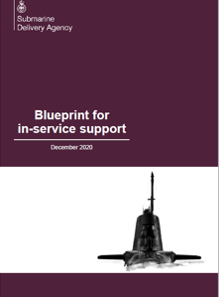
Project Resolution – Where it began
Project Resolution was stood up formally on 1 April 2021
The programme was formed to lead the cross-enterprise implementation of the Blueprint for In-Service Support
This document recommends a sustained effort to look into root causes and longer term initiatives alongside improving the current availability position with enterprise collaboration and data driven decision making at it’s heart

Slide 4
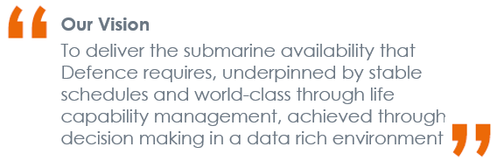
Vision

Slide 5
SDA28 Strategy – Focus areas & change definitions
Strategic Change:
Cross-cutting SDA or enterprise-wide improvement
New team set up & time-bound
High benefits or high dependencies on other improvements with cumulative high benefits
Change will be owned by a Director who is seen as accountable, but it is likely to require all Execs to sponsor/lead the change to assure engagement and achievement of benefits
BAU - Continuous Improvement:
Improvement of existing way of working
Existing team either not time-bound or likely to exist >3yrs
Led by TL/Director who have existing agreed responsibility; unlikely to need all Execs actively championing the change to ensure adoption
Strategic or BAU projects may exhibit some or all of the above characteristics;
Strategic Projects move from Strategic Change to BAU once complete – i.e once the change is adopted and embedded, it is usually necessary to refine and continue to embed
Project Resolution is structured around the SDA28 aims and change definitions

Slide 6
What?

Slide 7
We deliver under the following areas of scope
The following workstreams are all looking to improve areas that put pressure on submarine availability

Slide 8
Enterprise activities tackling the scope
Continuous Improvement
Strategic Change
MAINTENANCE OPTIMISATION
EQUIPMENT AVAILABILITY
WATERFRONT DELIVERY
AVAILABILITY ENABLERS
Maintenance Planning
Design Authority Requirement Reduction
Spares Provision & Operational Deficiencies Reduction
Devonport
Clyde
In Water Engineering
Navy Delivery
Best For Enterprise
Data
Asset Mgt
Project 1
Project 1
Project 1
Project 1
Project 1
Project 1
Project 1
Project 1
Project 1
Project 1
Project 1
Project 2
Project 2
Project 2
Project 2
Project 2
Project 2
Project 2
Project 2
Project 2
Project 2
Project 2
Project 3
Project 3
Project 3
Project 3
Project 3
Project 3
Project 3
Project 3
Project 3
Project 4
Project 4
Project 4
Project 4
Project 4
Project 4
Project 4
Project 5
Project 5
Project 5
Project 5
Project 6
Project 6
Project 6
Project 6
Project 7

Slide 9
Data Analytics & Insights
“To enable those in support of Project Resolution to make better, data-driven decisions around Submarine availability improvement focused activities”
Project Resolution’s Data Integration Team have been focusing on Data Analytics and Insights, utilising Palantir’s Foundry tool – this capability allows us to structure data gathered from across the enterprise into a model with associated relationships between objects, which we can then take advantage of to make better data-driven decisions
Our aspiration is to move into the predictive/prescriptive analytics space and develop a predictive ‘Process Digital Twin’
Foundry
Single
Source
of Truth
Prescriptive
Analytics
Predictive
Analytics
User
Population

Slide 10
How?

Slide 11
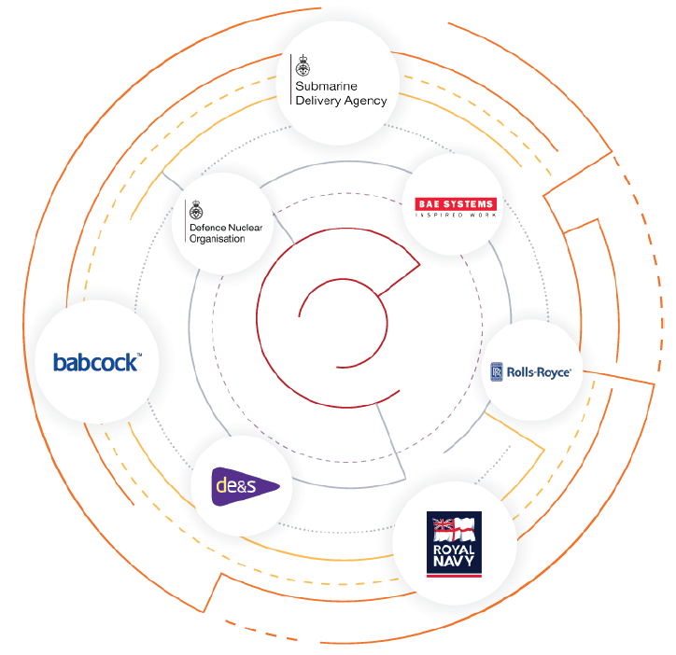
Multiple partner contributions to our scope
Data Integration &
Asset Management
Waterfront
Delivery
Navy
Delivery
Best for
Enterprise
Equipment
Availability
Maintenance
Optimisation

Slide 12
Availability – Governance strands and inputs
SDA Performance
Navy Command Capability
Submarine Delivery
Enterprise
Pan CADMID
Pan DLOD
Pan Enterprise
Defence Support Strategy
Pan Defence
Resolution
Core Team
Optimisation Process
Data
Key
SDA
Industry
Wider MOD
Navy Command
Notes:
Achieving Availability improvement requires multiple areas of the enterprise to come together around a common goal

Slide 13
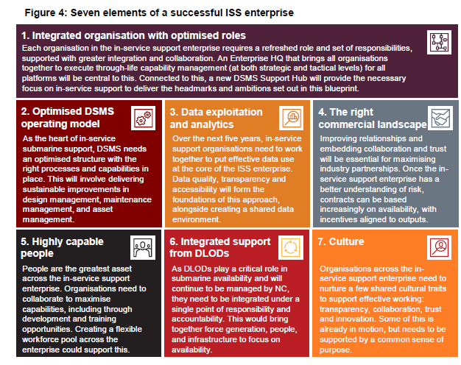
Building a successful in-service enterprise
No one partner can deliver the level of change, improvement and stability alone
The Blueprint description of a successful enterprise focuses on Enabling activities:
Joint teams and clear roles/responsibilities for all org’s
Through life capability management
Optimised organisation
Shared data used to inform decision making and status
Availability focused contracts
Highly skilled, flexible, collaborative workforce
Integrated Defence Lines of Development activity
Culture behind a common purpose
We need to grow these Enablers both across enterprise stakeholders and the submarine lifecycle
This is beyond the individual scope of Project Resolution or even the SDA, so it’s vital that we create an inclusive, best for enterprise approach to enabling activities

Slide 14
When?

Slide 15
Roadmap to 2025
2025
Increase time available to the operator
Our 2025 end state represents that required by the Royal Navy
Narrative:
We will deploy a number of availability improvement initiatives under the defined areas of scope
As those initiatives mature it will start to have an impact on our 4 target areas
Hitting these targets will help us achieve our 2025 Submarine availability end state
Waterfront Delivery
Equipment Availability
Maintenance Optimisation
Availability Enablers
A number of specific targets have been set against these 4 headings
Icons represent the focus areas that initiatives will be launched under

Slide 16
Our mission: To deliver available and capable submarines for the Royal Navy in defence of the Nation

