Slide 1
Successfully Integrating Complex Systems
for Submarine Programmes
Chris G Jones, Engineering Manager

Slide 2
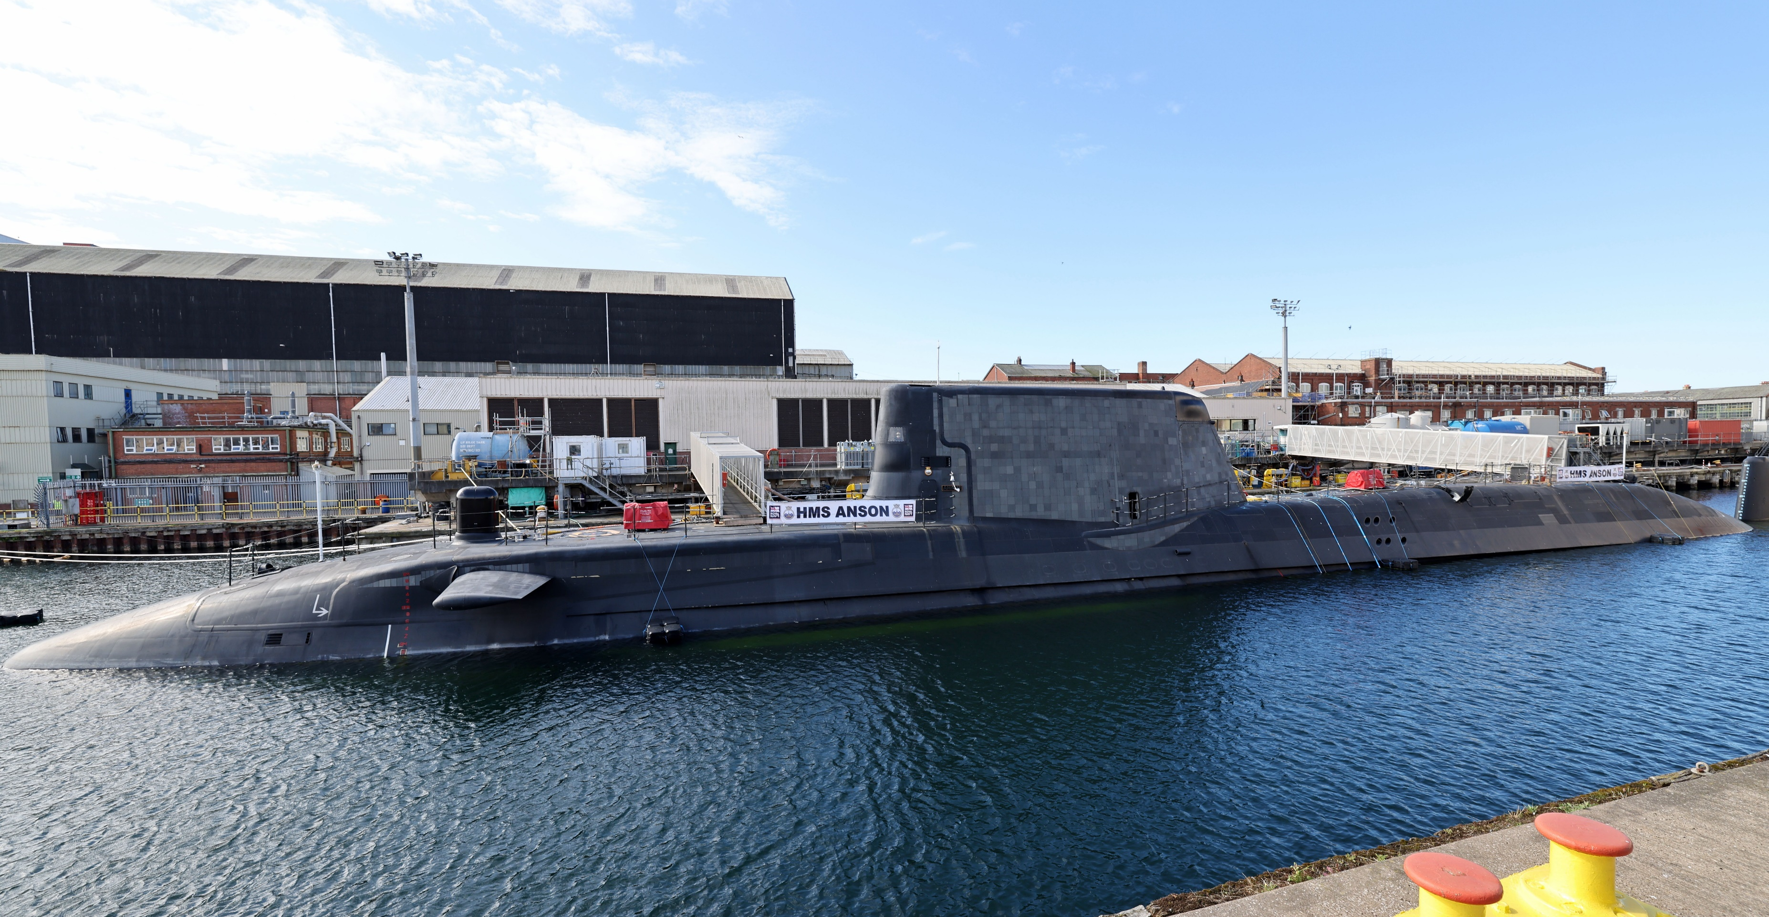
Modern submarines…
Complex
Integrated
Increasing use of platform wide software
UK MOD © Crown copyright 2022
Systems engineering can help, but how?

Slide 3

So what is systems engineering?
Systems Engineering is a way of designing and managing complex systems to make sure they work well and meet their intended goals. It involves looking at the big picture and understanding how different parts of a system fit together and interact
Think of it like building a puzzle. Systems engineers help figure out what the puzzle should look like, how the pieces should fit together, and how they should function as a whole

Slide 4





So what is systems engineering?
Systems Engineers consider various factors…
Cost
Reliability
Safety
User Needs
Performance
…and many more
It's about taking a systematic approach to problem-solving and ensuring that all the pieces of a system come together smoothly to achieve the desired outcome

Slide 5
The complexity and scale challenge…

Slide 6
The information space

Slide 7
The information space

Slide 8
The information space

Slide 9
The information space
The sheer quantity of information and data is vast
And that’s just part
of the equipment DLOD

Slide 10
The pan-DLOD issue

Slide 11
Timing is everything
2023
2024
2025
2026
2027
2028
2029
2030
…
2050
Concepts & Doctrine
Equipment
Information
Infrastructure
Interoperability
Logistics
Organisation
Personnel
Training
Exit Barrow
Range

Slide 12
What do we do about it?

Slide 13
Some modern methods explained
Model Based
Systems Engineering
A formalised, coherent and consistent toolset to clarify the requirements, structure, behaviour and parameters of a system
Model Based Design
Formalised method during the design lifecycle most commonly applied to control systems
Digital Twins
Digital representation of a system which accurately mimics a physical system

Slide 14
Model Based Systems Engineering

Slide 15
Model Based Systems Engineering
Model
Based
Systems
Engineering
In-Service Decommissioning
40+ years?
MBSE provides a centralised source of information throughout the lifecycle of a system
Traceability is built in

Slide 16
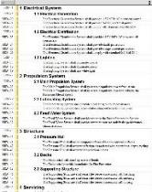
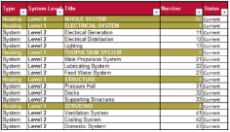
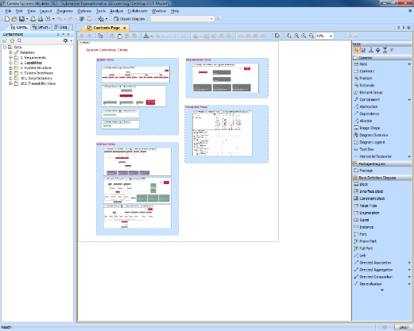
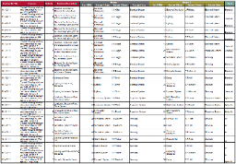
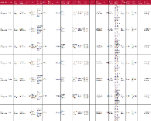
MBSE – Defence Example
System List
(Excel)
Requirements
(DOORS)
System Interface List
(Excel)
Design Issues List
(Access Database)
The MBSE Environment

Slide 17
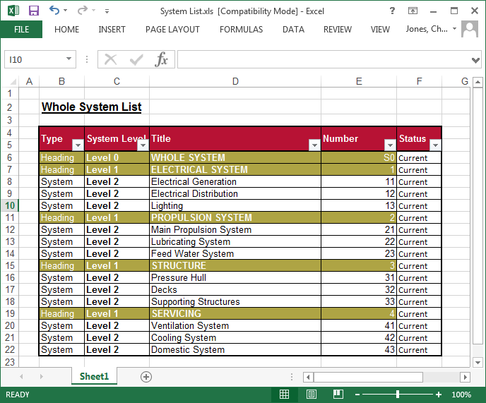
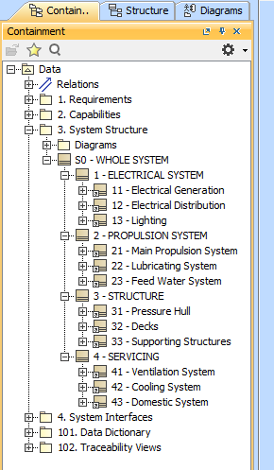
MBSE – Defence Example

Slide 18
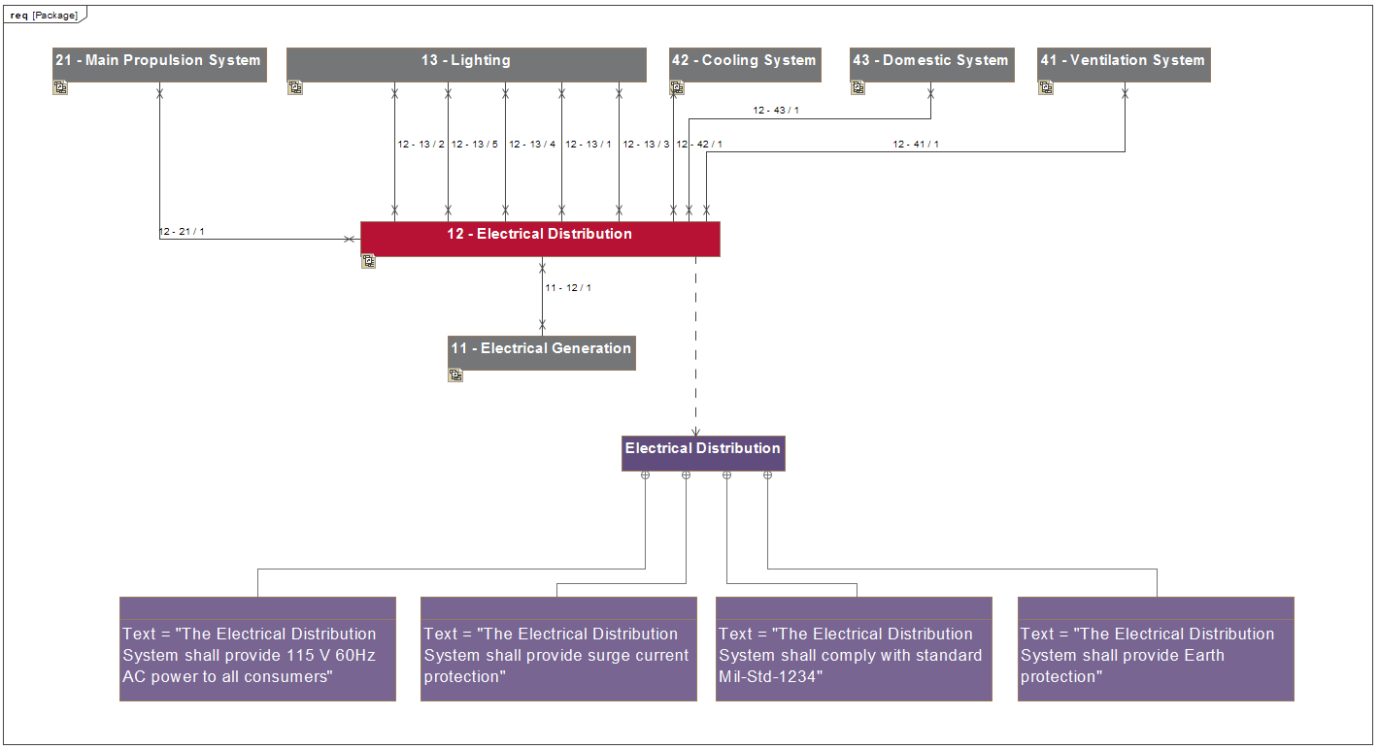
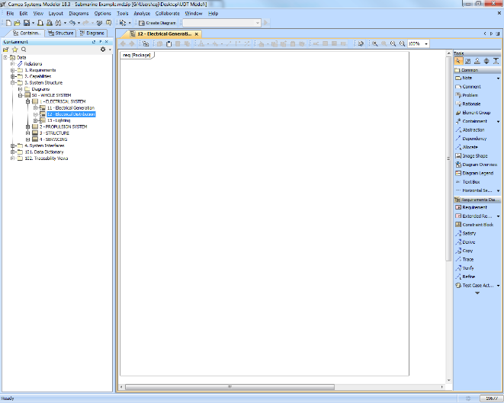
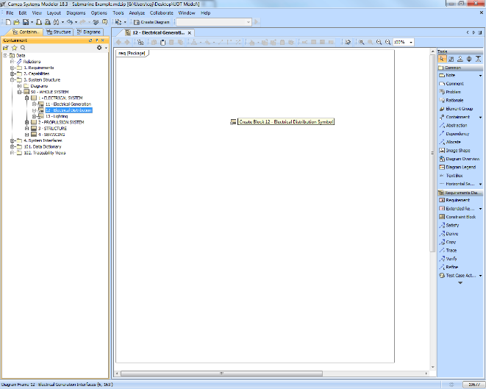
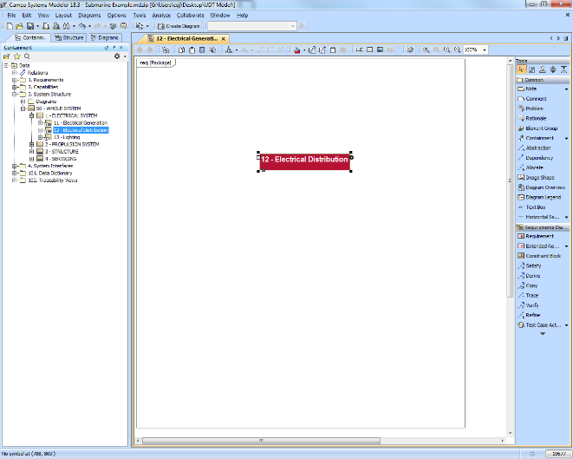
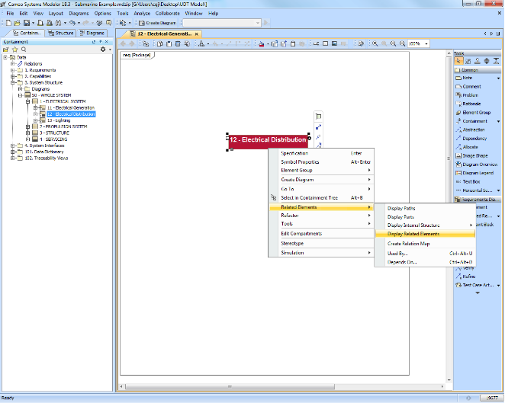
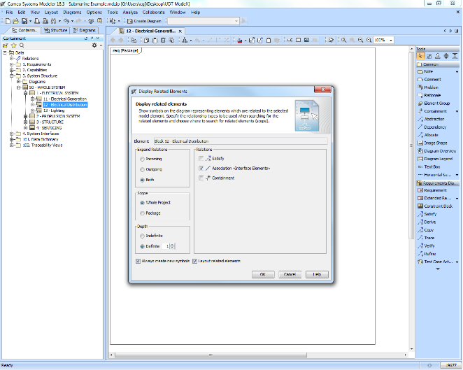
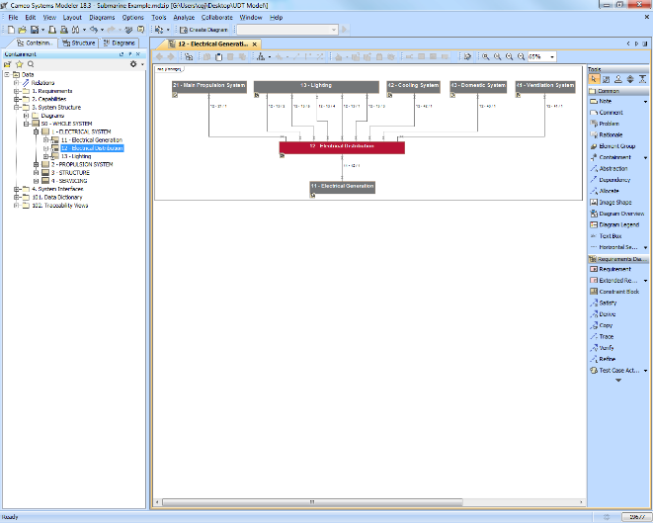
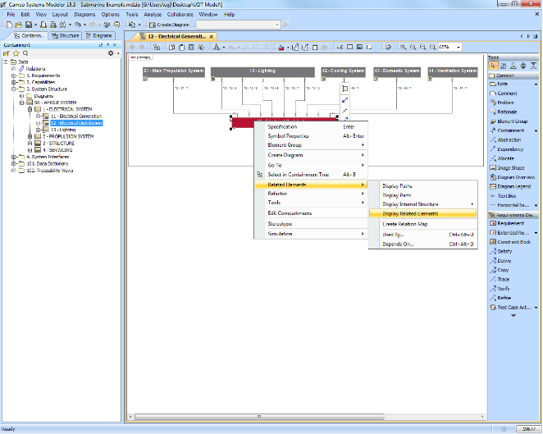
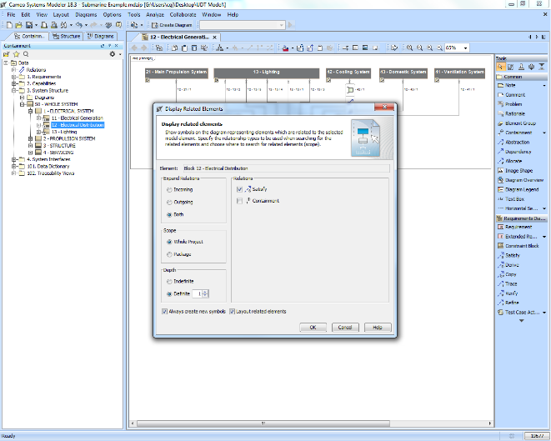
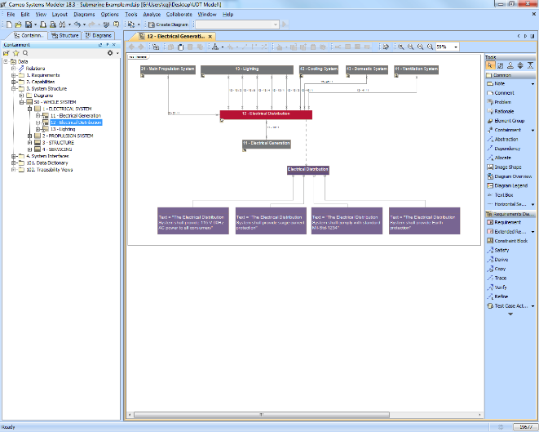
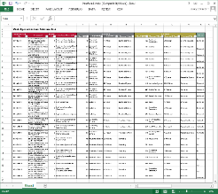
MBSE – Defence Example
One diagram which conveys:
  System information
  System interfaces
  Related system requirements
Taken from multiple data sources and combined to facilitate understanding
Each connection is a row from the interface list spreadsheet
Drag and Drop

Slide 19
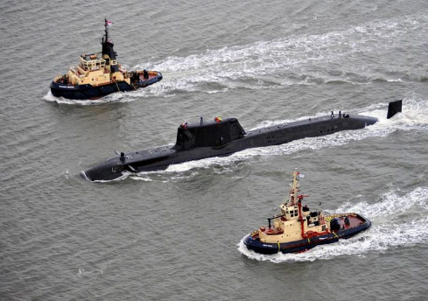
MBSE – Defence Example
The benefits:
  Better understanding of the totality of information
  Understand design maturity
  Self-generate analysis documentation
  Understand where key system integration risks
  may lie and the potential severity
  Increase awareness of likely issues and actions
  which could impact build and testing schedules
© Crown copyright

Slide 20
Model Based Design

Slide 21

Model Based Design
Overall aim is risk and cost reduction for:
  Requirements
  Functions
  Architecture
  Performance
  Integration
  Simulation
Develop models early and use often for successful development of complex systems as rectification of errors in the requirements is increasingly costly throughout the system life cycle

Slide 22
Model Based Design
Develop models early and use often
Fixing errors in the requirements is increasingly costly
Model in the Loop
Integrated Hardware Testing
Rapid Controller Prototyping
Hardware in the Loop Testing
Software in the Loop Testing

Slide 23

MBD – Modelling a Generic Submarine
Example development path:
  Plant model
    Hydrostatic
    Hydrodynamic
  Controller development
    Manual and automatic controls
    Beginnings of fault insertion
  Model validation & limitations

Slide 24
Digital Twins

Slide 25
Digital Twins
Virtual
Co-development of a system (or system of systems) throughout the development lifecycle
In-service
Physical

Slide 26
Summary
We can solve our puzzle but we need to have confidence from the outset in the Systems Engineering processes being adopted
The virtual world is an asset from the outset, not just once a design is established
Virtual + Reality (not Virtual Reality) is a key enabler to delivering success
UK MOD © Crown copyright 2022

Slide 27
Thank you
Chris G Jones
Engineering Manager
c.g.jones@fnc.co.uk

