Slide 1
”The Technical Platform” Underwater Weapons and Unmanned Systems
By Anders Svensson Product Manager Torpedo Systems

Slide 2
Topics
Introduction
History
Products/Capabilities
Technologies that are shared
Future Challanges
Q&A
End

Slide 3
Introduction - Anders Svensson
Samples from history during 27 years at FMV
FMV, 1996-2007 in the sonar branch;
PM Naval UW-sensor R&D
PM Noise Range Procurement
PM Naval Sonar Acoustic Post Processing System (SAPPS) Procurment
Swedish Repr Naval Systems WEAG
Chairman UCAC
CGE EDA
FMV, 2007- in UW weapons branch
Product Manager Torpedo Systems
Torpedo Defence
AUV 62, -SubROV
Torpedo Integration.
PM UW-Wepons Sustainment
Stearing Commity EDA UW-Coms

Slide 5
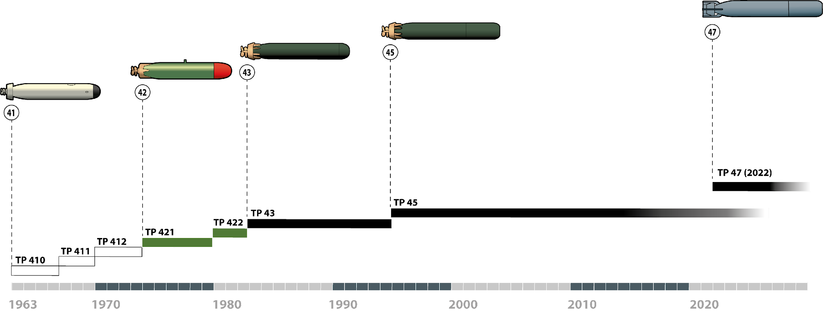
Swedish LWT history Timeline 1963–

Slide 6
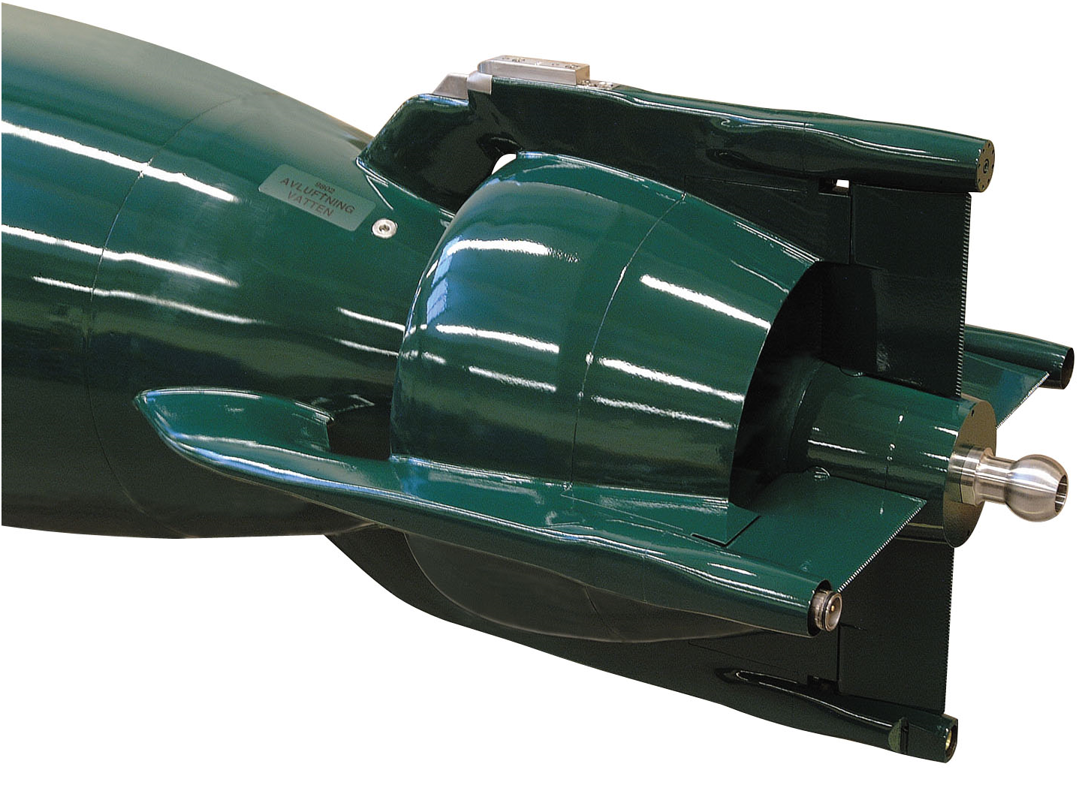
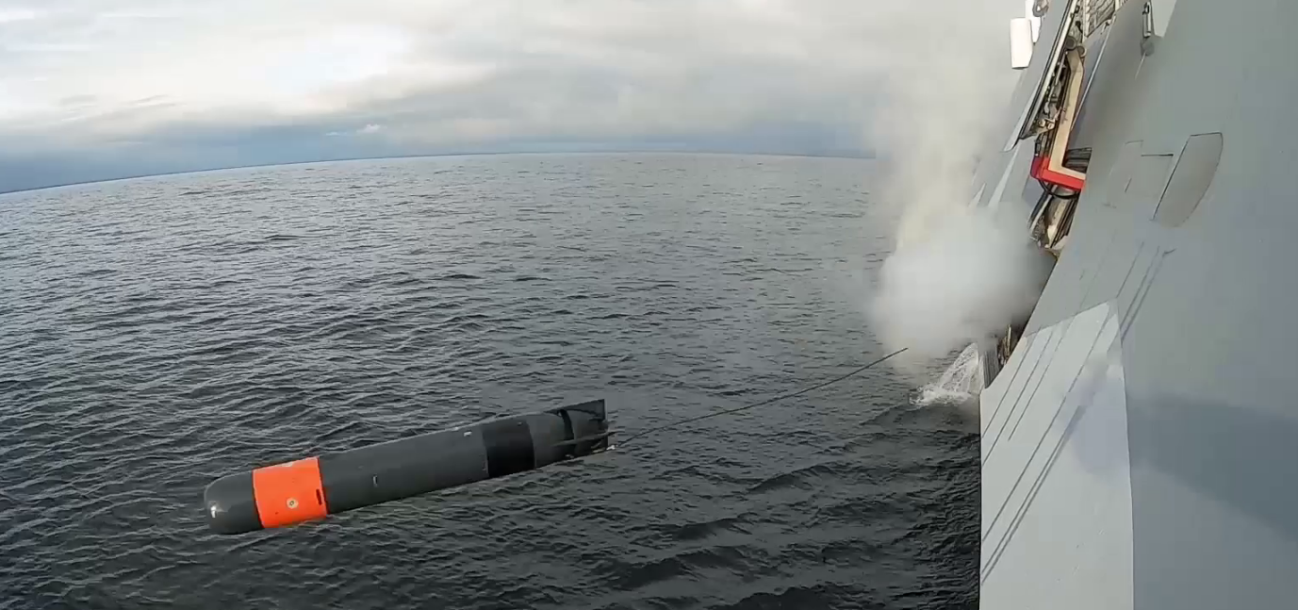
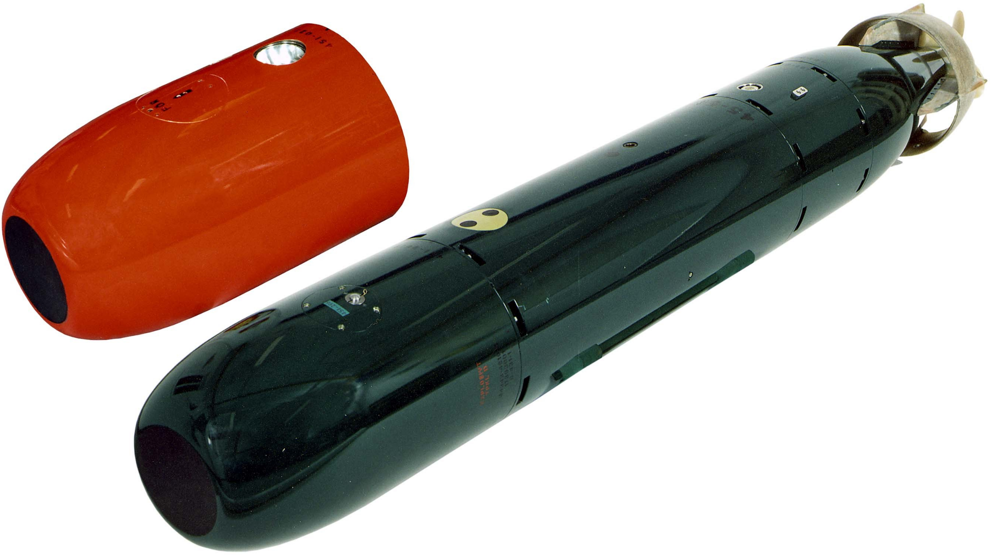
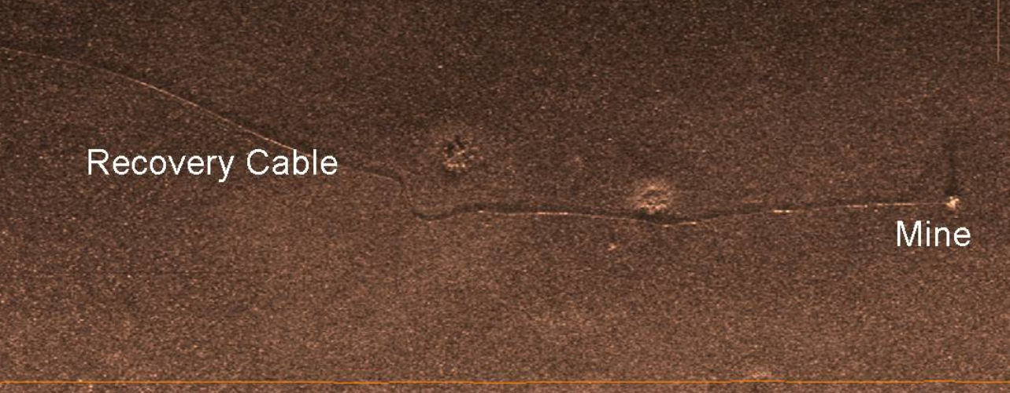
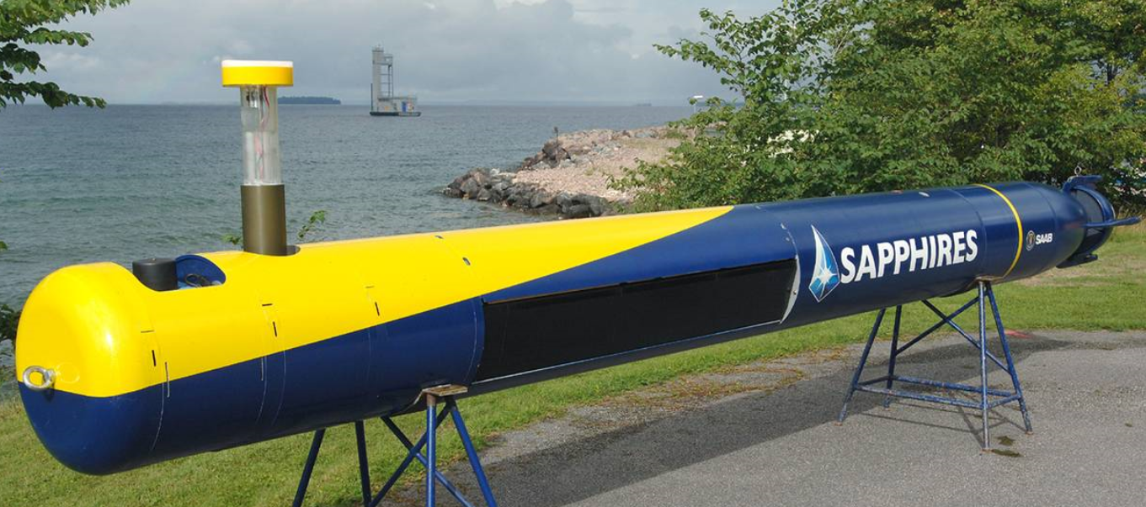
Products in The Underwater Weapons Portfolio
Lightweight Torpedos
Heavyweight Torpedos
Sea Mines
Autonomous Unmanned Underwater Systems (AUV 47/AUV 62)
Remotely Operated Underwater Systems (SubROV)
Signature Ranges, degausing-, deperming-, component-, noise ranges
Sustainment of Legacy Underwater Systems

Slide 7
Technologies – examples of need
Systems Engineering
Environmental Know How
Doctrin
Energy Systems, battery systems, fuel cells, metal burning
Hydrodynamics, propulsion, docking
Signatures, acoustics, magnetic, electric potential, chemical sniffing
Sensor Systems, target heads, AUV-sensors
Communications, wire, fiber optics, UW-Coms, RF
Navigation
Autonomy, ”AI”, Machine Learning

Slide 8
R&T and Systems Development
Technologies, Concepts, Demonstrations, R&T
Systems Development, continuity, competence, capabilities

Slide 9
Technical Platform – Soft Issues
Desires
Rapid industrial reaction times
Quickly from need to delivery
Threat Adaption During Life Cycle
EOL Management
Security of Supply
Cost Efficiency
Requires
Competence Sustainment
Continuity
Life Cycle Planning
Perception of Future Technologies
Threat Development Perception
Investments
“The technical platform is more than hardware, software and logistics support. It comes from knowledge, skills and capacity”

Slide 11
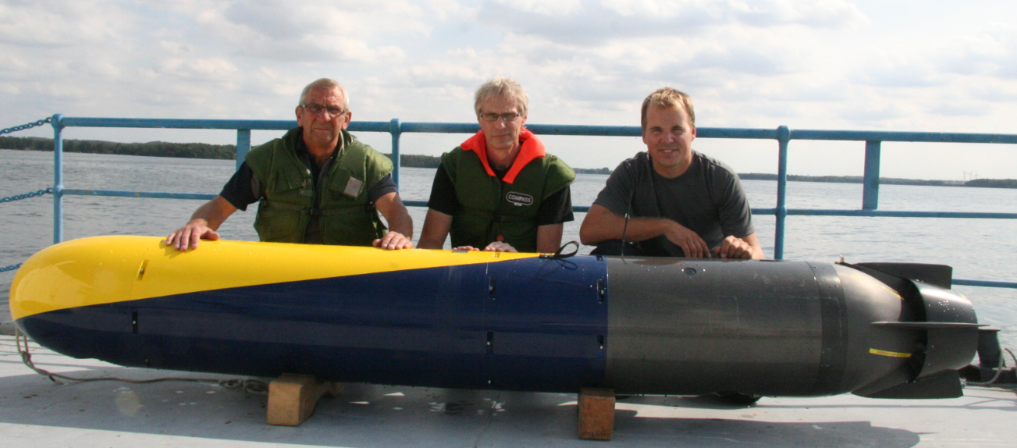
Critical success factors for Torped 47
Studies and development that sustained engineering capabilities

Slide 12
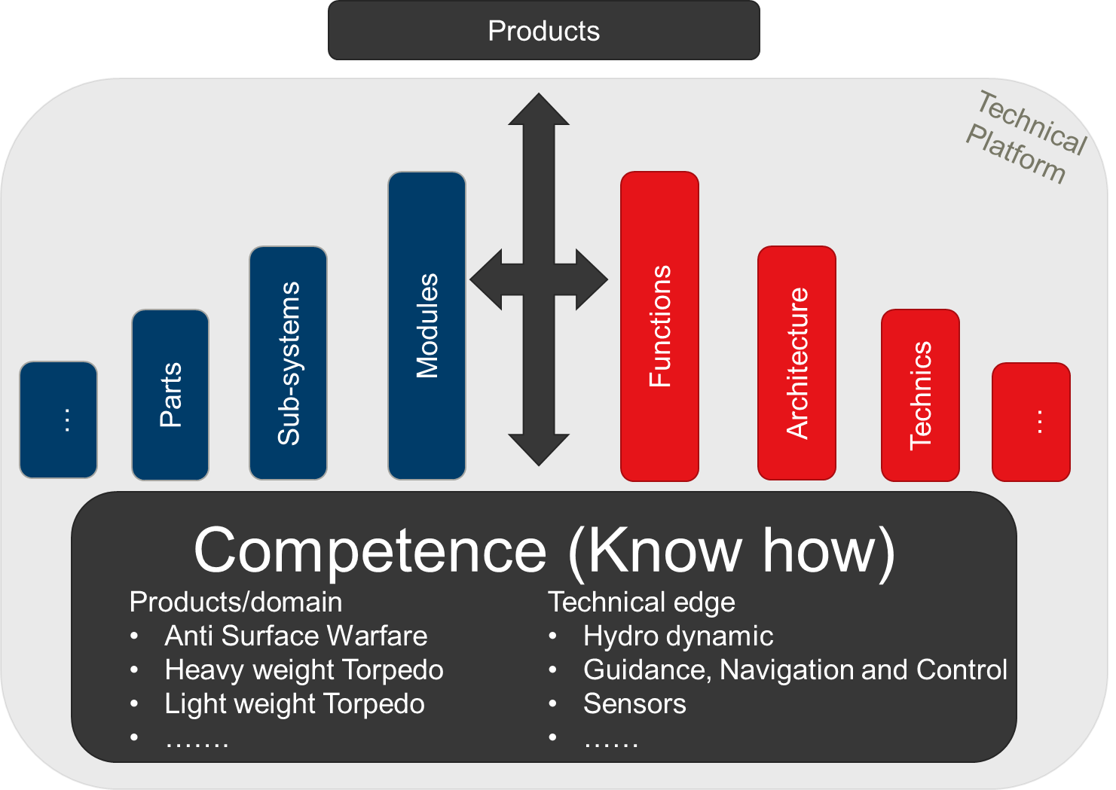
Technical Platform - Torpedo 47
The information in this document is the property of Försvarets materielverk (FMV) and must not be disclosed to any third party without FMV's prior written consent.

Slide 13
Torped 47 Development Finalised, operational
2014
2015
2016
2017
2018
2019
2020
2021
2022
2023
2024
2025
2026
2027
2028
2029
2030
2031
2032
2033
Torped 452
Pre Development
Torped 471 -> ~2050
Studies and Concepts
Evolutionary Developments
Balanced Production
Development based on new information and knowledge:
Perception of Threat Development
New Capability Requirements
Other develompement in unmanned systems and torpedo programs
Concept
Production
Development
Operational

Slide 14
Technical Platform - Torpedo 62
The information in this document is the property of Försvarets materielverk (FMV) and must not be disclosed to any third party without FMV's prior written consent.

Slide 15
Road Choises Torped 62
2023
2024
2025
2026
2027
2028
2029
2030
2031
2032
2033
2034
2035
2036
2037
2038
2039
2040
2041
2042
Software
Up-grade based on Torped 47 with up-graded thermal propulsion
Torped 621
EPOS
LTE Torped 62
Torped 622
Torped 63
Torped 63 ~2070
Torped 63 on novel future plattform
Software
Torped 621
Maintained current torpedo with up-graded propulsion
EPOS
Light LTF
Torped 621
Torped 63 based on Torped 47 technical plattform
EPOS
Torped 63
Torped 63 ~ 2060
Concept
Production
Development
Operational
The information in this document is the property of Försvarets materielverk (FMV) and must not be disclosed to any third party without FMV's prior written consent.

Slide 16
Future Challenges
Threat Perception and Development – from just manned systems towards swarms of unmanned
Signatures on Unmanned System Threat will be drastically lowered
Defense of Sea Bed Infrastructure is a huge task where technology may be one answer
Achieving collaborative tactical and technical development
To take decision to phase out mature legacy systems to make room for novel techniques
Mind Set

Slide 17
Q & A

Slide 18
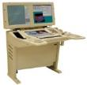
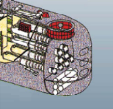
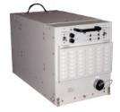
Torpedo System 47 - Definition
Sonar
Combat Management System
Torpedo
System
Torpedo
Interface System
Torpedo Tube
Communication System
Torpedo
The information in this document is the property of Försvarets materielverk (FMV) and must not be disclosed to any third party without FMV's prior written consent.

Slide 19
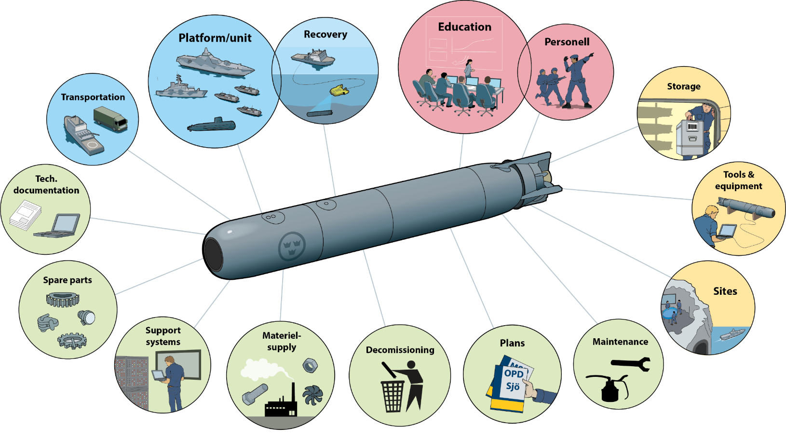
Torpedo System 47 - Definition
The information in this document is the property of Försvarets materielverk (FMV) and must not be disclosed to any third party without FMV's prior written consent.

Slide 20
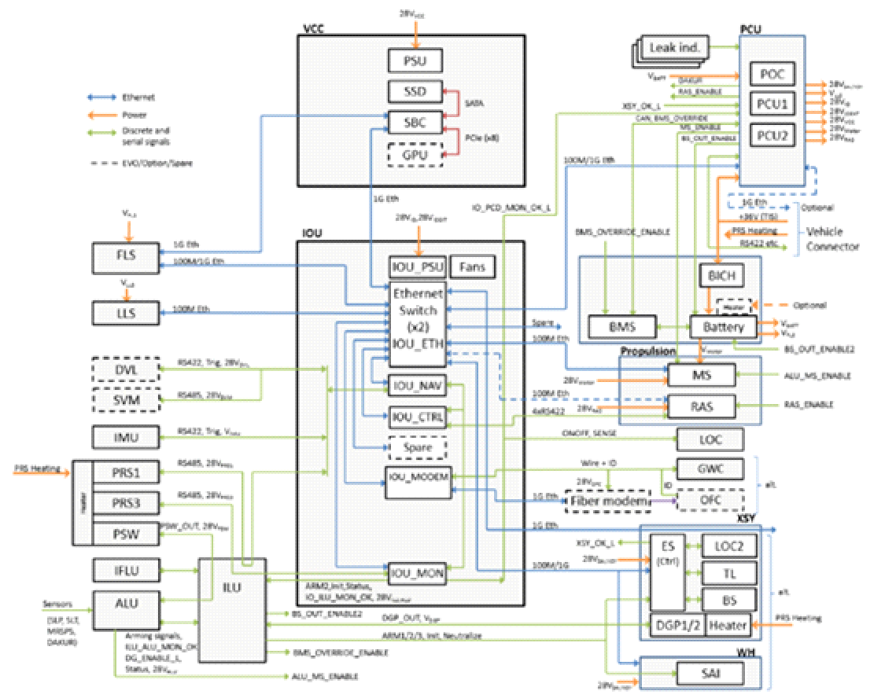
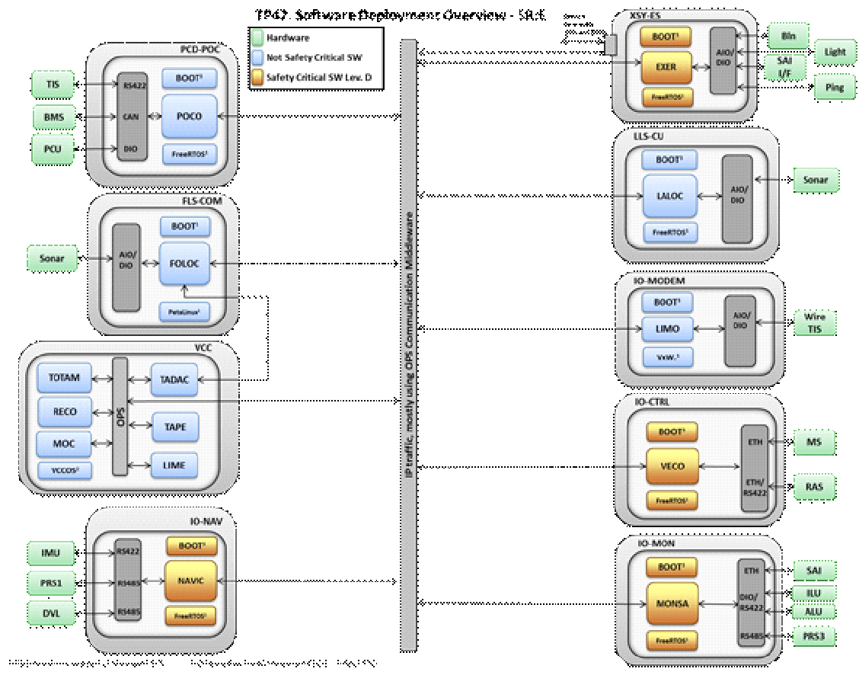
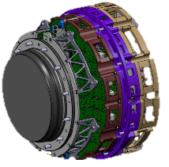
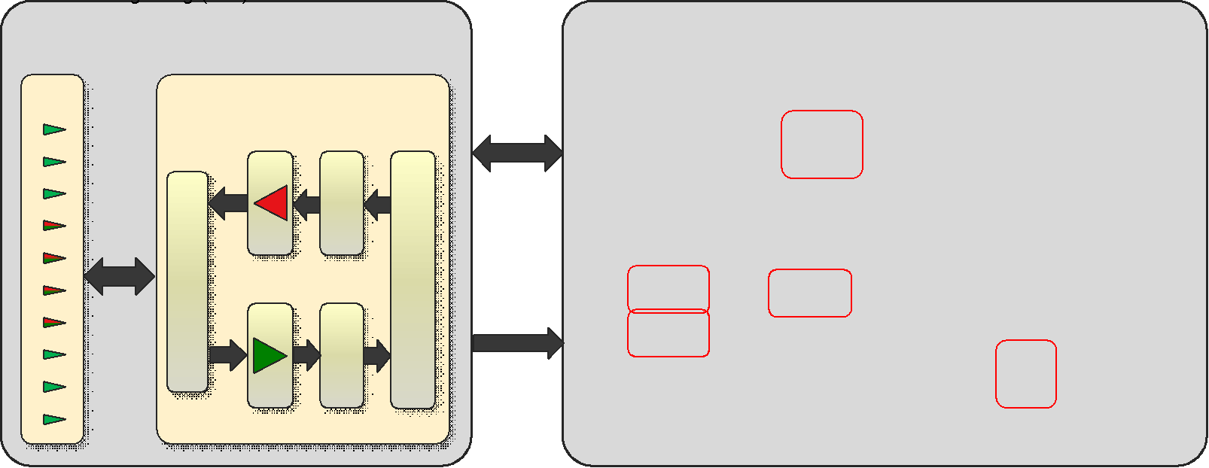
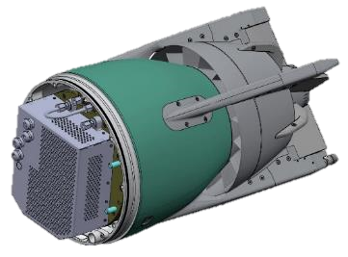
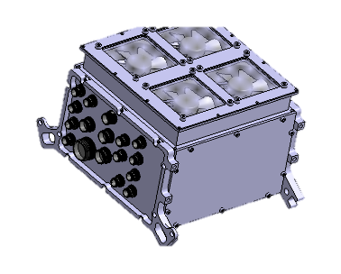
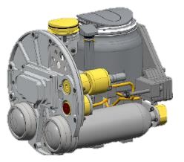
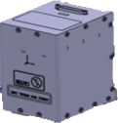
Technical Platform
Overall Torpedo Architectures (HW and SW)
Homing System (MS5)
Propulsion System Modelling and Design
Various System Components and Solutions
IMU IO-Unit Recovery System
The information in this document is the property of Försvarets materielverk (FMV) and must not be disclosed to any third party without FMV's prior written consent.

Slide 21
Modular design – Family – Techical plattform
2016
2017
2018
2019
2020
2021
2022
2023
2024
2025
2026
Torped 45
Torped 47
Torped 47
Torped 62
Torped 62
Torped 62
AUV47
AUV62
AUV62
AUV62
MS2
Ers F42
SubRov
SubRov
TIS
TorpG SIM
The information in this document is the property of Försvarets materielverk (FMV) and must not be disclosed to any third party without FMV's prior written consent.

Slide 22
INTRODUCTION

