Slide 1
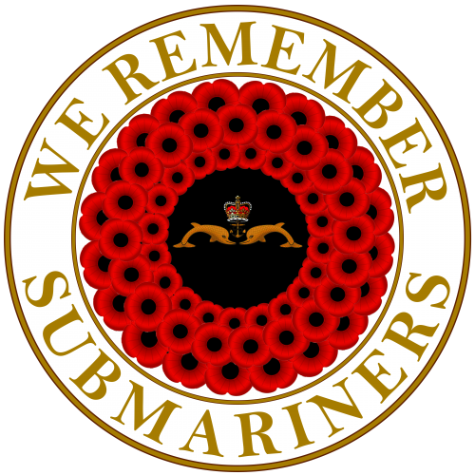
Safety Submerged
Supporting crew survival with mission critical gas analysis solutions
Presented By: Nathan Stevenson - Systems Architect
Proud sponsors of
We Remember Submariners
Notes:
Good morning
Thank you for taking the time to join this presentation
I’m Lee Kerswell, Sales Manager at Analox
A company specialising in gas detection for hostile & hazardous environments
Today I will be presenting our philosophy for supporting crew survival with mission critical gas analysis solutions

Slide 2
Themes
Submarines are changing - a quick overview
Legislation around occupational exposure levels is changing
The expectations of submariners are changing
Notes:
Hi.

Slide 3
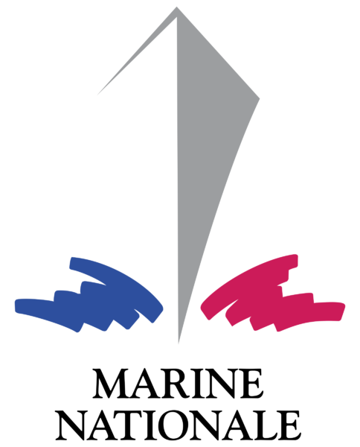
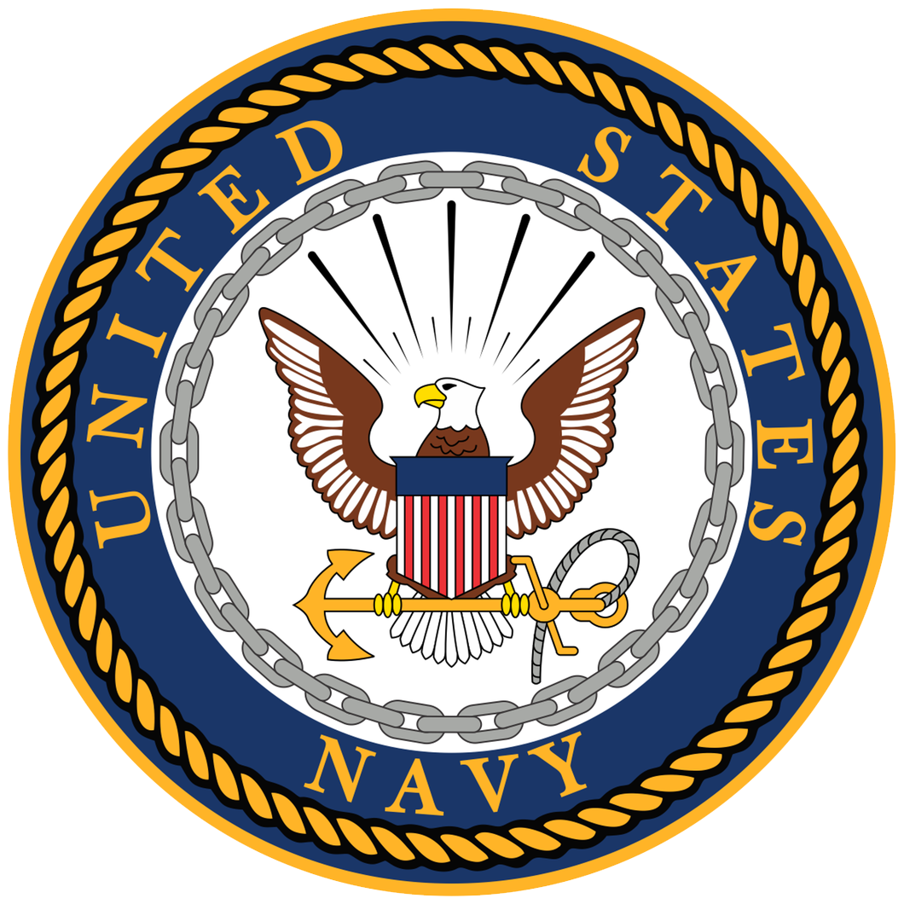
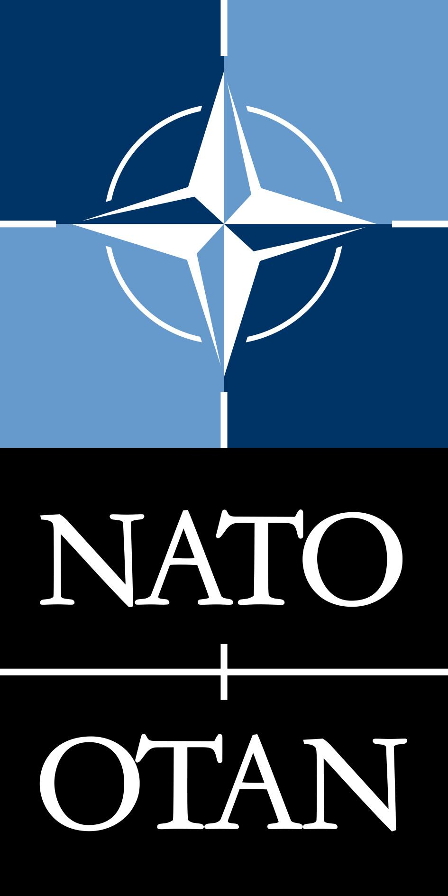
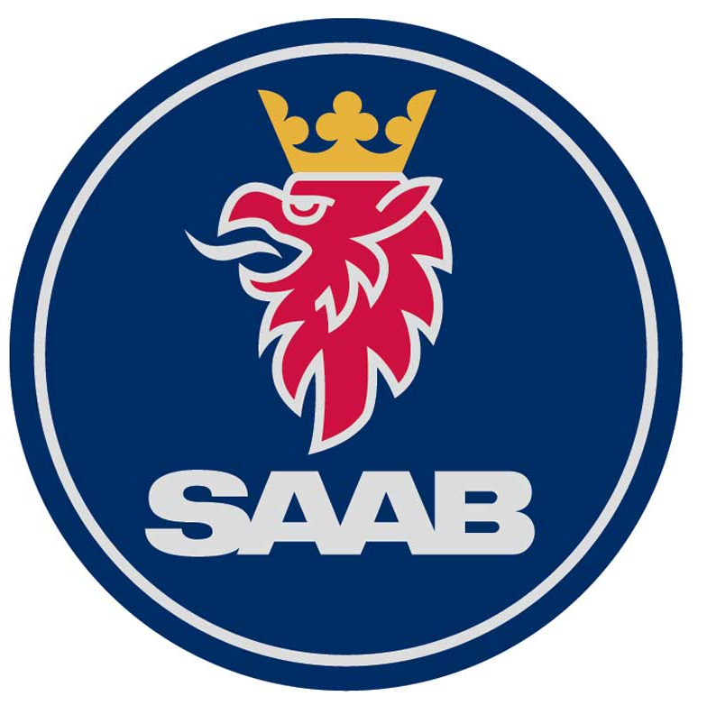
Who we are
30 years experience in diving and submarine air monitoring
Bespoke design solutions to meet submarine architecture & operational requirements
Cradle to grave product design and support
Compliant with UK Export and US ITAR controls
Expertise in hyperbaric sensors
Through life support & training
Sensing capabilities including toxic, flammable and inert gases
Proven Operational Business Management aligned to SC21
Notes:
Founded in 1981, we have become a trusted partner to our customers in a variety of industries including Submarines, and submarine rescue systems, diving, hospitality & beverage, laboratories and manned spacecraft.
With our in-house research, development, and manufacturing this allows us to offer both off the shelf (COTS) and bespoke solutions for our customers as well as training & through life support.
Analox was born out of the commercial diving industry back in the 80s, monitoring the atmosphere in the saturation diving chambers, where the divers lived at high pressure for up to 28 days, this is where we cut our teeth on hyperbaric gas sensing.
Essentially ensuring the sensors work as effectively under high atmospheric pressure as the do under ambient conditions.

Slide 4
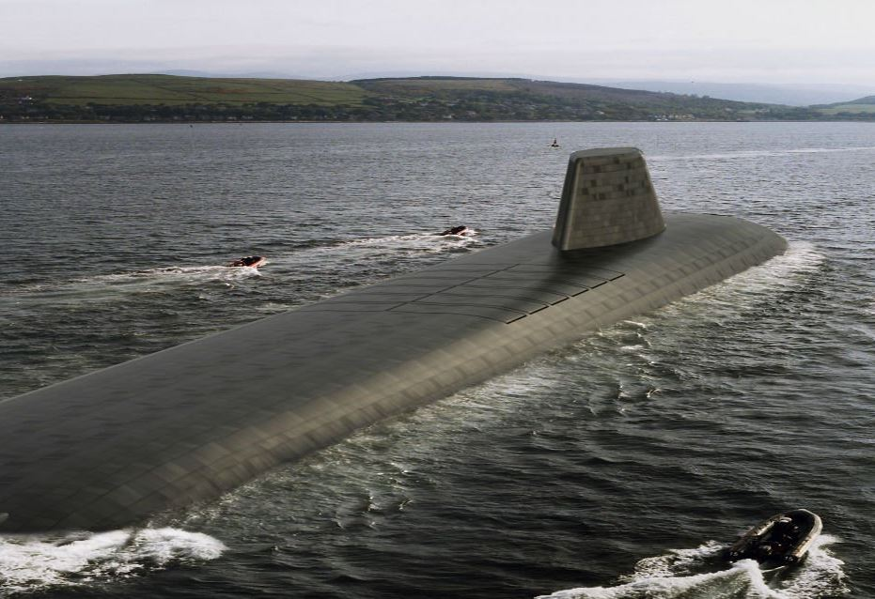
Submarines are changing
Endurance & deployment times continue to increase across all platforms.
Image courtesy of BAE Systems
Notes:
Endurance of various boats:
Diesel electrics -
AIP - 28 days is leading edge, 7 - 14 days is more standard
Nuclear boats - 60/90/120 days are routine. Will we see 200 days at some point?

Slide 5
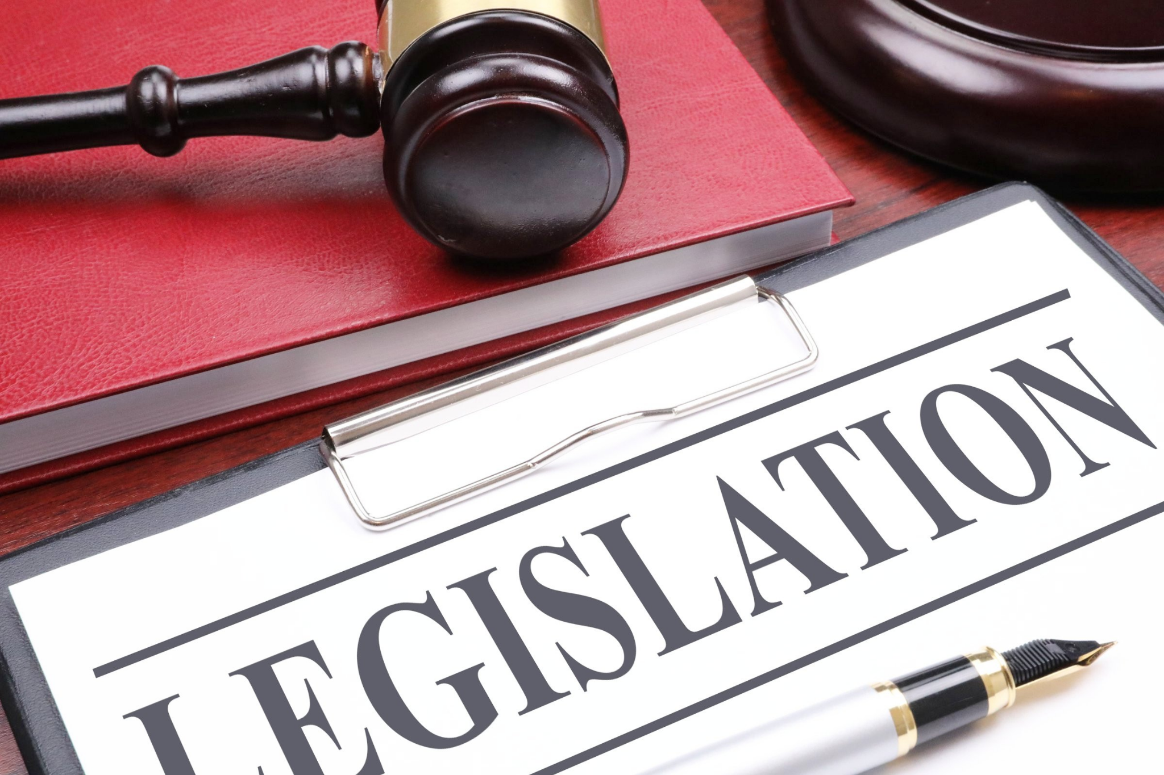
Legislation is changing
A submarine is a workplace.
24 hours a day, 7 days a week.
Occupational Exposure Levels (OEL) are falling
Guidance from UK Health & Safety Executive
So the safety of the breathable environment is becoming a serious issue.
Notes:
Sources of gases:
NO2 - Diesel engine exhaust or burning of contaminant gases
SO2 - Diesel engine exhaust
Acrolein - Diesel engine exhaust and cooking with oils / fats
HSE guidance is EH75/2 - Occupational exposure limits for hyperbaric conditions - in this case the pressure is nominally 1 bara

Slide 6
The world around us is changing
Many submarine nations find it very difficult to get crew. There will be less crew on future submarines.
Intuitive user interfaces
Seamless integration between systems
Instrumented systems with in-built diagnostics
Reduced need for hands-on maintenance
Cost of ownership
Data security
Environmental concerns
Notes:
People are changing.
The next generation of submariners have very different expectations than the children of the 60s, 70s and 80s they are replacing. They are much happier with the use of technology. They expect automation. They expect intuitive user interfaces. They expect guided maintenance. They expect systems to talk to each other and make intelligent decisions.
Cost of ownership is the key criteria for systems, we have to demonstrate value for money throughout the life of the system
Data security is a huge issue. Our systems need to be demonstrably secure
The environment is taking on much more significance. It is not acceptable to just dispose of everything overboard. Analox have ideas to minimise the waste from atmosphere control systems.

Slide 7
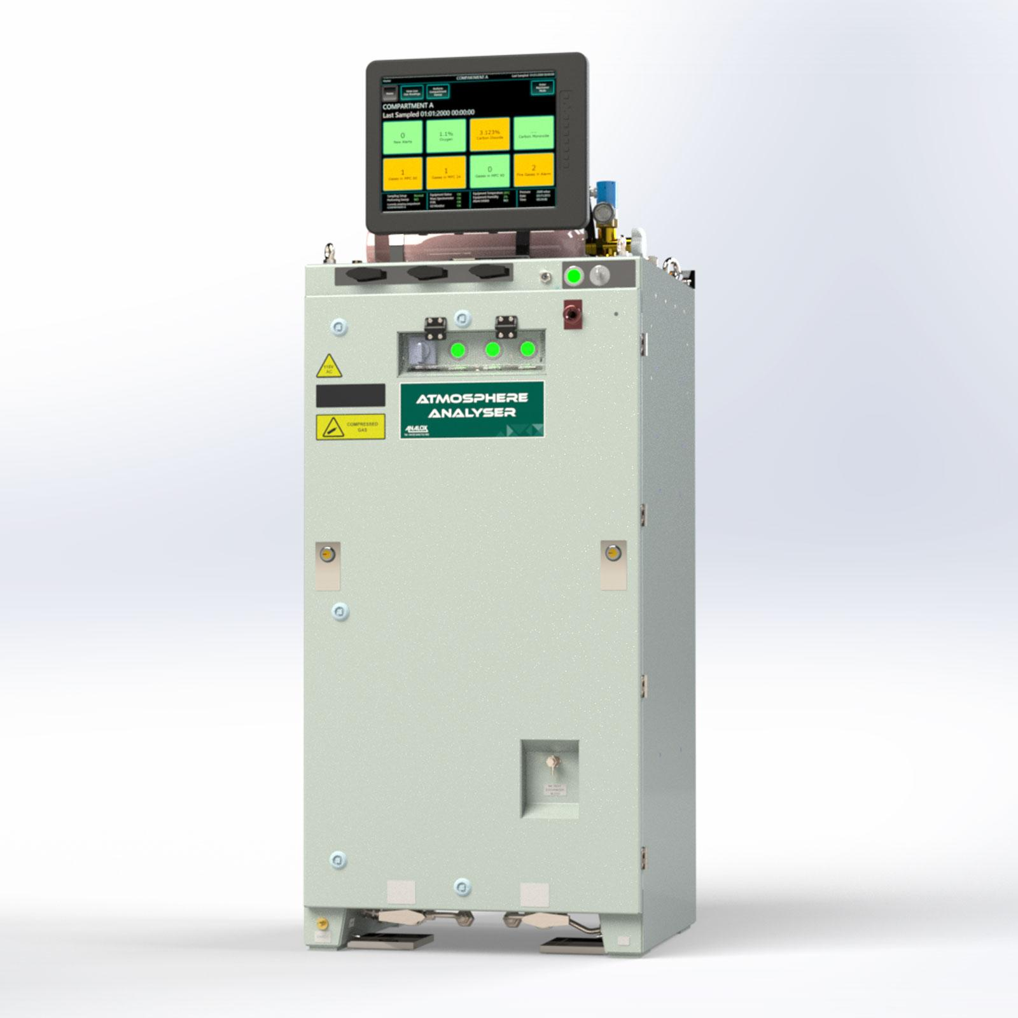
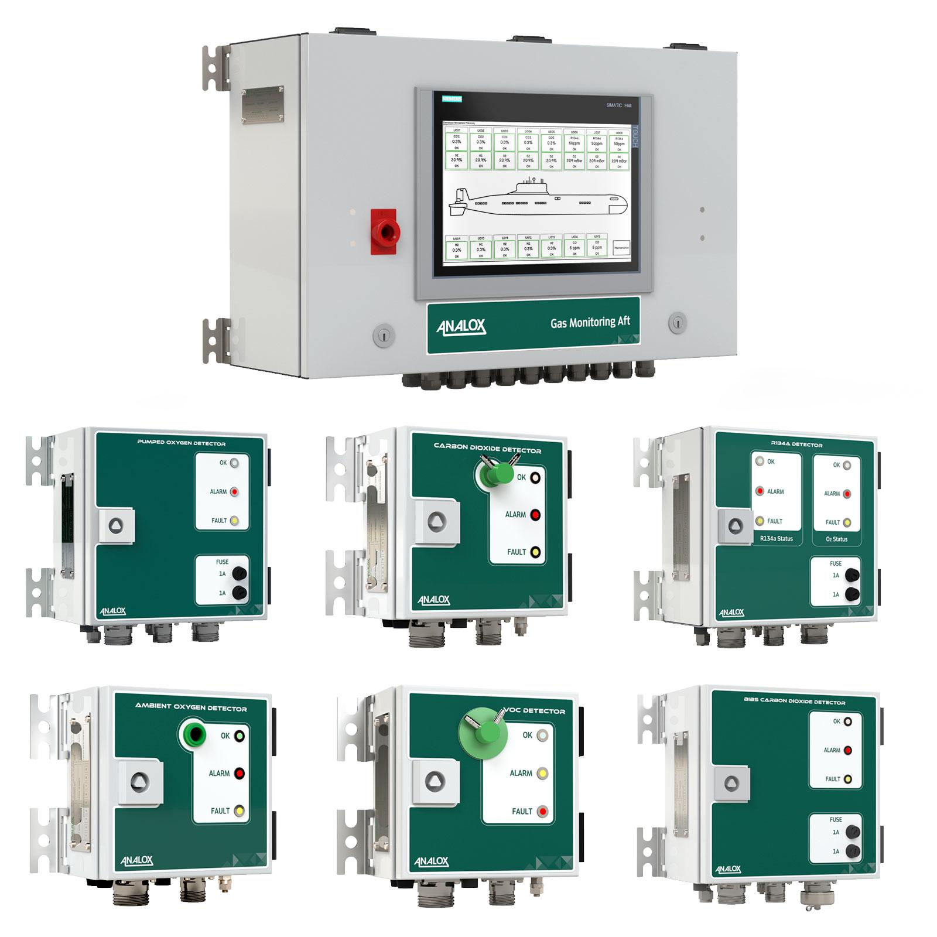
Layers of protection - vary by customer / boat
Primary Monitoring
Carried out by the primary atmosphere monitoring system
PRIMARY MONITORING

Slide 8
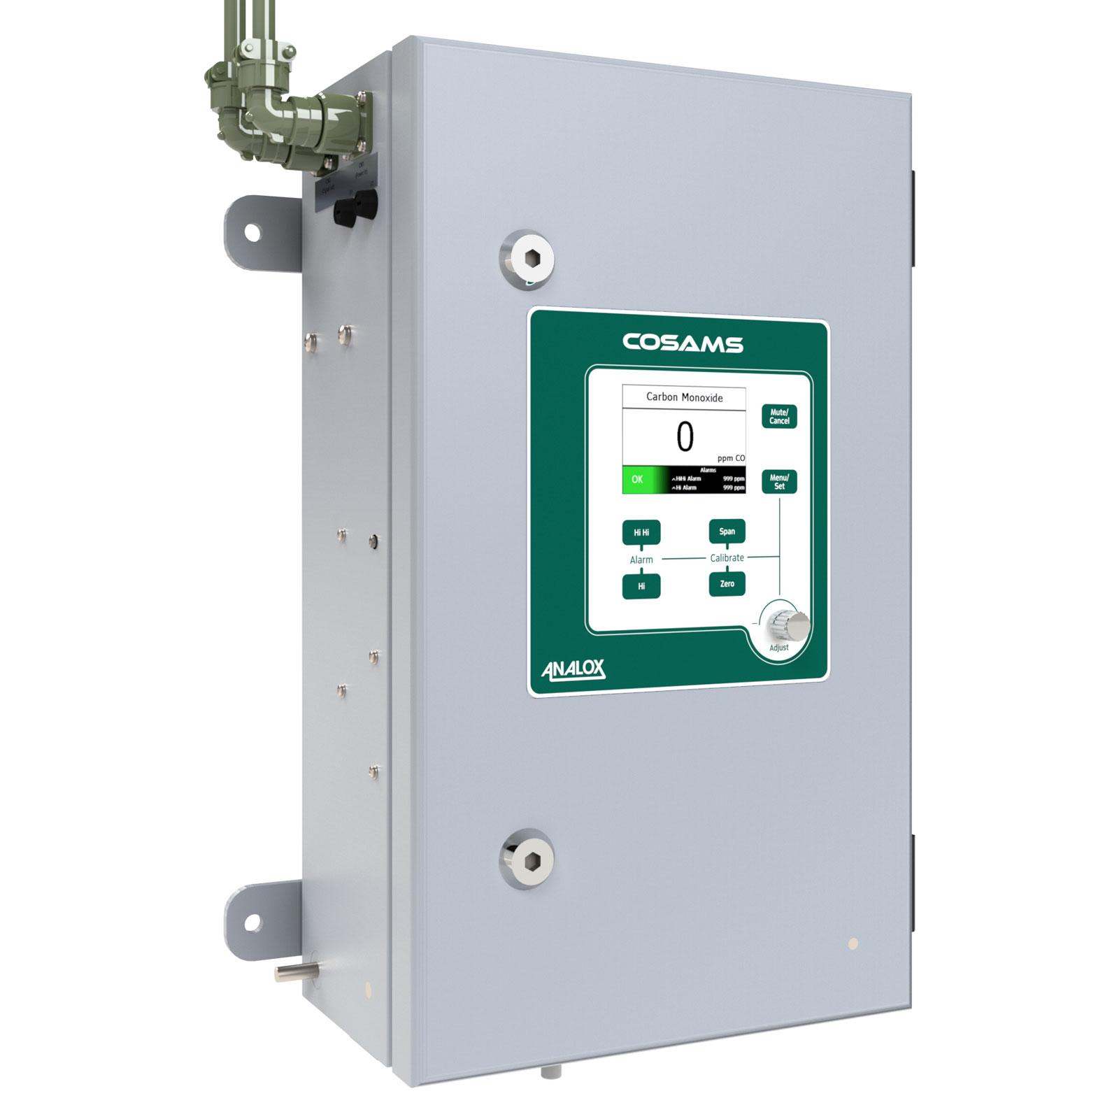
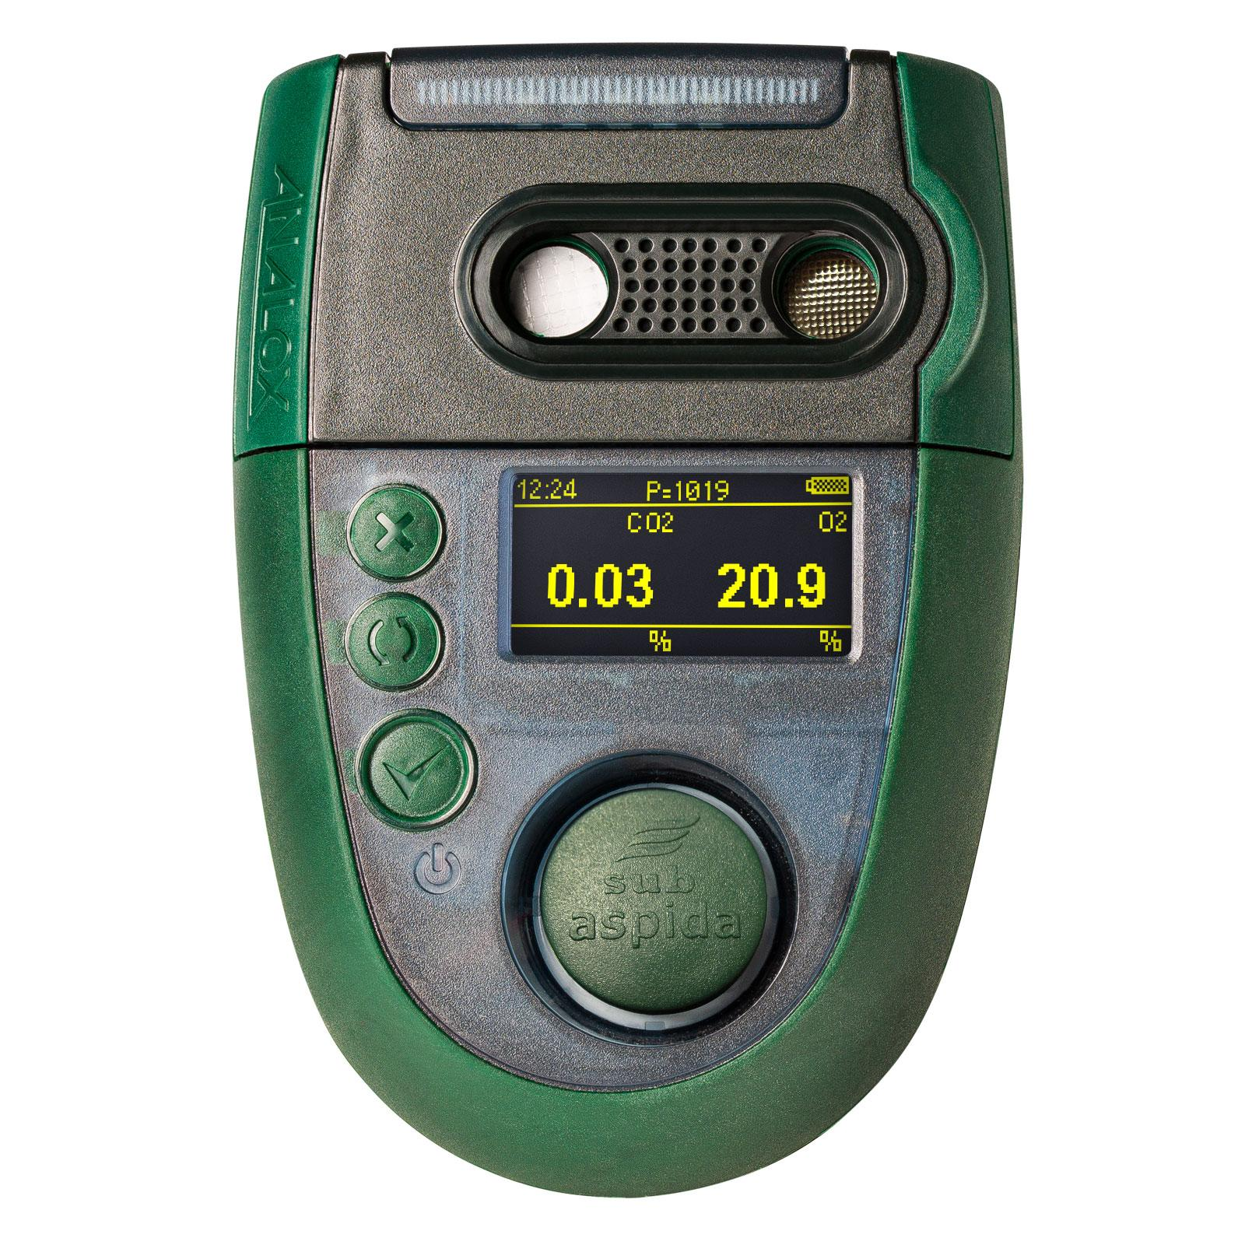
Layers of protection - vary by customer / boat
Secondary Monitoring
Carried out by the fixed & portable solutions
SECONDARY MONITORING

Slide 9
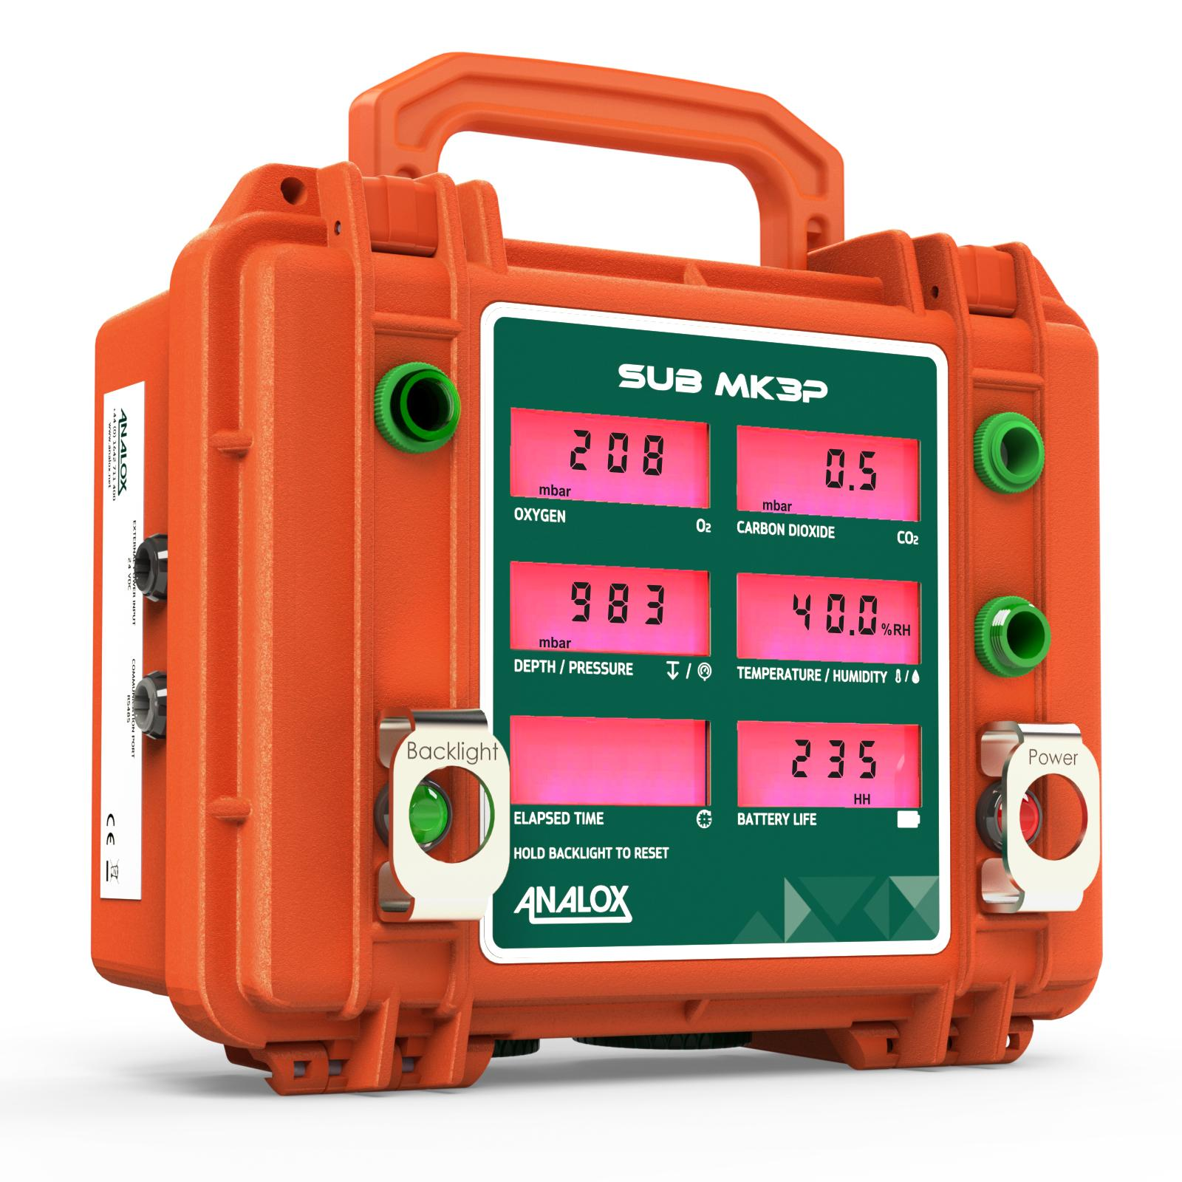
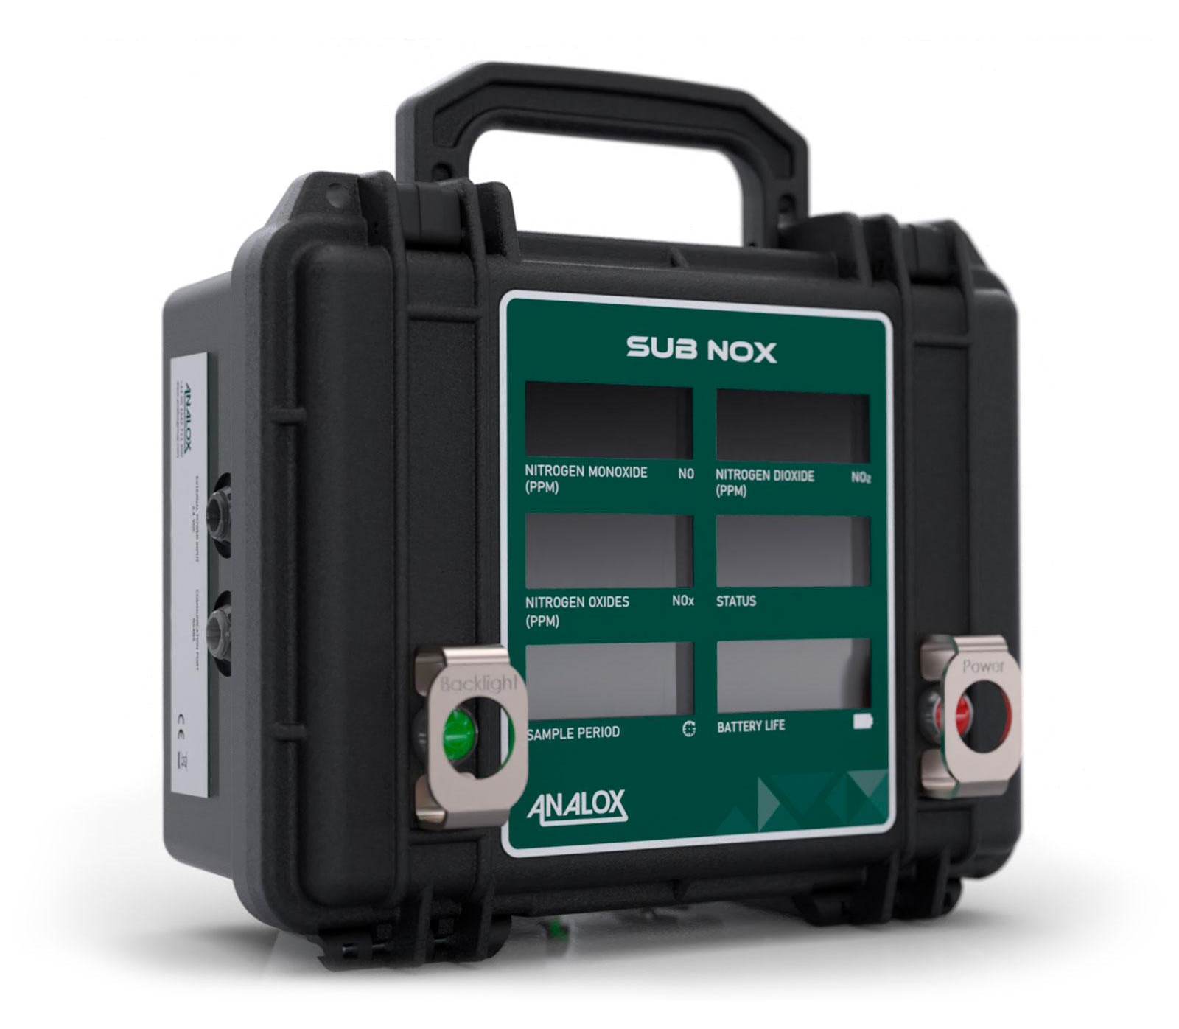
Layers of protection - vary by customer / boat
Emergency Monitoring
Carried portable solutions
EMERGENCY
MONITORING

Slide 10
The longer the time since the submarine was vented the higher the potential background contaminants
This means that the atmosphere monitoring requirements vary depending on the type of submarine…

Slide 11
Every boat is different
Creating standard building blocks
Every country has their own rules
So every Analox atmosphere monitoring system is different.
Tailored system designs
New system development

Slide 12
Our Collaborative Approach
Feedback
Reports
Repeat Forever
Understand your challenge
Required specifications and technical selection
Safety critical design & legislation
Modular design - future proofing
Training
Easy to use and service
Through life support
Understand your challenge
Required specifications and technical selection
Safety critical design & legislation
Modular design - future proofing
Training
Easy to use and service
Through life support

Slide 13
5 Key Gases
What must a submarine monitor
Oxygen
Carbon Dioxide
Carbon Monoxide
Hydrogen
Refrigerant

Slide 14
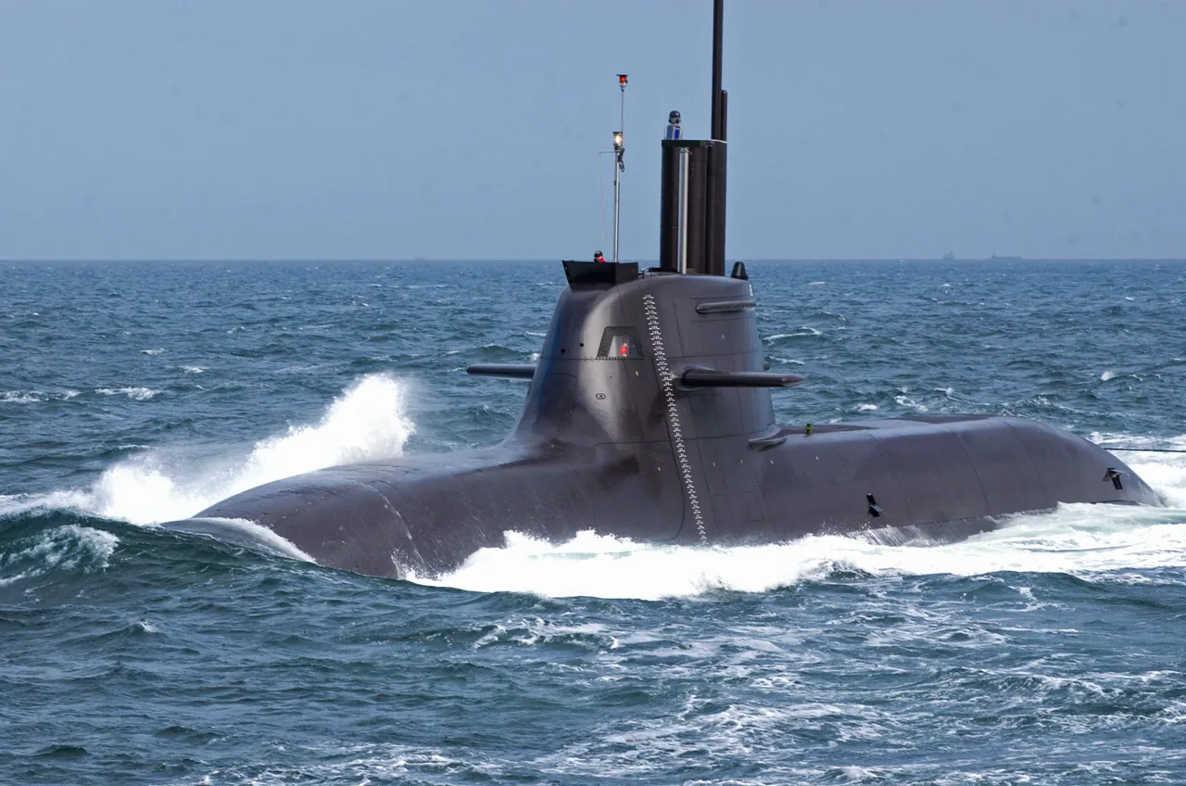
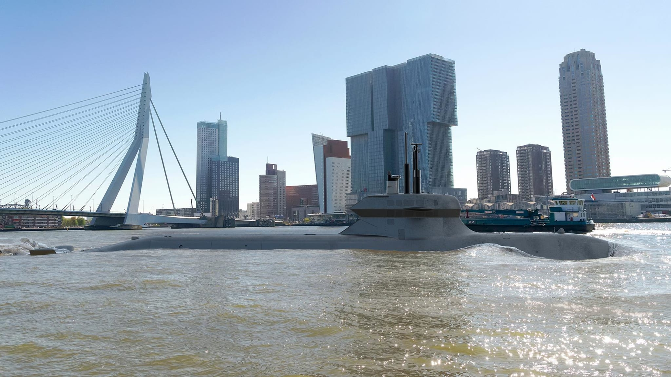
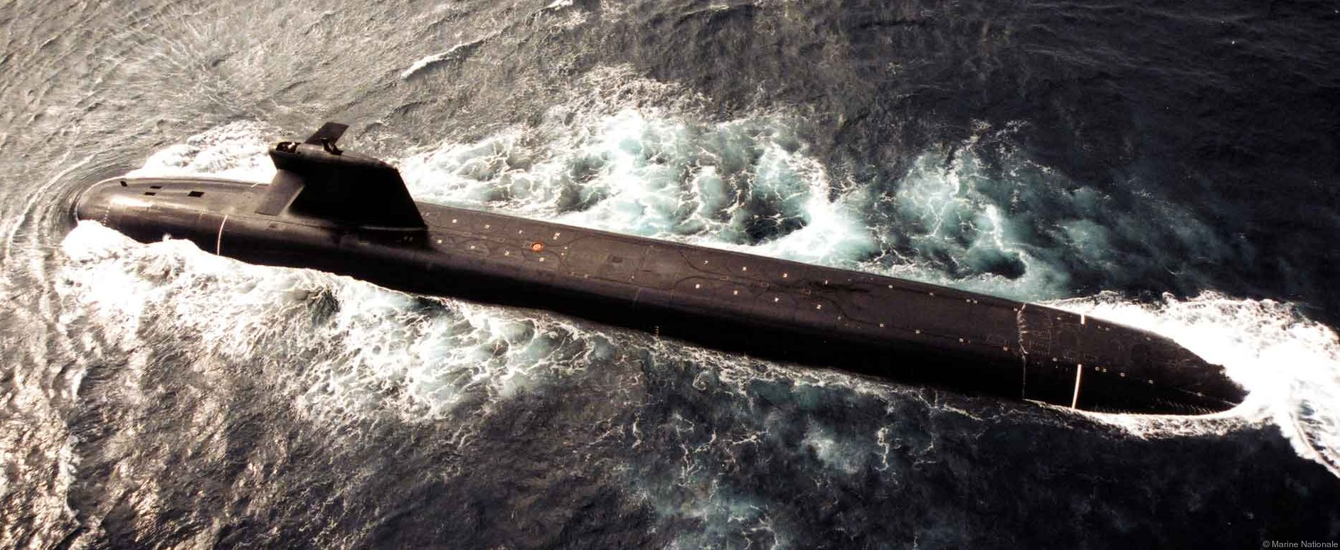
Atmosphere Monitoring across boats
Diesel
Submerged 7-14 days
Air Independent Propulsion (AIP) Submerged 2-4 Weeks
Nuclear
Submerged 3-4 Months
5 Key Gases (O₂, CO₂, CO, H₂, R134a
Torpedo Fuel Monitoring e.g. Otto Fuel
As per diesel
Volatile Organic Compounds
Nitric Oxides
As per AIP
20+ hydrocarbons
Particulates
Aerosols
Image courtesy of TKMS
Image courtesy of seaforces.org
Image courtesy of Saab

Slide 15
Atmosphere Monitoring across boats
Diesel
Submerged 7-14 days
Air Independent Propulsion (AIP) Submerged 2-4 Weeks
Nuclear
Submerged 3-4 Months
5 Key Gases (O₂, CO₂, CO, H₂, R134a
Torpedo Fuel Monitoring e.g. Otto Fuel
As per diesel
Nitric Oxides
Volatile Organic Compounds
As per AIP
20+ hydrocarbons
Particulates
Aerosols
Image courtesy of TKMS
Image courtesy of seaforces.org
Image courtesy of Saab

Slide 16
Atmosphere Monitoring across boats
Diesel
Submerged 7-14 days
Air Independent Propulsion (AIP) Submerged 2-4 Weeks
Nuclear
Submerged 3-4 Months
5 Key Gases (O₂, CO₂, CO, H₂, R134a
Torpedo Fuel Monitoring e.g. Otto Fuel
As per diesel
Volatile Organic Compounds
Nitric Oxides
As per AIP
20+ hydrocarbons
Particulates
Aerosols
Image courtesy of TKMS
Image courtesy of seaforces.org
Image courtesy of Saab

Slide 17
Distributed vs centralised atmosphere monitoring systems
In general:
Nuclear boats have centralised systems.
Diesel / AIP boats have distributed systems
The most advanced AIP boats tend to be hybrid

Slide 18
Typical distributed system
DAMS (Distributed Atmosphere Monitoring System
Flexible, robust & fully configurable,
Monitored centrally via PLC
Local sensing and alerts
Partial pressure sensing
Gases detected O2, CO2, CO H2 & Refrigerants
Data logging & download port
User maintainable in country
Full through life support

Slide 19
Typical Centralised System
The Atmosphere Analyser (AA)
Multi­-gas analyser
Capability to measure up to 30 gases
Sample gases from up to 16 compartments
AAs can be connected together

Slide 20
Laboratory in a box
For long endurance boats the monitoring of trace gases requires laboratory grade instruments.
Our solution is to create a laboratory in a box:
Fixed operating temperature
EMC shielded
Built in shock protection
Controlled humidity
This approach allows us to incorporate new laboratory grade techniques into the equipment over time, to keep limits of detection as low as possible, as legislation changes
A SIL2 rated Oxygen sensor is also included in the system
Notes:
Lab in a box
Lab technology does not work on a submarine unless the influence of the boat is reduced.
Analox created lab in a box.
It de-risks the technology
Allows for technology upgrade through life. Change a piece of equipment inside the lab in a box.

Slide 21
Challenges of measuring gases on a submarine
The submarine environment is an interesting place:
Subject to rapid pressure changes
It can be wet….it can be dry
Cross contamination concerns
Treating atmospheric contamination
Occupational Exposure Levels

Slide 22
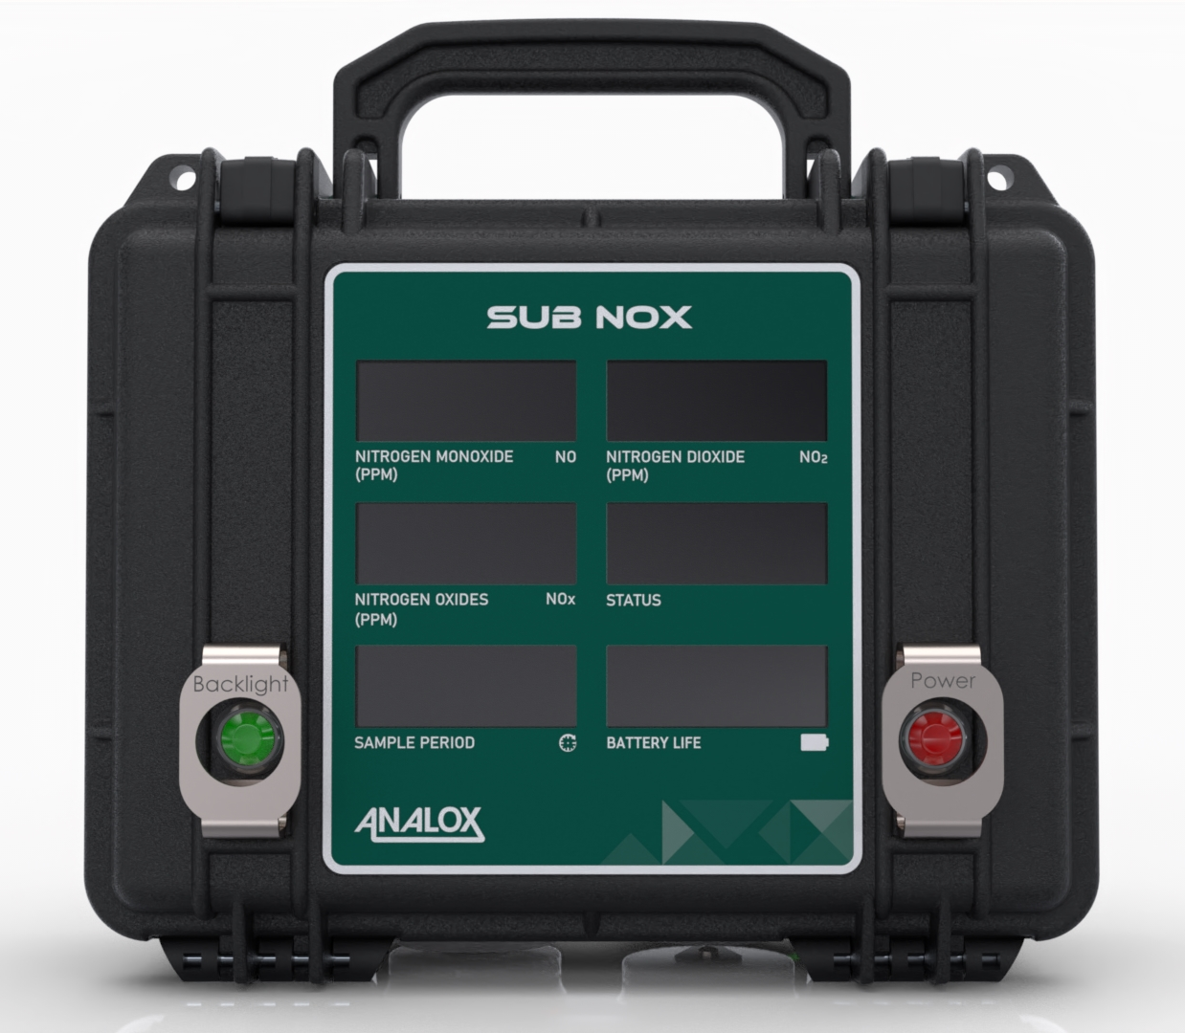
Gas measurement technologies
Standard Electrochemical Cells
Partial pressure electrochemical cells
NDIR for hydrocarbons
Gas Filter Correlation (GFC) NDIR
FTIR
Mass Spectrometry
Gas Chromatographs (GC)
Colormetric tubes
NO and NO2 monitoring post fire
Notes:
Picture of SUBNOx
Uses partial pressure NO & NO2 electrochemical cells.
Although SO2 cells measure NO2 really well, NO2 cells do not reciprocate!

Slide 23
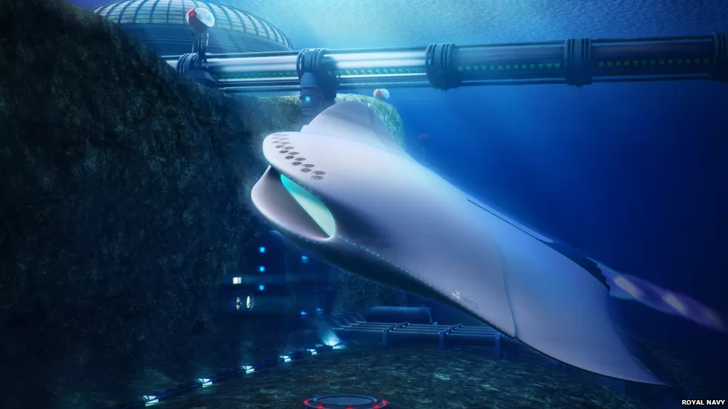
Future gas sensing technologies on-board
Laser Absorption Spectroscopy (LAS)
Chemiluminescence
UV-Vis Spectroscopy
FTIR using broadband laser source
UV LEDs
Image courtesy of Royal Navy

Slide 24
Technology Highlight - FTIR
Analox have an exclusive relationship with Gasmet Technologies for the use of their FTIRs on submarines.
Fixed rack mounted FTIR
Temperature controlled environment
Performance to measure most of the trace gases
Currently does not meet the shock / EMC / Tempest
Analox are adapting to be compliant
Unit could measure *80% of the trace gases
Image courtesy of Gasmet Technologies
* not Cl₂, F₂, Br₂, N_{2,} H₂

Slide 25
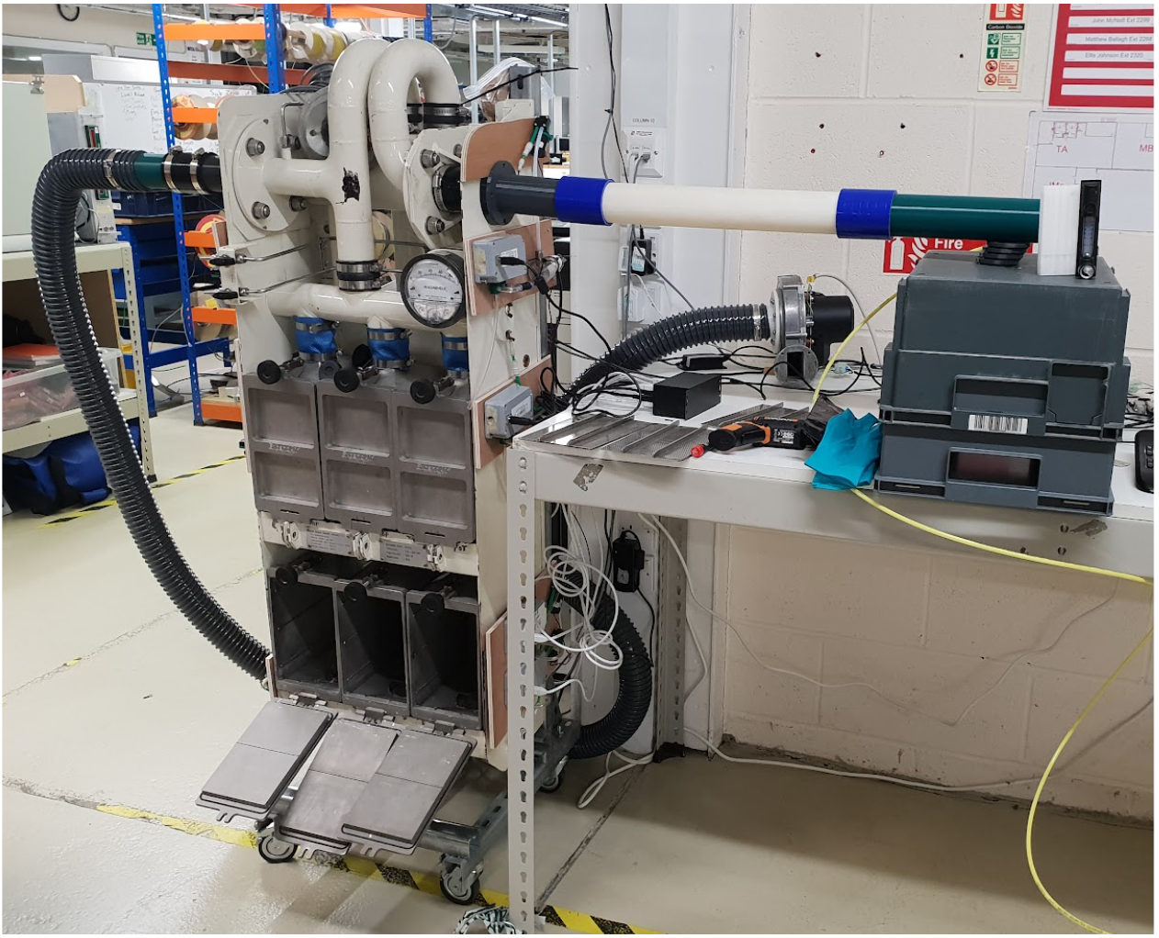
Systems Integration & Automation
Holistic approach to Atmosphere Control:
If CO2 is high we can enable more scrubbing
Active control of life support gases
Calibration & maintenance

Slide 26
If everything fails….
Fully user maintainable
Rigorously tested
Simpler Datalogging
Technical enhancements
Improved sensor technology

Slide 27
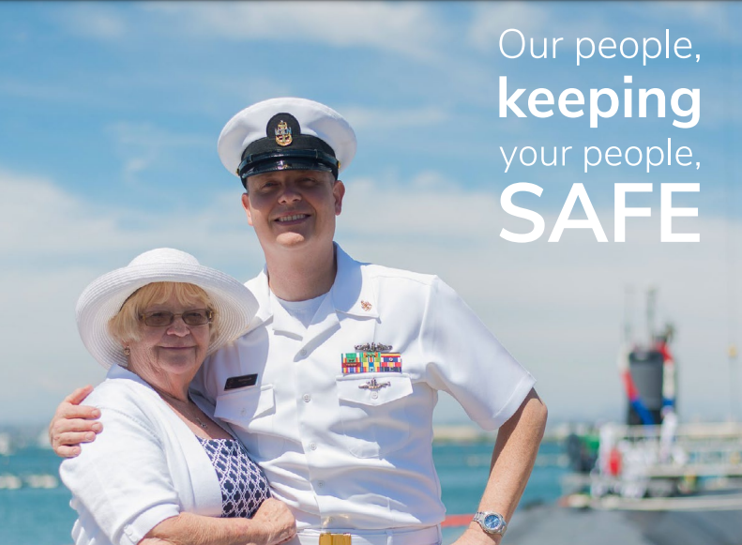
Notes:
The reason we are here!

Slide 28
Thank you for listening, any questions?
Scan the QR code to get a recording of this presentation!
visit the Analox Group Booth: E41
Nathan Stevenson - Systems Architect
E: nathan.stevenson@analoxgroup.com
M: +44 (0)7946 020028

Slide 29
analoxgroup.com
info@analoxgroup.com
Analox Group
Tweet us @AnaloxGroup
Proud sponsors of
We Remember Submariners
UK/Global: +44 (0)1642 711 400
US Office: (714) 891 4478
US Toll Free: (877) 723 3247

