Slide 1
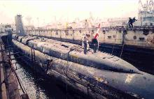
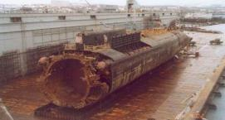
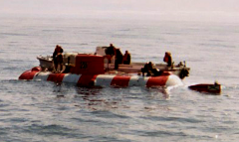
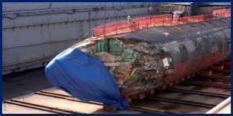
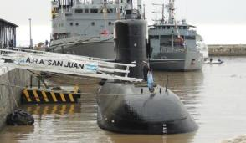
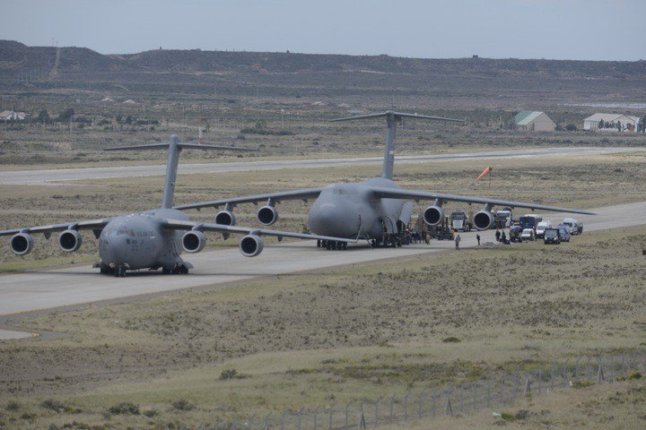
This brief is UNCLASSIFIED
Global Submarine Rescue Response
Bill Orr, Director, Submarine Survivability, Escape and Rescue CSP N3SER
ISMERLO Coordinator
+1-808-473-3783
william.p.orr3.civ@us.navy.mil
This brief is UNCLASSIFIED
1

Slide 2
KURSK
We identified we had no real plan for multinational cooperation and coordination
Telephone communication and message traffic doesn’t work for coordination in a multinational environment highly complex rescue deployment
We needed to develop a method to build preplanned responses and display the status of the multinational deployment
…Now ~23 years later, 5 new major systems have been built, the International Submarine Escape and Rescue Liaison Office ISMERLO has been stood up…are we ready?
Notes:
2

Slide 3
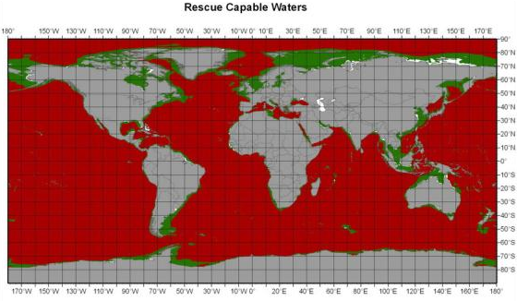
Rescuable Waters
Depth deception?
Though most of the waters are not rescueable…most of our operations especially those that are high risk (Sea Trials, track and trail, PD operations are in littorals)
Almost all rescuable waters are within 150NM of a major port

Slide 4
Global Rescue Response
What we have not yet fully learned from the KURSK, AS 28 PRIZ, ARA SAN JUAN, and KRI NANGALLA
  If only rescue could be executed as easy as Power Point
  It will be very hard
  Everyone will want to succeed (information flow will be overwhelming)
  Logistics and coordination (and Murphy) are likely to stop or delay many of the valiant efforts
  Only preplanned responses and detailed standing rescue plans will ensure success.
  For the most part, except for some national plans (SWE, JPN, RFN, others?) many details to overcome limitations are still in development.
  This includes medical response…and their ability to quickly integrate with the Operators and the operational plan.

Slide 5
Capabilities, Risks and Limitations
Alertment and Search
  Novel UUV search
  Automated or external alertment
Risks with current rescue seats and trunks
  Complexity to establish and maintain readiness and “certification”
  Rescue seat and trunk designs and corrosion
Rapid global response
  Airlift Capability
  System size and Logistics complexity
  Availability of Vessels Of Opportunity and adapting to Anchor Handling Vessels
Solutions needed for delays caused by Sea state limitations and need for Emergency Life Support resupply

Slide 6
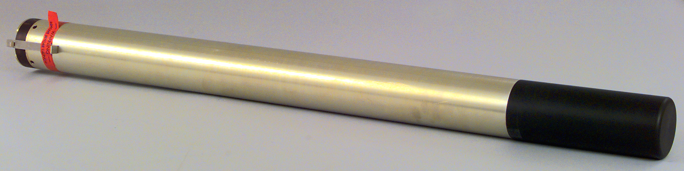
Automated Alertment
Many nations have eliminated rescue buoys due to risk of inadvertent deployment
Most nations now have Submarine Emergency Positioning Indicating Radio Buoys (SEPIRBS) and some have PLBs for escapees.
Some have hull mounted or ejectable transponder beacons to assist in localization.
Do we need better “covert” automated alerting?

Slide 7
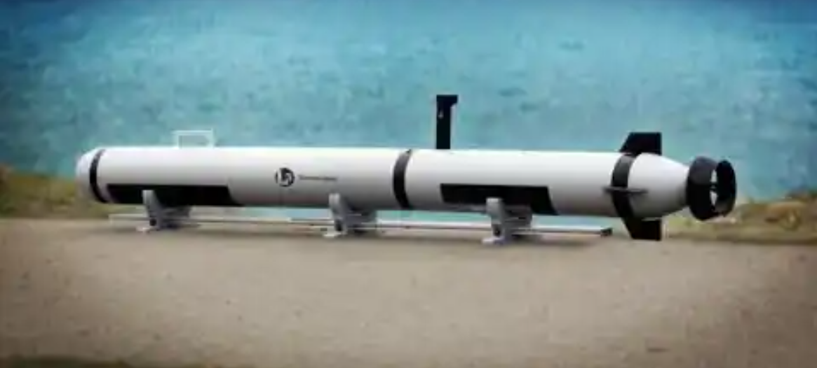
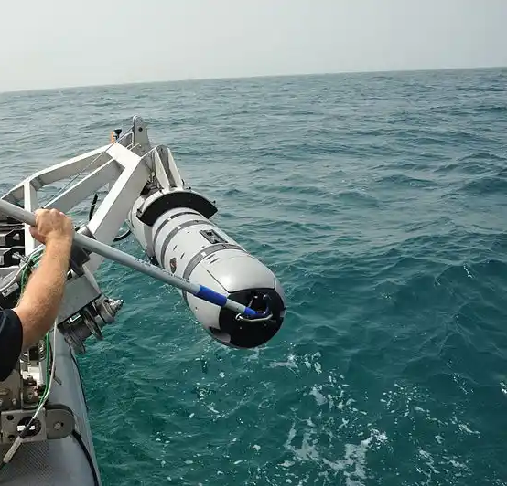
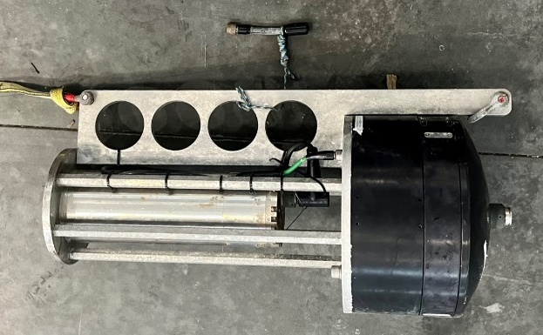
UUV Search and Localization
U.S. Navy development effort for submarine distress beacon localization has demonstrated multiple successes
  Unique BQN-13 (3.5KHz) distress beacon has provided opportunity for detection and localization of a distressed U.S. submarine. Viable for other nations beacons?
  Using commercial available UUV systems with specialized software
  Detect, localize and validate DISSUB condition
  Likely helo deployable capability on the near horizon
Representative UUVs
BQN-13

Slide 8
Rescue Seat and Trunk Readiness
Seat Flatness Requirement:
  0.125 in. (3.175 mm)
Structural conditions:
  Excessive corrosion
  Limited corrosion allowance in design
  No corrosion control
  Design is inadequate for expected loads
  As built conditions don’t meet design
Many surveys identify defects that could significantly impact or preclude safe rescue

Slide 9
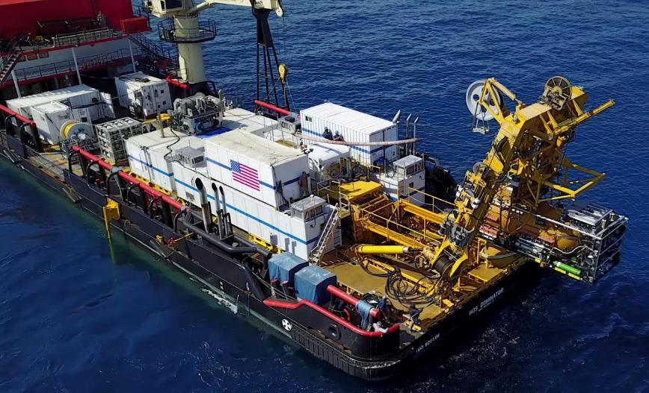
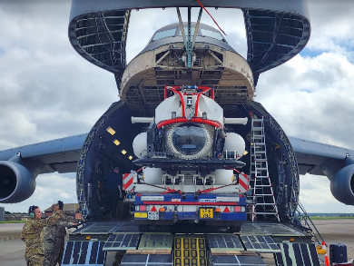
Globally Deployable Systems
The NATO Submarine Rescue System (NSRS) and US Submarine Rescue Diving Recompression Systems (SRDRS) were developed out of the NATO project group 38 in the late 90’s
  Top level requirements drove the systems to significant size
    NSRS Aircraft required 2 (C-17) and 3 (AN-124)
    US SRDRS Five (5) C-5s or Fifteen (15) C-17s or four (4) AN-124s
Airlift of U.S. SRDRS to ARA SAN JUAN identified need for further development of logistics deployment planning to ensure 96 hr time to first rescue success.

Slide 10
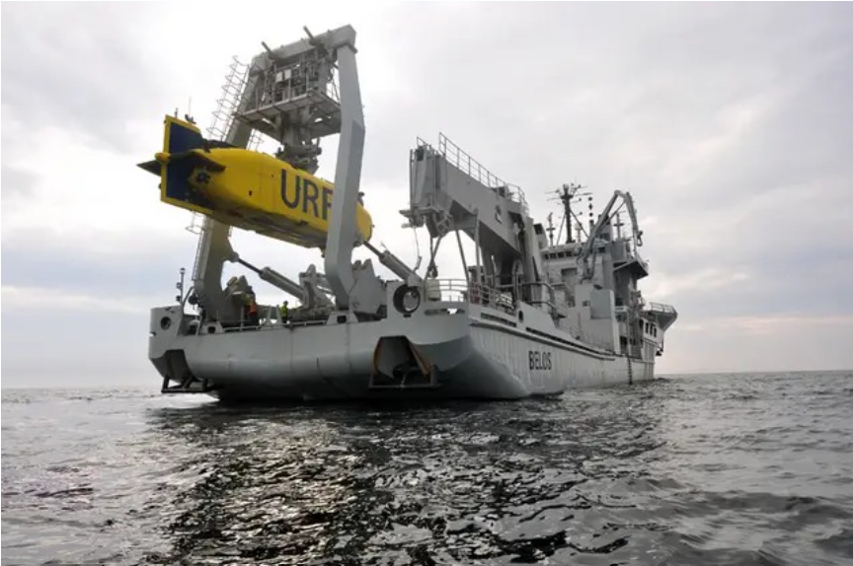
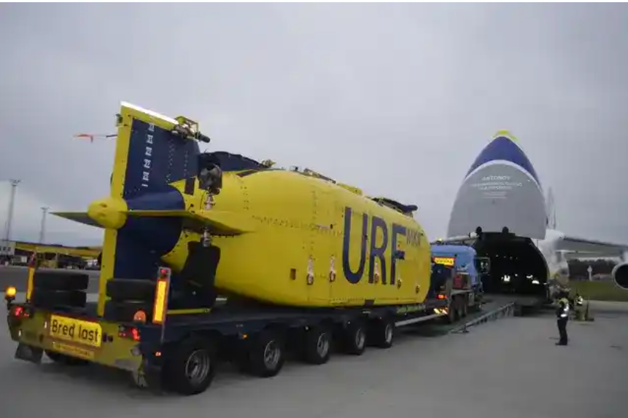
Globally Deployable Systems
Swedish URF. (Ubåtsräddningsfarkost – Submarine Rescue Vessel)
  Normally deployed locally on its mother ship HSwMS BELOS
  Can globally deploy in an AN-124 in fly and tow mode
  Considered the most rapid globally deployable system (TTFR <72 hrs)
  Limited to AN-124 air deployment. Only 5 non-Russian airframes available.

Slide 11
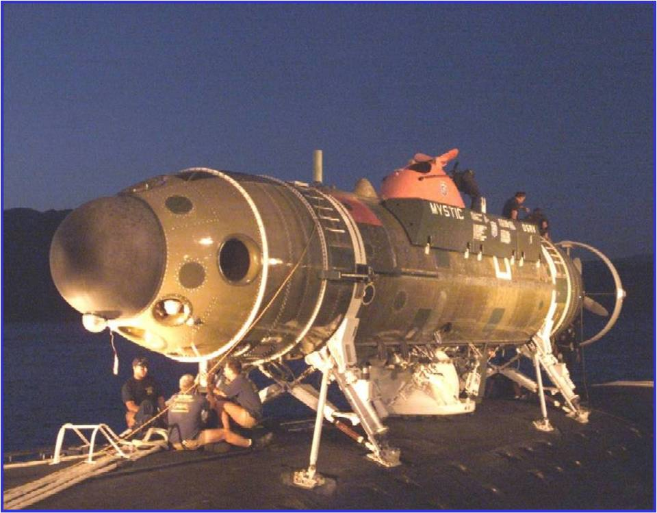
Global Response
War in Ukraine has caused significant fragility in availability of Antonov (AN-124) aircraft
Next generation for concept of fly and tow (URF like)
  Next generation vehicle for countries desiring global deployment needs to fit in smaller aircraft (C-17, 777X, Other airbus contributions?)
  Provides opportunity for more rapid global response
  Can provide significant life support stores
Can a US DSRV “like” submarine of opportunity be developed to enhance fly and tow rescue response
  Reduces sea state risk
  Significantly reduces TTFR for non-pressurized rescues

Slide 12
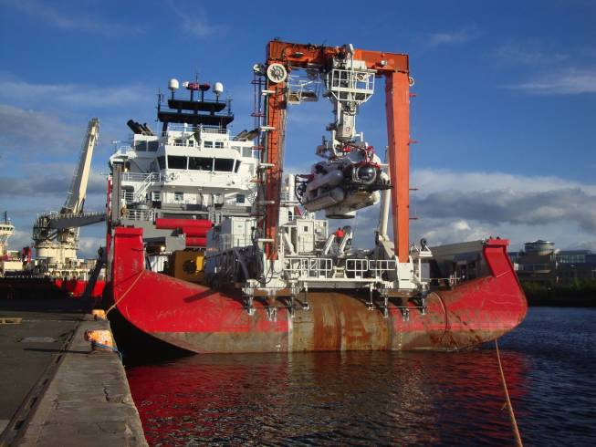
AHTS as a MOSHIP
AHTSs make up nearly 70% of offshore vessels that may support rescue
Rollers and towing gear like shark jaws complicate installation
Custom built roller accommodation platform likely to take too long
US currently working to develop special roller interface for common roller sizes

Slide 13
Way Ahead
Reemphasize rescue seat design and maintenance requirements.
Industry teaming needed to analyze previous NATO PG-38 assumptions and requirements
Likely one size fits all (NSRS/SRDRS like) systems are significantly more than many nations need.
Further analysis of risks to deployment with further emphasis on TTFR minimization
Analysis of decompression options (rescue vehicle decompression) with focus on more likely survival scenarios
Determine alternatives for:
  Higher sea state accommodation. Eg. Cooperative submarine mating/MOSUB
  Launch and recovery options including amphibious ships, lower sea state crane recovery and servicing

Slide 14
UNCLASSIFIED
Backup
UNCLASSIFIED
14

