Slide 1

YOUR PARTNER AT SEA
May 25TH , 2023

Slide 2
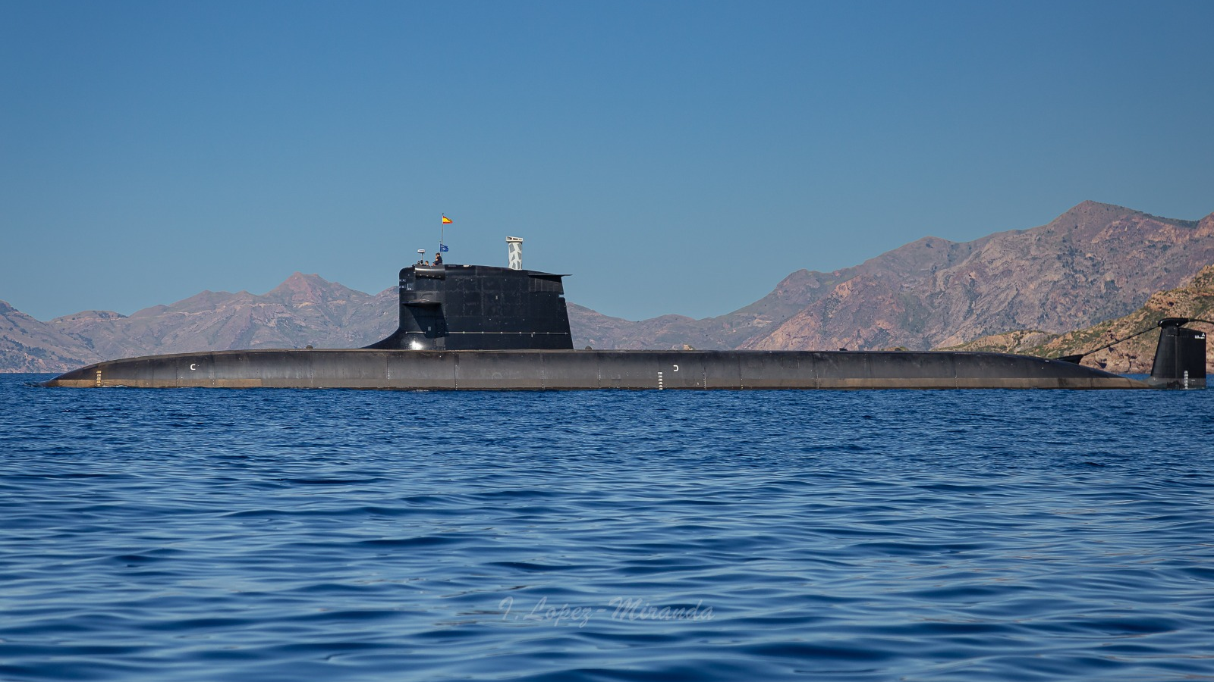
S80 SUBMARINE MAIN FEATURES
81m
Overall Length
7.3 m
Pressure hull diameter
6.3 m
Mean Draught
2,965 t
Submerged displacement
32 + 8
Crew and Special Forces

Slide 3
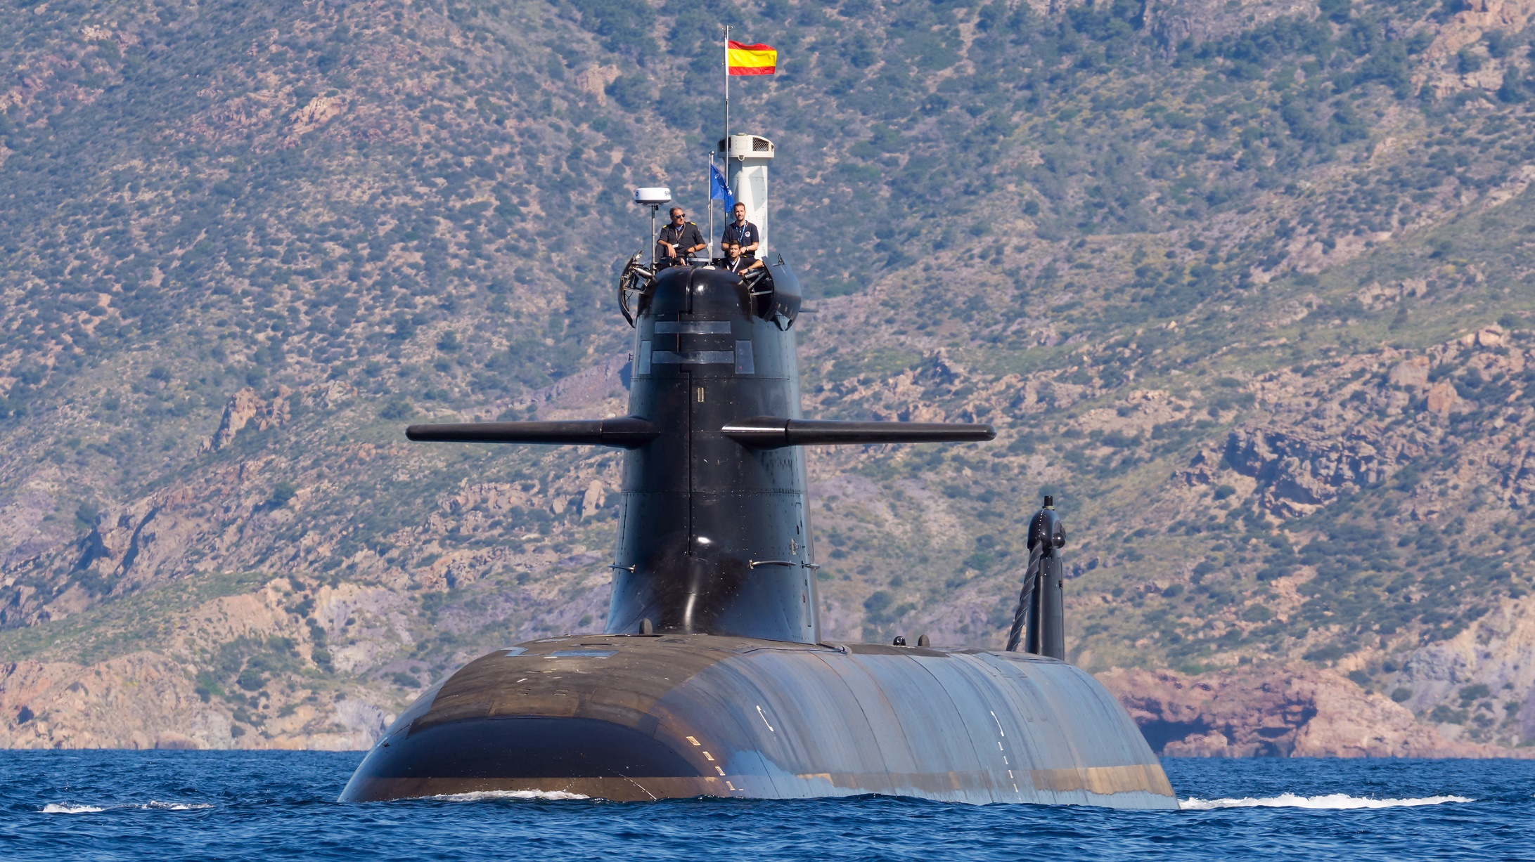
Anti-submarine Warfare (ASW)
LONG RANGE CONVENTIONAL SUBMARINE ENHANCED WITH AIR INDEPENDENT PROPULSION
Anti-Surface Warfare (ASuW)
Land-Attack capability
Capabilities
High-capability of Mine-laying
Full Integration in Task Force
Intelligence, Surveillance
and Reconnaissance (ISR)
activities

Slide 4
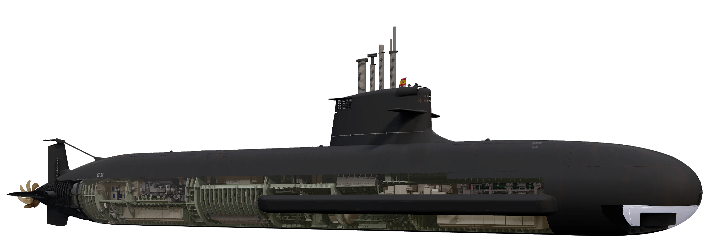
GENERAL ARRANGEMENT OVERVIEW
DSRV Platform and Escape Trunk
Diesel Engines
Command and Control
Weapons Handling and Discharge System
Electric Propulsion Motor
Accommodation
AIP System
Towed Array Sonar
Sonar arrays
Auxiliaries' rooms
Fore Batteries
Aft Batteries
LOX and Bioethanol tanks
Cofferdam

Slide 5
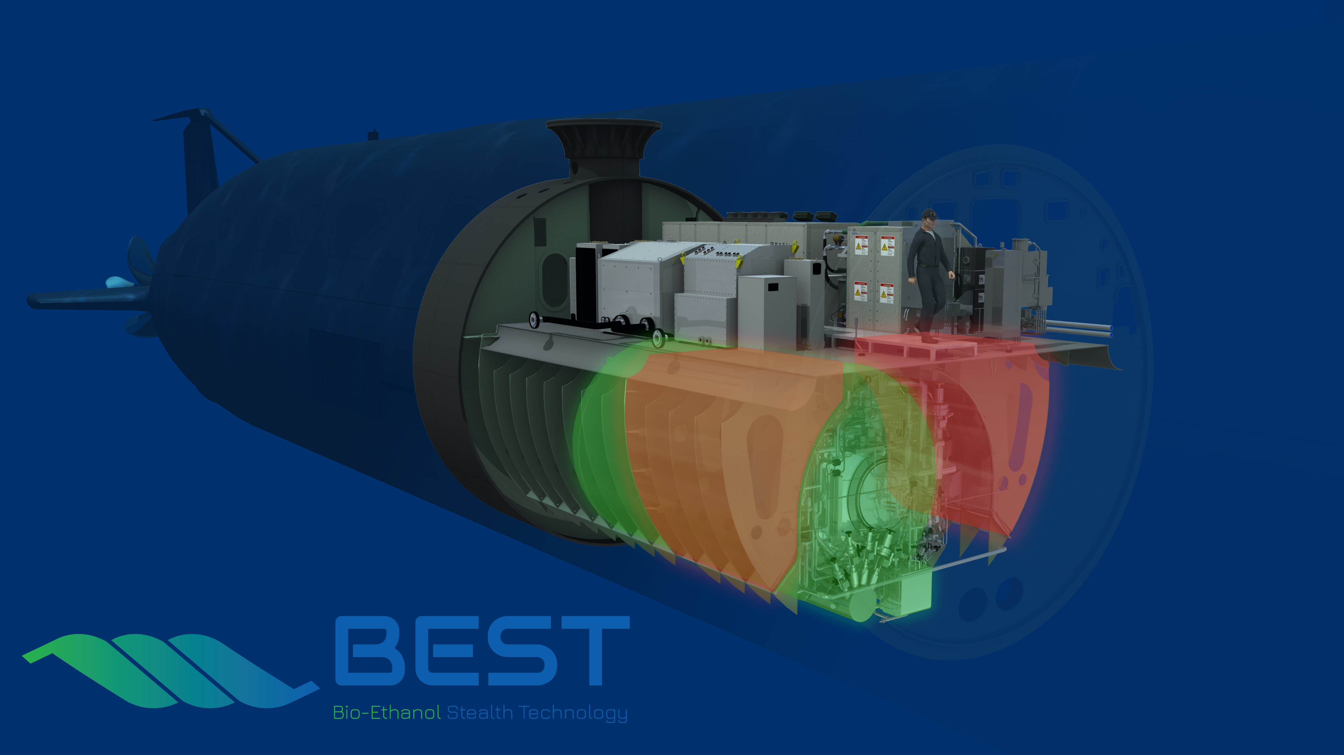
BEST AIP BIO ETHANOL STEALTH TECHNOLOGY
Fully automated power plant
Based on PEM Fuel Cells and fuel reforming
Fully integrated on platform systems
Safety based on submarine conventional means
AIP Power Plant
Structural tanks
Ambient temperature
CO₂ blanket
Refuelling through logistic hatch
Bio-Ethanol tanks
LOx tank

Slide 6




Third-generation air-independent propulsion system (AIP)
Bio Ethanol Stealth Technology based (BEST)
Submerged endurance
  Long submerged endurance (up to 3 weeks)
  Liquid fuel to maximize endurance
Maintenance
  Designed for no major component substitution between overhauls (6 years/>5,000 h)
  LRU embarkable through logistic hatch
Range
Leverage the full depth range (periscope to MOD)
Tropical to sub-arctic environments
Availability
  High availability all around the world
  Consider new threats and environmental sustainability

Slide 7




S80 SUBMARINE INTEGRATED SYSTEMS
INTEGRATED COMMUNICATIONS SYSTEM
INTEGRATED COMBAT
SYSTEM CORE
TACTICAL & PLATFORM SIMULATORS
INTEGRATED PLATFORM MANAGEMENT SYSTEM

Slide 8
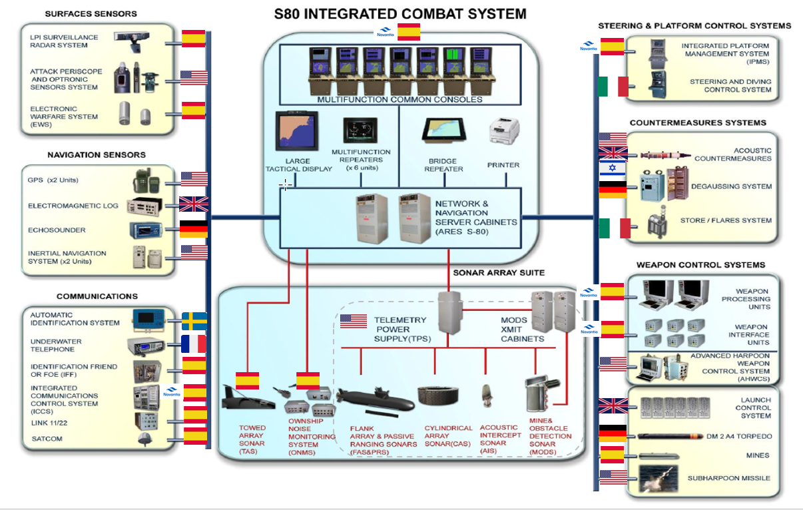
S80 SUBMARINE COMBAT SYSTEM

Slide 9
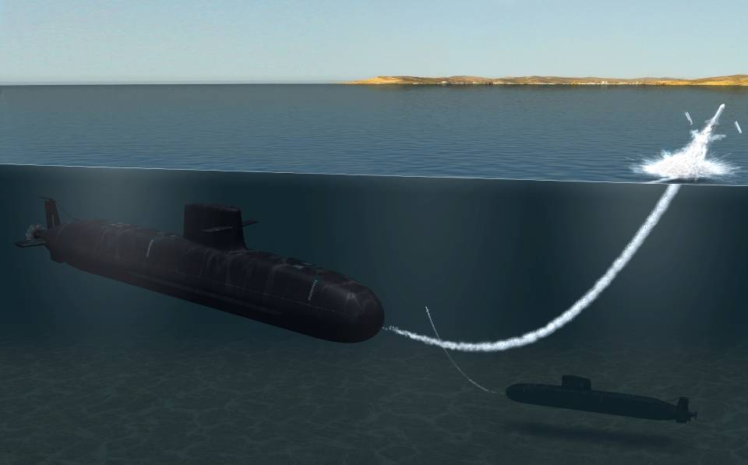
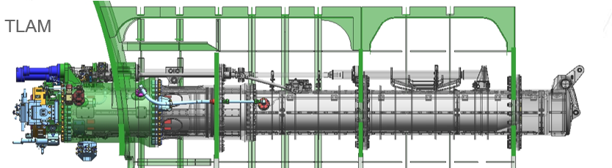
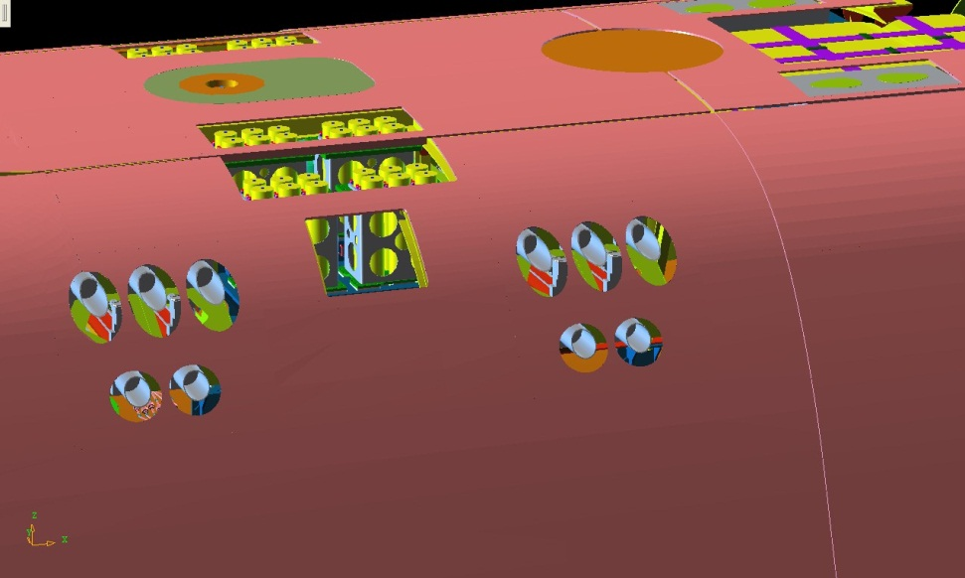
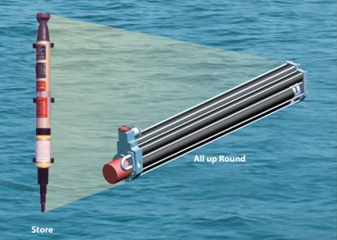
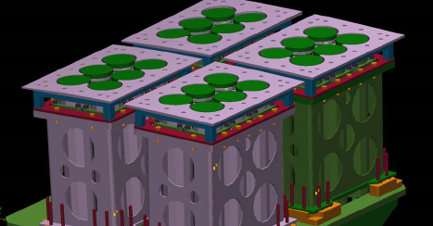
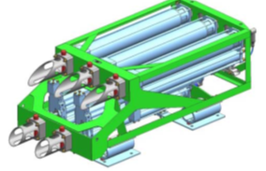
S80 SUBMARINE WEAPON SYSTEM
Weapons:
DM2A4 Torpedo
Sub-Harpoon Missile
Spanish Mine
Fitted for Tomahawk Missile
Ready for MK48 Torpedo
Acoustic Countermeasures:
SUBSCUT
NAE Beacon

Slide 10
S80 SUBMARINE IMMOBILIZATION PERIOD

Slide 11
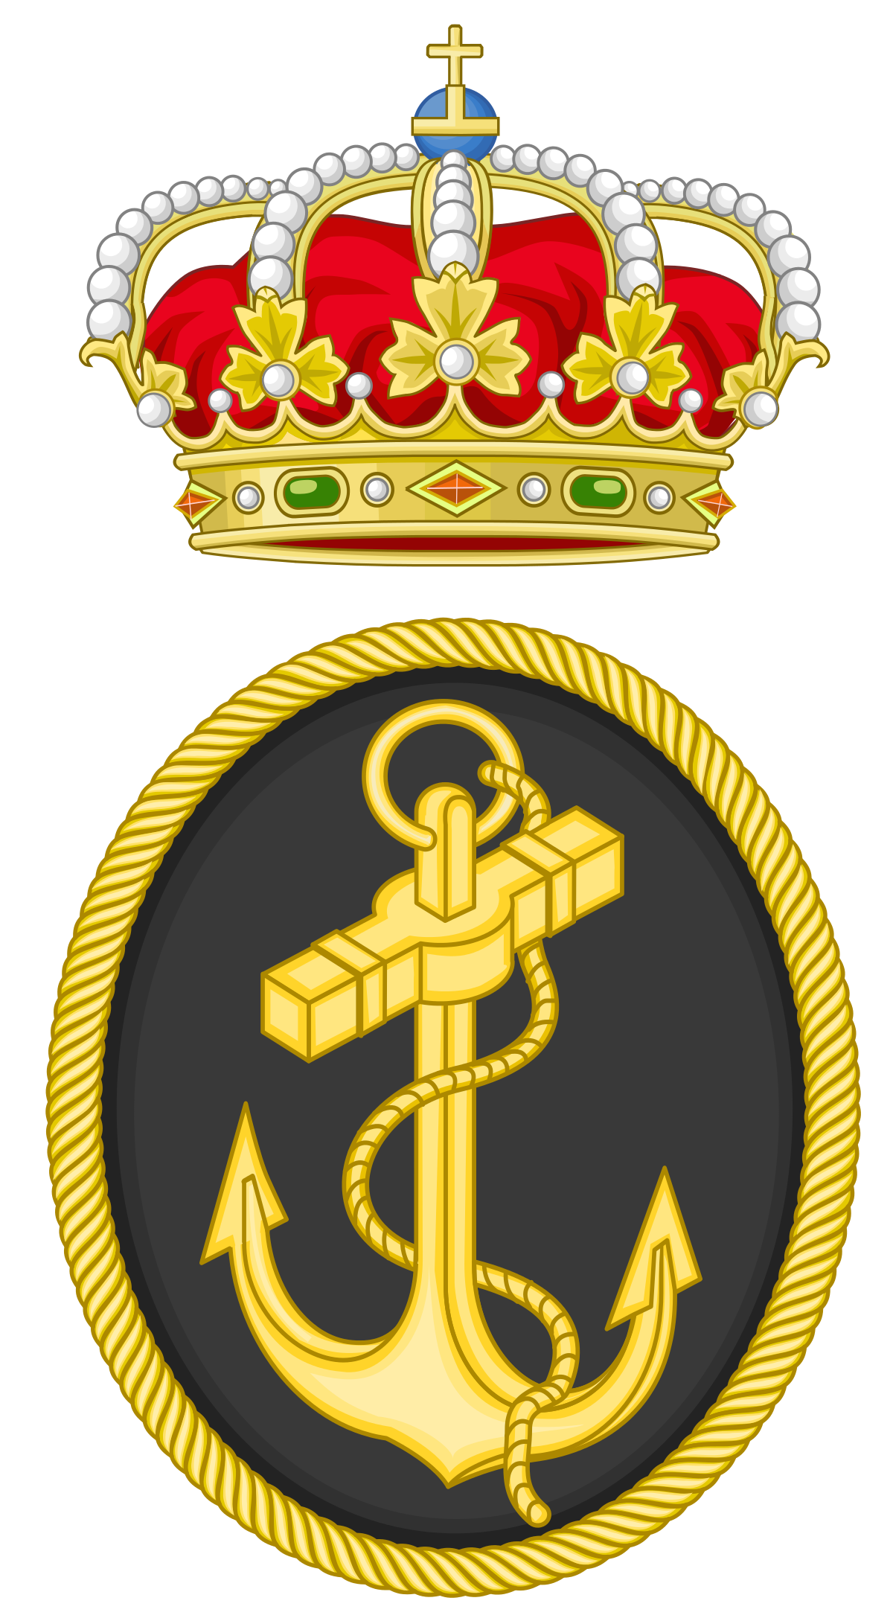

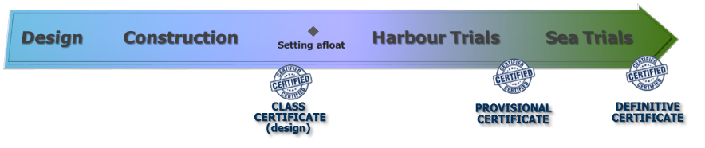

S-80 SUBMARINE THIRD PARTY CERTIFICATION
  CTSUB program approach to US Navy SUBSAFE
  It ensures the submarine is watertight and resistant to maximum operating depth and in case of water ingress, it is capable to safely get to the surface.
  It ranges from materiel verification, design assessment of watertight integrity & recovery systems, construction & testing verification processes, in-service certification and re-entry control during maintenance
  It complies with MIL-STD-882 and Fly by Wire

Slide 12












































INTEGRATION EFFORT SYSTEM OF SYSTEMS
Building a system of systems with industry leaders as key partners
  The S-80 submarine is the result of many collaborations between world-class companies, committed to supplying state-of-the-art technology and coordinated by Navantia as the main contractor.

Slide 13

S-80 SUBMARINE SAFETY MILESTONES
H02 (Feb, 21)
Embarkation of batteries
H04 (Oct, 21)
First Diesel Oil embarkation
H06 (Jan, 22)
Mooring test
H08 (March, 23)
Static Immersion
H10
First diving at DDD
SUBMARINE ASHORE
SUBMARINE AT HARBOUR
SUBMARINE AT SEA
H01 (Nov, 20)
Power Up
H03 (May, 21)
Launching
H05 (Nov, 21)
First battery charge with DARs
H07 (May, 22)
First sea outing at surface
H09
First diving navigation
H11
Delivery
Notes:
The goal of the Safety Milestones Management Plan is to establish a framework enabling to verify that the construction and testing process of the S-80 Submarine is done in such a way that it is possible to guarantee an ALARP risk level.
This process will enable obtaining the corresponding formal authorizations to perform each Safety Milestone and continuing with the construction and testing process of the submarine until final delivery.

Slide 14
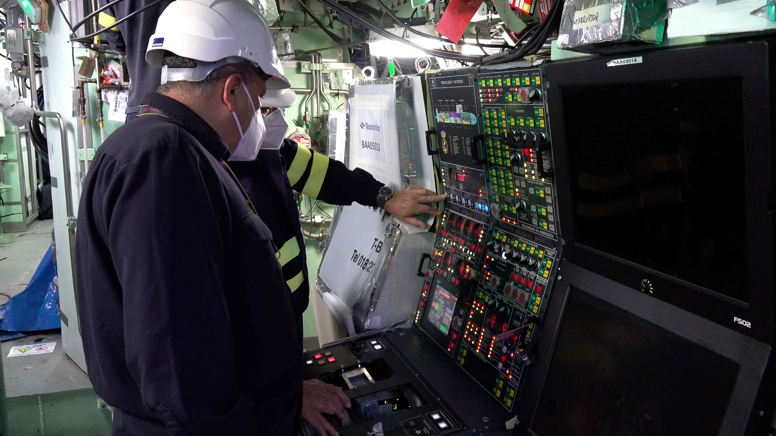
H01
Power Up

Slide 15
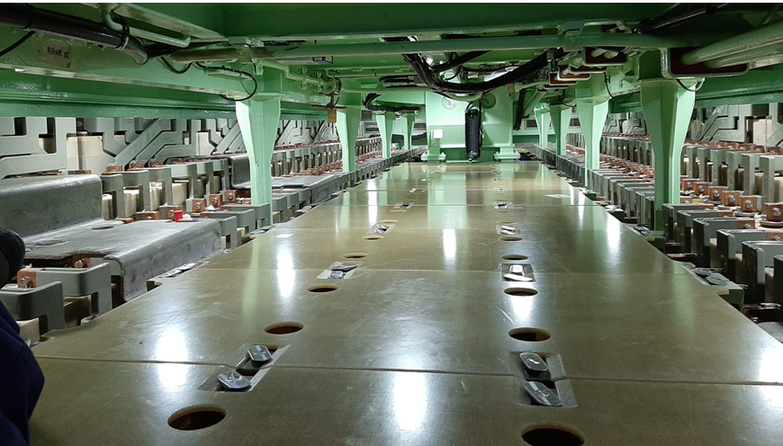
H02
Embarkation
of batteries

Slide 16
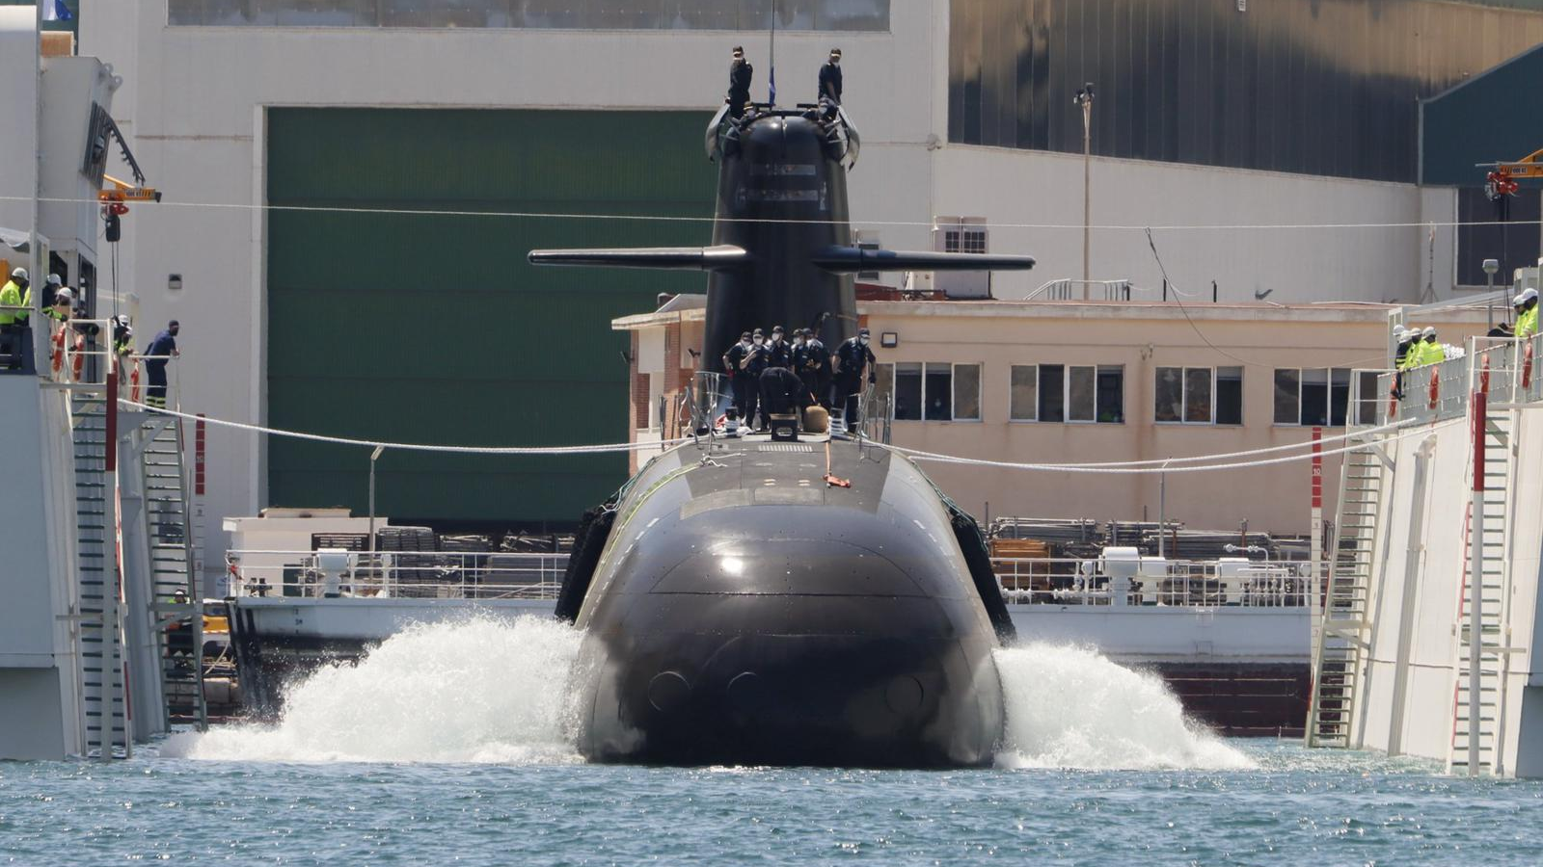
H03
Launching

Slide 17
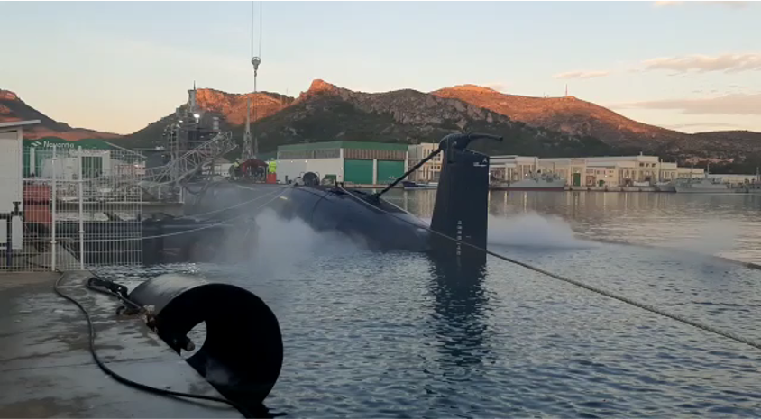
First H04 & 05
Diesel oil embarkation
&
battery charging with diesel engines

Slide 18
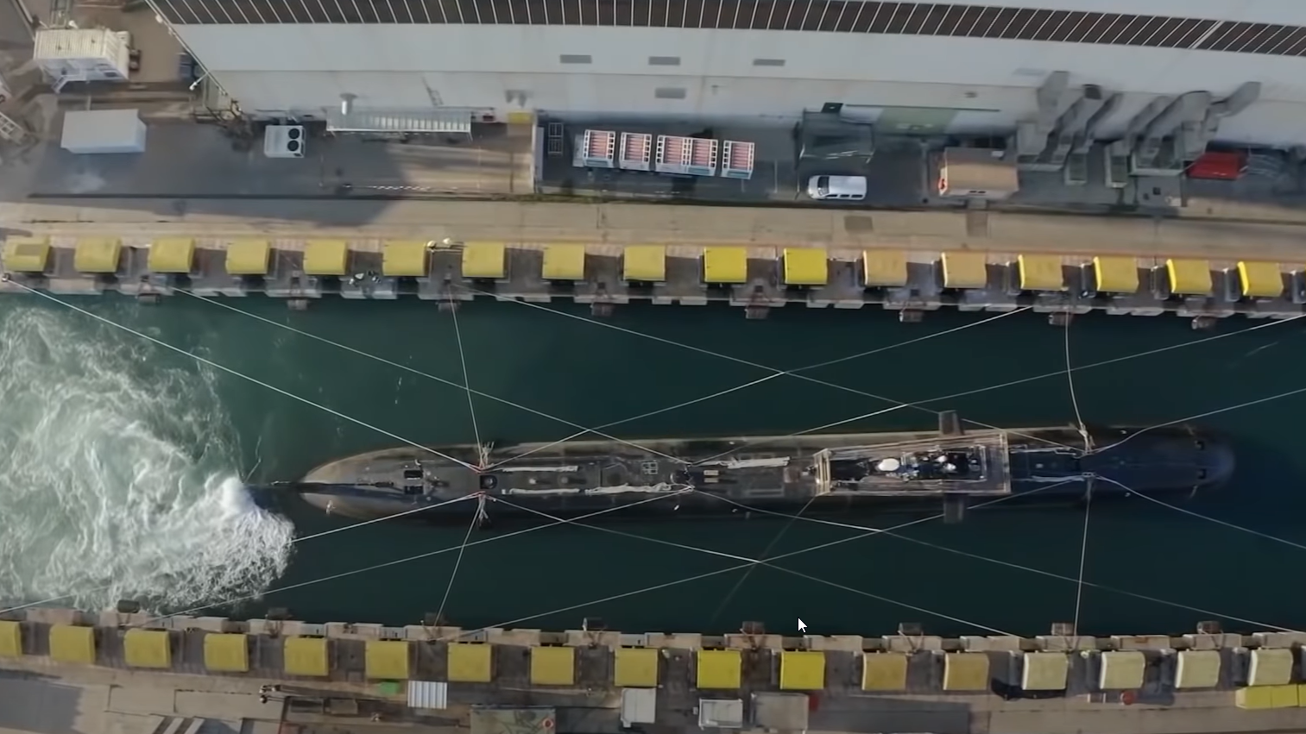
H06
Mooring Test

Slide 19
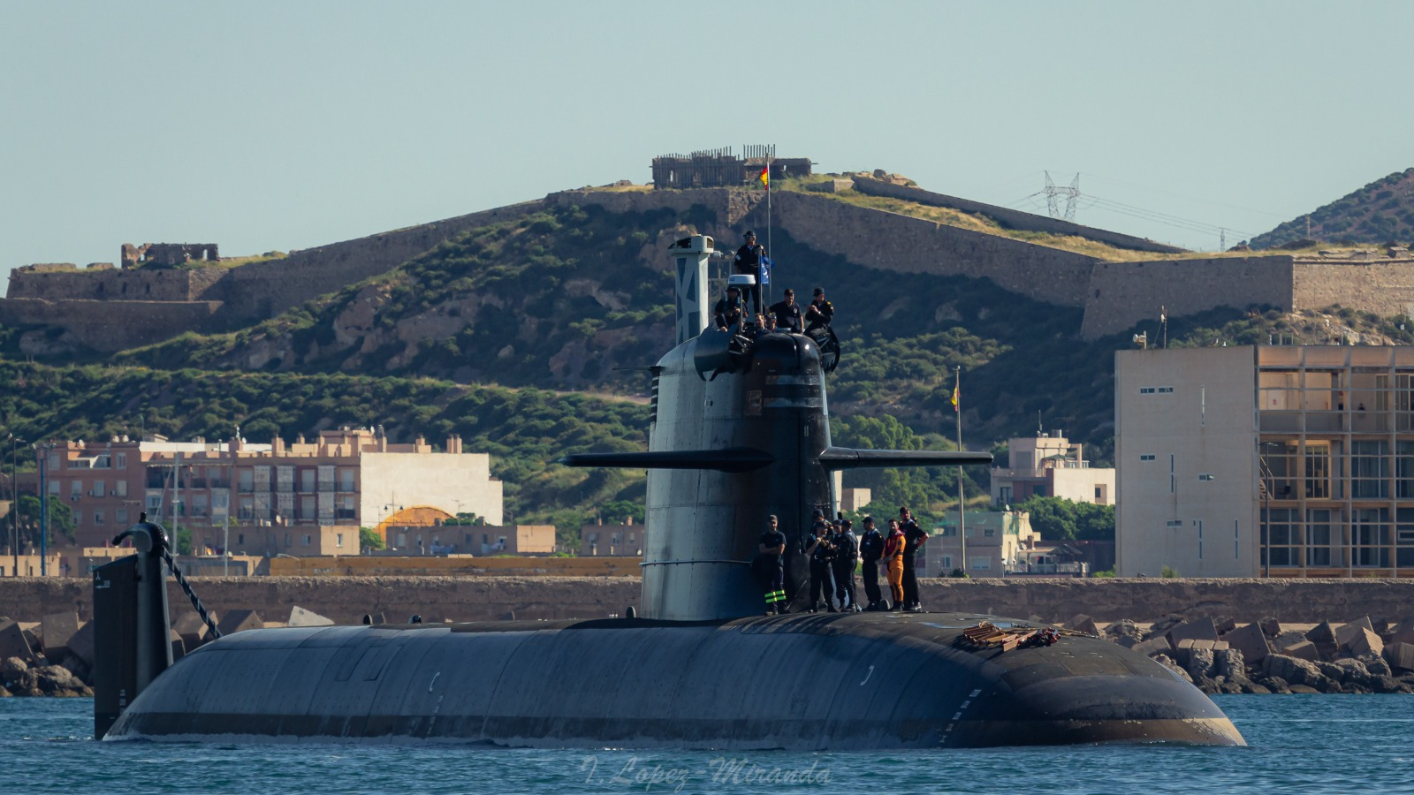
H07 First sea
outing at surface

Slide 20
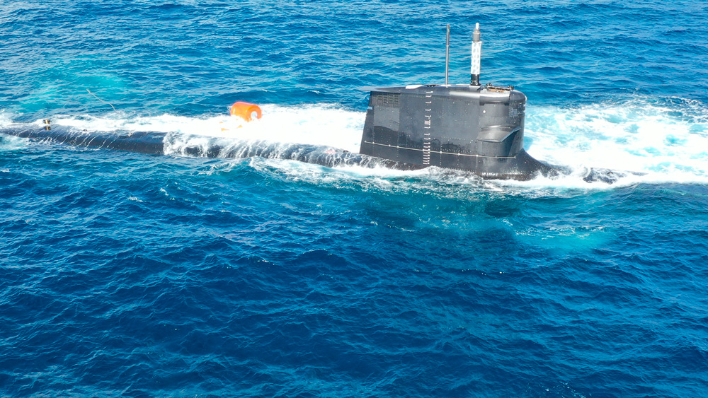
H08 Static
Immersion

Slide 21
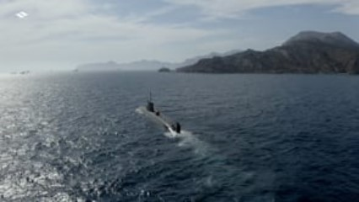

Slide 22
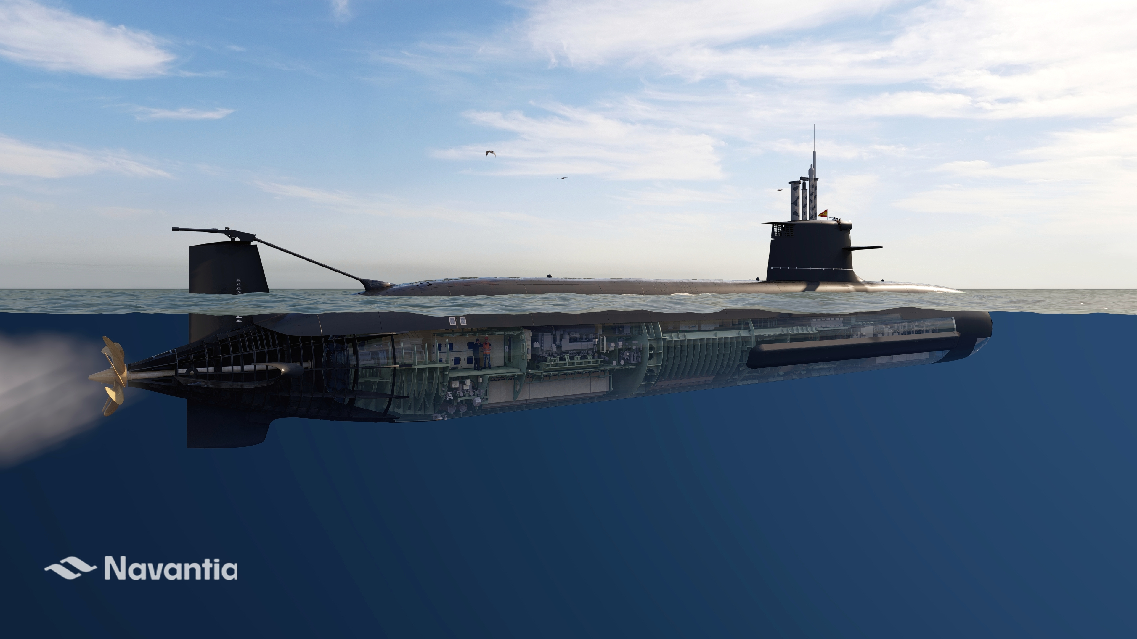
THANK YOU

